Slide 1



IODE Rules of Procedure for IODE
Paula Cristina Sierra-Correa, PhD
Head Ocean Research and Information at INVEMAR Co-chair IODE 2023 - 2025
December 2023 , www.iode.org

Slide 2
Background
The programme "International Oceanographic Data and Information Exchange" (IODE) of the IOC of Unesco was established in 1961. Its purpose is to enhance marine research, exploitation and development, by facilitating the exchange of oceanographic data and information between participating Member States, and by meeting the needs of users for data and information products.
The IODE system forms a worldwide service oriented network consisting National Oceanographic Data Centres (NODCs), Associated Data Units (ADUs) and Associated Information Units (AIUs).
This network has been able to collect, control the quality of, and archive millions of ocean observations, and makes these available to Member States.
The “Core” of IODE: Programmes ODIS (OBPS join GOOS), OBIS, OTGA
www.iode.org

Slide 3
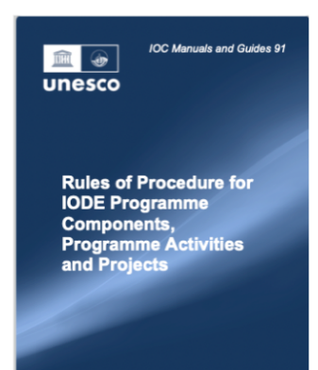
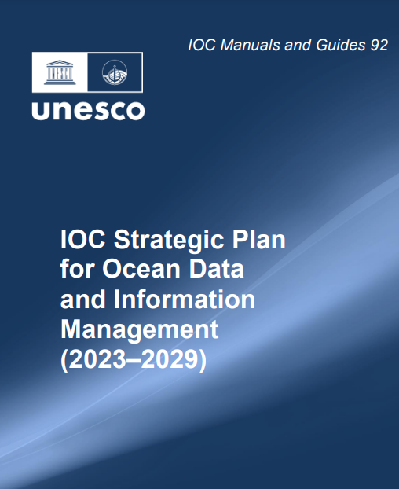
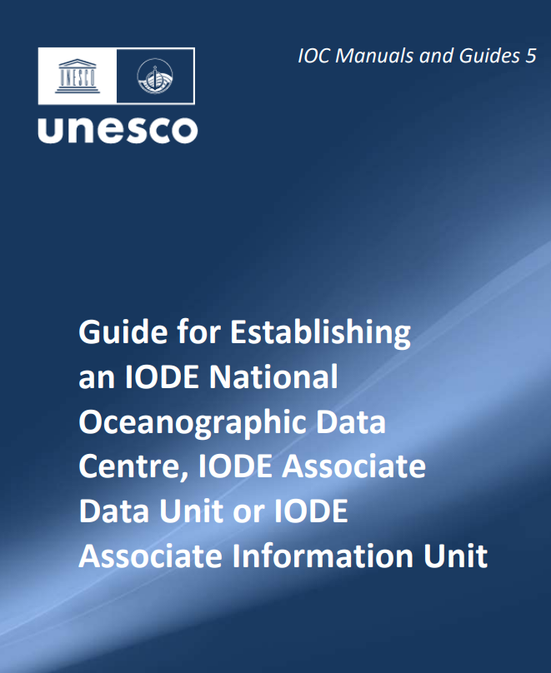

Guides or Manuals
The rules of procedure document explains how to establish a new IODE Programme, Activities & Projects, how to set up its governance mechanisms including steering group and project management.
IODE Committee adopted the IOC Strategic Plan for Ocean Data and Information Management (2023-2029) Recommendation IODE-XXVII/6.2.
www.iode.org

Slide 4
New Designation (March 2023)
Programme Component (PC): activity with at least core UNESCO/IOC RP
funding and staff support that enables the activity to operate on a permanent basis;
Programme Activity (PA): Long-term activity receiving minimal UNESCO/IOC RP funding supplemented by substantial in-kind and/or extra-budgetary support;
Project: Activity that is limited in time and is fully funded from extra-budgetary sources (Each Programme Component or Programme Activity can be further strengthened through “Projects”)
www.iode.org

Slide 5
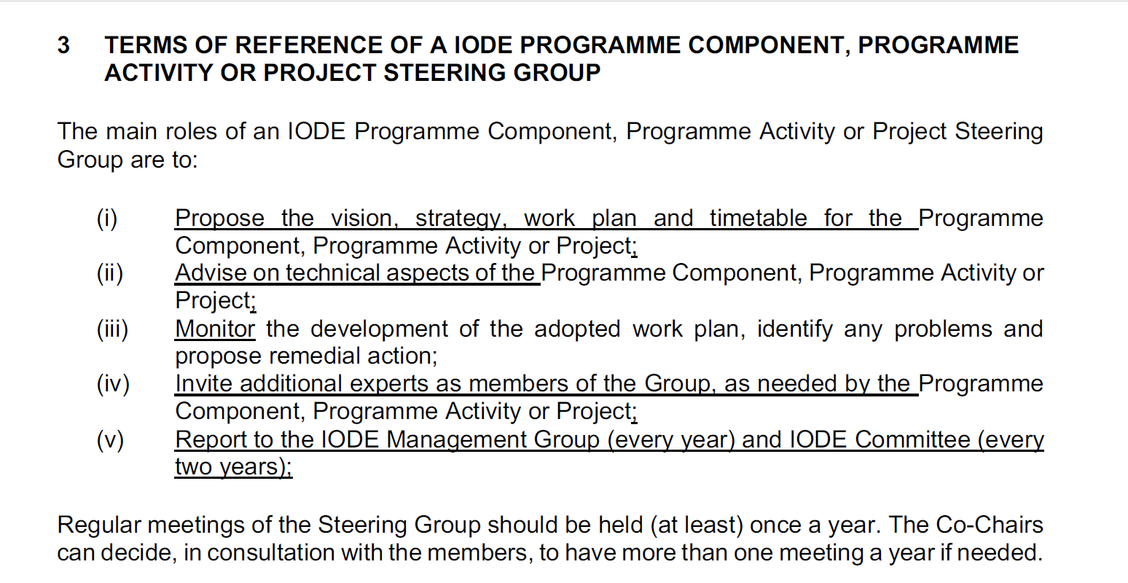
Terms of References – Steering Group
www.iode.org

Slide 6
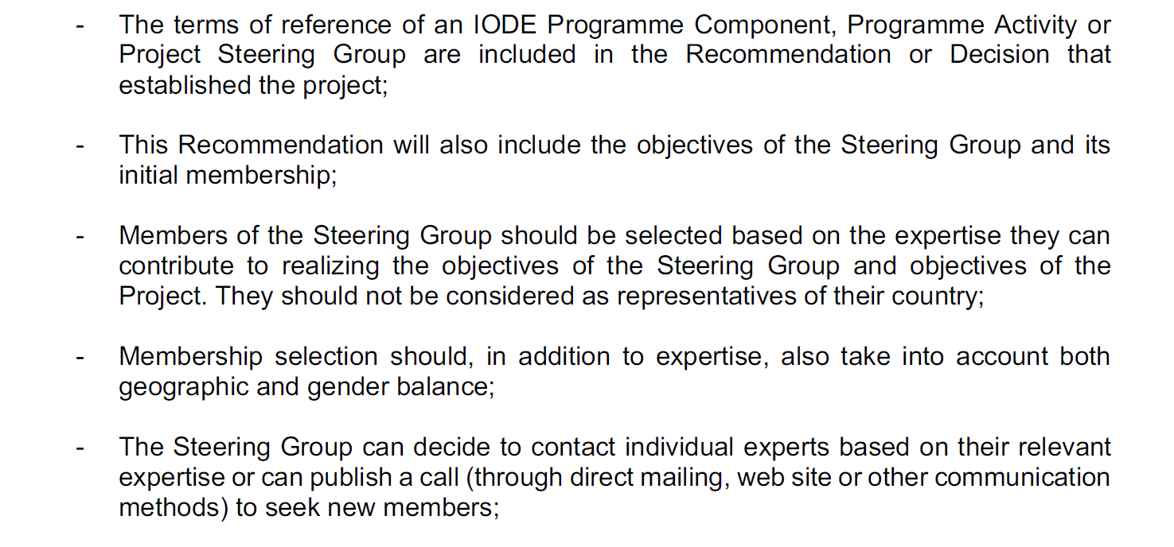
Terms of References – Steering Group
www.iode.org

Slide 7
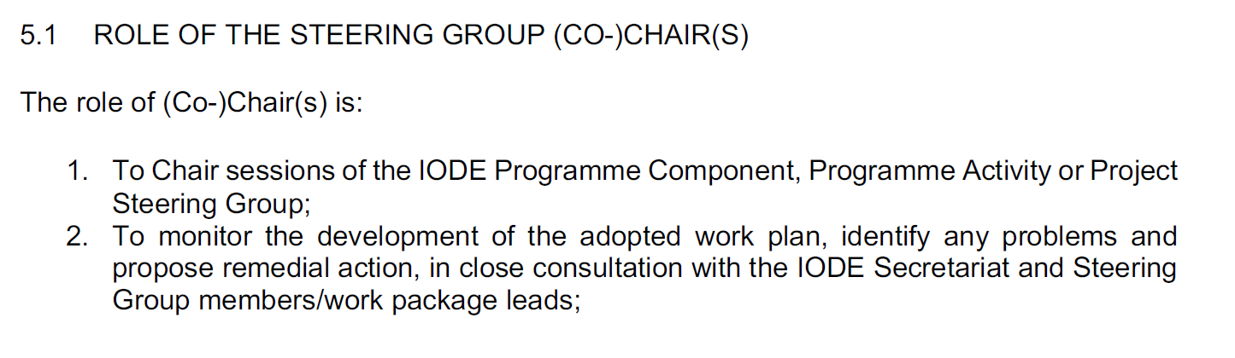
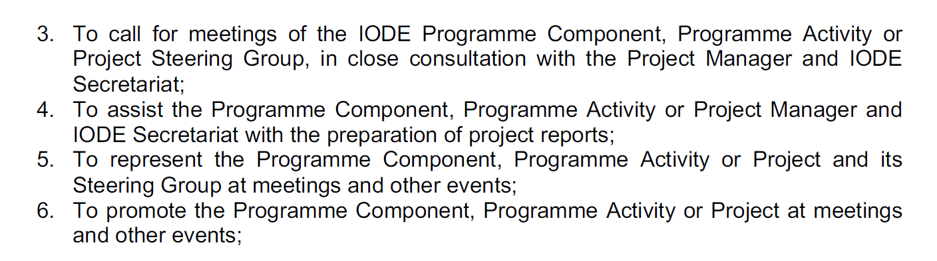
Terms of References – Role Co-Chairs
www.iode.org

Slide 8
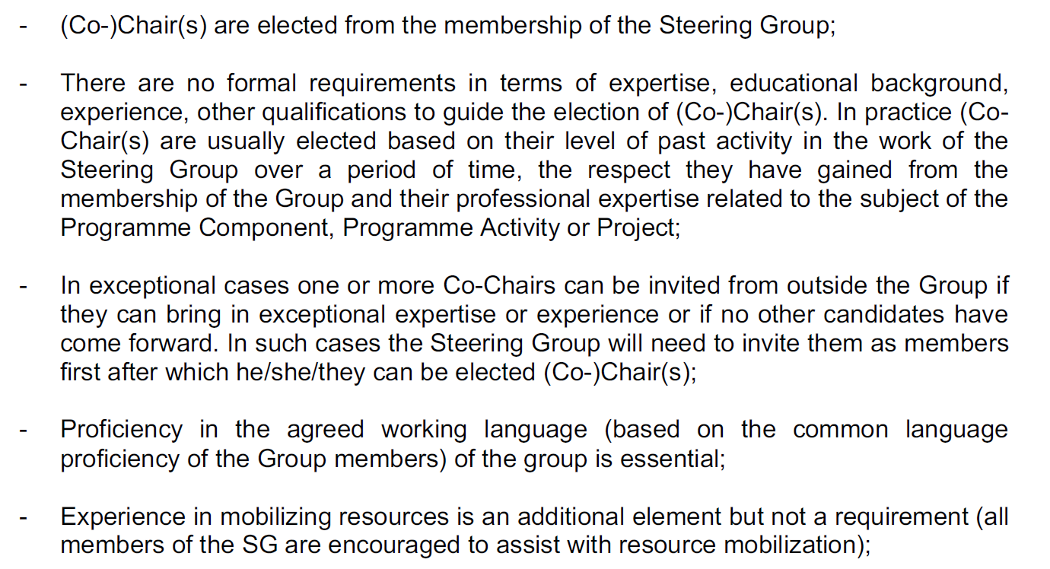
Election Criteria – Election Co-chairs
www.iode.org

Slide 9
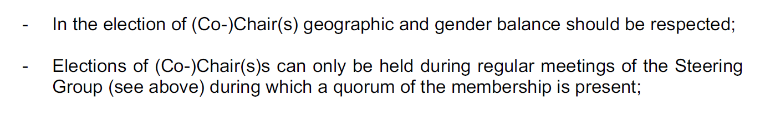
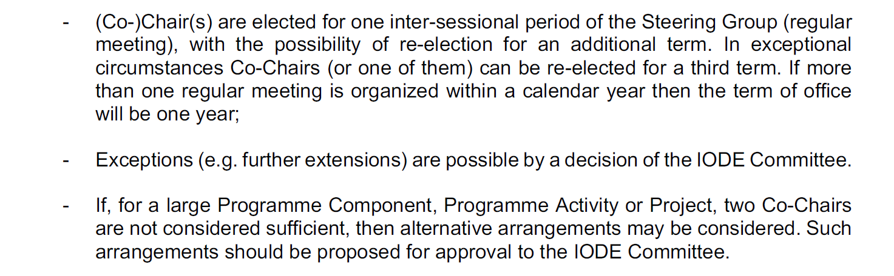
Election Criteria – Election Co-chairs
www.iode.org

Slide 10
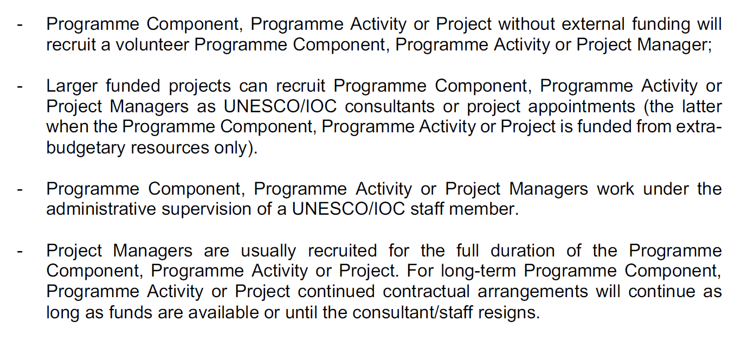
Election Criteria – Project Manager
www.iode.org

Slide 11
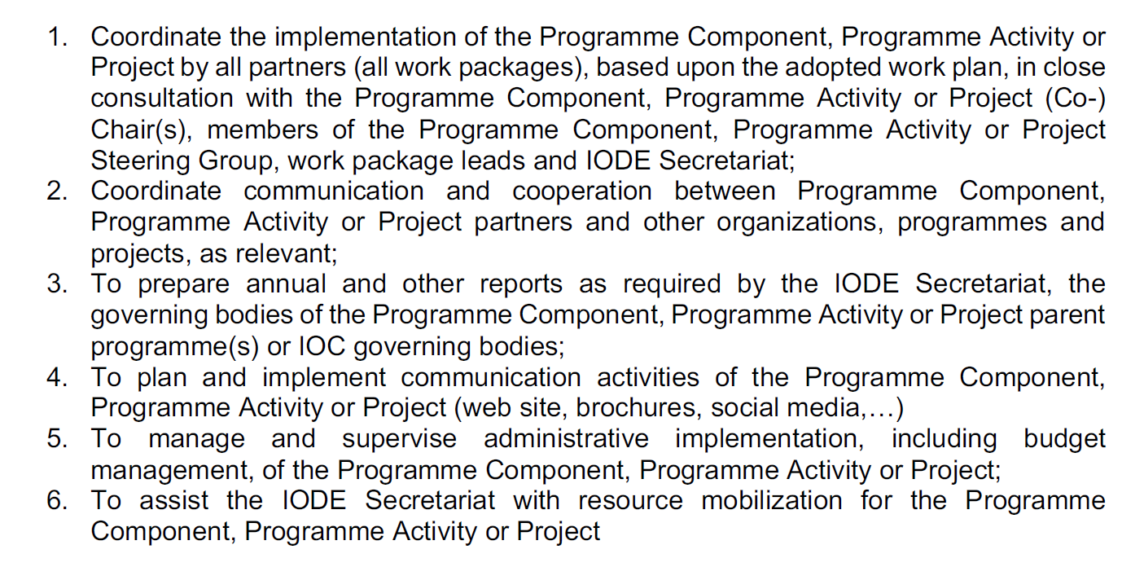
Election Criteria – Tasks PM
www.iode.org

Slide 13



