Slide 1
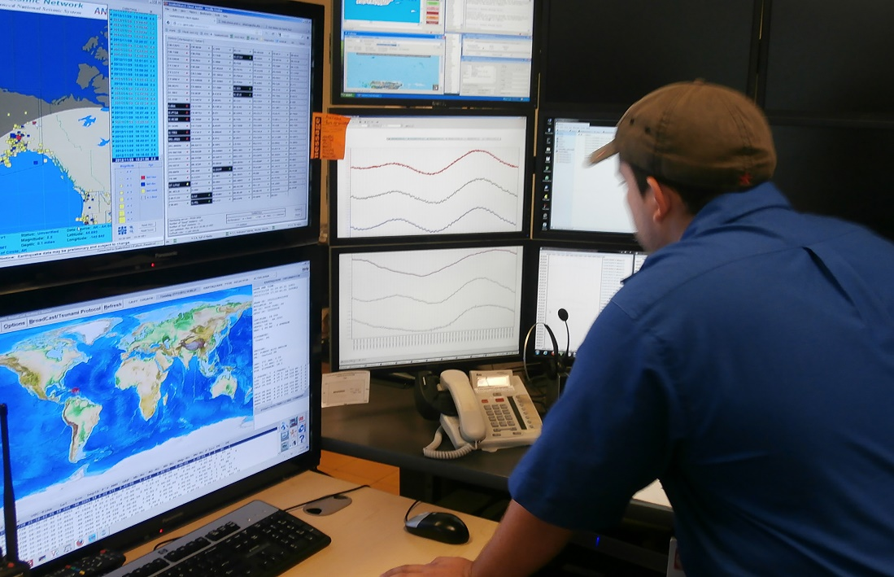
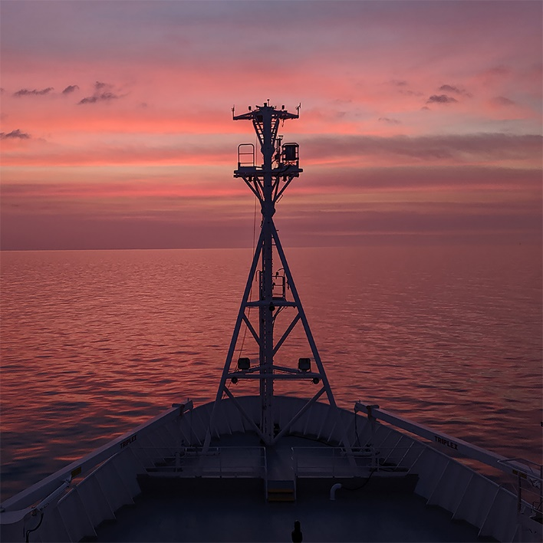
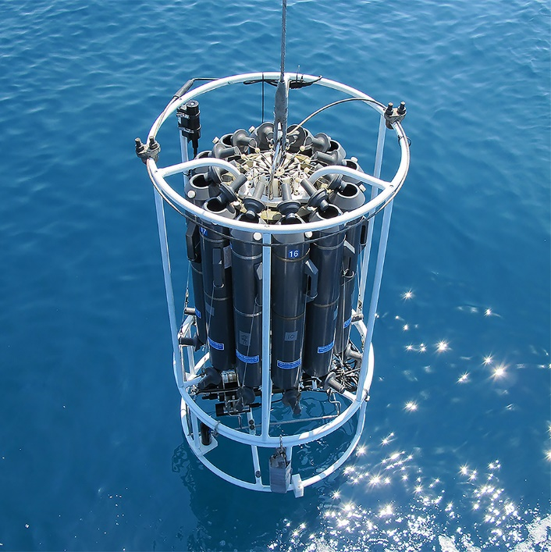
Our External Projects
Jay Pearlman
IEEE
www.oceanbestpractices.org

Slide 2
Project or Activity | Major efforts | Organizations engaged | approx. amount | Performance period
ODIP | Formation OBPS, Interoperabiity | IEEE | 105K | 2015-2017
AtlantOS | Formation OBPS, Innovation | IEEE, … | 150K | 2015-2019
JERICO | BP for Coastal Europe, CORE | IEEE, UNESCO | 115K | 2019-2024
EuroSea | BP for ocean Observing and applications | UNESCO, GEOMAR, IEEE, … | 90K* | 2019-2023
Capardus | Arctic Practices System | AWI, IEEE | 229K* | 2020-2023
BlueCloud2026 | BP Applications and outreach | IEEE, OTGA, | 107K | 2023-2026
Iliad | BP/Stds for Digital Twins | IEEE, … | 268K | 2022-2025
ObsSea4Clim | BP for EoV; FedNet | GEOMAR, IEEE | 380k | 2024-2026
IOC/NORAD ADAPT | BP training Caribbean | USF | 99K | 2023-2024
GROOM II | BP strategy for EU RI,convergence/endorsement | HCMR, GEOMAR | 30k | 2021-2024
EuroGO-SHIP | BP strategy for EU RI, secondary RM, convergence/endorsement | GEOMAR | 75k | 2022-2025
RCN | community/ training/Ambassador | USF | 70K | 2018-2023
Projects
*estimated

Slide 3
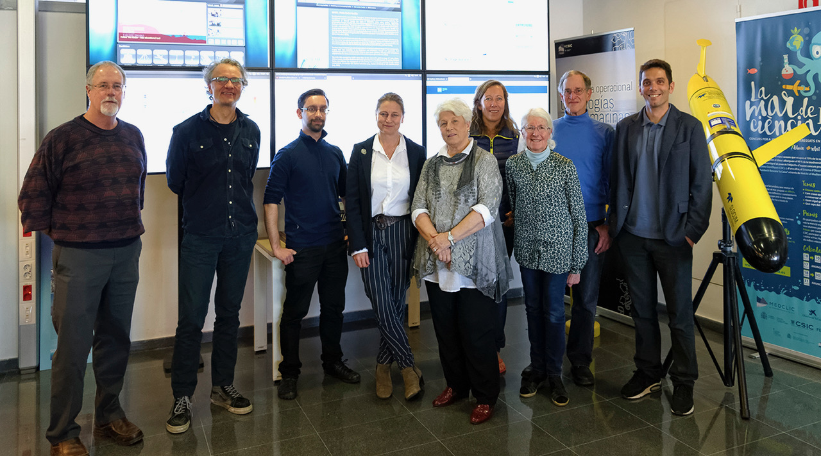
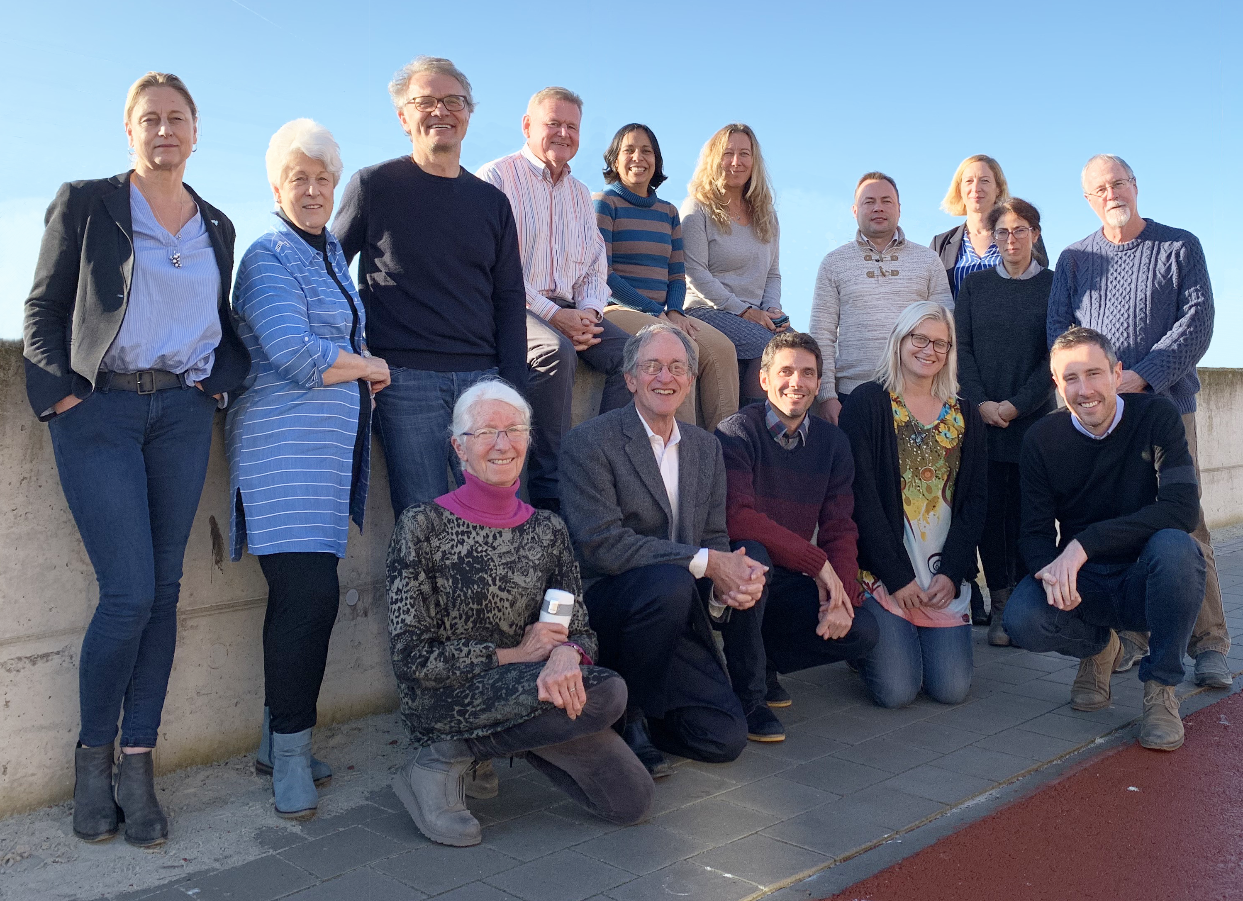
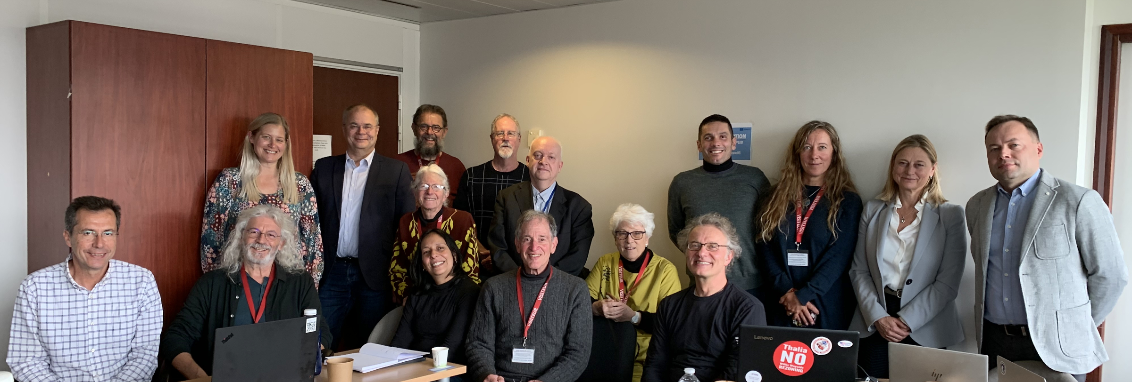
Dec 2019
Jan 2018
Nov 2022

Slide 4
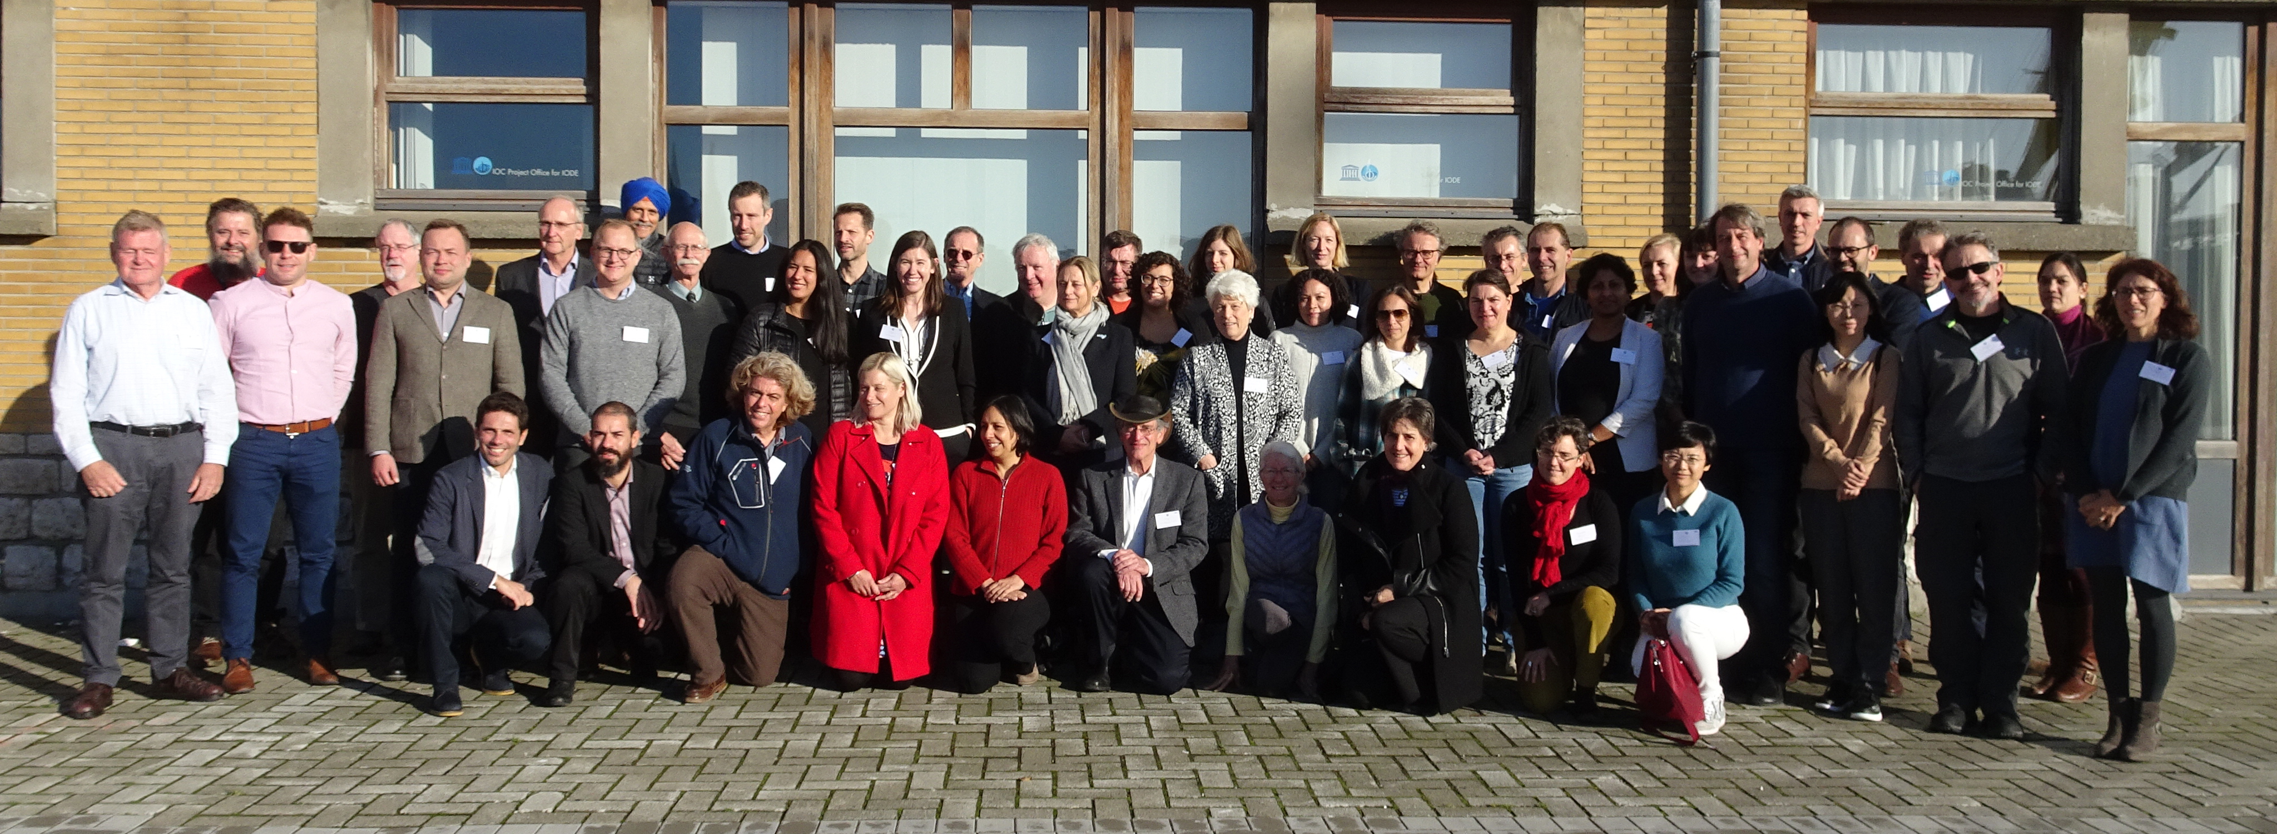
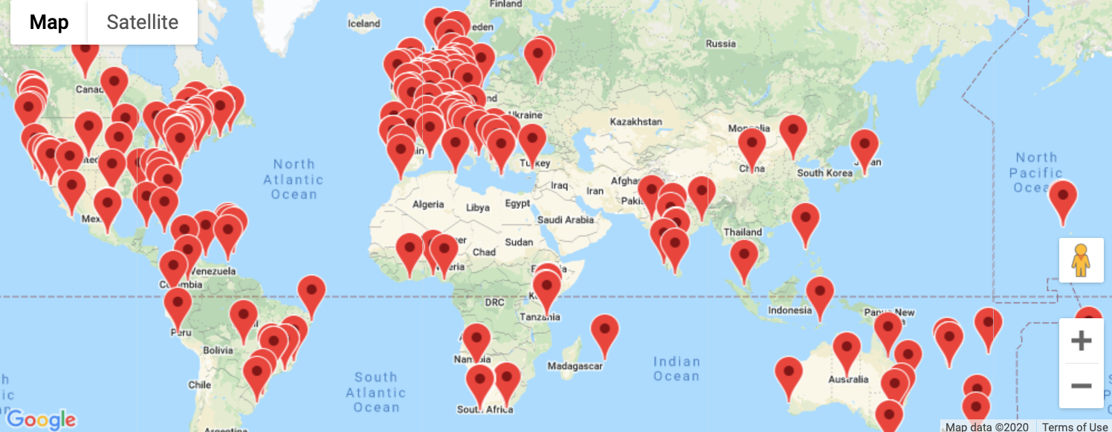
Life before COVID (Dec 2019 Workshop)
During COVID – a virtual life

Slide 5
