Slide 1
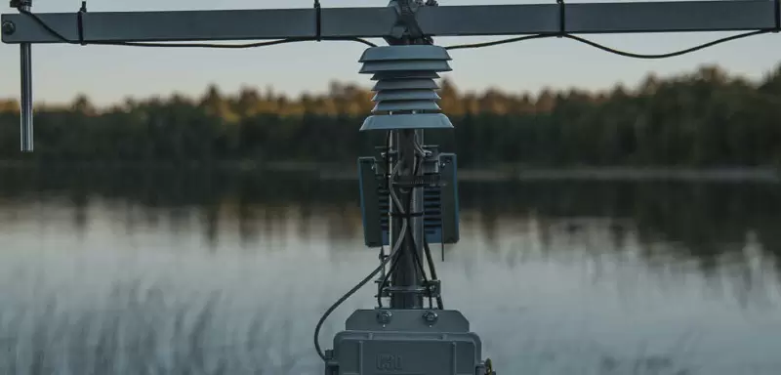


Early Warnings for All
Overview

Slide 2

EARLY WARNINGS for All
Overview

Slide 3



“Today I announce the United Nations will spearhead new action to ensure every person on Earth is protected by early warning systems within five years.’
António Guterres, Secretary-General of the United Nations, 23rd March 2022
The Sharm el-Sheikh Implementation Plan adopted by the COP-27 emphasized the need to address existing gaps in the global climate observing system, particularly in developing countries, and recognized that one third of the world, including sixty per cent of Africa, does not have access to early warning and climate information services.
It welcomed and reiterated the UN SG’s call to protect everyone on Earth through universal coverage of early warning systems against extreme weather and climate change within the next five years.
Notes:
Photo Credit: WMO Calendar Competition Flikr
Double Rainbow over the Caroni Plains
Photo by: Mr. Ziad Joseph (Trinidad and Tobago)
Location: Caroni, Trinidad and Tobago

Slide 4
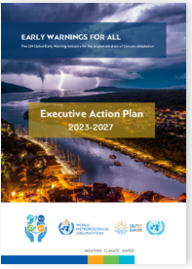
EW4All Executive Action Plan 2023-2027
Launched on 7 November at COP 27
EW4All Executive Action Plan is available in the WMO online library
High visibility and political support
Builds from and aligns with WMO and other stakeholders’ foundational elements already in place to pursue the early warning goal
WMO, 2022

Slide 5
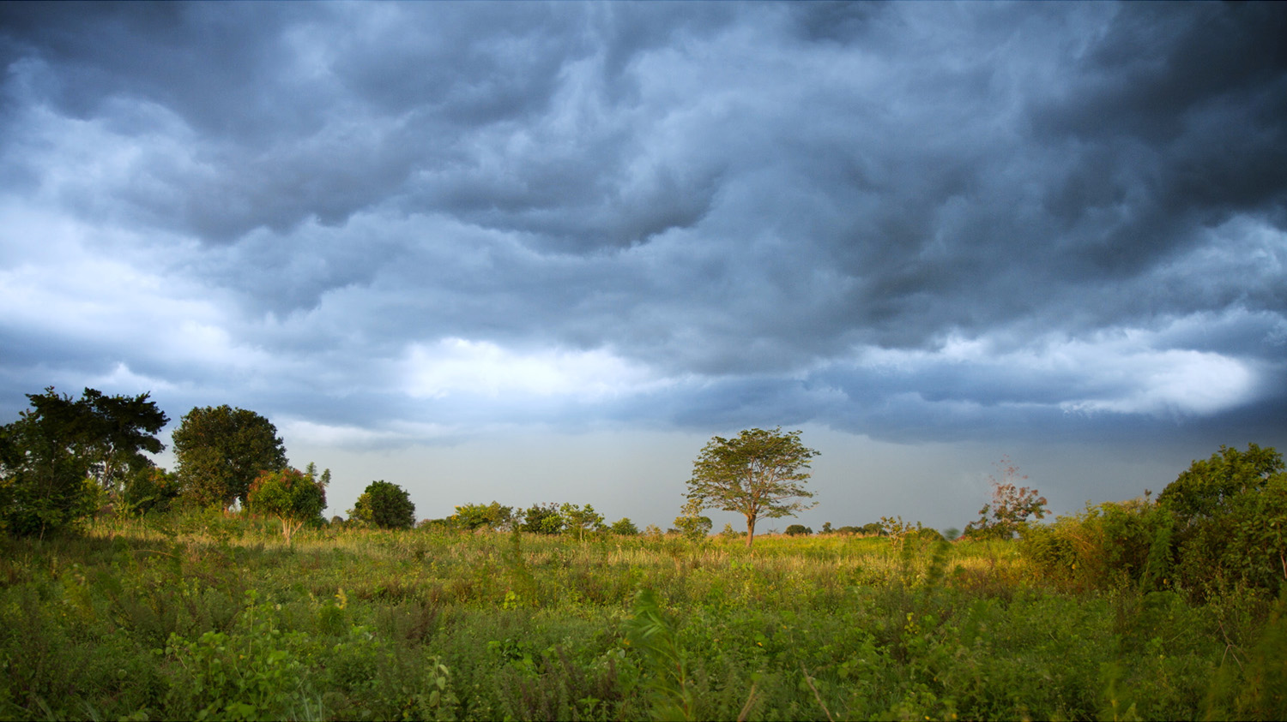
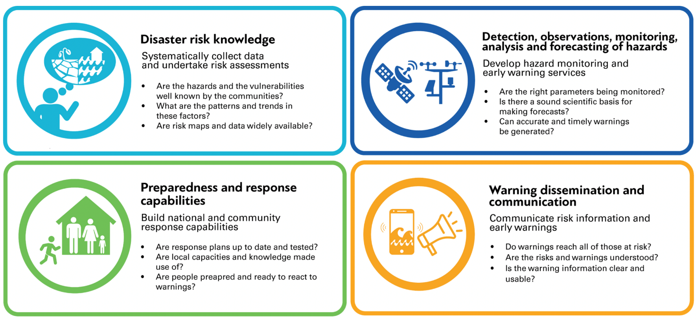
Early Warnings for All: Structure & Objectives
Pillar 1
Pillar 2
Pillar 4
Pillar 3
Notes:
The EW4All Initiative comprises four Pillars, in line with the four components of an end-to-end multi-hazard early-warning system: risk knowledge, observation and forecasting, communication and response.
Pillar 1: To be effective, EWS need to be contextualised and targeted through up-to-date, reliable and granular risk knowledge, including: assessments of hazards, vulnerabilities and exposure; applying a gender-lens and including indigenous and local knowledge. Significant shortcomings persist globally, from lack of data collection and assessments to lack of legislation and governance frameworks for risk information.
Pillar 2: In the forecasting area, many countries lack the capacity to incorporate an impact-based approach to forecasting and still have challenges in accessing, analysing and translating prediction model outputs into actionable warning messages.
Pillar 3: Considering warning dissemination and communication, the uptake of modern information technologies is lagging and even with more traditional methods (such as radio and mass media), there are still challenges in terms of inclusivity and reaching the most vulnerable.
Pillar 4: Having preparedness and response plans and capabilities, including at local government level is vital for responding to the hydro-meteorological warnings. Currently, less than half of the countries which have EWS in place have such plans and capacities available.

Slide 6





















Early Warnings for All: Partners
Pillar 1
Led by
Pillar 2
Led by
Pillar 3
Led by
Pillar 4
Led by
Notes:
Intragency process

Slide 7

Programmatic Approach: Global & Regional Level
Global Level
High-level Executive Action Plan
Advisory Panel for EW4All initiative
Global inter-pillar technical coordination group (ITCG): Programmatic planning, implementation strategy, and tools to support countries
M&E Framework: Theory of Change, maturity index, dashboard on country progress, annual report on progress at COP
Regional Level
Building on existing mechanisms, and regional inter-pillar coordination through WMO, UNDRR, ITU, and IFRC.
Africa EW4All Roadmap, in collaboration with AU
Country Level
National coordination, led by relevant authorities, UN Resident Coordinator/Development Coordination Office, multi-stakeholder and inclusive

Slide 8
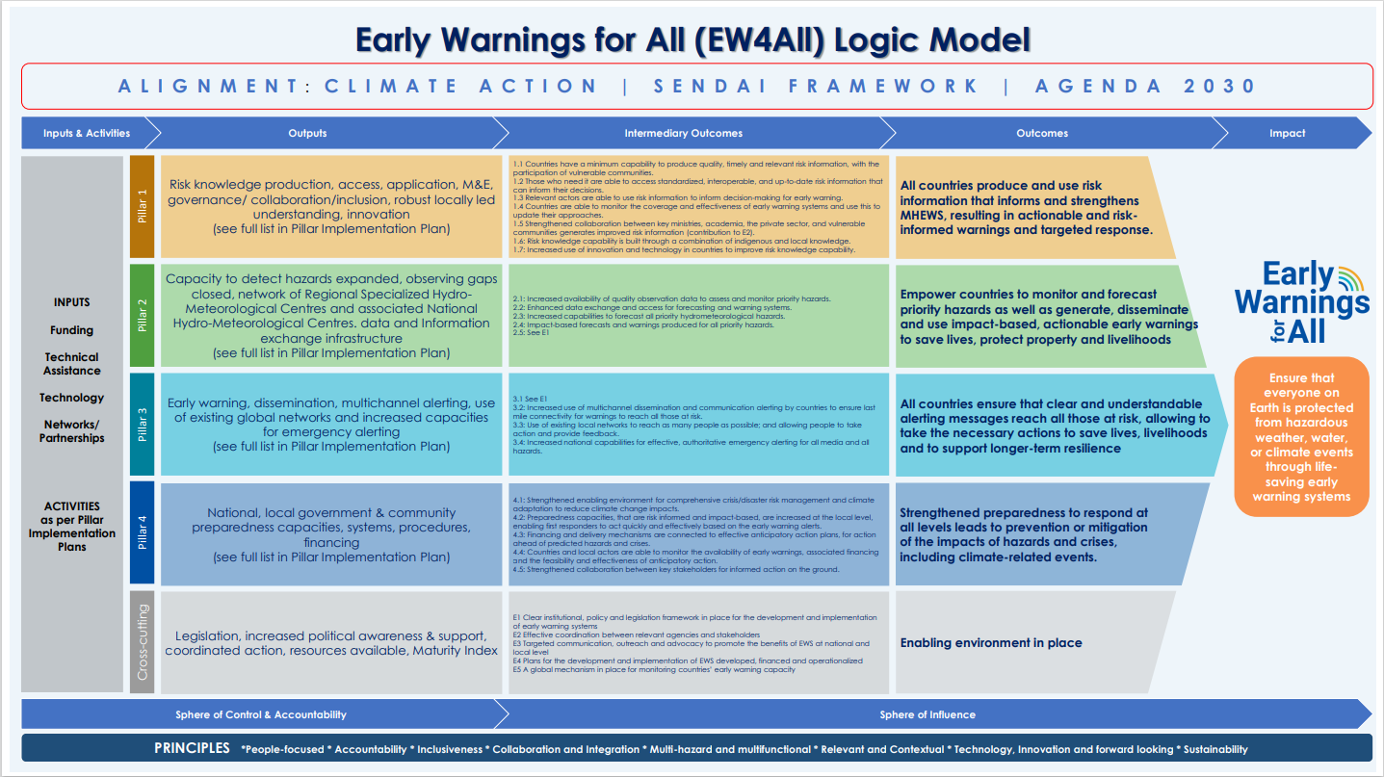

Slide 9

Joint roll-out activities
  Multi-stakeholder consultation workshop
  Focus on strengthening coordination across sectors and scales
  Identification of immediate technical support requirements
  National roadmap and financing strategies as needed
  Initial pillar implementation and capacity-building
  Common monitoring framework (30+)
  Country-led and defined content
  Cross-pillar alignment ensured as a principle

Slide 10

EW4All: Country Rollout Schedule
Completed
Country | Date of workshop
Ethiopia | 30 August - 1 September
Madagascar | 14-15 September
Tunisia | 9-10 November
Uganda | 15-17 November
Somalia | 15-16 November
South Sudan | 20-22 November
Mozambique | 20-22 November
Mauritius | 19-20 December
Haiti | 29-30 November 2023
Barbados | 01-02 November 2023
Antigua & Barbuda | 12 - 13 December 2023
Guatemala | 09 October 2023
Maldives | 30 August - 1 September
Tajikistan | 14-15 September
Nepal | 9-10 November
Cambodia | 15-17 November
Lao PDR | 15-16 November
Bangladesh | 16-17 November

Slide 11
EW4All: Country Rollout Schedule
Forthcoming in 2024
RA | Country
1 | Comoros
1 | Djibouti
1 | Chad
1 | Liberia
1 | Niger
1 | Sudan
2 | Guyana
2 | Ecuador
5 | Fiji
5 | Kiribati
5 | Samoa
5 | Solomon Islands
5 | Tonga

Slide 12


EW4ALL NATIONAL WORKSHOP
CURRENT STATUS of EWS
GAP ANALYSIS
Government-led discussion on current state of EWS
Application of Minimum Core Capability Checklist for all four Pillars of EWS
LINK & ALIGNMENT
NATIONAL STAKEHOLDER COORDINATION
Consolidation of key stakeholder engagements & linkages with existing EWS projects
Affirm or establish NSCM to to drive multi-stakeholder efforts to implement EWS
PRIORITY AREAS
NATIONAL ROADMAP
Introduction to EW4All and calibration with national priority areas on EWS
Leverage existing EWS strategy or develop a multi-year, multi-stakeholder EW4All national action plan

Slide 13

Outcomes from the Conference of the Parties serving as the meeting of the Parties to the Paris Agreement (COP28)
United Arab Emirates, 30 November to 12 December 2023
  FCCC/PA/CMA/2023/L.1 Establishment of a Loss and Damage, Section III Para 21 “Initiatives such as Early Warnings for All, Climate Risk and Early Warning Systems, the Systematic Observations Financing Facility and the Global Shield against Climate Risks are welcome, and relevant actors are encouraged to increase their support for activities that enhance response to loss and damage”
  FCCC/PA/CMA/2023/L.17 First global stocktake Section II Collective progress towards achieving Paris Agreement; B. Adaptation Para # 50 “Recalls the United Nations Secretary-General’s call made on World Meteorological Day on 23 March 2022 to protect everyone on Earth through universal coverage of early warning systems against extreme weather and climate change by 2027 and invites development partners, international financial institutions and the operating entities of the Financial Mechanism to provide support for implementation of the Early Warnings for All initiative”
Notes:
13

Slide 14
Outcomes from the Conference of the Parties serving as the meeting of the Parties to the Paris Agreement (COP28)
United Arab Emirates, 30 November to 12 December 2023 cont…
  FCCC/PA/CMA/2023/L.17 First global stocktake Section II Collective progress towards achieving Paris Agreement; B. Adaptation Para # 64 Global Goal on Adaptation “(a) Impact, vulnerability and risk assessment: by 2030 all Parties have conducted up-to-date assessments of climate hazards, climate change impacts and exposure to risks and vulnerabilities and have used the outcomes of these assessments to inform their formulation of national adaptation plans, policy instruments, and planning processes and/or strategies, and by 2027 all Parties have established multi-hazard early warning systems, climate information services for risk reduction and systematic observation to support improved climate-related data, information and services;”
Notes:
14

Slide 15
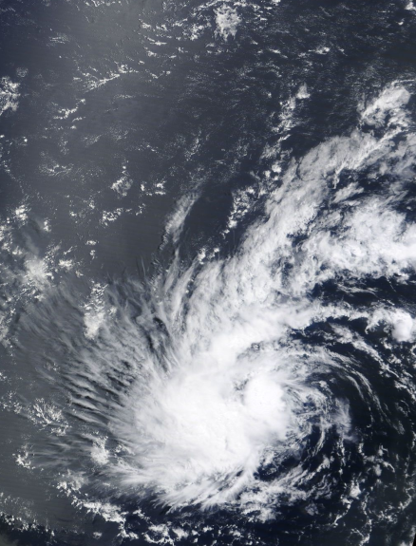
WMO’s approach to EW4All
Overview

Slide 16
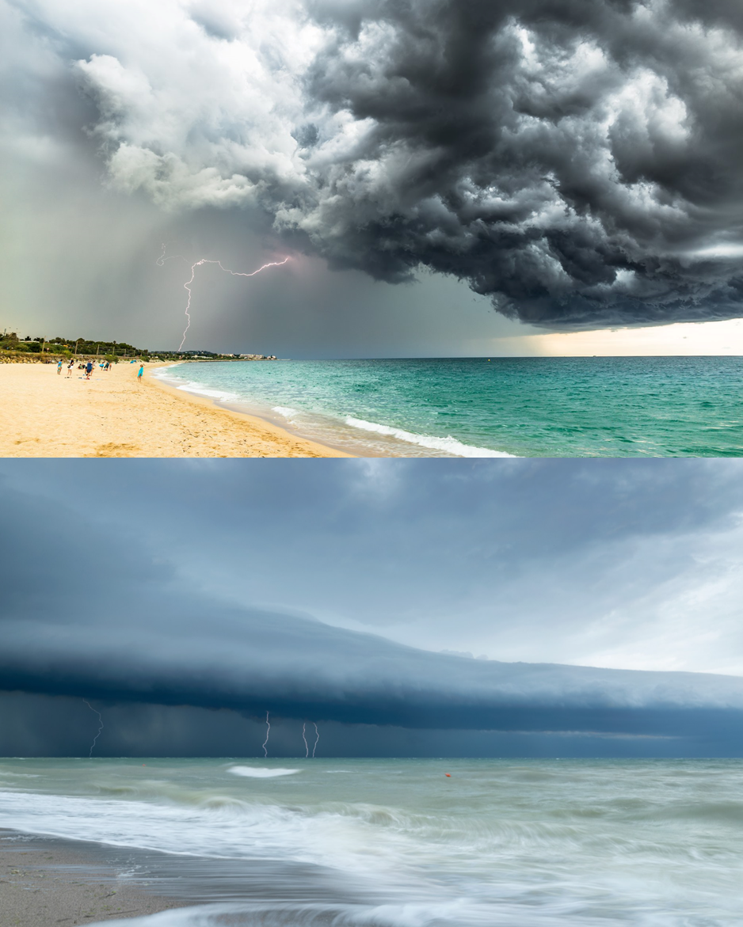
Upcoming engagement
  WMO role, approach and commitment
  WMO Co-leads the EW4All initiative with UNDRR at the UN SG’s request
  WMO leads and coordinates Pillar 2 activities on detection, observations, monitoring, analysis, and forecasting of hazards and contributes to all other Pillars and interpillar activities
  WMO Congress accorded EW4All the highest priority in the WMO Strategic Plan 2024-2027
  Rapid Assessment for Members launched during WMO Congress and results used to inform national consultations
  Roles of different WMO organs:
    WMO Members, as the actors with the primary responsibility to establish multi-hazard early warning systems
    World Meteorological Congress and Executive Council
    WMO Regional Associations
    WMO Technical commissions
    WMO Secretariat
Notes:
16

Slide 17
Pillar 2 Rapid Assessment Tool
  Purpose: quick baseline data to inform WMO missions and interventions
  Format: detailed questionnaire along
  8 areas, including per hazard, which is responded by means of structured interviews
  Methodology: based on Country Hydromet Diagnostics + CDEMA Checklist + CREWS Custom MHEWS Indicators
  Expected output: more granular data to inform decision-making
Governance, management and institutional mechanisms
General observation capacity
Hazard-specific observations
Remote-sensing data
General forecasting capacity
Impact-based forecasting capacity
Warning services and MHEWS operations
Cross-cutting enablers
Notes:
17

Slide 18
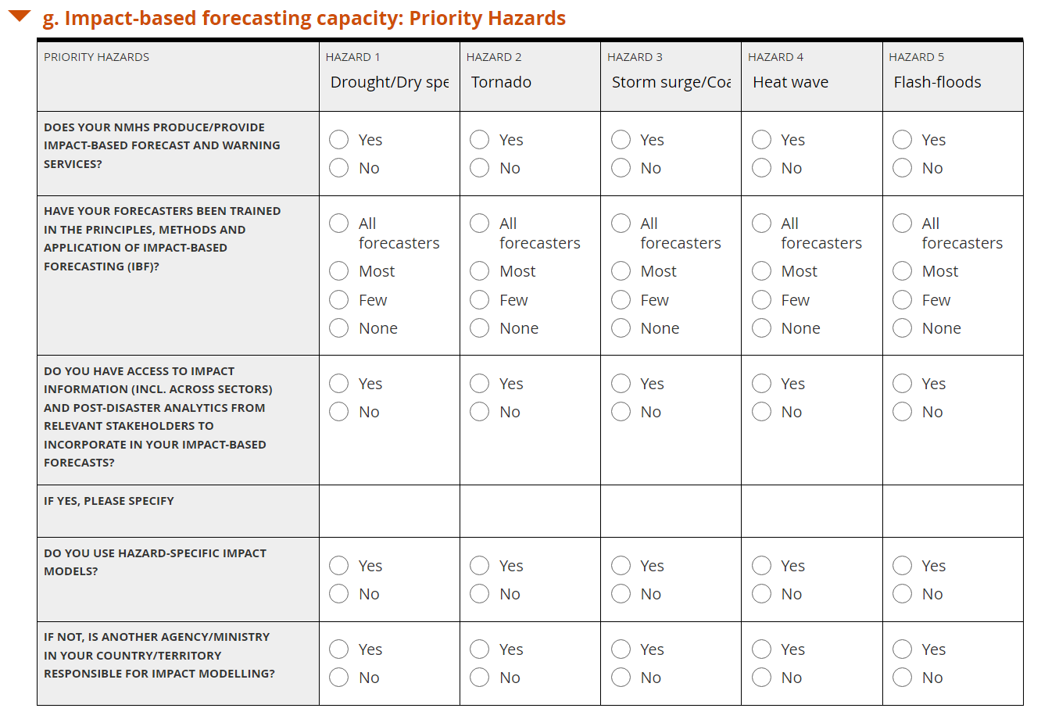
Data Collection
  During and after the World Meteorological Congress in May-June 2023:
  Collected data from all 30 countries
  Also collected from 10 non-EW4All countries:
  Burkina Faso, Cote D'Ivoire, Mali, Nigeria, Senegal, Sudan, Timor-Leste, Trinidad & Tobago, United Republic of Tanzania, Vanuatu
  Increased reliability and validity of the data through one-on-one interviews
  Members highly appreciated the dialogue and EW4All partners’ desire to understand their needs and target the assistance accordingly
Notes:
18

Slide 19


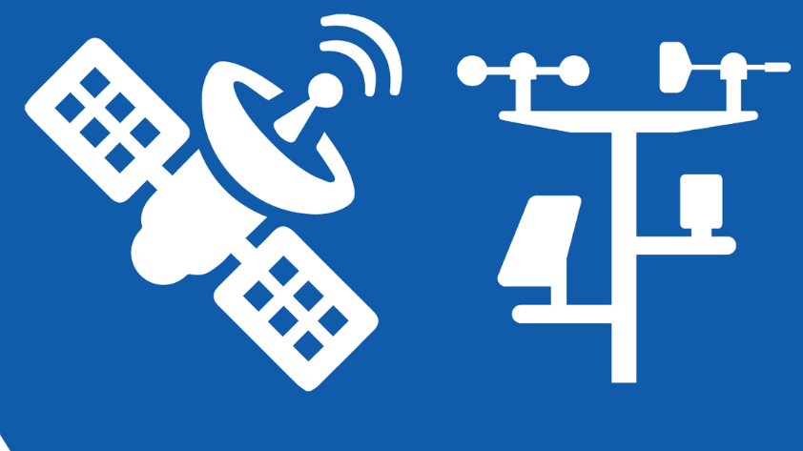





Despite a moderate amount of synoptic station, observations are limited by a lack of capacity to perform maintenance, QC and calibration, as well as to transfer data in (near)real-time. Forecasting capacity is impaired by a lack of training, incl. on remote sensing data. Cooperation with the national DRR agency is limited, and no risk and vulnerability data is available for IBF. Little financial resources are available for service improvements.
2
MAURITIUS
Pillar II capacity
Flash-floods
Governance and institutional setting
≈
–
Limited forecasting capacity
Lack of hydrological observations
Lack of vulnerability/impact data
Observation infrastructure
Tropical cyclones
Rogue waves/high seas
Hazard-based observation capacity
+
–
Benefit from RSMC la Réunion guidance
Lack of observation and IBF forecasting capacity
Remote-sensing data
Storm surge/coastal flood
General forecasting capacity
≈
–
Limited forecasting capacity
Lack of observation capacity
Lack of vulnerability/impact data
Impact-based forecasting capacity
Tsunami
Warning services & MHEWS operations
≈
–
Reliance on Regional Tsunami Service Providers
Lack of forecasting capacity, incl. use of regional products
Financial and technological enablers
The capacity assessment level above is ranked on a scale from 1 to 5, where 5 represents advanced capacity and 1 represents no capacity. The capacity level is determined via a quantitative (weighted rating) and qualitative analysis of the EW4All Rapid Assessment Tool (RAT) submission of the Member.
Rain/Wet spell
≈
–
Limited forecasting capacity
Lack of observation and IBF forecasting capacity
The colours of the bars above express the degree of attainment of each element as quantified by the EW4All RAT, following the percentages indicated hereafter:
0-20% | 21-40% | 41-60% | 61-80% | 81-100%
Sufficient observations (both local and remote)

Slide 20
EW4All – WMO SERCOM, INFCOM, RB
Priority hazard approach reflects on the ambition to support country level implementation
Identified priority hazards are to be used to prioritize Technical Commissions’ activities, including:
  Develop relevant guidance and training material;
  Strengthen and establish support under the framework of WIPPS;
  Develop and consolidate technical regulations and other guidance materials related to early warning services components
Further development of nomenclature of emerging hazard types, such as those due to changes in the cryosphere, in the framework of the Catalogue of Hazardous Events
Notes:
The regional associations:
(a) With the assistance of the regional offices to ensure that focused actions on the implementation of the EW4All falling within their terms of reference are prioritized in their respective work plans for the next financial period; and
(b) To regularly report progress to the EC for its guidance;
(4) The Hydrological Coordination Panel:
To ensure that the outputs of the WMO Plan of Action for Hydrology, which contribute to the EW4ALL, are prioritized for the next financial period; and
To regularly report progress to the EC for its guidance;
Based on the guidance of Cg-19 and EC-77, I have drafted the following on the EW4All for inclusion in the provisional agenda of TCC-1(2023):
3 EW4All: scoping and planning exercise​
In light of the revised terms of reference of the TCC, Resolution 4 (Cg-19) – United Nations Early Warnings for All initiative and Resolution 1 (EC-77) – WMO Contribution to the Early Warnings for All initiative, the Committee will consider the initial draft of an implementation plan for the WMO contribution to the EW4All initiative.
The Committee will consider in particular the following three aspects.
3.1 High-priority activities for inclusion in work programmes​
The Committee will agree on a list of priority activities to be included in the work programmes of technical commissions, additional bodies and regional associations to be adopted at their next sessions.
3.2 Priority emerging hazards to be covered by monitoring and early warning systems​
The Committee will agree on a tentative list of priority emergency hazards that should be covered by early warning systems, focusing on actions that can be implemented with existing means.
3.3 Coordination, consolidation and reporting mechanisms
The Committee will agree on ways to ensure the coordination of the WMO contribution to EW4All, the consolidation of relevant activities under the single implementation plan and reporting mechanisms to the Executive Council, Congress and the United Nations.
Please let me know what you think.

Slide 21













HAZARD IDENTIFICATION
Research
Data & Observations
Guide and support the RBON design process
Decision Support
Numerical Weather Prediction
Catalogue of Hazardous events
Dissemination & Communication
Forecaster added value
Short-Term
Medium-Term
Long-Term

Slide 22

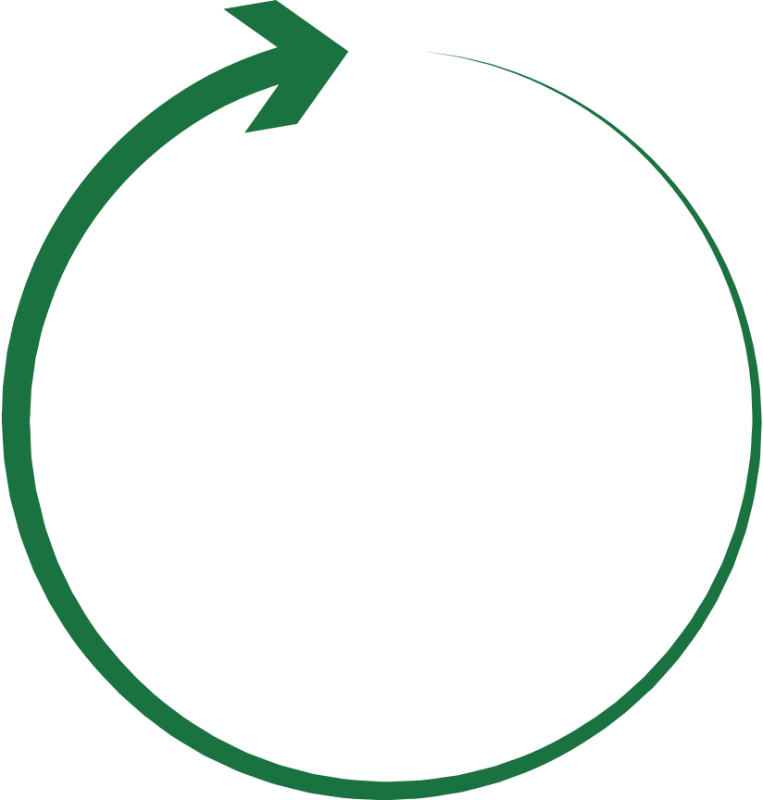
TROPICAL CYCLONES
Research
Data & Observations
Sowing Seeds of Innovation: workshop in Central America/Caribbean focused on hurricanes to be held in Feb 2024 and workshop in southern Africa on TCs to be held in late 2024
WWRP with SERCOM and INFCOM: Tropical Cyclone - Probabilistic Forecast Products (TC-PFP) using the vale-cycle approach to probabilistic tropical cyclone forecasts of TC formation, position, structure, rainfall and storm surge
Coordination to ensure continual access to satellite data/products, radar images, AWS data, buoys
Region-specific TC Operational Plans/ Manuals
Operational Plans are updated regularly during the tropical cyclone regional bodies sessions
Numerical Weather Prediction
Tropical Cyclone Programme (TCP), Severe Weather Forecasting Programme (SWPF), Coastal Inundation Forecasting Initiative (CIFI)
Decision Support
More Members to establish national coordination procedures / mechanisms, e.g. National Crisis and Emergency Management Council/Committee, legislative frameworks, etc
Definition of tropical low/cyclone vortices variables
MCs and cascading by TC RSMCs, ensemble forecasting, etc.
Forecaster added value
Three 6-hourly updating by TC RSMCs and NMCs, up to 5 days for each region
TC RSMCs for regional advisory products and NMCs for national forecasting and warnings, both with human intervention in formulating products and information
Dissemination & Communication
Common Alerting Protocol
Coordinated standard operating procedures at regional and national levels through operational plans
TC Forecaster competency framework (Compendium of WMO Competency Frameworks (WMO nr 1209)
Short-Term
Medium-Term
Long-Term
TC RSMCs are leading to developing IBF products with risk information, including impacting areas, utilities and communities for actions
Marine Services course - progress rollout across regions and languages; The application of the Competency Assessment Implementation (Toolkit) - progress; IMO Mariner model courses - updates to meteorological training

Slide 23
EW4All – next steps for collaboration
Call this afternoon to discuss activities in Guatemala
Within the countries that indicated tsunamis as a priority hazard, how should we engage with UNESCO?
Pacific and Caribbean islands how could we ramp up support and engagement?
Notes:
The regional associations:
(a) With the assistance of the regional offices to ensure that focused actions on the implementation of the EW4All falling within their terms of reference are prioritized in their respective work plans for the next financial period; and
(b) To regularly report progress to the EC for its guidance;
(4) The Hydrological Coordination Panel:
(a) To ensure that the outputs of the WMO Plan of Action for Hydrology, which contribute to the EW4ALL, are prioritized for the next financial period; and
(b) To regularly report progress to the EC for its guidance;

Slide 24


