Slide 1
ICG/CARIBE EWS midterm Officers Meeting, February 1-2, 2024
Working Group 1: Risk Knowledge
Chair: Frédéric Dondin (France)
Vice-Chair: Raphaël Paris (France)
Purpose of the WG: to advise the ICG on the identification and characterization of the risk associated with tsunami and other coastal hazards, and their assessment and required modelling.
Tasks:
• Review and evaluate required methods and data sets, including bathymetry and coastal topography for determining coastal hazards.
• Advise Member States on the requirements for operating the appropriate models for risk assessment.
• Advise and build capacity for risk assessments and their interpretation.
• Present a progress report based on the Key Performance Indicators related to the United Nations (UN) Ocean Decade Tsunami Programme (ODTP).
• Advise and seek advice from Member States about other coastal hazards that can be included into the warning system.
• Promote the sharing of experience and expertise, and capacity building essential to effective tsunami risk knowledge.

Slide 2
Recommendations last ICG CARIBE EWS meeting, April 2023:
To member states:
Member States to nominate members to actively engage in the Working Group.
Last updated list of members dates back to April 2023
New nominated member: Joël Letang (USVI).
Member States to nominate members with modeling experience to assist to get files prepared for display on CATSAM.
Question: WG1 now focuses on Risk Knowledge, including not only hazard assessment but also vulnerability, whereas the composition of the WG is rather hazard-oriented. Need for a discussion on the relevance of the WG1 composition facing its new contours.
Member States to upload their elevation data, at a minimum to provide status of available data (e.g., extent, resolution, access, etc.).
WG Chair and co-chair will initiate a new consultation this year to encourage Member States to provide updated data.

Slide 3
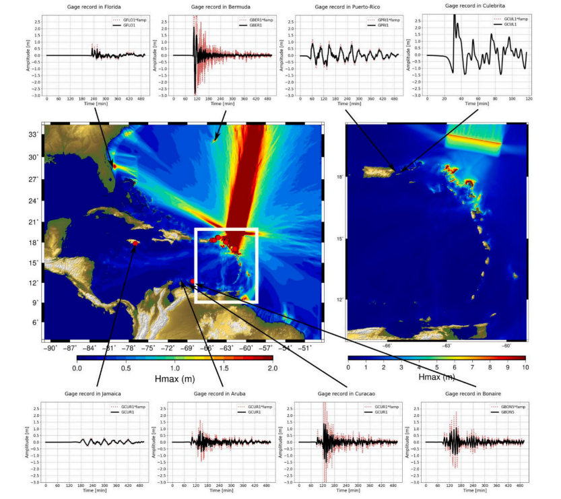
Recommendations last ICG CARIBE EWS meeting, April 2023:
To WG1:
To provide WG2 with the parameters, including associated files (e.g., shapefiles, geotiff, etc.) of the corresponding scenarios once they are available for future Caribe Wave exercises.
WG1 asks for a clarification of the criteria and procedures to define the new scenarios to be used for the CARIBE Waves exercises, in connection with WG2 and the Task Team CW.
WG1 had recent discussions on new scenarios to be implemented to CATSAM:
Rashidi et al. (2023): 6 new scenarios in the Lesser Antilles, some of them having no equivalent in the CATSAM database.
Useche et al. (2022): 1839-like scenario, no equivalent in CATSAM.
Cordrie et al. (2022): new megathrust scenario in the Anegada passage as a source of the pre-Colombian tsunami, likely similar to some scenario of CATSAM but slightly different geometry. Not a priority.

Slide 4
Recommendations last ICG CARIBE EWS meeting, April 2023:
To WG1:
To organize an Experts Meetings on “Non-Seismic Sources of Tsunamis for the Caribbean”.
Meeting to be organized in 2024 as a priority.
Meeting location and dates not decided yet.
One of the options is to schedule it together with another planned meeting on tsunami sources in the NW Caribbean.
Virtual meeting option is considered as a worst case scenario.
To compile and prioritize a list of non-seismic sources; encourages models of scenarios to be available, when possible.
This task will be addressed after the meeting on non-seismic sources of tsunamis.
We’ll also benefit from (a) new publications on volcanic / landslide sources of tsunamis in the Caribbean, (b) the work by the Task Team leaded by Valérie Clouard (see new paper published in Bulletin of Volcanology on the implementation of a VONUT procedure for volcanic tsunamis), and (c) the new IOC Technical Series report on volcanic tsunamis (TOWS ad-hoc task team).

Slide 5
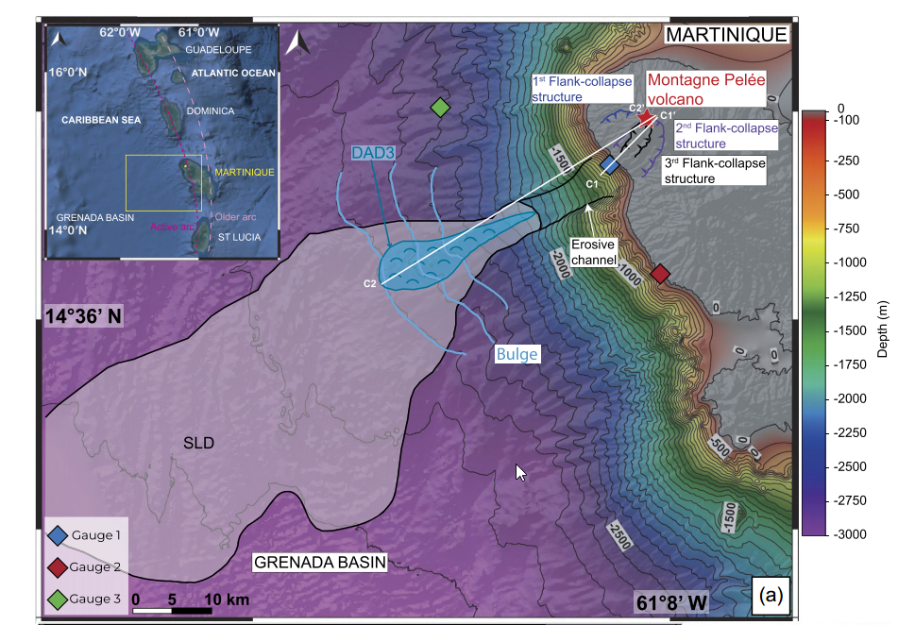
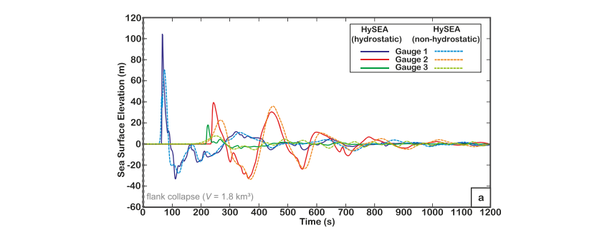
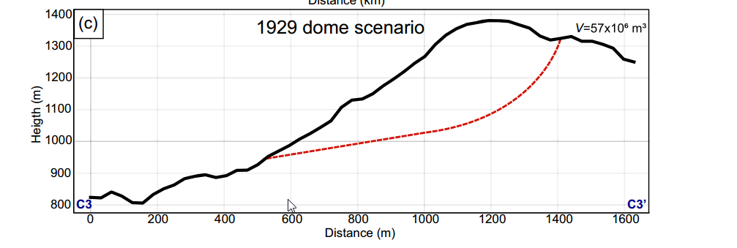
Examples of recent publication on volcanic tsunami in the Lesser Antilles
Poulain et al., 2023 :
Volcanic landslides from Mount Pelée
Volumes tested :
50 x 10⁶ m³ → Caribe Wave 23
1,8 km³ → DAD3 (36 ky BP)
1,8 km³ subdivided in 3 successive sub-events
16,2 km³
16,2 km³ subdivided in 3 successive sub-events
Used in Caribe Wave23 by MSVO to re-assess alert for local Prefecture, instead of LeRoy et al., 2017 tsunami source

Slide 6
Recommendations last ICG CARIBE EWS meeting, April 2023:
To WG1:
To organize a regional training on the development of digital elevation models (DEMs) for tsunami inundation modeling.
Still relevant but ranked as priority 2 compared to the expert meeting on non-seismic sources of tsunamis.
As a reminder, the aims of the training would be to:
1. Review and evaluate the required methods and data sets, including
bathymetry and coastal topography for determining the coastal hazards.
2. Advise the member states on the requirements for operating the
appropriate models.
3. Develop capacity building for the appropriate modelling.

