Slide 1


ICG/CARIBE EWS OFFICERS’ MEETING
01-02 February 2024
Online
3.1 Report of the Caribbean Tsunami Information Centre (CTIC)
April 2023 – January 2024
Alison Brome
Programme Officer, CTIC

Slide 2
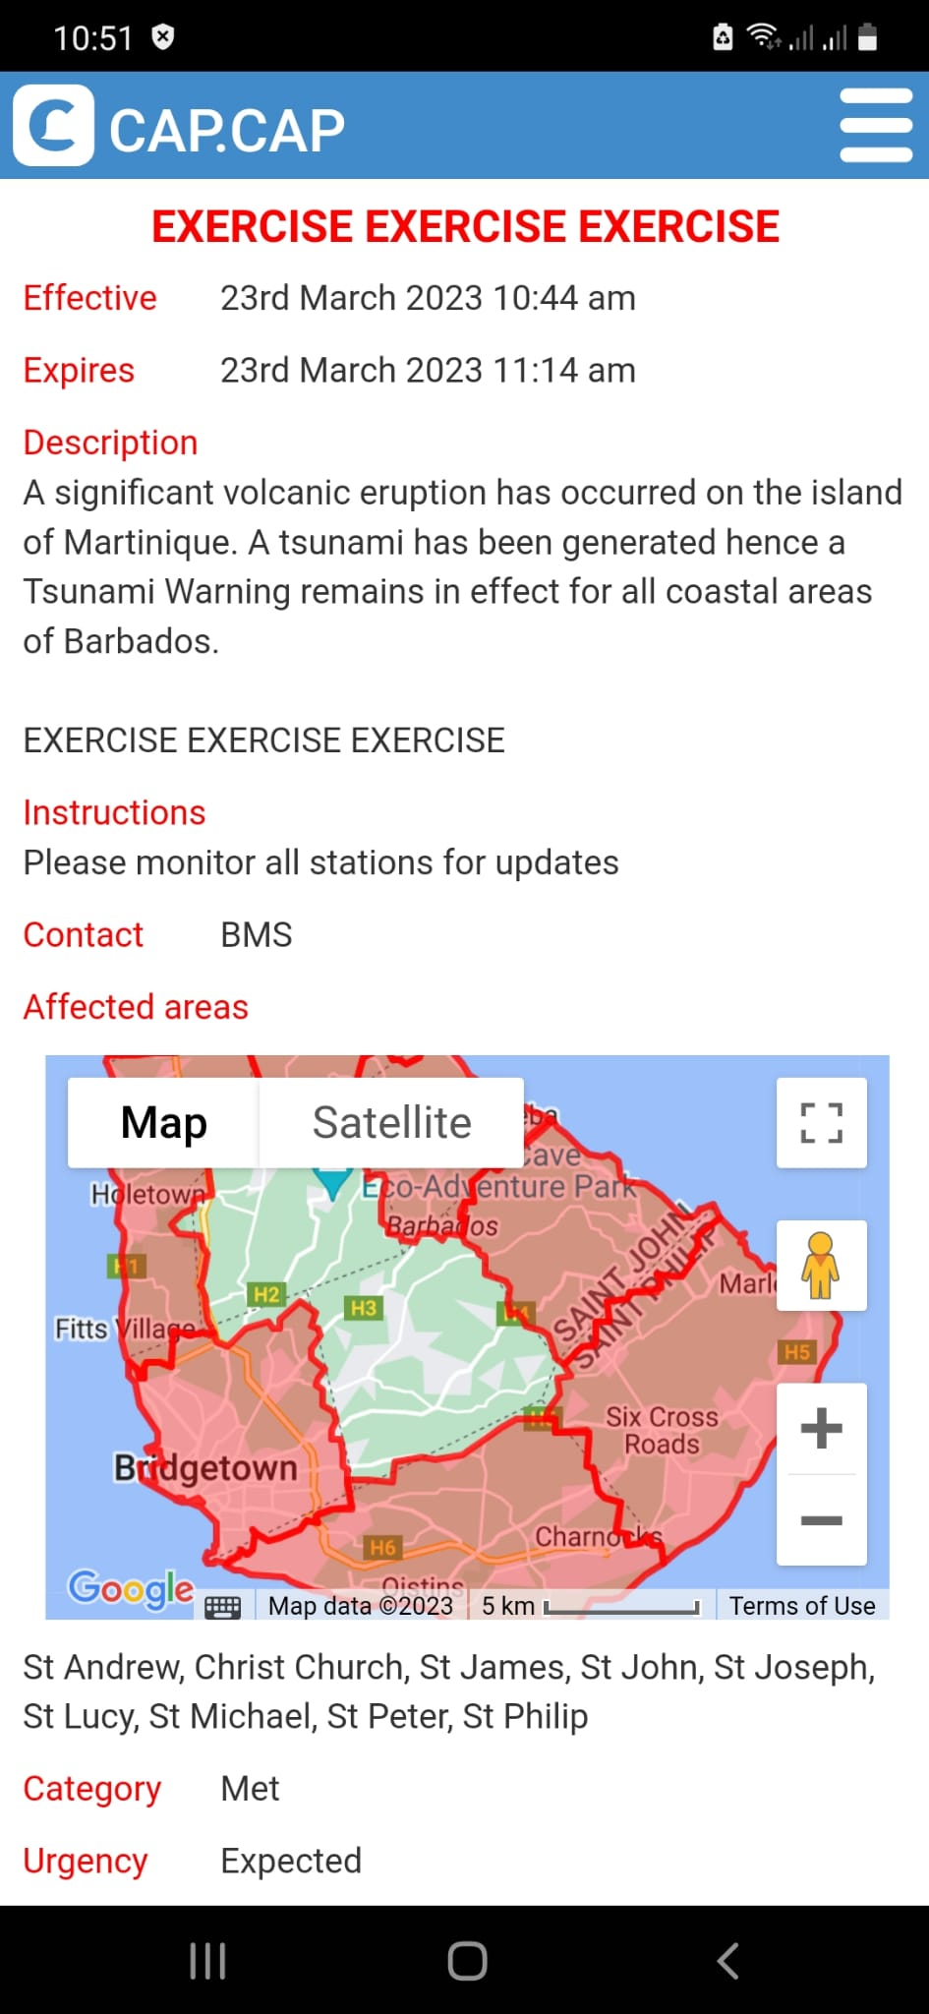
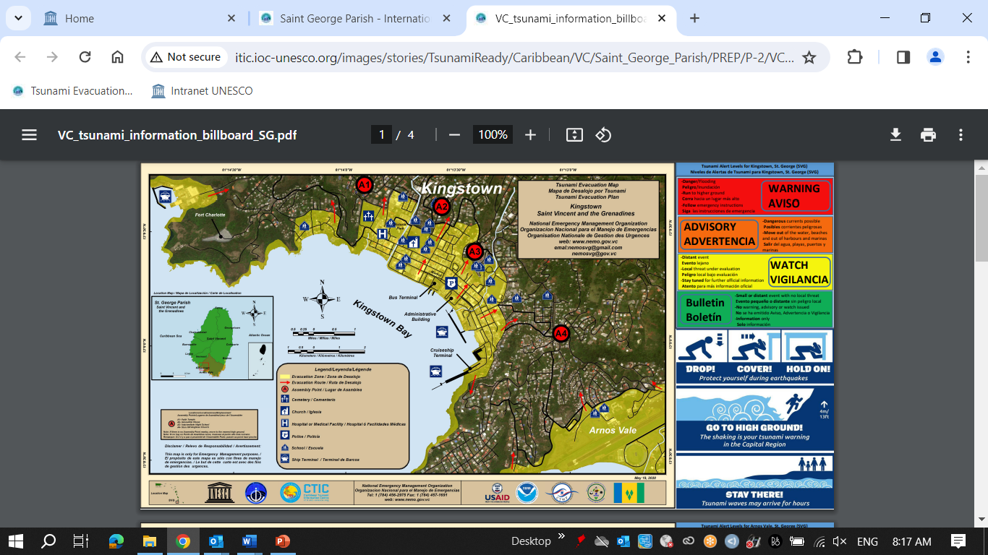
UNESCO/IOC Tsunami Ready Communities 2023
http://itic.ioc-unesco.org/index.php?option=com_content&view=category&layout=blog&id=2280&Itemid=2806
Deshaies, Guadeloupe, FRANCE: 01 June 2023, Self-funded
Saint George Parish, ST. VINCENT AND THE GRENADINES: 25 August 2023, ITIC-CAR USAID/BHA
Christ Church West, BARBADOS: 04 September 2023, ITIC-CAR USAID/BHA

Slide 3
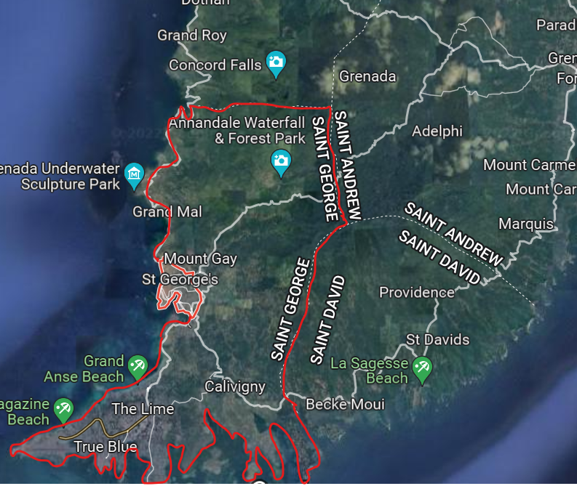
UNESCO/IOC CARIBE EWS Project, Grenada
Project Name: Strengthening Capacities for Tsunami Early Warning in Grenada
Donor: Government of Australia, Port of Spain Direct Aid Program & UNESCO/IOC
Funding: USD $57,000
Project Scope: Public Awareness and Education for Saint George Parish, Tsunami Ready nomination for St. George’s City to Point Salines
Inundation map for Saint George Parish
Evacuation maps, installation of signage, procurement of equipment, PAE completed for TR nominated community
Billboard signs to be installed & EOP under development for testing in CARIBE WAVE 2024
TR ceremony scheduled for week of 25 March 2024

Slide 4
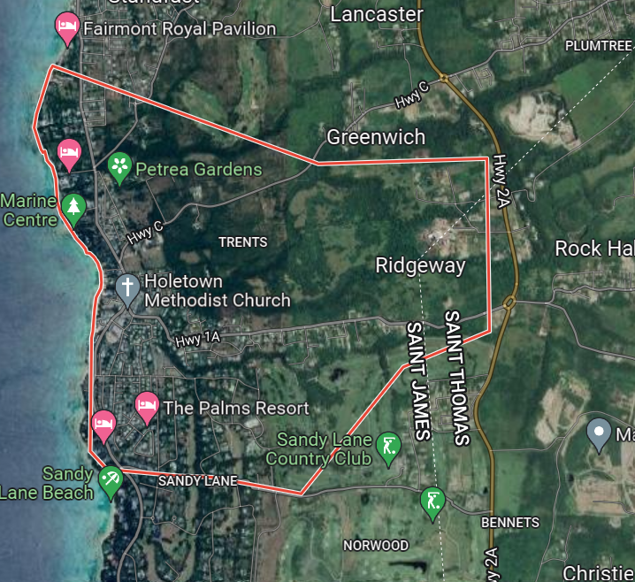
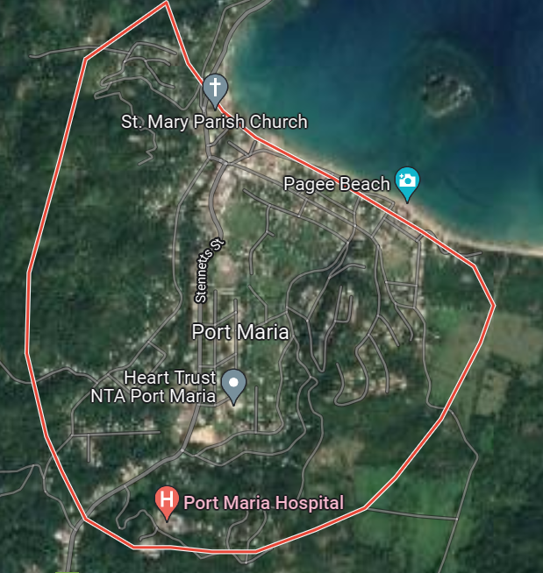
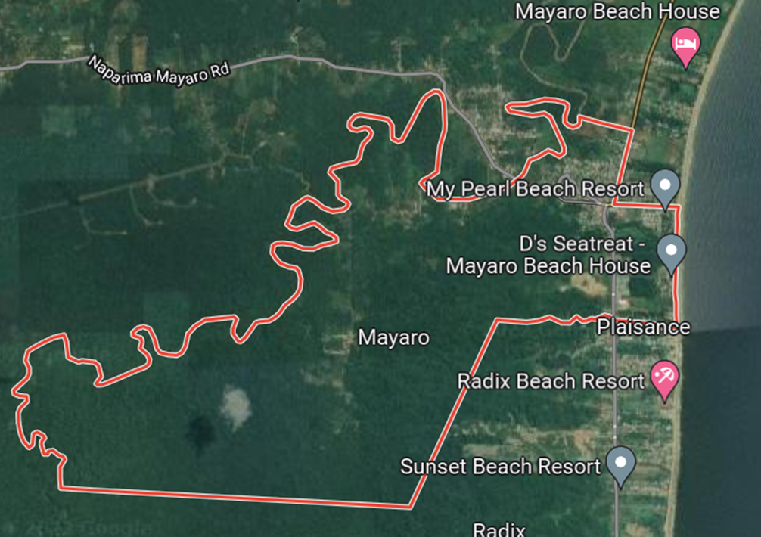
UNESCO/IOC CARIBE EWS NORAD Project Communities
Porters to Holders Hill, St. James, Barbados
Port Maria, St. Mary, Jamaica
Mayora Village, Mayaro–Rio Claro County, Trinidad and Tobago
Project Name: Towards a Safer Ocean in the Caribbean through Tsunami Ready Communities
Donor: Norwegian Agency for Development Cooperation (NORAD)
Funding: NORAD: 170,000, UNESCO: 30,000
Duration: January – September 2022, extended to July 2023, extension under consideration
Evacuation map completed for Barbados by Coastal Zone Management Unit (CZMU), National Consultants hired, PAE undertaken. EOP drafted for all communities
Procurement of signage and equipment, testing and community trainings to be conducted for all communities, inundation and evacuation mapping for Trinidad & Tobago and Jamaica to be undertaken
Project significantly challenged by fund transfer mechanism and to some extent other country priorities

Slide 5
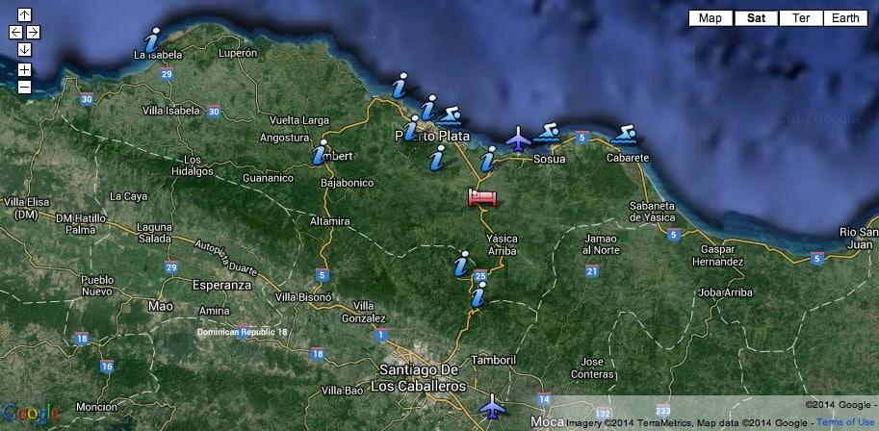
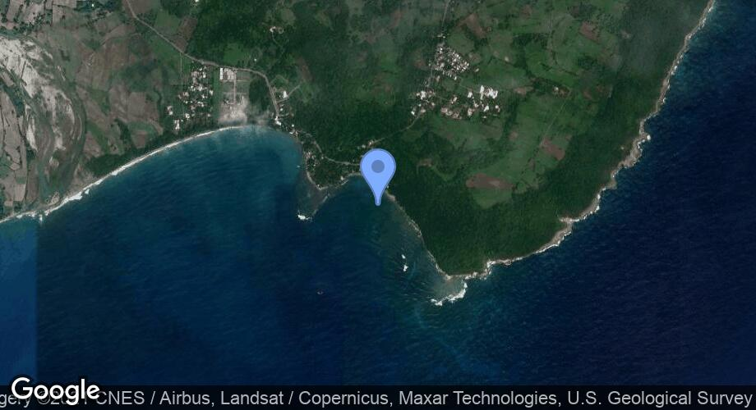
UNESCO/IOC CARIBE EWS Project, Dominican Republic
Puerto Plata and Sabana Grande de Palenque, Dominican Republic
Puerto Plata
Sabana Grande de Palenque
Tsunami Ready programme advanced in both communities through previous project funding
UNESCO/IOC in discussion with national and community authorities to finalise requirements including mapping, re-installation of signage etc.
Letter of support received from Municipality of Palenque

Slide 6
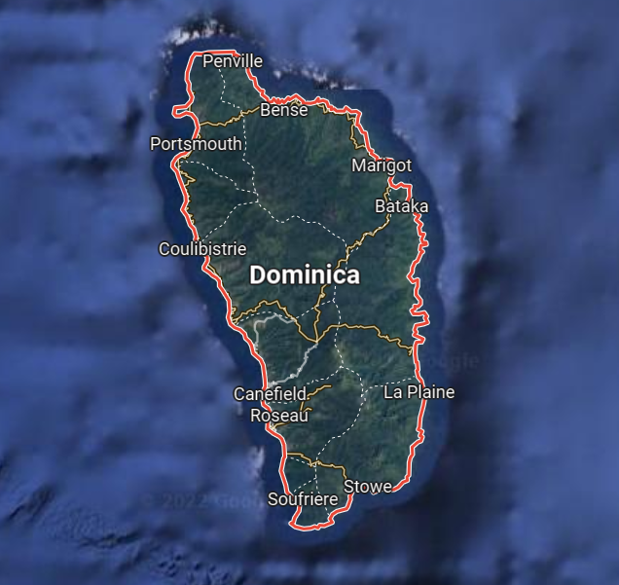
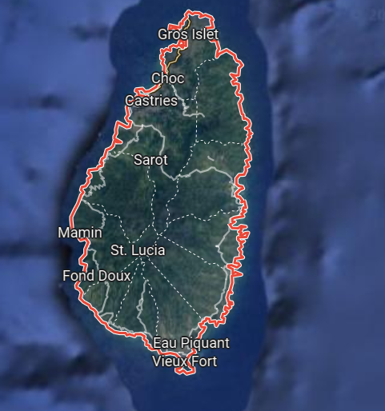
ITIC-CAR USAID/BHA Project Communities 2022 - 2023
Lead Implementing Agency: ITIC CAR
Laborie, Saint Lucia
Portsmouth, Dominica
Dominica – Portsmouth Council submitted its application to the TNC with all documentation in December. 2023, signage installation only remaining requirement to be fulfilled prior to submission of application to IOC
Saint Lucia – signage installation is only remaining requirement to be fulfilled prior to preparation of documentation and submission of application to IOC

Slide 7
ITIC-CAR USAID/BHA Project Communities 2023 - 2024
Lead Implementing Agency: ITIC CAR
ANGUILLA (TERRITORY-WIDE RENEWAL):
Project Launch – week of 11 March 2024
Tsunami Ready Committee established
Tsunami hazard assessment/modeling – discussions re: access and data reconfiguration etc. underway
PAE materials initiated
ANTIGUA AND BARBUDA (BARBUDA):
CTIC convened discussions with national authorities 12-14 December 2023
Barbuda proposed as TR community
Awaiting revert from National authorities re: data for modelling twin island/Barbuda, CTIC/ITIC-CAR to follow up
HONDURAS, RENEWAL (OMOA, TORNABE/TELA):
Signage, updated evacuation map, SOPs required
Identification and collection of date and resources ongoing
TR documentation and resources for Tornabe/Tela to be provided by IOC

Slide 8
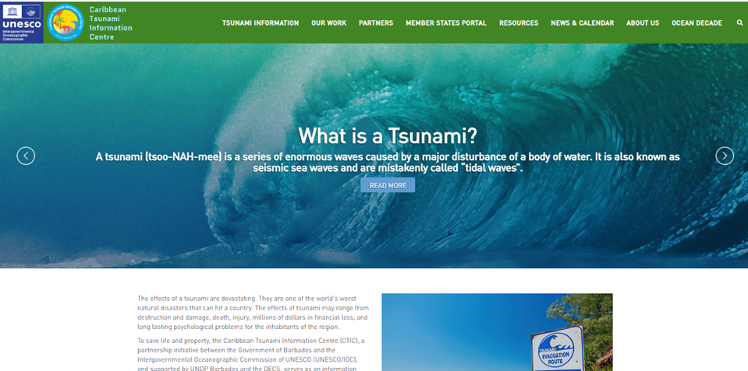
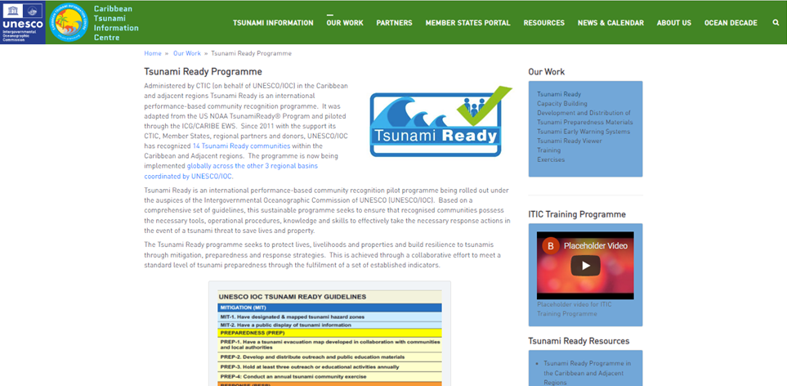
CTIC Activities 2023 - 2024
ICG/CARIBE EWS WG 4:
Meetings under enhanced restructure
CTIC WEBSITE:
Phase 1 redevelopment completed, deployment to be advanced
by IOC
CARIBE WAVE 2024:
Exercise webinars, registration, promotion, exercise, evaluation
WORLD TSUNAMI AWARENESS DAY 2023:
25K from UNDRR
Local, national and regional activities to be convened in Barbados Feb – March 2024
Process hampered by internal logistical challenges
OCEAN LITERACY:
Dissemination of PAE materials to Member States
Redevelopment of Tsunami Brochure (Spanish & English) near
finalization with technical & financial support of ITIC-CAR

Slide 9
Follow-Up Actions:
Advise countries currently implementing Tsunami Ready to follow Manuals and Guides 74 Standard guidelines for the Tsunami Ready Recognition Programme
Continue collaboration to mobilize funding and in-kind support
Instructs CTIC to identify actions arising from Caribe Wave Exercise 2021 and coordinate with corresponding Working Groups and Task Teams follow up actions
Requests the Caribbean Tsunami Information Center (CTIC) to develop specific public awareness materials for local tsunami events
Communicate with Member States to identify those interested in Tsunami Ready
Continue collaboration to mobilize funding and in-kind support - ongoing
CTIC to continue engaging with UNDRR, WG4 and Member States to engage, plan and take action for WTAD 2023 – collaboration with UNDRR ongoing
Requests the Caribbean Tsunami Information Center (CTIC) to develop specific public awareness materials for local tsunami events – collaboration through Barbados Community College not materialized, alternatives to be pursued
Communicate with Member States to identify those interested in Tsunami Ready – ongoing
CTIC and ITIC-CAR with funding from the USAID/BHA to conduct a training re: Manual and Guides 86 as part of Tsunami Ready projects – discussions ongoing re: timing and venue, including ICG/CARIBE EWS XVII
CTIC to identify actions arising from CARIBE WAVE Exercise 2022 and 2023 and coordinate with corresponding WGs and TTs follow-up actions – pending

Slide 10
Follow-up Actions:
Advise countries currently implementing Tsunami Ready to follow Manuals and Guides 74 Standard guidelines for the Tsunami Ready Recognition Programme
Continue collaboration to mobilize funding and in-kind support
Instructs CTIC to identify actions arising from Caribe Wave Exercise 2021 and coordinate with corresponding Working Groups and Task Teams follow up actions
Requests the Caribbean Tsunami Information Center (CTIC) to develop specific public awareness materials for local tsunami events
Communicate with Member States to identify those interested in Tsunami Ready
Recommends deeper cooperation between CTIC, CTWP, ITIC, ICG/CARIBE-EWS WG4, the Task Team on Tsunami Ready, and partners including UNDRR and the Regional Early Warning System Consortium (REWSC) to support Member State preparedness and resilience - ongoing
Further Recommends that the CTIC continues efforts for technical cooperation and in association with the TSU to pursue the formalization of agreements to provide a sustainable framework – ongoing, CDEMA MOU in process under UNESCO Cluster Office for Caribbean
Further requests CTIC in association with the Tsunami Ready Task Team and Member States determine the target number of communities in the CARIBE-EWS for Tsunami Ready recognition by 2030 – ongoing, to be further reinforced with restructured WGs & TT

Slide 11
CTIC Considerations and Challenges
Renewal of IOC MOU with Government of Barbados in process due 11 June 2023, draft MOU and Cabinet Paper referred to the Permanent Secretary, Ministry of Blue Economy. CTIC to provide further follow up
Review of previous efforts and initiate considerations for revamp of CTIC Board
Financial and human resource constraints, implications for achievements
Maximisation of opportunities for enhanced technical collaboration and resource mobilization
Need for sustained preparedness activities for tsunamis & deepening existing mechanisms and exploration of new opportunities to facilitate the integration of impacts and risks associated with other coastal hazards within CARIBE EWS - UNDRR-led Early Warning Systems for All (EWS4ALL) initiative
Limited avenues distribution of hard copy education and outreach materials

Slide 12
Thank You
a.brome@unesco.org

