Slide 1
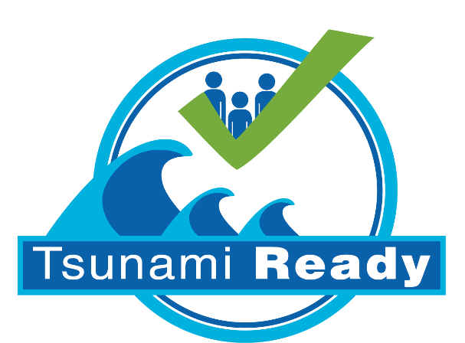

Tsunami Ready program
CoastWAVE
IOC/DG ECHO CoastWAVE Project Meeting
Morocco
Pr. EL KHALIDI Khalid, National coordinator of CoastWave project
Elkhalidi_khalid@yahoo.fr
Paris, 5th February 2024

Slide 2
TR Indicators
TR Indicators | Progress
Assess-1: Tsunami hazard zones are mapped and designated. | Completed before and updating with new data-external consultant support
Assess-2: The number of people at risk in the tsunami hazard zone is estimated | Completed before and updating with new data-external consultant support
Assess-3: Economic, infrastructural, political, and social resources are identified. | Completed
Prep-1: Easily understood tsunami evacuation maps are approved. | Completed
Prep-2: Tsunami information including signage is publicly displayed | ongoing
Prep-3: Outreach and public awareness and education resources are available and distributed. | ongoing
Prep-4: Outreach or educational activities are held at least three times a year | ongoing
Prep-5: A community tsunami exercise is conducted at least every two years. | Completed
Resp-1: A community tsunami emergency response plan is approved. | Started ongoing
Resp-2: The capacity to manage emergency response operations during a tsunami is in place. | Started ongoing
Resp-3: Redundant and reliable means to timely receive 24-hour official tsunami alerts are in place | Started ongoing
National Tsunami Ready Board | Started ongoing

Slide 3
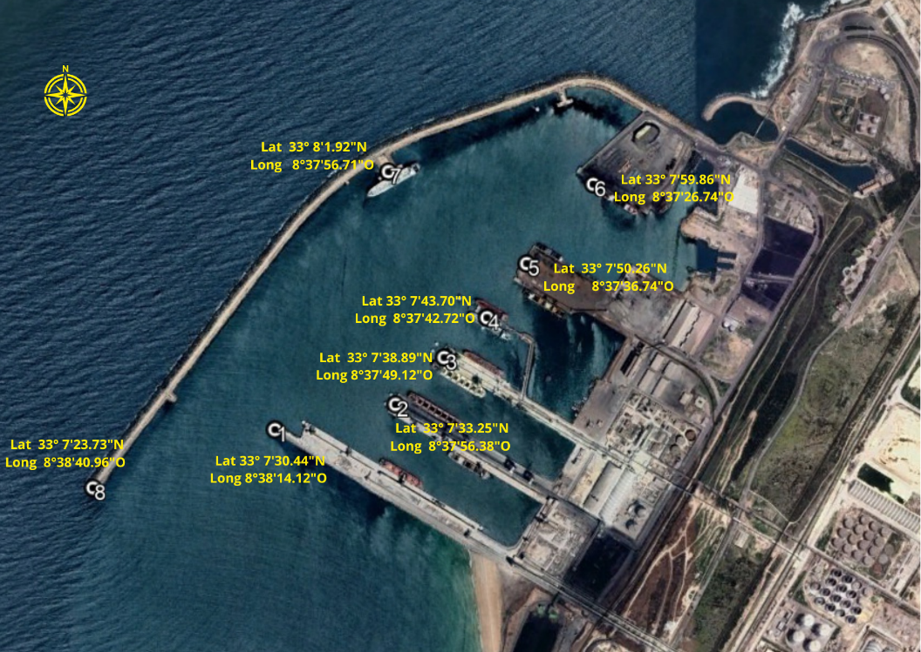
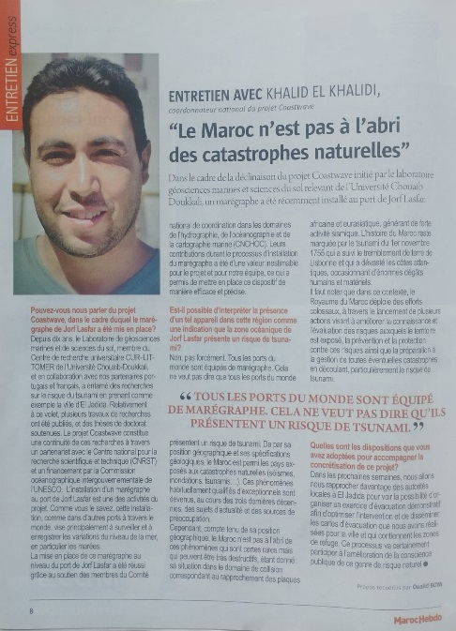
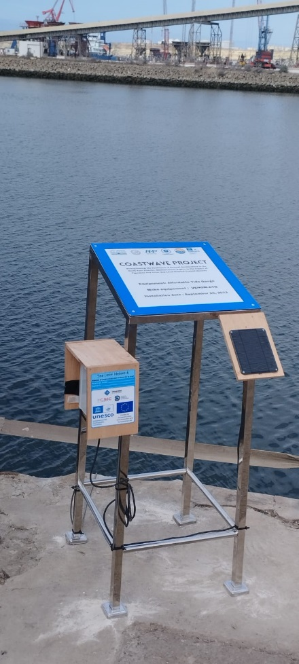
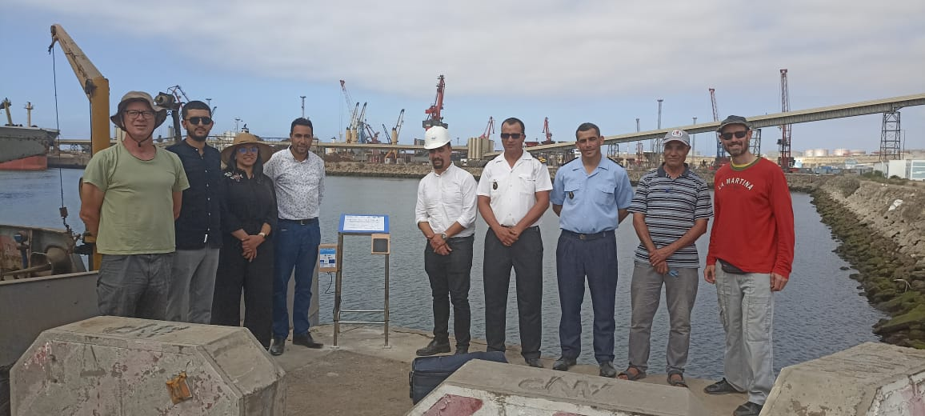
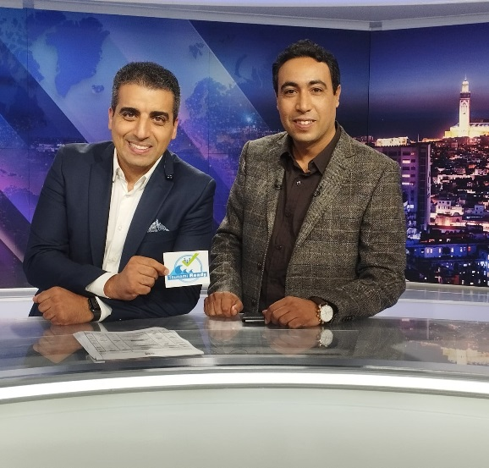
Installing Affordable Tide Gauge (ATG)
Successful installation
Dissemination:
National television
Newspapers
Website news
Social networks

Slide 4
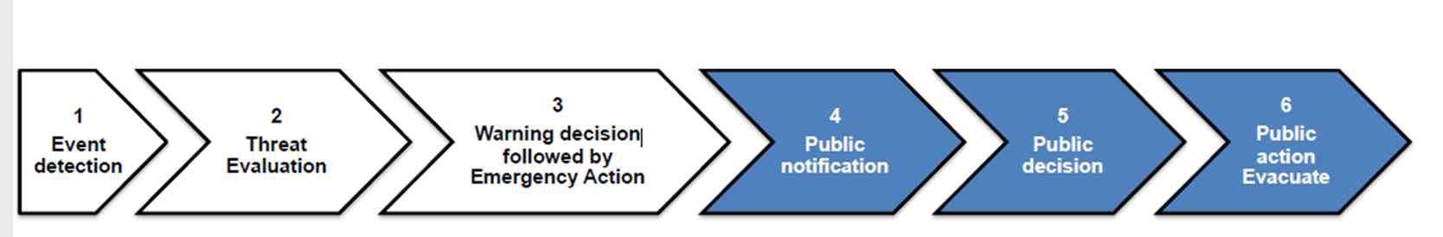
Tsunami exercise in the Jorf Lasfar Port
Operational response to a tsunami disaster
TSP and NTWC
EMA
Receipt of the first alert message TSP
CNRST and local commandment
Local commandment
Using serine (30 second)
Emergency services
Tow Evaluator end Tow observators

Slide 5
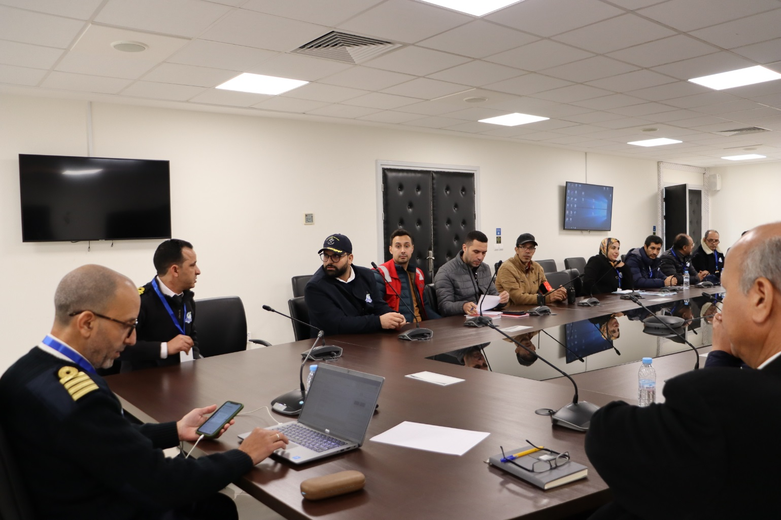
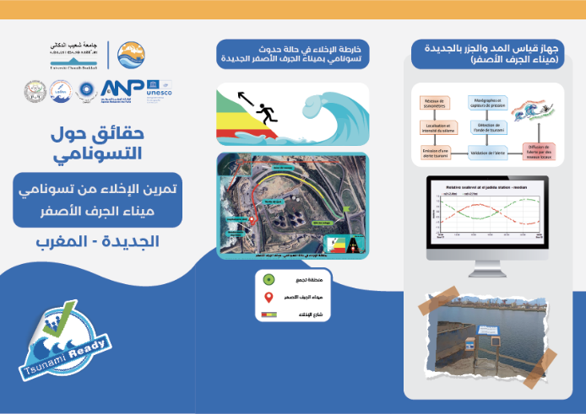
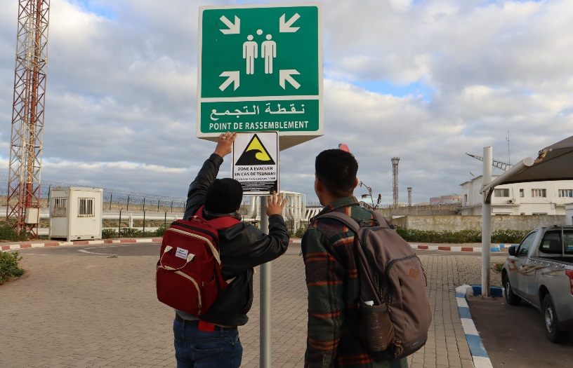
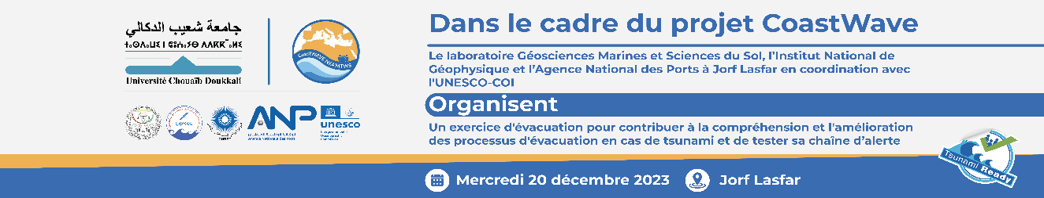
Before Tsunami Exercise
Arrange a meeting with all stakeholders and coordinate the activities with them

Slide 6
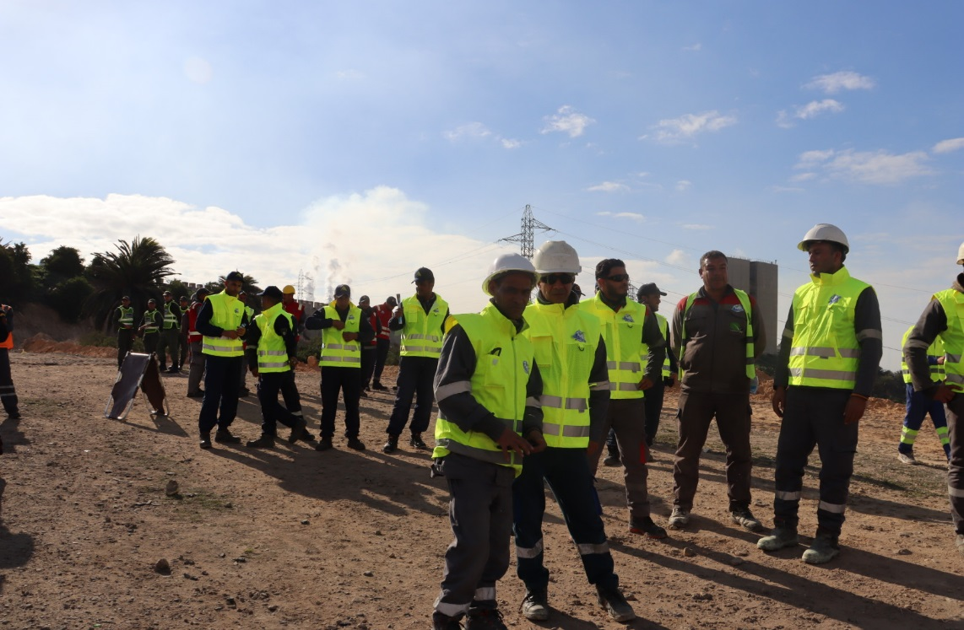
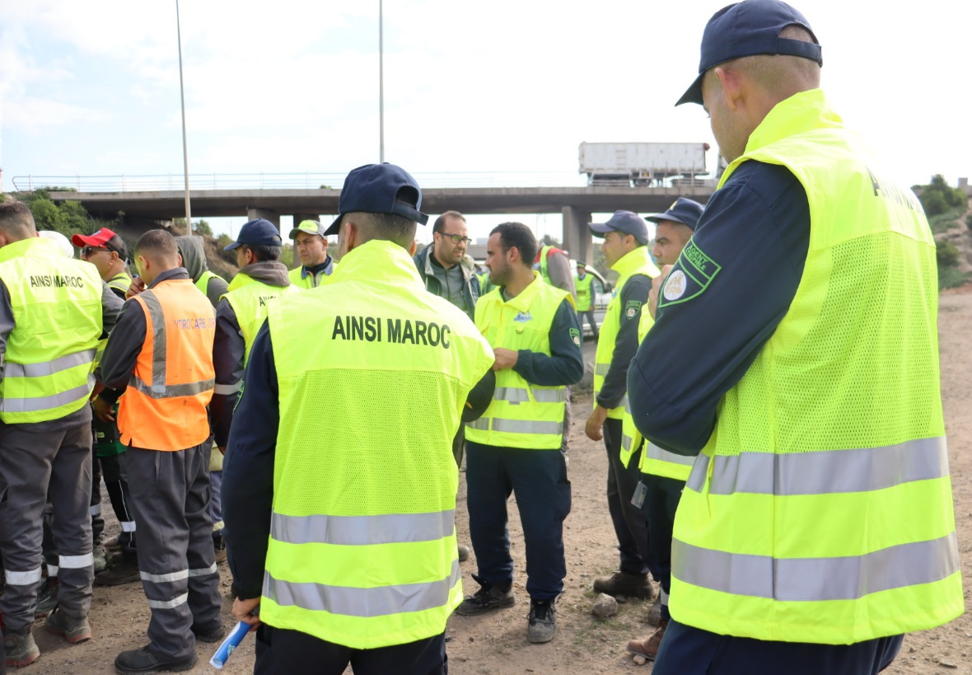
During Tsunami Exercise
Alarms/sirens sounds to give the sign to port users/Evacuation

Slide 7

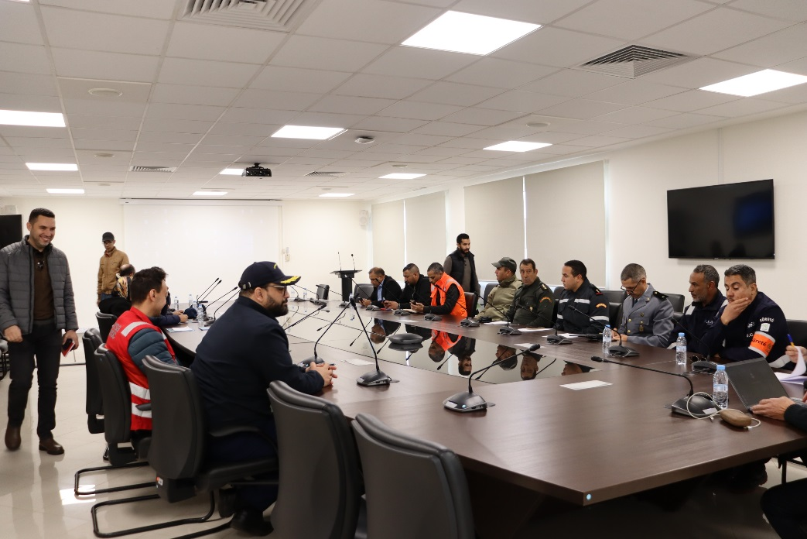
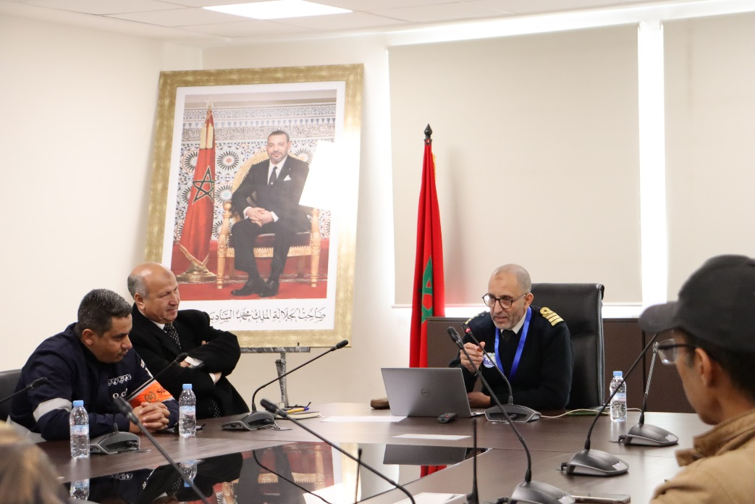
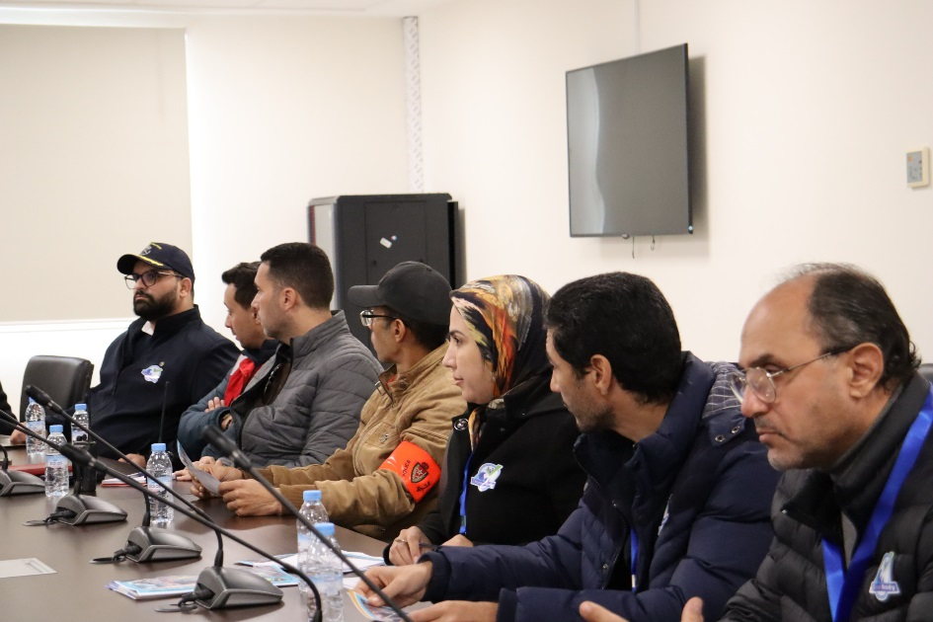
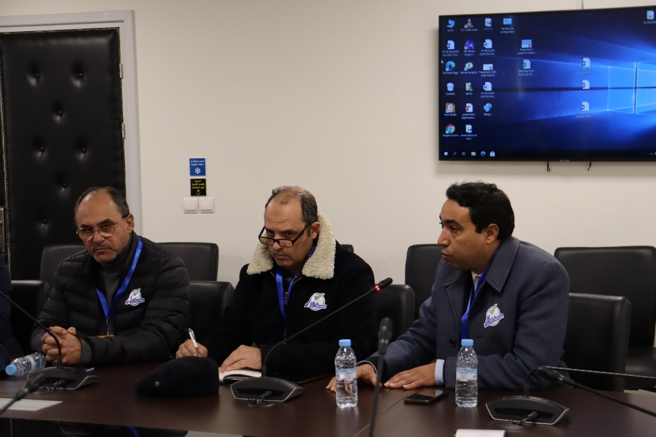
After Tsunami Exercise
Gather with the stakeholders and assess the exercise to improve for the real event

Slide 8
After Tsunami Exercise
Gather with the stakeholders and assess the exercise to improve for the real event
The siren is activated in the event of any kind of accident, the event was explained using telephone and radio communication.
Minimisation of the use of vehicles except for emergency services (ambulance, fire brigade) to reduce traffic jams.
In the crisis cell, each entity communicates with its subordinates (better way of communicating).
Everyone agreed that the exercise had gone well, and the majority of participants clearly understood the value of the exercise. However, there were still a few points that needed to be rectified: people need to be better warned of the tsunami risk, precious minutes elapsed between the first alert and the decision being taken (reading and interpretation), the alert was communicated by siren, and a megaphone would be very useful, especially for people from outside the port. There should also be two refuge areas, one to the north and the other to the south, to ensure that the entire port community is evacuated in the event of a real tsunami.
These exercises should be regular.

Slide 9
Challenges
1- Finalize concept note and questionnaire prepared by IOC ICG/NEMTWS and WGs/TTS. Identify target groups/communities, design survey protocol, socialise survey in target communities: This stage involved several discussions on different questions, given the socio-cultural differences between the countries taking part in the project. In the end, a common questionnaire was adopted and translations were made.
2- Conduct the survey, and analyse the results and prepare report: Despite the efforts made to prepare the survey, difficulties were faced during the monitoring; the local population does not know much about tsunamis and how to distinguish tsunamis from other coastal hazards. The analysis of the results showed this lack of information about coastal hazards and especially tsunamis.
3- Assessment estimate of the number of people at risk in the tsunami hazard zone, economic, infrastructural, political and social resources identified, preparedness: This step was relatively easy, given the experience of the "marine geosciences and soil science" laboratory at Chouaib Doukkali University. However, the data needed to be updated.
4- Workshop(s) and the development of government approved easily understood tsunami evacuation maps and local tsunami awareness materials: Several meetings have been held with local partners to present the evacuation maps for the city of El Jadida, despite the positive collaboration at this stage, but it should be noted that the procedures for the final approval of the maps are still relatively complicated.

Slide 10
Challenges
5- Social events, workshop(s) and distribution of outreach and public awareness and education resources. Conduct three times outreach or educational activities: On several opportunities, the CoastWave project was introduced to the local population. However, after the installation of a tsunami monitoring tide gauge, the decimation of the project started to take a serious turn. As a result, several media and social media have been in touch to explain CoastWave's objectives.
6- Organize and execute a community tsunami exercise: The main challenges faced at this step were related to the lack of knowledge of the authorities about the exercise and how to implement it, as well as worries about the public's attitude and their fears. Eventually, after several meetings, the exercise was conducted and evaluated.
7- Establishment of National Tsunami Ready Board and work procedures for recognition and management: This step is the most challenging, as it is necessary to convince our government of the importance of this committee. After writing to the Ministry of the Interior, which is in charge of natural risk management in Morocco, two meetings were held with the authorities. Following discussions, it was found to be impossible to establish a committee specifically for tsunamis, as this is an event that does not occur frequently in Morocco. The authorities have promised to establish the national tsunami committee by adding it to another existing committee in charge of natural risk management.

Slide 11

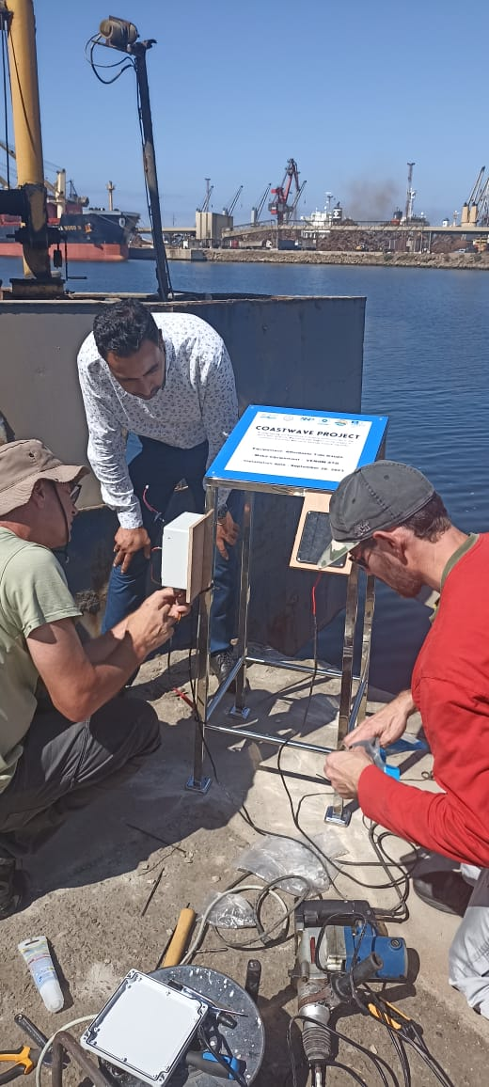
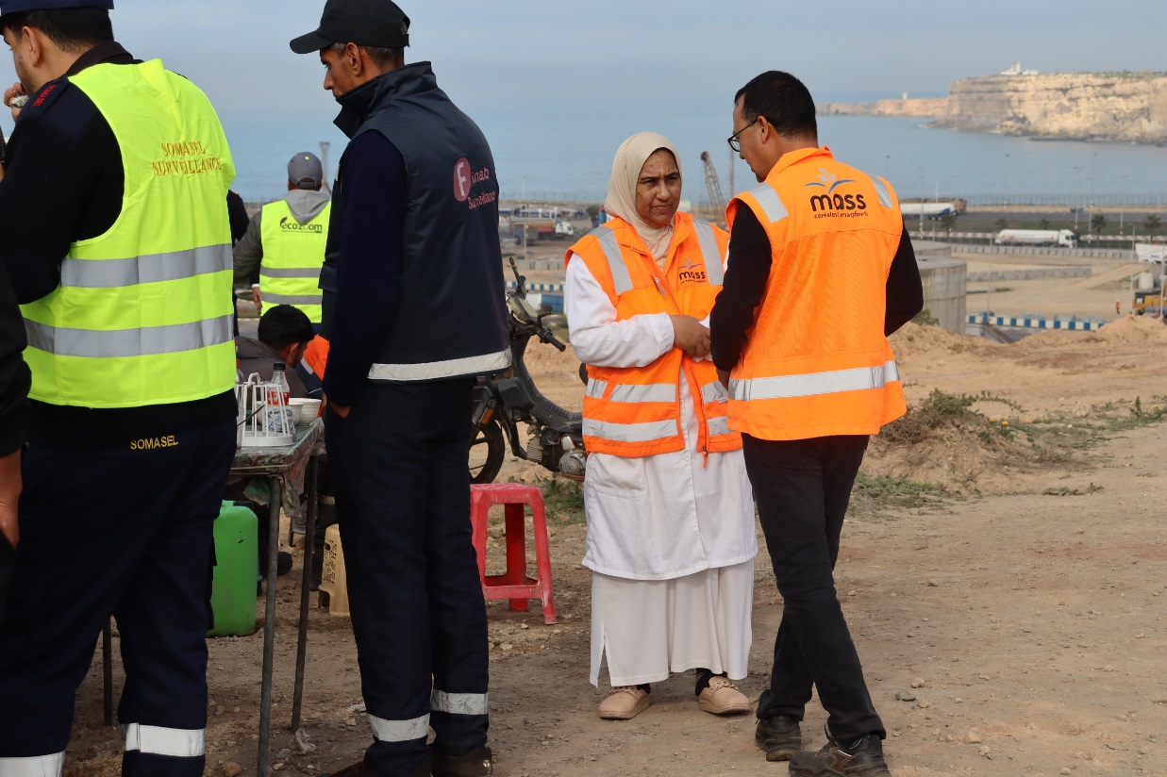
THANK YOU

