Slide 1
CAT-INGV Tsunami Service Provider
Activity 2023
ICG-NEAMTWS XVIII session, Paris, 6-8 February 2024
Alessandro Amato and the CAT team
with contributions from ISPRA
Centro Allerta Tsunami - Istituto Nazionale di Geofisica e Vulcanologia

Slide 2
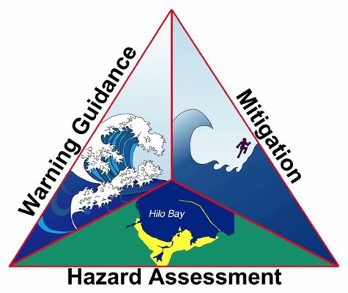
Activities of Italian TSP cover the three NEAM pillars
Hazard assessment
Tsunami warning
Mitigation
NOTE: Many things have been done in 2023 in all three areas.
This short summary will necessarily be incomplete!

Slide 3
Hazard assessment and inundation zones definition

Slide 4
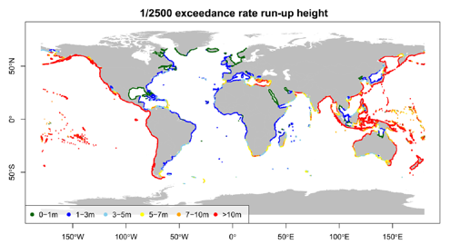
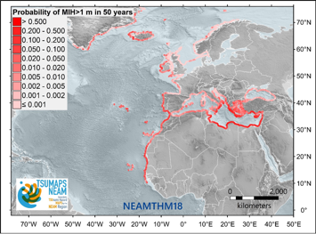
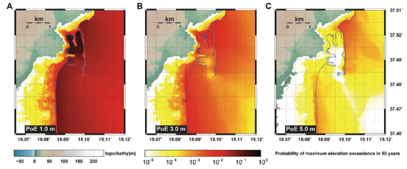
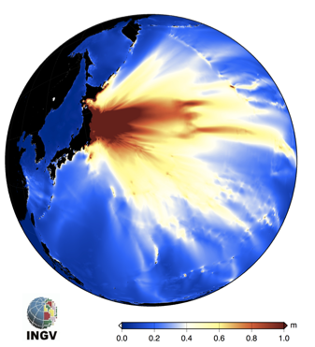
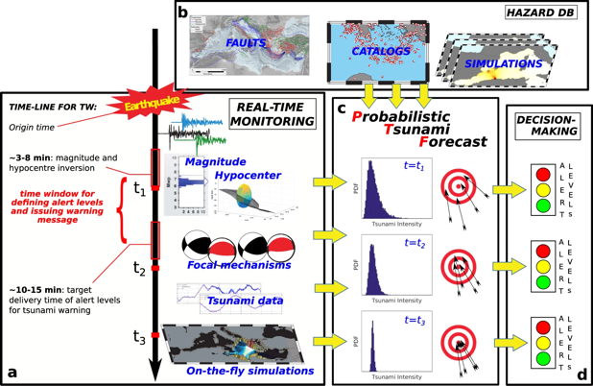
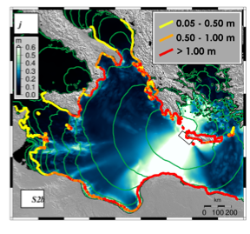
Global, Regional and Site-Specific PTHA
Forecasting methods (PTF)
Source of tsunami events
Scenarios

Slide 5
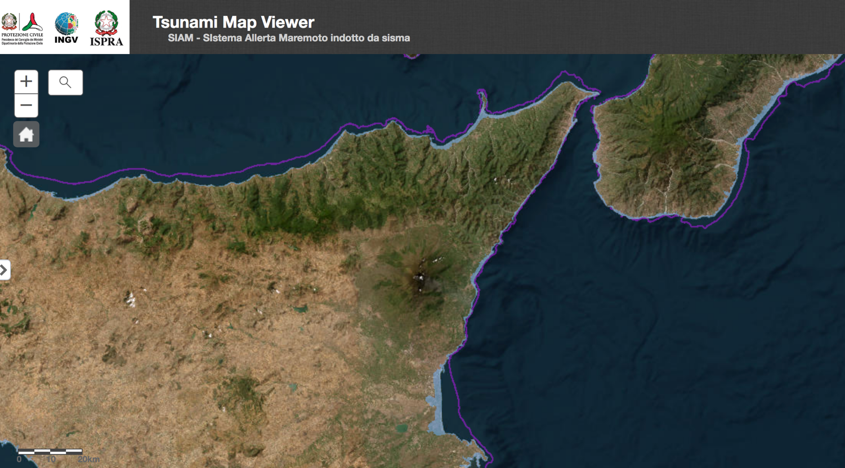
Inundation maps updates (ISPRA)
Maintenance of the website for visualization and download of inundation zones in Italy: http://sgi2.isprambiente.it/tsunamimap/
Support to local authorities (Regions, municipalities, etc.)
The goal for next years is to update the zonation using higher resolution DTM and Lidar data now available for almost all Italian coastal regions
First region to start with is SICILY (data collection and mosaic has started), including coastline data (demanding task)
Preliminary analysis of the exposition, especially for RIR (Relevant Risk Accidents) plants
Larnaca study (with INGV) within the CoastWave project
To be decided:
Which hazard model to use (TSUMAPS-NEAM or the new high resolution Italian one – see next slide)
Integration between the empirical methodology currently used with those based on modelling

Slide 6
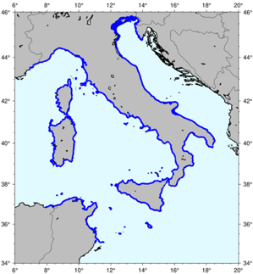


New Tsunami Hazard Assessment for Italy
New Probabilistic earthquake model
Points of interest
List of earthquake scenarios (almost 9 Million)
Tsunami modeling (Tsunami-HySEA)
waveforms at point of interest
10 m isobath
5 km spacing
Distribution of tsunami height for all scenarios at all target points
Computationally heavy task performed thanks to
High Performance Computing on GPU clusters
Hazard aggregation &
uncertainty quantification
HPC5@ENI
MARCONI100@CINECA
Hazard curves and maps for tsunami height at all target points and related uncertainty

Slide 7
New hazard map for Italy
New amplification factors (2023-2024)
A “revised” version of Amplification Factors (AF) db will be adopted in the Long-Term Probabilistic Tsunami Hazard Model for the Italian coast
Shallower offshore POIs (isobath from 50m to 10m depth) → new bathymetric profiles
A huge db of precomputed tsunami inundation scenarios (10m spatial resolution), that is orders of magnitude more than previous AF analysis

Slide 8
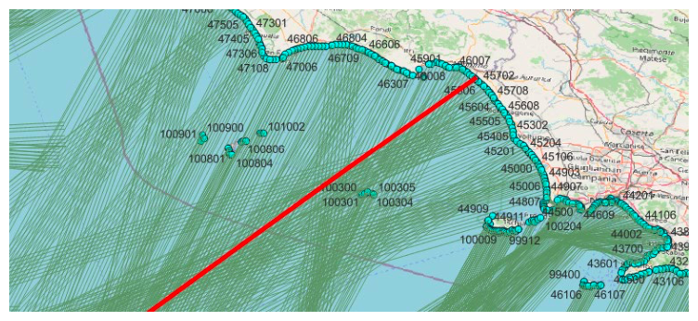
Shallower offshore POIs (isobath from 50m to 10m depth) → new bathymetric profiles:
1049 POIs
20 bathymetric profiles each (~9947 profiles)

Slide 9
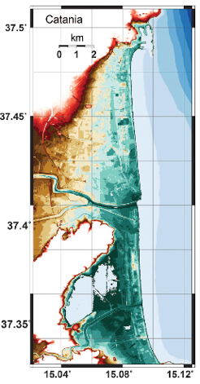
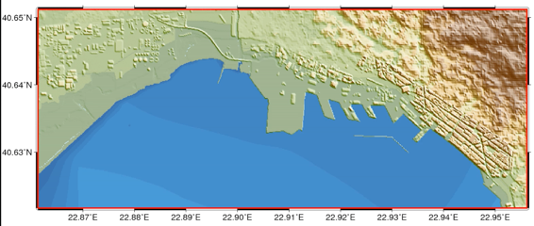
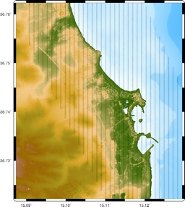
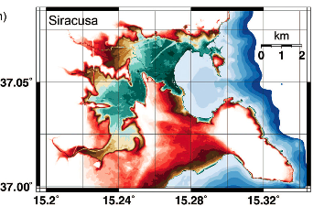
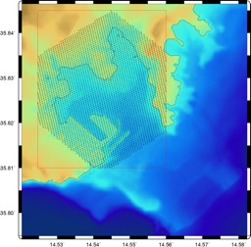
A huge db of precomputed tsunami inundation scenarios (10m spatial resolution), that is orders of magnitude more than previous AF analysis
Thessaloniki (Greece)
Marzamemi (Italy)
Catania (Italy)
Siracusa (Italy)
~500k Scenarios
Marsaxlokk (Malta)

Slide 10

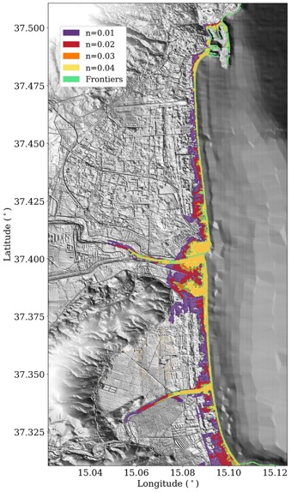
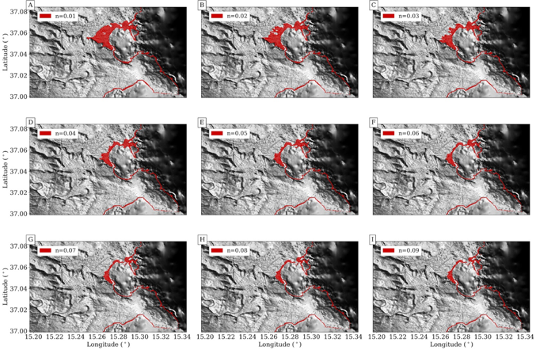
Local hazard - Improvements thanks to HPC
Sensitivity and uncertainty reduction support to local planning (e.g. Sicily)

Slide 11
Other methods have been proposed including those by Univ. Marche + ISPRA (Melito et al., 2022) and Gailler et al. (2018)

Slide 12







PTF e PTHA – HPC e Urgent Computing
Project Ecosystem
PTF
PTHA
PTF
PTHA
PTF
PTHA
PTF
PTF
PTHA
TA to PTHA

Slide 13
Warning / activities

Slide 14
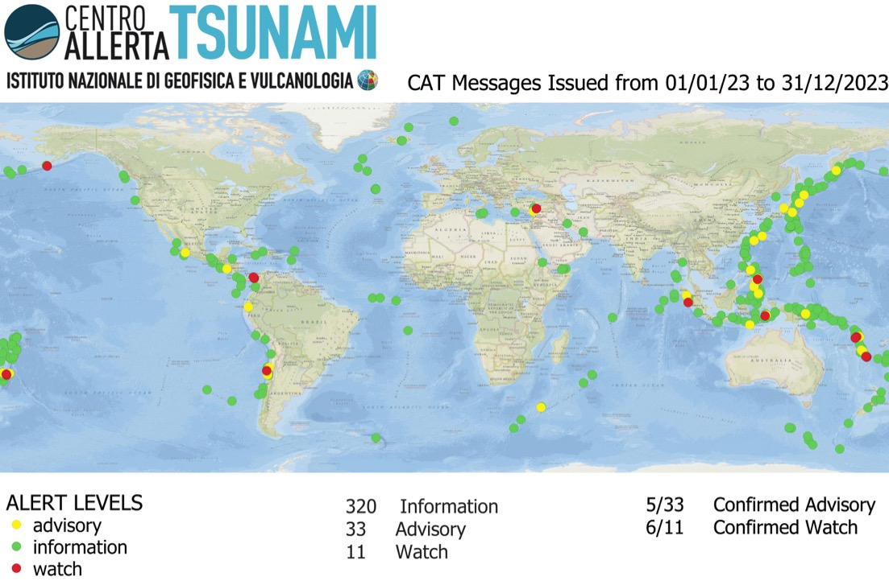
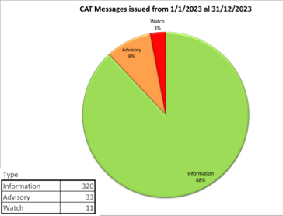
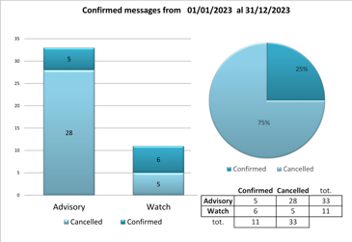
Worldwide monitoring for training

Slide 15
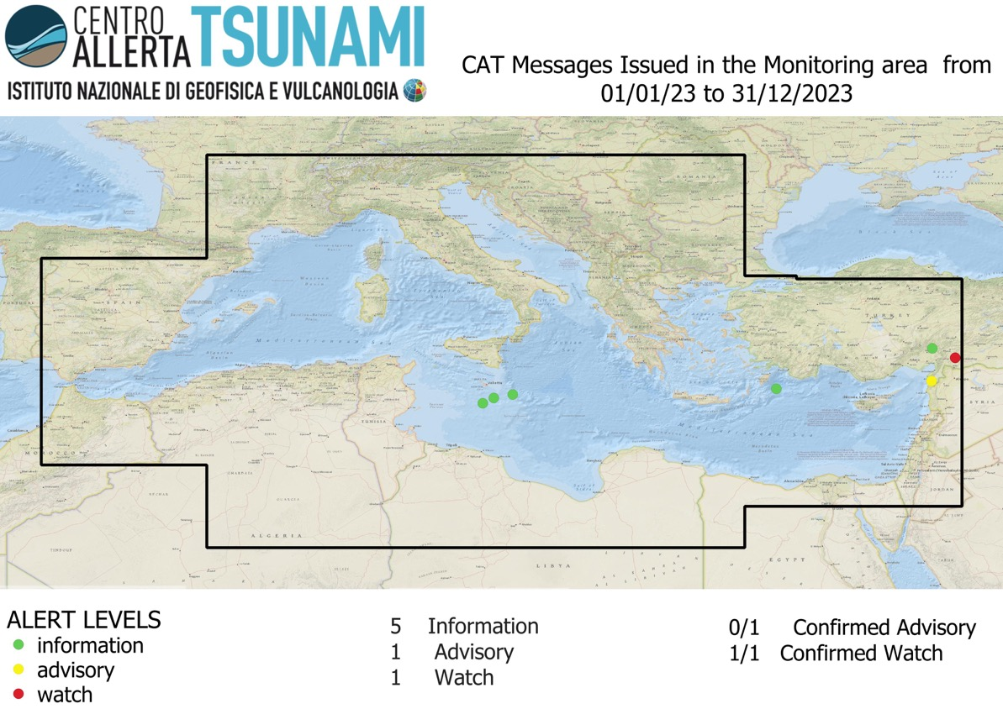
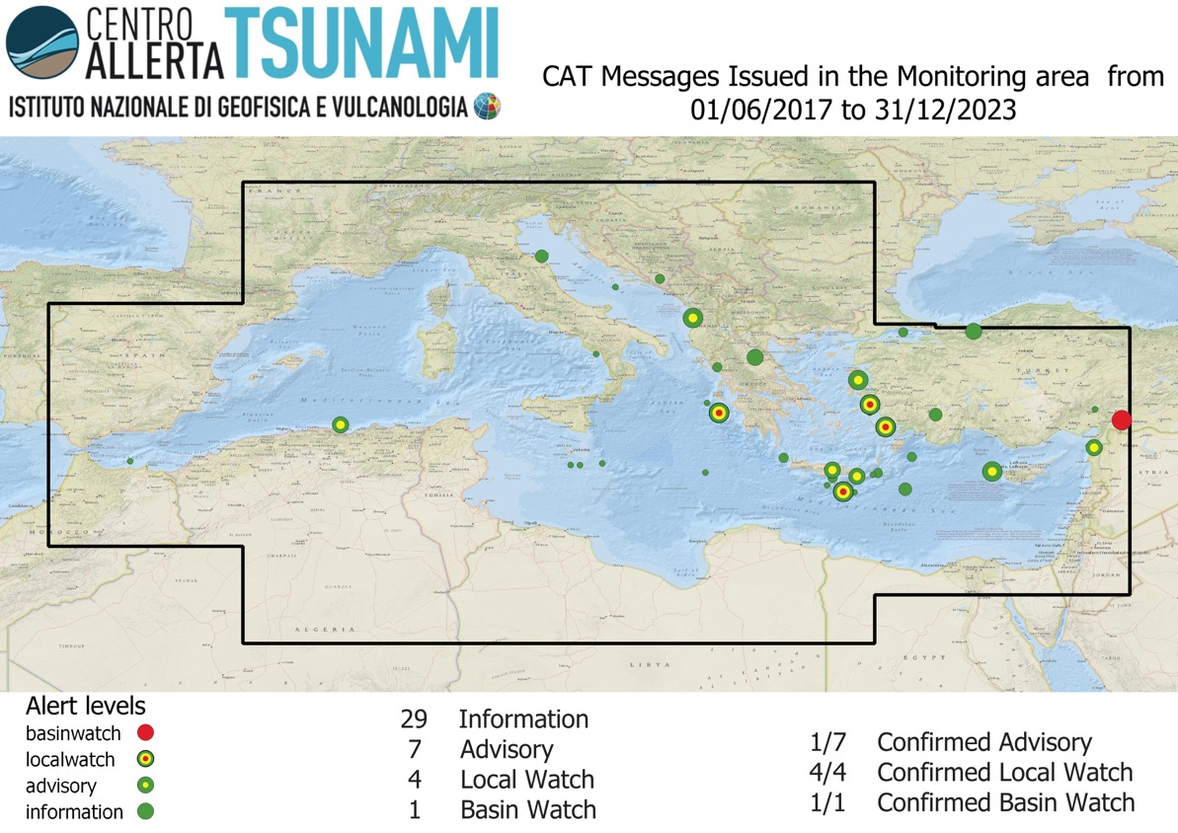
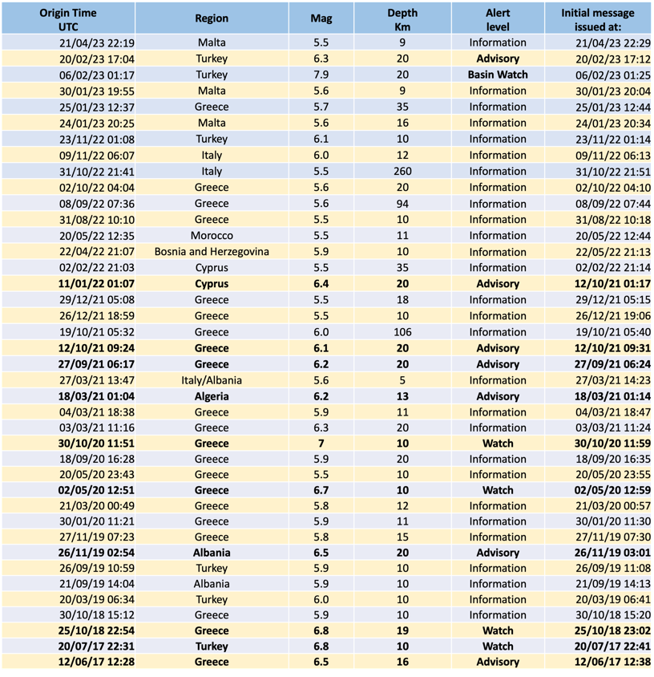
Mediterranean monitoring

Slide 16
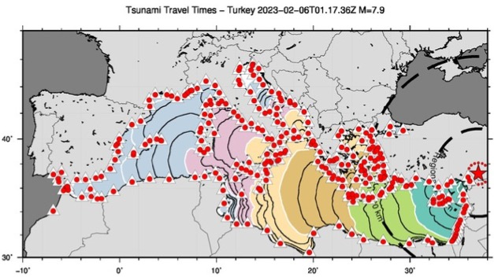
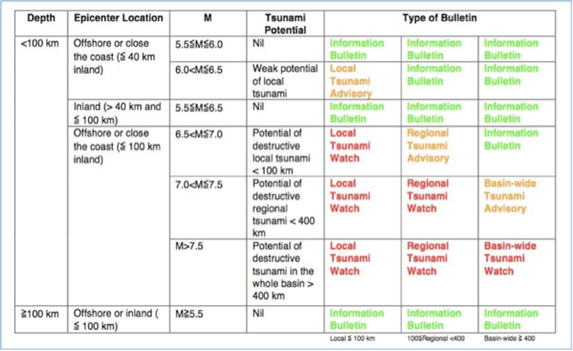
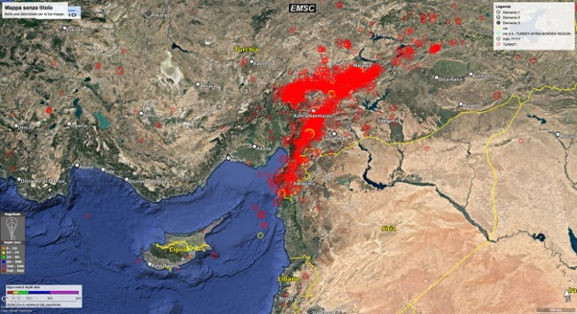
Turkey 2023
Initial message after 8’

Slide 17
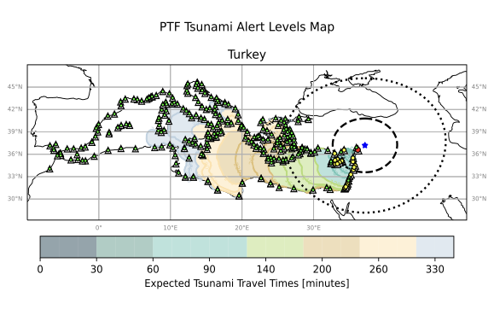
Turkey event 2023– some considerations
Tide gauges in Eastern Med coasts are not enough
First tsunami alert event to have attracted strong media attention in Italy (and in other countries)
First event to highlight the DM problems (already known)
Acceleration of the path towards the adoption of the PTF in the operational procedures
Adoption of the PTF is more and more urgent

Slide 18
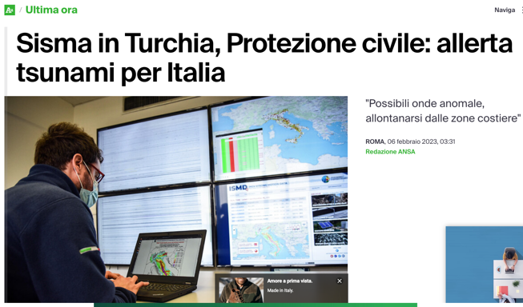
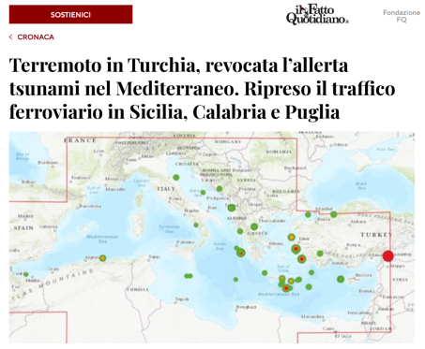
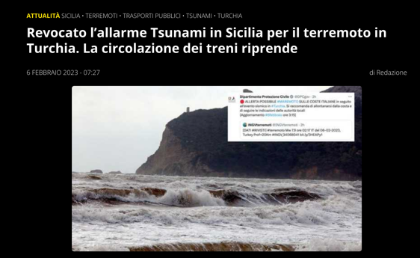

Feb. 6, 2023 Turkey tsunami alert triggered a great media attention

Slide 19
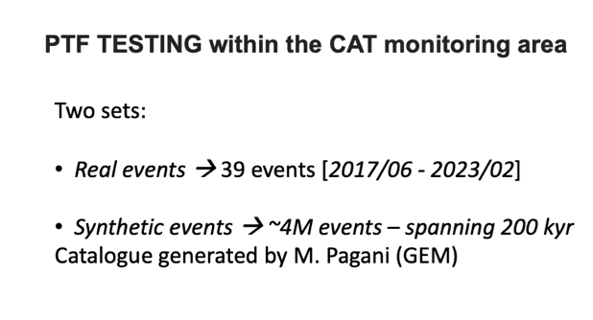
Probabilistic Tsunami Forecast
Current steps
Final discussion with Italian Civil Protection to decide the thresholds to convert probability into alert level
Install on the new computer and parallelize (ongoing with BSC PyCOMPSs)
Finalize calibration and sharpness testing against the GEM synthetic catalogue (completed 80%) as requested by INGV Scientific Advisory Board to endorse the method after external peer review
Agree on the usage as TSP within the NEAMTWS (SC and sessional discussion of the TT-OP)
New server dedicated to real-time PTF
RAM: 3TB
CPU: 2 x AMD EPYC 9654 2.4GHz, 96C/192T:
HD: 6x1.92TB SSD,-SATA 2x960GB SSD-SATA, 3x1.92TB SSD-NVMe

Slide 20
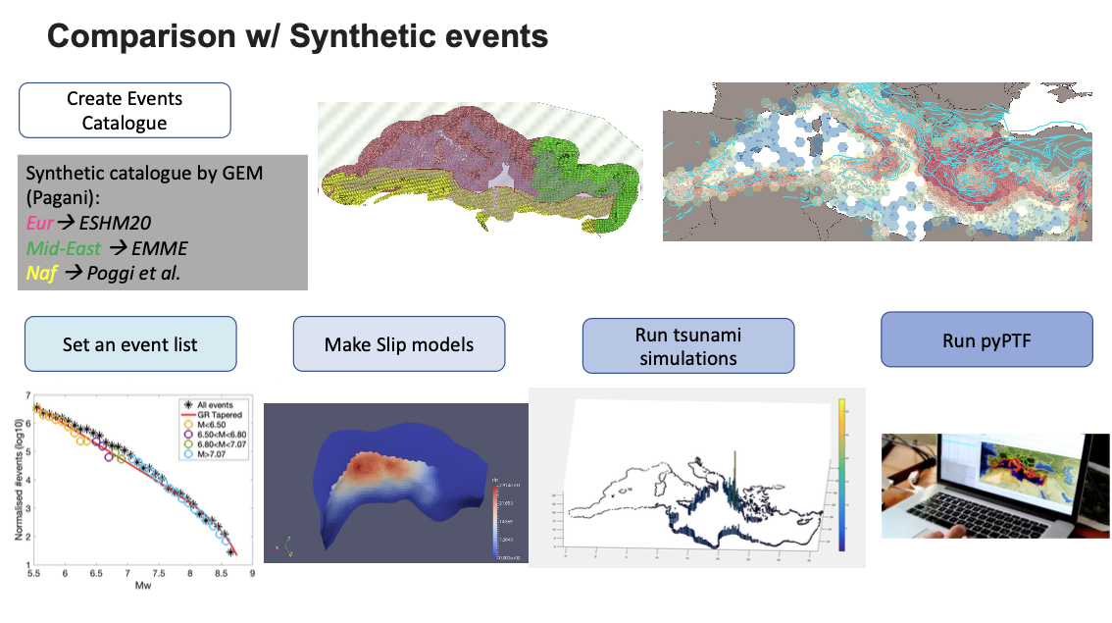

Slide 21
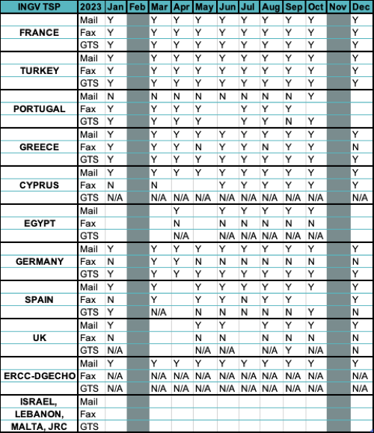
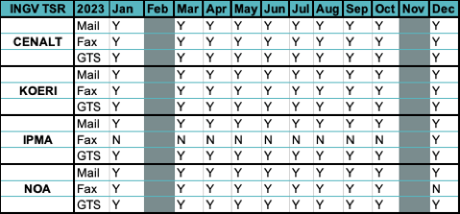
Communication tests 2023
Good results among TSPs both as TSP and as TSR
Decent results as TSP towards some MS (not continuous)
GTS not used much
No response from some MS
WE ARE NOT SURE THESE WILL RECEIVE TSUNAMI WARNING IN CASE OF REAL EVENTS

Slide 22
Warning / new instruments

Slide 23
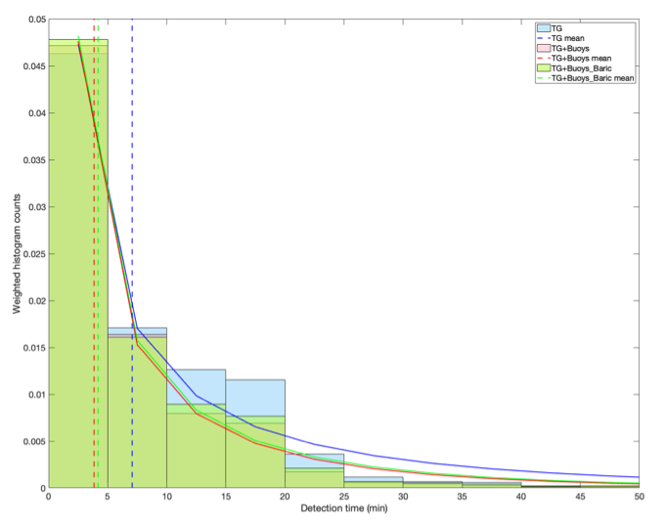
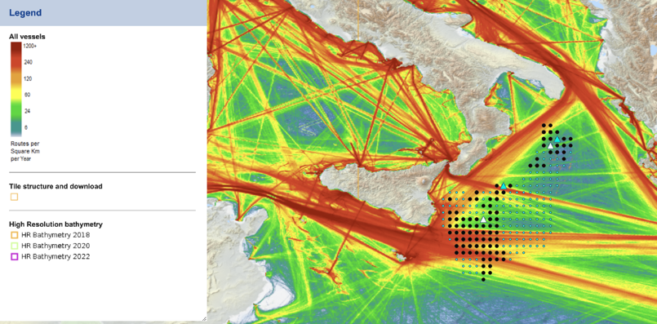
Technological advancements /1
DART-like buoys (2024-2025)
An accurate study has been carried out to optimize the position of the two ocean bottom sensors, taking into account all the possible tsunami sources and their characteristics (F. Romano et al.)

Slide 24
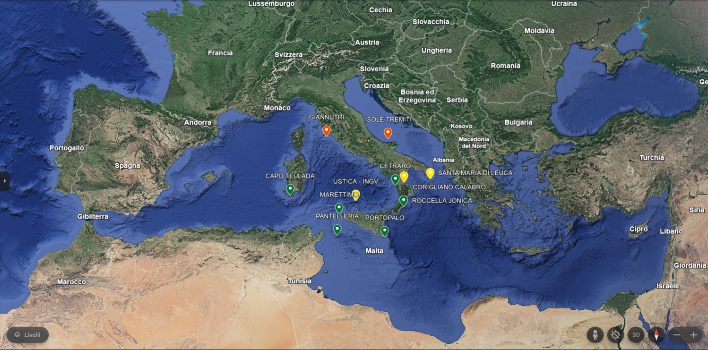
ISPRA - SiAM NETWORK
GREEN = OPERATIVE YELLOW = IN PROGRESS RED= PROGRAMMED 2025
Some more TGs will be installed in souther Italy within other projects in coop. INGV-ISPRA (e.g. Messina Straits)

Slide 25
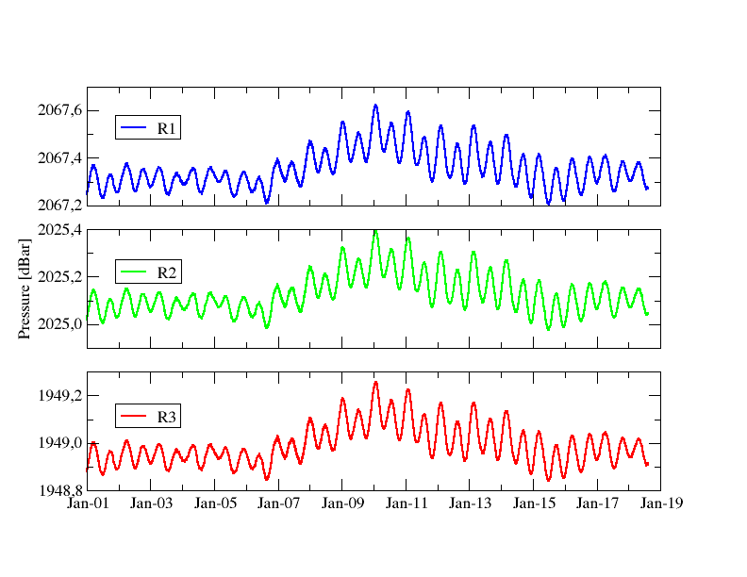
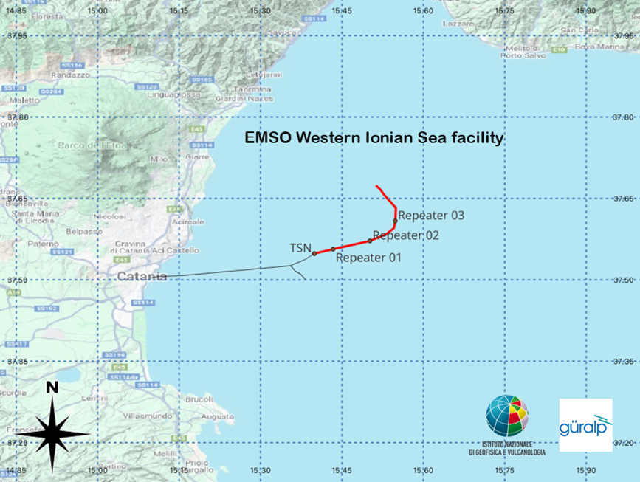
Technological advancements /2
SMART cable in the Ionian Sea (installed Dec. 2023)
Güralp Systems Ltd in partnership with INGV deployed a 21 km ‘SMART’ cable 30 km off the coast of Catania in Sicily, Italy at depth of 2,000-2,500 m b.s.l., in an area prone to earthquakes and tsunamis (1908, 1693…).
The InSEA project is funded by the Italian Ministry of Research and managed by the Istituto Nazionale di Geofisica e Vulcanologia (INGV).
Data transmission to Catania is active, soon it will to CAT.
Courtesy of Giuditta Marinaro and Davide Embriaco, INGV

Slide 26
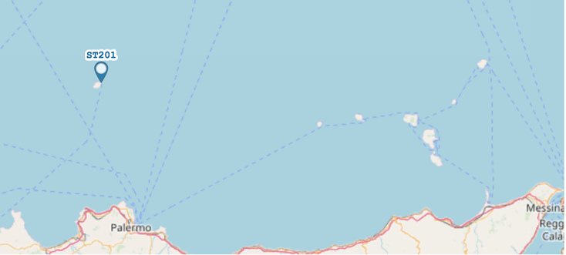
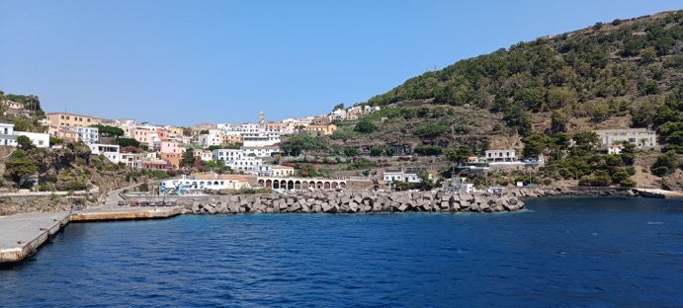
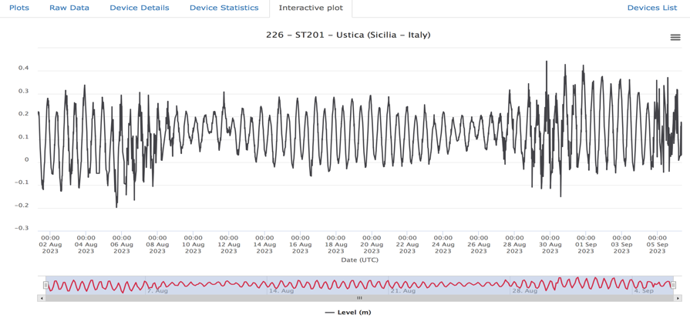
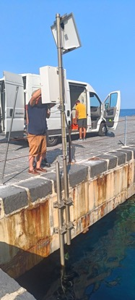
New tide gauge in USTICA (INGV – ISPRA - CNR) - 2023
A. Costanza et al., INGV

Slide 27
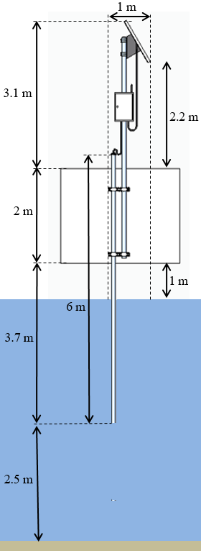
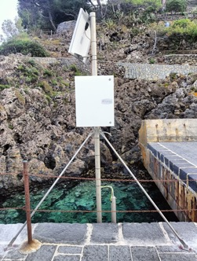

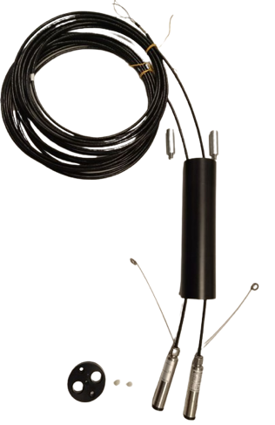
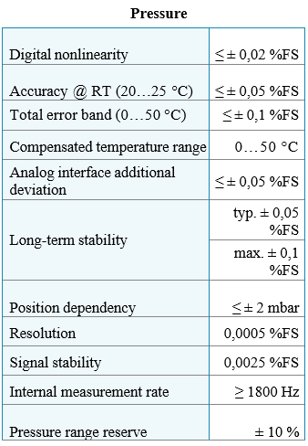
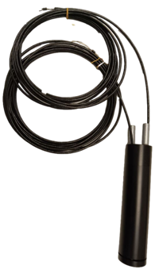
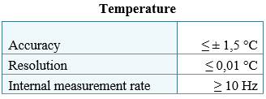
New tide gauge in USTICA – new version with two sensors – in construction 2024
A. Costanza et al., INGV
Piezoresistive level probe with highest accuracy
Keller Series 36XW
(it also has a temperature sensor)
Ballasts
Double sacrificial anode
(one for each probe)
Housing
Total assembly of the sensitive part positioned inside the pipe.
Double piezoresistive
level probe
Housing closing cap
Connections between the metal structure of the sensor and the sacrificial anode

Slide 28
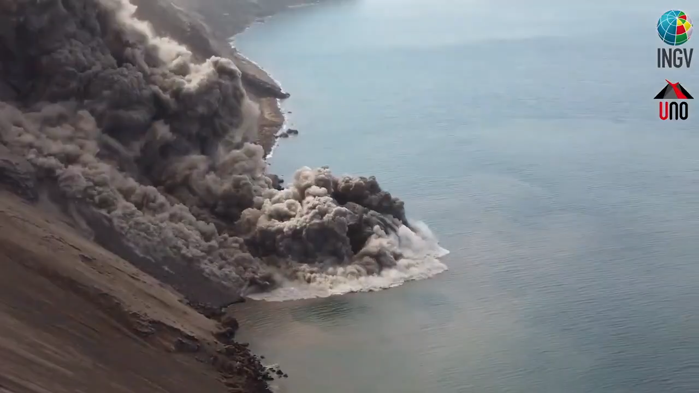
Stromboli volcano
2023: INGV is in charge of the local TWS in cooperation with Univ. Florence

Slide 29




The local Tsunami Early-Warning System in Stromboli
Stromboli tsunami, December 4, 2022
Tide gauge Ginostra (RMN-ISPRA)
Tide gauge Strombolicchio (RMN-ISPRA)
From the Report “Lo tsunami del 4 dicembre 2022 a Stromboli”

Slide 30

The local Tsunami Early-Warning System in Stromboli
July 2023: The system did not activate the alert because only for one sensor the STA/LTA threshold was overcome (for a fishing accident!)

Slide 31



The Tsunami Early-Warning System
Striature
CIMA
CIMA SUL
FONDALE
CIMA
NASSA
The submarine inspection revealed the presence of fishing activity at both elastic beacons, one was broken

Slide 32

Stromboli – DART-like buoy feasibility study done (2023)
 | Descrizione | Costo unitario | Costo totale | Programmazione | Aggiornamento Settembre 2023
GARA 1 su piattaforma tuttogare | Fornitura e assistenza installazione Boa strumentata e 2 moduli sottomarini | 125.000 | 125.000 | SI | AVVISO DI MANIFESTAZIONE D’INTERESSE ALLA FIRMA. Verrà richiesto l’inserimento nella prossima programmazione in scadenza il 15 settembre come fornitura superiore a 40.000 per il prossimo CdA.
Acquisto diretto 1 | 2 sensori di pressione assoluta Paroscientific | 12.500 | 25.000 | NO | PREVENTIVO AGGIORNATO RICHIESTO Da fornire in conto lavorazione e assemblaggio alla ditta cui sarà affidata la realizzazione e l’installazione della boa e dei 2 moduli sottomarini
Acquisto diretto 2 | 2 sganciatori 2.5 tons 1 sganciatiore 5 tons | 12.000 15.000 | 24.000 15.000 | NO | PREVENTIVO AGGIORNATO RICHIESTO Da fornire in conto lavorazione e assemblaggio alla ditta cui sarà affidata la realizzazione e l’installazione della boa e dei 2 moduli sottomarini
Acquisto diretto 3 | 2 Modem acustico modulo di superficie | 8.700 | 17.400 | NO | PREVENTIVO AGGIORNATO RICHIESTO Da fornire in conto lavorazione e assemblaggio alla ditta cui sarà affidata la realizzazione e l’installazione della boa e dei 2 moduli sottomarini
Cofinanziamento INGV | IDROFONO | 0 | 0
 |  | TOTALE | 206.400
 |  | IVA | 45.408
 |  | TOTALE | 251.808
Rimodulazione tecnica effettuata (luglio 2023).
In corso di acquisizione i sensori e i modem (settembre 2023).
In uscita la richiesta di manifestazione di interesse per la boa assemblata (settembre 2023).

Slide 33
Mitigation
(outreach, exercises, website, media including Tsunami Ready activities)
See also presentations
of WG4, of TT-TR, of DPC

Slide 34
Italian TSP – WG4 activities 2023
Education and Information
  Schools/University (Tivoli, Otranto, Rome)
  Public events (INGV-Rome, World Ocean Day)
  Website (News, events, Story maps)
Tsunami risk perception studies
  Italian coasts (peninsular regions and main islands)
  Stromboli volcano
Exercises
  NEAMWave2023
  Others (SismaExe)
Media coverage (Stromboli Dec. 2022, Turkey Feb. 2023, Japan Jan. 2024, Outreach events, etc.)

Slide 35
CAT-INGV news on website (Dec. 2022 - Jan. 2024) in Italian and English
01.01.24 - Giappone: terremoto M 7.4 e allerta tsunami
Tsu-Memo: il terremoto e maremoto del 28 dicembre 1908, raccontato in una Story Map
NEAMWave '23: 6 e 7 novembre 2023, il test del Sistema italiano per l’Allerta Maremoto
WTAD 2023 | 5 novembre 2023 #GetToHighGround
Tsu-Memo: 30 ottobre 2020, lo tsunami in Grecia e in Turchia
Tsunami Ready - un percorso partecipato per avviare Larnaca (Cipro) al riconoscimento di comunità Tsunami Ready
Secondo te l’isola di Stromboli può essere colpita da uno tsunami?
25.07.23 - Turchia: messaggio d'informazione per terremoto M 5.6
A Cipro il meeting per definire le aree di pericolosità locale da tsunami e le fasce d'inondazione a Larnaca
Tsunami Ready - Palmi (RC) in corsa per ottenere la certificazione UNESCO di comune Tsunami Ready
Tsunami Ready - Il comune di Otranto (LE), in Puglia, aderisce al programma di mitigazione del rischio tsunami
21.04.23 - Malta, messaggio d'informazione per terremoto in mare
18.04.23 - Tsunami Ready. Otranto (LE) si prepara a conquistare i 12 indicatori che le varranno il titolo di comune Tsunami Ready
14.04.23 - La Strategia per la riduzione del rischio tsunami nell’area NEAM 2022-2030
Tsu-Memo: 1 aprile 1946 e la nascita del primo Centro di Allerta Tsunami
Tsu-Memo: 11.03.11 lo tsunami del Giappone e gli oggetti dispersi e ritrovati
20.02.23 - Turchia, allerta tsunami ADVISORY per terremoto in prossimità della costa
09.02.23 – A Minturno gli ultimi step per diventare il primo comune italiano Tsunami Ready
30.01.23 - Malta, messaggio d'informazione per terremoto in mare
25.01.23 - Grecia, messaggio d'informazione per terremoto in mare
24.01.23 - Malta, messaggio d'informazione per terremoto in mare
Stromboli, 4 dicembre 2022: tsunami sì o tsunami no?

Slide 36


Tsunami Risk Perception in Italy - interviews distribution and sample
Total survey coverage in coastal municipalities (CATI) 2018 | 2020 | 2021 | 2024
Surveyed coastal regions | 100% (15 regions)
Surveyed provinces | 100% (72 provinces)
Surveyed coastal municipalities | 100% (645 municipalities )
Total respondents | 11,192
2021 | 2023 – Telepanel (General public)
3044 total respondents (1500 resp – 2020) (1544 resp – 2023) | Nationwide distributed according to: age, sex, geographic area, educational degree
Whole population (potential tourists)
Local residents
Representative of: 16.9 mn pop.
Representative of: 59.11 mn pop.
First survey wave - 2018
Second survey wave - 2020
Third survey wave – 2021-22
Fourth survey wave - 2024
PILOT SURVEY PHASE
• Calabria
• Apulia
1021 interviews
Eastern Sicilia
Ionian and Tyrrhenian Basilicata
Molise
614 interviews
(Cugliari et al.2020)
Latium
Campania
Sicily
Sardinia
4207 CATI interviews
1500 Telepanel (national sample)
(Cugliari et al. 2022, Cerase et al., 2023; Cerbara et al., submitted ‘24)
Abruzzo
Marche
Tuscany
Emilia Romagna
Liguria
Friuli Venezia Giulia
Veneto
5350 CATI interviews
1544 Telepanel (national sample)
Cerase et al., 2019

Slide 37





World Ocean Day June 2023
Santa Severa Castle, central Tyrrhenian sea, near Rome
WOD23 / Tsunami area
WOD23 / Tsunami pool

Slide 38


Slide 39


The three (+2) Italian pilot sites
Italian National Tsunami Ready Board: May 4, 2021
Stromboli volcano, Tyrrhenian sea
Pop. 450 / n,000 (summer)
High Hazard
In progress: July 2023
Minturno, Latium
Pop. 19,700
Medium-Low Hazard
Local TR Board: 03/2021
Otranto, Apulia
Pop. 5,769
Adriatic - High Hazard
Local TR Board: 10/2023
Palmi, Calabria
Pop. 17,000
Medium-High Hazard
Local TR Board: 12/2020
Marzamemi-Pachino, Sicily
Pop. 376 / 21,000
Ionian - High Hazard
Local TR Board: 04/2021

Slide 40

Minturno
January 17, 2024: joint meeting TRLC + TRNB
February 1, 2024: Formal approval by the municipal council
February 2, 2024: TR forms delivered to TRNB for evaluation
Tsunami Ready, ok to the advancement
The event The Local Committee met in the city
Latina oggi, January 20, 2024

Slide 41


Stromboli towards Tsunami Ready
(first case of a volcano)
Mayor’s decision (2023)
Risks on the volcano are obvious (more the volcanic ones)
New sirens (2024)
Signage (to be improved)
INGV info point on the island
Local TWS with automatic activation of sirens, SMS, email etc. (to be improved) – in progress
Tourists’ risk perception study (2023)
700 questionnaires

Slide 42
Thanks alessandro.amato@ingv.it www.cat.ingv.it
Notes:
As testified by this Factsheet, for about 15 years we have been building the NEAMTWS

