Slide 1
Emergency Warning Satellite Service
Eric Guyader, European Commission, Galileo and EGNOS programme
Eric.Guyader@ec.europa.eu
UNESCO, IOC/ICG/NEAMTWS XVIII Session • Paris, 6-8 February 2024

Slide 2

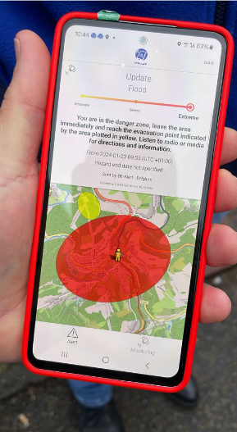

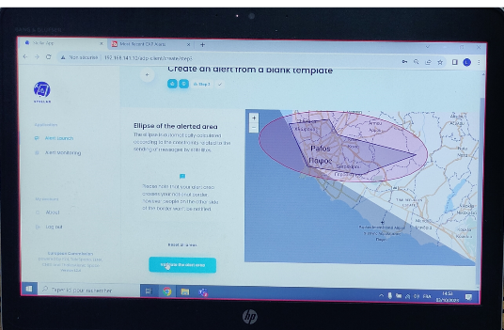
STATE OF PLAY AND NEXT STEPS
In-field demonstration campaign concluded
  4 sites: FR, DE, CY, BE/LU
  Different scenarios each time: industrial incident, tsunami + forest fire, floods, cross-border situation
  Civil protection authorities from 16 EU MS represented
  Final workshop 10-11 April 2024
IN
Notified
OUT
Not notified
Limit of alert area

Slide 3
Summary
Progress made by European Commission’s DG DEFIS towards introducing in the Galileo infrastructure the “Emergency Warning Satellite Service” (EWSS), as a multi-hazard alert dissemination means by satellite offered to EU national civil protection authorities in complement to existing terrestrial alert systems,
The completion of the demonstration campaign conducted in 2023/2024 with national civil protection authorities in FR, DE, CY and BE/LU as presented during the session

Slide 4
Next
Declaration initial service: 2025
  Service concept mature, industrial contracts on-going for implementation
  Service provision scheme under definition (terms and conditions of use)
Adoption by EU MS civil protection services
  Connection to Galileo, observation phase, integration in national PWS
Adoption by end users
  Marketing, standards, EU grants
  Dialogue with receiver and device manufacturers

Slide 5
THANK YOU
http://ec.europa.eu/galileo

