Slide 1


Ocean Decade Tsunami Programme
Research, Development & Implementation Plan
Srinivasa Kumar Tummala, Chair
Ocean Decade Tsunami Programme Scientific Committee (ODTP-SC)
Working Group on Tsunamis and Other Hazards Related to Sea-Level Warning and Mitigation Systems XVII Meeting
22 - 23 February 2024, Sendai, Japan

Slide 2


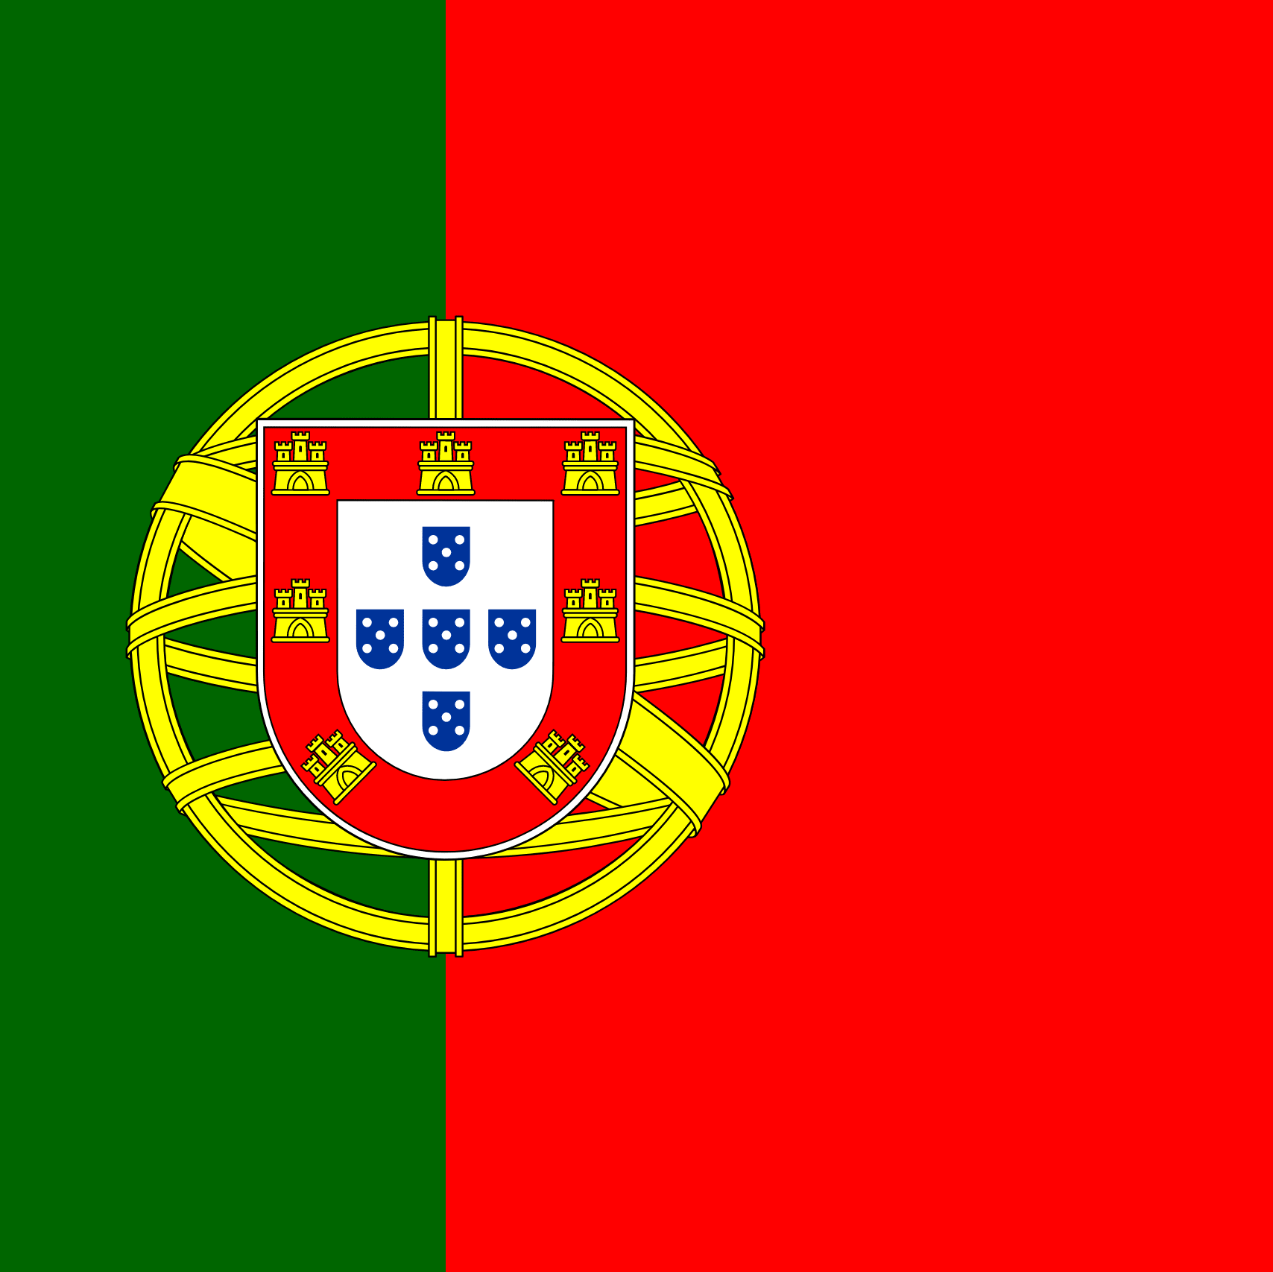


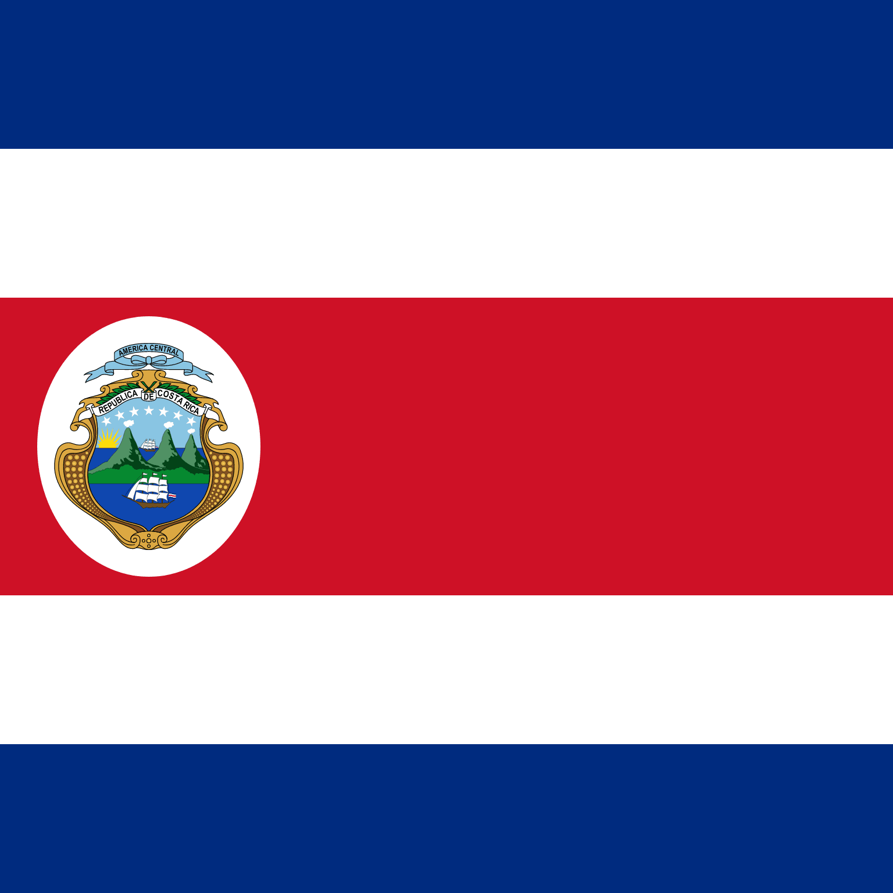


UN Ocean Decade Tsunami Programme Scientific Committee
2024-2025
Annex to Dec. A-31/3.4.1
Terms of reference of the Scientific Committee for the Ocean Decade Tsunami Programme
The Scientific Committee has an advisory role for the duration of the Ocean Decade Tsunami Programme (referred to as the programme).
Membership:
• Four (4) members nominated by the each of the TOWS-WG Task Teams;
• Three (3) members nominated by the TOWS-WG on the basis of their scientific expertise;
Annex to Dec. A-31/3.4.1 (cont.)
• All members will serve for a period of two years and would be eligible for renewal once.
• In selecting Expert Members, due consideration will be given to geographic, generational and gender balance.
Srinivasa Kumar Tummala
Chairperson
Christa von Hillebrandt
Maria Ana Baptista
Harkunti Pertiwi Rahayu
David Coetzee
Silvia Chacon
Srinivasa Kumar Tummala
Helene Hebert
Yutaka Hayashi
Michael Angove
Sergio Barrientos
Alexander Rabinovich

Slide 3
UN Ocean Decade Tsunami Programme Scientific Committee
Terms of References (ToRs) (Rev IOC EC-55)
Develop a Draft 10-Year Research, Development and Implementation Plan for the Ocean Decade Tsunami Programme based on the concept paper “Protecting Communities from the World's Most Dangerous Waves: A Framework for Action under the UN Decade of Ocean Science for Sustainable Development”;
Identify and address gaps in global tsunami hazard assessment as follows:
      a. comprehensive assessment to include all potential tsunamis, anywhere in the world, regardless of their source,
      b. strategies to validate historical tsunami sources, through the application of paleotsunami techniques and historical seismology;
Identify gaps in tsunami detection, measurement, forecasting, with a special emphasis on tsunamis generated close to populated coastlines;
Propose to enhance sensing and analysis strategies to enable the rapid characterization of tsunami sources through the combined use of land-based seismic and geodetic sensors, GNSS terminals, coastal sea level gauges, deep-ocean tsunameters, SMART repeaters on deep-ocean fiber-optic cables and satellite-based observations;
Propose a roadmap for collaboration with the ITU/WMO/IOC SMART Joint Task Force cable initiative to fully explore the feasibility of widespread deployment of scientific instrumentation on deep-ocean fiber-optic cables to improve capability to rapidly detect and characterize tsunami sources as well as propagating tsunami wave fields;
Consider and propose strategies, programmes and content to enhance societal resilience for tsunami and other ocean hazards;
  Build the framework needed to ensure the training and development of the next generation of technical-scientific expertise,
  Identify strategies that allow to characterize structural and social vulnerability in tsunami hazard zones
  Propose strategies for promoting implementation of community preparedness initiatives such as IOC Tsunami Ready to ensure 100 % at risk communities are prepared & resilient to tsunamis by 2030
Overview the consolidation of inputs received to IOC Circular Letter 2825 on Inventory of actions being considered under the United Nations Decade of Ocean Science for Sustainable Development (2021–2030) in the field of Tsunamis and Other Sea-Level Related Hazards warning and mitigation;
Submit a Draft 10-Year Research, Development and Implementation Plan for endorsement by the TOWS-WG at its 16th meeting.

Slide 4
UN Ocean Decade Tsunami Programme Scientific Committee
Goal=Draft a 10-Year Research, Development and Implementation Plan for the Ocean Decade Tsunami Programme
Progress
Consultants to draft chapters
Consultations with TSU community (TTs/ICGS)
Consult/contributions Member States (CL)
17 Feb 2022
24-25 Feb 2022
7-8 Apr 2022
13-17 Jun 2022
18-20 Jan 2023
2–3 Mar 2023
21–30 Jun 2023
SC 1st meeting
(online)
TOWS-WG
XV
Safe Oceans
Lab
IOC -EC 55
3rd SC meeting (in person)
TOWS-WG XVI
IOC
Assembly
IOC Governing body
Laboratories are innovative formats that function as self-sustaining events. They act as a creative platform to link diverse stakeholders and topics to trigger collaborative efforts regarding the UN Ocean Decade.
2nd SC meeting
(in person)
Final version of the 10-Year Research, Development and Implementation Plan for the Ocean Decade Tsunami Programme for the
Endorsement
10-Year Research, Development and Implementation Plan for the Ocean Decade Tsunami Programme
Endorsed by the IOC Assembly
The purpose of this meeting is to first and foremost meet (virtually) and present each other, but also to broadly discuss the terms of reference and agree on a timeline for delivering the 10-year plan
TOWS-WG is a standard setting and advisory body to the IOC on tsunami and other coastal hazards. This session will discuss among other matters, SMART Cable, Tsunami Ready & UN Decade
2nd draft of the 10-Year Research, Development and Implementation Plan for the Ocean Decade Tsunami Programme
1st Draft of the 10-Year Research, Development and Implementation Plan for the Ocean Decade Tsunami Programme
Draft TORs consultancies
  4th Call for Decade Actions 31 Jan 2023 – Coastal Resilience
1st Draft to TNCs/TWFPs Dec2022
  2nd draft to TOWS-WG/ICGs/TTs Jan2023

Slide 5
UN Ocean Decade Tsunami Programme
RDIP
The SC developed the draft 10-Year Research, Development and Implementation Plan for the Ocean Decade Tsunami Programme which was presented and endorsed at the IOC Assembly in June 2023

Slide 6
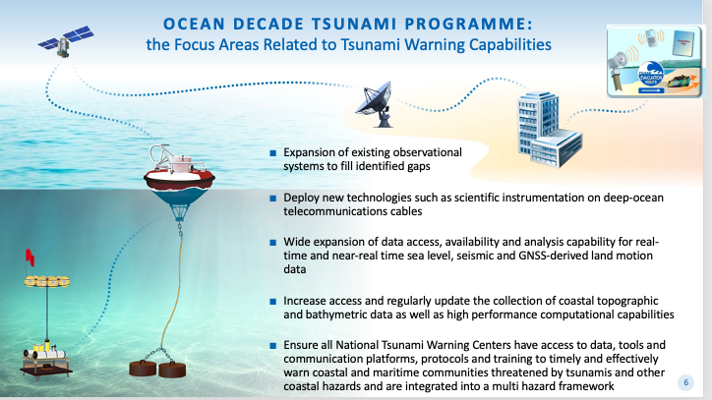
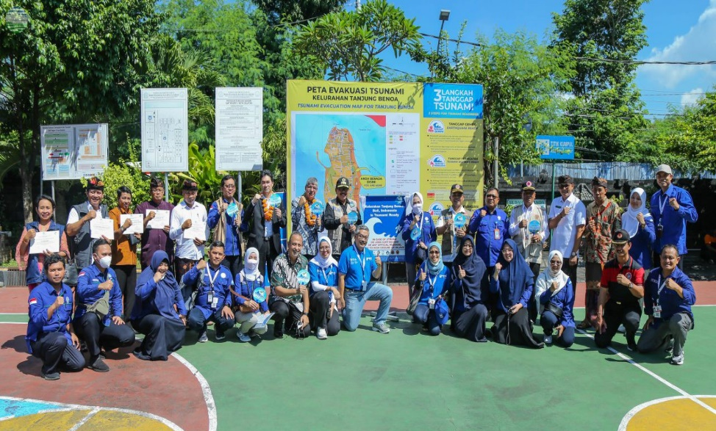
ODTP- Objectives
To develop the warning systems’ capability to issue actionable and timely tsunami warnings for tsunamis from all identified sources to 100% of coasts at risk
100% of communities at risk be prepared and resilient to tsunamis by 2030 through programmes like the IOC-UNESCO Tsunami Ready Recognition Programme (TRRP)

Slide 7
Key Elements of the Research, Development & Implementation Plan
1. Tsunami Risk Knowledge: Identify and prioritise at-risk communities
2. Tsunami Detection, Analysis and Forecasting: Expand existing, and deploy new observing technologies and warning systems
4. Preparedness and Response Capabilities: To build tsunami-resilient communities
3. Warning, Dissemination and Communication: Access to data, tools, communication platforms, protocols and training to effectively warn coastal and maritime communities
5. Capacity Development, SIDS and LDCs, Multi-hazard Framework: Underpinning elements
6. Governance and Pathways to Implementation
Notes:
Enhance tsunami risk assessments and the research on technologies for it, so the countries know their expected threat and vulnerability, and are able to identify and prioritise the at-risk communities.
Expand and improve existing detection and monitoring systems, including seismographs, coastal tide gauges, and deep ocean tsunameters, to fill identified gaps, and deploy new technologies to address observational gaps that cannot be covered by existing networks.
Ensure all National Tsunami Warning Centres (NTWCs) have access to data, tools and communication platforms, protocols and training to timely and effectively warn coastal and maritime communities threatened by tsunamis and other coastal hazards that are integrated into a multi-hazard framework
Emphasise the importance of building tsunami resilient communities through the IOC-UNESCO Tsunami Ready Recognition Programme, which is achieved through involvement of stakeholders at all levels.

Slide 8
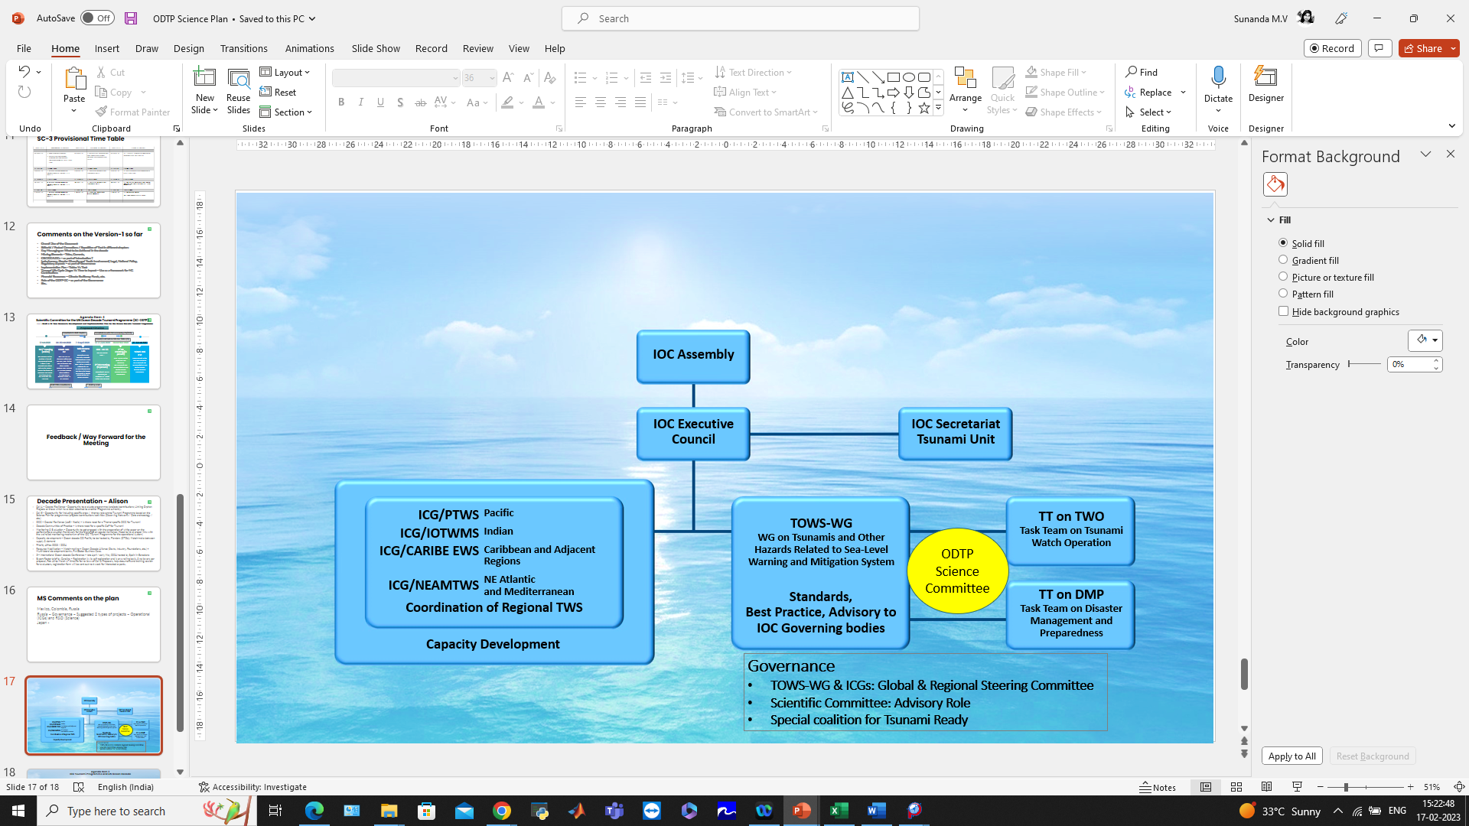
Governance
To explore opportunities and establish connections with Decade programmes, projects, contributions, DCCs and CoPs, Calls for Action
To align with international frameworks, call for action and multi-lateral environmental agreements – SFDRR, SDGs (3, 8, 11, 14), Paris Agreement on climate change, early warnings for all, UN Global Early Warning Initiative (2023-2027) etc.
To provide new cooperation opportunities by laying out the building blocks, through an international Science Committee and International Tsunami Ready Coalition while renewing and strengthen existing cooperation with partners
To encourage and promote inclusiveness and gender diversity, and that youth and early career professionals engage and involve in tsunami early warning systems and actions
To develop and operationalize a transparent performance monitoring system based on international norms, standards and agreements
ICG-TICS
  The IOC-UNESCO tsunami programme will oversee the overall implementation of the ODTP through contributions and engagement of Member States, in coordination with the ICGs, and with the collaboration of academic institutions, researchers, industry, philanthropic organisations and other stakeholders

Slide 9
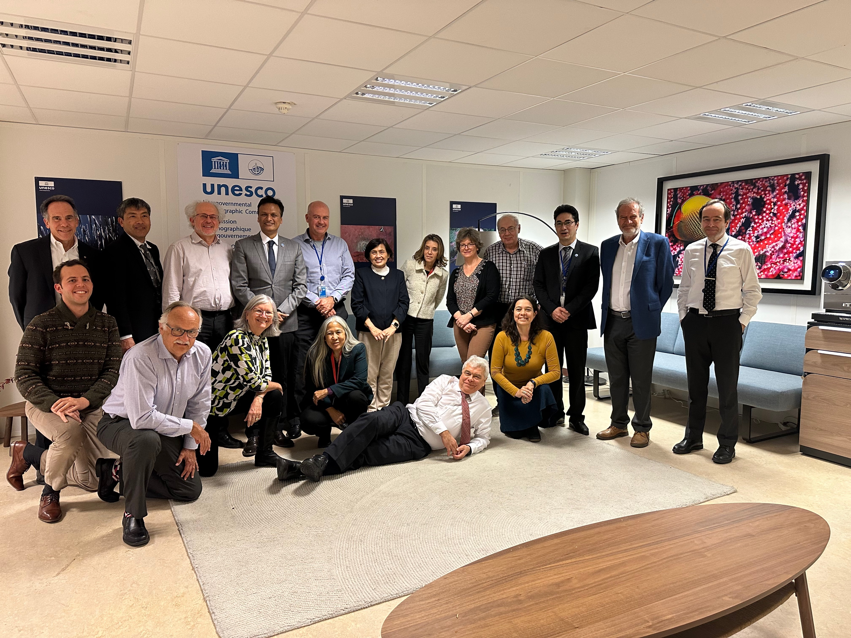
4th Meeting of SC-ODTP
25-26 January 2024, Paris
UN Ocean Decade initiatives and their relationship with ODTP
Current work programmes of TOWS-WG TT-TWO and TT-DMP
ODTP and Challenge 6 coordination with TOWS-WG Work Programmes
ICGs initiatives w.r.t ODTP
ODTP involvement in
  2nd UNESCO IOC Global Tsunami Symposium, 11 – 14 November 2024, Banda Aceh
  Pre-Event International Scientific Workshop, 8 - 9 November, Banda Aceh
  2nd UN Ocean Decade Conference, 10 – 12 April 2024, Barcelona
Review of Actions – 6th call referring to ODTP
SC-ODTP Work Programme

Slide 10
UN Ocean Decade Initiatives and relationship with ODTP
Capacity Development Facility
To build on unique strengths and expertise of IOC to support CD needs of institutions involved in OD with focus on SIDs, LDCs and ECOPS – Eg Co-Design, Actions
Need to Leverage CDF – TSR to keep track of the next call for action on CD facilities / resources and needs
Share capacity building efforts within the IOCs Tsunami Program (including IOTWMS UNESCAP Regional Tsunami Capacity Assessment Project, PTWS)
Thematic / Regional Decade Collaborative Centres / Coordination Offices
Links with DCC-PICT, DCC-OP, DCC-CR, DCC-IOR
Initiate communication with DCCs/DCOs to connect ODTP with their actions / activities
Elements of interest for TTTWO include Digital Twins, AI, Deep Learning, MeteoTsunamis, Multi-hazard Ocean Observations, 2nd Tsunami Symposium

Slide 11
Current work programmes of
TOWS-WG TT-TWO and TT-DMP
ODTP-SC noted the work progress of TOWS-TT-TWO and TOWS-TT-DMP, especially in connecfon to volcano-origin and meteo-tsunamis.
ODTP-SC further noted the prior initiative by TOWS-WG on the tsunami hazard assessment, and the need to explore the need for TOWS-WG to revisit global tsunami hazard/risk assessment, which is currently undertaken at the ICG level.

Slide 12
Endorsed Decade Actions related to ODTP and Challenge 6 and coordination with TOWS-WG Work Programmes
Need to identify gaps and work closely with the IOC/DCU for future calls to encourage national projects relevant to IOC’s tsunami programme to be submitted & endorsed – eg. SMART Cable, New Zealand DART Project, and UNESCAP IOTWMS Capacity Assessment project are not listed
Several reasons could contribute to this including awareness of UN Decade at the national level or the initafves not being perceived as “transformative” enough in the context of the Decade by the implementers
Proper communication through multiple means including by the DCU, TSR, ICGs, National Decade Committees
Further granularity required in the calls for action & DCU summaries to facilitate proper mapping to relevant programmes and monitoring

Slide 13
ICG initiatives/coordination with respect to ODTP
  Need to have a mechanism to relate the progress at each ICG with respect to ODTP goals as described in the RDIP – IOC TS 180
  Explore alignment with the Global Tsunami Performance Monitoring Framework
  Need for standardized reporting at the Member State/ICG level for further compilation at global level by TSR
  ODTP-SC decided to recommend TOWS-WG to request ICGs (through Member States) to report with respect to ODTP Appendices through an online interface to be provided by the IOC/TSR.
  All efforts in this regard should be synchronized with the IOC/DCU, which has its own assessment tools.
  ODTP-SC appreciated the presentations on Optimal Sensor Locations in the Pacific and progress in the implementafon of cabled systems in the ICG/NEAMTWS, also useful for planning purposes at the Member States level.
  ODTP-SC also noted ongoing efforts by the IOC/TSR towards determination of the total number of communities subject to TRRP.

Slide 14
ODTP involvement in other relevant Activities
  2nd UNESCO IOC Global Tsunami Symposium, 11 – 14 November 2024, Banda Aceh
    Reorganization of sessions in alignment with ODTP RDIP, the conceptual flow of the program, speakers, and public sessions
  2nd UN Ocean Decade Conference, 10 – 12 April 2024, Barcelona
    Side event “Coastal Futures” and satellite Event “Coastal Cities and Communities Joining Tsunami Ready”
    Talks by Lorna Iniss & Silvia Chacon Barrantes
  EW4All
    Hazards covered under the EW4All ? Guiding documents on geo-hazards?
    IOC/TSR to work with WMO and share OD white papers and capacity assessment

Slide 15




09
2| CHALLENGE 6: INCREASE COMMUNITY RESILIENCE TO OCEAN HAZARDS
Working Group
Ocean Decade Vision 2030
Working Group 6
Challenge 6: Increase community resilience to ocean hazards
Enhance multi-hazard early warning services for all geophysical, ecological, biological, weather, climate and anthropogenic related ocean and coastal hazards, and mainstream community preparedness and resilience.
CO-CHAIRS
Nadia Pinardi, DCC for Coastal Resilience, University of Bologna, Italy
Srinivasa Kumar Tummala, DCC for Indian Ocean Region, INCOIS, India
MEMBERS
Alessandra Burgos - Oregon State University, United States
Andrea Valentini - DCC for Coastal Resilience, University of Bologna, Italy
Antoine Queval - Alcatel Submarine Networks, France
David Cabana - Helmholtz-Zentrum Hereon, Climate Service Center, Germany
Dwikorita Karnawati - Indonesia Agency for Meteorology, Climatology and Geophysics, Indonesia
Enrique Alvarez Fanjul - OceanPrediction Decade Collaborative Center, Mercator Ocean International, Fance
Giovanni Coppini - Euro-Mediterranean Centre on Climate Change Foundation, Italy
Hellen J. Kizenga - Institute of Marine Sciences, University of Dar es Salaam, Tanzania
Iris Monnereau - Food and Agriculture Organization of the United Nations
Jason Holt - National Oceanography Centre, UK
Joel Kamdoum Ngueuko - Naturalia Environment, France
Joseph Ansong - University of Ghana, Ghana
Juliet Hermes - South African Environmental Observation Network, National Research Foundation, South Africa
Loreto Duffy-Mayers - Caribbean Alliance for Sustainable Tourism
Martin D. Smith - Nicholas School of the Environment, Duke University, United States
Martina Müller - United Nations Office for Disaster Risk Reduction
Mitchell Harley - UNSW Sydney, Australia
Purificació Canals - MedPAN, Spain
Sunanda Manneela - Indian National Centre for Ocean Information Services, India
*ECOPs
Ocean Decade Vision 2030 Webinars
Session 3: Science and Solutions for a Safe and Predicted Ocean
1

Slide 16
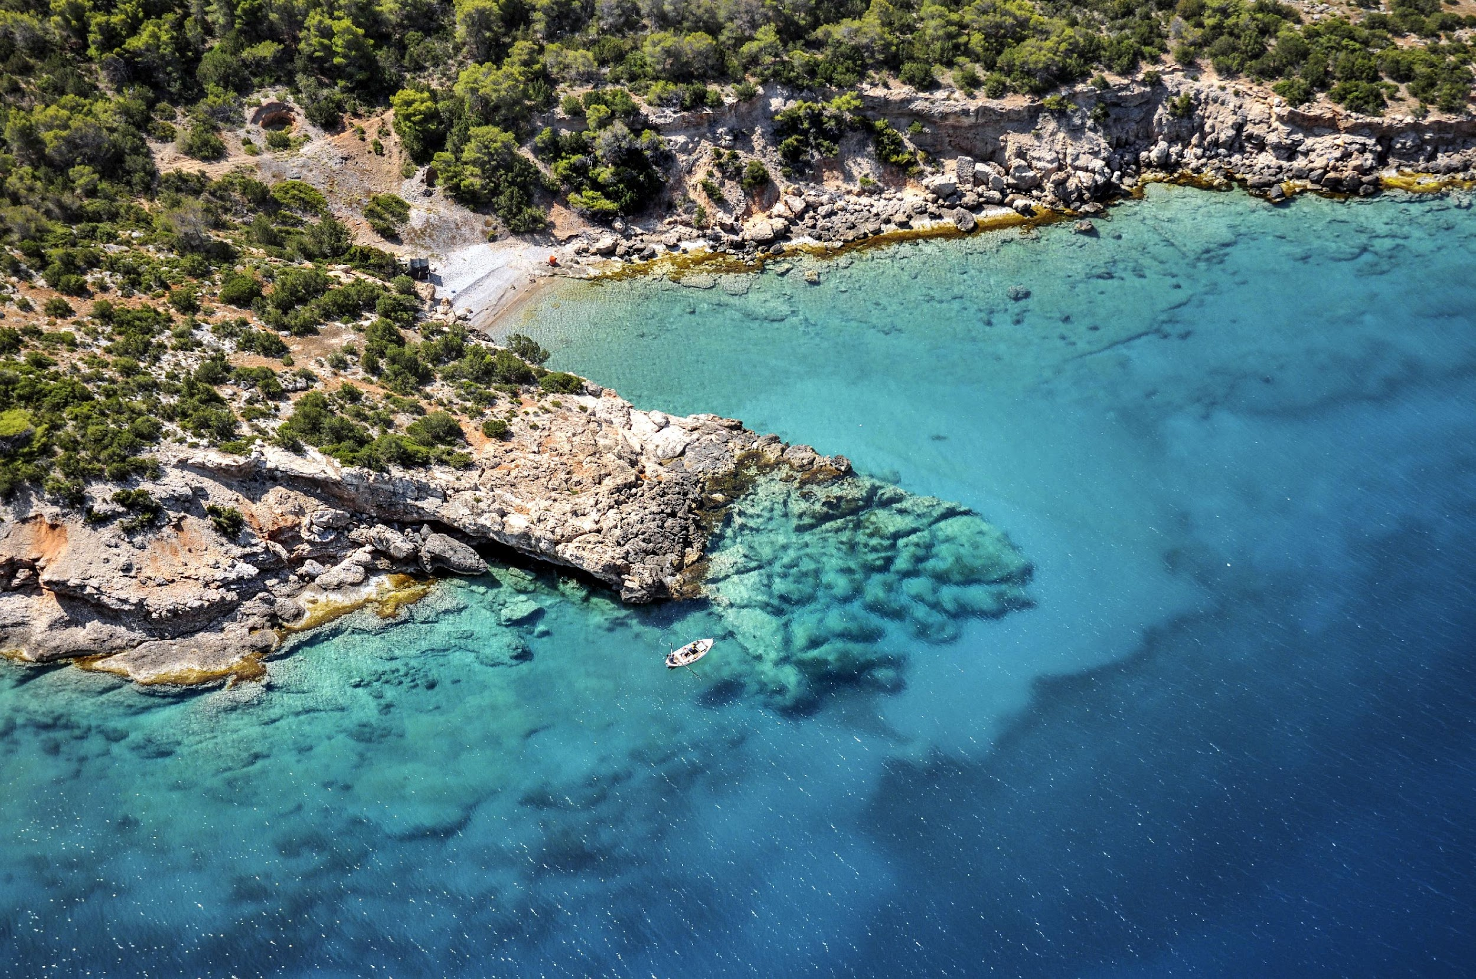
11
2| CHALLENGE 6: INCREASE COMMUNITY RESILIENCE TO OCEAN HAZARDS
Strategic ambition
Outcome 1
Design ‘people-centred’ multi-hazard
early warning systems
Outcome 2
Design adaptation planning strategies
to increase coastal resilience
GOAL:
A safe ocean where life and livelihoods are protected from ocean-related hazards
Characteristics:
Stakeholder engagement
Responsibility sharing
Accessible communication
Institutional capacity building
Use the new data from the Ocean Decade to prepare updated plans and solutions, also in view of the Marine Spatial Planning process
Ocean Decade Vision 2030 Webinars
Session 3: Science and Solutions for a Safe and Predicted Ocean
CHALLENGE 6 WHITE PAPER
CHALLENGE 6 WHITE PAPER

Slide 17
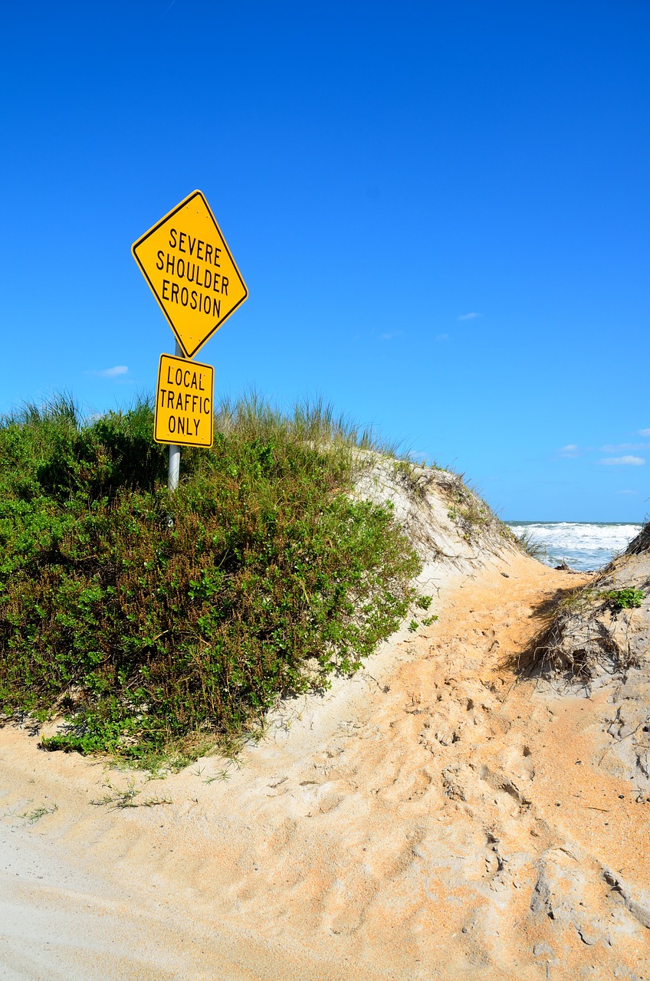
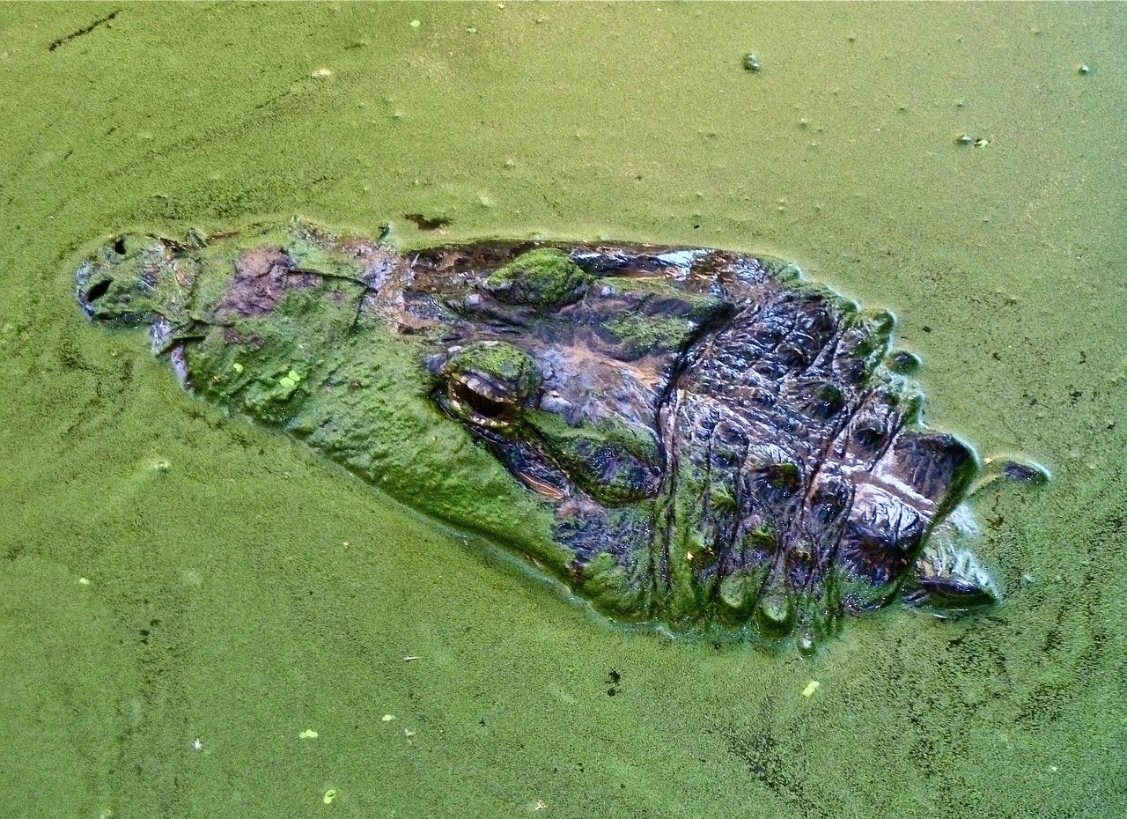
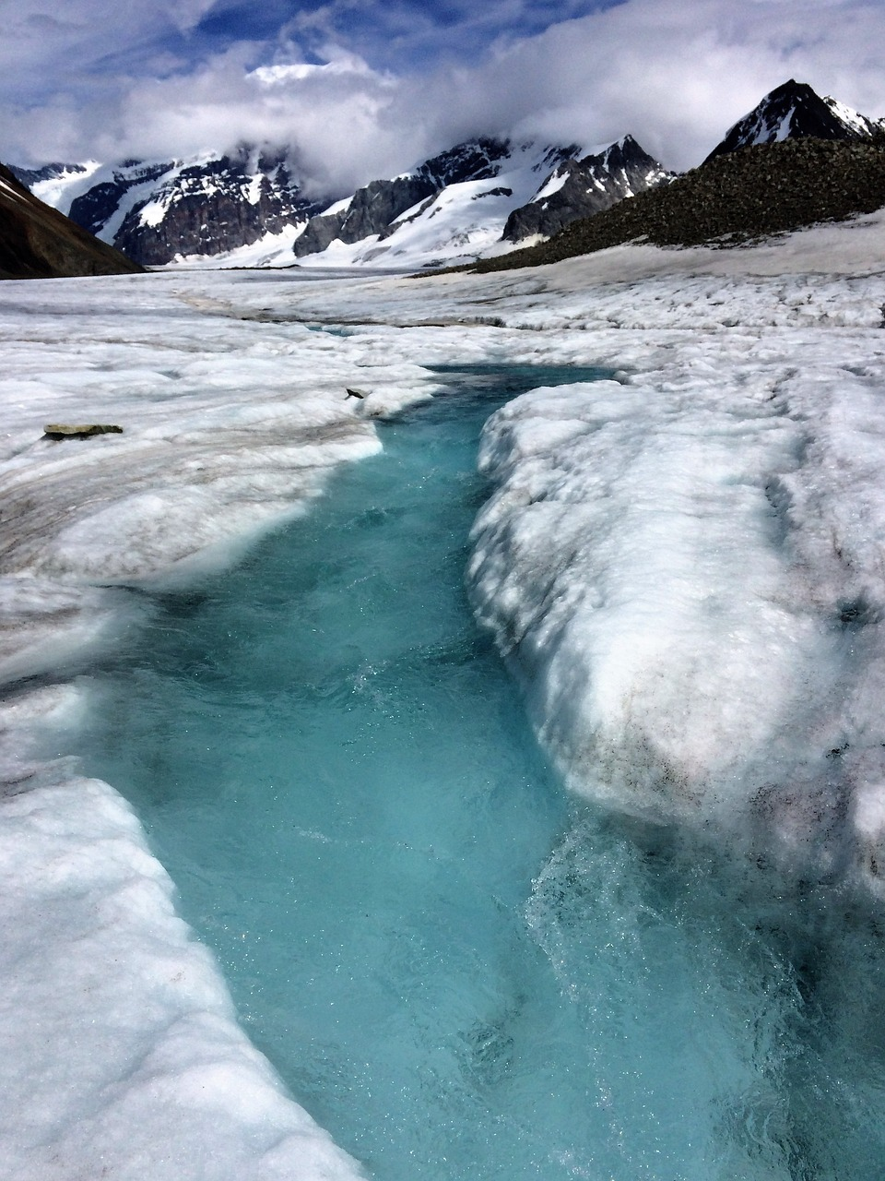
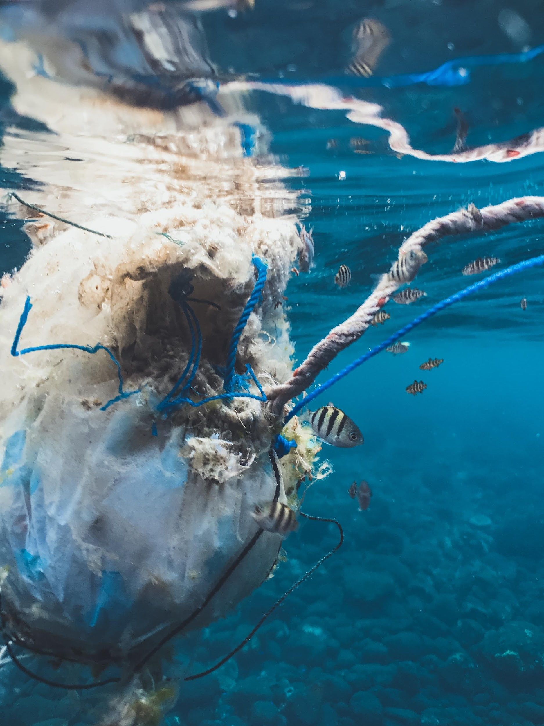
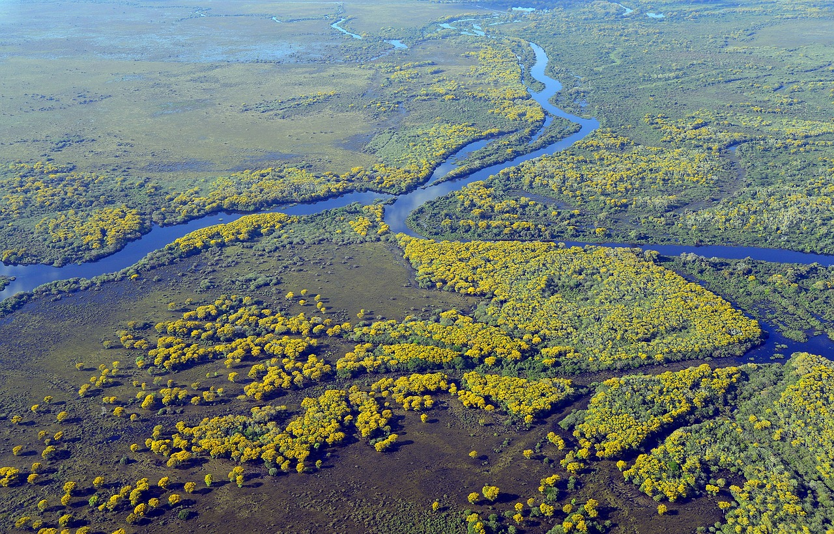
12
2| CHALLENGE 6: INCREASE COMMUNITY RESILIENCE TO OCEAN HAZARDS
Ocean and coastal hazards
Geophysical/Geological Related :
Tsunamis, Landslides, Subsidence, Volcanic eruptions, Coastal erosion, Earthquakes
Biological
Harmful algal blooms, invasive species, aquatic diseases, nuisance blooms
Ocean, weather, hydrology and climate
Tropical and extratropical cyclones and storms, sea-level rise, storm surge, meteo-tsunami, coastal flooding, waves and wave runup, currents, marine heat waves, glacial melt, heavy rainfall and river flooding, saltwater intrusions, droughts
Local anthropogenic
Coastal urbanization pressures, coastal wastewater system outflow, marine pollution, overfishing, chemical spills, oil spills, nuclear waste, agricultural runoff, coastal tourism pressures, political interference and corruption, maladaptive planning
Ecological
Wetland degradation, acidification, de-oxygenation, biodiversity loss, seabed habitat loss, coral bleaching, eutrophication, connectivity
Ocean Decade Vision 2030 Webinars
Session 3: Science and Solutions for a Safe and Predicted Ocean
CHALLENGE 6 WHITE PAPER

Slide 18



14
2| CHALLENGE 6: INCREASE COMMUNITY RESILIENCE TO OCEAN HAZARDS
Components of coastal resilience
Risk Assessment
RA.1 Multi-hazard evaluation frameworks
RA.2 Multi-level, multi-sector risk analysis
RA.3 Exposure and vulnerability analysis
Risk Reduction
RR.1 Monitoring, Forecasting and Early warning systems (multi-hazard)
RR.2 Warning Dissemination & Communication
RR.3 Preparedness & Response
RR.4 sectoral medium to long term planning (zoning, infrastructure)
RR.5 nature-based solutions
RR.6 digital twins
Institutional/
Governance / Social Transformation
GIS.1 Marine and Maritime Spatial Planning
GIS.2 Governance Framework
GIS.3 Disaster recovery planning
GIS.4 Equitable coastal resilience
GIS.5 Government investments, financing and insurance
GIS.6 Capacity building
GIS.7 Corporate social responsibility
Ocean Decade Vision 2030 Webinars
Session 3: Science and Solutions for a Safe and Predicted Ocean
CHALLENGE 6 WHITE PAPER

Slide 19
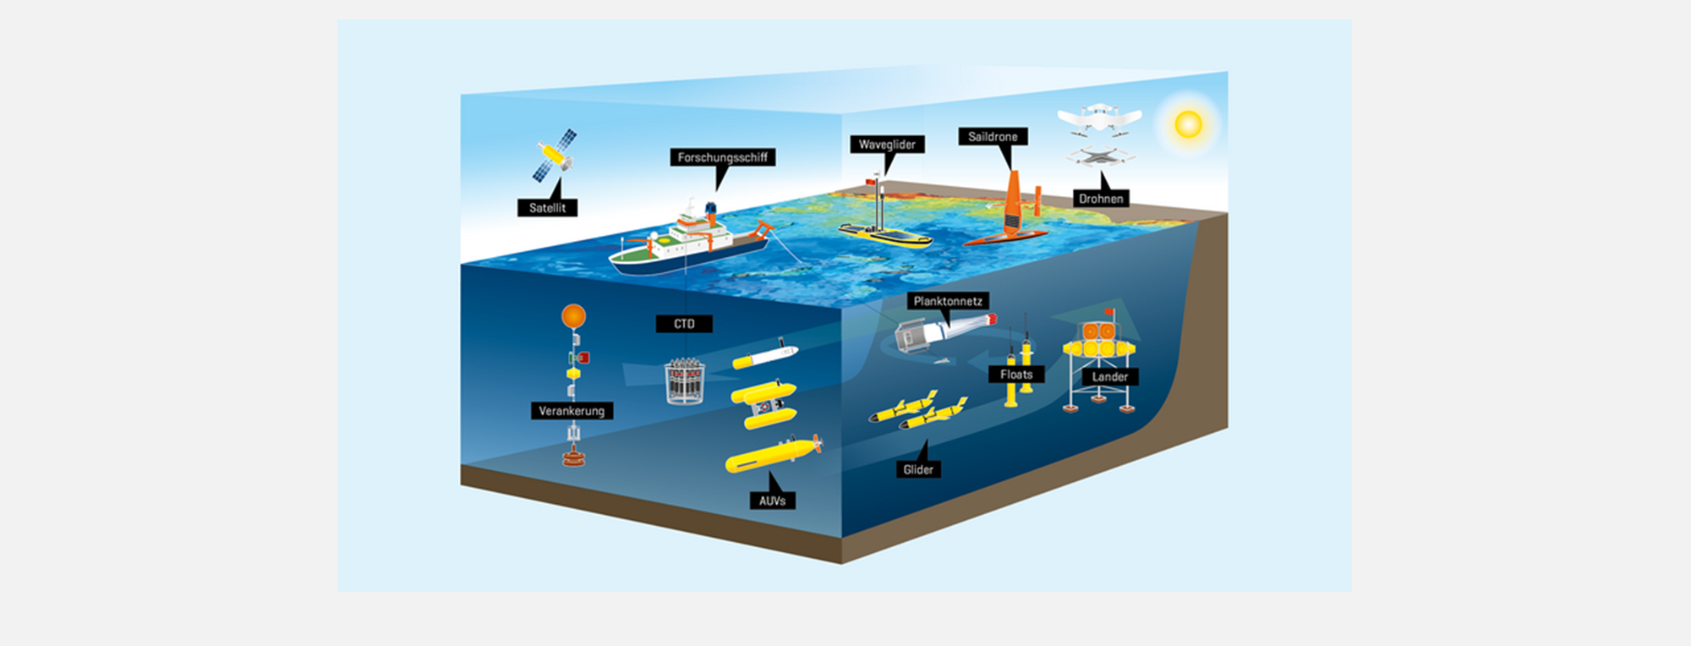
17
2| CHALLENGE 6: INCREASE COMMUNITY RESILIENCE TO OCEAN HAZARDS
Preliminary needs for coastal resilience components
Priority Data sets
Meteorological
Seismic & Geophysical
Hydrological
Oceanographic
Human activities
Seabed habitat
Bathymetry, terrain & geological data
Climate downscaled scenarios
Human health
Vital Role of Observations
Global Data Sharing
Crucial datasets for Warnings
Adaptation Planning Data
Ocean Decade Vision 2030 Webinars
Session 3: Science and Solutions for a Safe and Predicted Ocean
CHALLENGE 10 WHITE PAPER
Notes:
Vital Role of Observations: Observations are essential inputs for early warning systems, especially in predicting high-impact weather and ocean hazards within a few days
Global Data Sharing: Early warning systems depend on countries freely sharing data globally, using advanced computing centers for processing
Crucial Datasets for Warnings: these datasets are a suitable combination of past information (observations) and predictions by numerical modelling or AI
Adaptation Planning Data: Adapting to climate change requires downscaling climate scenarios and carry out impact modeling

Slide 20
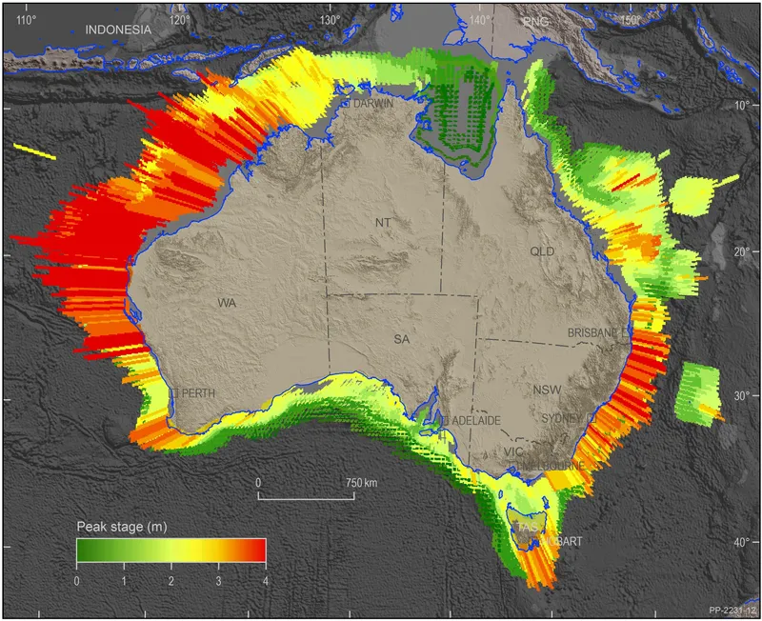
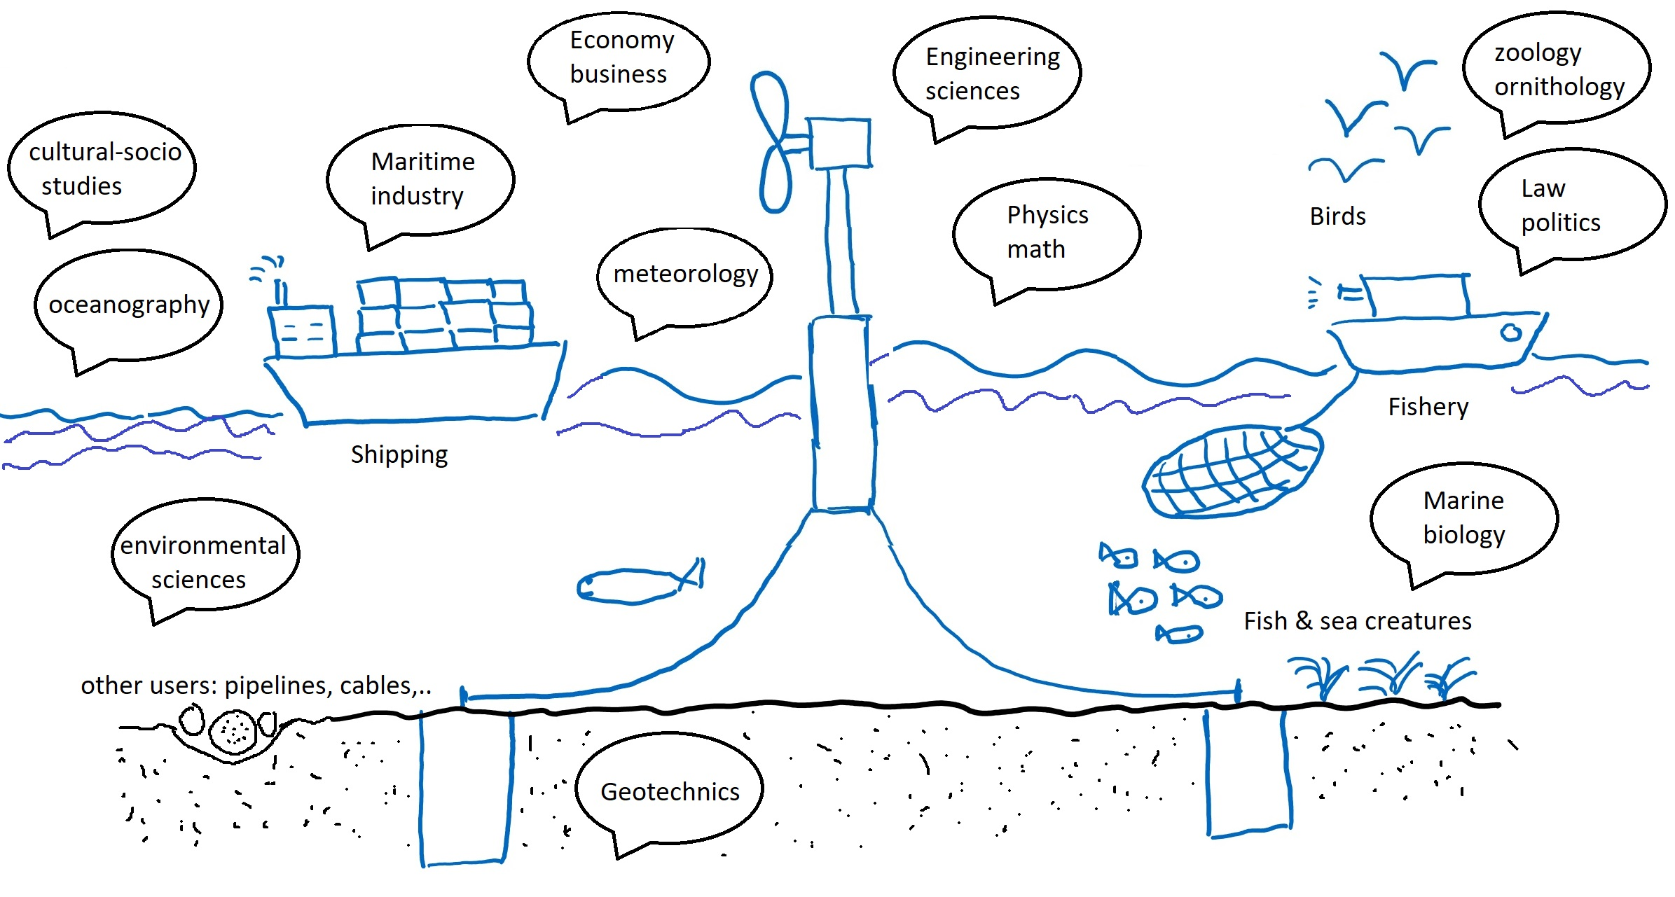

18
2| CHALLENGE 6: INCREASE COMMUNITY RESILIENCE TO OCEAN HAZARDS
Preliminary user needs for coastal resilience components
Knowledge generation and sharing
Systematic Risk Knowledge Building
Initiatives for Enhanced Risk Knowledge
Dissemination
Courtesy – Geoscience Australia
Ocean Decade Vision 2030 Webinars
Session 3: Science and Solutions for a Safe and Predicted Ocean
CHALLENGE 10 WHITE PAPER
Notes:
Systematic Risk Knowledge Building: Building risk knowledge relies on collecting data systematically and communicating region-specific hazards and vulnerabilities to communities
Initiatives for Enhanced Risk Knowledge: Primary initiatives involve investing in interdisciplinary research, leading to innovative tools for data analytics, risk mapping, and accessible repositories.
Dissemination: training programs are essential. Examples include initiatives such as the WMO Global Multi-hazard Alert System (GMAS), the UNESCO-IOC International Tsunami Information Center (ITIC) training program, and the Ocean Teacher Global Academy (OTGA) of UNESCO-IOC.

Slide 21
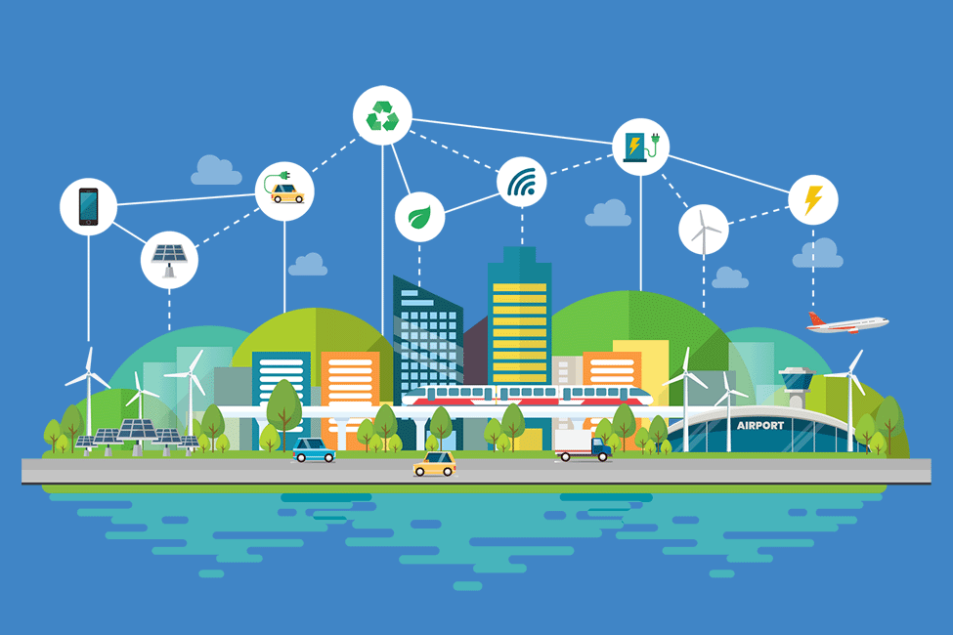
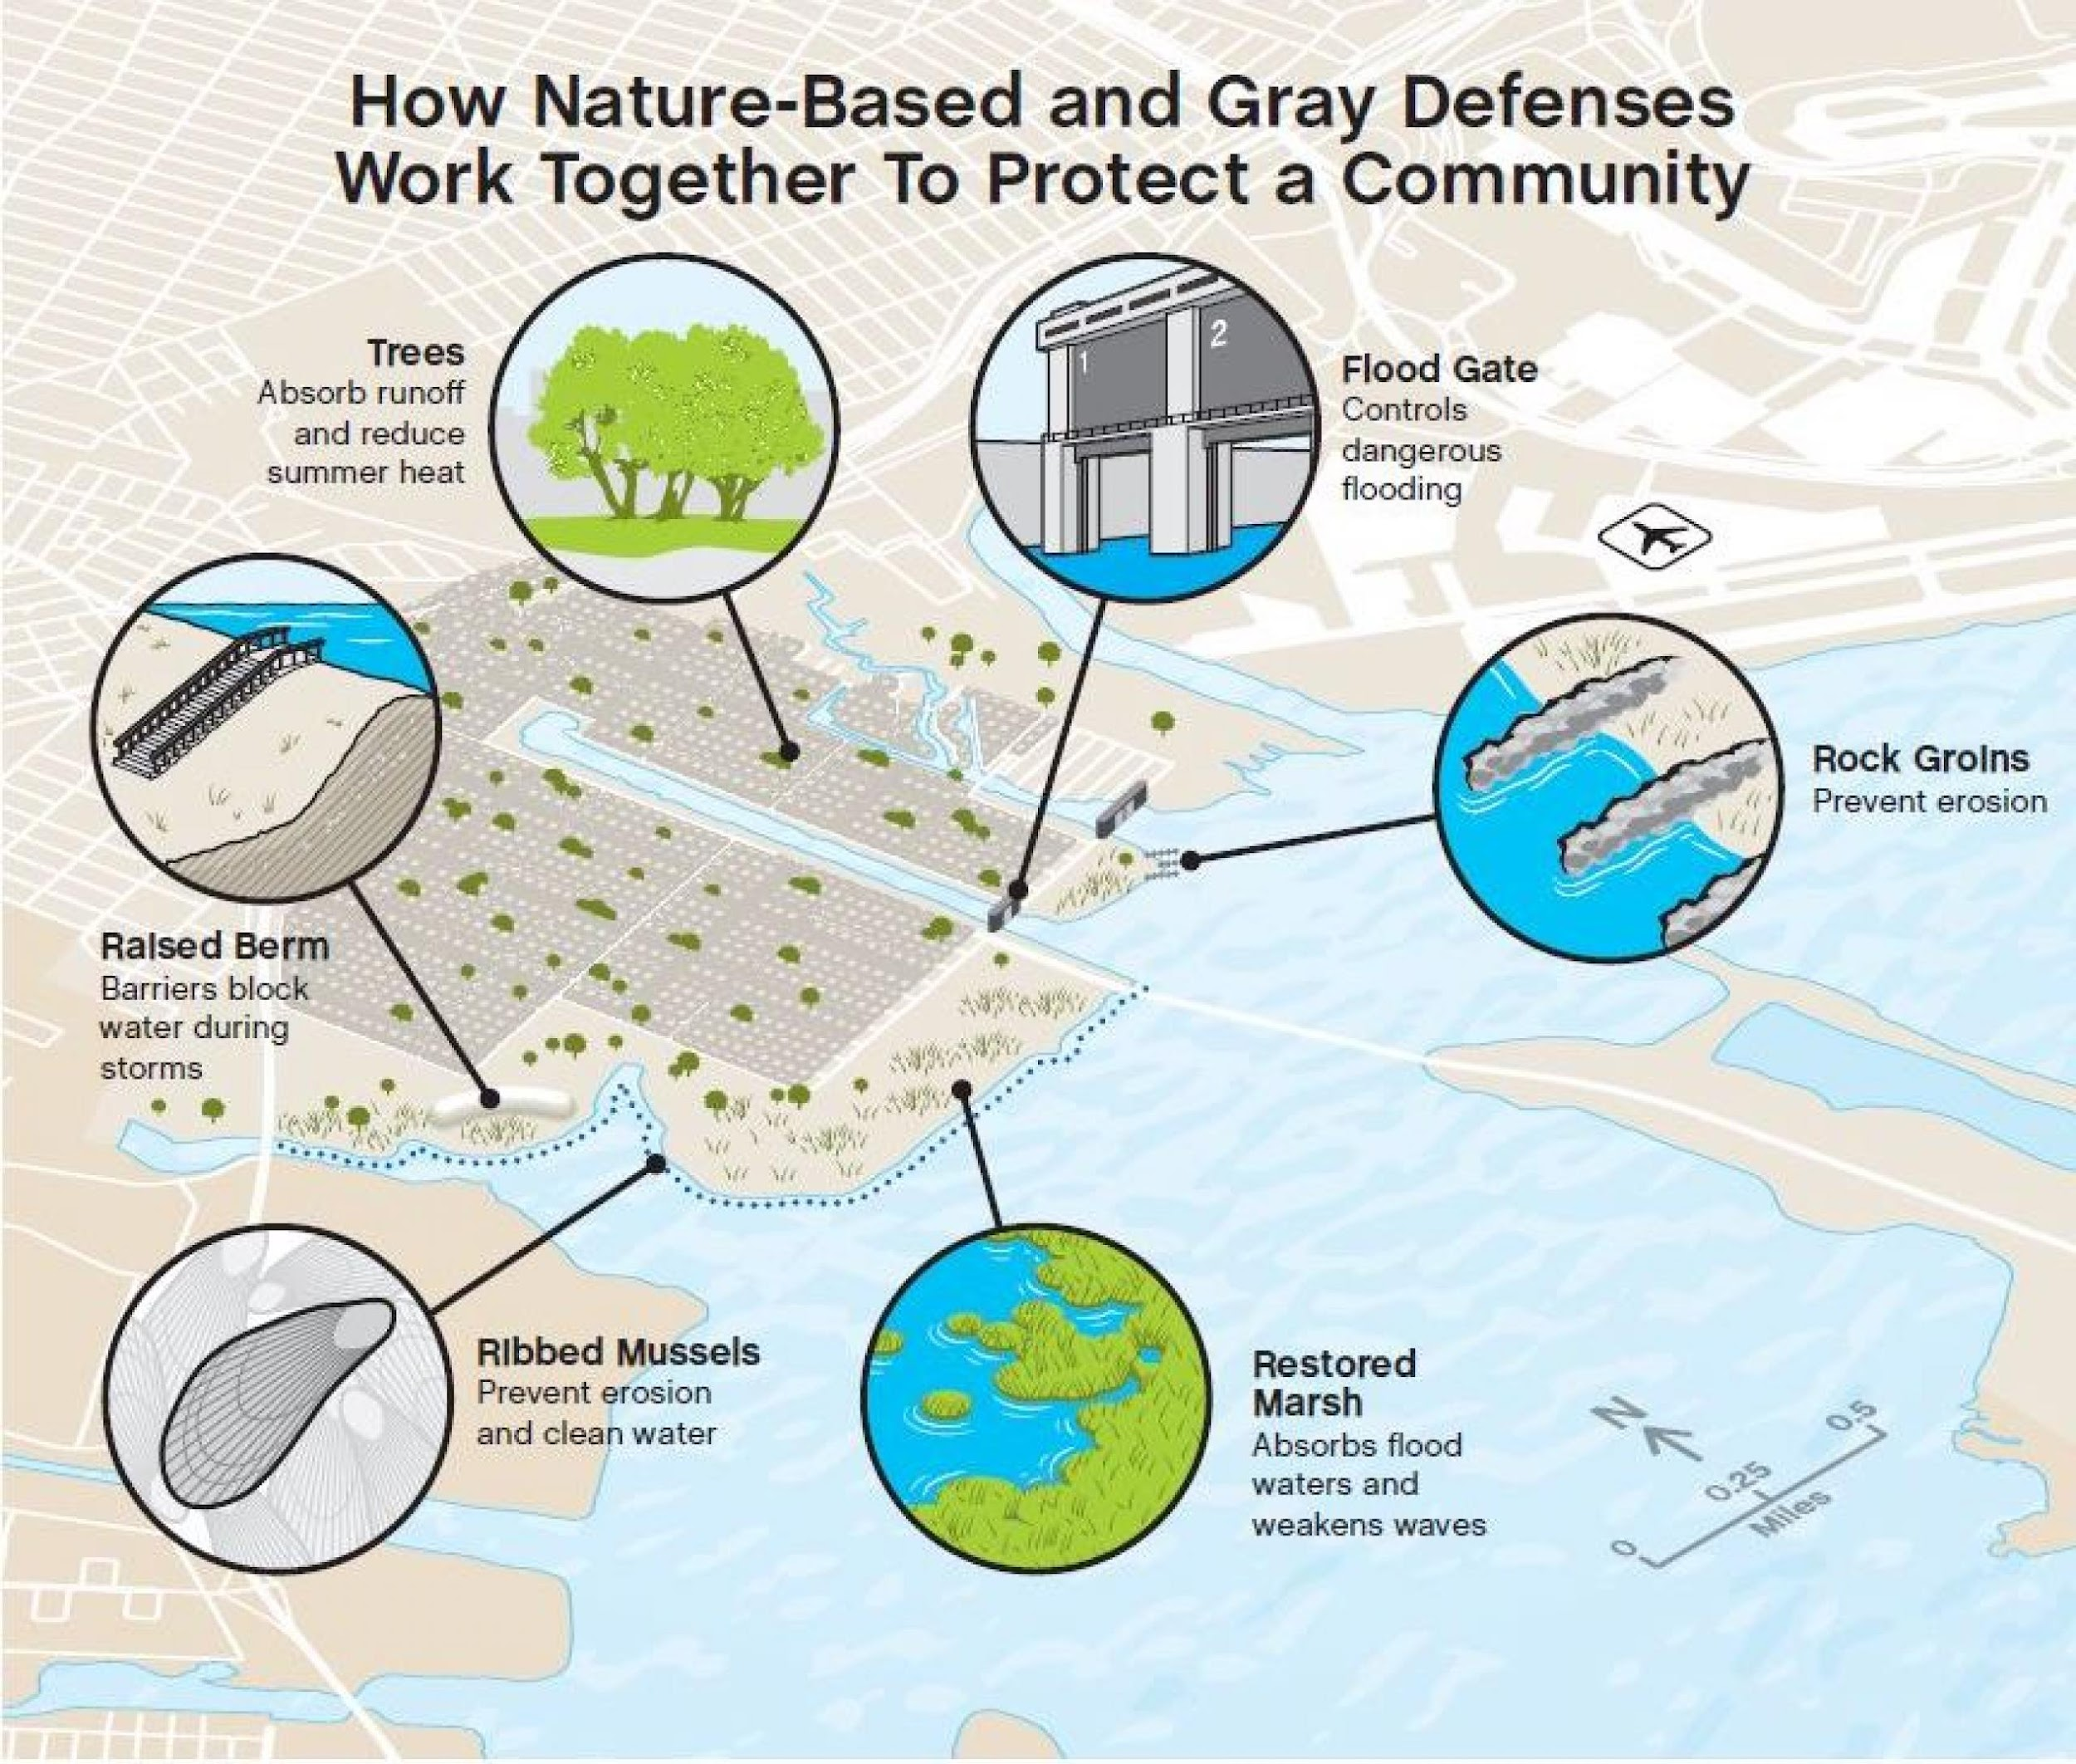
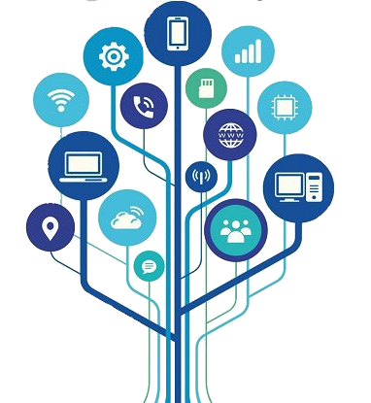
19
2| CHALLENGE 6: INCREASE COMMUNITY RESILIENCE TO OCEAN HAZARDS
Preliminary user needs for coastal resilience components
Technology and innovation solutions
Technology for Resilience
Climate-Resilient Infrastructure
Effective Communication with ICT
Ocean Decade Vision 2030 Webinars
Session 3: Science and Solutions for a Safe and Predicted Ocean
CHALLENGE 10 WHITE PAPER
Notes:
Technology for Resilience: Advanced sensors, satellites, and AI/ML is vital for early warnings against ocean hazards, following F.A.I.R. principles. Numerical modeling and Digital Twin Frameworks improve forecasting.
Climate-Resilient Infrastructure: Mix grey and green infrastructure with smart technologies for climate resilience. Innovations in sand mobilization, sustainable aquaculture, and waste management contribute to overall resilience.
Effective Communication with ICT: Use emerging ICT technologies, such as cellphone apps, for efficient early warnings, especially in vulnerable communities. Detailed technology requirements are listed in Annex 4.

Slide 22
20
2| CHALLENGE 6: INCREASE COMMUNITY RESILIENCE TO OCEAN HAZARDS
WG6 White Paper in synthesis
Key Outcomes
- Design and implement ‘people-centred’ multi-hazard early warning systems
- Design and demonstrate innovative adaptation planning strategies
Challenges
- Adopting a multi-hazard framework involves dealing with complex technologies
- Ocean hazards have important cascading effects not yet fully understood
Recommendations
- Utilize a risk framework instead of solely relying on a hazard-based approach
- Focus on technologies that remove barriers to rapid innovation uptake
Expected impacts
- Reconceptualization of challenge 6 within the framework of risk assessment and management strategies
- Establishment of an evaluation matrix to be used to measure and assess progress.
Ocean Decade Vision 2030 Webinars
Session 3: Science and Solutions for a Safe and Predicted Ocean
CHALLENGE 10 WHITE PAPER

Slide 23
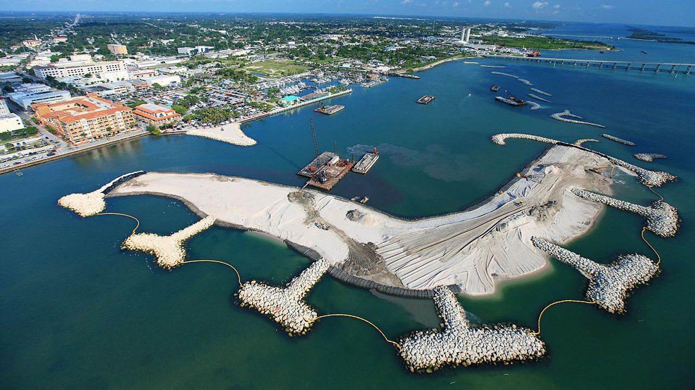

17| CHALLENGE 6 WHITE PAPER
CONTACT
25
2| CHALLENGE 6: INCREASE COMMUNITY RESILIENCE TO OCEAN HAZARDS
Contacts
WHITE PAPER REVIEW WEBINAR
January 22 to February 22
https://oceandecade.org/news/vision2030-white-papers-review-process/
CONTACTS:
Nadia Pinardi
nadia.pinardi@unibo.it
Srinivasa Kumar Tummala
srinivas@incois.gov.in
Ocean Decade Vision 2030 Webinars
Session 3: Science and Solutions for a Safe and Predicted Ocean
CHALLENGE 10 WHITE PAPER

Slide 24
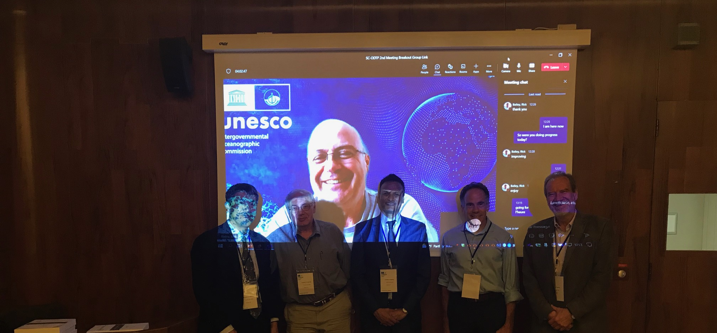
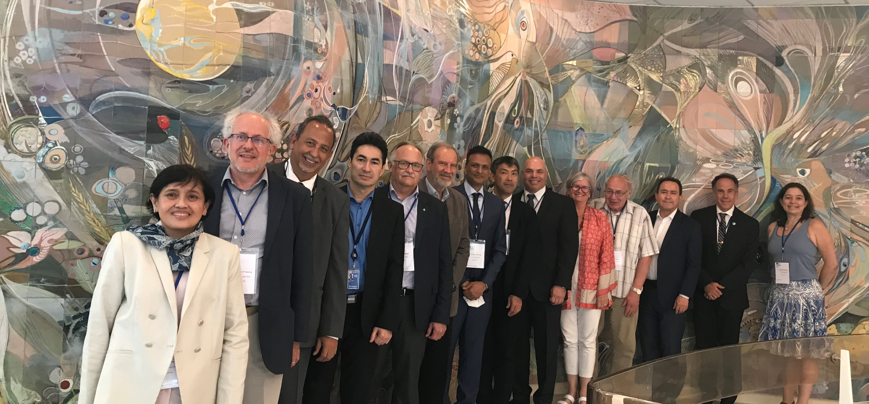
THANK YOU

