Slide 1
Task Team Disaster Management and Preparedness
Recommendation and Action
Harkunti P. Rahayu
Chair

Slide 2
Terms of Reference
Facilitate in collaboration with organization such as UNISDR (United Nations Office for Disaster Risk Reduction), the exchange of experiences and information on preparedness actions, education/awareness raising campaigns and other matters related to disaster management and preparedness;
Promote preparedness in coastal communities through education and awareness products and campaigns;
Facilitate SOP training across ICGs to strengthen emergency response capabilities of Member States and their Disaster Management Offices;
Promote preparedness programs and assessment tools that have been successful in one regional Tsunami Warning and Mitigation System in the others as appropriate;
Facilitate the coordination of the TICs of the ICGs;
Report to the TOWS–WG.

Slide 3
TTDMP Members
NAME | COUNTRY | ORGANIZATION | REGION / ROLE IN TTDMP
Harkunti Pertiwi Rahayu | Indonesia | ITB | ICG/IOTWMS (Chair)
Denis Chang Seng | France | UNESCO IOC | NEAMTIC, ICG/NEAMTWS (Technical Secretary)
Ardito M. Kodijat | Indonesia | UNESCO Jakarta | IOTIC, ICG/IOTWS
Laura Kong | USA | NOAA | ITIC, ICG/PTWS
Ashleigh Fromont | New Zealand | NEMA | ICG/PTWS
Marinos Champalakis | Greece | NOA | ICG/NEAMTWS
Ignacio Aguirre Ayerbe | Spain | IH Cantabria | ICG/NEAMTWS
Alison Brome | Caribbean | CTIC | CTIC, ICG/CARIBE-EWS
Silvia Chacón | Costa Rica | National Tsunami Monitoring System | ICG/CARIBE-EWS
OBSERVERS
Rosalind Cook | Geneva | UNDRR | Head Campaigns and Community Unit, UN Office for DRR
Sarah Grimes | Geneva | WMO | Head, Marine Services Division
Derya Vennin | France | UNESCO IOC | CoastWave Project
Prof Amr Hamouda | Egypt | NIOF | ICG/NEAMTWS

Slide 4
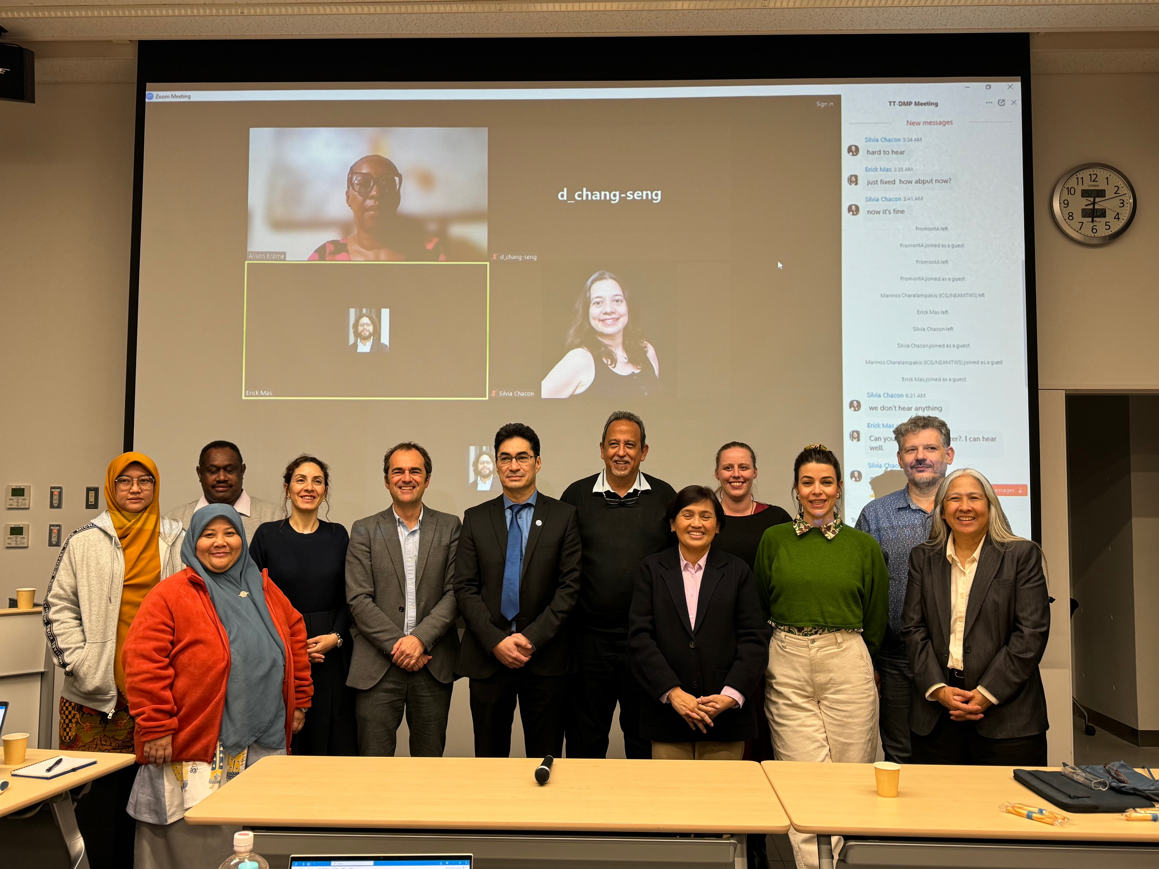

Slide 5
Agenda of the Joint Meeting TTDMP & TTTWO and Agenda of TTDMP
Day 1: Joint Meeting of TTWO & TTDMP
Day 2: Meeting of TTDMP
Welcome & Introductions
Session Organisation
Wave Exercises and Significant Tsunami Events in each ICG
Planning for Ocean Decade
Local Source SOPs
Update on PTWS NTWC Competency Framework and Development of Global Framework
Tsunami Glossary Update
IUGG update
Update UN Sec General “Early Warnings For All” Initiative
Public Warning Systems - Galileo Emergency Warning Satellite Service (EWSS)
Planning for WTAD 2024
Update on Planning for the next Global Tsunami Symposium in Indonesia in November 2024
Session Organisation
Discuss Outcomes of the joint Meeting TTWO & TT DMP
Review Action Items
Tsunami Ready Implementation Status
Synergy with Local and National Resilient Programmes, including Tsunami and Critical Infrastructures, and ISO 22328-3 (Community-based Early Warning Systems for Tsunamis)
Education and World Tsunami Awareness Day 2023 and Planning for 2024
Creating Conversations / Dialogues on challenging issues to attract greater stakeholder engagements (vulnerable groups and social integration)
Discussion on Local Response Systems to Other Sources of Tsunamis (Volcanoes and Meteo- tsunamis)
Support for Ocean Decade Tsunami Programme Research & Development Implementation Plan
Close of TT DMP Meeting

Slide 6
TTDMP Recommendation and Actions
Tsunami Glossary Update
Notes the progress achieved in the revision concerning the Tsunami Glossary 2023 (IOC/2008/TS/85 rev 5) concerning clarifying definitions (e.g., meteotsunamis, arrival time) and updates (e.g., global, regional, deadly tsunami maps, tables, tsunami service provider, edits, and simplifying), as well as addressing new terms, including Lamb Wave, Tsunami Ready Recognition Programme, and volcanic tsunamis, and that the IOC is working to finalize the layout for publishing in 2024,
Notes the concerns of WMO on the definition of meteotsunami,
Requests the TT TWO Ad Hoc Team on Meteotsunamis in consultation with WMO to review the definition of meteotsunami for endorsement by TOWS-WG and consideration by the IOC/WMO JCB, taking into account the historical derivation and use of the term, any potential confusion with other existing products/services, and the public understanding of any associated warnings, with a view to updating the Tsunami Glossary before publication in 2024

Slide 7
TTDMP Recommendation and Actions
IUGG update
Appreciates the update on the IUGG meetings organized in 2023-2024,the participation of IUGG members in the work of the TOWS Working Group and on the UN Ocean Decade Tsunami Programme Scientific Committee, i, collaboration in organizing the 8th Joint IOC ICG/PTWS - IUGG JTC Technical Workshop on Understanding and Lessons Learned from Tsunami Generated by the Hunga Tonga - Hunga Ha’apai Volcano Eruption on 15 January 2022, and the 2nd Global Tsunami Symposium in November 2024, and contributions towards several reports, including UNESCO-IOC Tsunami Generated by Volcanoes Report
Notes that India, under the leadership of Mr. T. Srinivasa Kumar (Director, Indian National Centre for Ocean Information Service, INCOIS) will host the 2025 International Tsunami Symposium in Hyderabad, India

Slide 8
TTDMP Recommendation and Actions
Update UN Sec General “Early Warnings For All” Initiative Public Warning Systems
Notes the UN EW4ALL initiative currently focuses on meteorological and climate warning systems, although inclusion of geophysical related hazards like tsunami may be possible,
Notes capacity development and enhancement of meteorological and climate warning systems, for example in national warning infrastructure of the identified priority countries, will also benefit national tsunami warning systems,
Notes forensic review and enhancements to national tsunami warning chains, through activities such as undertaken by the ICG/IOTWMS for all its 24 Member States, will be beneficial to MHEWS and contribute to the UN EW4ALL initiative,

Slide 9
TTDMP Recommendation and Actions
Update on Planning for the next Global Tsunami Symposium in Indonesia in November 2024
Notes with appreciation the extensive work to-date of Harkunti Rahayu and the Programme Organizing Committee (POC), Suci Anugrah and the Local Organizing Committee (LOC), and the support of the Government of Indonesia in hosting the symposium,
Endorses the programme outline and proposed 8 sessions, which align with the four pillars of EWS and the objectives and focus of the ODTP and its RDIP,
Encourages the POC to ensure the programme takes into consideration UNESCO priorities with regards African States, SIDS, and LDCs,
Requests the POC to next identify invited speakers inclusively, especially taking into account gender balance and region representation.

Slide 10
TTDMP Recommendation and Actions
Tsunami Ready Implementation Status (1)
Appreciates the continued progress in the implementation of Tsunami Ready in the Caribbean, Indian Ocean, the NEAM region, and in the Pacific region,
Appreciates Cannes Municipality (Alpes Maritimes), France, as the first UNESCO IOC Tsunami Ready recognized community in France, the North-eastern Atlantic, the Mediterranean, and the connected seas region, and new communities in Indonesia (Nagari Tapakih) in the Indian Ocean, Barbados (Christ Church West), Guadeloupe (Deshaies), and St. Vincent and the Grenadines (Saint George) in the Caribbean, and Costa Rica (Dominical, Dominicalito y Barúm Olaya Hermosa, Puerto Jiménez, Tivives), Fiji (Navuevu, Sila) in the Pacific
Further appreciates the ongoing training support provided by IOTIC on Tsunami Ready in several SIDS countries (Indonesia, India, Timor-Leste, and the Seychelles),

Slide 11
TTDMP Recommendation and Actions
Tsunami Ready Implementation Status (2)
Encourages the completion of the OTGA Tsunami Awareness and Tsunami Ready courses by the ITIC and IOTIC as a key contribution to building capacity for implementation the Tsunami Ready Recognition Programme globally,
Welcomes the Evaluation Form prepared by CARIB TR-TT and the evaluation conducted in the Caribbean on the interest of countries in implementing the UNESCO-IOC Tsunami Ready Programme,
Recommends the introduction of TR Evaluation Form in the other ICGs, its translation to Spanish and French and administered by TRS/IOC/UNESCO,
Requests the IOC, led by the TICs, to share a Tsunami Ready Toolkit to assist Member States in implementing the Tsunami Ready Recognition Programme, to include a standard and clear procedure, format, and method for submitting the Tsunami Ready application and its supporting documentation

Slide 12
TTDMP Recommendation and Actions
Tsunami Ready Implementation Status (3) Tsunami Ready Viewer
Notes that IOC UNESCO/TSR is developing a new website, and the importance of ensuring the Tsunami Ready components, such as the community pages hosted by the ITIC, are continued and with high visibility.
Recommends Secretariat to inform Member States on the Toolkit’s availability via IOC Circular Letter
Request the Toolkit to include scale of community in TR guidance (in appendix), and define what is a community,
Further recommends organizing a meeting to elaborate on the details of the Toolkit and letter,

Slide 13
TTDMP Recommendation and Actions
Synergy with Local and National Resilient Programmes
Notes the recommendation of TOWS-WG-XVI for “ICGs to explore and inform on mechanisms for recognition of UNESCO IOC Tsunami Ready similar standards already in place in some countries”,
Appreciates the progress made by ICG/PTWS concerning exploring mechanisms of how to include national tsunami preparedness and readiness programmes and initiatives in the UN Ocean Decade Programme “tsunami readiness goal”, and that Tsunami Ready ‘Equivalency’ framed under other similar initiatives approach seeks to enable reporting on tsunami preparedness in a manner compatible with TRRP, using existing national frameworks and requirements.
Requests ICG/PTWS Task Team Tsunami Ready to share the development of formal ICG/PTWS guidance on “Tsunami Ready Parity” with TT-DMP, as a potential mechanism for reporting toward this goal.

Slide 14
TTDMP Recommendation and Actions
Tsunami Ready Recognition Sign Guidance
Noting that both local and distant tsunamis can cause damaging and deadly tsunami impacts to communities, and specifically, that strong or long shaking from earthquakes will not be felt by distant communities, recommends implementation of the Public Safety Instruction of the UNESCO/IOC Tsunami Ready recognition sign, and other signs, most appropriate to the local context to ensure maximum understanding in order to save lives.
Further recommends that Tsunami Ready Recognition Sign, and other sign guidance, including for text content, sign shape and size and color, will be included in the Tsunami Ready Implementation Toolkit to be developed under the guidance of the IOC TICs.
Notes the need for Tsunami Ready Disaster Risk Reduction approach (Assessment, Prevention, Mitigation, Emergency Response, and Recovery) to critical Coastal Infrastructures, including Tsunami Ready Airports, Tsunami Ready Hotels,
Further notes that UNESCO IOC Tsunami Recognition can support Making Cities Resilient initiative (MCR2030), and recommends that TICs advocate Member States and National Tsunami Ready Board implementing Tsunami Ready to link with MCR.
Request Secretariat to follow up on the MCR ISO requirements

Slide 15
Basic Service vs Critical Infrastructures at Tsunami Prone Area
BASIC SERVICE | CRITICAL INFRASTRUCTURE | REMARK
1. Accessibility | Airport | Indonesia: NYIA Airport
 | Port
 | Railway
2. Accommodation | Hotel | Indonesia: Bali Tsunami Ready Hotel
3. Energy | Power Plant
4. Industrial Estate | Heavy Industries (steel manufactures or plywood), Chemical industries | Indonesia: initiated since 2007
5. Tourism area
4. Health | Hospital especially with nuclear treatment
 | Pharmacy Factories
5. Education | School
 | University

Slide 16
TTDMP Recommendation and Actions
Tsunami Ready Critical Infrastructure
Appreciates the presentation of Dr. Harkunti P. Rahayu on the initiatives done in Indonesia on several type critical infrastructures: (1) NYIA Airport Ready Tsunami, (2) Bali Tsunami Ready Hotel, and (3) the needs of Industrial Zone Ready for Tsunami learning from Cilegon Industrial Estate. These are road for the development of guideline for Tsunami Ready Critical Infrastructure as an effort to achieve goal no 2 of UN ODTP on achieving 100% people at risk to be ready and resilience to tsunami by 2030.
Recommends encouragement for the development of guideline for Tsunami Ready Critical Infrastructure as an effort to achieve goal no 2 of UN ODTP on achieving 100% people at risk to be ready and resilience to tsunami by 2030

Slide 17
TTDMP Recommendation and Actions
ISO 22328-3 (Community-based Early Warning Systems for Tsunamis)
Appreciates the presentation of Ms. Suci on progress and status of ISO 22328-3 (Community-based Early Warning Systems for Tsunamis) which is targeting on private sectors to be Tsunami Ready, i.e. industrial estate, port, airport, and tourism area.
Encourages to adapt the approach of ISO 22328-3 to be used for critical facilities

Slide 18
TTDMP Recommendation and Actions
Tsunami Ready and Making Cities Resilient (MCR2030)
Appreciates the presentation of Mr. Ardito Kodijat on review of possibility to upscale Tsunami Ready into city level, through benchmarking Tsunami Ready with Making Cities Resilient (MCR 2030) as an effort to achieve goal no 2 of UN ODTP on achieving 100% people at risk to be ready and resilience to tsunami by 2030.
Recommends TICs for further study on upscale Tsunami Ready into city level, through benchmarking Tsunami Ready with Making Cities Resilient (MCR 2030) as an effort to achieve goal no 2 of UN ODTP on achieving 100% people at risk to be ready and resilience to tsunami by 2030.

Slide 19
Early Warning for All Update
Further notes to build connections with EW4ALL multi-hazard approach to coastal risk and Making Cities Resilient (MCR2030);
Further notes the 2023 WTAD theme will highlight the importance of fighting inequality for a resilient future;
Further notes activities will include continuing the #GetToHighGround initiative and the #TsunamiReady to engage citizens on tsunami awareness. The theme aligns closely with the current focus of the TOWS-WG in the context of the UN Ocean Decade, The Mid-Term Review of the Sendai Framework, and action to accelerate the implementation of the Early Warnings for All (EW4All) initiative to ensure everyone on earth is covered by MHEWS in the next four years, prioritizing the most at-risk communities;

Slide 20
TTDMP Recommendation and Actions
Education and World Tsunami Awareness Day 2023 and Planning for 2024
Appreciates the continued collaboration between the UNDRR and IOC UNESCO on the World Tsunami Awareness Day (WTAD) in 2023, and the success achieved in scaling up the #GetToHighGround Campaign mobilizing action globally,
Further notes that the 2024 theme on the WTAD is Empowering Children and Youth, ensuring the next generation is tsunami prepared,
Welcomes the major events and activities planned by the UNDRR in partnership with IOC includes:
the commemoration of the 20 anniversary of the 2004 tsunami and engaging children and youth,
the Asia Pacific Ministerial Conference on DRR and the Africa Regional Platform on DRR,
Global Exhibition bringing the story of eyewitness survivors, progress since 2004, art and hope for a resilient future, schools and community dialogues, youth advocates, engagement and #GetToHighGround activations.
Further Welcomes other activities planned by the UNDRR, encompassing the Global media engagement on tsunami documentaries, innovative tools, games and stories for reduction (Stop Disasters Game), Social and Digital Activation toolkit with social cards, customizable cards, videos, dedicated WTAD webpage, Video collaboration UNESCO IOC and reinforcing interlinkages with Early Warning for All Initiative,

Slide 21
TTDMP Recommendation and Actions
Creating Conversations / Dialogues on challenging issues to attract greater stakeholder engagements (vulnerable groups and social integration)
Notes the importance of creating dialogues on challenging issues to attract greater stakeholder engagements (vulnerable groups), and social integration and technical support needed to bridge and facilitate effective engagement and social integration

Slide 22
TTDMP Recommendation and Actions
Recommendations to TOWS-WG TT DMP:
TT DMP to further investigate requirements and methods to warn people with disabilities and underserved communities, especially given WTAD objective 2023 “fighting inequality for a resilient future”.
TT DMP take action now to upgrade NTWC competency training framework from a Pacific to global approach and include competency training for Tsunami Warning Focal Points (TWFPs) in the framework given their key role in tsunami warnings.

