Slide 1

International Union of Geodesy and Geophysics (IUGG)
2024 update
TOWS WG, 22-23 Feb 2024, Agenda 2.2, Non-UN Bodies
prepared by
Laura Kong (ITIC), Maria Ana Baptista (Vice-Chair), Yuichiro Tanioka (Chair)

Slide 2
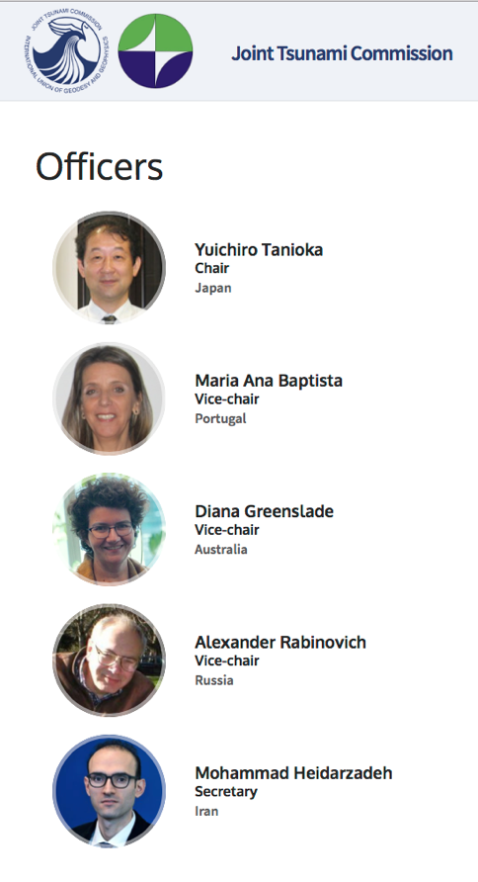
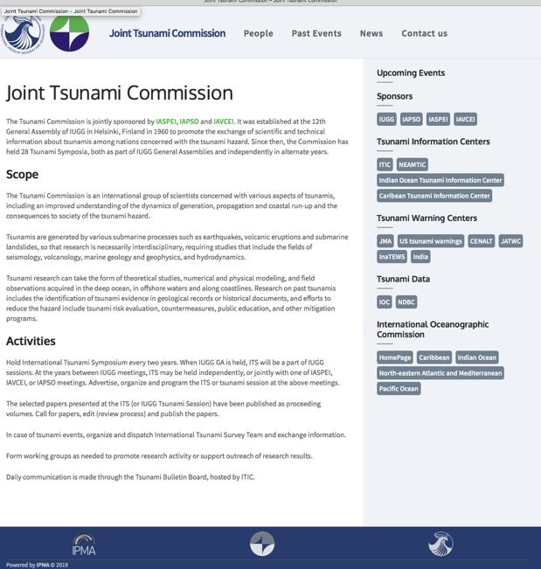
IUGG Joint Tsunami Commission
https://tsunamicommission.ipma.pt/home/
Associations: IAPSO (Oceans), IASPEI (Seismology), IAVCEI (Volcanology)
Est 12th General Assembly of IUGG, July 1960
Promote the exchange of scientific and technical information about tsunamis among nations concerned with the tsunami hazard
~70 members (Australia, Bulgaria, Canada, Chile, Costa Rica, Croatia, Estonia, France, Greece, India, Indonesia, Italy, Japan, NZ, Norway, Oman, Portugal, Turkiye, India, Russia, Singapore, UK, USA)
Last Business Meeting: 16 Jul 2023 https://tsunamicommission.ipma.pt/wp-content/uploads/2023/10/IUGG-JTC-2023-Berlin-meeting-minutes-v6-YT-3.pdf
Working Groups – enable focused efforts
  Tsunami Terminology (review IOC TS 85, Tsunami Glossary) - Dr. William Power, NZ
  Science-based Tsunami Warning (TOWS Ad Hoc TT, TS 183 - TGV) - Dr. Laura Kong, USA
  Tsunami Magnitude – Dr. Vasily Titov, USA
  GNSS Data for Tsunami Warning - Dr. Tony Song, USA
  Meteotsunami (TOWS Ad Hoc TT) – Dr. Ivica Vilibić, Crotia
  Tsunami Data –Dr. Viacheslav ‘Slava’ Gusiakov, Russia
Elected 2019

Slide 3
Meetings and Publications – 2022 - 2024
Meetings (JTC members involved in hosting and/or organizing)
EGU 2024, 2023, 2022 (14-19 April 2024, Vienna: NH5.1 on tsunami science)
AGU 2023, 2022 (San Francisco) Interdisciplinary Tsunami Science
IUGG JTC - PTWS Tsunami Symposium (ICG/PTWS-XXX, Tonga, 2023)
3rd World Conference on Meteotsunamis, 13-17 Oct 2024, Turkiye
IUGG JTC - IOC 2nd Global Tsunami Symposium, 11-14 Nov 2024, Banda Aceh
Publications – Special Volumes
Tonga Volcanic Eruption 2022: Topical collection in Pure and Applied Geophysics (PAGEOPH), 13 papers published online.
Turkey-2023 Earthquake and Tsunami: Topical collection in Pure and Applied Geophysics (PAGEOPH), 3 papers published online.

Slide 4


Scientific Committee of ODTP
Meeting at UNESCO Headquarters in Paris. Altogether, 4 meetings. Last: 25-26 January 2024
IUGG JTC members part of UN Ocean Decade Tsunami Programme Scientific Committee (SC):
Dr. Alexander Rabinovich
Christa von Hillebrandt-Andrade
François Schindelé
Dr Srinivasa Kumar Tummala (SC Chair)
Dr. Helene Hebert
Dr. Laura Kong
Dr. Maria Ana Baptista
Dr. Silvia Chacon

Slide 5

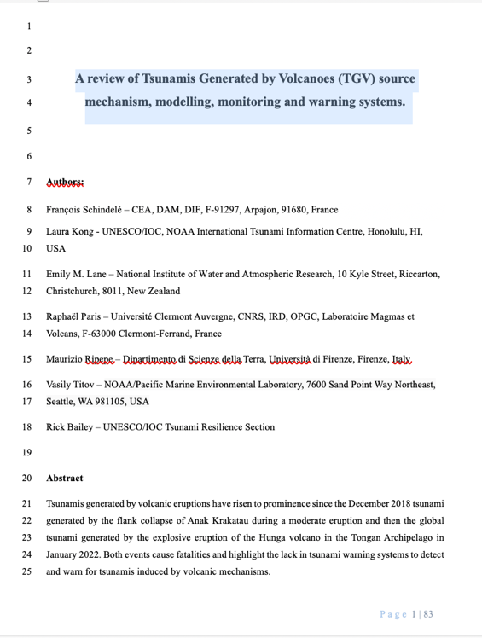
Tsunamis Generated by Volcanoes
Participation in TOWS ad hoc TT Report: Monitoring and Warning for Tsunamis Generated by Volcanoes (TS 183, 2024)
Paper submitted Jan 2024 to PAGEOPH journal: A review of Tsunamis Generated by Volcanoes (TGV) source mechanism, modelling, monitoring and warning systems
  François Schindelé
  Dr. Laura Kong
  Dr. Vasily Titov

Slide 6
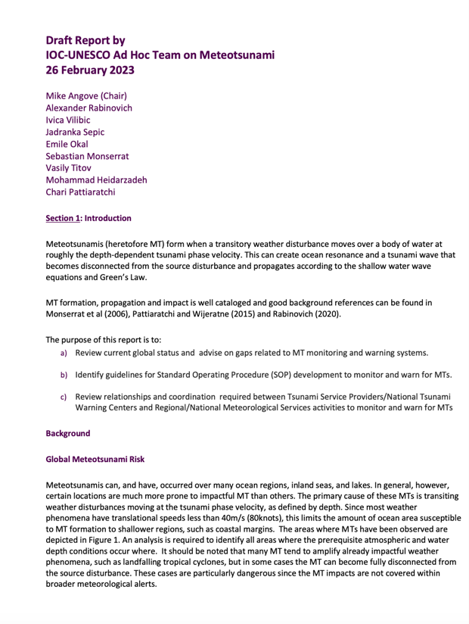

Meteo-tsunamis
Participation in TOWS ad hoc TT Report: Meteotsunamis (draft Feb 2023):
  Dr. Alexander Rabinovich
  Dr. Ivica Vilibić
TS 85 Tsunami Glossary recs
  Meteotsunami – science definition

Slide 7
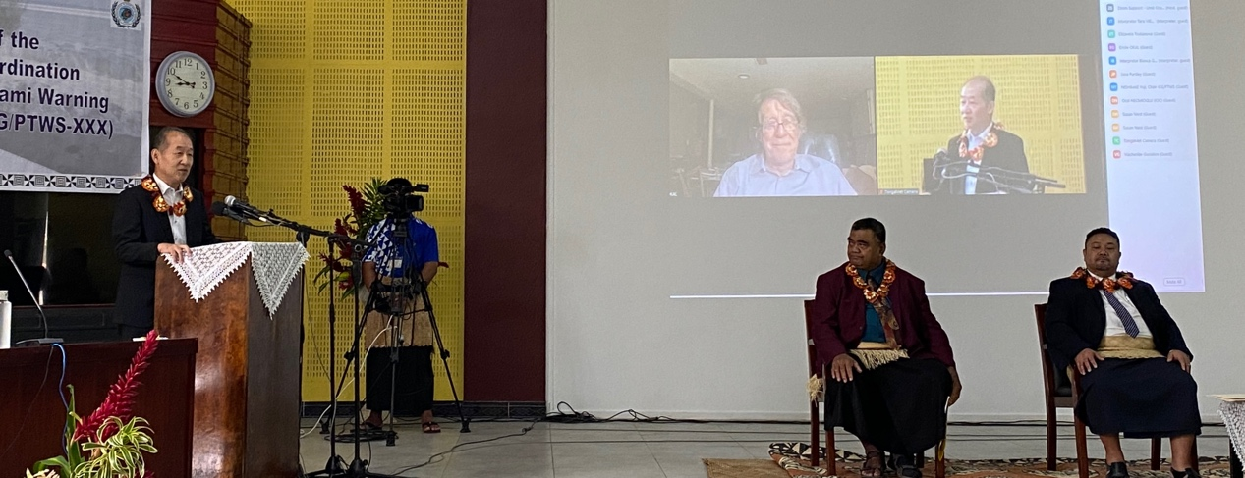
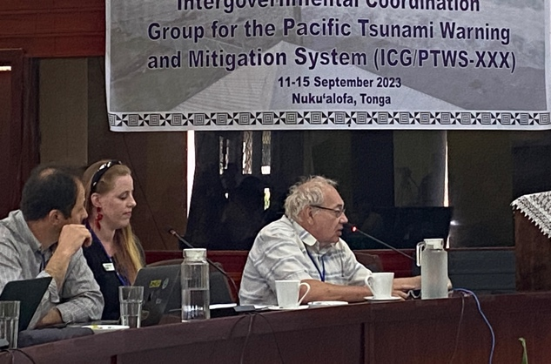
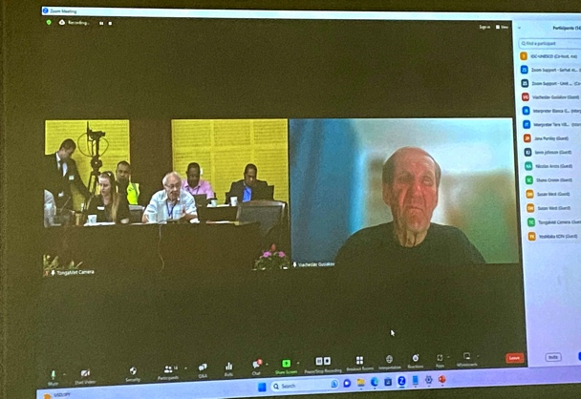
8th Joint ICG/PTWS-IUGG/JTC Technical Workshop, 11 Sept 2023
Understanding and lessons learned from the tsunami generated by the Hunga Tonga-Hunga Ha'apai volcano eruption on 15 January 2022 for development of Tsunami Warning and Mitigation System for tsunamis generated by volcanoes and other non-seismic sources
(1st Joint Workshop ICG/ITSU was 1985)
Science Committee and Speaker (remote *)
Dr. Yuchiro Tanioka
Dr. Alexander Rabinovich
Dr. Viacheslav ‘Slava’ Gusiakov *
Dr. Emile Okal *
Dr. Vasily Titov
Dr. Laura Kong

Slide 8

2nd Global Tsunami Symposium, Nov 2024
Steering Committee
Dr. Yuchiro Tanioka, IUGG-JTC
Program Organizing Committee
Dr. Srinivasa Kumar Tummala (Chair - SC-ODTP)
Dr. Laura Kong (International Tsunami Information Centre)

Slide 9
2025 International Tsunami Syposium (ITS)
ITS – every 2 years – tsunami research, incl on disaster prevention
ITS 2023 – Bali, Indonesia
ITS 2021 – Sendai, Japan
ITS 2025 will be in Hyderabad, India
At the JTC Business Meeting (July 2023), Dr Srinivasa Kumar Tummala (Director, Indian National Centre for Ocean Information Service, INCOIS), made a proposal to host ITS 2025 in Hyderabad, India. The JTC accepted India INCOIS’s proposal.

Slide 10
International Union of Geodesy and Geophysics (IUGG)
2024 update
TOWS WG, 22-23 Feb 2024, Agenda 2.2, Non-UN Bodies
prepared by
Laura Kong (ITIC), Maria Ana Baptista (Vice-Chair), Yuichiro Tanioka (Chair)

