Slide 1

Making Cities Resilient
And Tsunami Ready
TTDMP – TOWS Meeting
19-23 February 2024
IRIDES, Tohoku - Sendai
Ardito M KODIJAT
UNESCO-IOC Indian Ocean Tsunami Information Centre
National Professional Officer DRR (SC/IOC)
Disaster Risk Reduction and Tsunami Information Unit
UNESCO Office Jakarta
a.kodijat@unesco.org

Slide 2
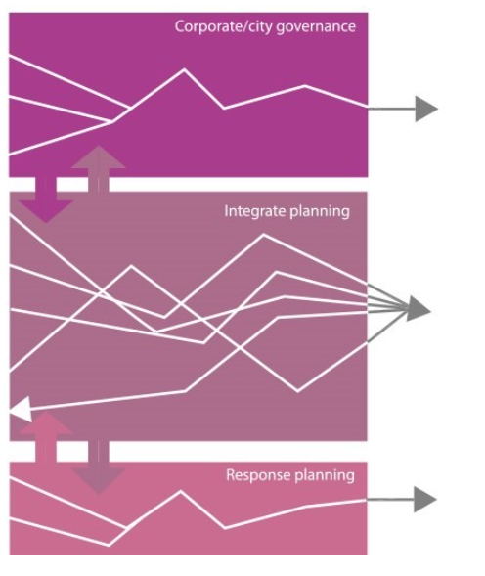
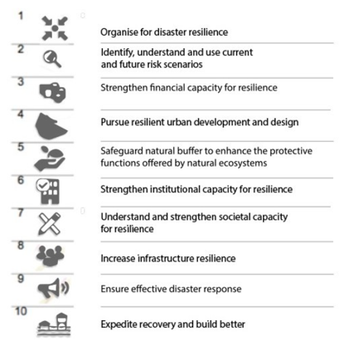
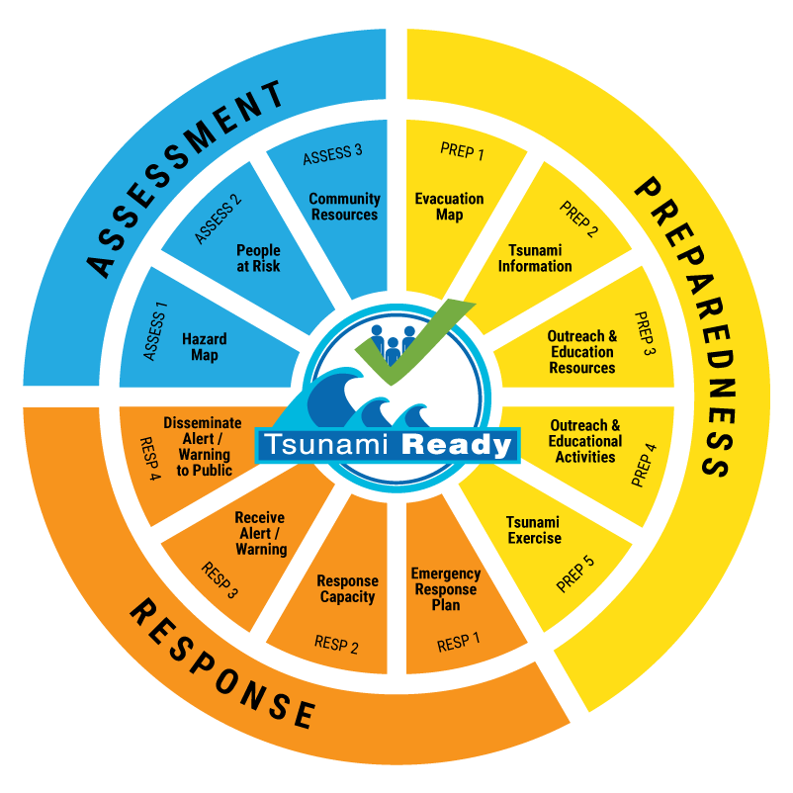

Making Cities Resilient & TR
The Ten Essentials for Making Cities Resilient and Tsunami Ready

Slide 3
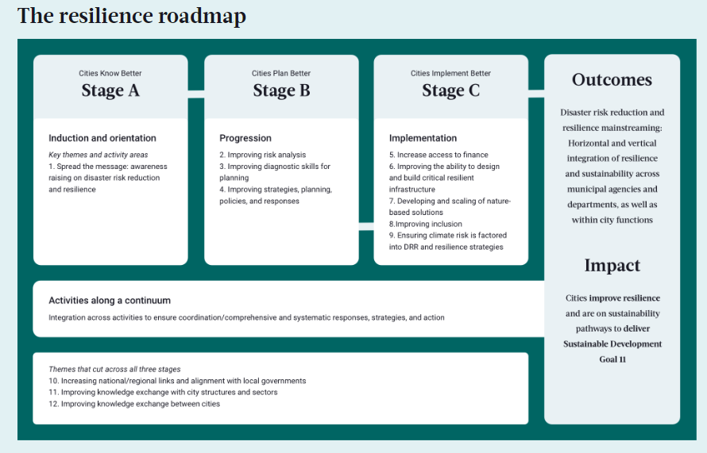
Making Cities Resilient
Community Capacity Development
12 indicator Tsunami Ready

Slide 4
Making Cities Resilient & TR
Stage A - Cities Know Better
Enhancing cities’ understanding on risk reduction and resilience. Cities are committed to move along the resilience pathway to develop and implement DRR and resilience strategy by raising awareness around DRR and resilience and bringing relevant city actors and the public on board with the city’s plans for DRR and resilience.
Assessment Indicator 1: Tsunami hazard zones are mapped and designated.
Assessment Indicator 2: The number of people at risk in the tsunami hazard zone is estimated
Assessment Indicator 3: Economic, infrastructural, political, and social resources are identified

Slide 5
Making Cities Resilient & TR
Preparedness Indicator 1: Easily understood tsunami evacuation maps are approved.
Preparedness Indicator 2: Tsunami information including signage is publicly displayed.
Preparedness Indicator 3: Outreach and public awareness and education resources are available and distributed.
Preparedness Indicator 4: Outreach or educational activities are held at least 3 times a year.
Preparedness Indicator 5: A community tsunami exercise is conducted at least every two years.
Response Indicator 1: A community tsunami emergency response plan is approved.
Response Indicator 2: The capacity to manage emergency response operations during a tsunami is in place.
Response Indicator 3: Redundant and reliable means to timely receive 24-hour official tsunami alerts are in place.
Response Indicator 4: Redundant and reliable means to timely disseminate 24-hour official tsunami alerts to the public are in place.
Stage B - Cities Plan Better
Cities may have had some early successes and momentum towards achieving DRR, sustainability and resilience improvements, and have some form of strategy to address disasters but may not yet incorporate risk reduction or preventive measures. The cities must demonstrate the commitment to move towards development or refinement of a DRR and resilience strategy and ensure development plans are risk-informed.

Slide 6
Making Cities Resilient & TR
Stage C - Cities Implement Better
Supporting cities in the implementation of risk reduction and resilience actions. Cities in this stage have a relatively robust DRR, resilience and sustainability plan in place and may be in the early stages of implementation or already working towards mainstreaming the DRR/resilience strategy and activities across its governments’ structure. These cities will be initially focused on improving their cross-sector governance structure, increasing their ability to access finance and to design and deliver resilient infrastructure, developing nature-based solutions and improving inclusion, and must demonstrate commitment to implement and mainstream DRR and resilience across all sectors and to share experiences with others. Cities certified with ISO37123 - Sustainable cities and communities will automatically join this stage.
Maintain and Sustain Community Tsunami Ready

Slide 7
Summary
Linking TR and MCR
Opens the possibilities to capitalize on the cities’ effort in making cities resilience.
Support to increase the visibility of Tsunami Ready
UNESCO-IOC Tsunami Ready Recognized Community is an example of good practice in the Making Cities Resilience

Slide 8
Making Cities Resilient & TR
Definition of City
National
State /
Territories
Municipals/ City / Districts
Sub-Districts
Villages
Neighbourhood
Tsunami Ready Community
Making Cities Resilient
(?)

Slide 9
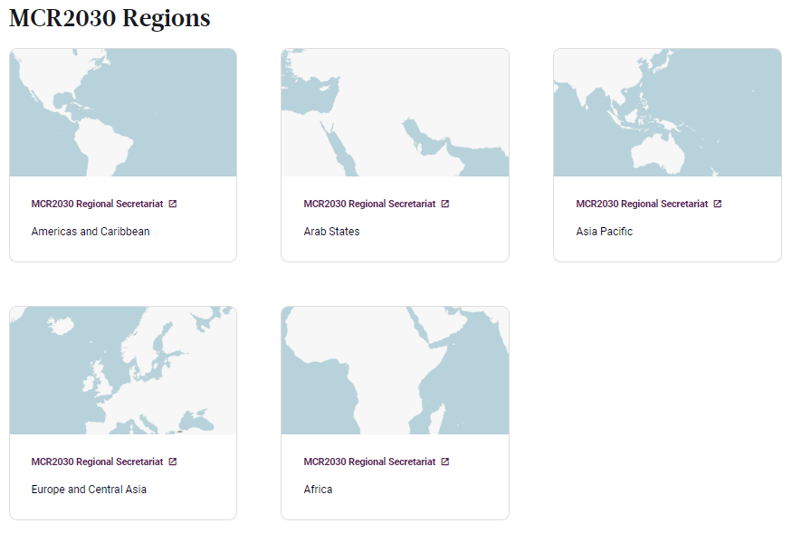
Making Cities Resilient & TR
MCR Regions and ICGs
ICG/PTWS
ICG/CARIBE-EWS
ICG/NEAMTWS
ICG/IOTWMS

Slide 10
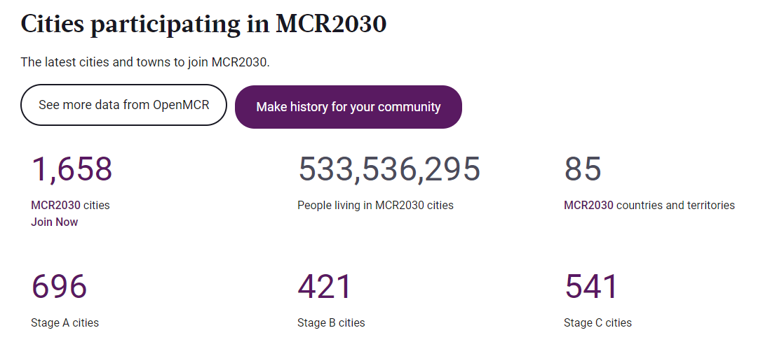
Making Cities Resilient & TR

Slide 11
Recommendation
ICGs and TICs to advocate member states implementing Tsunami Ready to link with MCR.
To encourage the National Tsunami Ready Board of Member States to include national agency work on MCR to be member of join the NTRB meeting.
ICGs and TICs to promote Tsunami Ready in MCR events
i.e. hold Tsunami Ready workshop as MCR events in the regions:
MCR Asia Pacific Region: ICG/IOTWMS and ICG/PTWS
MCR Africa Region: ICG/PTWS and ICG/NEAMTWS

Slide 12







Thank you
Follow us
iotic.ioc-unesco.org
www.iotsunami.org
facebook.com/iotsunami
Ardito M. KODIJAT
a.kodijat@unesco.org
iotsunami
@iotsunami
UNESCO-IOC Indian Ocean Tsunami Information Centre
IOTIC-BMKG Programme Office
Disaster Risk Reduction and Tsunami Information Unit
UNESCO Jakarta Office
youtube.com/iotsunami
iotic@unesco.org

