Slide 1

Tsunami Ready Implementation Status in the Caribbean and Adjacent Regions
TOWS TT DMP, 20 Feb 2024, Sendai
Agenda Item 4
Alison Brome (CTIC) and Silvia Chacon-Barrantes (UNA & Chair, WG4)

Slide 2
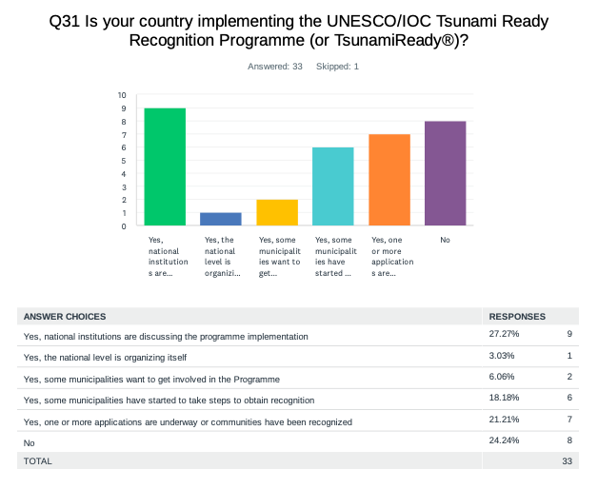
Evaluation Form CW – Tsunami Ready
According to Member States and Territories, there are about 66 communities recognized for TsunamiReady® or Tsunami Ready.

Slide 3
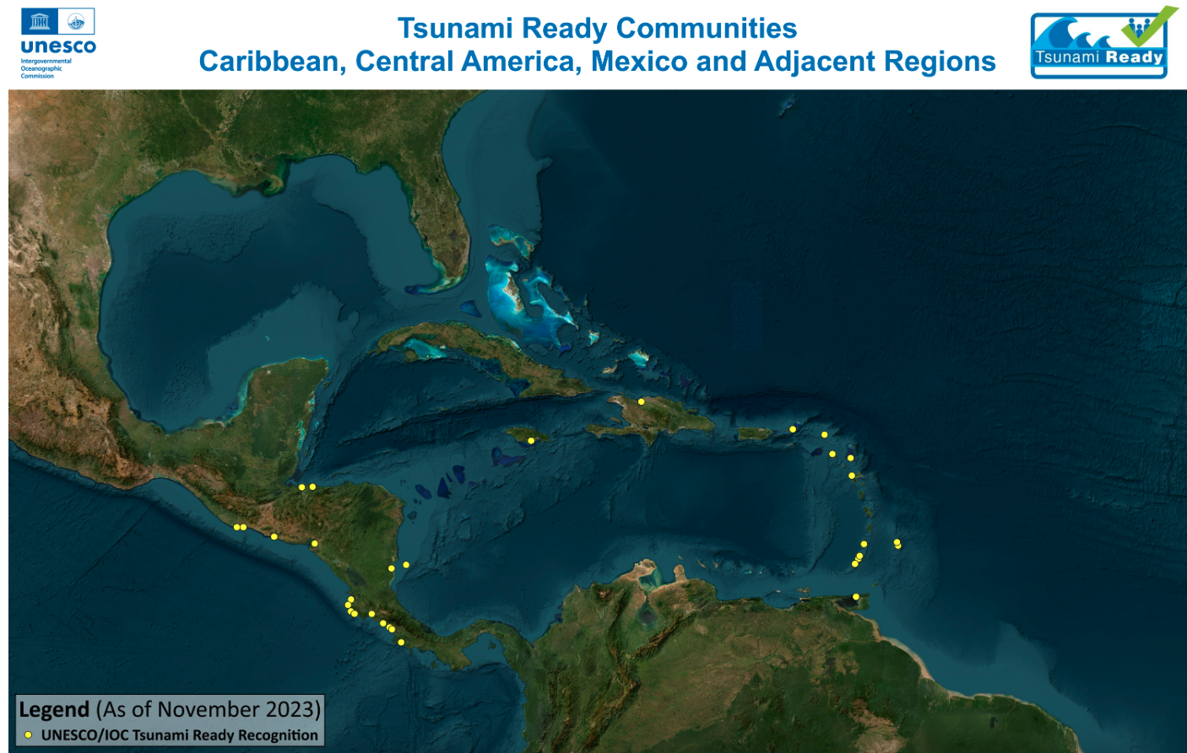
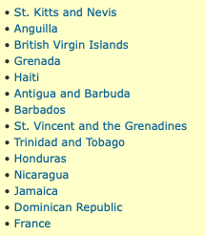

Slide 4
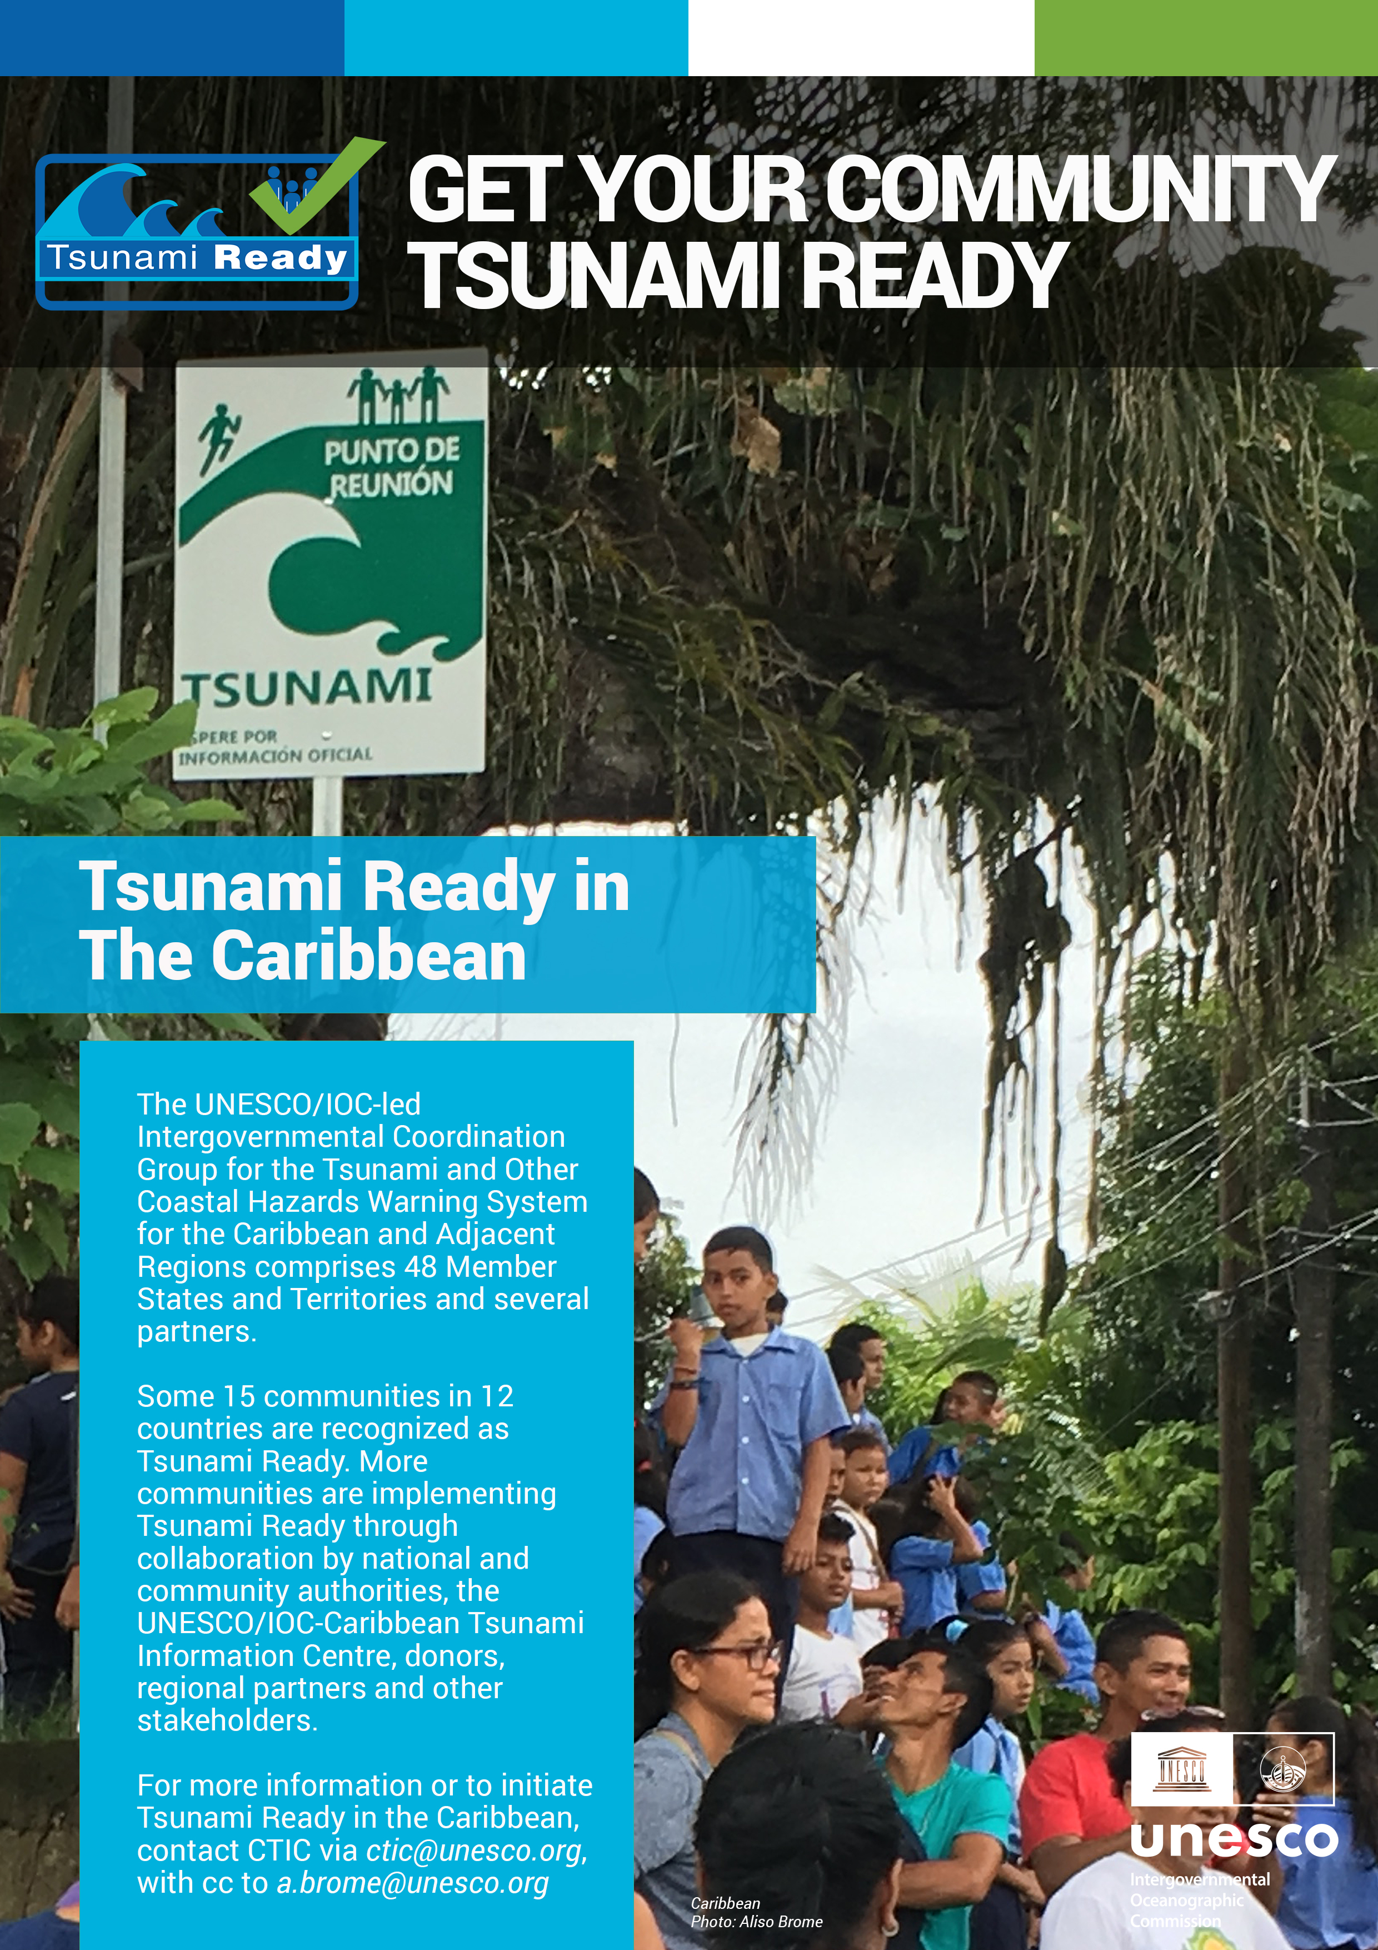
UNESCO/IOC Tsunami Ready Recognition Programme
18 Tsunami Recognized Communities in 13 Member States/Territories
12 Communities in nomination/renewal process

Slide 5
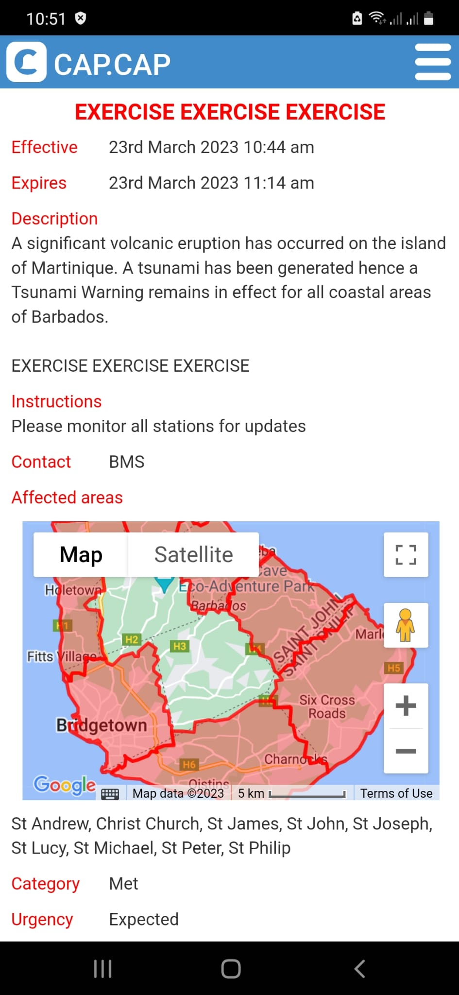
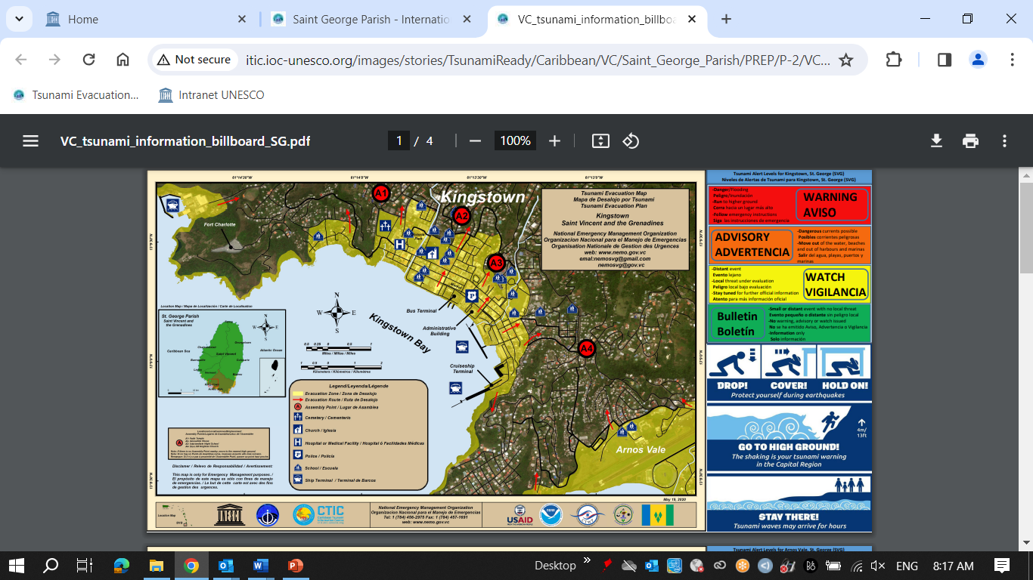
UNESCO/IOC Tsunami Ready Communities 2023
http://itic.ioc-unesco.org/index.php?option=com_content&view=category&layout=blog&id=2280&Itemid=2806
Deshaies, Guadeloupe, FRANCE: 01 June 2023, Self-funded
Saint George Parish, ST. VINCENT AND THE GRENADINES: 25 August 2023, ITIC-CAR USAID/BHA
Christ Church West, BARBADOS: 04 September 2023, ITIC-CAR USAID/BHA

Slide 6
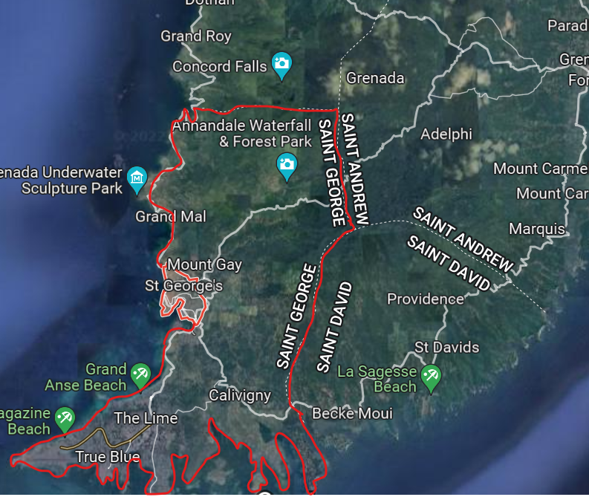
UNESCO/IOC CARIBE EWS Project, Grenada
Project Name: Strengthening Capacities for Tsunami Early Warning in Grenada
Donor: Government of Australia, Port of Spain Direct Aid Program & UNESCO/IOC
Project Scope: Public Awareness and Education for Saint George Parish, Tsunami Ready nomination for St. George’s City to Point Salines
Billboard signs to be installed & EOP under development for testing in CARIBE WAVE 2024
TR ceremony scheduled for week of 25 March 2024

Slide 7
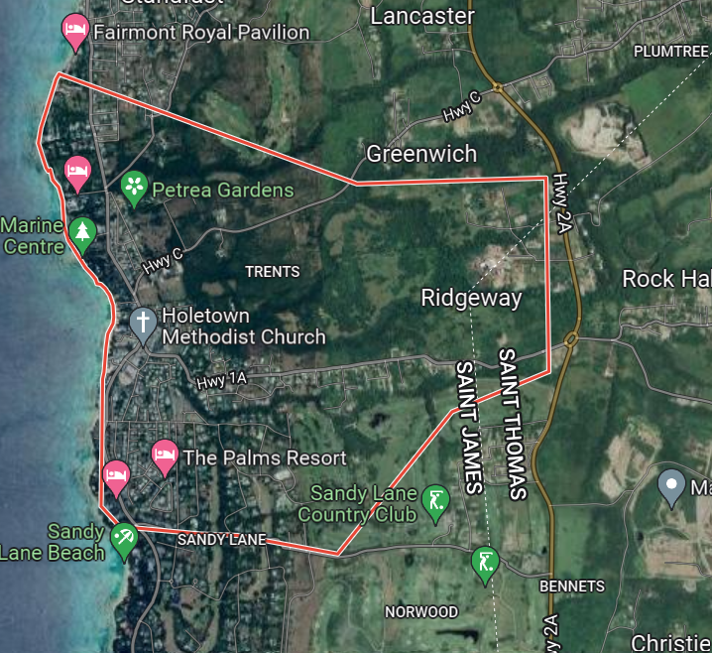
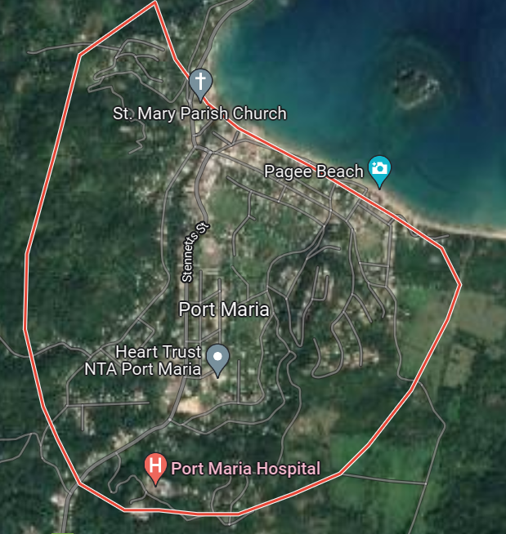
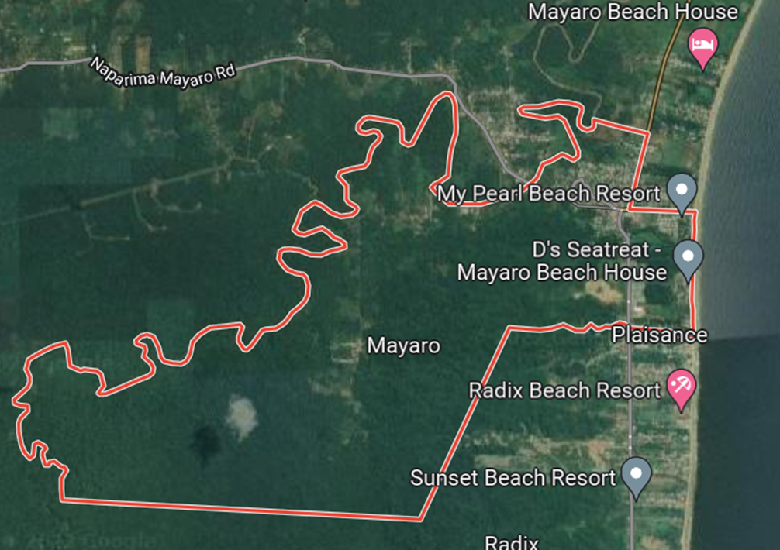
UNESCO/IOC CARIBE EWS NORAD Project Communities
Porters to Holders Hill, St. James, Barbados
Port Maria, St. Mary, Jamaica
Mayora Village, Mayaro–Rio Claro County, Trinidad and Tobago
Project Name: Towards a Safer Ocean in the Caribbean through Tsunami Ready Communities
Donor: Norwegian Agency for Development Cooperation (NORAD)
Funding: NORAD: 170,000, UNESCO: 30,000
Duration: January – September 2022, extended to July 2023, extension under consideration
Evacuation map completed for Barbados, National Consultants hired, PAE undertaken. EOP drafted for all communities
Procurement of signage and equipment, testing and community trainings to be conducted for all communities, inundation and evacuation mapping for Trinidad & Tobago and Jamaica to be undertaken
Project significantly challenged by fund transfer mechanism and to some extent other country priorities

Slide 8
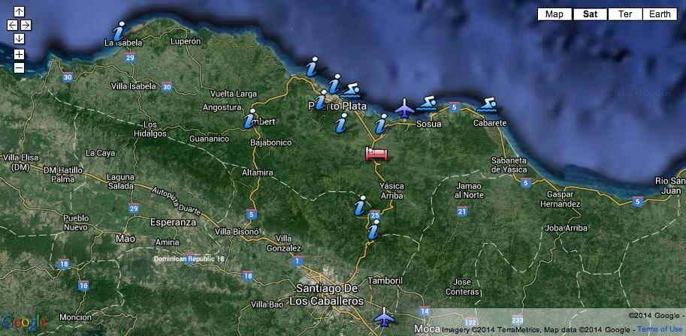
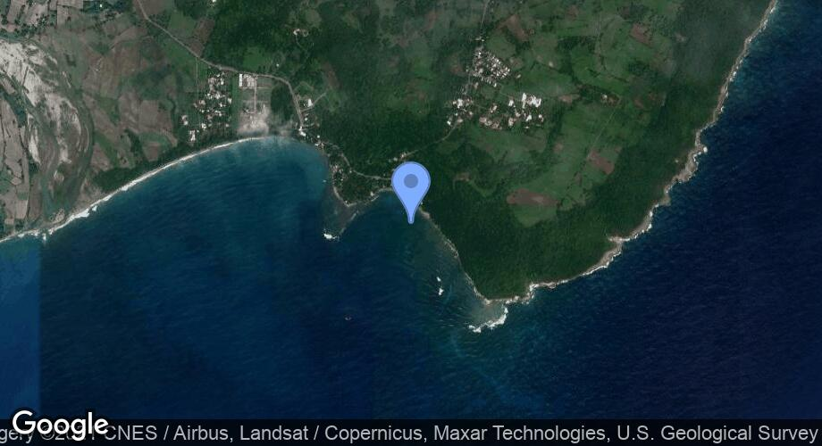
UNESCO/IOC CARIBE EWS Project, Dominican Republic
Puerto Plata and Sabana Grande de Palenque, Dominican Republic
Puerto Plata
Sabana Grande de Palenque
Tsunami Ready programme advanced in both communities through previous project funding
Letter of support received from Municipality of Palenque
UNESCO/IOC to resume discussions with national and community authorities to finalise requirements including mapping, re-installation of signage etc.

Slide 9
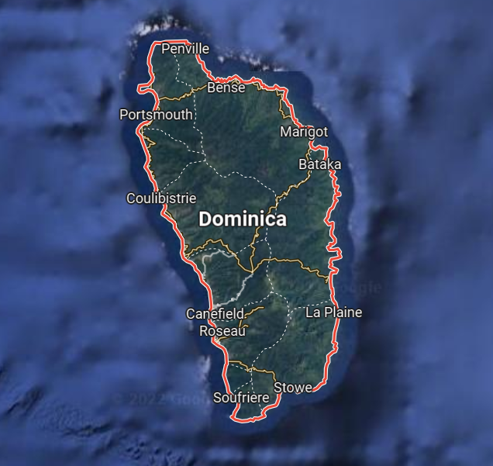
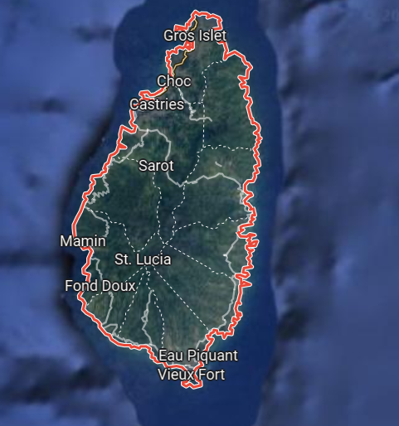
ITIC-CAR USAID/BHA Project Communities 2022 - 2023
Lead Implementing Agency: ITIC CAR
Laborie, Saint Lucia
Portsmouth, Dominica
Dominica – Portsmouth Council submitted its application to the TNC with all documentation in December. 2023, signage installation only remaining requirement to be fulfilled prior to submission of application to IOC
Saint Lucia – signage installation is only remaining requirement to be fulfilled prior to preparation of documentation and submission of application to IOC

Slide 10
ITIC-CAR USAID/BHA Project Communities 2023 - 2024
Lead Implementing Agency: ITIC CAR
ANGUILLA (TERRITORY-WIDE RENEWAL):
Project Launch – week of 11 March 2024
Tsunami Ready Committee established
Tsunami hazard assessment/modeling – discussions re: access and data reconfiguration etc. underway
PAE materials initiated
ANTIGUA AND BARBUDA (BARBUDA):
CTIC convened discussions with national authorities 12-14 December 2023
Barbuda proposed as TR community
ITIC & National Authorities initiate discussion re: data, modelling
HONDURAS, RENEWAL (OMOA, TORNABE/TELA):
Signage, updated evacuation map, SOPs required
Identification and collection of date and resources ongoing
TR documentation and resources for Tornabe/Tela to be provided by IOC

Slide 11
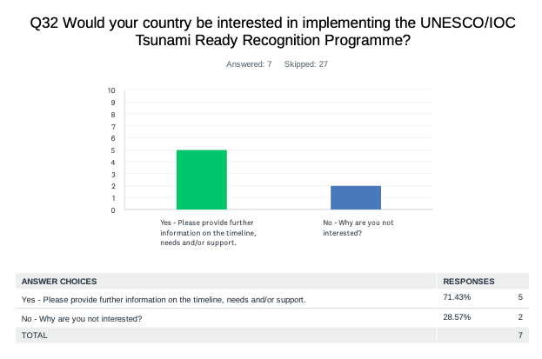
Evaluation Form CW – Tsunami Ready
The results indicated that 71% of the countries are interested in implementing Tsunami Ready, with 87 as total number of target communities to be recognized (this is a much lower number than previous years).
Countries Interested in Implementing TR
Aruba
Colombia
Cuba
Honduras
Sint Maarten

Slide 12
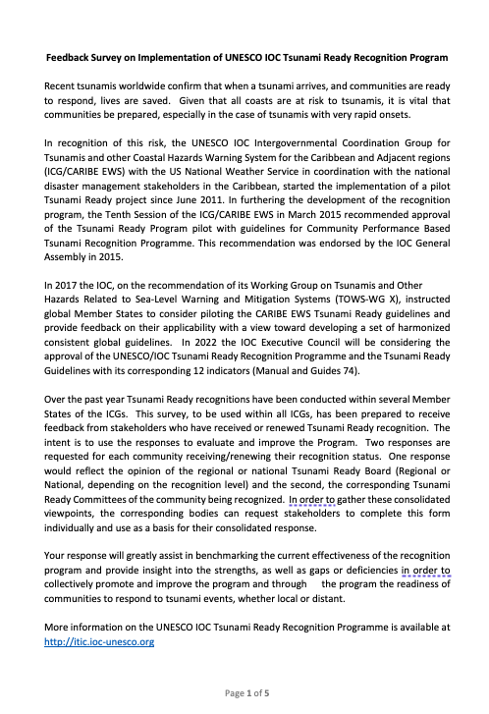
TR Evaluation Survey
The TR-TT prepared an Evaluation Survey
For TR Recognized Communities
Approved in ICG-XVI
We recommend:
  The introduction at the other ICGs
  The translation to SP &FR
  Administration by TRS/IOC/UNESCO

Slide 13

Questions overview
Effectiveness of the guidelines
Recommendations of additional indicators
Effectiveness of TR as part of school curricula
Effectiveness of TR in developing or testing SOPs
Effectiveness of TR verification process
Effectiveness of TR guidelines in preparing the community to respond appropriately
Level of difficulty in implementing each indicator
Helpfulness of TR guidelines in preparing for other hazards
Helpfulness of TR guidelines for improving design of MHEWS
Would you recommend it for other communities?

Slide 14

Thanks for your attention
a.brome@unesco.org silvia.chacon.barrantes@una.ac.cr
#CARIBEWAVE #TSUNAMIREADY

