Slide 1
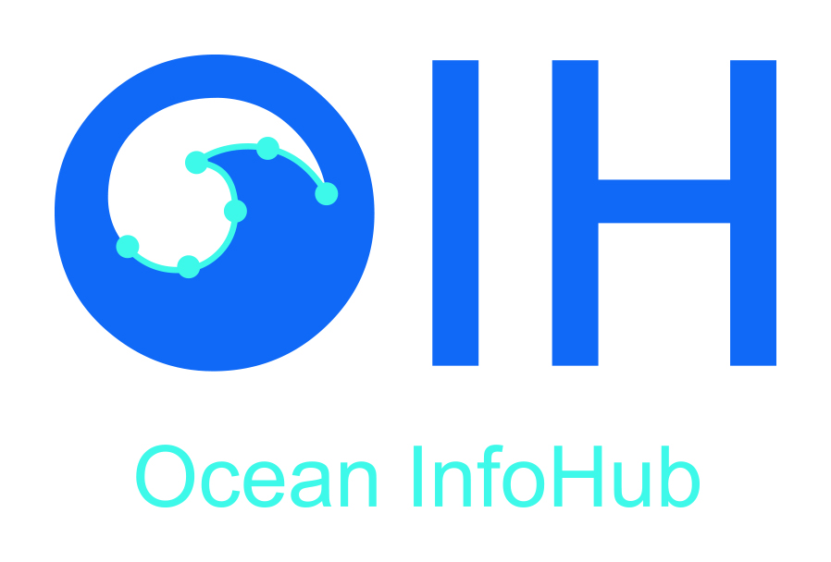
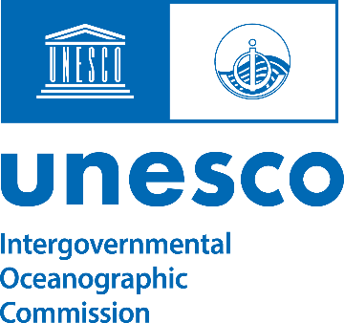
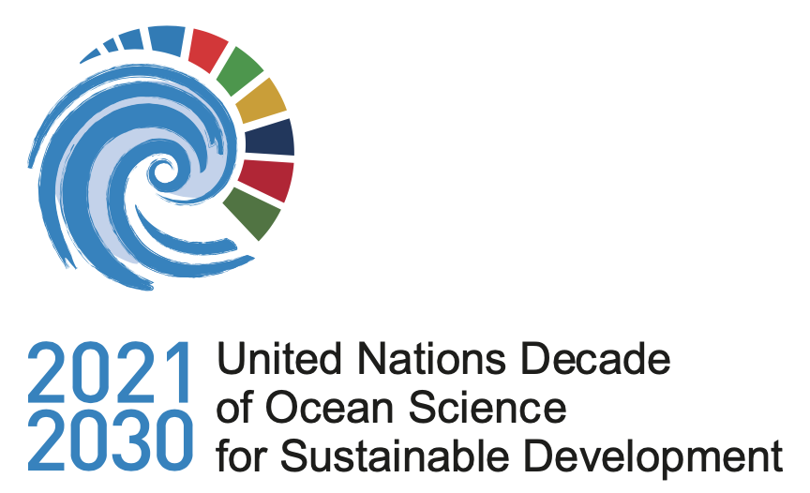
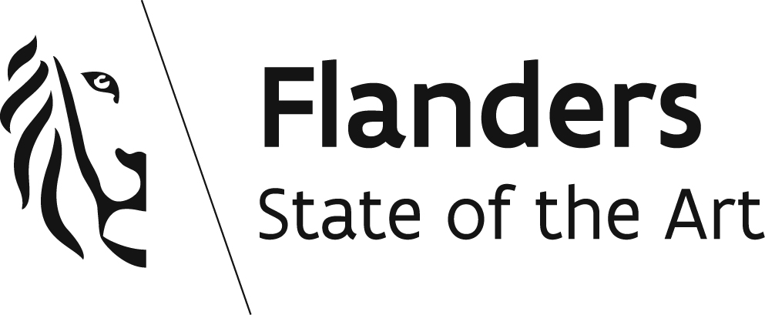
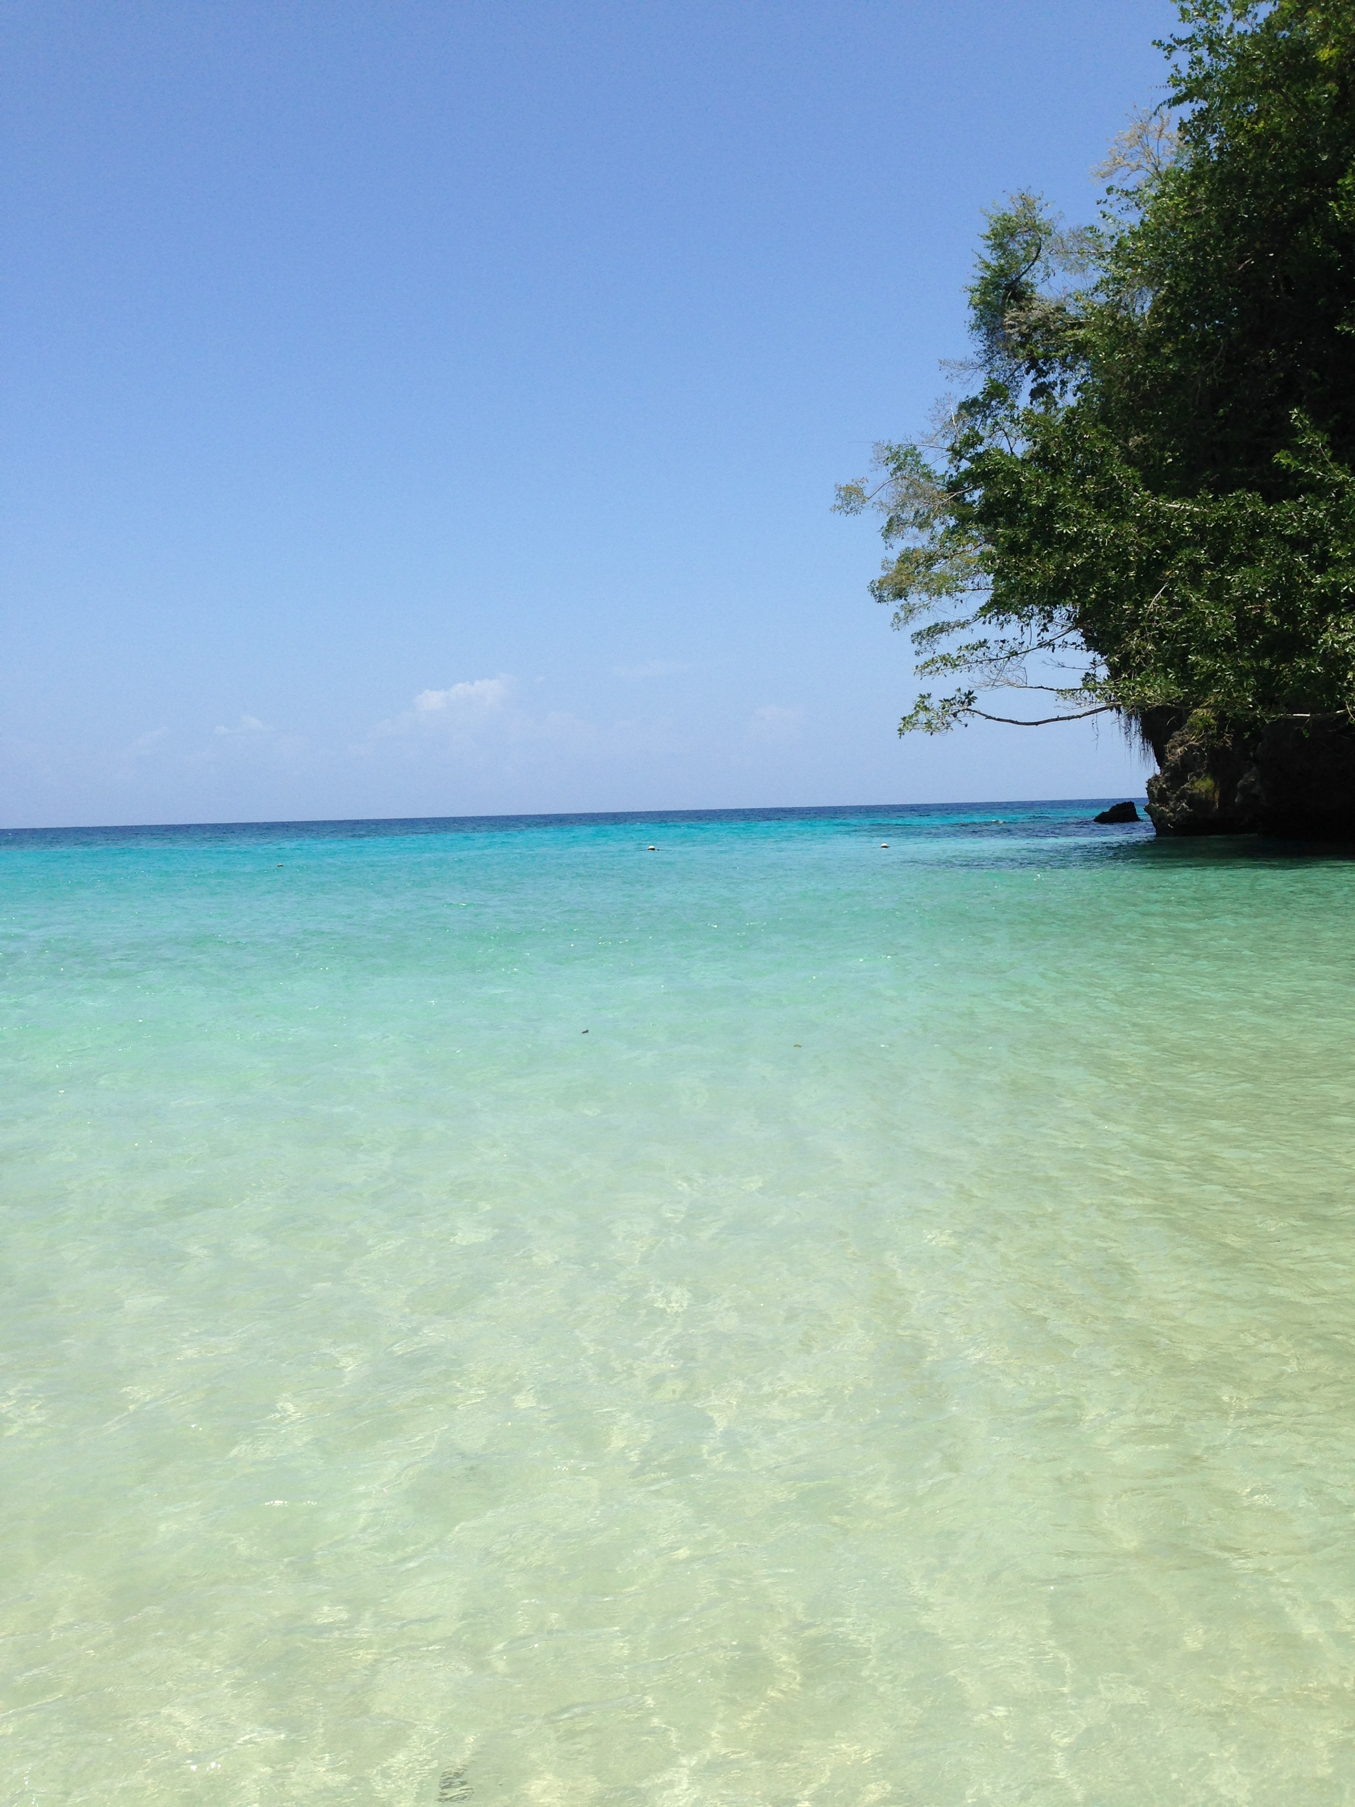
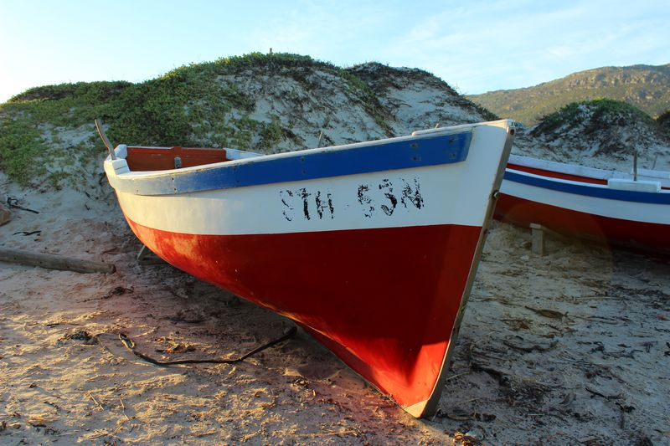
The IOC/UNESCO Ocean InfoHub Project
GE-CD-V Meeting
27 to 29 February, Paris
Lucy Scott
L.Scott@unesco.org

Slide 2
History and background
The First Session of the IOC Group of Experts on Capacity Development was held in Paris between 21-23 March 2018. The Task Team on the implementation of a TMT/CHM "portal" and related activities was convened and held its first meeting in March 2019.
The meeting discussed the results of a survey (on CD needs assessment and on the clearing house mechanism) which had been launched on 5 October 2018 until 14 February 2019.
It focused on the three regional sub-commissions (IOCAFRICA, IOCARIBE, WESTPAC) and regional committee IOCIDIO, including SIDS.

Slide 3
History and background
All regions reported that such a mechanism would be instrumental to the further development of ocean science capacity in the countries.
All regions expressed preference for an online central portal integrating the data and information harvested from regional/sectoral CHM portals.
The respondents identified the need for a series of nodes rather than one global central node but using technology that allows interoperability between the nodes.
The majority of respondents had recommended a “A hybrid model: online central portal with deep-links to regional/sectoral CHM portals”.

Slide 4
History and background
Based on this, INVEMAR (Colombia) developed a pilot CHM for the Latin America and Caribbean region, in the context of the Caribbean Marine Atlas (CMA-II) project.
The pilot Clearing-House Mechanism LAC (http://portete.invemar.org.co/chm) is a hybrid model, with a centralized portal that provides access to information sources identified by the users as most relevant (Databases on Training and Education resources, List of experts, Research vessels,..) and integrated from a number of existing web sources developed and maintained under IOC (OceanExpert, Ocean Teacher Global Academy, ODISCat)

Slide 5
History and background
From these and several other preparatory activities, the Ocean InfoHub (OIH) Project was designed and approved and was implemented, starting in April 2020, funded by the Government of Flanders (Kingdom of Belgium) .

Slide 6
Challenges identified
A proliferation of online sources of data and information (ODISCat currently contains over 3100 records https://catalogue.odis.org/)
A diversity of online data systems
Member states may have very valuable and useful resources, but they are difficult to find
Global data and information resources have useful content, but local users might not know about them
Challenges of trust in some regions

Slide 7
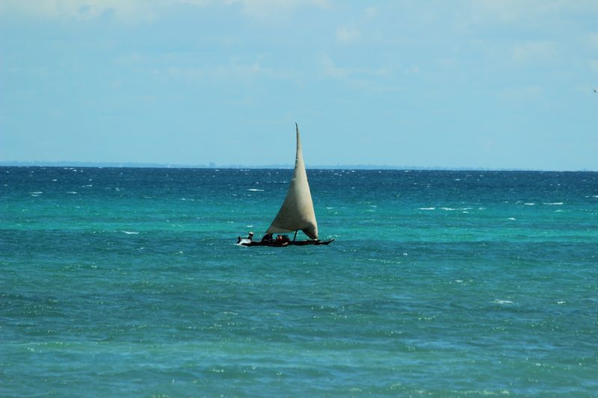
Objectives
Respond to the global challenges of understanding and managing marine ecosystems in a rapidly changing world
Develop interoperability between existing information systems, thus improving the flow of information to end users.
Improve access to marine and coastal data for multiple purposes, but especially to inform sustainable management and informed policy development.
Facilitate equitable access to Ocean information and knowledge products
Connect independent digital initiatives to form a diverse, but interoperable and inclusive, Ocean Data and Information System.
Our overall aim was proof of concept.

Slide 8
Approach
  By harnessing digital revolutions, and facilitating the sharing of new technologies between countries and institutions.
  Fast-track new technologies
  Exchange of technologies not N -> S, but a true co-design process between partners, brokered by the the OIH Project

Slide 9
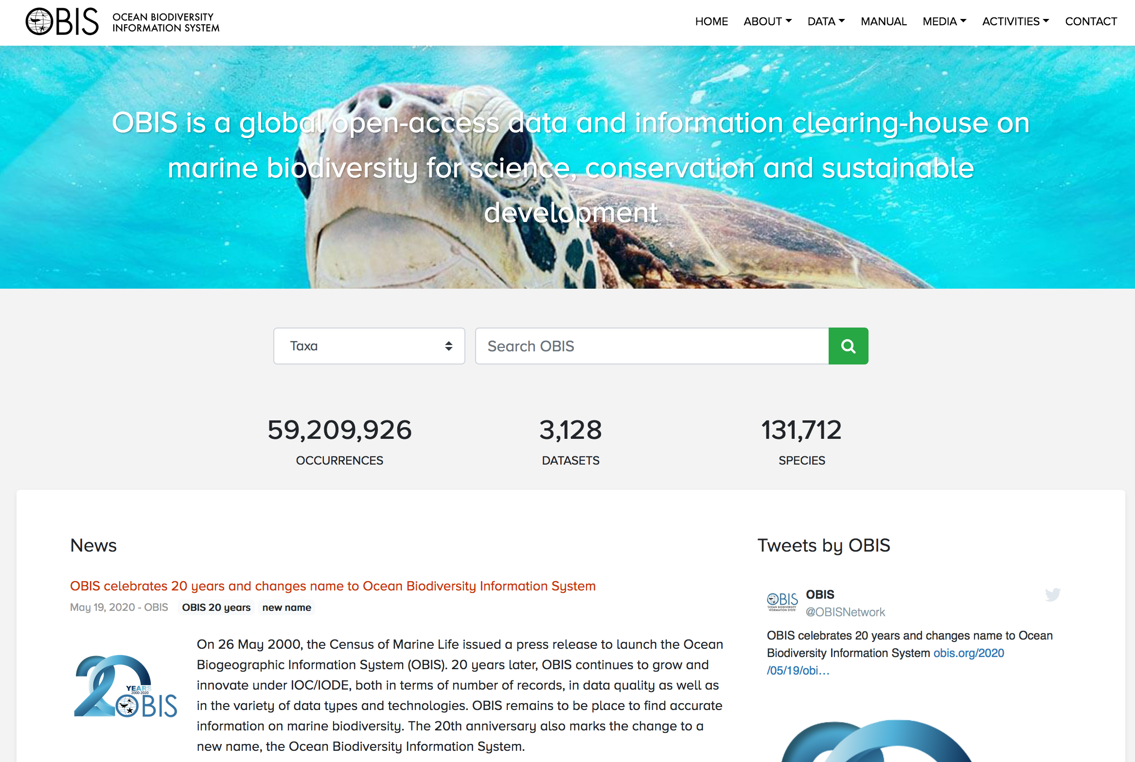
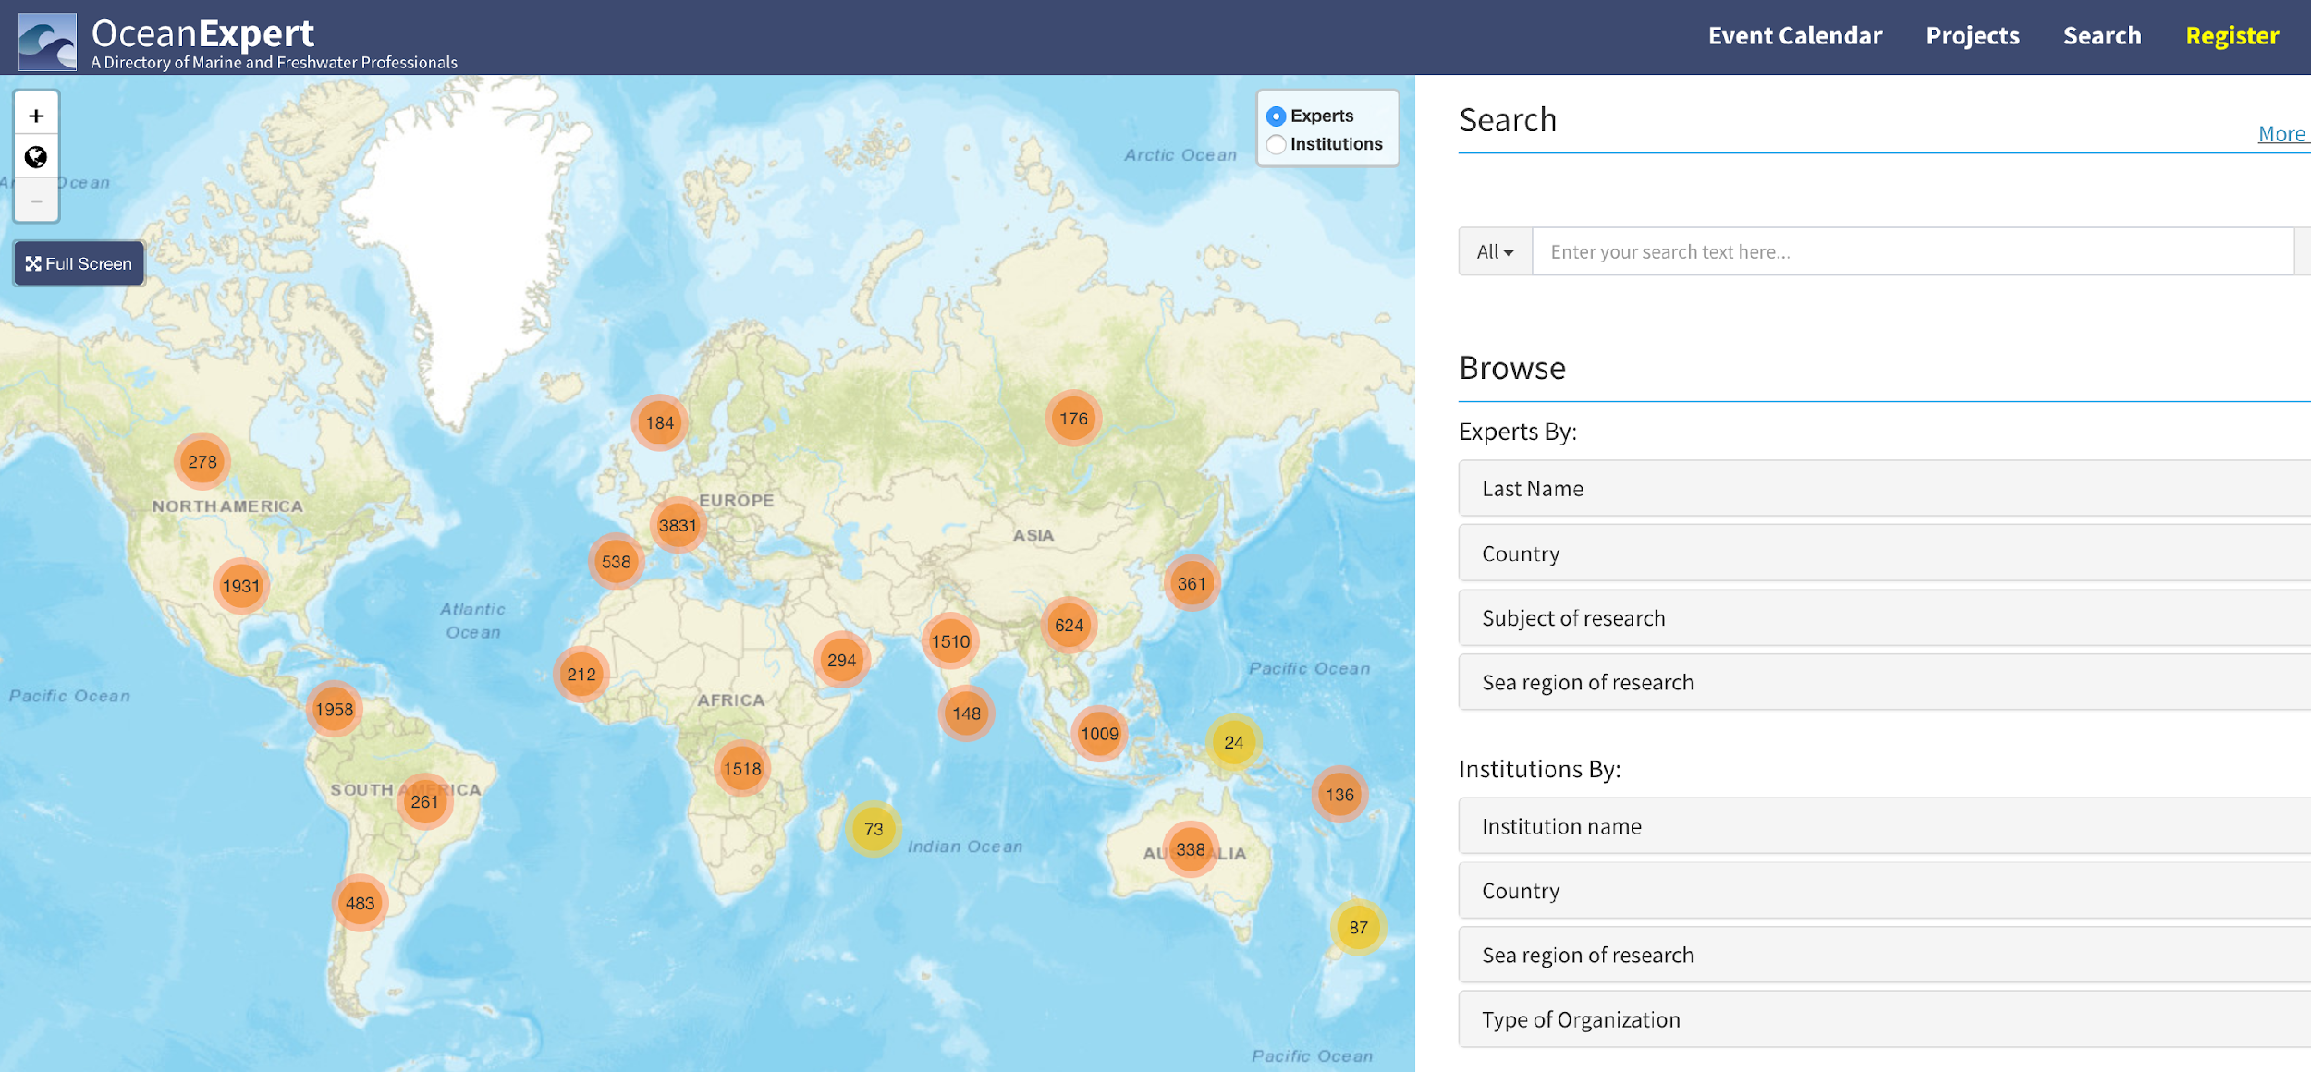
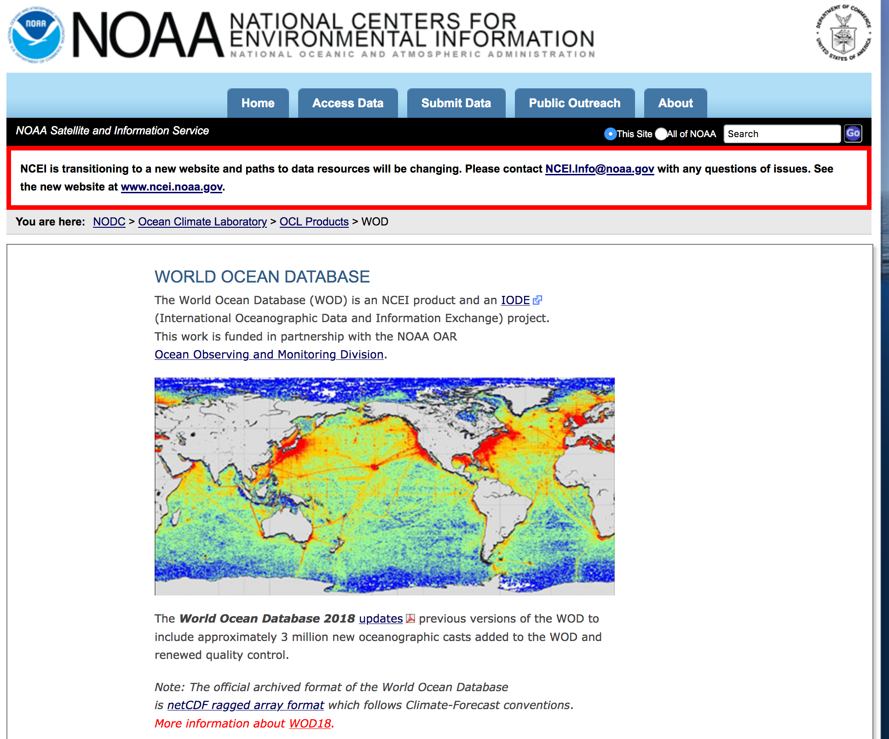
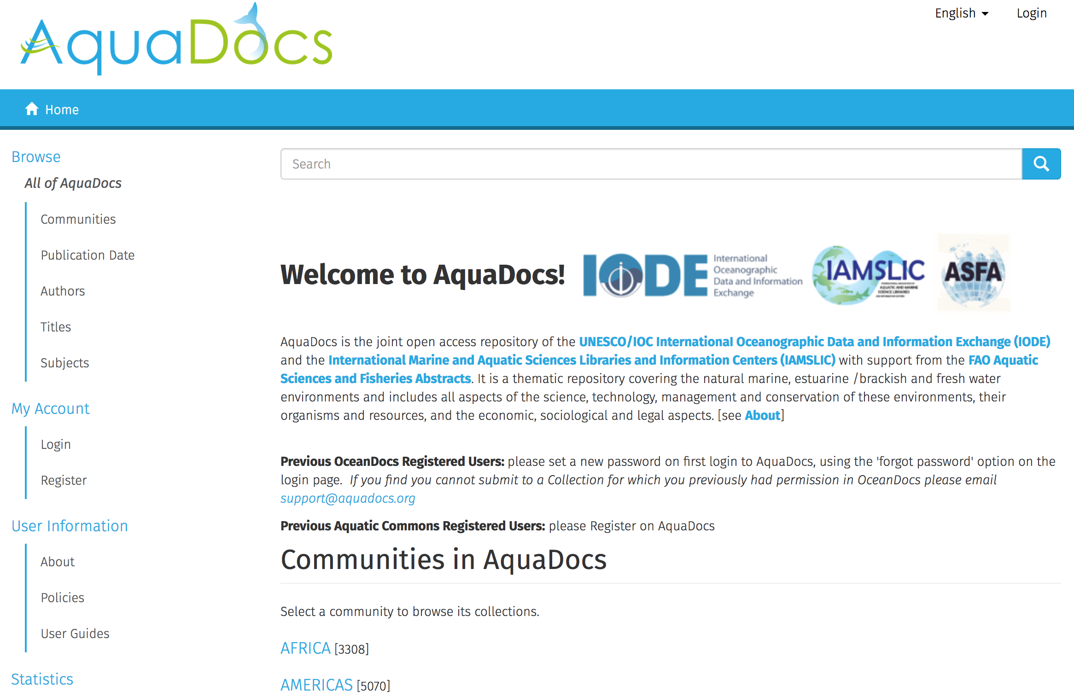
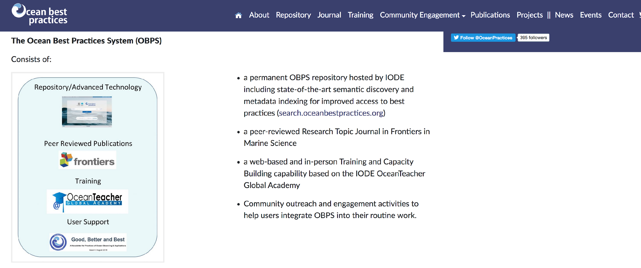
Approach
  We worked with a number of founding partners including the University of Ghent, WIOMSA, SPREP, SPC, EUROCEAN, EMODnet and other sister projects within IODE, including:
  Ocean and Data information system Catalogue of data sources (ODISCAT)
  OceanExpert : People, institutions and events
  AquaDocs : Documents and Publications
  The GOOS/IODE Ocean Best Practices System (OBPS)
  The Ocean Biodiversity Information System (OBIS)
  The World Ocean Database (WOD)

Slide 10
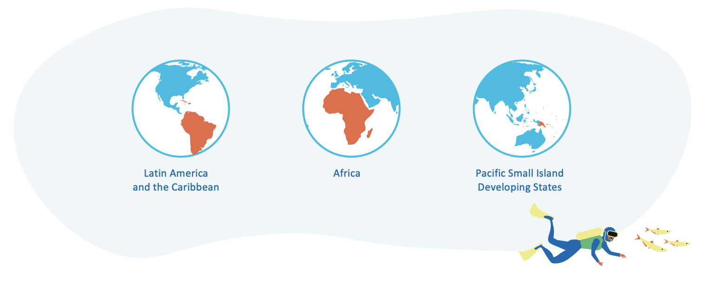
Three pilot regions
Approach: Three pilot regions
We also worked initially within three pilot regions

Slide 11
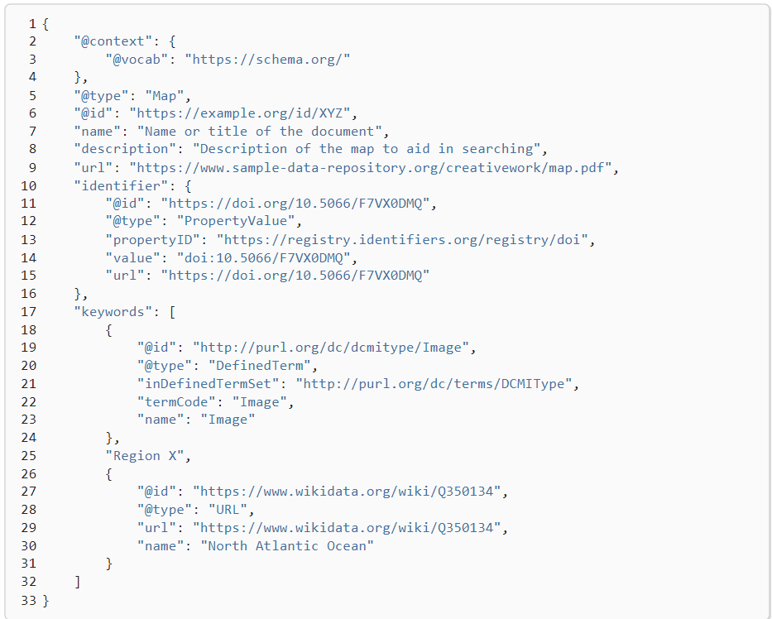
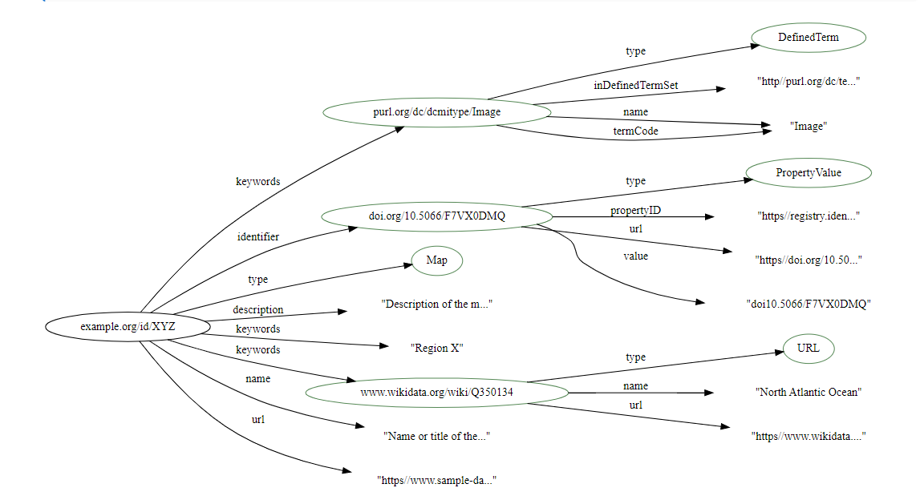
We developed: 1. The ODIS architecture
The Ocean Data and Information System links nodes through a JSON-LD+schema.org based, decentralized interoperability architecture
(ODIS-Architecture).
Partners aligned to ODIS-Arch are also discoverable by Google, Microsoft, Yahoo, and others.
Partners retain their own data and complete control over what they share through their node or nodes.

Slide 12
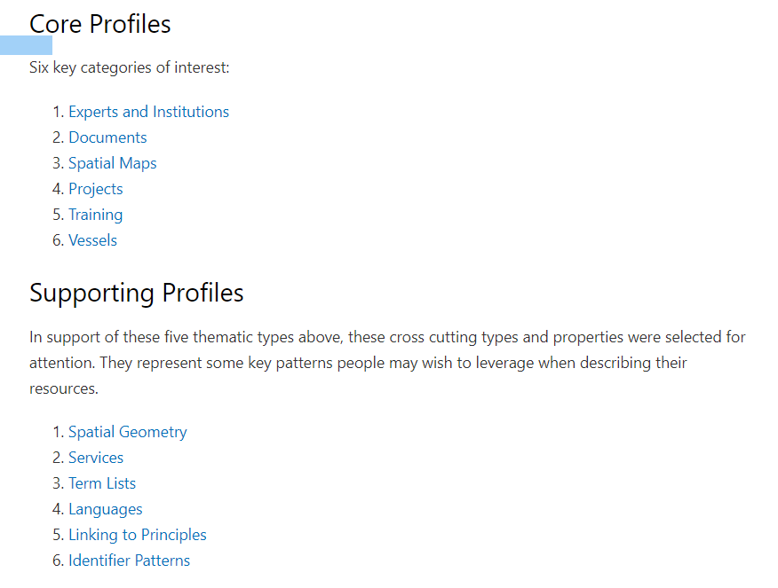
We developed: 1. The ODIS architecture
As with natural ecosystems, ODIS will be resilient to the gain or loss of parts, and accommodate a high diversity of products and services, while maintaining its core functions.
The data are labelled according to different patterns or specifications, created based on the focal areas of the IOC and requests from its community of users (e.g. for sensors and instrumentation, SDG indicators, EOVs).
It was an important objective, in working with existing systems, that the barriers to joining be LOW and that we should not require re-design of any existing systems.
The project’s open-source philosophy of open and transparent documentation promotes reuse and adaptation by any institution, whether or not they are an OIH project partner. This will build resilience and sustainability of ODIS as it becomes adopted and implemented by more partners beyond the life of the OIH Project.
ODIS-arch Documentation https://book.oceaninfohub.org

Slide 13
We developed: 2. A partner network and communities of practice
Although we first worked with global IOC partners and our three pilot regions, we gradually expanded over time so that now we are engaging with over 90 organisations at some level, to enable them to expose their metadata and to join the growing network, and continue the ongoing process of co-design.
The ODIS-architecture has been established and currently indexes 32 databases from 28 partner organisations. These 32 nodes are contributing openly discoverable content to the Ocean InfoHub knowledge graph.

Slide 14
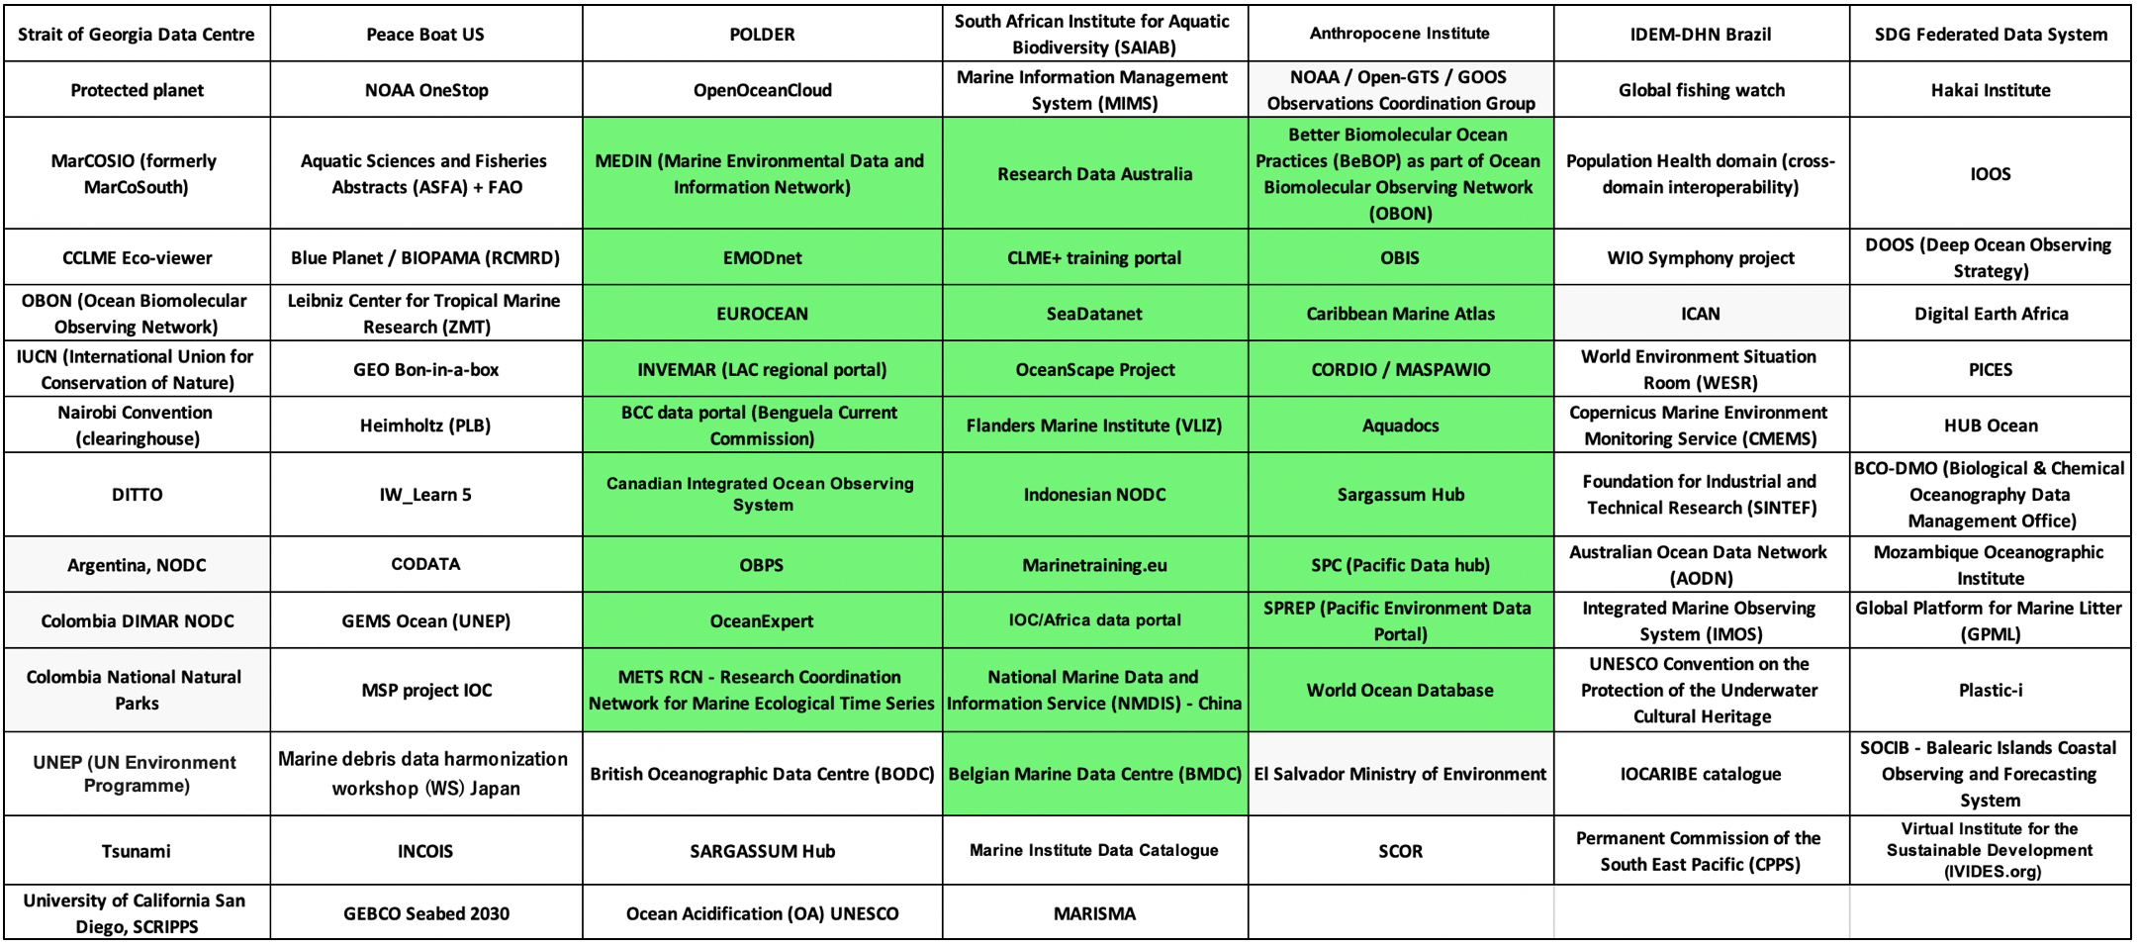
Current status of the ODIS network
developing in white, indexed in green

Slide 15
We developed: 2. A partner network and communities of practice
With the assistance of co-financing from NORAD, we have been able to work beyond the three initial focus regions and bring in additional partners.
Many other data-sharing initiatives work primarily in Europe or North America, but the Ocean InfoHub and ODIS is demonstrating interoperability between highly diverse themes, regions, and capacities across the globe.

Slide 16
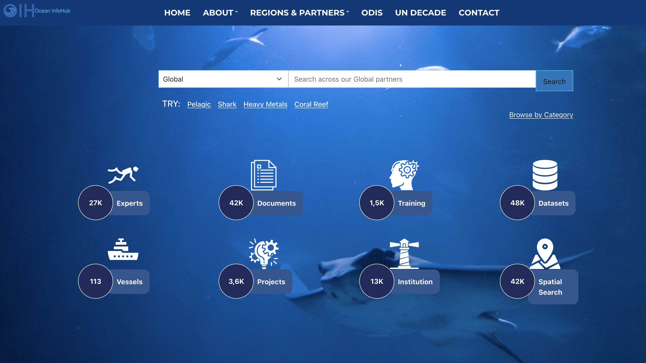
We developed: 3. An OIH Global Search portal
A Global Search portal has been developed as a demonstration of ODIS (https://oceaninfohub.org). The portal currently contains over 130,000 content items in seven content categories: (i) Experts (27,000); (ii) Institutions (13,000; (iii) Documents (42,000); (iv) Training (1,500); (v) Vessels (113); (vi) Projects (3,600); and (vii) Datasets (48,000).

Slide 17
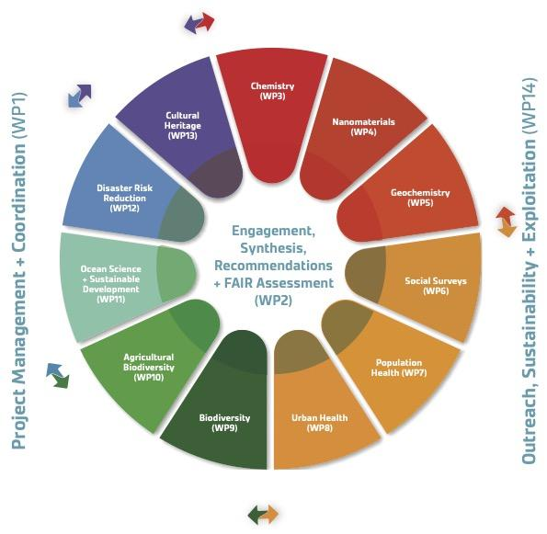
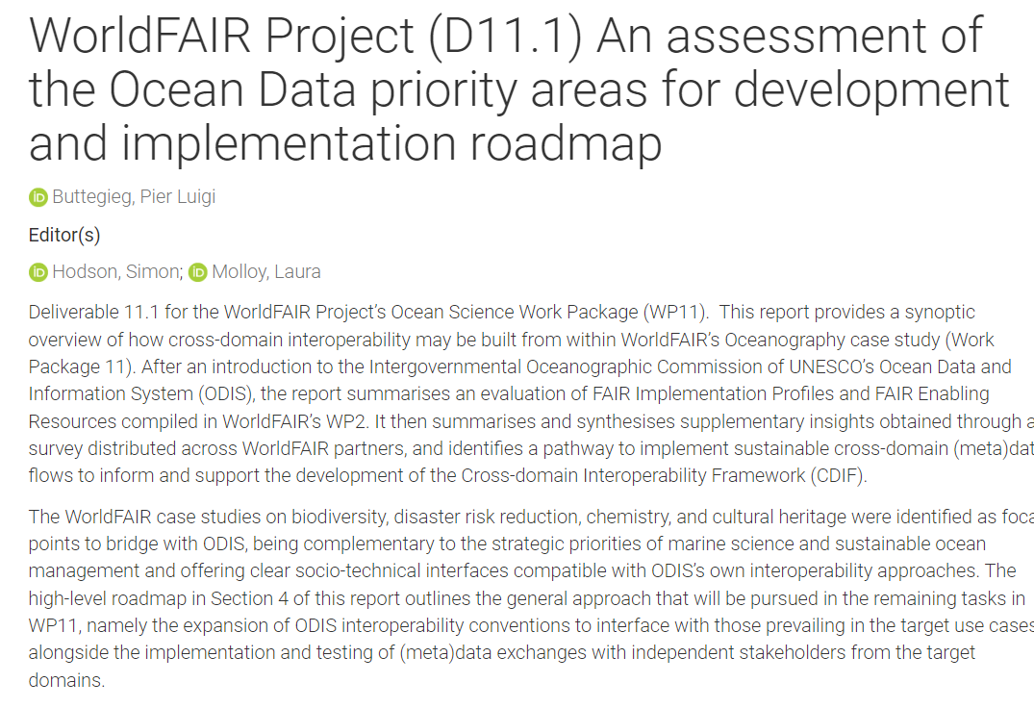

We developed: 4. Cross-domain interoperability technology
Other UN agencies, global data systems, and initiatives in other domains and sectors have also expressed an interest in adopting the ODIS technology. We are aligning to the emerging CODATA Cross-domain interoperability framework (CDIF).
We are discussing interoperability solutions with organisations including GEO BON, the Helmholtz Metadata Collaboration (HMC), the Earth Science Information Partners (ESIP), and the Polar Data Discovery Enhancement Research (POLDER) project). OIH/ODIS is also a case study in the ongoing WorldFAIR project representing the ocean domain in a constellation of 11 case studies.
https://doi.org/10.5281/zenodo.7682399

Slide 18
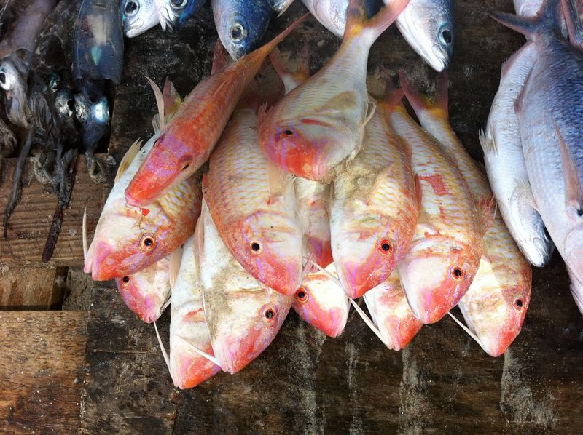
The Ocean InfoHub, through ODIS, now provides a:
Sustainable, interoperable, inclusive, and openly accessible ODIS infrastructure
Composed of nodes, through which data providers and partners can share (meta) data
Does not depend on a central Hub, the web is our collective Hub;
Nodes (maintained by partners) have complete ownership and control, and choose which metadata they would like to share.
Anyone can develop thematic or regional portals.
Provenance is maintained: metadata links back to the original, authoritative source
Architecture is a lightweight, minimal layer and workflows should not need to change.

Slide 19
Capacity development activities
Underpinning all these activities, are our capacity development activities, contributing also to the IOC’s Capacity Development strategy.

Slide 20
Capacity development contributions
The OIH is needs driven, with investment in tools that have been requested by regions
The OIH will optimise the exchange of knowledge, information and learning
It responds to national and regional priorities
It will respect cultural and geographic diversity (regional identity of hubs, including language)
Targets knowledge generators and users
Builds on and strengthens existing resources
Focuses on the transfer of local knowledge,
on supporting early career scientists,
and on remedying gender disparity by increasing access to information, technologies and opportunities.
Facilitates equitable access to Ocean metadata.
The low barriers to joining enable the inclusion of very simple, to highly complex systems.

Slide 21
Capacity development activities
Our partnership with OTGA is very important. To reach the thousands of partners that we would ultimately need to connect to, bilateral and in-person training is just not practical.
The IOC/OTGA/OIH Training course: Implementing the Ocean Data and Information System (ODIS) architecture was held in 2021 in English and then in 2023 in four languages.
It was held online over a week-long period, and then made available as a self-paced course. [9 courses in total]
2021: 59 in English
2023: 81 across English, Spanish, Portuguese, French

Slide 22
Capacity development activities
We have worked closely with the International Coastal Atlas Network (ICAN), to support GeoNode training in association with the activities supporting the African Coastal and Marine Atlas.
We do bilateral co-design as we have a consultant on board who holds 1:1 meetings with partners to walk them through the joining process. This also has a two way feedback as they use the interactions to improve the documentation as well as to develop a Getting Started manual that is currently in process.

Slide 23
Capacity development activities: local context
OIH has supported the three pilot regions in the specific ways they wanted to link to OIH.
INVEMAR has a regional node of OIH, which links to datasets from 12 countries in the LAC region as well as regional partners that include CLME+ Training and Capacity Development Portal, The Sargassum Information Hub and the Caribbean Marine Atlas.
Africa has developed three thematic portals that link to the global OIH,
The Pacific has linked its two existing regional portals to OIH.
The Ocean InfoHub Project and ODIS have succeeded in creating a self-sustaining network of partners, but there remains much work to do to widen the collaboration to other regions and nations, build capacity and digital equity in regions with low resourcing, and continually upgrade the capabilities of the network.

Slide 24
Links to the UN Decade of Ocean Science for Sustainable Development
A Programme called An Ocean Data and Information System supporting the UN Decade of Ocean Science for Sustainable Development (OceanData-2030) has been registered with the UN Decade for Ocean Science for Sustainable Development.
The “ocean digital ecosystem” concept promoted and developed through OIH/ODIS is adopted also by the UN Decade of Ocean Science for Sustainable Development and is referred to in the “Data & Information Strategy for the UN Ocean Decade”. A Decade Coordination Office (DCO) for Data Sharing, is hosted by the IOC Project Office for IODE, Oostende, Belgium

Slide 25
The Future
ODIS offers a long-term solution for any organisation, including NODCs and ADUs and new partners to keep ownership and complete control over their data holdings, while choosing which (meta)data to share with a growing global ocean digital ecosystem.
The OIH Project will close in June 2024 but the Ocean Data and Information Programme component of IODE will continue to support core services seamlessly with IODE RP funding. OIHAfrica will also continue with RP funding and resources will be actively sought for other regions and further development of ODIS.

Slide 26
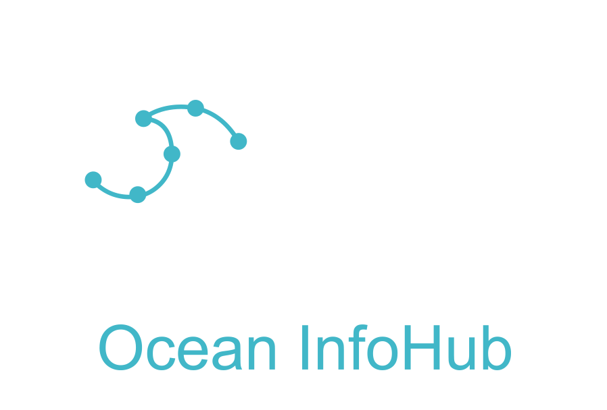
Resources
Website https://oceaninfohub.org/
Documentation https://book.oceaninfohub.org/index.html
Walk-through of documentation (free OTGA sign-in required)
IOC/OTGA/OIH Training course: Implementing the Ocean Data and Information System (ODIS) architecture. https://classroom.oceanteacher.org/course/view.php?id=722
Video: https://drive.google.com/file/d/1YvEMcETZlt-E4aHTad4K1jopbF6ODi4u/view?usp=share_link
Brochure: https://drive.google.com/file/d/1TeWhcciX6UVcQMh9HAsfxG-jKd-3BOlj/view?usp=share_link
Find out more / join us: L.Scott@unesco.org

Slide 27
