Slide 1
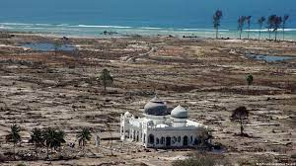
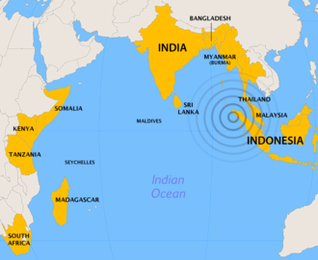
2nd UNESCO IOC Global Tsunami Symposium “Two Decades After 2004 Indian Ocean Tsunami: Reflection and the Way Forward”
Monday 11th - Thursday 14th November 2024
in BANDA ACEH, INDONESIA

Slide 2
PRE-EVENT International Workshop Venue: USK Banda Aceh | 2nd UNESCO IOC Global Tsunami Symposium Venue: Banda Aceh Convention Hall (11 – 14 November, 2024) |  |  |  | POST-EVENT ICG IOTWMS XIV Session Venue: Banda Aceh or BMKG Jakarta
Hosted by IABI in collaboration with TDRMC, IGI | Day 1 (11 Nov 2024) | Day ( 12 Nov 2024) | Day 3 (13 Nov 2024) | Day 4 (14 Nov 2024) | Hosted by BMKG
Hosted by IABI in collaboration with TDRMC, IGI Location: USK | Opening Ceremony | Session 3 | All Day Excursion | Session 7
 |  | Session 4 |  | Session 8
 | Lunch Break (12:00 – 14:00) | Lunch Break (12:00 – 14:00)
 | Session 1 | Session 5 |  | Closing Ceremony
 | Session 2 | Session 6
Side Events: Exhibitions, Posters, Ignite Stages and “Rumah Resilience Indonesia” located at Banda Aceh Convention Hall | Side Events: Exhibitions, Rumah Resilience Indonesia, Posters, and Ignite Stages

Slide 3
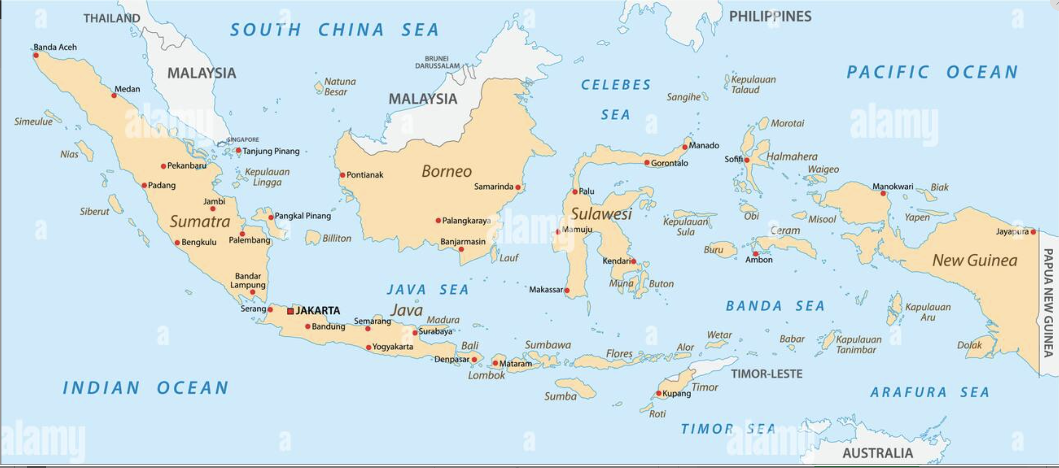
Location of Banda Aceh Indonesia
One registration for all events → at the symposium website (at BMKG)
How to get there:
Via Jakarta (all domestic flight)
Via KL – Malaysia using Air Asia

Slide 4
Aims
To commemorate two decades after 2004 Indian Ocean Tsunami
To reflect what has been achieved in two decades
To identify gaps, challenges and priorities for tsunami early warning
To identify synergy with global challenges and coherence with global commitments
To gather global tsunami community

Slide 5
Scopes
Session 1 to 8 open to public
Invited speakers for the sessions will be nominated/selected by POC, i.e., global and local prominent academia, engineers, practician, politician and public figures.
Anticipated 1,000 participants
Each session will be chaired by 1 Chair Session supported by 1 Rapporteur + 1 Timekeeper
Chair Session and Rapporteur will be nominated by POC
One Day
Exhibitions, Poster Sessions, Ignites Stage, Rumah Resilience and local elementary school drawing competition will be organized by collaboration of BMKG, Government of Banda Aceh, IABI, USK, IGI.
Tsunami United: Indian Ocean Youth Tsunami Conversation and Campaign Initiatives (IOYTCCI) organized by IOTIC
Open access edited UNESCO IOC book “Two Decades After 2004 Indian Ocean Tsunami: Reflection and the Way Forward”, drawing upon inputs from each session - editor HPR, DA and RH
Extensive promotion has been started in January 2024

Slide 6
Host
Government of Indonesia – BMKG (Host)
UNESCO IOC - Tsunami Resilient Section (Co-host)
IUGG (International Union of Geodesy and Geophysics) – Joint Tsunami Commission (Co-host)

Slide 7
Steering Committee (Approved by TOWS WG)
To guide the Programme Organizing Committee on the substance of symposium: the themes, topics, programme, expertise and speakers, etc.
Government of Indonesia:
Head of BMKG: Prof. Dwikorita Karnawati (Chair of UNESCO IOC/ICG IOTWMS)
Head of BNPB: Letjen Suharyanto
Representative of Ministry of Foreign Affairs: (TBD)
UNESCO Jakarta Office:
Director and Representative: Ms. Maki Katsuno-Hayashikawa
UNESCO IOC:
Tsunami Resilient Section: Mr. Bernardo Aliaga
UNESCO IOC / ICG IOTWMS:
Head of Secretariat: Mr. Rick Balley
UN ODTP:
Chair of Scientific Committee: Dr. Srinivasa Kumar Tummala
UN DRR:
Tbd
IUGG-JTC:
Chair of Join Tsunami Cooperation: Prof. Tanioka
GDRC:
Prof. Dilanthi Amaratunga
Prof. Richard Haigh
Notes:
We are also currently discussing other potential members for the steering committee

Slide 8
Programme Organizing Committee (Approved by TOWS WG)
To coordinate and organize the 2nd Global Tsunami Symposium on the detailed planning of the program and agenda
Chair : Dr Harkunti Rahayu (UNESCO IOC-TOWS WG-TTDMP)
Vice Chair 1: Dr. Yuji Nishimae (UNESCO IOC-TOWS WG-TTWO)
Vice Chair 2: Ms. Suci Dewi Anugrah (BMKGUNESCO IOC/ICG IOTWMS WG3 / BMKG)
Members:
Mr. Hanif Andi (Deputy of Geophysics of BMKG)
Dr. Laura Kong (ITIC-International Tsunami Information Centre)
Denis Chang-Seng (NEAMTIC-Northeast Atlantic and the Mediterranean Seas TIC)
Allison Broom (CTIC-Caribbean Tsunami Information Centre)
Ardito M Kodijat (IOTIC-Indian Ocean Tsunami Information Centre)
IUGG rep
Nora Gale (Secretariat of ICG/IOTWMS)
JP (ICG/IOWMS)
(tbd)

Slide 9
National Committee Indonesia
to coordinate, support, and manage the technical arrangement and organization of the symposium nationally and in Banda Aceh (In collaboration with Programme Organizing Committee - POC)
Advisor: Deputy of Geophysics
Head of Technical Committee : Director of Earthquake and Tsunami
Members:
Mitigation Division and other Division of Center for Earthquake and Tsunami BMKG
Intl Cooperation BMKG
Public Affairs Division BMKG
Communication and Networks Division BMKG
Aceh Geophysical Station BMKG
Regional Centre Medan BMKG
BNPB (NDMO)
Indonesian Ministry of Foreign Affairs
BPBA Province Nangroe Aceh Darussalam (LDMO)
BPBA Kota Banda Aceh (LDMO)

Slide 10
Potential Funding Partners
Japan: JICA
Germany: GFZ, GIZ
Norway
Swiss
Finland
UN ESCAP
Note:
Follow up activities from the symposium with these donor partnership:
Strengthening the local capacity of LDCs, SIDs and Developing Countries through UNESCO IOC Tsunami Ready and/or Similar Program, as well as development/strengthening local early warning infrastructure
Enhancement the knowledge and capacity building on non-seismic tsunami warning

Slide 11
Agenda of 2nd Global Tsunami Symposium (11-14 November 2024)
 | Day 1 (11 Nov 2024) | Day 2 (12 Nov 2024) | Day 3 (13 Nov 2024) | Day 4 (14 Nov 2024)
Morning (09:00–12:00) | Opening Ceremony | Session 3 | All Day Excursion | Session 7
 |  | Session 4 |  | Session 8
Lunch Break (12:00 – 13:30)
Afternoon (13:30–16:30) | Session 1 | Session 5 |  | Closing Ceremony
 | Session 2 | Session 6
Symposium Side Events: Exhibitions, Posters Sessions, Ignite Stages and “Rumah Resilience Indonesia” (30 booth @2x3 ) | Side Events: Exhibitions, Posters, Ignite Stages and “Rumah Resilience Indonesia”
Note Exhibition IABI & USK – pre-event di USK organized by IABI & USK

Slide 12
Day 1 Morning: Opening Ceremony
Opening Ceremony’
Indonesian Anthem
Prayer
Moment of Silent (Video) + eyewitness
Opening Performance (Saman Dance)
Remarks
Welcoming Remarks
Governor of Nangroe Aceh Darussalam Province
Head of BMKG
ADG/ES of UNESCO-IOC (If not attending, Director of UNESCO Office Jakarta).
IUGG Representative
The UN Resident Coordinator for Indonesia (TBC)
Special Representative of the Secretary-General for Disaster Risk Reduction (TBC)
Opening Remark
Coordinating Minister for Maritime and Investment (TBC)
Keynote Speech by the Newly Elected President (TBC)
Group Photo
Press Conference

Slide 13
Day 1 Afternoon: Plenary Session
Session I: Review of the Tsunami Warning and Mitigation Systems over the past 2 decades (130 min - invited speakers)
Opening session 1 minutes UNDRR video
Learning from Mega Tsunamis : 2004 Indian Ocean Tsunami and 2011 Tohoku Tsunami 2 person @ 20 min (40 mins): Prof Jan Sopaheluwakan & ….
Panel on history of IOTWMS (Past and present chairs ICG/IOTWMS, Chair PTWS rep, SCS-WS Rep, JMA Rep, UNESCAP, UNDRR rep – 5 persons (40 mins): Mr. Rick Bailey / Dr. Andi Eka, Dr. Chales Mc Creery, Mr. Fujiang Yu, Mr. Singo Ushida, ...
Gaps, challenges, and priorities in tsunami risk, detection, warning and dissemination, awareness and preparedness including the needs for disruptive technologies (AI and 4.0) (current four ICG Chairs 50 mins): Prof. Dwikorita Karnawati, Dr. Yuji Nishimae, Mr Gerard Metayer, Dr. Alessandro Amato
Session 2: Non-Seismic Tsunami in response to UN ODTP UN Ocean Decade Tsunami Programme (50 min - invited speakers)
Opening session 3 minutes Stromboli Volcanoes (Denis Chang-Seng)
Progress, gaps and emerging challenges of detecting and warning for tsunamis generated by non-seismic sources (20 Min): Prof. Francois Schindele and/or Dr. Maurizio Ripepe
Evaluating non-seismic generated tsunami modelling (15 Min): Dr Aditya R. Gusman
Developing awareness and preparedness of communities for tsunamis generated by non-seismic sources (15 Min): Dr. Laura Kong

Slide 14
Day 2 Morning: Plenary Session
Session 3: Tsunami Hazard and Risk Assessment (90 min - invited speakers)
Evaluating seismic and non-seismic generated tsunami hazards (3 speaker) 45 minutes: 1. Prof. Fumihiko Imamura, 2. PTHA - Dr. Gareth Davis / Dr. Adrienne Moseley/Prof Mokthari, 3. Data Assimilation (non seismic) – Prof. Yuichiro Tanioka
Identifying communities at-risk (3 speaker) 45 Minutes: Dr. Christa von Hillebrant, Dr. Okta Rina Aceh-Indonesia,
Session 4: Tsunami Detection, Warning and Dissemination (90 min - invited speakers)
How to we Enhance Timeliness and Accuracy of Tsunami Warnings? (3 speaker): 1. India – Dr. Srinivasa Kumar Tumala, 2. WHOI – Mr. Lee Freitag, 3. Michael Angove
How do we Ensure Tsunami Warnings Reach all in the community? (3 speaker): 1. Dr Andi Eka, 2. Mr. Bernado Aliaga, 3…..

Slide 15
Potential Invited Speakers (tbc) To be added to
USA:
Prof Emile Okal (Northwestern University)
Prof. Costas Synolakis (University of South Carolina)
Prof. Hermann Fritz (Georgia Institute of Technology)
Prof. Thorne Lay (University of California Santa Cruz)
Dr. Stuart Weinstein (NOAA)
Dr. Elena Suleimani (University of Alaska Fairbanks)
Dr. Bryan Atwater (USGS)
Prof. Louise Comfort (Univ of Berkley)
AUSTRALIA:
Prof. Charita Pattiarachi (University of Southwest Australia)
Dr. Gareth Davies (Geoscience Australia)
JAPAN
Prof. Shunichi Koshimura (Tohoku University)
Prof. Fumihiko Imamura (Tohoku University)
Prof. Yuichiro Tanioka (Hokkaido University)
Prof. Kenji Satake (University of Tokyo)
Prof. Yoshihiro Okumura (Kansai University)
Prof. Yushiro Fujii (Univ of Tokyo)
Prof. Megumi Sugimoto (Kyushu University)
RUSIA:
Dr. Vasily Titov (NOAA Center for Tsunami Research)
Prof. Efim Pelinovsky (Russian Academy of Sciences)
SINGAPORE
Prof. Philip Liu (University of Singapore)
UK:
Mohammed Heiderzadeh (Univ of Bath)
Prof. Dilanthi Tumaratungga (Univ of Huddersfield)
Prof. Richard Haigh (Univ of Huddersfield)
ITALY:
Dr. Laura Graziani (Institute of Geophysics and Volcanology)
Dr. Maurizio RIPEPE (Univ of Florence)
SPANYOL:
Prof. Elisa Buforn (Universidad Complutense Madrid)
PNG:
Prof. Hugh Davies (University of Papua New Guinea)
INDONESIA:
Prof. Dwikorita Karnawati (BMKG)
Dr. Dimas Salomo Sianipar (BMKG)
Suci Dewi Anugrah (BMKG)
Dr. Harkunti P. Rahayu (ITB)
Prof Syamsul Maarief (former Head of BNPB)
Prof Yan Sophaheluwakan (UI)
India:
Dr. Srinivasa Kumar
Chile:
…
SIDS:
…

Slide 16
Day 2 Afternoon: Plenary Session
Session 5: Achieving 100% Communities at Risk to be Prepared for and Resilient to tsunami by 2030 (90 min - invited speakers)
Progress of UNESCO IOC Tsunami Ready recognition programme (3 speaker): Ms. Suci Anugerah, Caribee, NEAM
Synergizing Tsunami Ready with national programmes for tsunami preparedness (3 speaker): IDRIP–Dr Raditya Jati, PTWS – Ms. Ashley Fromont NZ, ISO – Dr Weniza
Tsunami Ready Coalition (2 speaker): Dr Laura Kong, Mr. Ardito Kodijat
Session 6: Other critical issues for building community resiliences (90 min - invited speakers)
Social and Humanities perspective in Tsunami Science and Tsunami Early Warning System: Ms. Irina Rafliana,
Critical infrastructure ready for tsunami: design, implementation, and maintenance: Dr. Harkunti P. Rahayu
Tsunami Disaster Governance, Policy, and Justice: Dr. Abdul Muhari
Mainstreaming DRR into Urban Planning: Prof. Dilanthi Amaratunga
Cascading and compound hazards, systemic risk: Prof. Louise K. Comfort and/or Prof Richard haigh

Slide 17
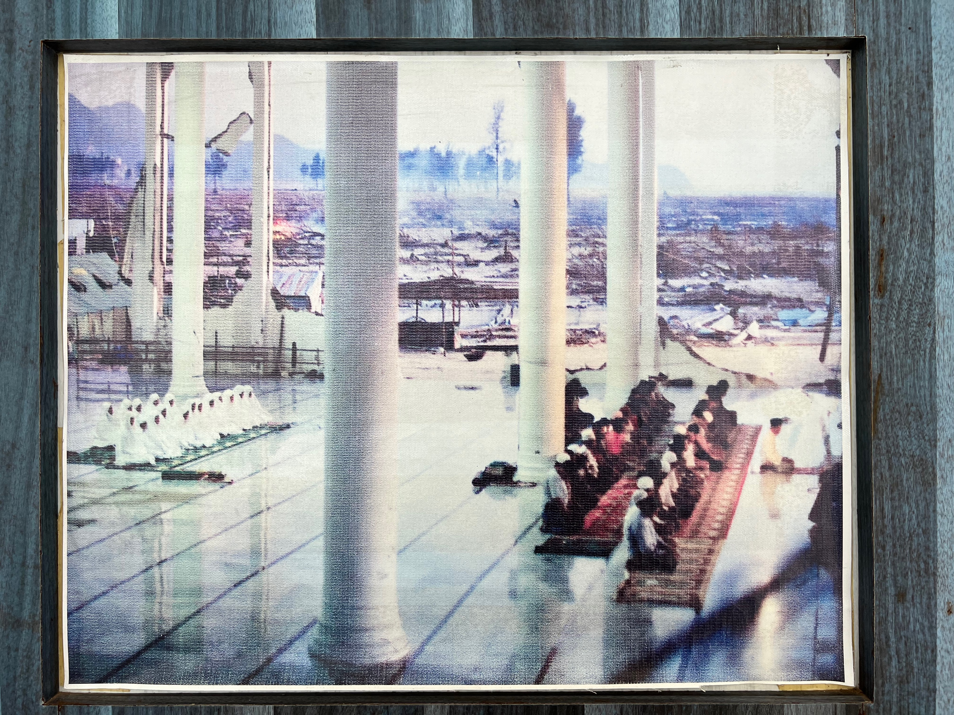
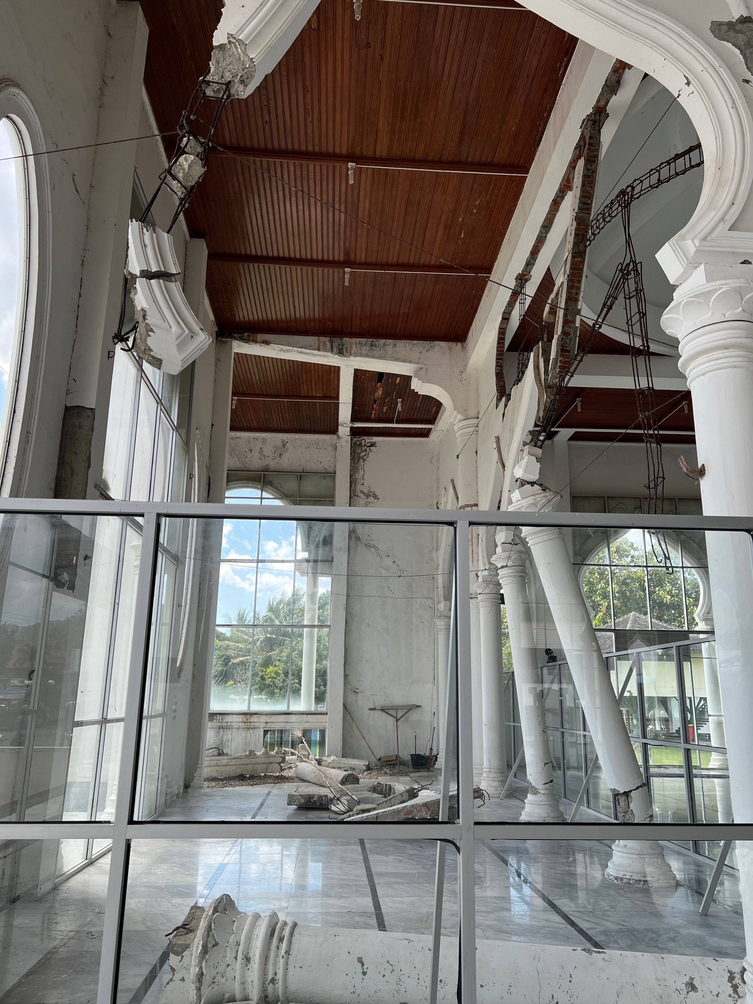
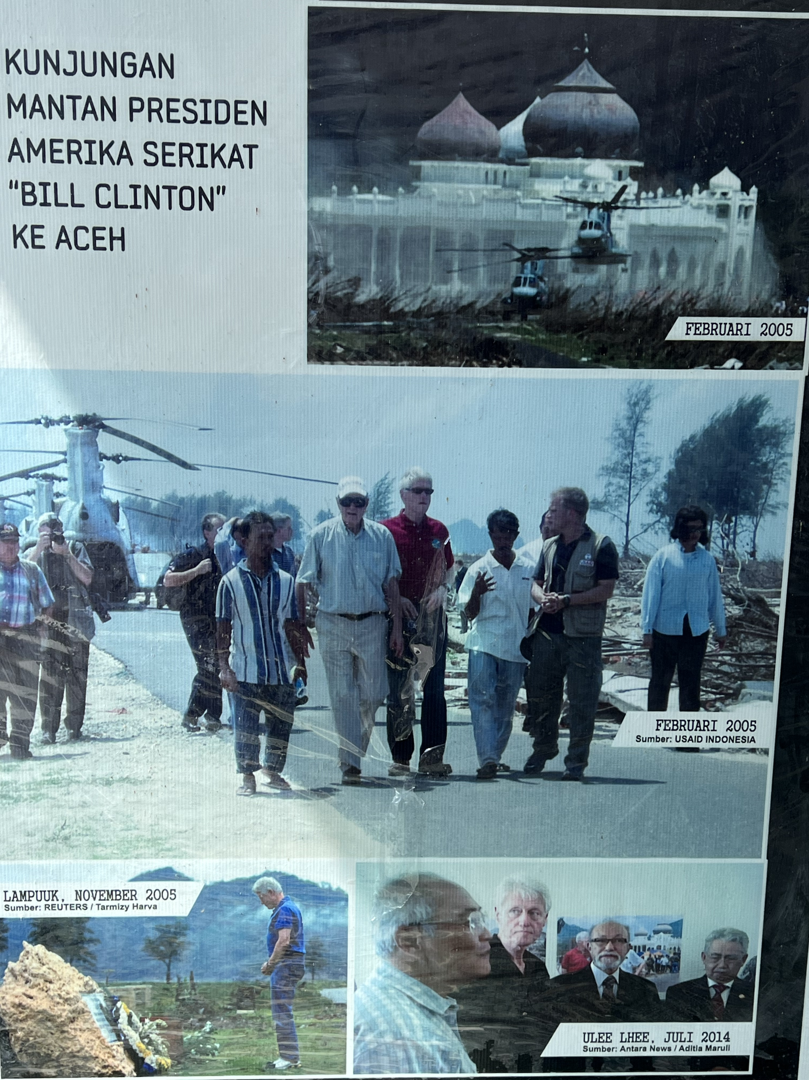
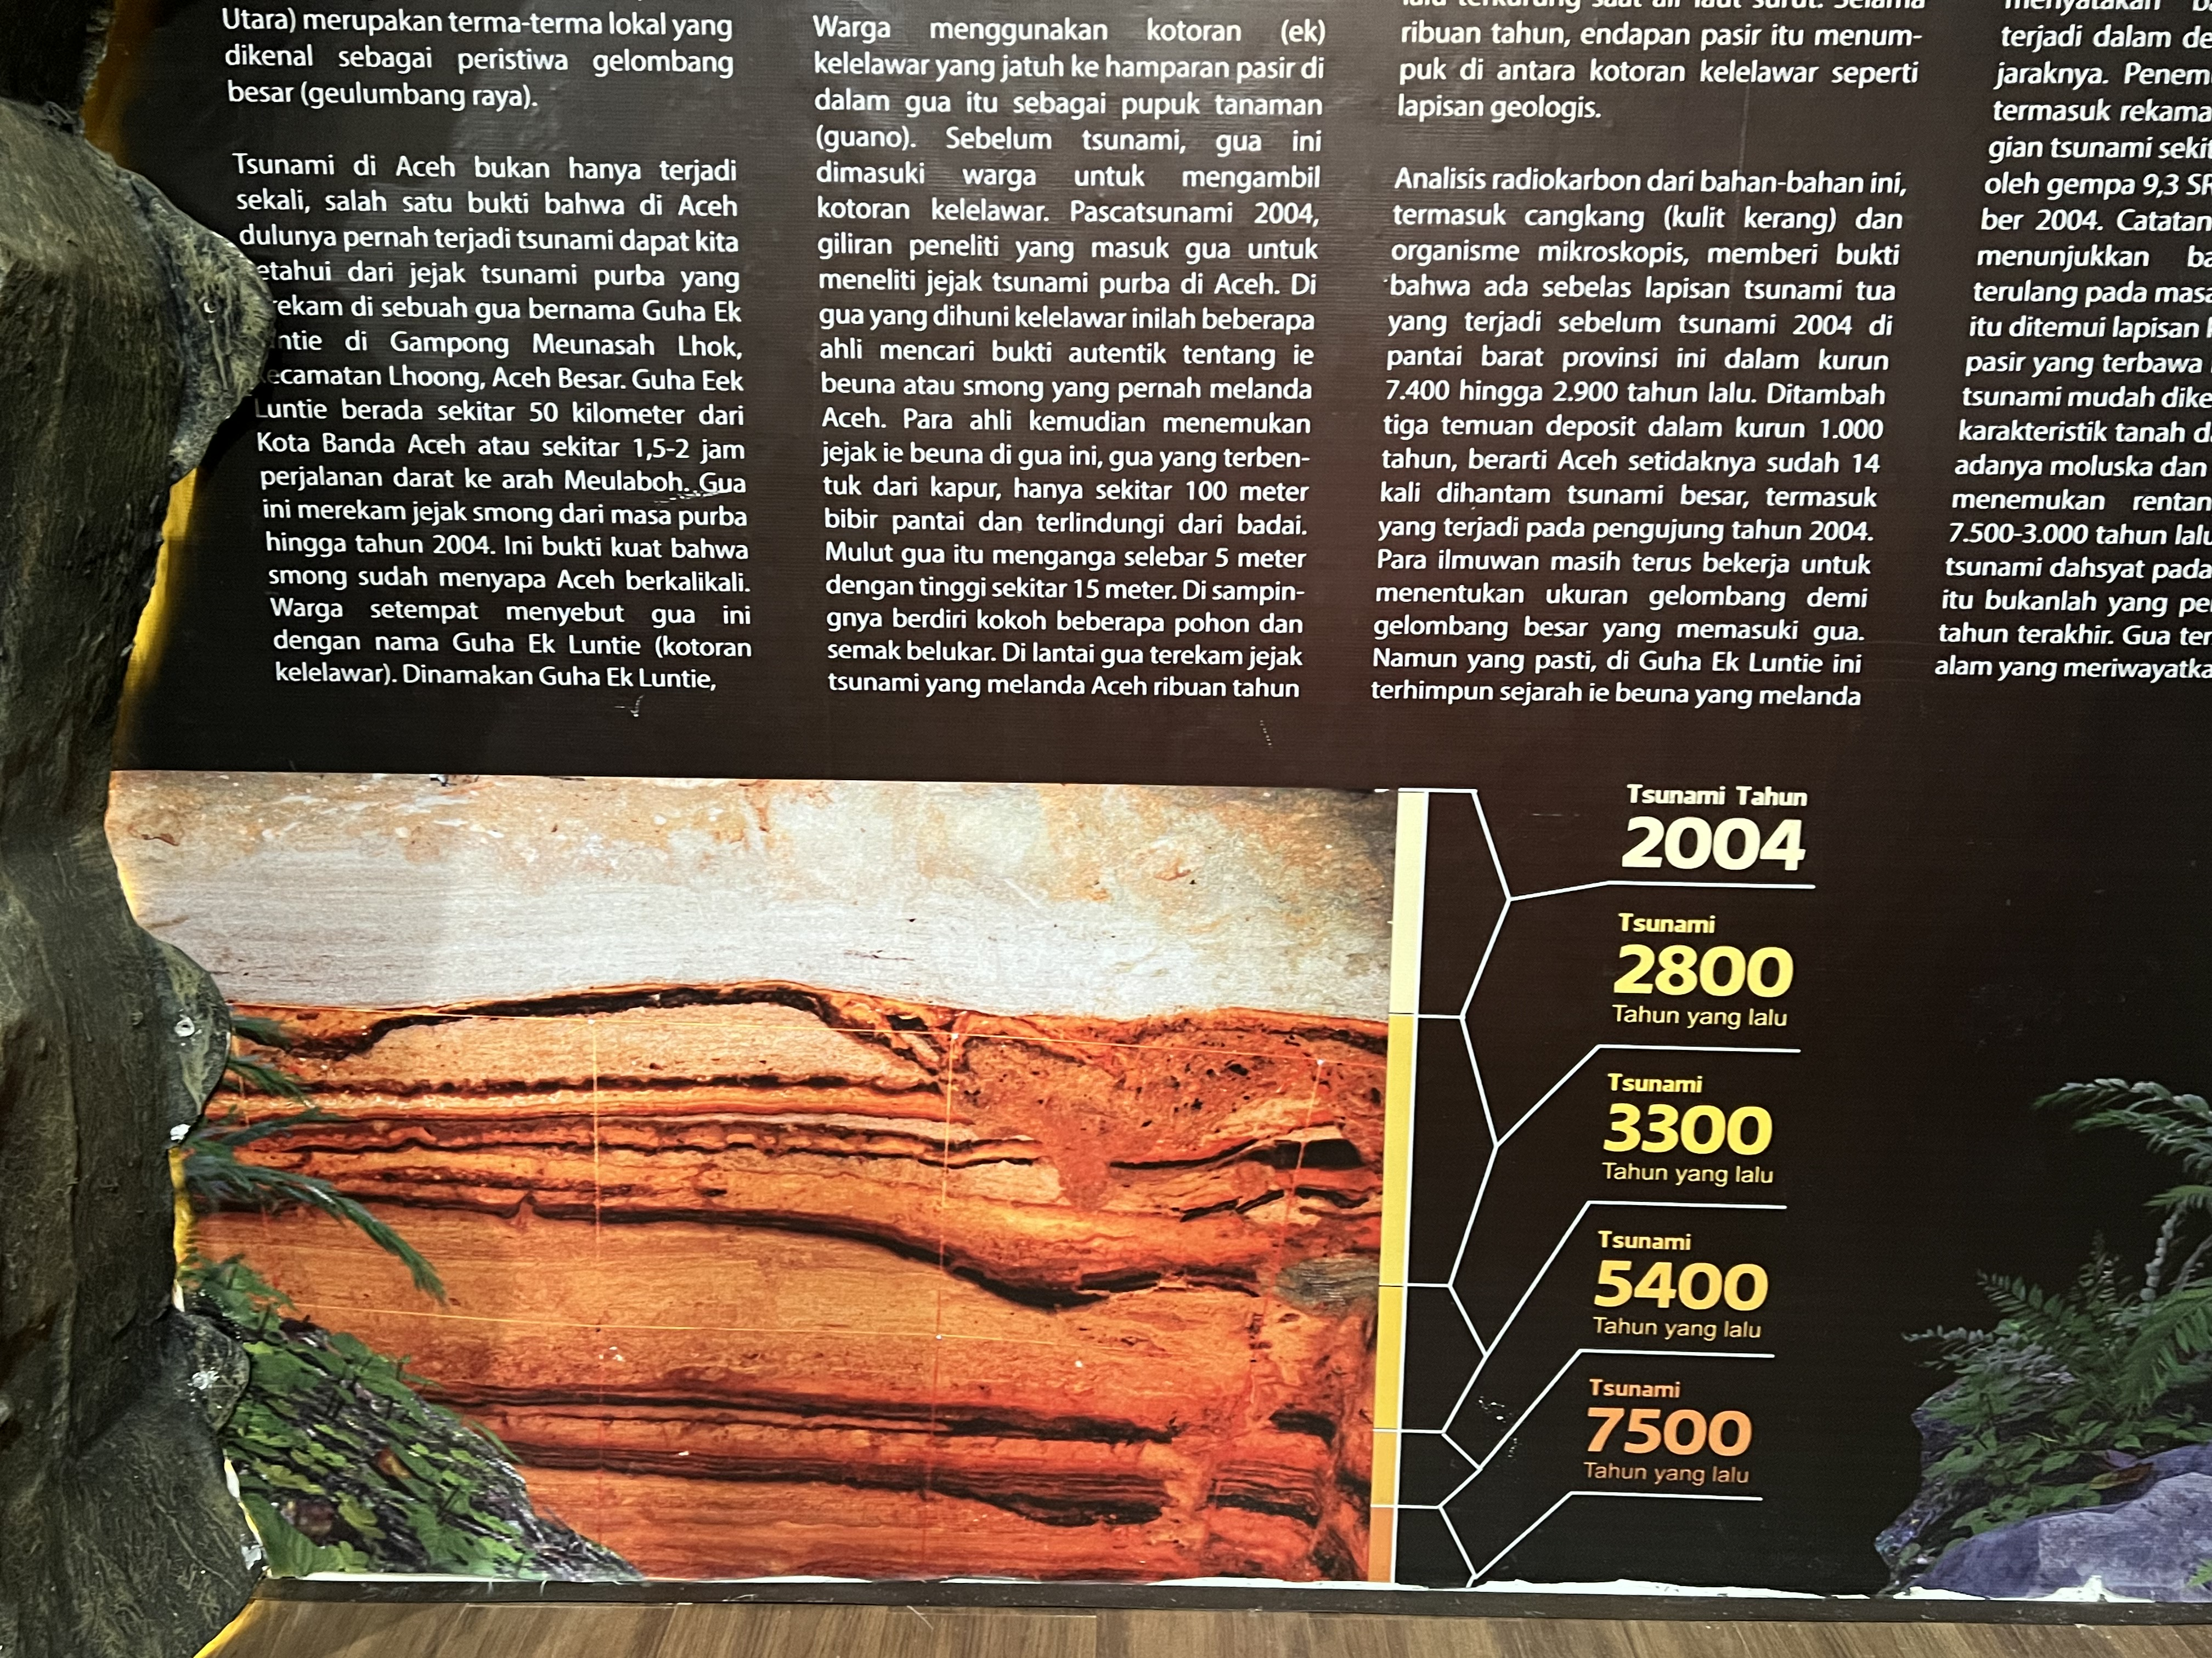
Day 3: Excursion
All Day Excursion
Museum Tsunami Aceh
Affected area: Lampuu
Tsunami Ready Village: Inauguration Tsunami Ready and Tsunami Drill
…

Slide 18
Day 4 Morning: Plenary Session
Session 7: Contributions of TEWS to global initiatives (90 min - invited speakers) 7 person
MHEWS
EWS4ALL: WMO
UN Ocean Decade: 1. Dr. Srinivasa K. Tumala
SDGs,
SFDRR,
COP28
MCR2030
Session 8: Wrap up /Synthesis/Way Forward
An outcome document, drawing upon achievements, gaps, challenges, and priorities from each session, including pre-event → 7 session moderators present brief summaries → input for the draft Banda Aceh Declaration
Round Table Discussion on Way Forward (Chairs and TIC representatives each ICG, IUGG expert, Chair ODTP Science Committee)

Slide 19
Day 4 Afternoon: Closing Ceremony
Closing Ceremony
Indigenous Story-Teller – Pak Ngah
Hand-over price to the Indian Ocean Youth Tsunami Conversation and Campaign (IOYTCC) Winners (4 Indian Ocean competition regions)
Winner announcement for best poster presentation
Winner announcement for school children art/drawing competition
Closing Remark:
Head of BMKG
Representative of the Local Government
Representative of UNESCO IOC
Representative of the Government (Officially Closed the event)
Banda Aceh Declaration (in one powerful sentence
Press Conference

Slide 20
Potential Invited Speakers (tbc) To be added to
USA:
Prof Emile Okal (Northwestern University)
Prof. Costas Synolakis (University of South Carolina)
Prof. Hermann Fritz (Georgia Institute of Technology)
Prof. Thorne Lay (University of California Santa Cruz)
Dr. Stuart Weinstein (NOAA)
Dr. Elena Suleimani (University of Alaska Fairbanks)
Dr. Bryan Atwater (USGS)
Prof. Louise Comfort (Univ of Berkley)
AUSTRALIA:
Prof. Charita Pattiarachi (University of Southwest Australia)
Dr. Gareth Davies (Geoscience Australia)
JAPAN
Prof. Shunichi Koshimura (Tohoku University)
Prof. Fumihiko Imamura (Tohoku University)
Prof. Yuichiro Tanioka (Hokkaido University)
Prof. Kenji Satake (University of Tokyo)
Prof. Yoshihiro Okumura (Kansai University)
Prof. Yushiro Fujii (Univ of Tokyo)
Prof. Megumi Sugimoto (Kyushu University)
RUSIA:
Dr. Vasily Titov (NOAA Center for Tsunami Research)
Prof. Efim Pelinovsky (Russian Academy of Sciences)
SINGAPORE
Prof. Philip Liu (University of Singapore)
UK:
Mohammed Heiderzadeh (Univ of Bath)
Prof. Dilanthi Tumaratungga (Univ of Huddersfield)
Prof. Richard Haigh (Univ of Huddersfield)
ITALY:
Dr. Laura Graziani (Institute of Geophysics and Volcanology)
Dr. Maurizio RIPEPE (Univ of Florence)
SPANYOL:
Prof. Elisa Buforn (Universidad Complutense Madrid)
PNG:
Prof. Hugh Davies (University of Papua New Guinea)
INDONESIA:
Prof. Dwikorita Karnawati (BMKG)
Dr. Dimas Salomo Sianipar (BMKG)
Suci Dewi Anugrah (BMKG)
Dr. Harkunti P. Rahayu (ITB)
Prof Syamsul Maarief (former Head of BNPB)
Prof Yan Sophaheluwakan (UI)
India:
Dr. Srinivasa Kumar
Chile:
…
SIDS:
…

Slide 21
Registration
Participants: 1,000 (Day 1 and Day 2)
Registration: free but should be regsritrate by ….
One registration for all events → website BMKG; pre-event link ke IABI; others tetap BMKG
Question to Bernado about speaker logistic transportation → sponsor funding. Note Bernado 70% self funding, 30% Panitia mencari sponsor funding
BMKG expect co-sponsorship for accommodation for invited speakers → get funding support from sponsorship
BMKG will provide snacks and coffee for Day 1 and Day2
Lunch for Day 1 and Day 2: paying at the stalls at the exhibition
BMKG will provide full meals for Day 4 (200 person by invitation only)
BMKG will host gala dinner for Day 3 evening for invited by participants (200 persons: UNESCO, National official, invited speakers)
BMKG will provide transportation, snack and lunch box Day 3 tour (limited registration max 300 person/ 200 registered participants + 100 OC and speakers – 6 bus)

Slide 22
Venues of Main Events
Day 1 and Day 2: Banda Aceh Convention Hall
Day 4: Hermes Hotel

Slide 23
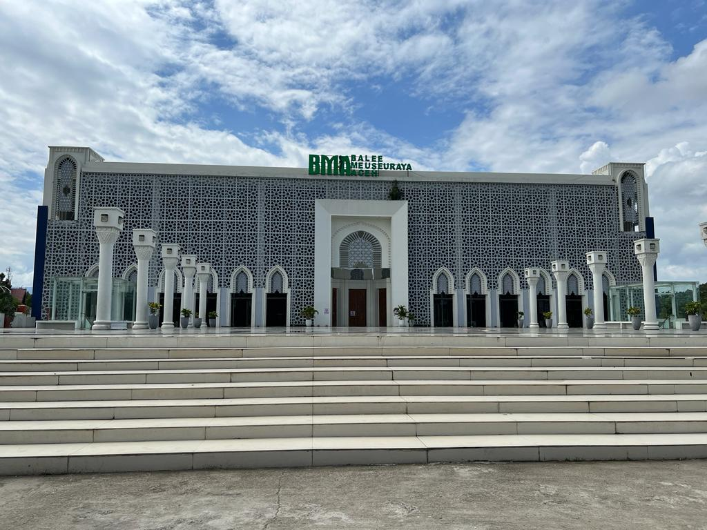
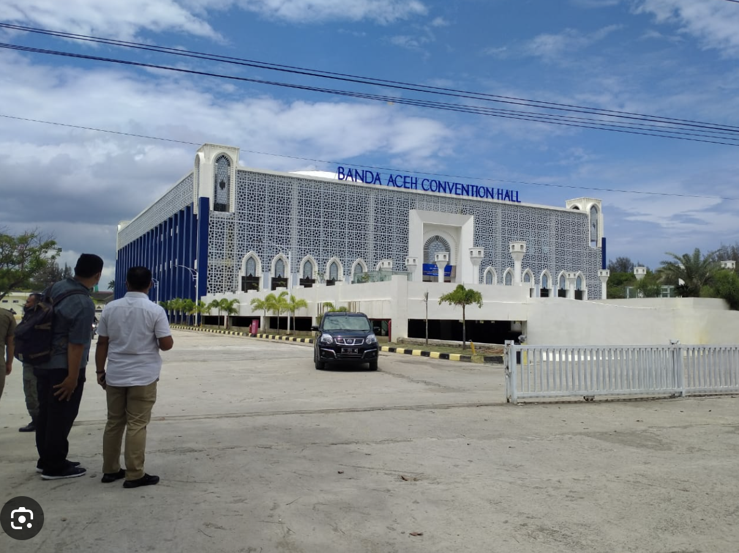
Main Event 11-12 November 2024
Banda Aceh Convention Hall
Opening, Closing, Plenary and Side event activities
Capacity:1,000 people

Slide 24
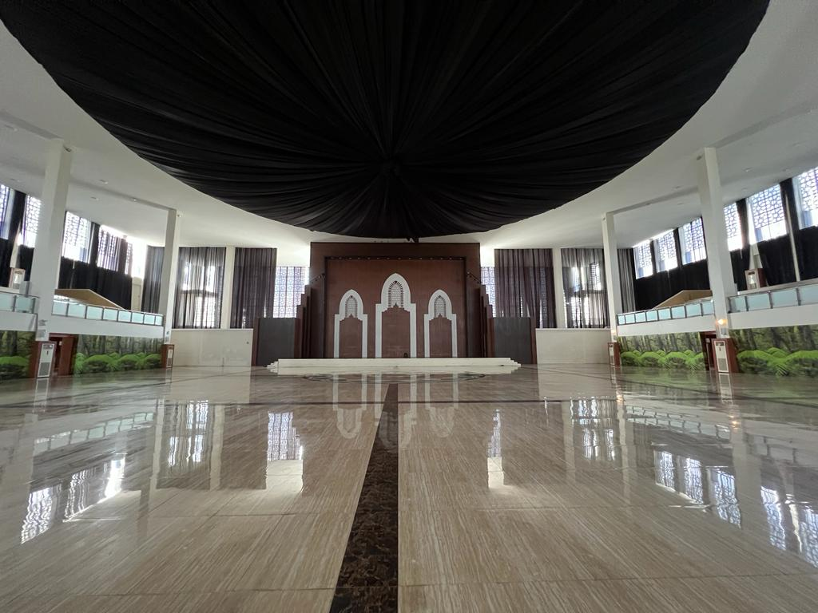
Main Event 11-12 November 2024
Banda Aceh Convention Hall
Opening, Closing, Plenary and Side event activities
Capacity:1,000 people

Slide 25
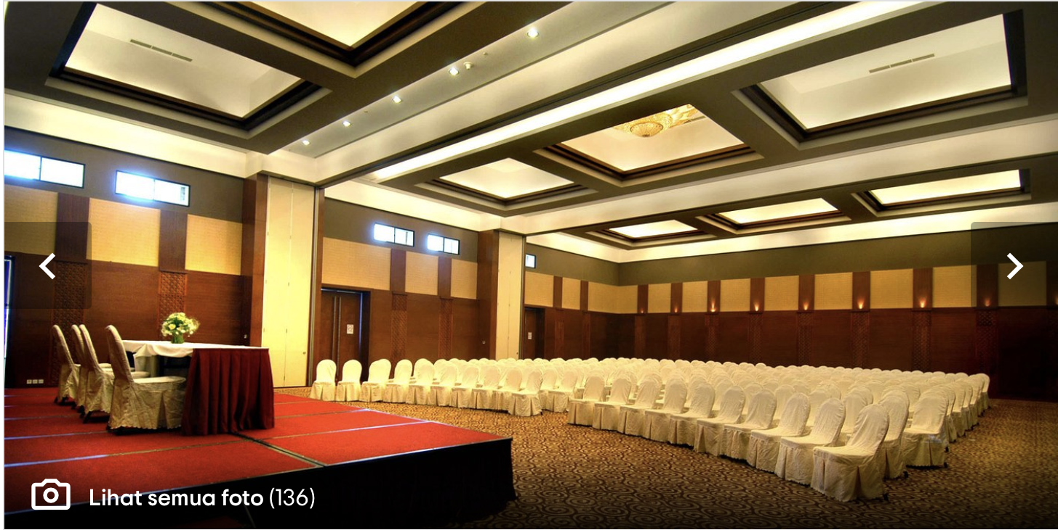
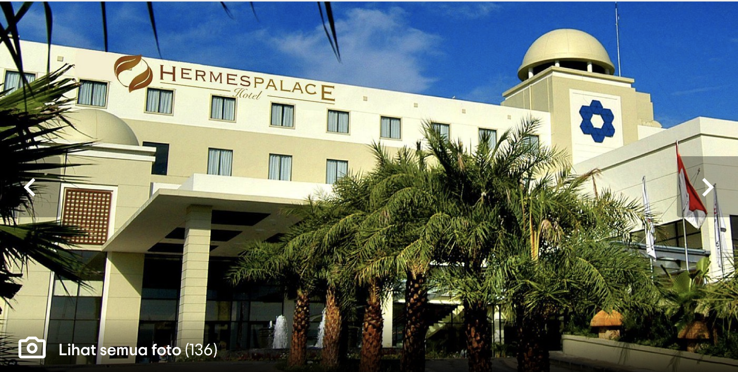
Main Event 14 November 2024
Hermes Hotel
Session 7 & 8 and Closing Ceremony
Capacity: 200 people

Slide 26
Side-Events: Ignite Stage, Booth and Poster Exhibition
Date: 11 – 14 November 2024
Venue: Banda Aceh Convention Hall

Slide 27
Side-Event:
The side event using the concept of Rumah Resiliensi (Resilient House) “small expo from us to us”
Aims to provide platform for
Tsunami open to public to participate for Global Tsunami Symposium
and DRR players to show product, result, and innovation on Tsunami Mitigation, Tsunami Preparedness, Tsunami Awareness, Tsunami Early Warning, etc.
Youth and young professionals (i.e. early career researcher and scientist) to showcase their research and activities on Tsunami Risk Reduction
For donor and sponsors to participate and showcase their engagement in the symposium

Slide 28
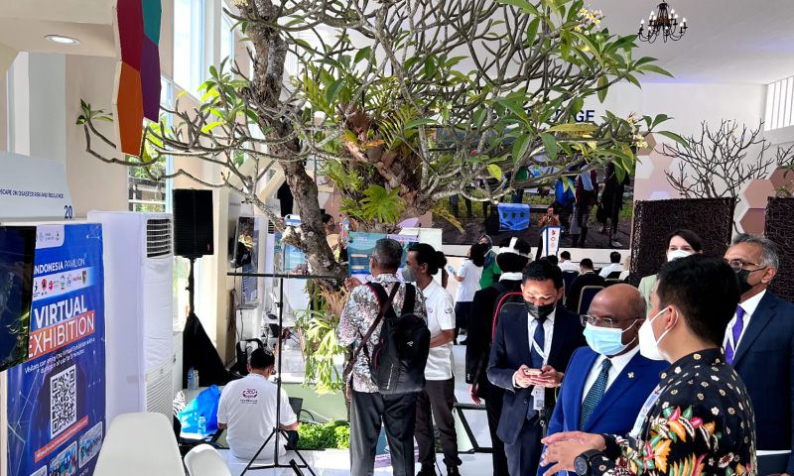
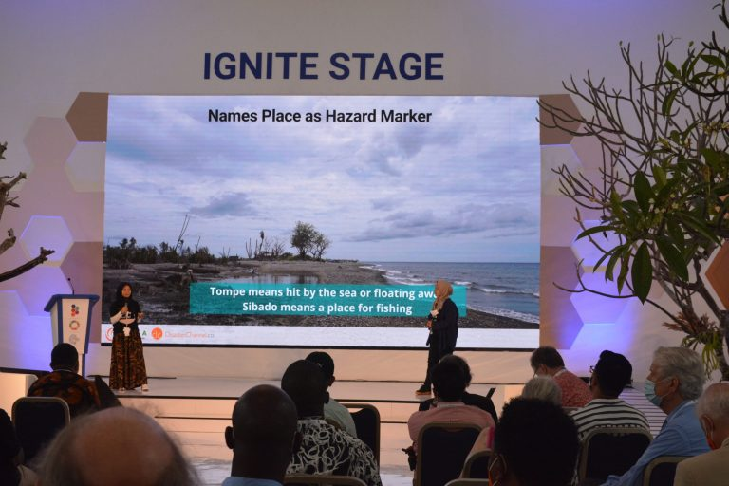
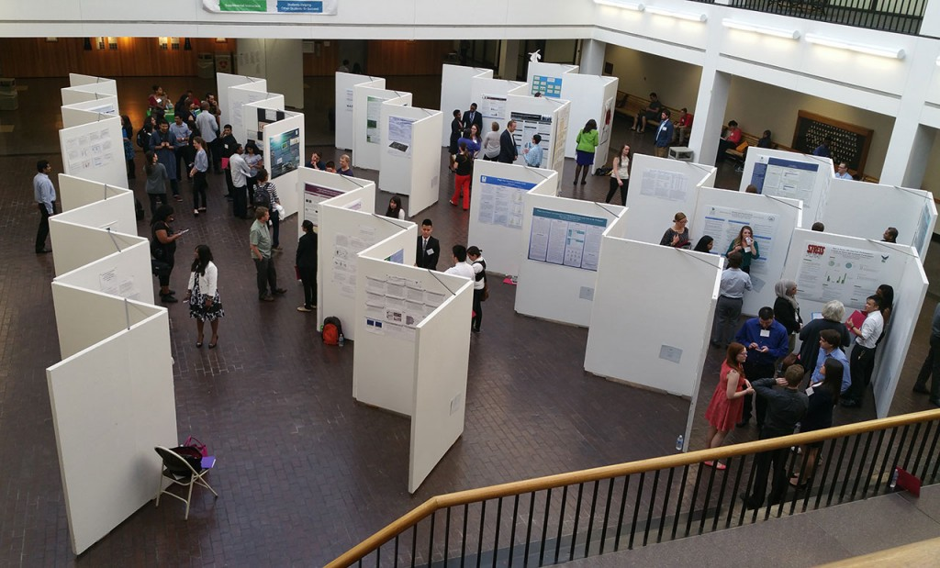
Side Events: 9-12 November 2024
1. Exhibitions
2. Ignite Stage: for invited
institutions/organization
experts/celebrities/public figures
tsunami survivors
Schedule: During Coffee Breaks, Lunch Breaks and 1 hour after the end of day of the main event activities
4. Booth Display:
winner of Banda Aceh local school art drawing competition
Winner of Video competition
3. Poster Session: open to public to participate for Global Tsunami Symposium

Slide 29
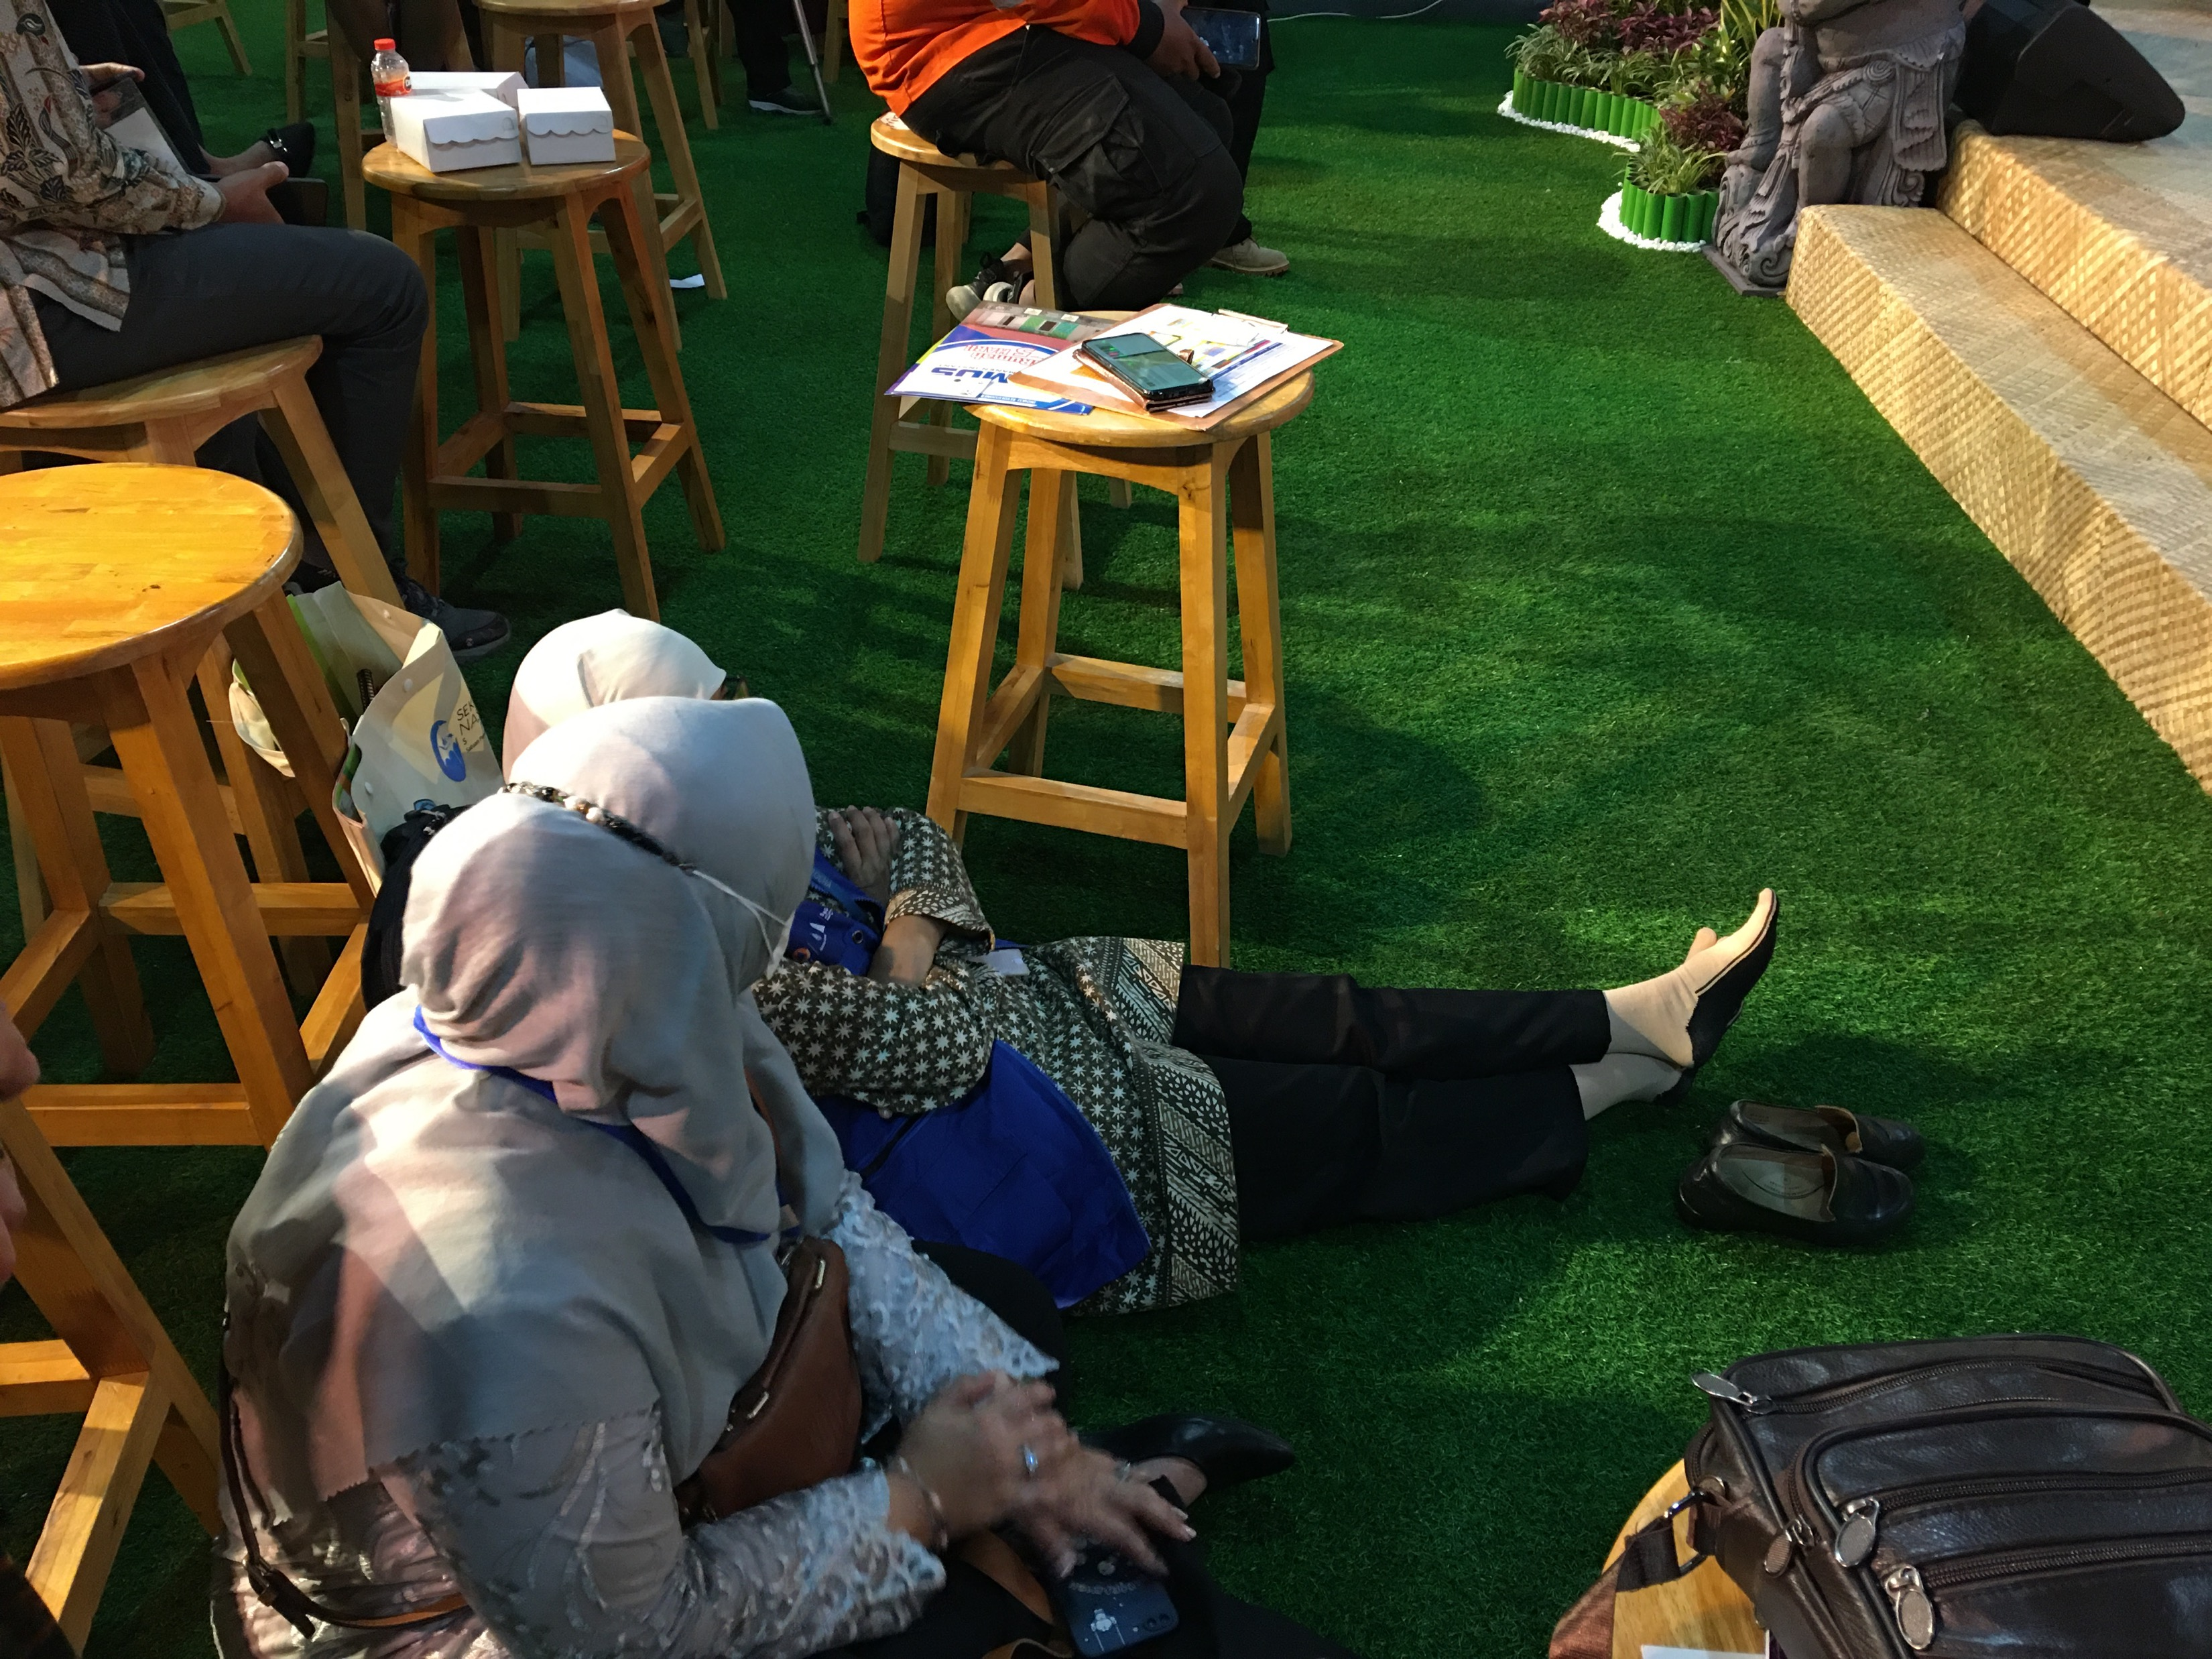
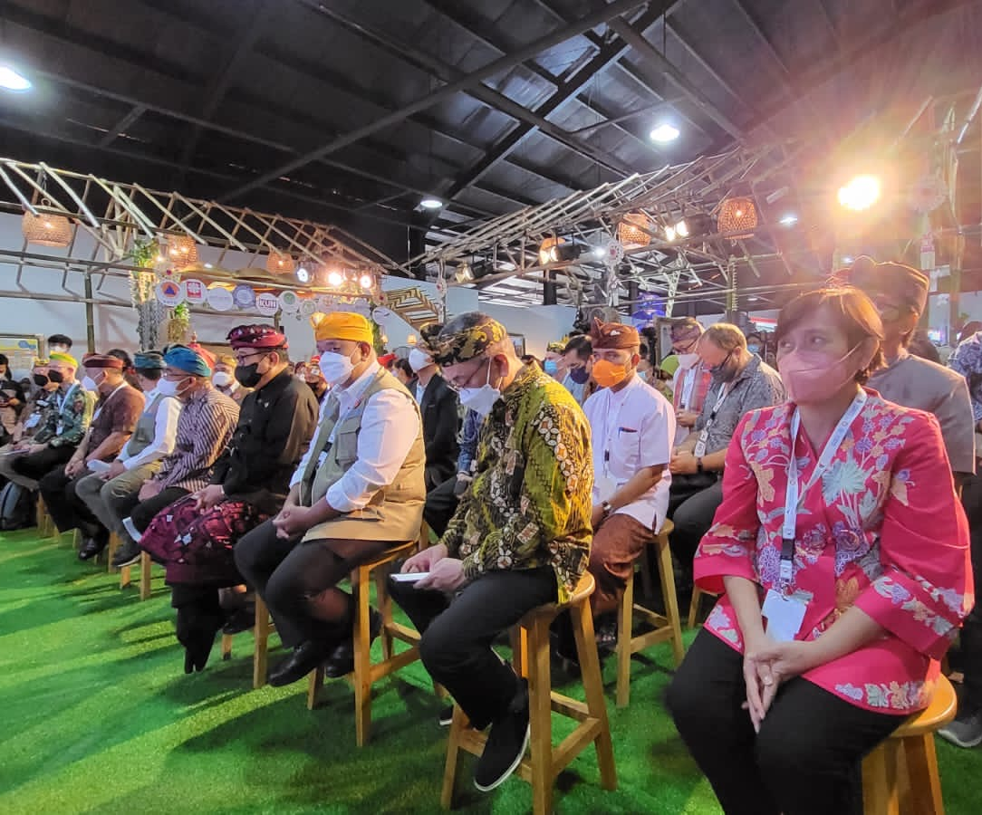
Example of Rumah Resiliensi Indonesia @GPDRR

Slide 30
Exhibition Venue 9-12 November 2024
Banda Aceh Convention Hall
Outdoor Tents surrounding the Convention Hall area

Slide 31
Hotel and Accommodations

Slide 32
Hotels
Alternatives Hotel for Delegation/Participants
Hermes Hotel (4 star)
Kyriad (4 star)
Many 3 star hotels

Slide 33
Pre-Event: International Scientific Workshop
Hosted by IABI collaborated with TDRMC – USK and IGI

Slide 34
Pre-Event: International Scientific Workshop 9-10 November 2024
Aims:
To commemorate 2 decades post 2004 Tsunami
To conduct PIT IABI 2024 collaborate with AIWEST
To accommodate International and National Public to present their works/thoughts before participate the UNESCO IOC Global Symposium
Scope:
Call for papers for Scientific Workshop
Pre event scientific workshop Book of abstracts, Indexing proceedings, Special issue of journals
Open to global scientific and practician communities

Slide 35
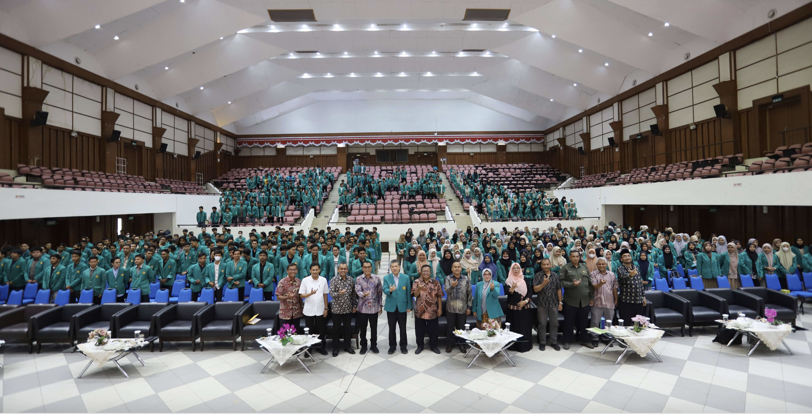
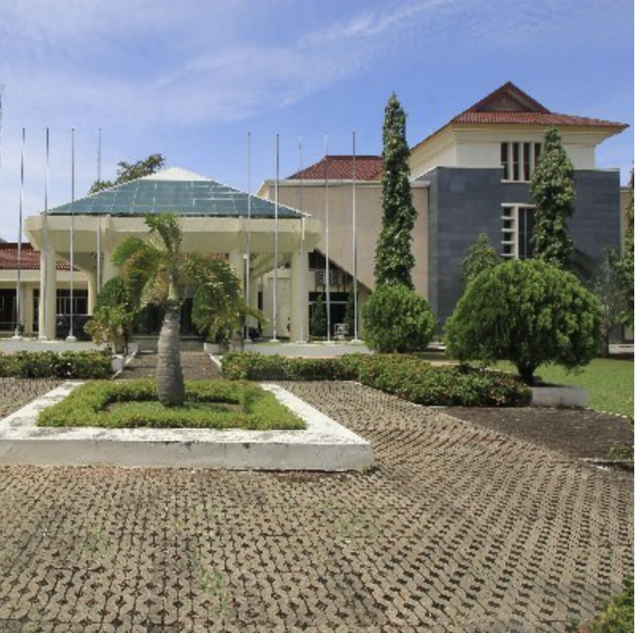
Pre-Event Venue 9-10 November 2024
AAC Dayan Dawood Auditorium –
University of Syiah Kuala
Capacity: 1,000 people

Slide 36
Preparation done

Slide 37
Preparation Done
Follow up Meeting after TOWS WG Meeting March 2023
Discussed with Prof Dwikorita (Head of BMKG), Prof Syamsul Maarief (Former Head of BNPB/NDMA) (March 2023)
Discussed with BMKG and BNPB core team (March and April)
Discussed with IABI (April 2023)
Meeting with Prof Tanioka (May 2023)
Meeting with IABI and IGI (August 2023)
Meeting with BMKG, IOTIC, University Syiah Kuala, Government of Aceh (September 2023)
Hand over PIT IABI from UB in 2023 to USK 2024 (27-28 November 2023)
Symposium Technical Meeting with BMKG, BNPB, IOTIC, and Ministry of Foreign Affairs (8 December 2023)
Online meeting with Program Organizing Committee
Site Visit to Banda Aceh by Chairs (HPR and SA) and BMKG team (20 December 2024)
Several meeting conducted in January 2024 online and offline

Slide 38
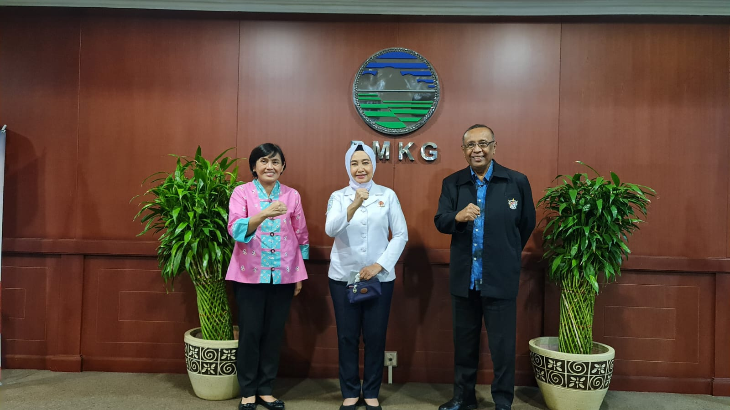
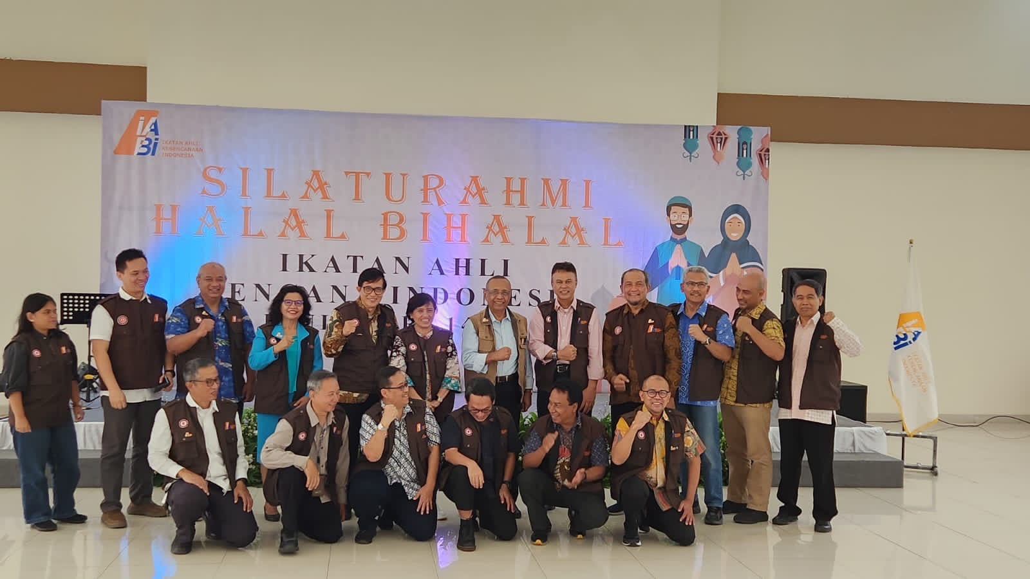
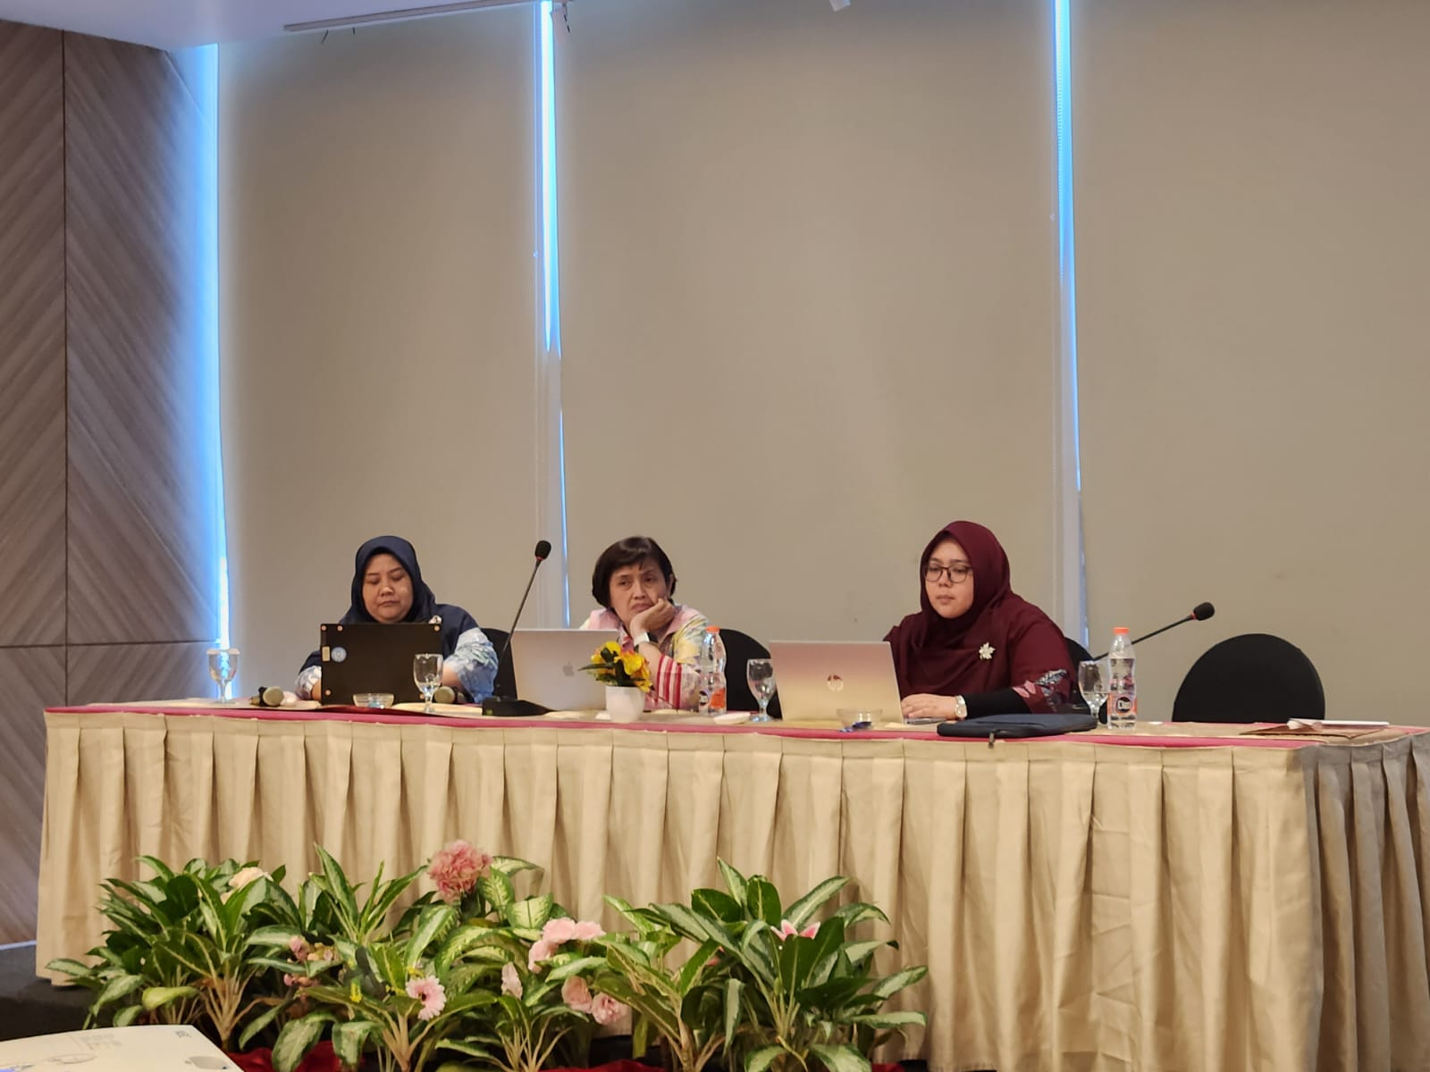
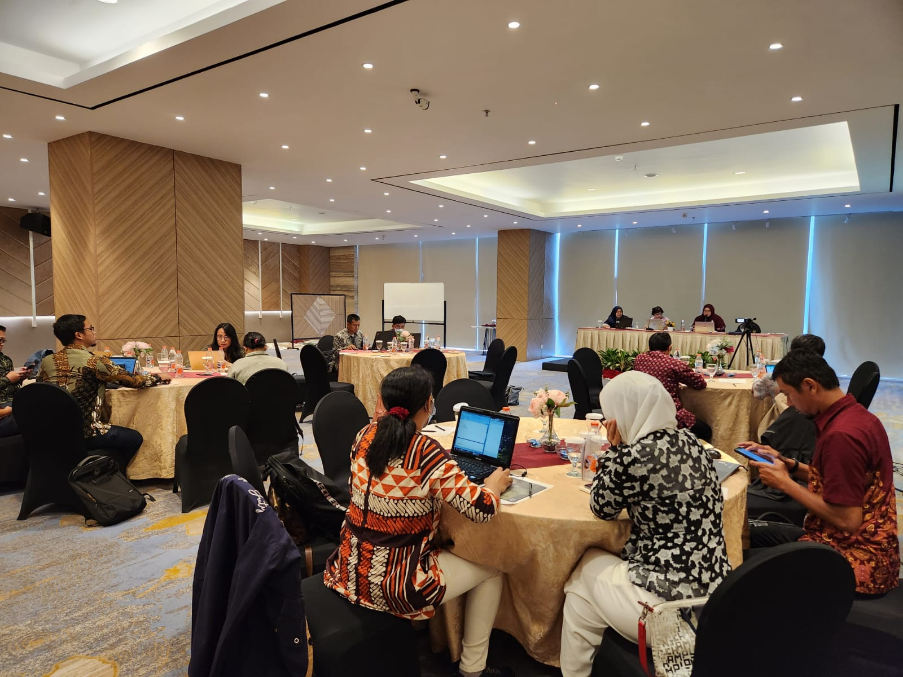
Preparation Meetings
March 2023
April 2023
August 2023
8 December 2023

Slide 39
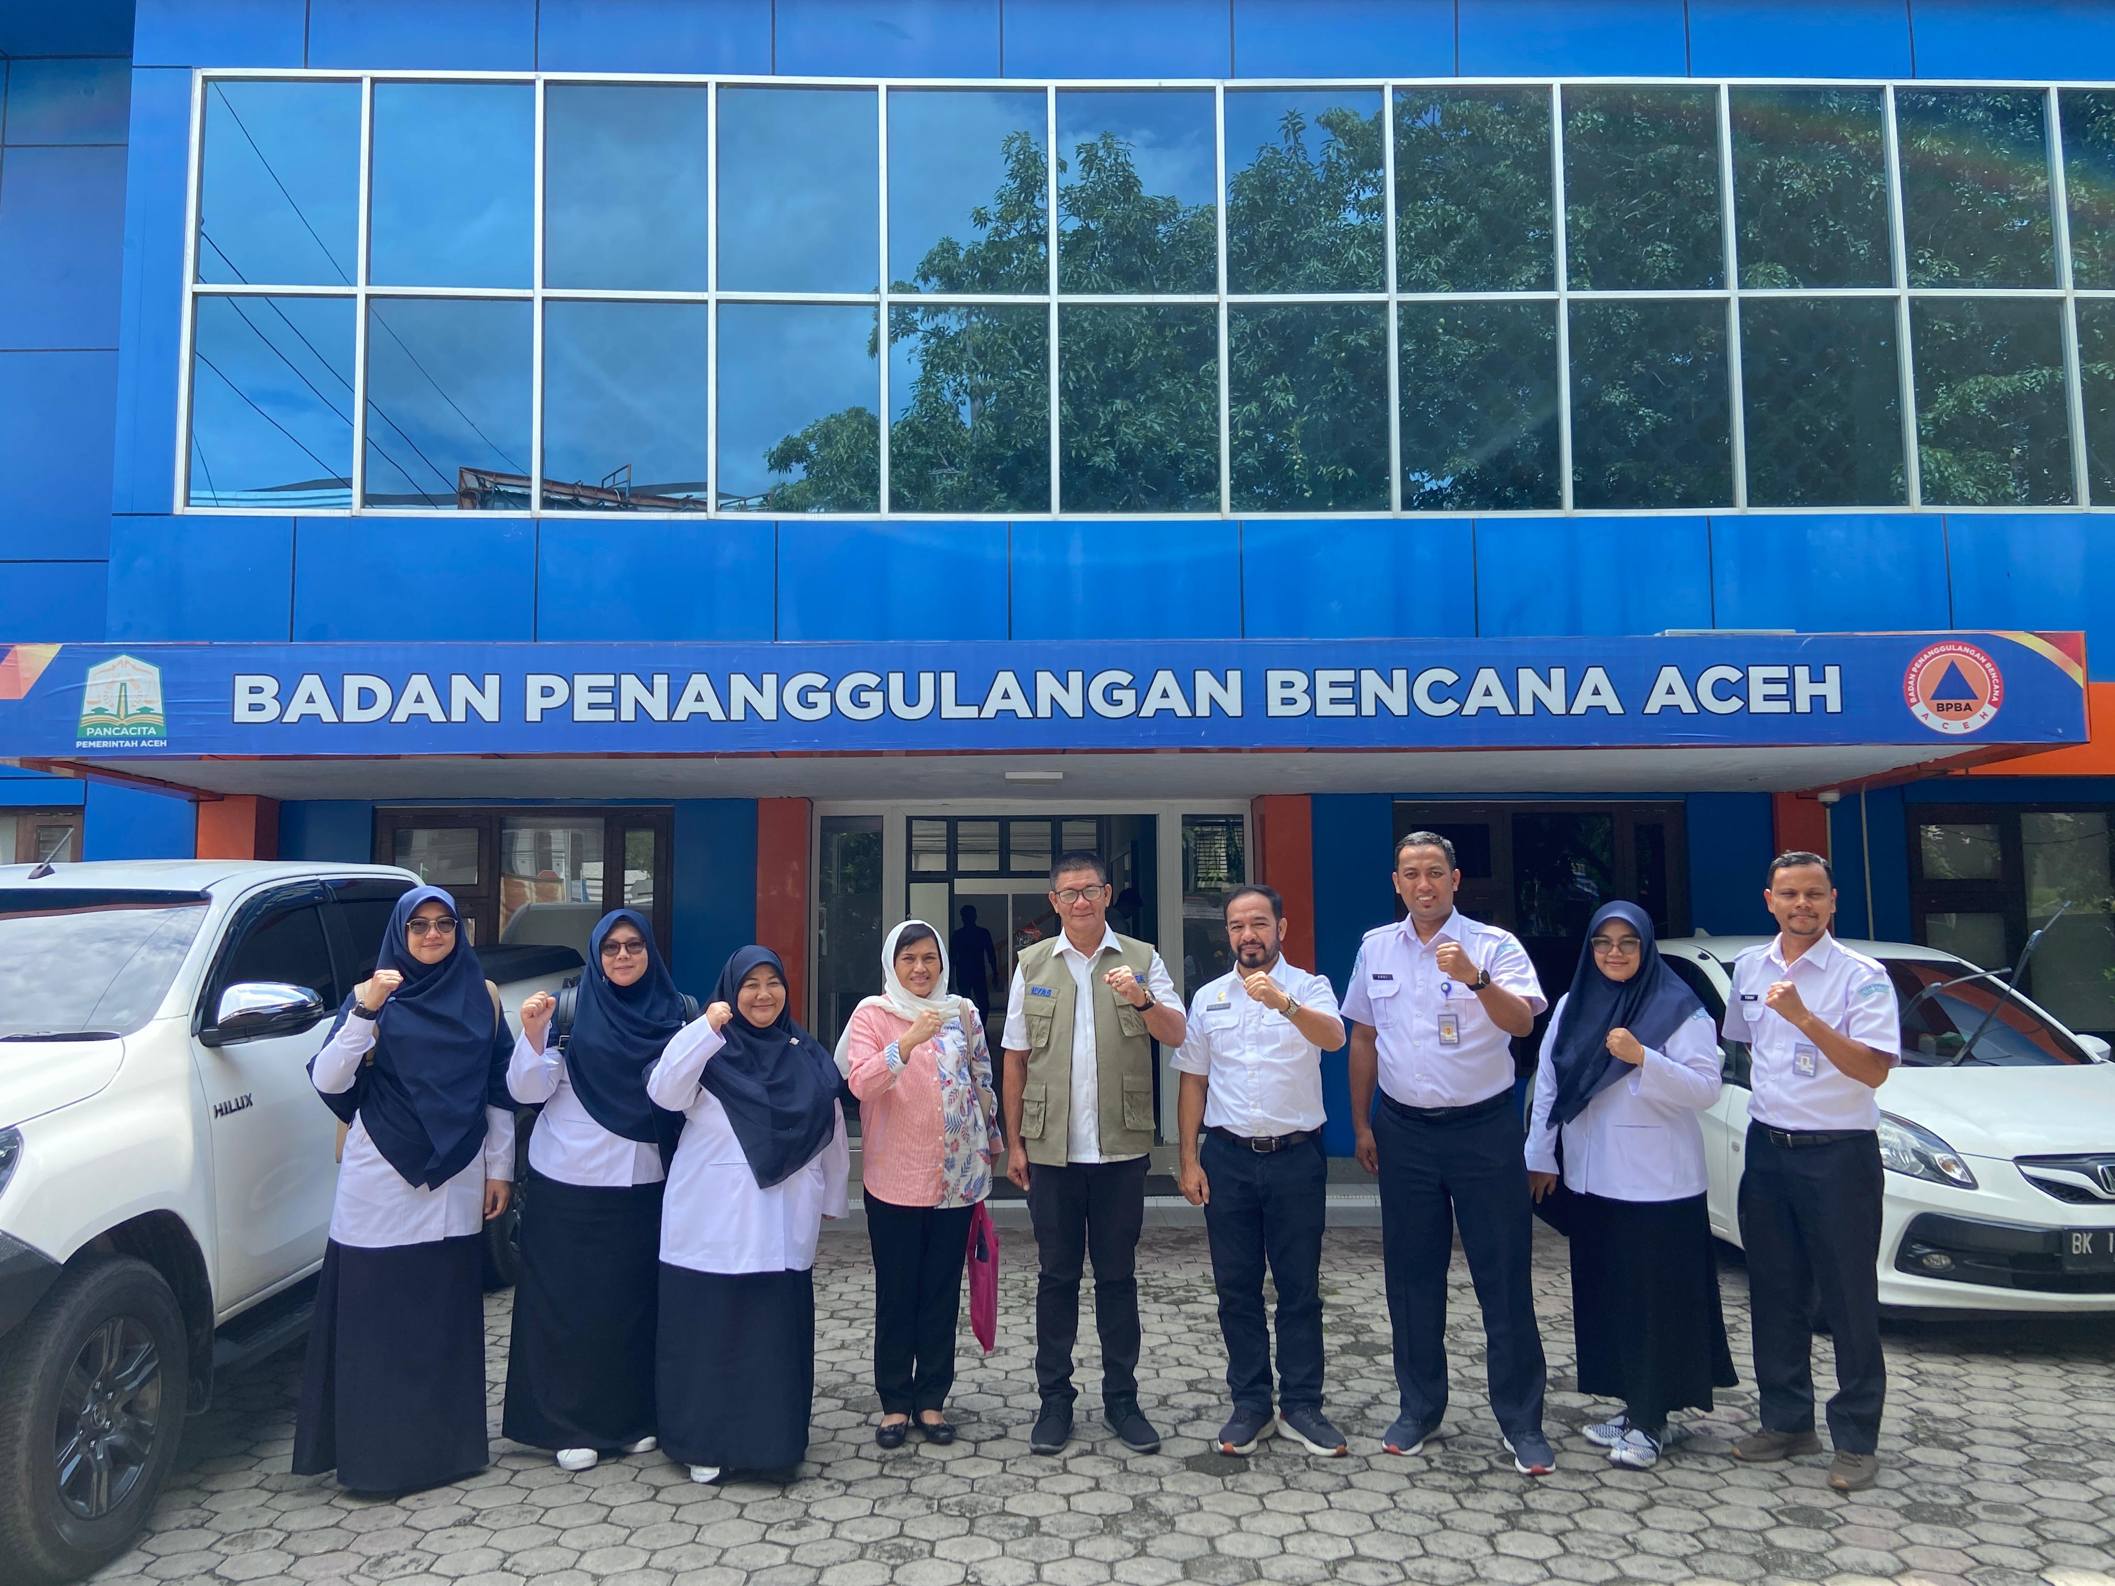
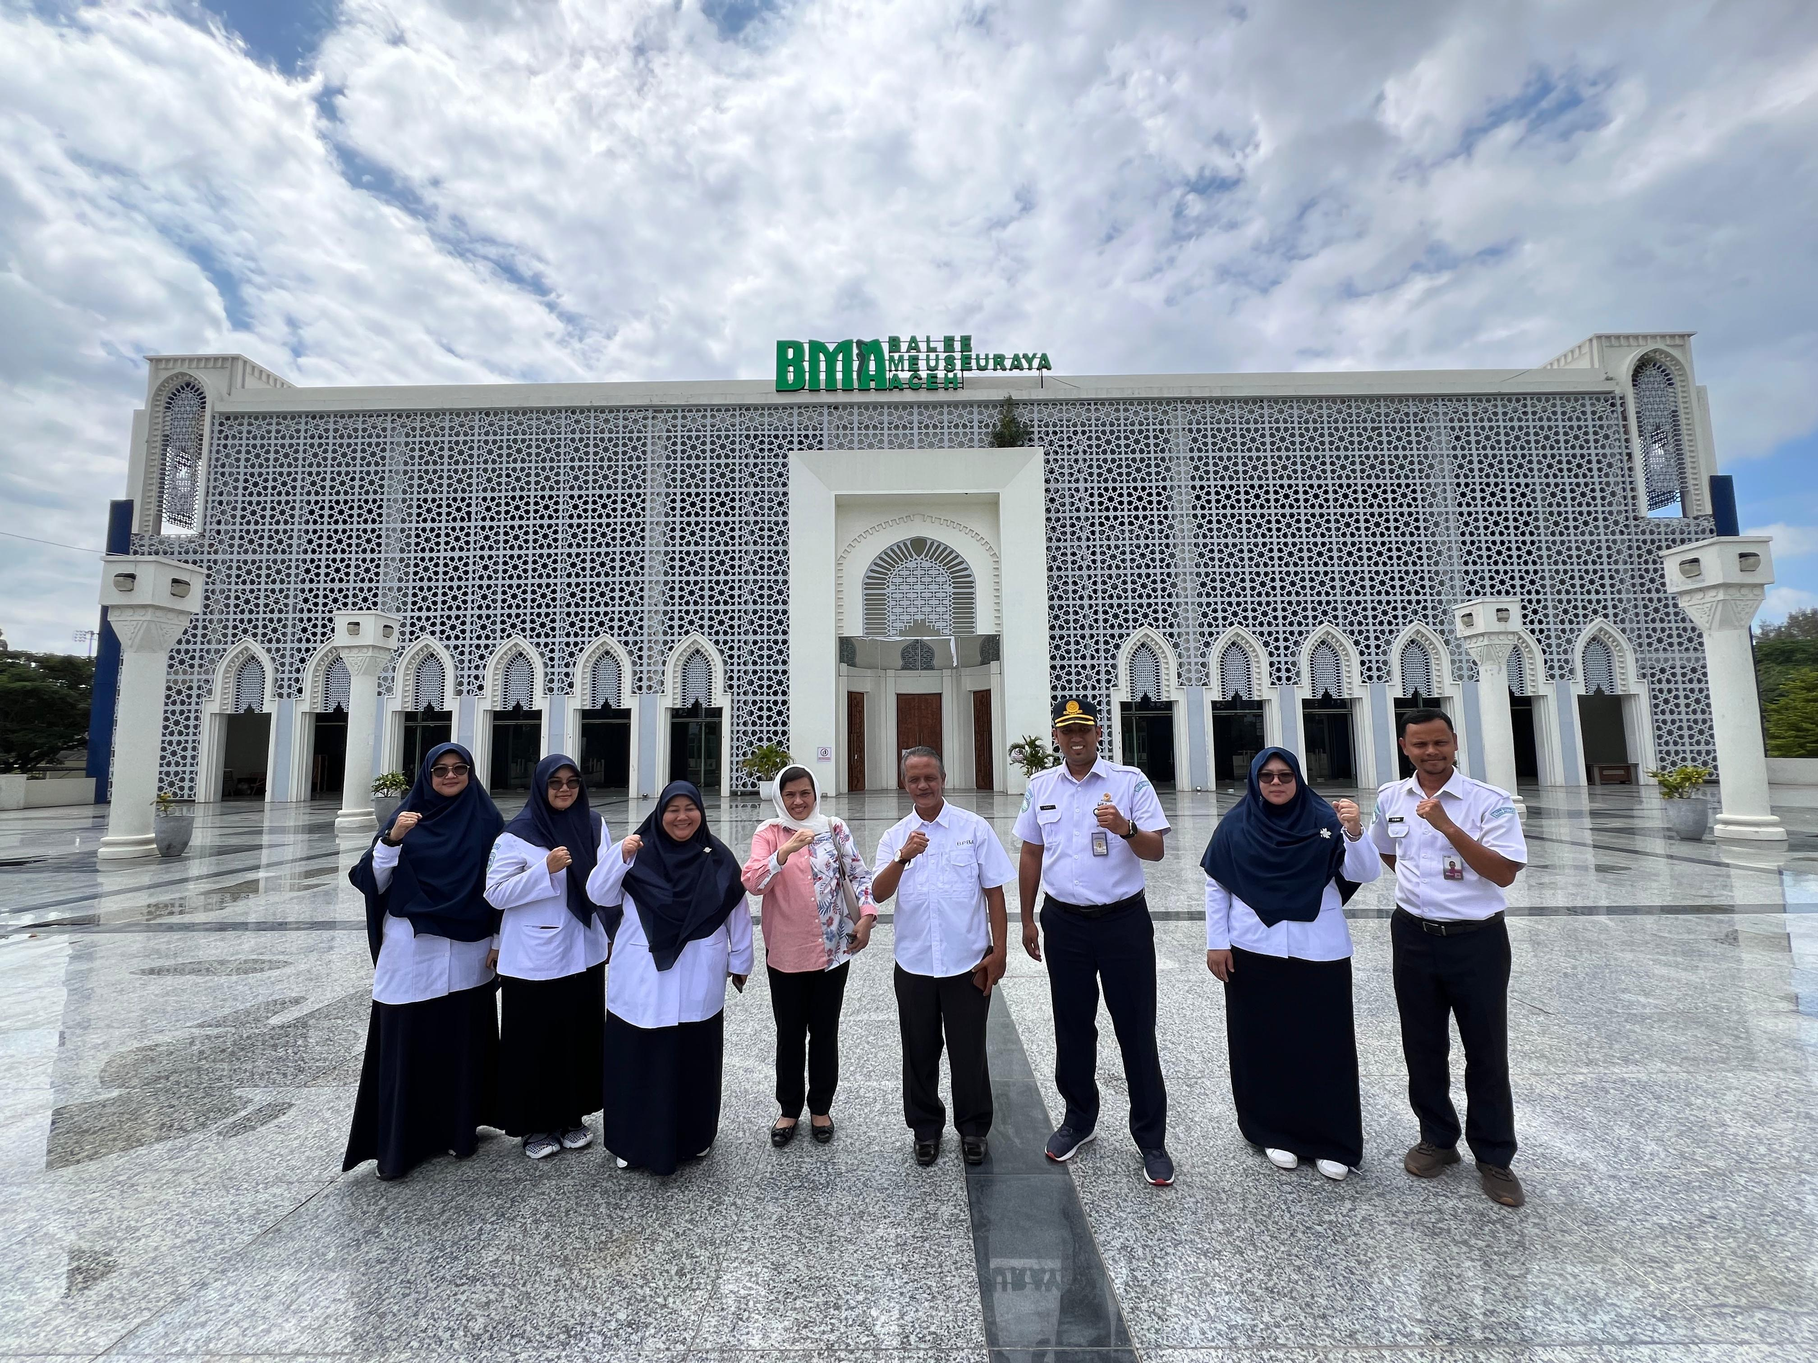
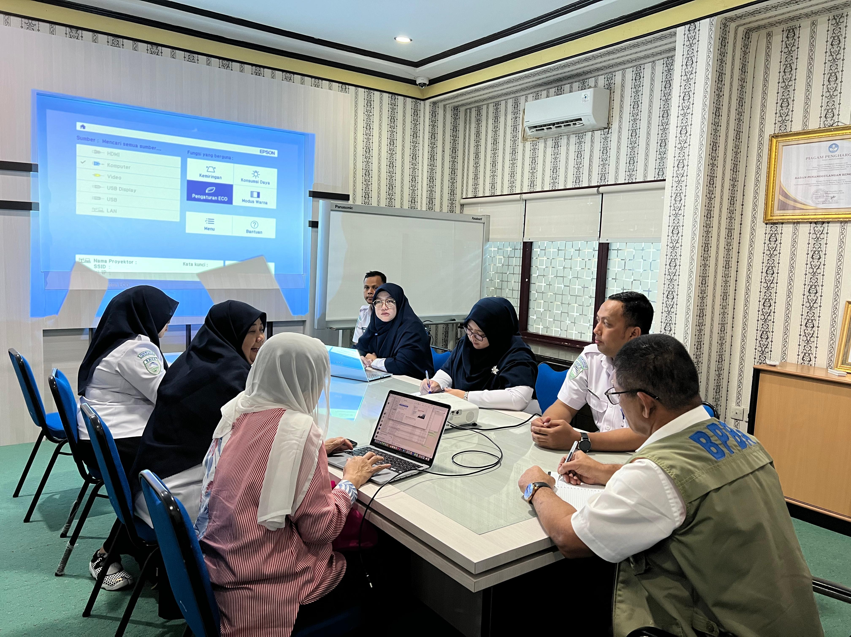
Courtesy Local Governments and Site Visits (19-21 December 2024)
Courtesy to Vice Rector of USK and TDRMC
Courtesy to Vice Rector of USK and TDRMC

Slide 40
Socialization Presentation for the Symposium
Steering Group online meeting (January 2024)
UN ODTP meeting in UNESCO Headquarter Paris, 25-26 January 2024
ICG/CARIBE EWS Midterm Officers Meeting - Day 2 – online 2 February 2024
Indian Ocean Decade Conference in Hyderabad India – offline 2 February 2024
ICG/NEAMTWS-XVIII - Eighteenth Session of the Intergovernmental Coordination Group for the Tsunami Early Warning and Mitigation System in the North- Eastern Atlantic, the Mediterranean and connected Seas - online 7 February 2024 (today)

Slide 41
Post Event: UNESCO IOC/ICG IOTWMS XIV
In BMKG Jakarta / Banda Aceh
16-19 November 2024 (tbd with Chair of ICG IOTWMS)

