Slide 1
Node Training
SG-12
2024-03-25/26
Elizabeth Lawrence, Pieter Provoost, Silas Principe, Ward Appeltans

Slide 2
Darwin Core
Notes:
This first session will cover DwC, which is an important data standard that OBIS data must adhere to

Slide 3
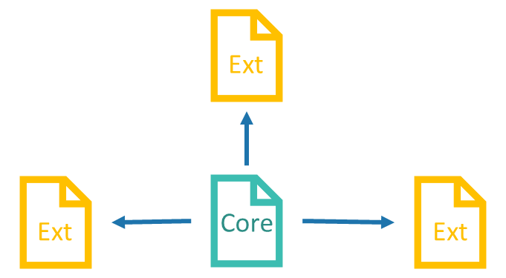
What is Darwin Core (DwC)?
A body of standards to facilitate sharing biodiversity information, includes
identifiers
labels
definitions
Provides stable terms and vocabularies related to biological objects, data, and their collection
Maintained by TDWG (Biodiversity Information Standards, formerly The International Working Group on Taxonomic Databases)
Notes:
SO what is DwC? It’s a body of standards that incudes standardized identifers, labels, and definitions, all of which are used to make it easier to share biodiversity information
It includes stable terms and vocabularies that relate to biological objects, data and how these are collected.
The body responsibile for maintaining this standard is TDWG, or Biodiv information standards

Slide 4
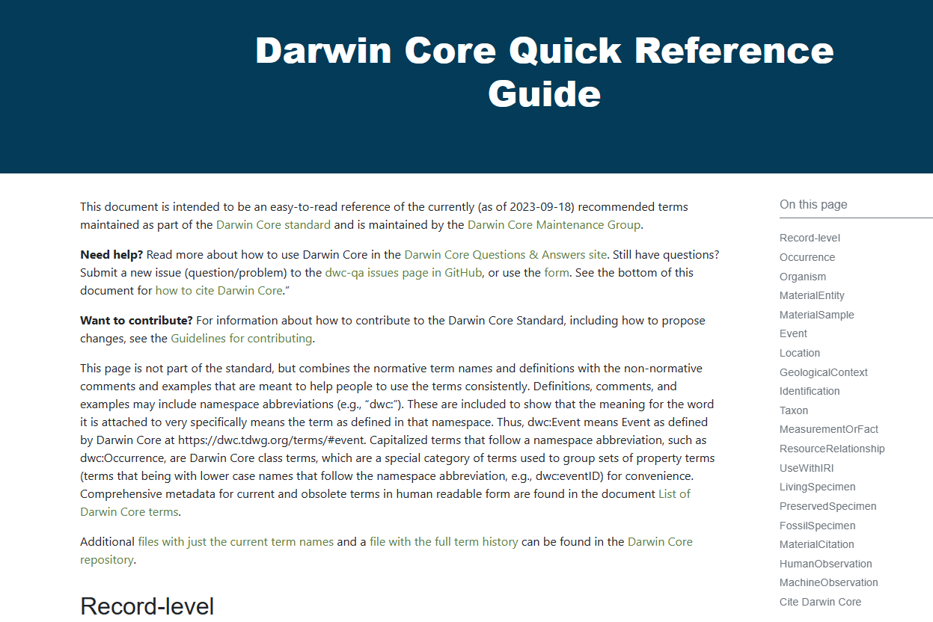
Bookmark!
https://dwc.tdwg.org/terms/
Notes:
There is a DwC Quick Reference guide which can be extremely useful and I suggest book marking the page so you can easily access it. Let’s take a look at the page to see some examples of DwC terms…
Note to self: show this page to demon some examples

Slide 5
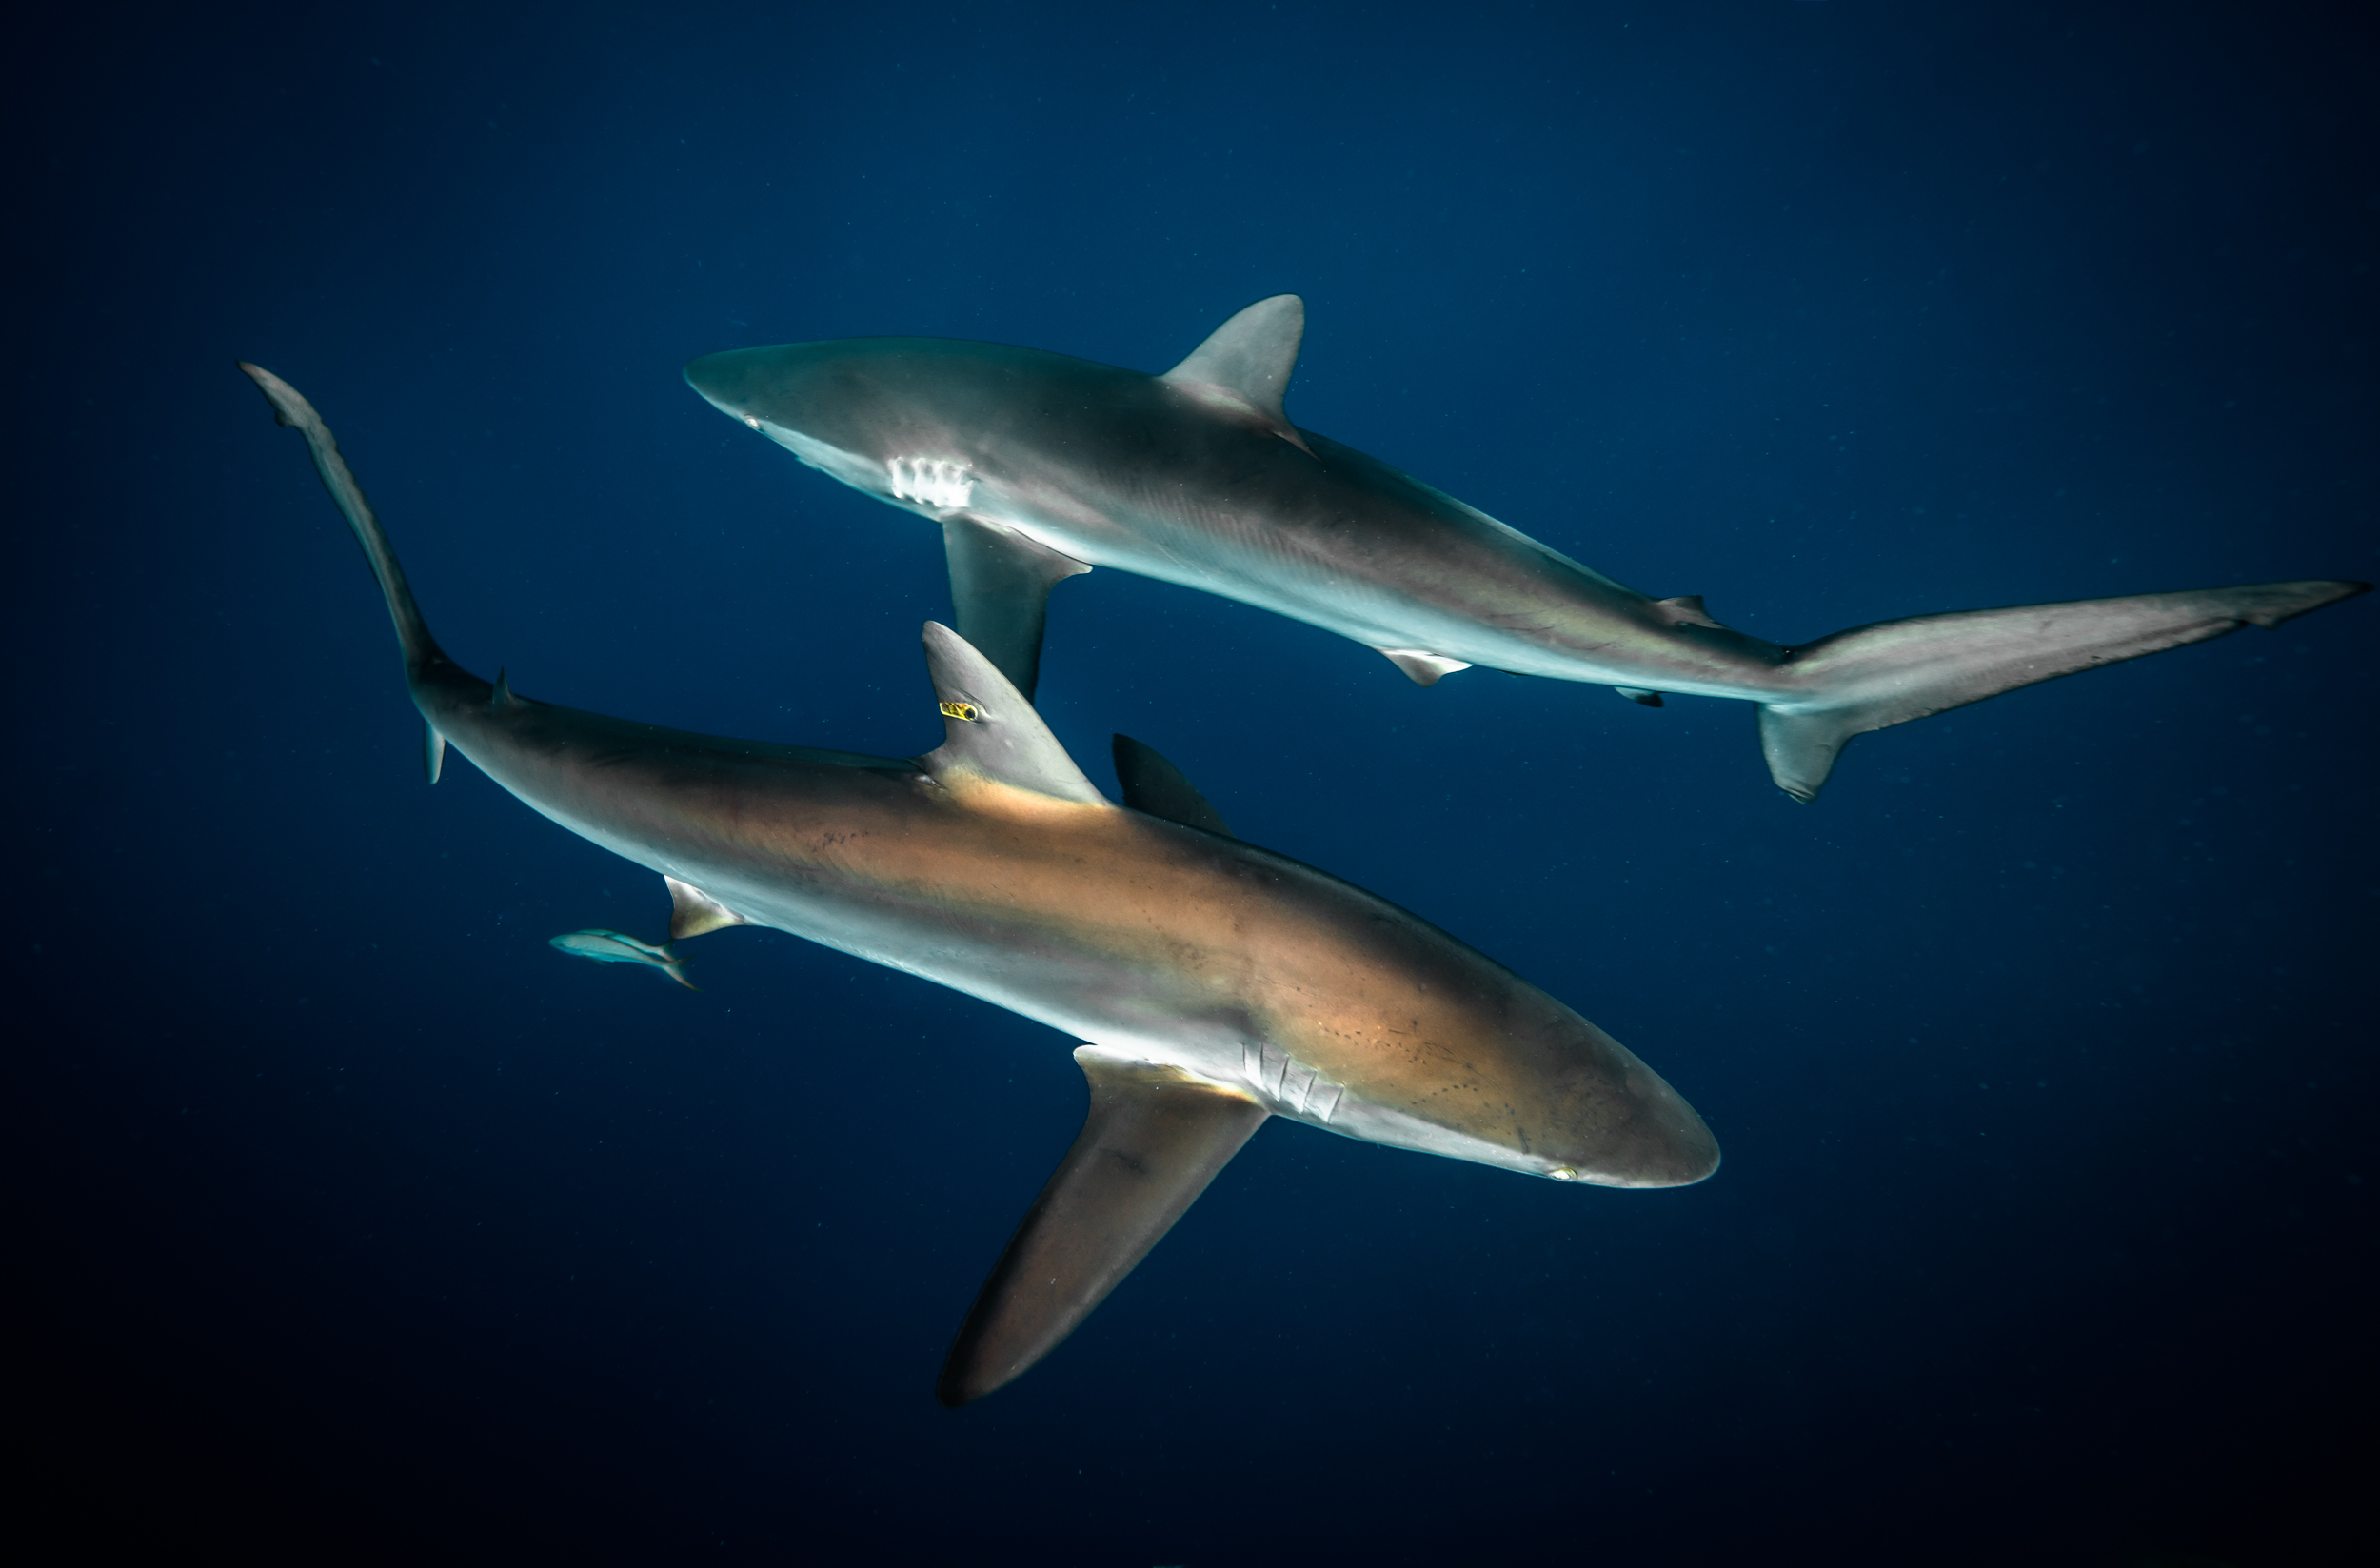
OBIS Required DwC terms
eventDate
eventID
decimalLatitude
decimalLongitude
occurrenceID
occurrenceStatus
basisOfRecord
scientificName
Credit: Philip Hamilton / Ocean Image Bank
https://manual.obis.org/checklist.html#darwin-core-term-checklist-for-obis
Notes:
Now that we’ve seen some DwC terms it’s important to know which ones are important to include in your dataset. As we saw there are a lot of terms, but the minimum terms required for datasets being published to OBIS include …

Slide 6
OBIS Required DwC terms
eventDate
eventID
decimalLatitude
decimalLongitude
occurrenceID
occurrenceStatus
basisOfRecord
scientificName
Date at which an event or observation occurred
Must be provided in ISO 8601 formatting
e.g. YEAR-MM-DDTHH:MM:SS
2023-01-24
1932-03-12T08:20
2001-10
1989
See Manual for more examples
https://manual.obis.org/checklist.html#darwin-core-term-checklist-for-obis

Slide 7
OBIS Required DwC terms
eventDate
eventID
decimalLatitude
decimalLongitude
occurrenceID
occurrenceStatus
basisOfRecord
scientificName
Stable, unique identifiers used to distinguish between separate events (e.g. samples, sub-samples, observation periods, etc) and occurrences (e.g. individual species identifications)
Can be manually created or machine-created
Examples:
eventID: CRUISE_2000_day1_tow1
occurrenceID: CRUISE_2000_day1_tow1_spp1
https://manual.obis.org/checklist.html#darwin-core-term-checklist-for-obis

Slide 8
OBIS Required DwC terms
eventDate
eventID
decimalLatitude
decimalLongitude
occurrenceID
occurrenceStatus
basisOfRecord
scientificName
Must be in decimal degrees
Record original formatting in verbatimLatitude/Longitude
https://manual.obis.org/checklist.html#darwin-core-term-checklist-for-obis

Slide 9
OBIS Required DwC terms
eventDate
eventID
decimalLatitude
decimalLongitude
occurrenceID
occurrenceStatus
basisOfRecord
scientificName
occurrenceStatus must be PRESENT or ABSENT
basisOfRecord must be one of:
HumanObservation
MaterialSample (e.g. for DNA samples)
MachineObservation
LivingSpecimen
PreservedSpecimen
FossilSpecimen
…
Darwin Core Basis of Record Vocabulary
https://manual.obis.org/checklist.html#darwin-core-term-checklist-for-obis

Slide 10
OBIS Required DwC terms
eventDate
eventID
decimalLatitude
decimalLongitude
occurrenceID
occurrenceStatus
basisOfRecord
scientificName
Name down to the lowest certain taxonomic identification, include authorship
Also strongly recommended to include
scientificNameID (from World Register Marine Species WoRMS)
https://manual.obis.org/checklist.html#darwin-core-term-checklist-for-obis

Slide 11
Data files…
Notes:
Okay we know about DwC terms and that the column names in our data should use these, but what about the datasheets themselves?

Slide 12
Data files…
Notes:
Data files are usually one or more spreadsheets or other file and data could spread out in different locations, or all in one. This can make it really difficult to interpret different datasets if there’s no standard way of structuring the data

Slide 13
Data files…
& Darwin Core-Archive
Ext
Ext
Core
Ext
Notes:
This is where DwC and the DwC-Archive comes in! It provides a standard way to structure datasets. there is one “core” data table and then there are optional extension data tables

Slide 14
Data files…
& Darwin Core-Archive
Ext
Ext
Core
Ext
Occurrence core
Event core

Slide 15
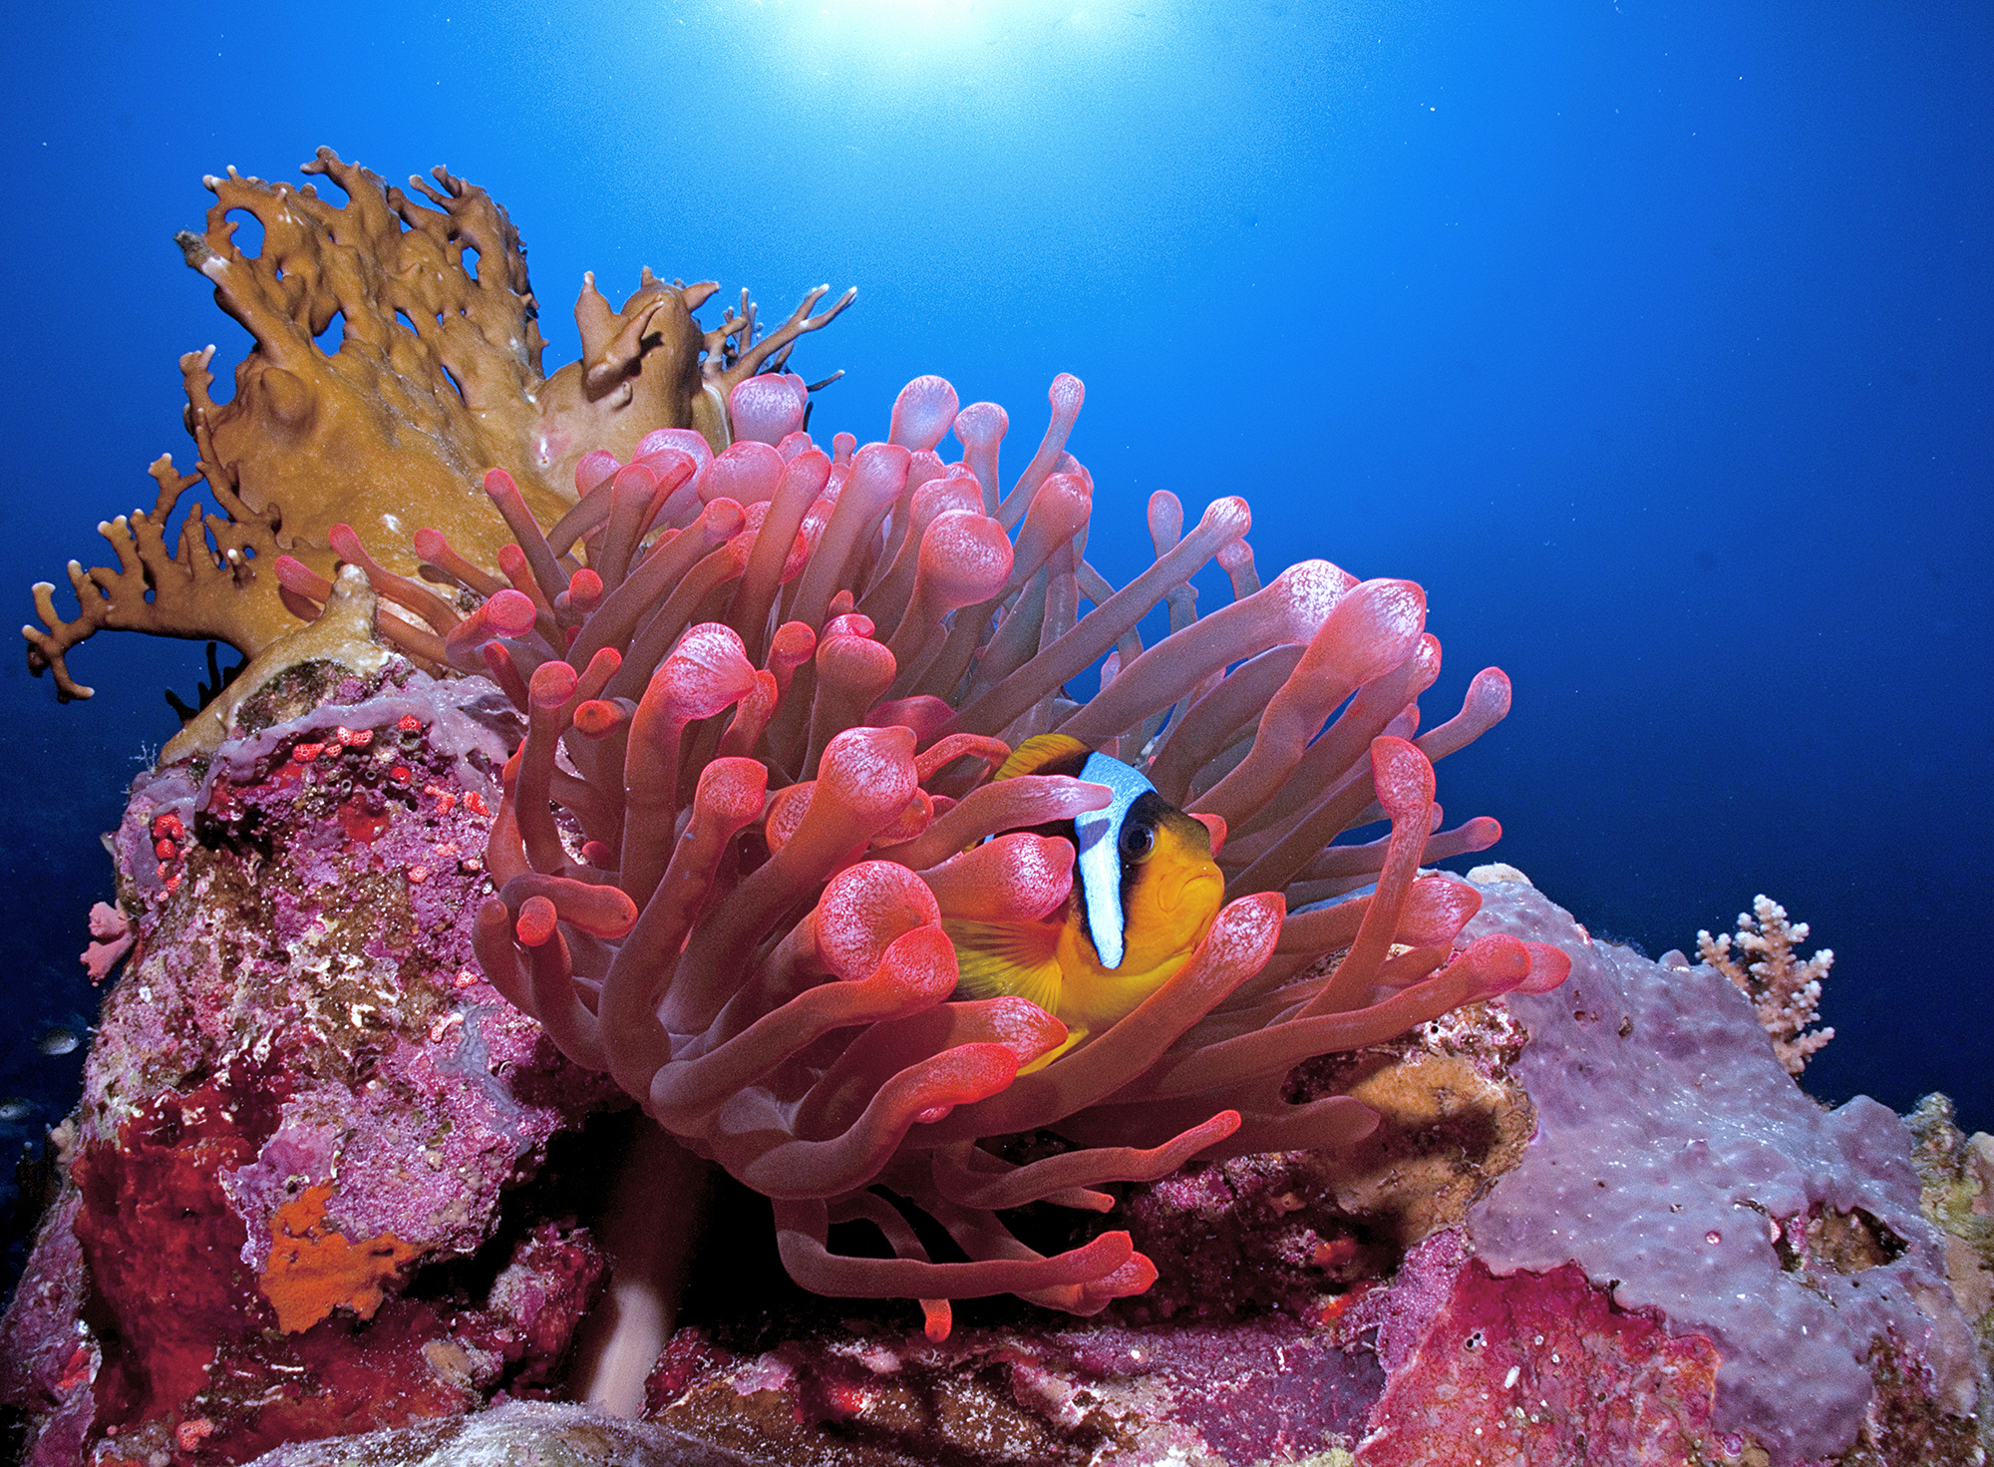
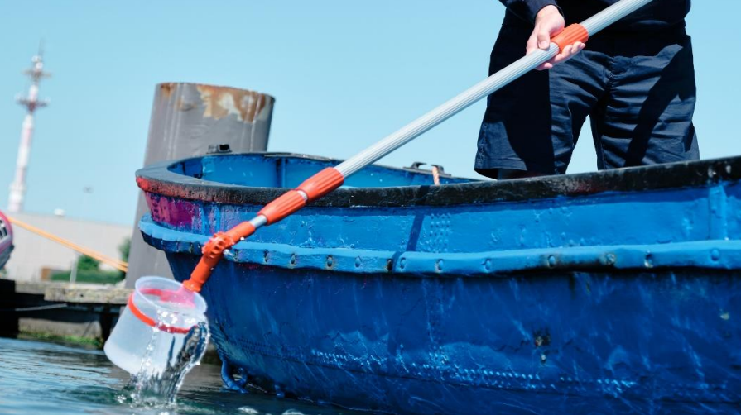
Ext
Ext
Core
Ext
Occurrence core
Event core
Credit: Cinzia Osele Bismarck / Ocean Image Bank
No sampling information
Measurements only on single occurrence
DNA derived data
eDNA sampling https://unesdoc.unesco.org/ark:/48223/pf0000384014 (C) UNESCO/Raw Visuals LTD and (C) UNESCO/Ward Appeltans

Slide 16
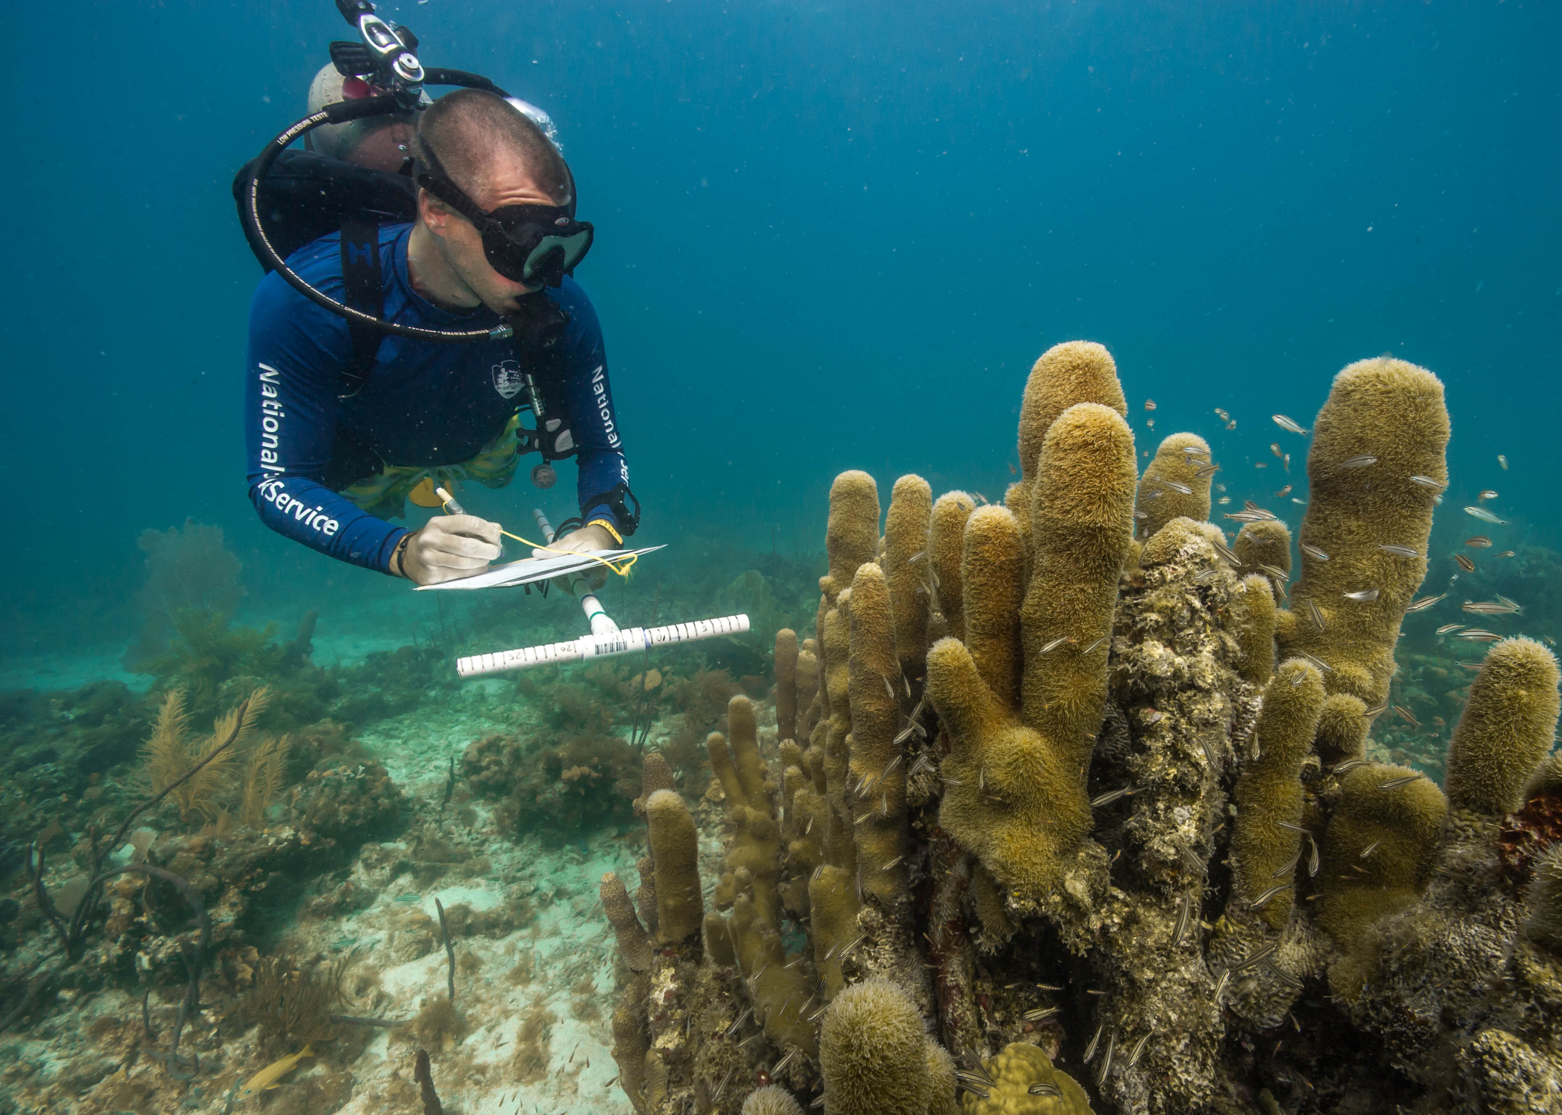
Ext
Ext
Core
Ext
Occurrence core
Event core
Credit: Cinzia Osele Bismarck / Ocean Image Bank
No sampling information
Measurements only on single occurrence
DNA derived data
Known sampling information
Measurements on entire sample
eDNA sampling https://unesdoc.unesco.org/ark:/48223/pf0000384014 (C) UNESCO/Raw Visuals LTD and (C) UNESCO/Ward Appeltans
Credit: Shaun Wolfe / Ocean Image Bank
Notes:
This will be one of the first steps

Slide 17
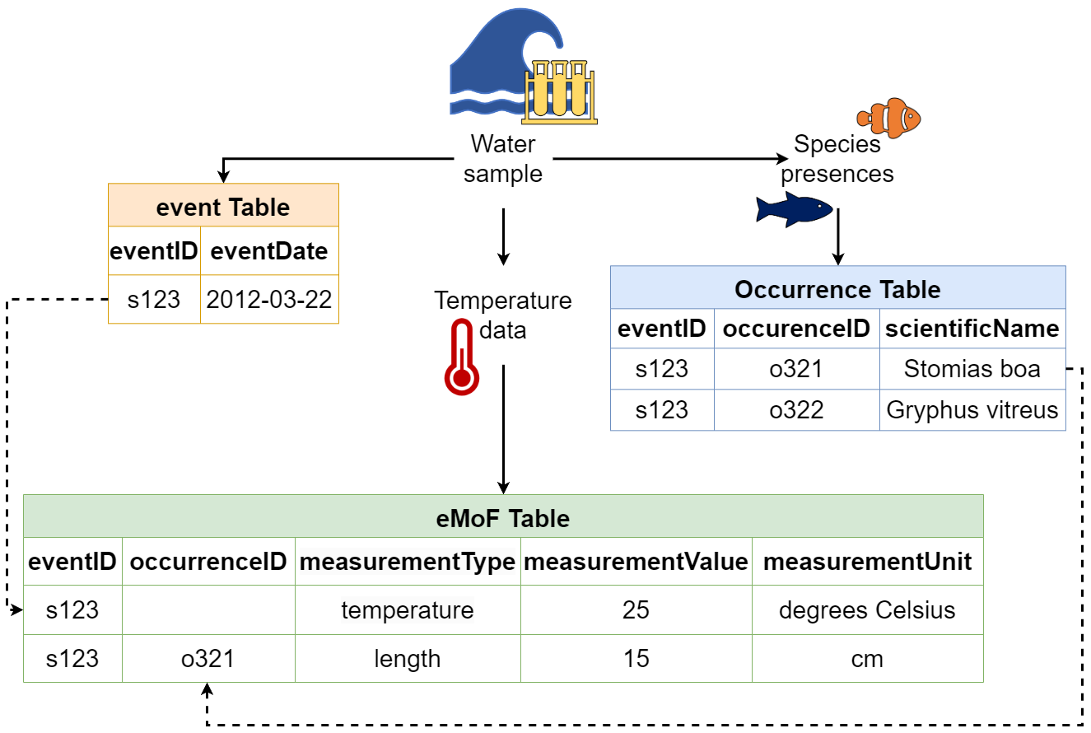
Extension tables
Connect additional information to the core table
Includes
Occurrence (when Event core is used)
extendedMeasurementOrFact
DNA derived data
…more
Uses unique identifiers (occurrenceID or eventID)

Slide 18
How to choose?

Slide 19
How to choose?

Slide 20
How to choose?
Occurrence
Occurrence

Slide 21
Exercise:
Use the flow chart to determine what kind dataset structure is best suited for each example:
Individual whale sightings at sea
eDNA samples from rocky intertidal with temperature and salinity measurements
Harbour monitoring program collecting fish samples and water quality parameters
Historical data on presence of benthic invertebrates from 1800-2000
Citizen science event where species presences along shoreline were recorded at several sites

Slide 22
Individual whale sightings at sea
eDNA samples from rocky intertidal with temperature and salinity measurements
Harbour monitoring program collecting fish samples and water quality parameters
Historical data on presence of benthic invertebrates from 1800-2000
Citizen science event where species presences along shoreline were recorded at several sites
Occurrence
Occurrence

Slide 23
Exercise:
Use the flow chart to determine what kind dataset structure is best suited for each example:
Individual whale sightings at sea
eDNA samples from rocky intertidal with temperature and salinity measurements
Harbour monitoring program collecting fish samples and water quality parameters
Historical data on presence of benthic invertebrates from 1800-2000
Citizen science event where species presences along shoreline were recorded at several sites
Occurrence core only
Occurrence core + DNA derived data + eMoF
Event core + Occurrence + eMoF
Occurrence core only
Event core + Occurrence

Slide 24
Break!

Slide 25
JupyterHub & OBIS Products
https://iobis.github.io/sg-12-training/

Slide 26
Git & GitHub
https://iobis.github.io/sg-12-training/

Slide 27
eMoF & Controlled Vocabulary

Slide 28
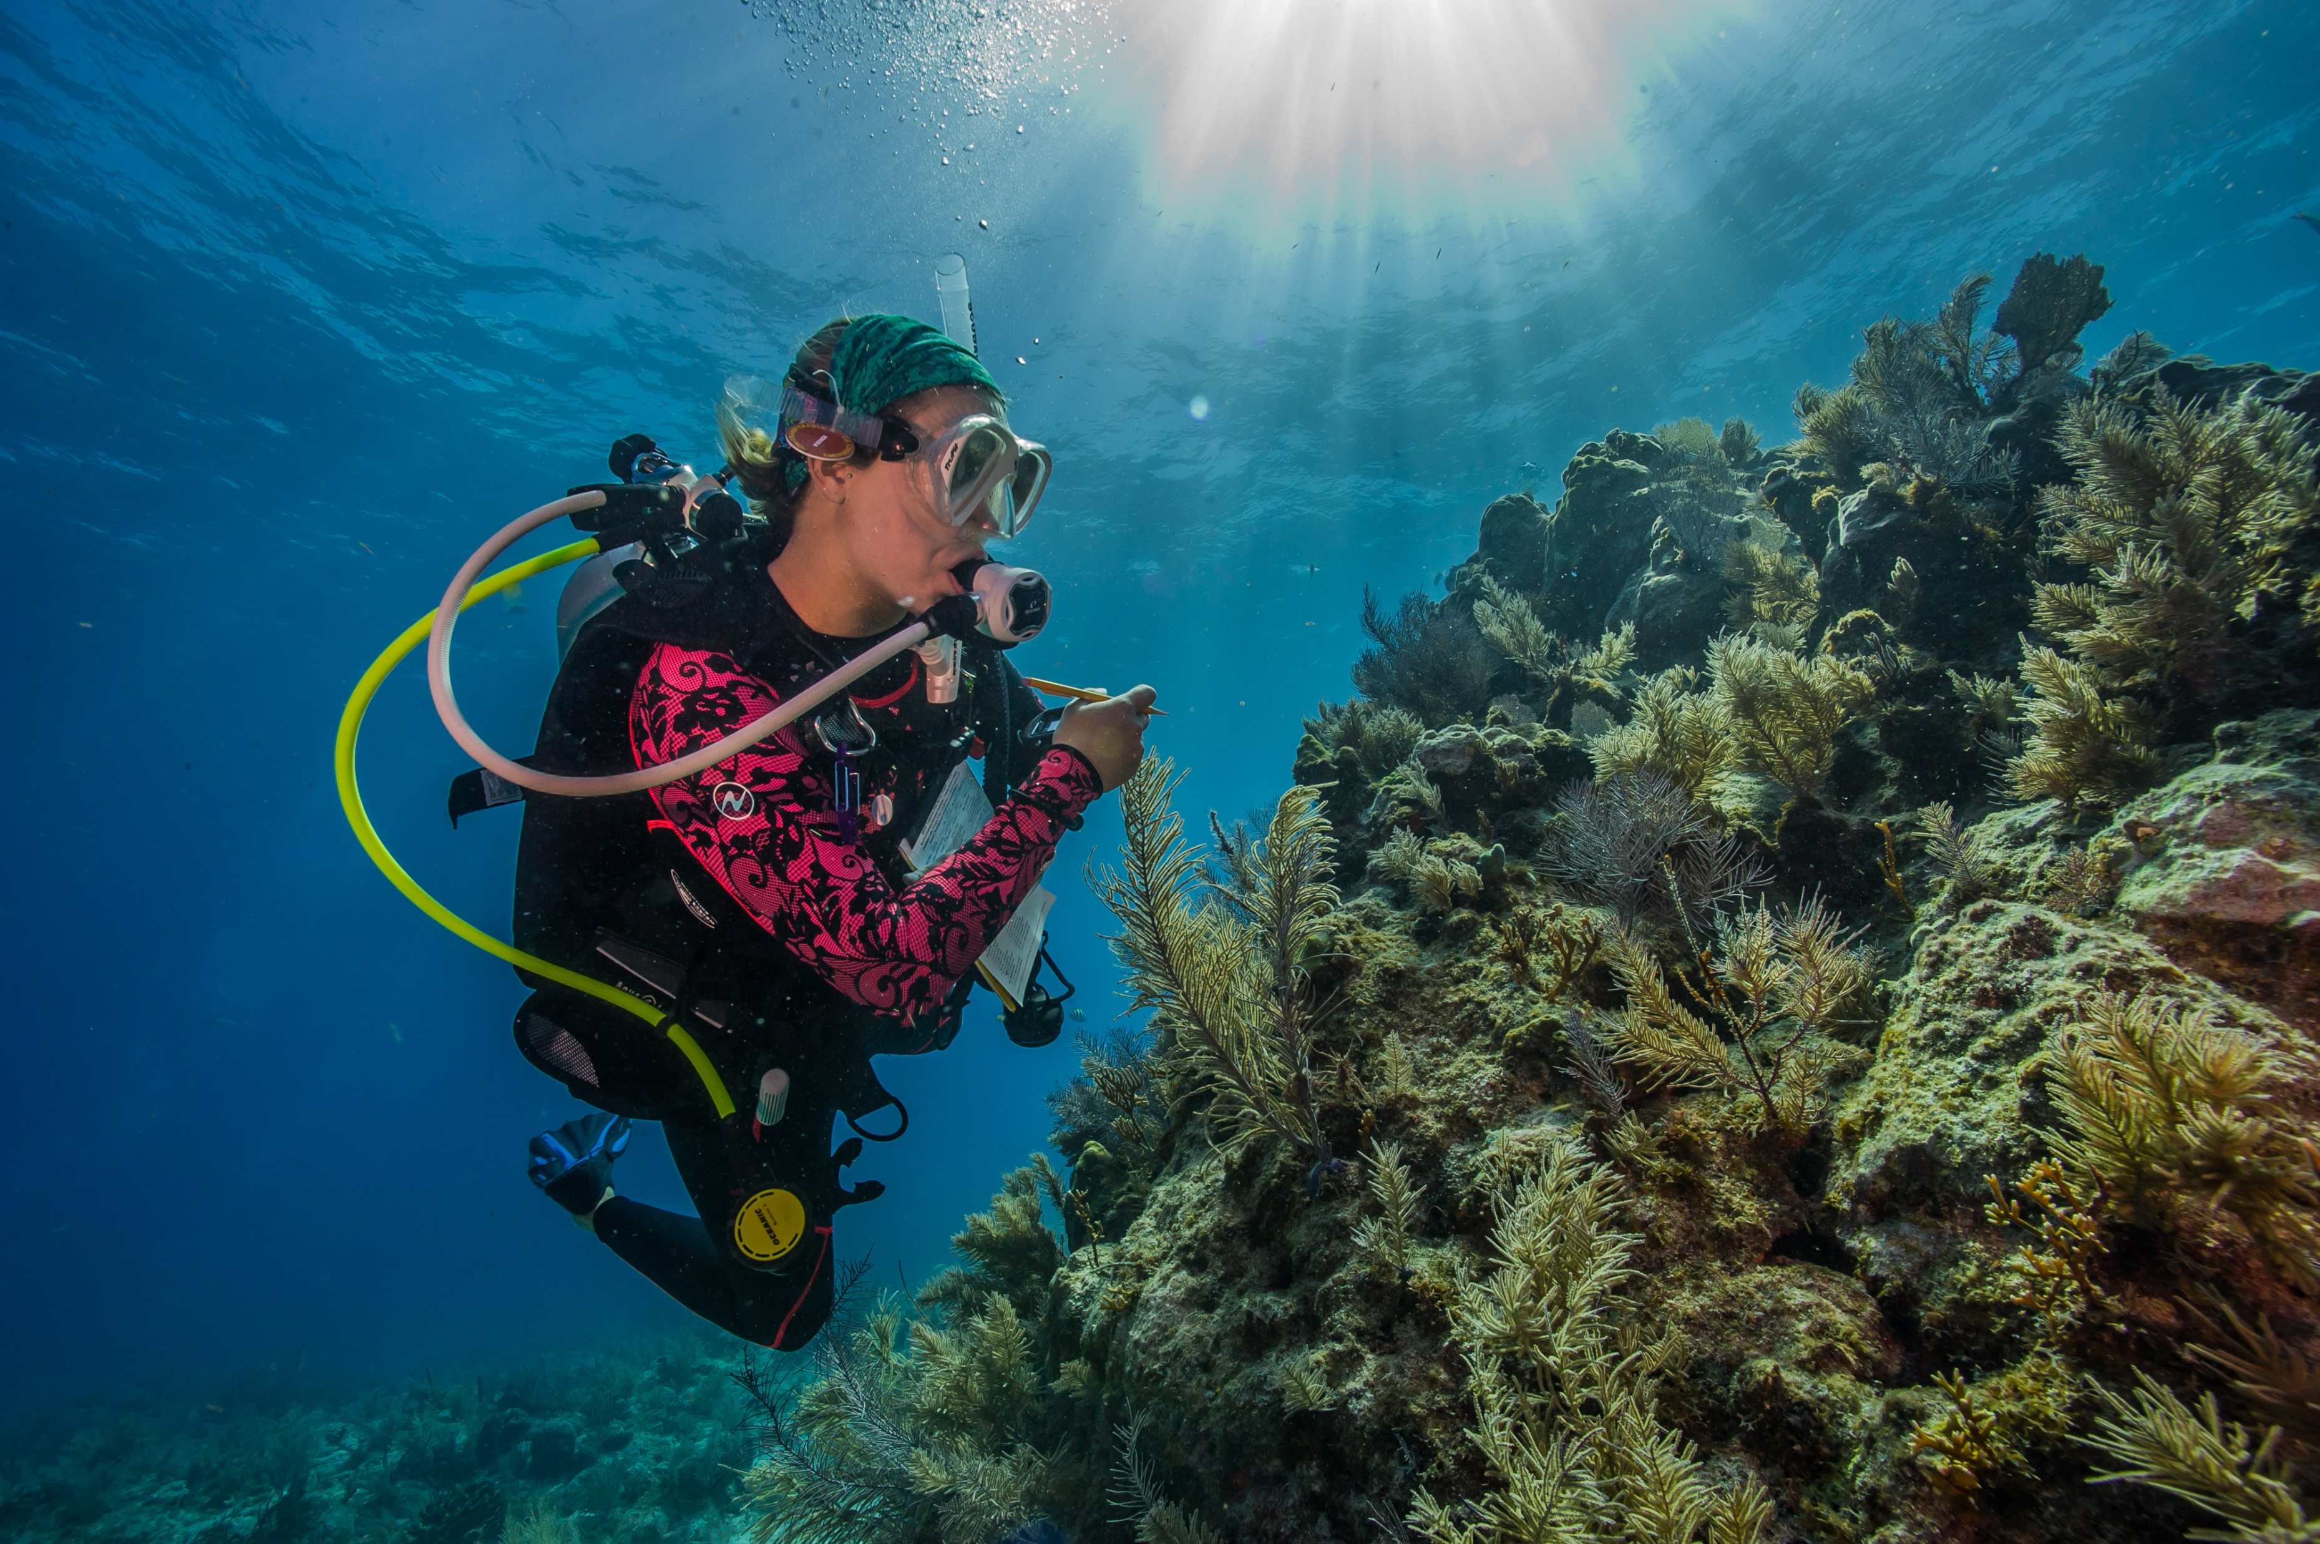
extendedMeasurementOrFact table
Extension table to record all types of measurements (abiotic, biotic, sampling...)
Credit: Shaun Wolfe / Ocean Image Bank

Slide 29
extendedMeasurementOrFact table
Extension table to record all types of measurements (abiotic, biotic, sampling...)
Measurements in long format
speciesID | measurementType | measurementValue | measurementUnit
spp1 | length | 15 | um
spp1 | net diameter | 30 | cm
spp1 | net length | 60 | cm
spp1 | temperature | 5 | C
spp1 | name of net | KC Denmark AS small plankton net
speciesID | Length (um) | Temperature (C) | Net
spp1 | 15 | 10 | 30cm Denmark AS small plankton net
spp2 | 30 | 12 | 30cm Denmark AS small plankton net
spp3 | 23 | 11 | 100 cm Denmark AS small plankton net

Slide 30
extendedMeasurementOrFact table
Extension table to record all types of measurements (abiotic, biotic, sampling...)
Measurements in long format
measurementType recorded as free text = heterogeneity
speciesID | measurementType | measurementValue | measurementUnit
spp1 | length | 15 | um
spp1 | net diameter | 30 | cm
spp1 | net length | 60 | cm
spp1 | temperature | 5 | C
spp1 | name of net | KC Denmark AS small plankton net
len
carapace length
length
lnth
survey length
fish length
fork length
longueur
largo
total length
mean length
standard length

Slide 31
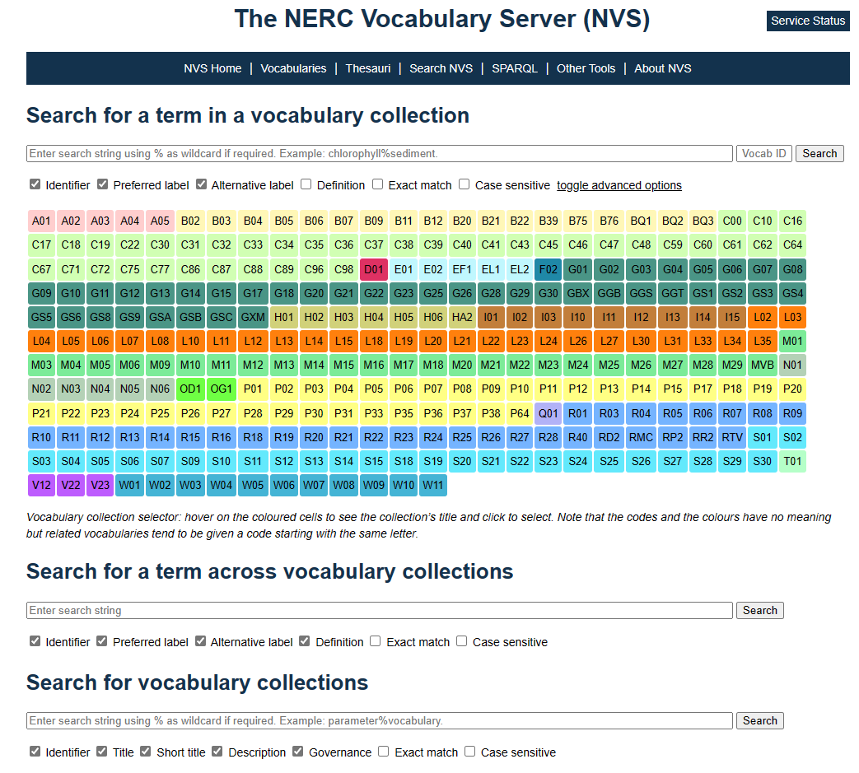
Controlled Vocabulary
Use identifiers for each mof column (as applicable)
measurementTypeID
measurementValueID
non-numeric values
measurementUnitID
OBIS recommends populating these with NERC vocabulary collections
https://vocab.nerc.ac.uk/search_nvs/

Slide 32
Controlled Vocabulary
Use identifiers for each mof column (as applicable)
measurementTypeID
measurementValueID
non-numeric values
measurementUnitID
OBIS recommends populating these with NERC vocabulary collections
https://vocab.nerc.ac.uk/search_nvs/

Slide 33
Controlled Vocabulary
Use identifiers for each mof column (as applicable)
measurementTypeID
measurementValueID
non-numeric values
measurementUnitID
OBIS recommends populating these with NERC vocabulary collections
https://vocab.nerc.ac.uk/search_nvs/

Slide 34
Controlled Vocabulary
Use identifiers for each mof column (as applicable)
measurementTypeID
measurementValueID
non-numeric values
measurementUnitID
OBIS recommends populating these with NERC vocabulary collections
Many collections, e.g. C35, L22, L05, C17, S10, S11…
https://vocab.nerc.ac.uk/search_nvs/

Slide 35
What are vocabulary codes?
Labels for data composed of different elements (with perhaps sub-elements)
P01 collection is biggest and most relevant for OBIS
Each element is associated with different NERC collection(s)

Slide 36
What are vocabulary codes?
Labels for data composed of different elements (with perhaps sub-elements)
P01 collection is biggest and most relevant for OBIS

Slide 37
What are vocabulary codes?
Labels for data composed of different elements (with perhaps sub-elements)
P01 collection is biggest and most relevant for OBIS
EXAMPLES
2. mantle, wing, arm..
4. Particles > threshold

Slide 38
How to find & choose vocabulary codes
measurementTypeID STRONGLY recommend SeaDataNet P01 facet search

Slide 39
How to find & choose vocabulary codes
measurementTypeID STRONGLY recommend SeaDataNet P01 facet search
measurementUnitID and measurementValueID respective NERC vocabulary collections

Slide 40
Vocabulary decision tree
Available on OBIS Manual: https://manual.obis.org/vocabulary.html#selecting-p01-codes-for-measurementtypeid
YouTube tutorial videos:
https://www.youtube.com/playlist?list=PLlgUwSvpCFS4hADB7Slf44V1KJauEU6Ul

Slide 41
Vocabulary decision tree
measurementUnitID
P06 collection
Available on OBIS Manual: https://manual.obis.org/vocabulary.html#selecting-p01-codes-for-measurementtypeid
YouTube tutorial videos:
https://www.youtube.com/playlist?list=PLlgUwSvpCFS4hADB7Slf44V1KJauEU6Ul
Notes:
Self: show the P06 collection

Slide 42
Vocabulary decision tree
Explore C35
measurementValueID
(non-exhaustive)
Available on OBIS Manual: https://manual.obis.org/vocabulary.html#selecting-p01-codes-for-measurementtypeid
YouTube tutorial videos:
https://www.youtube.com/playlist?list=PLlgUwSvpCFS4hADB7Slf44V1KJauEU6Ul
Notes:
Note to self after showing C35 show some others

Slide 43
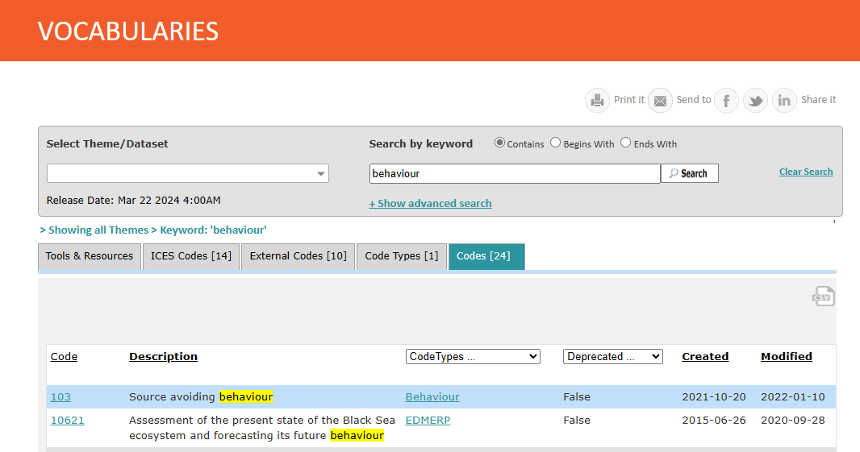
Vocabulary decision tree
Demo: https://vocab.ices.dk/
measurementValueID
(non-exhaustive)
Available on OBIS Manual: https://manual.obis.org/vocabulary.html#selecting-p01-codes-for-measurementtypeid
YouTube tutorial videos:
https://www.youtube.com/playlist?list=PLlgUwSvpCFS4hADB7Slf44V1KJauEU6Ul
URI for measurementValueID:
https://vocab.ices.dk/services/api/codedetail/d0268a96-afc9-436e-a4db-4f61c2b9f6ba/539a2cfa-03c9-400e-a3a0-a490b2c41e48

Slide 44
Vocabulary decision tree
measurementTypeID
Use with the SeaDataNet P01 facet search
(shown later)
Available on OBIS Manual: https://manual.obis.org/vocabulary.html#selecting-p01-codes-for-measurementtypeid
YouTube tutorial videos:
https://www.youtube.com/playlist?list=PLlgUwSvpCFS4hADB7Slf44V1KJauEU6Ul

Slide 45
Vocabulary decision tree
measurementTypeID
Available on OBIS Manual: https://manual.obis.org/vocabulary.html#selecting-p01-codes-for-measurementtypeid
YouTube tutorial videos:
https://www.youtube.com/playlist?list=PLlgUwSvpCFS4hADB7Slf44V1KJauEU6Ul

Slide 46
Vocabulary decision tree
measurementTypeID
Available on OBIS Manual: https://manual.obis.org/vocabulary.html#selecting-p01-codes-for-measurementtypeid
YouTube tutorial videos:
https://www.youtube.com/playlist?list=PLlgUwSvpCFS4hADB7Slf44V1KJauEU6Ul

Slide 47
Vocabulary decision tree
measurementTypeID
Available on OBIS Manual: https://manual.obis.org/vocabulary.html#selecting-p01-codes-for-measurementtypeid
YouTube tutorial videos:
https://www.youtube.com/playlist?list=PLlgUwSvpCFS4hADB7Slf44V1KJauEU6Ul

Slide 48
Vocabulary decision tree
measurementTypeID
E.g. http://vocab.nerc.ac.uk/collection/P01/current/ADBIOL01/
NOT ADBIOL01
Available on OBIS Manual: https://manual.obis.org/vocabulary.html#selecting-p01-codes-for-measurementtypeid
YouTube tutorial videos:
https://www.youtube.com/playlist?list=PLlgUwSvpCFS4hADB7Slf44V1KJauEU6Ul

Slide 49
P01 SeaDataNet facet search demo
https://vocab.seadatanet.org/p01-facet-search
Example terms:
Sea star arm length
Stable isotope of Carbon-13 from an organism by mass spectrometry
Starting depth

Slide 50
https://vocab.seadatanet.org/p01-facet-search
Sea star arm length
Carbon-13
Starting
depth

Slide 51
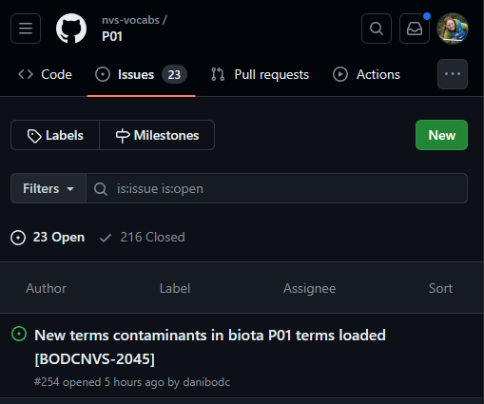
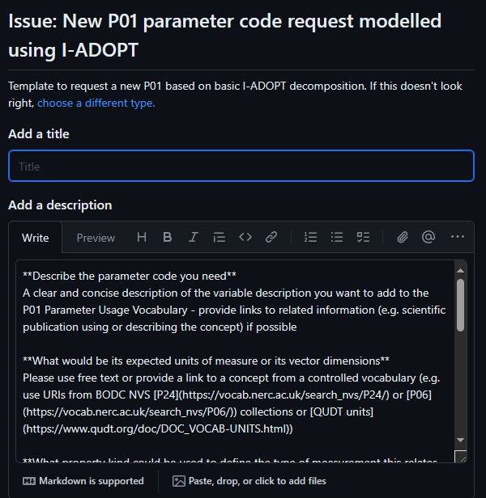
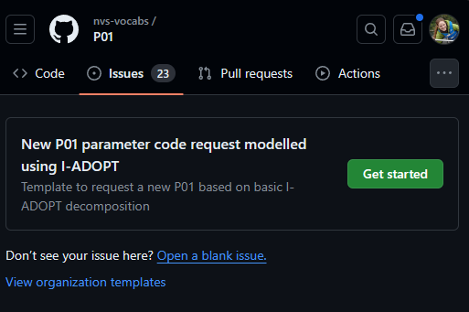
Request new code
Submit GitHub ticket: https://github.com/nvs-vocabs/P01/issues
1
3
2

Slide 52
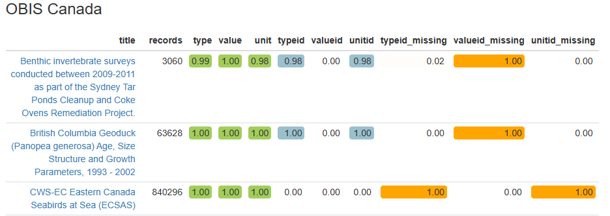
MoF Tools
Report: https://r.obis.org/mof/
Summary for each dataset per node

Slide 53
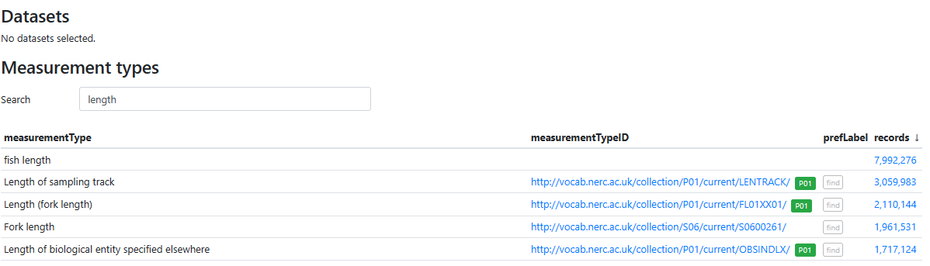
MoF Tools
Report: https://r.obis.org/mof/
Summary for each dataset per node
Viewer: https://mof.obis.org/
Use only for reference!
Always ensure codes match your data measurements

Slide 54
DNADerivedData extension

Slide 55
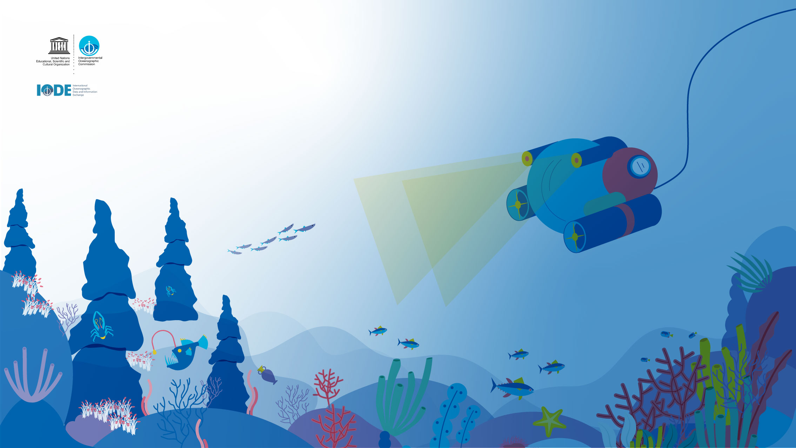
https://manual.obis.org/
OBIS Slack
Thank you!
Notes:
I wish to thank to all the supporters, donors and the thousands of scientists and the hundreds data managers who have been involved and contributed to OBIS. Without their efforts we would not have this fantastic resource to use today and in the future by our children.

