Slide 1
The Global Ocean Observing System
goosocean.org
2024 Ocean Decade Conference
GOOS Regional Alliance Forum (GRF-XI)
8-9 April 2024, Barcelona , Spain
Round Table Discussion
RT2: Strengthening Capacity between GRAs, GOOS Panels, Projects, and Networks
Denis Chang Seng, PhD
Programme Specialist
IOC/UNESCO
Notes:
I'm here to talk to you about what makes a collection of activity into a cohesive and high-performing system - how we can work at global and regional levels to leverage our individual national contributions and make them stronger together

Slide 2
Round Table Discussion #2 13:45-15:30 (105 mins)
GRAs
GOOS Panels
Projects
Networks
Strengthening Capacity between GRAs, GOOS Panels, Projects, and Networks
Aim: Explore opportunities to actively engage with other aspects of GOOS

Slide 3
Discussion Questions
What are the observing needs in regions that align with Projects, Panels, and Networks
What additional information would you need to better engage with these groups?
Other Questions?
What priority actions could be made with partners over the next 2 years to enhance GRA observing?
Rapporteur

Slide 4
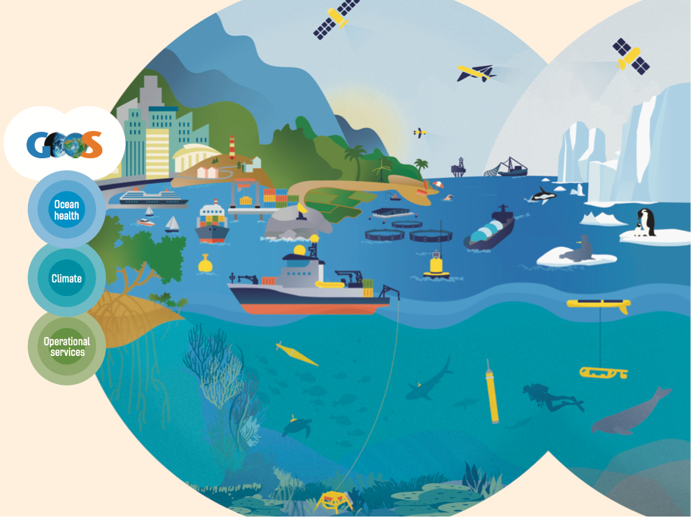
www.goosocean.org/join

