Slide 1
Strengthening Cooperation between ICG CARIBE/EWS and IOCARIBE
Ms. Lorna Inniss,
Regional Coordinator
February 02, 2024

Slide 2
OUTLINE
Decisions of IGM XVII
IOCARIBE Work Plan 2024
Options for Cooperation

Slide 3
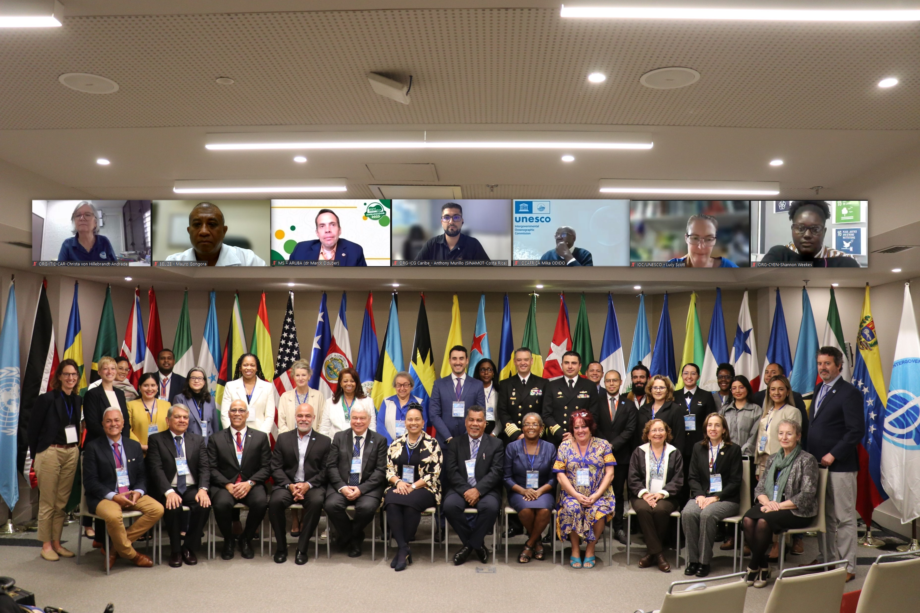
IOCARIBE DECISIONS OF MEMBER STATES
1
2
3
4
Rec1 - Prioritization
Rec2 - Governance
Rec3 - Stakeholder engagement
Rec4 - Youth engagement
Rec5 - Communication
Rec6 - Collaboration
Rec7 - Awareness
Rec8 - Data, information, knowledge and tools
Rec9 - UN Ocean Decade
Rec10 - IOCARIBE-GOOS
5
6
7
8
9
10

Slide 4
Recommendation 1- Prioritization
1.1. | Develop an advanced early warning system for extreme weather events. Include the implementation of regular drills in coastal communities and training of residents in response measures, improving preparedness and resilience.

Slide 5
Recommendation 2 - Governance
2.6. | Actively seek and cultivate strategic partnerships with various and innovative sources to secure funding opportunities and in-kind resources in support of IOCARIBE initiatives.

Slide 6
Recommendation 3 – Stakeholder Engagement
3.2. | Provide assistance to Member States in executing ocean literacy activities, which include utilizing "A New Blue Curriculum: A toolkit for policymakers" and conducting a feasibility study for the establishment of a new regional blue schools’ network.

Slide 7
Recommendation 6 - Collaboration
6 | 6.1. | Organize and align all the threats that IOCARIBE is addressing within a multi-hazard framework, leveraging the resources and expertise available through the Integrating Coastal Hazard Early Warning Systems for the Tropical Americas and Caribbean (iCHEWS) UN Ocean Decade endorsed project.

Slide 8
Recommendation 7 - Awareness
7.2. | Create strategies and mechanisms for actively involving stakeholders in the improvement and utilization of applications, services, tools, and products within the region.

Slide 9
Recommendation 8 – Data, Information, Knowledge & Tools
8.1. | Conduct an assessment to identify, prioritize, and proactively address the data, information, and knowledge needs within the context of IOCARIBE programs and projects.

Slide 10
Recommendation 10 – IOCARIBE GOOS
10.2. | Support the re-establishment of a sustained regional ocean observing and forecasting system, through the appointment of qualified experts to participate in the IOCARIBE Global Ocean Observing System (GOOS) working group, by issuing a Circular Letter to this effect.

Slide 11
IOCARIBE GOOS
10.1. | Conduct a formal vote to select the permanent coordinator for IOCARIBE Global Ocean Observing System (GOOS).
10.2. | Support the re-establishment of a sustained regional ocean observing and forecasting system, through the appointment of qualified experts to participate in the IOCARIBE Global Ocean Observing System (GOOS) working group, by issuing a Circular Letter to this effect.
10.3. | Identify and inventory priority observational needs including communication, social science and ocean literacy within the region while considering available resources and avoiding the duplication of previous work.
 | Develop a regional strategy for ocean observing and forecasting, including ways to collectively facilitate domestic marine scientific research clearances for instrument deployments.
10.4. | Establish a sustainable governance structure that includes ECOPs.
 | Develop ToRs for IOCARIBE-GOOS that amongst other issues provides mechanisms for sharing experiences and activities among Member States
10.5. | Actively engage in efforts to secure representation and participation from each of the Member States within IOCARIBE Global Ocean Observing System (GOOS).
10.6. | Actively capitalize on existing regional and international activities and partnerships, such as the Caribbean Institute for Meteorology & Hydrology (CIMH) and the Caribbean Coastal Ocean Observing System (CARICOOS), to enhance collaboration and information sharing.
10.7. | Establish an effective process for reporting metadata and other relevant information to OceanOPS (formerly JCOMMOPS).

Slide 12
IOCARIBE GOOS
Field training and access to technology
Training in use of data networks
Training for Ocean Observations for decision making
Support of approvals for data collection in EEZs
Engagement sessions for policy-makers

Slide 13
IOCARIBE (TAC) GOOS
ACTIVITIES | PROJECTS
1. Governance 2. Pilot Observing System (via Observing Council) | CoastPredict TAC Region
 | A Turnkey Basic Observing System for Caribbean SIDS
 | Observation and Modelling for Decision Making

Slide 14
OCEAN LITERACY
ACTIVITIES
Promote Regional Ocean literacy research activities among partner universities and institutions. Encourage new research related to OL (Deep Sea)
Official Launch of the Caribbean SIDS Ocean Literacy Program at UN SIDS4 Summit (May 2024) LAC Ocean Literacy Dialogue
Establish Regional Group on Ocean Literacy Regional tourism and fisheries sector ocean literacy training
Plan for Caribbean SIDS and Central American Countries Two pilot countries – GRENADA and HONDURAS

Slide 15
HARMFUL ALGAL BLOOMS
ACTIVITIES | PROJECTS
Reactivate the current FAN introductory virtual reality course that is in the Play store | Increased visibility among the different social stakeholders in the Caribbean region.
Inclusion of the toxins module in the virtual reality course | Train HAB researchers for the region, taking advantage of the existing knowledge in the Caribbean and the international cooperation.
Reorganization of the task group: ANCA-HAEDAT | Collect and analyze information that allows making decisions related to HABs in the Caribbean region.
Conducting the Course: La Ciguatera a potential risk for the tourism industry | Increased visibility among the different social stakeholders in the Caribbean region.
Continue with the HAB outreach and training program | Increased visibility among the different social stakeholders in the Caribbean region.
Layout and publication in digital format of the Ciguatera book, already existing in Spanish and English | Increased visibility among the different social stakeholders in the Caribbean region.
In-person workshop on HAB early warning systems | Progress in initiatives on HAB early warning systems. Reorganize the group

Slide 16
Sargassum Priority 1 – Integrated Observing System
ACTIVITIES Task Team 3
Inventory of experts’ groups, governmental institutions and citizen scientists’ initiatives producing Sargassum data.
Engagement and synergies with the Sargassum observing community to foster agreement on harmonization and sharing of existing datasets.
Description of needed technical solution to support data sharing and engagement with relevant groups (i.e. IODE)

Slide 17
Ocean Data and Information Management
ACTIVITIES
OBIS: A global open-access data and information clearing-house on marine biodiversity for science, conservation and sustainable development
OBPS: Ocean Best Practises System (ADAPT PROJECT)
ODIS: Ocean InfoHUB LAC Pilot
OTGA: Ocean Teacher Global Academy

Slide 18
Marine Spatial Planning Activities
PROCARIBE+ Project
Regional MSP Forum
Regional MSP Training (Train the Trainer)
Dominican Republic and Colombia
Implement outcomes from IOCARIBE MSP Forum 2022

Slide 19
OCEAN DECADE
DCO Establishment
Potential DCCs/DIPs to support the region
Ocean Decade Task Force
Implementation of Existing Projects
Submission of Decade Actions

Slide 20
GOVERNANCE FOR CAPACITY DEVELOPMENT
Governance framework for IOCARIBE GOOS
Capacity Development Working Group
Ocean Literacy Sub-Group
Marine Spatial Planning Sub-group
Ocean Data and Information Working Group
Support national ocean policies
Regional governance architecture – OCM

Slide 21
PARTNERSHIPS FOR CAPACITY DEVELOPMENT
All Atlantic Ocean Research and Innovation Alliance AAORIA
Potential partnership with Puerto Rico Sea Grant Programme
Possible Regional UNESCO Chair
Exploratory discussions on:
* A regional Decade Collaborative Center
* Seeking Decade Implementing Partners

