Slide 1

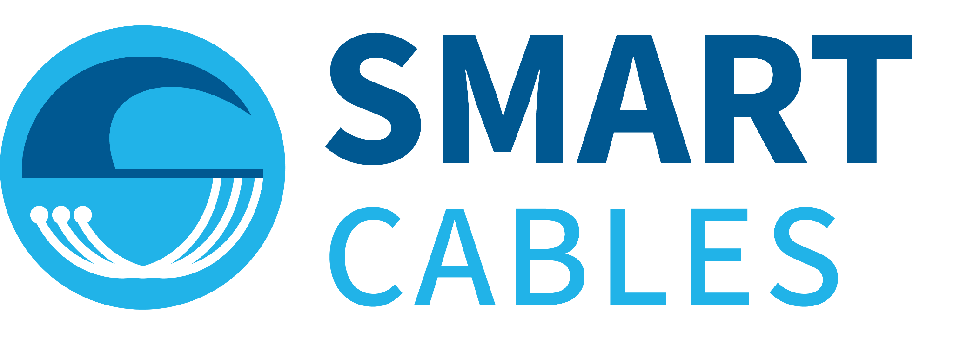





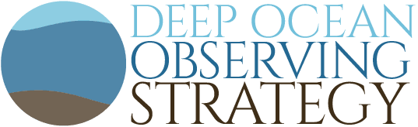
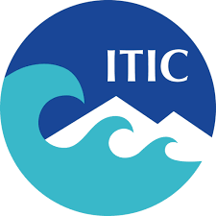


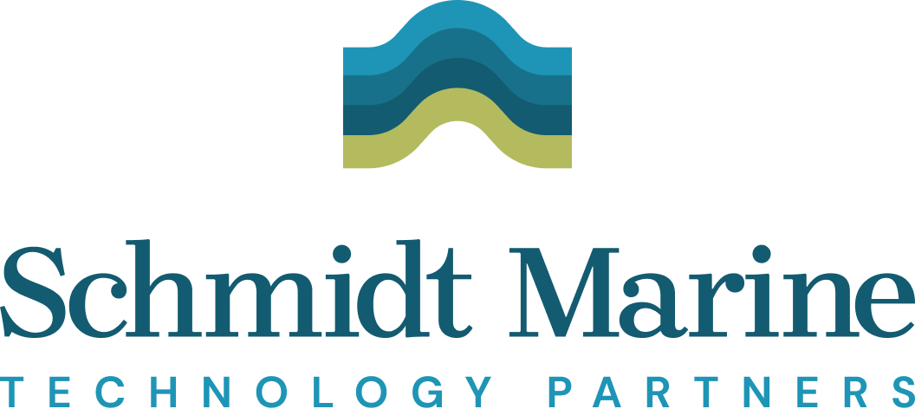

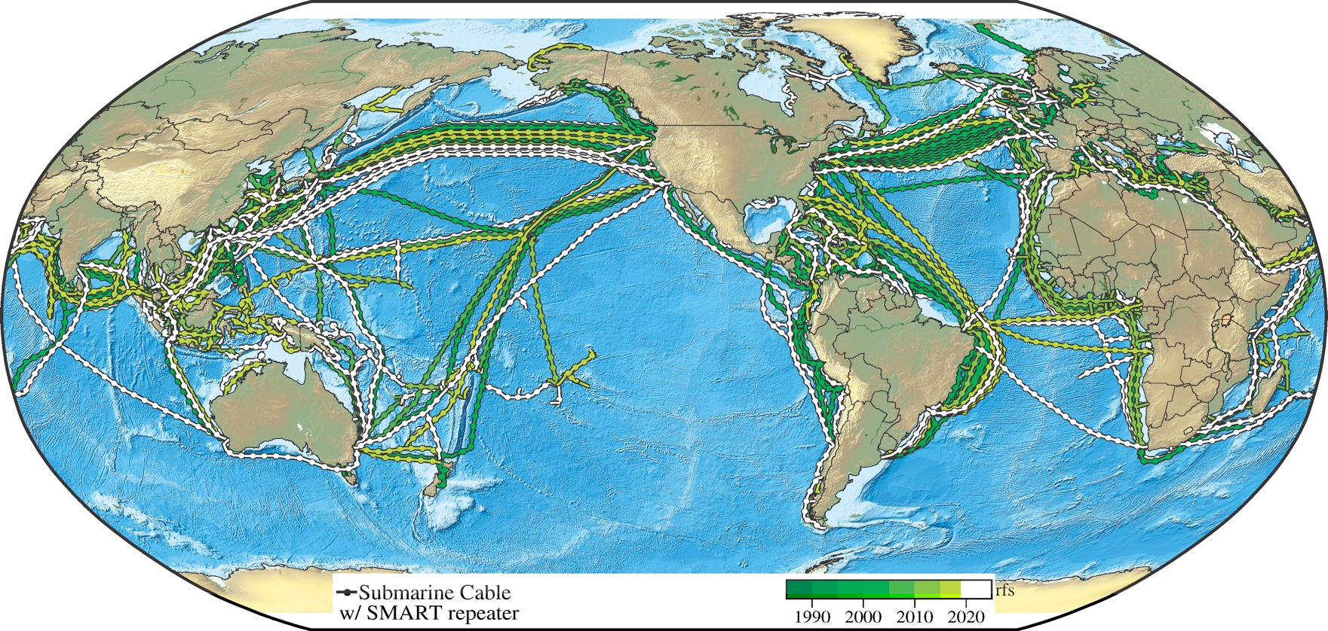
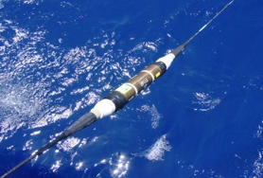
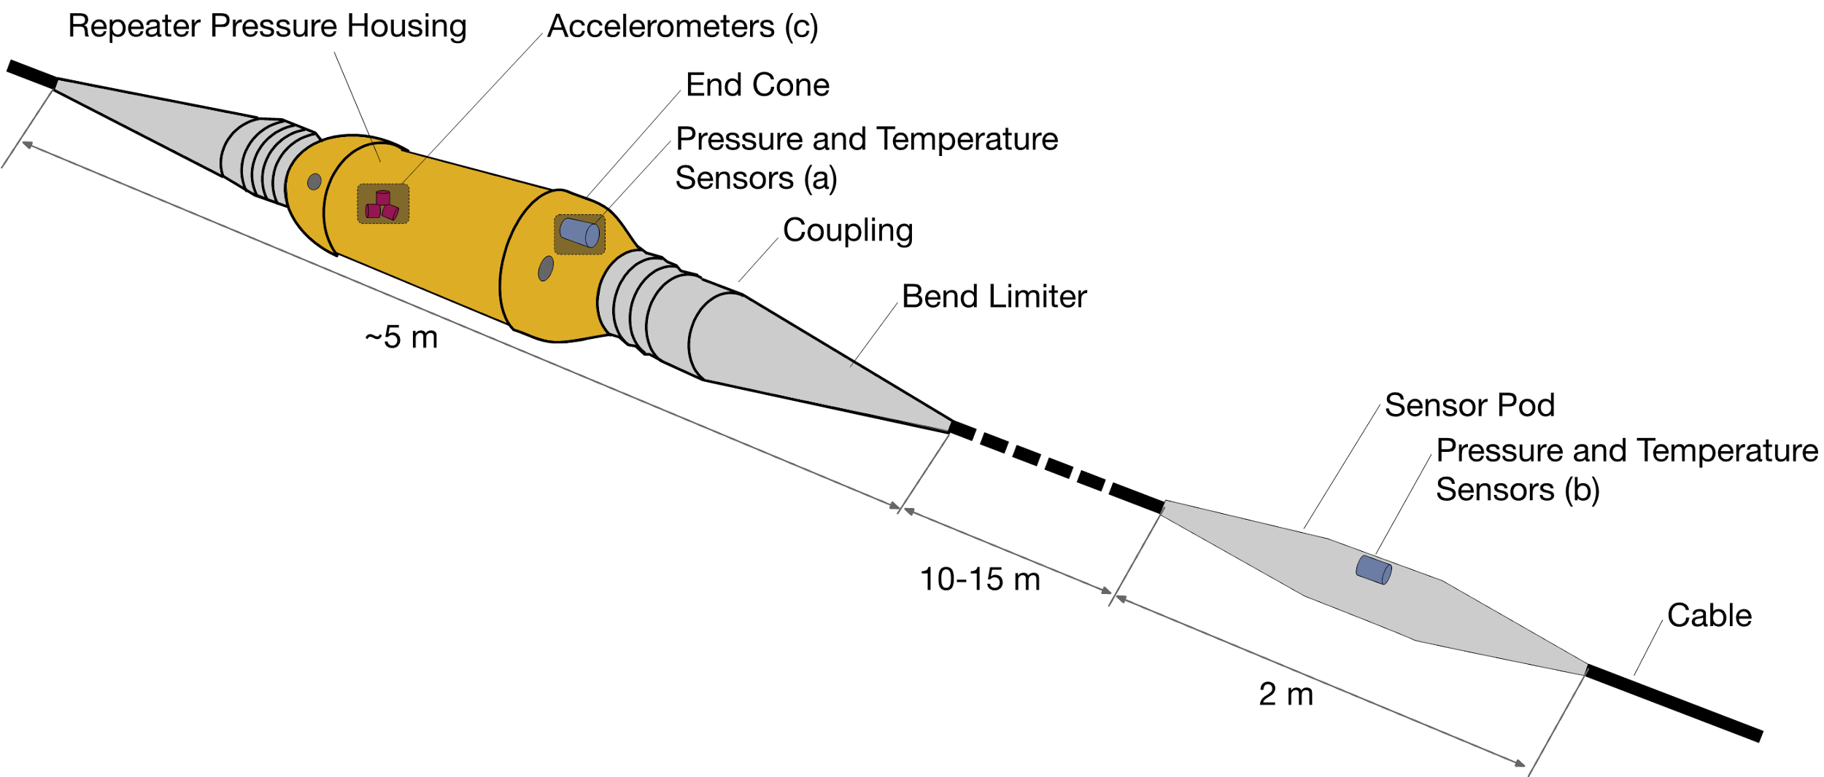


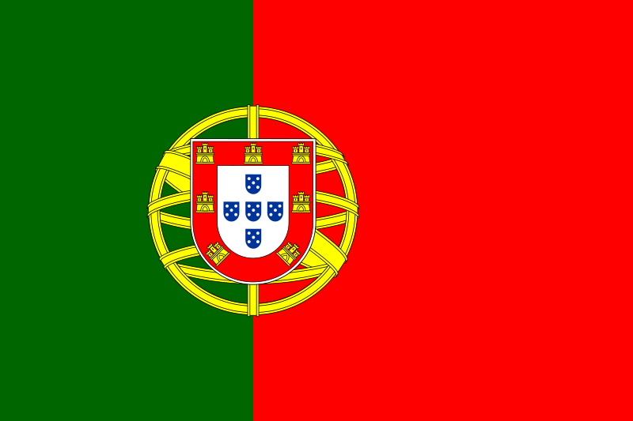

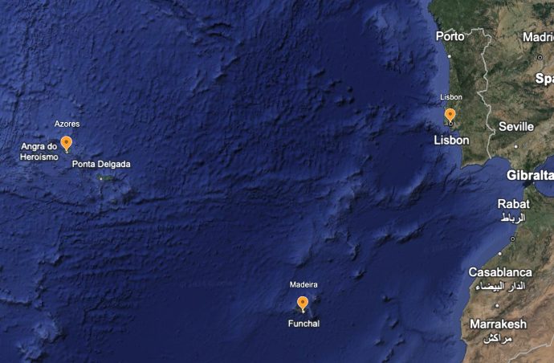
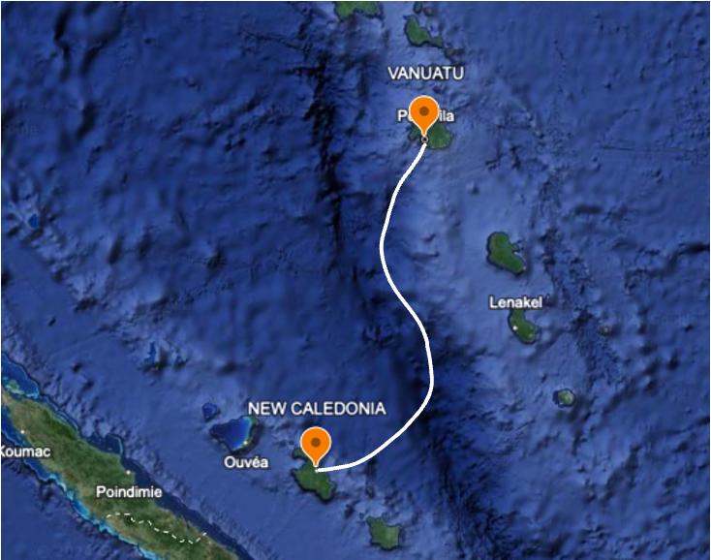
Observations Coordination Group (OCG)
SMART Cables Network
GOOS Emerging Network -
Bruce Howe (bhowe@hawaii.edu)¹; Chris Barnes² (crbarnes@uvic.ca ) William Wilcock (wilcock@uw.edu )³ Ceci Rodriguez Cruz (cecirc@hawaii.edu)⁴
^{1,4}University of Hawaii | ²University of Victoria | ³University of Washington
The SMART (Science Monitoring And Reliable Telecommunications) Cables Initiative is led by the ITU/WMO/UNESCO-IOC Joint Task Force (JTF) comprised of volunteers from government agencies, research and academic institutions, and the private sector.
SMART Cables is working to integrate sensors (temperature, pressure, and seismic motion) into undersea telecommunications cables. These sensors share the power and communications infrastructure of millions of kilometers of undersea fiber optic cable, enabling seafloor-based global ocean observing at modest incremental cost. They will provide climate and ocean data and improve global tsunami and earthquake warning networks.
By investing now, we can build a global ocean network of long-lived SMART cable sensors and realize transformative additions to the global ocean observing system to adequately model, understand, and address climate change and disaster risk reduction.
Green circles, systems funded. Orange and teal circles under discussion.
Current and planned cables span the oceans (> 1 Gm, 500 systems). As they are replaced and expanded over their 10–25-year refresh cycle, environmental sensors can be added to every ~100 km, gradually achieving real time global coverage. Symbols show systems under consideration. The Portugal SMART Atlantic CAM and Vanuatu-New Caledonia will be ready for service 2026.
Below: Possible implementation of SMART sensors into the telecom system. Seismic sensors are in the housing; the water sensors are external.
SMART Cables in the Ocean Decade
SMART Cables is an endorsed project of the UN Decade of Ocean Science for Sustainable Development 2021-2030, entitled “Science Monitoring And Reliable Telecommunications (SMART) Subsea Cables: Observing the Global Ocean for Climate Monitoring and Disaster Risk Reduction, ID 94”; it is affiliated with “UN1. Ocean Observing Co-Design — Evolving ocean observing for a sustainable future.”
Challenges and Concerns
Standardize Data Management for SMART Data
Opportune knowledge of Subsea Telecom Systems Projects to be deployed in the ocean.
Access to member states to educate their local science community, telecom industry and stakeholders that will support decision making for SMART Cable systems connecting respective countries.
Process to set up the SMART Cable Observing Network as an emerging and mature network.
First SMART Cable Systems in the world
TAMTAM
ATLANTIC CAM
Future Plans and Opportunities
Strengthen coordination with ITU, WMO and UNESCO-IOC to develop SMART cables in an organized way globally.
Improve access to World Bank, Inter-American Development Bank, Asian Development Bank, etc., to suggest business models to member states, to obtain capital costs from them.
With the support of the French Government, the world’s first Science Monitoring And Reliable Telecommunications (SMART) cable Tamtam connecting Vanuatu and New Caledonia will be installed in 2026. This system will have 4 SMART modules.
Motivated by the great earthquake and tsunami of 1755, the government of Portugal is investing in the Atlantic CAM SMART Cable System. This system will connect Lisbon, Azores and Madeira in a ring allowing environmental sensing for ocean, climate and disaster risk reduction.
References: https://www.itu.int/en/ITU-T/climatechange/task-force-sc/Pages/default.aspx
https://www.smartcables.org/

Slide 2
Observations Coordination Group (OCG)
Network LOGO
Network Title
Subtitle -
Name (email)¹; Name² (email)
¹Affiliation | ²Affiliation
Please include the following information:
Status map
Future Plans and Opportunities
Challenges and Concerns
What are your links to the Ocean Decade? (List programs etc. you are involved in)
Plus highlight other elements that you want to share or discuss with OCG - for example new technology, capacity development, data….
Questions - Please reserve space on the poster to respond to and ask questions to be discussed at the poster session or in the networks session:
Requirements: Are you utilizing / are responsive to any requirements from e.g., GCOS? If yes, how?
Data: What are your data access URLs? How are you exchanging metadata with OceanOPS?
Questions for other networks, networks specific questions for discussion at the session, and highlight cross OCG questions for discussion next day session
Text/Picture
Text/Picture
Text
Text/Picture
More…
Text
References:

