Slide 1
5.2 ICG CARIBE-EWS XVII Session
CARIBE WAVE 2025
Antonio Aguilar
CARIBE WAVE Chair, FUNVISIS, Venezuela
Gisela Báez-Sánchez
CARIBE WAVE Vice Chair, Puerto Rico Seismic Network, USA
Christa G. von Hillebrandt-Andrade
Manager, ITIC Caribbean Office
ICG CARIBE EWS WG III Chair
May, 2024

Slide 2
Goals for ICG XVII
Reconfirm Scenarios for CARIBE WAVE 25
Decide on the Date and TimeCARIBE WAVE 25
Suggestions for Scenarios Beyond 2025
Multi-Annual Exercise (MG 86) Workshop with CARIBE WAVE TASK TEAM
Review Recommendation and Decisions for CW

Slide 3
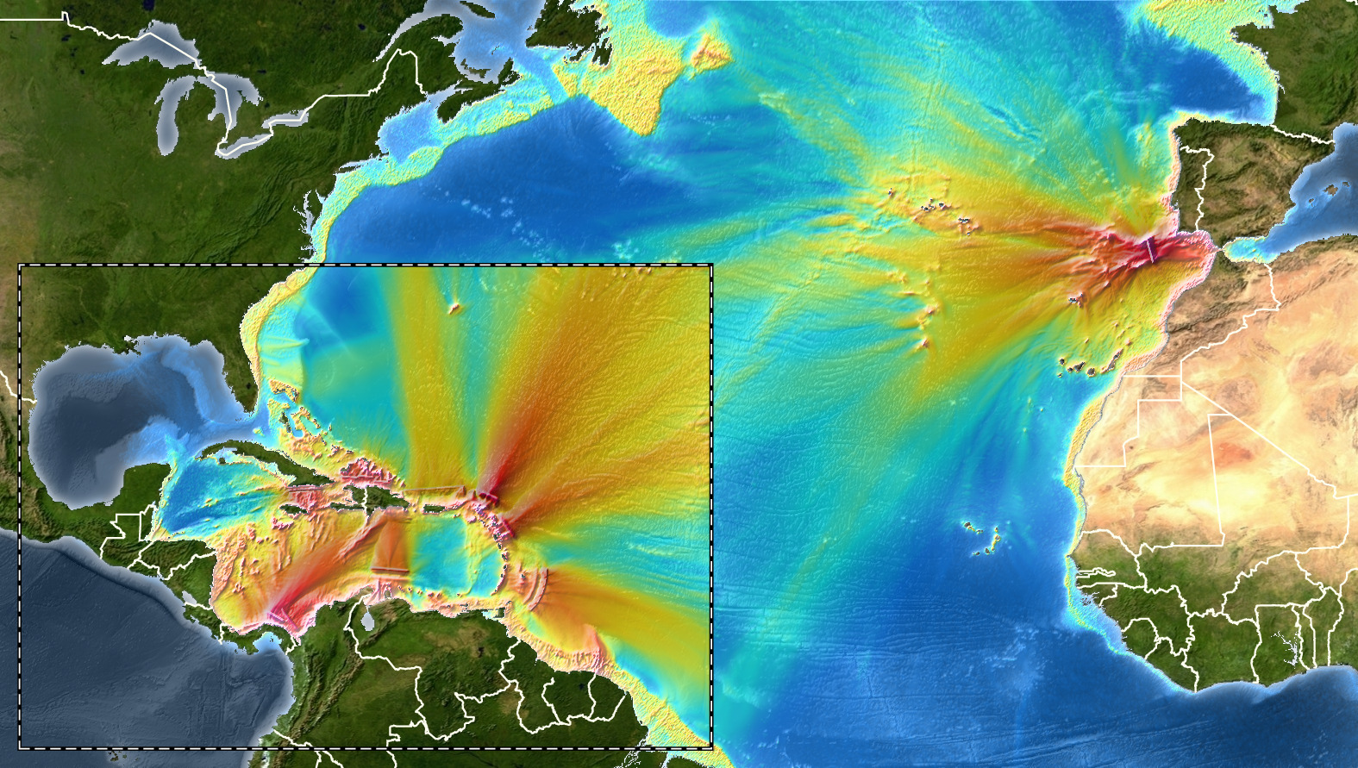
Coverage of Past Exercises
The black circles are the proposed CW 25 scenarios, which are the same as CW 20

Slide 4
Decisions of ICG XVI on CW 25
Suggests that the CARIBE WAVE 25 exercise consist of 2 scenarios that include 1) 1692 Jamaica scenario, and 2) the 1755 Lisbon scenario
These were the exercise scenarios for CW20 but because of the pandemic it was limited in scope.

Slide 5
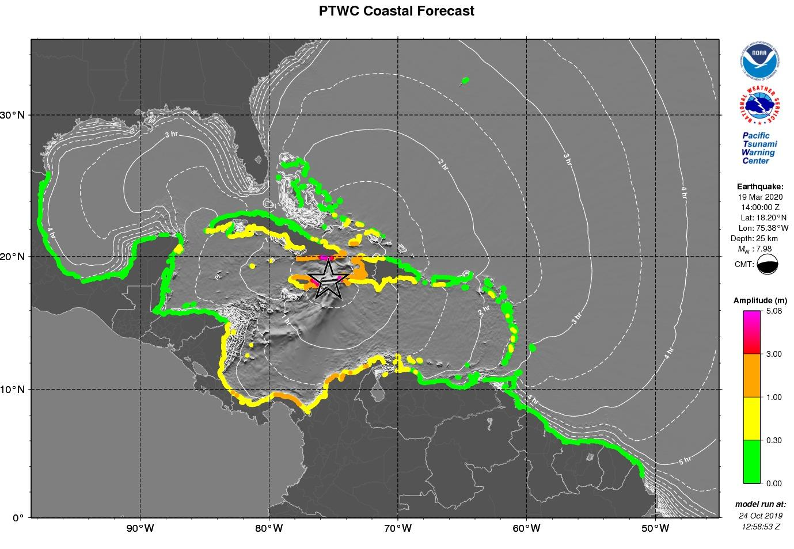
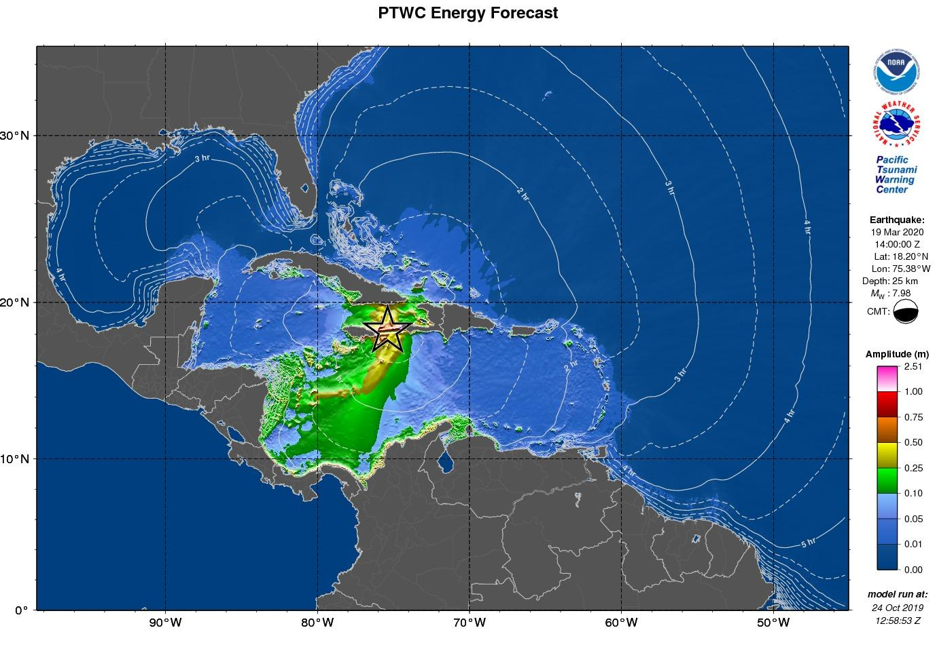
Scenario 1:
Jamaica 1692 Port Royal earthquake

Slide 6
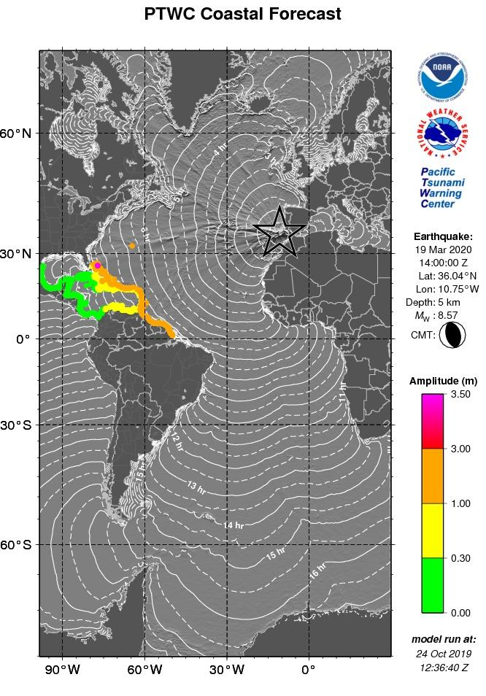
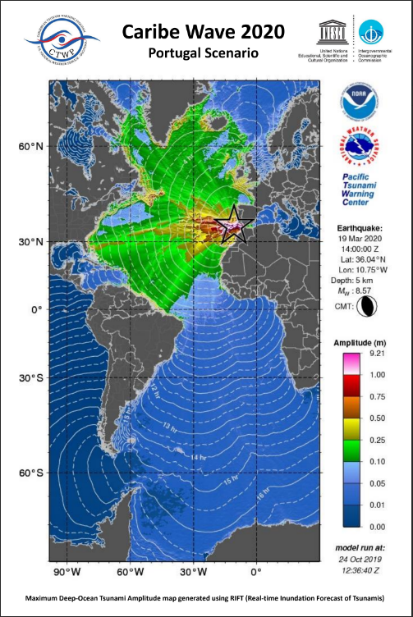
Scenario 2:
1755 Portugal
Earthquake and Tsunami

Slide 7
Date and Time of the Scenario
Keep Thursday at 1500UTC?
Interest in running a scenario at night/off hours?
Possible Thursday Dates in March: March 13, March 20
March 1-4 🡪 Carnaval (many countries, just before Ash Wednesday)
March 23 🡪 World Meteorology Day
April 13-19 🡪 Holy Week

Slide 8
Multi-Annual Exercise Workshop
Pending is a Workshop on MG 86 (Multiannual Exercise) with a hybrid meeting of CARIBE WAVE Task Team
Tentative Date of Meeting: January 2025 in Antigua and Barbuda
ITIC-CAR currently has some funding to support as part of Tsunami Ready efforts supported by USAID
Coordinator: CTIC

Slide 9
CARIBE WAVE 26
CW 25 Survey Results
Member State/Territory | Suggestion
Aruba | Jamaican Trench & Puerto Rico Trench
Barbados | Volcanic source - Kick 'em Jenny Martinique scenario
Costa Rica | maybe one close to Costa Rica
Cuba | Emphasize less frequent source scenarios such as landslides and volcanic eruptions and return to sources of earthquakes that produced tsunamis in ancient times.
Dominican Republic | Groove of the Dead (SMT 1 or 2)
France | - non-seismic sources - alternating remote and local scenarios, so that ETA should vary - people seem to be more concerned when the expected wave is high (ie > 1m)
Guatemala | Any near to Central America
Mexico | Tsunami due to underwater volcanic eruption by the Kick-'Em-Jenny located in Granada
NL-Bonaire, Saba, and Sint Eustatius | Large eruption of Kick 'em Jenny volcano.
Panama | I suggest any volcanic source should be very interesting consider a cold reaction after Tonga eruption.
Saint Vincent and the Grenadines | Yes volcanic sources La Soufriere, Mt Pelee and Kick em Jenny
UK - British Virgin Islands | Kick em Jenny
UK- Cayman Islands | Kingston Harbour vicinity (Jamaica))

Slide 10
Decision and Recommendations:
The Intergovernmental Coordination Group for the for the Tsunami and Other Coastal Hazards Warning System for the Caribbean and Adjacent Regions (ICG/CARIBE-EWS),
Notes the CARIBE WAVE draft final, media, supplement reports and presentation.
Further notes the successful conduct of the CARIBE WAVE 24 Exercise with the participation of 100% of the Member States and over 475,000 people engaged.
Congratulates all the participating Member States for promoting, coordinating, participating and providing feedback on the CARIBE WAVE 24 exercise.
Encourages Member States who have yet to submit the post exercise questionnaire to respond by May 17 to include their feedback in the final reports.

Slide 11
Recommendation ICG/CARIBE-EWS-XVII._ (CONT)
Appreciates the International Tsunami Information Centre Caribbean Office (ITIC-CAR) for their support in generating the handbook, reports and overall coordination and and the Pacific Tsunami Warning Center (PTWC) and the Central America Tsunami Advisory Center providing and disseminating dummy message and simulated products for the CARIBE WAVE 24.
Further appreciates the United States Geological Survey (USGS) for their continued support in generating simulated ShakeMap and PAGER products for the exercises.
Acknowledges the good collaboration between the CARIBE WAVE Task Team, CTIC and ITIC-CAR in planning, promoting, executing and evaluating the annual CARIBE WAVE Exercises.
Instructs the CARIBE EWS Working Groups and the CARIBE WAVE Task Team to identify actions arising from CARIBE WAVE 24 and past CARIBE WAVE Exercises and identify follow up actions in coordination with CTIC and the CARIBE-EWS secretariat.

Slide 12
Recommendations for review of the Intrasessional WG, based on those of ICG XVII
Reconfirms that CARIBE WAVE 25 will use the 2 CARIBE WAVE 20 scenarios 1) 1692 Jamaica scenario, and 2) the 1755 Lisbon scenario,
Also Decides that the CARIBE WAVE 25 exercise will take place on Thursday, March, ____, 2025 commencing at 15:00 UTC with one dummy message, and the 1st message for the scenarios shortly after according to PTWC and CATAC simulated procedures for the corresponding scenarios,
Recommends following a similar coordination process, timetable and benchmarks for CARIBE WAVE 25 and that preparatory webinars follow the same or similar process as used in previous exercises,
Further recommends that the registration process remains at www.tsunamizone.org and that Member States promote among their stakeholders
Recalls again the importance of including vulnerable and marginalized groups, including persons with disabilities, in CARIBE WAVE 25.

Slide 13
Recommendation ICG/CARIBE-EWS-XVII. (CONT)
Recommends the Secretariat to inform the UNDRR on the date of CARIBE WAVE 25 and request the theme of the WTAD 25 in advance of the Exercise.
Further recommends that Task Team CARIBE WAVE consider the theme of WTAD 2025 in conduct and reporting of the exercise.
Noting CATSAM as a tool for identifying sources, associated threat and exercise planning features;
Reminds Task Team CARIBE WAVE assist WG1 in prioritizing of scenarios to be included in CATSAM.
Further Reminds Member States consider alternative dates for running of CARIBE WAVE 25, if the agreed date is not feasible, and that information on conducting the exercise on alternative dates be shared in the Handbook.
Additionally Reminds Member States to combine their selected CARIBE WAVE 25 scenario with multi-hazard events.

Slide 14
Recommendation ICG/CARIBE-EWS-XVII. (CONT)
Additionally Recommends that Task Team CARIBE WAVE review and consider updates to the CARIBE WAVE Post-Exercise Questionnaire.
Suggests again that TT CARIBE WAVE explore opportunities to further involve tourists and tourism organizations in CARIBE WAVE Exercises, with the aim to develop guidelines/resources on involvement of tourists in CARIBE WAVE Exercises.\
Recalls the recommendation for holding a workshop on a workshop on the MG 86 Multiannual Exercise Guidelines together with a meeting of the CARIBE WAVE Task Team to discuss enhancements to facilitate and streamline the execution and reporting, as well as integrating gradual flexibility and complexities in CARIBE WAVE Exercises and synergies with the Tsunami Ready Programme
Welcomes support of the USA through ITIC-CAR
Requests CTIC with Secretariat to organize this workshop and meeting.
Suggests that the CARIBE WAVE 26 exercise consist of 2 scenarios that include 1) 2)
__________________
Financial Implications: None

