Slide 1


WMO Session
OCG-15 Meeting
13-17 May 2024
Victoria, British Columbia, Canada
Champika Gallage, Jon Turton

Slide 2

Content
1 WMO Strategic Objectives
2 INFCOM – 3 outcomes
3 Global Basic Observing Network (GBON)
4 Tiered Networks
5 Rolling Review of Requirement (RRR)
6 Global Greenhouse Gas Watch (G3W)
7 Key takeaways

Slide 3





WMO Strategic Plan 2024-2027
The place of Earth system observations and predictions
VISION 2030
By 2030, we see a world where all nations, especially the most vulnerable, are more resilient to the socioeconomic consequences of extreme weather, climate, water and other environmental events; and underpin their sustainable development through the best possible services, whether over land, at sea or in the air
MISSION
To facilitate worldwide cooperation on monitoring and predicting changes in weather, climate, water and other environmental conditions through the exchange of data, information and services, standardization, application, research and training.
1
2
3
4
5
LONG-TERM GOALS
Services
Better serve
societal needs
Infrastructure
Enhance Earth system observations and predictions
Science & Innovations
Advance targeted research
Member Services
Close the
capacity gap
Smart
Organization
Strategic realignment of structure and programmes
STRATEGIC OBJECTIVES
National multi-hazard early warning/alert systems
Climate information and services
Hydrological services
Decision-supporting weather information and services
Address global risks associated with irreversible changes in the cryosphere
Optimize observation data acquisition
Improve access to, exchange and management of Earth system observation data and products
Enable access and use of numerical analysis and prediction products
Advance scientific knowledge of the Earth system
Enhance science-for-service value chain to improve predictive capabilities
Advance policy-relevant science
Enable developing countries to provide and utilize essential weather, climate, hydrological and related environmental services
Develop and sustain core competencies and expertise
Scale up partnerships
Optimize WMO constituent body structure
Nurture WMO strategic partnerships
Advance equal, effective and inclusive participation
Environmental sustainability

Slide 4
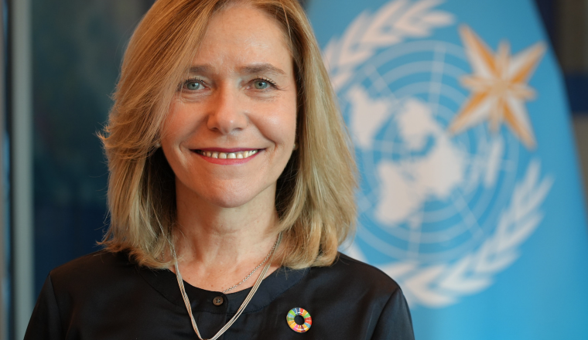


Secretary-General’s priorities
Supporting Members
accelerating Early Warnings for All
Global Greenhouse Gas Watch
Closing the gaps in the basic observing system, including through SOFF
Celeste Saulo, WMO SG
Ko Barrett, DSG
Thomas A, Asare, ASG

Slide 5


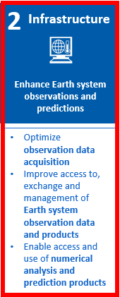

Weather
Prediction
Early warning
Marine services
WMO Strategic Objectives
1
2
3
4
5
6
WMO Integrated Global Observing System (WIGOS)
Climate
Monitoring
Climate services
Assessment
Greenhouse Gases
WMO Information System (WIS)
WMO Integrated Processing and Prediction System (WIPPS)

Slide 6
INFCOM-3 outcomes
1 Work Programme of the INFCOM for next intersessional period (Resolution 6.1/1)
  Development of additional GBON and RBON observational requirements for ocean observations
  Collaboration with GOOS on the development of relevant standards/best practices
  Interoperability with data sharing systems (ODIS and WIS2.0)
  Increase observations availability from the Southern ocean (south of 60 S)
2 Study Group on Environmental Sustainability (Decision 7.3/1)
3 Implementation plan for the Global Greenhouse Gas Watch (Recommendation 7.2/1)
4 Amendments to WIGOS Manual (Recommendation 8.1(1)/1)
  Members should operate GBON stations/platforms in areas of global commons including the High Seas and the Antarctic
5 Amendments to the WIGOS Guide (Resolution 8.1(2)/1)
6 GOOS SC chair is an ex-officio of the INFCOM Management group (Decision 6.2/2)

Slide 7
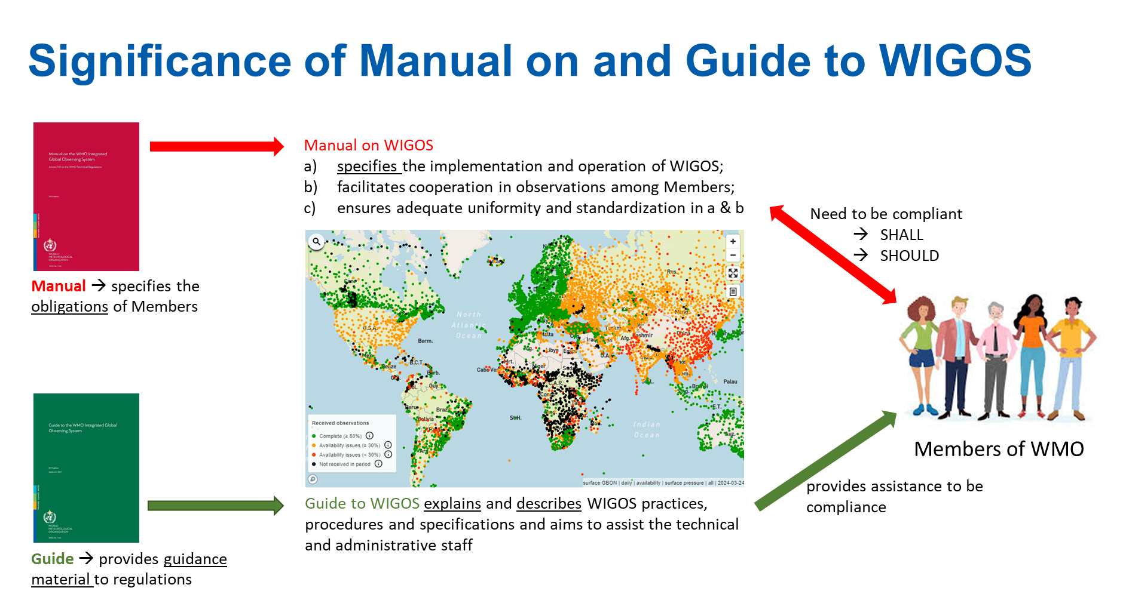
WMO Regulatory material: significance of Manuals and Guides
The designations employed and the presentation of material on this map do not imply the expression of any opinion whatsoever on the part of the Secretariat of the World Meteorological Organization concerning the legal status of any country, territory, city or area or of its authorities, or concerning the delimitation of its frontiers or boundaries.

Slide 8
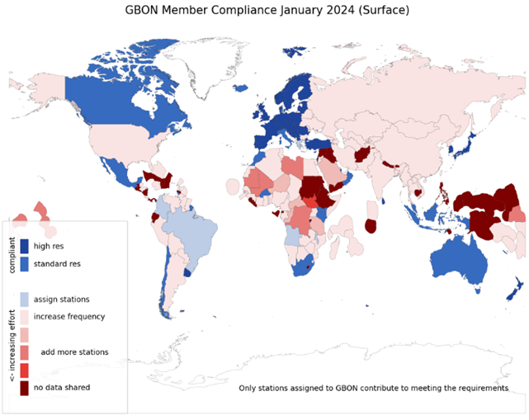
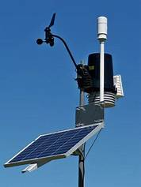

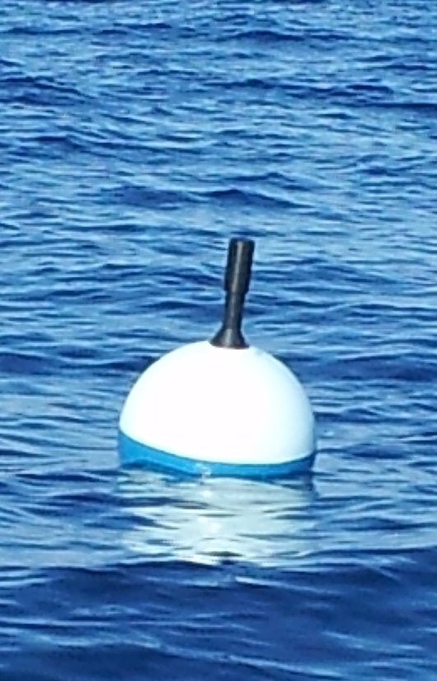
Global Basic Observing Network (GBON)
A global public good for improved weather prediction and climate reanalysis
Worsening gaps in the basic surface-based observations that keep weather predictions on track - full implementation estimated to bring USD 5 billion in annual benefits
Members in 2021 accepted the obligation to take and share GBON observations at minimum horizontal and time resolution
  Surface land at 200 km, hourly
  Upper air over land at 500 km, 2x daily
  Surface marine in EEZ at 500 km, hourly
WMO co-created the Systematic Observations Financing Facility (SOFF) to help Members meet that GBON obligation, with priority on support to LDCs and SIDS
The designations employed and the presentation of material on this map do not imply the expression of any opinion whatsoever on the part of the Secretariat of the World Meteorological Organization concerning the legal status of any country, territory, city or area or of its authorities, or concerning the delimitation of its frontiers or boundaries.

Slide 9
GBON Requirements
Type of observing station​ | HR​ | VR​ | Obs Cycle​ | Variables​ | Other Requirements​
Surface land stations ​ | 200km ​ 100km ​ | n/a​ | 1h​ | SLP, T, U,​ Wind, precip, snow depth​ | Exchanged in real​ time through WIS2​
Upper air stations operated from land ​ ​ | 500km​ 200km​ | 100m​ | 2/24h​ | T, U, wind​ | Up to 30 hPa, exchanged in real time through WIS- 2​
Subset of upper air stations ​ ​ | 1000km​ | 100m​ | 24h​ | T, U, wind​ | Up to 10hPa,​ Exchanged in real time through WIS2​
Surface marine stations in EEZs ​ ​ | 500km​ | n/a​ | 1h​ | SLP, SST​ | Exchanged in real​ time through WIS2​
Upper air stations operated in EEZs ​ ​ | 1000km​ | 100m​ | 2/24h​ | T, U, wind​ | Up to 30 hPa, exchanged in real time through​ WIS2​
Aircraft data ​ ​ | 100km at flight level​ | 300m for profiles​ | 1h​ | T, U, wind​ | Data exchange per licensing agreement​
Remote sensing ​ profiler observations ​ ​ | Where available​ | 100m​ | 1h​ | T, U, wind​ | n/a​

Slide 10
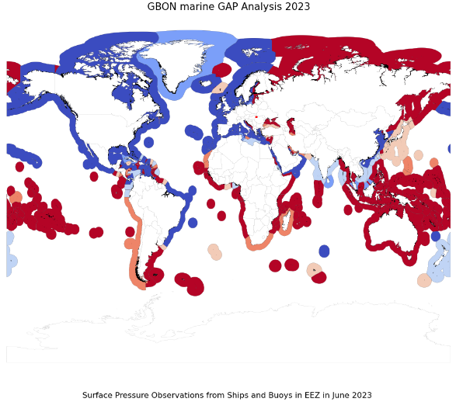

GBON: surface marine observations in EEZ
calculation of GBON targets for marine Exclusive Economic Zones, based on all platforms reporting within EEZ – global gap 465
no need to formally assign surface marine observations to GBON – all obs considered
All observations – “domestic” or “foreign” are counted
  Might be variable in time, make planning more complex
  in context of SOFF, potentially reduces GBON marine gap
  But, reflects reality of the observations available, and the non-exclusive responsibility for observations in EEZ
Best value monitoring platform for GBON variables are surface drifters and ships, but these drift – could drive to more fixed platforms (more expensive, requiring more technical capacity, exposed to vandalism) – but these may also have greater local value
The designations employed and the presentation of material on this map do not imply the expression of any opinion whatsoever on the part of the Secretariat of the World Meteorological Organization concerning the legal status of any country, territory, city or area or of its authorities, or concerning the delimitation of its frontiers or boundaries.

Slide 11
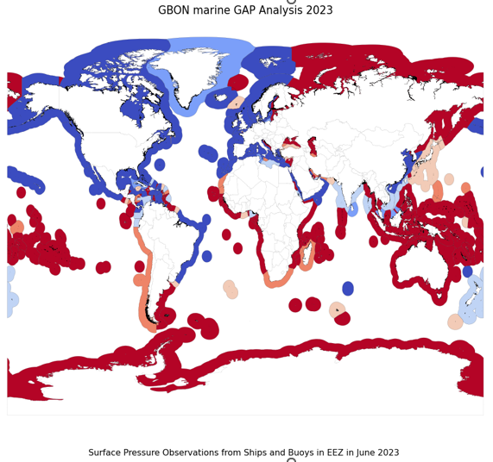
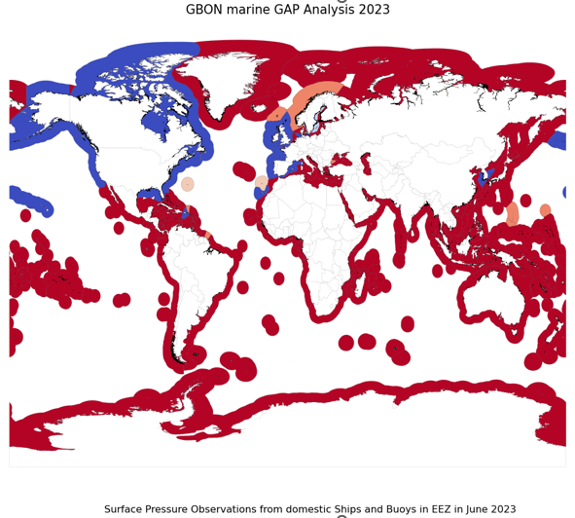
GBON Marine Gap analysis based on SLP observations in June 2023
The designations employed and the presentation of material on these maps do not imply the expression of any opinion whatsoever on the part of the Secretariat of the World Meteorological Organization concerning the legal status of any country, territory, city or area or of its authorities, or concerning the delimitation of its frontiers or boundaries.

Slide 12
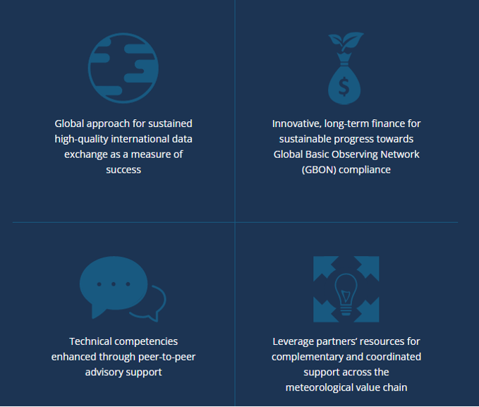
Systematic Observations Financing Facility (SOFF)
SOFF provides long-term technical and grant-based financial assistance to enable countries to acquire and internationally exchange GBON observations
It focuses on the sustainability of investments by providing open-ended result-based finance upon verification of data sharing through WMO Tools
SOFF prioritizes Small Island Developing States (SIDS) and Least Developed Countries (LDCs) to close the largest data gaps
Fast-moving: 83 $million raised, 51 countries approved for readiness funding, 11 countries in investment phase

Slide 13
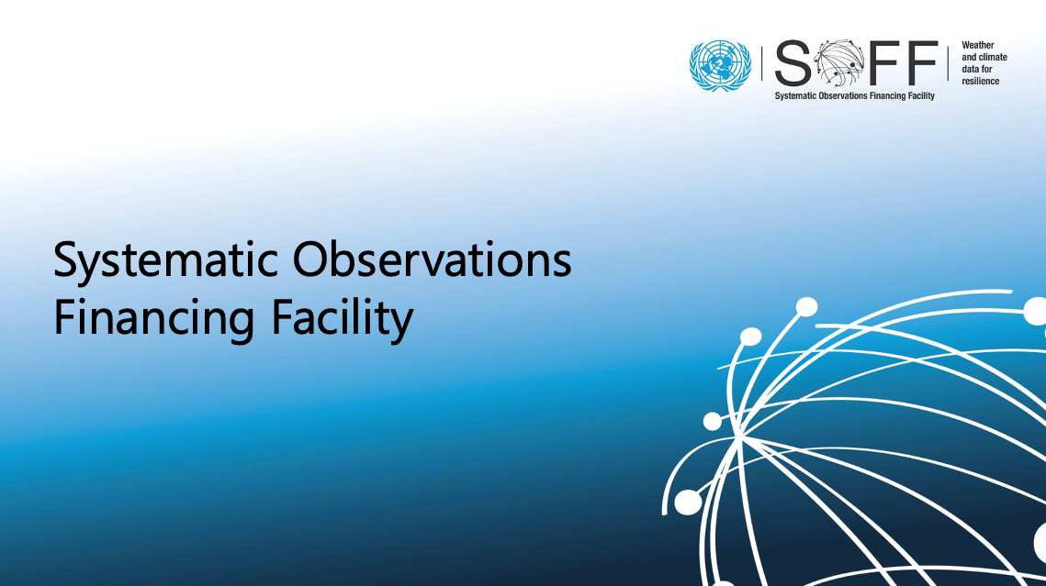
Systematic Observations Financing Facility (SOFF)
Countries in readiness phase
Beneficiary Country | Peer Advisor | Implementing Entity | Beneficiary Country | Peer Advisor | Implementing Entity
Antigua and Barbuda | United Kingdom | UNDP | Malawi | Norway | UNDP
Bahamas | Finland | IADB | Marshall Islands | United Kingdom | UNEP
Bangladesh | Norway | IsDB | Mauritius | South Africa | AfDB
Barbados | Finland | IADB | Nauru | Australia | UNEP
Burkina Faso | Spain | AfDB | Nepal | Finland | UNEP
Cambodia | United Kingdom | World Bank | Niger | Nigeria | AfDB
Chad | Austria | WFP | Palau | United Kingdom | UNEP
Comoros | Morocco | AfDB | Papua New Guinea | Australia | UNDP
Cuba | Spain | UNDP | Saint Kitts and Nevis | Finland | IADB
Democratic Republic of the Congo | Switzerland | AfDB | Saint Lucia | Austria | WFP
Djibouti | Austria | UNDP | Saint Vincent and the Grenadines | Austria | WFP
Dominica | Austria | WFP | Samoa | Australia | World Bank
Dominican Republic | Spain | WFP | Sao Tome and Principe | Netherlands | UNDP
Ecuador | Switzerland | IADB | Senegal | Netherlands | IsDB
Federated States of Micronesia | United Kingdom | UNEP | Seychelles | South Africa | AfDB
Fiji | Australia | World Bank | Somalia | Nigeria | UNDP
Grenada | Spain | N/A | Sudan | N/A | N/A
Guatemala | N/A | N/A | Suriname | Netherlands | UNDP
Guinea-Bissau | Portugal | UNEP | Tajikistan | Finland | World Bank
Guyana | Austria | IADB | Timor-Leste | Finland | UNEP
Haiti | Switzerland | IADB | Tonga | New Zealand | World Bank
Jamaica | Finland | IADB | Trinidad and Tobago | Finland | IADB
Lao People's Democratic Republic | Austria | World Bank | Tuvalu | New Zealand | UNEP
Liberia | Nigeria | AfDB | Uganda | Netherlands | IsDB
Madagascar | Germany | AfDB | Vanuatu | New Zealand | World Bank
 |  |  | Zambia | United Kingdom | WFP
Countries in investment phase
Beneficiary Country | Peer Advisor | Implementing Entity
Belize | United Kingdom | IADB
Bhutan | Finland | UNEP
Cabo Verde | Netherlands | UNEP
Ethiopia | Norway | UNDP
Kiribati | Australia | UNEP
Maldives | Finland | UNEP
Mozambique | South Africa | WFP
Rwanda | Finland | UNDP
Solomon Islands | Australia | UNDP
South Sudan | Austria | AfDB
Tanzania | Denmark | UNDP

Slide 14
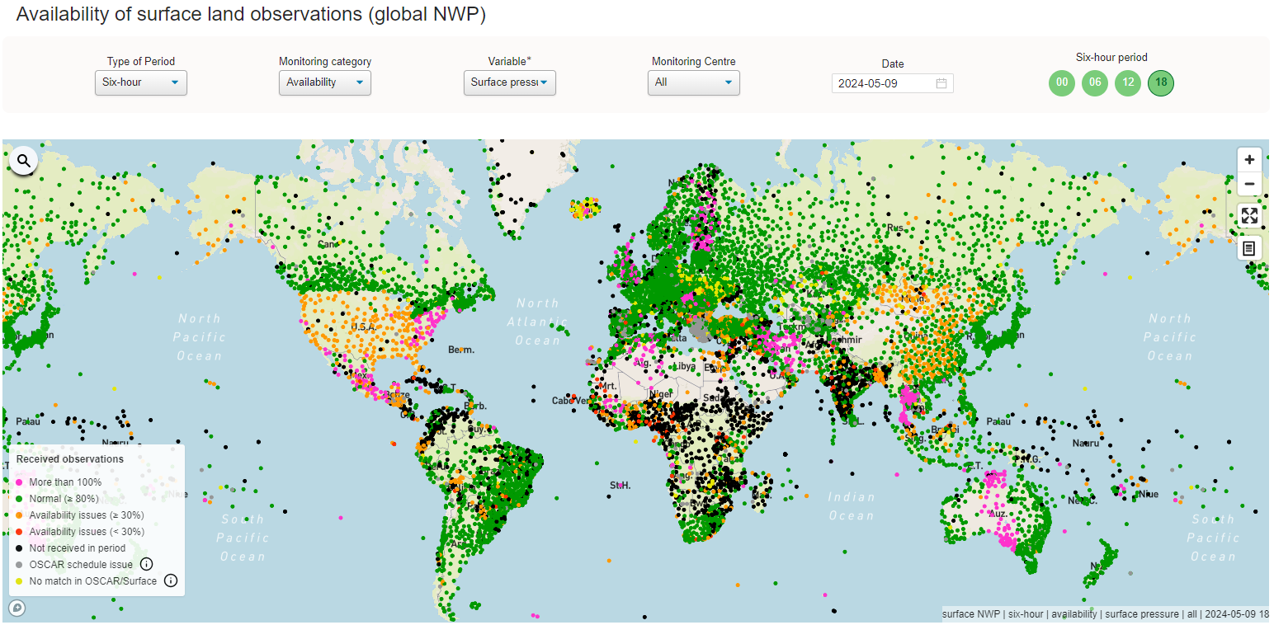
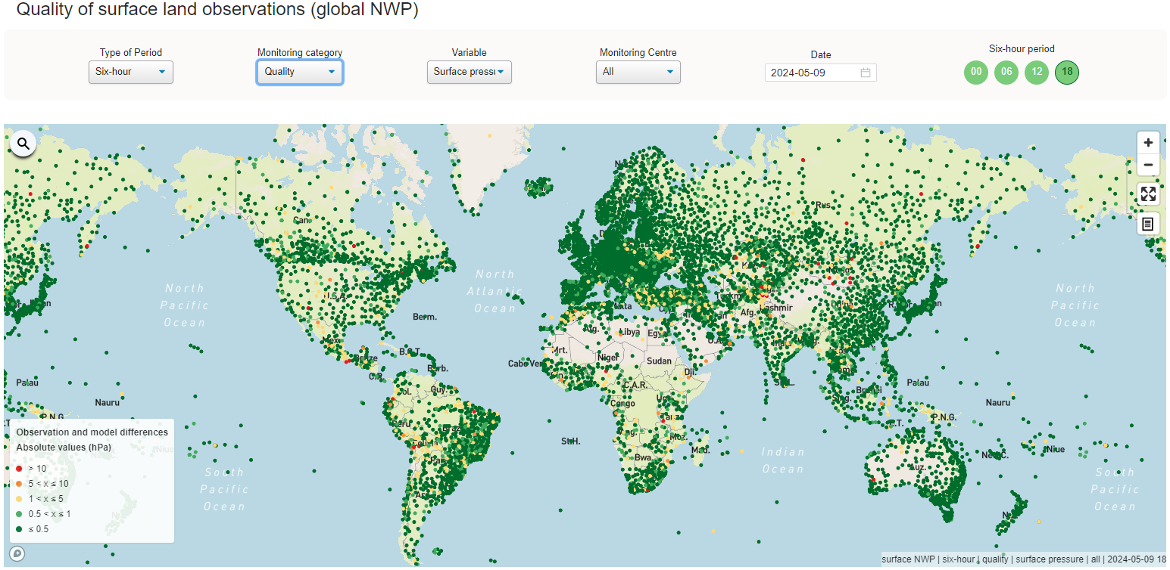
Compliance Monitoring
WIGOS Data Quality Monitoring System (WDQMS)
monitors the availability and quality of observational data based on near-real-time monitoring information.
developed by the WMO, and hosted by ECMWF.
near-real-time monitoring information from the four participating (NWP) centers (DWD, ECMWF, JMA and NCEP).
driven by an Expert Team to develop tools and developed by WMO
WDQMS (wmo.int)

Slide 15
Tiered Networks
WIGOS Observing Network Design Principle No. 7 states that observing network design should use a tiered structure, through which information from reference observations of high quality can be transferred to other observations and used to improve their quality and utility
However, there is no specific guidance on how to apply this principle
Cross-domain workshop convened in October 2023 with the aim to develop guidance on assessment criteria to assign networks to the appropriate tiers of a system of tiered networks

Slide 16
Perspectives noted relative to the tiering of marine/ocean networks
Moored buoys are generally regarded as providing the highest-quality observations of a wide range of marine meteorological variables
GO-SHIP provides the highest quality hydrographic data (including CTD) through the full depth of the ocean (annual to decadal cruises)
OceanSITES ‘reference’ moorings measure many variables through the full depth of the ocean
Autonomous platforms such as Argo floats and gliders need to be cross-checked against ship-based CTD data to identify and correct measurement errors (e.g. sensor drift)
The drifter and Argo arrays are the only networks that provide near global coverage over the main ocean basins
Moored buoys (other than the tropical array) and gliders are mainly operated in near coastal regions

Slide 17
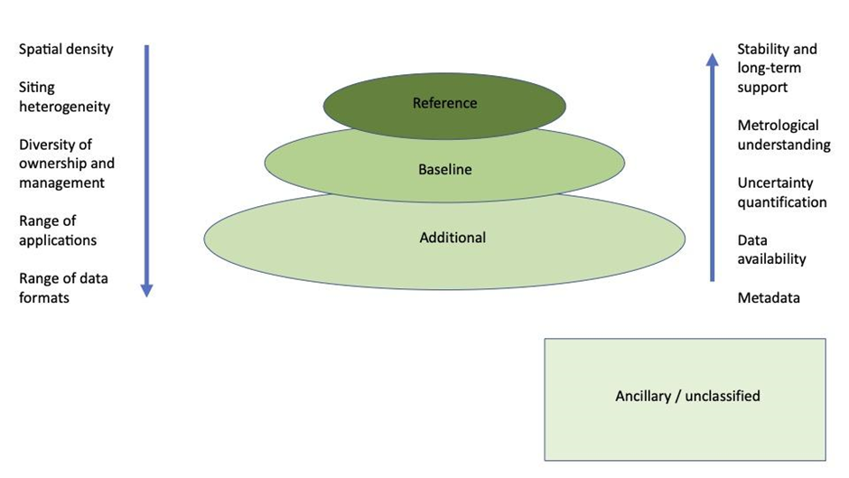
Tiered Networks
The tiered system will have three tiers, Reference, Baseline, Additional, supplemented by a 4th tier, Ancillary, for networks not belonging to the first 3 tiers or which could not be assessed
The tiering of observing networks will specify the purpose and classify the quality and characteristics of observing networks within and across domains and provide a hierarchy of data usage in support of user application areas
Networks will be qualified by criteria such as timeliness, spatial density, uncertainty quantification, quality of instruments, network infrastructure and sustainability of operations

Slide 18
Tiered Networks
The approach reflects that there is a trade-off between spatial-temporal observational density and aspects of observing quality - higher quality tiers can provide observational data of high-quality that can be used to understand data in lower tiers - conversely, observations taken at lower tiers provide the rich spatial-temporal detail necessary to capture real geophysical signals and gradients that sparse networks of high-quality observations cannot
The workshop agreed the assessment should be divided into two dimensions, an information quality assessment and a suitability assessment, that recognizes for each application area different aspects (e.g. information quality, observation density) will have higher or lower priorities
A task team will be established to continue this work and to submit its first deliverable by INFCOM-4 (2026).

Slide 19
Task Team on Tiered Networks
The Task Team should develop, test and undertake a pilot phase for assessing network information quality and application suitability, Task Team members will be representatives of broader communities and expected to interact with these communities
The assessment criteria should be tested for at least two networks from each domain (atmosphere, ocean, terrestrial) and modified as necessary
Specifically, the Task Team should create an assessment criteria guidance document for an information quality assessment matrix, including the definition and the approach of assigning to tiers, this should include assessment pillars that include (but are not necessarily limited to):
  Data management and access
  Measurement qualification
  Documentation and metadata
  Network management and sustainability
  Spatial, temporal coverage and timeliness
Submit progress report to INFCOM-4, and subject to approval from SC-ON and SC-MINT submit a pilot implementation plan to INFCOM-4

Slide 20
Rolling Review of Requirements (RRR)
1
2
3
4
5
6
Notes:
The purpose of the Rolling Review of Requirements (RRR) process is to provide a systematic and transparent process to support the high-level design and evolution of WIGOS. The RRR process compiles information about requirements for observations, about observing system capabilities, and draws on experts and impact studies to provide guidance on the most important priorities for addressing the gaps between requirements and capabilities.

Slide 21
Rolling Review of Requirements (RRR)
Application Areas (AAs):
2.1 Global NWP and Real-time Monitoring
2.2 High-Resolution NWP
2.3 Nowcasting / Very Short Range Forecasting
2.4 Sub-Seasonal to Longer Predictions
2.5 Atmospheric Climate Monitoring
...............
Earth System Application Categories (ESAC)
1. Space Weather Applications
2. Atmospheric Applications
3. Oceanic Applications
4. Hydrological and Terrestrial Applications
5. Cryospheric Applications
6. Integrated Earth System Applications
Application Areas (AAs):
3.1 Ocean Forecasting and Real-time Monitoring
3.2 Coastal Forecasting
3.3 Oceanic Climate Monitoring and Services
3.4 Tsunami Monitoring and Detection
3.5 Marine Environmental Emergency Response
3.6 Marine Safety (Ports to Open Ocean)
3.7 Ocean Biogeochemical Cycles

Slide 22

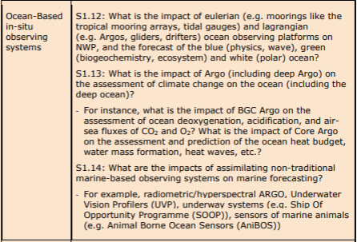


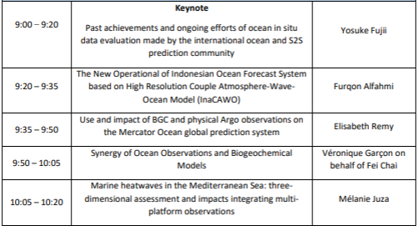
27 May 2024
28 May 2024
Posters
Impact of Ocean Observations, Features and Processes on Tropical Cyclone Prediction (Scott Glenn)
Assessment of the ocean state, variability and changes in the northwestern Mediterranean Sea in the context of climate change using a decade of Argo data (Carla Chevillard)
Convergence of North Atlantic deoxygenation trend by combining shipboard and Argo-Oxygen observations using machine learning algorithms (Taka Ito)
Geographic Variations in the Impact of Marine Observations in Global NWP (Sharon Jewell)
..............
30 May 2024
Workshop website: 8th WMO Workshop on the Impact of Various Observing Systems on Numerical Weather Prediction and Earth System Prediction | World Meteorological Organization
Registration: https://forms.office.com/e/xjak3ERESM
Provisional Agenda (as of 15.03.2024): WMO CPDB Extranet - 8th_WMO_Impact_Workshop_Draft_Provisional_Programme.pdf - All Documents (sharepoint.com)

Slide 23
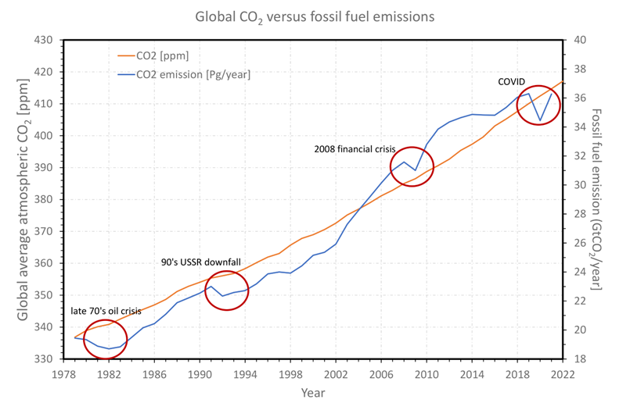
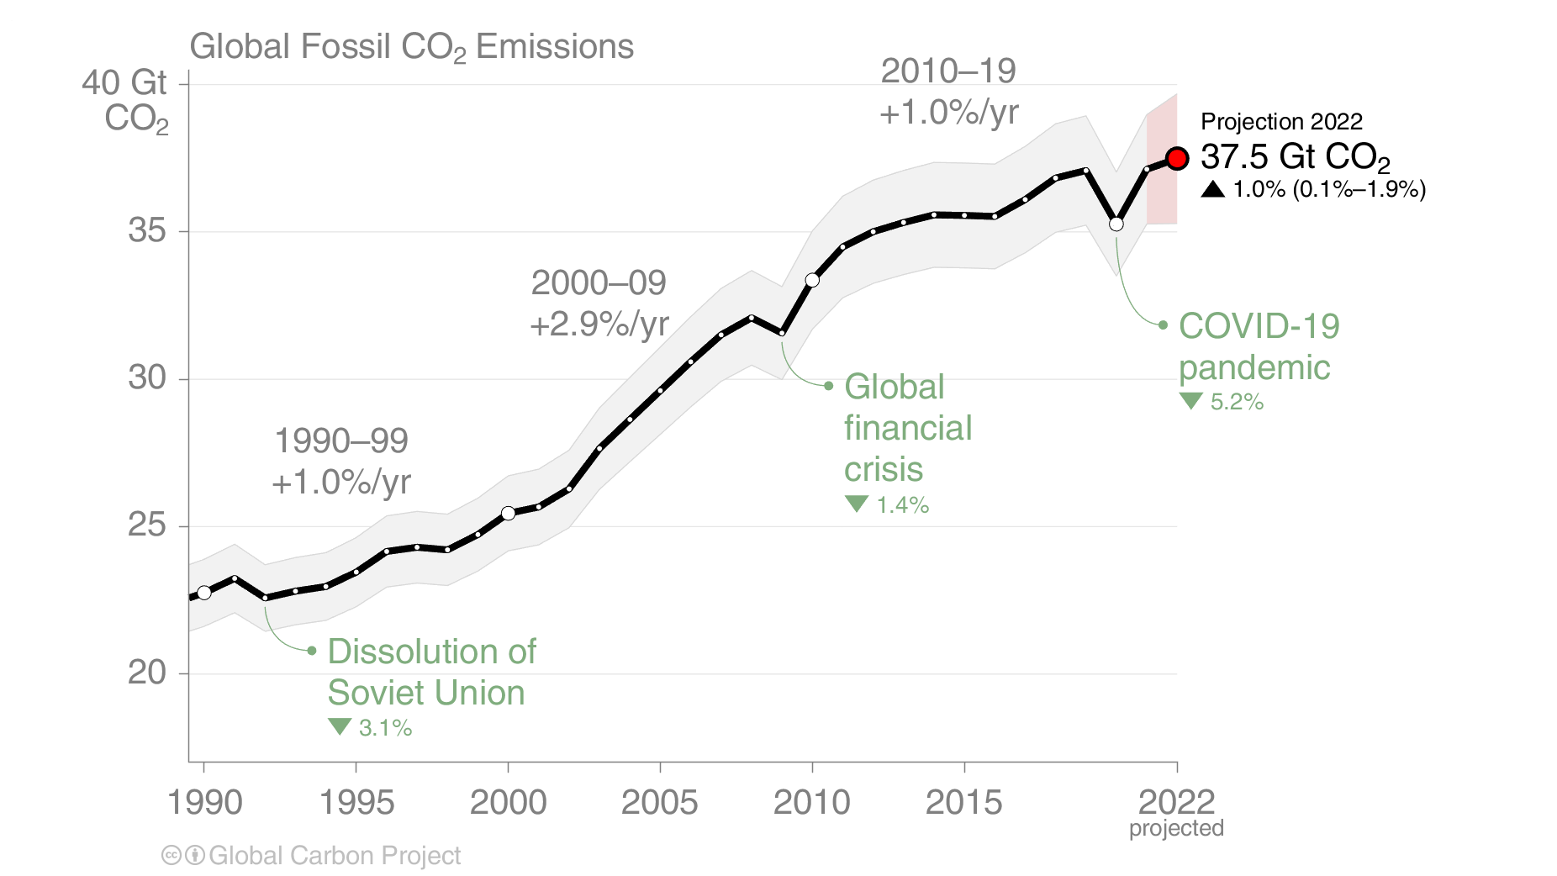
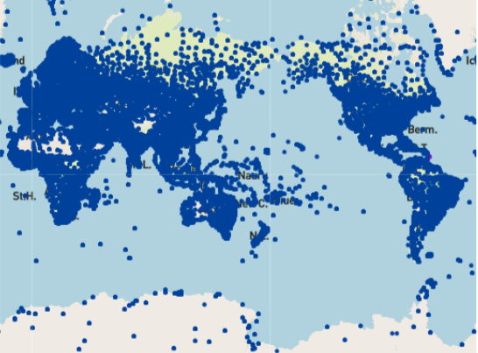
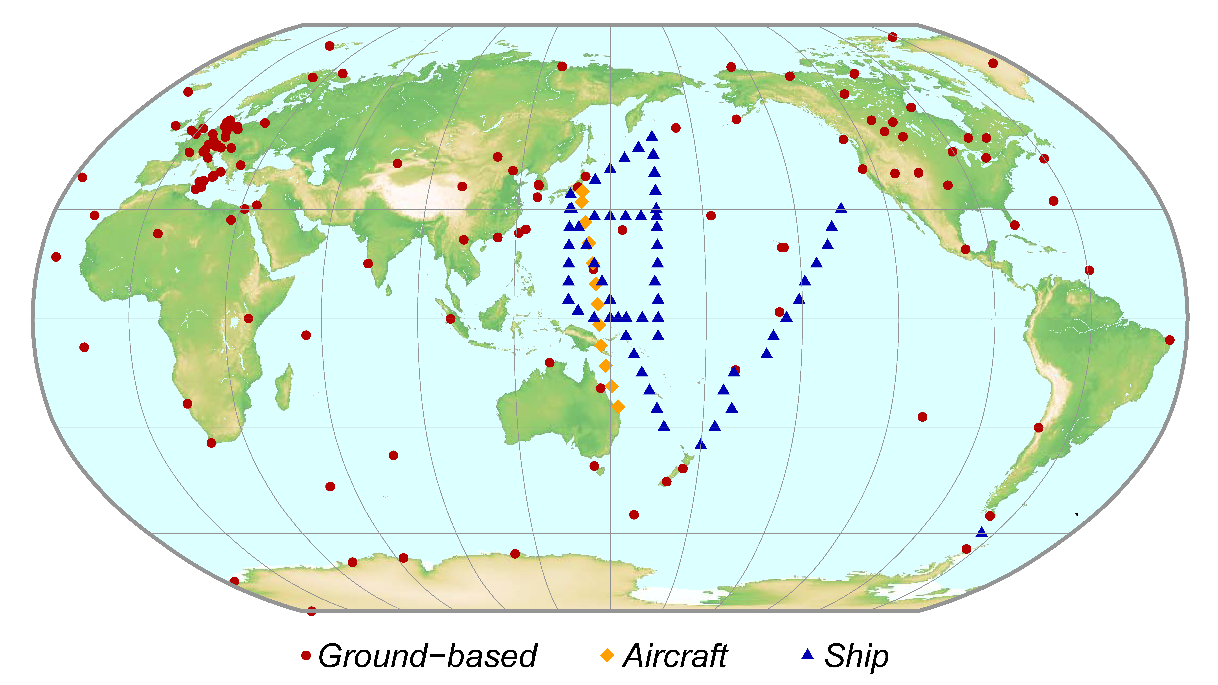
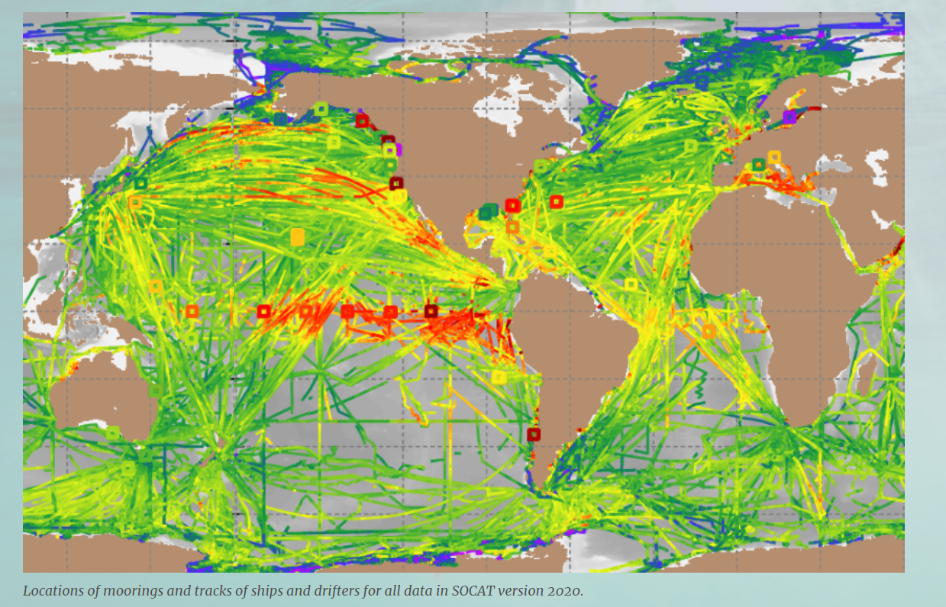
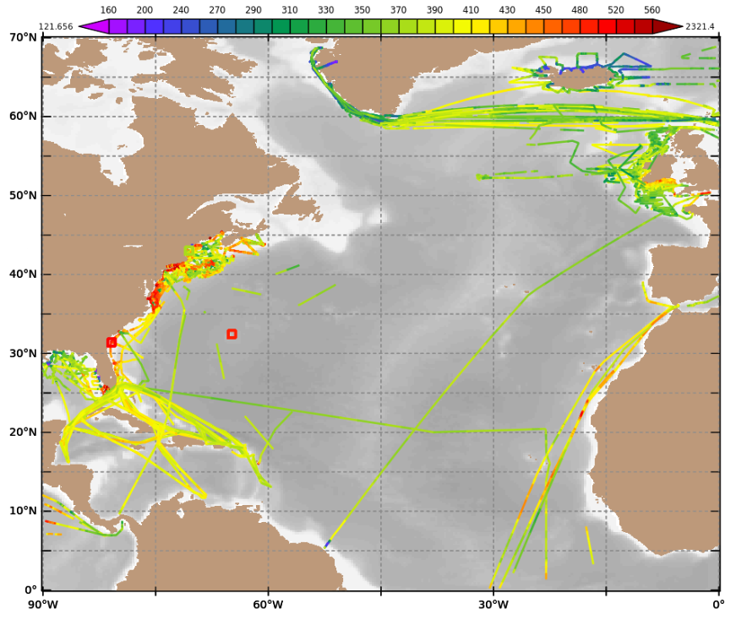
Global Greenhouse Gas Watch (G3W)
From research efforts to a more integrated global system
“We do not yet have an integrated global system that operates the way weather prediction and climate analysis is done.”
Research efforts have provided much insight, but cannot guarantee sustained funding, cannot deploy a truly global observing system, fund operational modeling and data assimilation and do not lead to near-real time exchange of data
Weather network
GAW Greenhouse Gas network
SOCAT PCO2; all data since 1970
N Atlanctic 2018

Slide 24
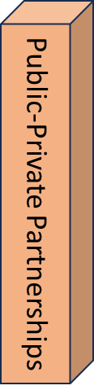
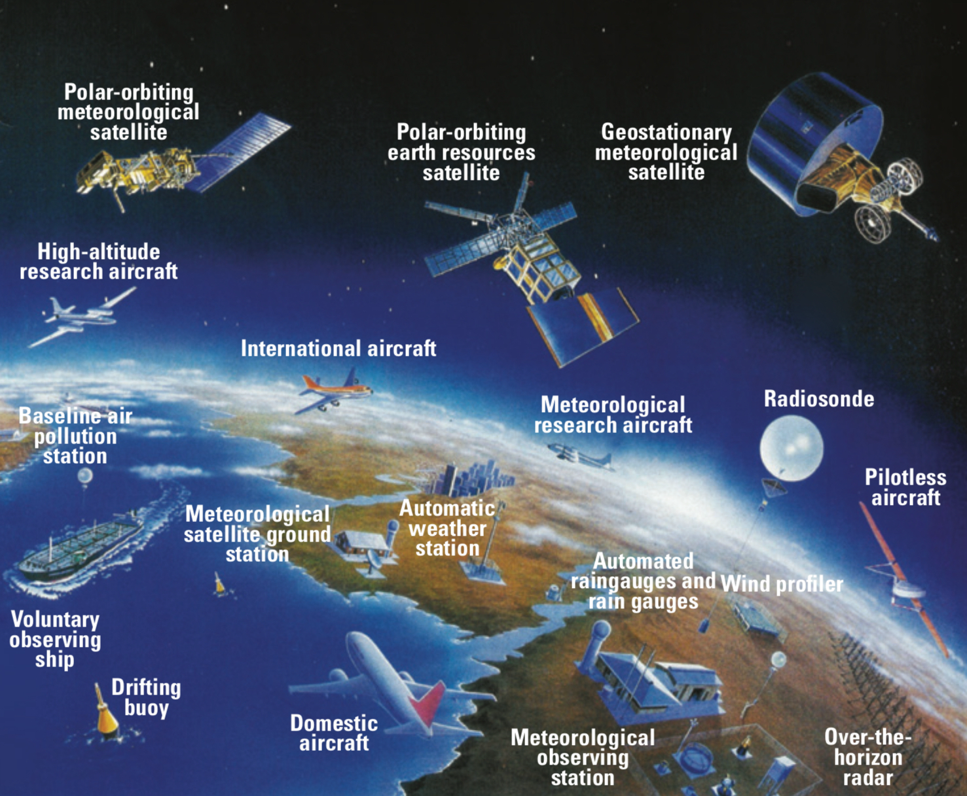

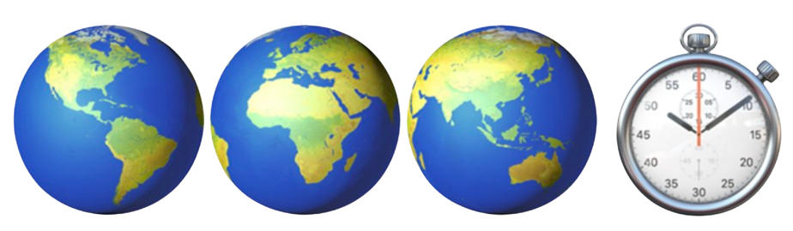
2023 2024 -- 2027 2028 -- 2031 2032 -- 2050
Cg-19 → G3W
WMO Congress
G3W – IPP
Implementation Pre-Oper Phase
G3W – IOP
Initial Operational Phase
G3W – EOP
Enhanced Operational Phase
GST-1
Initial Monitoring Systems
GST-2
Enhanced Systems
GST-n
COP28
COP33
ETF, NDCs
“for Measuring, Understanding, and Managing the Earth’s Climate”
UN family
IPCC-IOC-
UNEP-UNFCCC-
WHO-WMO-WTO
UNFCCC
COP-SBSTA
WMO
WIGOS-WIS-WIPPS
CO₂, Carbon dioxide
GHGs Earth’s Observing Systems is building on Weather experience
G3W – Global Greenhouse Gas Watch
Implementation plan: G3W stages and timeline

Slide 25


Opportunities to exploit
Future GBON expansion (e.g. sea level, waves, etc.)
Engagement in the RRR process (in gap analysis and development of the Statement of Guidance)
Contributions to WMO Technical Regulations, including Manuals and Guides (e.g. S&BP and WMO No.8)
Leverage from existing inter-organization collaborations (i.e. ET-RFC, radiofrequency allocation, satellite community)

Slide 26
Thank you.
^{wmo.int}

