Slide 1
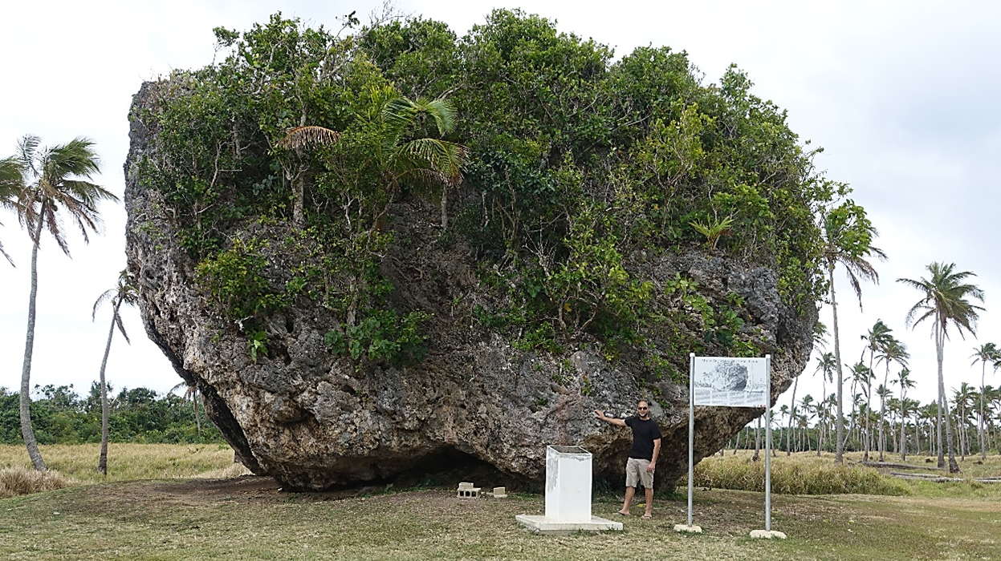
Paleotsunami
Current State Scientific Update
ICG/PTWS Scientific meeting of experts to understand tsunami sources, hazards, risk and uncertainties associated with the Vanuatu, San Cristobal and New Britain Subduction Zones
Port Vila, Vanuatu
14–17 May 2024
Shaun Williams

Slide 2



Acknowledgments

Slide 3
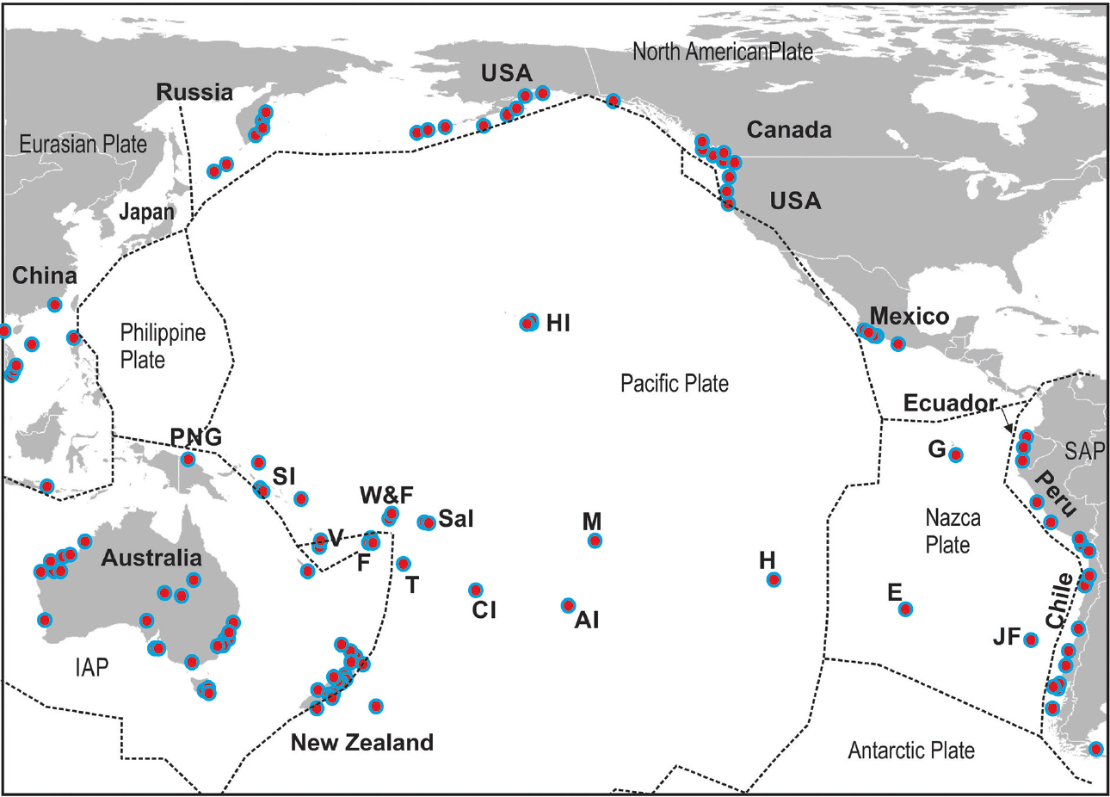
Outline
Overview – Paleotsunami in the SW Pacific
New Caledonia, Vanuatu, Solomon Islands and Papua New Guinea focus
Commentary on Investigative Techniques
Gaps and Challenges
Goff et al. 2020

Slide 4
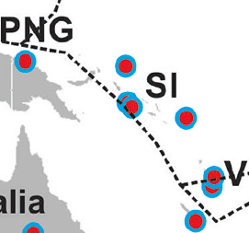
Overview of evidence
Local sources – New Guinea Fault related events
Trans-Pacific source interpretation – TKT Source
New Caledonia, Vanuatu – mixture of sedimentary/ geological, archaeological, contextual
Solomon Islands – based on re-interpretations of archaeological / contextual evidence
PNG – limited to New Guinea fault
Goff et al. 2020; 2022
Combination - Trans-Pacific (TKT) source and local EQ/Volcano sources

Slide 5
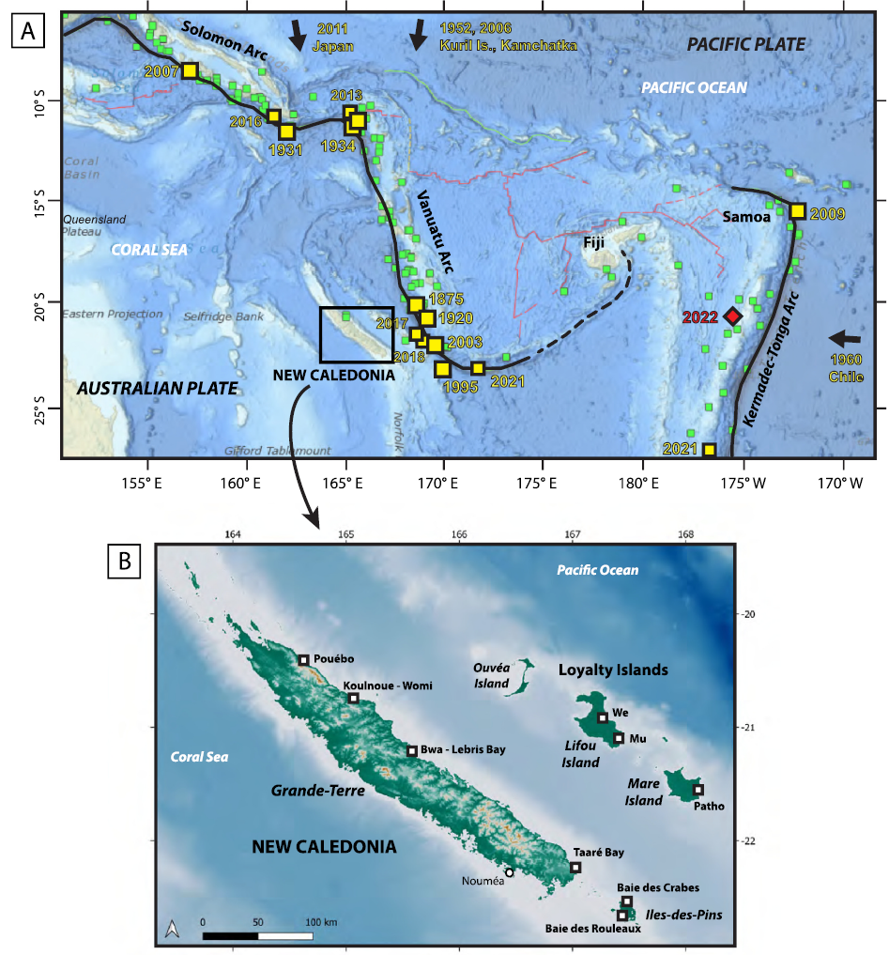
2023 Update –Paris et al. 2023 New Caledonia
First study on paleo-tsunamis (sedimentary evidence) in New Caledonia
6 tsunamis preserved in the sedimentary record.
3 events <1000 BP
28-Mar 1875 tsunami
~1700 CE tsunami (related to 1729 Vanuatu EQ)??
15th C tsunami?? (trans-pacific event – TKT source )
2 events between 1000-2000 BP
1 event ~3000 BP
Notes:
Emphasis here on stars dating to about 15th C (i.e. suggested trans-pacific ~M9.3 TKT paleotsunami

Slide 6
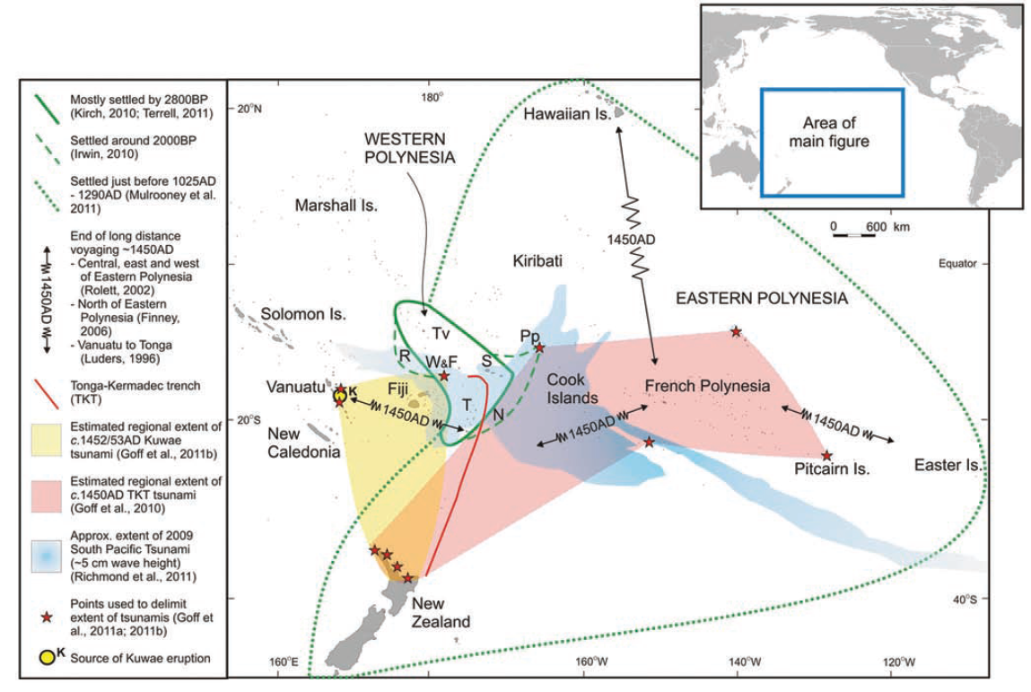
Potential significant 15th C Trans-Pacific event
So-called ‘history-changing event’ on Pacific migration/cultural shifts (Goff et al. 2012; 2020 and 2022)
~1450 AD event
Suggested to be linked to a possible Mw 9.4 Tonga-Kermadec EQ

Slide 7
15th C event – contrasting factors
The interpreted sources for a 15th C TKT-sourced event in West Pacific (Solomon Is., Vanuatu, New Caledonia) is ambiguous:
Cain et al. 2019 (Solomon Islands) – TKT vs local/regional?
Goff et al. 2022 (Solomon Is. / Vanuatu) – TKT vs Kuwae eruption?
Paris et al. 2023 (New Caledonia)
Lavigne et al. 2021 (Tonga) – introduces a potential volcanic instead of EQ source at TKT?
Notes:
Emphasis here on stars dating to about 15th C (i.e. suggested trans-pacific ~M9.3 TKT paleotsunami

Slide 8
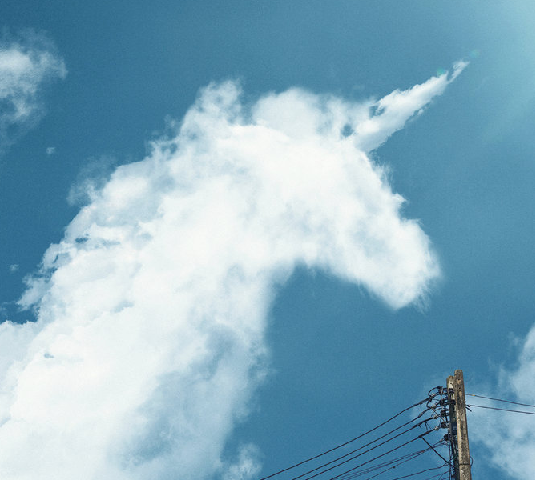
Commentary on Investigative Techniques
Over the last decade – a major shift to using inter-disciplinary techniques in combination:
  Geological, geomorphological, chemical, biological, numerical and geospatial modelling, archaeological, anthropological, contextual…
Evidence, or interpretations thereof, are subject to ambiguity –
  “...beware of seeing shapes in the clouds…”

Slide 9

Challenges & Gaps
Very limited paleotsunami investigations in Vanuatu, New Caledonia, Solomon Islands, Papua New Guinea
Such work can be relatively expensive and time consuming – but nevertheless important
Distinguishing tsunami from cyclone/storm deposits has improved – but interpretations can be ambiguous
Numerical modelling significantly helps narrow down areas to look for deposits – and help to validate potential sources corresponding to depositional evidence
Interpretations should be treated with care and scrutiny

Slide 10
Paleotsunami
Constraints on Sources
ICG/PTWS Scientific meeting of experts to understand tsunami sources, hazards, risk and uncertainties associated with the Vanuatu, San Cristobal and New Britain Subduction Zones
Port Vila, Vanuatu
14–17 May 2024
Shaun Williams

Slide 11
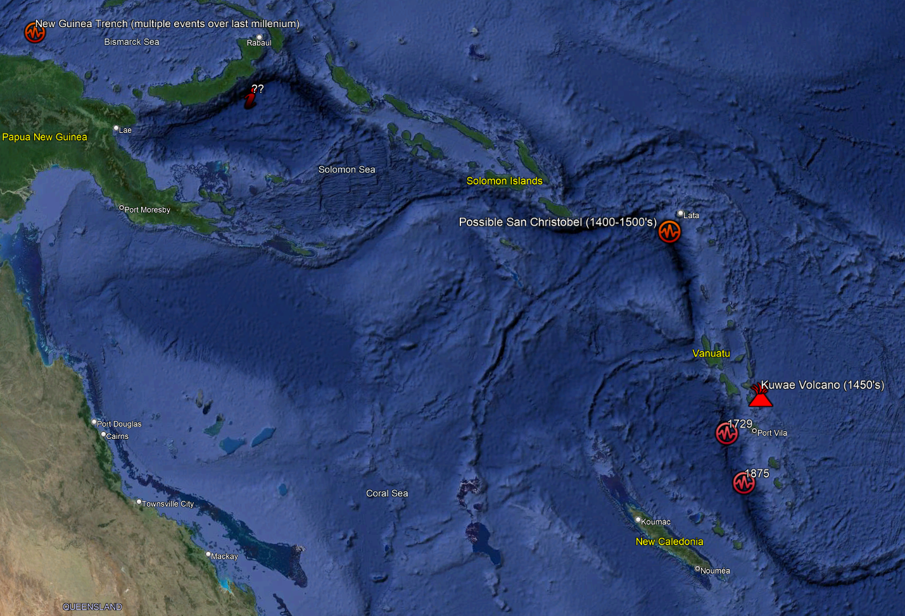
Paleotsunami constraints on sources
No paleotsunami constraints currently available for New Britain subduction source
Some events potentially constrained by paleotsunami evidence
  Vanuatu Arc
    1875 event (historical + sedimentary evidence – New Caledonia - Paris et al. 2023)
    1729 event? (geological + sedimentary evidence – New Caledonia - Paris et al. 2023)
    1452/53 – Kuwae eruption source - Vanuatu
  1450 event? (archaeological + contextual evidence – Solomon Islands + New Caledonia + Vanuatu (Cain et al. 2019; Goff et al. 2022; Paris et al. 2023)
    Currently interpreted to be associated with a potential 15th C TKT ~Mw9.4 event
    However – the possibility of a Kuwae source or local-sourced event at San Cristobel subduction cannot be ruled out

Slide 12
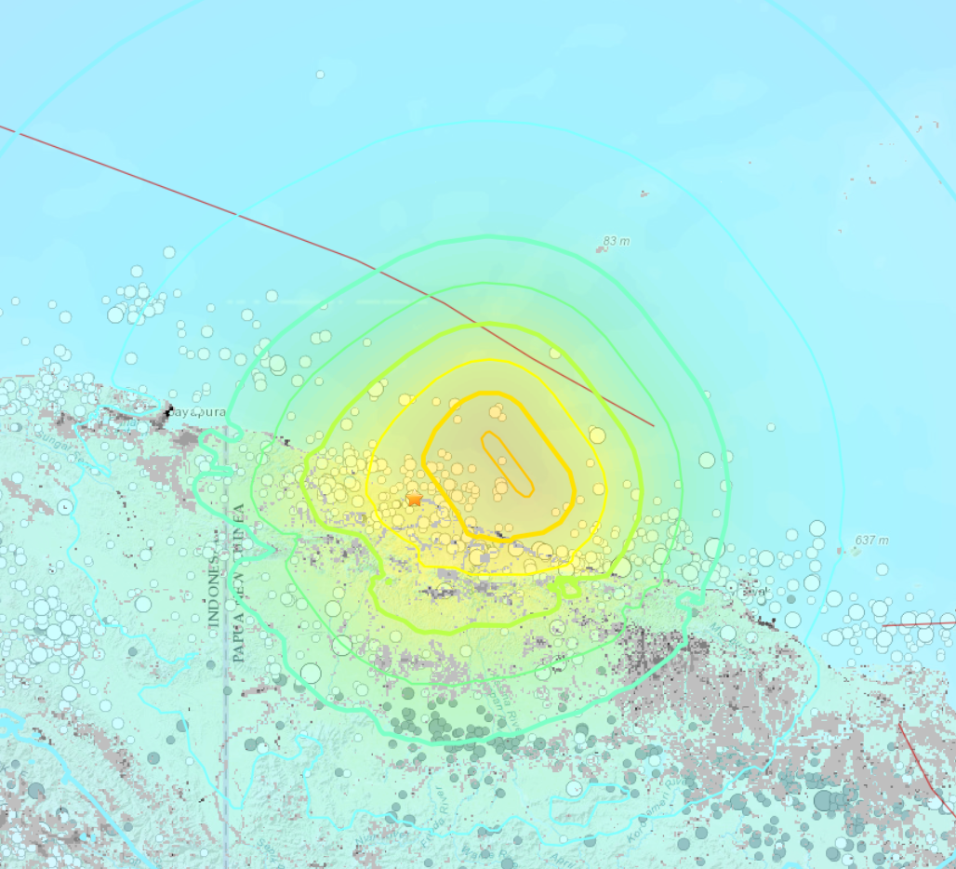
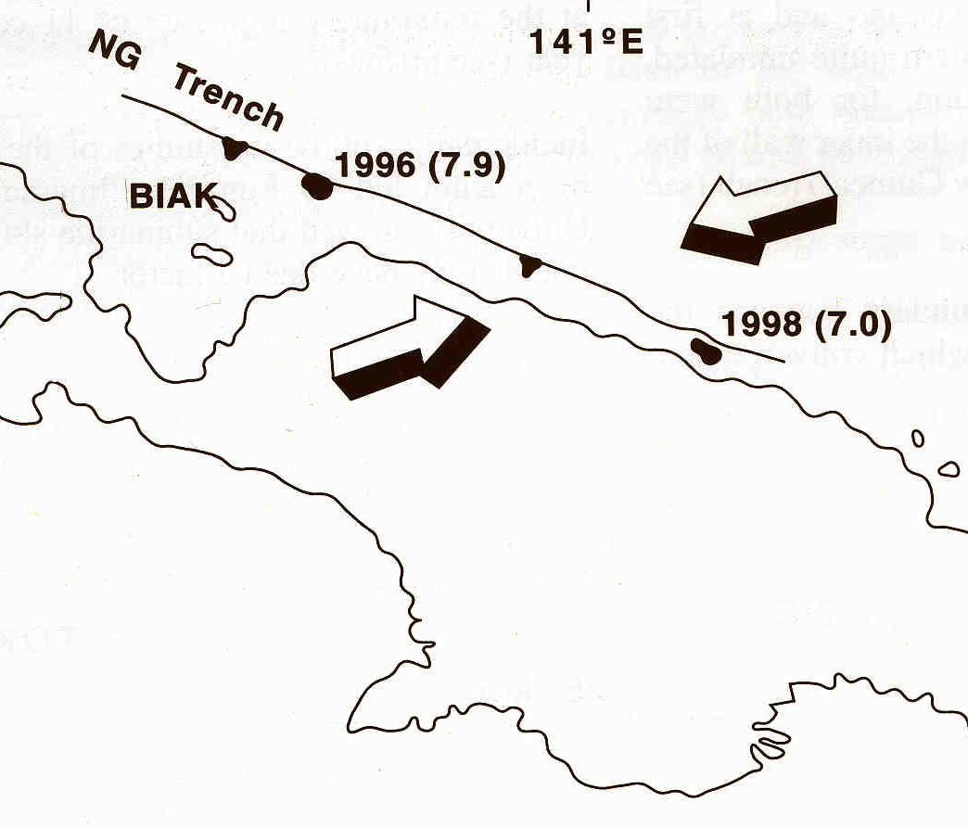
PNG – 1998 analogy for interpreting paleo-evidence at Aitape/Sissano Lagoon
July 1998 Aitape EQ and Landslide Tsunami
Specific to New Guinea fault in the north
Notes:
Emphasis here on stars dating to about 15th C (i.e. suggested trans-pacific ~M9.3 TKT paleotsunami

Slide 13
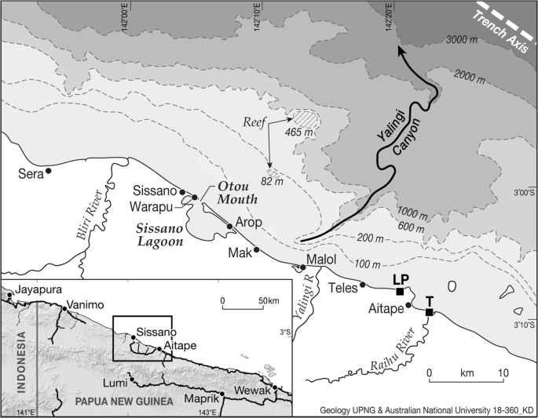
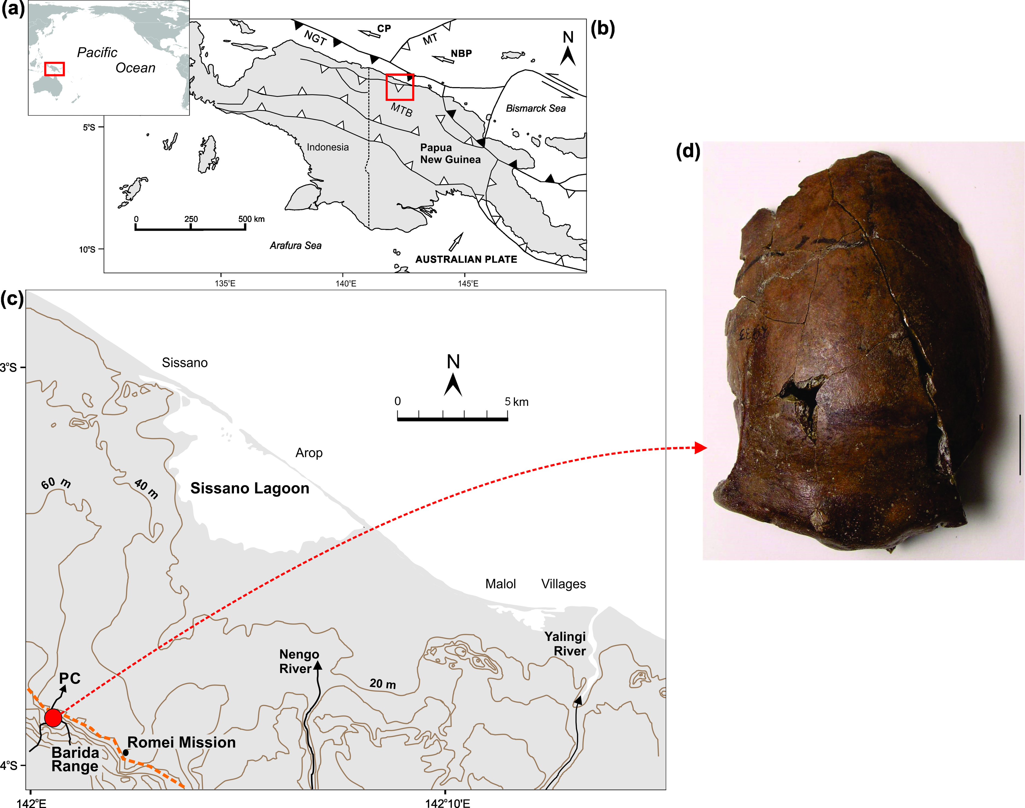
Aitape / Sissano Lagoon – evidence for local events
Goff et al. 2017
Davies et al. 2019
Notes:
Emphasis here on stars dating to about 15th C (i.e. suggested trans-pacific ~M9.3 TKT paleotsunami

Slide 14

Thank you for your Time and Attention
shaun.williams@niwa.co.nz

