Slide 1
ICG/NEAMTWS SC Meeting
13 May, Paris, France
TSUNAMI READY AND SUPPORT TOOLS
NEAMTIC (1.4)
Update on TR Toolkit (1.2)
Update on TRRP: Planning TR Application for Recognition (1.1)
Denis Chang Seng, PhD
Programme Specialist and
ICG/NEAMTWS Technical Secretary
CoastWAVE Project Officer
Tsunami Resilience Section
UNESCO IOC

Slide 2
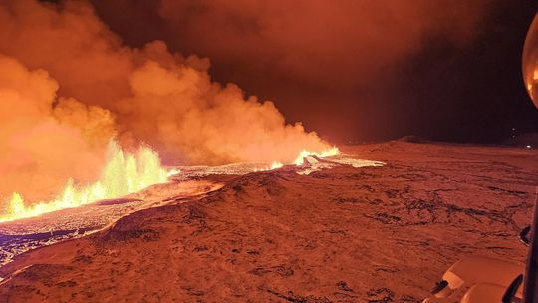
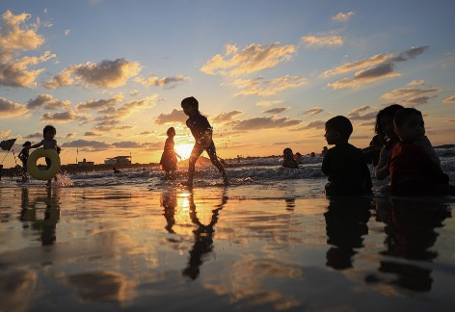
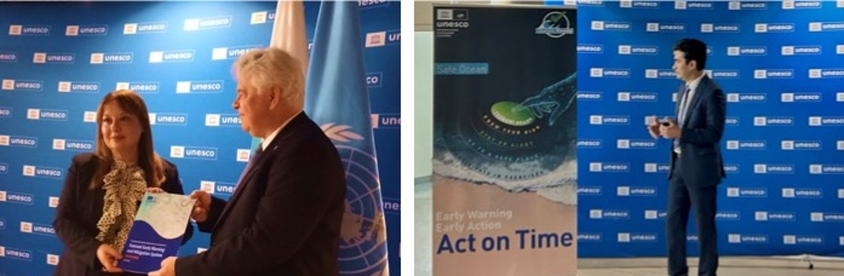
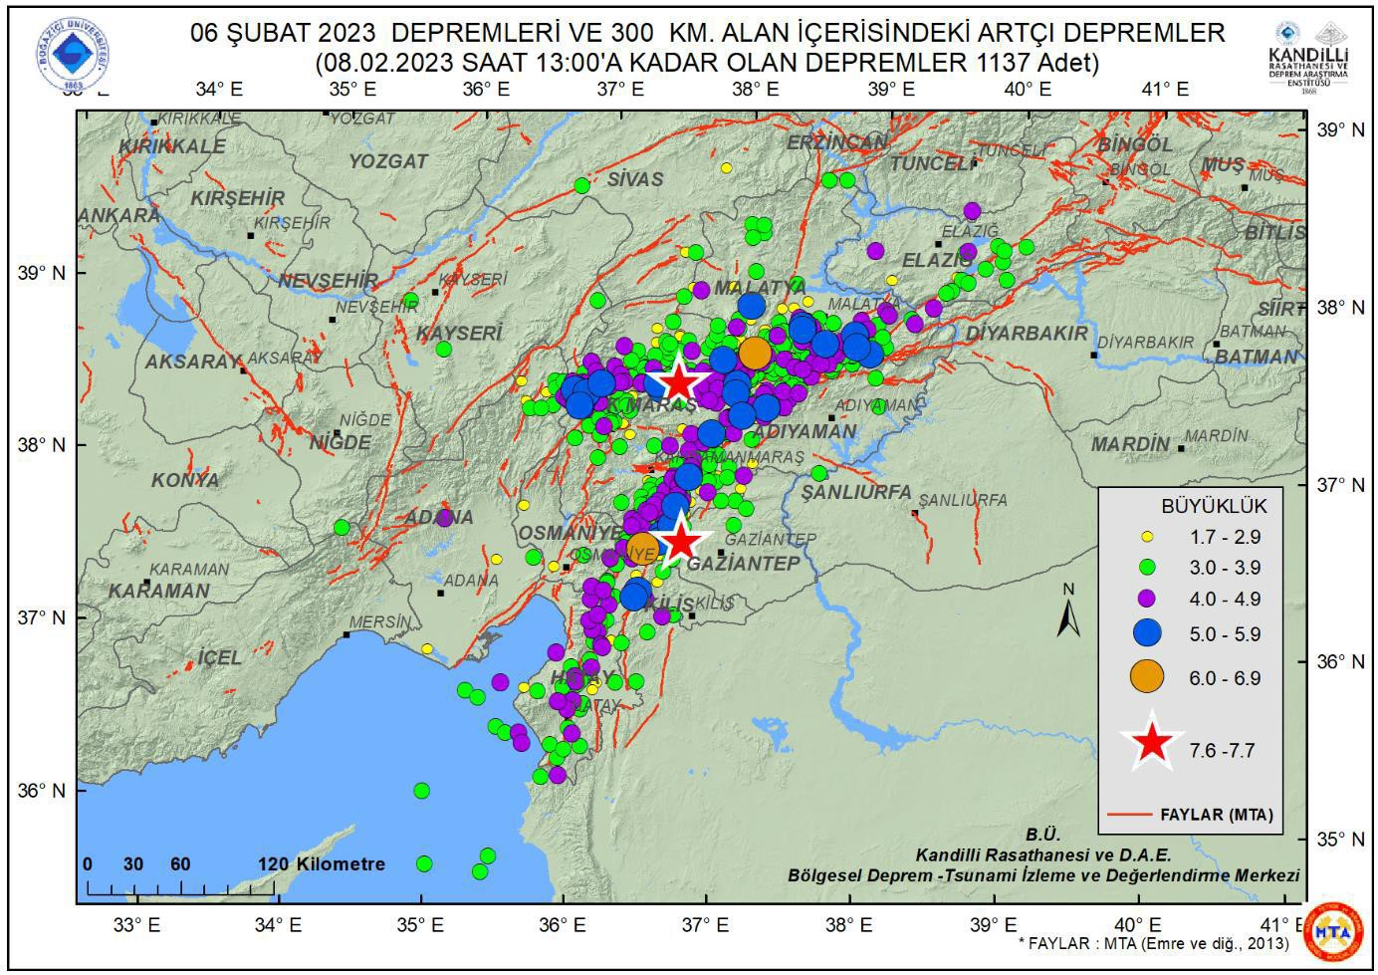

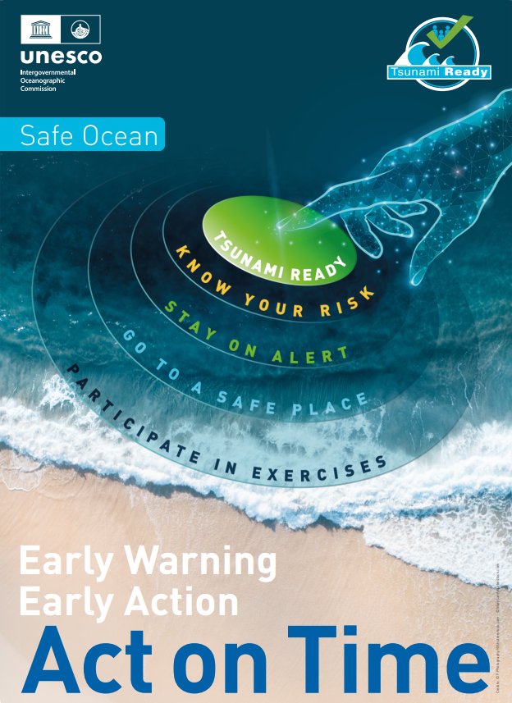
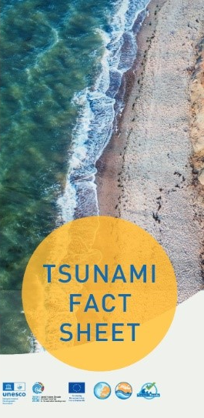
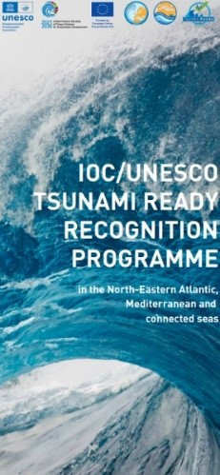
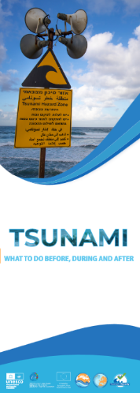
NEAMTIC 2023-2024
Over 30 Articles
10 Brochures/Leaflets and Posters
  NEAMTWS 2030 Strategy Brochure
  NEAMWave Exercise – Information Brief
  NEAMWave23 Exercise – Information leaflet
  Tsunami Fact Sheet Brochure
  Tsunami What to do Brochure.
  Tsunami Ready Recognition Programme Brochure
  Tsunami Ready Poster
  Coastal Hazard Ready Poster
  ICG/NEAMTWS Poster update

Slide 3
NEAMTIC CONTRIBUTION TO ITIC

Slide 4
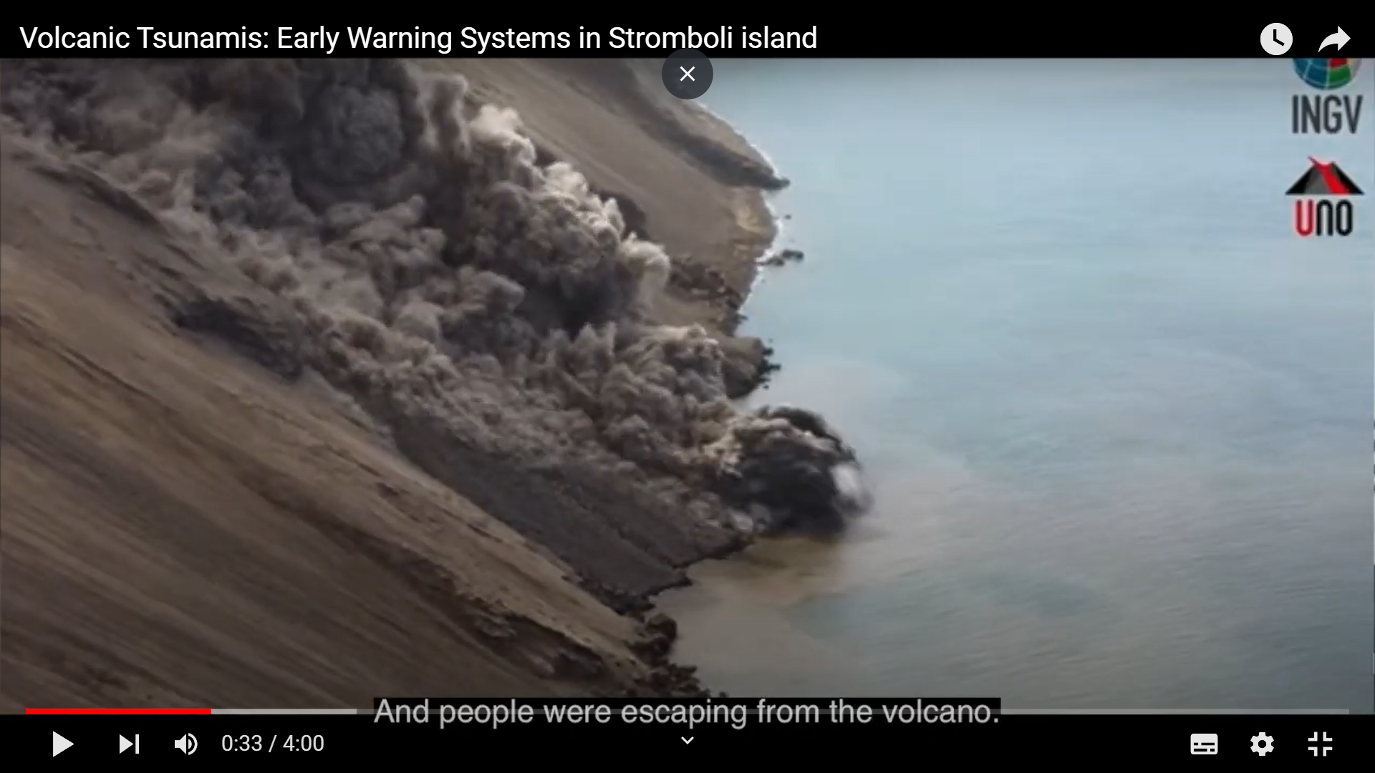
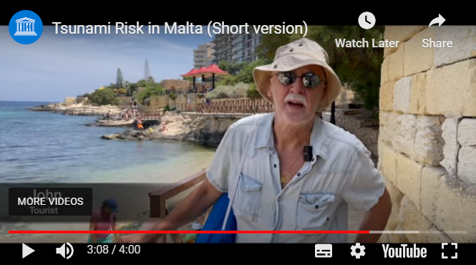
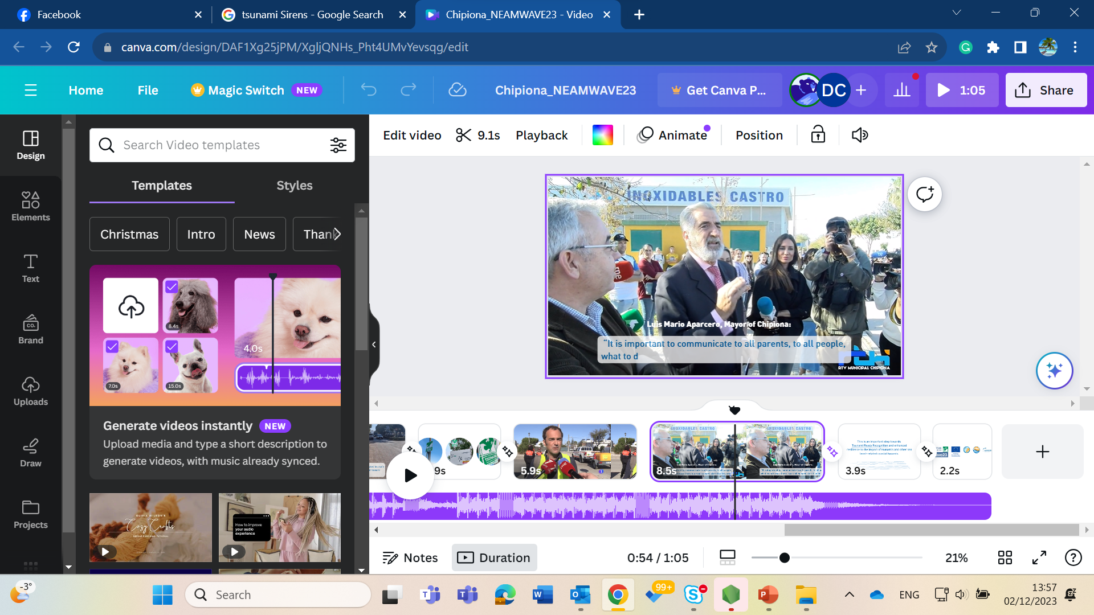
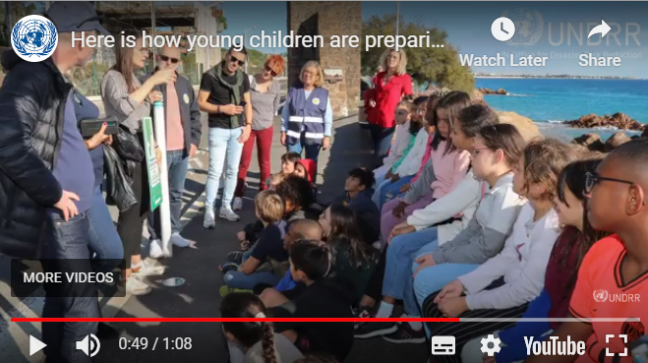
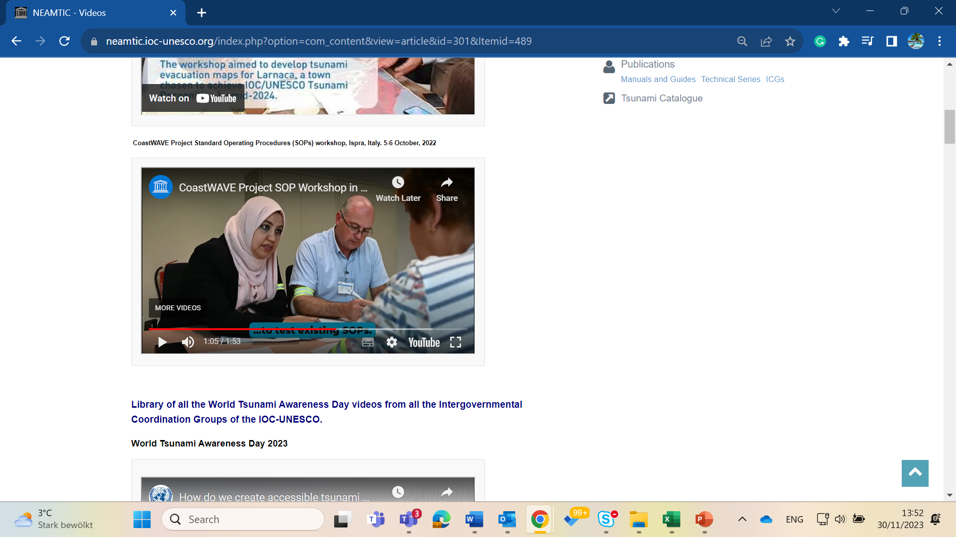
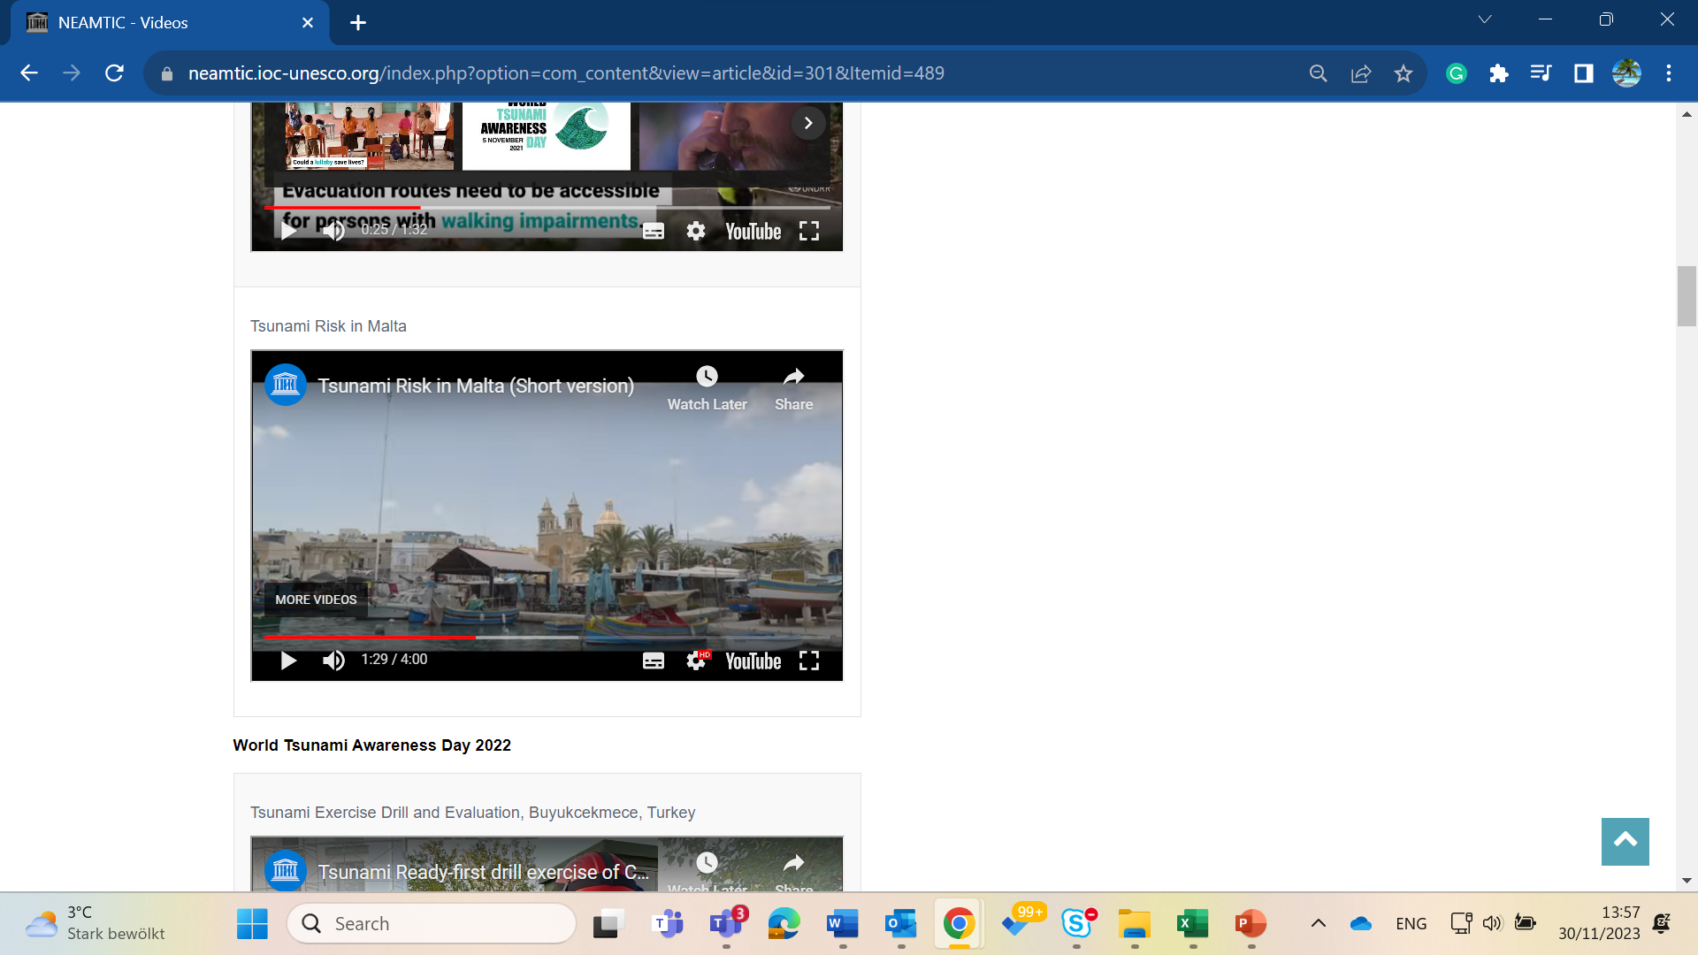
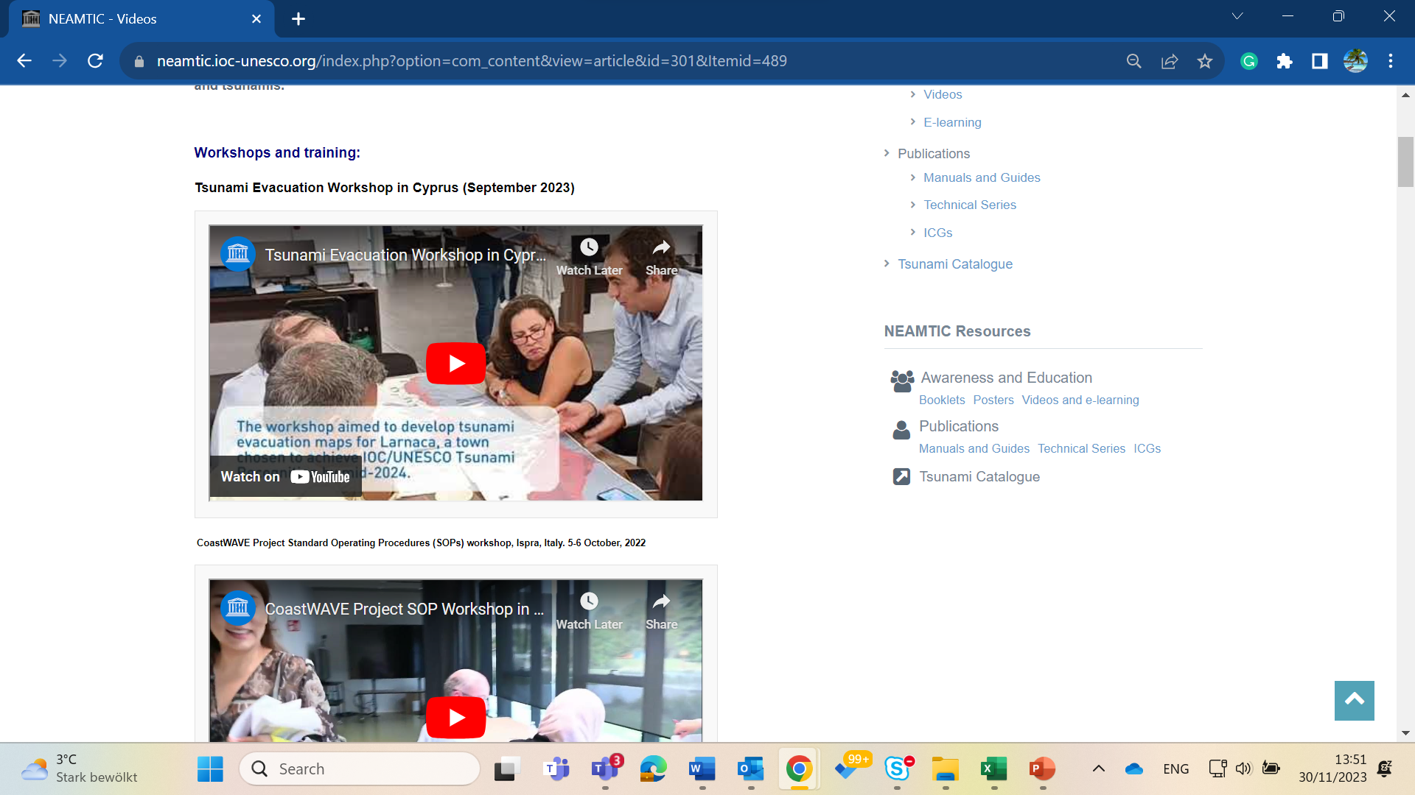
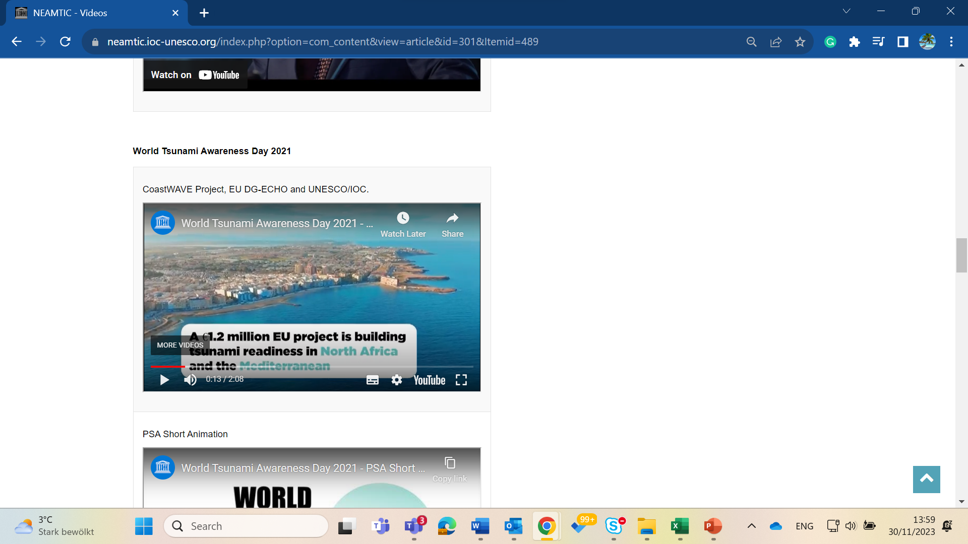
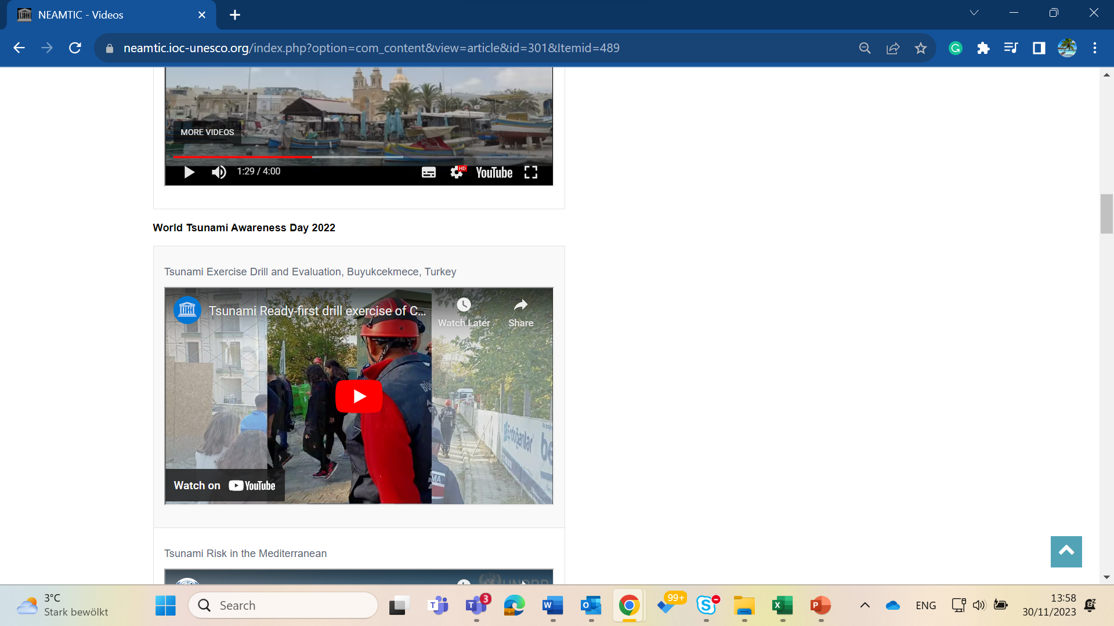
10 Videos
2 Stromboli Volcano - Tsunami Warning System documentary, 3 min, 10 min versions) (To be launched in Feb 2024)
Tsunami Exercise in Chipiona, Spain, Dec 2023
2 Tsunami Risk in Malta (documentary, 3 min, 10 min versions), 5 Nov 2023
Supporting Children Prepare, 5 Nov 2023
Commemorating the Aegean Sea event, October 2023.
Tsunami Evacuation Workshop in Cyprus, Sep 2023.
CoastWAVE Project Standard Operating Procedures (SOPs) Workshop, Ispra, Italy.
Tsunami Exercise, Istanbul during WTAD 2022

Slide 5
NEAMTIC is Not Only a Web Portal
Meetings
TICs meeting in the margin of TOWS-WG TTs meetings
TICs representatives involved in planning and organizing the 2 Global Tsunami Symposium, Indonesia.
Tools
Development of new website and common TICs platform (Derya to add)
NEAMTIC on social media platform, but lack members
TICs –Fundamental structure in the implementation of Tsunami Ready
TICs working together to develop common tools and products, but slow!
Survivors story and eyewitness (featured/center stage at 57 IOC EC, 27 June 2024)
Training
Regional SOP training (CoastWAVE 1.0)
Anticipated Regional Tsunami Hazard Assessment, Evacuation Mapping and Planning (CoastWAVE 2.0)

Slide 6

NEAMTIC Support
Interns
Projects
Consultant
Partners (MoU)
Sharing of resources & products
Several IOC Governing Body Decisions called MS to support NEAMTIC (Financial and Staff)

Slide 7
Tsunami Ready Toolkit
TT DMP D & R (Sendai , Japan, 2024)
Requests the IOC, led by the TICs, to develop and share a Tsunami Ready Toolkit to assist Member States in implementing the Tsunami Ready Recognition Programme.
The toolkit can include a standard and clear procedure, format, and method for submitting the Tsunami Ready application and its supporting documentation…
Recommends Secretariat to inform Member States on the Toolkit’s availability via IOC Circular Letter to the Tsunami National Contacts, National Tsunami Ready Board, and widely through the attaching this as an appendix of the Manual and Guide 74,
TT DMP plans to hold meetings, when possible, to discuss key action items e.g. Toolkit’s and the preparation of the IOC Circular Letter.

Slide 8
Tsunami Ready Application and Recognition Ceremony
Mid -Year Planning
 | Countries | Tentative dates | 29 April-4 May | 6-11 May | 13-18 May | 20 -25 May | 27 May- 1 June | 3-8 June | 10-15 June | 17-21 June
1 | Cyprus | Very likely after June
2 | Egypt | End of May |  |  |  |  | EGYPT (28 May)
3 | France | 19 Jan
4 | Greece | 18-21 June |  |  |  |  |  |  |  | GREECE
5 | Italy |  |  |  |  |  |  | ITALY?
6 | Israel | Application Submission 10 April Very likely after June
6 | Malta | End of May/ Later after June? |  |  |  | Malta
7 | Morocco | TBC |  |  |  |  |  |  | Morrocco
8 | Spain | TBC |  |  |  |  |  |  |  | SPAIN
9 | Türkiye | 15 March

