Slide 1
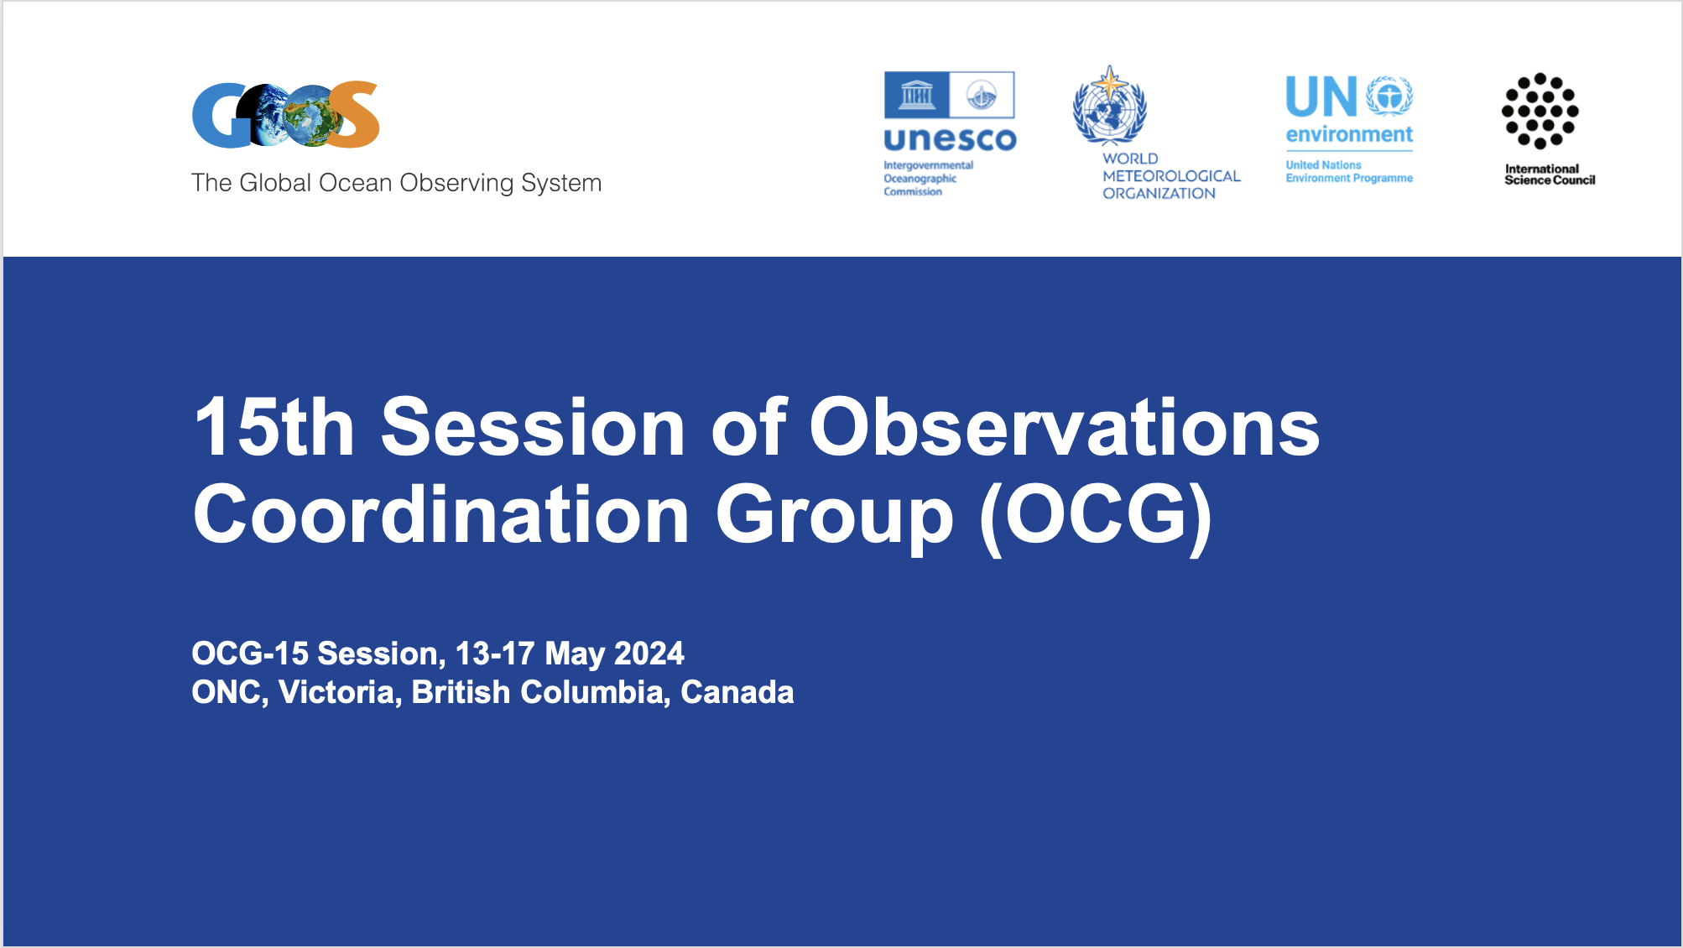
Best Practices – Juliet Hermes

Slide 2
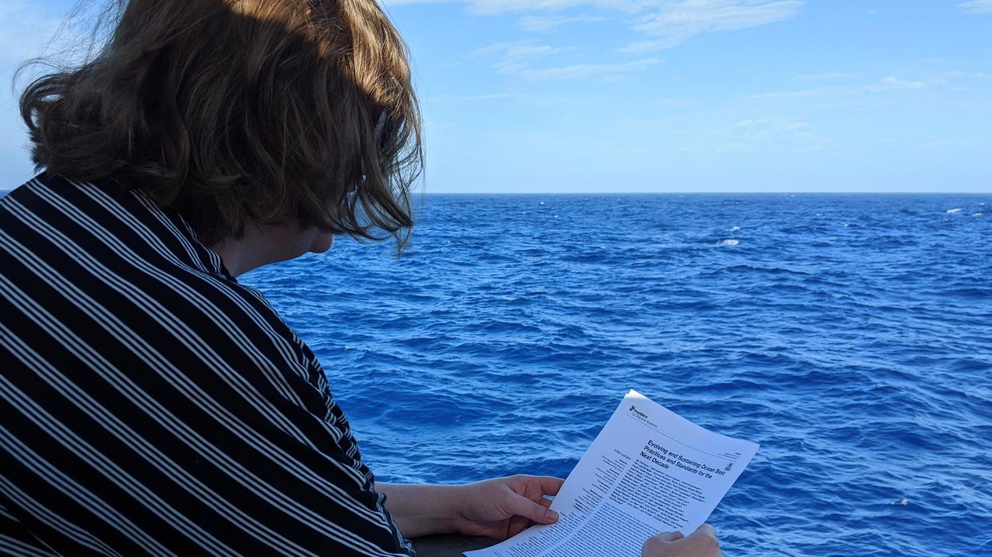
Why use “best practices”?
Efficient use of time
Collaborative opportunities
Data comparability and collatability
Greater trust in data
Streamlined regulatory approval
Higher funding success
Reproduceable
Improved systems interoperability

Slide 3




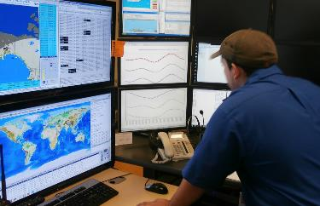
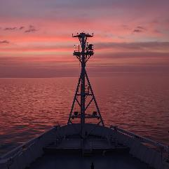
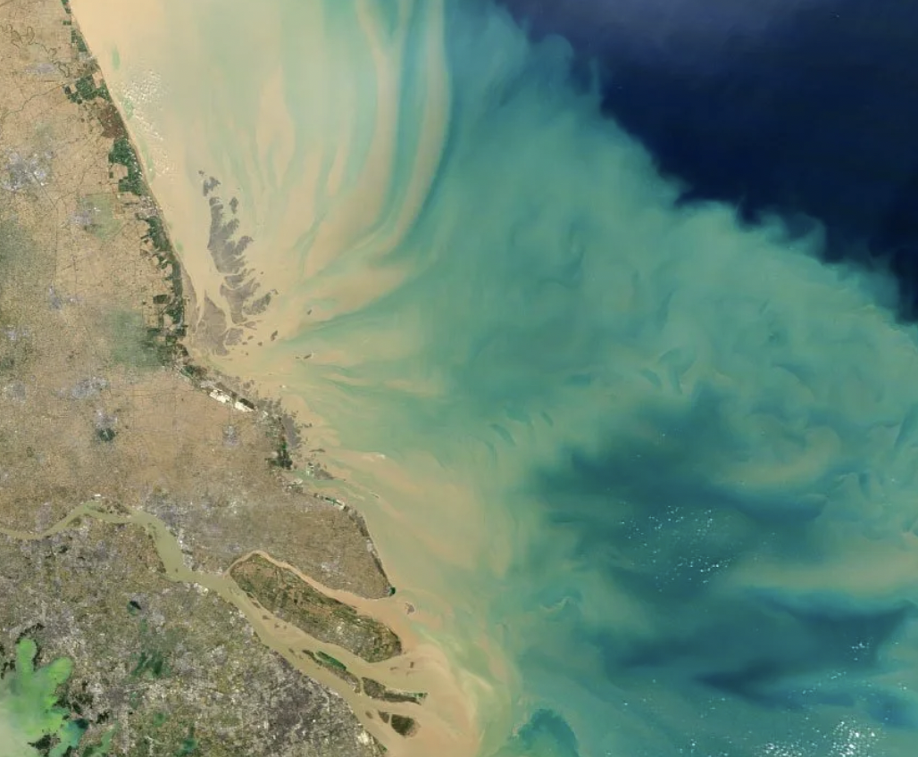
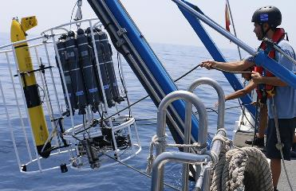
Summary of OBPS
Juliet Hermes, Johannes Karstensen,
George Petihakis, Rene Garello, Jay Pearlman, Rebecca Zitoun
www.oceanbestpractices.org

Slide 4
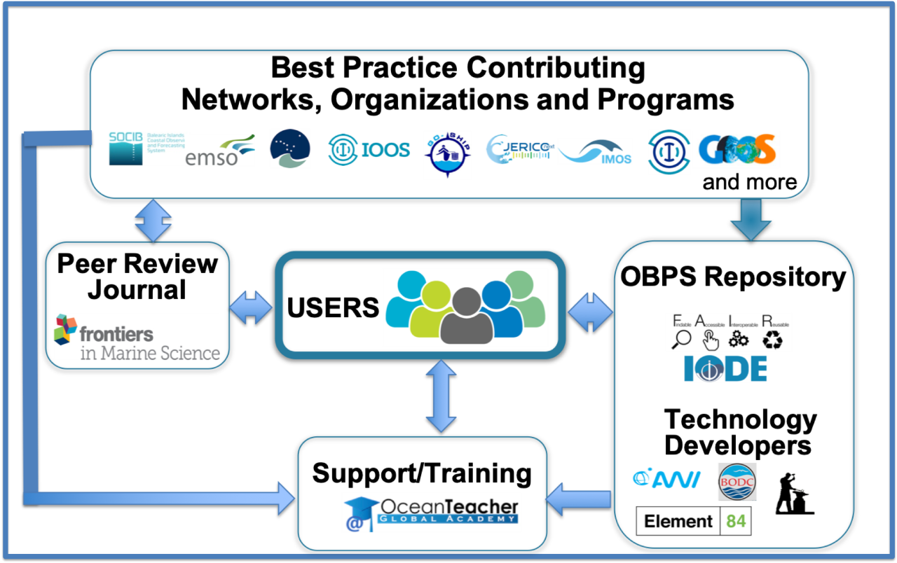

What is the Ocean Best Practices System (OBPS)?
International project supported by IOC, co-sponsored by IODE and GOOS
Our Vision: To have agreed and broadly adopted methods across ocean research, operations and applications.
Original Capacities
Repository
Journal – Frontiers
Training
User Support
Expanded Capacities
Task teams
Early Career Ocean Practitioner (ECOP) Ambassadors
International annual workshop
OceanPractices – a UN Decade of Ocean Sciences for SD Program
Notes:
I’ll spend the rest of the presentation briefly describing these different features of the OBPS
"International Oceanographic Data and Information Exchange" (IODE)

Slide 5

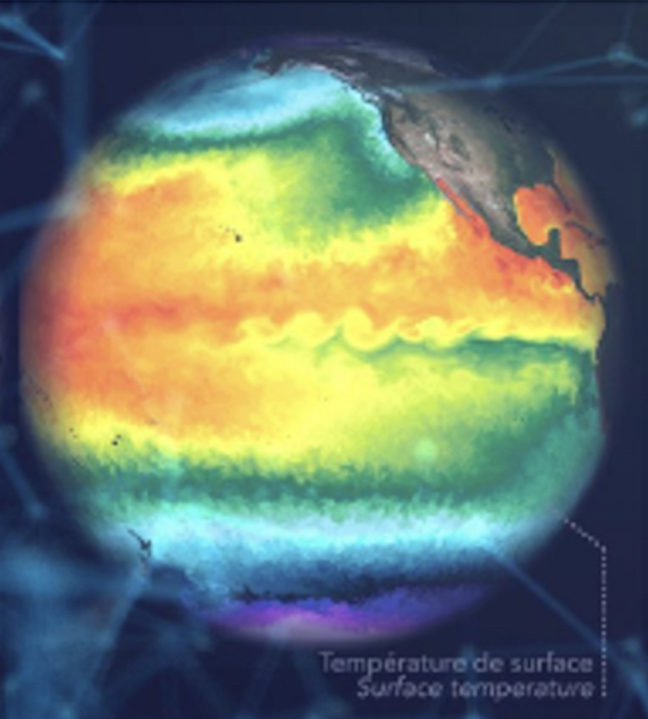
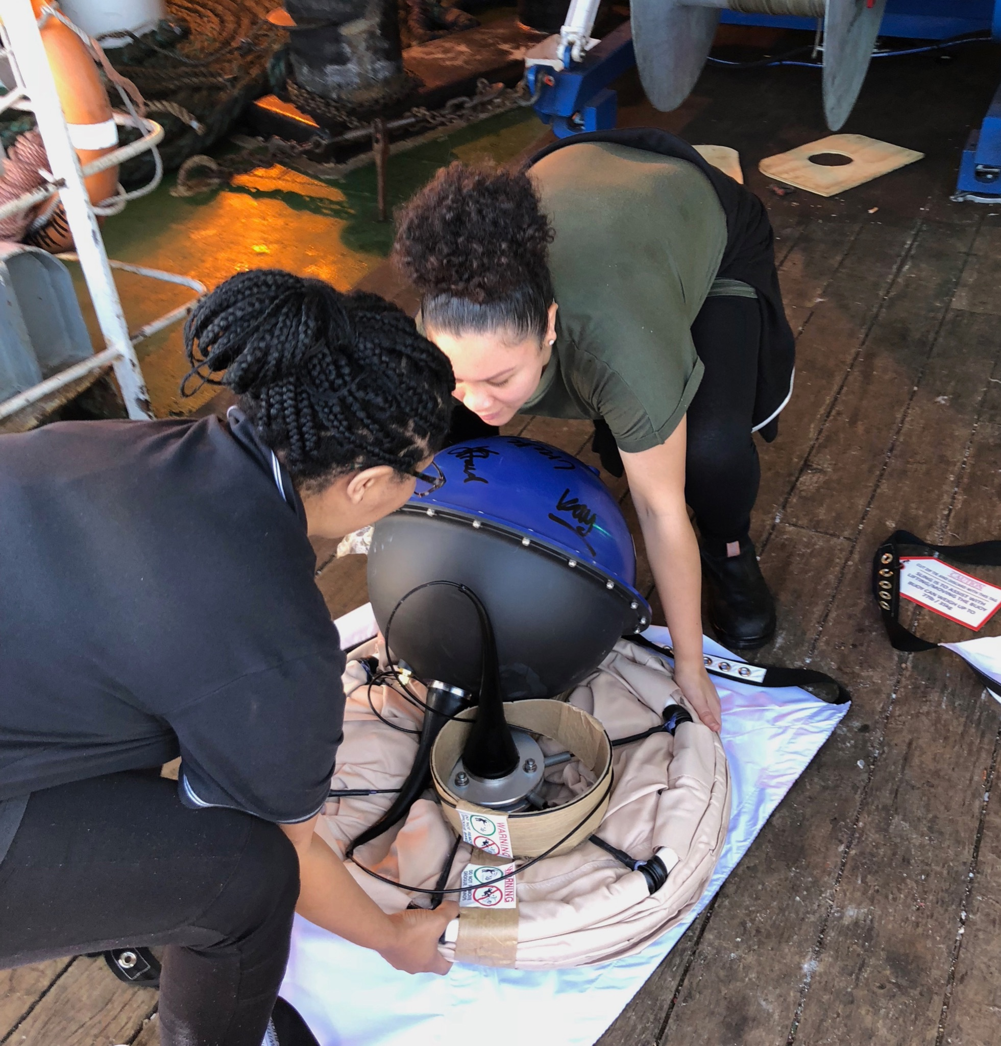
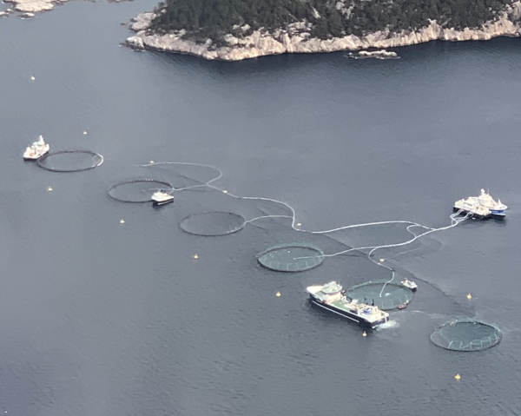
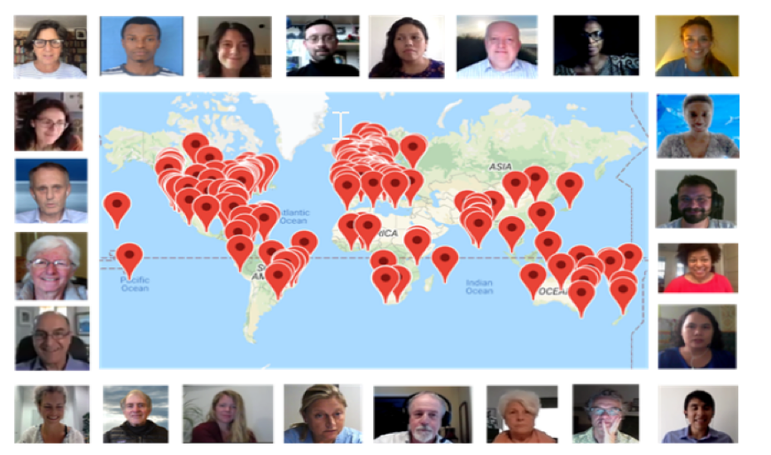
OBPS Globalizing and Socializing Methods
Data
Applications
Models
Global Recognition
Motivating Interoperability & Trust for observations data, analyses and applications
Resource for Capacity Development
Best Practices Adoption and adaptation
Publication
BP Endorsement
UNDecade OceanPractices
Annual Global Workshops

Slide 6
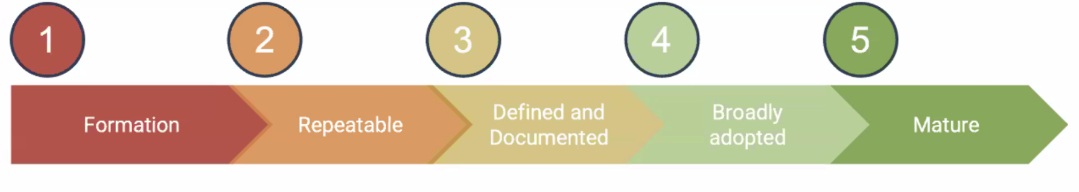
Evolution of A Practice
The Challenge is to find the applicable Best Practice for your mission
Formation Emerging Good Better Best
of a practice Practice Practice Practice Practice

Slide 7

Endorsement
Now the Challenge is to find the applicable Best Practice for your mission among the many Practices now accessible
Endorsement: process where coordination groups and communities approve documents as the current standard for their operations
Initially OBPS/GOOS Endorsed Ocean Best Practices by GOOS Panels - Hermes, J. (ed.) (2020)¹
OBPS now has an endorsement process which can include a broader, rigorous and transparent community review process - Bushnell, M. ed (2024)²
¹Hermes, J., (ed) GOOS Best Practices Endorsement Process. Version 1. Paris, France, Global Ocean Observing System, 7pp. DOI: http://dx.doi.org/10.25607/OBP-926
²Bushnell, Mark and Pearlman, Jay (eds) (2024) Ocean Best Practices System Endorsement: Guidance for the Ocean Community, Version 2024-03-20. Ocean Best Practices System, 8pp. DOI: https://doi.org/10.25607/OBP-1983

Slide 8

What practices can be endorsed?
> completed a rigorous and transparent community review process
> successfully used by multiple institutions
> approved by the leadership of the relevant network, expert team or institution
> fit-for-purpose
> available in the OBPS repository
> updated at relevant timeframes
> addresses uncertainty
> adheres to metadata standards of international data repositories

Slide 9
OBPS News
The Annual OBPS workshop will be held virtually October 14 – 18. Sessions are being solicited.
A Task Team on best practices for policy formation and implementation is being formed. Volunteers are invited.
OBPS has a request for interest to be a member of the OBPS Advisory Board. Deadline is May 31 for applications. Selection will be announced in July.
For updates on news, see OBPS News Flash (https://www.oceanbestpractices.org/ocean-best-practices-systems/resources/news-flash/)

Slide 10

OBPS Roadmap – furthering a global, sustained and trusted resource
Expand work with developing nations, remote regions and Indigenous Peoples (e.g. in Africa, Arctic, South Pacific)
Motivate and focus a global conversation around practices
Encourage organizations to endorse what “is best” for them
Define and evolve a maturity model for better and best practices
Harmonize metadata and structures (FAIR BP)
Promote federated network of methodological management systems
Synergize best practices and standards
Notes:
For its future, the OBPS is working to be a global, sustained and trusted hub of knowledge about ocean practices

Slide 11


OceanPractices
UN Ocean Decade Programme
decade@oceanbestpractices.org

Slide 12
Best Practices – Juliet Hermes

Slide 13


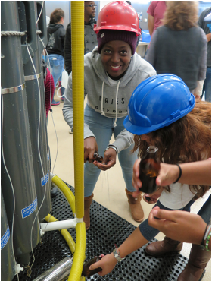
Outcomes
GOALS
Ensure network endorsed best practices are findable and utilized
Provide network Best Practices for all EOVs that the network observes, for each stage of the observation life cycle, and have recorded in metadata
Ensure harmonization across networks and support joint capacity development

Slide 14
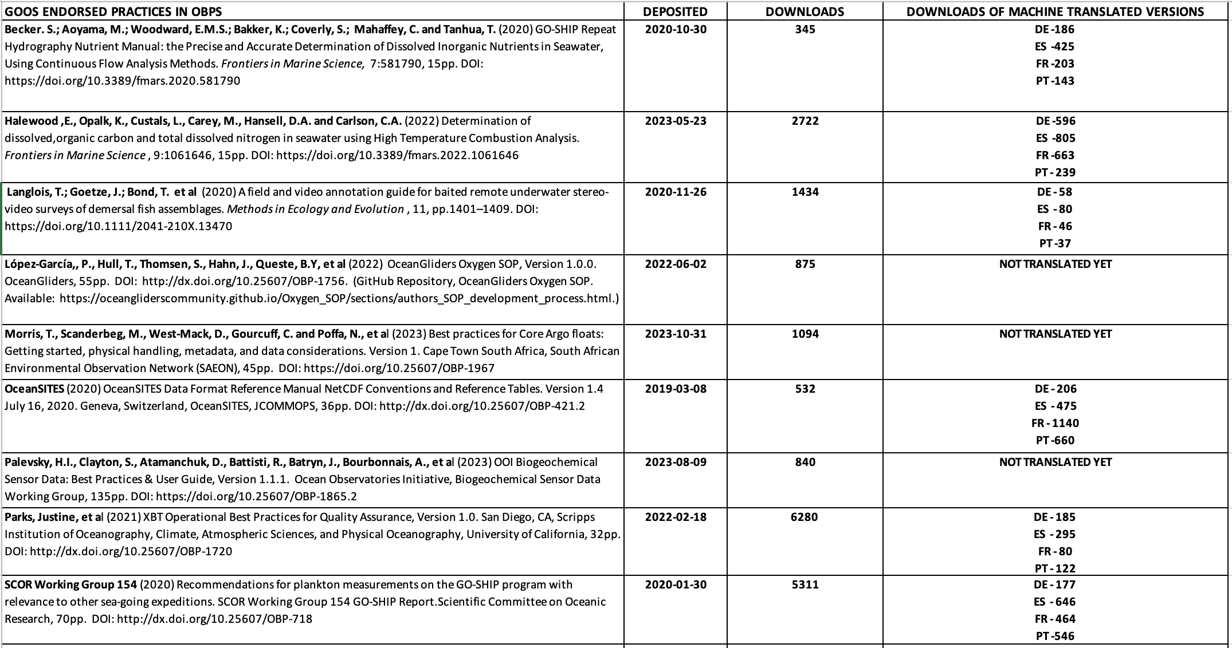
Outcomes
Notes:
Justine, awaiting endorsement

Slide 15
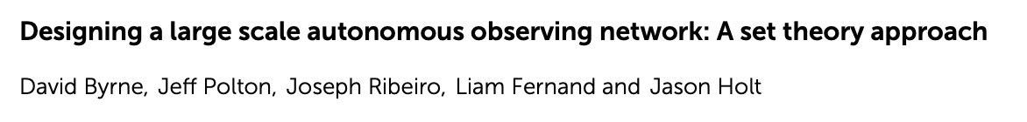
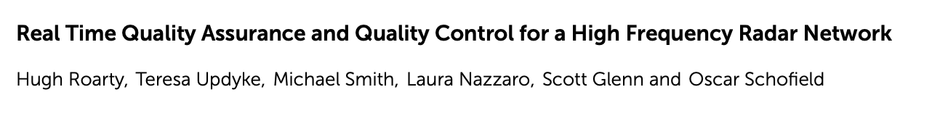
Outcomes
Notes:
71 articles in Frontiers these are the ones I have edited b

Slide 16
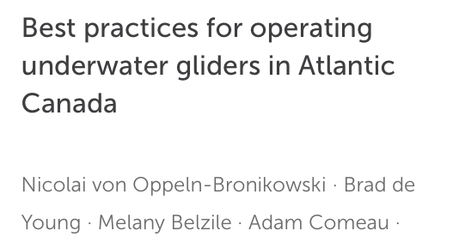
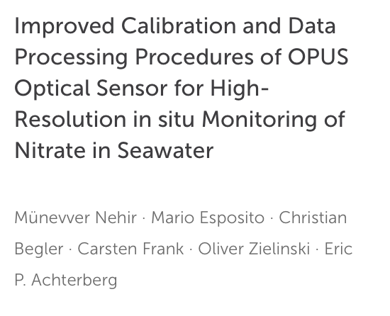
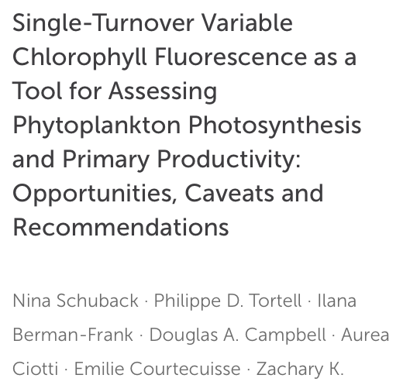
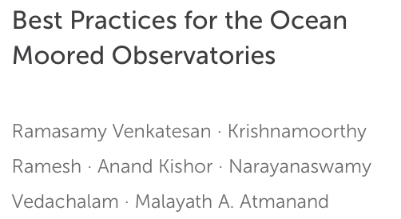
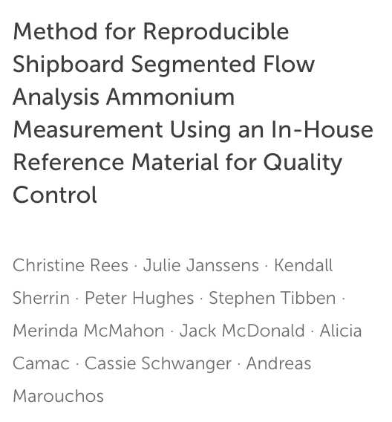
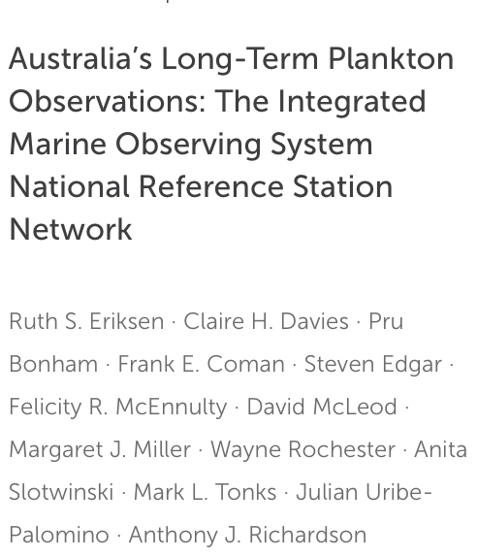
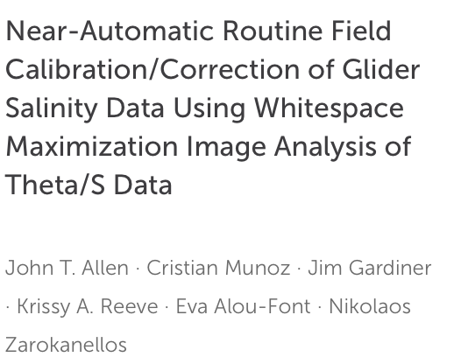
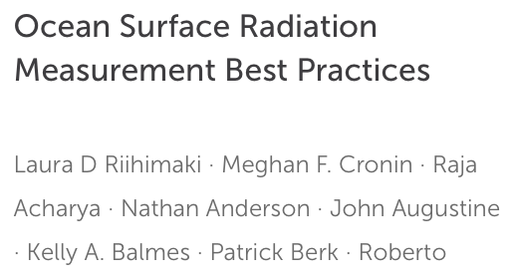
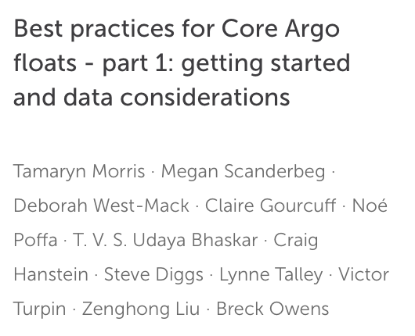
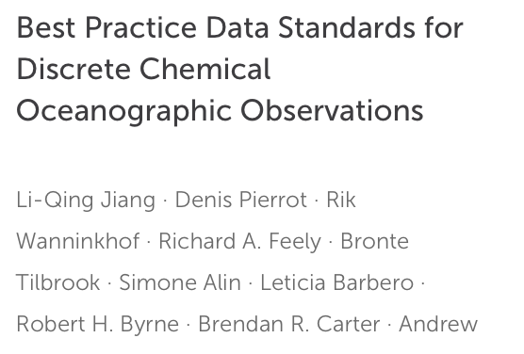
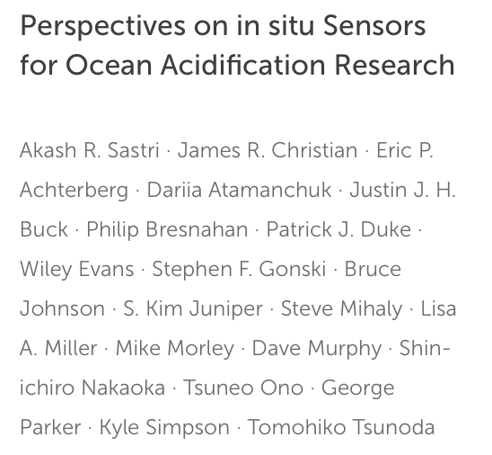
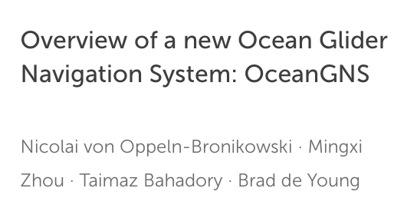
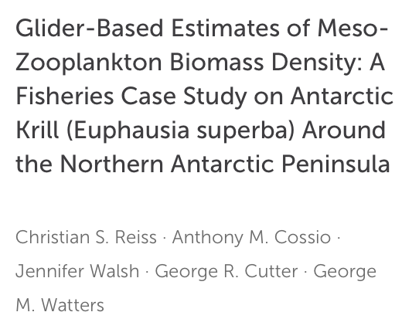
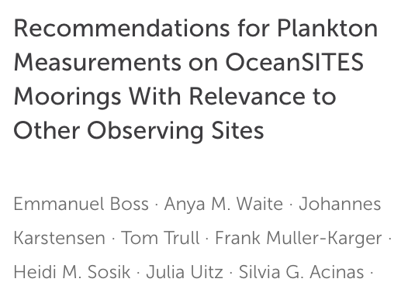
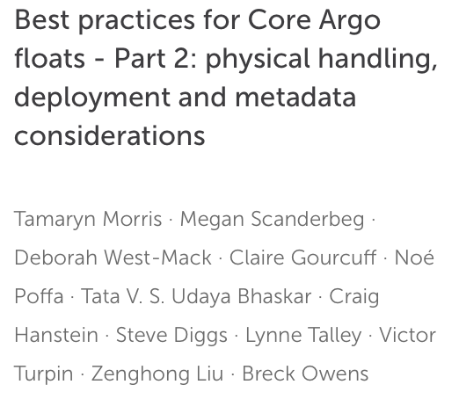
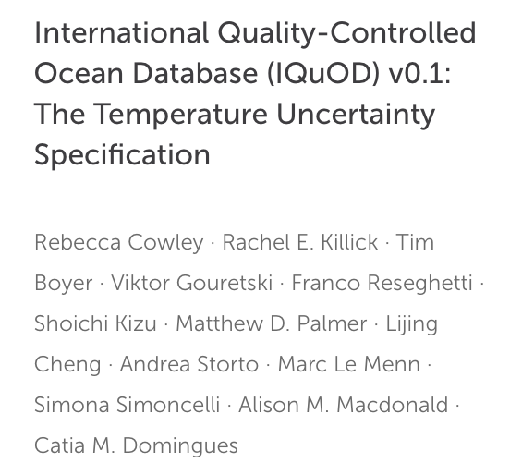
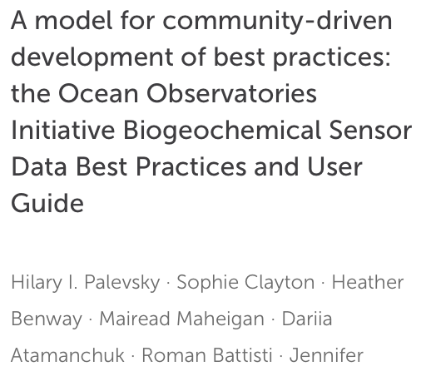
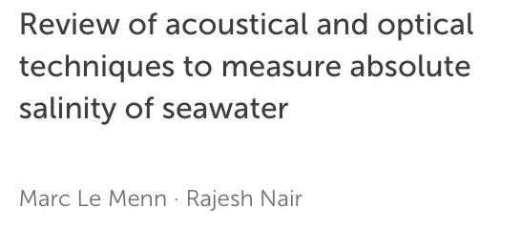
Outcomes
Notes:
I can’t be an expert on all the BP which is why the networks are requested to highlight BP that they are aware of or if they need assistance in writing them. Some of the networks have really taken on this challenge, in particular Justin Parks and Tammy Morris, along with others.
These are BP related to the networks published in Frontiers, some I have directly requested to the networks if they should be endorsed .
There needs to be a BP lead for each network and/or across the GOOS panels

Slide 17
Outcomes
WHAT NEXT
Link the BPs to specification sheets and include in metadata
Include precision details as a must have
Provide more guidance on community review process
Consider how to deal with regional best practices in a global context
Create a small team across networks/GOOS panels. Momentum needs to continue but needs more support (as per most things!)

