Slide 1
In-Person Meeting of the UN Decade TAC Task Force
San Jose, Costa Rica
June 04 – 06, 2024
Dear Participants,
Welcome to thein-person Meeting of the UN Decade TAC Task Force in San José, Costa Rica from June 4-6, 2024. To facilitate your preparations, please find here information on the logistical arrangements for the meeting.
Session webpage: https://oceanexpert.org/event/4247
INFORMATION AND GUIDELINES TO PARTICIPANTS
The Meeting will be held at the Hotel Bougainvillea San José in Costa Rica
Hotel Bougainville San José
Costado Oeste Escuela Santo Tomas
Reservations: +506 8824-3641 Phone: +506 2244-1414
E-mail: info@hb.co.cr
IOCARIBE CONTACT PERSONS
Lorna Inniss / Patricia Wills / Bianis Palacios/Juan Pabon
/
+57 3126229649
+57 3003486911
+57 3167481346
L.Inniss@unesco.org
p.wills-velez@unesco.org
b.palacios@unesco.org

Slide 2
LODGING
A block of rooms has been reserved at the Hotel Bougainville San José, including breakfast, Lunch, Dinner. Airport and University Transfers are included.
Hotel Venue for the Meeting: Hotel Bougainville San José
MEETING INFORMATION
MEETING ROOM: Bromelias.
MEETING HOURS: 09:00 – 12:30 and 13:30 – 17:30, unless otherwise notified.
COFFE BREAKS: Coffee will be served daily at 10:30 – 11:00 and 15:45 – 16:00.
GENERAL INFORMATION
Local transportation: Public transport in San Jose is by bus and taxi. Local taxis usually average about US$0,98 per Kilometer.
Tipping: Most restaurants and hotels add a 10% service charge. It is advisable to look if it is included in their bills.
Electricity: Electricity voltage is 110 or 120 volts.

Slide 3
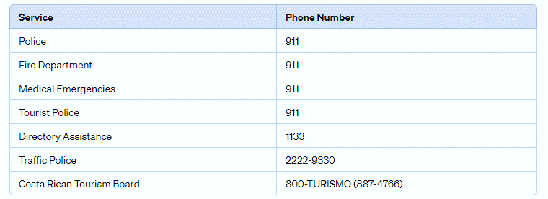
GENERAL INFORMATION
Weather: Costa Rica has a tropical climate with two main seasons: the dry season, from December to April, characterized by sunny and warm days, and the rainy season, from May to November, with abundant rainfall, especially in September and October. Conditions can vary depending on the topography, with coastal areas being warmer and highlands cooler and wetter, featuring specific microclimates in areas such as mountains and cloud forests.
Currency: Colón costarricense is the currency in Costa Rica. The approximate exchange rate is: 1 U.S. Dollar = $ 514,93 Colón costarricense app.
Important Phone Numbers:

