Slide 1











The ODIS Federation
  Where OIH has brought us, and the bright future ahead
Pier Luigi Buttigieg
Notes:
Global cooperation on FAIR data policy and practice’ (WorldFAIR) has received funding from the European Union’s Horizon Europe project call HORIZON-WIDERA-2021-ERA-01-01, grant agreement 101058393.

Slide 2
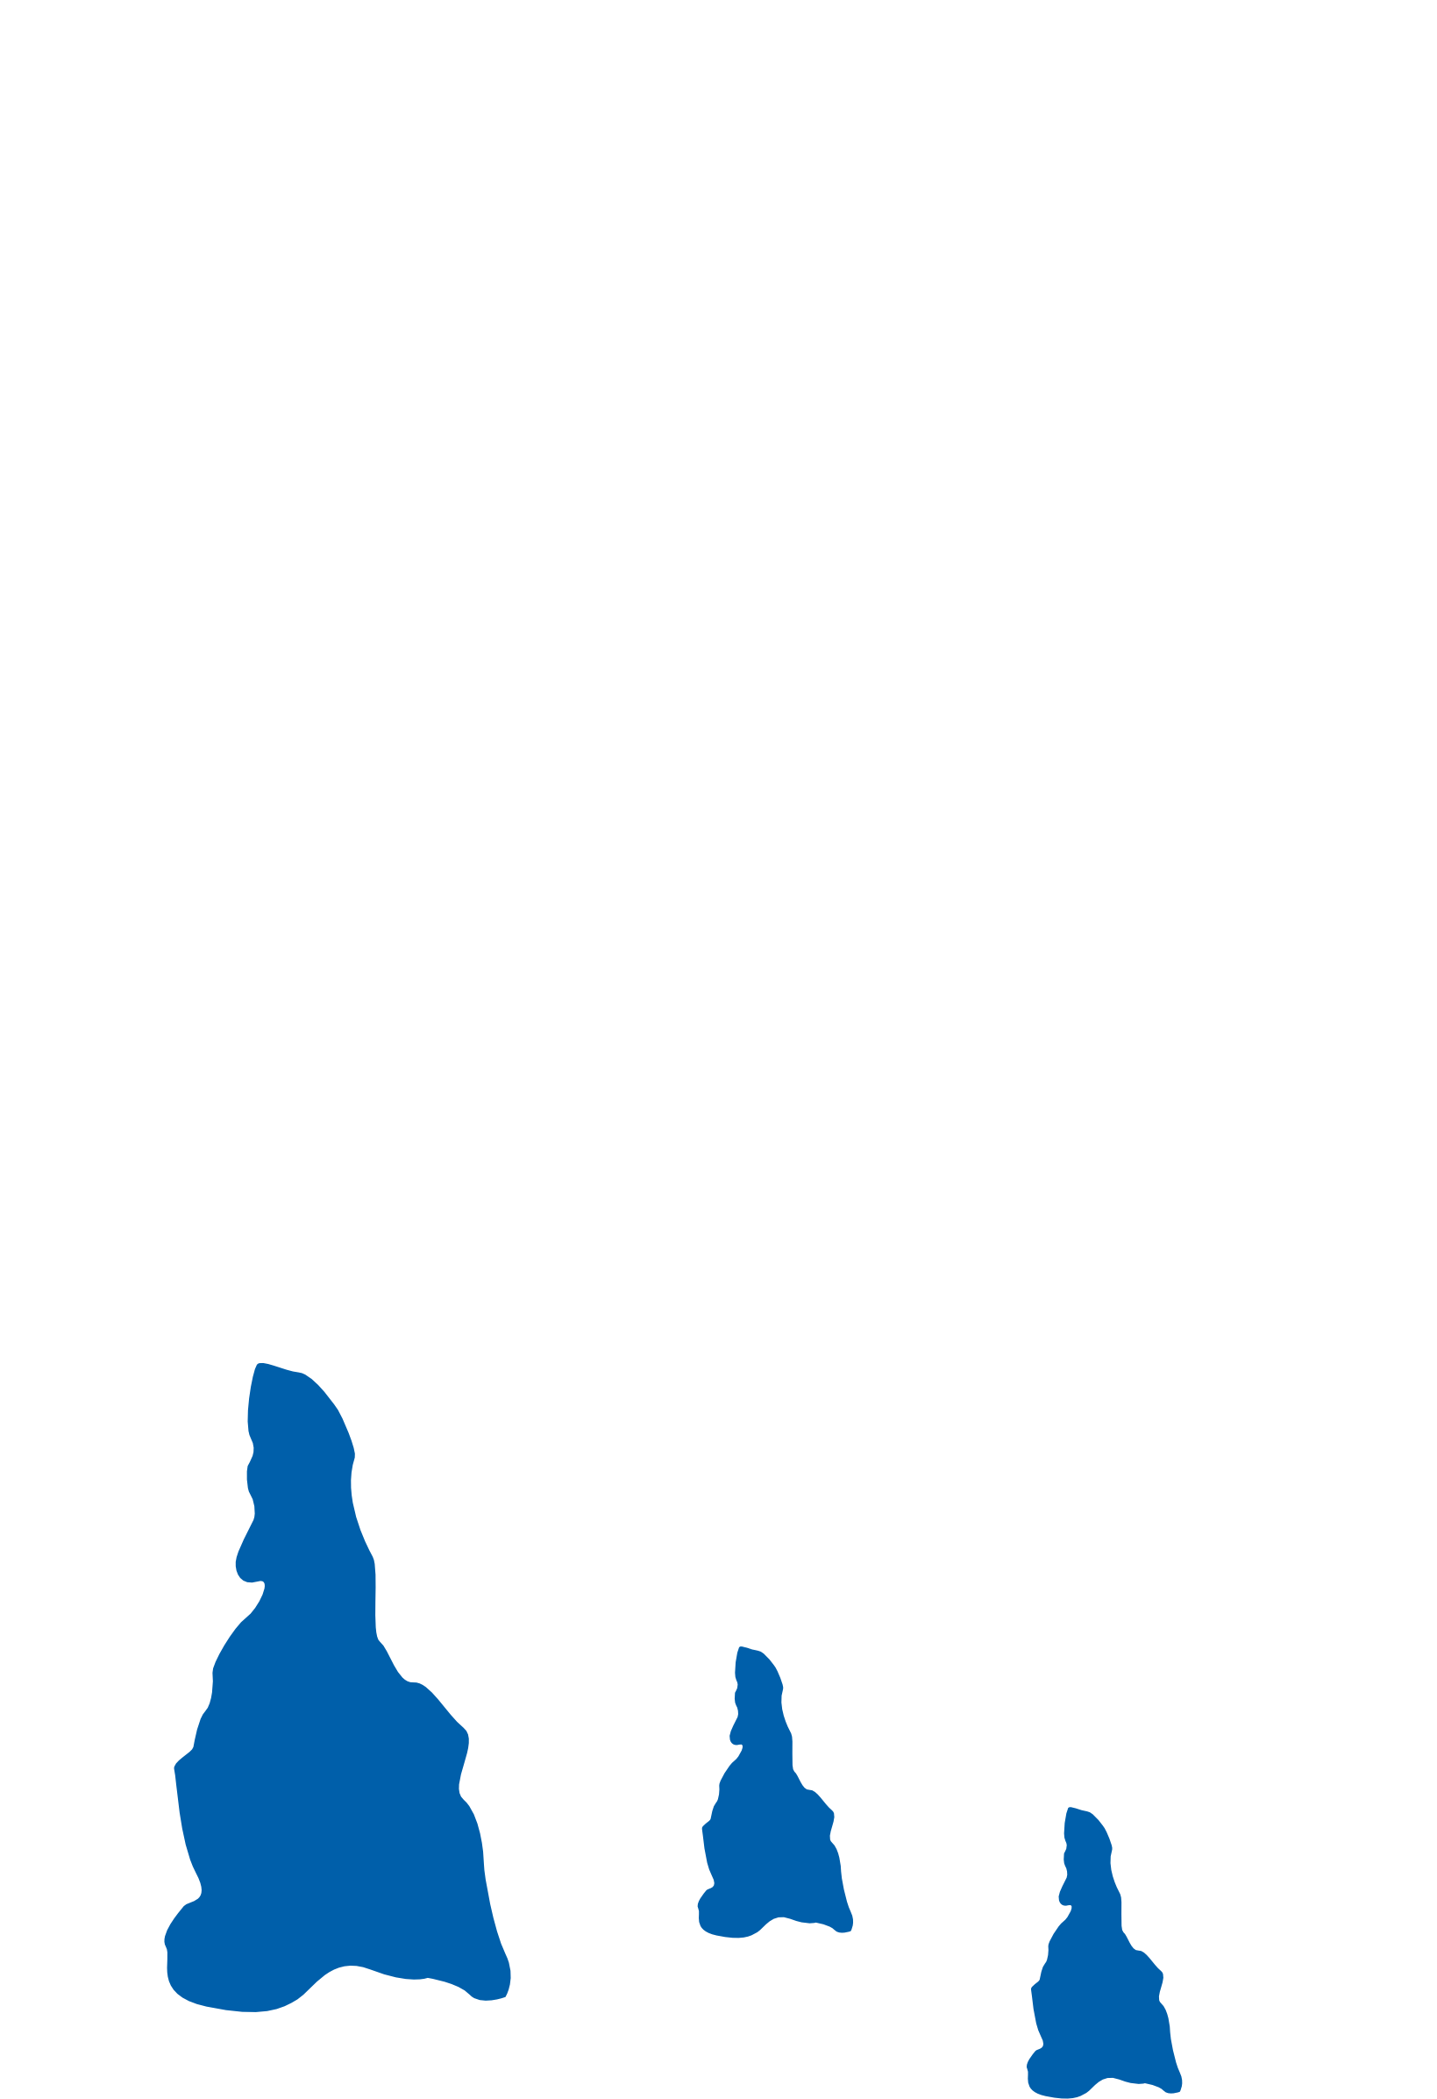
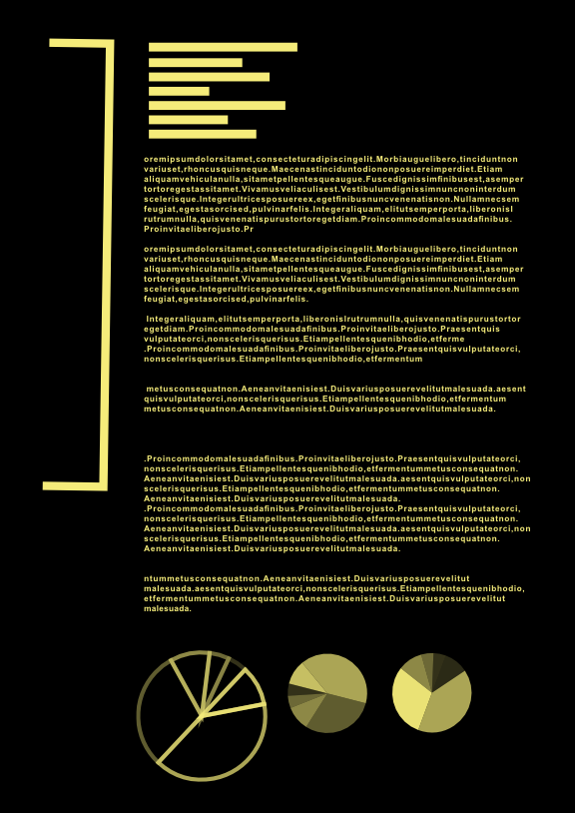

Not having FAIR research data costs the European economy at least €10.2bn every year (https://data.europa.eu/doi/10.2777/02999)
The Australian Research Data Commons (ARDC) references the “Incentives to Invest in Identifiers” report (https://zenodo.org/records/7100578)
  Potential savings of up to
    $24 million per annum through the use of persistent identifiers (PIDs)
    38,000 person days, freed from re-keying information that PIDs provide.
Courtesy of Doug Fils

Slide 3

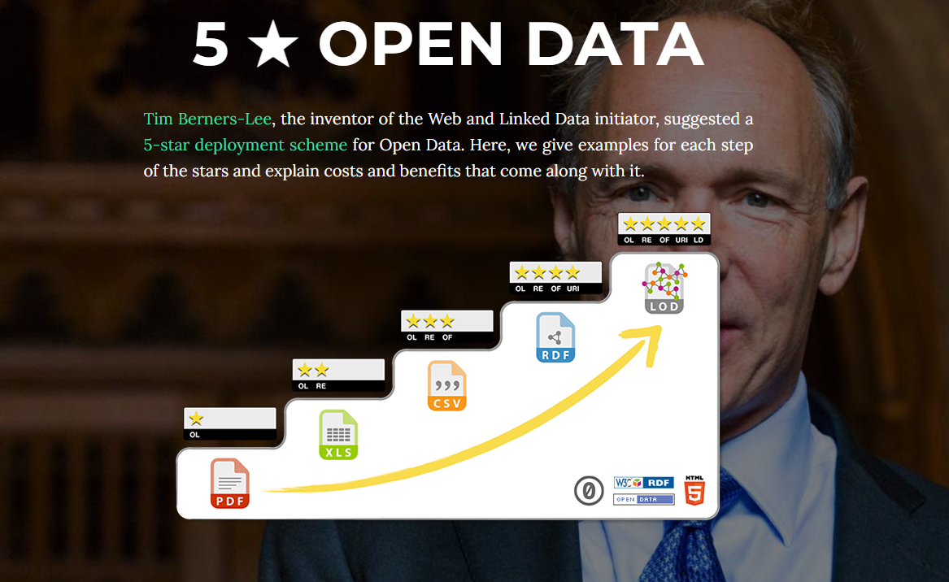
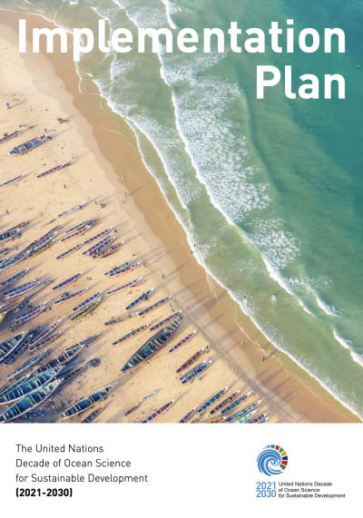
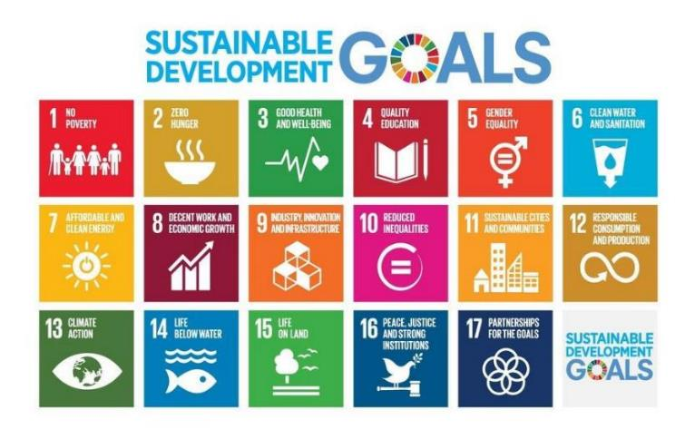
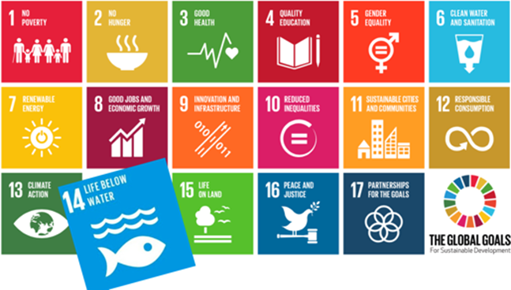
The UN Ocean Decade
A strong emphasis on linked open data and Web-mediated interoperability
Ocean Decade Implementation Plan
adopted by the UN General Assembly
December 2020

Slide 4
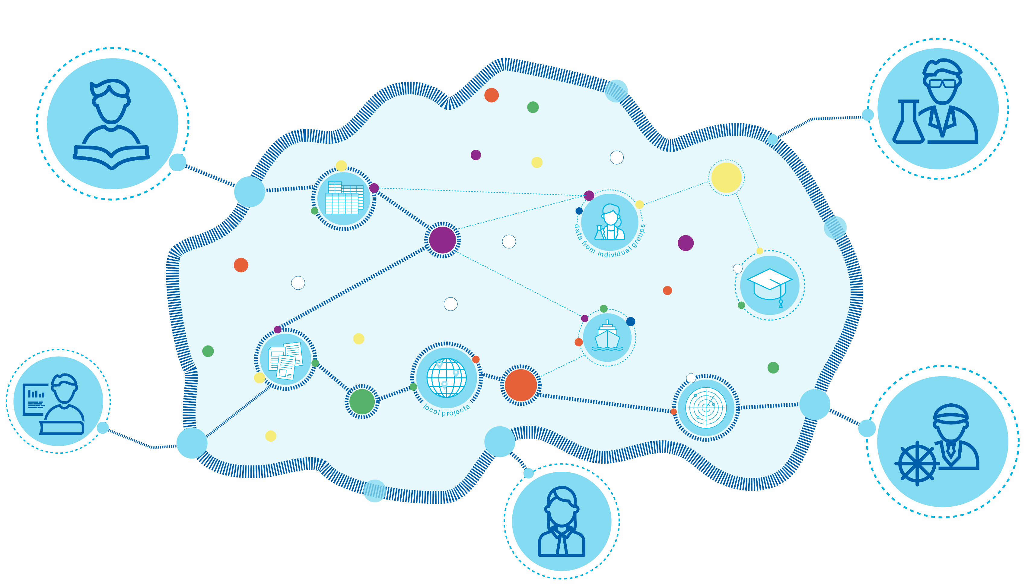

OIH’s seeding of ODIS is a new paradigm for the ocean’s digital ecosystem
A socio-technical system …

Slide 5

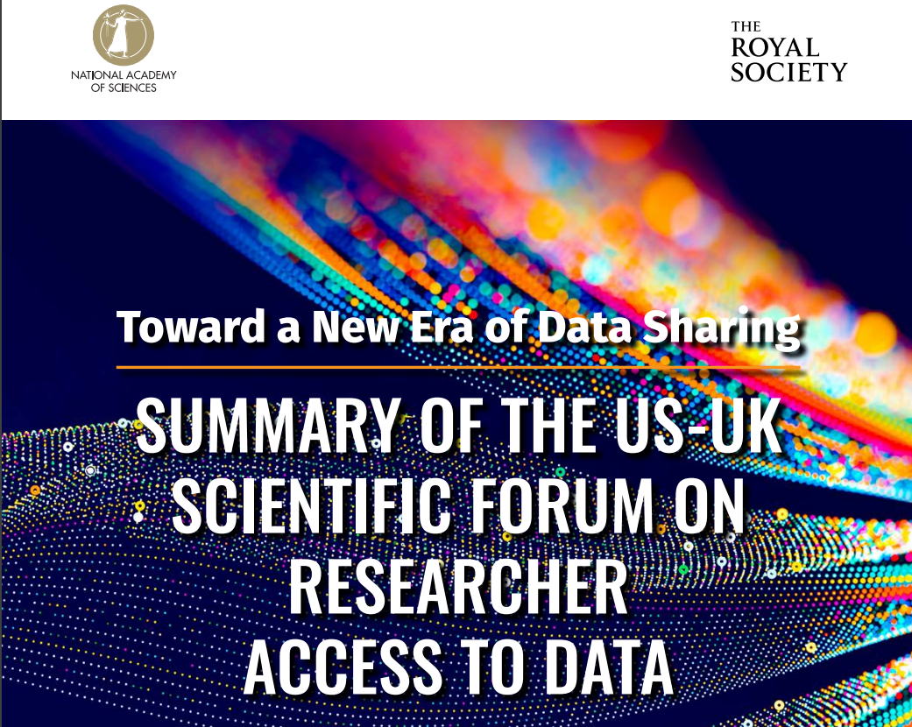
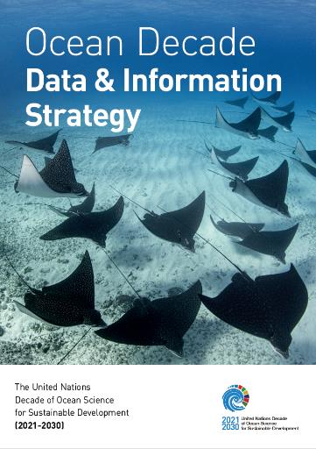
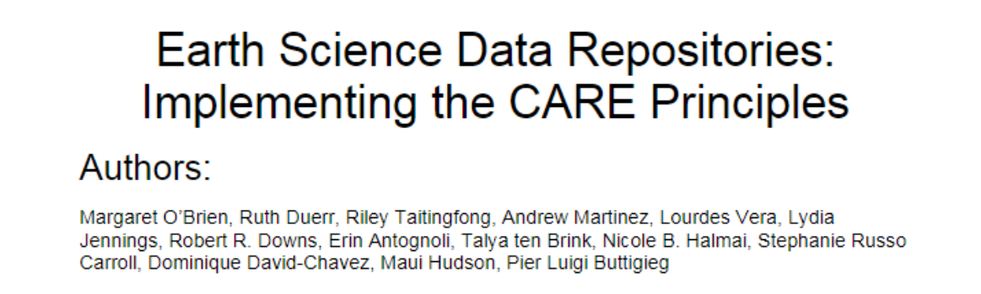
Alignment of digital strategy and implementation with global policy and goals
Coming soon
The Data and Information Strategy’s Implementation Plan

Slide 6
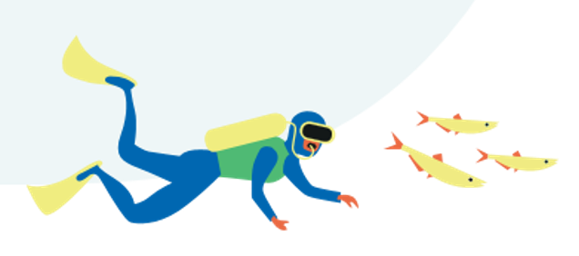

Robust and flexible
interoperability is the key
!
?
One-stop-shops need
global supply chains

Slide 7
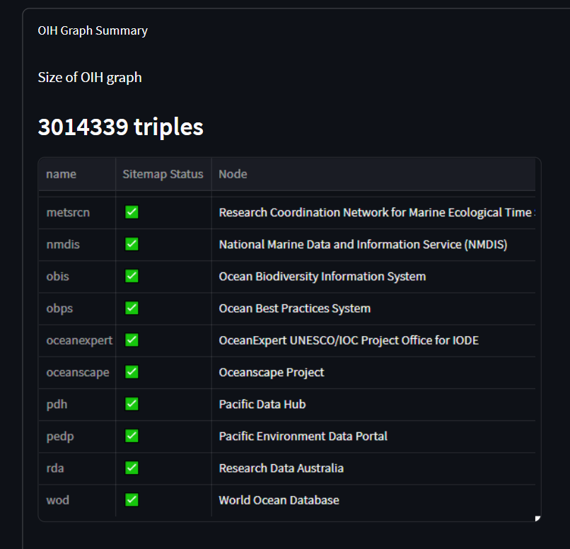

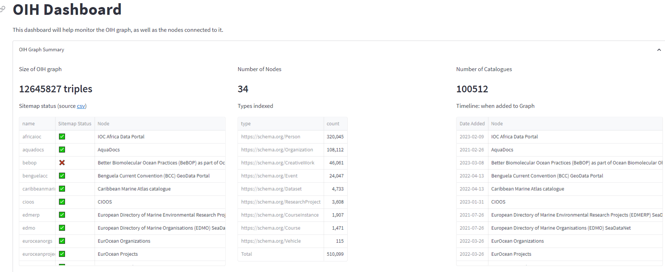
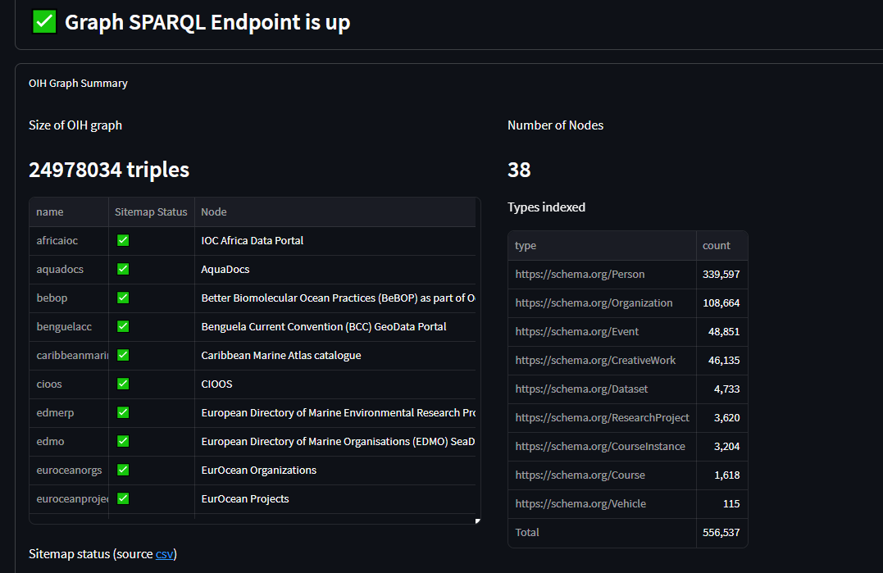
http://dashboard.oceaninfohub.org/
Towards a concrete monitoring framework for ocean data exchange
Trust through verification
Demonstrating and validating FAIRness across the ODIS Federation

Slide 8
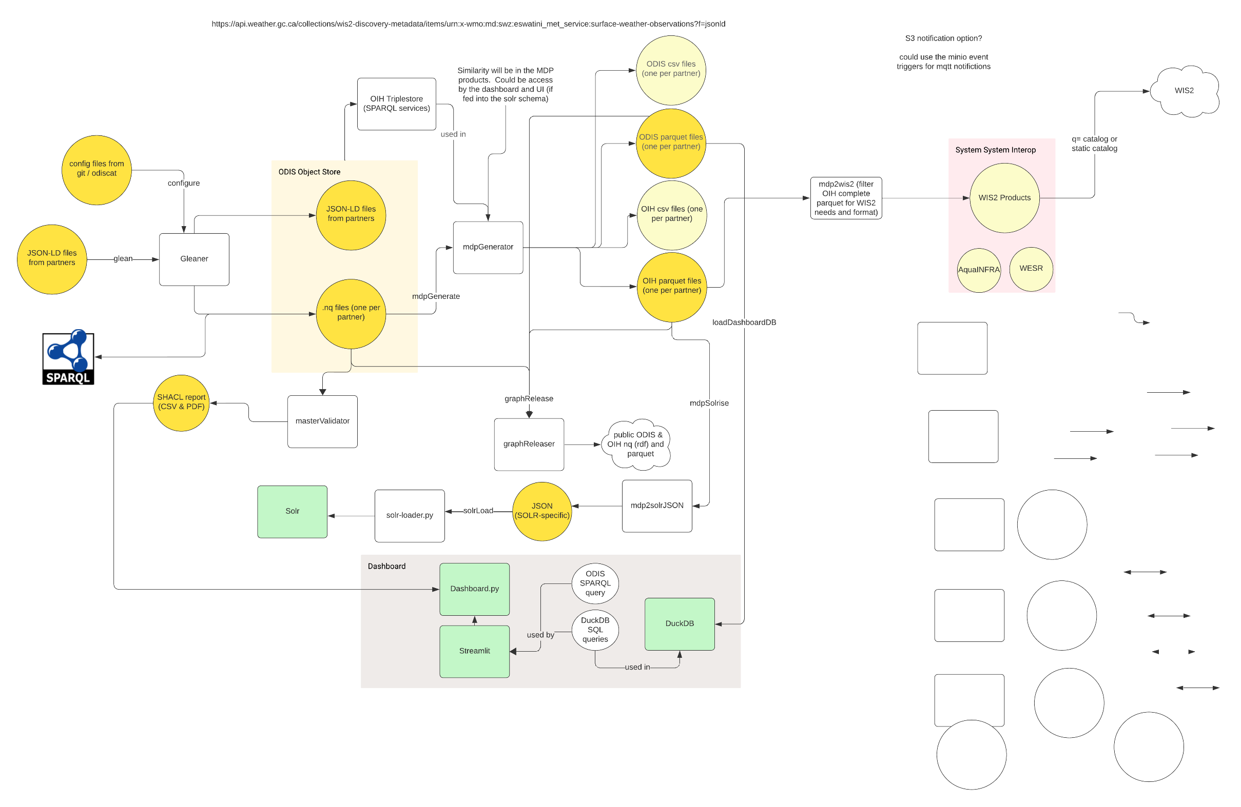
A stable Architecture to coordinate the ODIS Federation

Slide 9





Slide 10
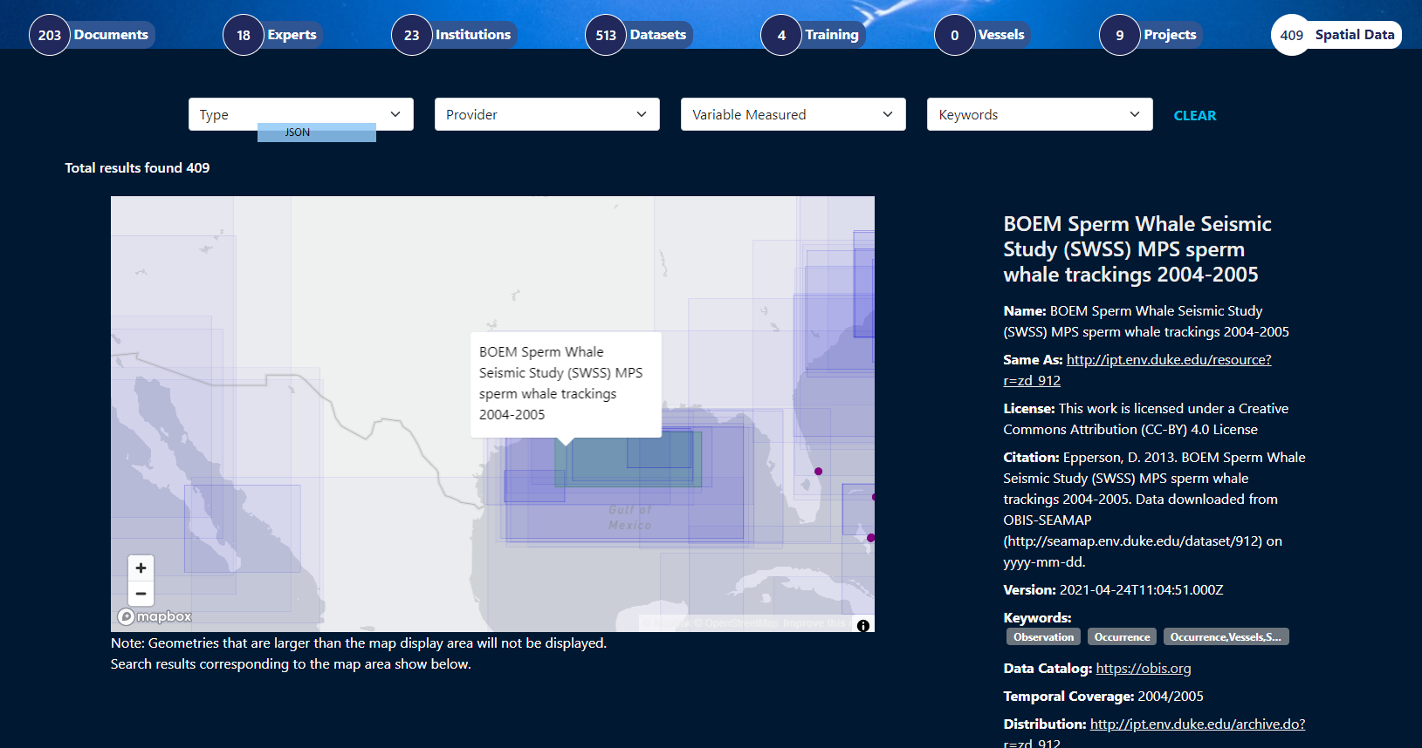
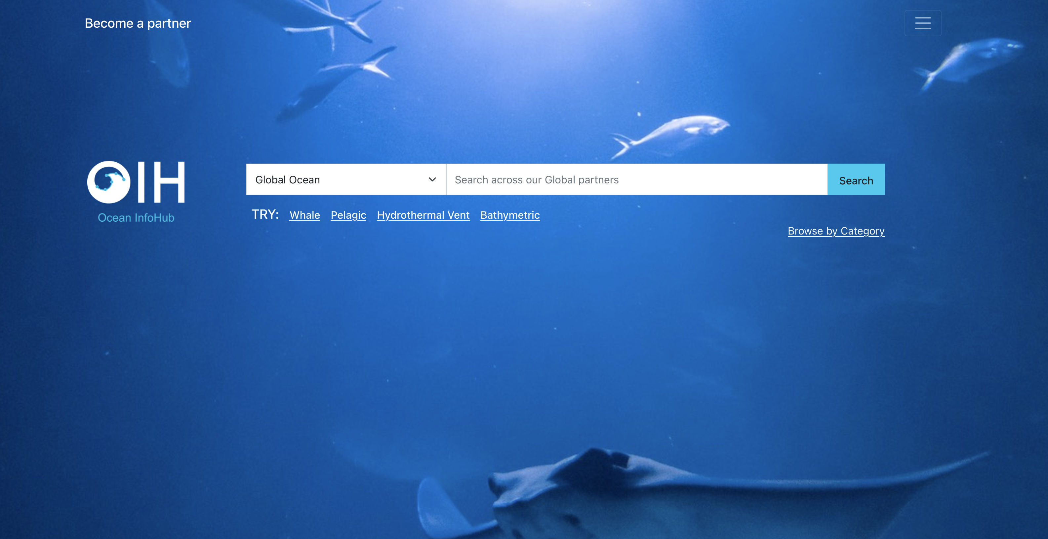
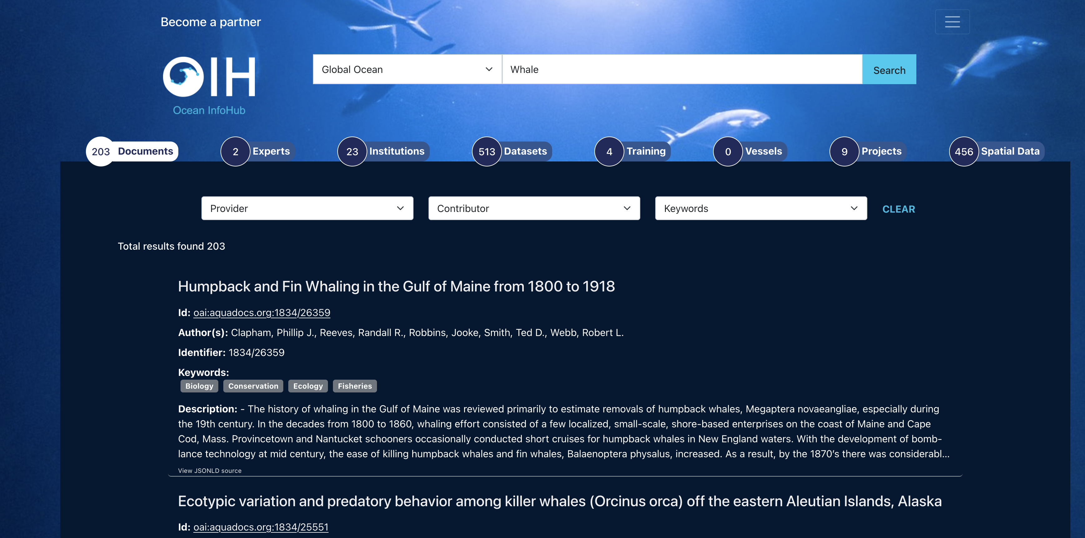
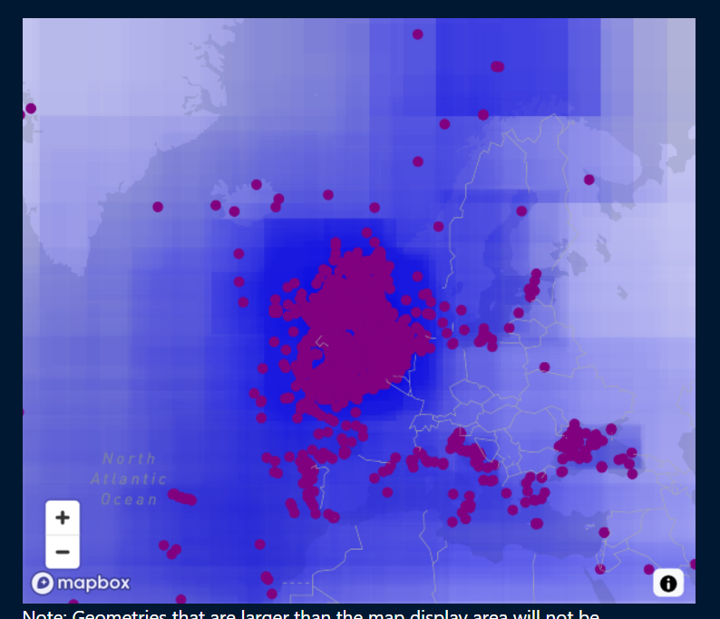
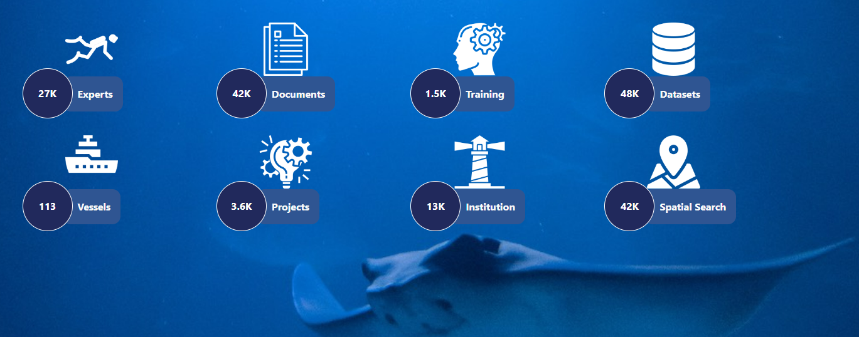
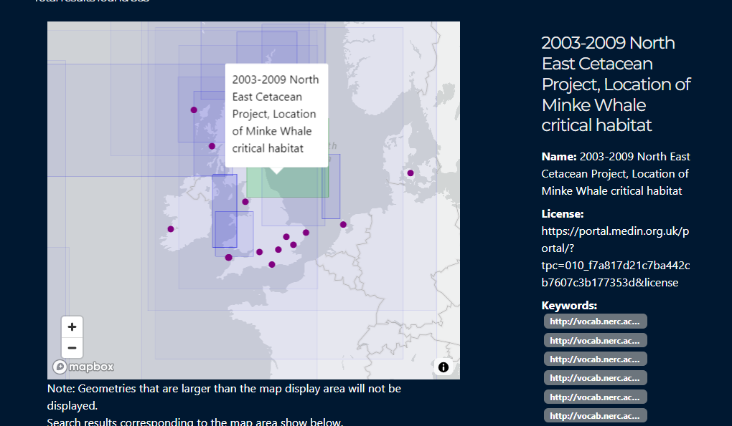
We have a global, federated index to our communal data lake
We have the basis to mature & extend our metadata exchange
Data lakes →
Data lakehouses →
Data warehouses →
Data spaces

Slide 11

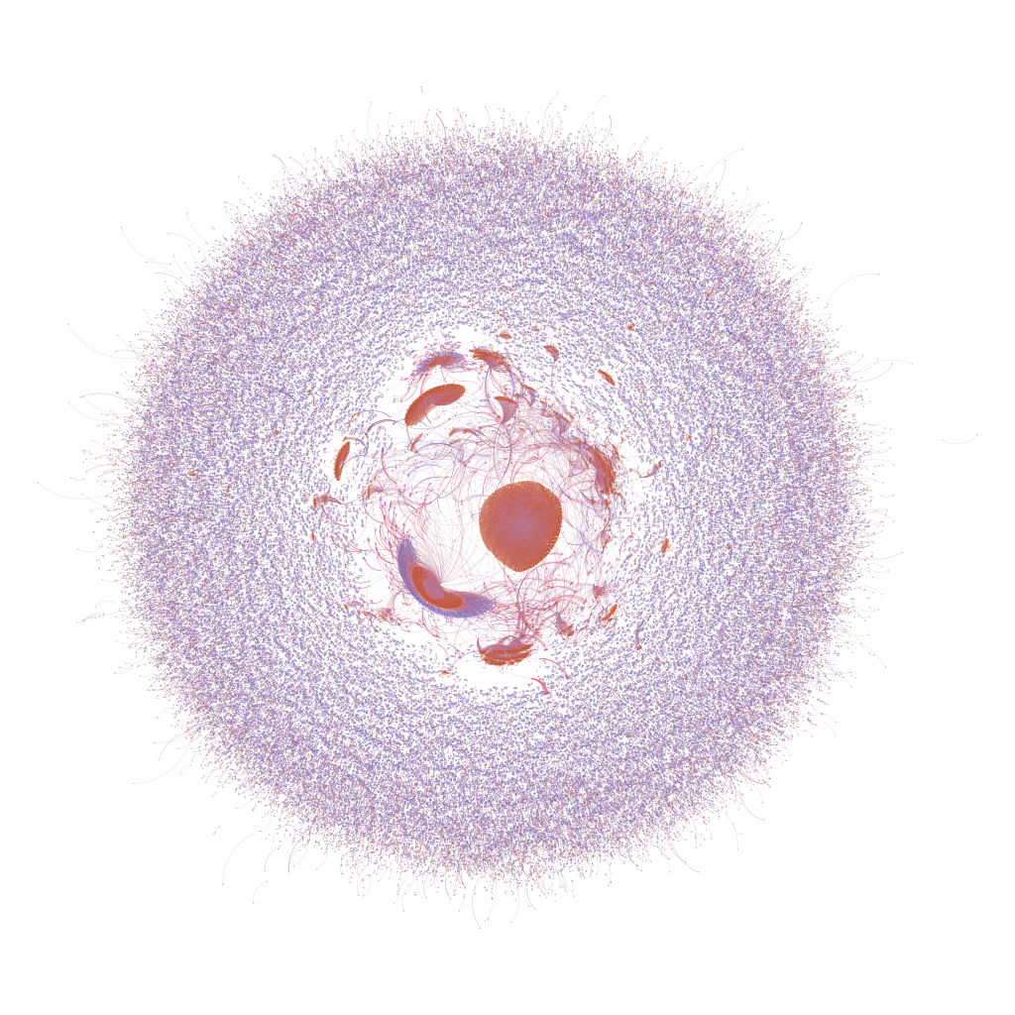

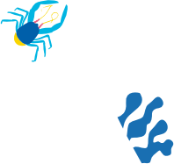
Mapping the ocean’s digital ecosystem
Through ODIS, we have better collective intelligence than ever before

Slide 12

What next?

Slide 13
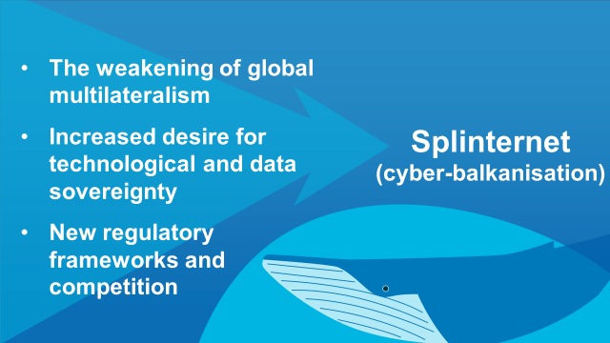
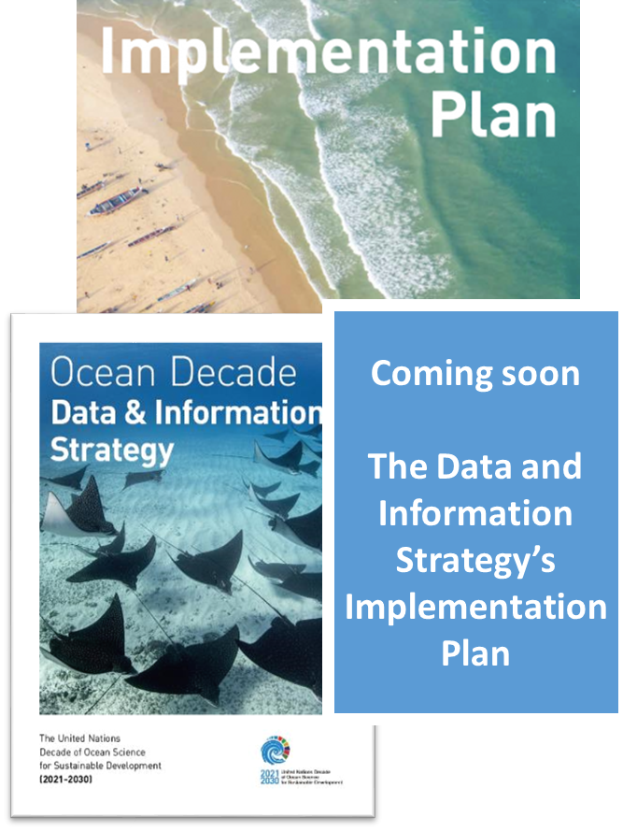
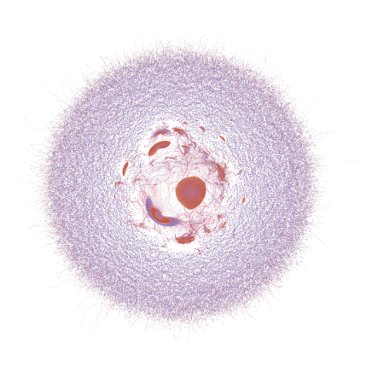
Deepen and broaden ODIS’ current state to enable deeper digital asset exchange in a data space model
vs

Slide 14
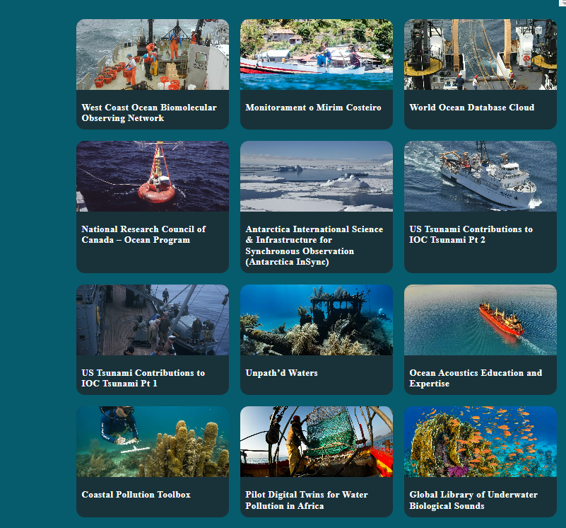
A programme for data leads in each Action
OceanData2030

Slide 15
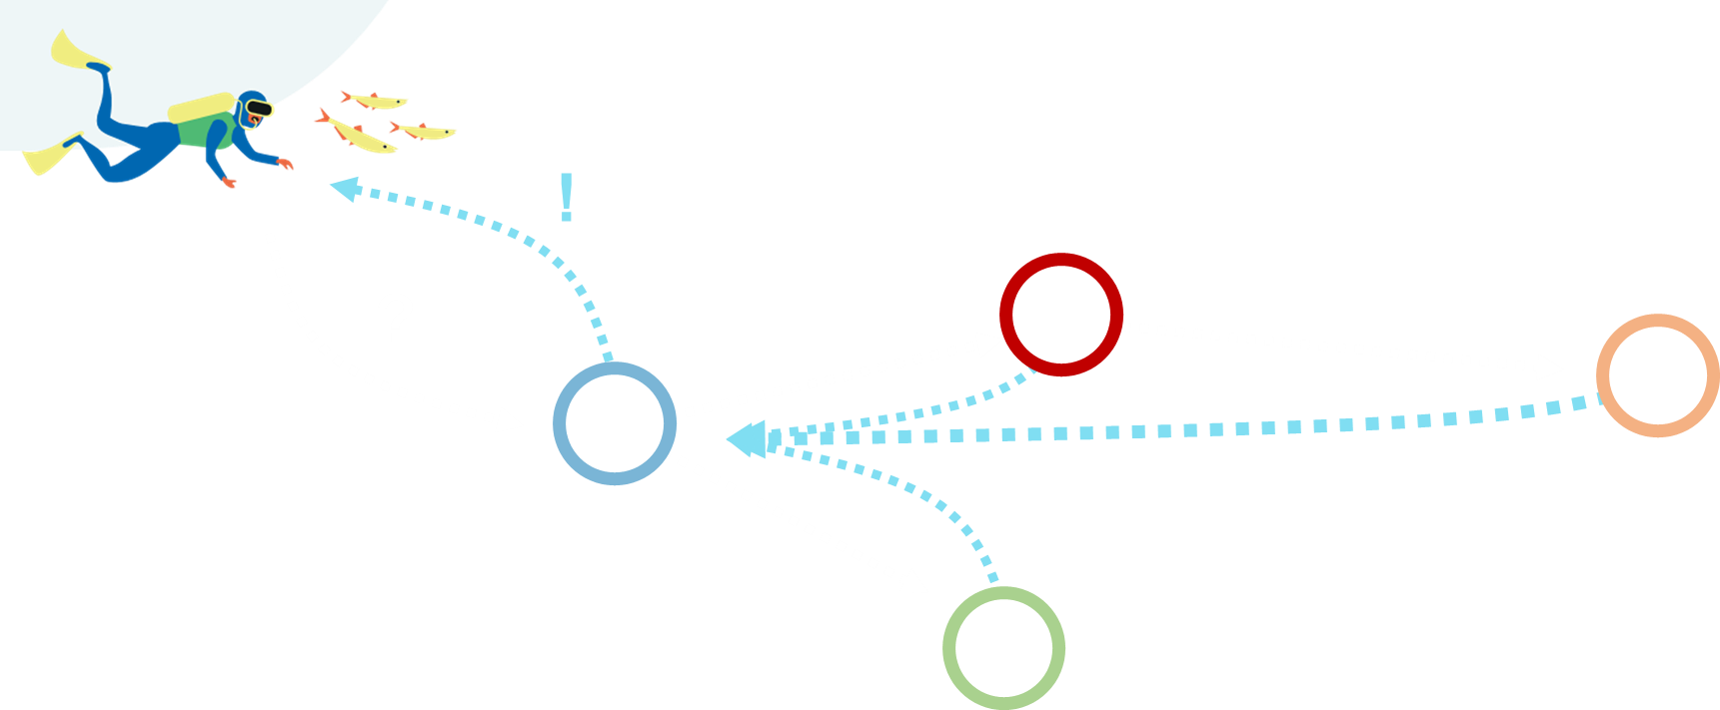
OIH SG →
ODIS Operations Committee
Call for a new ODIS SG: Visionaries, experts, and people who deeply understand the science-society interface from each region who can help us predict how the Web and ocean data flows will change on decadal scales

Slide 16
Ocean Data 2030

Slide 17
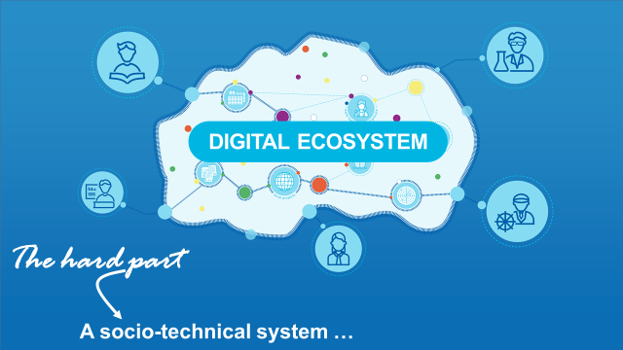
OceanData2030 – A catalyst for maturing the ocean digital ecosystem
We have the plans, strategy, and (soon) implementation guidance, as well as a collection of impressive – but siloed – implementations across Actions
We need a bigger framework for Decade Actions to collectively mature our ocean digital ecosystem and execute the Strategy and Implementation Plans, and act on Vision 2030
OceanData2030 will provide this framework

Slide 18
A programme for data leads in each Action
OceanData2030

Slide 19
OceanData2030
It’s a shapeable environment – but grounded in technical soundness
A hub for all digital initiatives in the Decade to figure out exactly how to interoperate
Empowering the data/digital leads in each Action to help their programmes mesh into the ecosystem, in pursuit of a data space

