Slide 1



Ocean INFO HUB for Latin American and the Caribbean region node:
Activities (2023 - 2024)
Last project Meeting for the Ocean InfoHub Project
2024

Slide 2
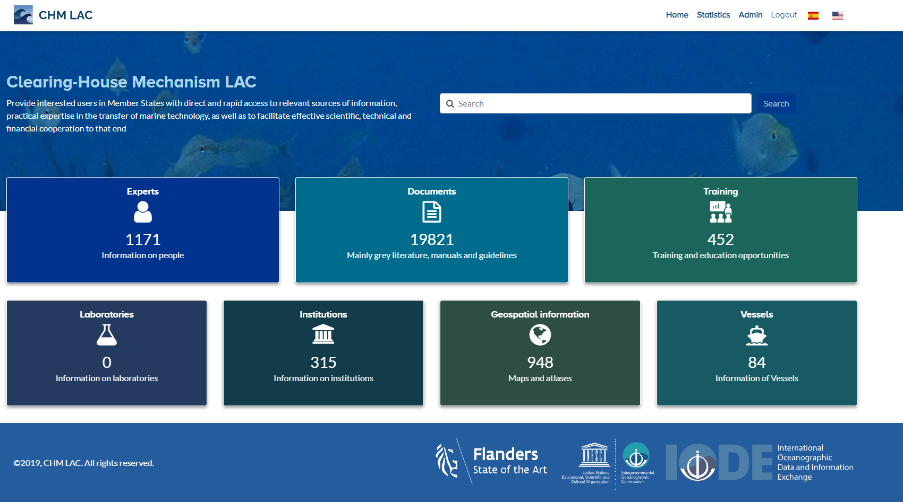

Overview of OIH activities: stats on regional portal
CHM Lac technological platform is currently fully operational 24/7.
Users can efficiently access its resources and functionalities, ensuring a smooth and satisfying experience.
Recently, new records(ArcGIS REST resources) have been obtained for geospatial information module, given the operation of a robot made in Python developed by an engineer from INVEMAR. In addition, new data has been collected from the previously worked tools, thus keeping the modules updated.
May 2024

Slide 3
Overview of OIH activities: stats on regional portal
22791 data sets from > 17 countries of the region.
ODIS Training course –OTGA:
10 experts trained in Colombia (4 INVEMAR )

Slide 4
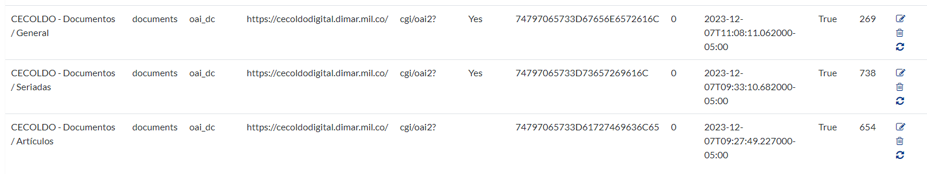
Overview of OIH activities: data providers
Partners currently being engaged from: Argentina, Chile, Peru, Ecuador, Brazil, Uruguay, Venezuela, Colombia, Panama, Costa Rica, Honduras, Dominican Republic, Trinidad & Tobago, Cuba, Mexico, EEUU, Canada. CECOLDO platform (1661 resources - documents category).
24/7 platform availability.
10 Technical meetings attended (two by month with expert team for the Global project)

Slide 5
Overview of OIH activities: End user engagement
End-user engagement through dissemination at regional meetings/events:
2023
MACHC Marine Spatial Data Infrastructure Working Group (MMSDIWG) (Meso-American and Caribbean Hydrographic Commission -MACHC) – March – 2023.
76th GCFI Conference – November
2024
MACHC Marine Spatial Data Infrastructure Working Group (MMSDIWG) (Meso-American and Caribbean Hydrographic Commission -MACHC) – March – 2024.

Slide 6
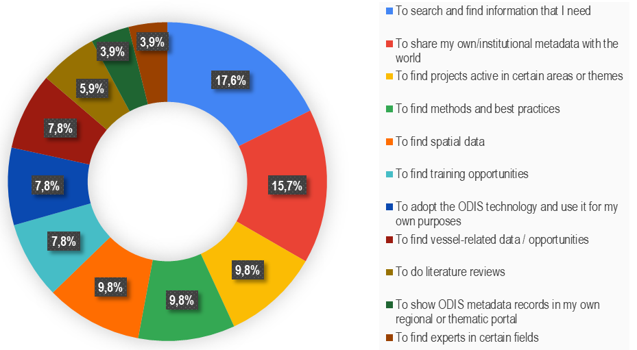

LAC Results from “end user engagement survey”:
How are you, or would you, engage with the Ocean InfoHub?
Recommendations:
I think must improve the smartphone interface.
Guidelines or criteria on sharing or uploading research reports from the Institute of Marine Affairs
Use alphabetic order for the options in each search to facilitate queries
* 10 responses from LAC countries (Argentina, Brasil, Colombia, Mexico, Perú, Trinidad and Tobago)

Slide 7
End user engagement planned
ACTIVITY | DATE
To continue technical support 24/ 7 for the platform. | 2024
Continue engagement of new data providers, as much as possible Invemar's technical capacity | 2024
Dissemination of OceanInfoHUB LAC node use (77th GCFI Conference) – | November 2024
Notes:
of the Ocean InfoHub LAC node at the seventy-seventh GCFI Conference in November.

Slide 8
Recommendations
The most part of institutions/countries of the region don´t have published/online the offer of capacities (marine instrumentation/vessels mainly e.g.) and available to be linked from metadata. Given this, OIH LAC has not yet been able to capture all the real supply of capacity in the topics proposed for the region. Thinking about strengthening the capacities of institutions to publish information can be an activity to be taken into account in the framework of the Decade of Ocean Sciences (A transparent ocean...) and that in an important way also influences the results for the GOSR ( Global Ocean Science Report).
The characterization of the "Laboratory" category lacks a template with minimum attributes, which means that no records have been reported for that category to date, despite the fact that there are records for the region.
NODC and ADU must have more intense activity to promote information sharing to OIH

Slide 9
Challenges (technical)
Strengthen the development team; in skills such as Marine Data Management, Governance and the MEDIN toolset and Data Analysis with Python Programming for Career Ocean Professionals skills.
Provide to librarians in interested countries small trainings on "how to enable and configure OAI (Protocol for Metadata Harvesting) in their document repositories (Koha, Dspace, etc.)" to make the resources offered more visible.

Slide 10
Thank you
Gracias

