Slide 1
UNESCO IOC / ICG / NEAMTWS XVIII Session 6-8 February 2024
ICG NEAMTWS
Task Team on Tsunami Ready
Co-chairs
Ignacio Aguirre Ayerbe (Spain)
Elena Daskalaki (Greece)
UNESCO IOC/ICG/NEAMTWS XVIII Session
6 - 8 February 2024. Paris, France

Slide 2
ICG NEAMTWS TASK TEAM TSUNAMI READY TASK TEAM TSUNAMI READY
INDEX
1
Brief background
Update on activities by Task Team on Tsunami Ready
Progress in the Implementation of Tsunami Ready in the NEAM Region
Main challenges found in TRRP implementation in NEAM region
Recommendations by ICG NEAMTWS TT-TR
2
3
4
5
Notes:
The presentation contains quite a lot of information and the time for it is rather limited, therefore it will have to be done relatively fast. However, if there is anyone interested in further information, please do not hesitate to ask myself and Elena Daskalaki.

Slide 3
BACKGROUND
INTRODUCTION
1
ICG-NEAMTWS-WGs / TTs
24-26 Nov. 2020 (link)
ICG/NEAMTWS
XVII Session
24 - 26 Nov. 2021
(online)
ICG/NEAMTWS
XVII Session
Establishment of intersessional WGs and TTs
ICG/NEAMTWS
Steering Committee
8-12 April 2022
(online)
Nov. 2020
Nov. 2021
Jan. 2022
April 2022
WG4 proposed to set up a dedicated Group on Tsunami Ready within WG4 to start coordinating and implementing Tsunami Ready
The ICG/NEAMTWS decides to formally establish a Task Team on Tsunami Ready with Terms of Reference in Appendix 5
Establishment of the NEAMTWS TT on TR
and appointment of new cochairs
Establishment of First TT-TR Plan of Action (PoA) (requested during ICG/NEAMTWS XVII 2021
IOC Circular Letter No 2821
7 Dec. 2020
ICG-NEAMTWS XVII Decisions and recommendations
(Working Document 23 Nov 2021)
ICG-NEAMTWS XVII Session Report.
Approved TT-TR Plan of Action 2022
Draft Plan of Action
Notes:
Say: there is no time to show the ToR and the POA, but that they are available for anyone who wants to read them.

Slide 4
UPDATE ON ACTIVITES DEVELOPED
2
Task Team on Tsunami Ready: Plan of Action for 2022-2023
Objectives | Objectives | Activity
1 | Membership of Tsunami Ready Task Team. | Confirm membership of the Task Team by former members of TR Group.
Country | TT-TR member | TRRP in progress
Cyprus |  | ü
Egypt |  | ü
France | ü | ☑
Greece | ü | ü
Israel | ü | ü
Italy | ü | ü
Lebanon | ü
Malta |  | ü
Morocco |  | ü
Portugal |  | ü
Spain | ü | ü
Turkey | ü | ü
Total members of ICG/NEAMTWS TT-TR = 27
(April 2023)
TNCs were asked to propose members (IOC Circular Letter No 2821)

Slide 5
UPDATE ON ACTIVITES DEVELOPED
2
Task Team on Tsunami Ready: Plan of Action for 2022-2023
Objectives | Objectives | Activity
2 | Promote community preparedness. Support and promote Tsunami Ready programme in NEAM region. | a) Monitoring of TR pilot projects in NEAM area.
 |  | b) Interact with the WG4 group and foster its activities.
Advice and support was provided to Loulé (Portugal) Municipal Civil Protection to apply for the recognition of TR (meeting and emails exchange).
Provided support to the ICG Technical Secretariat to review country's applications giving constructive feedback.
A jointly monitoring of TR pilot projects is being carried out between TT-TR, Tsunami Resilience Section (TRS), Technical Secretariat of ICG/NEAMTWS and CoastWAVE project coordinators.
Two dedicated coordination meetings were held in Nov. 2022 and March 2023 between WG4, TT-TR and Technical Secretariat of ICG/NEAMTWS.

Slide 6
UPDATE ON ACTIVITES DEVELOPED
2
Task Team on Tsunami Ready: Plan of Action for 2022-2023
Objectives | Objectives | Activity
3 | Encourage and support approval of NEAMTWS TR guidelines, as part of the downstream component of the ICG/NEAMTWS programme. | Establish communication with other ICGs TTs and WGs related to Tsunami Ready, to share/discuss knowledge, experiences and challenges. Identify critical points (and promote solutions to address them) of TR guidelines. Identify methodologies followed by each TR community to promote discussion on them (e.g., to define inundation areas, to generate adequate maps addressing local particularities, to communicate to local stakeholders, on alert dissemination methodologies).
Work in progress on identifying the main challenges faced by the countries of the NEAM region in the implementation of the TRRP.
Contributions were made at the Inter ICG TOWS Task Team on Disaster Management and Preparedness – IOC UNESCO 21 -22 Feb. 2022 and 27-28 Feb. 2023 (both attended online).
Work is in progress related to identifying critical points based on current TRRP initiatives in NEAM countries and other ICGs, looking into solutions and methodologies to address them.

Slide 7
UPDATE ON ACTIVITES DEVELOPED
2
Task Team on Tsunami Ready: Plan of Action for 2022-2023
Objectives | Objectives | Activity
4 | Represent Tsunami Ready TT in ICG/NEAMTWS. | Represent TT-TR at meetings scheduled throughout the year 2022 and 2023.
5 | Cooperation with other Working Groups and Task Teams. | Supporting where appropriate and providing feedback.
Participation and presentations at the SC/NEAMTWS Meeting, Paris, 12-13 Apr. 2023.
Participation (as observers) in the meeting of the Inter ICG TOWS Task Team on Disaster Management and Preparedness - IOC UNESCO, 27-28 Feb. 2023.
Participation, organization and presentations at the Tsunami Ready Training Workshop of the IOC-UNESCO EU DG-ECHO CoastWAVE project, 16-17 February 2023.
Participation and presentations at the ICG/NEAMTWS Experts Meeting: Implementing NEAMTWS 2030 Strategy, opportunities and actions to explore. Naples, 28-30 Nov. 2022.
Participation of TT-TR members on the Webinar on Tsunami Risk Perception Studies Within the NEAM Region - November 2022.
NEAMTWS Local Tsunami Warning in the Context of Multi-Hazard Disaster Risk Mitigation: Requirements, Challenges, Opportunities & CoastWave project Tsunami Ready meeting. October 2022, Ispra, Italy.

Slide 8
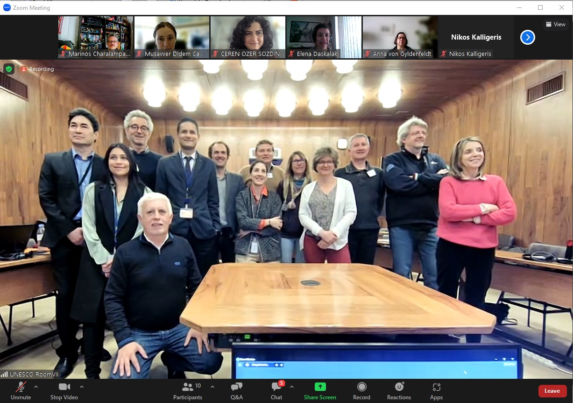
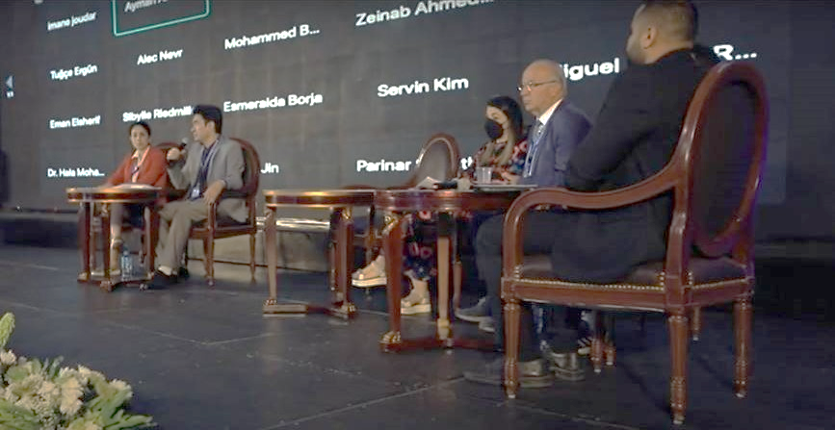
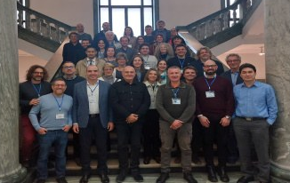
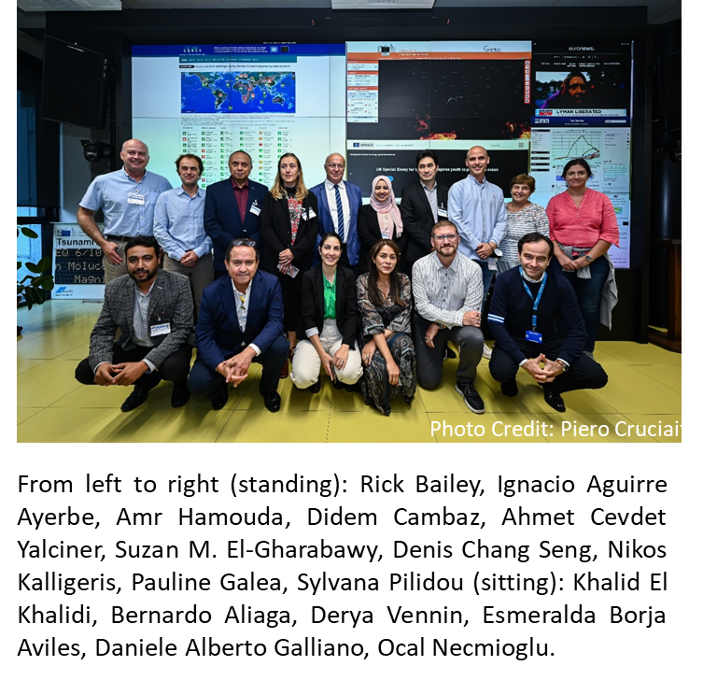
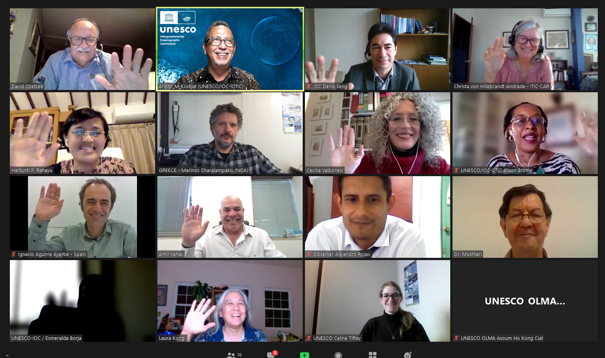
UPDATE ON ACTIVITES DEVELOPED
2
Task Team on Tsunami Ready: Plan of Action for 2022-2023
Represent TT-TR at meetings scheduled throughout the year 2022 and 2023.
ICG/NEAMTWS SC Meeting Paris, 12-13 April 2023
ICG/NEAMTWS Experts Meeting: Implementing NEAMTWS 2030 Strategy, opportunities and actions to explore. Naples, 28-30 Nov. 2022
African Conference Side Event “Resilient and Safer Coasts” - May 2022, Cairo, Egypt.
ICG/NEAMTWS Meeting Local Tsunami Warning in the Context of Multi-Hazard Disaster Risk Mitigation: Requirements, Challenges, Opportunities & CoastWave project Tsunami Ready meeting. October 2022, Ispra, Italy
Inter ICG Task Team on Disaster Management and Prepared. Feb., 2023, online.

Slide 9
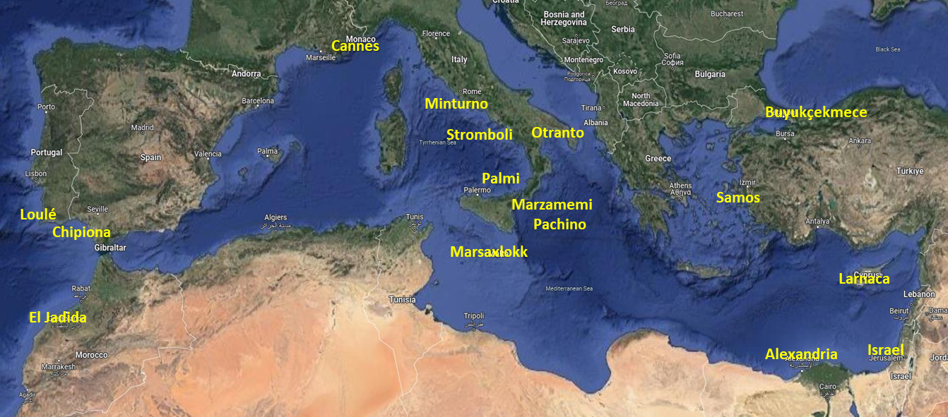
TRRP IMPLEMENTATION NEAM REGION
3
Tsunami Ready Recognition Programme Implementation in NEAM Region
11 Countries and 15 communities (7 countries under IOC-UNESCO EU DG-ECHO CoastWAVE Project)
Atlantic: El Jadida (Morocco); Loulé (Portugal); Chipiona (Spain).
Central/Western Mediterranean: Cannes (France); Marzamemi-Pachino, Minturno, Palmi, Stromboli volcano, Otranto (Italy); Marsaxlokk (Malta).
Eastern Mediterranean: Buyukçekmece (Turkey), Samos (Greece), Larnaca (Cyprus), Israel, Alexandria (Egypt).

Slide 10
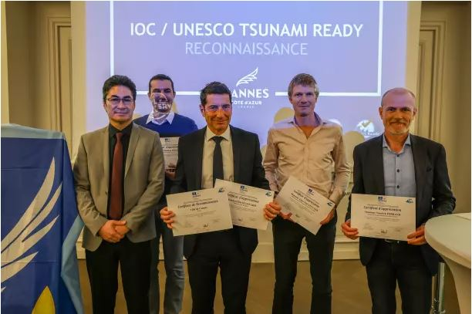
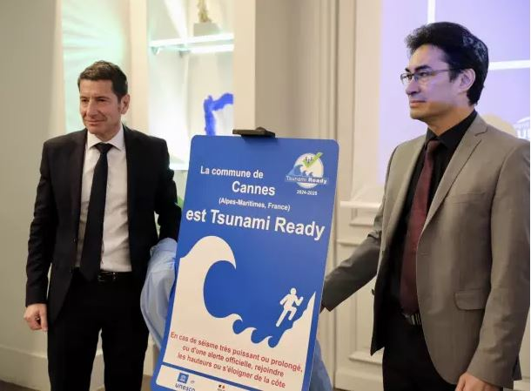
Cannes Municipality - FRANCE
TRRP IMPLEMENTATION NEAM REGION
3
January 19, 2024: First Community in NEAM region to obtain the Recognition for UNESCO-IOC Tsunami TRRP.
The municipality's actions, including hazard assessments, evacuation mapping, drills, and exercises, align with the UNESCO Tsunami Ready 12 key indicators, demonstrating unwavering commitment to tsunami preparedness and community resilience.

Slide 11
CHALLENGES TRRP NEAM REGION
4
GENERAL BARRIERS
Some stakeholders (tourism, commerce etc.) are difficult to brought in because they are worried that acknowledging and actioning upon tsunami risk may harm their business, due to international and sectoral competition.
Difficulties to get local officials to accept the signage because it materializes the tsunami risk (especially for municipalities oriented towards the tourism economy).
Reluctance from local authorities to officially endorse the evacuation plan because they are worried about legal liabilities in case of human losses during the evacuation.
General populations’ lack of knowledge and education about coastal hazards and especially tsunamis. Some coastal communities may underestimate the tsunami risk. Distress and fear among exposed population may also contribute to this underestimation.
Difficulties in public awareness due to special conditions (summer time, temporary population etc.).

Slide 12
CHALLENGES TRRP NEAM REGION
4
INSTITUTIONAL, ORGANIZATIONAL, TECHNOLOGICAL BARRIERS
Establishment of NTRB/ establishment of the TRLC.
Institutional Coordination between different organizations at all spatial scales and administrative divisions.
Existing national Governance structures imply the integration of local tsunami emergency plans (slow down the process, depending on the political will of each community etc.).
Dependency on only one mean of dissemination for alerting the population.
International signage is not always easily acceptable by local decision makers - Need for adapting the tsunami signage and facilitating its integrations into the urban environment (fear…..).
Alerting Devices Issues: Maintenance / Expensive.
Financial, technical, human resources, and time demands.
Sustainability of TRRR. Continuous support by scientific and distaster/emergency experts.

Slide 13
TT-TR RECOMMENDATIONS
5
Recommendations are mainly based on:
Established ToR and approved PoA 2022/2023
Expertise as Chairs of TT TR
Recommendation of Inter ICG TOWS WG - TT DMP
The TT-TR of the ICG NEAMTWS greatly appreciates the efforts of the NEAMTWS Technical Secretariat and the IOC UNESCO TRS in promoting and supporting the implementation of the TRRP in the NEAM region, both in the countries that are participating in the CoastWAVE project and in those that are not part of the CoastWAVE project but are also implementing the TRRP.
Notes:
These recommendations are mainly driven by the activities assigned to the TT-TR, set out in both the Terms of Reference and the approved Plan of Action 2022, as well as on the lessons learned during this intense period in relation to the TRRP globally. Several activities and initiatives that took place during this time, both in the ICG NEAMTWS and in other ICGs and in the Inter ICG-TOWS, have also contributed to inspire these recommendations.

Slide 14
TT-TR RECOMMENDATIONS
5
RECOMMENDATIONS FROM ICG/NEAMTWS TASK TEAM ON TSUNAMI READY
It is recommended to establish and report a membership mechanism and updated and cross-checked list with WG4 membership list.
It is suggested to establish two annual coordination meetings between TT-TR, WG4 and NEAMTWS Tech. Secretariat.
It is recommended to contact the TNCs on a regular basis (e.g., annually) to promote new proposals of candidates for the Tsunami Ready Program.
Strengthen the promotion of the TRRP among key stakeholders in the NEAM region: one annual event (online workshop) for the promotion and explanation of the TRRP in NEAM region, for a wide audience, especially representatives of municipalities from all NEAM countries, civil protection officials from all levels, and institutions that can provide support to meet all TRRP requirements.
Based on the pioneering progress in the implementation of the TRRP in the NEAM region, explore possible solutions for identified critical points, analyze the need to establish guidelines for the development of some indicators, and evaluate whether MG74 should be adapted to the NEAM region.
Notes:
These recommendations are mainly driven by the activities assigned to the TT-TR, set out in both the Terms of Reference and the approved Plan of Action 2022, as well as on the lessons learned during this intense period in relation to the TRRP globally. Several activities and initiatives that took place during this time, both in the ICG NEAMTWS and in other ICGs and in the Inter ICG-TOWS, have also contributed to inspire these recommendations.
SAY ALSO THAT THESE ARE PRELIMINARY AND WILL BE DISCUSSED DURING INTERSEASSIONAL SESSION AND MAY SLGIHLTY CHANGE

Slide 15
TT-TR RECOMMENDATIONS
5
RECOMMENDATIONS FROM ICG/NEAMTWS TASK TEAM ON TSUNAMI READY
It is recommended to translate MG74 into other languages (currently in English, Spanish, French and Arabic).
It is recommended to translate the newly developed tsunami related brochures into other languages (currently in English).
It is recommended strength interaction between ICG/NEAMTWS TT-TR, Inter ICG TT-DMP, Tsunami Ready Coalition and other ICGs. This can be done by ICG/NEAMTWS TT-TR representatives to be invited to, at least as observers, Inter ICG TOWS TT DMP meetings.
It is recommended to conduct a Survey Questionnaire after TRRP certification, to receive feedback from implementers. Explore other ICG examples in this regard.
It is recommended to interact with other ICGs to follow up the preparation of guidelines for critical infrastructures from tsunami impacts.
It is recommended, in cooperation with the TOWS Task Team on Disaster Management and Preparedness, to explore ways to recognize communities which applies National Tsunami Programmes and Initiatives similar to IOC UNESCO TRRP.
It is recommended that TRRP information and resources be centralized on a single website (preferably on the current dedicated ITIC site), with all other web pages referring to the general repository.
Notes:
These recommendations are mainly driven by the activities assigned to the TT-TR, set out in both the Terms of Reference and the approved Plan of Action 2022, as well as on the lessons learned during this intense period in relation to the TRRP globally. Several activities and initiatives that took place during this time, both in the ICG NEAMTWS and in other ICGs and in the Inter ICG-TOWS, have also contributed to inspire these recommendations.

Slide 16
UNESCO IOC / ICG / NEAMTWS XVIII Session 6-8 February 2024
Thank you!
ICG NEAMTWS
Task Team on Tsunami Ready
Co-chairs
Ignacio Aguirre Ayerbe (Spain)
Elena Daskalaki (Greece)
UNESCO IOC/ICG/NEAMTWS XVIII Session
6 - 8 February 2024. Paris, France

