Slide 1
Ocean Surface Data, Products and Services at NOAA/NCEI
DBCP Training Workshop 2024
(John) Huai-Min Zhang¹
NOAA/NCEI Ocean Surface Section Chief
WMO/IOC Ship Observations Team (SOT) Chair
¹ NOAA National Centers for Environmental Information (NCEI)
https://www.ncei.noaa.gov/
https://www.ocean-ops.org/sot/
Contact: huai-min.zhang@noaa.gov
2024-08-06

Slide 2
WMO/IOC Ship Observations Team (SOT)
DBCP

Slide 3
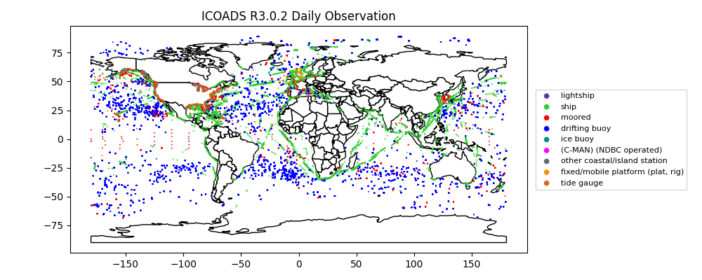
At NOAA NCEI, We Integrate All Observations Together
NOAA National Environmental Satellite, Data, and Information Service

Slide 4
NCEI Data Stewardship and Products Tiers
6: National Services &
International Leadership
5: Authoritative Records
4: Derived Products
NOAA National Environmental Satellite, Data, and Information Service
3: Scientific Improvements
2: Enhanced Access and Basic Quality Assurance
1: Long Term Preservation and Basic Access

Slide 5
NCEI Ocean Surface Portfolios
https://www.ncei.noaa.gov/products/ocean-physics
Carrying out an integrated, end-to-end, and collaborative approach for the data collection and stewardship, quality control and processing, product generation, and societal service for the surface marine and meteorological observational data, from both in-situ and satellite observations.
The scope ranges from foundational datasets (e.g. ICOADS, Pathfinder SST) to high level authoritative gridded, blended & merged datasets (e.g. ERSST, OISST and Blended Sea Surface Winds) (tiered scientific data stewardship).
NOAA National Environmental Satellite, Data, and Information Service

Slide 6
A Foundational Dataset - The International Comprehensive Ocean-Atmosphere Data Set (ICOADS)
Scope: The world’s most extensive surface marine & meteorological data collection from 1662 onward; a foundational dataset for climate monitoring & studies as well as societal services (e.g. legal service)
Objective: Development, stewardship, archive & service of ICOADS
1) Monthly Version (1662 - present); 2) Daily Version (Jan 2015 - present)
NOAA National Environmental Satellite, Data, and Information Service
ASVs
https://icoads.noaa.gov

Slide 7
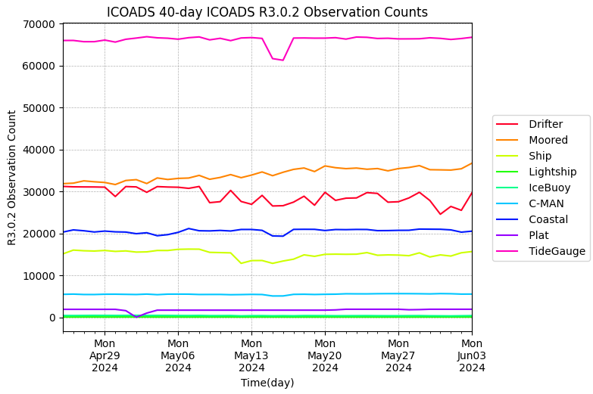
1) Daily monitoring of surface obs systems/platforms
2) Merge BUFR + TAC GTS data streams
2) Daily ICOADS used as input to high level Products
NOAA National Environmental Satellite, Data, and Information Service
https://icoads.noaa.gov

Slide 8
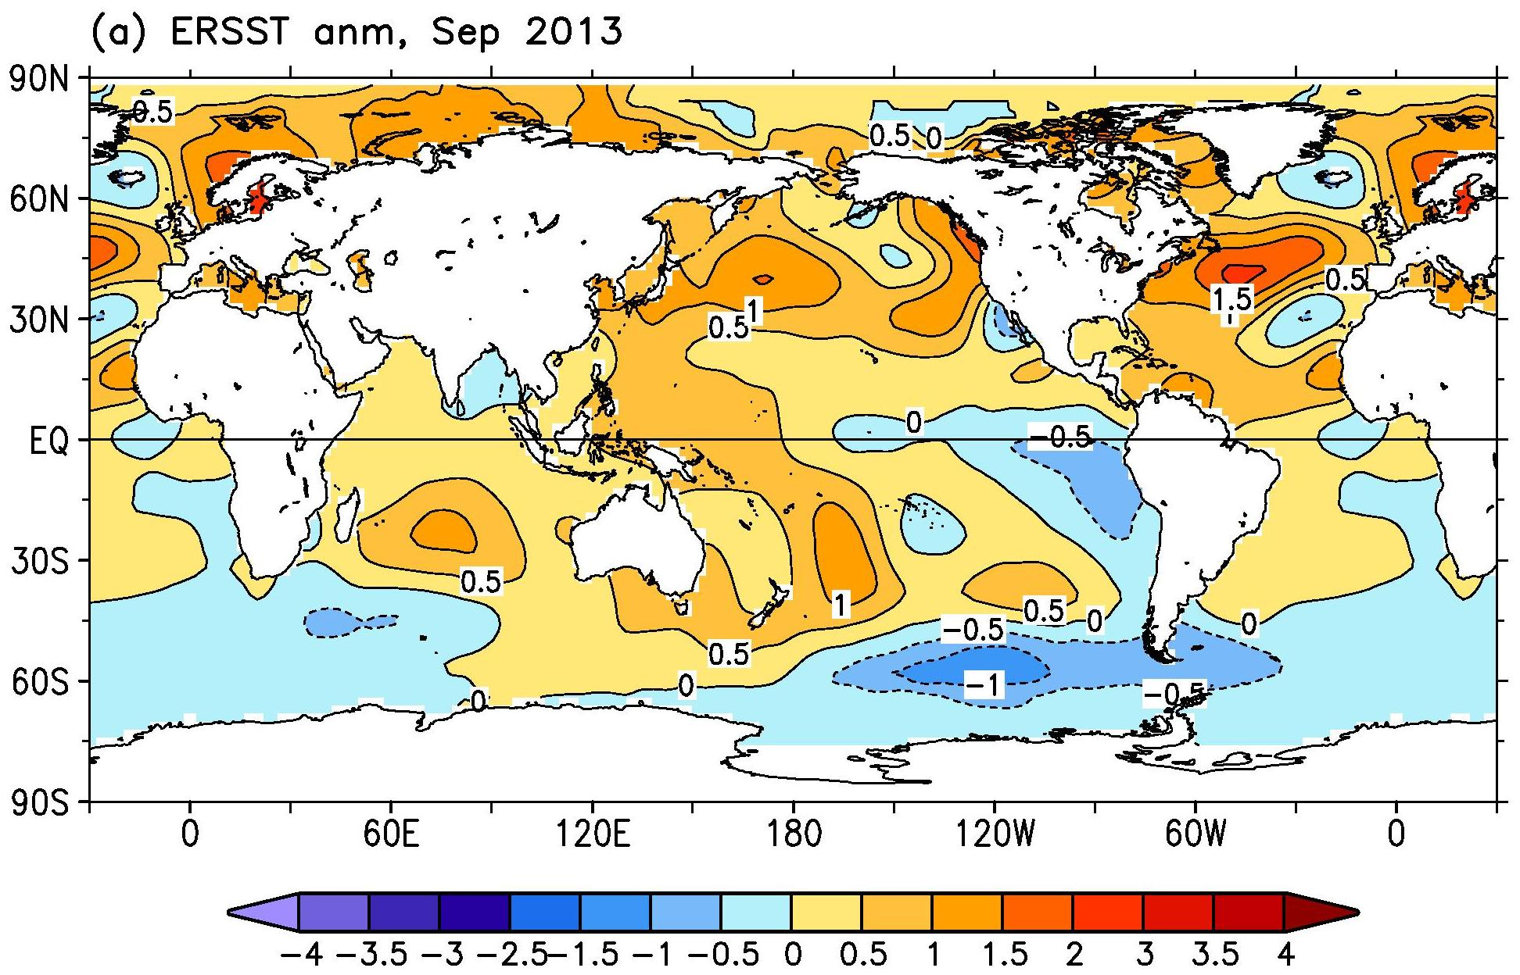
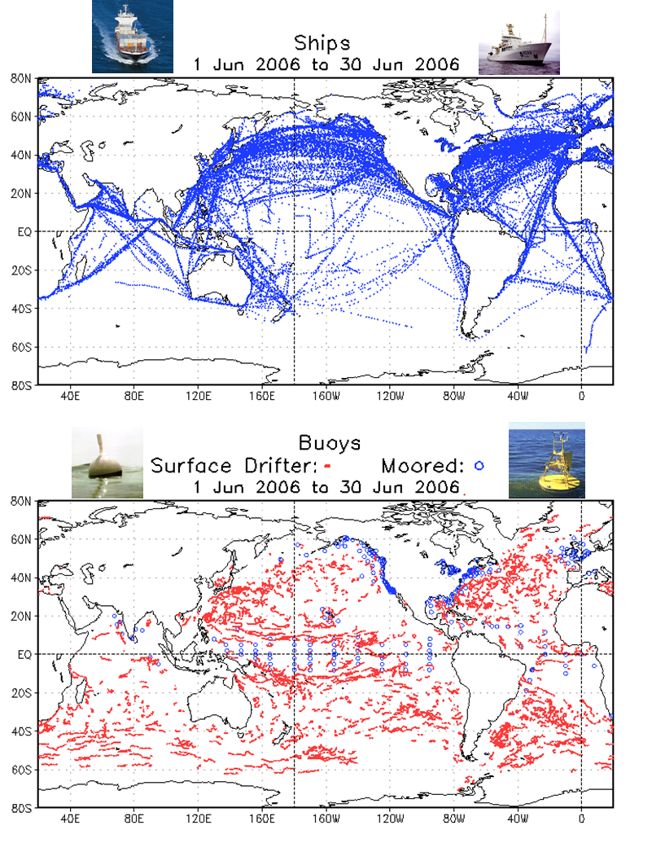
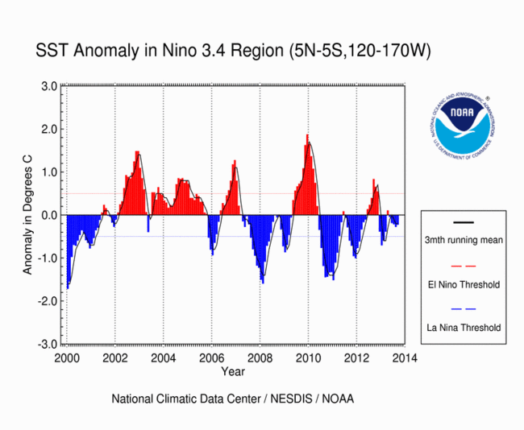
Centennial Scale (1854 - present - The Extended Reconstructed Sea Surface Temperature (ERSST)
https://www.ncei.noaa.gov/products/extended-reconstructed-sst
Input: ICOADS, Argo Floats
ERSST
Scope: Authoritative centennial global sea surface temperature dataset for climate change research, assessment & monitoring (Monthly from Jan 1854 – present)
Objective: Monthly production & dissemination; development to remain state-of-the-science & authoritative
Version update history:
v1 - 2003; v2 – 2004; v3 - 2008; v4 – 2015;
v5: 2017 (J. Climate)
v6: AI/ML based, under review
Use & public interests: Used for climate reports and assessments. New bias corrections starting from v4 showing no recent warming hiatus
NOAA National Environmental Satellite, Data, and Information Service
Use Example:
El Nino Index
‹#›

Slide 9
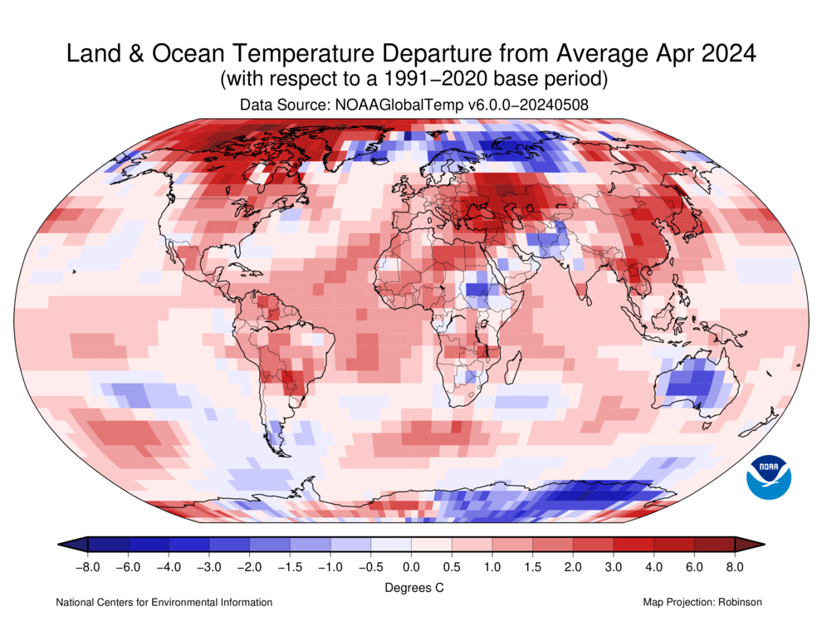
NOAAGlobalTemp – Global Surface Temperature: Over Land Air Temperature + Ocean Surface Temperature
https://www.ncei.noaa.gov/products/land-based-station/noaa-global-temp
NOAA National Environmental Satellite, Data, and Information Service
https://www.ncei.noaa.gov/access/monitoring/climate-at-a-glance/global/time-series/globe/land_ocean/1/6/1850-2024

Slide 10
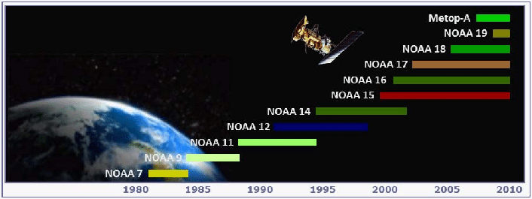
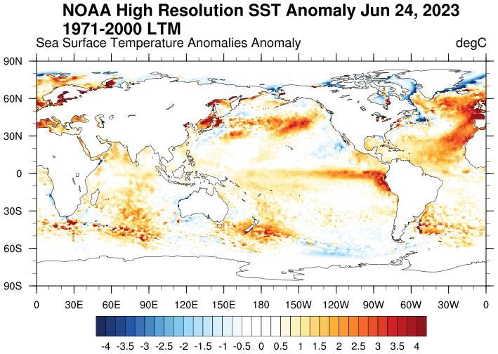
The NOAA Optimum Interpolation Sea Surface Temperature (OISST) Product
Integrated Use of Global Ocean Observations from In-Situ Platforms and Satellites
NCEI works with NOAA (OAR, NWS) and international partners to collect data from the international Global Ocean Observing Systems.
OISST is designed to take integrated global ocean observations from in-situ platforms and NOAA and partner’s satellites
The integrated use enables consistent time series over time as a Climate Data Record (CDR), ancored to in-situ observations.
OISST has been used as the basis for computing the Marine Heat Wave Indices by the international community.
Current rapid ocean surface warming garners media attention and NCEI has been contacted by many media via NOAA Communications & Outreach
https://www.ncei.noaa.gov/products/optimum-interpolation-sst

Slide 11
Use Cases – Record Breaking Sea Surface temperature

Slide 12
Use Cases – Hurricane Monitoring
Earliest Catogary-5 Hurricane over 100 years
Very rapid intensification from Cat-1 to Cat-5
Fueled by recording breaking ocean surface temperature

Slide 13
Use Cases – Coastal Water Temperature Guide

Slide 14
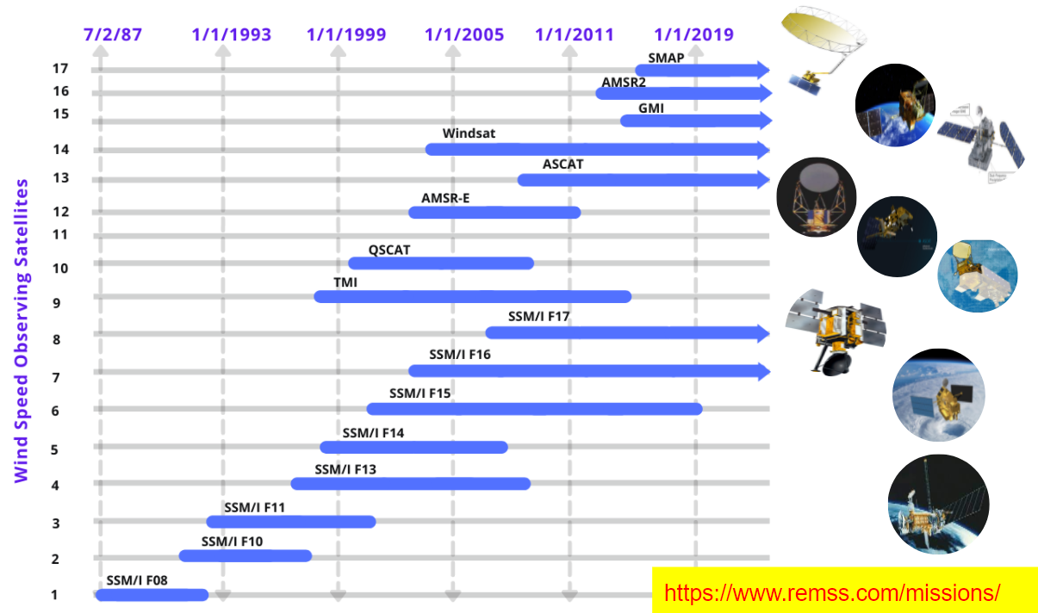
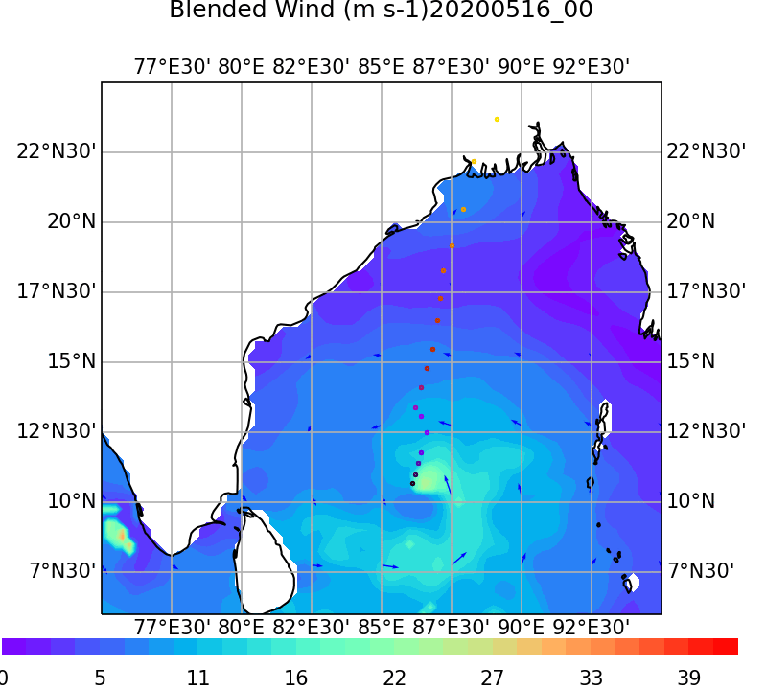
Daily Production & Service: NOAA Blended Sea Surface Winds (NBS) V2.0 – Resolving Storm Winds
Characteristics:
Storm (Hurricane) wind resolving
Global ¼º grid, gap-free
6-hourly and daily (🡪 monthly, climatology)
Blending from multiple satellites
July 1987 - onward
Production schedule
Preliminary produced every day in near real time (1-day delay)
Replaced by final (science quality) version on monthly basis
Recent development
Evaluation by in-situ data
Preparing for formal release of v2.0
Experimental data available - contact us
NOAA National Environmental Satellite, Data, and Information Service
https://www.ncei.noaa.gov/products/blended-sea-winds

Slide 15
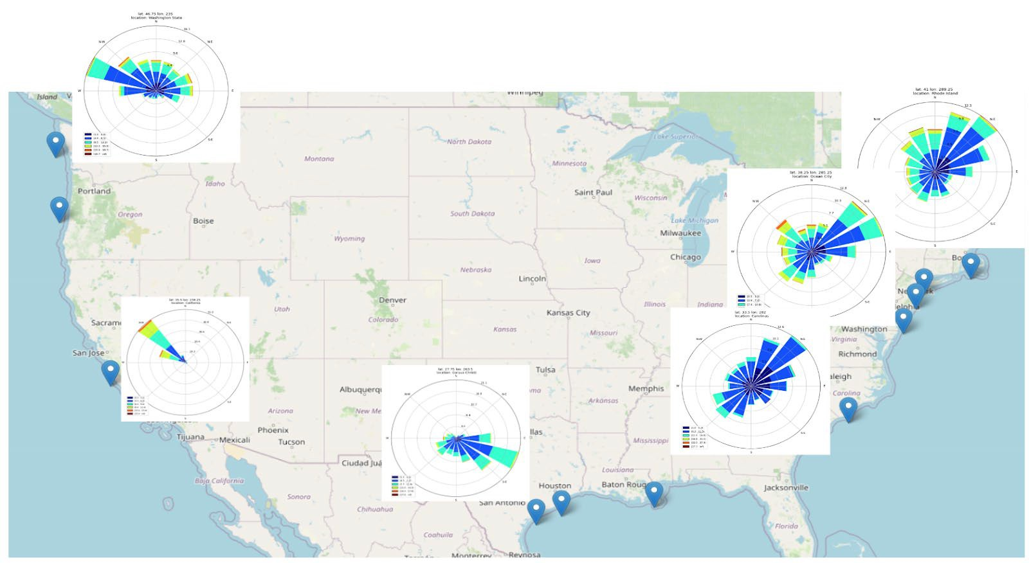
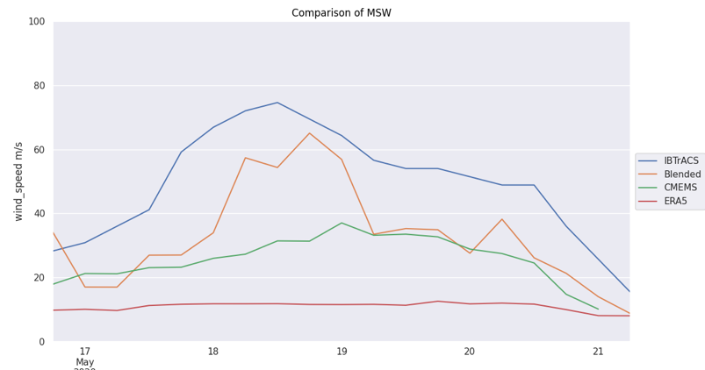
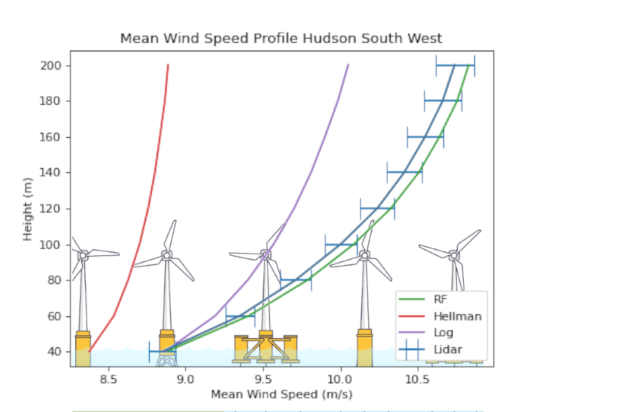
Offshore Wind Profiles Dataset for Wind Energy
Offshore Wind Farm Applications: Wind Roses & AI/ML Extrapolation
Evaluation against IBTrACS data
IBTrACS
NBS
NOAA National Environmental Satellite, Data, and Information Service
CMEMES
ERA5
Green Line:
AI/ML extrapolation
Blue Line:
Radar observational data
Red/Purple (left) Lines: Traditional Empirical methods
Frech et al., 2024: A New Gridded Offshore Wind Profile Product for US Coasts Using Machine Learning and Satellite Observations. (To be submitted

Slide 16
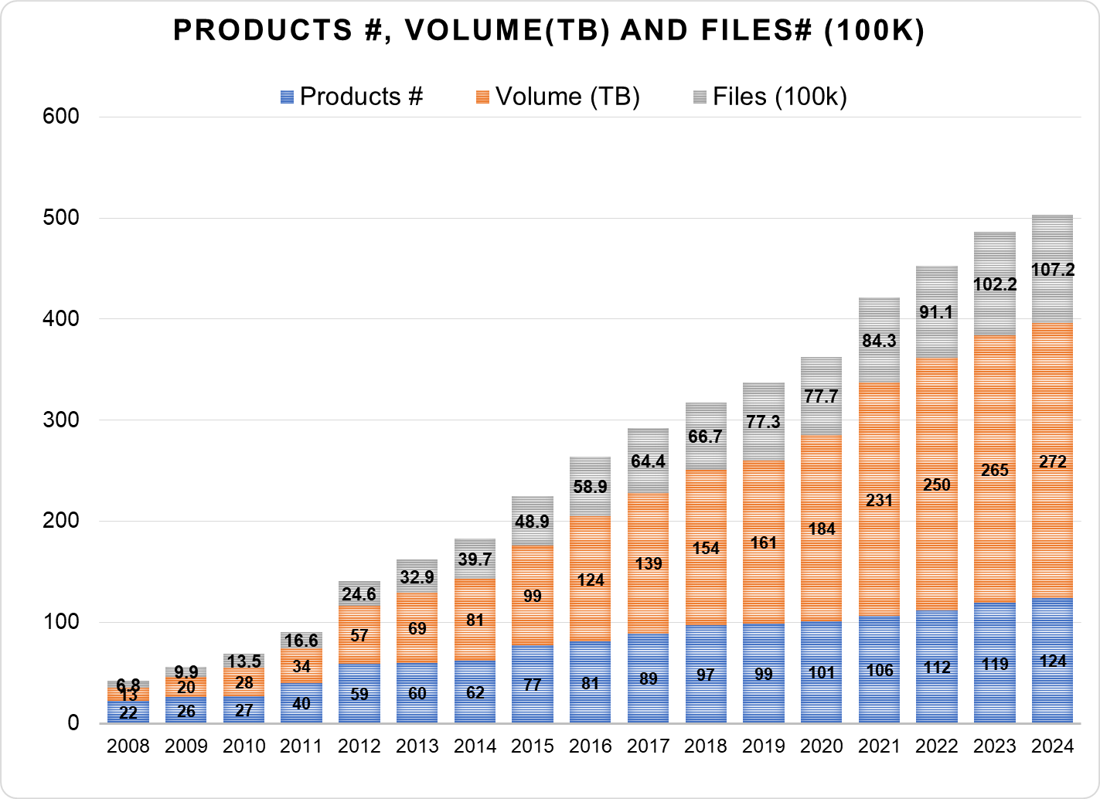
NCEI Long Term Stewardship and Reanalysis Facility: Total Archive Holdings
New Products Archived Since G24
NOAA/STAR ACSPO N21 VIIRS L2P SST (V2.80)
NOAA/STAR ACSPO N21 VIIRS L3U SST (V2.80)
NOAA/STAR ACSPO LEO Daytime L3S sub-skin SST (v2.81)
NOAA/STAR ACSPO LEO Morning L3S sub-skin SST (v2.80).
NOAA/OSPO ACSPO MSG04 SEVIRI L2P SST (V1.0)

Slide 17
Summary: End-to-End Process
- From observations to data ingest, data management, data quality control, products development to Societal Applications
6: National Services &
International Leadership
5: Authoritative Records
4: Derived Products
NOAA National Environmental Satellite, Data, and Information Service
3: Scientific Improvements
2: Enhanced Access and Basic Quality Assurance
1: Long Term Preservation and Basic Access

