Slide 1
GBON Ocean Integration and WIS 2.0
Data Buoy Cooperation Panel (DBCP)
Training Workshop on Ocean Observations for Weather Forecast and Climate Prediction
06 to 08 August 2024
Champika Gallage
Scientific Officer
Infrastructure Department
WMO

Slide 2
Content
1 WMO Strategic Objectives
2 WMO Integrated Global Observing System (WIGOS)
3 Global Basic Observing Network (GBON)
4 Systematic Observations Financing Facility (SOFF)
5 WMO Information System (WIS)
6 Key takeaways

Slide 3
WMO Strategic Plan 2024-2027 The place of Earth system observations and predictions
VISION 2030
By 2030, we see a world where all nations, especially the most vulnerable, are more resilient to the socioeconomic consequences of extreme weather, climate, water and other environmental events; and underpin their sustainable development through the best possible services, whether over land, at sea or in the air
MISSION
To facilitate worldwide cooperation on monitoring and predicting changes in weather, climate, water and other environmental conditions through the exchange of data, information and services, standardization, application, research and training.
1
2
3
4
5
LONG-TERM GOALS
Services
Better serve
societal needs
Infrastructure
Enhance Earth system observations and predictions
Science & Innovations
Advance targeted research
Member Services
Close the capacity gap
Smart
Organization
Strategic realignment of structure and programmes
STRATEGIC OBJECTIVES
National multi-hazard early warning/alert systems
Climate information and services
Hydrological services
Decision-supporting weather information and services
Address global risks associated with irreversible changes in the cryosphere
Optimize observation data acquisition
Improve access to, exchange and management of Earth system observation data and products
Enable access and use of numerical analysis and prediction products
Advance scientific knowledge of the Earth system
Enhance science-for-service value chain to improve predictive capabilities
Advance policy-relevant science
Enable developing countries to provide and utilize essential weather, climate, hydrological and related environmental services
Develop and sustain core competencies and expertise
Scale up partnerships
Optimize WMO constituent body structure
Nurture WMO strategic partnerships
Advance equal, effective and inclusive participation
Environmental sustainability

Slide 4
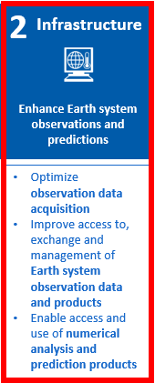
WMO Strategic Objectives
1
2
3
4
5
6
WMO Integrated Global Observing System (WIGOS)
WMO Information System (WIS)
WMO Integrated Processing and Prediction System (WIPPS)

Slide 5
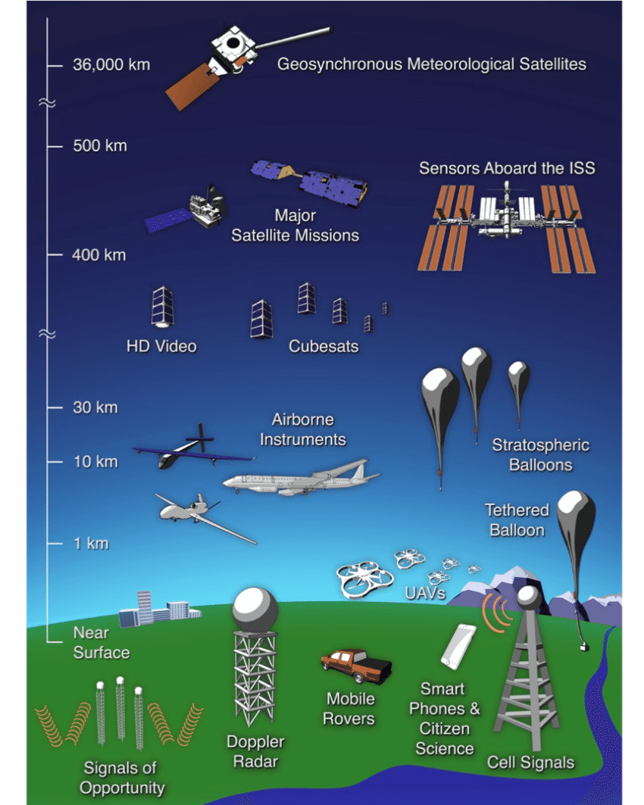
WMO Integrated Global Observing System (WIGOS)
Framework for the integration, coordination and optimized evolution of existing observing systems
Enhance governance/management functions, mechanisms/activities to be accomplished by contributing observing systems to satisfy, in a sustained and cost-effective manner, the evolving observing requirements of Members
Supports better use of existing and emerging observational capabilities of Members
Enable Members/partners to better respond to natural hazards, improve weather, water, climate and related environmental monitoring, and to adapt to climate change while providing avenues capacity development
Notes:
.

Slide 6
WIGOS Processes and Roles
Unified Data Policy
Core data
Requirements
Recommended data
Design
Standards / best practice
Implementation
Quality
Delivery
Monitoring
Feedback/review
Capacity development
WIGOS Manual (WMO No.-1160)

Slide 7
WIGOS in WMO’s Strategic Plan 2024-2027
Objective 2.1: “Optimize the acquisition of Earth System observation data through WIGOS”
Focus in 2024–2027:
The availability and scope of observational data increased
Observations across domains into WIGOS integrated
Observations to support climate adaptation and mitigation coordinated
New technologies brought into operations
Environmentally sustainable design of WMO observing programmes ensured

Slide 8
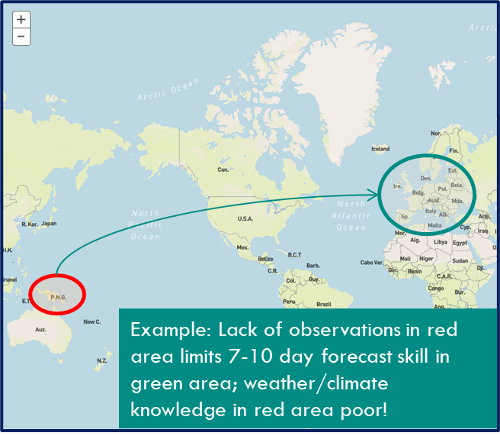
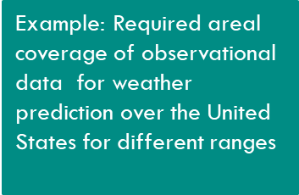
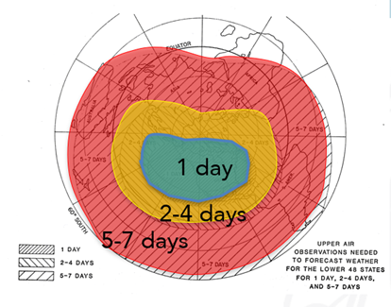
Global Basic Observing Network (GBON)
A global public good for improved weather prediction and climate reanalysis
Lack of observations limits ability to monitor, understand and predict weather and climate, both locally and globally
Weather prediction beyond 3-4 days for any location on the globe requires exchange of observations world-wide.
GBON
Fundamental element of WIGOS addressing geographical inconsistencies in the availability of internationally exchanged data
Improves the availability of the essential surface-based observational data, which are expected to enhance the quality of weather forecasts

Slide 9
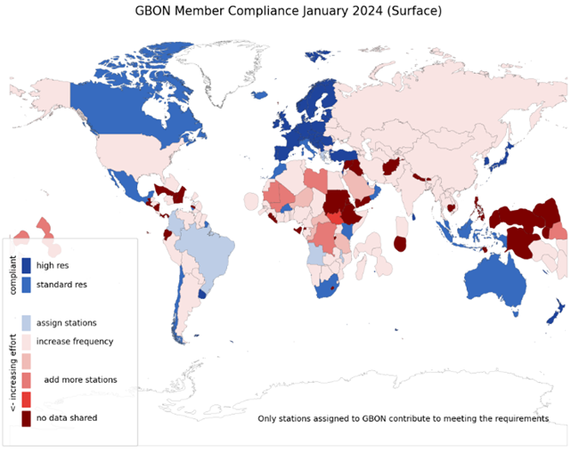
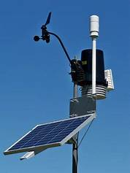
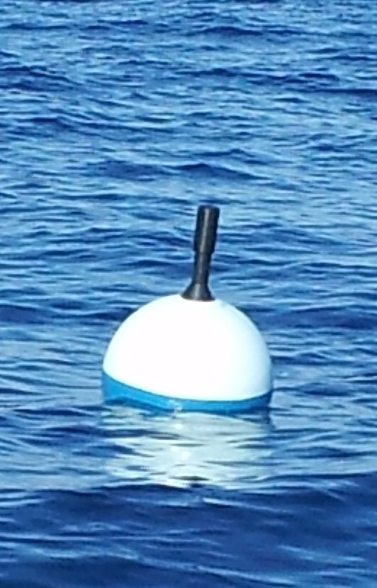
Global Basic Observing Network (GBON)
A global public good for improved weather prediction and climate reanalysis
Worsening gaps in the basic surface-based observations that keep weather predictions on track - full implementation estimated to bring USD 5 billion in annual benefits
Members in 2021 accepted the obligation to take and share GBON observations at minimum horizontal and time resolution
Surface land at 200 km, hourly
Upper air over land at 500 km, 2x daily
Surface marine in EEZ at 500 km, hourly
WMO co-created the Systematic Observations Financing Facility (SOFF) to help Members meet that GBON obligation, with priority on support to LDCs and SIDS
The designations employed and the presentation of material on this map do not imply the expression of any opinion whatsoever on the part of the Secretariat of the World Meteorological Organization concerning the legal status of any country, territory, city or area or of its authorities, or concerning the delimitation of its frontiers or boundaries.

Slide 10
GBON Requirements
Type of observing station​ | HR​ | VR​ | Obs Cycle​ | Variables​ | Other Requirements​
Surface land stations ​ | 200km ​ 100km ​ | n/a​ | 1h​ | SLP, T, U,​ Wind, precip, snow depth​ | Exchanged in real​ time through WIS2​
Upper air stations operated from land ​ ​ | 500km​ 200km​ | 100m​ | 2/24h​ | T, U, wind​ | Up to 30 hPa, exchanged in real time through WIS- 2​
Subset of upper air stations ​ ​ | 1000km​ | 100m​ | 24h​ | T, U, wind​ | Up to 10hPa,​ Exchanged in real time through WIS2​
Surface marine stations in EEZs ​ ​ | 500km​ | n/a​ | 1h​ | SLP, SST​ | Exchanged in real​ time through WIS2​
Upper air stations operated in EEZs ​ ​ | 1000km​ | 100m​ | 2/24h​ | T, U, wind​ | Up to 30 hPa, exchanged in real time through​ WIS2​
Aircraft data ​ ​ | 100km at flight level​ | 300m for profiles​ | 1h​ | T, U, wind​ | Data exchange per licensing agreement​
Remote sensing ​ profiler observations ​ ​ | Where available​ | 100m​ | 1h​ | T, U, wind​ | n/a​

Slide 11
GBON: surface marine observations in EEZ
calculation of GBON targets for marine Exclusive Economic Zones, based on all platforms reporting within EEZ – global gap 465
no need to formally assign surface marine observations to GBON – all obs considered
All observations – “domestic” or “foreign” are counted
Might be variable in time, make planning more complex
in context of SOFF, potentially reduces GBON marine gap
But, reflects reality of the observations available, and the non-exclusive responsibility for observations in EEZ
Best value monitoring platform for GBON variables are surface drifters and ships, but these drift – could drive to more fixed platforms (more expensive, requiring more technical capacity, exposed to vandalism) – but these may also have greater local value
The designations employed and the presentation of material on this map do not imply the expression of any opinion whatsoever on the part of the Secretariat of the World Meteorological Organization concerning the legal status of any country, territory, city or area or of its authorities, or concerning the delimitation of its frontiers or boundaries.

Slide 12
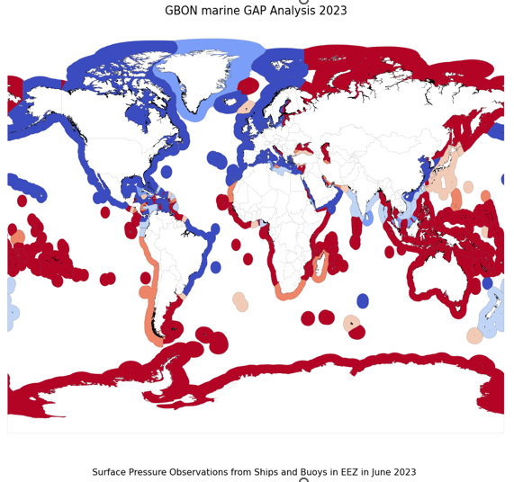
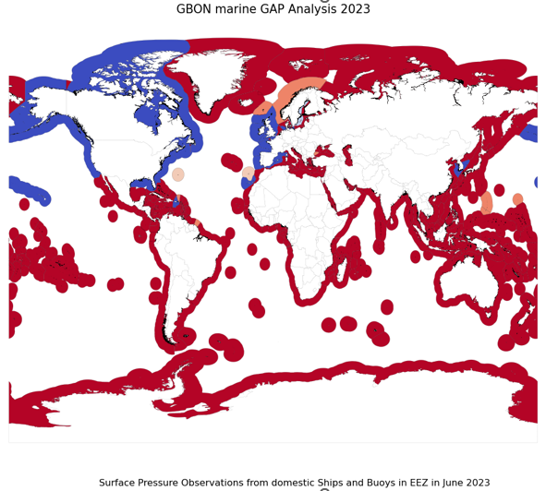
GBON Marine Gap analysis based on SLP observations in June 2023
The designations employed and the presentation of material on these maps do not imply the expression of any opinion whatsoever on the part of the Secretariat of the World Meteorological Organization concerning the legal status of any country, territory, city or area or of its authorities, or concerning the delimitation of its frontiers or boundaries.

Slide 13
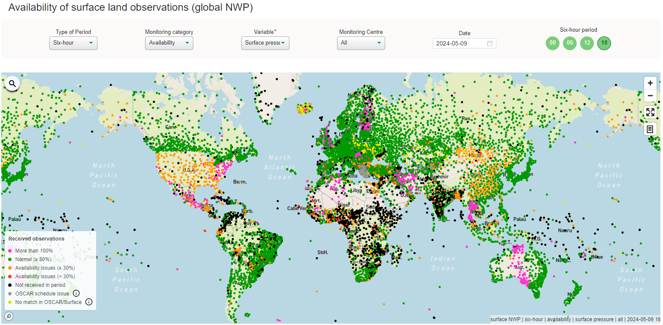
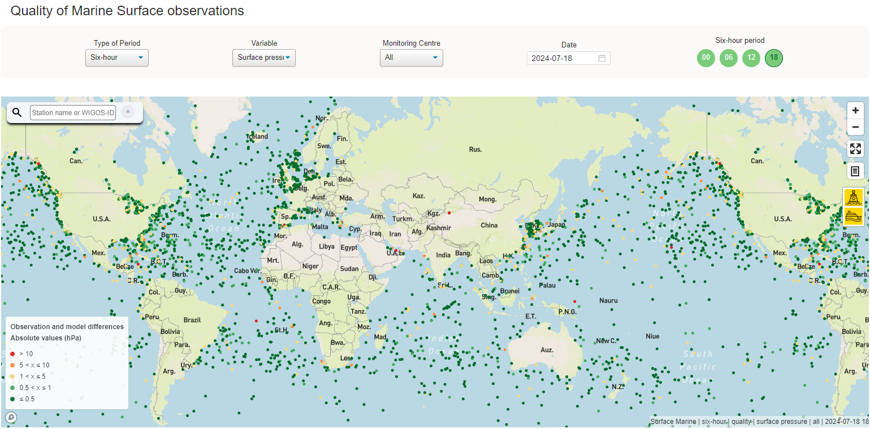
Compliance Monitoring
WIGOS Data Quality Monitoring System (WDQMS)
monitors the availability and quality of observational data based on near-real-time monitoring information.
developed by the WMO, and hosted by ECMWF.
near-real-time monitoring information from the four participating (NWP) centers (DWD*, ECMWF*, JMA and NCEP).
* Centers providing Quality of marine Surface Observations
WDQMS (wmo.int)

Slide 14
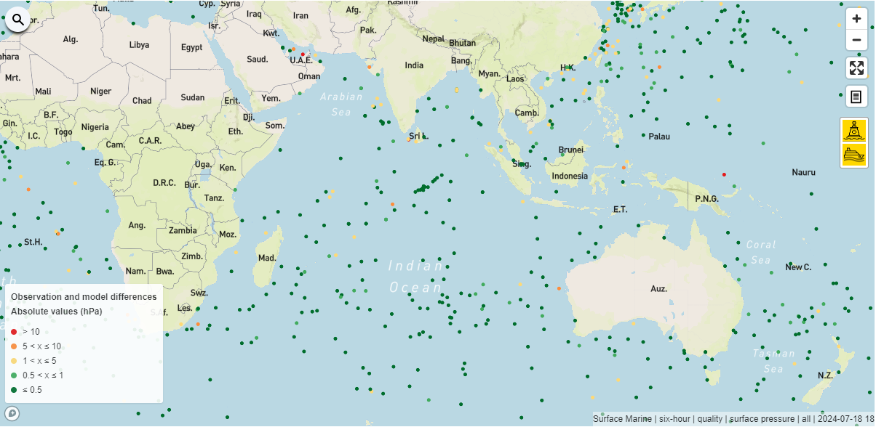
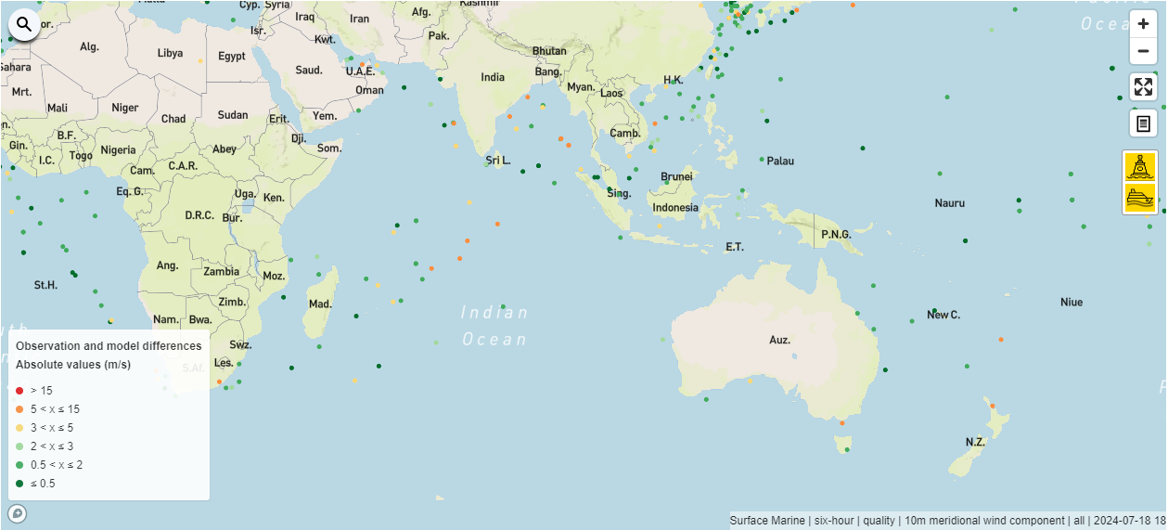
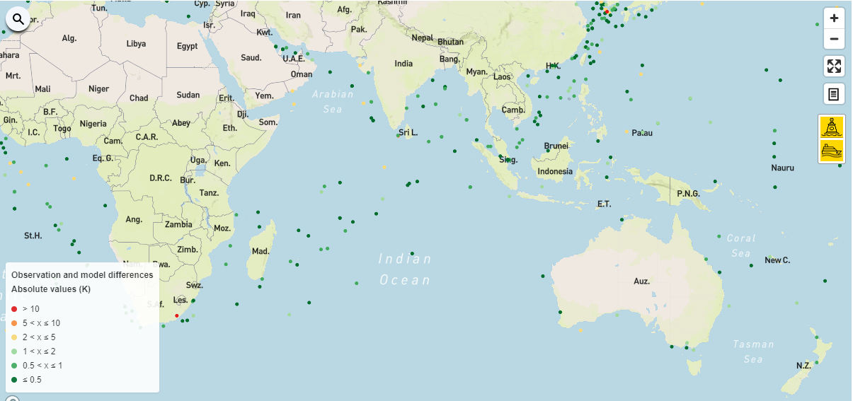
Quality of Marine Surface observations
Surface Pressure
10m Meridional Wind
2m Temperature
2m Relative Humidity
https://wdqms.wmo.int/nwp/marine_surface/six_hour/quality/pressure/all/2024-07-15/18

Slide 15
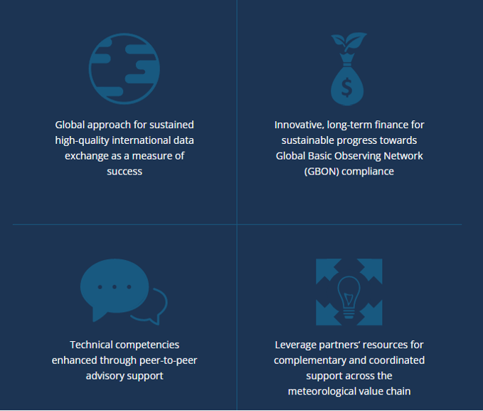
Systematic Observations Financing Facility (SOFF)
SOFF provides long-term technical and grant-based financial assistance to enable countries to acquire and internationally exchange GBON observations
It focuses on the sustainability of investments by providing open-ended result-based finance upon verification of data sharing through WMO Tools
SOFF prioritizes Small Island Developing States (SIDS) and Least Developed Countries (LDCs) to close the largest data gaps
Fast-moving: 83 $million raised, 51 countries approved for readiness funding, 11 countries in investment phase
Notes:
According to the WMO GBON Global Gap Analysis of June 2023, the more than 100 countries classified as SIDS, LDCs and LMICs deliver only 7 % of the mandatory GBON surface land data and 24 percent of the GBON upper air data.

Slide 16
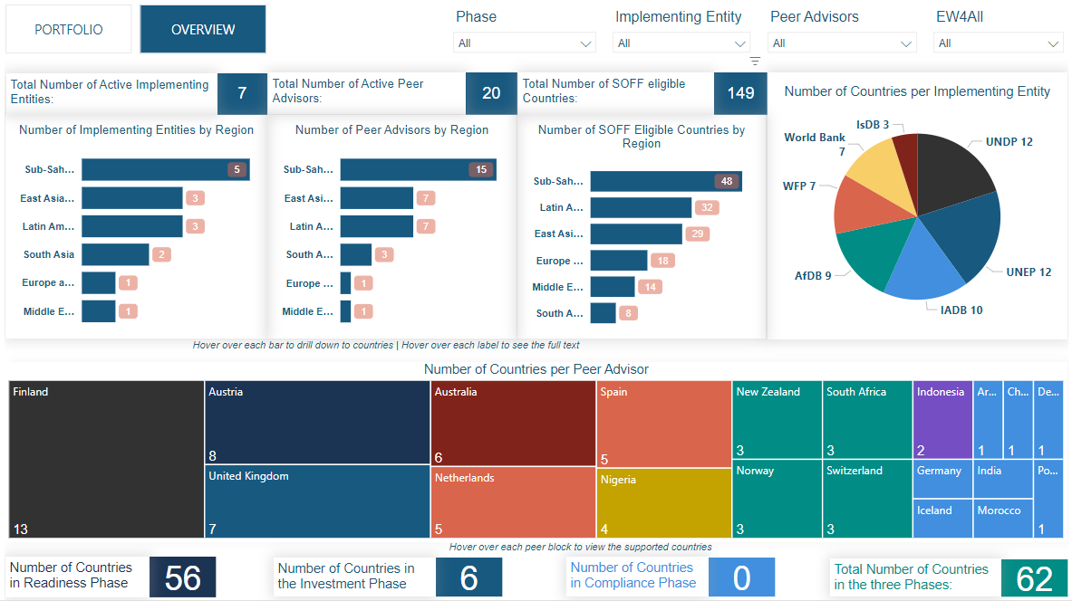
Systematic Observations Financing Facility (SOFF)

Slide 17
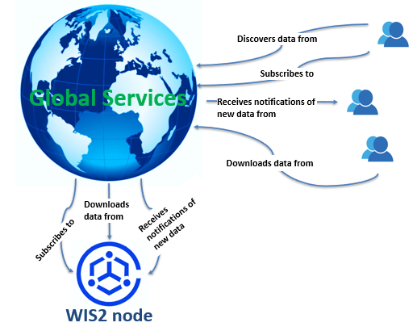
WMO Information System 2.0 (WIS2.0)
framework for WMO data sharing in the 21st century for all WMO domains and disciplines
supports the WMO Unified Data policy, the Global Basic Observing Network (GBON) and makes international, regional, and national data sharing simple, effective, and inexpensive.
https://vimeo.com/761382308

Slide 18
WIS2 / ODIS Integration
The WIS2 principles enable lowering the barrier to weather/climate/water data for WMO members. Lowering the barrier is driven by international standards for data discovery, access, and visualization
WIS2 and ODIS, data and metadata exchange is realized using Web architectural principles and approaches
to enable cross-pollination and federation.

Slide 19
WIS2 progress: Pilot Phase complete
Pilot Phase
Pre-operational
2030
2033
Operational
Pre-oper Global Brokers
2025
Pilot Global Brokers
Global Brokers operation
90% of Members migrated to WIS 2.0
Stop transition infrastructure and GTS transmission
Pilot Global Discovery Catalogue
Pre-oper Global Caches
Global Caches operation
Pilot Global Caches
2023
2022
2024
Technical Regulations
Pre-oper Global Discovery Catalogue
Global Discovery Catalogue operation
WIS 2.0
Guidelines
NCs
DCPCs
Q1
Q2
Q3
Q1
Q2
Q3
Q1
Q2
Q3
WIS2 box release 1.0
Transition Infrastructure
WIS2 Monitoring
NCs & DCPCs
NCs & DCPCs
Workshops and training
INFCOM-2
EC 75
Cg-19
EC-76
EC 77
WIS 2.0 Tech- Reg approved
Guidelines for WIS 2.0
implementation published
INFCOM-3
EC 78
technical guidance in the Guide to WIS
Report on WIS2 progress
NCs/DCPCs may stop WIS1 functions if migrated to WIS2
GISCs contributing to Global Services may stop WIS1

Slide 20
WMO Information System 2.0 (WIS2.0)
After 01/01/2025, no data will be published on WIS2, without having a metadata record in OSCAR (Observing Systems Capability Analysis and review Tool)
For any question related to WIS2 contact us in:
wis-support@wmo.int
Adobe Stock/mozZz

Slide 21
Key takeaways
Members commitment for GBON ocean compliance in EEZ
Metadata made available for OSCAR
Future GBON expansion (e.g. sea level, waves, etc.)
Engagement in the RBON design process
Data sharing transition from GTS to WIS2.0

Slide 22
Thank you.
Misaotra
Mersi
Asante
شكرا
谢谢
धन्यवाद
ឣរគុណ
Terima kasih
Cám ơn
ধন্যবাদ
mahadsanid
ขอบคุณ
शुक्रिया
நன்றி
ကျေးဇူးတင်ပါတယ်
Tubwa kõr
Tanggio
ස්තූතියි
Asante
Tangkyu
شكر
^{wmo.int}
ممنون

