Slide 1
Session 1: GOOS Update Requirements for Data
Emma Heslop, Programme Specialist GOOS, IOC/UNESC
Data Buoy Cooperation Panel (DBCP) Training Workshop on Ocean Observations for Weather Forecast and Climate Prediction.
6-8 August 2024, hosted by BMKG, Indonesia

Slide 2
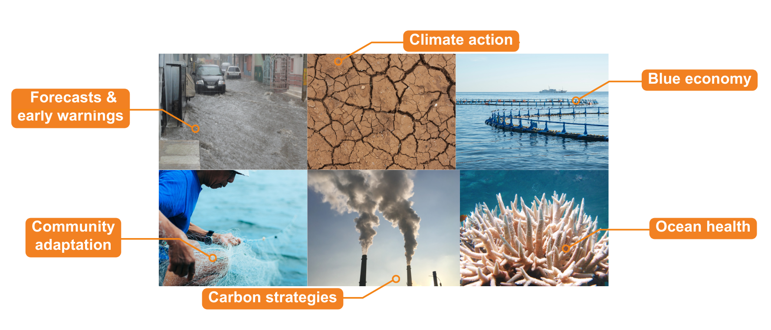
Ocean observations: fundamental to society
No one country can observe the ocean effectively on its own.
Notes:
We know that the ocean plays a huge role in the Earth’s climate, supports the livelihoods of 3 billion of the planets 7 billion population, provides food, pathways for transport, whole ecosystems, is source of biodiversity, a sink for anthropogenic carbon and heat. Ocean observations – data from the ocean – is vital our weather prediction, to hazard warnings, to predict and adapt to climate change globally, and our ability to effectively manage ocean ecosystems under the combined stress of climate change, overfishing pollution. However, the ocean is vast, processes complex, and no one country or project can cover or provide enough data to support global needs.

Slide 3
Opportunity for nations & communities
Enabling coastal communities to evolve and flourish
Supporting blue economic growth
Underpinning sustainable development
Notes:
Ocean observations underpin our adaptation to climate change and weather forecasts they are the key to the future of coastal communities being able to survive and thrive, and are the stable foundation for sustainable development and growing a diverse blue economy.

Slide 4
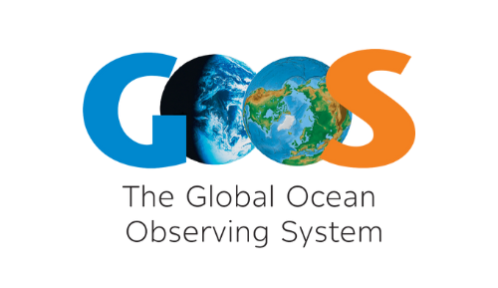
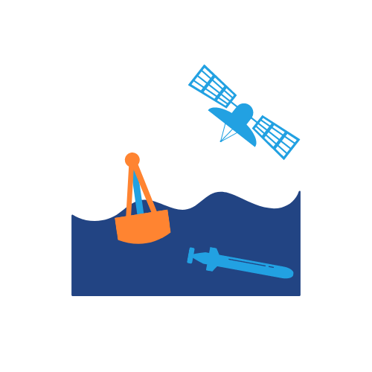
Critical infrastructure for ocean observing
Global Ocean Observing System
Ecosystem of providers Observation infrastructure
Beneficiaries of ocean information
GOOS Management Team
Coordination – Integration - Advocacy
Ocean observing community & partners
Research, Decision makers, Users, Policy, Investors
Notes:
GOOS:
Creates links and frameworks to ensure that observations meet global policy needs
Works on strengthening delivery through best practices, data and metadata standards,
Advocates for OO, ensuring governments and UN know what underpins their weather, ocean health, risk management, blue economy, reporting and decisions
Makes the partnerships to ensure ocean data is turned into actionable information

Slide 5
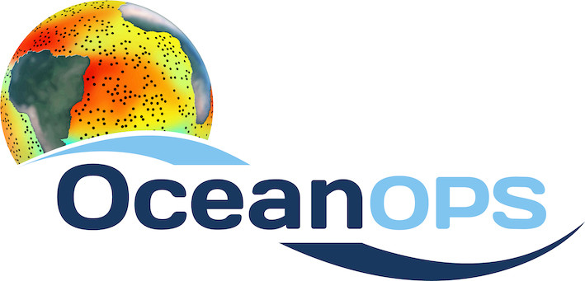
GOOS Today
84 countries, 8,400+ observing platforms
More than 120,000 observations per day - operational systems
13 mature global networks + 3 new ‘emerging’ networks 2024
12 BioEco EOV networks
“The weather forecasting systems will run off the rails if they don’t have the surface pressure information over the ocean to constrain them” - Lars Peter Riishojgaard, Director of the Earth System Branch WMO
www.ocean-ops.org/reportcard2023
Notes:
In the last 30 years, GOOS developed -
Mature networks drifting buoys, voluntary observing ships, tide gauges, Argo floats, and emerging networks; HF Radar, ocean gliders
Ocean Observing is big science

Slide 6
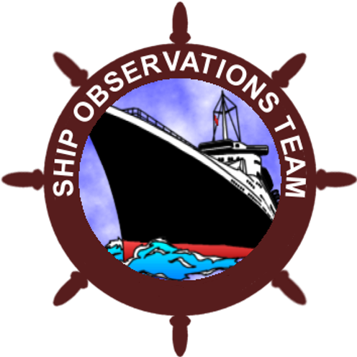
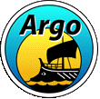
New emerging networks
FVON
SmartCables
SOCONET
www.ocean-ops.org/reportcard2023
www.ocean-ops.org/reportcard2020

Slide 7
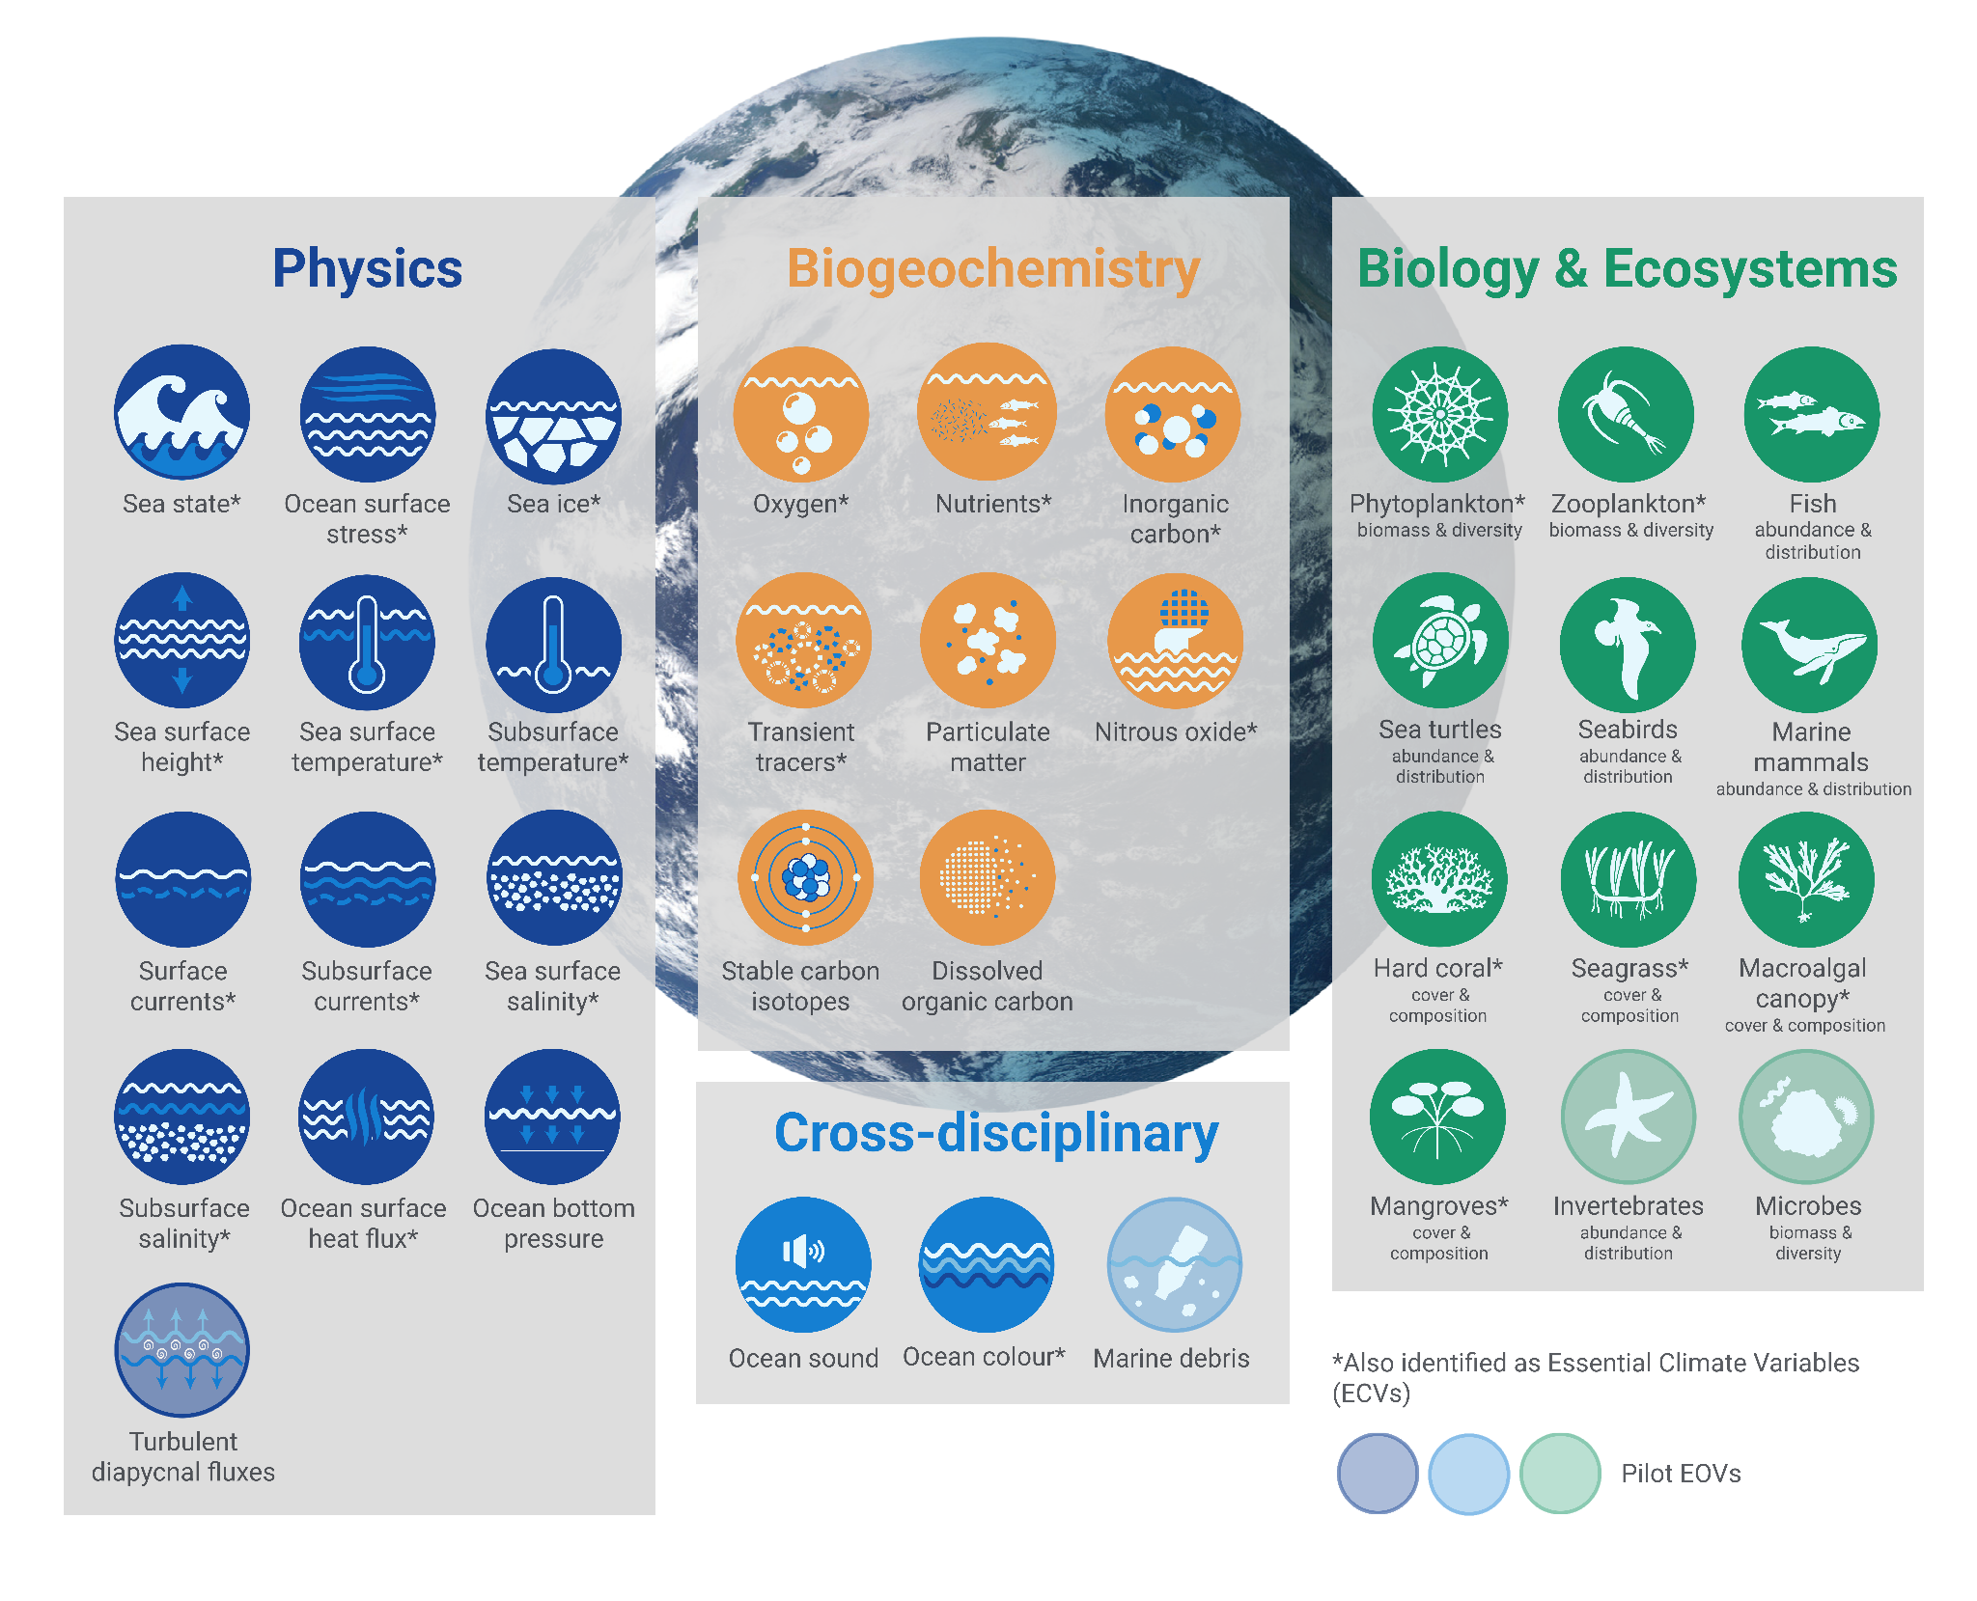
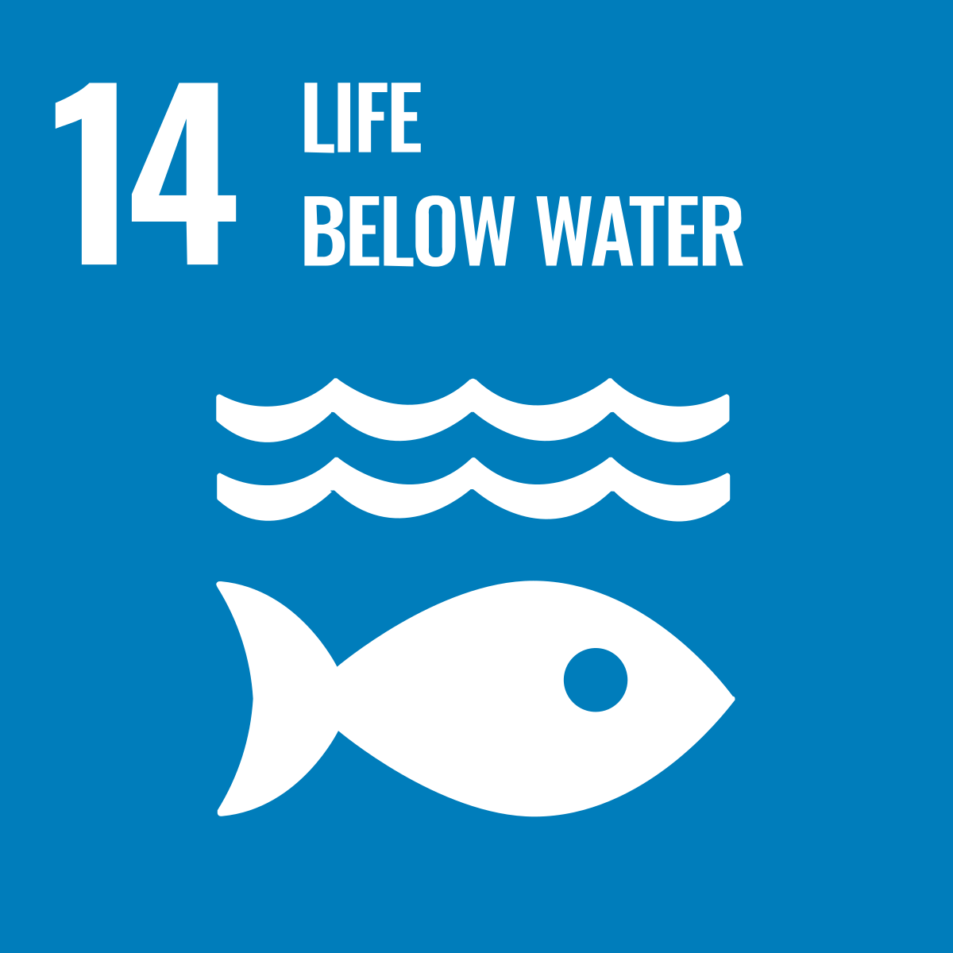
36 Essential Ocean Variables (EOVs)
Post-2020 Biodiversity Framework
International Legally Binding Instrument on Plastic Pollution 2024
+ Biodiversity Beyond National Jurisdiction
Notes:
Convention on Biological Diversity - add the post-2024 framework

Slide 8
Regional & National Alliances
SAON (Arctic TT)
EuroGOOS
CIOOS
Black Sea GOOS
NEARGOOS
US IOOS
MONGOOS
IOCARIBE-GOOS
76 GOOS National Focal Points
SEAGOOS
GOOS-Africa
IOGOOS
PI-GOOS
OCEANTLAN
GRASP
IMOS
SAEON
SOOS
Notes:
GOOS is a global network.
1) 13 GOOS Regional Alliances – all very different in governance, scope and mandate – connected to 130 countries
Orange is in the network, Green is in dialogue
CIOOS: Canadian Integrated Ocean Observing System - to adopt today!
PI-GOOS: New hosting Office at SPC (Pacific Community, Fiji)
IOCARIBE-GOOS: Special session at the IOCARIBE meeting
GOOS Africa: Africa Roadmap Ocean Decade, new opportunities for support
2) Now have 73 GOOS NFPs – person employed to support them
National Focal Points – ToRs reviewed and adopted by SC in April. First meeting Oct 2023, now 73 GOOS NFPs.
Regional and national work: in the last 2 years supported development of regional and national coordination.
With growing recognition of the role of the ocean, have a clear, revival of interest, recognition of the need and value of regional coordination and a rejuvenation of coordination in some areas:
NEED:
CORE CO-ORDINATION

Slide 9
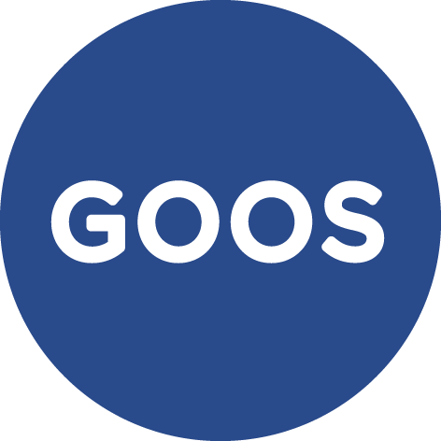
GOOS National Focal Point Role
National ocean observing system that is fit-for-purpose, integrated and sustained
National activities align nationally, regionally, and globally, lowering cost, increasing efficiency
Visibility of national ocean observing contribution to global system
Communicate with GOOS Member States and system around national needs
National advocates ocean observations
Strengthen national and global ocean observing systems
Increase efficiency and scope through cooperation and capacity sharing
Align priorities, understanding national needs, towards fit for purpose system
Next steps – building ETOOFS support
Notes:
OCG oversees implementation by coordinating activities across (currently) 13 individual global ocean observing networks. OCG. OCG also addresses data and metadata systems, standards, etc. …
Within its discipline, each of the 3 expert panels is responsible for:
Identifying and setting requirements for EOVs.
Developing sampling requirements and implementation strategies.
Guiding evaluations and assessment of the system.
Collectively GOOS (OCG and networks) try our address system integration, new technologies, and evolution of the global system.
Also perhaps in your notes you might like to identify the connections between the expert panels, the observation systems and then forecasting (slide 4) as they are all interconnected. The panels provide the supporting specifications, SOPs and best practices that the observing systems (and other networks/communities) then implement (at various levels depending on infrastructure, funding, capacity etc), with the observations collected by the systems then feeding into predictive/forecast/projection models. So while they are identified as three separate parts, they are (should be) interconnected. The three decade programs are then (at least as I understand things) meant to then extend these interconnections and facilitate broader engagement.

Slide 10
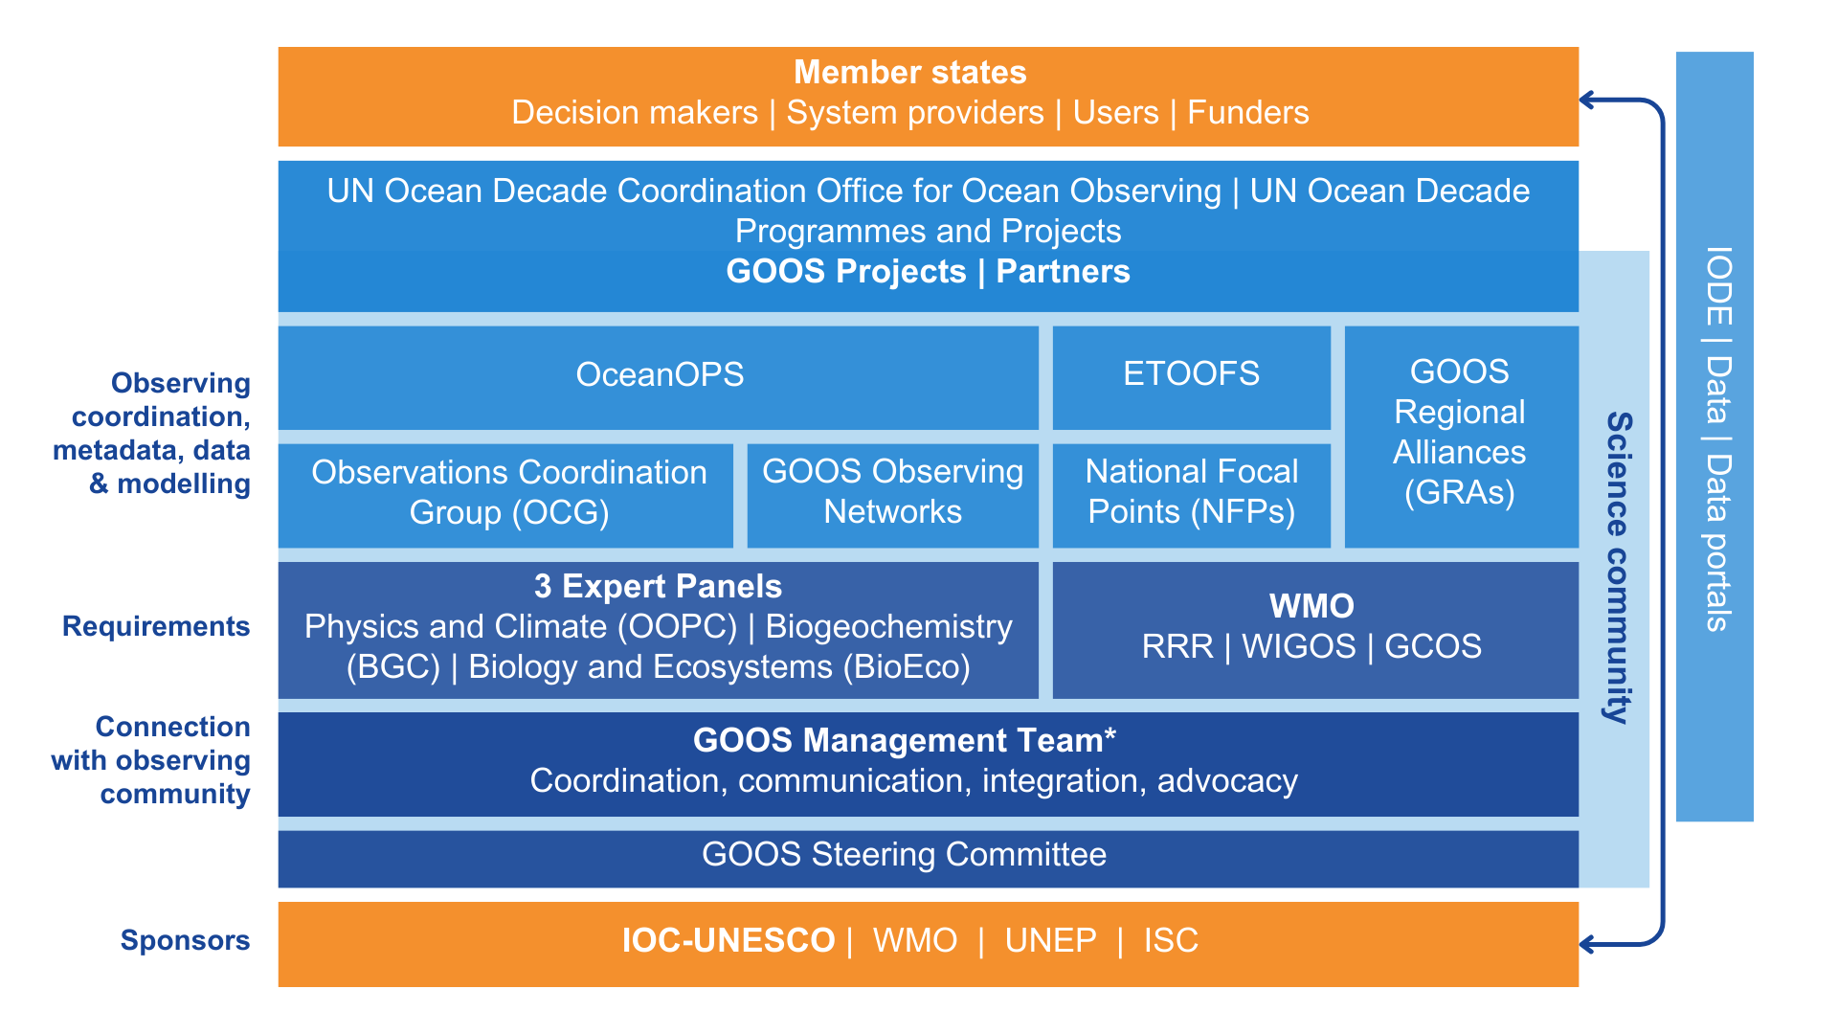
Structure
Title subtitle
* GOOS Management Team HQ based at IOC secretariat, Paris

Slide 11
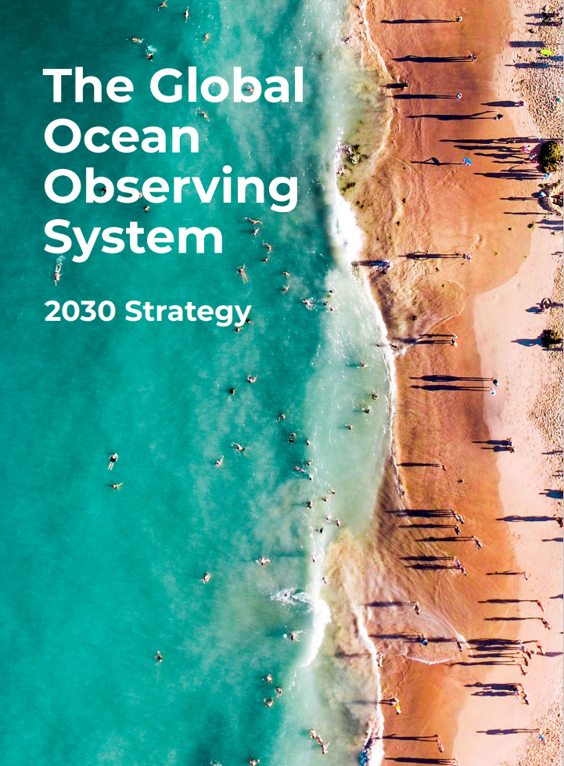
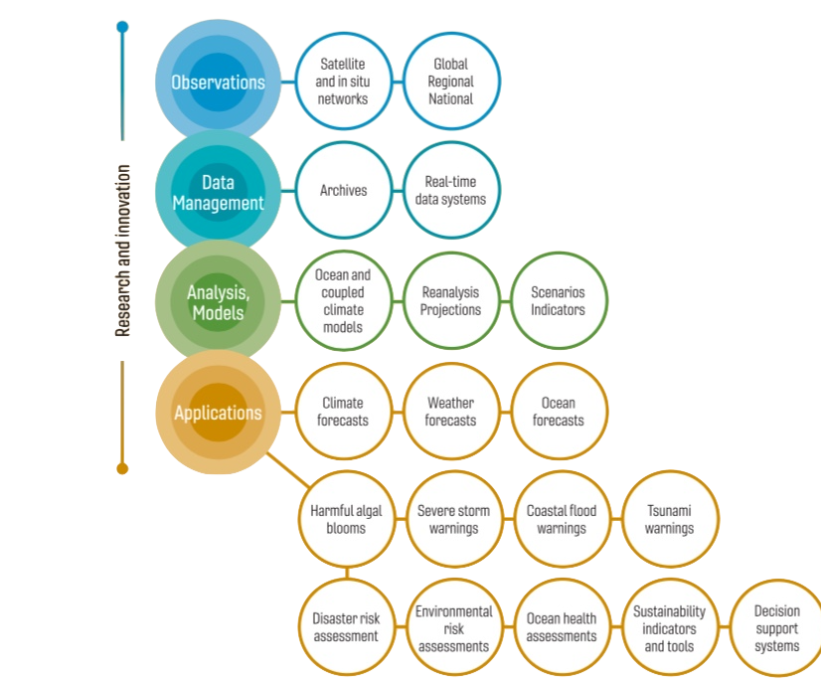
Sustained observations for a wide range of applications
Notes:
Underpinning the strategy is the ocean observing value chain, and the need for the ocean observing system – satellite and in situ - to support a wide range of applications and for partnership along the value chain to ensure that the observations are fit for purpose.

Slide 12
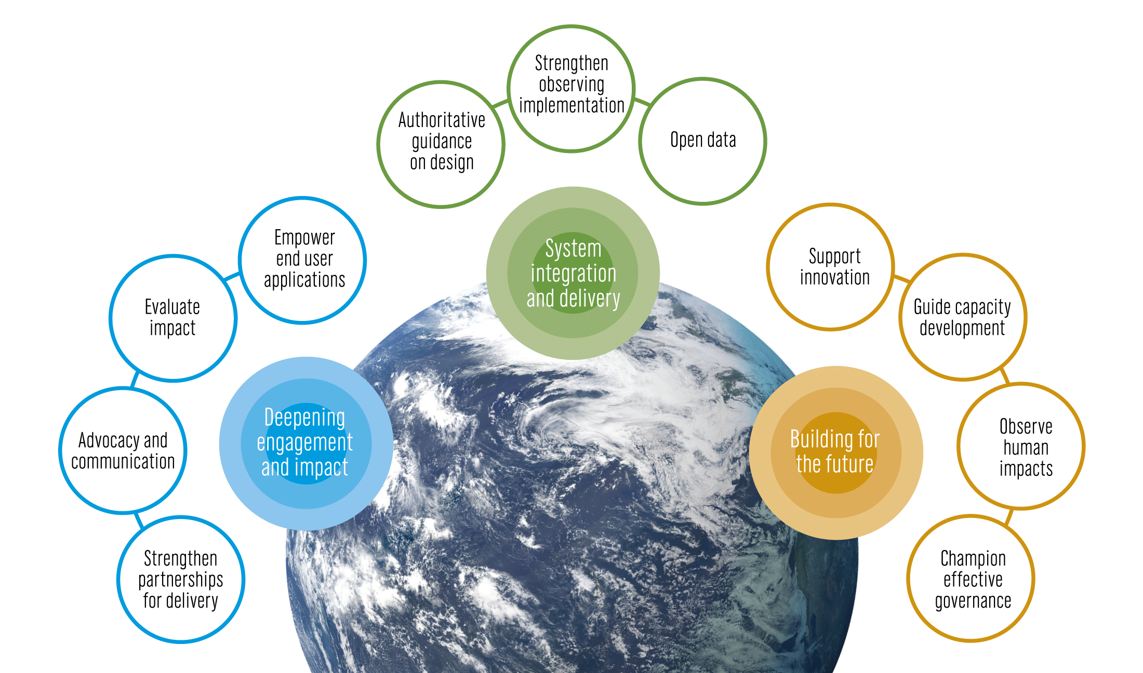
An integrated system supporting a wide range of applications
Notes:
In 2019 IOC Assembly adopted a Global Ocean Observing System 2030 Strategy which guides our our work
Here we spell out the need for a step-change in our observing capacity
GOOS and its ocean observing and forecasting communities have deep experience and knowledge, and through the work of its core components, Decade Programmes, and initiatives, GOOS is the hub where global expertise gathers to define priorities and action.
System integration and delivery are the ‘core’ of GOOS ‘business’ today
Deepening engagement and impact are key priorities, only achievable with strong support of our 4 sponsors and partnership with key stakeholders

Slide 13
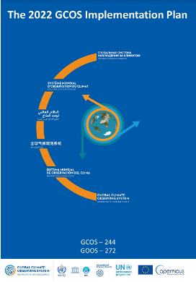
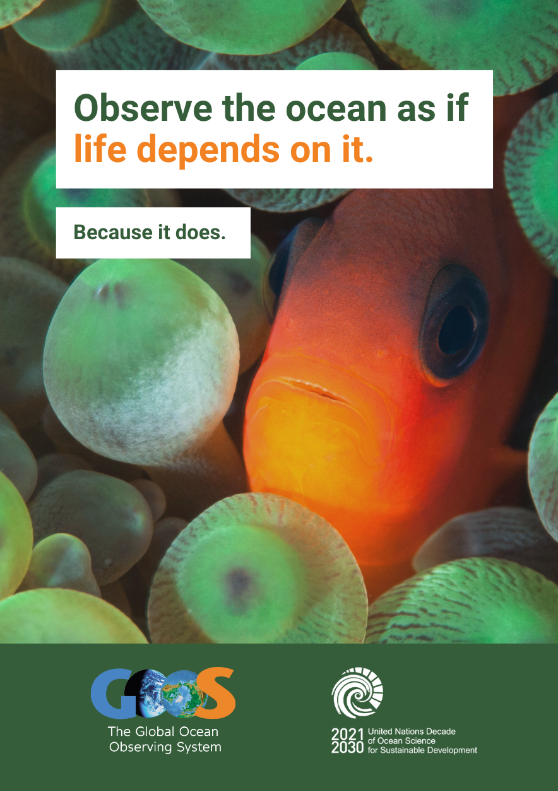
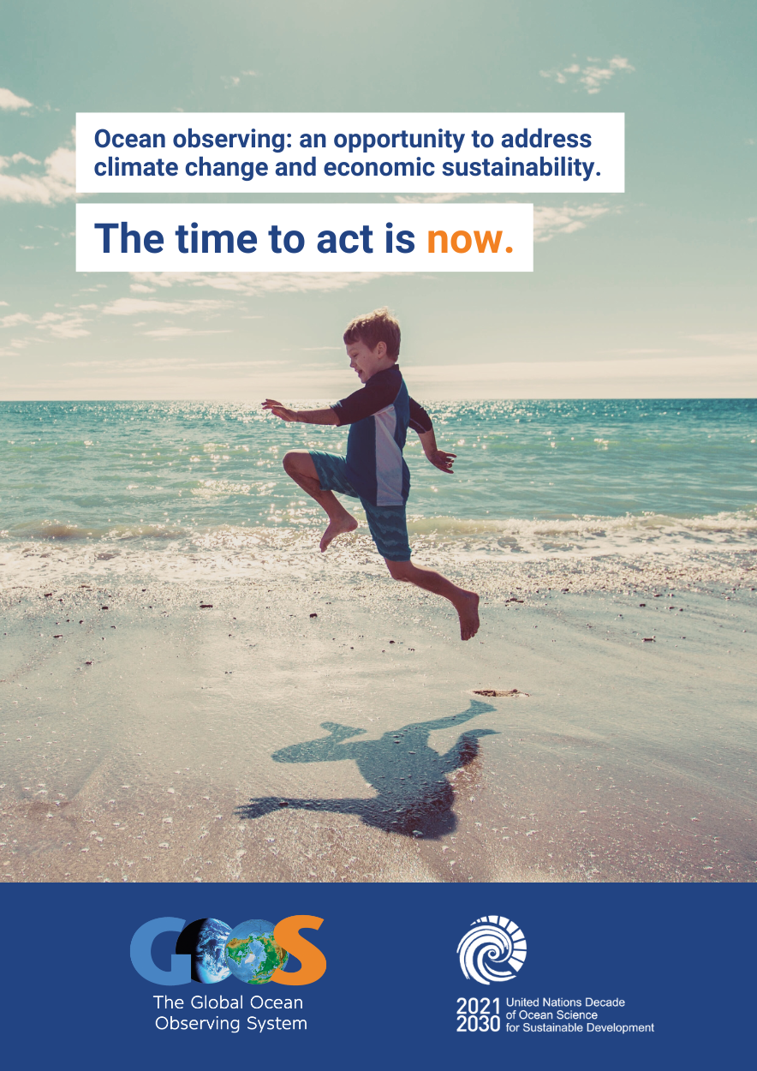
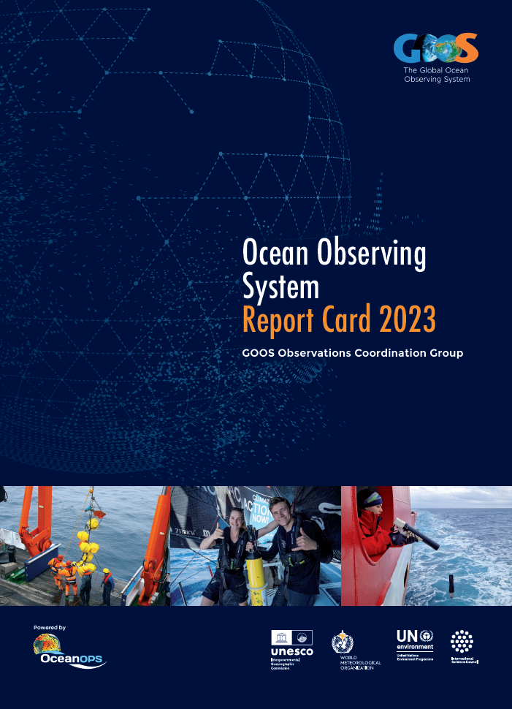
Advocacy within
United Nations
Implementing GOOS Communication Plan
Strengthened partnerships
2000+ mailing list subscribers
Articles and stories from the observing system
Flagship annual Report Card
Notes:
Implementing GOOS Communication Plan: Since August 2022, with a focus on both community and supporters/users, clear messaging and channels. Ocean Observing System Report Card is now fully cross GOOS.
Advocacy within UN: Increasing recognition of observing system and GOOS (e.g., Ocean Conference, COP27 and COP15).
Strengthened partnerships: WMO connection developed to the Rolling Review of Requirements, IODE and data, GCOS - ocean component of the GCOS Implementation Plan - work to strengthen with UNEP, GEO BON, MSP, and others.
Change: Building understanding need for ocean observing and GOOS - through consistent and clear messaging across communications and advocacy. We have adopted a professionally developed Communications Plan last August that channels and focuses our communications on both our observing community and on the supporters, users and funders (broader audience) on the observing system.

Slide 14
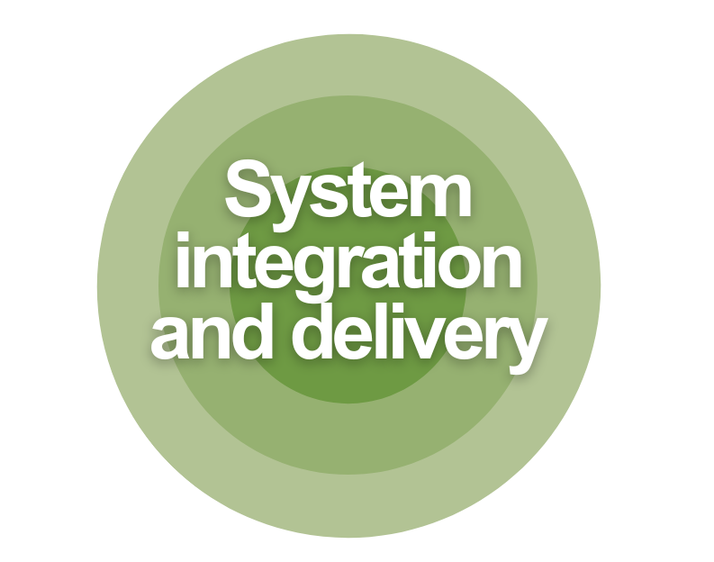
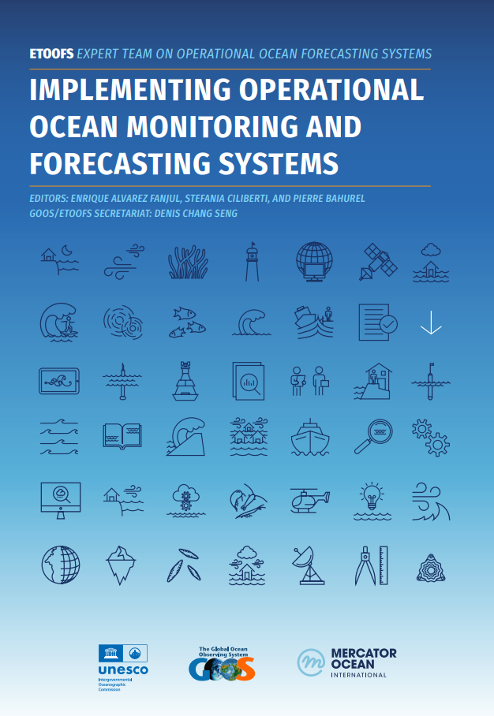
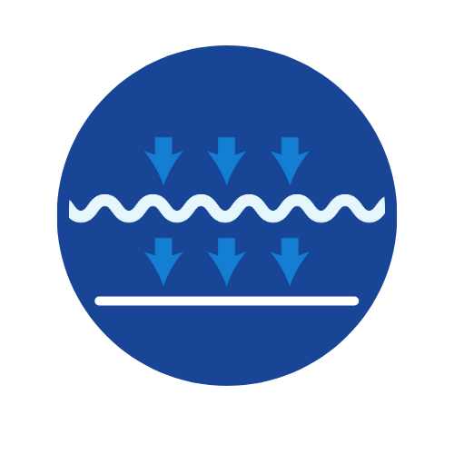
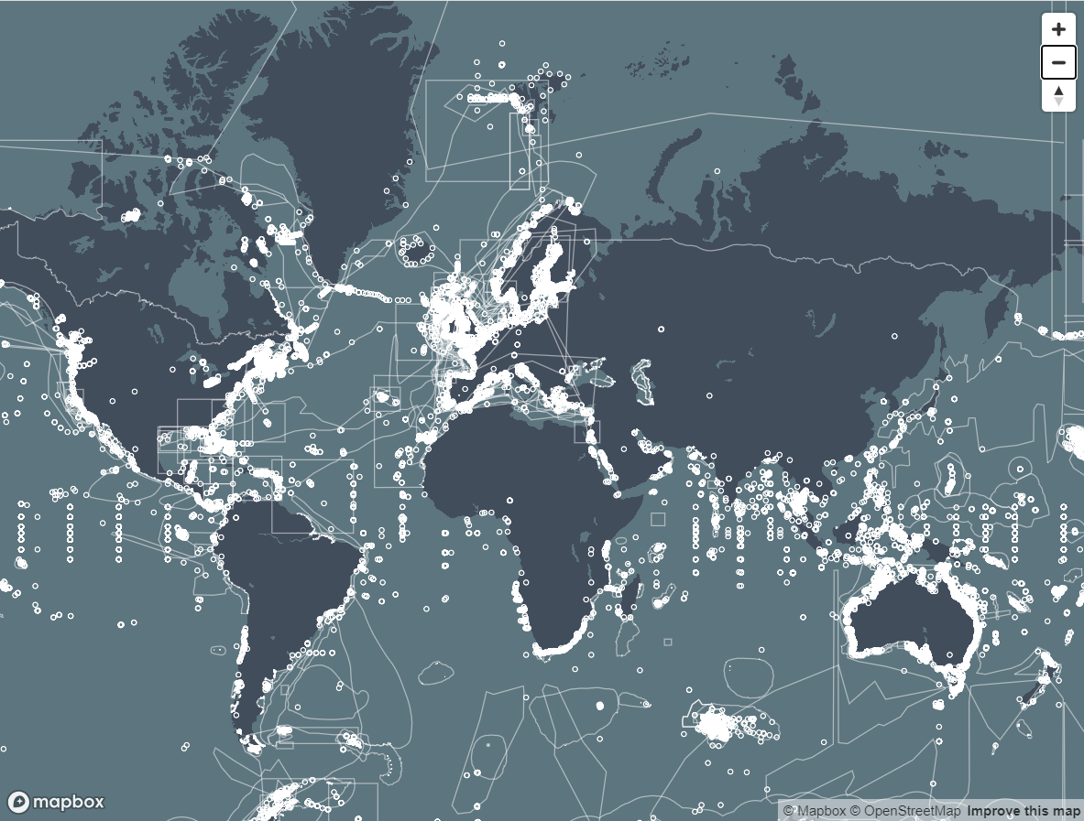
Structure & Standards
User focus – connecting down the value chain
Digital Ecosystem
Essential Guide to Operational Ocean Forecasting
36 Essential Ocean Variables
10 GOOS Endorsed best practices
GOOS Network Data Implementation Strategy
New BioEco Portal
GOOS-IODE-Decade Data Meeting – Sept 2024

Slide 15
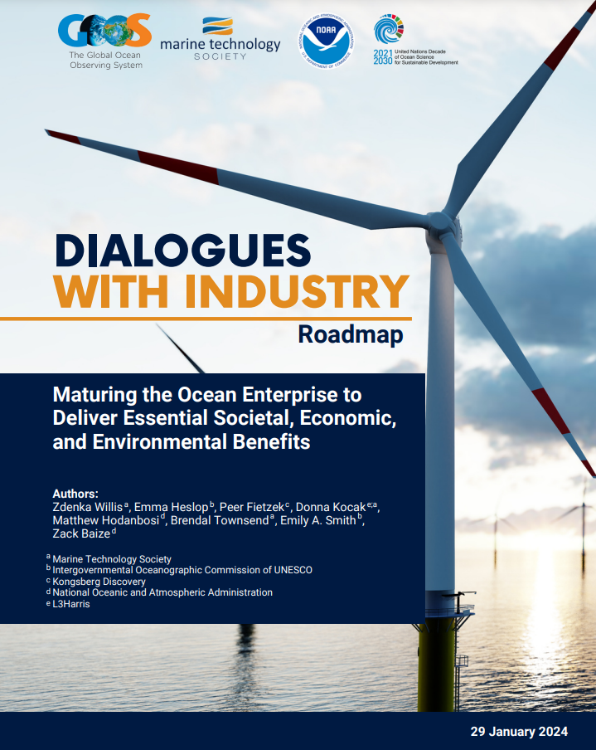
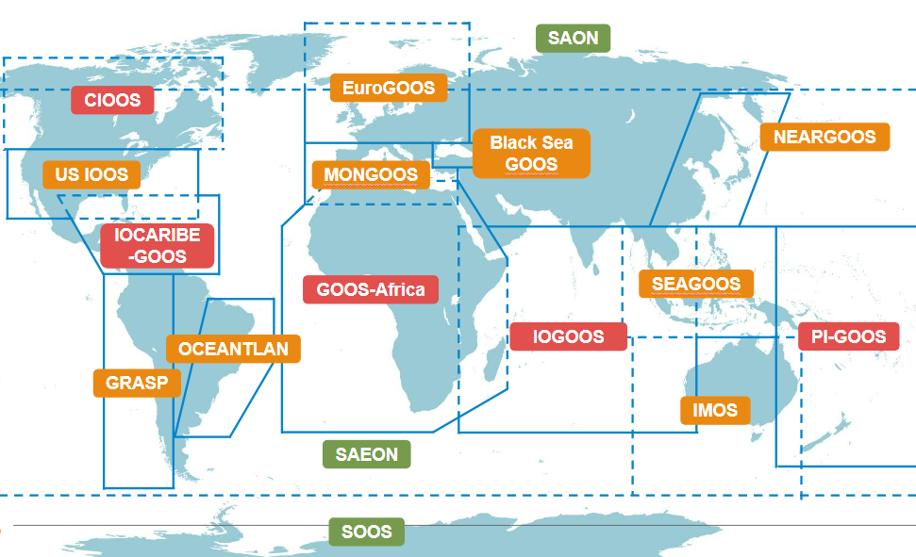
Collaboration with private sector
Tracking human impacts
National Focal Points & Regional activation
Ocean Enterprise Initiative government-industry-science
collaborate to be recognised & to grow
3 Essential Ocean Variables
76 GOOS National Focal Points
4 GRA regions being reinvigorated Africa, Caribbean, Pacific Islands, Indian Ocean
Marine debris
Ocean colour
Ocean sound

Slide 16
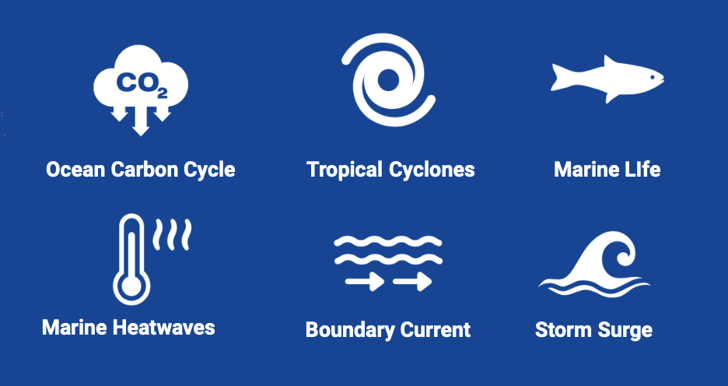
Decade Coordination Office – Ocean Observing
11 Ocean Decade Programmes
91 Projects
30% Ocean Decade Actions
Connection across the Decade
Connecting observing-modeling-users
Co-Design to address challenge areas
6 Exemplar Projects
Establish investment priorities & make ocean information relevant
GlobalCoast
125+ Pilot Sites
65+ countries
Revolutionise global coastal observing and forecasting
Ocean Decade Challenge 7
Vision 2030 White Paper
https://oceanexpert.org/document/33599
Notes:
Finally, GOOS is very active in the Ocean Decade, using this to help transform GOOS, implement the 2030 Strategy and Ocean Decade - :
The Co-Design programme is tackling key areas in which we need more observations using co-design process with modelling and with users to ensure the observations are optimised, we can express their value, and reach their targets as services. There are 6 ‘first off the block’ Co-Design Exemplar Projects with several now maturing towards pilots including tropical cyclones, boundary currents, marine heatwaves and ocean carbon.
CoastPredict aims to revolutionize coastal observing, forecasting and service delivery, and GlobalCoast is the overarching implementation project, and has identified more than 120 pilot sites across the globe, covering 30 oceanographic regions and 65 countries.
Ocean observing is important to the Ocean Decade, it will underpin work towards a sustainable future and work of the other 9 challenges, expanding ocean observations is vital to the work of the Ocean Decade. GOOS supports the Ocean Decade Coordination Office for Ocean Observing (also supported directly by the Ocean Decade). This Decade Coordination Office for Ocean Observing connects and supports the ocean observing programmes - and this is quite a big job - there are 11 Programmes, 91 projects, which represents fully 31% of all Ocean Decade Actions. The DCO for Ocean Observing also connects to similar bodies for modelling and data to connect flow of data and information
GOOS will continue this transformative work with the Ocean Decade, but also looking to transforming GOOS and be an integral part of GOOS work in building for the future.

Slide 17
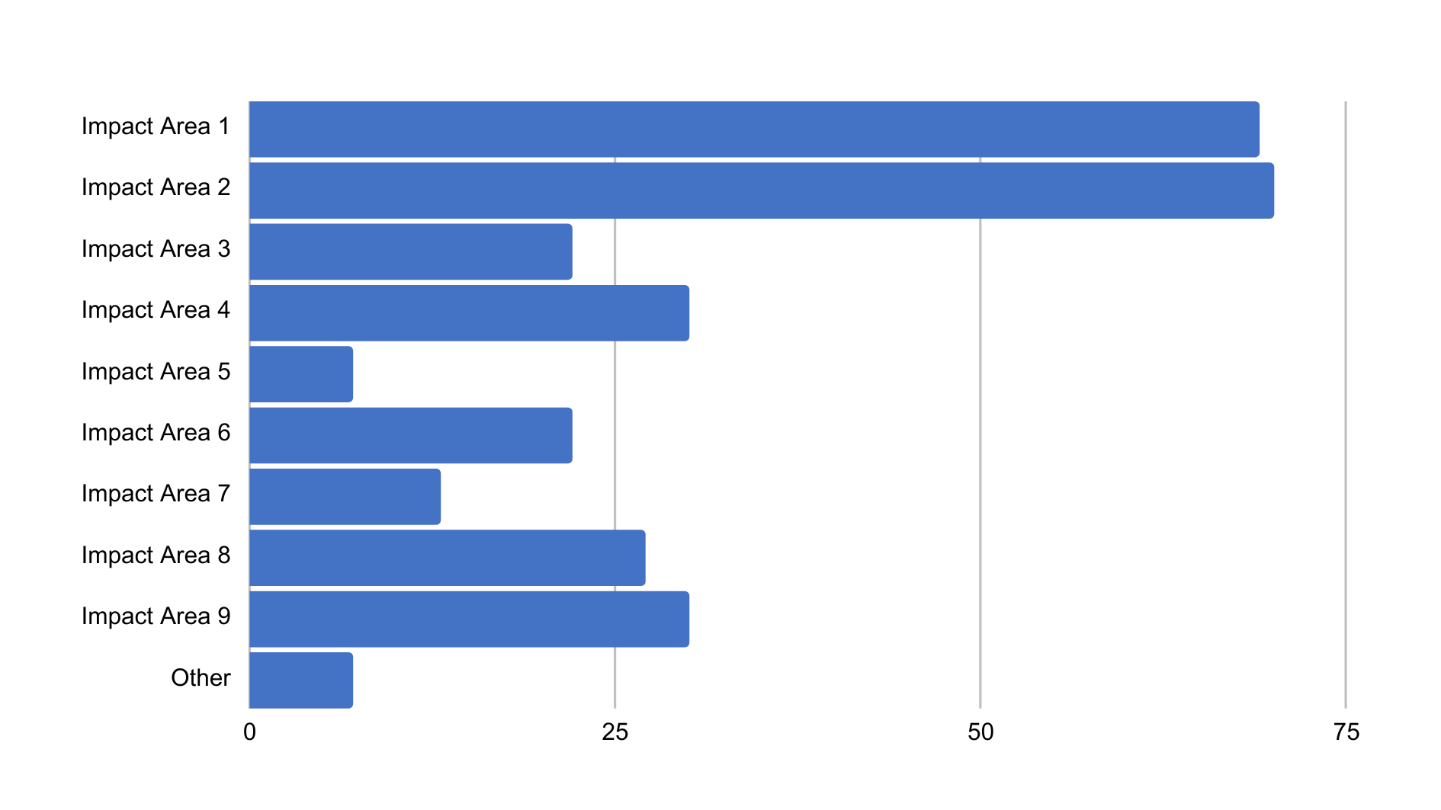
PRIORITY IMPACT AREAS
Q: Select up to three impact areas that will be addressed in your Pilot Site
IMPACT AREA 1
Capacity in disaster risk reduction - real-time forecasting of extreme events
IMPACT AREA 2
Support adaptation to/mitigation of impacts of climate change on coasts incl. indicators of sea level, temperature, biochemistry, biodiversity
IMPACT AREA 3
Prevention/mitigation of pollution impacts - hazard/risk mapping & forecasting at coastal scales
IMPACT AREA 4
Minimise climate & shorter-term impacts on morphodynamics
Improve urban oceanography science & planning
IMPACT AREA 5
Reduce impact of climate change through blue carbon monitoring, carbon dioxide uptake enhancement, NBS, ecosystem restoration
IMPACT AREA 6
Sustainable food production through coastal mariculture support system
Increase capacity on environmental awareness for all operations at sea - maritime safety, Search and Rescue
IMPACT AREA 7
Improvement in Integrated Coastal Zone Management & / or
Marine Spatial Planning
IMPACT AREA 8
IMPACT AREA 9

Slide 18
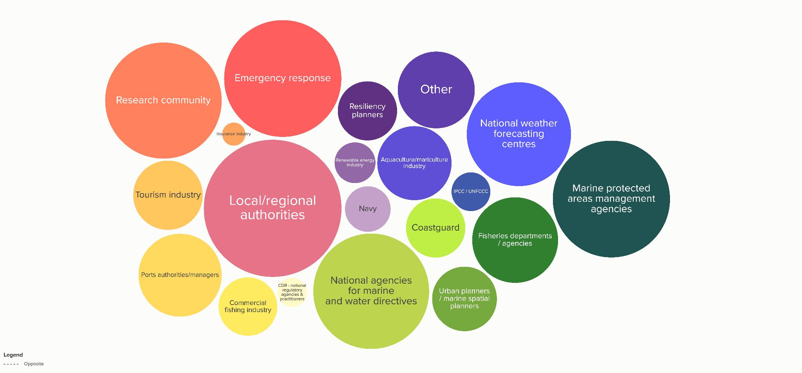
STAKEHOLDER GROUPS
Q: Who are key intermediate and end-users for the integrated observing & predicting system in your Pilot Site?
IMPACT AREA 1
IMPACT AREA 4
IMPACT AREA 5
IMPACT AREA 6
IMPACT AREA 7
IMPACT AREA 8
IMPACT AREA 9

Slide 19
GOOS Data Strategy
Notes:
Focus areas for the next period:
Communications and advocacy
Regional coordination
UN Ocean Decade - Co-Design
Evolving GOOS Governance - key 2023
AND
Strengthening GOOS core support is absolutely vital

Slide 20
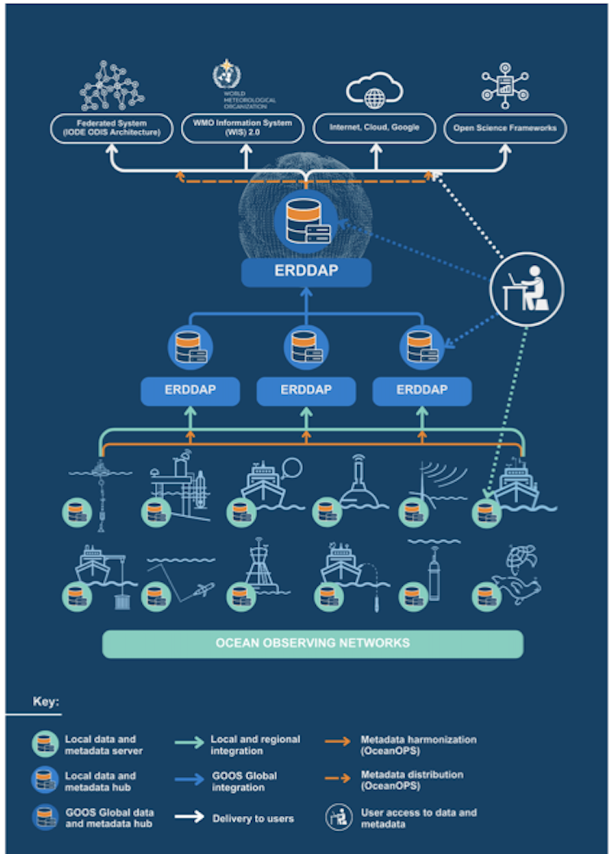
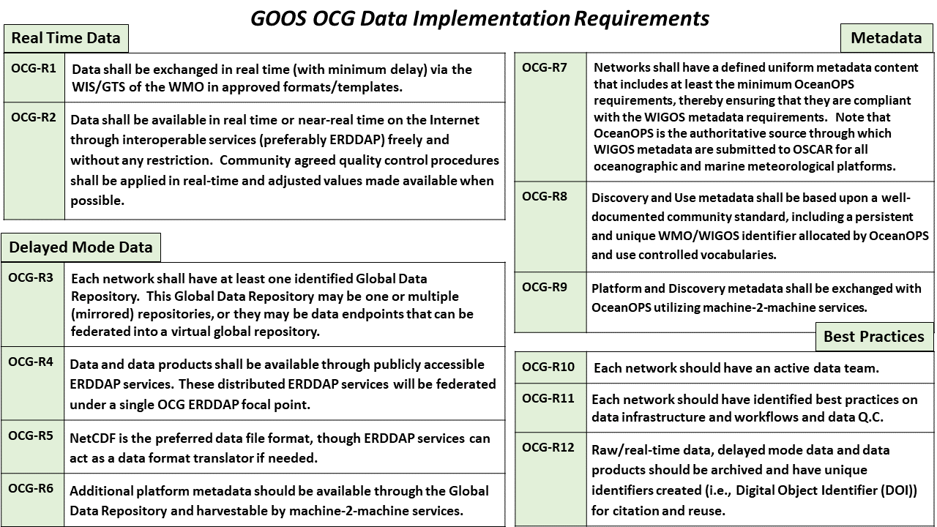
Cross-Network Data Implementation Strategy - 2024
This Implementation Plan is an effort to define specific and actionable ways OCG network/programs can move towards FAIR compliance
Improve (meta)data discovery, exchange, accessibility and usability for all stakeholders
Improve access to distributed (meta)data endpoints through federated, uniform data services

Slide 21
Tracking Progress towards Implementation

Slide 22
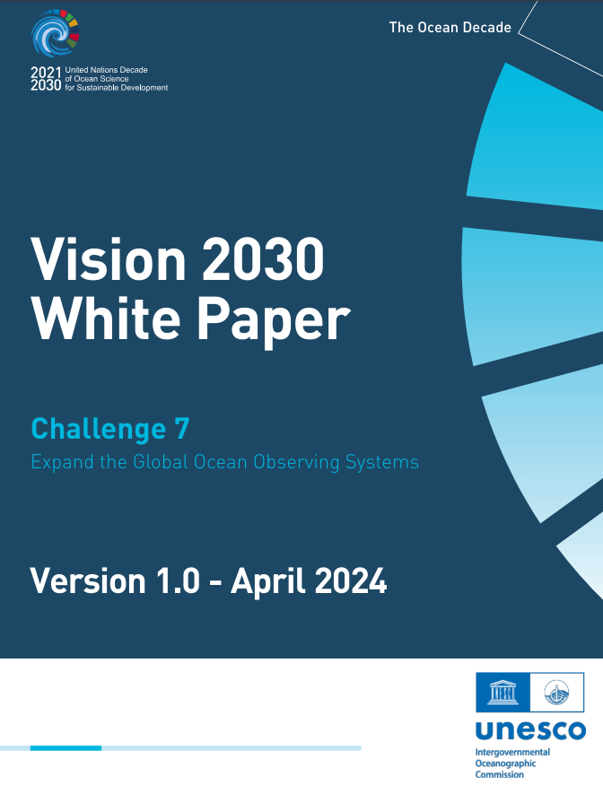
Integration with/responding to:
WMO Data Policy, WIS 2.0
UN Decade Data Strategy
IODE Data Policy, ODIS Architecture, OBIS & BioEco Portal
GOOS Digital Ecosystem Strategy – Workshop Sept 2024
'Create a functioning Digital Ecosystem to enable end user applications’ IOC Executive Council June 2024

Slide 23
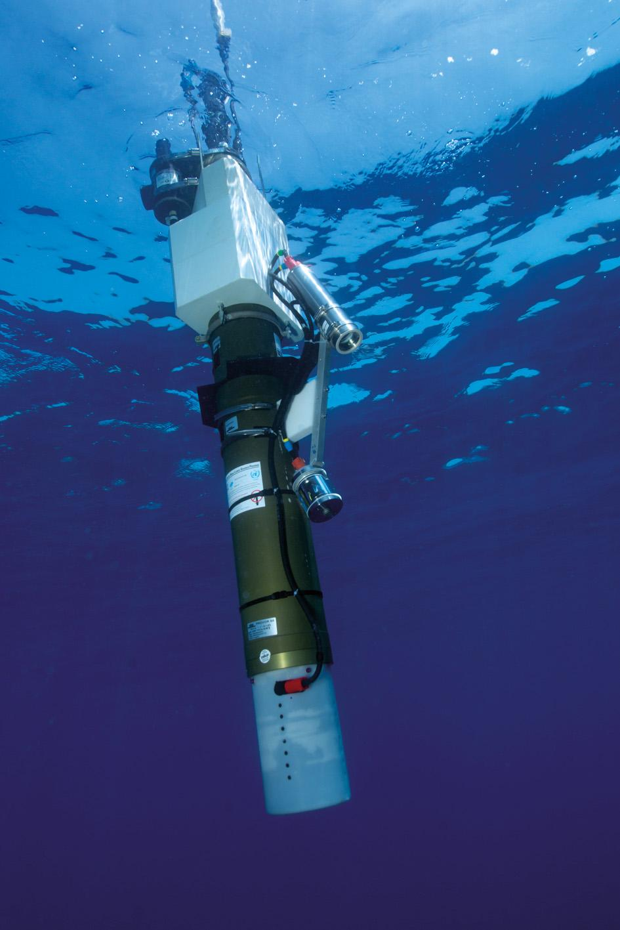
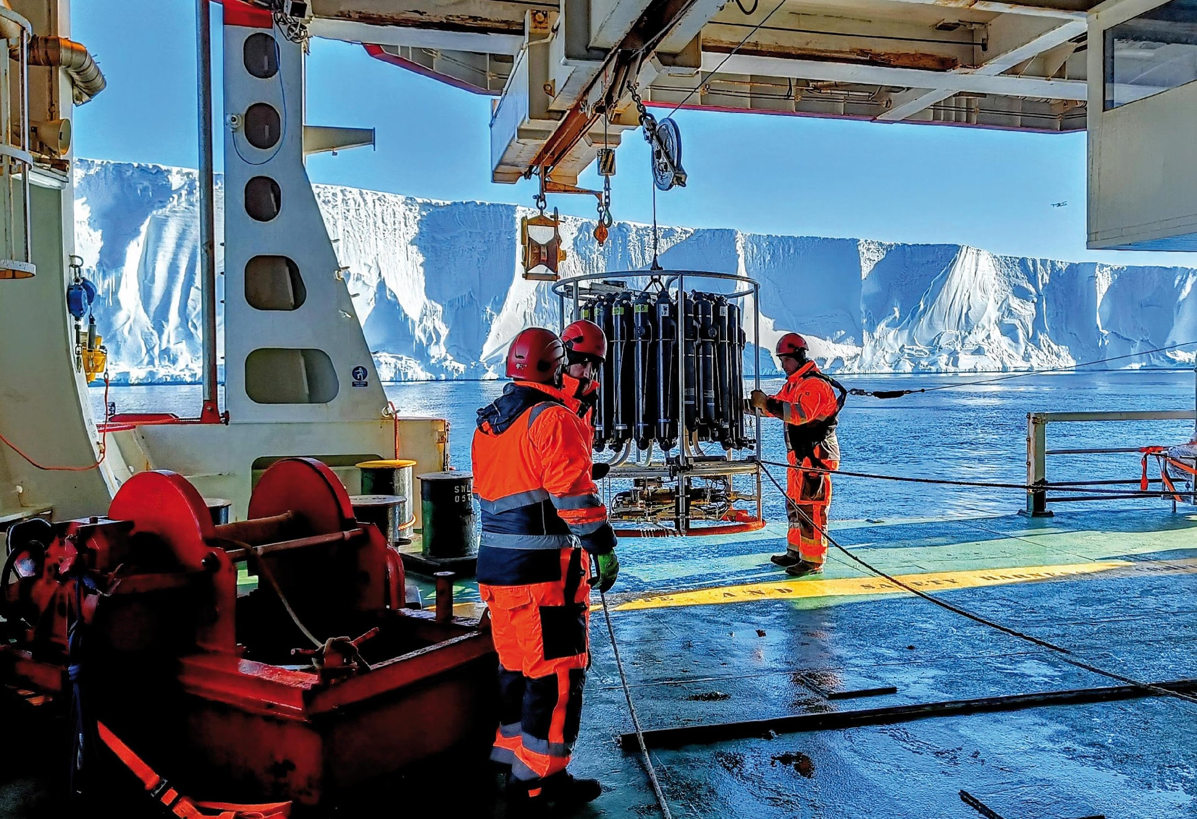
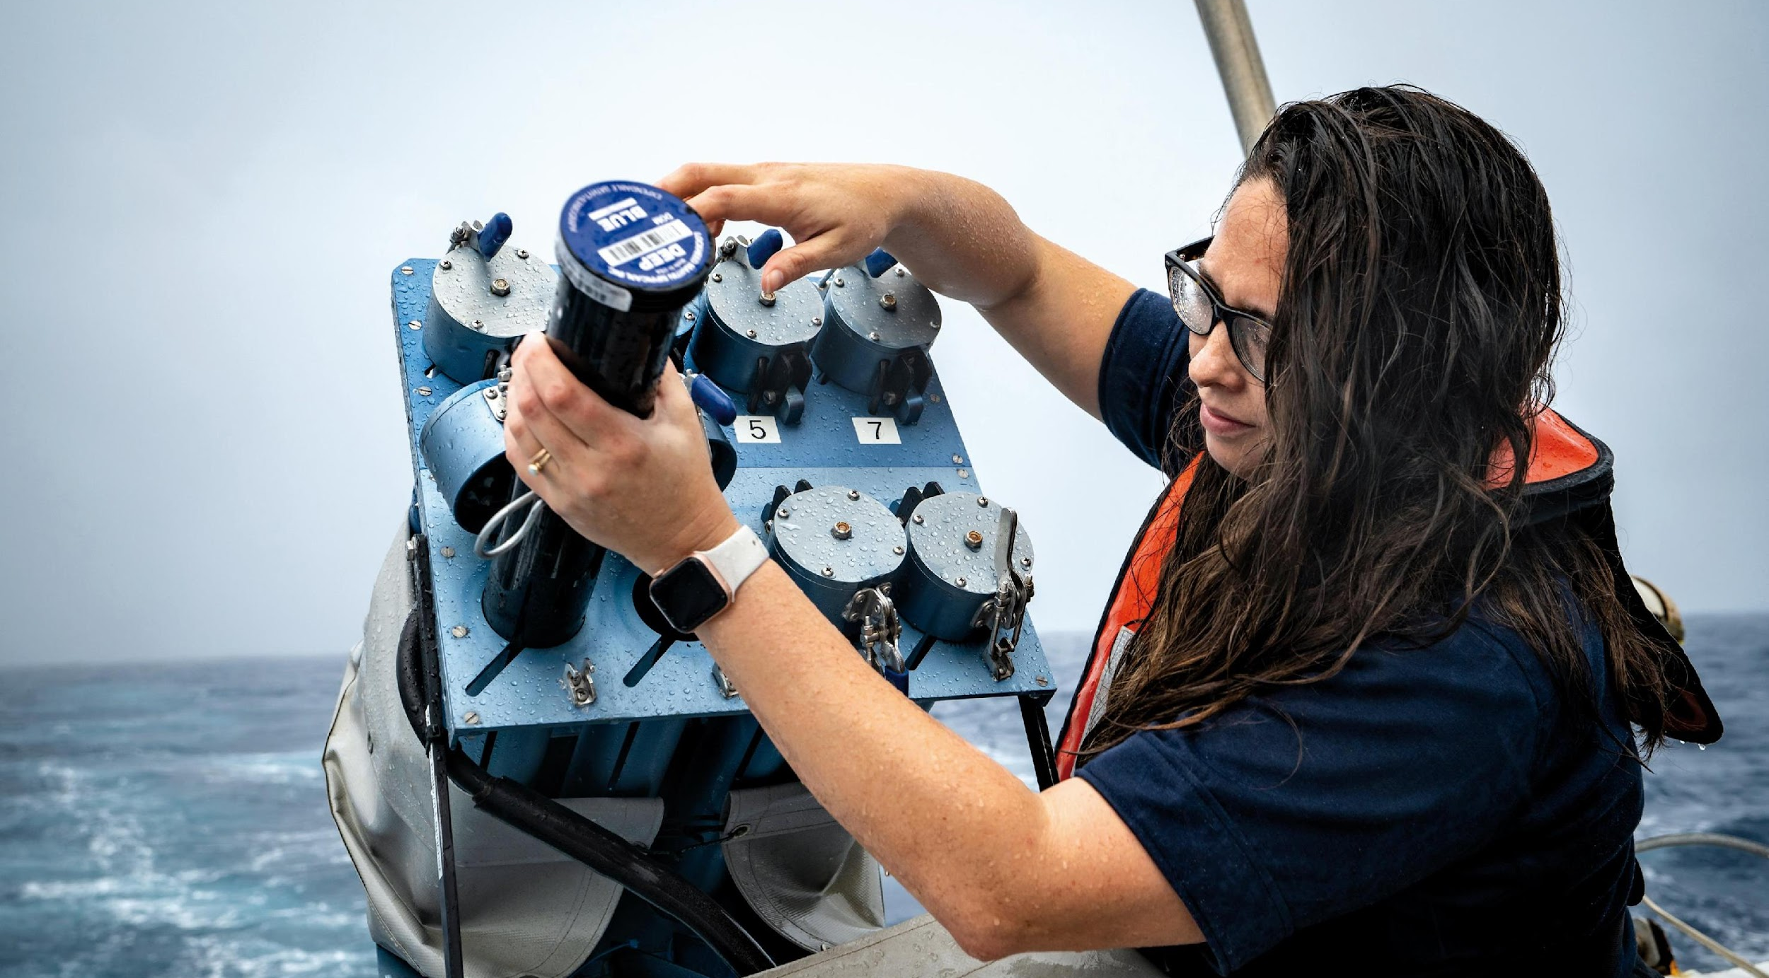
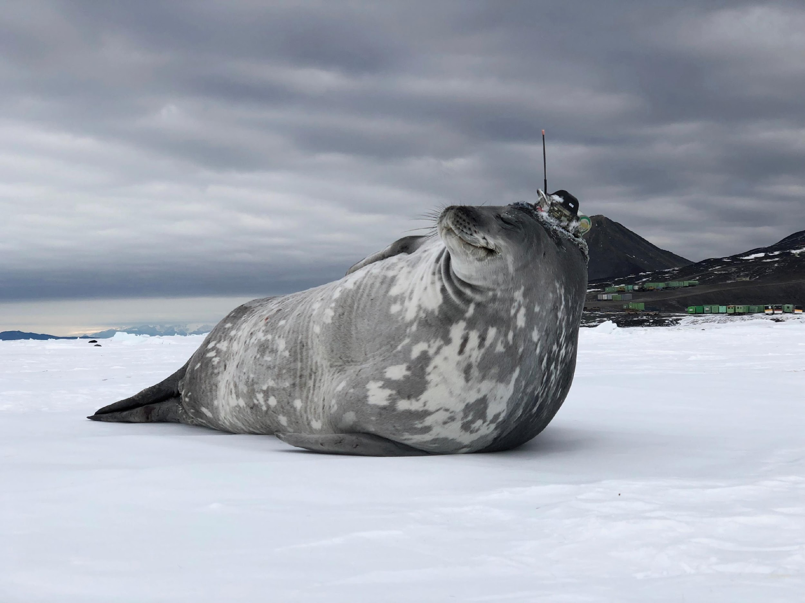
Thank you
Revolutionise global coastal observing and forecast
Revolutionise global coastal observing and forecast
goosocean.org

Slide 24
A sustained and sustainable critical ocean observing infrastructure
From the coast to the open ocean – From the surface to the sea floor
national – regional – global
Co-designed ocean observing system for operational services, as well as research
FAIR data for the Essential Ocean Variables with clear standards, QA and QC
Equitable, federated global ocean digital ecosystem and data community
Global, regional and national coordination, integration and advocacy
Build new economic thinking, literacy, capacity, innovation and partnerships
Notes:
Why do we need to strengthen and evolve GOOS?

Slide 25
Executive Council 57 Decision:
Proposal for Assembly 2025 and ongoing outreach
A first step – is a proposal for assembly 2025 – whilst building coordination, integration and advocacy
Proposal for evolving GOOS (outlining what needs to be done as a first step)
Focus GOOS to be fit for purpose to meet the needs of Member States
Review components and revise TOR, as well as MoUs with sponsors and partners
Create a functioning Digital Ecosystem to enable end user applications
Evolve a user and uptake strategy
Determine a process to set a new GOOS strategy synergised with Decade Challenge 7 and across IOC proceses
Management Team
Coordinate and advocate international, regional and national support and engagement, with clear communications and process
Continue to engage with Member States and other stakeholders for transparency and support

Slide 26
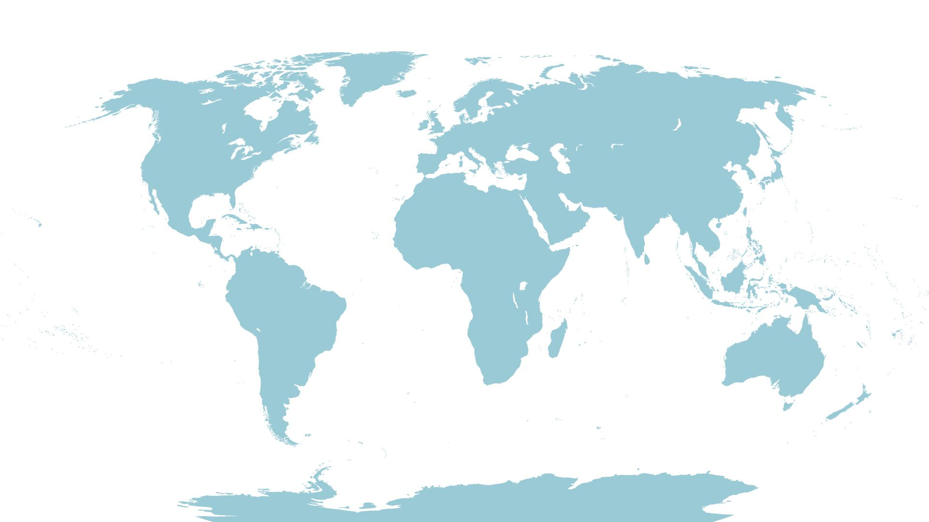
Co-design Pilot Areas
Notes:
Suggested pilot areas for Ocean Obs Co-design
Looking forward to working with regions

Slide 27
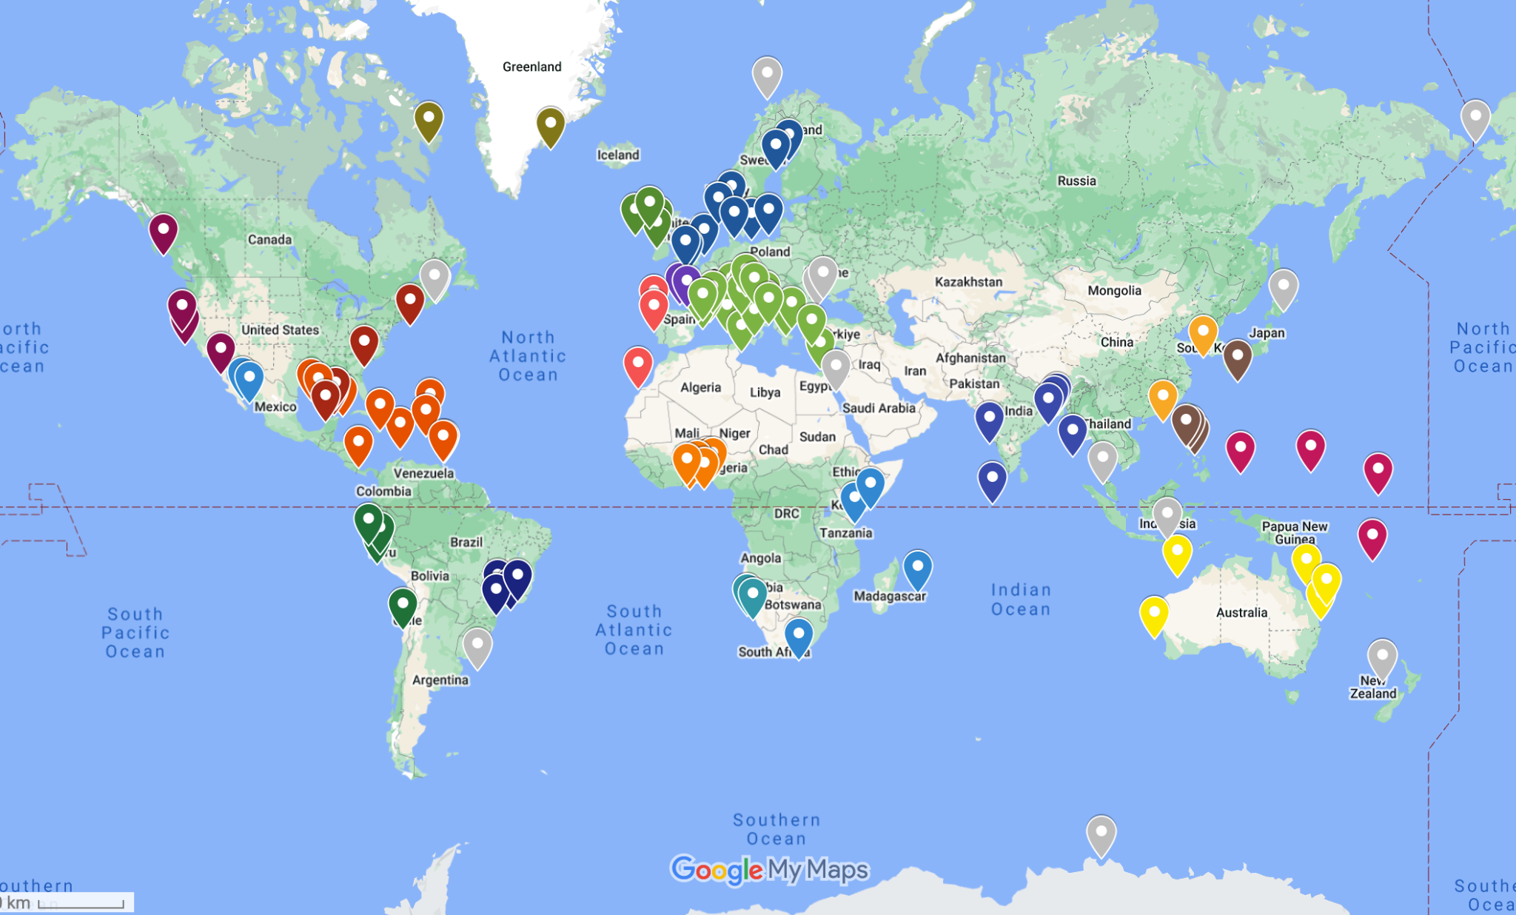
CoastPredict Pilot Site locations
30 Regions
> 125 Pilot Sites
225 institutions in
65 countries

Slide 28
Vision 2030 White Paper
Ambition: a clear roadmap to achieving a sustainable, co-designed, fit-for purpose, multidisciplinary, and geographically expanded global ocean observing system that delivers accessible data to all nations and users.
Access here:
https://oceanexpert.org/document/33599

Slide 29
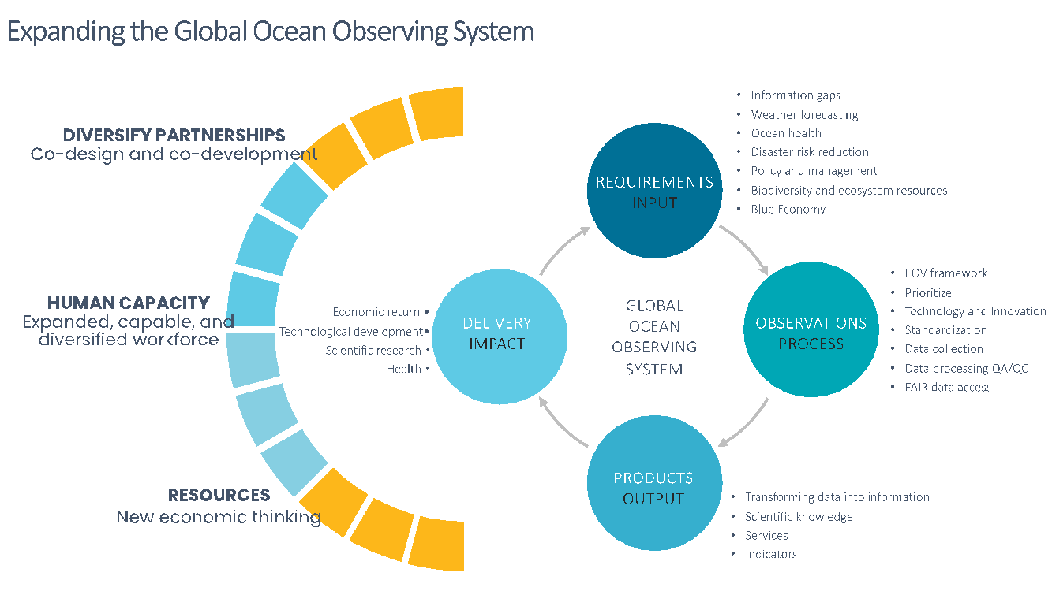
Vision 2030 White Paper
Recommendations include expanding global ocean observation capabilities, the translation of observations into information, fostering diversified partnerships, building a capable and diversified workforce, and emphasising a new economic thinking for resourcing ocean observing
https://oceanexpert.org/document/33599

