Slide 1
DBCP Training Workshop on Ocean Observations for Weather Forecast and Climate Prediction
6-8 August 2024, BMKG, Indonesia
Data Buoy Cooperation Panel
and OceanOPS
JIANG Long, Technical Coordinator
(ljiang@ocean-ops.org, ljiang@wmo.int)

Slide 2
OUTLINE
Data Buoy Cooperation Panel
Data
Buoy
Cooperation
Panel
OceanOPS

Slide 3
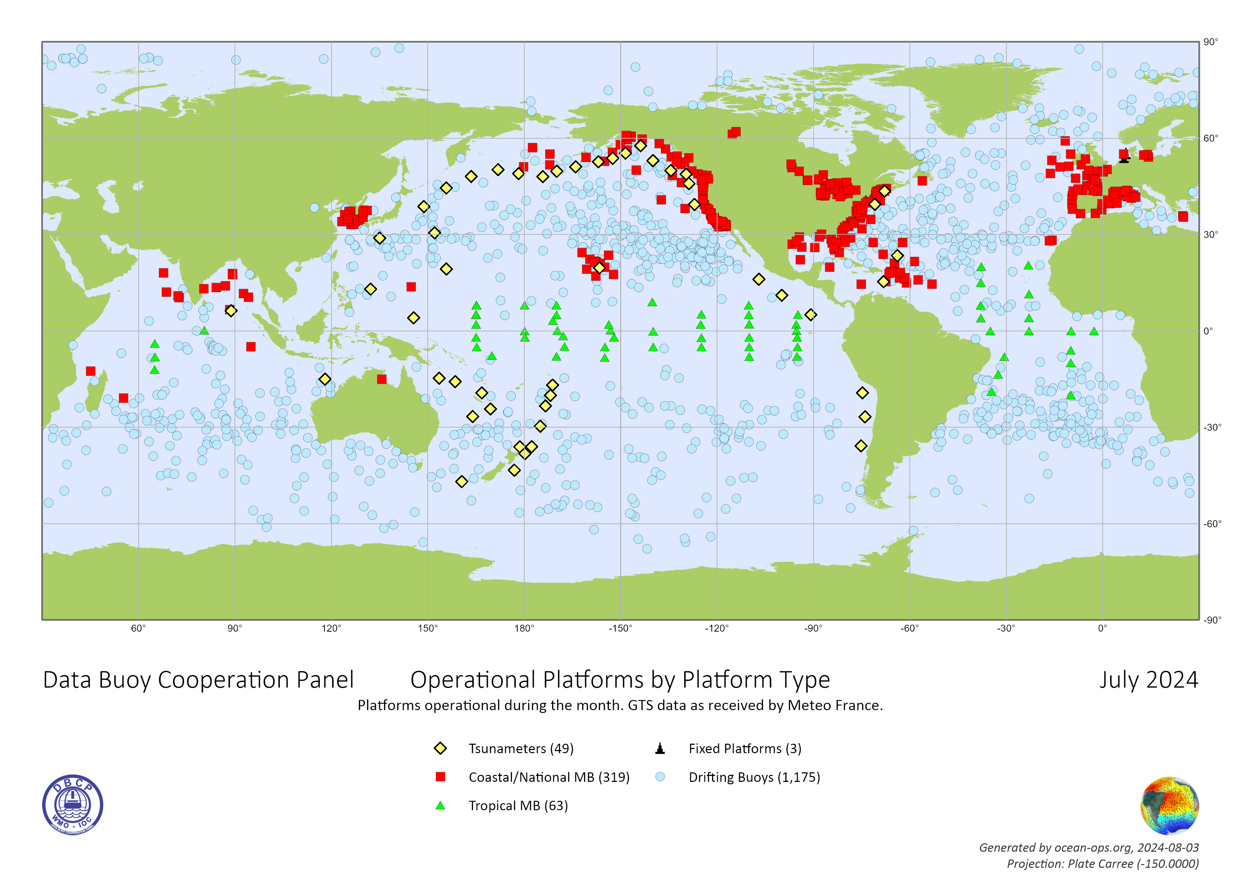
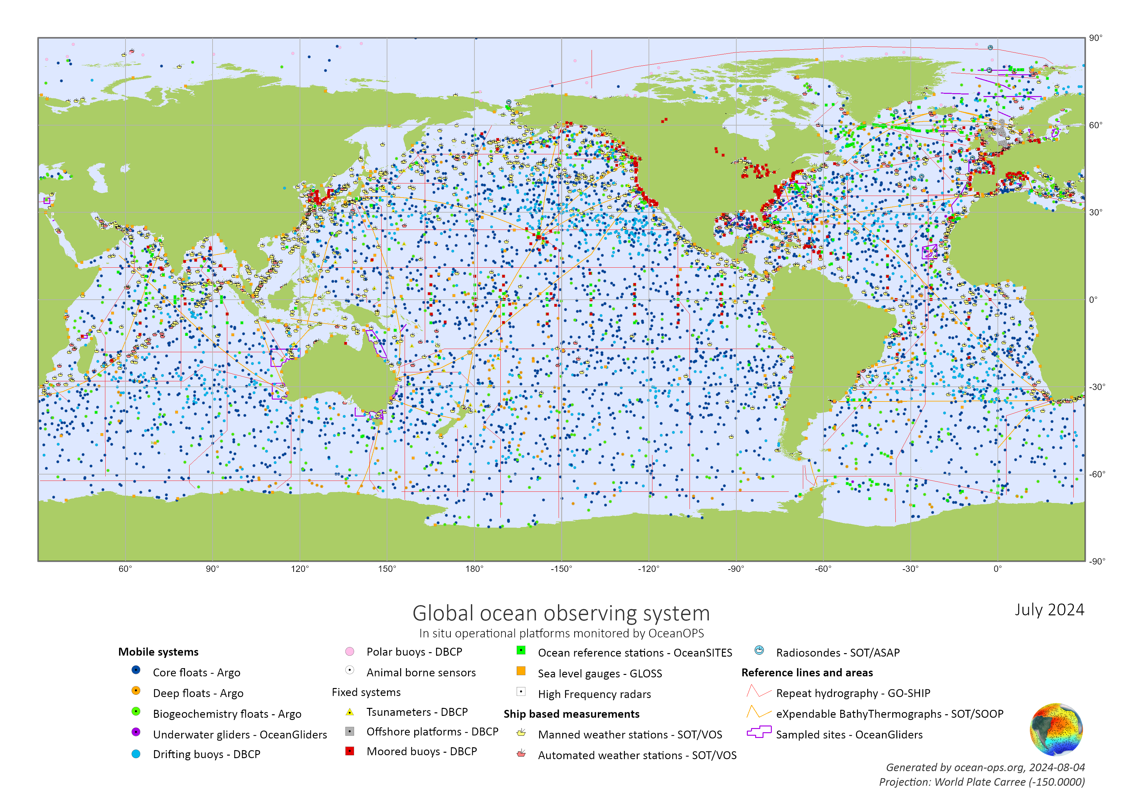

Slide 4
Cal/Val – a driver for buoy data
© Anne O’Carroll

Slide 5
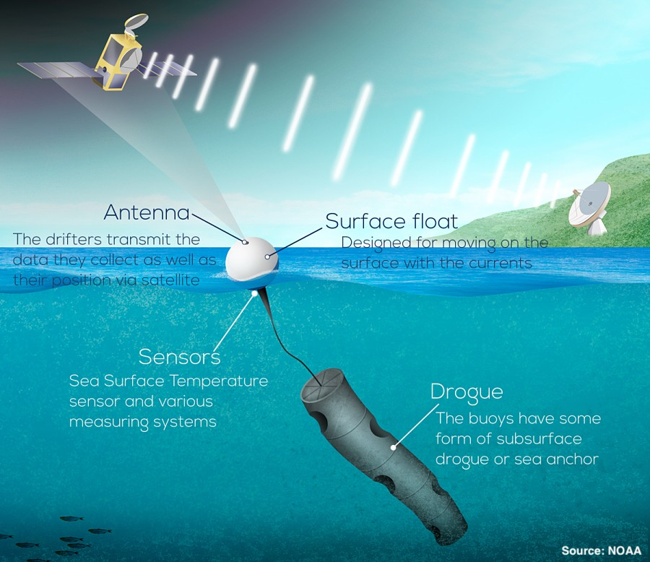
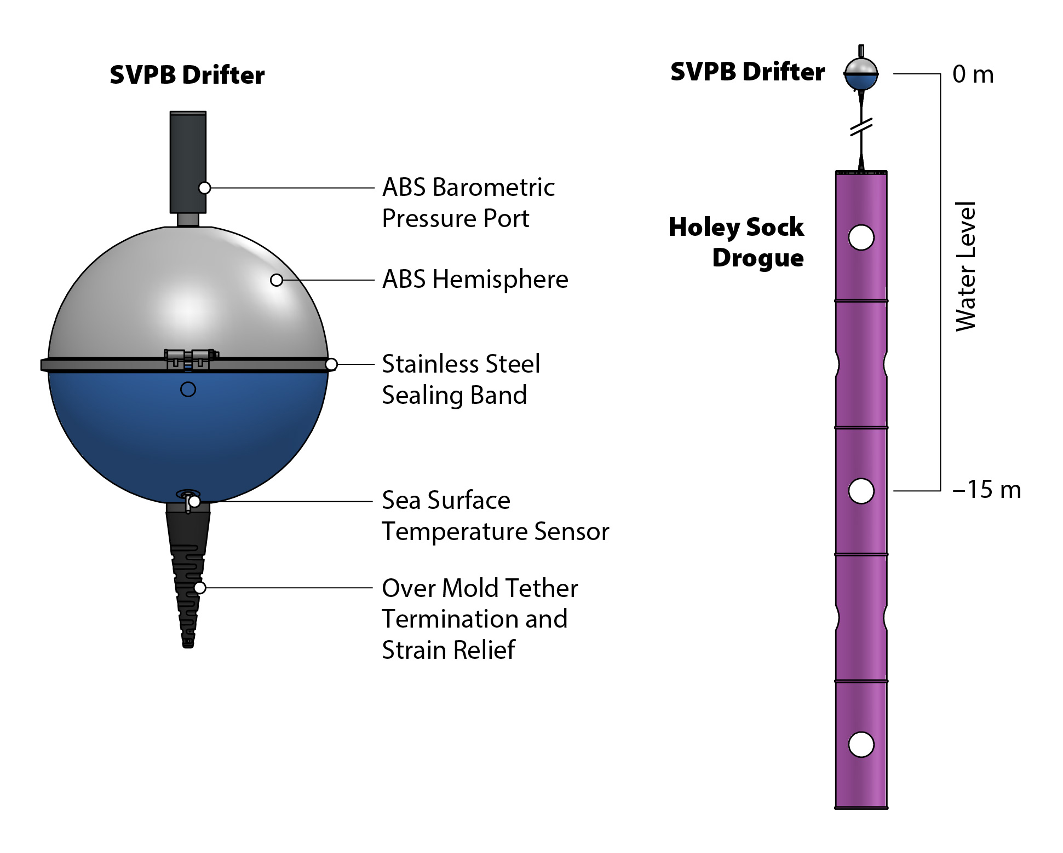
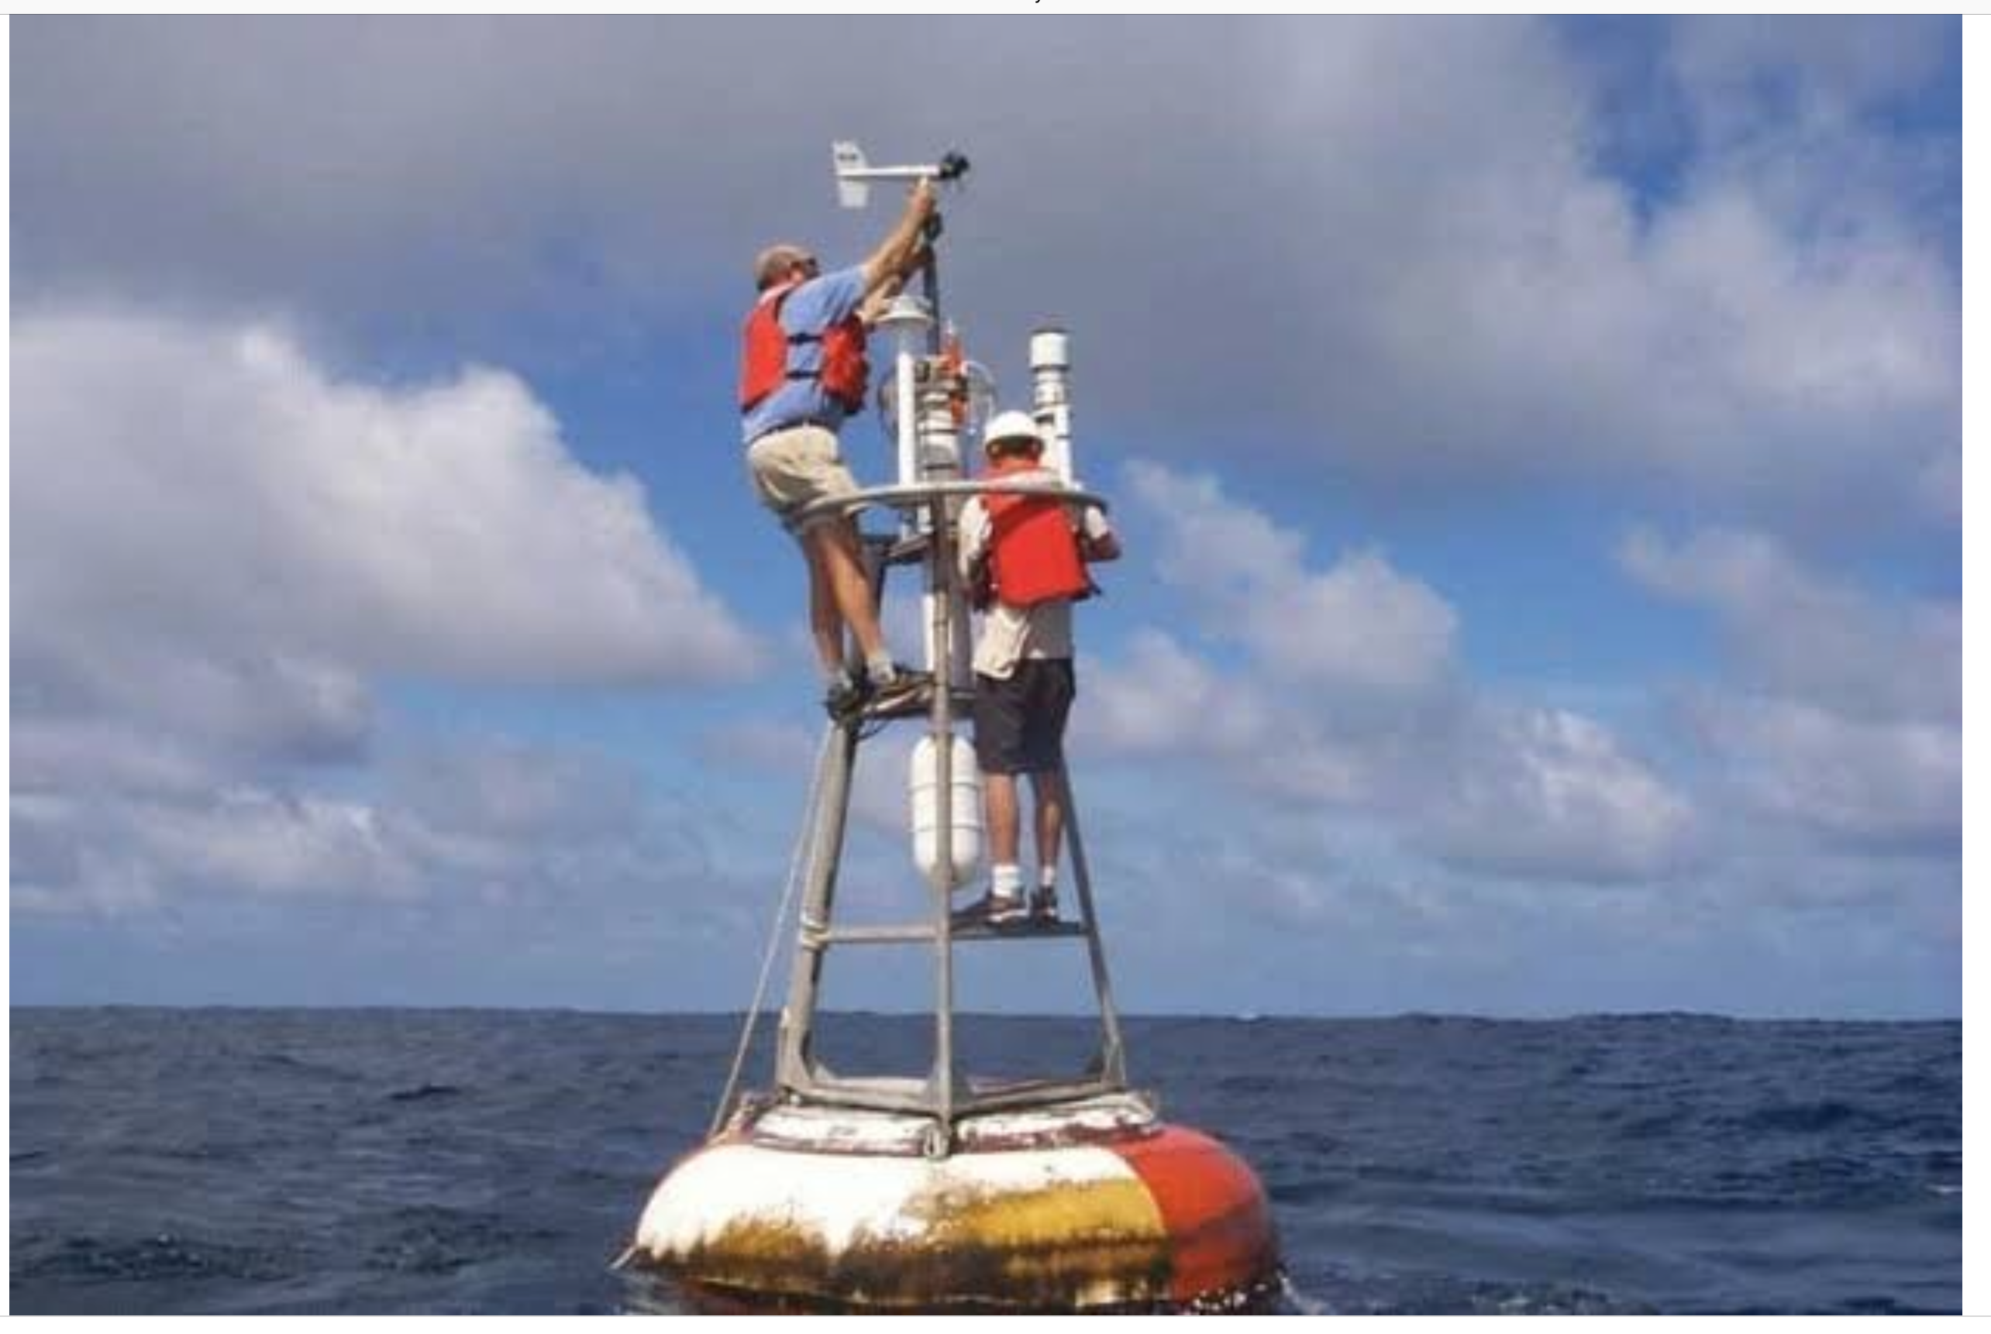
Evolution
1974-1985
1985-1993-1999-2005
2005-2019
2019-

Slide 6
DBCP
Drifting Buoys, incl. polar buoys
Coastal/national moored buoys, incl. lake buoys
Tsunami buoys
Tropical moored buoys
Fixed platforms (oil rigs)
AUVs (saildrones)

Slide 7
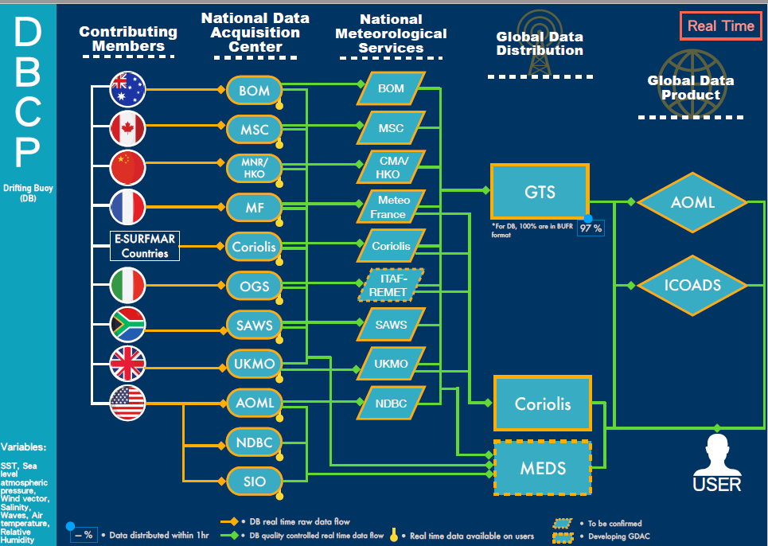
DATA
Quantity
Quality
Coverage
Accessibility
Metadata

Slide 8
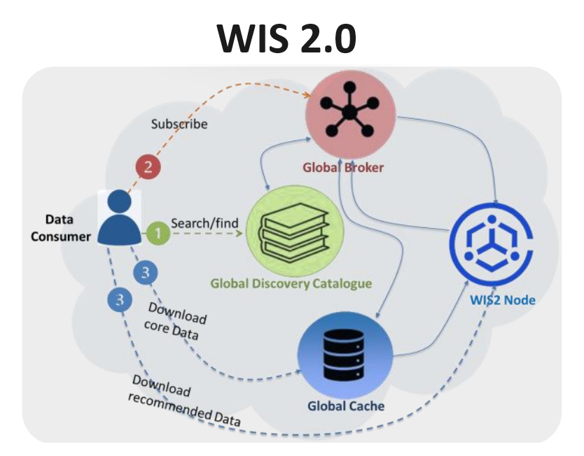
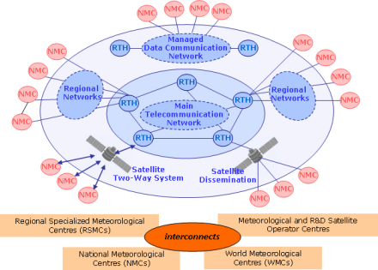
Data Accessibility
Sharing
Global Telecommunication System
WIS 2.0
DACs&GDACs

Slide 9
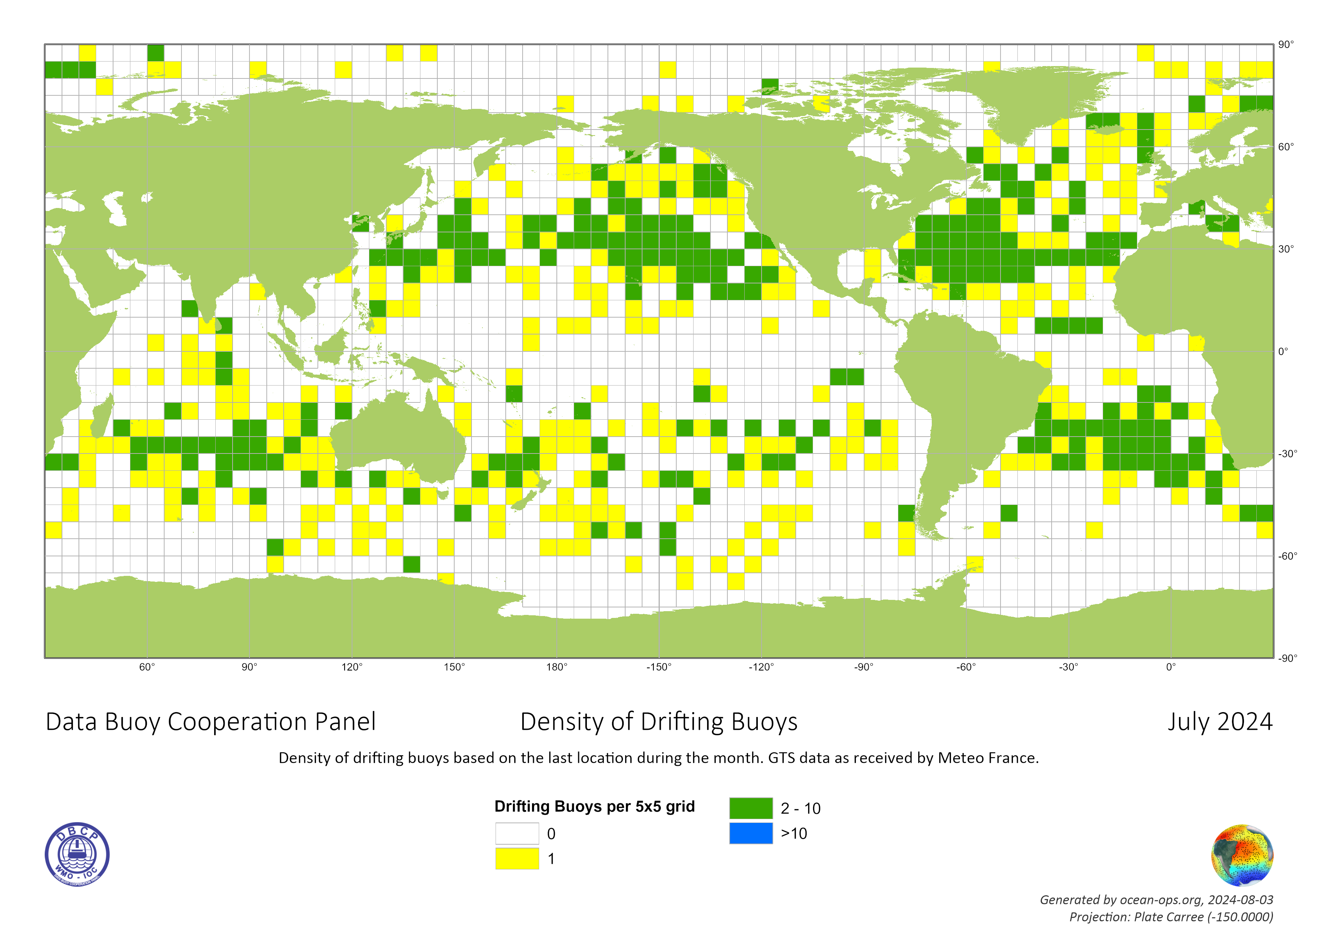
Data Quantity and Coverage

Slide 10
Data Quality
Automatic QC
Regular QA
Quality Stats
WDQMS

Slide 11
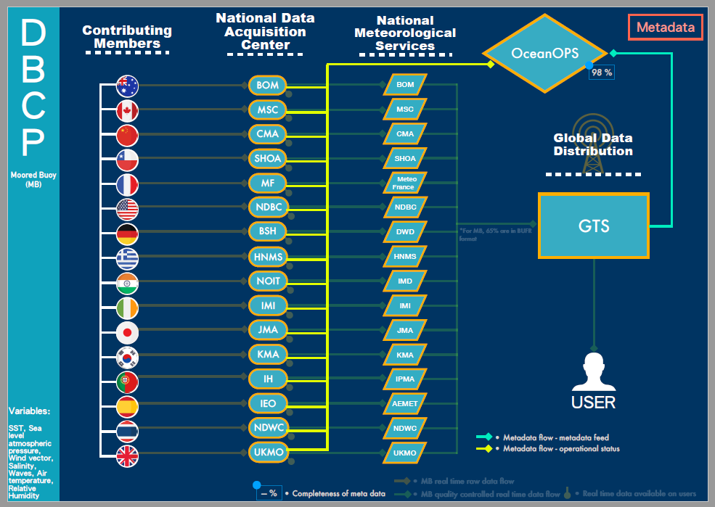
Metadata
Definition
Standardization and Integration
Two Way Communication
Machine 2 Machine

Slide 12
BUOY
Sensors and Instruments
Deployment and Maintenance
Vandalism
Environmental Stewardship
Recovery

Slide 13
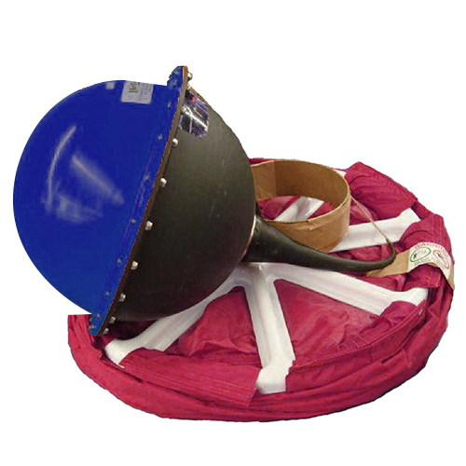
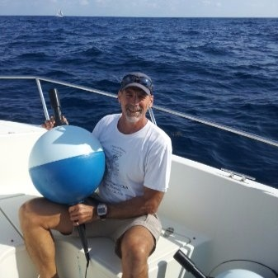
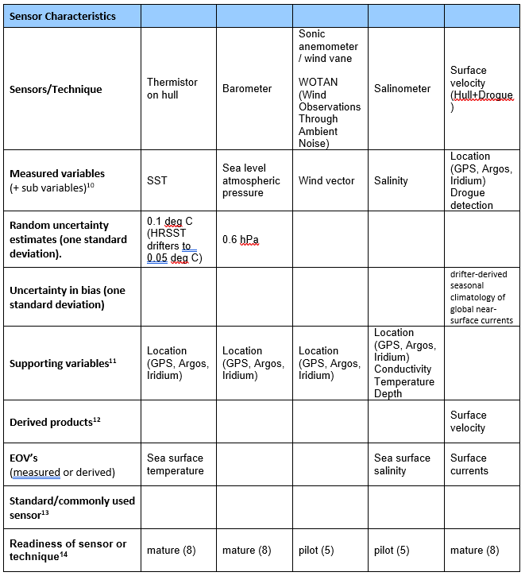
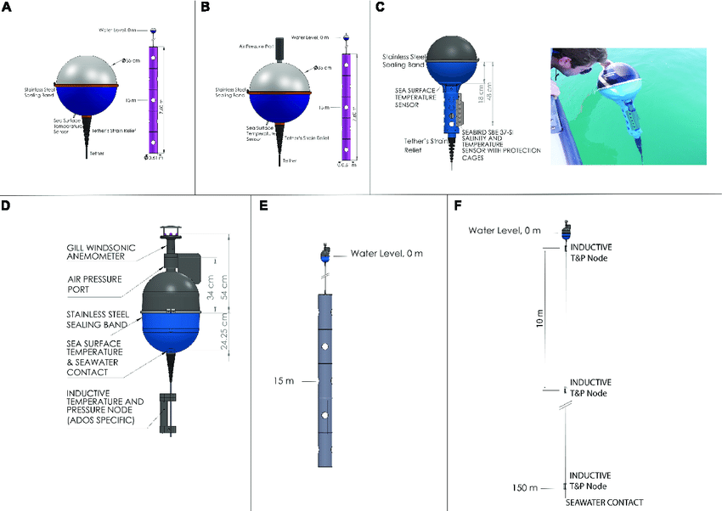
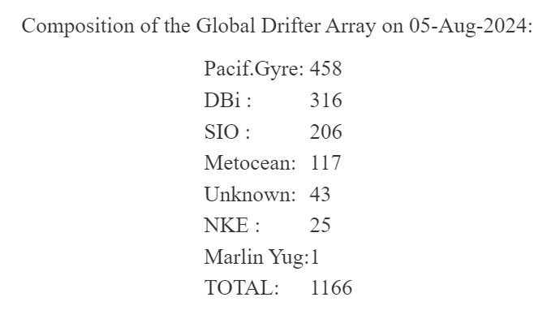
Sensors and Instruments

Slide 14
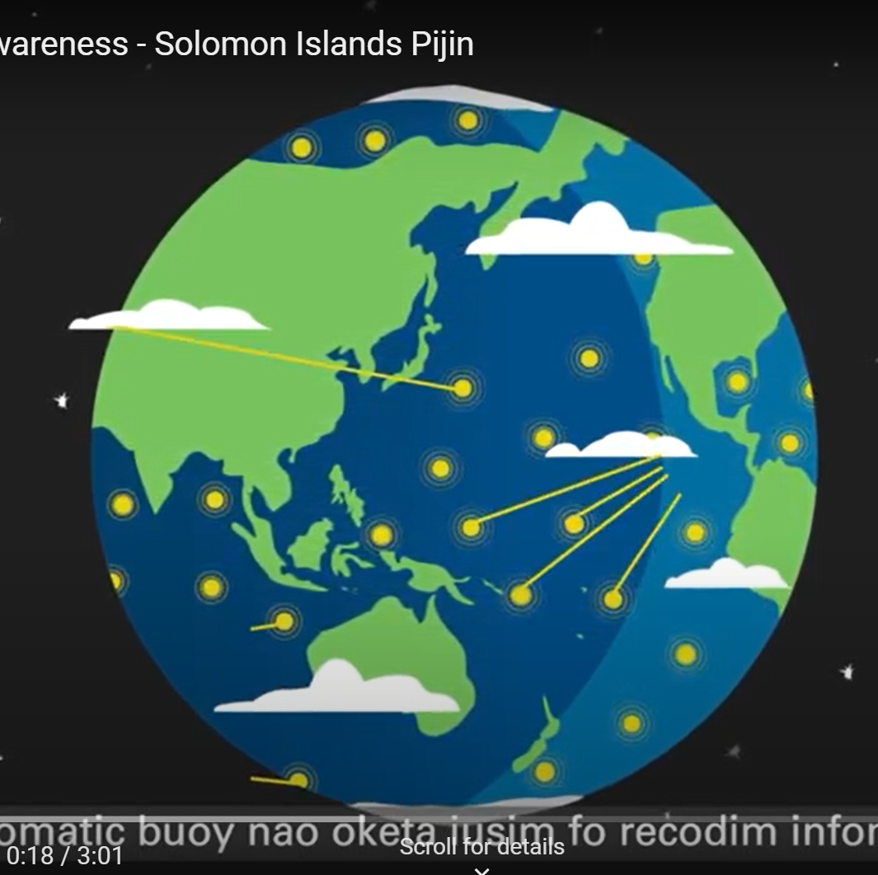
Vandalism
Working Group
Documentation: https://www.ocean-ops.org/dbcp/deployments/anti-vandalism.html
Videos: https://www.youtube.com/watch?v=nGEAdjYWYp0&list=PLNaX-uTWSWrHr554n5hLdemL-idLcefMq

Slide 15
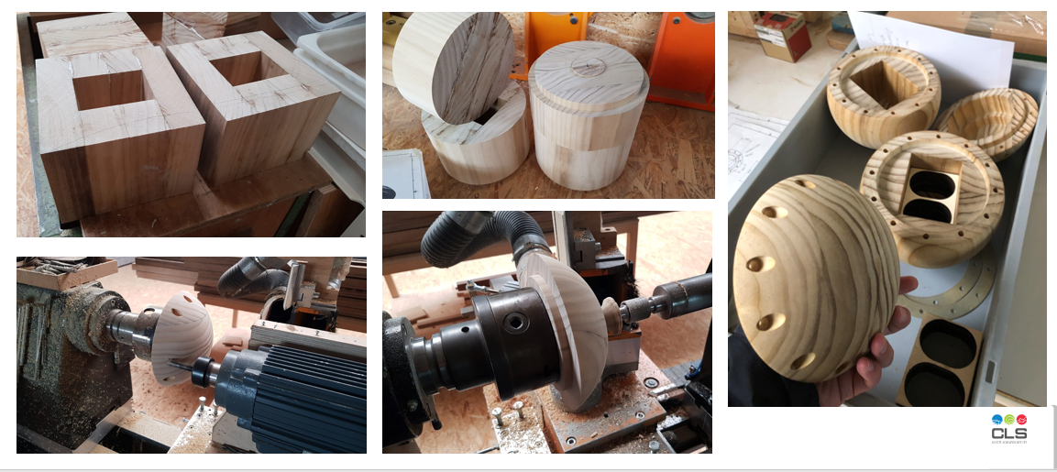
Environmental Stewardship
Task Team
https://www.ocean-ops.org/dbcp/community/environmental.html
Survey and Baseline Study
Recovery pilots

Slide 16
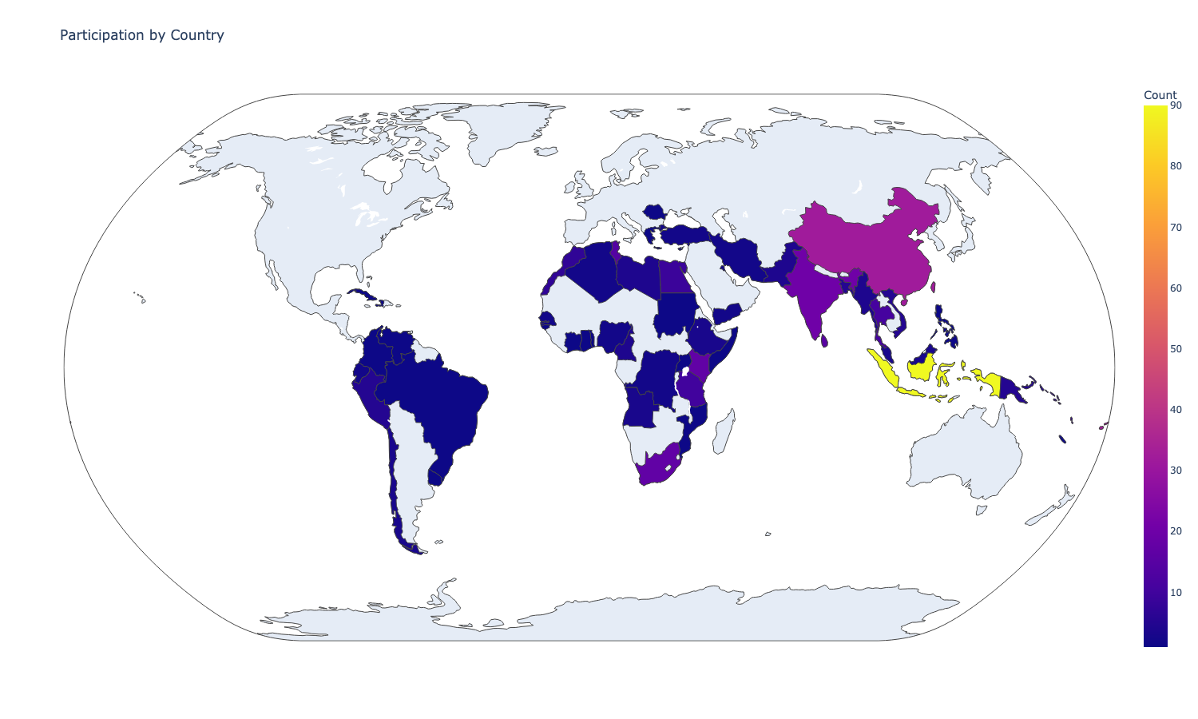
COOPERATION
Data Sharing
Cost-sharing
Sensor Upgrade (barometer, wave, …)
Deployment opportunities
Capacity Building
Knowledge Management
Standards and Best Practice
Technology Transfer
Training workshops

Slide 17
PANEL – How DBCP works
Chair, Vice chair
Environmental Stewardship
Scientific Excellence
Technology Innovation
International cooperation partnerships
Diversity and Inclusivity
Operational excellence
Impact and value

Slide 18
How DBCP operates
GOOS Observations Coordination Group
Executive Board
WMO & IOC
Secretariats
Technical
coordinator
Task Teams
Action Groups
e.g. ENVIRONMENTAL
STEWARDSHIP,
CAPACITY BUILDING
Pilot Projects
e.g. INDIAN OCEAN
DEPLOYMENTS
e.g. HIGH RESOLUTION
SST BUOYS

Slide 19
Task Teams
Data Management (Lance Braasch, Shaun Dolk)
Moored Buoys (Ken Connell)
Capacity Building (Rachel Qiu)
Wave Measurement (Candice Hall)
Environmental Stewardship (Karen Grissom)
Impact and Value (Users) (Marc Lucas)
For more info: https://www.ocean-ops.org/dbcp/overview/taskteams.html

Slide 20
Where to FIND?
FAQs: https://www.ocean-ops.org/dbcp/overview/FAQs.html
Documents: https://www.ocean-ops.org/dbcp/community/documents.html
Metadata: https://www.ocean-ops.org/board?t=dbcp
Events: https://www.ocean-ops.org/dbcp/community/meetings.html
Contacts: https://www.ocean-ops.org/dbcp/community/contacts.html
More to contact: Ljiang@ocean-ops.org; support@ocean-ops.org

Slide 21
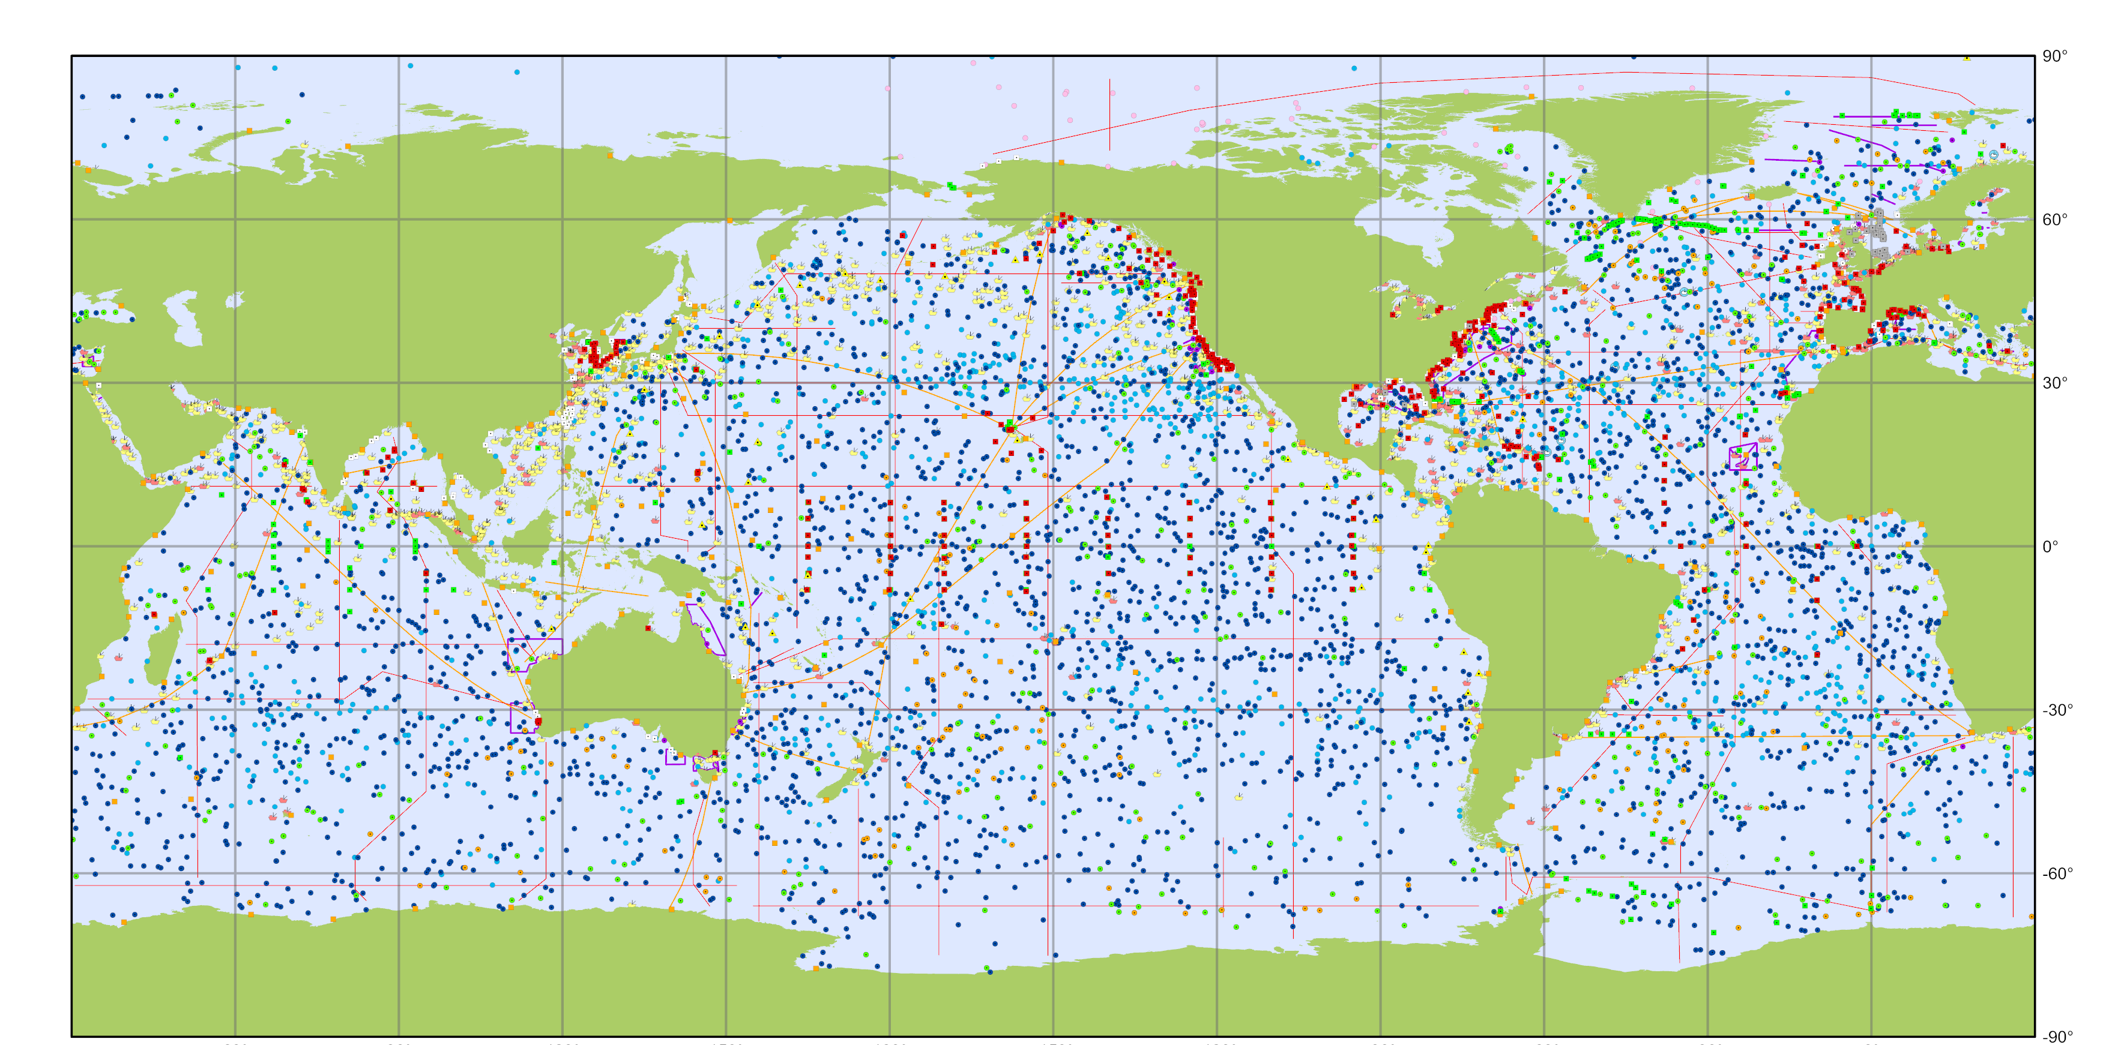
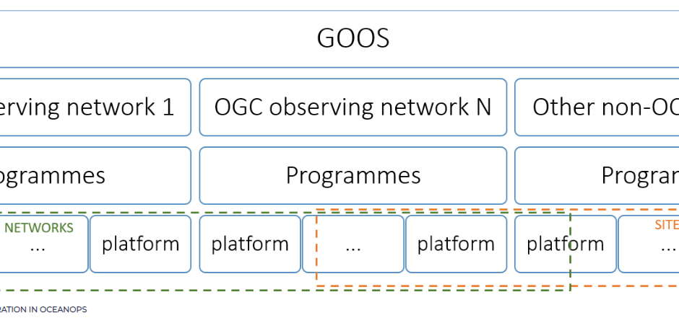
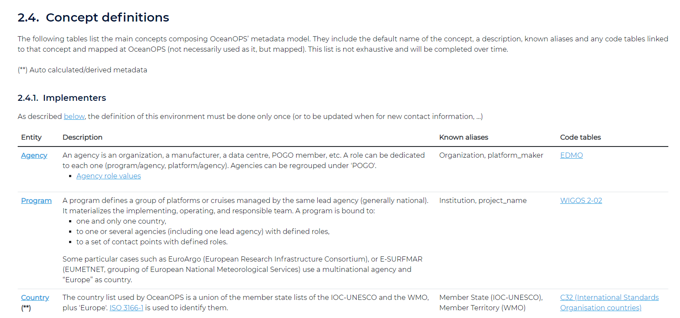
OceanOPS
Overall Structure
Metadata
Definitions
Reference table
Inputs and Outputs

Slide 22
OceanOPS
Monitoring GOOS networks
Metadata system
https://www.ocean-ops.org/metadata
WMO ID allocation
https://www.ocean-ops.org/api/1/help/#about-the-api
Annual report card
https://www.ocean-ops.org/reportcard
Facilitate global and regional coordination
Facilitate new data stream and deployment initiatives

Slide 23
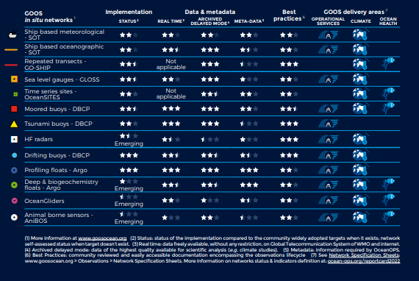
https://www.ocean-ops.org/reportcard/reportcard2023.pdf

Slide 24
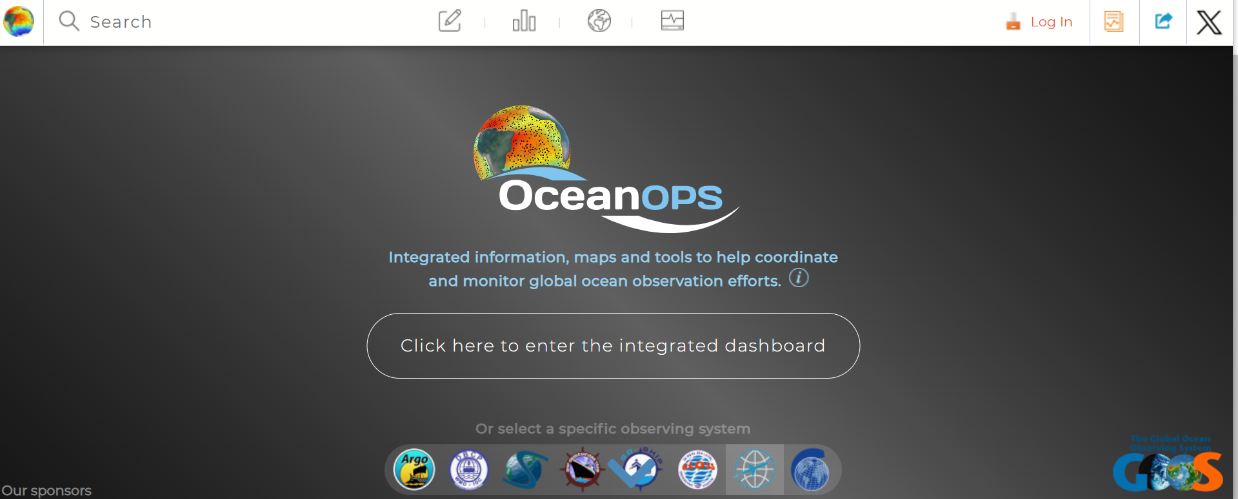
https://www.ocean-ops.org/board

Slide 25
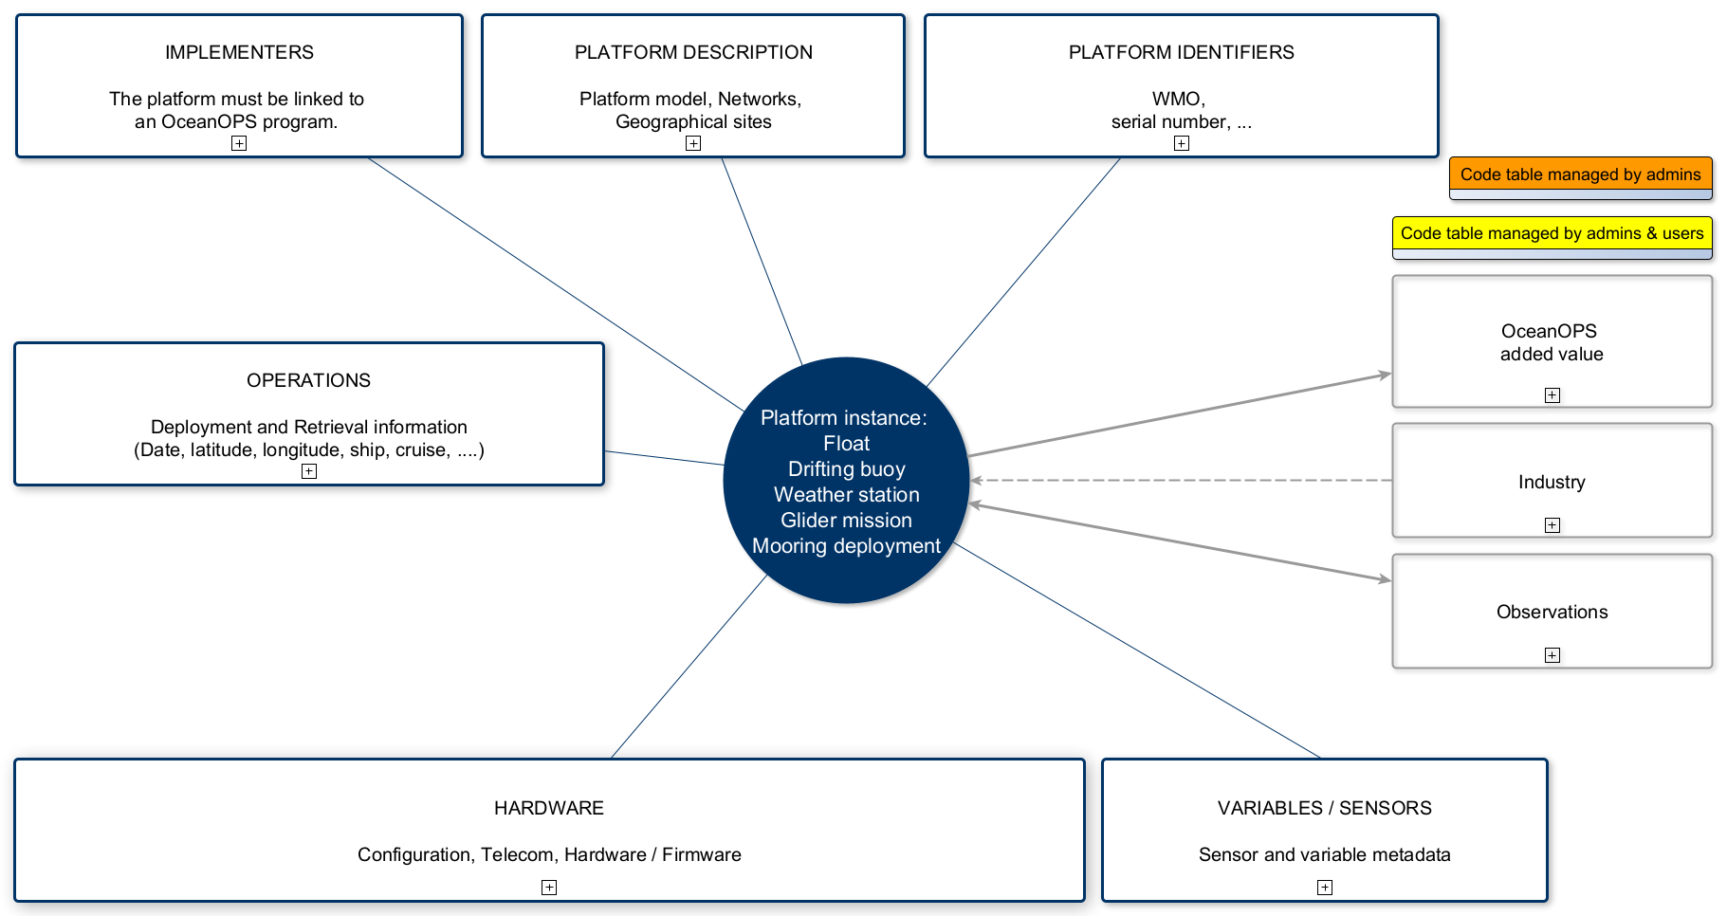
Metadata at OceanOPS https://www.ocean-ops.org/metadata

Slide 26
Metadata at OceanOPS https://www.ocean-ops.org/metadata
Key concepts
GOOS OCG network
Programme
Contacts
WMO ID and IMEI
Deployment date, AND lat/long
Deployment ship/cruise
Sensors (model, depths/heights, serial numbers, drogue, battery)
Telecommunication type

Slide 27
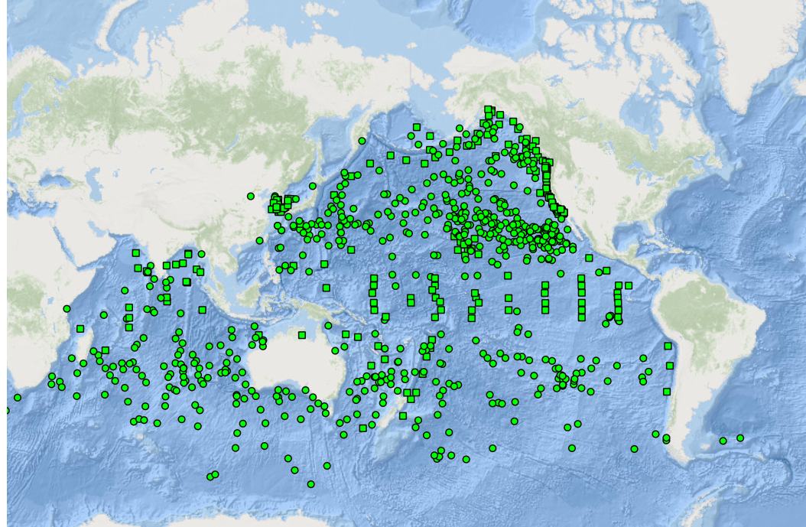
Thank You & Questions?

