Slide 1




Tropical Cyclone and Storm Surge Forecasting method
Data Buoy Cooperation Panel Workshop
on Ocean Observations for Weather Forecast and Climate Prediction,
6-8 / Aug / 2024
Bogor, Indonesia
Nadao Kohno
The Third Laboratory,
Department of Applied Meteorology Research,
Meteorological Research Institute, JMA
nkohno@mri-jma.go.jp; nkono@met.kishou.go.jp

Slide 2

Overview
Introduction
  Tropical Cyclones (TCs) and storm surges
  How observations are used
How to analyze TC and storm surges
  TC Forecasts
  Storm surge forecast
Summary

Slide 3
Historical deadliest storm surge cases
year | cause | Total death | Total damage (Million US$) | Country
1970 | (Bhola) | 300,000 | 86.4 (651.3) | East Pakistan (Bangladesh)
1991 |  | 138,866 | 1,780 (3,824.9) | Bangladesh
2008 | Nargis | 138,366 | 4,000 (5,437.1) | Myanmar
1965 |  | 36,000 | 57.7 (535.9) | Bangladesh (East Pakistan)
1963 |  | 22,000 | 50 (477.8) | Bangladesh (East Pakistan)
1985 |  | 15,000 | 50 (136.0) | Bangladesh
1977 |  | 14,204 | 498.5 (2,407.2) | India
1965 |  | 12,047 |  | Bangladesh (East Pakistan)
1999 | 05B | 9,843 | 2,500 (4,392.2) | India
2013 | Haiyan | 7,354 | 10,000 (12,562.6) | Philippines
1959 | Vera | 5,098 | 600 (6,023.8) | Japan
2007 | Sidr | 4,234 | 2,300 (3,246.4) | Bangladesh
1953 |  | 2,000 | 300 (3,274.2) | Nederland
2005 | Katrina | 1,833 | 125,000 (187,319.1) | USA
Source: EM-DAT (https://public.emdat.be/)

Slide 4
Storm surges…
They are capable of causing significant disasters:
killing more than thousands of people at once
damaging infrastructure critically.
The deadliest case by natural disasters in recent decades was the storm surge case by Bhola Cyclone in 1970.
Studies have shown that nearly half of direct fatalities in US are attributed to storm surge (Rappaport 2014).
While storm surges have devastated many parts of the world, the death toll is remarkably decreased in recent cases (< 100), although economic losses become sometimes huge.
This would have partly come from improved warning services on coastal hazards.
Economic damages tend to be larger as economic development.
Moreover more and more people come to live in beach zone due to urbanization.
Storm surge is one of the key hazards associated with tropical cyclones, although severe storm surge disaster does not happen so frequently.

Slide 5
Main mechanism of storm surges
1. Inverse barometer effect
1hPa pressure decrease ≒ 1cm surge
2. Wind setup
surge
∝τ_{s} (V²) (wind stress: square of wind speed)
∝L (horizontal scale of wind: fetch)
∝1/h (inverse of water depth)
 | Inverse barometer effect | Wind setup | Wave setup
Large shallow basin | ○ | ◎ | ×
Steep bottom sea, Solitary island | ○ | × | ○
offshore | ○ | × | ×

Slide 6
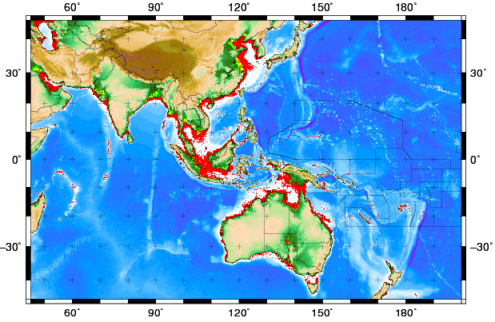
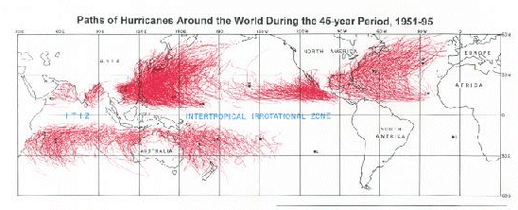


Geographic condition
Sea Bathymetry(GEBCO 30seconds)
The area storm surge may predominant
large storm surge
Mid-latitude lows
Tropical Cyclones
Rare Tc
Tropical Cyclones
-50
Mid-latitude lows
Contours are drawn in every 50m.

Slide 7
How marine observations are used
Direct use
  Those data are directly referred for monitoring the situations.
  There are some parameters directly used:
  Pressure, wind, SST, wave, water levels, etc
  It should be noted that some parameters directly show the physical conditions (e.g. winds, waves, tides), and others are indicate the environmental conditions like SST.
Indirect use
  Supplemental data in real-time operational work
  Assimilation / verification data for NWP models.
  Those data may not be directly used in operations, those data are crucial for improving analysis / forecast accuracy.

Slide 8
Schematic of marine observed data usage
Tropical cyclone Analysis/ forecast
Storm surge forecast
Risk assessment
Information
Warning/advisory
Observed conditions
Storm surge models
NWP models
Satellite images
Weather conditions
Marine conditions
(SST, TCHP)
Marine conditions
Tides, waves, etc.
Weather conditions
  Winds, SLPs

Slide 9
Tropical Cyclone forecast
Track forecast
  Environmental weather conditions
  TC structure
  Orographic effects
  Some other interactions
  The track forecasts are basically conducted by NWP products,
  and accuracy of NWP forecasts are the key issues.
Intensity forecast
  weather / oceanographic conditions
  TC structure
  Situation (on sea/ landfall)
  Since NWP models do not necessarily resolve the adequate TC intensity, TC intensity is mainly analyzed by operational staff.
  Various observed data are referred in the operations.

Slide 10
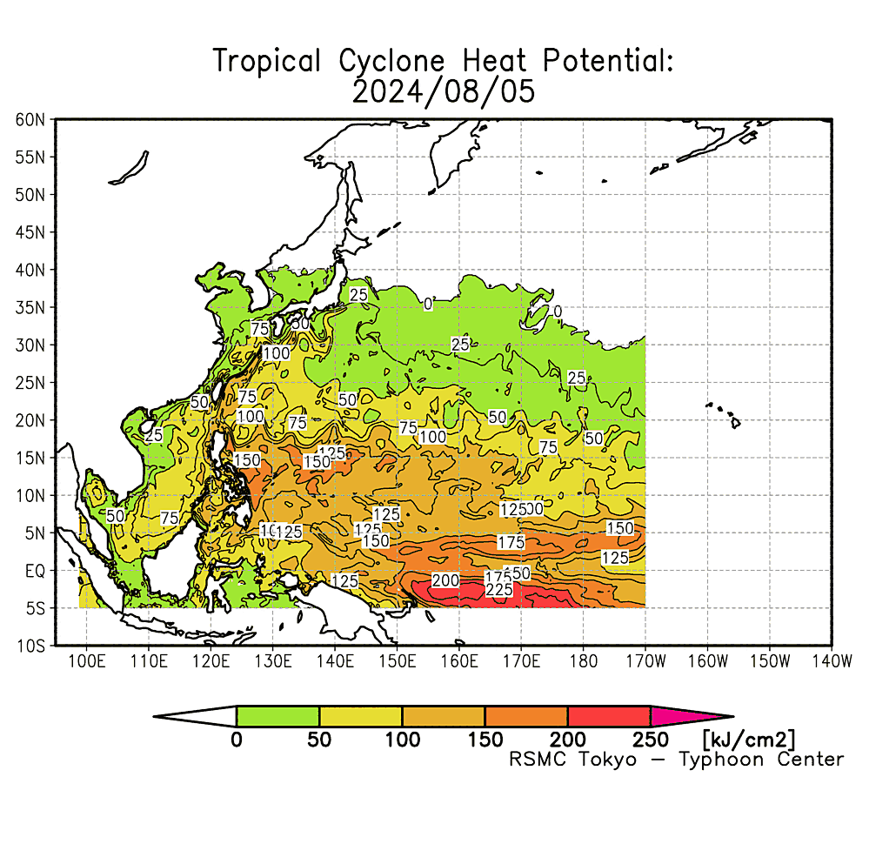
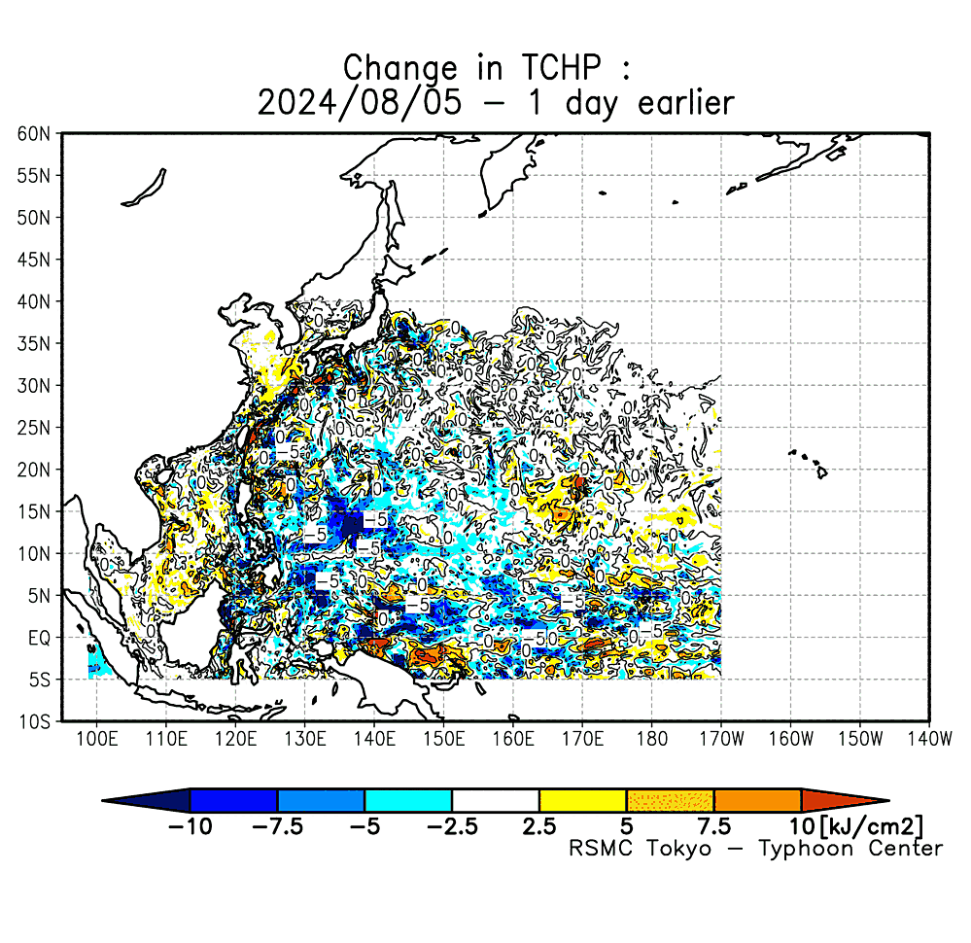
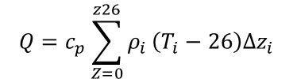
Intensity Forecast of Tropical Cyclones
Based on satellite analysis (Dvorak method)
Statistical method (e.g. SHIPS)
Environmental observed conditions
(Model forecasts are used too.)
Tropical cyclone heat potential (TCHP) Q
Ocean heat content from the surface to the depth of the 26°C isotherm.
$$Q=c_{p}\sum_{Z=0}^{z26}{ρ_{i}}\left(T_{i}−26\right)∆z_{i}$$
C_{p} : specific heat at a constant pressure,
T_{i} : water temperature in °C at the i-th level,
Δz_{i} : i-th layer water thickness,
ρ_{i} : the water density at the i-th level.
Z26 : the depth (m) of the 26°C isotherm.
Ex. TCHP and its 1-day difference

Slide 11
Dvorak Method
Most common method to analyze Tropical Cyclone conditions, used in operational centers. Geostationary Satellite images are the base of the analyses.
Recently other kind images such as microwave sensors of satellites are used too

Slide 12
Statistical method
Statistical Hurricane Intensity Prediction Scheme (SHIP)
[DeMaria and Kaplan (1994), Demaria et al. (2014)]
SHIPS is a statistical and dynamical system to predict TC intensities, based on various parameters which influence TC intensity change. The parameters, such as pressure, winds, vertical sheer, ocean heat contents (OHC), and so on, are basically derived from NWP products.
The method was applied to typhoon predictions, as TIFS (Typhoon Intensity Forecasting scheme based on SHIPS), and now operationally used at JMA (Yamaguchi et al., 2018).
MSLP: Minimum sea level pressure at initial
VMA2: square of VMAX at initial
COHC: Ocean heat content (OHC)
OHC2: square of OHC
SHDC: Vertical wind sheer magnitude
…
Notes:
12

Slide 13
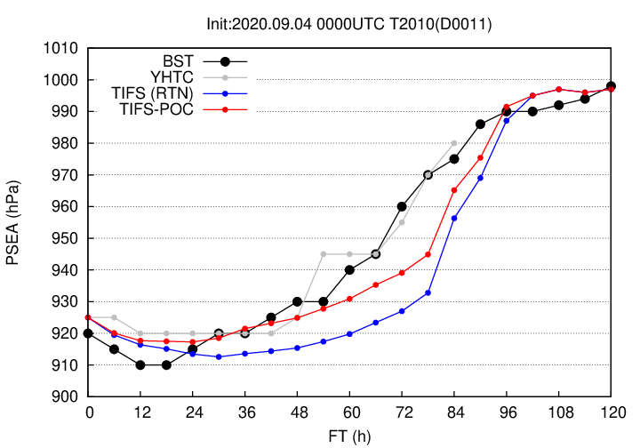
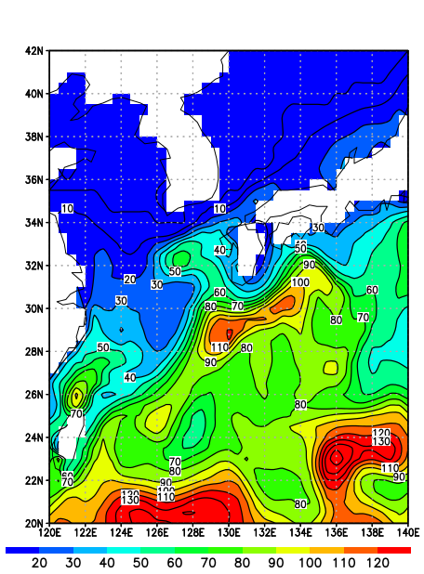
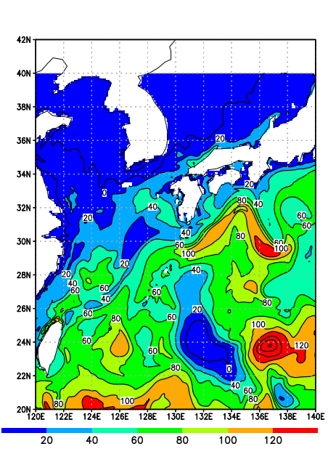
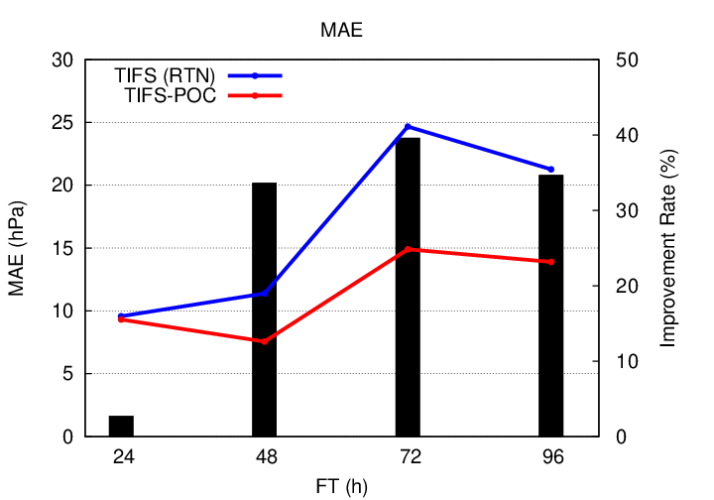
Impact of OHP to Typhoon Intensity
Case of Typhoon Haishen (2010) in 2020.
TIFS overestimated the intensity of TY Haishen in 2020, whose main cause was supposed to be the constant SST (and OHC) derived from MGDSST and MRI.COM-NP01. The test case used SST and OHC, which was predicted by MRI.COM-NP01 and change of values are included.
Difference of OHC
TIFS(RTN)
constant
TIFS-POC
（at T+60）
OHC of TIFS-POC is 40% smaller than RTN
(courtesy Yamaguchi, 2024)
Notes:
13

Slide 14
Storm Surge Forecasts
Recently storm surge forecasts are mainly conducted by numerical models (storm surge models). Recently, storm surge forecasts mean to predict storm tide or more generally total water levels, not merely storm surges (anomaly), for evaluating their hazard risk.
Therefore, various factors must be considered in storm surge forecasts, and their accuracy of storm surge forecasts depend on those various factors, such as:
  TC conditions
  Related factors (astronomical tides, wave effects, river interaction, oceanographic effects, and so on)
  Bathymetry
However, time scale of storm surges is short and their values can be basically determined by atmospheric forcing, and thus assimilation of observed tides are not so effective.
In this regards, observed data are used to rectify the water level (astronomical tides), rather than modifying surge heights.

Slide 15
Assimilation of tides
An Example of assimilation of tides
  Tide observed data at tide gauges and satellite are blended for assimilation data.
  Ensemble Optimum Interpolation (EnOI) scheme was used.
[From Madsen(2014), presentation in eSurge Training]

Slide 16
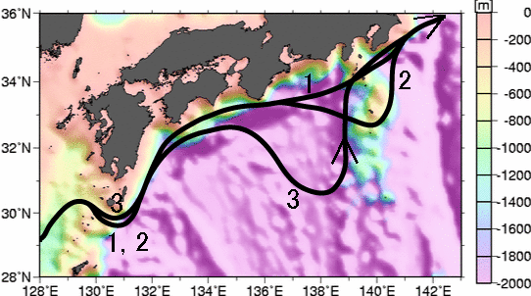
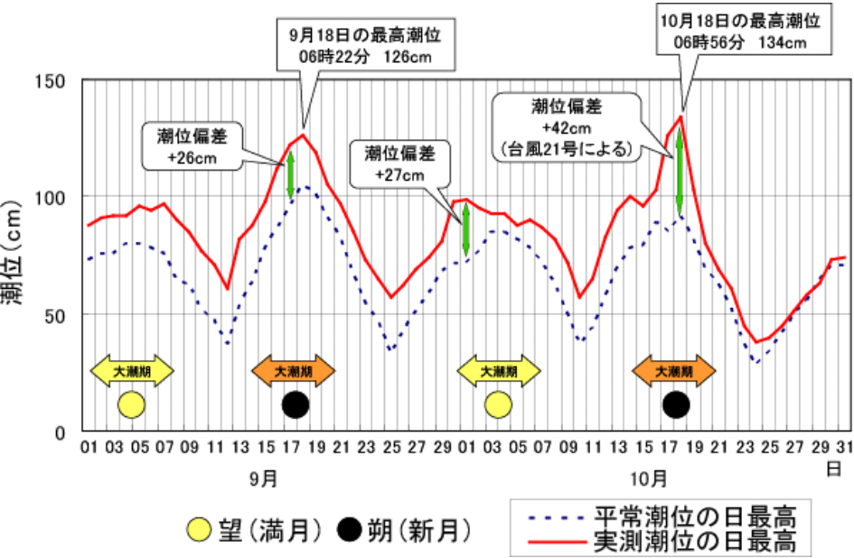
Oceanographic effect
One of the oceanographic effect for water level is an abnormal tide level.
  High sea temperature (low density) → high sea level (large volume)
  Ocean conditions (ocean current, water vortex etc.) have long time scale, and they looks like a certain constant bias.
Aburatsu
Kuroshio
Sep.2001
Oct.
No.1-3 lines show a typical “Kuroshio” position.
1. the nearshore path
2. offshore non-large-meander paths
3. the large-meander path
Full moon
New moon
Predicted tide
Observed tide
The differences from astronomical tides are maintained for weeks or more.

Slide 17
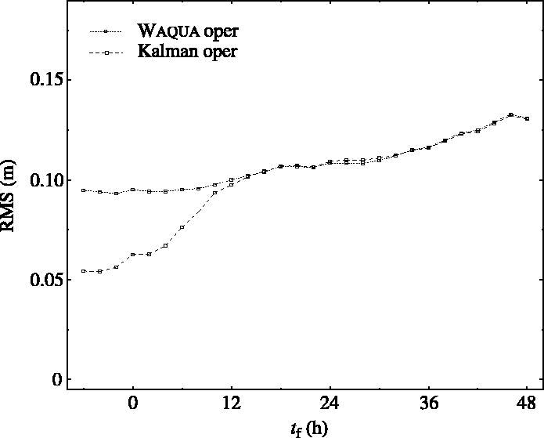
Assimilation impact to Storm surges
A case of assimilation impact to storm surges in the North Sea
  Water levels and currents were assimilated with Kalman filter.
  Storm surge may propagate as a long wave in the North Sea due to its shallow water condition.
  The assimilation impact was detected till 12 hours forecast, but there was no difference after that.
Verlaan et al.(2005): Operational storm surge forecasting in the Netherlands: developments in the last decade. Phil. Trans. R. Soc. 363, 1441–1453.
Change of RMSE(m) in forecast time
(control)
(assimilated)
The result clearly indicated that storm surges are mainly determined by in-situ forcing.
It does not mean that tide observations are useless for storm surge forecasts.
Those observed data are important for both in real-time operation and model developments.

Slide 18
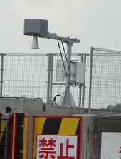
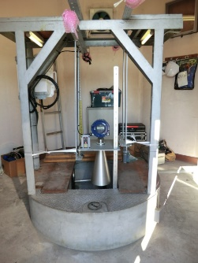
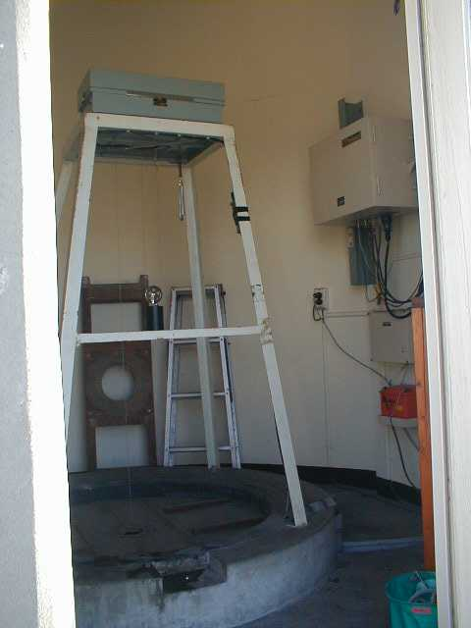
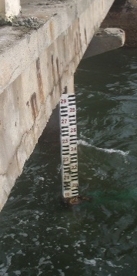
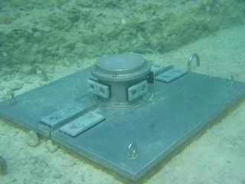
Observed data for storm surge forecasts
Although observations at tide gauges are not so effective for storm surge models, the observed values are crucial for monitoring water levels, modifying forecast/warnings, and verification / improvement of storm surge models.
It should be noted that remote sensing such as satellites can not observe detailed condition at nearshore part, storm surges at beaches are not observed.
Therefore, tide gauge at coasts are the main source of tide observations.
Tide gauges
There are various kinds of types for tide gauges,
but they are in-situ observations.
Local observation is crucial!
Notes:
18

Slide 19
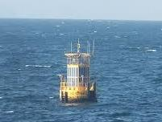
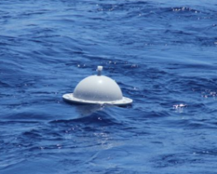
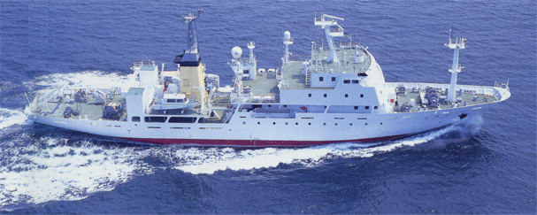
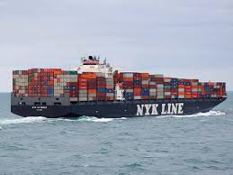
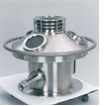

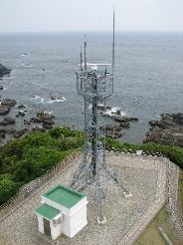
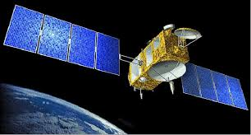
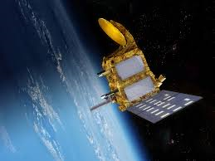
Wave observations
Wave observations are important for marine information services, including storm surge forecasts.
There are various instruments for observing wave conditions, in mechanism / target area etc.
Ships
Buoys
Mooring
Drifting
Coastal
recorders
(Remote sensing)
USW
ADCP
Radar
Satellites
(Offshore)
Jason-3
(NOAA / EUMETSAT)
SARAL
(CNES / ISRO)
19

Slide 20
Summary
Storm Surges are the most hazardous phenomena associated with Tropical Cyclones (TCs). Although disasters rarely happen, they may bring about huge damages in lives and economies.
The forecasting method for TCs and Storm surges have enormously developed in these decades, and they are now very reliable.
It is essential to improve the forecasting methods, but observed data are also very crucial for the forecast accuracy/reliability.
Ocean observation might not directly contribute to those forecasting systems much, but those observed data are crucial for accurate forecasts, supporting as background data, and for verification and improvement of forecasting models.
Notes:
Ensure images are legible

Slide 21
Final words…
It is not easy to keep marine observations, because of their vulnerable conditions and huge costs. Vandalism of offshore observation instruments is always a big problem.
Therefore, observation by remote sensing (e.g. satellites) becomes more powerful tools instead of in situ observations.
Model products (reanalysis) are also very popular now and widely used instead of observed data.
However, model mumerics are not necessarily cover all of the processes and their products do not contain effects based on unknown physics.
Those unknown physics and possible findings of them are only available from real observed data.
It is important to record observed conditions, which can not be conducted afterward.
Notes:
Ensure images are legible

Slide 22

Any Questions?
The JMA Mascot “Harerun”
(The word “hare” means fine weather in Japanese. )

