Slide 1

Data Application in Forecasting
Drifter Data
Dr. TVS Udaya Bhaskar
Head, Ocean Data Management (ODM) Division,
INCOIS, MoES, Govt. of India
DBCP Training Workshop 2024,
6 – 8 Aug 2024
Indonesia.

Slide 2
Outline of Talk
History of Drifter.
Objective of Global Drifter Program.
Schematic of Drifters
Management of Drifters Data.
Applications
Sources of data and derived products.
Summary & Conclusions

Slide 3
History of Drifters
1872-76- HMS Challenger expedition
Early measurements of drifters were visual sightings using telescopes, and sextants to measure bearings and locations.
1950: Radio direction finding and radar were used to track drifters over longer ranges and times from shore, ship, and airplane
1960: Some early drifter trajectories were obtained by Fritz and Charlie in the Gulf Stream and its rings using radar.
1970-The first satellite tracking of drifters occurred using the Interrogation Recording and Location System (IRLS) system flown on Nimbus 3 and 4 satellites
1978- The First Global Atmospheric Research Program (GARP) Global Experiment (FGGE) (Argos implemented)
1988- The Surface Velocity Program (SVP) was established in conjunction with the Tropical Ocean Global Atmosphere (TOGA)
The objective was to maintain drifter arrays with enough samples in 2° latitude × 8° longitude areas to define the mean 15-m circulation, the seasonal cycle
1991-India (NIO, Goa) deployed first batch of drifters in the north Indian Ocean.

Slide 4
Objective of Drifters
The Objective of Global drifting buoy programme is:
To meet the need for an accurate and globally dense set of in-situ observations of mixed layer currents, sea surface temperature, atmospheric pressure, and salinity.

Slide 5
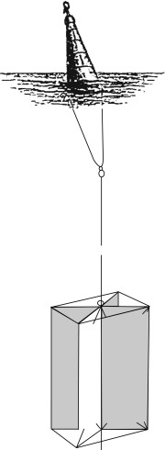
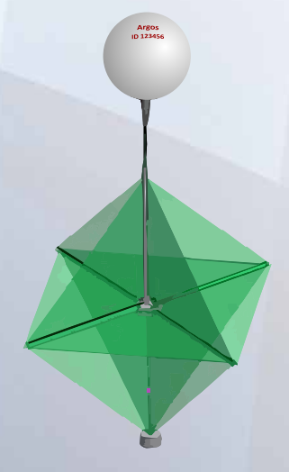
Schematic of Drifters
Schematic of an early drifter and drogue from the Challenger expedition (1872–76). Niiler, et al., (1987) Deep Sea research
Holey-sock drogues TRISTAR drogues
The holey-sock drogue was chosen because it allows the drifter to be compacted in a smaller volume package than the TRISTAR, thus making, storage, shipping, and deployment of the drifters easier and less expensive, thus opening the way to the implementation of a sustainable global array.

Slide 6
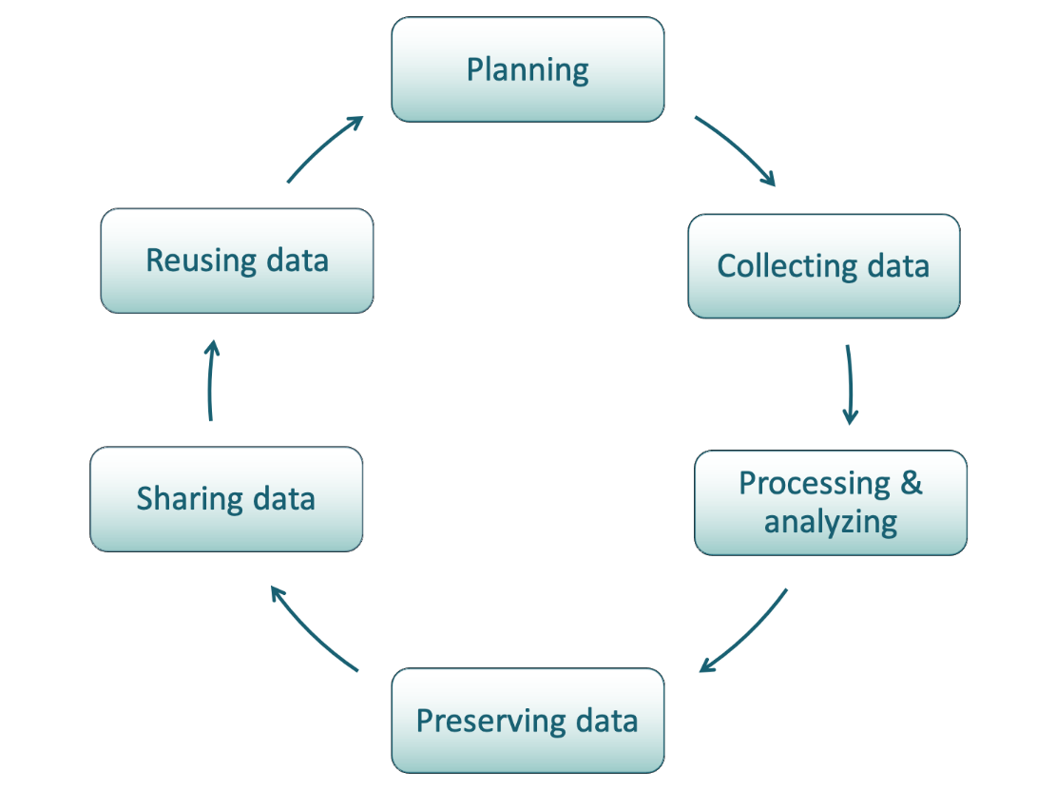
Data Management

Slide 7
Drifter Data management
Data management refers to activities and practices that support long term preservation, access, and use of data.
Data management activities can include :
Planning
Storing
Documenting
Anonymising
Controlling access
Formatting

Slide 8
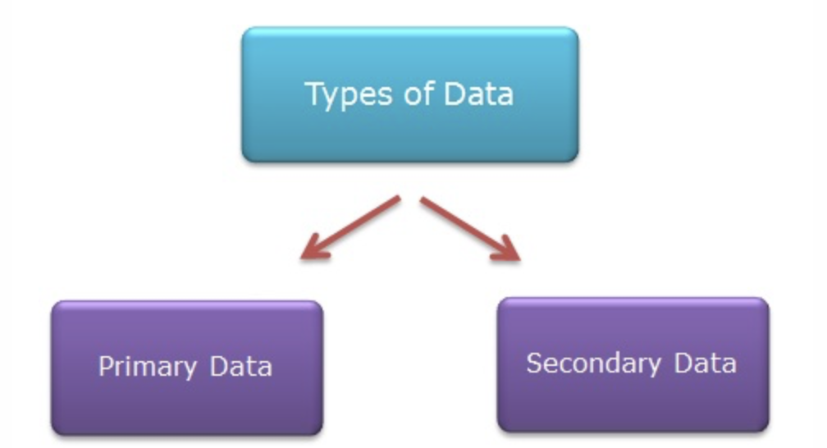
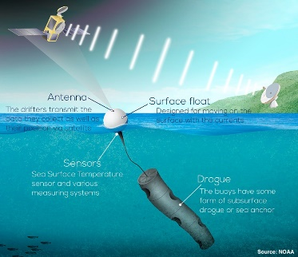
Primary & Secondary data
Primary data is factual and original
Secondary data is the analysis and interpretation of the primary data
  Can include reports, conference papers, books, web sites

Slide 9
Flow of Drifters Data
AOML-The drifter Operations and Data Assembly Center is located at the Atlantic Oceanographic and Meteorological Laboratory (AOML) oversees most of the global drifter deployments, performs the delayed-mode quality control of the drifter data, creates several gridded products, and archives the data.
SIO- The Scripps Institution of Oceanography, provides most of the drifters for the global array either through fabrication and purchasing, oversees the drifter technology, manages the real-time incoming data stream from the Iridium satellite system, provides project-specific web-based visualization interfaces

Slide 10
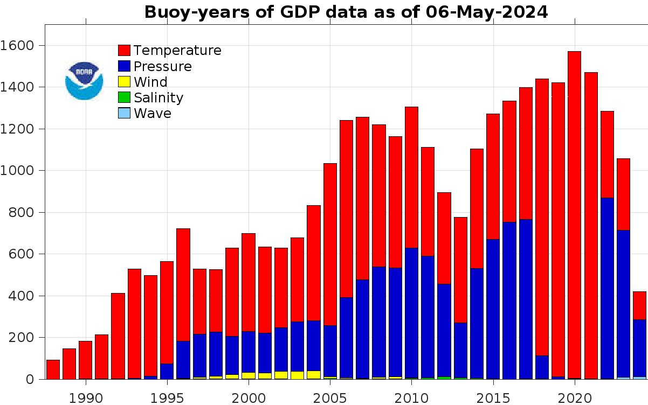
Years and types of buoy data

Slide 11
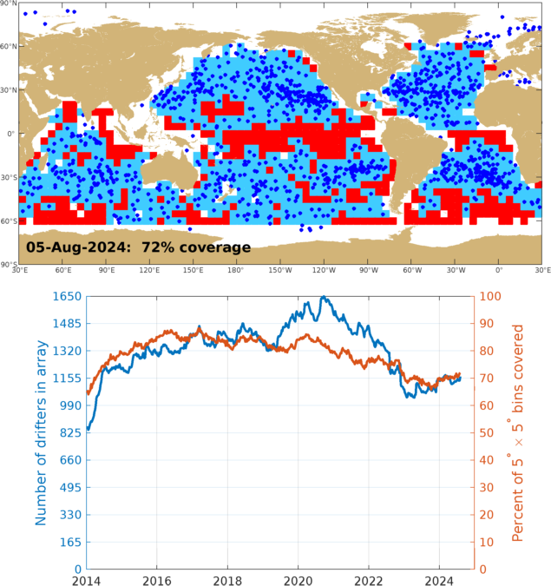
% of oceans covered by Drifters

Slide 12
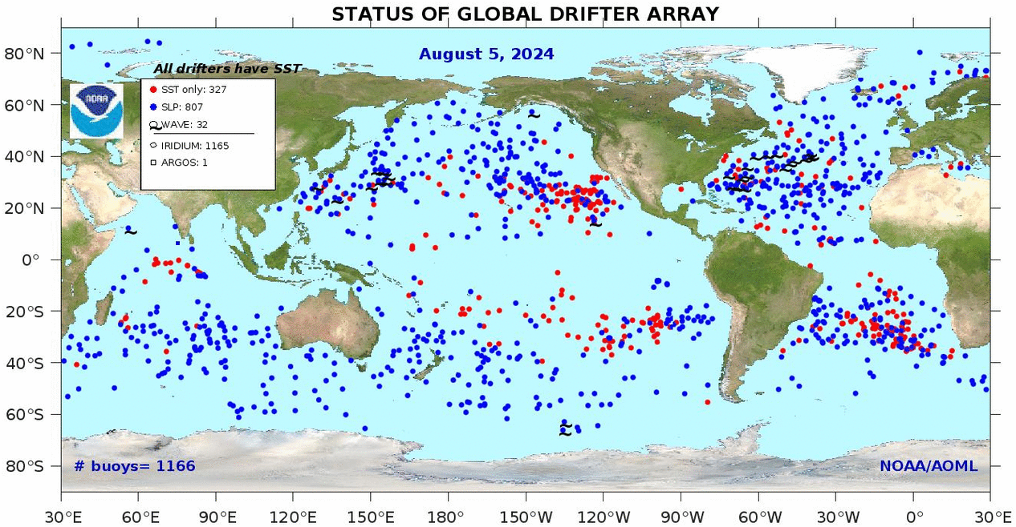
Latest Status of Drifters

Slide 13
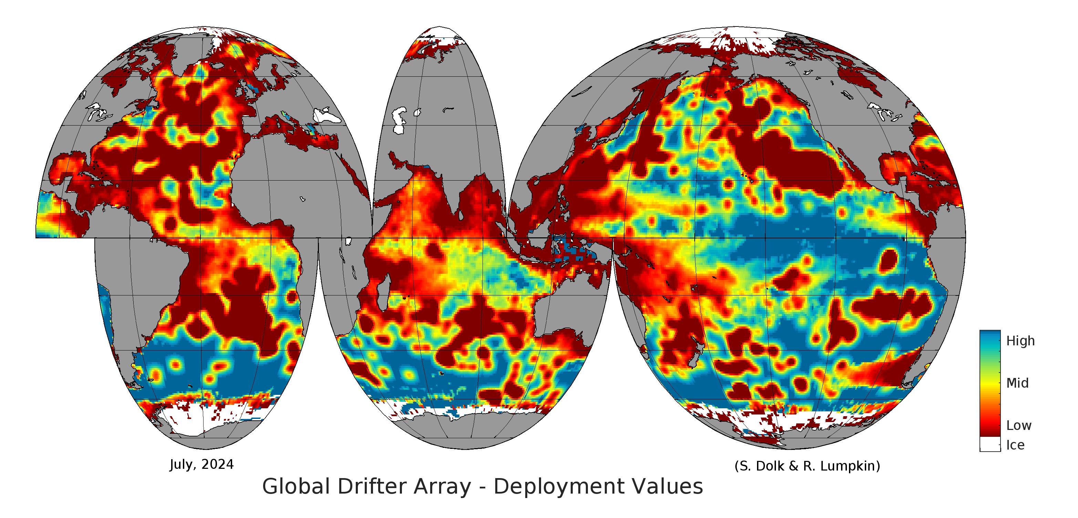
Drifters Density

Slide 14
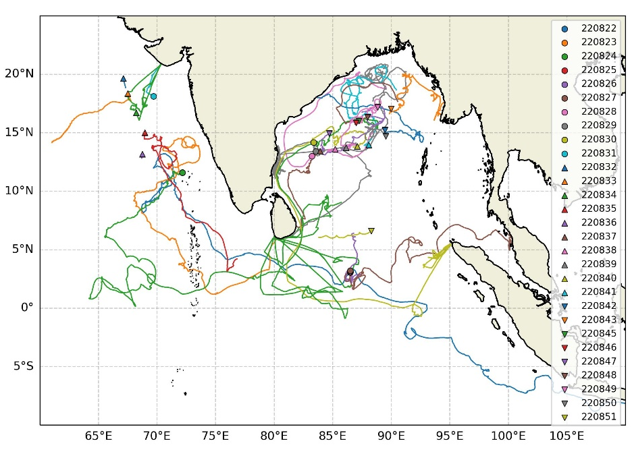
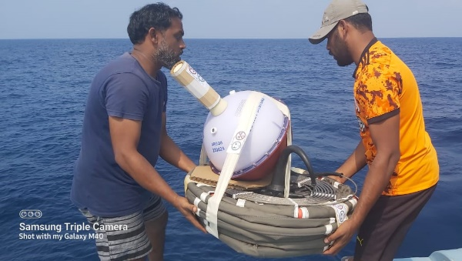
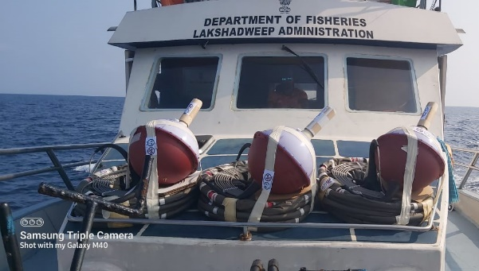
Satellite Tracked Surface Drifters
Vessel | Period | Deployed | Area
Sagar Kanya | 17 January-17 February, 2022 | 3 | Southern BoB
Sagar Kanya | 5 March-5 April 2022 | 6 | North-eastern AS
Sagar Tara | 4-15 February 2022 | 3 | South western BoB
MV Blue Fin | 14-15 February, 2022 | 3 | Eastern AS
Sagar Nidhi | 5-14 September 2022 | 11 | Bay of Bengal
Sagar Nidhi | 28 Jan to 14 Feb, 2023 | 4 | Bay of Bengal
Presently active numbers: 7
Specifications
Model | SVP-B/40H; Drogue centered at 15m
Make | Marlin Yug
Sensors | SST, Barometric pressure

Slide 15
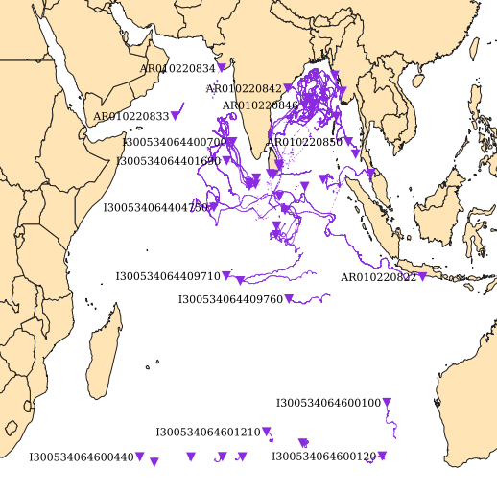
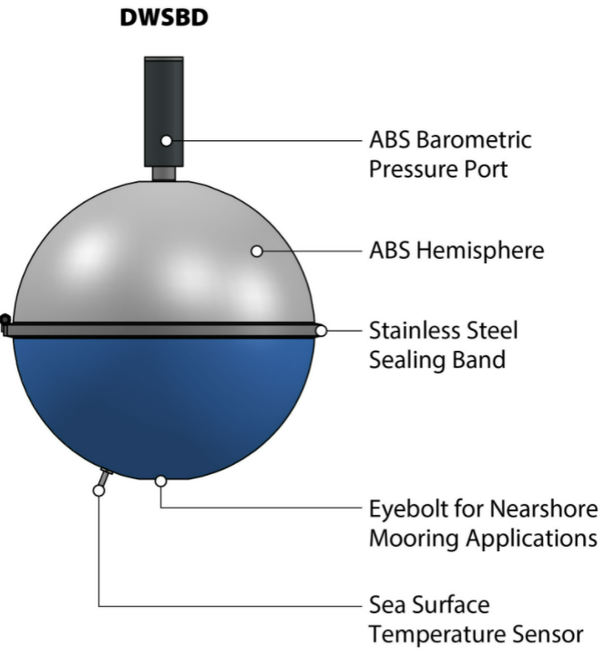
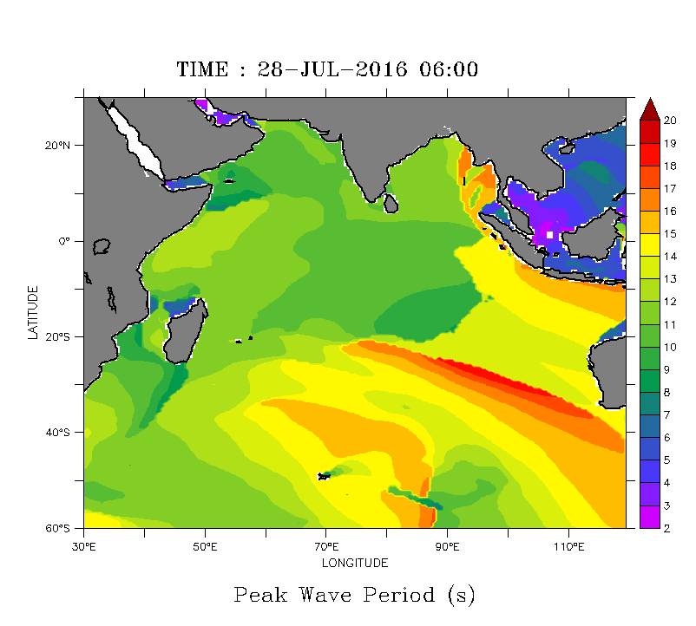
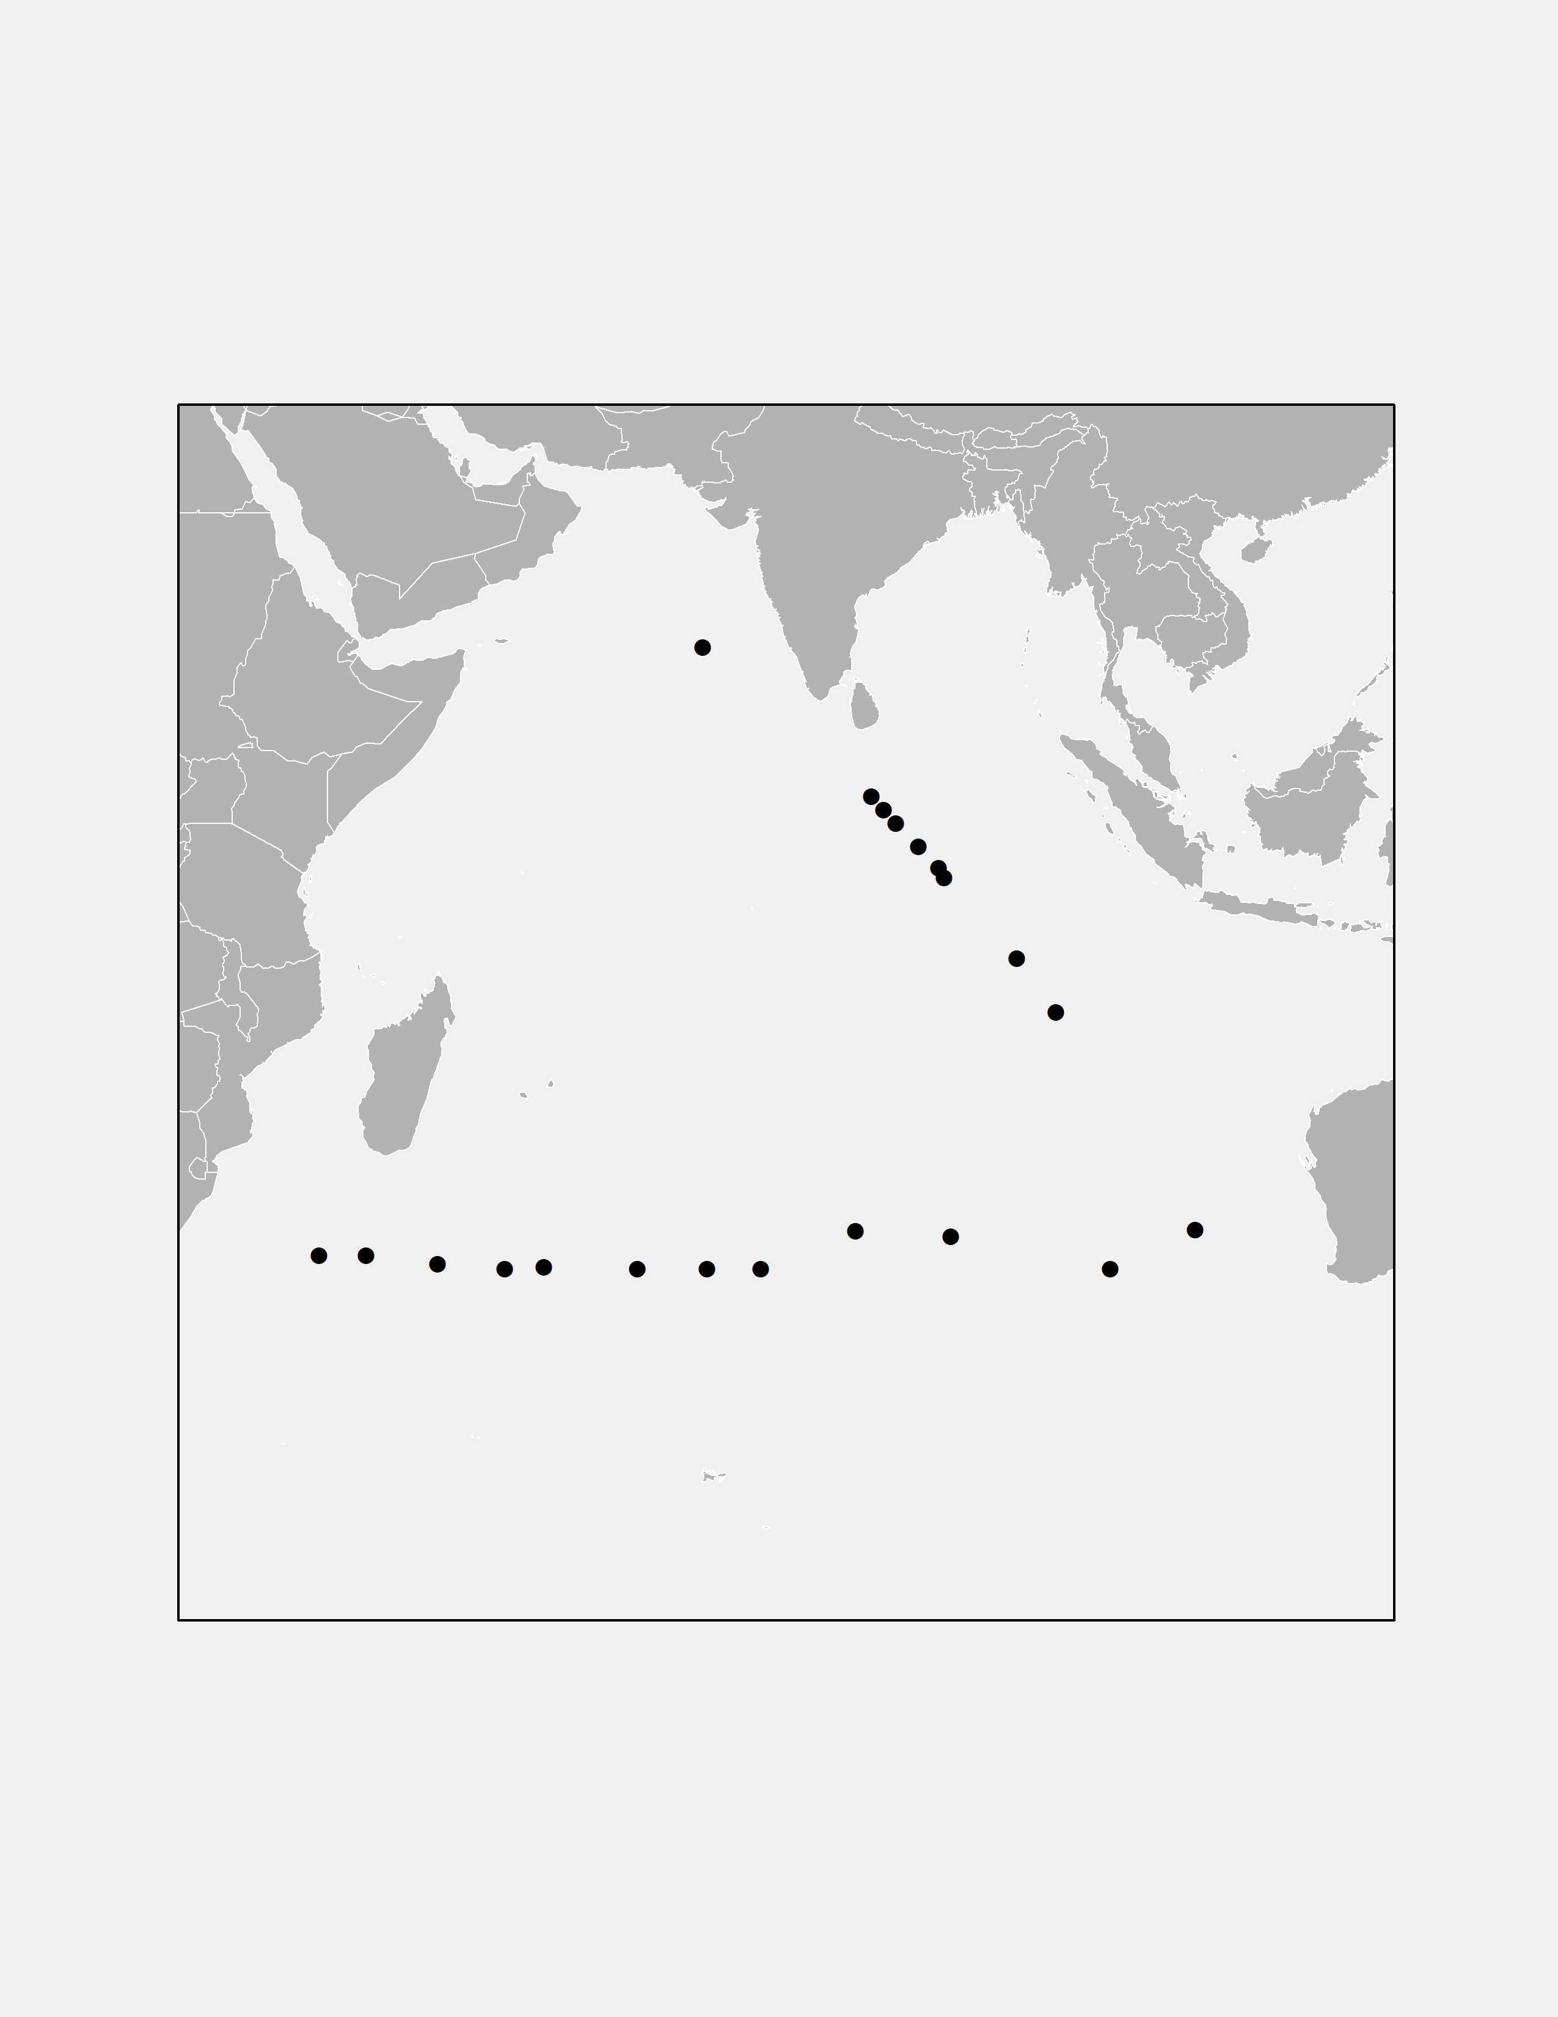
Wave Drifters
Deployment of 30 DWSBD per year as a part of DOM
Parameter: wave parameters, surface currents, SST and Atmospheric pressure
  Applications: Impact of southern ocean swell on Indian coast, wave characteristics in different time scales, Real-time evaluation of operational wave forecast, Validation of wave model output and Remote Sensing Data
Operational Program | YES
Met / ocean research | YES
Developmental | YES
Main deployment areas | Indian Ocean
Quality of buoy data | As per WMO standard
Communications | Iridium satellite telemetry
Buoy lifetimes | 01 year
Deployed during the year | 30
Reporting on GTS | yes
Planned for deployment in the next 12 months | 30
30 Nos of WAVE DRIFTERS was deployed in 2023
Received 30 Nos of wave drifters for deployment in 2024

Slide 16
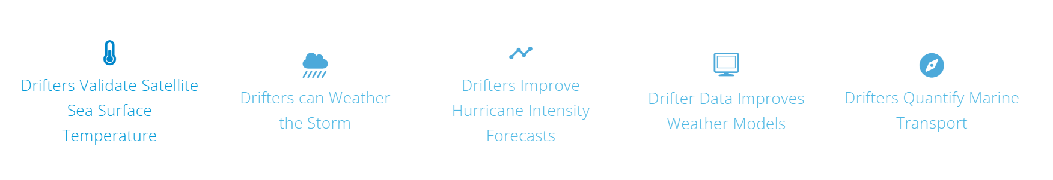
Applications
Drifters Provide Critical Data to Improve Forecasts

Slide 17
Applications
Drifters Provide Critical Data to Improve Forecasts
Drifters have a thermistor that measures water temperature at the base of the surface float. These data are used to calibrate and validate temperature measurements made from satellites, which can be thrown off by atmospheric particles or biased by the day-to-night changes in temperature sampled only while the satellite is passing overhead.

Slide 18
Applications
Drifters Provide Critical Data to Improve Forecasts
Global drifters can survive large and destructive waves in the open ocean, sending data as they pass through storm after storm, even from the heart of passing hurricanes. The drifter data also greatly increase the accuracy of forecasting one of the most dangerous marine phenomenon: the “bomb cyclone”, a winter storm that quickly explodes into a life-threatening monster.

Slide 19
Applications
Drifters Provide Critical Data to Improve Forecasts
Each year, Air Force “Hurricane Hunter” aircraft deploy drifters ahead of some Atlantic hurricanes with a goal of measuring upper ocean and sea surface conditions. These drifters measure pressure, wind, and temperature as the storm passes above. These data are used to improve hurricane intensity forecasts, and they are a rigorous way of determining if the forecast models are accurately representing the interaction between the atmosphere and the ocean.

Slide 20
Applications
Drifters Provide Critical Data to Improve Forecasts
Drifter measurements of barometric pressure have been shown to be the single most important observation in the observing system to improve weather forecasts, on a per-observation basis. They are particularly valuable to accurately forecast rapidly-strengthening winter storms at high latitudes, which pose significant threats to mariners.

Slide 21
Applications
Drifters Provide Critical Data to Improve Forecasts
Drifters show us where the ocean carries floating objects such as marine debris, fish plankton, and oil. By examining the trajectories of all the drogued and undrogued drifters, studies have determined where debris such as plastic piles up in the great “garbage patches” of the Atlantic, Pacific, and Indian oceans.

Slide 22
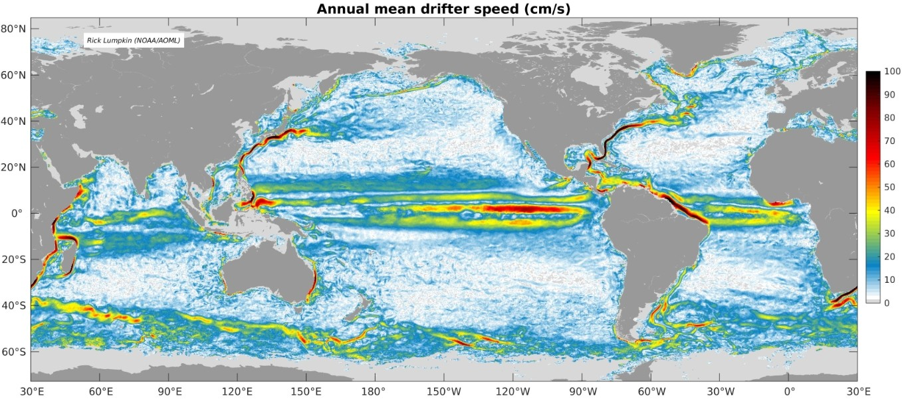
Applications
Satellite Tracked Surface Drifters: Speed of the ocean currents obtained from bin-averaging the 6-hourly drifter observations

Slide 23
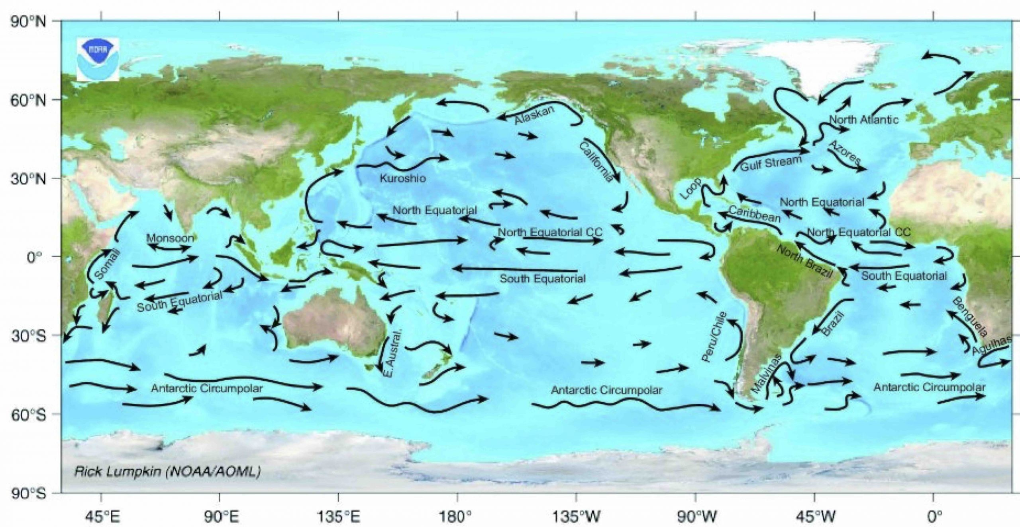
Climatology of Currents
Drifters Surface Currents: Majors Currents mapped using Drifter data.

Slide 24
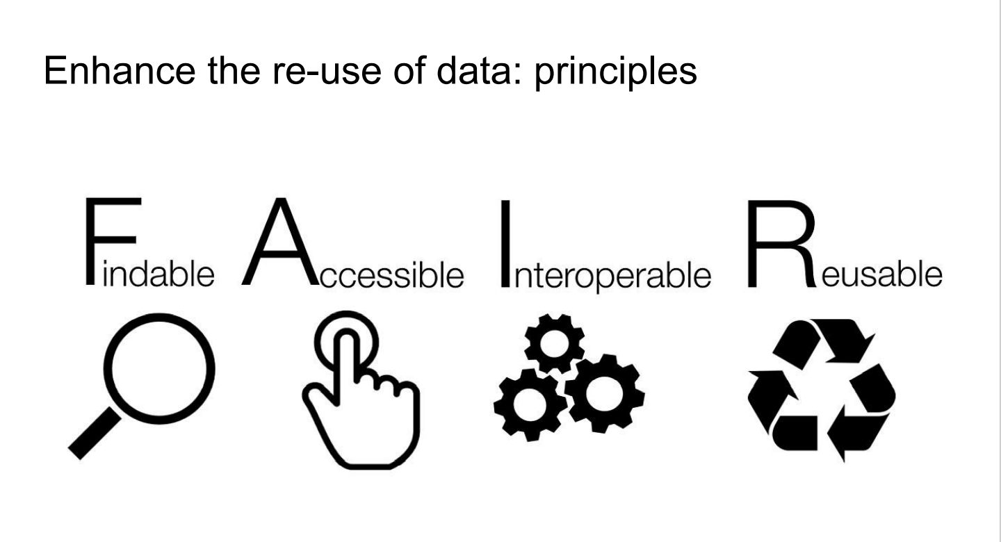
FAIR Drifer data Services

Slide 25
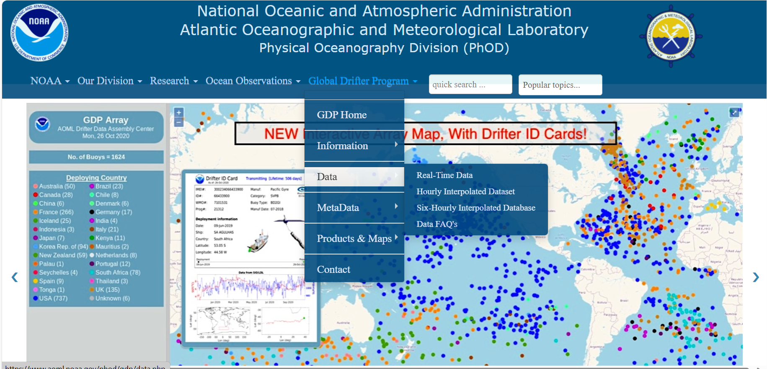
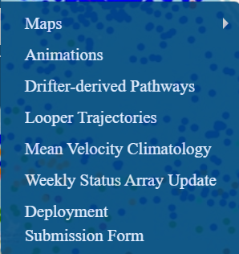
Data availability
https://www.aoml.noaa.gov/phod/gdp/

Slide 26
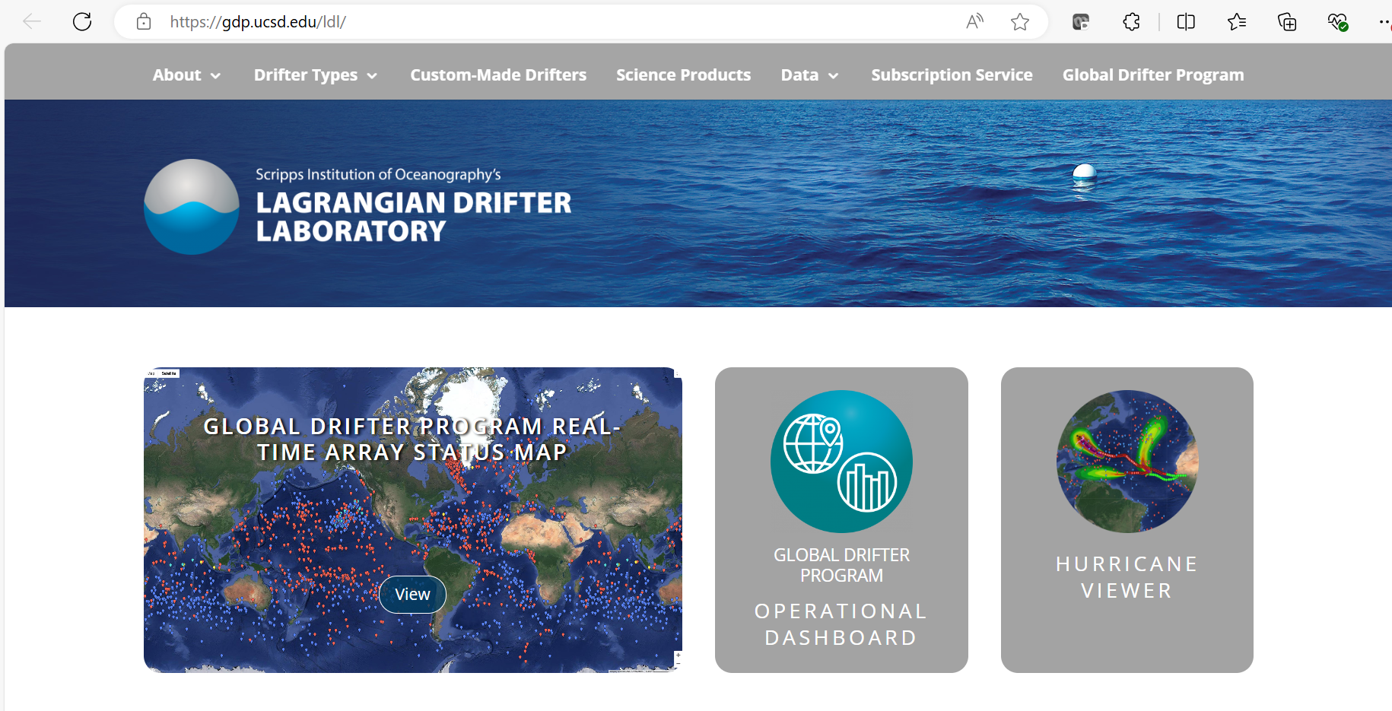
Data availability
https://gdp.ucsd.edu/ldl/

Slide 27
Summary
Drifters are being used since HMS Challenger expedition (1872-76)
Drifters Provide Critical Data to Improve Forecasts.
  Drifters Validate Satellite Sea Surface Temperature.
  Drifters can Weather the Storm.
  Drifters Improve Hurricane Intensity Forecasts.
  Drifter Data Improves Weather Models.
  Drifters Quantify Marine Transport.
Drifter Data management needs support long term preservation, access, and use of data.
FAIR data principles enhances the use of data.

