Slide 1
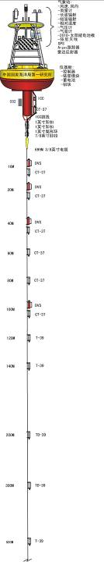
Application of the moored buoy data to monitor and predict the extreme disasters associated with cyclone/typhoon and Madden-Julian Oscillation crossing over the maritime continent
Weidong Yu
Center for Ocean Expedition and School of Atmospheric Sciences
Sun Yat-Sen University, Guangzhou/Zhuhai/Shenzhen, China
yuwd@mail.sysu.edu.cn

Slide 2
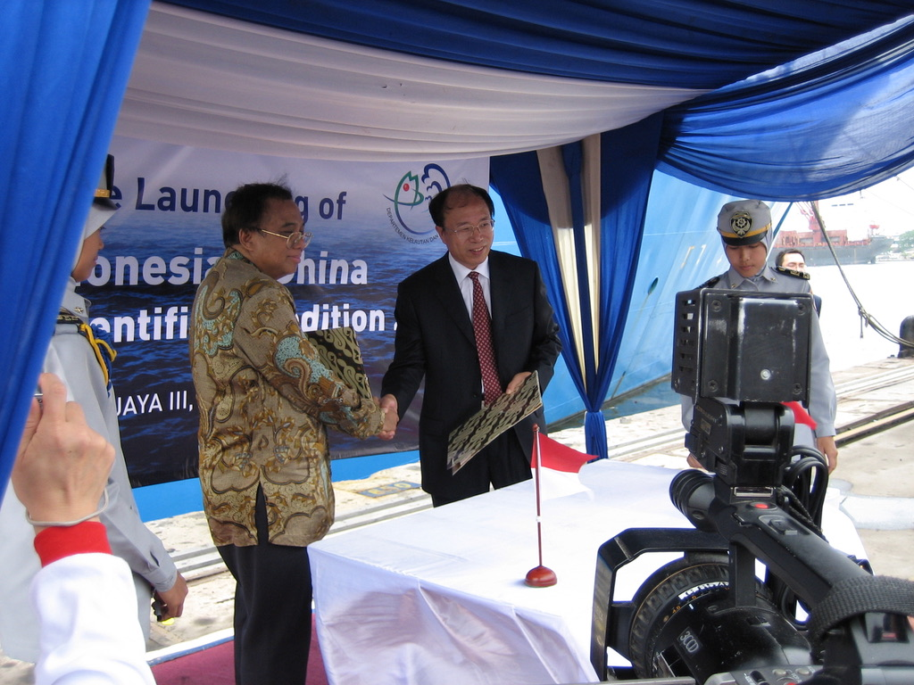
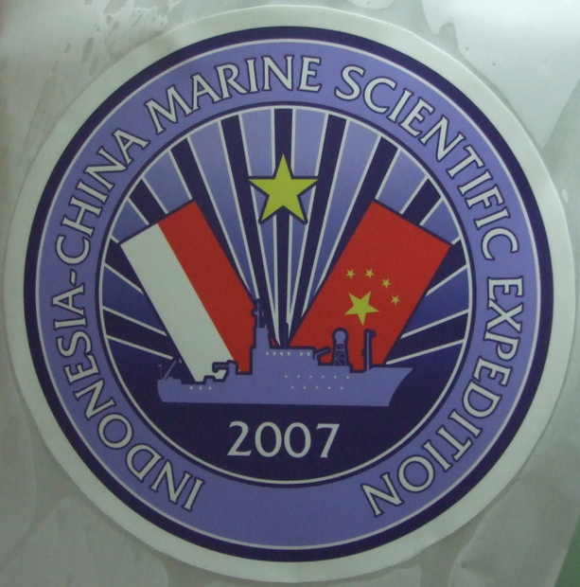
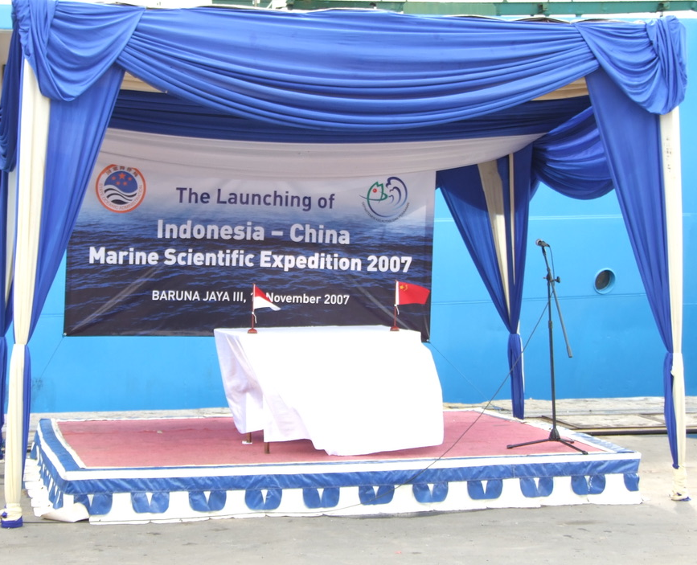
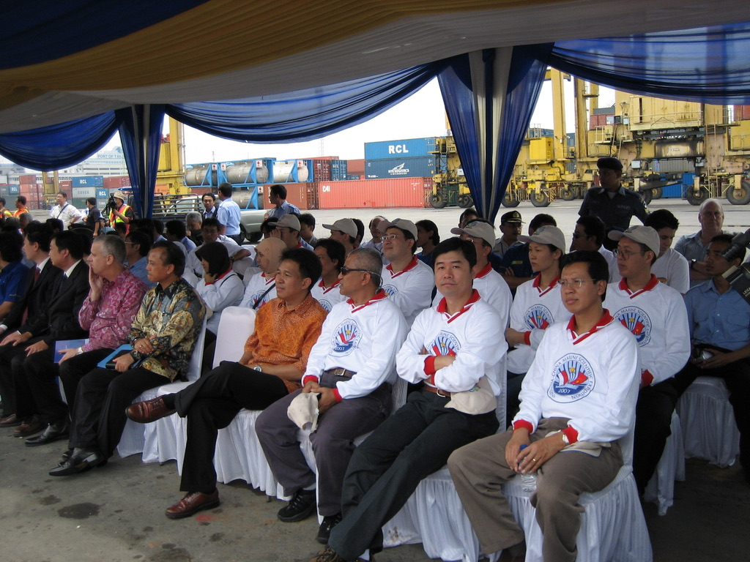
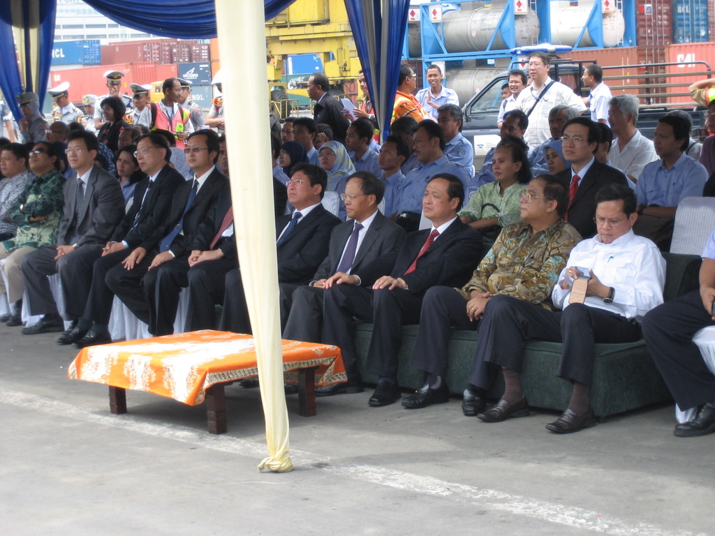
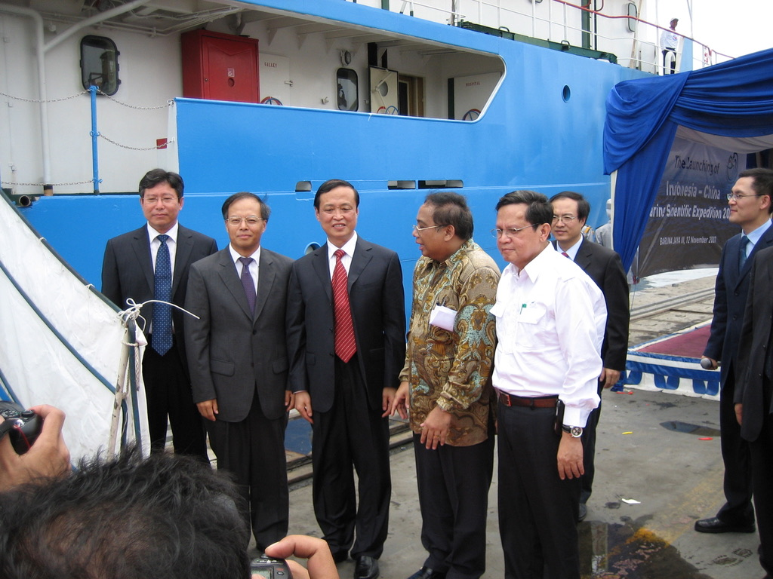
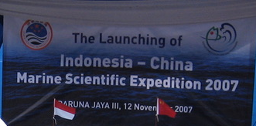
The Launching of the Indonesia-China Marine Scientific Expedition 2007
-- onboard R/V Baruna Java III

Slide 3
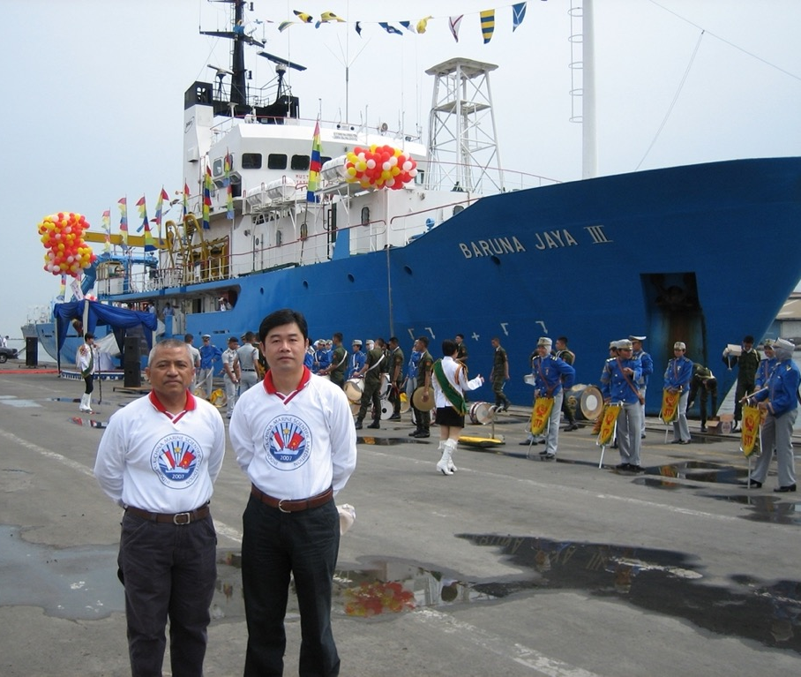

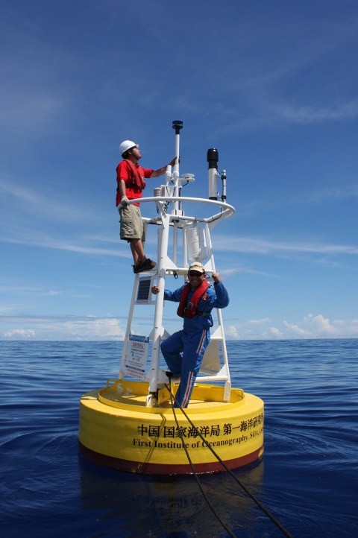
My 1st Indian Ocean Cruise（Nov. 12, 2007）
My 1st buoy deployment in Indian Ocean（May 30, 2010)

Slide 4
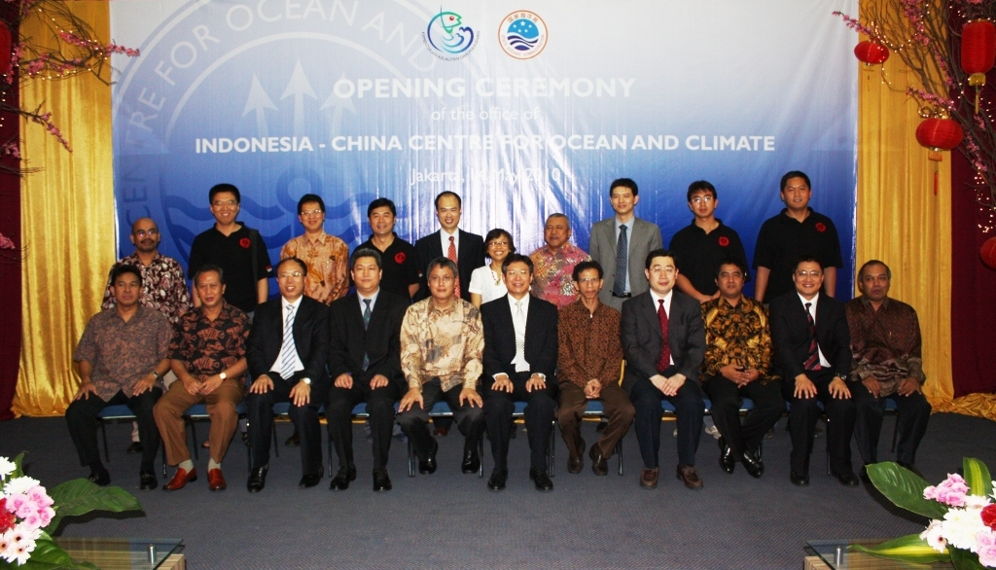
Launching Ceremony
May 14, 2010
中国－印尼海洋与气候联合研究中心

Slide 5
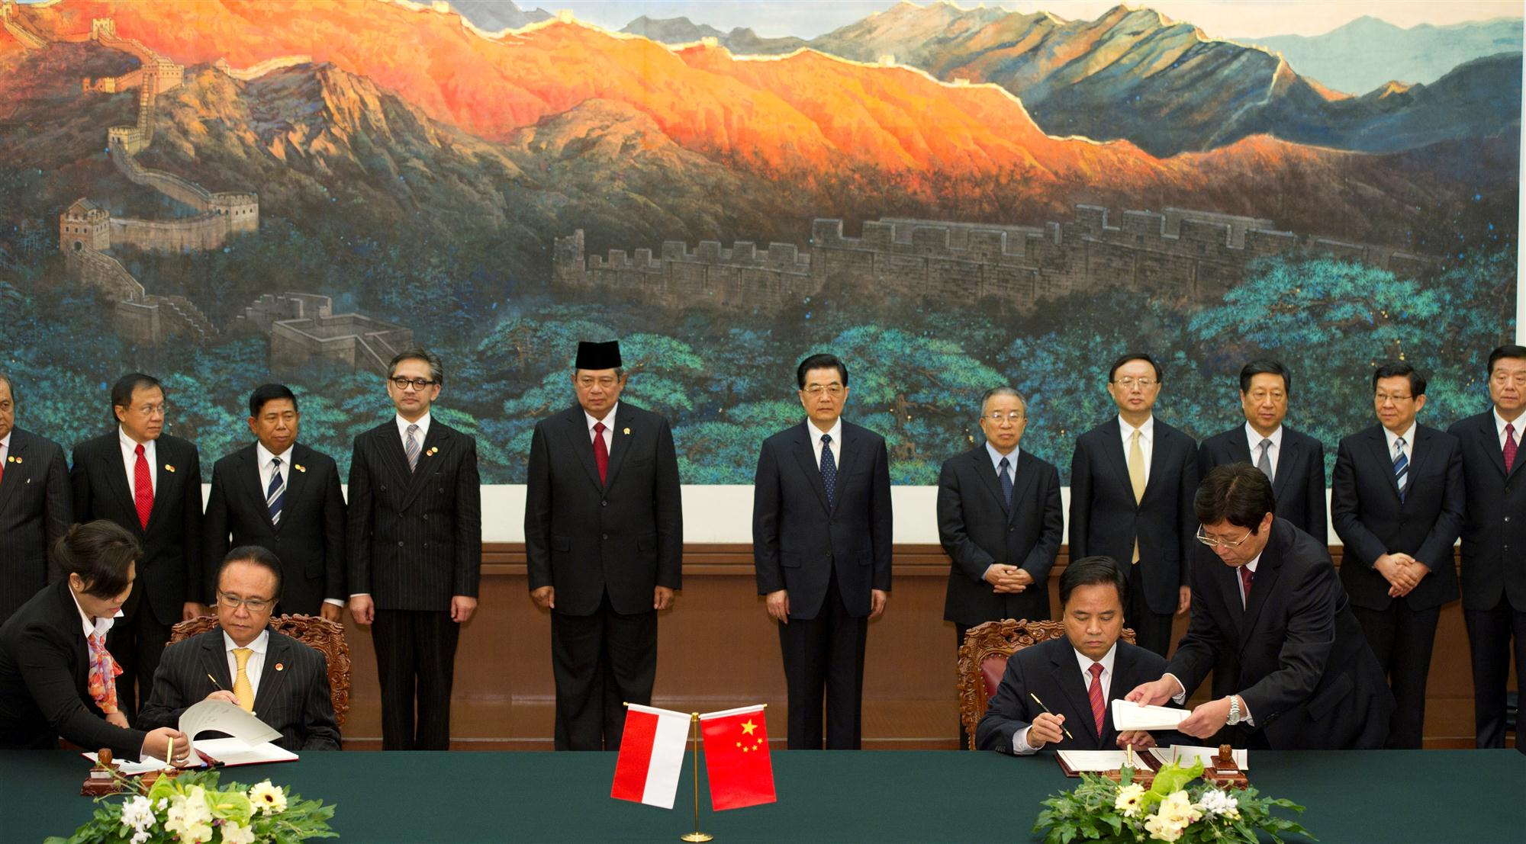
中国－印尼海洋与气候联合研究中心
ICCOC Development Arrangement SOA-MMAF
Beijing, Mar. 23, 2012

Slide 6
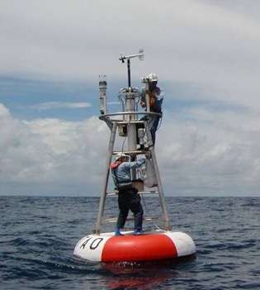
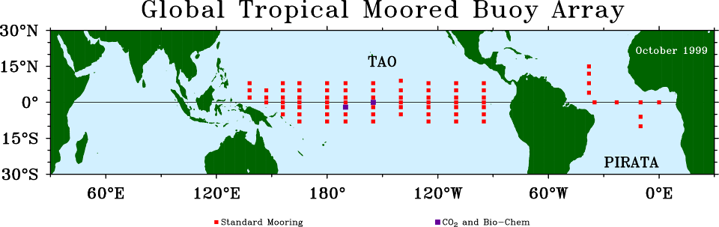

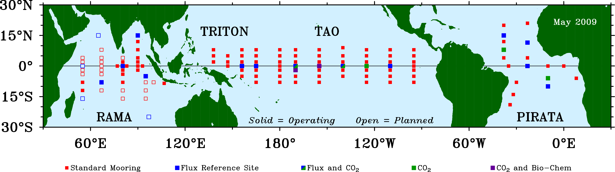
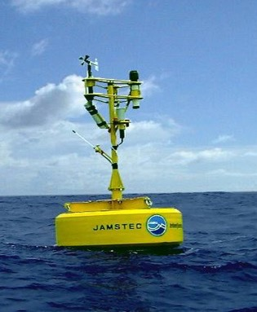
NOAA
FIO
Decadal Progress of tropical moored buoy array
JAMSTEC

Slide 7
What is the data value in shaping our science and reducing the risk?
Example 1. Cyclone
Example 2. Madden-Julian Oscillation

Slide 8
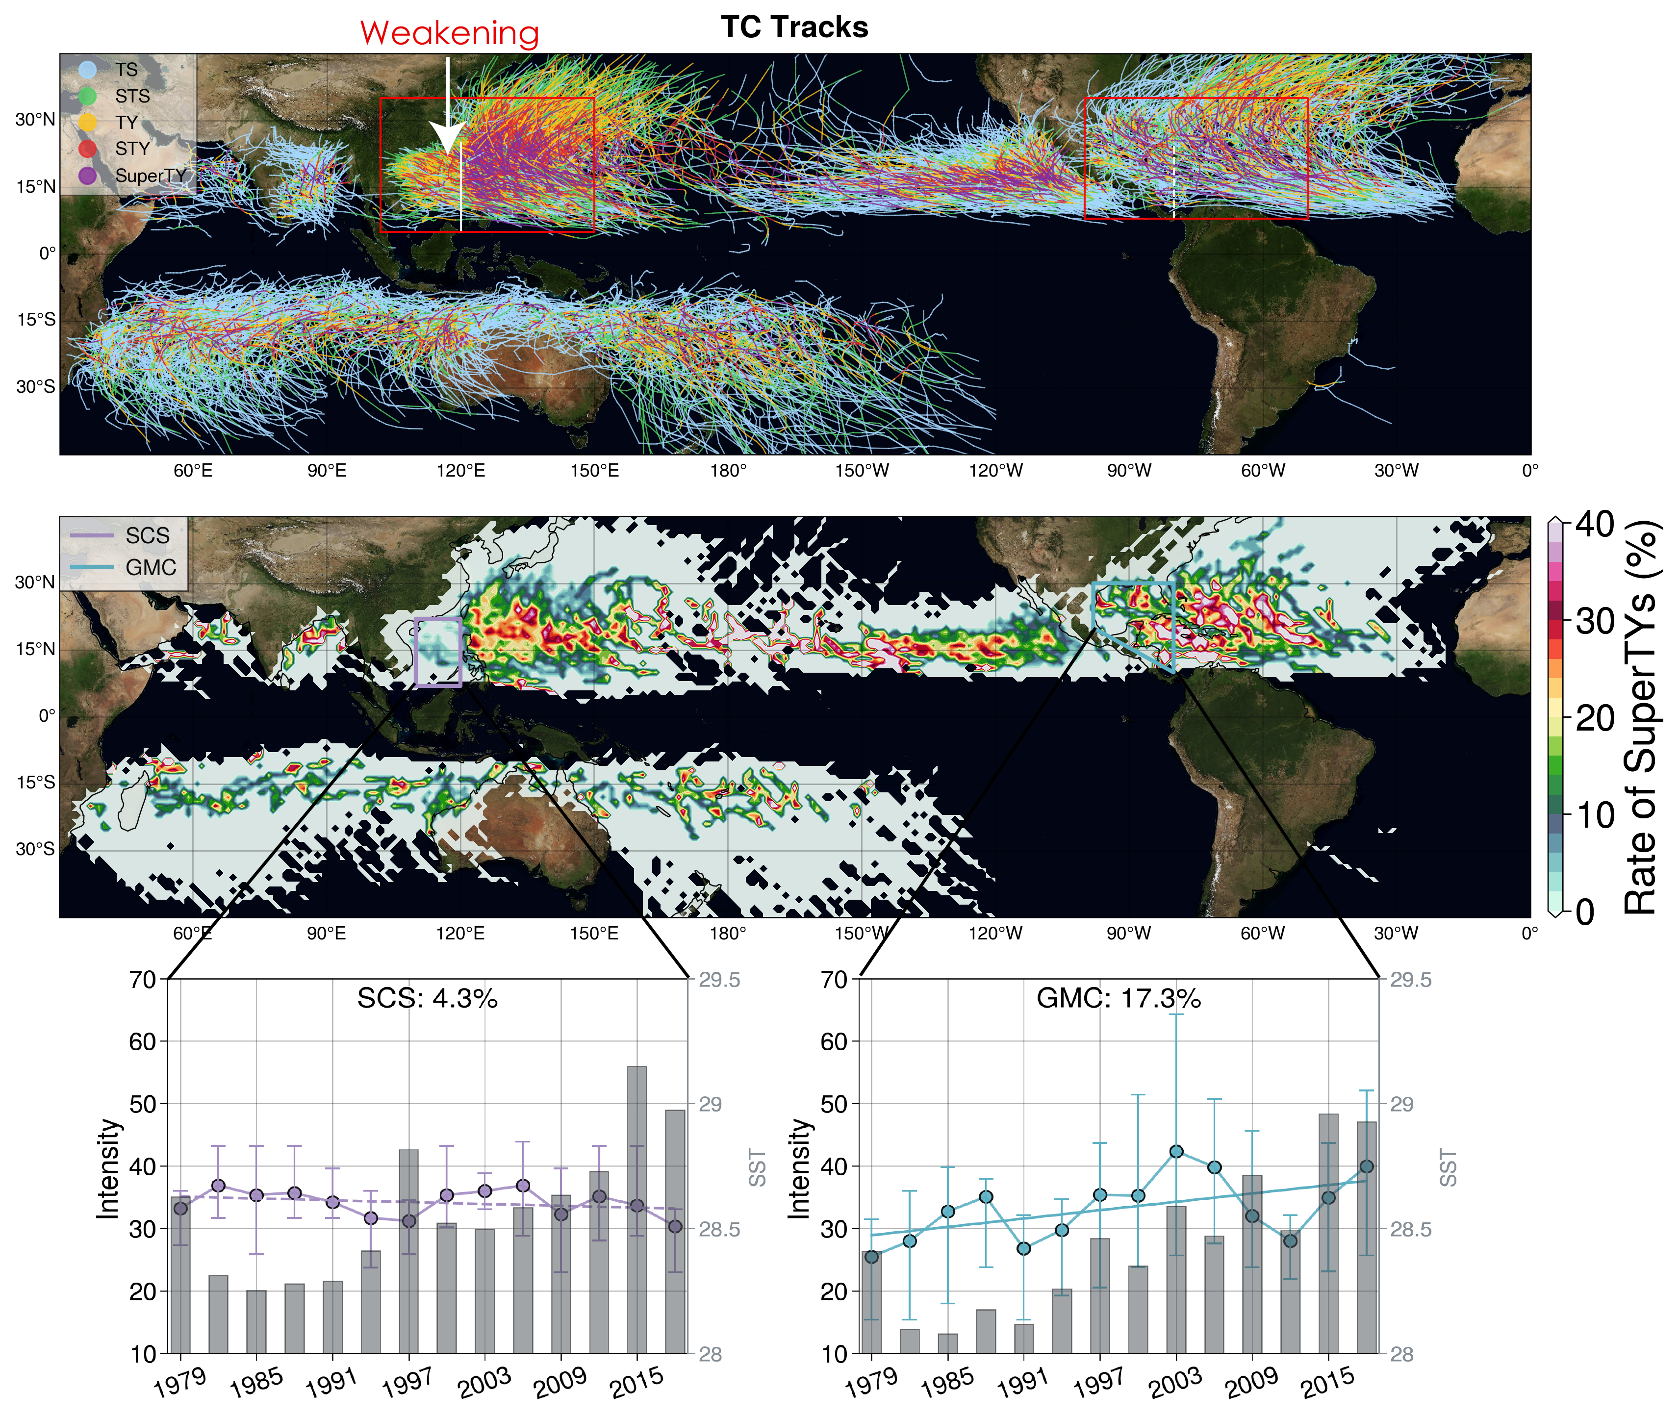
Example 1.
Cyclone
Cyclone Tracks
Corridor of
Super Cyclone
Ratio of
Super Cyclone
SCS：4.3%
Gulf of Mexico：17.3%

Slide 9
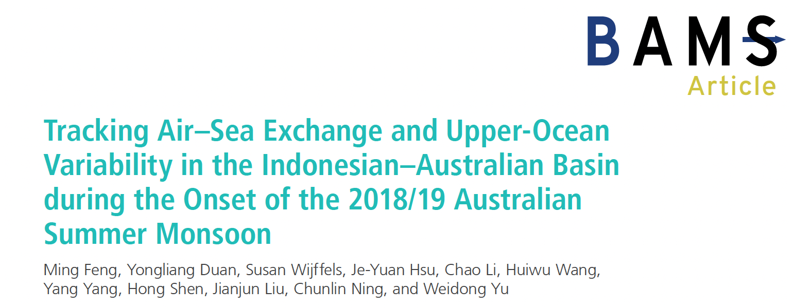
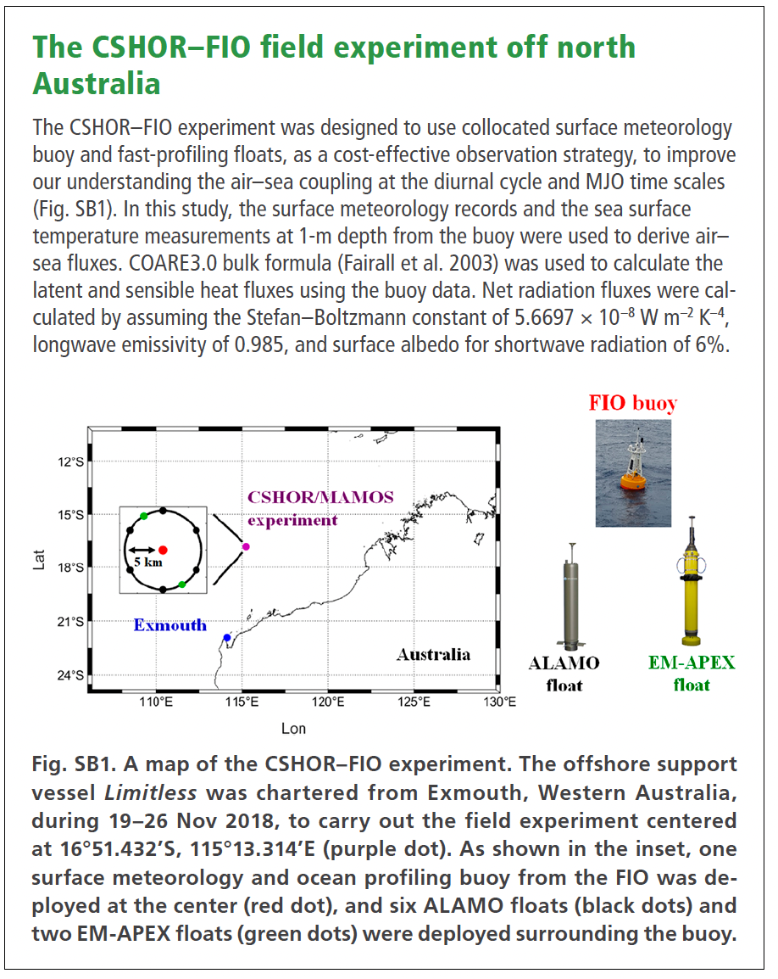
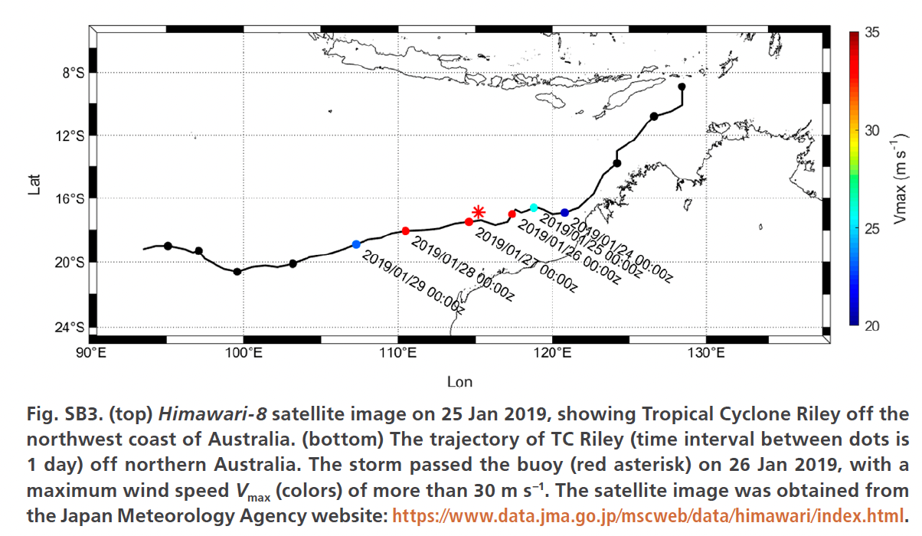

Slide 10
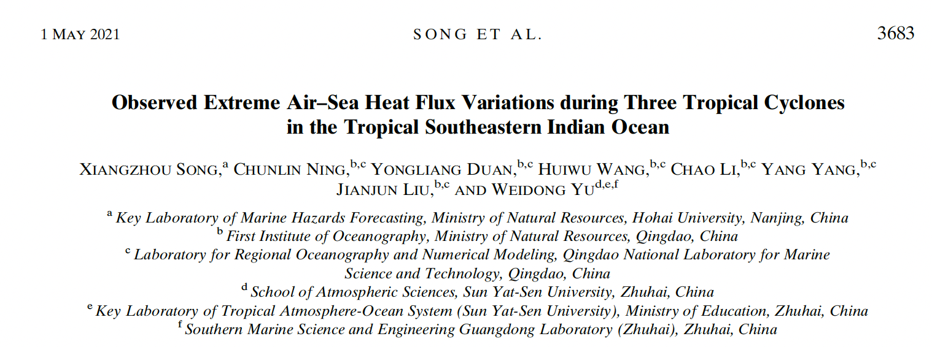
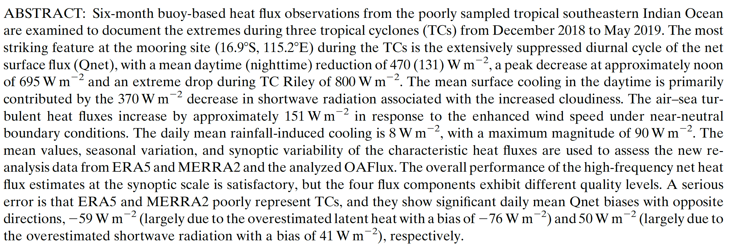

Slide 11
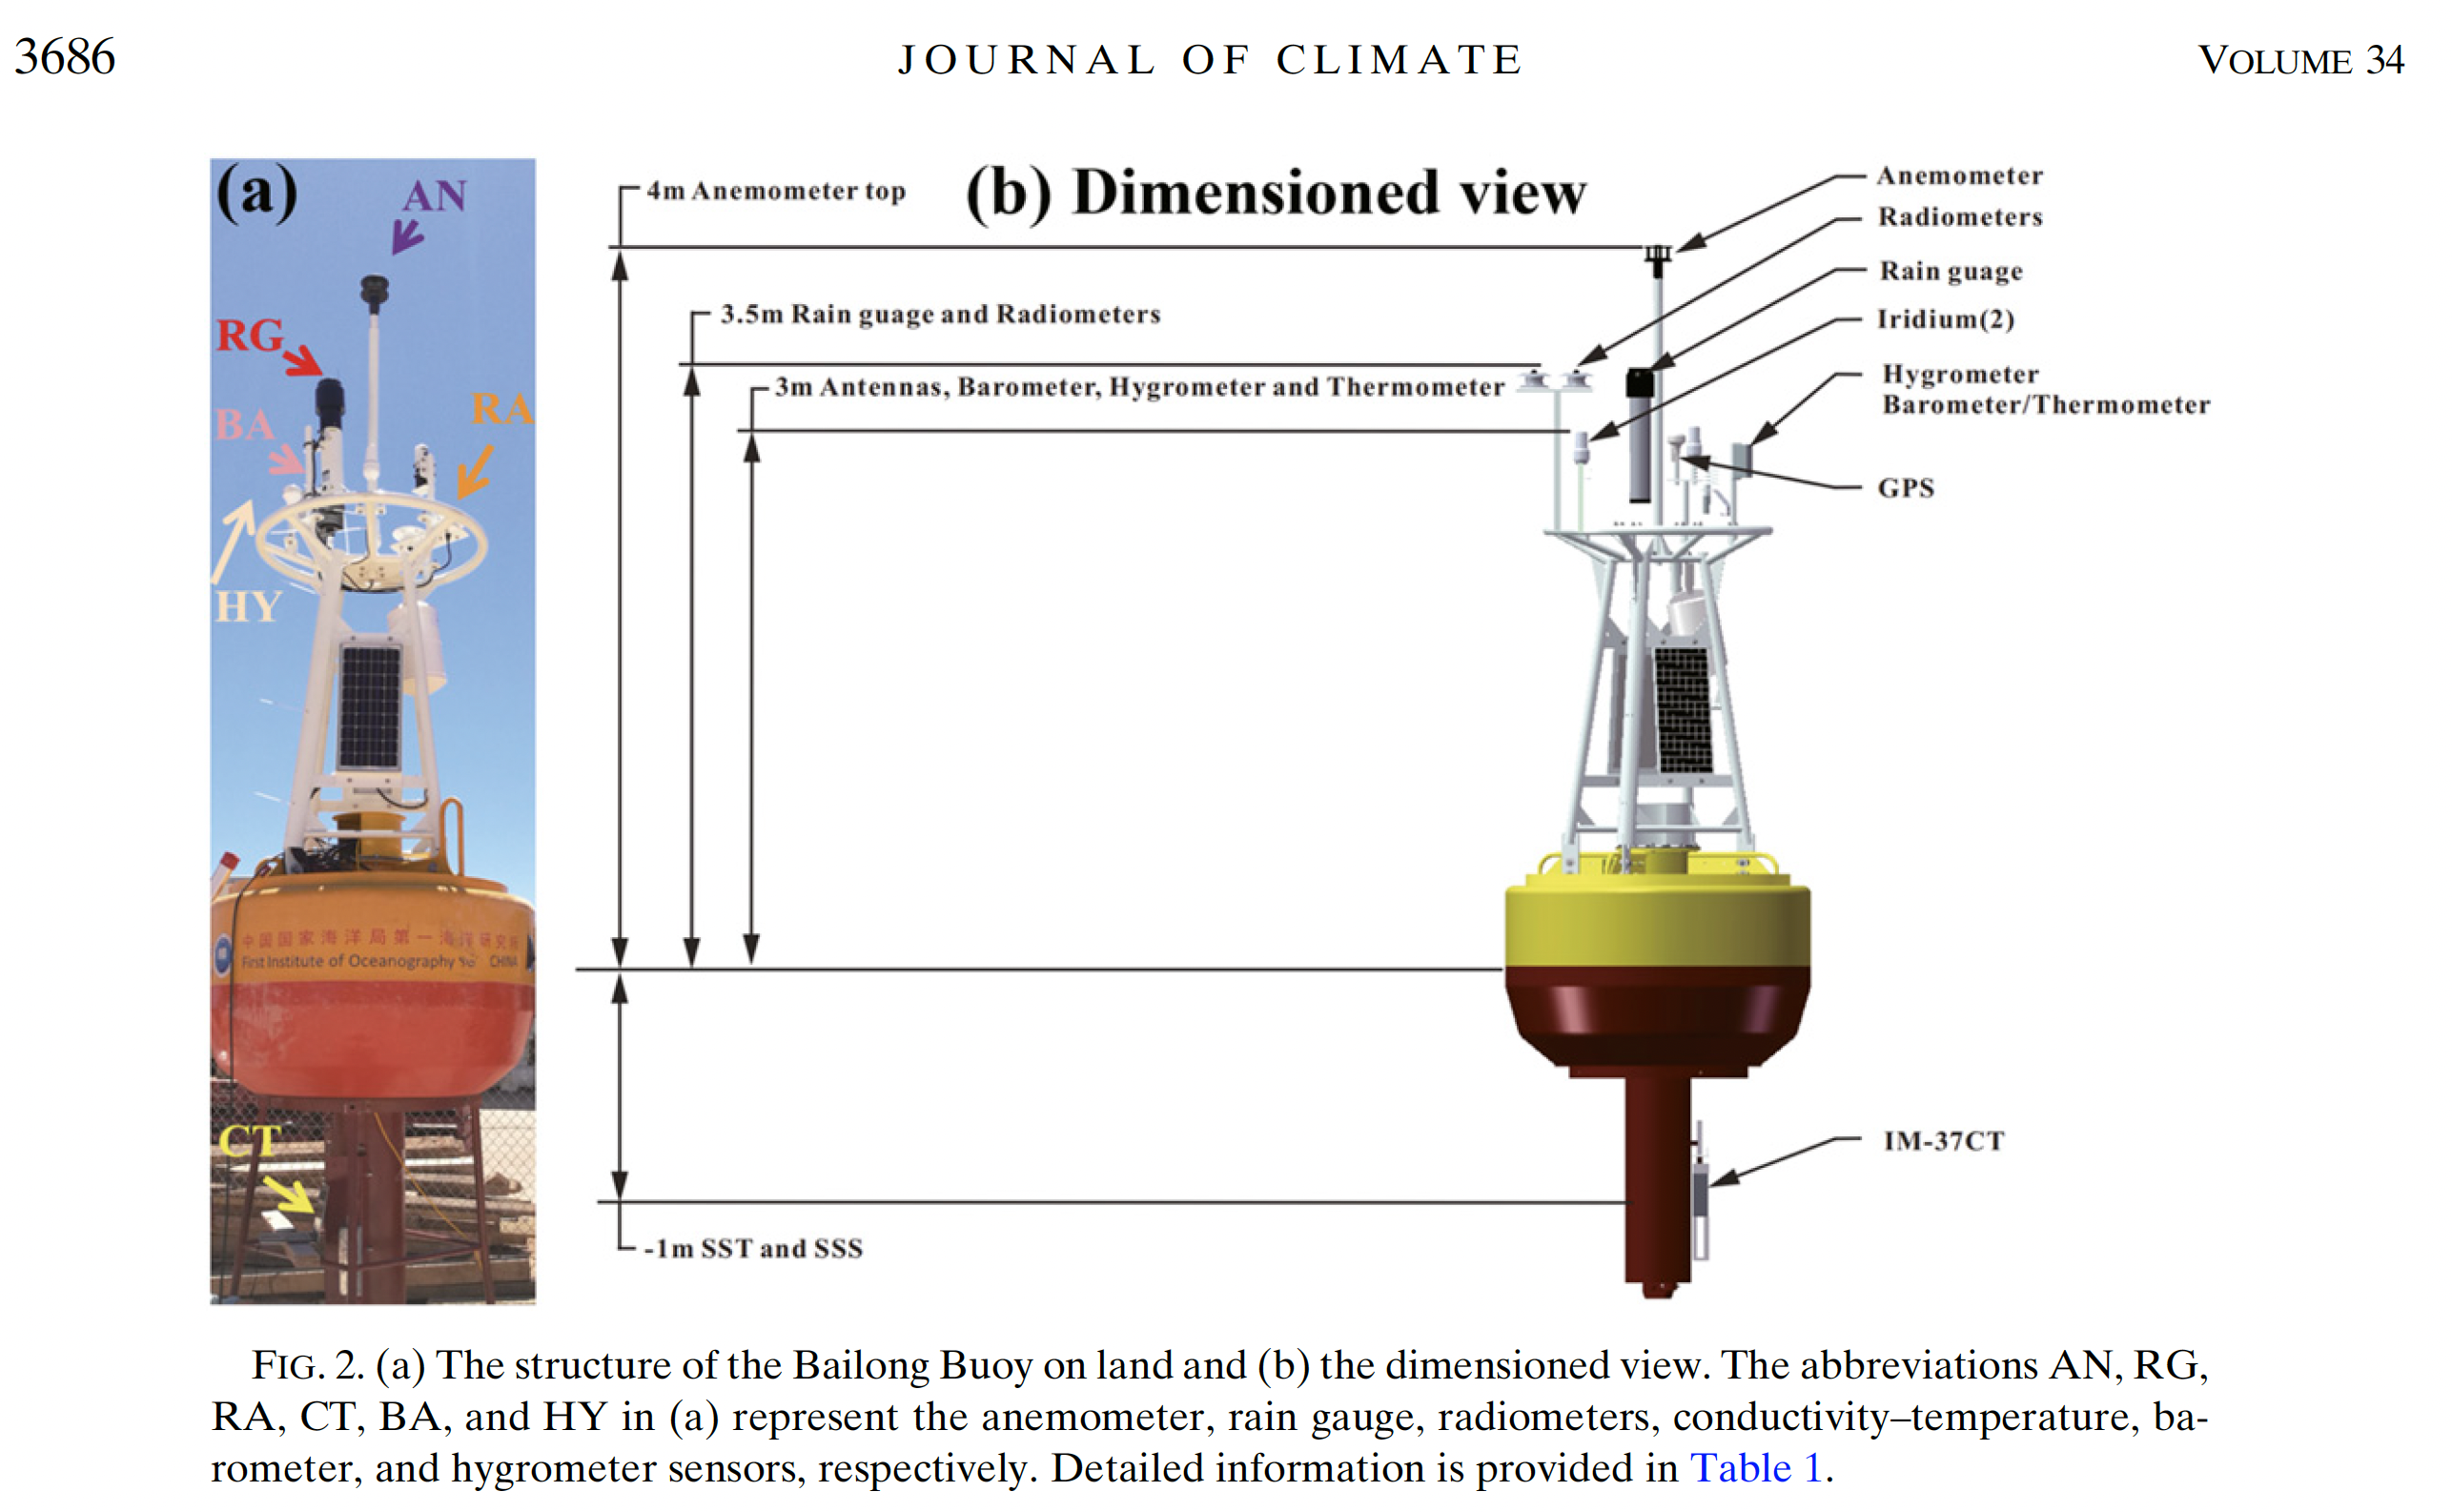
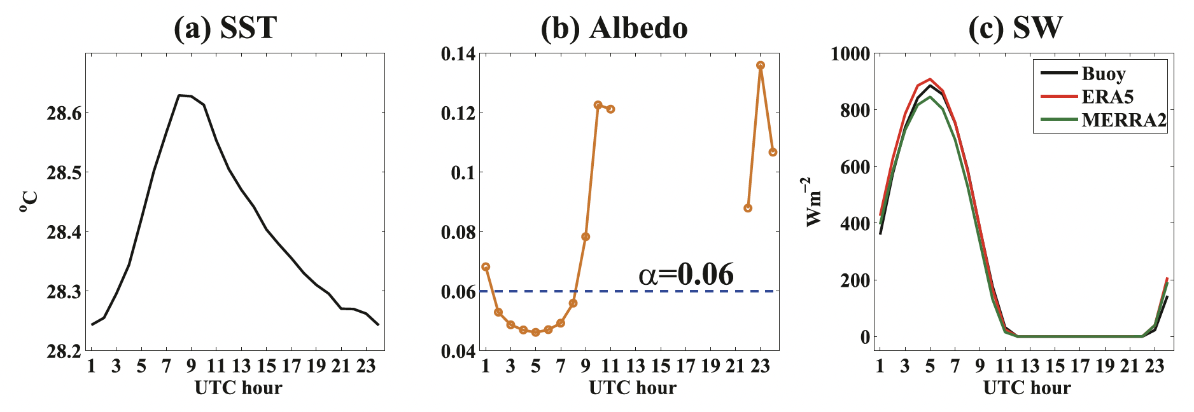

Slide 12
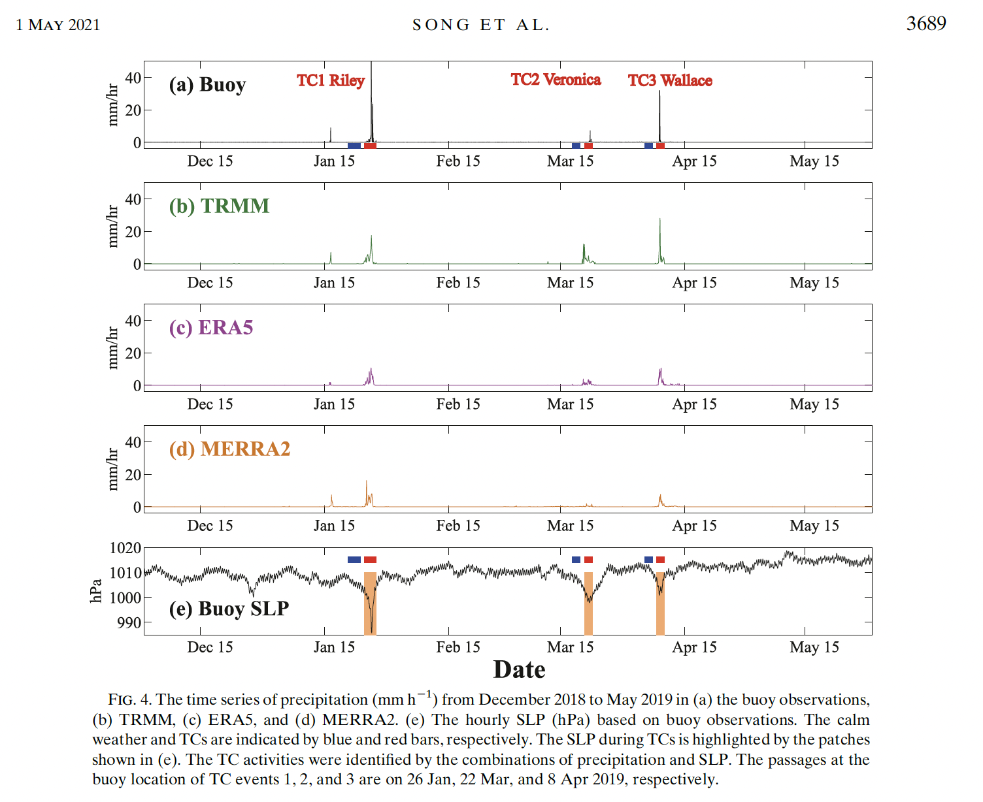

Slide 13
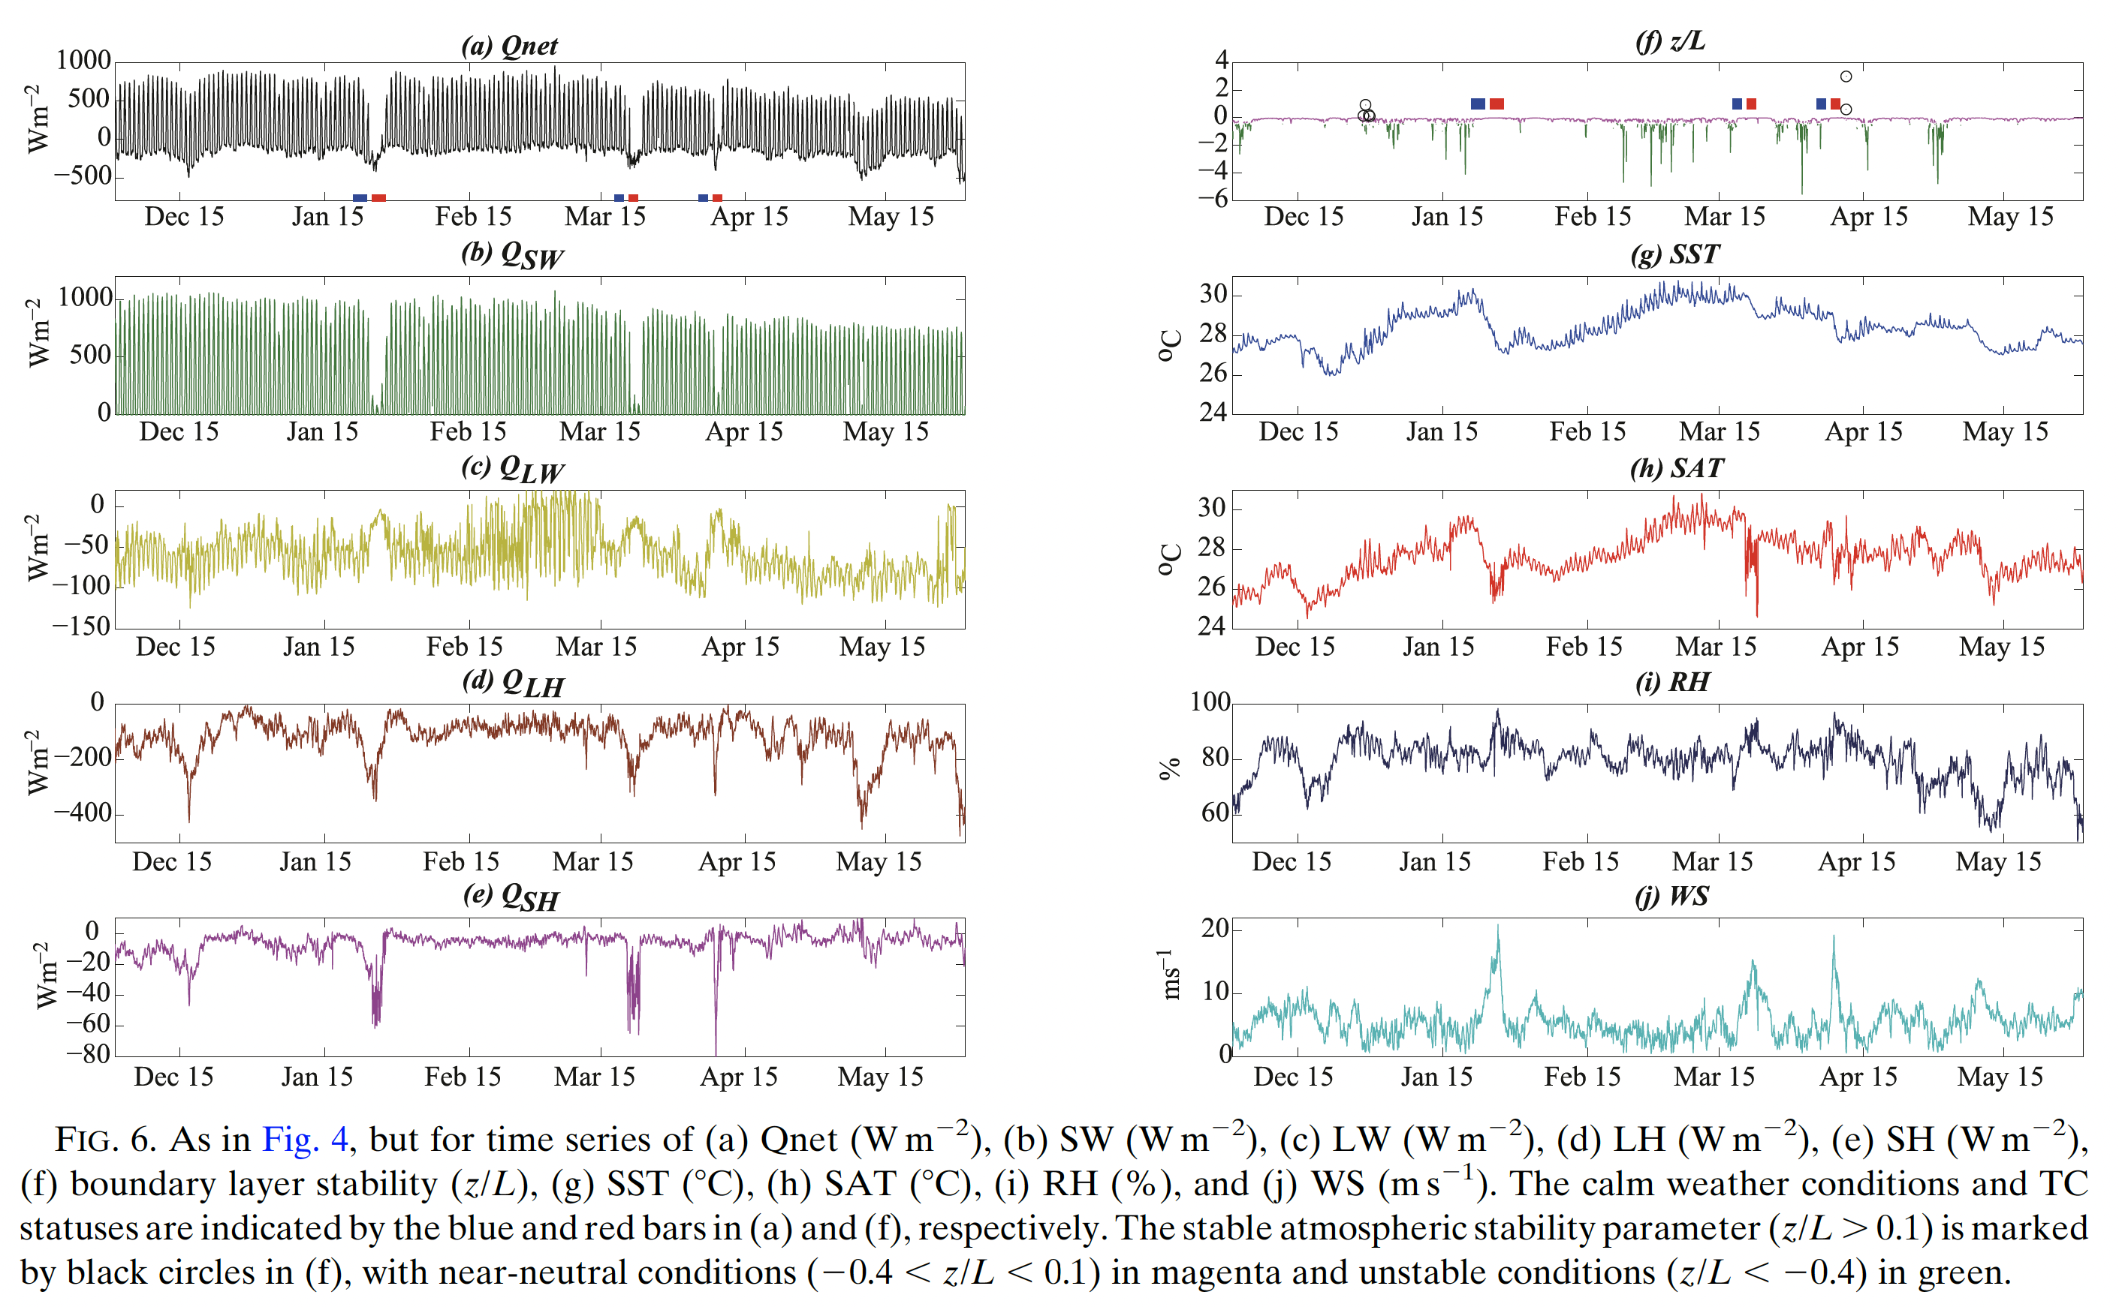

Slide 14
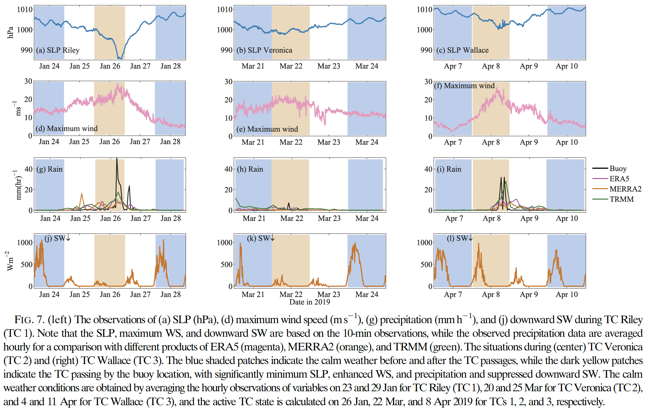

Slide 15
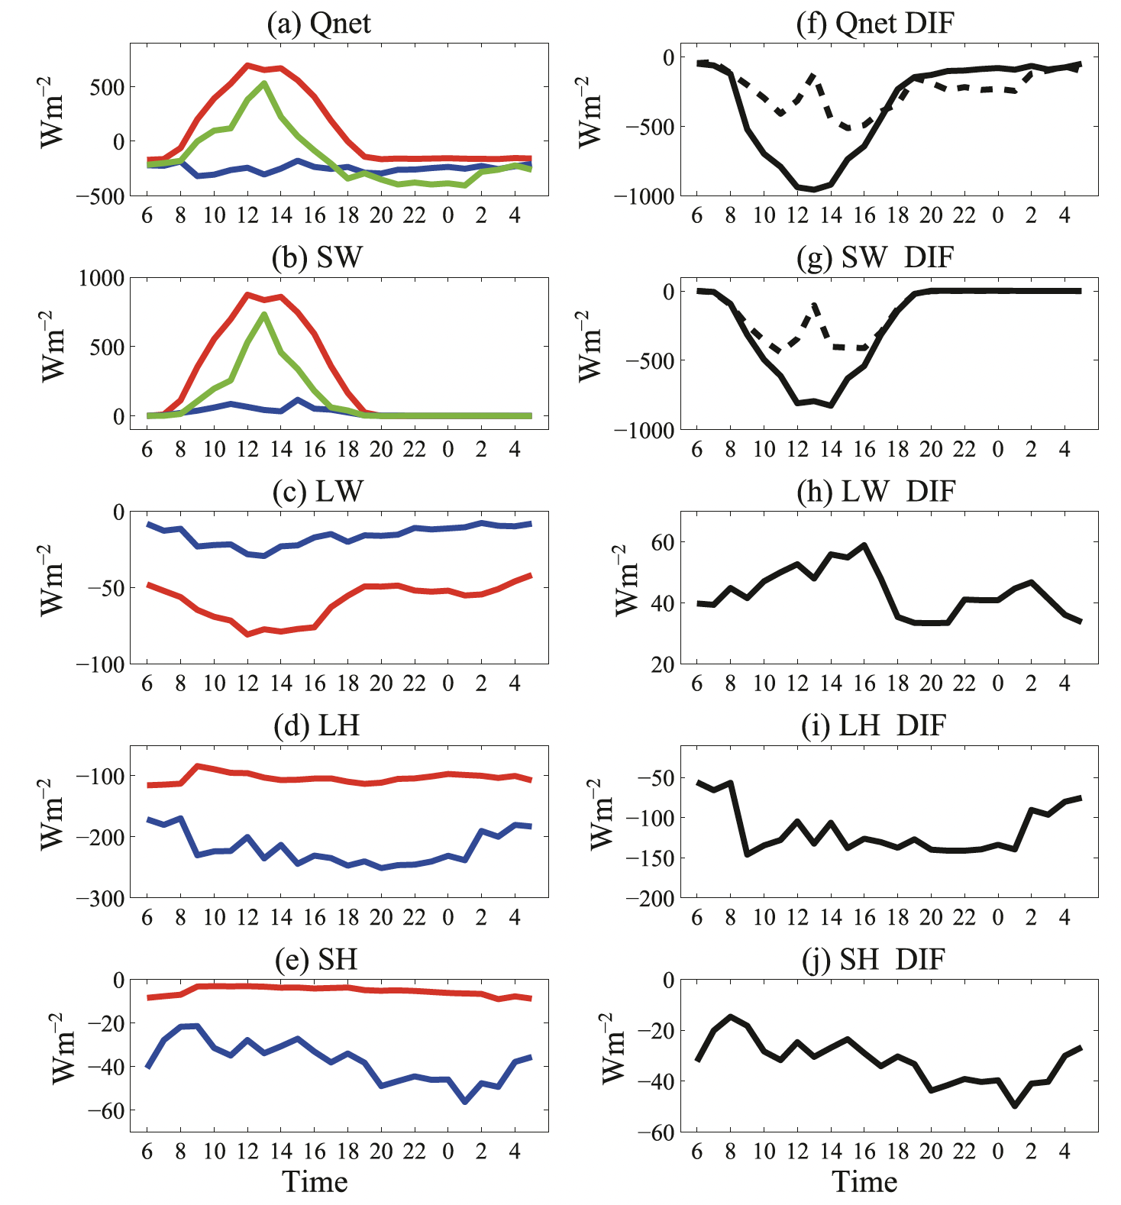
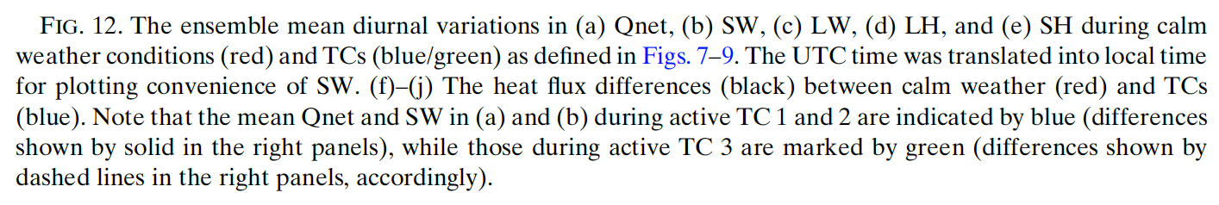
Dramatically Suppressed diurnal cycle in Qnet
✓
Dramatically Suppressed diurnal cycle in SW
Reduced LW
✓
Significantly Enhanced LH
Enhanced SH

Slide 16
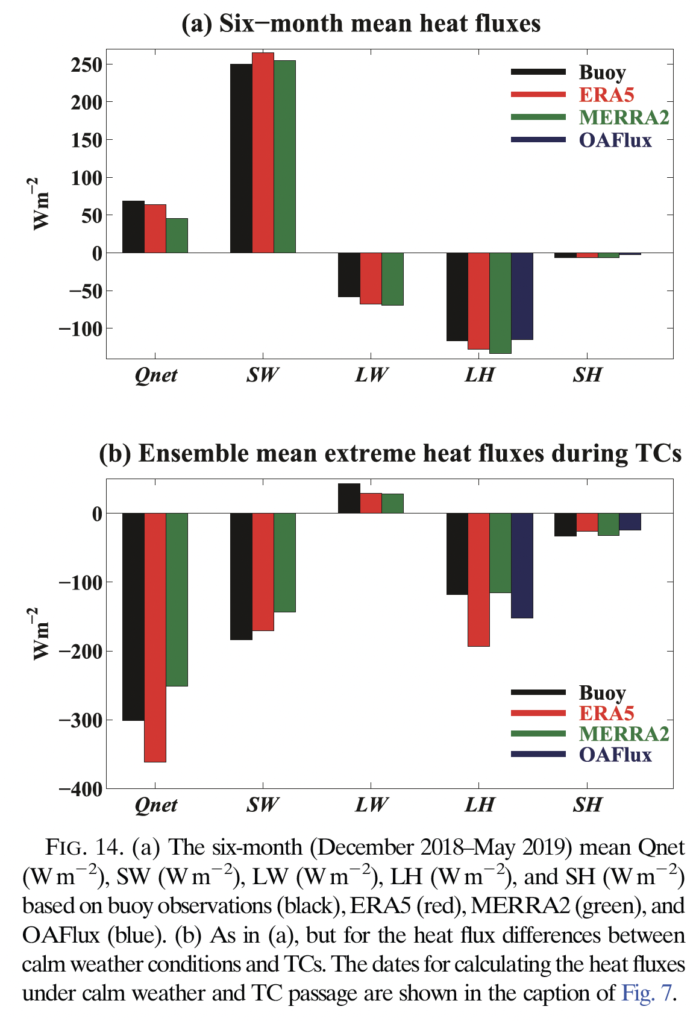
The Re-analysis data sets (ERA, MERRA, OAFlux) exhibit reasonable consistency with observation on seasonal mean scale.
×
×
×
×
The Re-analysis data sets (ERA, MERRA, OAFlux) exhibit significant bias from observation for extreme events,
especially the overestimated/underestimated Qnet in ERA/MERRA, due to the overestimated LH in ERA and underestimated SW in MERRA.
OAFlux shows overestimated LW bias.

Slide 17
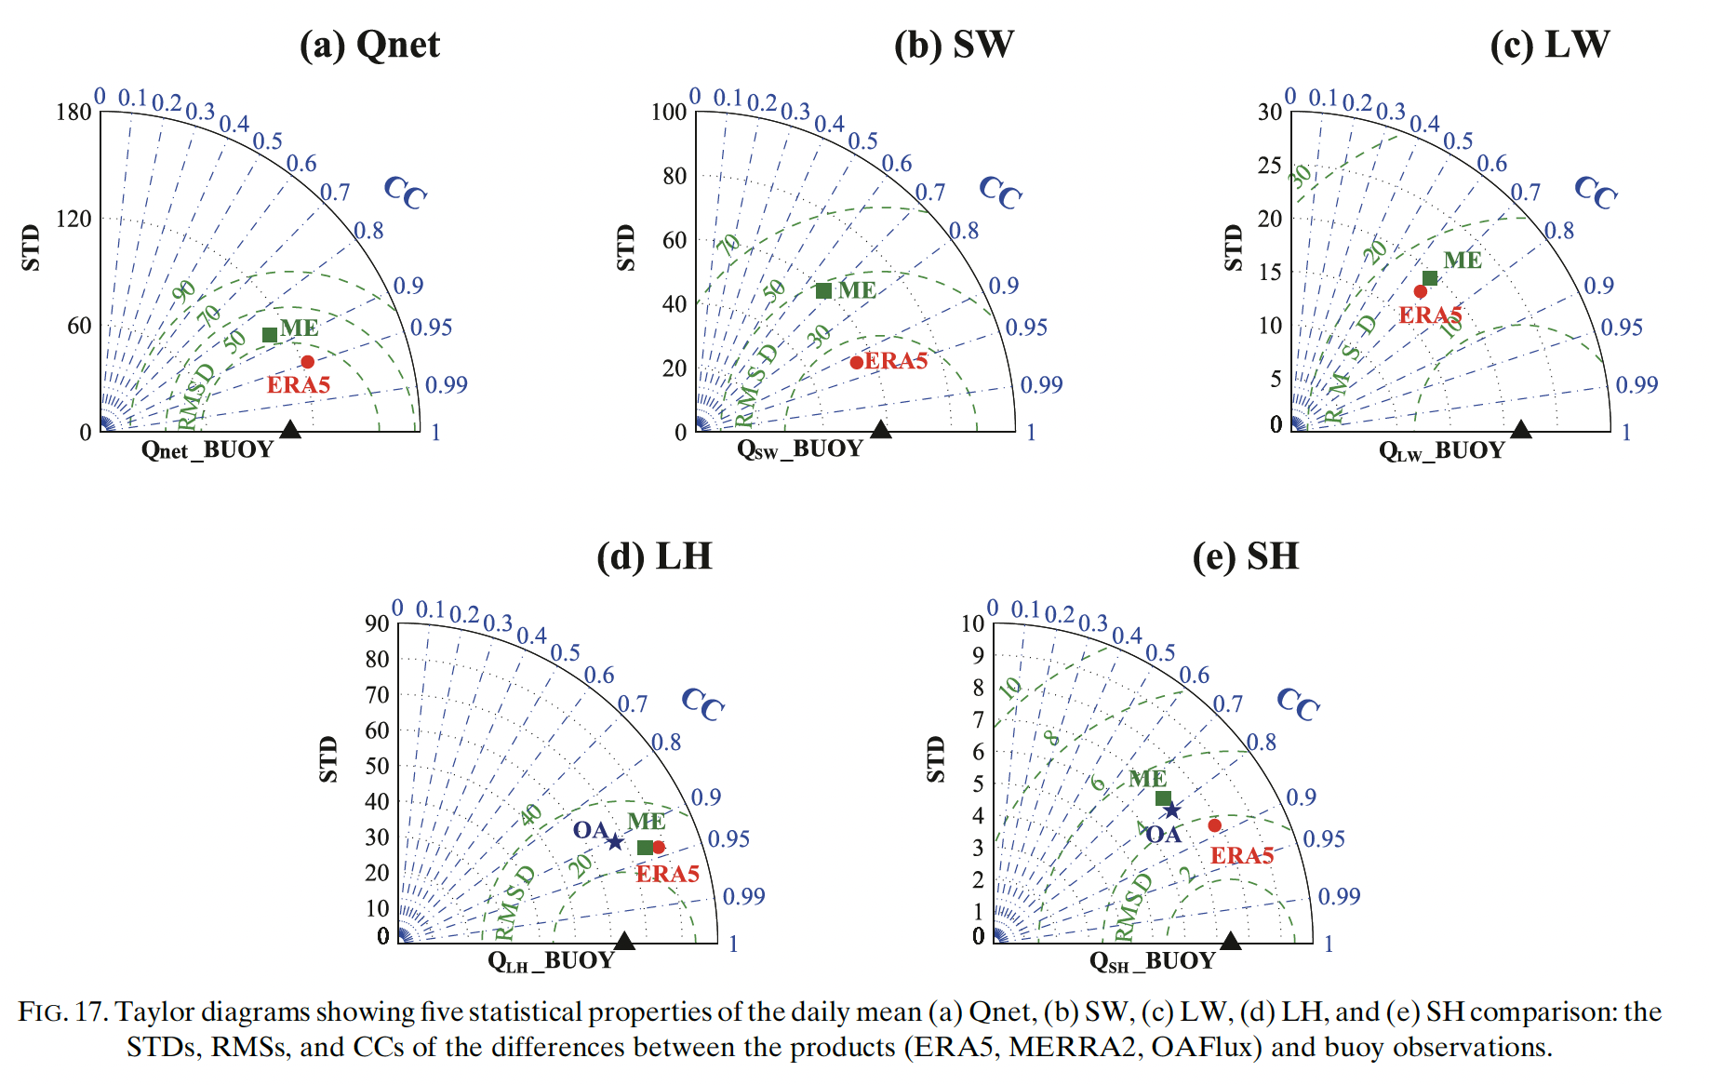
MERRA with significant bias
ERA with significant bias

Slide 18
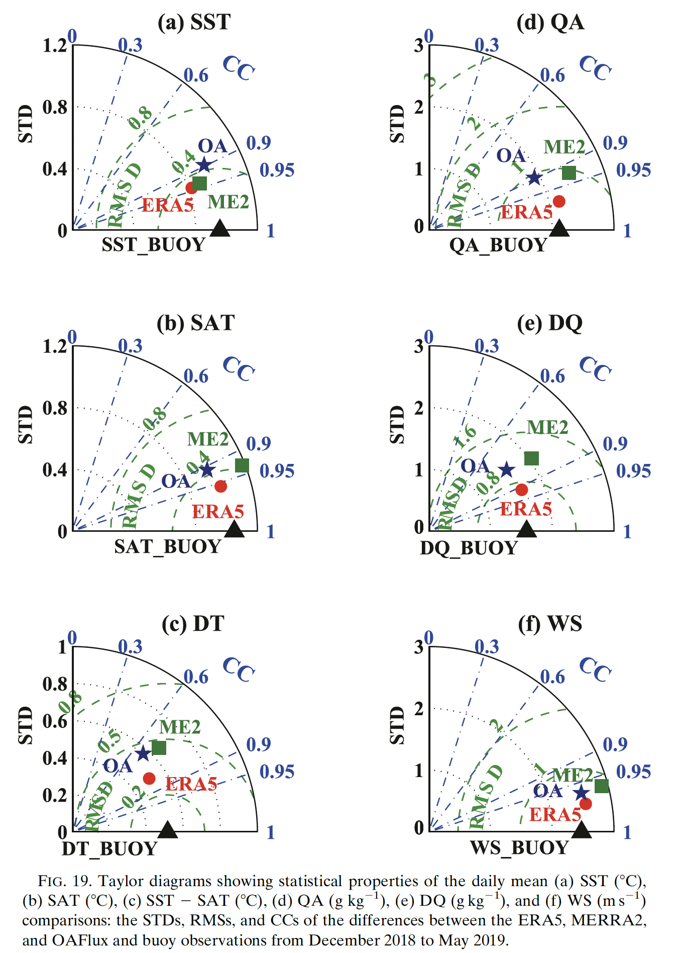
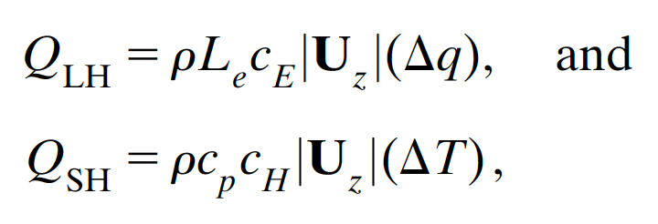
ERA bias in LH is more associated with SST and sea surface air RH, rather than the sea surface wind speed, calling for more SST and RH in situ observations as well as the data assimilation.

Slide 19
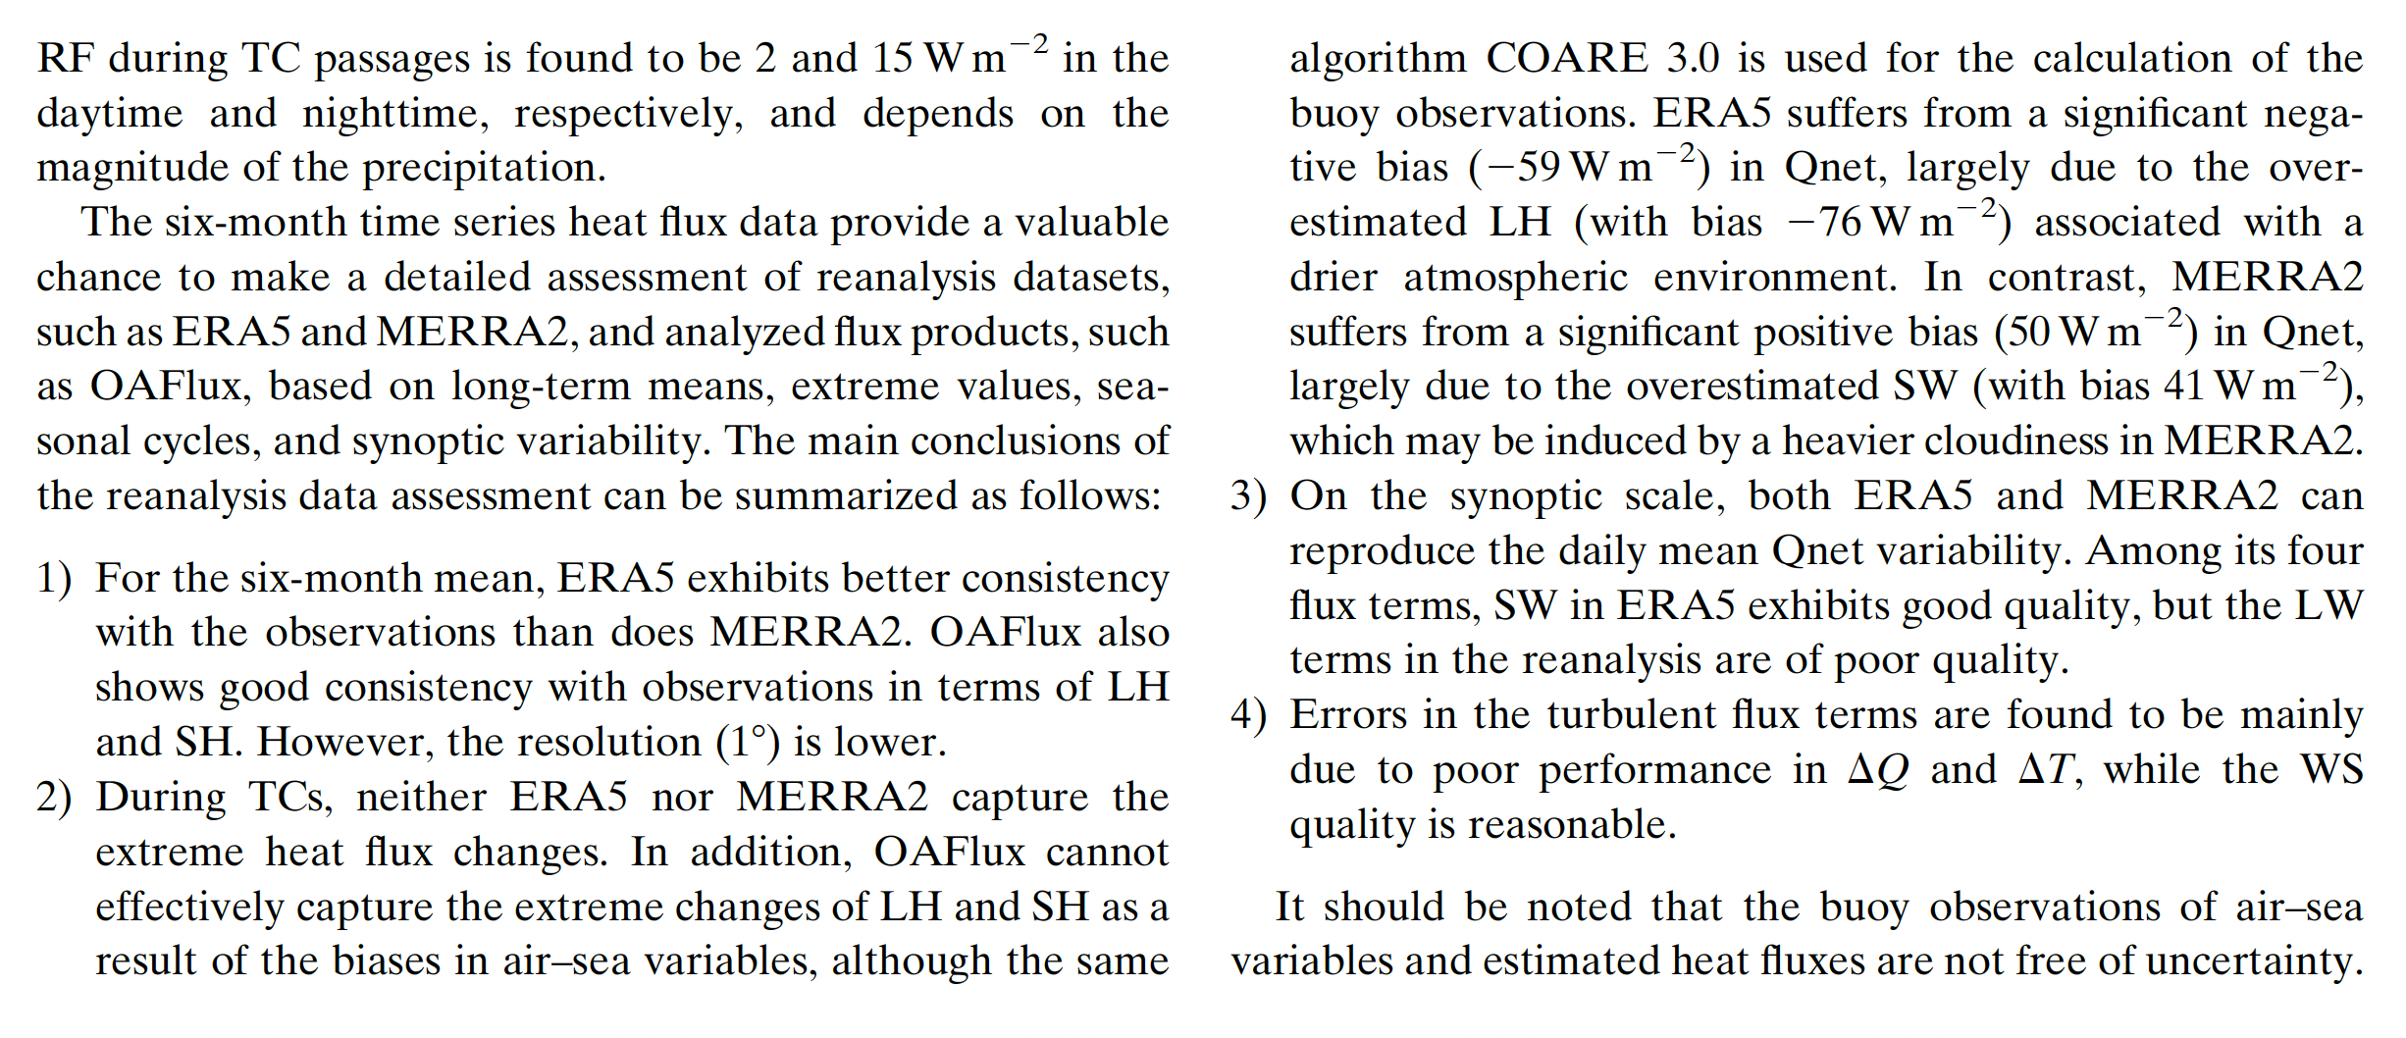
Conclusion on cyclone observation study

Slide 20
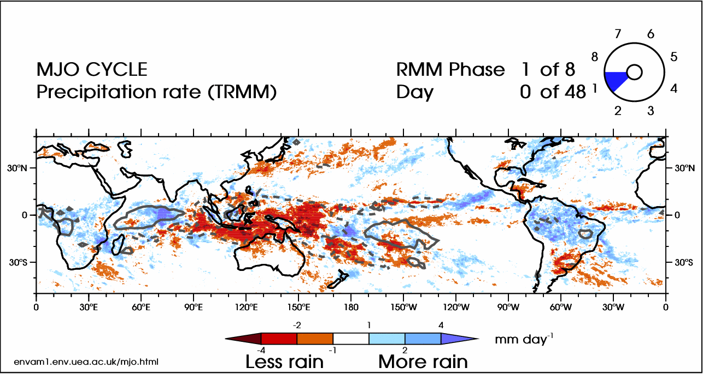

Slide 21
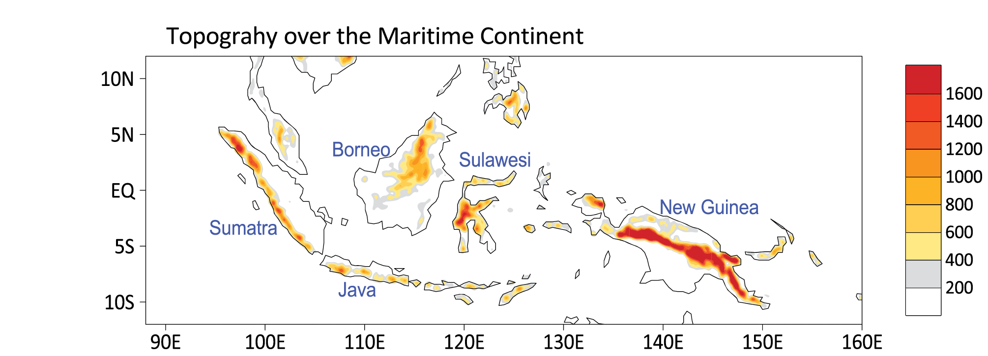
Maritime Continent′s Barrier effect for MJO eastward propagation
Jiang et al., 2019, JGR-Atmosphere

Slide 22
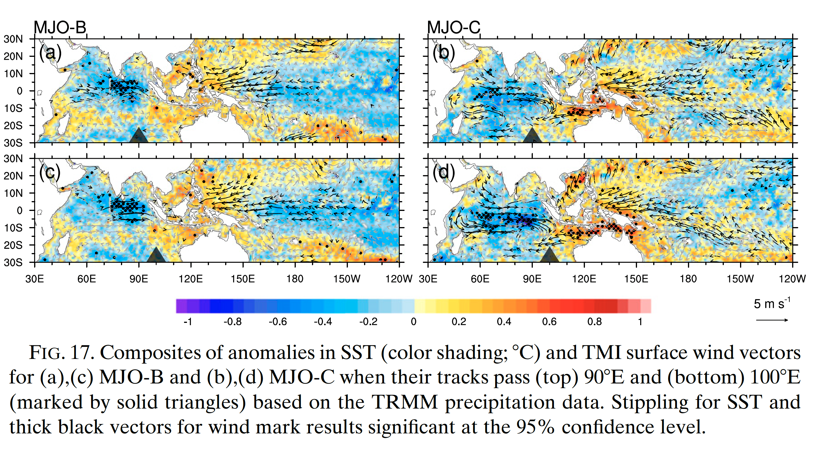

Slide 23
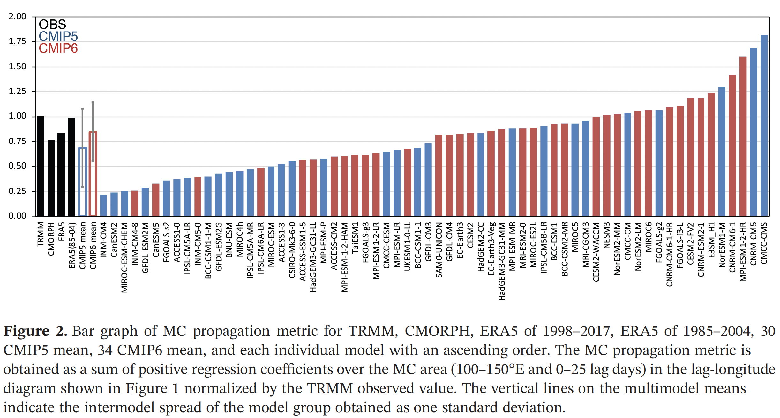
Ahn et al., 2020, GRL

Slide 24
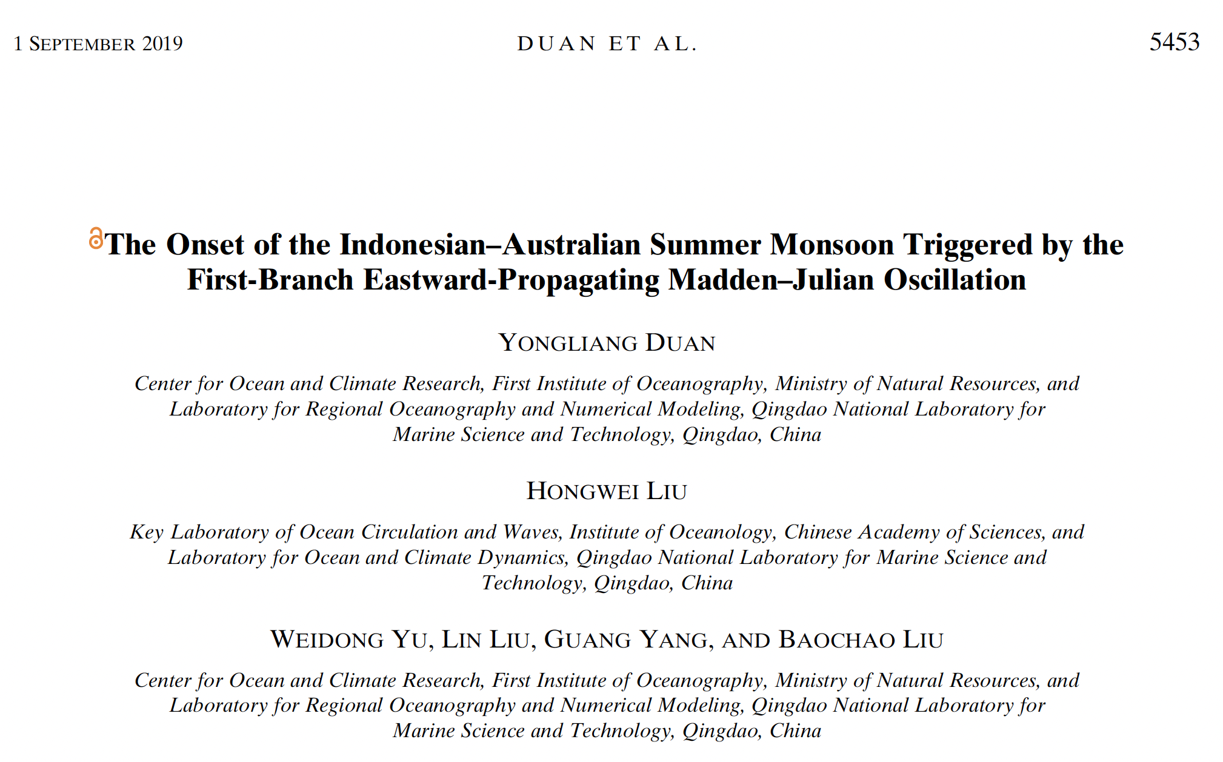
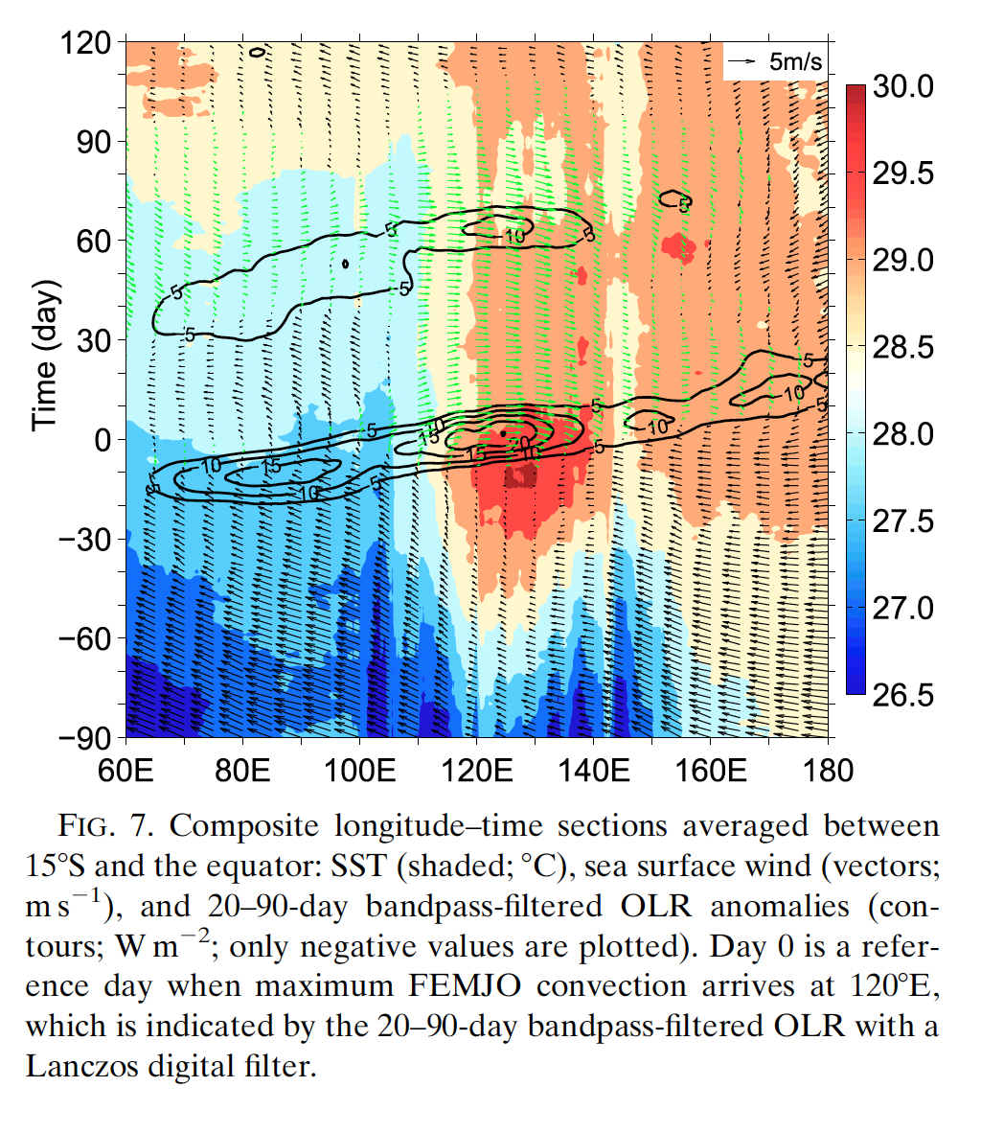

Slide 25
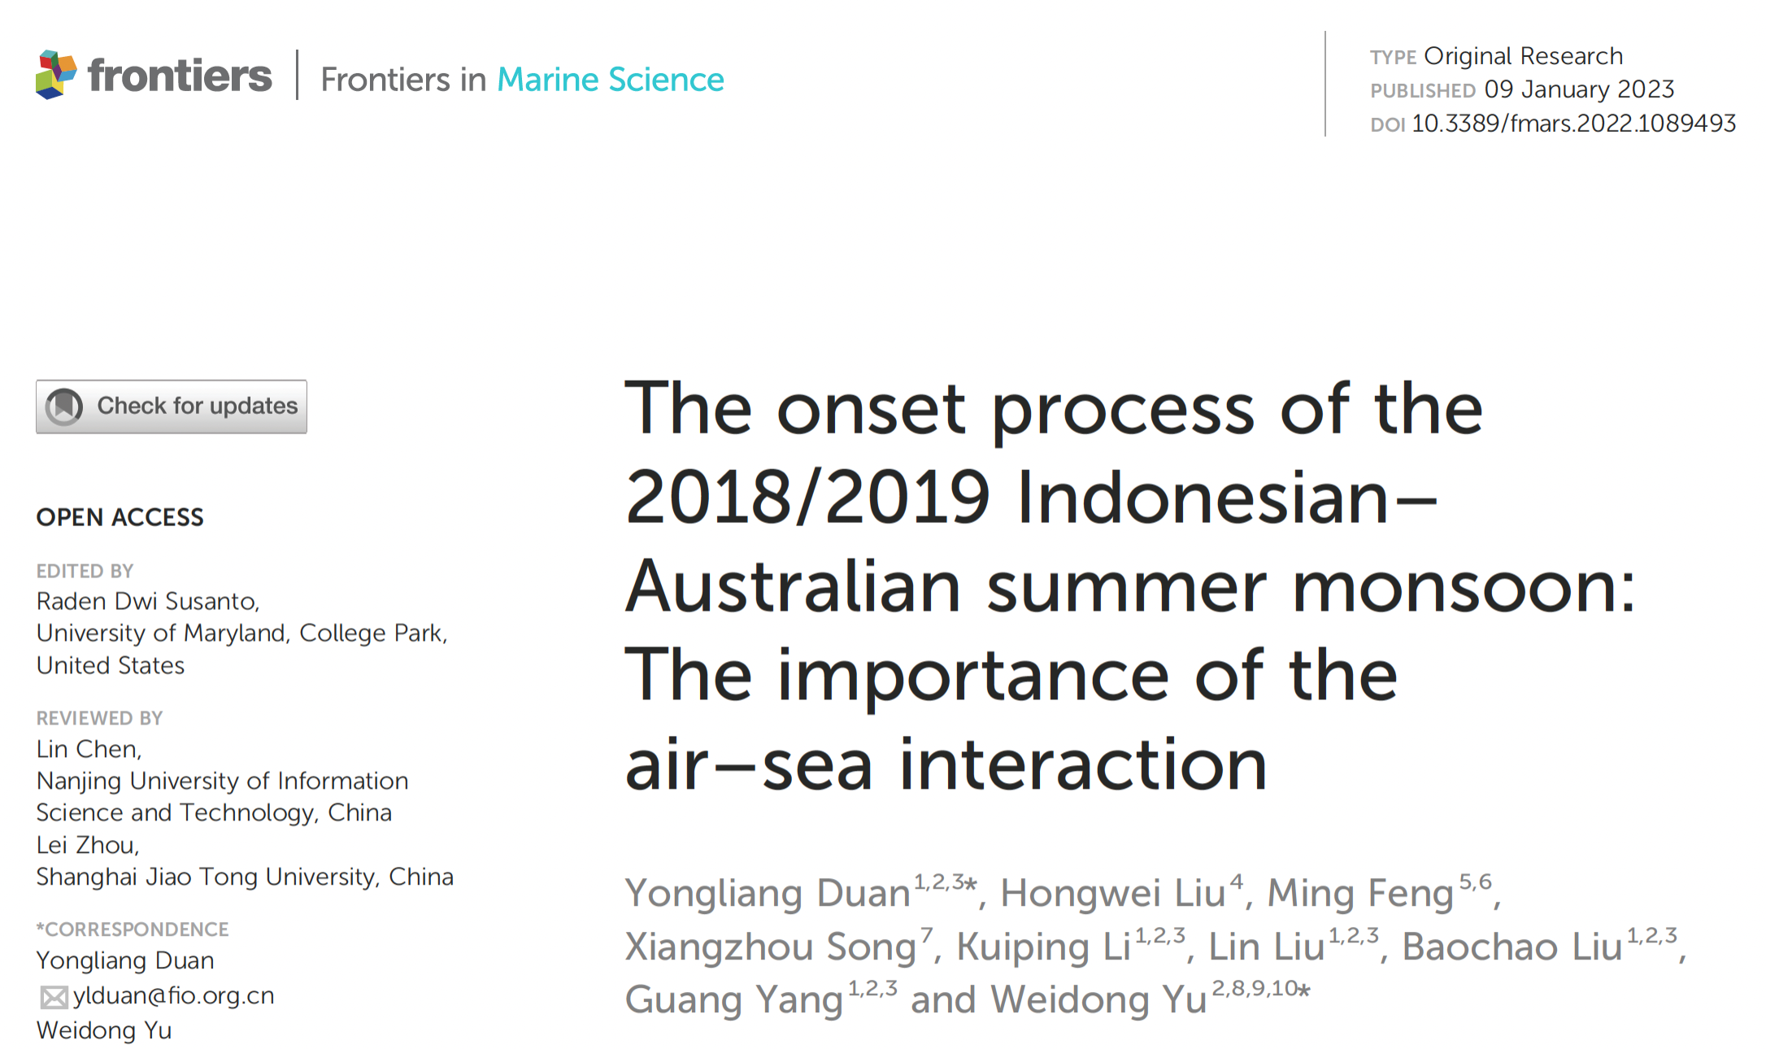
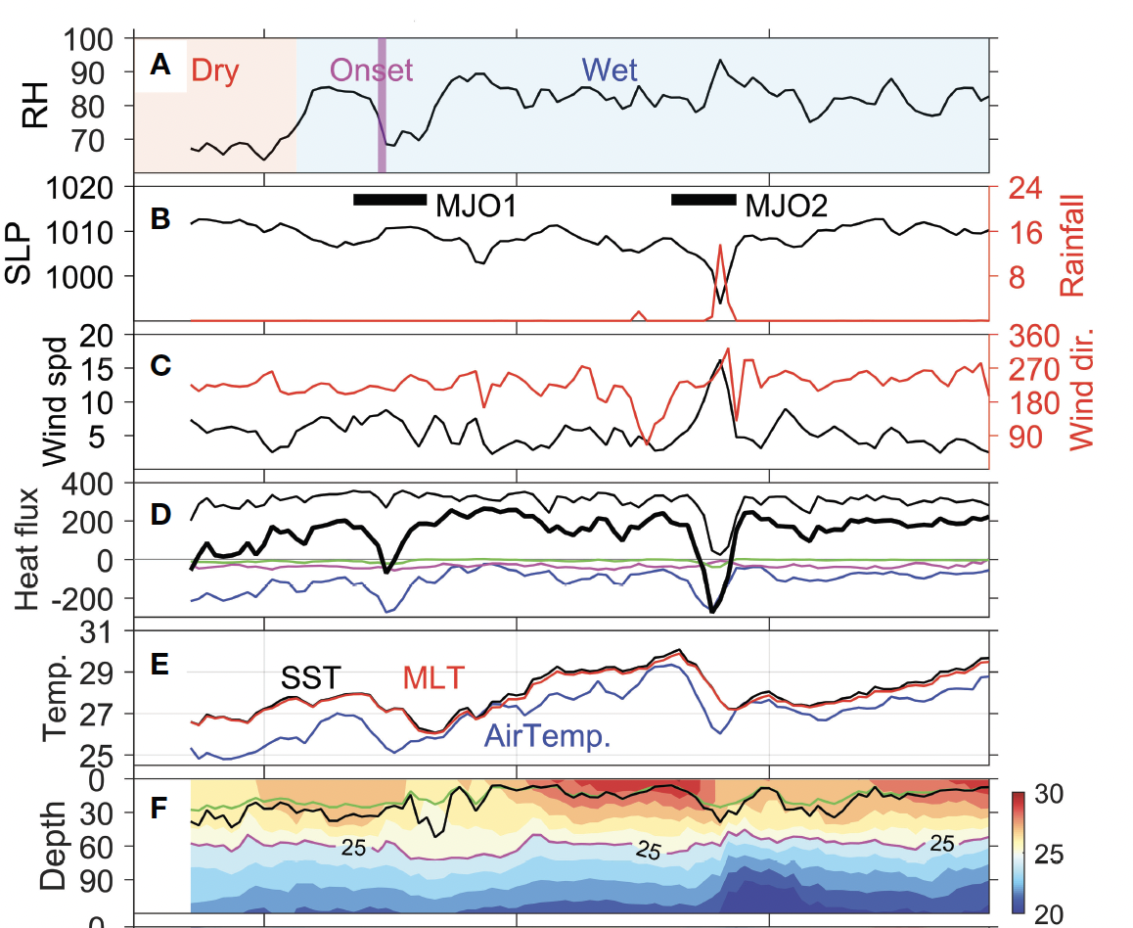
Conclusion on MJO crossing Maritime Continent
-- SST helps MJO crossing Maritime Continent

Slide 26
Take Home Messages
Tropical Moored Buoy Array is coming into good shape, after continuous efforts since 1980s, including TAO/TRITON, PIRATA and RAMA
Moored buoy helps identify the model and re-analysis bias in the air-sea heat-flux during extreme event such as cyclones: ERA demonstrating the overestimated latent heat-flux, which call for more SST, Ta, RH observation
Moored buoy helps clarify the role of SST and mixed layer heat content in supporting MJO crossing the Maritime continent

Slide 27
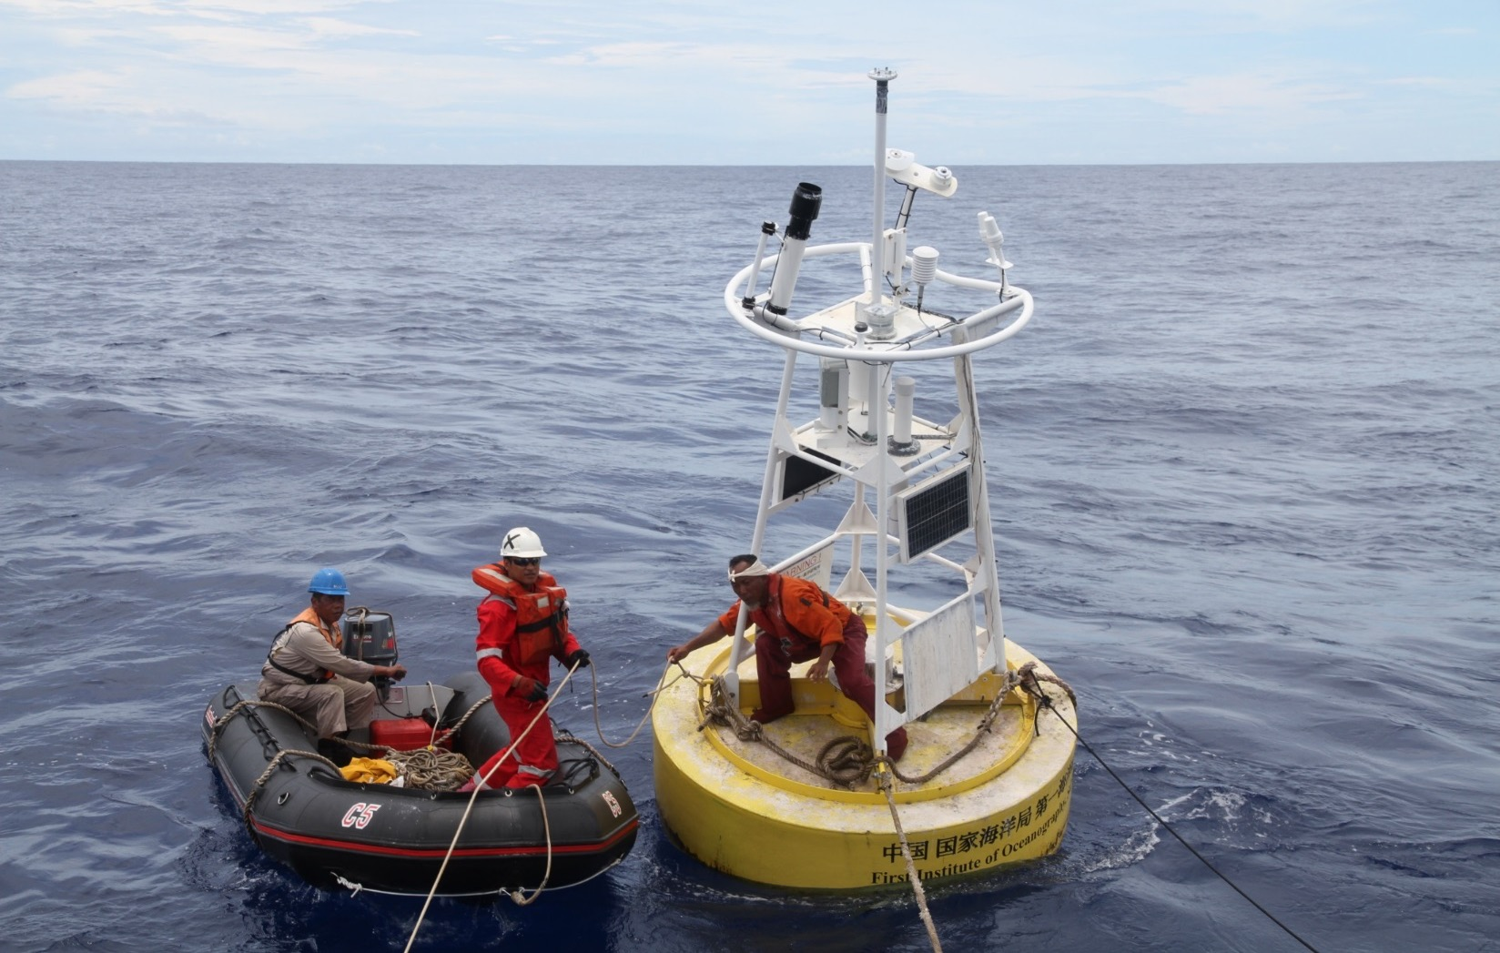
Thanks！

