Slide 1
Current and Future Ocean Profile Data Access through the Marine Climate Data System
Data Buoy Cooperation Panel (DBCP) Training Workshop on Ocean Observation for Weather Forecast and Climate Prediction, Indonesia
Tim Boyer
NOAA National Centers for Environmental Information
August 8, 2024

Slide 2
OUTLINE
Define the Marine Climate Data System (MCDS)
Example of data flow through the MCDS: ocean profile data
How does the MCDS fit into the evolving flow of data in the cloud?

Slide 3
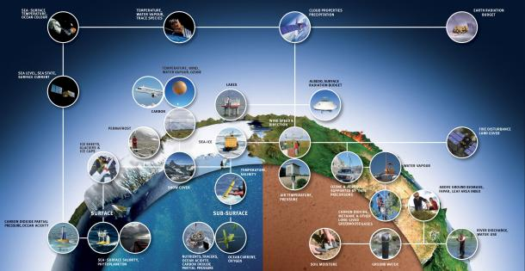
Essential Climate Variables including Essential Ocean Variables of the World Meteorological Office
The Global Ocean Observing System (GOOS), structured under the Framework for Ocean Observing (FOO), consists of the requirements, assessment, design, execution, and utilization/dissemination of networks of measurements of relevant essential ocean variables (EOVs).

Slide 4
What is the Marine Climate Data Service?
GLOBAL TELECOMMUNCATIONS SYSTEM (GTS) WMO INFORMATION SYSTEM 2.0 (WIS 2.0) FOCUS ON REAL-TIME DATA FOR OPERATIONAL PURPOSES.
MCDS DELIVERS DELAYED-MODE DATA FOR OPERATIONAL, ASSESSMENT, UNDERSTANDING + CONTRIBUTES PRODUCTS
Delayed-mode data: observations conveyed to users and to data repository for long-term storage, usually after additional calibration and/or quality assurance. Used for research and climate products
Notes:
Points: (1) MCDS is not the full spectrum of data management.
(2) MCDS handles DM data, GTS handles RT

Slide 5
WHY DO WE NEED THE MCDS?
Bring some clarity to the submission points for data
Bring clarity on how/where submitted data will be disseminated
Work toward standardization of forms, metadata, quality control processes
Encourages dissemination and sharing of marine data
Bring clarity to a user looking for specific (or general) data
Recognition of contribution to global data system

Slide 6
SETTING UP AND POPULATING THE MCDS
A well formed MCDS enables WMO/IOC to establish a much needed operational international path for acquisition and for sharing of relevant public access delayed-mode global marine meteorological and oceanographic data leveraging existing tested resources.
NODC = IODE National Oceanographic Data Centre
ADU = IODE Associate Data Unit SODC = IODE Specialized Ocean Data Centre ODIN = Ocean Data and Information Networks GRA = GOOS Regional Alliances MM = Marine Meteorological DM = Delayed-mode data RT = Real-time data DAC = Data Acquisition Centre GDAC = Global Data Assembly Centre CMOC = Centre for Marine Meteorological and Oceanographic Climate Data QC = Quality Control
Notes:
Points:
Three partitions for DAC, GDAC representing IODE, WMO, and other present pathways
Simplified version discussed in following slides

Slide 7
DAC
Simplified MCDS Structure
GDAC
DAC
Three main components
Data Acquisition Center (DAC): first line data receiver – directly from measurement source
Global Data Assembly Center (GDAC): world-wide aggregation for specific observation system
Center for Marine Meteorology and Oceanographic Climate Data (CMOC): Aggregates all relevant data types for a specific set of environmental variables
DAC
GDAC
CMOC
DAC
DAC
GDAC
DAC
Notes:
Points: (1) simplify – take away other functions, focus on data flow
(2) Note that all circles are equal. This is not a hierarchy, data access from DAC, GDAC can be more important, easier, with better knowledge, depending on the users need, use case.

Slide 8
SIX TO TEN MCDS AREAS ENVISIONED
1. MARINE METEOROLOGY – ICOADS AS CMOC
VOS DM (USA)
VOS DM (DE)
VOS DM (Hong Kong)
GDAC - UK
ICOADS
VOS DM (UK)
ICOADS – INTERNATIONAL COMPREHENSIVE OCEAN-ATMOSPHERE DATA SET
VOS – VOLUNTARY OBSERVING SHIP PROGRAM INCLUDING UNITED STATES OF AMERICA (USA), GERMANY (DE), HONG KONG, UNITED KINGDOM (UK), INDIA, JAPAN (JP)
GDAC - DE
VOS DM (India)
VOS DM (JP)
MARINE METEOROLOGY
Notes:
Points: (1) ICOADS expected to be CMOC for MM as it was for MCSS – but no proposal yet until the ICOADS community is satisfied that ICOADS is sufficiently resourced

Slide 9
SIX TO TEN MCDS AREAS ENVISIONED
MARINE METEOROLOGY – SUCCESSOR TO THE MCSS WITH ICOADS AS CMOC
SURFACE TRAJECTORY – CMOC CHINA, GDAC CANADA, FRANCE
VOS DM (USA)
VOS DM (DE)
VOS DM (Hong Kong)
GDAC - UK
ICOADS
VOS DM (UK)
GDAC - DE
VOS DM (India)
VOS DM (JP)
MARINE METEOROLOGY
DAC
DAC
CANADA
DAC
CHINA
DAC
DAC
FRANCE
DAC
DRIFTING BUOY
Notes:
Points: (1) already a CMOC and two GDACS for drifing buoy
(2) Why difting buoy which is a subset of MM? Because drifting buoy in addition to MM (SST/pressure) has trajectory information
(3) What do GDACs gain from CMOC for drifting buoys? [Need help with that one.]

Slide 10
SIX TO TEN MCDS AREAS ENVISIONED
MARINE METEOROLOGY – SUCCESSOR TO THE MCSS WITH ICOADS AS CMOC
DRIFTING SURFACE DROGUE BUOYS – CMOC CHINA, GDAC CANADA, FRANCE
OCEAN PROFILE – SUBSURFACE PHYSICAL, CHEMICAL VARIABLES
VOS DM (USA)
VOS DM (DE)
VOS DM (Hong Kong)
GDAC - UK
ICOADS
VOS DM (UK)
GDAC - DE
VOS DM (India)
VOS DM (JP)
MARINE METEOROLOGY
DAC
DAC
DAC
CANADA
DAC
GDAC
DAC
DAC
CHINA
GDAC
CMOC
DAC
DAC
DAC
FRANCE
DAC
GDAC
DAC
DRIFTING BUOY
DAC
OCEAN PROFILE
Notes:
Points: (1) overlap of OP, DB is purely graphical, not input of OP to DB
(2) Discuss details of OP later

Slide 11
WHAT OTHER ENVIRONMENTAL AREAS WOULD BENEFIT FROM MCDS?
ROBUST BUT POSSIBLY DISPERSED MEASUREMENT PROGRAMS
VITAL TO UNDERSTANDING CLIMATE CHANGE AND/OR CRITICAL TO FACILITATING HUMAN ENDEAVOUR/HEALTH
DAC
DAC
GDAC
DAC
GDAC
OBIS?
DAC
DAC
GDAC
DAC
PLANKTON?
DAC
DAC
GDAC
DAC
GDAC
DAC
DAC
DAC
GDAC
CMOC
GDAC
CMOC
DAC
DAC
DAC
DAC
GDAC
GDAC
DAC
DAC
OCEAN CURRENTS?
SEA ICE?
Notes:
Points: (1) three MCDS categories at present. Who is actively working to set up more?

Slide 12
CSIRO
JMA
INCOIS
KORDI
CORI
AOML
Argo
BODC
NMDIS
KMA
CSIO
MEDS
DAC
Argo profiling floats: Ready to plug into MCDS
- Huge effort to normalize DAC output (quality control, formatting, data delivery)
Two GDACS: mirror images
Happy to be part of MCDS as it will help to recognize Argo data flow, relieve some international reporting
Not yet a GDAC as there was some discrepancy between WMO and IOC definitions of GDAC
GDAC
CMOC
DAC
DAC
GDAC
DAC
ASSEMBLING OCEAN PROFILE MCDS
Notes:
Points: (1) Area where JCOMM can take leadership: unified definition of GDAC between WMO/IOC
(2) Much of the MCDS is ready-made, just needs designation and recognition
(3) Need an active JCOMM to assist in assembling the pieces

Slide 13
DACS
GLOBAL TEMPERATURE AND SALINITY PROFILE PROGRAM: GTSPP
ESTABLISHED 1990 TO PRESERVE AND QUALITY CONTROL OCEAN PROFILE DATA FROM THE GTS (REAL-TIME, RT).
DFO MEDS-CANADA IS RT DAC
ALSO REPLACE RT WITH FULL QUALITY DELAYED-MODE (DM) DATA.
CANADA, AUSTRALIA, FRANCE, UNITED STATES (AOML+SCRIPPS), JAPAN HAVE DM DACS
MAIN DM STREAM IS EXPENDABLE BATHYTHERMOGRAPH (XBT) DATA
SOME RT PROFILING FLOATS WHICH ARE NOT PART OF Argo
Argo
DACS
DM
GTSPP
CMOC
RT
DAC
GDAC
DAC
Assembling Ocean Profile MCDS
Notes:
Points: (1) again, ready-made to plug into MCDS. Need JCOMM leadership to get it done

Slide 14
DACS
CLIVAR AND CARBON HYDROGRAPHIC OFFICE (CCHDO):
ORIGINALLY SET UP AS WORLD OCEAN CIRCULATION EXPERIMENT (WOCE) DAC. NOW FOR REPEAT HYDROGRAPHY (GO-SHIP)
NO TRUE DAC. DATA COME DIRECTLY FROM CRUISE PRIMARY INVESTIGATOR (PI) OR MARINE TECH IN MANY CASES
Argo
DACS
DM
GTSPP
CMOC
RT
CCHDO
PI
PI
Assembling Ocean Profile MCDS
Notes:
Points: (1) MCDS system needs to be flexible. System needs to adapt to existing realities more than reality to system

Slide 15
NODC
NATIONAL OCEANOGRAPHIC DATA CENTERS (NODC): BACKBONE OF IOC INTERNATIONAL DATA EXCHANGE (IODE)
NOT ALL RELEASE THEIR DATA PUBLICLY
NOT INSTRUMENT SPECIFIC
OCEAN GLIDERS GDAC
INSTITUTES (INST): RESEARCH INST, FISHERIES, UNIVERSITIES, NAVIES
- SOME PASS DATA TO NODC, SOME DO NOT
CMOC
INST
IOOS
IMOS
GLIDERS
DEVELOPING DATA MANAGEMENT: GLIDERS
US DAC: INTEGRATED OBSERVING SYSTEM (IOOS)
AUSTRALIA DAC: INTEGRATED MARINE OBSERVING SYSTEM (IMOS)
EUROPE DAC: OCEAN GLIDERS INITIATIVE
OCEAN GLIDERS GDAC IFREMER, FRANCE
OGI
Assembling Ocean Profile MCDS
Notes:
Points: (1) being an NODC does not automatically qualify as part of the MCDS – must make data public
(2) Being part of MCDS – official status may convince Navies, others that public release of data is for international benefit and country benefit
(3) MCDS is an opportunity to shape/assist newer observing systems – such as facilitation a glider GDAC

Slide 16
International Quality Controlled Oceanographic Database
The Marine Climate Data System (MCDS) – WMO and IOC structure for data flow
Partnership for ocean profile CMOC

Slide 17
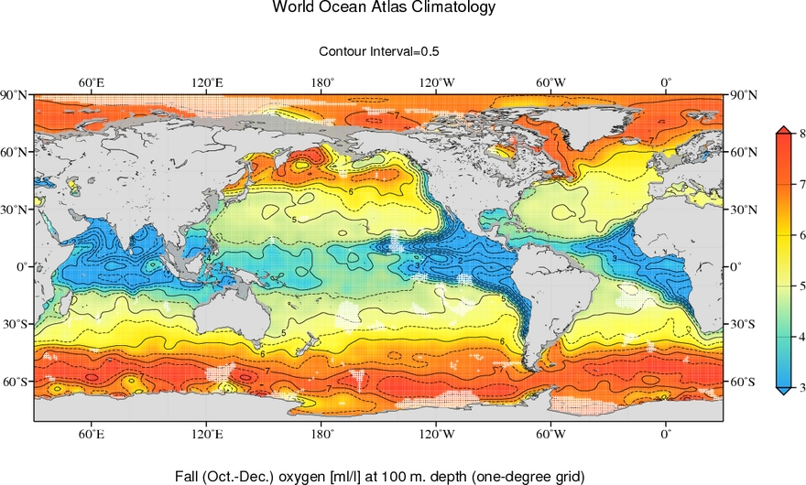
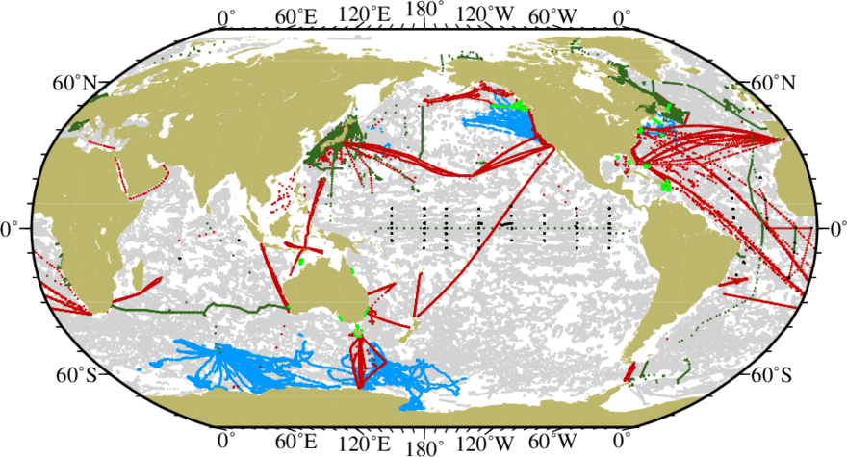
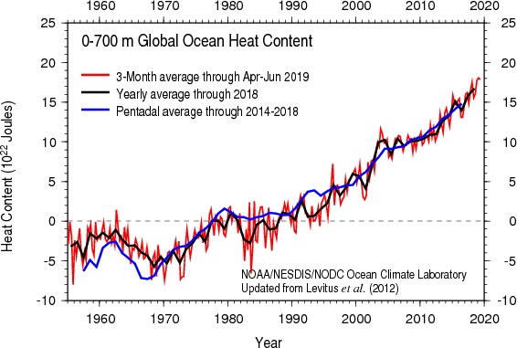
Ocean Observing System
World Ocean Atlas
Every 5 years
Daily
World Ocean Database
NCEI Archive
Quarterly
Quarterly
Ocean Heat Content Time Series
World Ocean Database: CMOC for Ocean Profile data

Slide 18
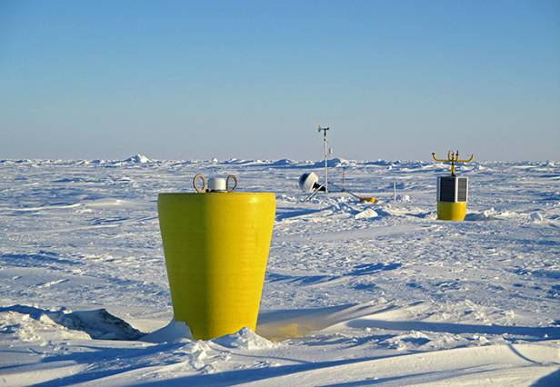
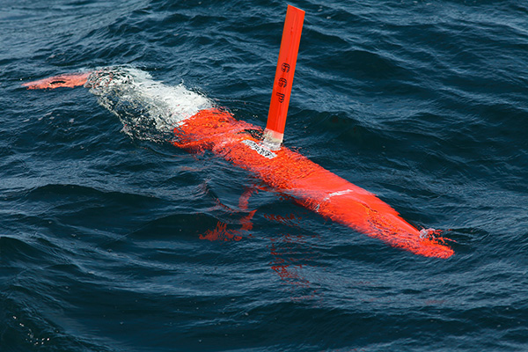
World Ocean Database: World’s largest publicly available
oceanographic profile database
a) bottle/reversing therm. b) MBT c) XBT d) CTD
e) towed CTD f) profiling float g) moored buoy h) ice-tethered profiler
i) instrumented animal j) glider k) surface j) Plankton tow
Glider photo Robert Todd WHO fromhttps://www.coastalstudiesinstitute.org/gliders-mobile-oceanographic-observing-platforms/
Ice-tethered profiler photo John Kemp WHOI https://phys.org/news/2015-03-ice-tethered-devices-arctic-ocean.html

Slide 19
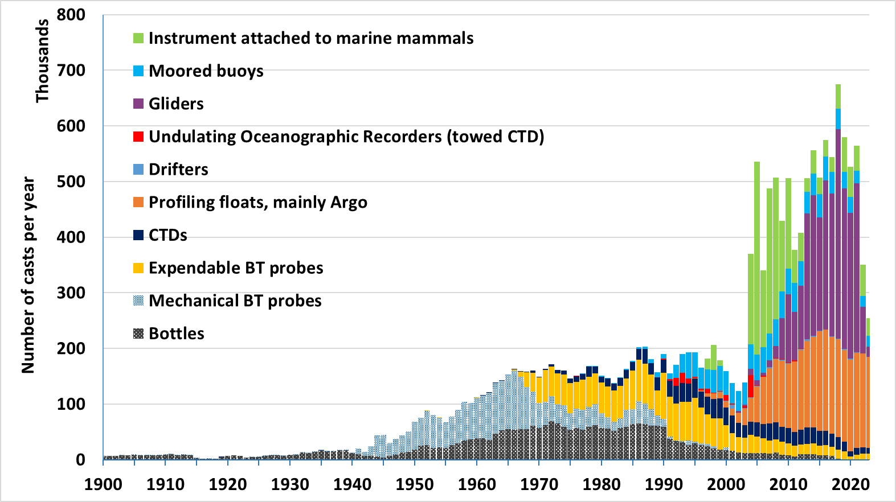
Number of subsurface ocean temperature profiles yearly in the World Ocean Database.

Slide 20
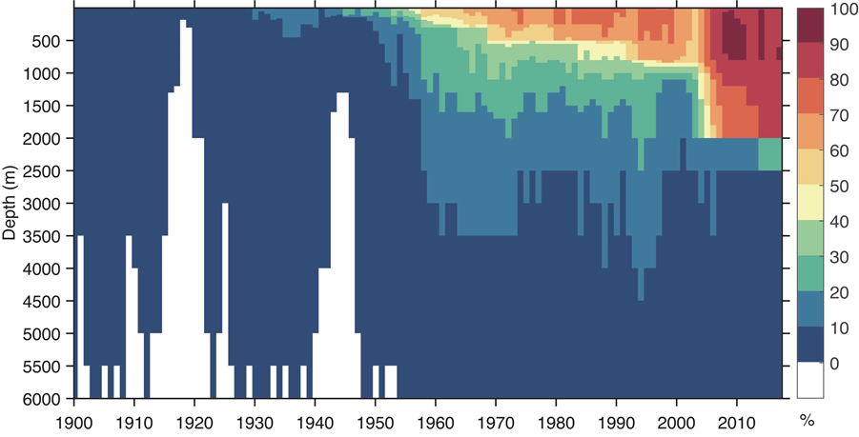
WOD Global Coverage by depth/year
Meyssignac et al (2019) https://doi.org/10.3389/fmars.2019.00432
Notes:
Points: (1) in 1963 when MCSS was formed complexity of observing system was just starting to increase
(2) Now the speed of transmission, number of observations, different observing systems/instruments need more complex data management

Slide 21
World Ocean Database data sources year 2023
356,727 casts added total
[bringing total casts in WOD to 19.1 million]
164,190 Profiling float cycles
10,138 CTD casts
11,135 XBT drops
20,328 moored buoy dailys
86,062 glider cycles
31,181 pinniped dives
Sources: GTSPP*, Argo*, PMEL moored buoys*, CCHDO*, WHOI Ice Tethered Profilers, IOOS glider DAC, IMOS (Australia), EGO (European Union), OceanSITES *regular quarterly

Slide 22
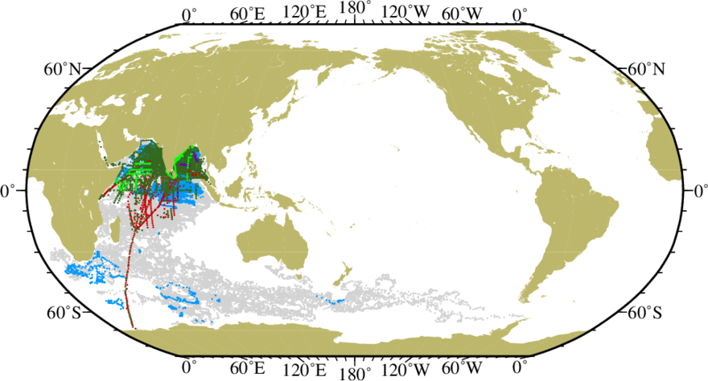
Indian data in the World Ocean Database
80,430 Argo cycles (grey) 11,361 of those BGC (blue)
5,180 bottle/CTD casts (dark Green) 3,083 XBT casts (red)
540 MBT casts (light green) 60 XCTD (purple)

Slide 23
Examples of Delayed-mode data Updates to WOD
ICES
CCHDO
Blue – Quarterly
Orange- Yearly
Green - Irregular
WHOI Ice
Tethered Buoys
DFO-MEDS
CANADA
CalCOFI
World Ocean
Database Quarterly
Updates
NOAA
Northeast
Fisheries
Japan Ocean
Data Center
INIDEP
(Argentina)
CSIRO
Line W

Slide 24
Idealized Flow of data from originator to database
Recorded measurements
Observing System I Assembly Center
Recorded measurements
Recorded measurements
Recorded measurements
WOD Homogenous Formatted Database
Recorded measurements
Observing System I I Assembly Center
Recorded measurements
Recorded measurements
Recorded measurements
Recorded measurements
Observing System III Assembly Center
Recorded measurements
Recorded measurements
Recorded measurements
Recorded measurements
Observing System IV Assembly Center
Recorded measurements
All data in the same format from measurement all the way to the main assembled database
Recorded measurements
Recorded measurements
Notes:
Points: (1) current system for ocean profile data is ad hoc
(2) For marine meteorology, MCSS no longer best supports the needed functions
(3) if we had this idealized data flow, there would be no need for any MCDS structure

Slide 25
Real Flow of Data from Originator to WOD
Different, multiple paths, many formats. Some data with no path.
Recorded measurements
Observing System Assembly Center
Recorded measurements
Recorded measurements
Recorded measurements
WOD Homogenous Formatted Database
Recorded measurements
Recorded measurements
Recorded measurements
Recorded measurements
Project Database
Recorded measurements
Recorded measurements
Recorded measurements
Recorded measurements
Institute Database
Recorded measurements
Regional Assembly Center
Recorded measurements
National Assembly Center
Recorded measurements
Recorded measurements

Slide 26
International Quality-Controlled Ocean Database (IQuOD) v0.1: The Temperature Uncertainty Specification – Cowley et al 2021
Exploration of manufacturer specifications for instrument types, peer-reviewed journal articles on measurement and instrumentation methods, project and institution guidelines for measurement, calibration information, etc.
Define uncertainties in temperature and depth/pressure for major instrumentation categories.
Assign uncertainties to each measurement in the IQuOD v0.1 https://doi.org/10.7289/v51r6nsf
https://doi.org/10.3389/fmars.2021.689695

Slide 27
United Nations Decade of Ocean Science
for Sustainable Development (2021–2030)
… gather ocean stakeholders worldwide behind a common framework that will ensure ocean science can fully support countries in creating improved conditions for sustainable development of the Ocean.
https://en.unesco.org/ocean-decade

Slide 28
World Ocean Database Cloud (WODc): Optimized access to and utilization of the world largest oceanographic profile database in the cloud
Make WOD available through NOAA’s Open Data Dissemination cloud providers to increase open access data and utility.
Increase global participation and contribution to the WOD both in data aggregation and quality assurance of the data (e.g., UN Decade of ocean science for sustainable development 2021–2030).
Availability of higher level tools for optimized utilization of data by researchers, decision/policy makers, managers, the general public.
Control of core WOD to assure highest level of scientific quality of data.

Slide 29
World Ocean Database
DATA AND QC PROVIDERS
DATA AND PRODUCT USERS
Archive: Original Data
User Communities
NESDIS/NCEI
Open Data Dissemination
https://registry.opendata.aws/noaa-wod/
Higher level tools
World Ocean Database Cloud
NOAA
U. N. Decade of the Ocean Contribution

Slide 30
Optimize ocean profile data exposure and delivery – optimized cloud format
NCEI working with NOAA Center for Artificial Intelligence and University of Colorado cooperative institute on an optimized format for ocean profile data.
Starting point is the parquet format utilized by French GDAC for Argo data.
Some changes introduced to best accommodate ocean profile data in the World Ocean Database. Will work with French GDAC on a community standard parquet form.
Jupyter notebook demonstrates simple functionality: https://colab.research.google.com/drive/1QbZufOW4ajZKDdT52ll7PDLrlnL1xYwt?usp=sharing

Slide 31
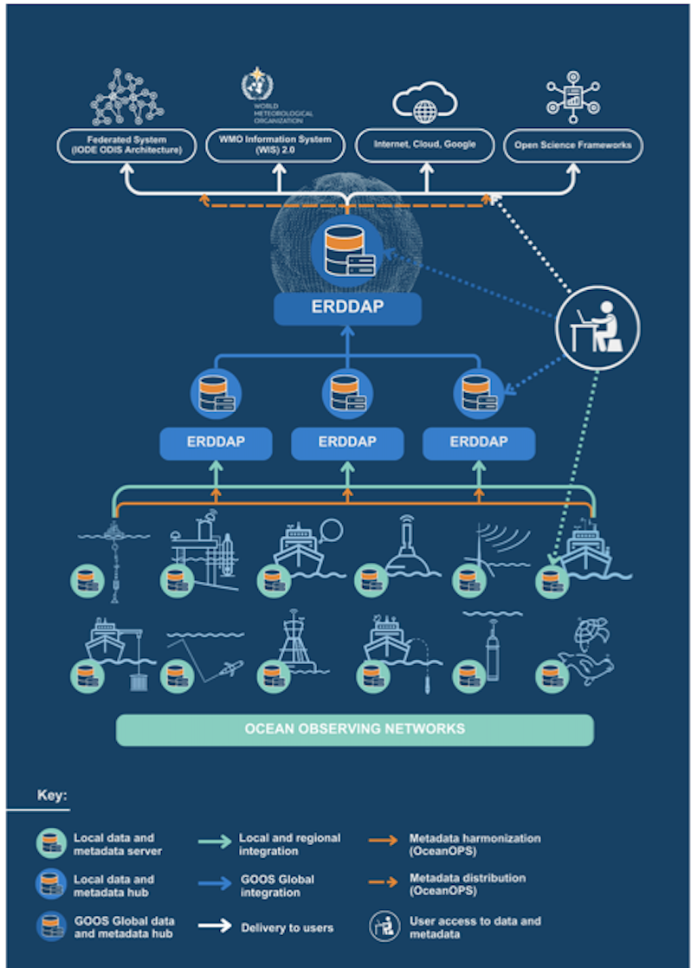
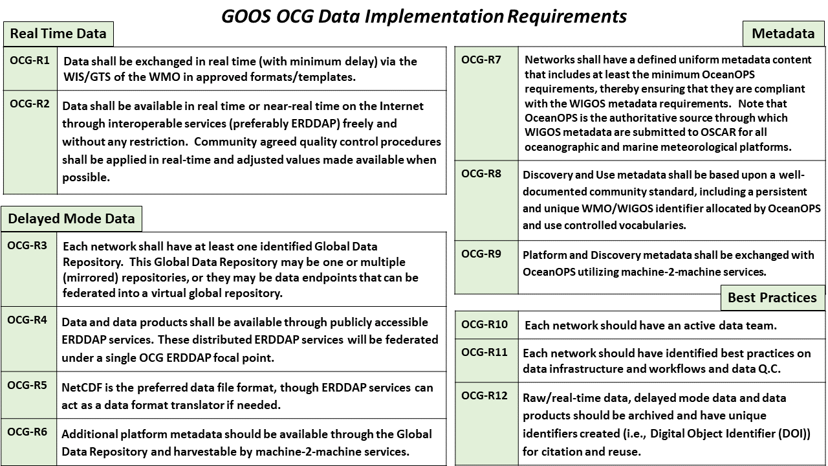
OCG Cross-Network Data Implementation Strategy Released
This Implementation Plan is an effort to define specific and actionable ways OCG network/programs can move towards FAIR compliance
Improve (meta)data discovery, exchange, accessibility and usability for all stakeholders
Improve access to distributed (meta)data endpoints through federated, uniform data services
Courtesy of Kevin O’Brien GOOS Observations Coordination Group

Slide 32
Summary
The Marine Climate Data System (MCDS) is a means for preservation and dissemination of delayed-mode environmental data to complement real-time dissemination in WIS 2.0
The MCDS is a resource for operational models, for climate assessment, and for understanding the ocean environment among other uses
MCDS Centers for Marine Meteorology and Oceanographic Climate Data (CMOC) aggregates data for a particular environmental data area through Data Assembly Centers and Global Data Assembly Centers.
The MCDS is a pathway for contribution of quality environmental data from investigators, institutes, projects, data centers to global dissemination and use in standardized products for essential ocean and climate variables
How does the MCDS fit into the evolving flow of data in the cloud?

