Slide 1
Strategic priorities of the WMO Community
Ko Barrett, Deputy Secretary-General, WMO
September 2024

Slide 2
To facilitate worldwide cooperation in the design and delivery of meteorological services, foster the rapid exchange of meteorological information, encourage research and training in meteorology.
United Nations specialized agency to address issues related to weather, climate, water and safeguarding the environment for present and future generations.
A world where all nations, especially the most vulnerable, are more resilient to the socioeconomic impact of extreme weather, climate, water and other environmental events, and empowered to boost their sustainable development through the best possible weather, climate and water services
WMO in a nutshell
OUR MISSION
OUR MANDATE
OUR VISION
Notes:
Our mandate and mission are defined in the WMO Convention, adopted in 1947

Slide 3
What is WMO and what does our community do?
193 Member States and Territories
x
x
x
x
x
Sustainable Development
Data exchange & modelling
Services (national & regional)
Forecast products
Decision support
Observations
Disaster
Risk Reduction
Paris
Agreement
Climate
x
Research & Development, Standards, Capacity Dev, Education & Training, M&E

Slide 4
Seamless predictions: Decision support across timescales
Long-term National and international policy development
Strategic planning and investment cycles, foresight
Slow onset warnings and anticipatory actions, tactical & contingency planning
Early warnings, preparatory actions, operational support
Centuries
Months
Decades
Seasons
Hours
Years
Past climate
Days
Weeks
climate records
Now
weather forecasts
Sub-seasonal to seasonal predictions
annual to decadal
Climate projections

Slide 5
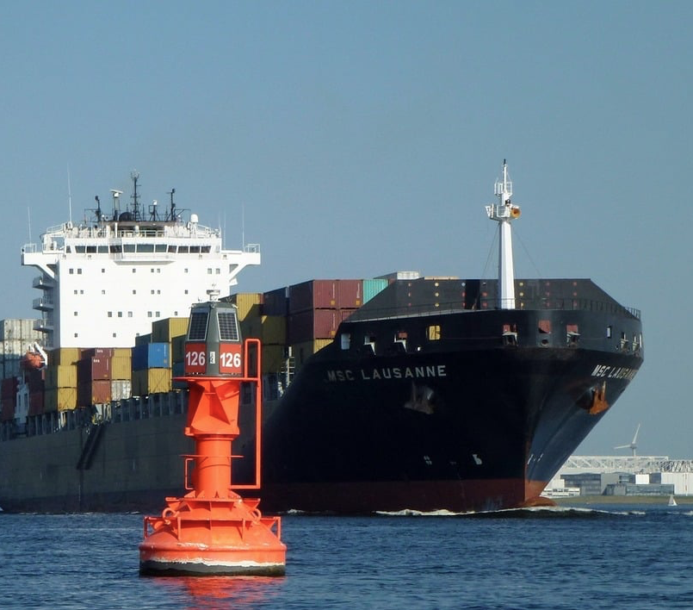
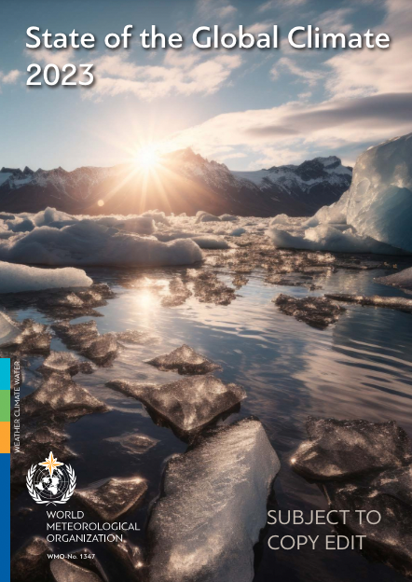
Science, Infrastructure and Services for all Sectors

Slide 6
Hydrometeorological information and services ownership: Who owns the data? Who provides the services?
Forecast
Communicate
Monitor
Perform regular earth-system observations, according to established standards
Establish, improve and maintain hydrometeorological networks.
Collect and share data
Interact and engage with public, private and academic sectors.
Engage with economic sectors
Provide evidence to support decision-makers in developing and implementing policies
NMHSs
Provide forecasts at different time scales, from early warnings to climate outlooks
Co-develop sectoral services (risk management, transport, energy, agriculture, health, tourism, etc.)
SCIENCE
INNOVATION
Notes:
Remember to hiighlight our rol as coordinators and faccilitators of international cooperation (defining frameworks, standards and best practices, sharing data)

Slide 7
Our flagship initiatives

Slide 8
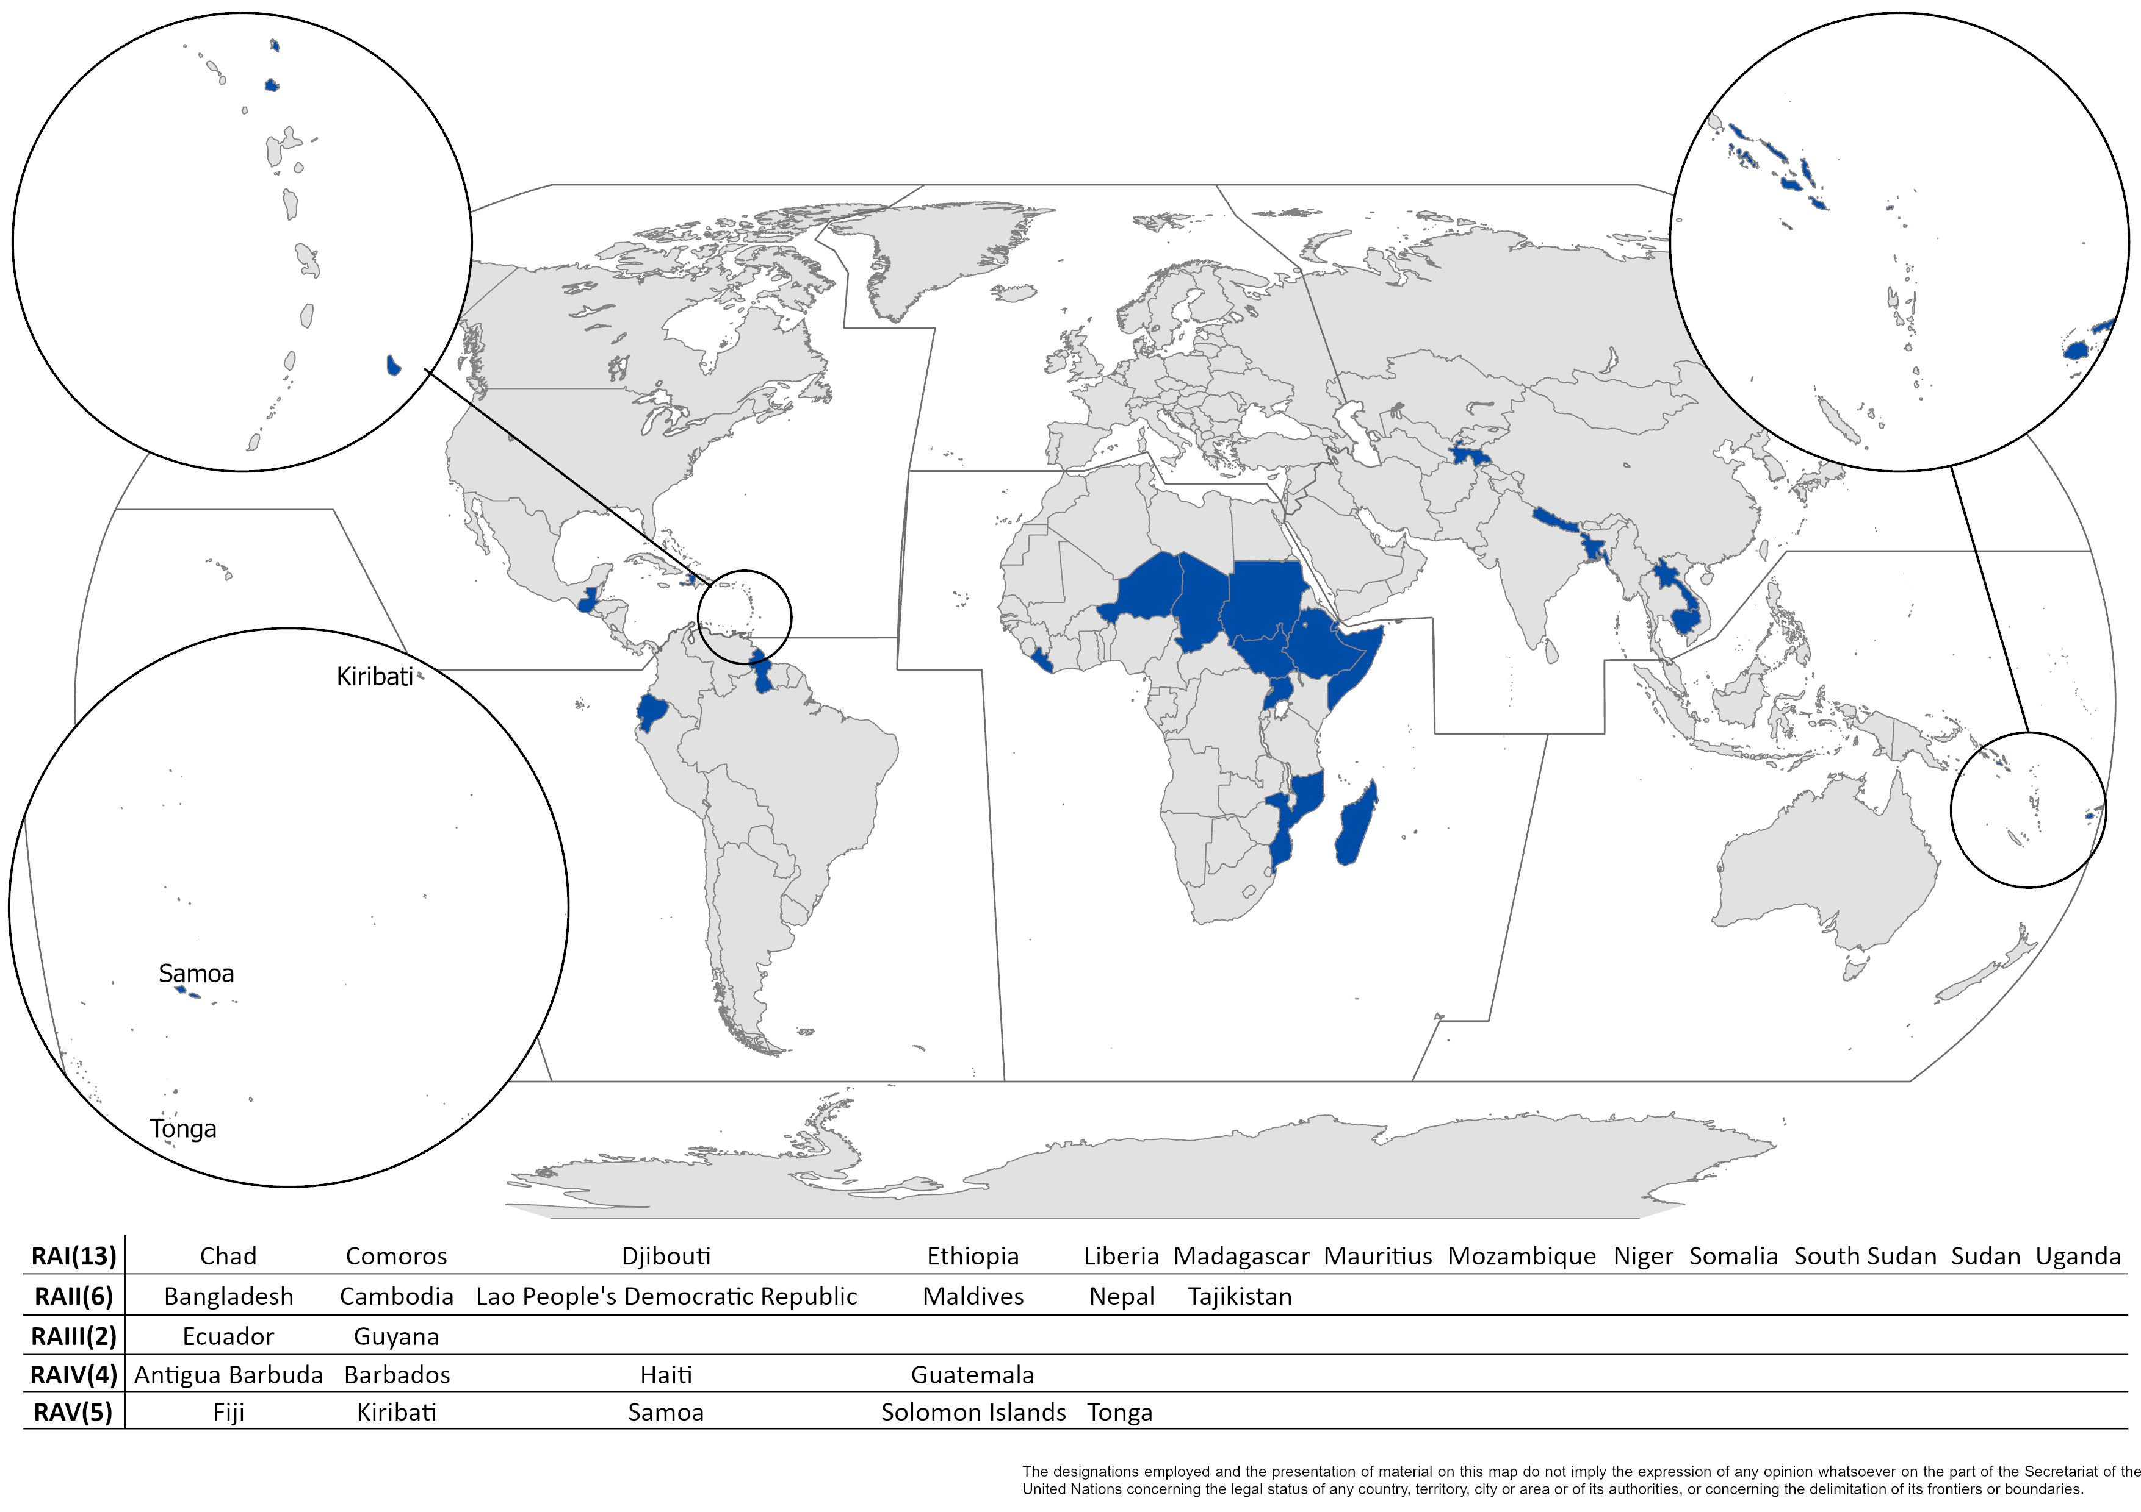
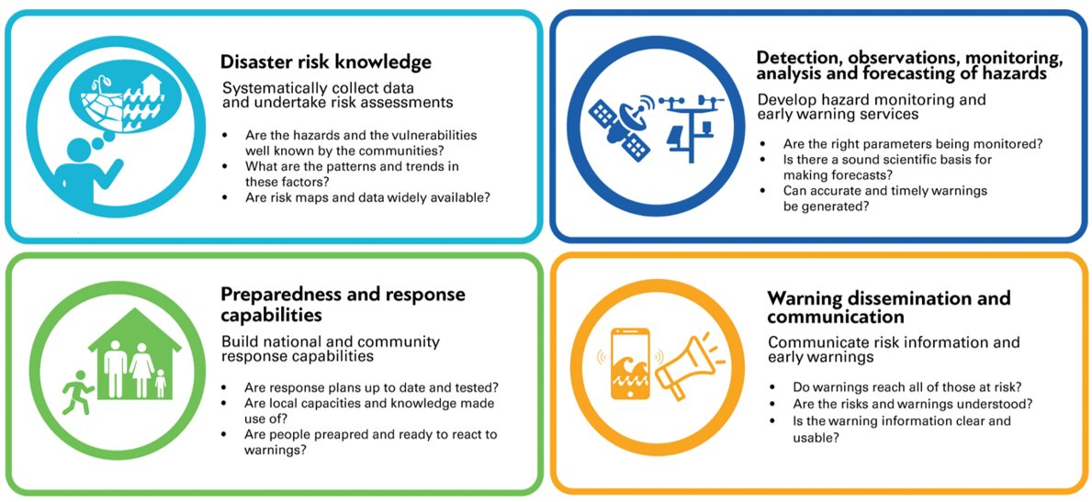
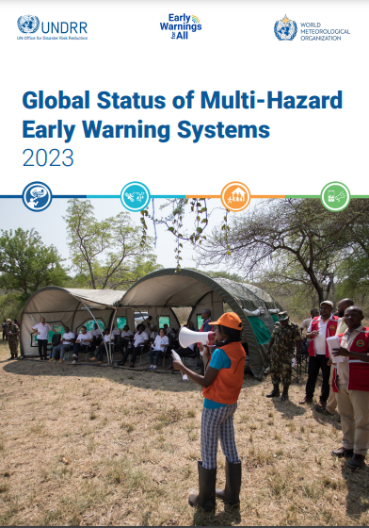
The Early Warnings for All initiative is a groundbreaking effort to ensure everyone on Earth is protected from hazardous weather, water, or climate events through life-saving early warning systems by the end of 2027.
The delivery of Early Warnings for All requires scale up and coordinated investments and action across the four essential pillars of end to end, people-centred Multi-Hazard Early Warning Systems
How?
Pillar 2 is focused on delivering 5 outcomes:
Increased availability of quality observation data to assess and monitor priority hazards.
Enhanced data exchange and access for forecasting and warning systems.
Increased capabilities to forecast all priority hydrometeorological hazards.
Impact-based forecasts and warnings are produced for all priority hazards.
Strengthened relevant policy, institutional mechanisms, and stakeholder engagement processes in place to support MHEWSs

Slide 9
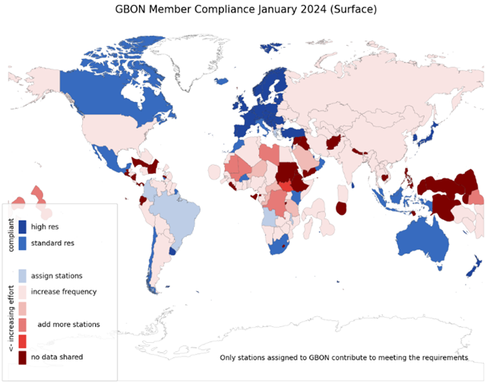
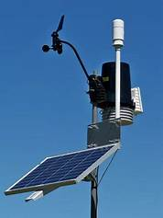
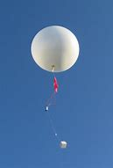
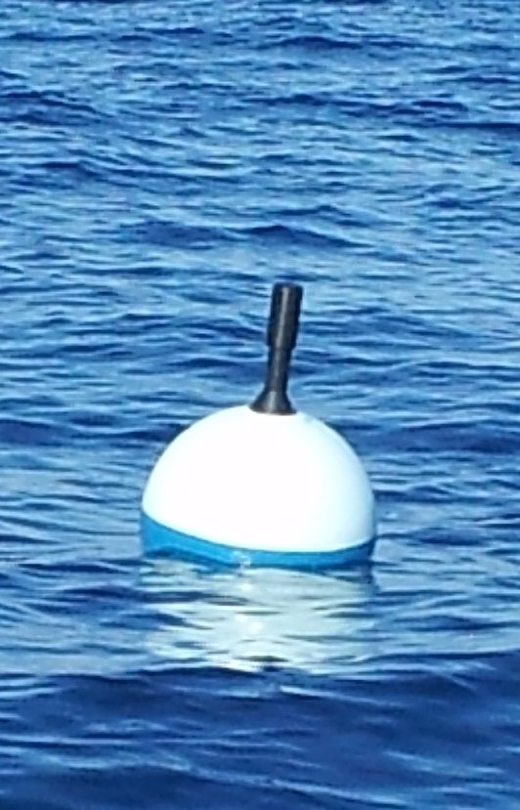
Global Basic Observing Network (GBON) of WIGOS
A global public good for improved weather prediction and climate reanalysis
Worsening gaps in the basic surface-based observations
Members in 2021 accepted obligation to take and share GBON observations at minimum horizontal and time resolution
WMO co-created the Systematic Observations Financing Facility (SOFF) to help Members meet that GBON obligation, with priority on support to LDCs and SIDS
Notes:
The Global Basic Observing Network (GBON) is a fundamental element of the WMO Integrated Global Observing System that responds to the geographical inconsistencies in availability of internationally exchanged data, in support of weather forecasts. GBON introduces a new approach in which the basic surface-based observing network implemented by WMO Members is designed, defined and monitored at the global level. GBON works to improve the availability of the essential surface-based observational data, which are expected to enhance the quality of weather forecasts, thus helping improve the safety and well-being of citizens throughout the world and bring socioeconomic benefits. that keep weather predictions on track - full implementation estimated to bring USD 5 billion in annual benefits
Surface land at 200 km, hourly
Upper air over land at 500 km, 2x daily
Surface marine in EEZ at 500 km, hourly
GBON is a radical overhaul of the international exchange of observational data, which underpin all weather, climate and water services and products. The Systematic Observations Financing Facility (SOFF) also facilitates implementation of GBON in the Least Developed Countries and the Small Island Developing States to generate and internationally exchange the required GBON station data.

Slide 10
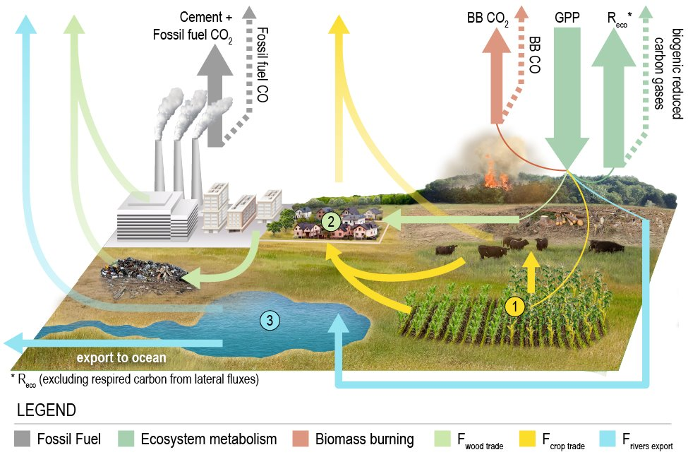
Global Greenhouse Gas Watch (G3W)
A new global greenhouse gas monitoring initiative that aims to support WMO Members in mitigation actions undertaken to implement the Paris Agreement.
Fill critical information gaps and provides an integrated, operational framework that brings under one roof all space-based and surface-based observing systems
 | 10
Notes:
The following outputs will be generated by GGGW on a routine and sustained basis:
Monthly CO2 and CH4 net fluxes between the Earth surface and the atmosphere with 1x1 degree horizontal resolution delivered with a maximum delay of one month
3D fields of atmospheric CO2 and CH4 abundance with hourly resolution and the latency to be defined through user requirements and further consultation (tentatively on the order of a few days).
N2O abundances and net fluxes with resolution and latency still to be defined.

Slide 11
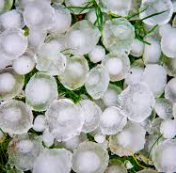
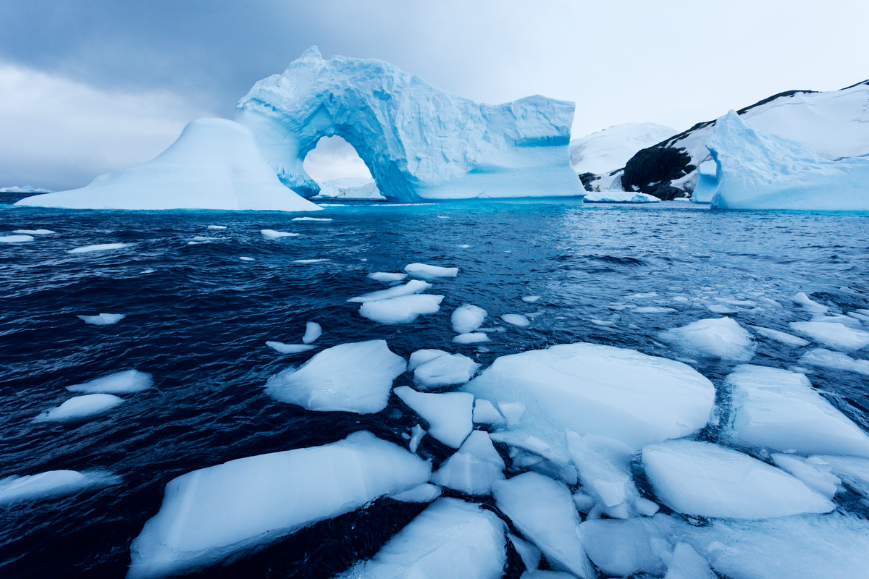
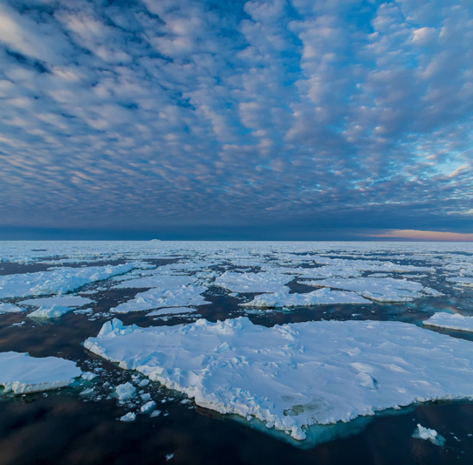
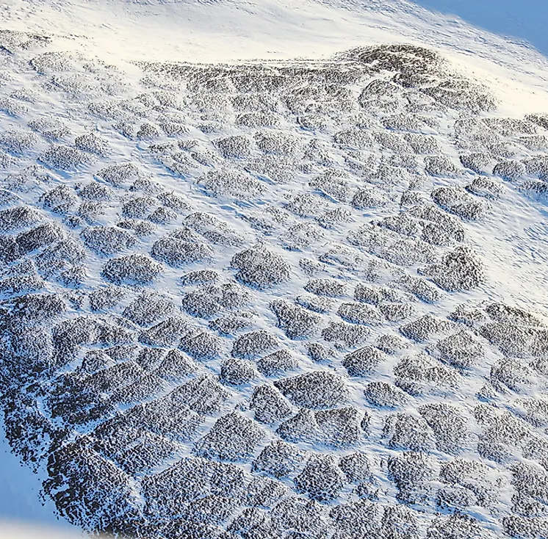
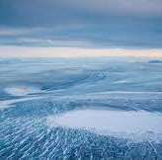
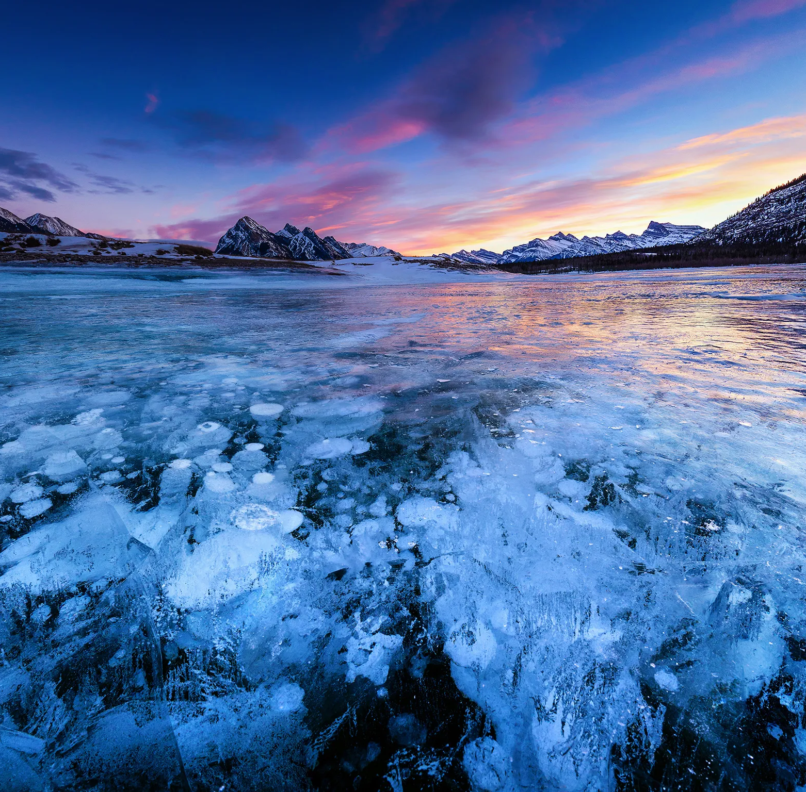
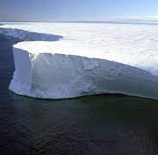
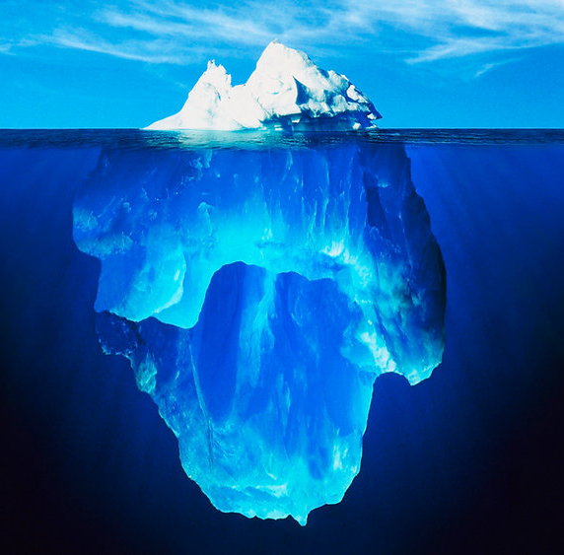
Cryosphere
The global cryosphere is changing rapidly, with global impacts:
We must reduce the uncertainties in our predictions and projections for effective decisions and action
Snow Cover
Solid
Precipitation
Glaciers
Permafrost & Seasonally Frozen
Ground
Mountain snow and glaciers are critical reservoirs of freshwater
Arctic permafrost is melting and is a “sleeping giant” of greenhouse gases
Melting Greenland and Antarctica ice sheets and glaciers account for about 50% of the sea level rise
Increased risks of emerging hazards as the cryosphere changes
CRYOSPHERE
Ice
Sheets
Sea, Lake,
River
Ice
Ice
Shelves
Icebergs

Slide 12
Thank you.
^{wmo.int}

