Slide 1

Joint WMO-IOC Collaborative Board​
Item 6. Science perspectives and the Ocean Decade

Slide 2
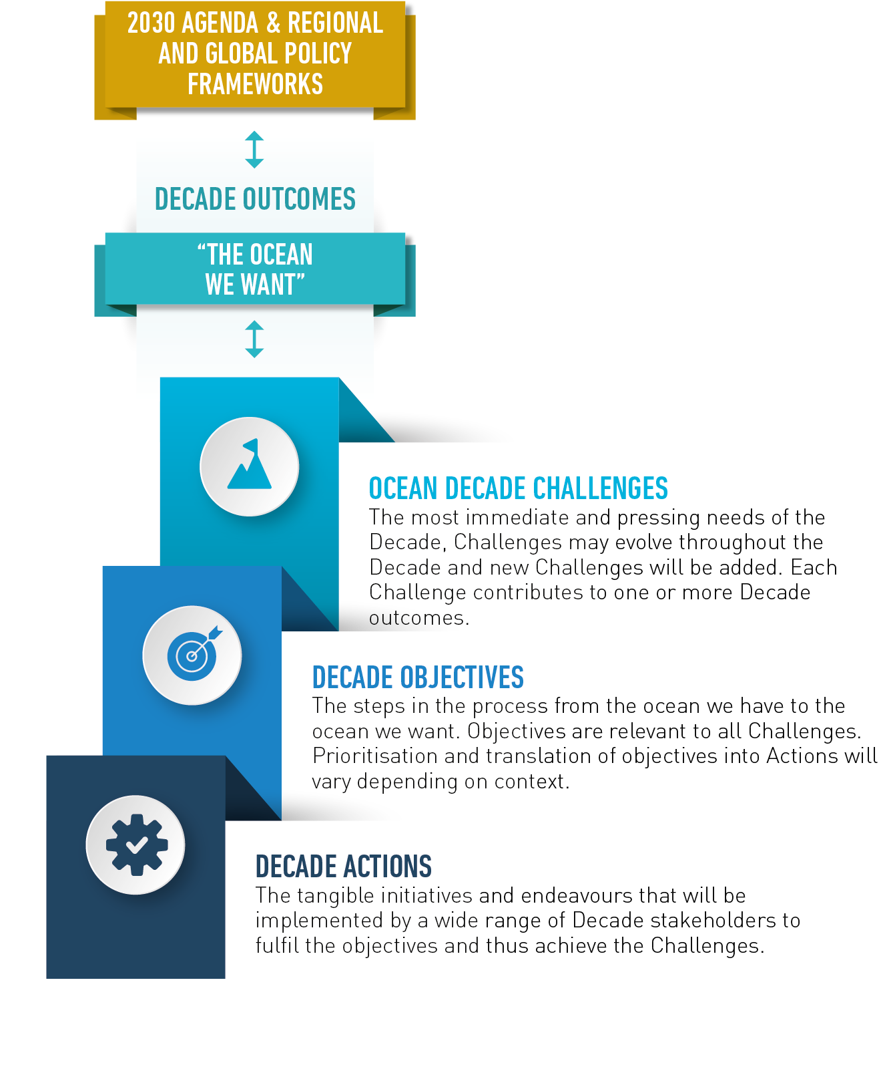

Decade Action Framework: 10 Challenges, 10 years, 1 Ocean
Knowledge & Solutions Challenges:
Marine Pollution
Protect and Restore Ecosystems
Sustainable Blue Food
Sustainable Ocean Economy
Ocean-Climate Nexus
Infrastructure Challenges:
6. Community & Coastal Resilience
7. Ocean Observations
8. Digital Representation of the Ocean
Foundational Challenges:
9. Capacity Development, Skills and Technology for All
10. Restoring Human Connection to the Ocean
Decade Programmes, Projects, Activities and Contributions solicited on a regular basis to contribute to Ocean Decade Challenges
Notes:
Mission oriented science
Action framework (implementation plan)

Slide 3
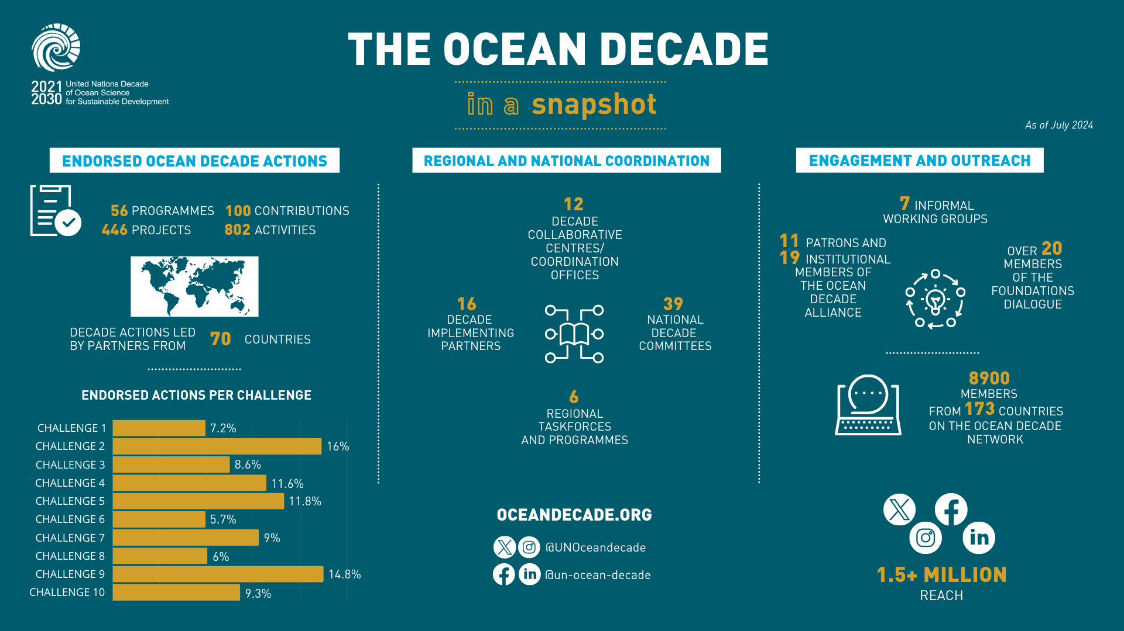
2024 OCEAN DECADE CONFERENCE
Where are we in 2024?
DELIVERING THE SCIENCE WE NEED FOR THE OCEAN WE WANT 10-12 APRIL 2024
BARCELONA, SPAIN
As part of the Ocean Decade Week (8-12 April 2024)

Slide 4
THE VISION 2030 PROCESS
Strong demand from Decade community to shape a common vision for the next 7 years & enhance collective impact
Unique window of opportunity to deliberately design the ‘science we need’ and avoid dispersion of Decade Actions
Growing need to measure & document impact of the Ocean Decade
STRATEGIC AMBITION:
What does success look like for this Ocean Decade Challenge at the end of the Decade?
What milestones / targets do we need to achieve throughout the Decade to be on the path for success for this Challenge?
Priority datasets to unlock & generate
Indicators to measure progress
Technology & innovation solutions
Strategic Ambition
Capacity development & exchange needs
Infrastructure for data & knowledge generation
Partnership & resources
Knowledge to generate & share

Slide 5

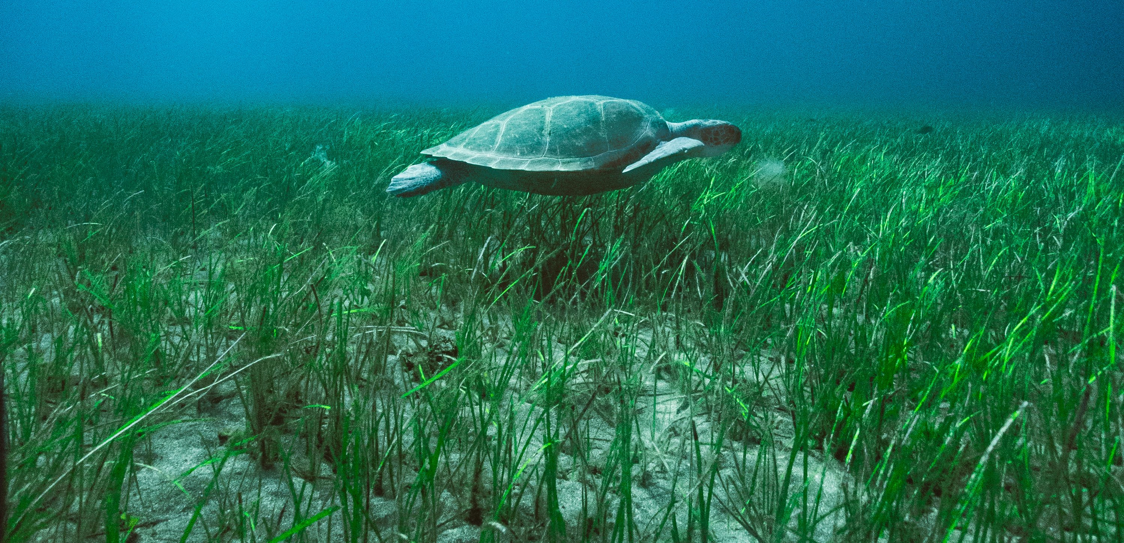
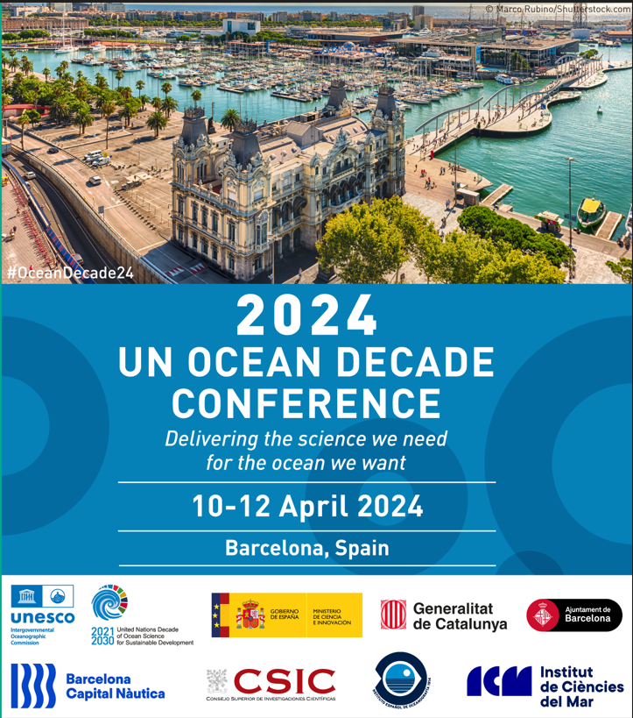
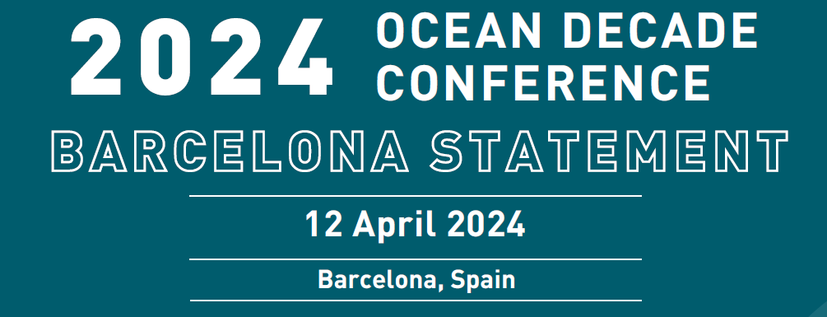
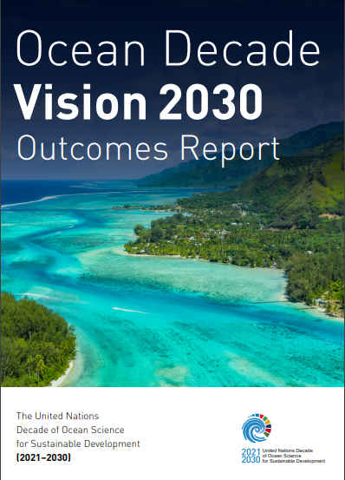
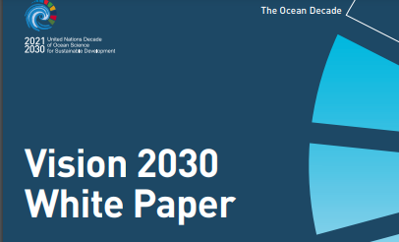
2024 OCEAN DECADE CONFERENCE
Take Stock – Set Priorities – Catalyze Action to 2030
2,630 in-person attendees from 124 countries
> 3,000 online viewers
165 Satellite Events
1.SCIENCE & KNOWLEDGE PRIORITIES
2.CROSS-CUTTING / ENABLING ENVIRONMENT PRIORITIES
3. ANNOUNCEMENTS & COMMITMENTS
10 x
Notes:
Decade conference had 3 goals -

Slide 6
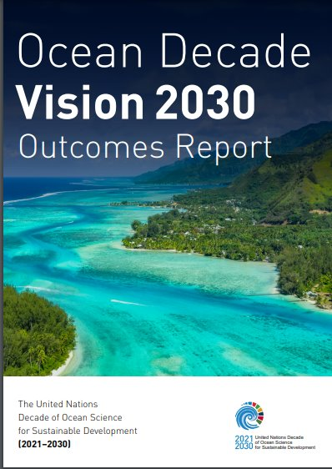
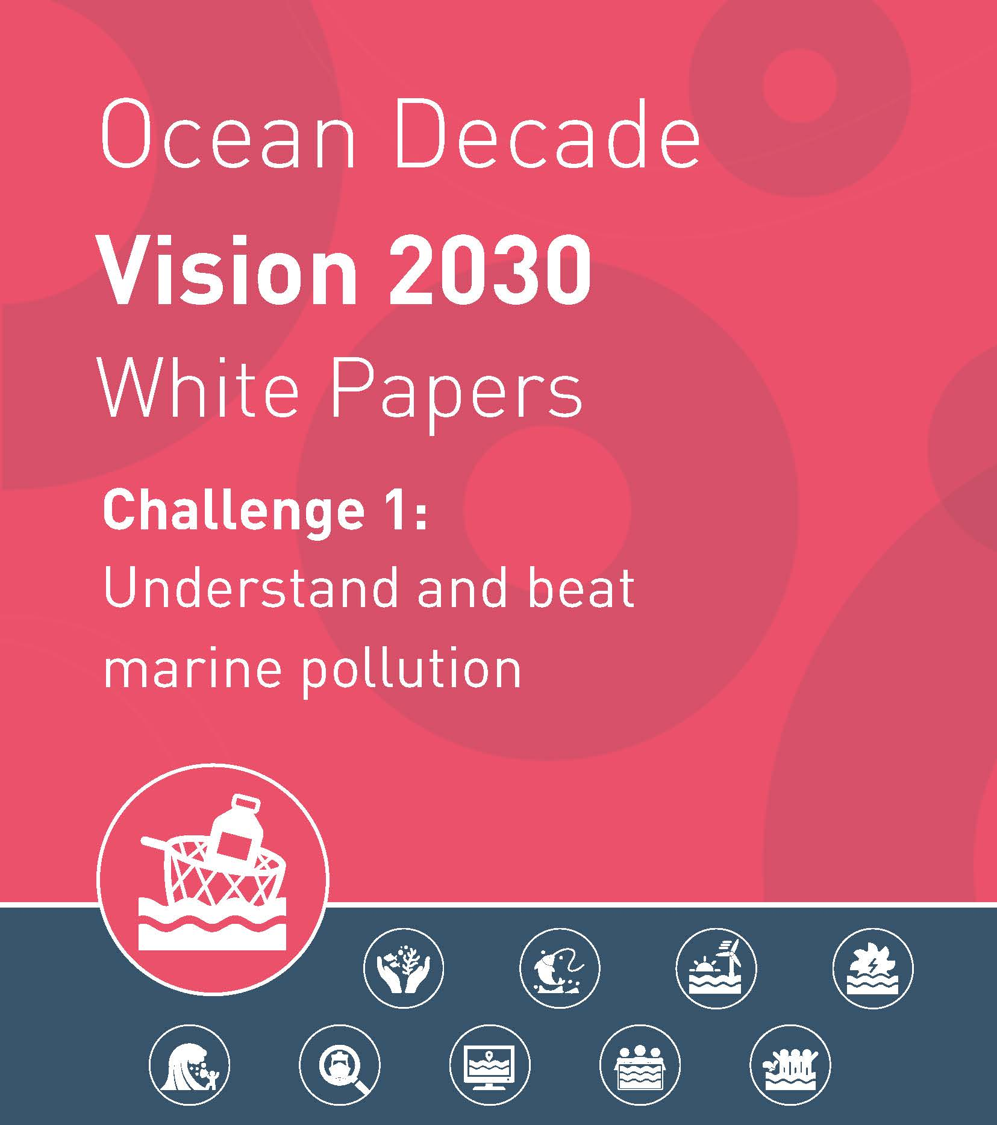
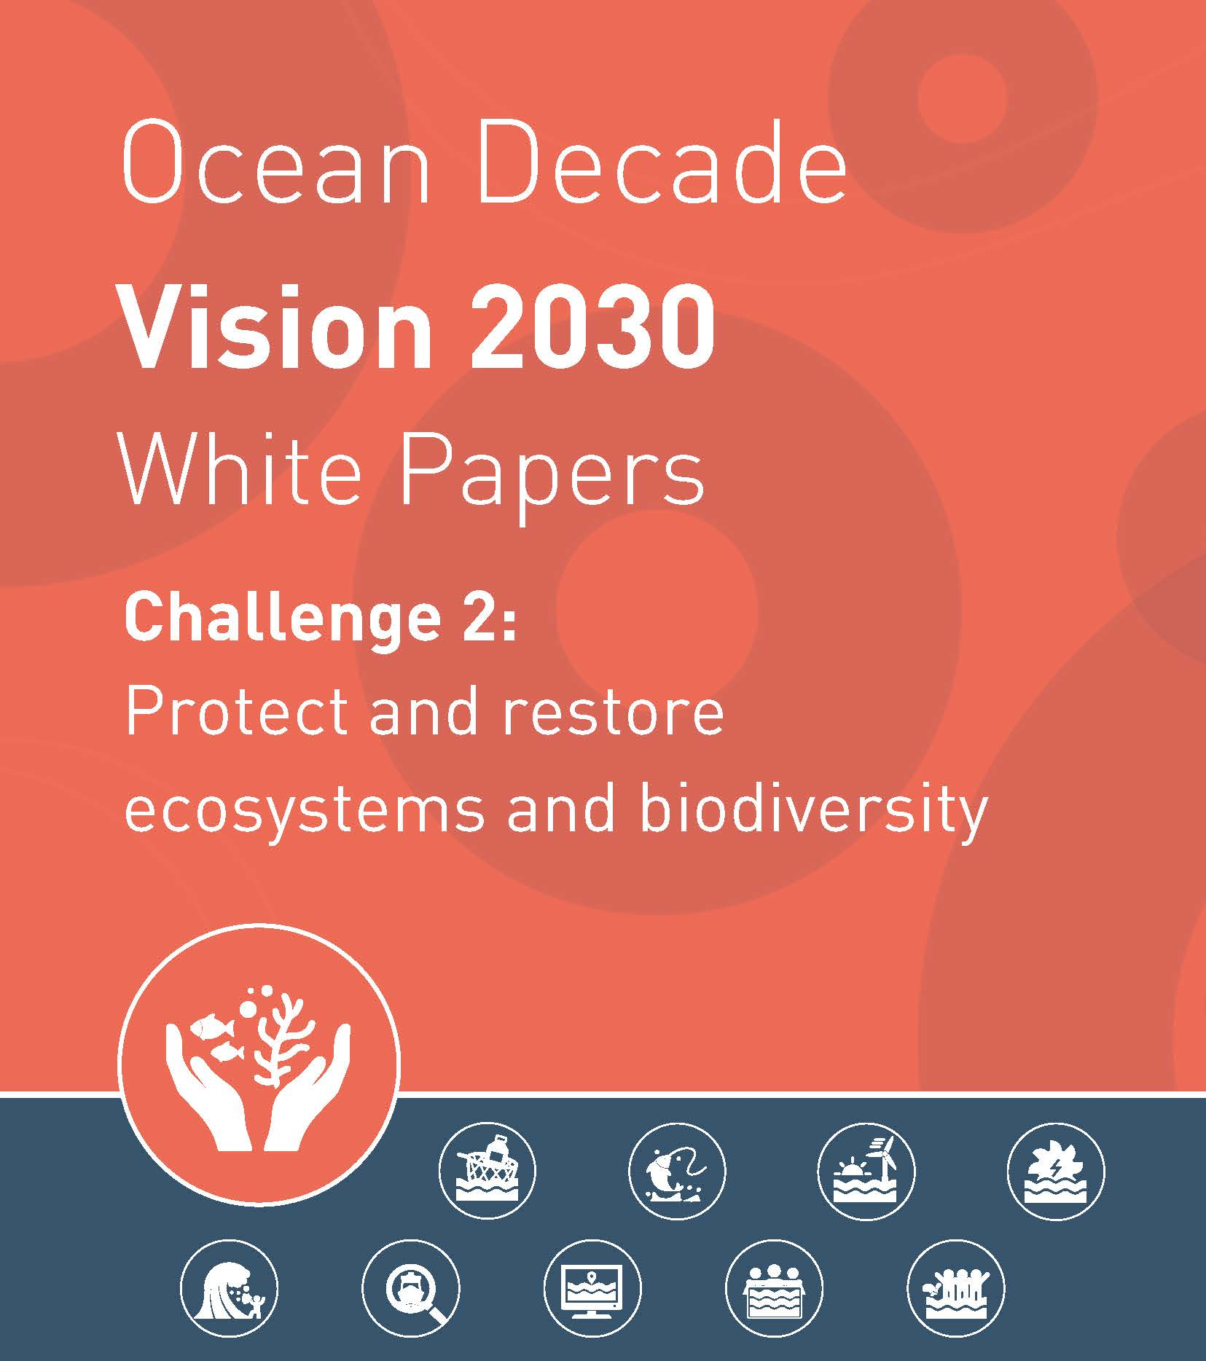
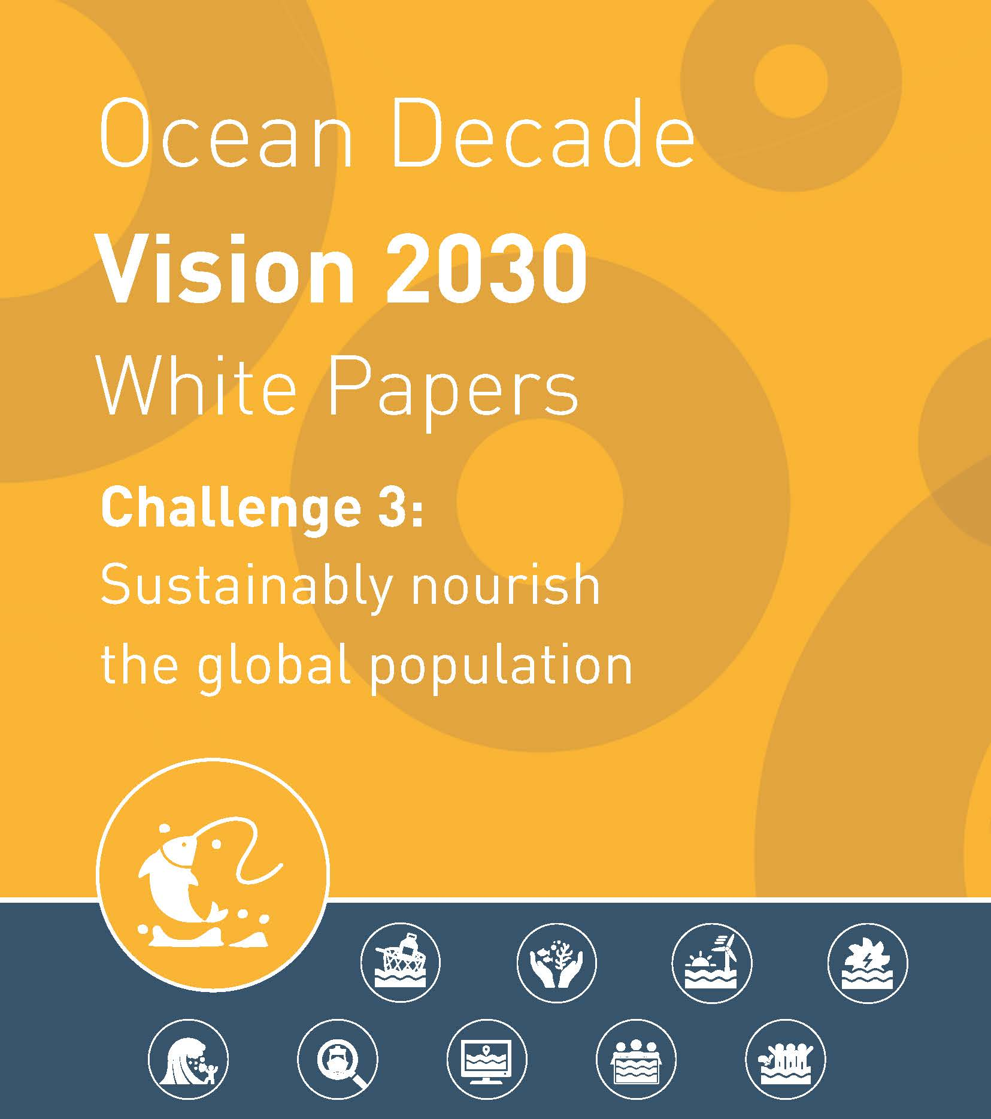
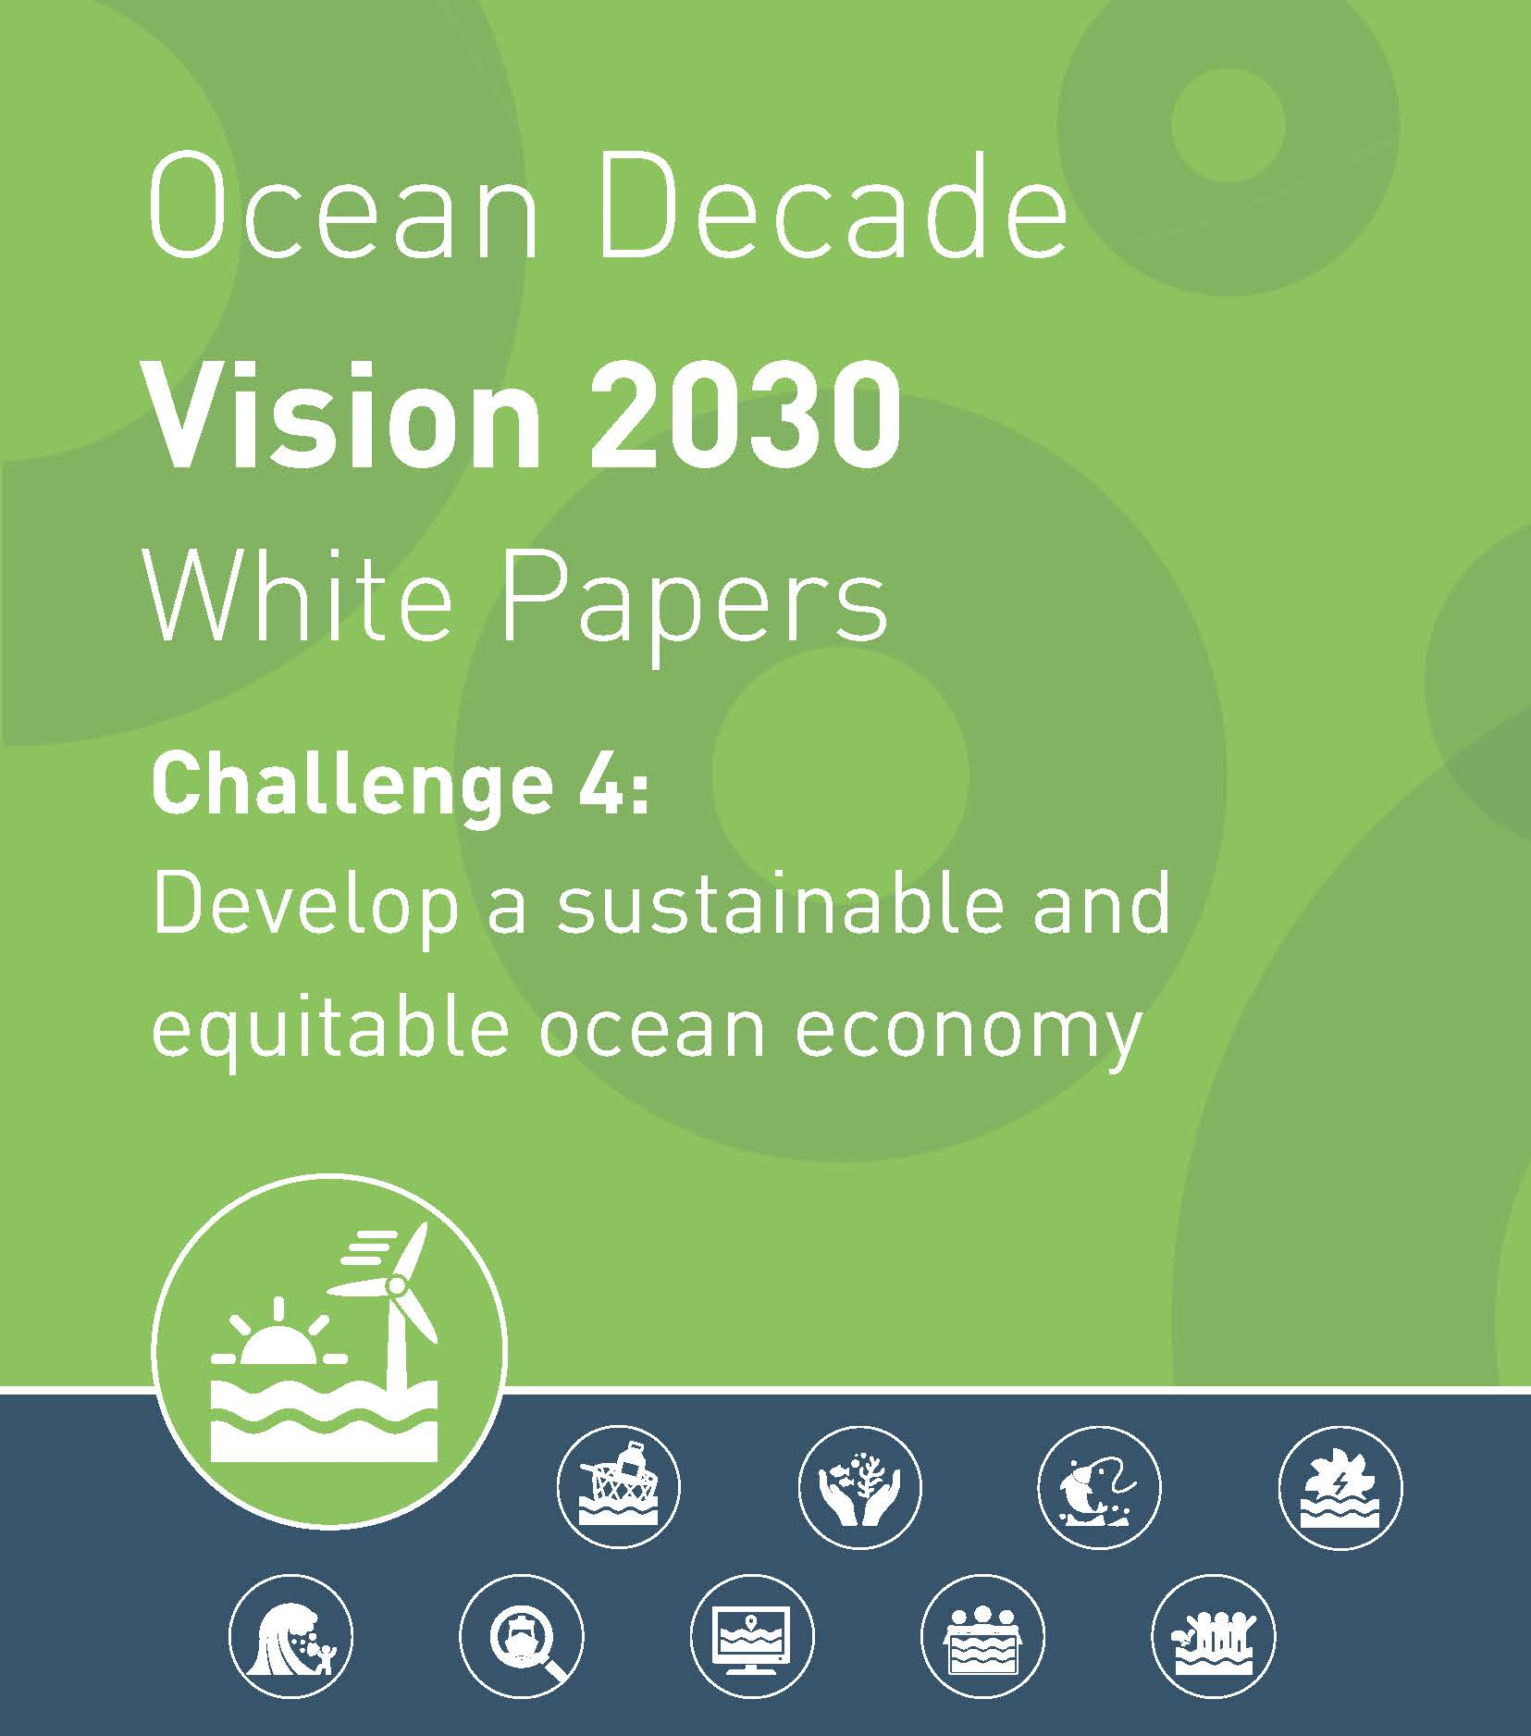
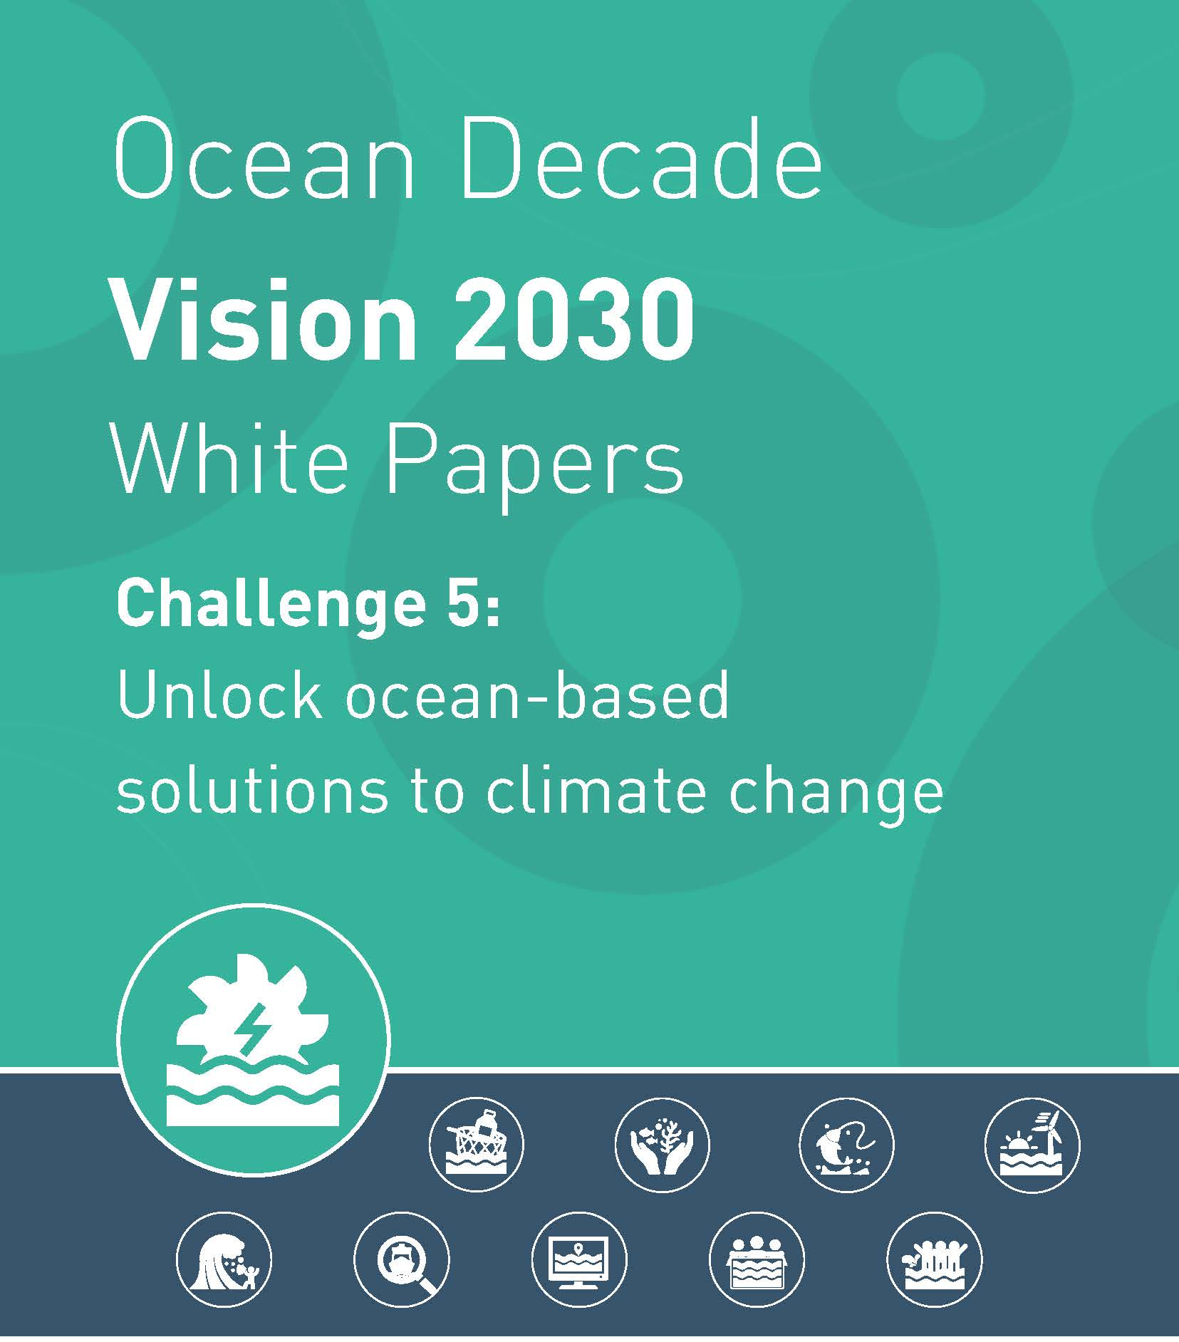
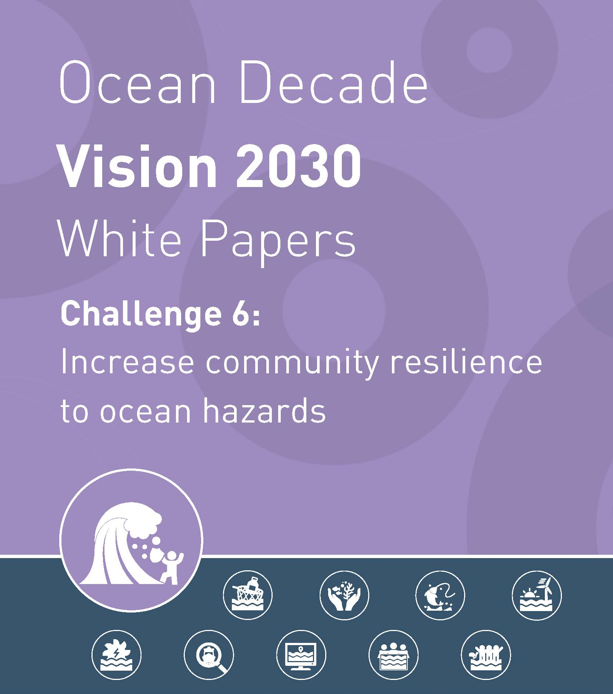
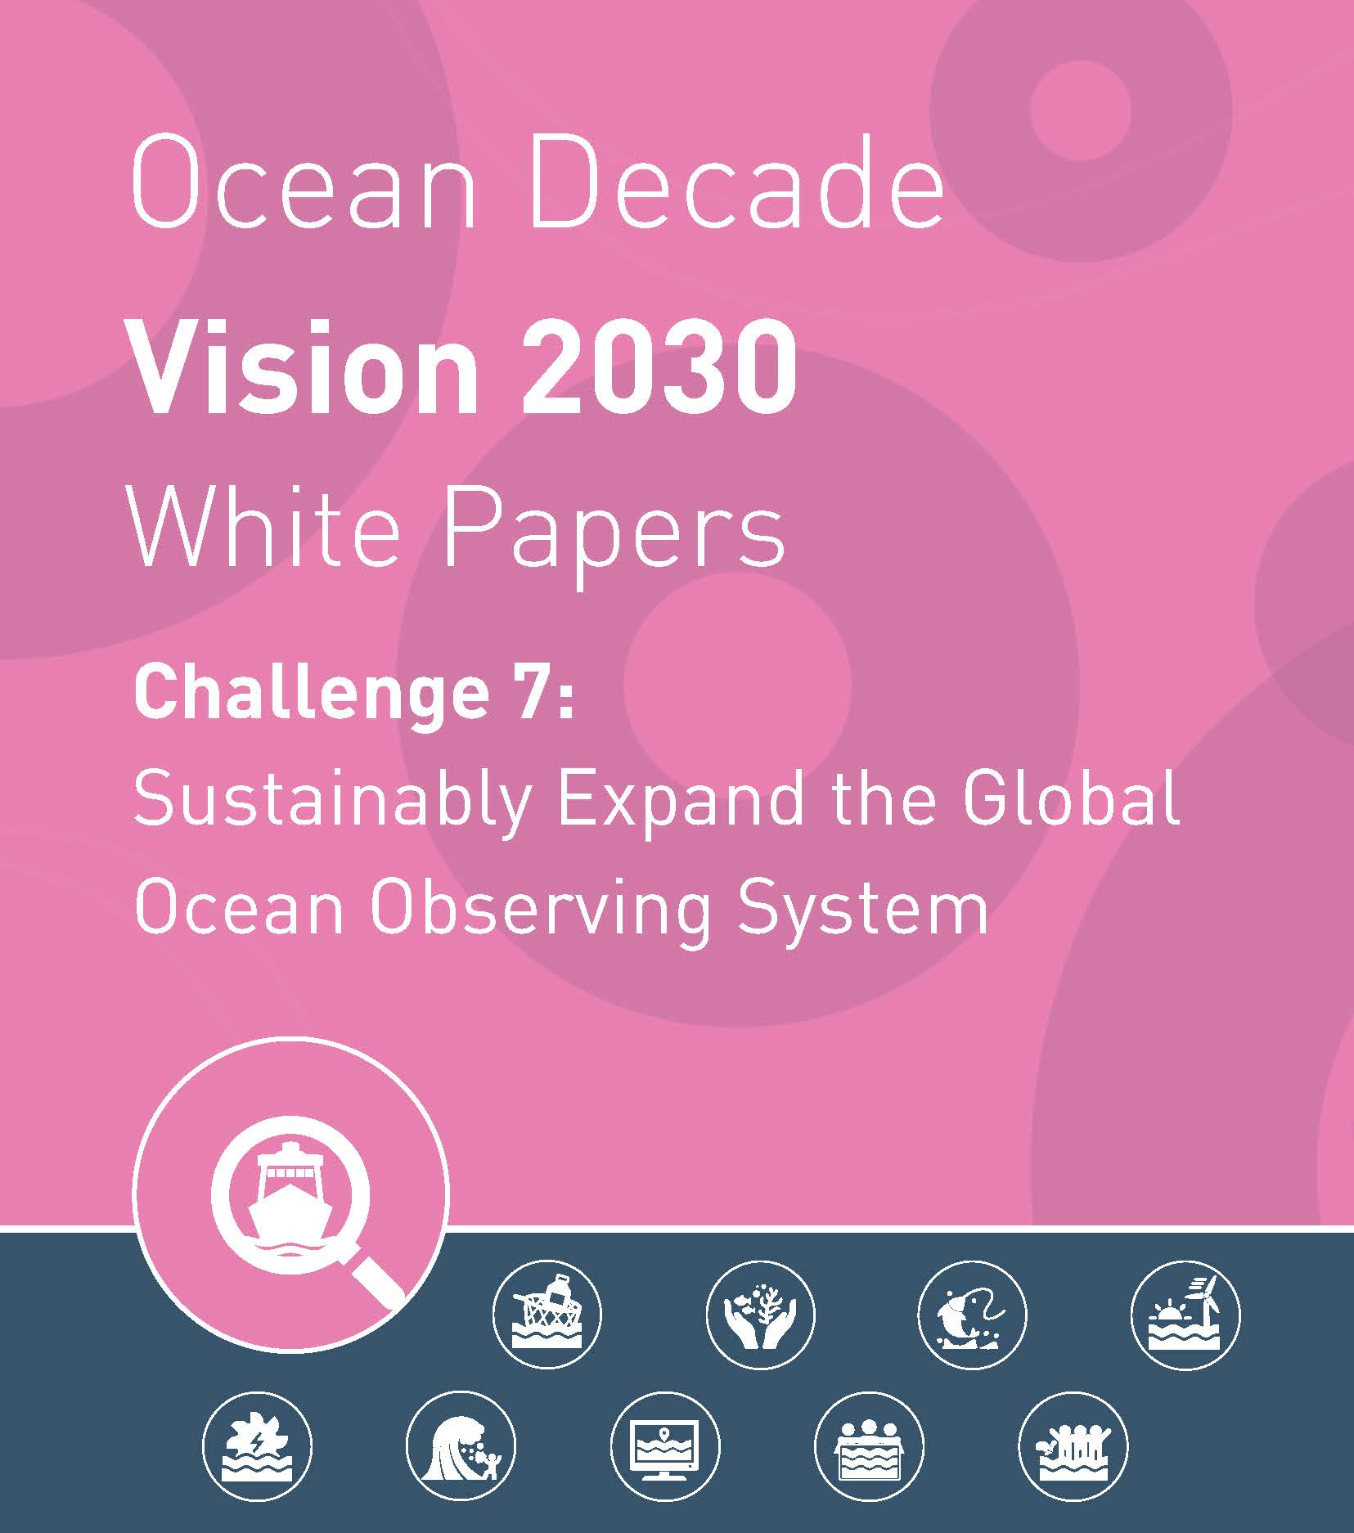
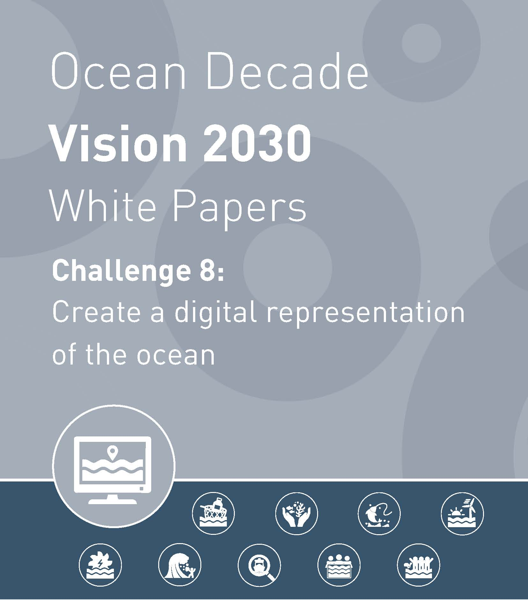

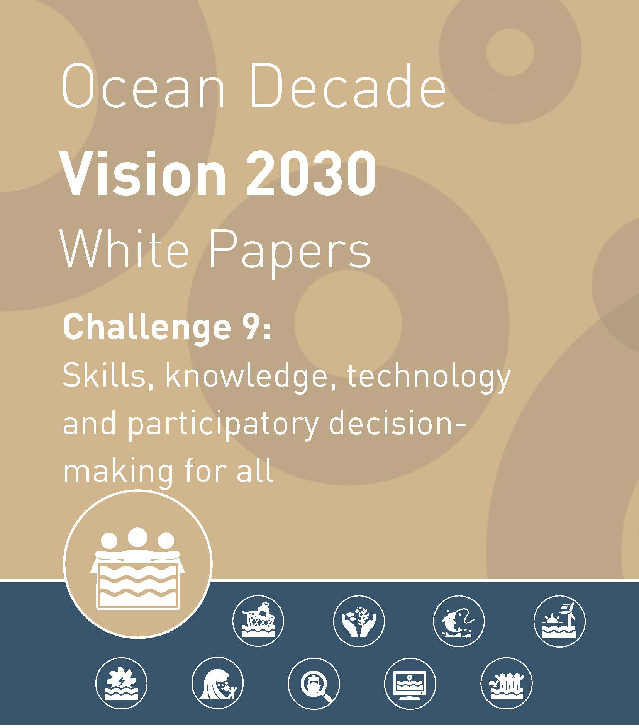
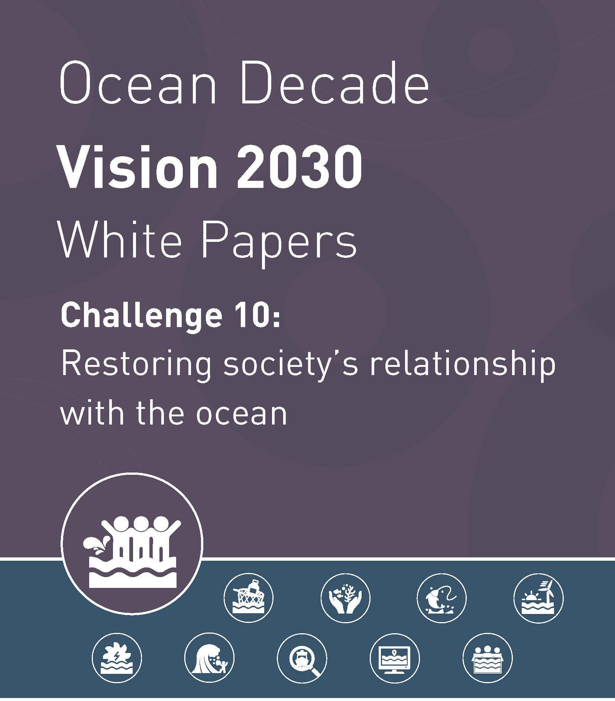
VISION 2030 WHITE PAPERS
Vision 2030 Key Elements
Refinement of Challenges
Priorities by Challenges
Priorities across Challenges
Cross-Cutting Issues
10 White Papers authored by 10 expert Working Groups
Report drawing on the WPs and including additional analysis authored by the DCU
INFORMATION SESSIONS FOR ENDORSED DECADE ACTIONS
JUNE 2024
Notes:
Vision 2030 process outcomes and the discussions of the 2024 Ocean Decade Conference reinforced the importance of all 6 WMO – IOC cooperation areas as priorities for the coming years of the Ocean Decade
Strong recognition of foundational role of observations, data and prediction to underpin the generation and use of ocean science and knowledge across Ocean Decade Challenges, SDG targets and to inform development and implementation of ocean related policy and decision making.
Conference findings highlighted the urgent need for sustained and sustainable infrastructure for ocean observations, data sharing and modeling and prediction that address current geographical and thematic gaps and improved accessibility to all actors.

Slide 7
CONNECTIONS WITH WMO – Climate Change and Ocean Hazards
CHALLENGE 5: Unlock ocean-based solutions to climate change
‘Enhance understanding of the ocean-climate nexus and generate knowledge and solutions to mitigate, adapt and build resilience to the effects of climate change across all geographies and at all scales, and to improve services including predictions for the ocean, climate and weather’
CHALLENGE 6: Increase community resilience to ocean hazards
‘Enhance multi-hazard early warning services for all geophysical, ecological, biological, weather, climate and anthropogenic related ocean and coastal hazards, and mainstream community preparedness and resilience’
RECOMMENDATIONS
Adaptive governance and management should be supported by decision support tools for the assessment of vulnerability and risk to coastal communities and marine industries, and for developing climate change adaptation pathways.
Equity in implementation. Prioritize fairness and inclusivity in the execution of mitigation and adaptation measures to ensure all stakeholders benefit equitably.
RECOMMENDATIONS
Developing an open and accessible information system to support risk assessment and management, leveraging observations, advanced numerical/AI models, and people-centered early warning systems for multiple hazards.
Integrating coastal resilience targets into SDGs, particularly by incorporating indicators for coastal cities within SDG 11, indicators for coastal and ocean hazards within SDG 13, and indicators for coastal resilience within SDG 14.
Establishing a Coastal Resilience Review of Requirement (C3R) process, which involves clearly identifying diverse stakeholder needs and implementing a periodic consultation mechanism with Member States to assess progress.

Slide 8
CONNECTIONS WITH WMO – Climate and Environmental Observations
CHALLENGE 7: Sustainably expand the Global Ocean Observing System
‘Ensure a sustainable ocean observing system across all ocean basins that delivers accessible, timely, and actionable data and information to all’ users.
RECOMMENDATIONS
Upgrade and expand ocean observing capacity in poorly-observed areas (e.g., polar regions, SIDS and LDCs, deep-ocean). Thematic priorities should focus on key climate risk and adaptation needs, extreme events, coastal services for ocean management, ocean carbon, marine pollution, biogeochemistry, and biodiversity.
Establish new and sustained financing mechanisms for global ocean observing, including resourcing for SIDS and LDCs. Use economic models for ocean investment to diversify and accelerate investment in ocean observing and infrastructure from new actors.
Integrate and harmonise observations across observing platforms (in situ, satellite, emerging networks). Develop innovative in situ, autonomous and cost-effective technologies to maximise reach, ensuring standardisation and best practices. Lower technology barriers to ensure everyone has equitable access and use of observing technology (e.g. AI).
Training and capacity development will be critical across the observing ‘ecosystem’ outlined in the Framework for Ocean Observing (FOO), from data collection to data analysis and modelling, and for data use and application.

Slide 9
CONNECTIONS WITH WMO – Tools, Forecasting and Capacity Development
CHALLENGE 9: Skills, knowledge, technology, and participatory decision-making for all
‘Ensure comprehensive capacity development and equitable access to data, information, knowledge and technology across all aspects of ocean science and for all stakeholders’
CHALLENGE 8: Create a digital representation of the Ocean
‘Through multi-stakeholder collaboration, develop a comprehensive digital representation of the ocean, including a dynamic ocean map, which provides free and open access for exploring, discovering, and visualizing past, current, and future ocean conditions in a manner relevant to diverse stakeholders’
RECOMMENDATIONS
A federated global Ocean Data Discovery and Access Service (DDAS) providing access to multi-disciplinary data, data products and information on the past and current state and use of the ocean, accompanied by an Ocean Data Help Desk and distributed Data Ingestion service.
A global Technical and Organizational Structure for Ocean Forecasting, promoting harmonized methods, data standards, shared architectures, and tools to foster ocean prediction worldwide.
RECOMMENDATIONS
Technical, transdisciplinary, and transversal skills required by scientists, resource users, educators, communicators, managers, and policymakers are strengthened and evenly distributed with an emphasis on LDCs, SIDS and other under-represented groups.
Users and stakeholders from currently under-represented groups (i.e., women; ECOPs; Indigenous communities; LDCs and SIDS; people with disabilities; and others) are well-represented and participatory in ocean science, communication, management, decision making, and policy within the Decade framework.

Slide 10
ENABLING FACTORS FOR SUSTAINED IMPACT…
Systematic processes and structures to strengthen role of policy / user needs as drivers of Decade Actions
Translation of global priorities to specific needs of SIDS/LDCs & proactive support and partnerships
Approaches, tools and skills to increase inclusivity of all knowledge systems
Reinforced national level action & strengthened guidance for national science – policy – society uptake
Capacity development with sustained impact for individuals and institutions
Industry engagement including with insurance, finance, tourism & fisheries sectors
Strategic communications and broad approach to ocean literacy across all sectors of society
Equity, inclusivity & diversity across generations, genders and geographies
Sustained & sustainable financing, investment and resourcing for ocean science initiatives and infrastructure as a legacy of the Ocean Decade
Notes:
Cross cutting priorities – to create success we need to look at the environment in which the Decade operates
Systematic processes and structures to strengthen role of policy / user needs as drivers of Decade Actions
Translation of global priorities to specific needs of SIDS/LDCs & proactive support and partnerships
Approaches, tools and skills to increase inclusivity of all knowledge systems
Reinforced national level action & strengthened guidance for national science – policy – society uptake
Capacity development with sustained impact for individuals and institutions
Industry engagement including with insurance, finance, tourism & fisheries sectors
Strategic communications and broad approach to ocean literacy across all sectors of society
Equity, inclusivity & diversity across generations, genders and geographies
Sustained & sustainable financing, investment and resourcing for ocean science initiatives and infrastructure as a legacy of the Ocean Decade

Slide 11
Way forward – What the Decade may offer to the IOC & WMO collaboration ?
OD renewed priorities offer a visible and impactfull framework for collaboration (links with societal/policy actors)
Opportunities to generate a shift in the way ocean obs/data is resources
Generate greater integration across value chain – Observation-data-prediction – linking to diverse end-users, though enhance global /regional coordination
Address capacity development needs of Member States, tailored to regions, leveraging the OD Capacity Development Facility
Strengthen IOC & Decade national and regional coordination mechanisms engagement with WMO’s own mechanims
Create joint collaborative Decade Actions with high societal impacts and policy relevance, and leverage Decade ecosystem (Private sector, philantropy, Ocean tech, etc)
Notes:
a shift in the way ocean observations and data is resourced – with a move from funding to investment, including generating and widely communicating information on the societal benefits of observation, data and prediction / forecasting => Ocean Decade is planning a new flagship initiative on investment in ocean science and would welcome collaboration with WMO as part of this
greater coordination across the observations – data – prediction value chain at the global level and regional level => Ocean Decade network of Decade Coordination Offices and Decade Collaborative Centres for observations, data, prediction and regional centres provide a framework to start this coordination and with the right resourcing and investment could be one of the major Decade legacies post-2030 – would welcome WMO engagement / resourcing in the further development of Centres
targeted skills building and capacity development across the observations – data – prediction value chain with heterogenous priorities in different regions and for different target groups => Ocean Decade Capacity Development Facility can provide a coordinating mechanism for identifying priority needs and linking CD initiatives to beneficiaries – would welcome WMO contributions to this Facility via registration of existing initiatives or creation of new joint initiatives
highlight network of IOC regional subsidiary bodies, Ocean Decade regional taskforces and National Decade Committees that are in many cases already engaging with national and regional initiatives led by WMO and note importance of maintaining and indeed strengthening these collaborations into additional to collaboration at the global level

Slide 12






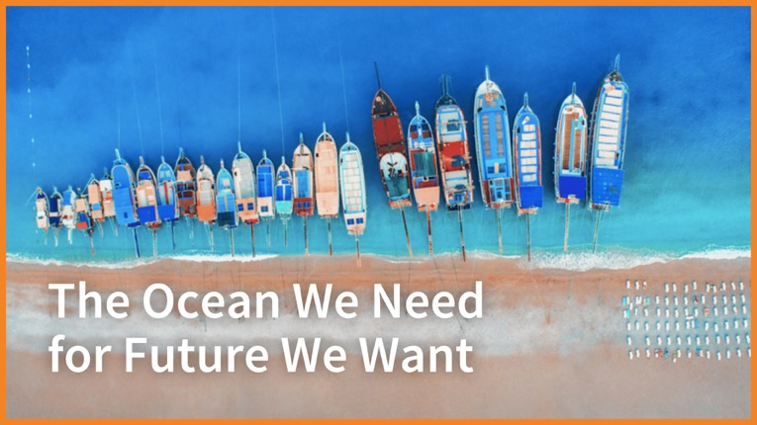








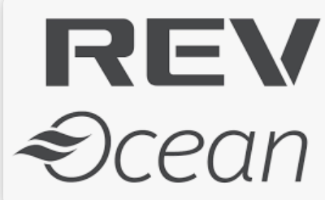


And many others that have contributed in-kind support…
Thank you

