Slide 1
PTWS-SG
Agenda item 7.2:
WG2 Progress Summary
Bill Fry, WG2 Chair
17 September, 2024
Honolulu

Slide 2
TT TGV
Developments
  Confirmed membership and still to be confirmed co-chair Matias Sifon
  ToR – revision will be proposed at the next ICG
  Need to expand catalogue of volcanoes that pose a tsunami threat for PTWS service areas
Upcoming tasks
  Hazard and Forecasting (Develop MCE?)
    Break into 7+1 tsunami source mechanisms
  Develop links with IAVCEI-WOVO and WMO-VAAC
  Establish POC for VAL triggered exchange of information between volcano and tsunami experts during volcanic unrest
  Discussion of interactions with TT FOO
    Both pragmatic short-term source dependent and long-term source agnostic
  Discussion of interactions with WG1
    Can we provide information to help develop hazard and risk assessment?

Slide 3
TT ISN 1
Developments
  ToR revision to be proposed at the next ICG
  Network analysis approach considering “in use” vs. “novel” technologies
  In Use technologies:
    E.g. OBP, Seismic, GNSS static displacement, tide gauges, inclusive HF coastal radar
    Subcategory of in-use candidates for near real-time operational measurements, e.g. satellite altimetry, MERMAID, SMART
  Novel technologies:
    E.g. Optic fibre interferometry, GNSS TEC
SMART projects in train, but in early stages no data availability

Slide 4
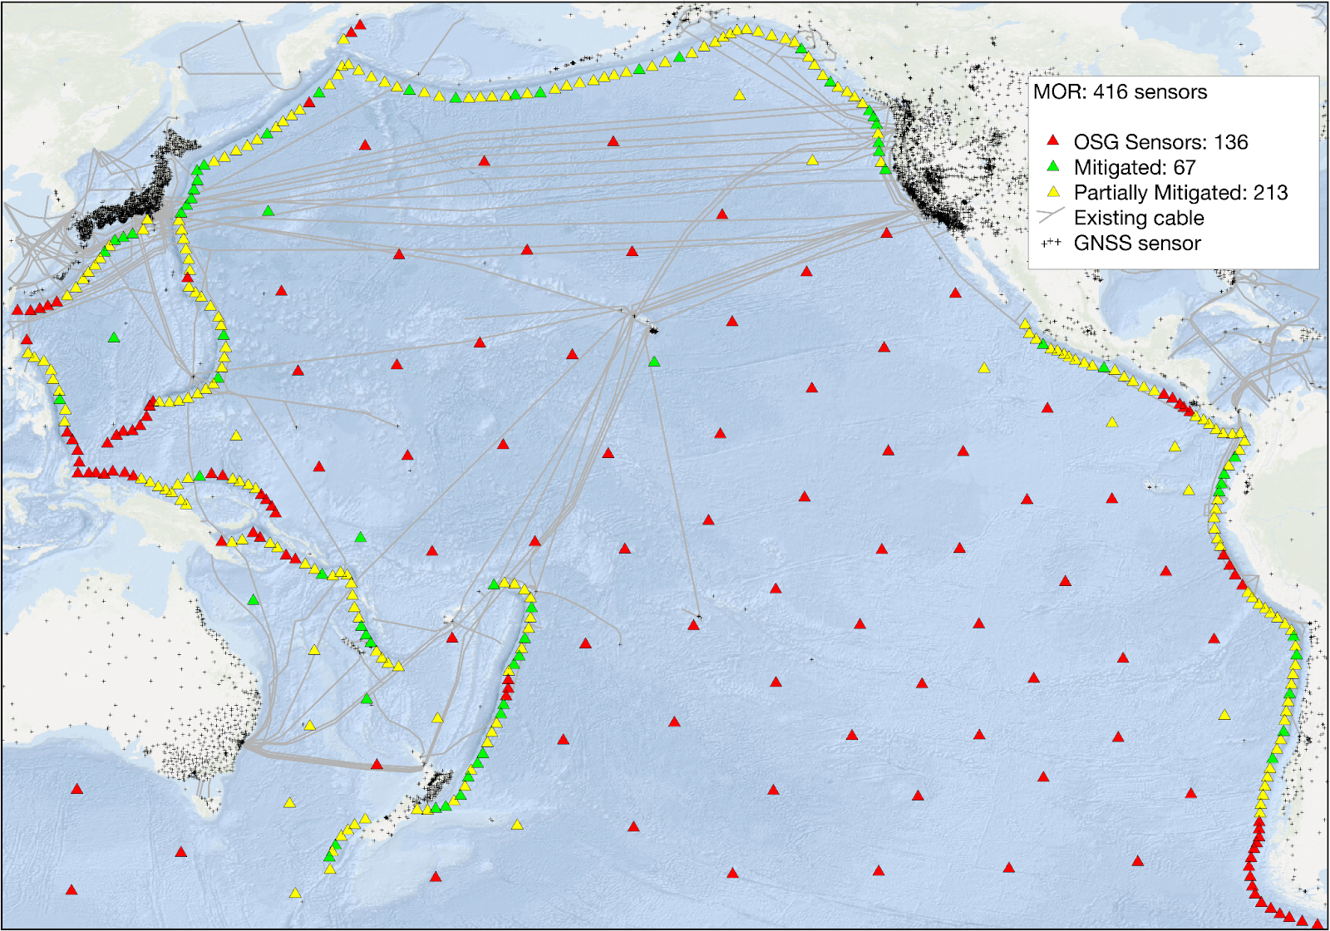
TT ISN 2
OSN assessment to deliver ODTP implementation plan target warning

Slide 5
TT ISN 3
Ongoing:
  Data sharing and availability is still an ongoing concern across all technologies
  GeTEWS Oceania – targeting increased GNSS infrastructure for DRR in SW Pacific – November 2025 regional meeting
  Establish contacts with GOOS, GGOS and through these group 1) raise awareness about needs of PTWS and to 2) promote top-down advocacy for data to be made available for tsunami DRR (papaʻaina nui).

Slide 6
TT FOO
Developments
  ToR revisions to be proposed at the next ICG
  Summarized big data approaches applicable to real-time tsunami forecasting. Tests and implementation are currently being undertaken in Japan, U.S.A. and New Zealand. Note, these include both source dependent and source-agnostic capabilities and have possible links with WG1 basin-wide hazard assessment.
  French and New Zealand studies suggest that using regional Green’s Functions can improve time-dependent accuracy of Wphase results for tsunami forecasting in the SW Pacific and Japan.
  Discussion of alignment with TT ISN and TT TGV.

Slide 7
WG2 General 1
Developments
  Recognise the need across all TT to improve links to international bodies responsible for various data activities relevant to tsunami forecasting.
  Australia, US, France and Aotearoa New Zealand work prototyping a system for real time sharing of wphase solutions and future capability of ocean observation inversion solutions.
  US contributions to development of common ocean observation-based source inversion for forecasting. Operational system deployed in Aotearoa New Zealand.
  Aotearoa New Zealand have developed a SC module to improve analysis of slow tsunami earthquakes based on rupture duration and will make this module available to member states.

Slide 8
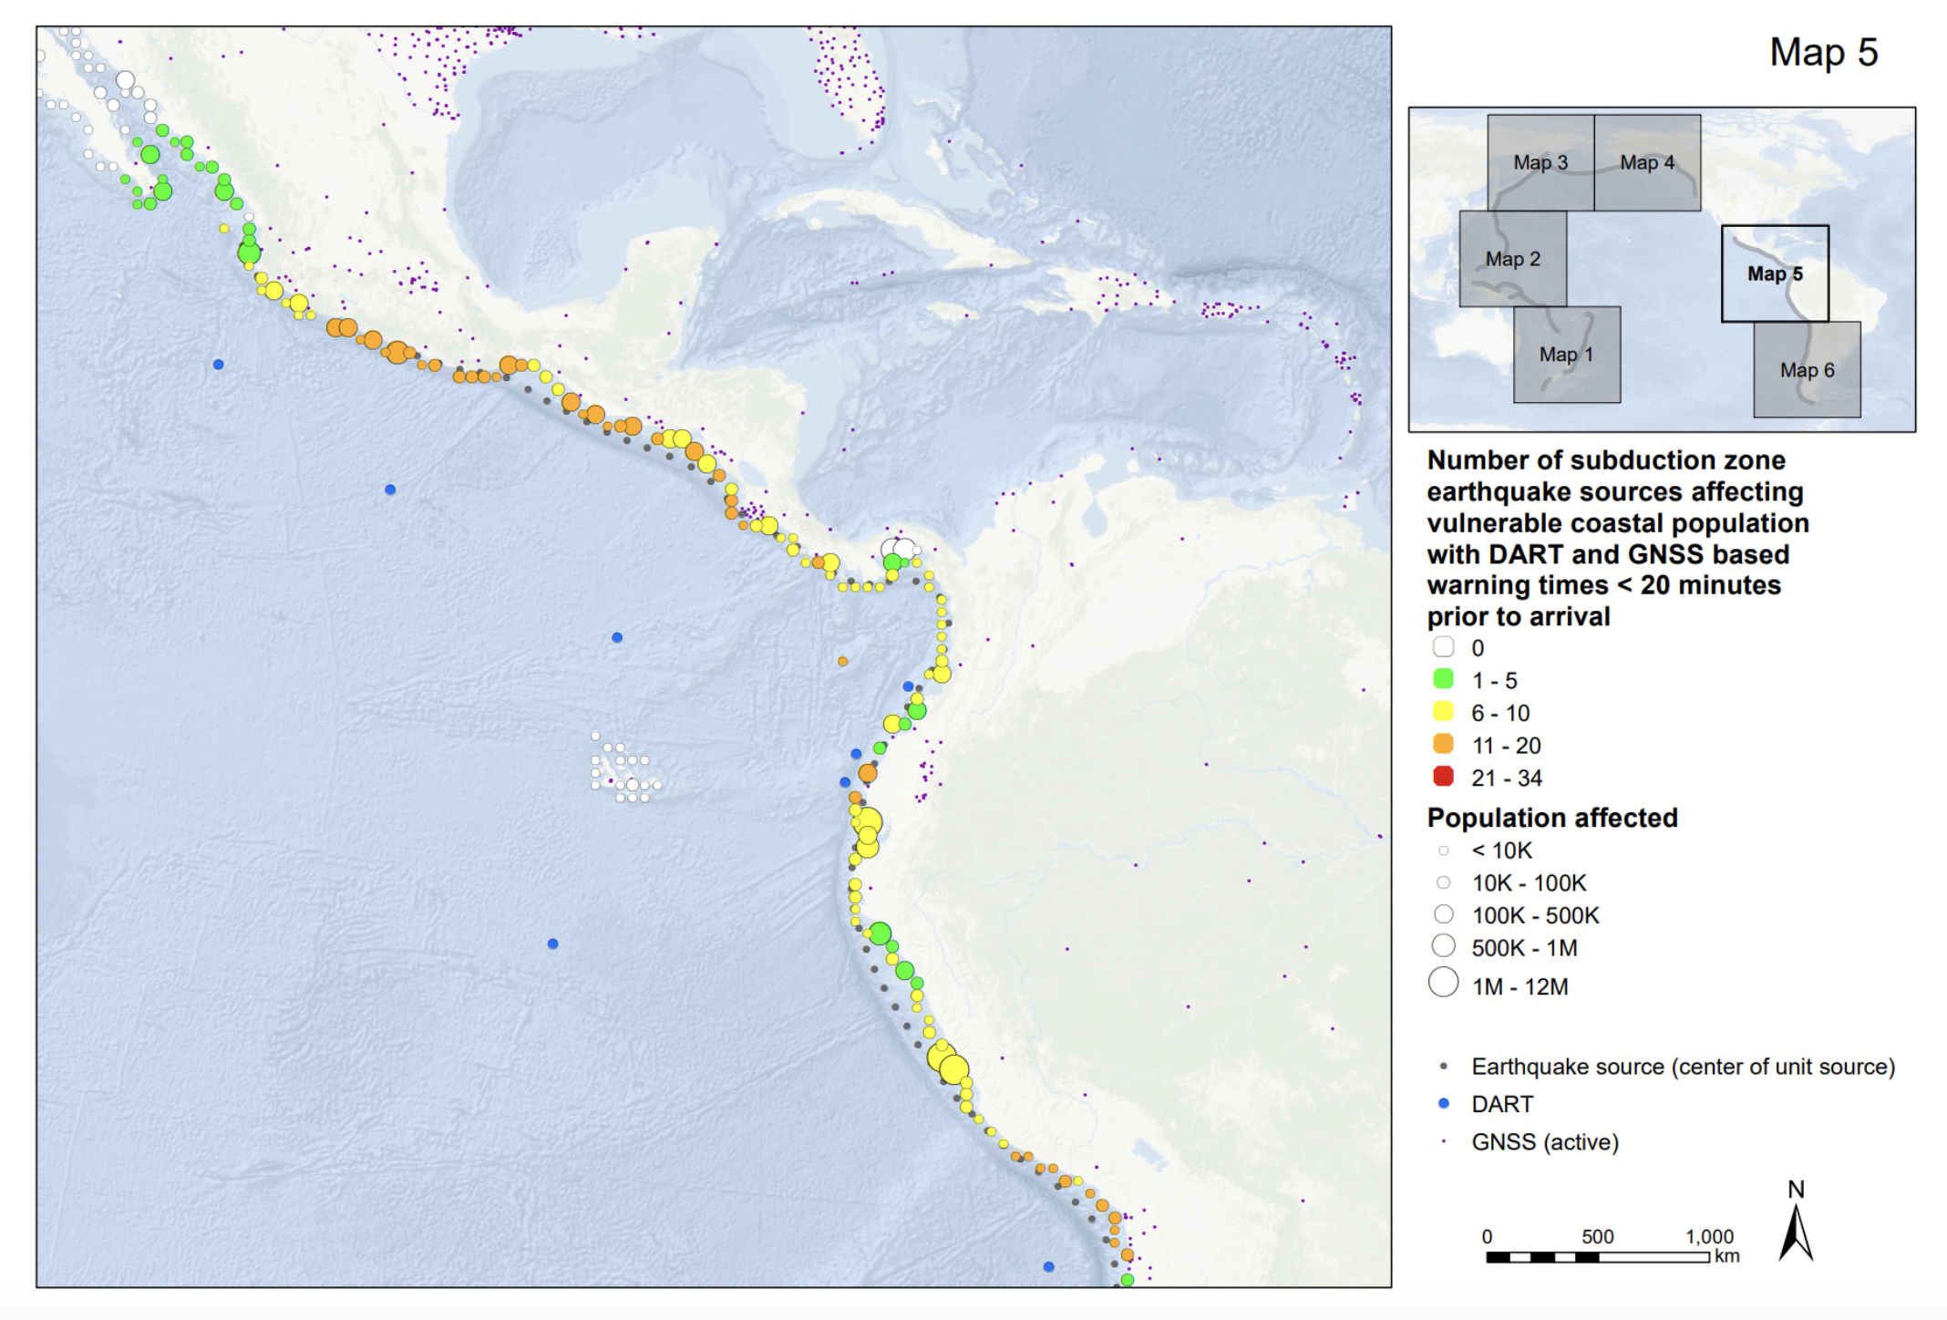
WG2 General 2
Developments continued
  Aotearoa New Zealand have developed a simple risk-based method to assess multi-sensor network warning time capability and propose to make this available to member states for their own use in informing network investment.

Slide 9
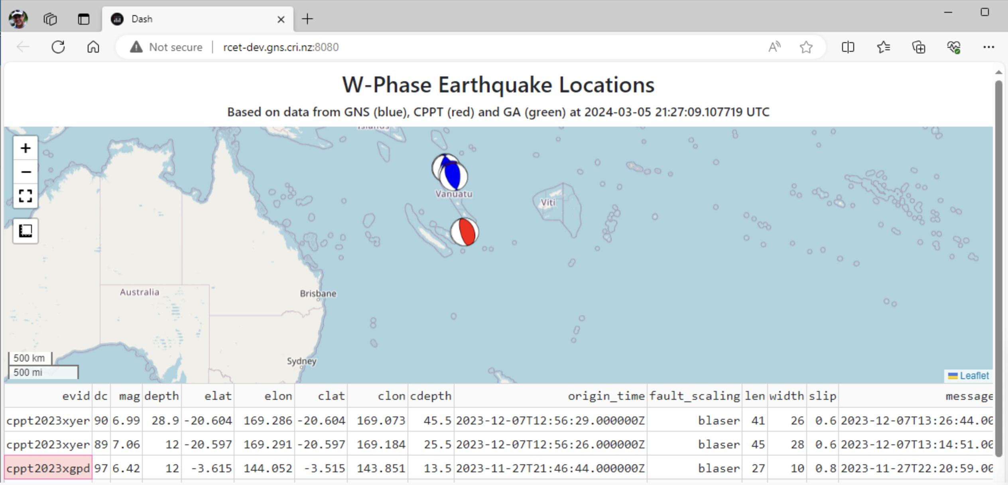
WG2 General 2
Developments continued
  Australia, US, France and New Zealand work prototyping a system for real time sharing of wphase solutions.

Slide 10
WG2 General 2
Developments continued
  New Zealand have developed a SC module to improve analysis of slow tsunami earthquakes based on rupture duration and will make this module available to member states.
Upcoming
  Utilize the 2025 Capability Assessment to stocktake current monitoring capability across member states.

Slide 11
mahalo

