Slide 1
10.1. Expected Date of the ICG/PTWS-XXXI session
ICG/PTWS Steering Committee Meeting
18 - 20 September 2024, Hawaii, USA
Dakui WANG
National Marine Environmental Forecasting Center, China

Slide 2
The ICG/PTWS XXXI Session
Will be held
in Beijing, China
on 7-11 April 2025
at Capital Hotel

Slide 3
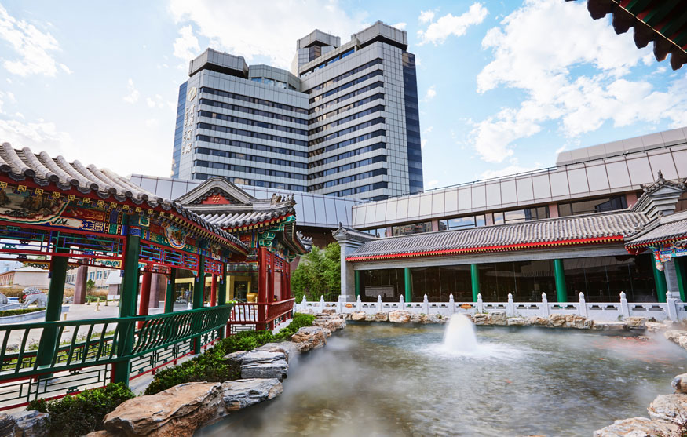
Capital Hotel
is a five-star hotel located in the center of Beijing. It has a superior geographical location and convenient transportation. It is surrounded by a number of national scenic spots and historical sites.
Opened:1989 Renovated:2018 Number of Rooms:588

Slide 4

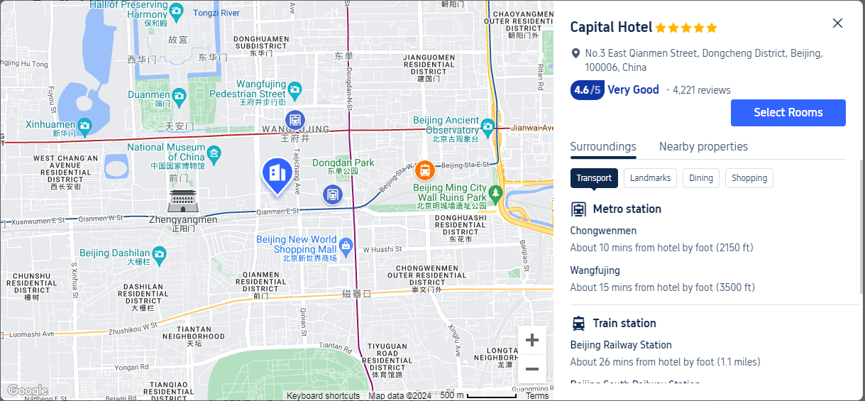
Location

Slide 5
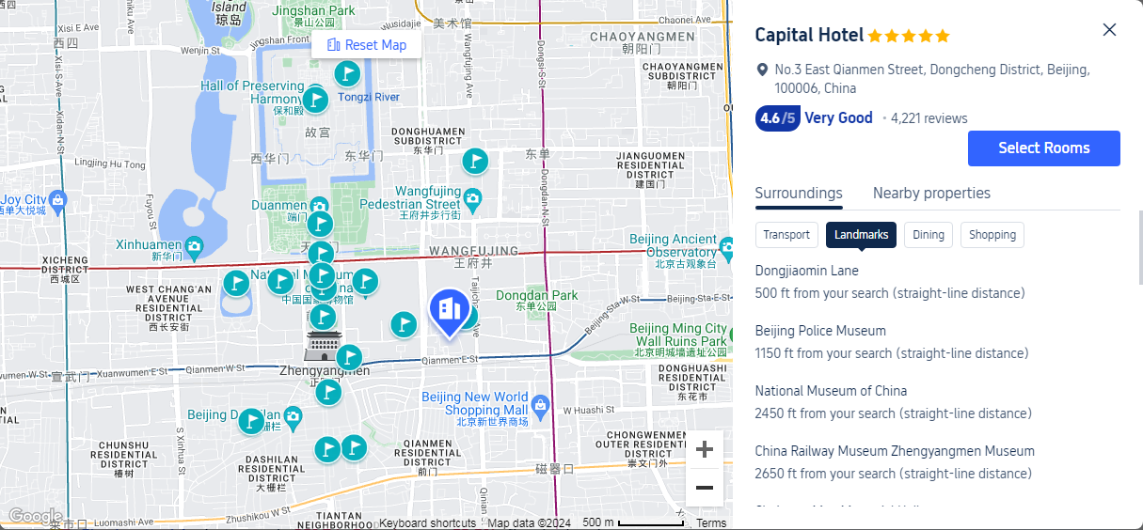
Landmarks

Slide 6
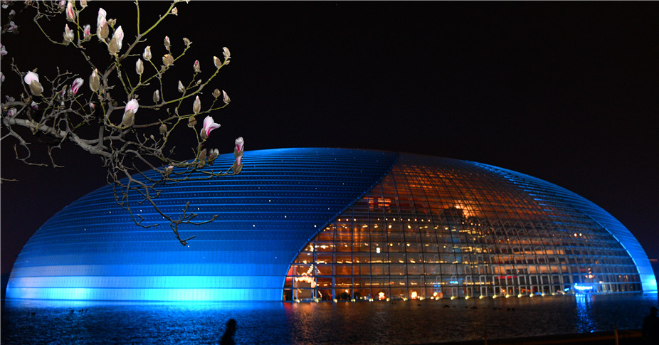
National Center for
Performing Arts

Slide 7
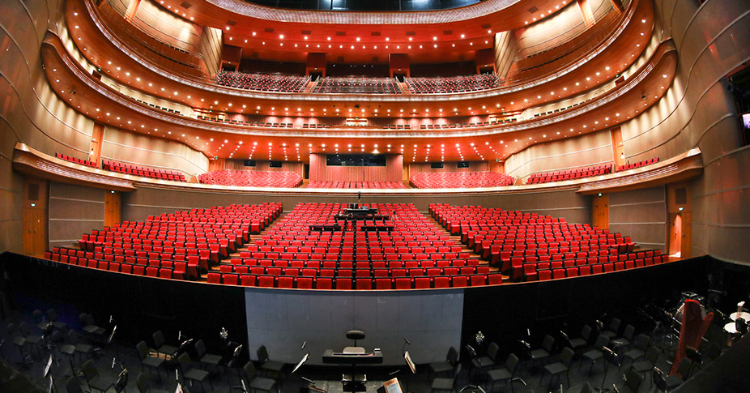
National Center for
Performing Arts – Opera Hall

Slide 8
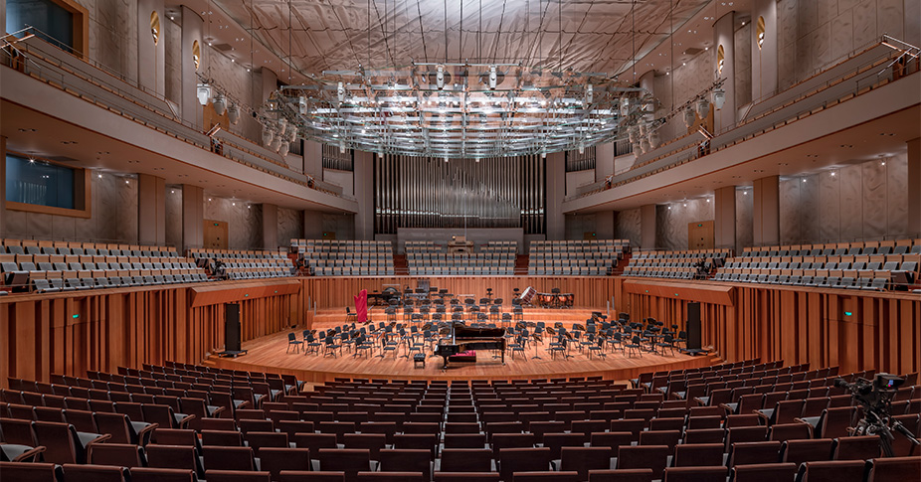
National Center for
Performing Arts– Concert Hall

Slide 9
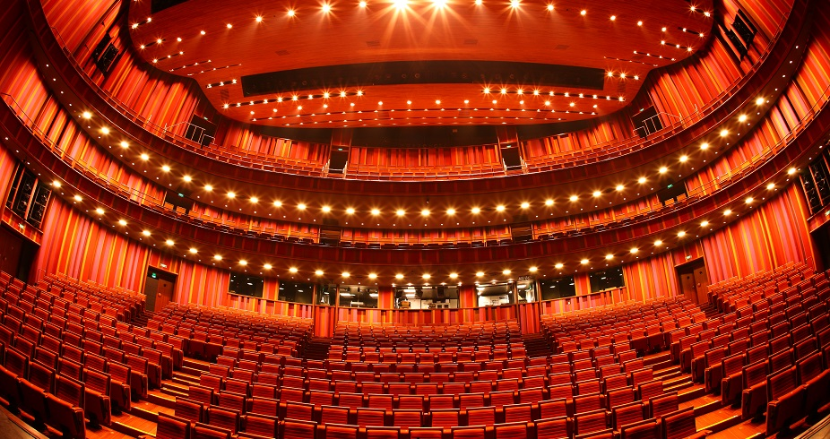
National Center for
Performing Arts– Theater

Slide 10
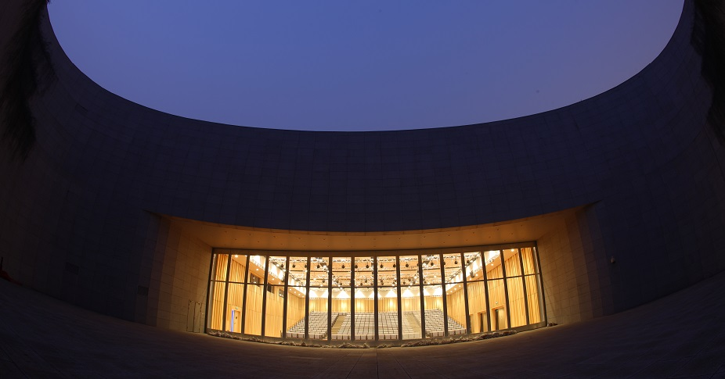
National Center for
Performing Arts– Small Theater

Slide 11
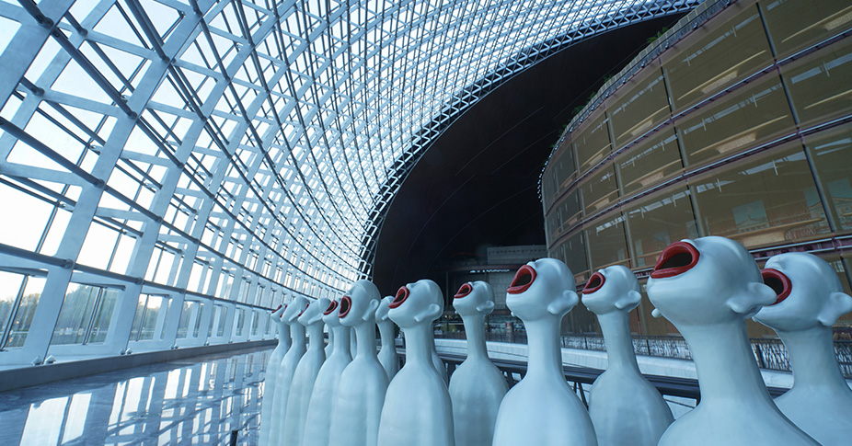
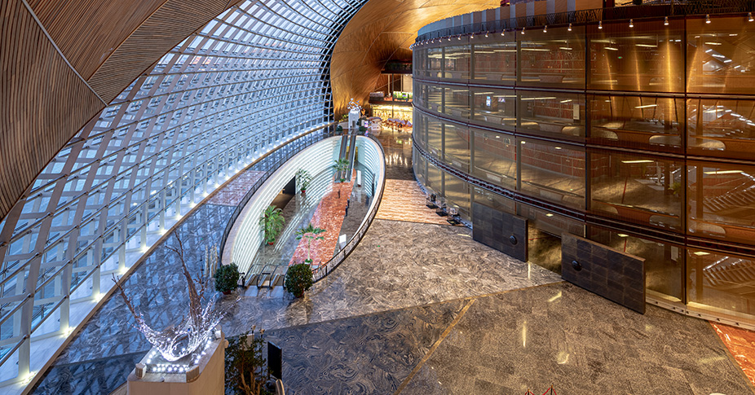
National Center for
Performing Arts– Theater

Slide 12
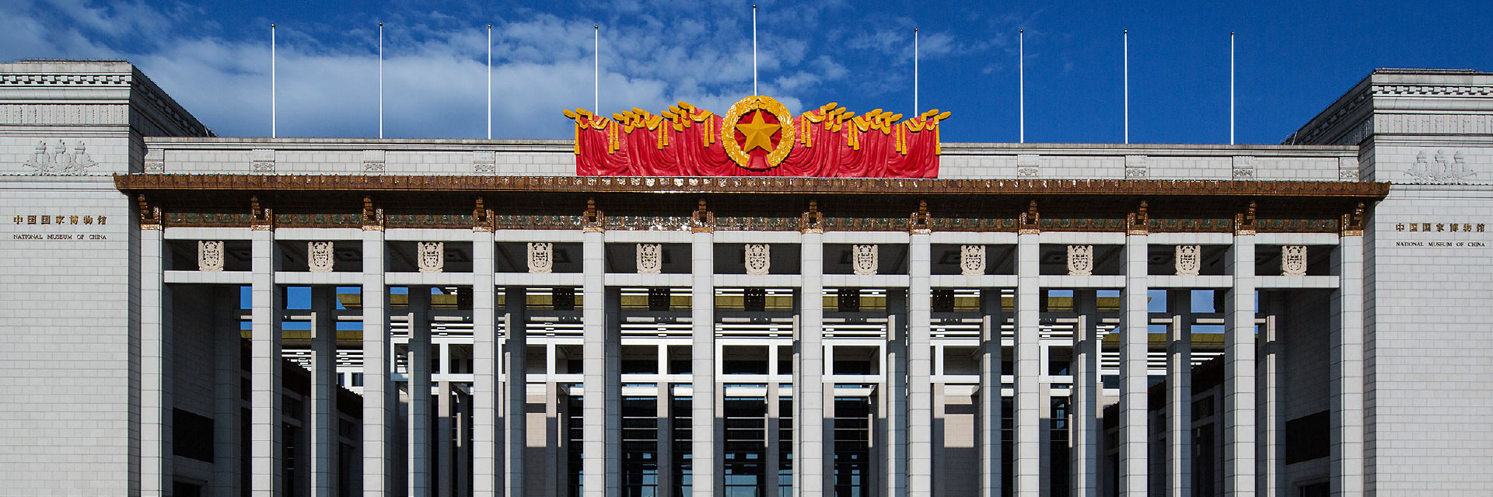
National Museum of China
The National Museum of China is China's supreme establishment that collects, researches, displays and interprets China's fine traditional culture, revolutionary culture and advanced socialist culture. NMC is the top palace of history and art and a cultural parlor for China.

Slide 13
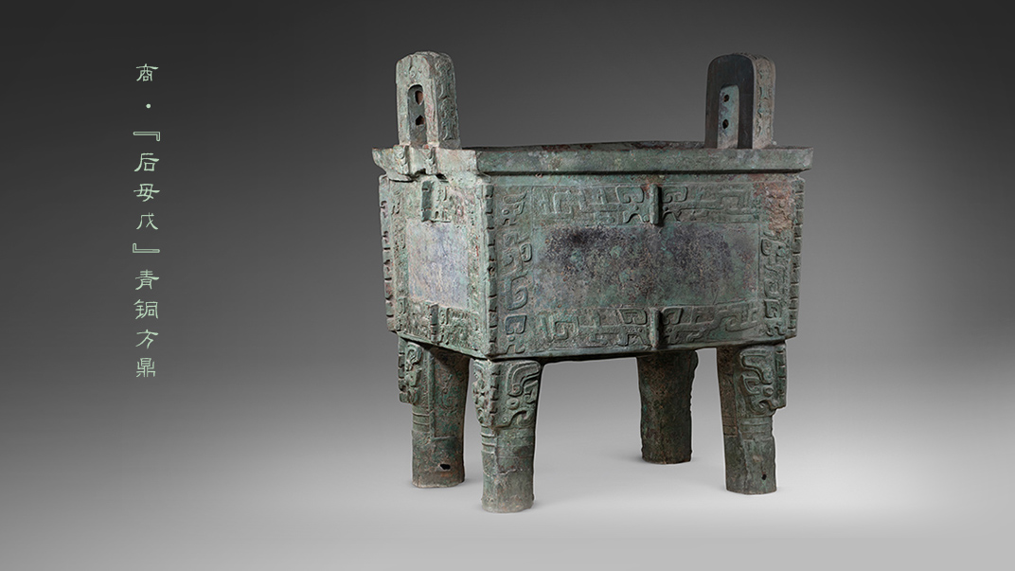
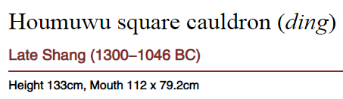
National Museum of China

Slide 14
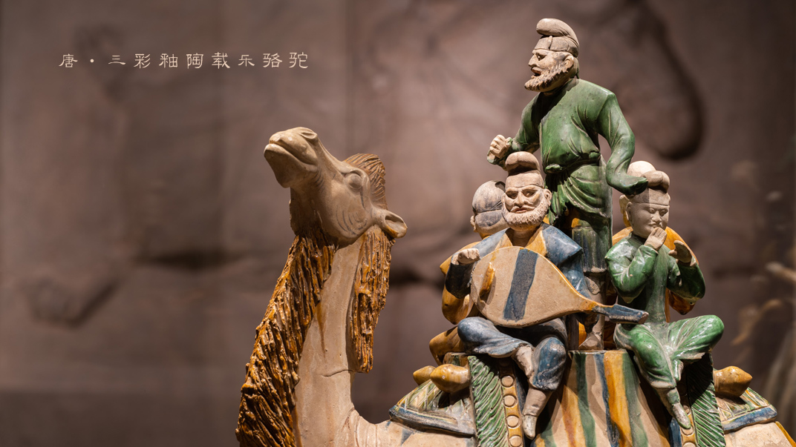
National Museum of China

Slide 15
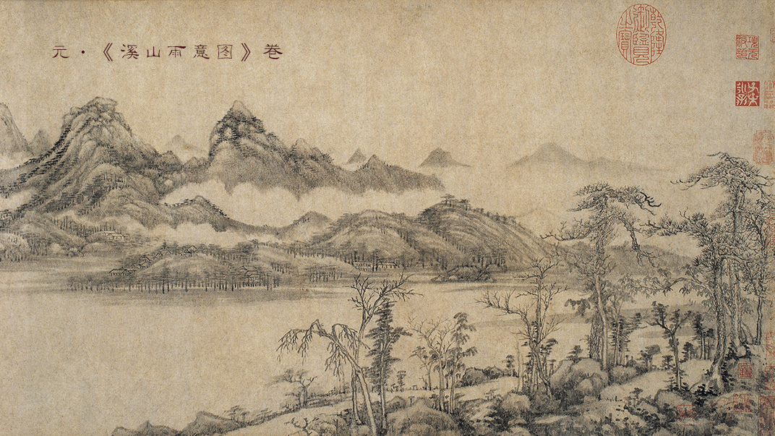
National Museum of China

Slide 16
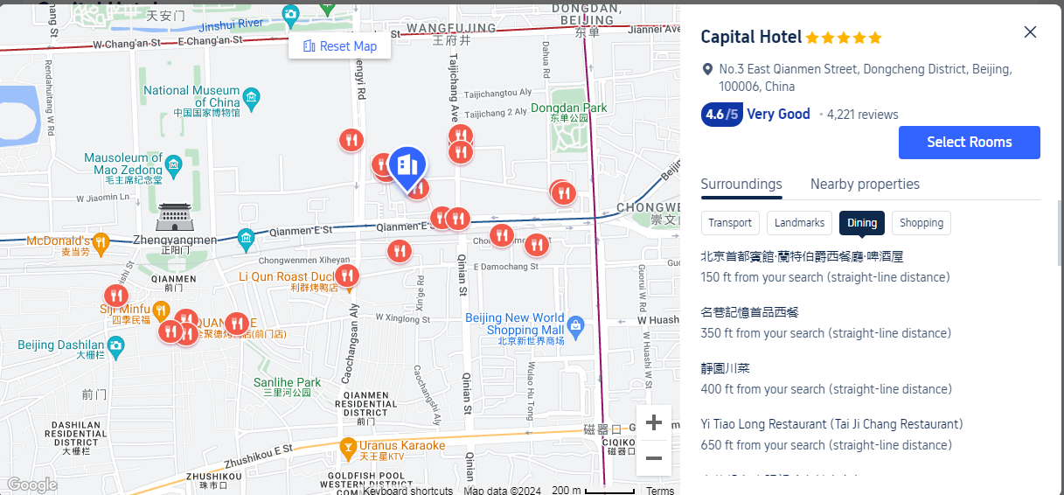
Dinning

Slide 17
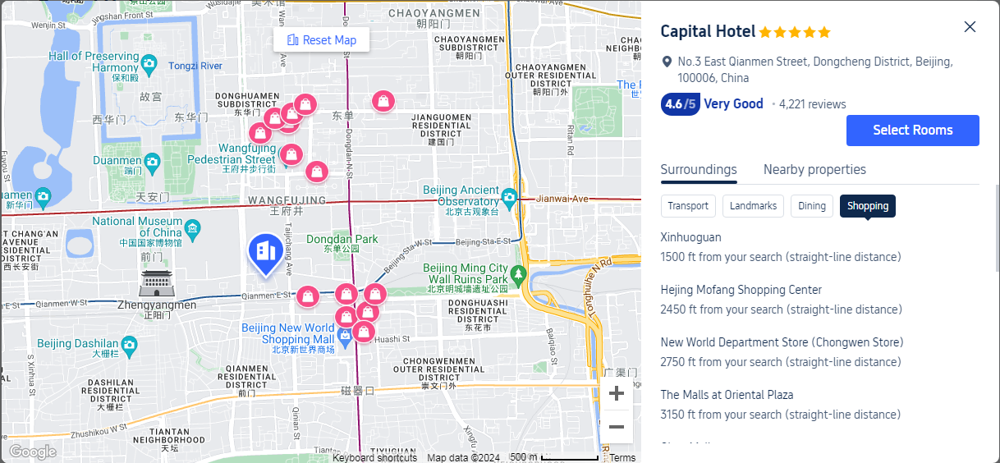
Shopping

Slide 18
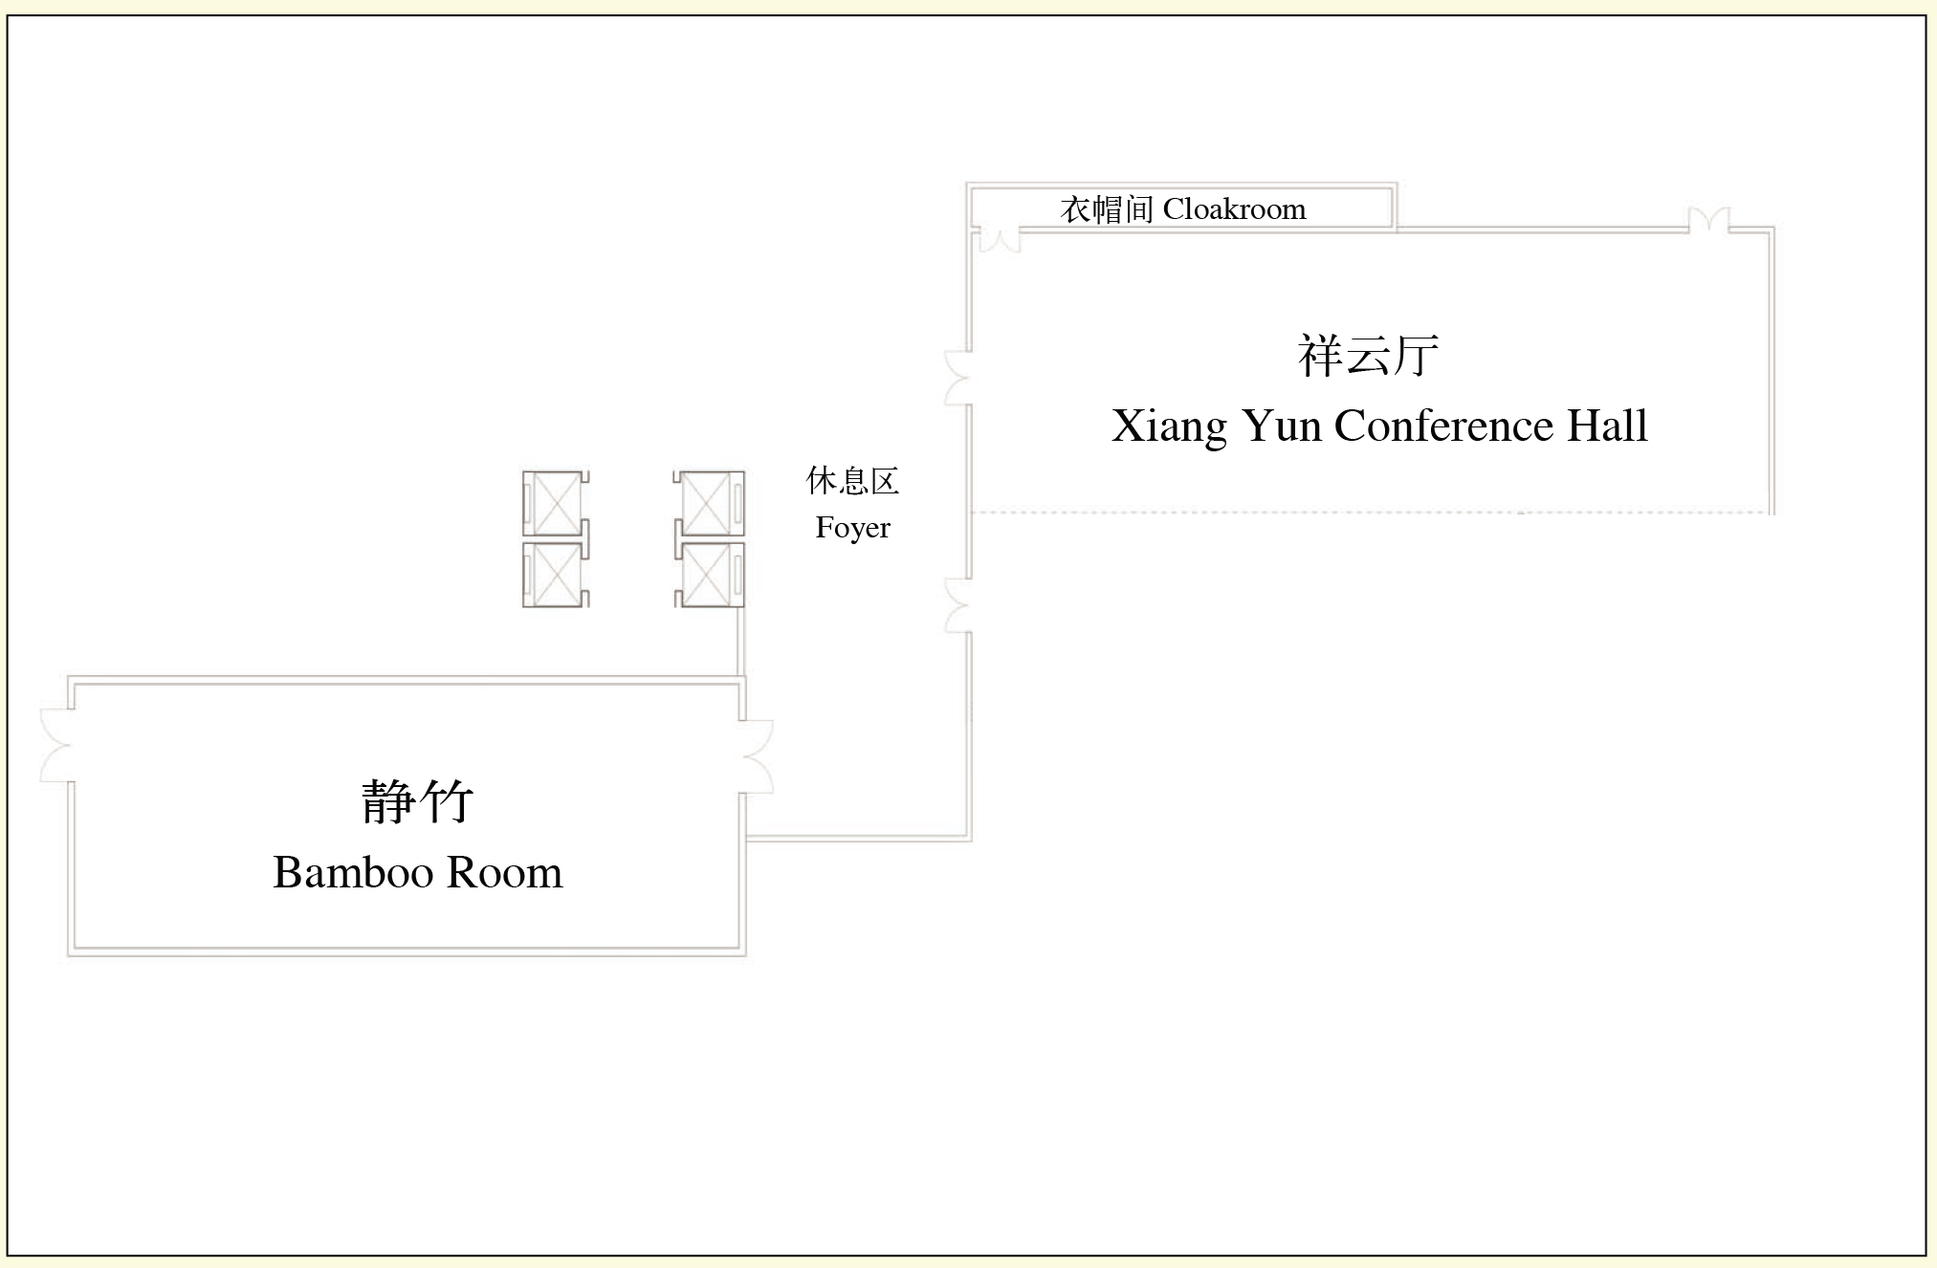
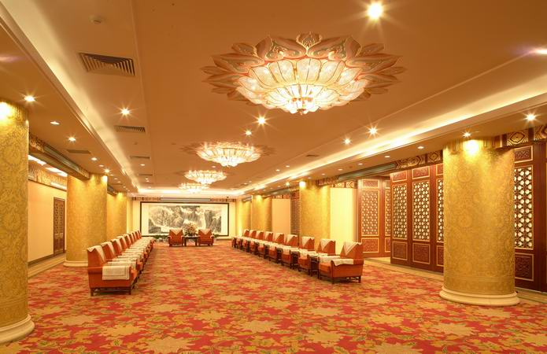
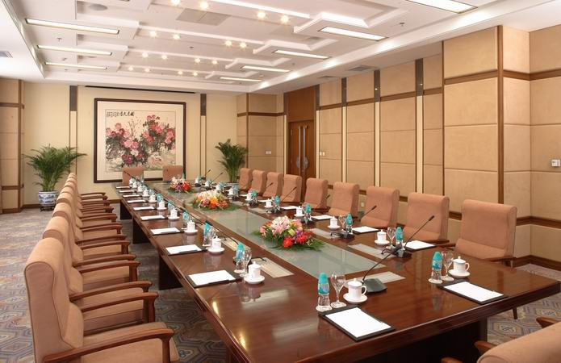
Meeting Room
Notes:
Floor plan

Slide 19
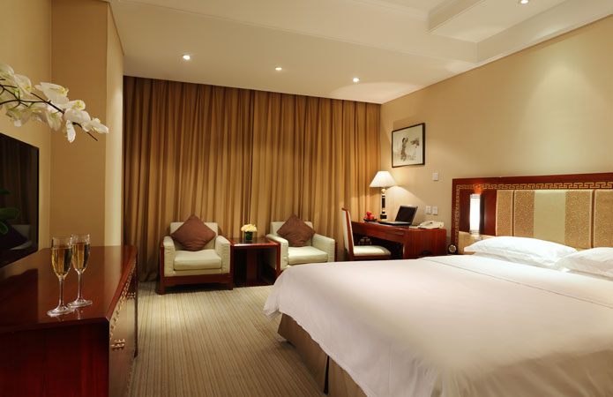
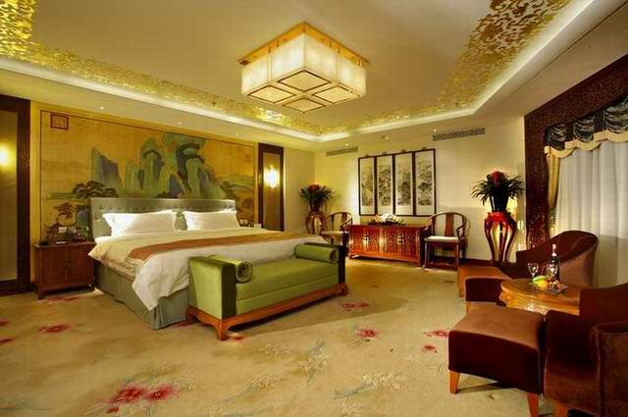
Meeting Room
Rate for Superior & Standard rooms: CNY 550.00
Notes:
Floor plan

Slide 20
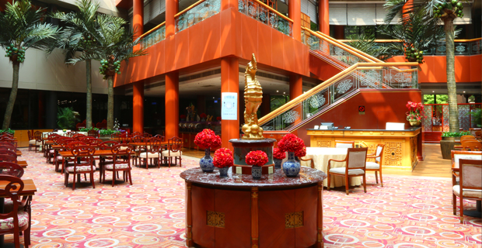
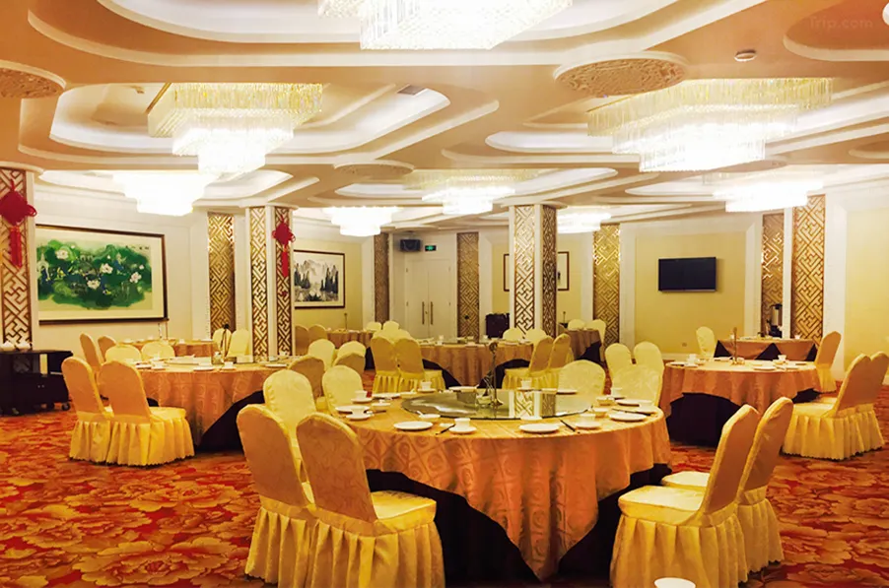
Restaurants
Notes:
9 restaurants and bars

Slide 21
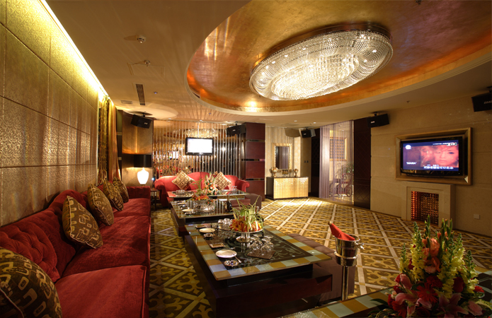
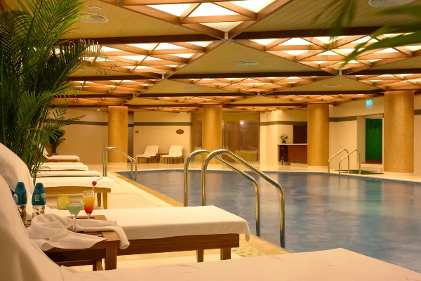
Leisure and Recreation
Notes:
9 restaurants and bars

Slide 22
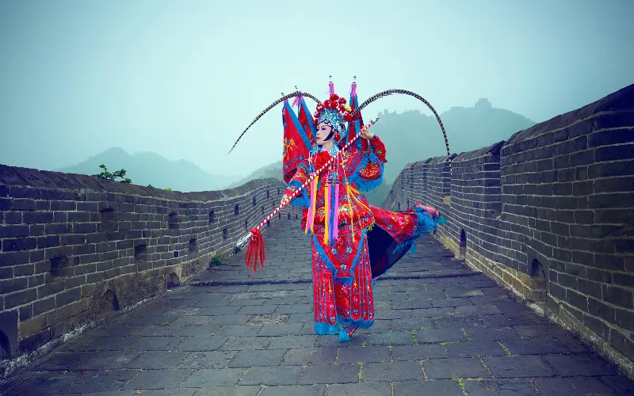

WARMLY
Welcome to Beijing, China!

