Slide 1
Overview of TOWS-WG Proposal to the World-Wide Navigational Warning Service Sub-Committee (WWNWS-SC) on
Tsunami Service Provider Messages for the Maritime Community
Only for potential or confirmed tsunamis >0.3m in TSP’s Area of Service (AOS)
Disseminated to IMO/IHO NAVAREA Coordinators covering that TSP’s AOS
Issued when TSP issues a Quantitative, not Qualitative, forecast
Only reissue if forecast changes
Issue a final message when threat mostly passed
NAVAREA Coordinators turn into maritime safety messages issued via SafetyNet to ships at sea.
Message Content
NAVAREA names (21 of these world-wide)
General Area (e.g., Western Pacific, South China Sea)
Key Subject (e.g., Confirmed Tsunami Threat, Final Message)
Tsunami Source (e.g., a magnitude 8.4 earthquake on May 17, 2020 at 0718 UTC in the Solomon Islands)
List of countries and islands with threat >0.3m and corresponding harbors
Amplifying remarks (e.g., strong currents, coastal flooding, etc.)
Cancellation Details – up to local authorities to determine

Slide 2
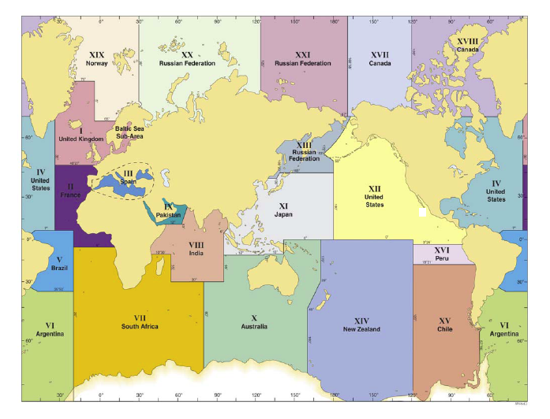
Global NAVAREAs

Slide 3
Sample Message 1 - Tsunami Threat
NAVAREA XI, NAVAREA XIII, NAVAREA X
NORTHEAST PACIFIC COASTS
TSUNAMI THREAT MESSAGE [or whatever the correct term will be] ISSUED BY PACIFIC TSUNAMI WARNING CENTRE [fill in name of the issuing TSP] in support of the UNESCO/IOC PACIFIC TSUNAMI WARNING AND MITIGATION SYSTEM [fill in name of the regional system] AT DDHHMM UTC MMM YY. [This clearly identifies that the message has been issued by the recognised expert]
A TSUNAMI HAS BEEN GENERATED BY A MAGNITUDE 8.4 EARTHQUAKE THAT OCCURRED IN VICINITY OF [Position] DD-MM N/S DDD-MM E/W, THE RYUKYU ISLANDS DDHHMM UTC MMM YY [this is the date/time of the earthquake, rather than the originating message]
HAZARDOUS TSUNAMI WAVES ARE FORECAST FOR SOME COASTS OF JAPAN, THE PHILIPPINES, AND INDONESIA [from a list of countries/islands]
TSUNAMI WAVES ARE NOT A HAZARD TO SHIPS IN DEEP WATER BUT CAN CAUSE STRONG CURRENTS AND RAPID SEA LEVEL CHANGES IN SHALLOW WATER, AS WELL AS INUNDATION OF THE COAST. SHIPS APPROACHING THE COAST SHOULD CONSULT LOCAL AUTHORITIES REGARDING LOCAL CONDITIONS AND ADVICES.

Slide 4
Sample Message 2 - Cancellation
NAVAREA XI, NAVAREA XIII, NAVAREA X
NORTHEAST PACIFIC COASTS
TSUNAMI CANCELLATION MESSAGE [or whatever the correct term will be] ISSUED BY PACIFIC TSUNAMI WARNING CENTRE [fill in name of the issuing TSP] in support of the UNESCO/IOC PACIFIC TSUNAMI WARNING AND MITIGATION SYSTEM [fill in name of the regional system] AT DDHHMM UTC MMM YY. [This clearly identifies that the message has been issued by the recognised expert]
THE THREAT HAS NOW LARGELY PASSED FOR THE TSUNAMI GENERATED BY A MAGNITUDE 8.4 EARTHQUAKE THAT OCCURRED IN IN VICINITY OF [Position] DD-MM N/S DDD-MM E/W, THE RYUKYU ISLANDS DDHHMM UTC MMM YY [this is the date/time of the earthquake, rather than the originating message]
HOWEVER, SHIPS APPROACHING THE COAST SHOULD STILL CONSULT LOCAL AUTHORITIES REGARDING LOCAL CONDITIONS AND ADVICES.

Slide 5
Strategy for PTWC NAVAREA Messages Implementation
November 5, 2024 at 01:00 UTC: As a part of the PacWave24 exercise, PTWC will issue a dummy-only test message by email to NTWCs of PTWS Member States responsible for Pacific NAVAREAs: Russian Federation, Japan, Australia, New Zealand, United States, Peru, and Chile. They will, in turn, send them to their NAVAREA Coordinators. (should we send directly to NAVAREA Coordinators too, if they are identified?)
The same message will be sent by PTWC directly to Argentina’s NAVAREA Coordinator as a courtesy since they are not part of the PTWS and so do not have an NTWC. (should we still do this?)
PTWC is still developing software to generate the messages following the example provided by the WWNWS. Based on the RIFT forecast, the message will name the NAVAREAs with immediately adjacent coasts having any forecast values greater than 0.3 m.
Should PTWC send the NAVAREA message only to the affected NAVAREA NTWCs, or always to all 7 of them?
Although not requested by the WWNWS, PTWC could include tsunami ETAs for major ports in those NAVAREAs with expected amplitudes greater than 0.3m.
PTWC will finish the software and write a descriptive manual prior to ICG/PTWS-XXXI in April 2025. If accepted, a date for commencement of service can be decided upon, the WWNWS can be notified, and PTWC will start the service on that date.

Slide 6
PacWave24 NAVAREA Dummy Message
TEST... DUMMY MARITIME MESSAGE FOR PACWAVE24 EXERCISE...TEST
NWS PACIFIC TSUNAMI WARNING CENTER EWA BEACH HI
0100 UTC TUE NOV 05 2024
...THIS MESSAGE IS FOR TEST PURPOSES ONLY...
...TEST PACWAVE24 TSUNAMI EXERCISE MARITIME PRODUCTS TEST...
THIS IS A TEST. THIS MESSAGE IS BEING ISSUED AS A PART OF THE
PACWAVE24 TSUNAMI EXERCISE. ITS PURPOSE IS TO TEST THE END TO
END COMMUNICATIONS BETWEEN THE PACIFIC TSUNAMI WARNING CENTER
AND PACIFIC REGION NAVAREA COORDINATORS THROUGH THE NATIONAL
TSUNAMI WARNING CENTERS OF THE COUNTRIES RESPONSIBLE FOR THOSE
NAVAREAS. THIS MESSAGE IS BEING SENT ONLY BY EMAIL TO THOSE
NATIONAL TSUNAMI WARNING CENTERS FOR PROMPT RELAY TO THEIR
NAVAREA COORDINATORS BY APPROPRIATE MEANS.
THIS IS A TEST. IN THE CASE OF AN ACTUAL TSUNAMI THREAT...
THIS MESSAGE WOULD CONTAIN INFORMATION ABOUT THE TSUNAMI
SOURCE... POTENTIALLY AFFECTED COASTAL AREAS... AND RELATED
INFORMATION. NAVAREA COORDINATORS CAN RELAY THIS INFORMATION
TO SHIPS AT SEA FOR THEIR AWARENESS.
THIS IS A TEST. PLEASE RECORD THE TIME OF ARRIVAL OF THIS
MESSAGE BY NATIONAL TSUNAMI WARNING CENTERS AND NAVAREA
COORDINATORS FOR REPORTING IN THE POST-EXERCISE EVALUATION
BEFORE DECEMBER 15 2024.

Slide 7
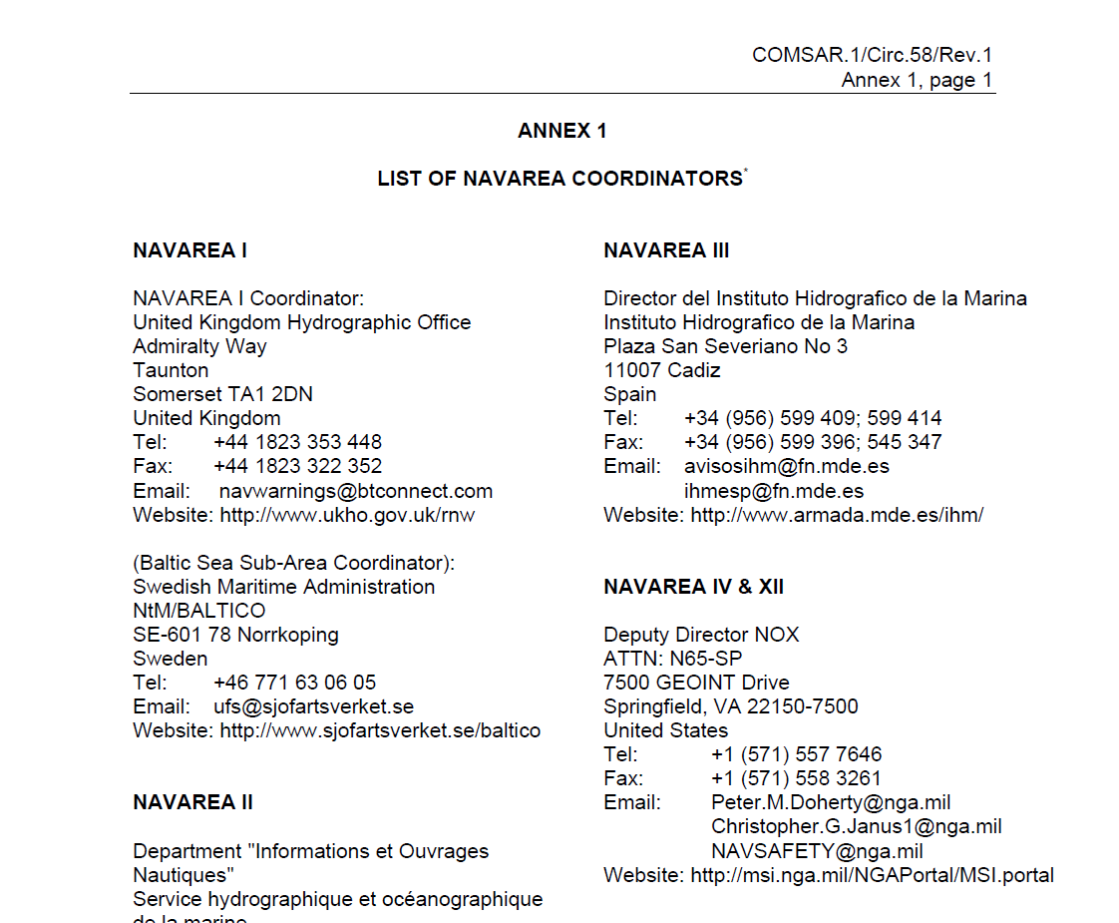
NAVAREA Coordinators Contact Information from
International Maritime Organization document from October 31, 2018

