Slide 1
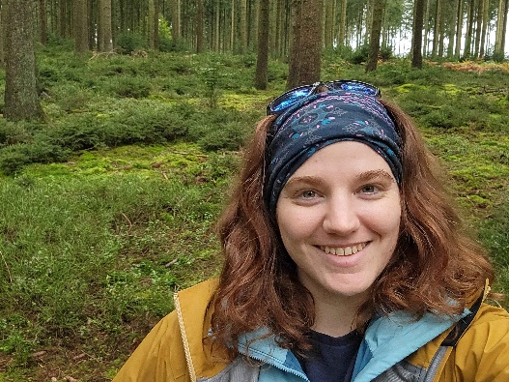
6th SESSION
GROUP OF EXPERTS ON CAPACITY DEVELOPMENT
(GE-CD-VI)
Elizabeth Lawrence
OBIS Capacity Development Officer/BioEcoOcean Project Officer
Oct 22, 2024
Notes:
I am the capacity development officer for OBIS as well as the project officer for the Horizon Europe project BioEcoOcean

Slide 2
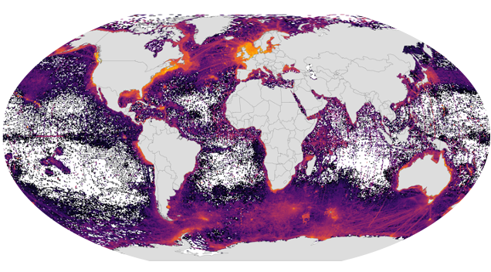
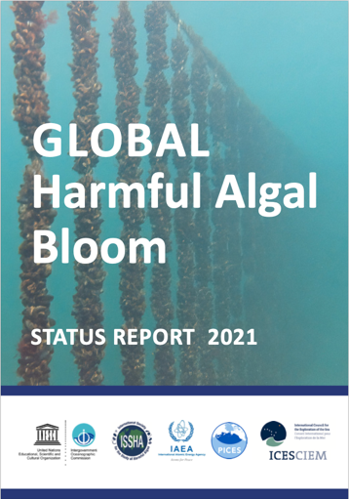
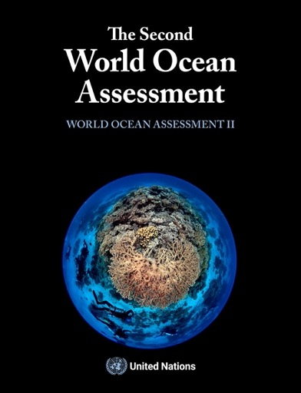
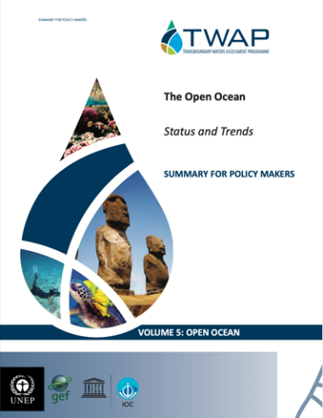
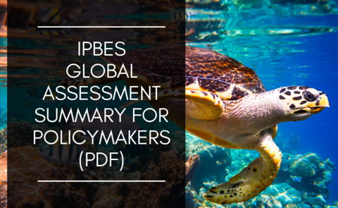
UNESCO-IOC OBIS
Ocean Biodiversity Information System
Gateway to ocean biodiversity data you can trust
Global network of 30+ nodes
Supports several global & Regional Ocean Assessments
Increase scientific capacity through data standardization
Notes:
First a very brief background on OBIS, We are your gateway to ocean biodiversity data that you can trust
OBIS is a global network of more than 30 regional and thematic nodes and the work we do supports global and regional ocean assessments, including the global harmful algal bloom, the world ocean assessment the status and trends of the open ocean, and IPBES
OBIS is increasing scientific capacity through the standardization of marine biological data

Slide 3
IOC CD Strategy Outputs and Activities
Output 1: Human resources developed at individual and institutional levels
Notes:
Now I will summarize the actions OBIS has taken to support the IOC CD strategy, grouping our actions under each relevant IOC output. Of course text in green boxes will be supportive actions and those in red will be actions that are currently underway or require more work/effort

Slide 4
IOC CD Strategy Outputs and Activities
Output 1: Human resources developed at individual and institutional levels
Comprehensive OBIS Manual
Courses
PacMAN: Marine Invasive Species Early Detection: 85 certifications (2022 & 2024)
Contributing & publishing datasets to OBIS: 47 certifications (2023-2024)
Training Materials
26 YouTube tutorial videos
7 Spanish translated videos
Spanish OTGA course (Oct 2024)
1.2.5
1.2.1
Notes:
Training Materials
Comprehensive & well-maintained OBIS Manual
Formatting examples for datasets on 7 taxa groups
26 YouTube videos on data formatting, publishing & controlled vocabulary
7 Spanish translations
OTGA Courses
47 participants OBIS-certified
15 OBIS node staff
Contributing & publishing datasets to OBIS
eDNA for detecting invasive species

Slide 5
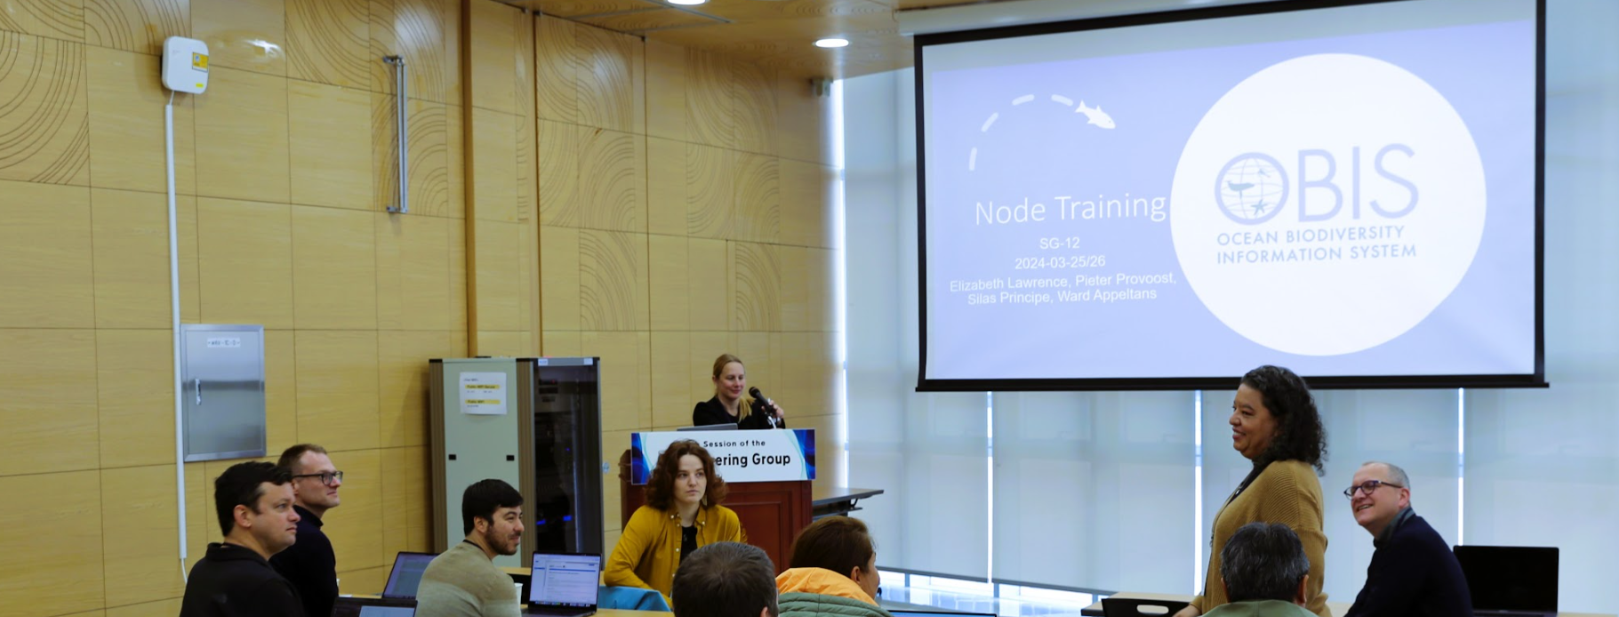
IOC CD Strategy Outputs and Activities
Output 1: Human resources developed at individual and institutional levels
Workshops
IOC Ocean Training internship:
Internships
OBIS Deep Sea
MPA Europe: Marine biology curriculum for Ostend 4th grade class
School Curricula
OBIS-SG-12 Nodes training (Mar 2024)
OBIS Australia
Marine Biological Data Mobilization workshop (2024 and 2025) OBIS-USA, IOOS, Hakai, CIOOS, MBON, OTN, Caribbean-OBIS, and OBIS-Chile
1.2.1
1.2.2, 1.3.4
1.4.1
Notes:
With respect to internships, OBIS promoted the IOC ocean training internships two of our nodes have successfully hired interns to assist with data management activities which will allow interns to develop biodiversity data skills to bring back to their home institutions.
Finally through the horizon Europe project, MPA Europe, we developed a marine biology curriculum for 4th grade students in Ostend, helping to foster early interest in marine biology and environmental stewardship

Slide 6
IOC CD Strategy Outputs and Activities
Output 1: Human resources developed at individual and institutional levels
Higher Education
Propagules program not funded
In-Person Training
GOOS BioEco Panel (Feb 2025)
Mentoring
Exploring other avenues
Develop data products platform
Improve mentoring within network
Training Materials
Reusable modular training content
Living Data conference (Oct 2025)
UN Ocean Decade OBON eDNA workshop (Nov 2024)
1.1.1
1.2.5
1.2.1
1.3.2
Notes:
Propagules program enlist university educators to incorporate OBIS content into their courses to develop biodiversity data capacity in graduate students
We are also creating open access training modules so that any trainer wishing to run a course or workshop can use the materials and ensure their training aligns with current standards
within UN ocean Decade programme OB
ON We are running a workshop this nov for eDNA scientists to increase their capacity for biodiversity data management
We also have plans to improve mentoring of nodes wirtin obis network to ensure nodes have similar capacity to deliver training to their region

Slide 7
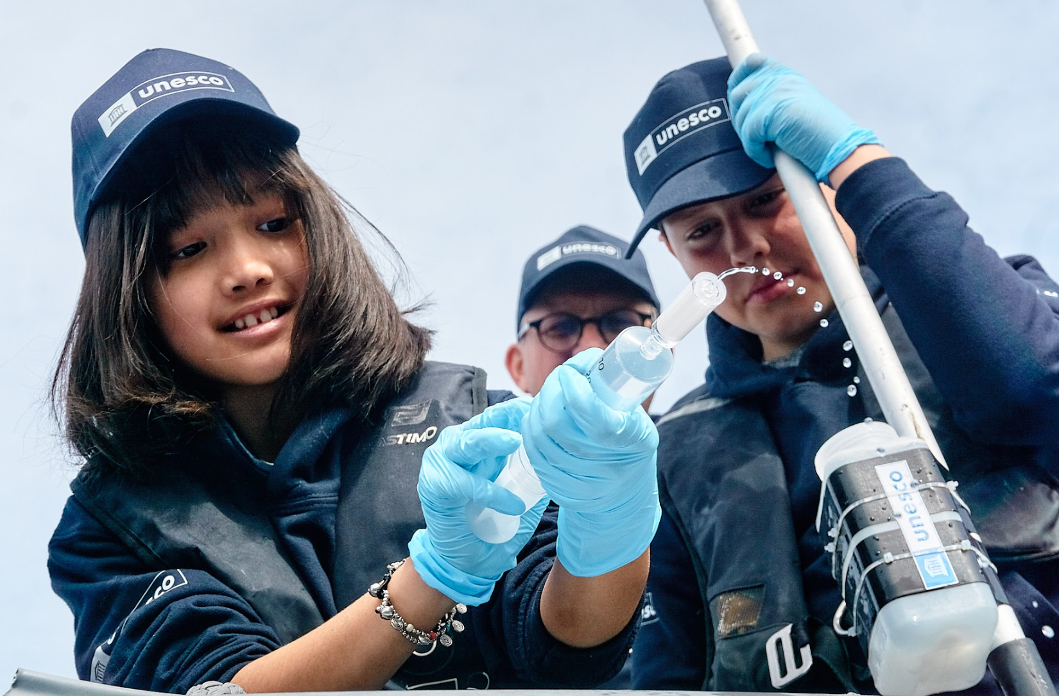
IOC CD Strategy Outputs and Activities
Output 2: Access to technology, physical infrastructure, data and information established or improved
Spanish training content:
Open Data Access
OBIS nodes contribute to global open access data system
Equitable access
Co-develop EOV specification sheets with GOOS
OTGA Course
Sessions in workshops
Citizen Science
UNESCO eDNA expeditions: 200 schoolchildren, 17 countries
2.1.3
2.2.1
2.2.1, 2.2.2
Notes:
We led the unesco edna expediations
As a global data system, OBIS integrates and makes accessible data from OBIS nodes, allowing for one easy place to access open marine biodiversity data
within bioecoocean obis is co-developing the EOV spec sheets with GOOS to faciliate accessible data flows of Essential ocean variables

Slide 8
IOC CD Strategy Outputs and Activities
Output 2: Access to technology, physical infrastructure, data and information established or improved
Citizen Science
Provide more translations of training content
Develop stronger workflows with citizen science communities
Equitable Access
Blueprint for ocean observing
Guide ocean observing programs through each step of ocean observation value chain
2.1.3
2.2.2
2.2.2
Notes:
Activities under output 2 that require more work include developing strong workflows within citizen science communities, where the OBIS UK node has already began making strides in this area
Within the BioEcoOcean project we are leading a capacity development work package to co-create training materials for a blueprint that will guide ocean observing programs through each step of the value chain –from planning to data collection, to integration into policy. This project’s outputs will improve data accessibility of essential ocean variables
Finally we have plans to provide translations of our training content in more languages to ensure equitable access and improved capacity

Slide 9
IOC CD Strategy Outputs and Activities
Output 3: Global, regional and sub-regional mechanisms strengthened
Community Engagement Officer hired to improve
coordination and communication
within and outside network
Communication
Node Coordination Group established
Regional Engagement
Regional nodes working together to lead CD
3.2.1
3.4.1
Notes:
Under Output 3, with respect to communication, we have the newly established this year node coordination group as well as a just recently hired community engagement officer. Both of these will improve coordination, communication within the OBIS network, as well as outside the network
Several of our Latin American and North American nodes are already working together to lead CD in their regions, which is fantastic, and we are looking to see improved engagement in other regions as well

Slide 10
IOC CD Strategy Outputs and Activities
Output 3: Global, regional and sub-regional mechanisms strengthened
Regional Needs & Communication
OBIS Nodes Coordination Group:
Identify gaps in training needs
Enhance communication within community
3.2.1, 3.3.1

Slide 11
IOC CD Strategy Outputs and Activities
Output 6: Sustained resource mobilization reinforced
In kind
5 European Union, Horizon Europe projects
GOOS, BODC, TDWG, ODIS, EurOBIS-EMODNet, GBIF-OBIS Joint Strategy for Marine Biodiversity Data
NORAD, LifeWatch ERIC
FUST/OTGA (Flanders)
OBIS Nodes
Resource Mobilization
Cooperation Agreements
Establish formal agreements: GOOS, MBON, GBIF, ProtectedSeas
BiOES (Biosphere Observatories in SIDS – not funded)
6.1.1
6.2.1
6.1.1, 6.2.1
Notes:
finally under output 6 actions related to resource mob, first related to in-kind resources, OBIS fosters a number of in-kind support relationships with a number of organizations include GOOS, British Oceanographic Data Centre, TDWG (Biodiversity Information Standards), ODIS, GBIF
And nodes
w/respect to resource mob, we are involved in five EU projects, have collaborated with NORAD and LifeWatch ERIC, and have been supported by the Flanders UNESCO Science Trust Fund and OTGA
We are looking to formalize our cooperation agreements with GOOS, MBON, GBIF, and ProtectedSeas. Finally, a FUST project proposal to establish Biosphere observatories in Small Island Developing States (SIDS) was unfortunately not funded so we are looking to find other ways to mobilize this opportunity

Slide 12
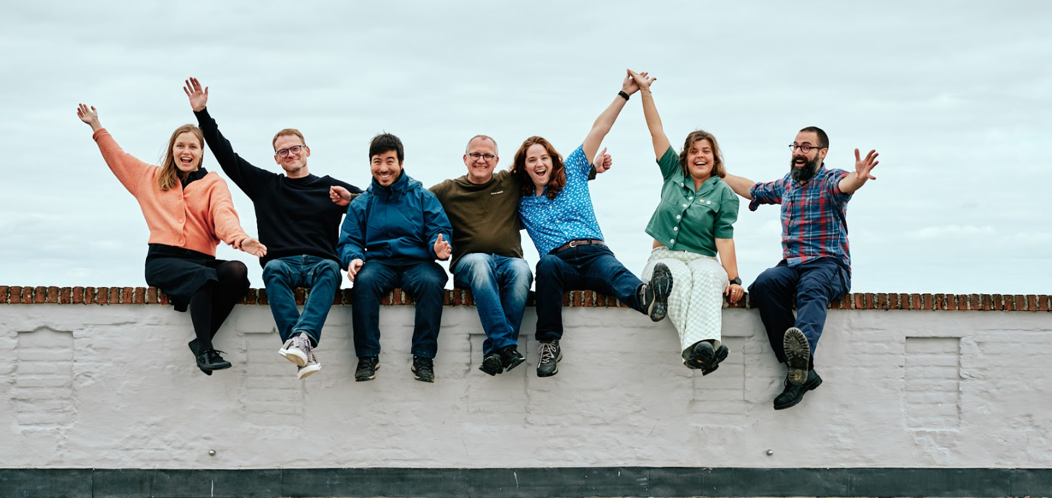
THANK Y U
e.lawrence@unesco.org
helpdesk@obis.org

Slide 13
Appendix:
OBIS Inputs to the IOC CD Strategy Outputs and Activities
Table summaries

Slide 14
IOC CD Strategy Outputs and Activities
Output | Activity | Action | Relevant Programmes/Actions Taken
1. Human resources developed at individual and institutional levels | 1.1 Academic and higher education | 1.1.1 Promote and assist with the strengthening and establishment of consortia of higher education and research institutions at the appropriate geographical scale | Propagules program to develop university curriculum – was not funded
 |  | 1.1.2 Promote collaboration between UNESCO Chairs and IOC, and between IOC and other organisations dealing with ocean matters on human resources development
 | 1.2 Continuous professional development | 1.2.1 Promote and assist with the organisation of training courses, workshops and “summer schools”, relevant to the IOC mandate, including training of trainers/technicians and executive career development for institutional managers/decision makers, in collaboration with other organisations | OBIS/OTGA Contributing and Publishing Datasets to OBIS (self-paced) Oct 2023 – Feb 2024, May 2024-present Co-hosted annual Marine Biodiversity Data Mobilization Workshop with OBIS-USA, IOOS, Hakai, CIOOS, MBON, OTN, Caribbean-OBIS, and OBIS-Chile with dedicated sessions for Spanish speakers (April 2024, fall 2025) PacMAN project established OTGA eDNA course for detecting invasive species, in person training (Fiji 2022) and self-paced course (2023-2024) OBIS Nodes training at SG-12 (Mar 2024) Ocean Decade OBON eDNA workshop (Nov 2024) In person training Oct 2025 during Living Data Conference GOOS BioEco Panel data training (Feb 2025)
 |  | 1.2.2 Establish, or collaborate with other organisations to develop internship/fellowship and on-board training programmes | OBIS Australia and OBIS Deep Sea will host interns selected through the IOC Ocean Training internships
 |  | 1.2.3 Establish and collaborate with other organisations on visiting lecturer/scholar/researcher programmes and professional exchanges (peer to peer)
 |  | 1.2.4 Promote and assist with the establishment of regional training (and research) centres relevant to the IOC mandate
 |  | 1.2.5 Promote the development and sharing of training materials and tools | Continuously maintained OBIS Manual for biodiversity data standards 26 YouTube training videos data formatting and controlled vocabulary with 7 translated to Spanish eDNA workshop to compare bioinformatics pipelines OBIS Data Products coordination Group will develop data products platform Develop modular training content facilitating reuse

Slide 15
IOC CD Strategy Outputs and Activities
Output | Activity | Action | Relevant Programmes/Actions Taken
1. Human resources developed at individual and institutional levels | 1.3 Sharing of knowledge and expertise including through community building | 1.3.1 Establish a travel grant “fund”
 |  | 1.3.2 Establish or collaborate with other organisations on a mentoring programme | Plans for improving OBIS Node mentoring through OBIS Node Coordination Group
 |  | 1.3.3 Promote and assist with the development and strengthening of IOC alumni networks, and professional networks including for youth leaders
 |  | 1.3.4 Promote funding, grant and scholarship programs to facilitate ocean research, technical development and scientific exchange through bringing visibility of opportunities via an online CD hub | - Promoted and joined IOC Ocean Training Internship
 | 1.4 Integration of ocean science in basic education | 1.4.1 Promote the integration of ocean science in curricula of primary and secondary schools | Horizon Europe project MPA Europe developed marine biology curriculum for local 4th grade class in Ostend
 |  | 1.4.2 Promote careers in ocean research and ocean management
 | 1.5 Improving gender, generational and geographic diversity | 1.5.1 Promote participation of women in ocean research
 |  | 1.5.2 Promote and support “young scientist” and “women in science” awards
2. Access to technology, physical infrastructure, data and information established or improved | 2.1 Facilitating access to technology and infrastructure | 2.1.1 Establish and maintain a register of infrastructure to facilitate access, and promote transfer of marine technology | Leading work package on CD in Horizon Europe project BioEcoOcean that aims to guide ocean observing programs through each step of ocean observation value chain
 |  | 2.1.2 Promote the development of regional collaboration on sustainable scientific infrastructure
 |  | 2.1.3 Promote involvement of citizen science in ocean research | UNESCO eDNA expeditions with 200 schoolchildren in 17 countries Develop stronger workflows with citizen science communities (OBIS UK)

Slide 16
IOC CD Strategy Outputs and Activities
Output | Activity | Action | Relevant Programmes/Actions Taken
2. Access to technology, physical infrastructure, data and information established or improved | 2.2 Facilitating equitable access to and sharing of ocean data and information | 2.2.1 Promote the development and wide use of regional and global data and information systems | OBIS nodes contribute to global open access OBIS data system Collaborated with OBIS Colombia, OBIS Caribbean, and ESP OBIS nodes to release OBIS/OTGA Spanish course (Oct 2024)
 |  | 2.2.2 Promote the sharing of ocean data and information by stakeholders | OBIS nodes contribute to global open access OBIS data system Provide translations of training materials Collaborating with GOOS to develop data management guidelines for EOV Specification sheets
3. Global, regional and sub-regional mechanisms strengthened | 3.1 Further strengthening and supporting secretariats of regional sub-commissions | 3.1.1 Improve staffing of secretariat of regional sub-commissions
 |  | 3.1.2 Reinforce budgeting of regional sub-commissions
 | 3.2 Enhancing effective communication between regional sub-commission secretariats and global programmes as well as other communities of practice (incl. other organisations) | 3.2.1 Establish an effective coordination and communication mechanism between the secretariats of the regional sub-commissions and the global programmes | OBIS Node Coordination Group will more effectively engage all members of community Community Engagement Officer hired (Oct 2024) to improve internal and external communication mechanisms

Slide 17
IOC CD Strategy Outputs and Activities
Output | Activity | Action | Relevant Programmes/Actions Taken
3. Global, regional and sub-regional mechanisms strengthened | 3.3 Identifying specific national and regional capacity development needs through regular needs assessment | 3.3.1 Organise and conduct biennial capacity development needs survey | Through OBIS Nodes Coordination Group identify specific gaps in training needs
 | 3.4 Encouraging regional and sub-regional organisations to be leaders in, and amplifiers of capacity development | 3.4.1 Reinforce engagement of regional and sub-regional organisations in consultation process and capacity development initiatives | Through OBIS Nodes Coordination Group Collaboration between regional nodes (OBIS Caribbean, OBIS Colombia, ESP OBIS) already producing targeted regional CD Collaborating with EurOBIS-EMODNet
4. Development of ocean research policies in support of sustainable development objectives promoted | 4.1 Fostering the development of ocean research policies | 4.1.1 Compile and compare information on existing ocean research policies, and disseminate to Member States for their use
 |  | 4.1.2 Assist and enable Member States with the development of ocean research policies, making use of the results of 4.1.1
5. Visibility, awareness and understanding on the roles and values of the ocean and ocean research in relation to human wellbeing and sustainable development increased | 5.1 Fostering the development of ocean related public information and communication services | 5.1.1 Encourage the development of public information (communication) departments in ocean research institutions
 | 5.2 Fostering the development of ocean literacy | 5.2.1 Assist with the strengthening and development of ocean literacy programmes at national and regional levels
6. Sustained resource mobilization reinforced | 6.1 Enhancing sustained support (in-kind and financial) to the IOC for its international coordination role | 6.1.1 Foster partnerships to increase in-kind support opportunities | EurOBIS-EMODNet, GOOS, GBIF-OBIS Joint Strategy for Marine Biodiversity Data, BODC, TDWG, ODIS Establish formal cooperation agreements with GOOS, MBON, GBIF, ProtectedSeas
 | 6.2 Promoting sustained bilateral and multilateral support among Member States | 6.2.1 Encourage resource mobilisation in particular from Member States, and other donors to support the outcomes of the IOC Capacity Development needs assessment | European Union and Horizon Europe projects (BioEcoOcean, DTO-BioFlow, eDNA Aquaplan, MARCO-BOLO, MPA Europe), NORAD, LifeWatch ERIC, FUST/OTGA (Flanders; PacMAN) and BiOES (Biosphere Observatories in SIDS – not funded)

