Slide 1


2024 Tsunami Preparedness Capacity Assessment in Asia and the Pacific
(Indian Ocean)
Prepared by Rick Bailey
Compiled by: Suci Dewi Anugrah

Slide 2
History of the Indian Ocean Capacity Assessment
Assessment of Capacity Building Requirements for an Effective and Durable Tsunami Warning and Mitigation System in the Indian Ocean in 2005
10th Session UNESCO-IOCICG/IOTWMS (Muscat,August2015) identified the need to conduct a reassessment of state of tsunami preparedness of the Indian Ocean Member States in order to evaluate progress since the2004 Indian Ocean Tsunami, as well as identify specific gaps and prioritise capacity development requirements at both the regional and national level.
11th Session UNESCO-IOC ICG/IOTWMS (Putrajaya, April 2017) established the inter sessional “Task Team on Capacity Assessment of Tsunami Preparedness” (TT-CATP) to oversee the capacity assessment of tsunami preparedness of the IOTWMS. The Task Team was chaired by Dr. Harkunti Rahayu (Indonesia) with representatives from Australia, India, Indonesia, Oman, Malaysia, Indian Ocean Tsunami Information Centre (IOTIC),the ICG/IOTWMS Working Groups, and invited experts from the Global Disaster Resilience Centre of the University of Huddersfield, UK.
Task Team designed an extensive online survey distributed to Member States by the Secretariat, covering all aspects of the end-to-end tsunami warning and mitigation system. The online questionnaire was built upon the ICG/IOTWMS National Report Template,Post-IOWave Exercise Surveys,UNESCO-IOCPost-Event Assessment Surveys
To renew the 2018 IOTWMS capacity assessment, expand to the PTWS, provide narrative on the progress made since the 2004 Indian Ocean Tsunami, and inform policymakers at the subregional level on the further needs for tsunami preparedness in Asia and the Pacific

Slide 3
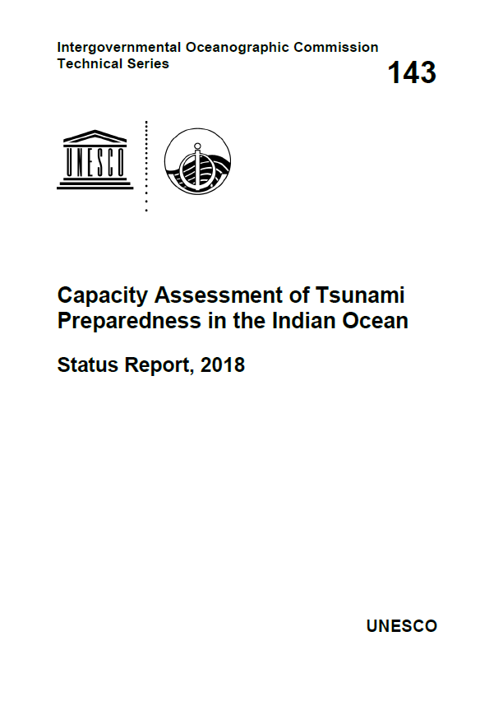
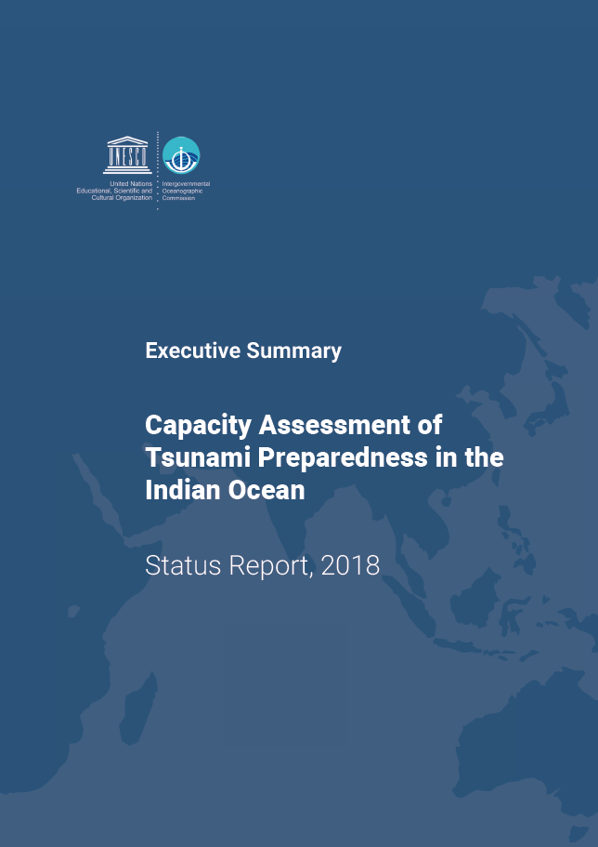
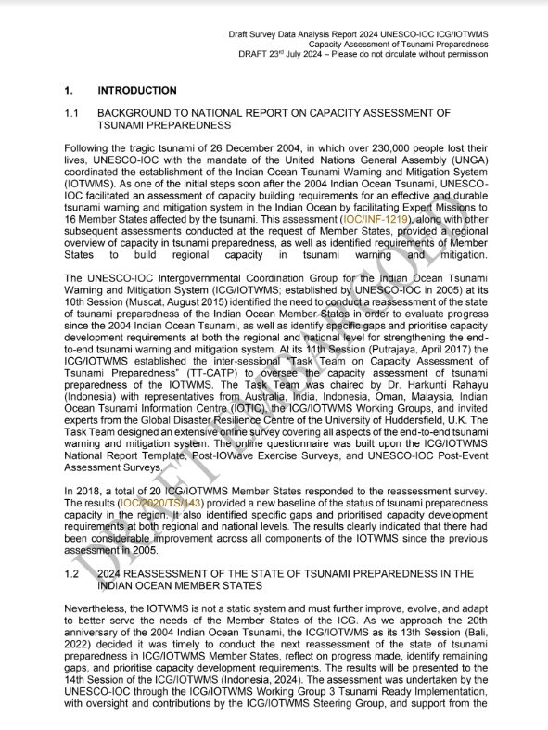
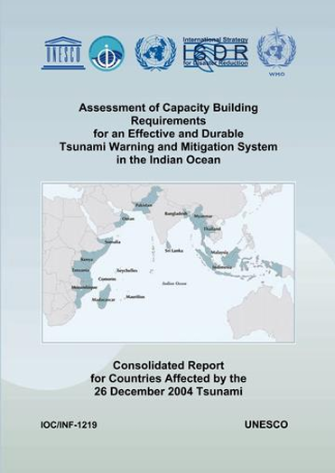
Previous Capacity Assessments
2005
Assessment of Capacity Building Requirements for an Effective and Durable Tsunami Warning and Mitigation System in the Indian Ocean
2018
Capacity Assessesment of Tsunami Preparedness in the Indian Ocean based on the 3 pilars:
Capacity assessment framework and tools already developed
2024
Tsunami Preparedness Capacity Assessment in Asia and the Pacific
Additional assessment on Tsunami Ready Capacity
Notes:
Several comprehensive capacity assessments have been undertaken for both the IOTWMS and PTWS:
The Australian Government in 2009/2010 conducted a capacity assessment of tsunami preparedness for 14 SW Pacific countries.
ESCAP in 2011 conducted a survey Immediately following the aftermath of the 2004 Indian Ocean tsunami, UNESCO-IOC in 2005 conducted a baselines capacity assessment of tsunami preparedness for the Indian Ocean.
To evaluate progress since 2005, in 2018 the ICG/IOTWMS conducted a 2nd capacity assessment of tsunami preparedness for the Indian Ocean.
In 2011

Slide 4




OBJECTIVES
  To evaluate the existing technical capacity of the UNESCO-IOC Indian Ocean Tsunami Warning and Mitigation System (IOTWMS) and Pacific Tsunami Warning & Mitigation System (PTWS) and highlight the progress made since 2004 Indian Ocean Tsunami and subsequent assessments.
  To identify specific gaps and capacity development requirements at regional and national levels for strengthening the technical and policy aspects of the tsunami warning and mitigation systems in the region
  To reinvigorate political commitment and provide recommendations for investments in tsunami preparedness, aiming to address the identified gaps in Asia and the Pacific through regional and subregional cooperation.

Slide 5
METHODOLOGY
  National technical online survey: comprehensive technical survey as developed through 2018 IOTWMS capacity assessment exercise to be completed by Member States with guidance from UNESCO-IOC,
  Survey analysis: analysis of national survey data, including a comparison with previous capacity assessments, to understand the capacity building requirements
  Validation consultation workshops: validation of analysis and sharing of good practices with ICG/IOTWMS Steering Group and ICG/PTWS Steering Committee
The assessment will be completed within a total duration of 23 months (14 months for Phase one and 9 months for Phase two), from November 2023 to September 2025,
for data collection and analysis,
drafting and validation,
editing and design,
adoption and launching across all relevant platforms.

Slide 6
Output of the Capacity assessment of tsunami preparedness
2024 OUTPUTS - IOTWMS
1.A_ Member States Survey Analysis for IOTWMS (IOC)
1.B_ IOTWMS assessment summary and comparative analysis (IOC)
3.A_ Tsunami preparedness recommendations for ASEAN policymakers (UNESCAP)
3.B_ Tsunami preparedness recommendations for SAARC policymakers (UNESCAP)
2025 OUTPUTS - PTWS
2.A_ Member State Survey Analysis for PTWS (IOC)
2.B_ PTWS assessment summary and comparative analysis (IOC)
3.C_ Tsunami preparedness recommendations for PIF policymakers (UNESCAP)

Slide 7
Result Presentation
Results will be presented to:
UNESCO-IOC Member States at14th Session ICG/IOTWMS(Jakarta, Nov’24)
UNESCO-IOC 2nd Global Tsunami Symposium commemorating 20 years since Indian Ocean Tsunami of 2004 (Banda Aceh, Nov’24)
Other events commemorating the Indian Ocean Tsunami of2024
Asia-Pacific Ministerial Conference on Disaster Risk Reduction (Manila, Oct’24)
Association of South-East Asian Nations (ASEAN)
South Asian Association for Regional Cooperations (SAARC)
World Tsunami Awareness Day (WTAD) 2024 (Nov’24)
Early Warnings for All (EW4ALL) by 2027 initiative
Summary reports tailored for policy-makers and potential donors, containing recommendations on filling gaps and priorities for capacity development support
Research and scientific publications about early warning and mitigation system

Slide 8
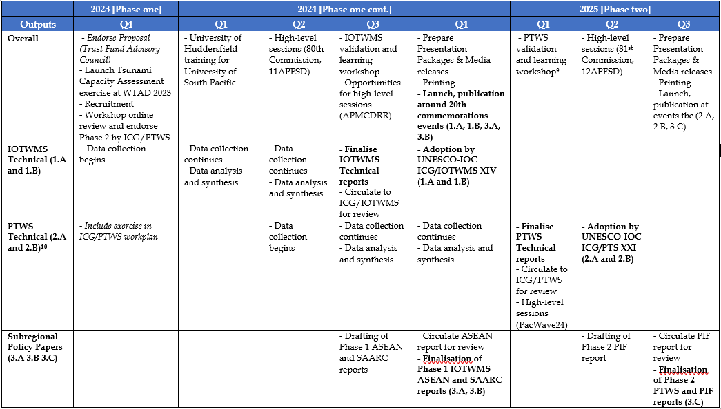
Schedule of the Project

Slide 9
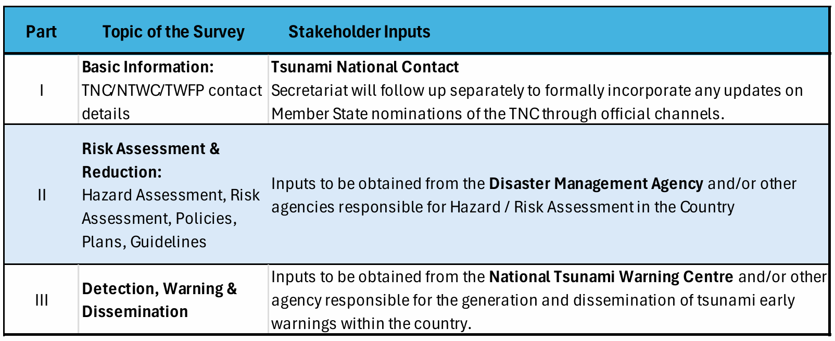
Survey Structure
The survey has six (6) distinct parts, which may need inputs from different stakeholders based on their national responsibility in the end-to-end tsunami warning and mitigation system

Slide 10
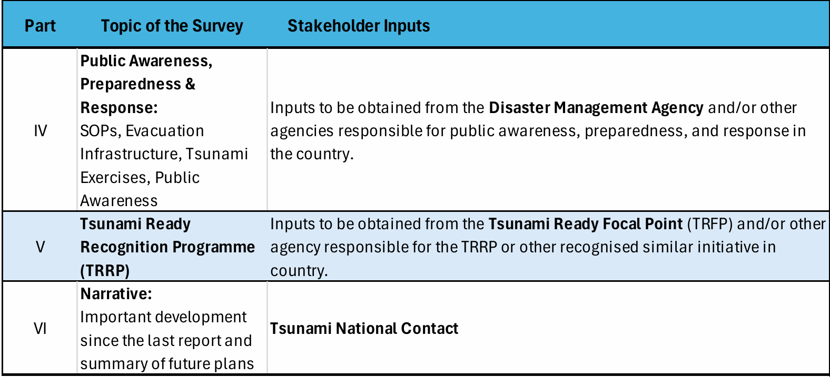

Slide 11

Major IOTWMS Milestones
Data Collection and Analysis
Nov 2024 UNESCO-IOC 20th Commemoration Event & ICG-IOTWMS (Endorsement)
Dec 2022 ICG/IOTWMS-XIII Assessment included in 2023/24 workplan
July 2023 CDRR8 Member State consultations
Aug 2023 ADB Endorse concept note and budget
Apr 2024 80th Commission
Oct 2024 APMCDRR
Nov 2024 WTAD and 25th Advisory Council
Dec 2024 ASEAN 20th Commemoration Event (ASEAN political statement)
Sep to Dec 2023 IOC Establish Capacity Assessment Team
Sept 2024 Validation workshop and Steering Group ICG/IOTWMS Recommendations Endorsement
Planning and Inception
Validation and Review
Mar 2024 11APFSD
Finalisation and Communication
Jan to Sep 2024 IOTWMS data collection and synthesis
May to Sep 2024 Develop IOTWMS summary for policy and decision makers
Sep to Oct 2024 Finalise ESCAP draft summary for policy and decision makers report
Nov 2024 43ACDM & 11AMMDM
Sep to Oct 2024 Finalise UNESCO-IOC draft capacity assessment report

Slide 12
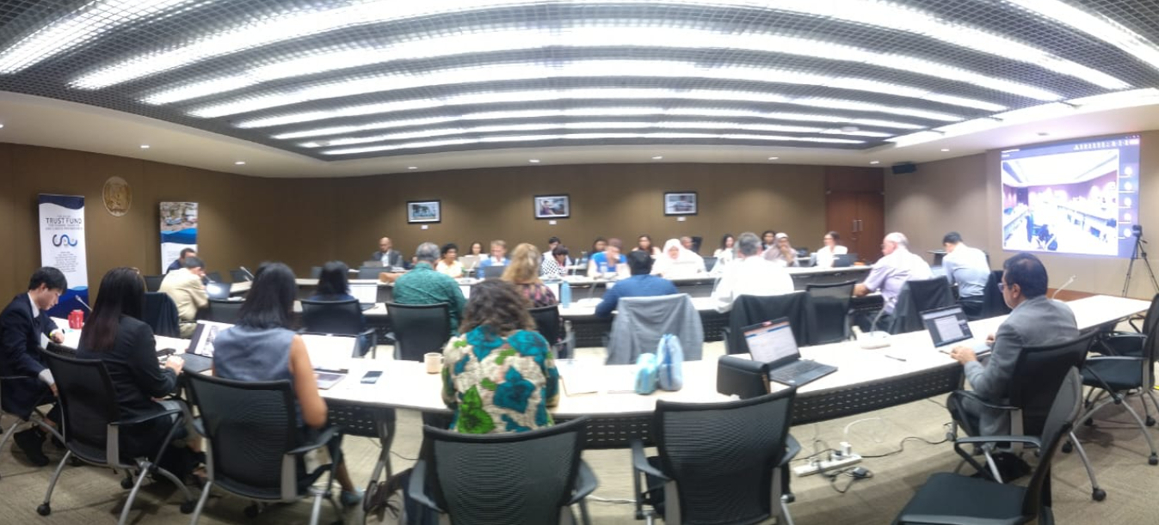
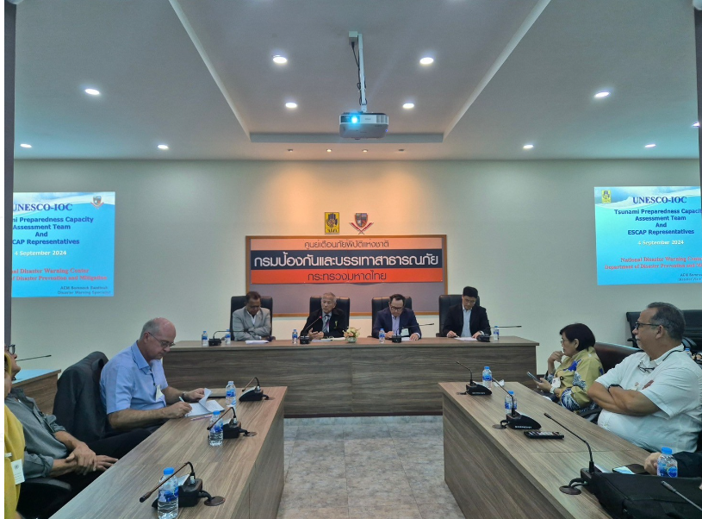
Validation Workshop
Bangkok, 4-6 September 2024
The aim is to validate the response of the survey
Visited the NDMA of Thailand to validate the Warning chain, Dissemination, Preparedness, Risk, and Similar Activities with Tsunami Ready

Slide 13
Capacity Assessment Input
Member States Survey:
  The official Tsunami National Contacts (TNCs) of the UNESCO-IOC ICG/IOTWMS were requested to coordinate the completion of an online survey (based on 2018 survey to enable comparisons), in consultation with other national stakeholders involved in end-to-end tsunami early warning and mitigation within the country.
  22/24 Member States completed and submitted the survey in May/June 2024.
  The survey data was analysed by the University of Huddersfield
National tsunami warning chains review:
  As part of three SOP training workshops for all Member States in 2023, national tsunami warning chains and associated SOPs were forensically reviewed.
  A report was prepared on the status of national tsunami warnings and SOPs, which is used for the current capacity assessment
ICG/IOTWMS Work Programmes:
Capacity gaps have been identified by the WGs and TT of the ICG/IOTWMS and reflect Member State needs

Slide 14
Process to Draft Recommendations
The experts from the ICG/IOTWMS, the chairs of the Working Groups and Task Team, met in Bangkok 3-6 September 2024 to review the analysis of the survey data and the identified gaps, along with input from the national warning chains review and other capacity gaps identified by the WGs and TT of the ICG/IOTWMS.
Draft recommendations to address the identified gaps have been produced during the workshop
Draft recommendation is classified into: Tsunami Plans and Policies, Tsunami Hazard and Risk Assessment; Tsunami Detection, Warning, and Dissemination; Tsunami Public Awareness, Preparedness, & Response; Tsunami Ready Recognition Programme (TRRP) or Similar National Intiatives; Tsunami Warning Exercises
The draft recommendations will be reviewed by the Steering Group of the ICG/IOTWMS, Chaired by the Chair of the ICG/IOTWMS, to be endorse by the Chair..
A full report will be produced on the outcomes of the capacity assessment, including an Executive Summary, the results from which will be tabled at the upcoming 2nd Global Tsunami Symposium and 20th Commemoration of the Indian Ocean Tsunami of 2024 in November 2024.
The full report will also be reviewed in detailed at the 14th Session of the ICG/IOTWMS in November in Banda Ache, Indonesia.
UN ESCAP is also producing a summary of the full report for policy- and decision-makers to facilitate the uptake of the outcomes of the assessment for action

Slide 15
To Confirm Whether Countries Have an Interest to Participate in The Unesco-IOC TRRP
Result on Tsunami Ready
Result
13 countries (59%) confirmed that they are already participating in TRRP, while eight responded that they are not currently doing so.
Of those that are not currently participating, six responded that they have plans to do so in the near future, while two do not.
Countries have less understanding on the TRRP, to implement 12 indicators

Slide 16
Whether Countries Currently Implementing Any Other Tsunami Resilience And Preparedness Related Initiatives or Programmes.
Result on Tsunami Ready
Result:
Six countries (27%) responded currently implementing other initiatives and programmes. Examples DESTANA, national level campaigns and exercises, training of trainers, awareness raising workshops, and as part of multi-hazard workshops.
14 countries (63%) responded to confirm they are not currently implementing any other programme or initiatives.
Most of the example of the similar initiative is not a comprehensive and integrative program to establish a prepare and resilient community.

Slide 17
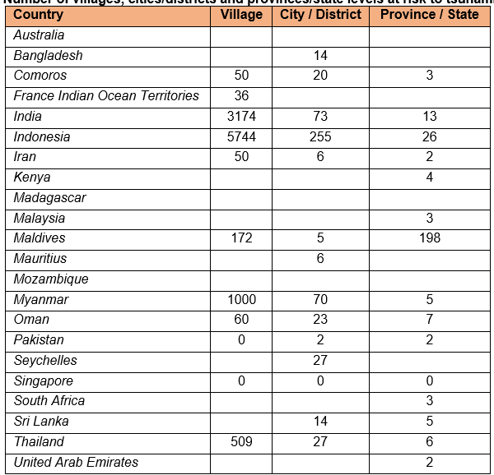
Estimate What Number of Villages, Cities/Districts And Provinces/State Levels Are at Risk To Tsunami.
Result on Tsunami Ready
One of the recommendation of the WG3 meeting in Hyderabad:
  To identify the number of communities/village living in the Tsunami prone area, in order to develop a complete information to response to the Unesco Tsunami Program
  “100% communities should be prepared for and resilient to tsunami by 2023”
  To prioritize number of community to be supported to implement the Tsunami Ready Program or Similar Initiative

Slide 18
National Tsunami Ready Board (NTRB)
Result on Tsunami Ready
Result:
Five countries (23%) reported having a National Tsunami Ready Board (NTRB)
NTRB is a function to monitor, advocate, to implement the propose and process the recognition.
NTRB involve many institutions, ex: NTWC, NDMO, LDMO, University, Ministry of earth Science, Agency of Research and Innovation.
Countries need to have this function to process the UNESCO-IOC TRRP

Slide 19
Institution(s) Should be Involved in The Implementation of TRRP or Similar National Initiative
Result on Tsunami Ready
Result
Country responses varied greatly, such as NTWC, NDMO/LDMO, National and Local Government Agency, Army, Emergency Service, Humanitarian agencies.
Implementing Tsunami Ready Needs many collaborators, including:
Private Sector
Critical infrastructure
University
Media

Slide 20
Summary of national capacity according to different aspects of the TRRP
Three is a strong need for technical support organized through IOTIC and/or ICG/IOTWMS
National and Regional Training / workshop Capacity Building
It can be partially done through mobilizing national experts and funding, but also needs some international expertise
It can be easily done through mobilizing national expert and funding
Advocacy, Guidance, and Tools

Slide 21
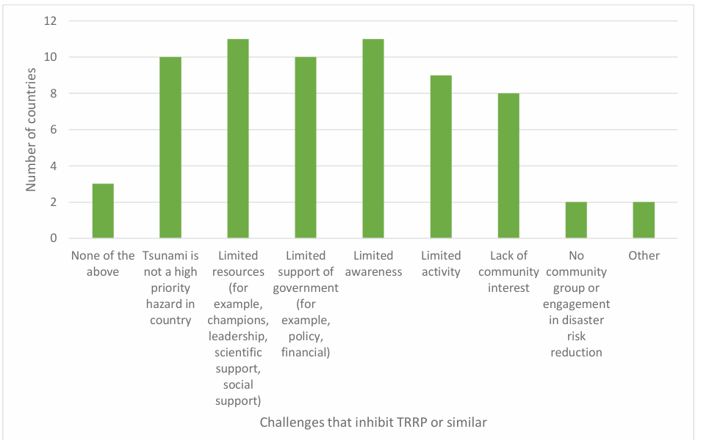
Challenges that inhibit the implementation of TRRP or similar national initiatives
Advocacy to community
Multi-hazard approach

Slide 22
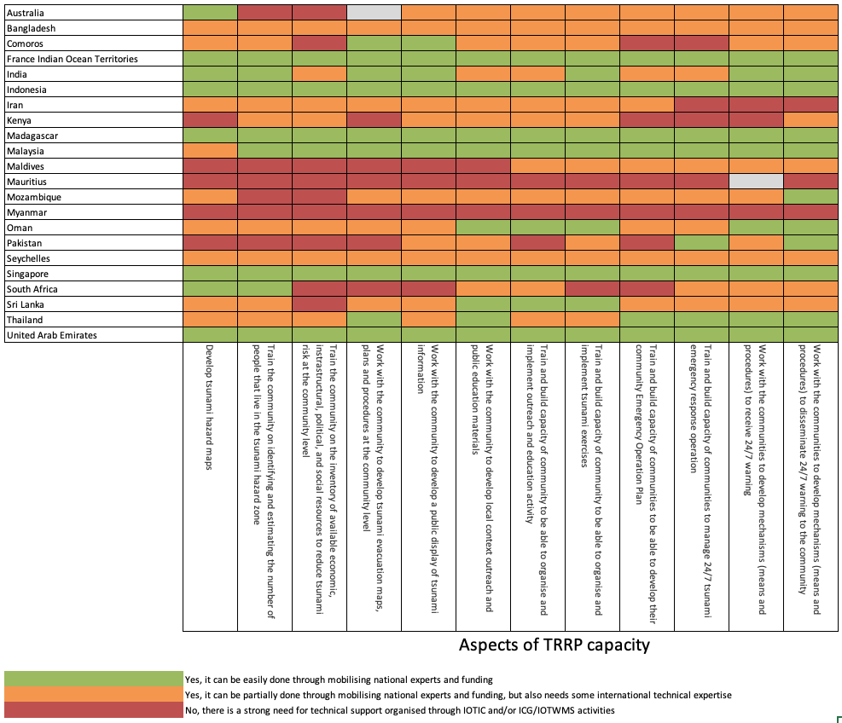
Country responses on national capacity according to different aspects of the TRRP
TRFP
Bangladesh
India
Indonesia
Iran
Kenya
Madagascar
Malaysia
Maldives
Mauritius
Seychelles
South Africa
Sri Lanka
United Arab Emirates
Timor Leste
Australia
Comoros
France IOT
Mozambique
Myanmar
Oman
Pakistan
Singapore
Thailand

Slide 23
Result on Tsunami Ready
SIDS:
Comoros
Maldives (2024)
Mauritius
Seychelles (2023)
East-Timor (2023)
LDCs
Bangladesh
Myanmar
East-Timor (2023)

Slide 24
Result on Tsunami Ready
NWIO IO
India
Iran
Oman
Pakistan
United Arab Emirates
Yemen

Slide 25
Result on Tsunami Ready
Western IO
Australia
Bangladesh
Indonesia
Malaysia
Myanmar
Thailand
Sri Lanka

Slide 26
Result on Tsunami Ready
Eastern IO
Kenya
Madagascar
Mozambique
South Africa
Tanzania

Slide 27
Draft Recommendations from the Working Group
Experience Sharing: Countries have implemented the TRRP to exchange their experiences on the Tsunami Ready implementation.
Familiarization and Review: Countries should familiarize themselves with the Tsunami Ready Communication Tool, especially the Manual and Guide No. 74, and review their national tsunami preparedness programs to ensure alignment with the 12 Tsunami Ready indicators.
Translation of Communication Materials: Ensure the member states have access to Tsunami Ready presentation materials and communication tools to be translate to the national and/or local languages and collaborate with communities to create education materials tailored to their local context
Data Collection and Planning: Countries need to identify and provide data on communities/villages in tsunami-prone areas to develop a prioritized support plan for implementing the Tsunami Ready Program.
Evaluation of NTRB: Countries should evaluate the roles, responsibilities, and functions of the National Tsunami Response Body (NTRB) to determine if a new coordination body is needed or if the existing disaster management mechanism should be expanded.

Slide 28
Draft Recommendations from the Working Group
Engagement with Private Sector: Countries must actively engage the private sector and critical infrastructure as part of the community to accelerate the implementation of the Tsunami Ready Program.
Capacity Building:
  Support Member States in training and capacity building, both regionally and in-country, to implement the Tsunami Ready program in their respective countries.
  Support the Tsunami Ready Focal Points through advocacy and guidance (Online discussion).
  Support advocacy and guidance to Tsunami Ready Focal Points (online meetings and discussions).
Tsunami Ready Implementation in Indian Ocean: Proposal for Funding to support Member States to Implement Tsunami Ready or Similar Programme in pilot areas.
Synergy with Other Approaches: Encourage countries to integrate other ocean and multi-hazard approaches with the Tsunami Ready approach.

Slide 29
Draft Recommendations from the Working Group
Ownership: Empower local communities to take ownership of Tsunami Ready/Preparedness Program by increasing local engagement, providing training in order to they can independently organize drills, exercises, and public outreach activities related to tsunami readiness.
Tsunami Evacuation Map: Support communities in creating detailed and regularly updated evacuation maps that guide safe evacuation during tsunami events.
24/7 Community Operation System: Train communities to develop comprehensive Emergency Operation Plans Help communities develop 24/7 systems to receive and disseminate tsunami warnings, ensuring timely and effective communication.
Best Practices: Promote the sharing of best practices and lessons learned between countries to help others improve their tsunami readiness, especially those with less experience.

Slide 30
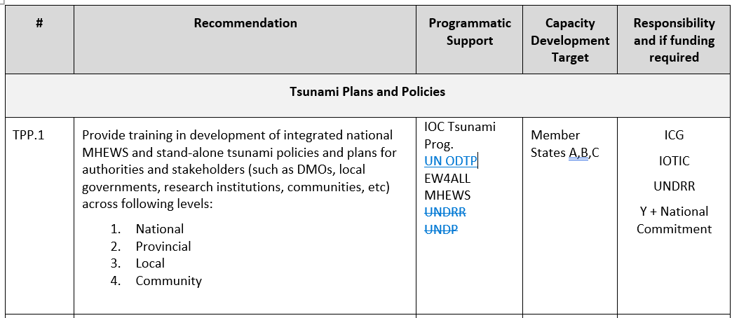
Compilition of the Draft of the Recommendation

Slide 31
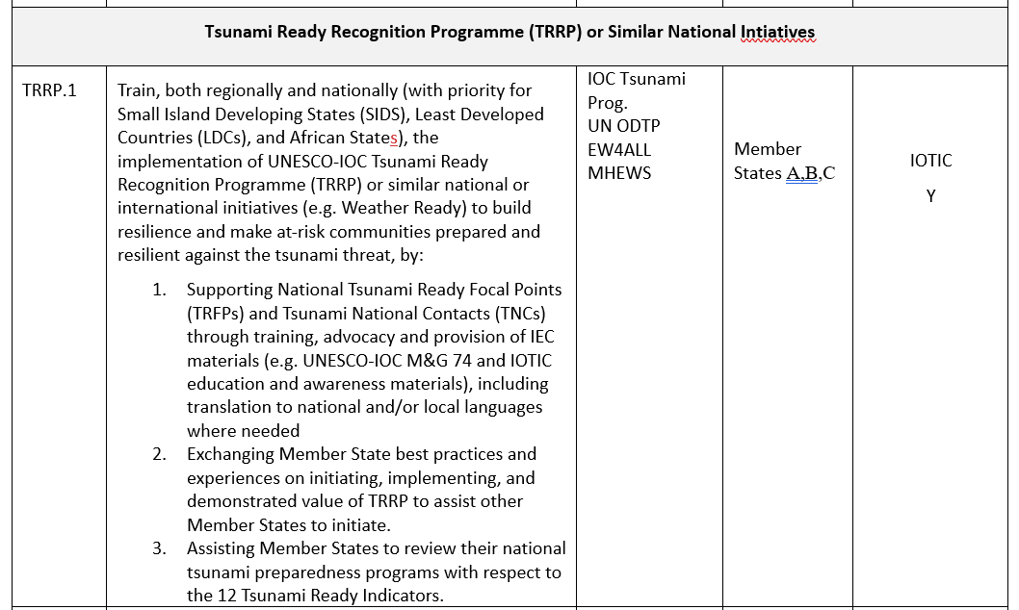
Compilition of the Draft of the Recommendation

Slide 32
Remarks
Capacity Assessement to identify the Gap, and progress after 2018
Need more stakeholder engagements (NTWC, NDMO, Sea Level Monitoring Organization)
Validation of the result
Producing Result and Recommendation, invite Chair WG and Task Team, experts
Cross Cutting Recommendation
Final Recommendation Endorse by the ICG Steering Committees
Promoted in the Global Platform

Slide 33
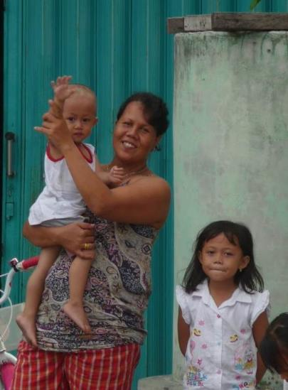


We all need work together to make the world’s at-risk coastal communities
Tsunami Ready

