Slide 1
WG2 Pre-SG TT Meetings
TGV
ISN
FOO
17 September, 2024
Honolulu

Slide 2
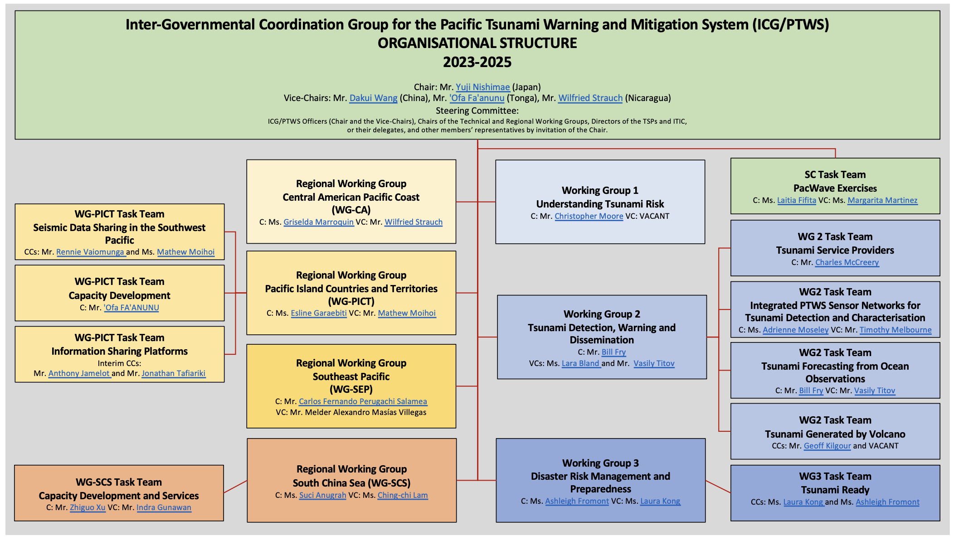
Structure

Slide 3
WG2 Task Team TGV
WG2 TT Network
13 Sept, 2023
Nuku’alofa, Tonga
Co-Chairs:
Geoff Kilgour
TBC

Slide 4
TT TGV
ToR
Open discussion for MS advances or work in train
NZ progress
Gaps
Discussion of interactions with TT FOO
Discussion of interactions with WG1
AoB

Slide 5
TT TGV
To confirm the list of volcanoes identified by the TGV as posing a potential threat to the Pacific (referred in Annex 4 Technical Series 183), to identify additional potential threat volcanoes, and continually review the list.
Among the volcanoes with potential tsunami threat, to identify those with implemented tsunami hazard assessment, monitoring, warning, and preparedness systems.
4. To establish direct collaboration between ICG/PTWS member states and IAVCEI to facilitate the contribution of PTWS tsunami expertise to the monitoring and warning
capability of existing volcano monitoring centres or NTWCs, as appropriate
Identify potential volcanic partners in countries and international bodies, and
recommend collaboration opportunities with them to improve tsunami early warning and to support the downstream decision makers affected by the volcanically-generated
tsunami
To develop guidelines on SOPs to monitor, detect, warn, and prepare for any volcano-induced tsunami waves.

Slide 6
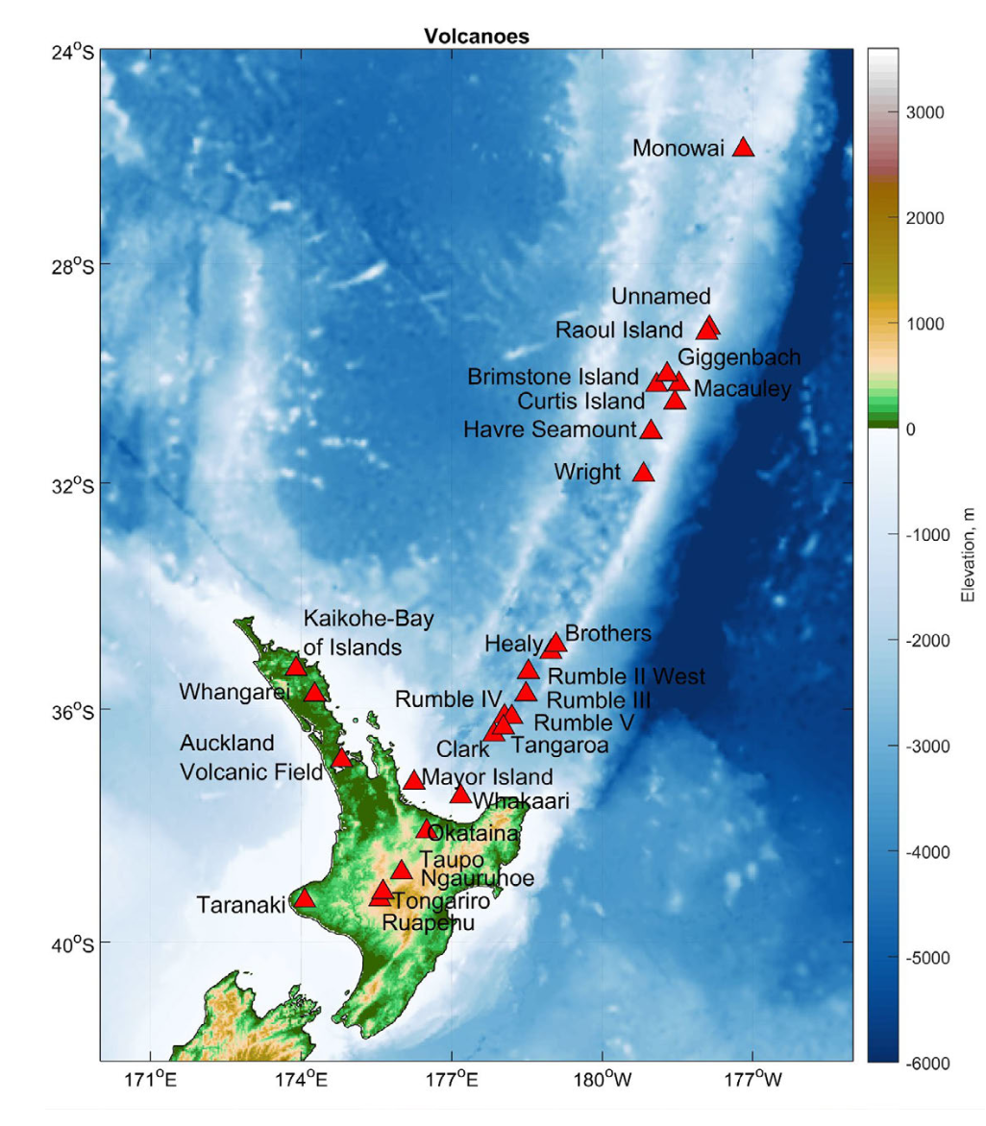
New Zealand interim approach
28 volcanoes identified with tsunamigenic potential and short travel times
Includes both oceanic and terrestrial sources
Gusman and Wang, 2024

Slide 7
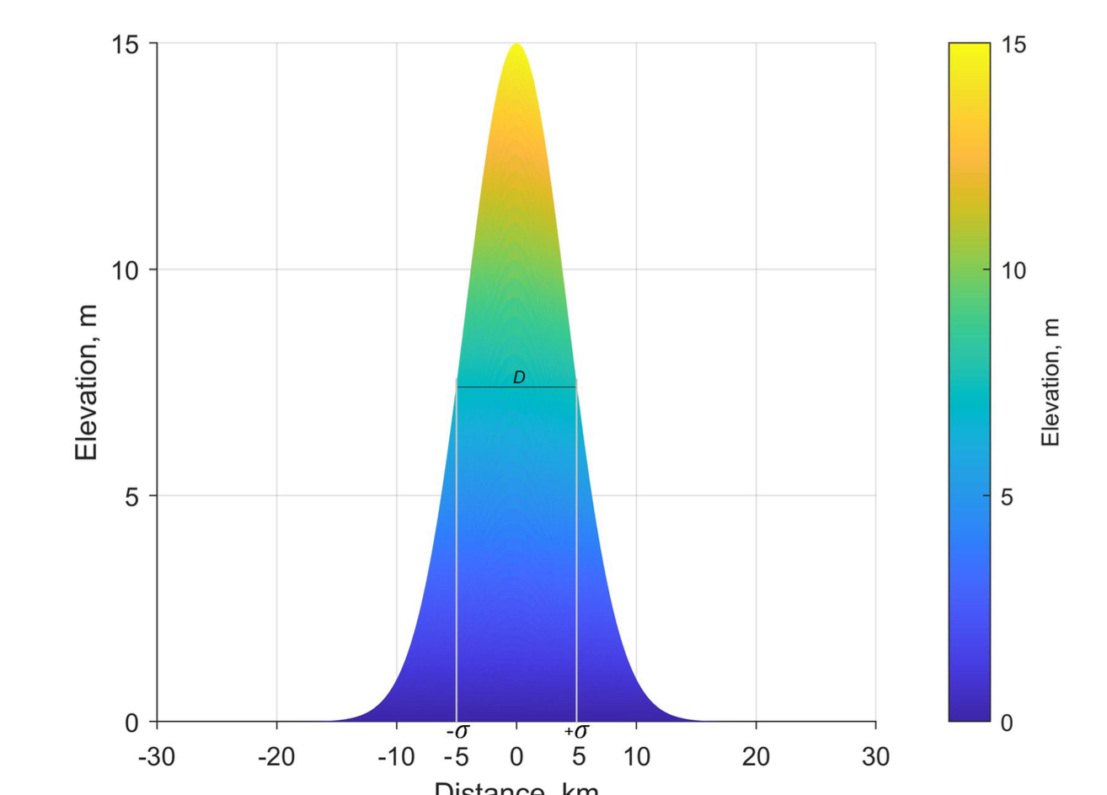
Maximum credible tsunami for direct generation (not coupled acoustic wave)
Symmetric
Conservative
To be iterated in expert panel
Gusman and Wang, 2024

Slide 8
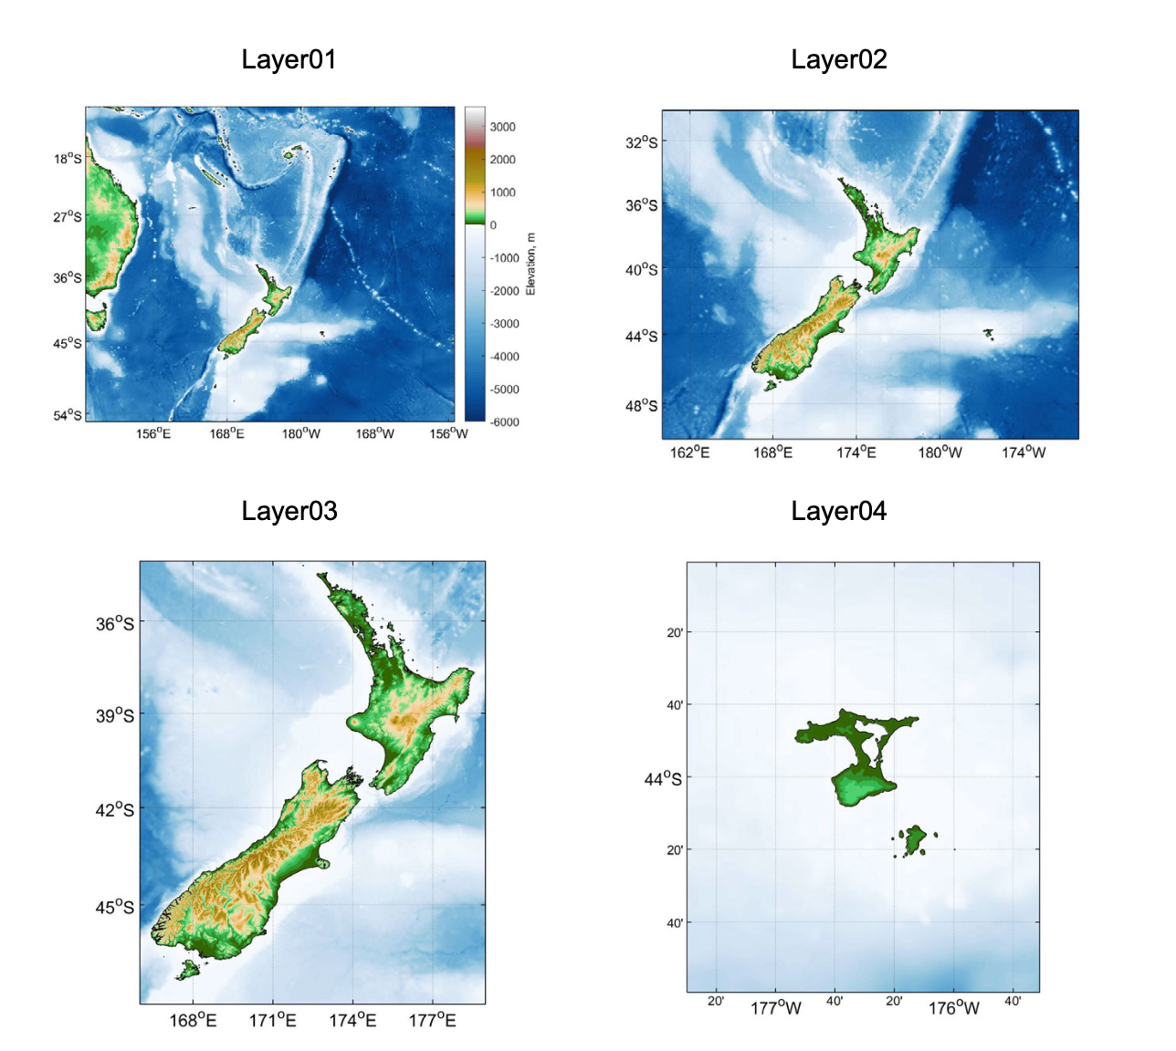
Modelling
Nested Grids (120, 60, 15 and 15 arcseconds
Hybrid shallow water non-linear and deep water linear equations
Gusman and Wang, 2024

Slide 9
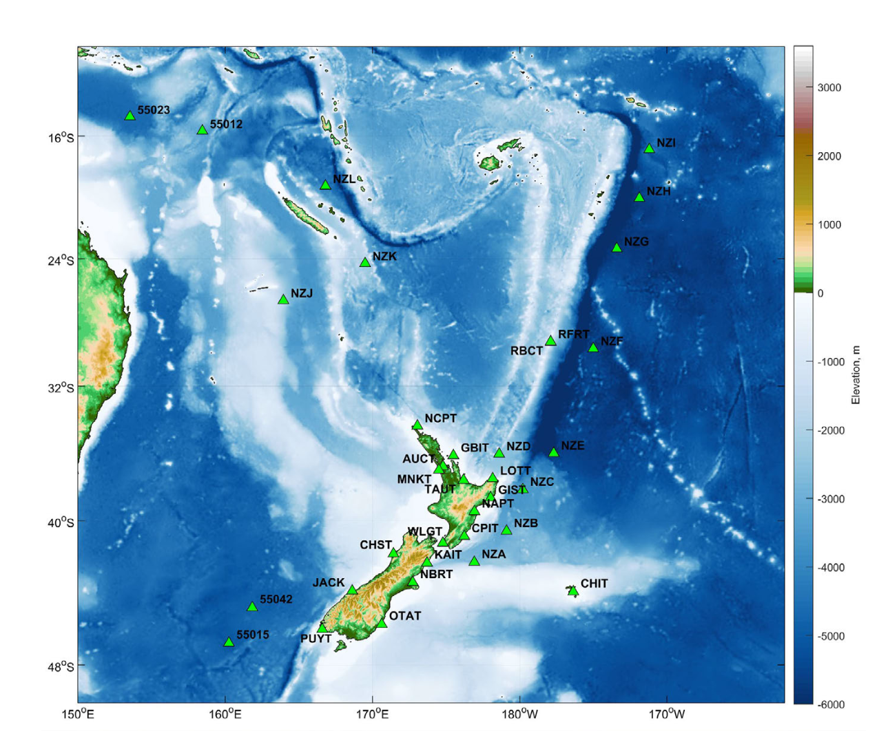
Modelling
Nested Grids (120, 60, 15 and 15 arcseconds
Hybrid shallow water non-linear and deep water linear equations
Solve for coastal and synthetic observations
Gusman and Wang, 2024

Slide 10
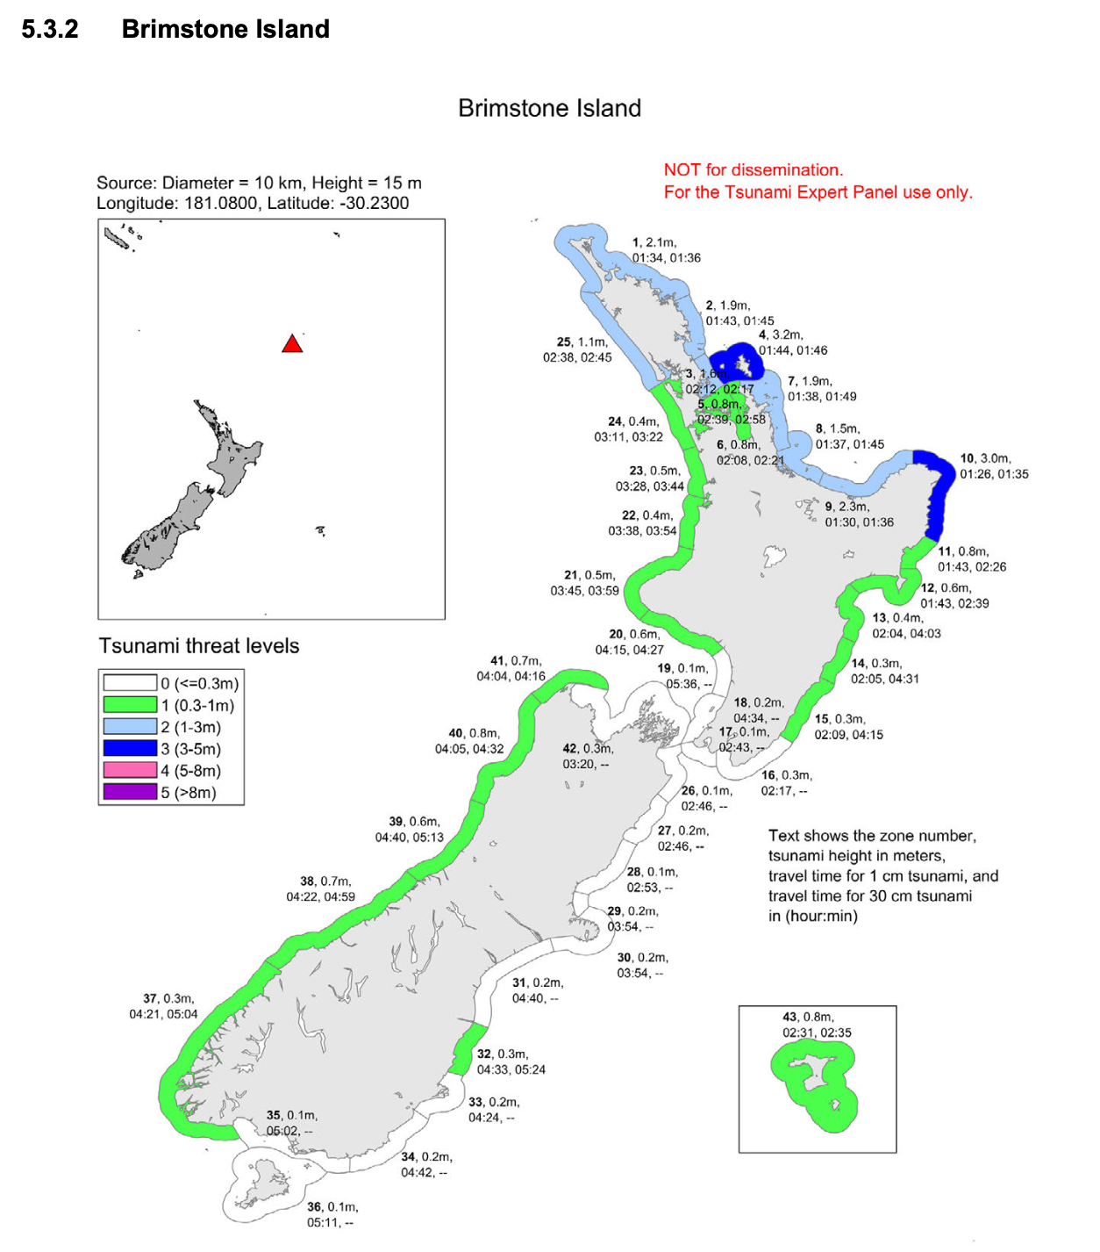
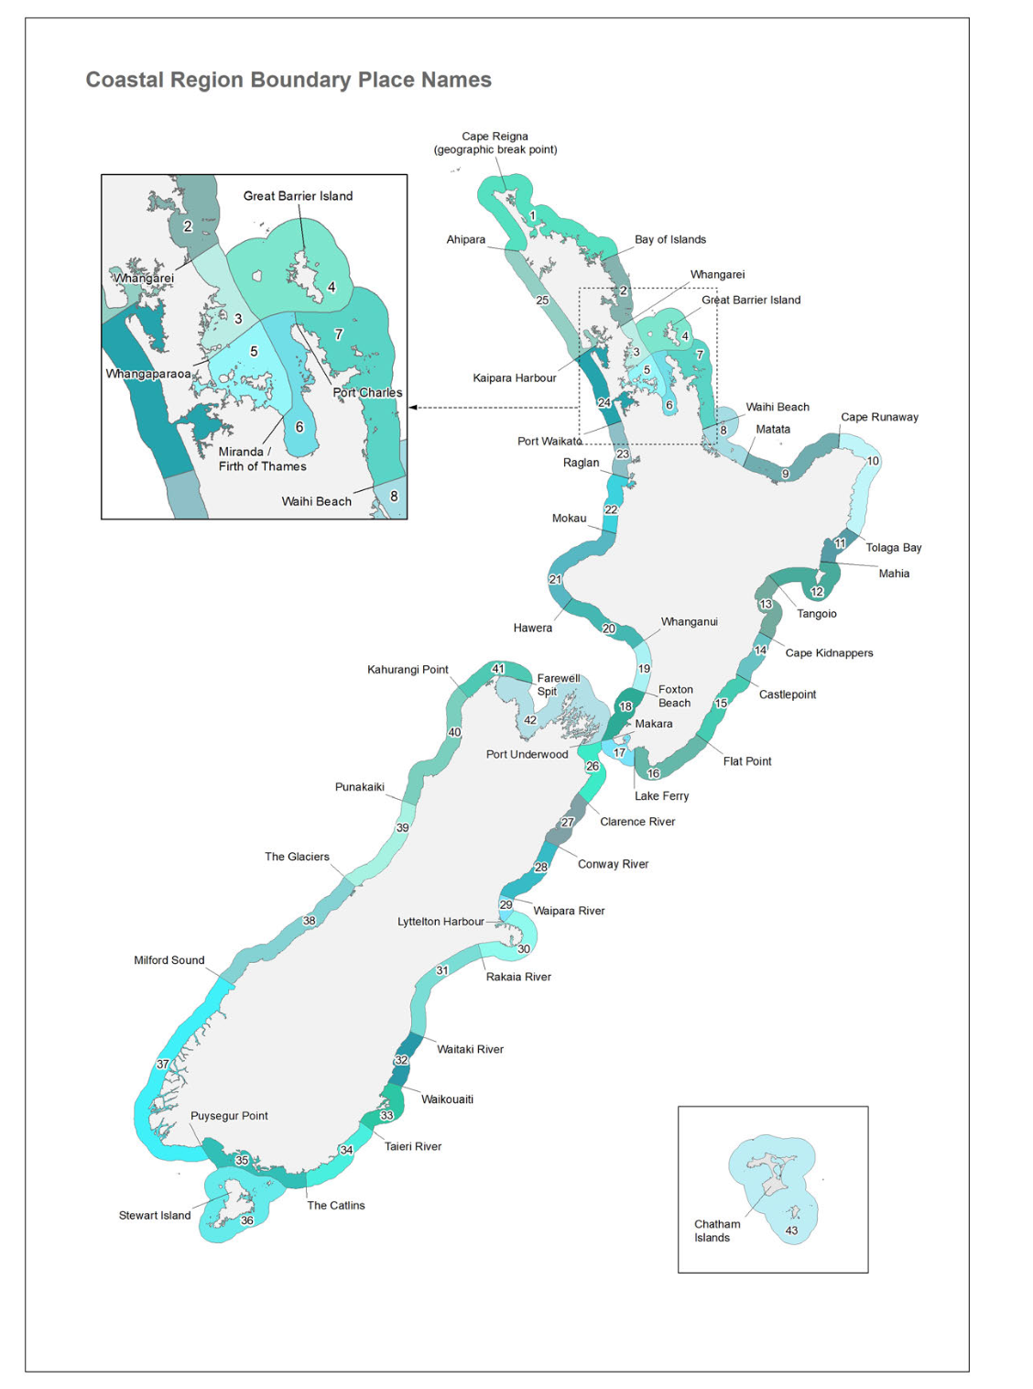
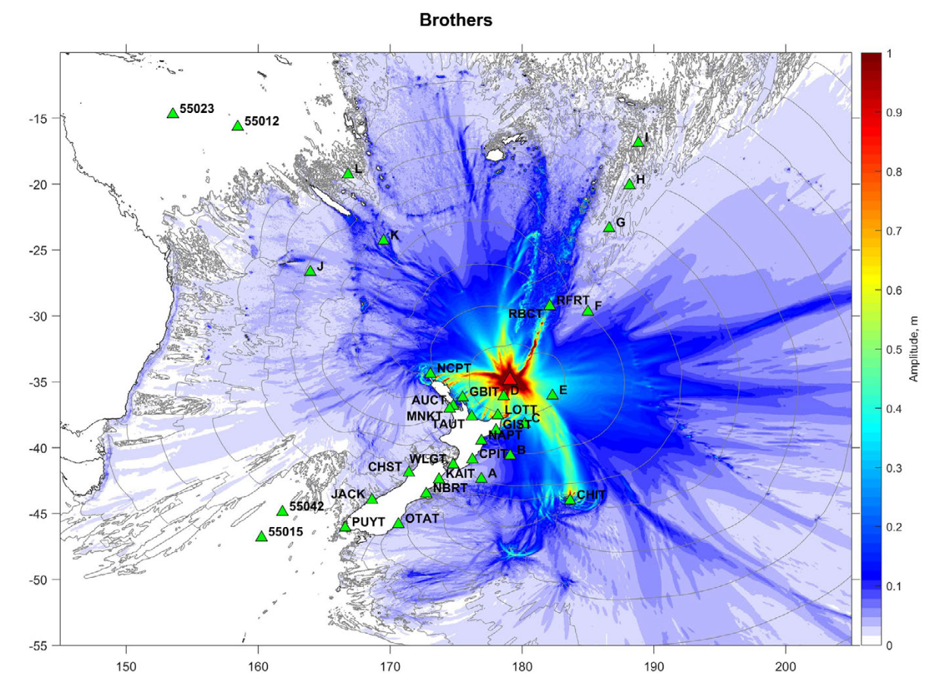
Modelling
Synthetic forecasting threat level maps to be used only as a starting point within expert panel discussions
To be scaled by DART observations where possible
Gusman and Wang, 2024

Slide 11
TT TGV
ToR
Open discussion for MS advances or work in train
NZ progress
Gaps
Discussion of interactions with TT FOO
Discussion of interactions with WG1
AoB

Slide 12
WG2 Task Team Integrated Sensor Network (INS)
WG2 TT Network
13 Sept, 2023
Nuku’alofa, Tonga
Co-Chairs:
Adrienne Moseley
Tim Melbourne

Slide 13
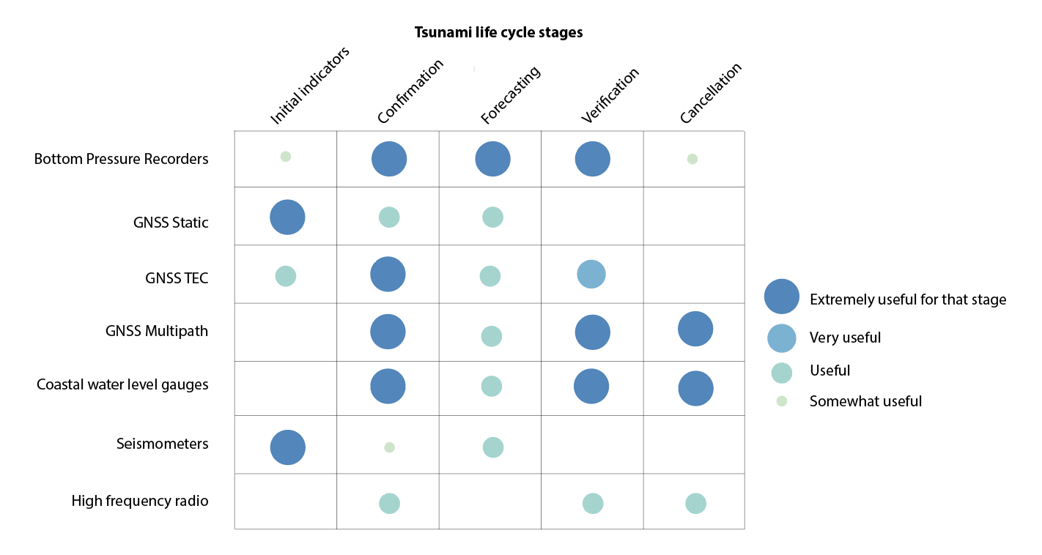
Science paper (Gledhill and team)

Slide 14
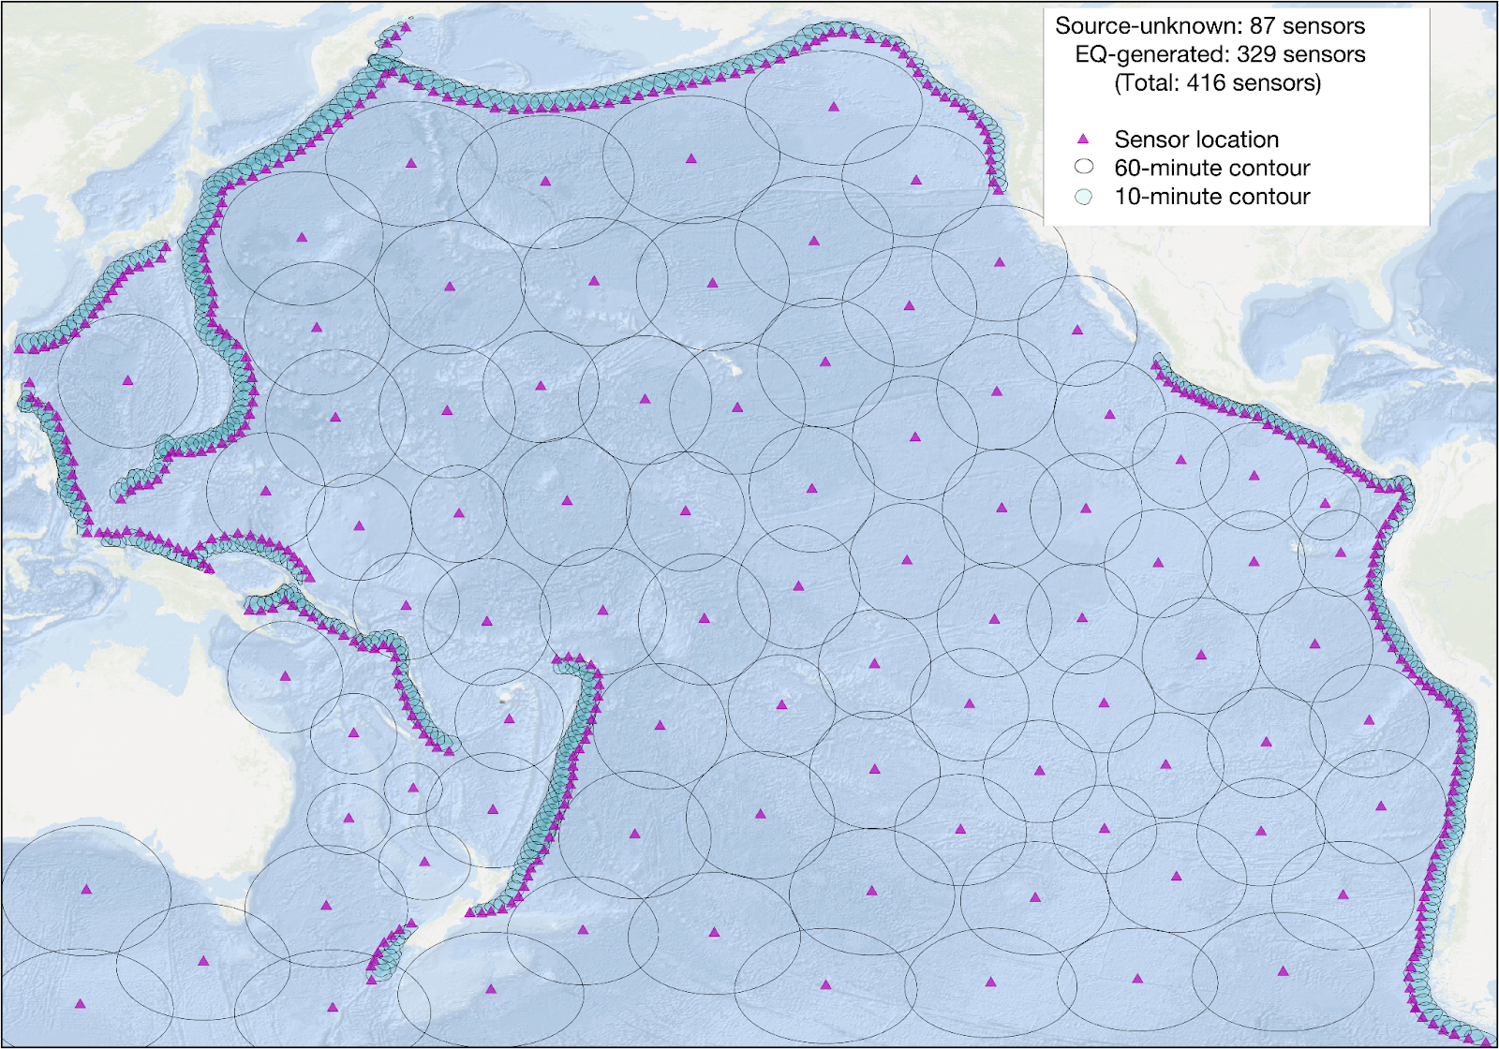
Science paper (Gledhill and team)
Minimum necessary observational grid to detect tsunami from subduction zones within 10 minutes and other sources within 60 minutes

Slide 15
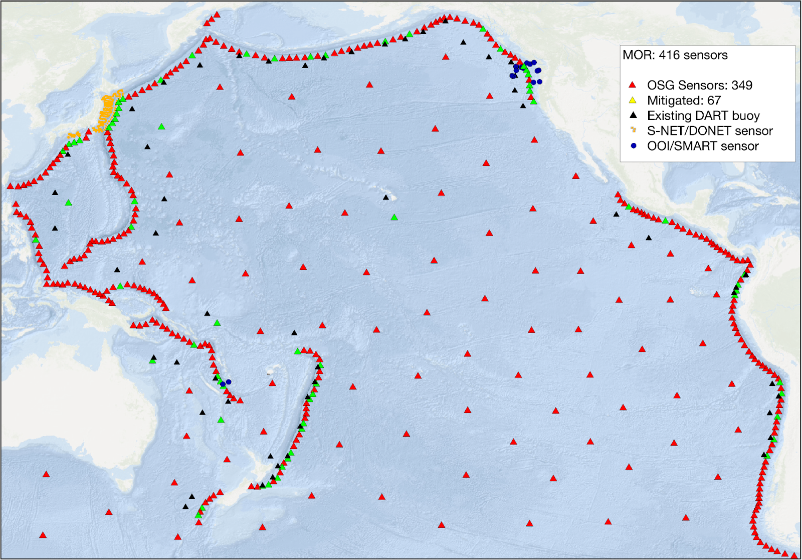
Science paper (Gledhill and team)
Mitigated observational array considering existing cables and DARTs

Slide 16
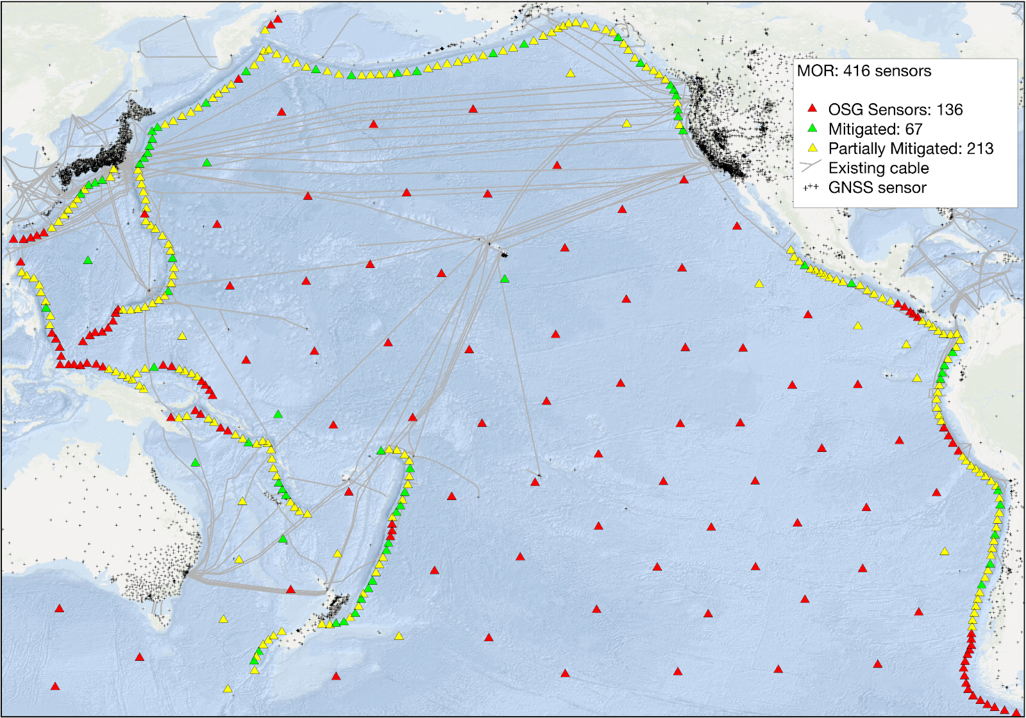
Science paper (Gledhill and team)
Largescale mitigation possible with GNSS and cabled technologies

Slide 17
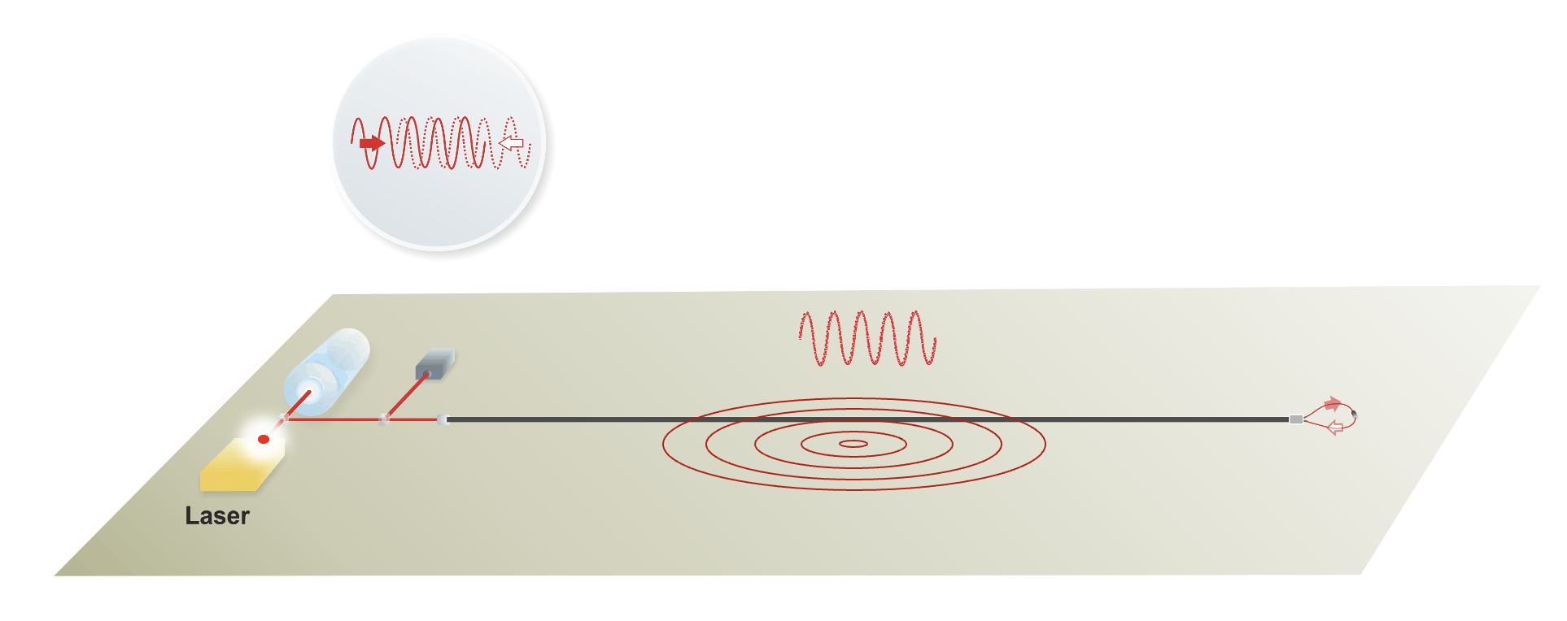






Cable Interferometry (Giuseppe Marra, NPL)

Slide 18
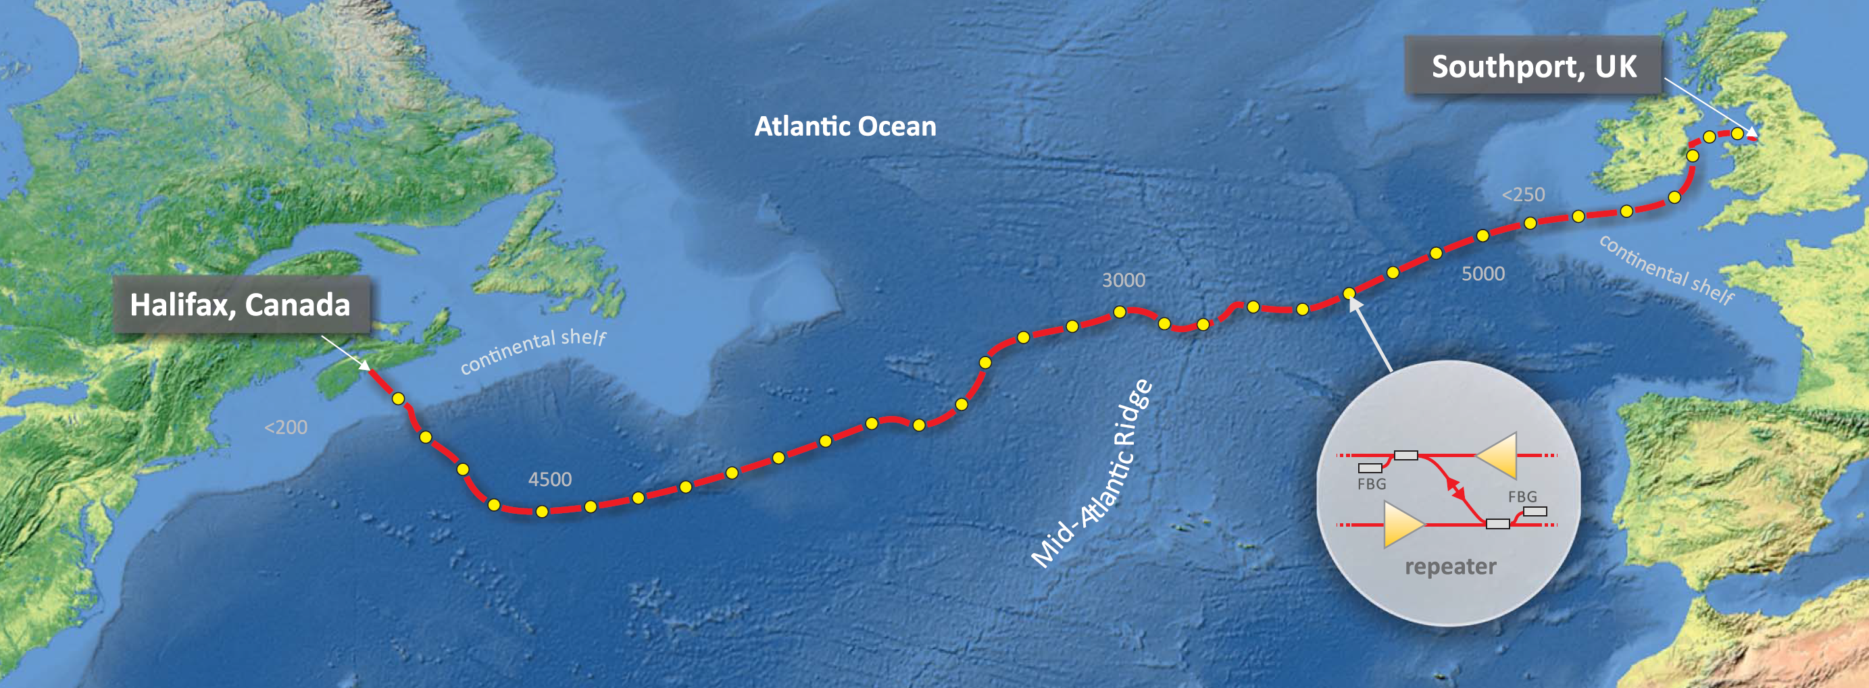
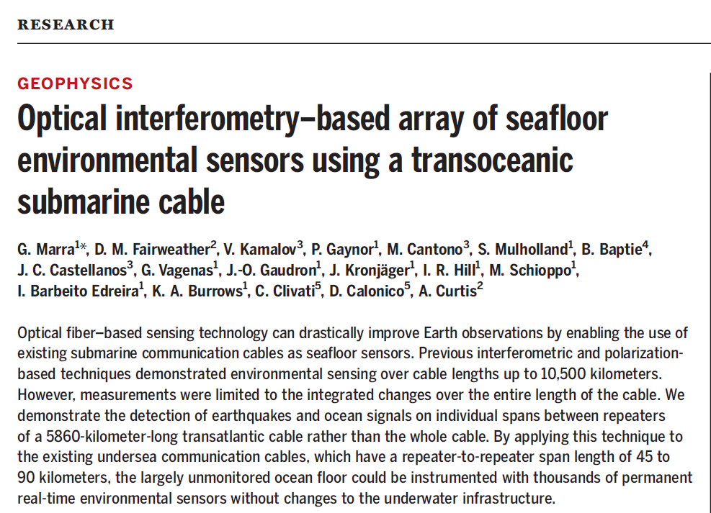
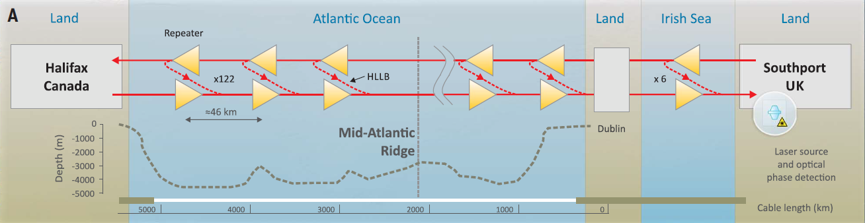
Giuseppe Marra, NPL

Slide 19
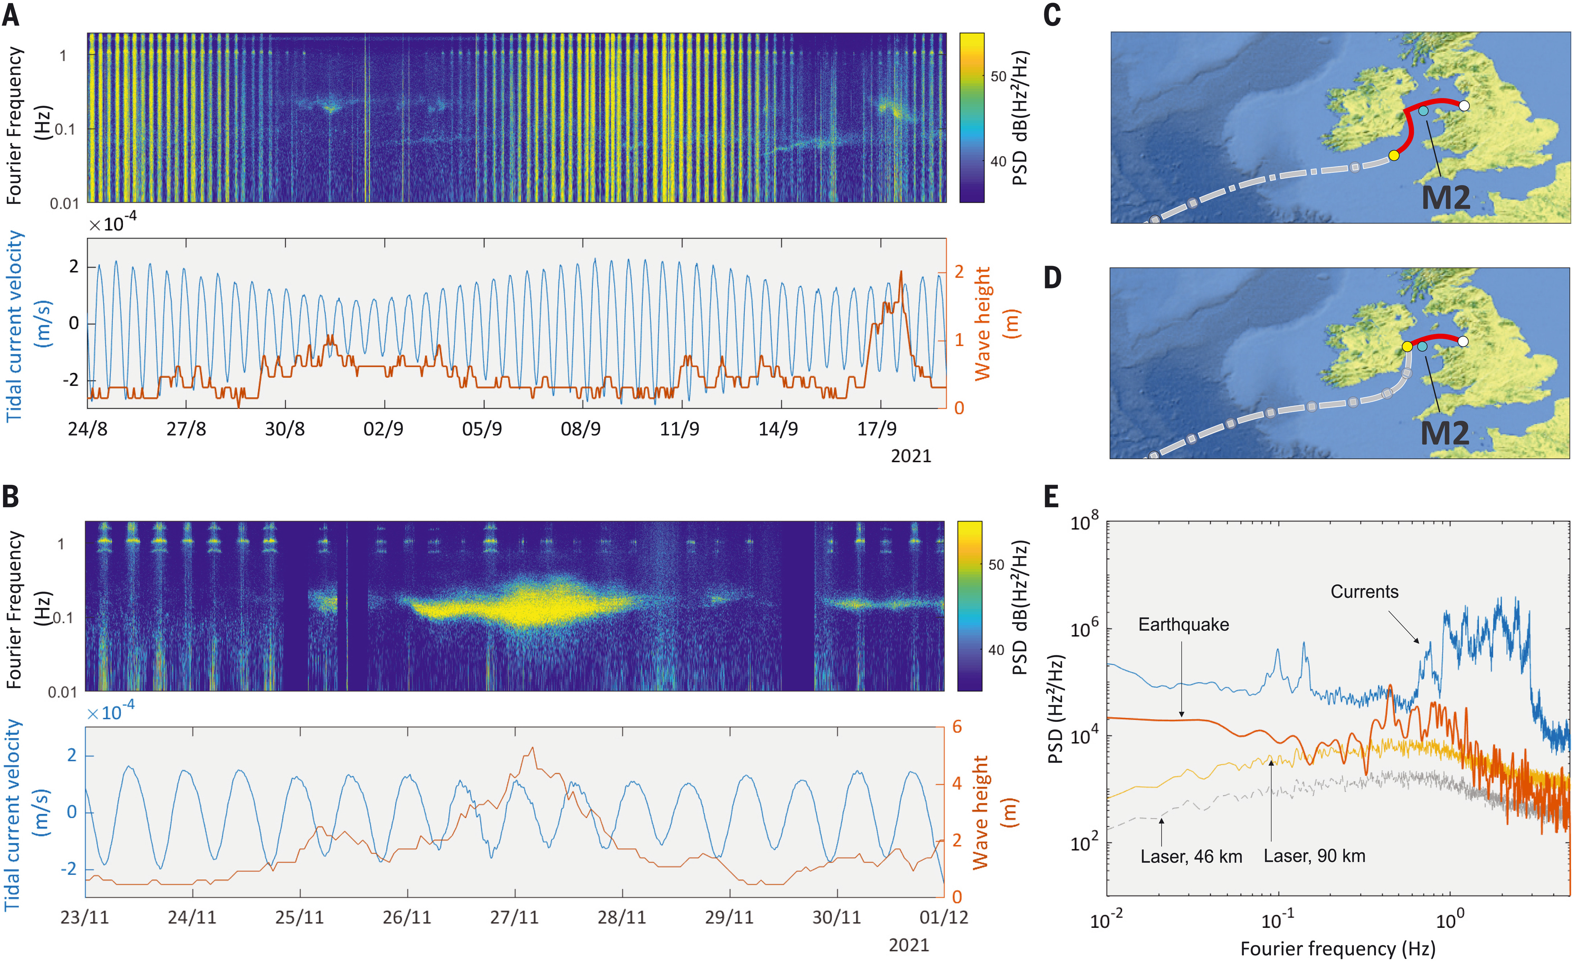
Sensitive to earthquake and tsunami frequency ranges
Mara et al., Science 2022

Slide 20
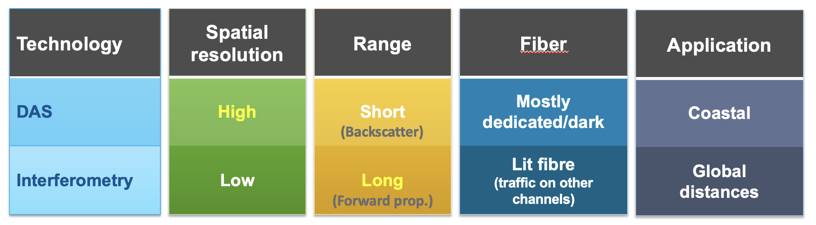
Complementarity of DAS and cabled interferometry
G. Marra

Slide 21
U.K. Funded pilot
Laser installed on existing cable, repeaters every ~50-60km
Pilot will record until March 2025, probably December 2025
WG2 working with NPL to test forecasting potential

Slide 22
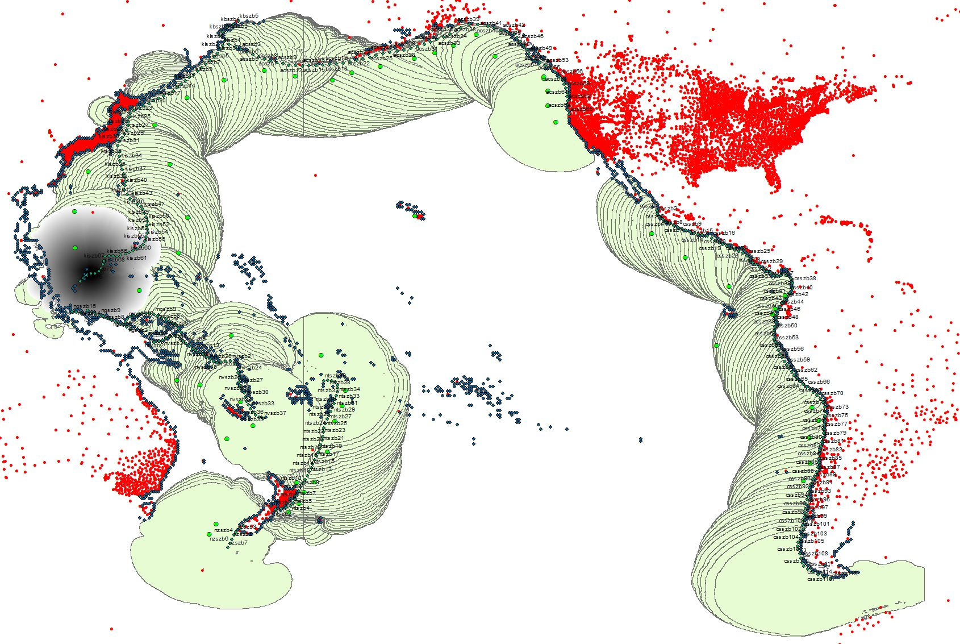
Light green show 2-hour travel times from most likely tsunami sources. Red dots are gnss. Black dots are coastal exposure (people in harms way)
GNSS Network potential for subduction zone sources

Slide 23
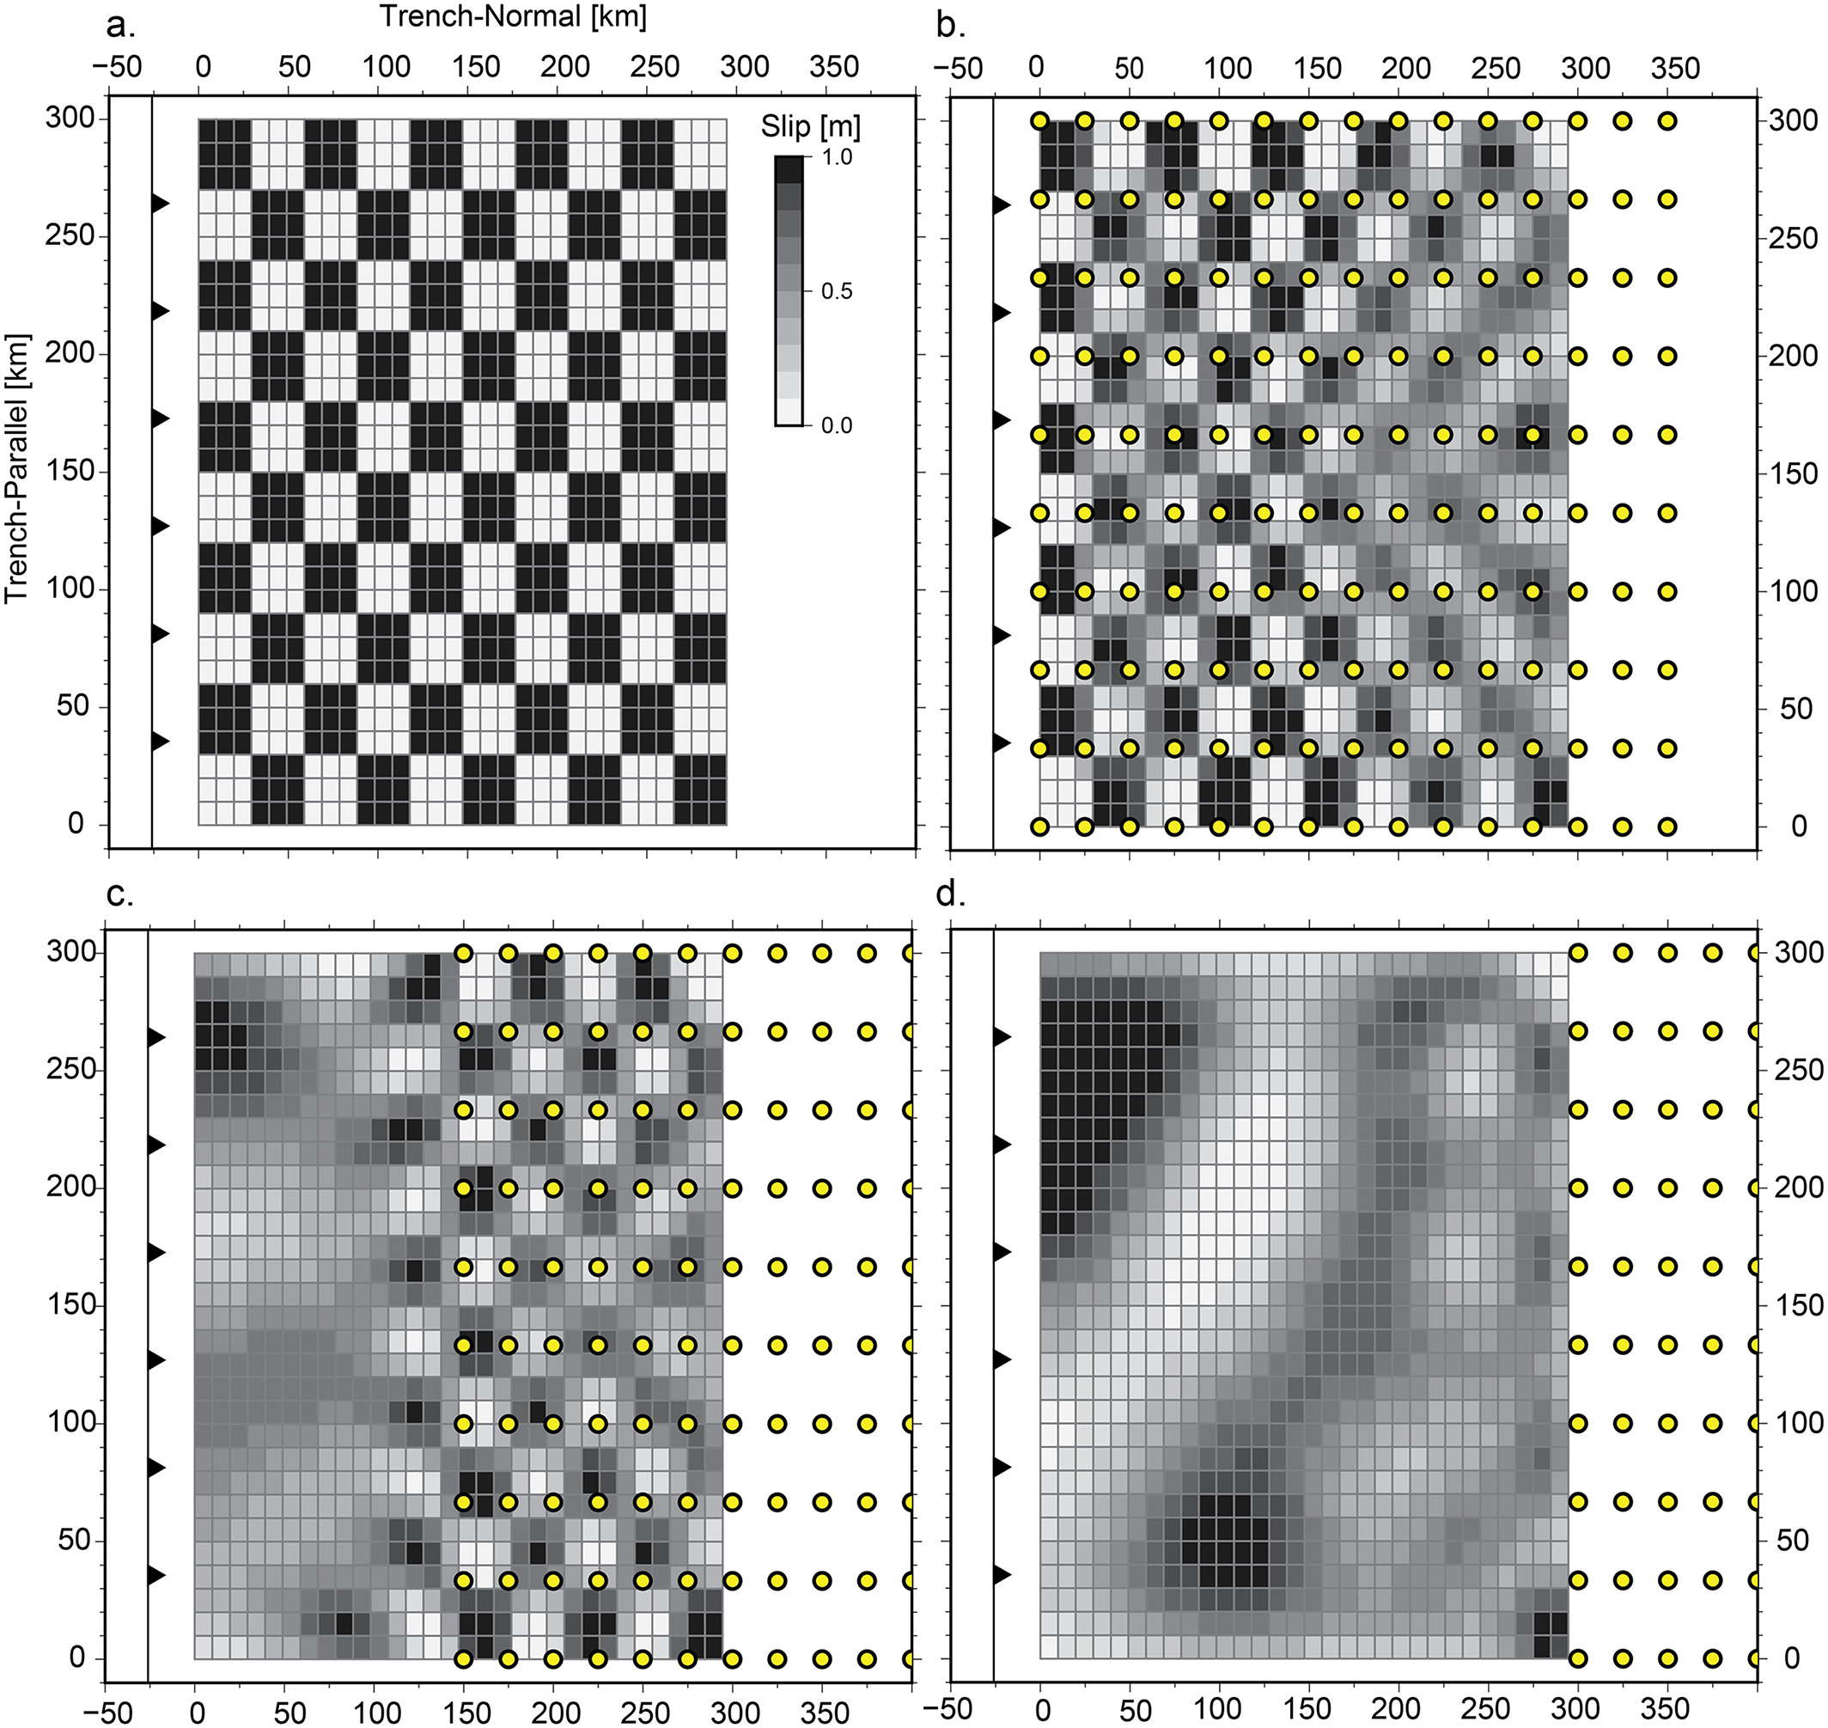
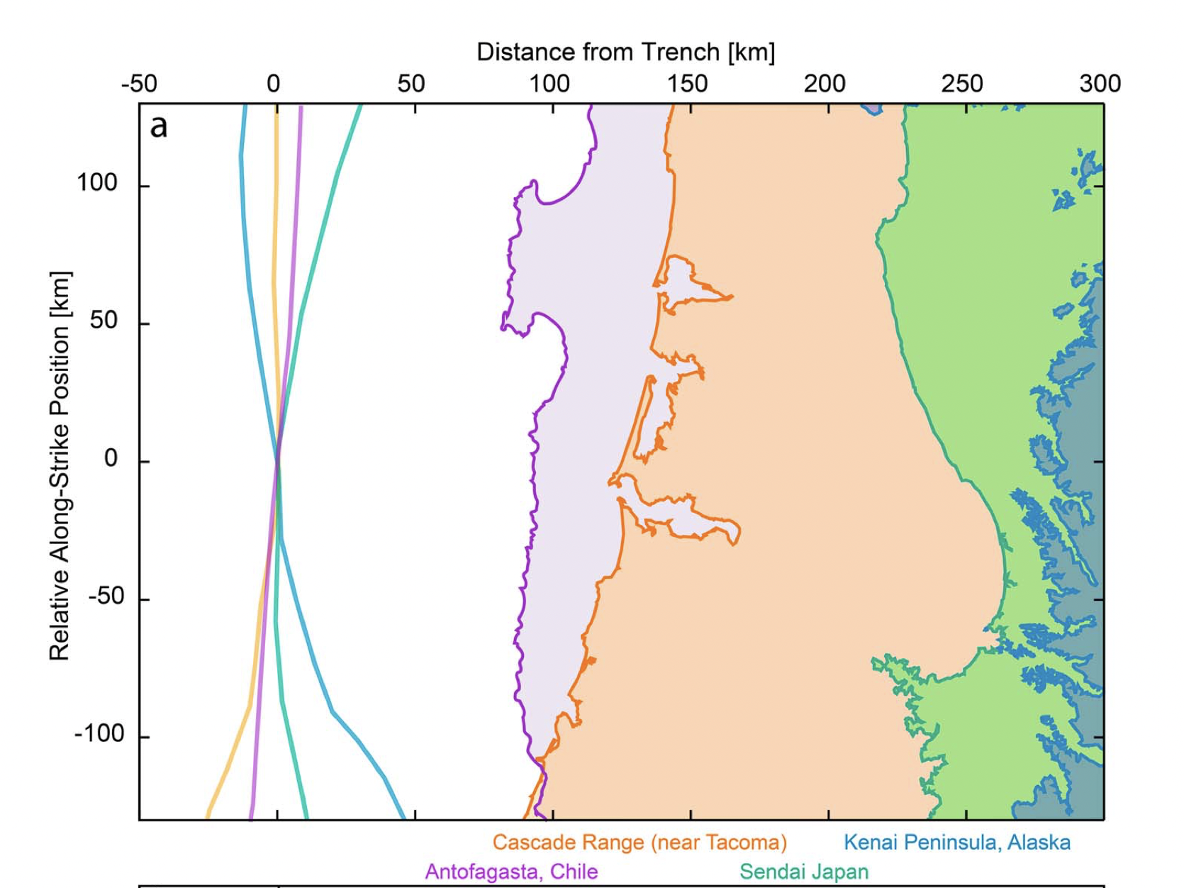
GNSS static displacements and TEC
Resolution of GNSS network to resolve earthquake information diminishes with increasing distance to the trench
Williamson and Newmann, 2018

Slide 24
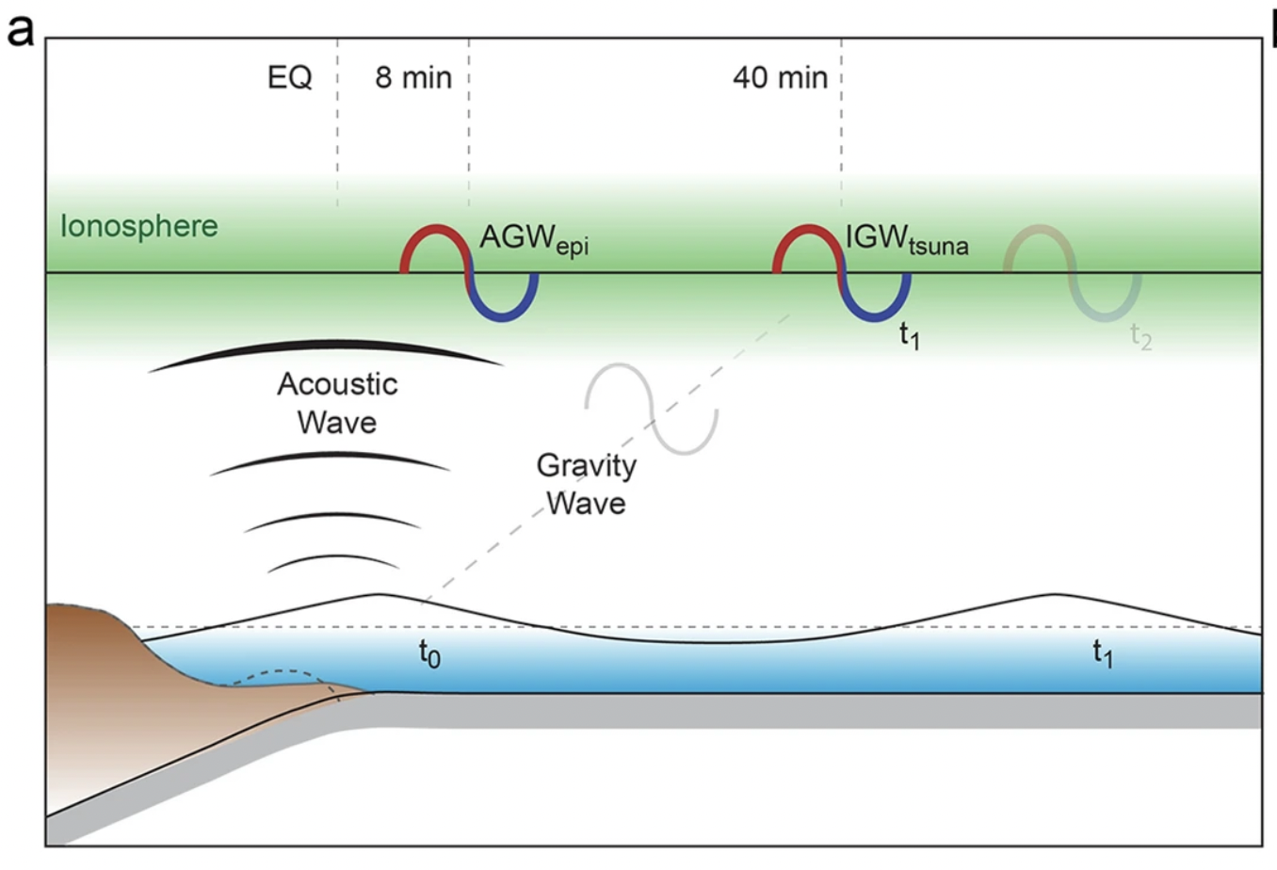
GNSS TEC potential for source agnostic forecasting
Relatively robust detector of tsunamis
Provides location information, not amplitude of wavefield disturbances
Manta et al., 2020

Slide 25
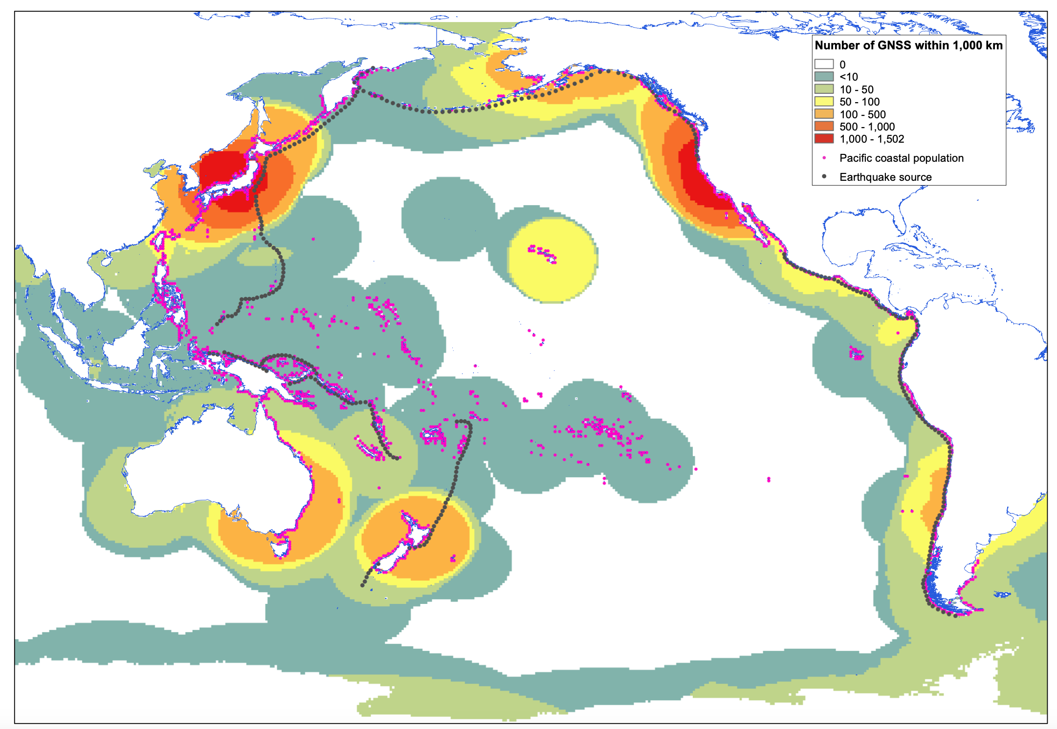
GNSS TEC potential for source agnostic forecasting
Density of GNSS stations within 1000km of 0.5degree discretized ocean
Range sensititivity is a swath from ~600-1200 km from GNSS locations
Spatial density of measurements dependent on GNSS network density and satellite constellation density

Slide 26
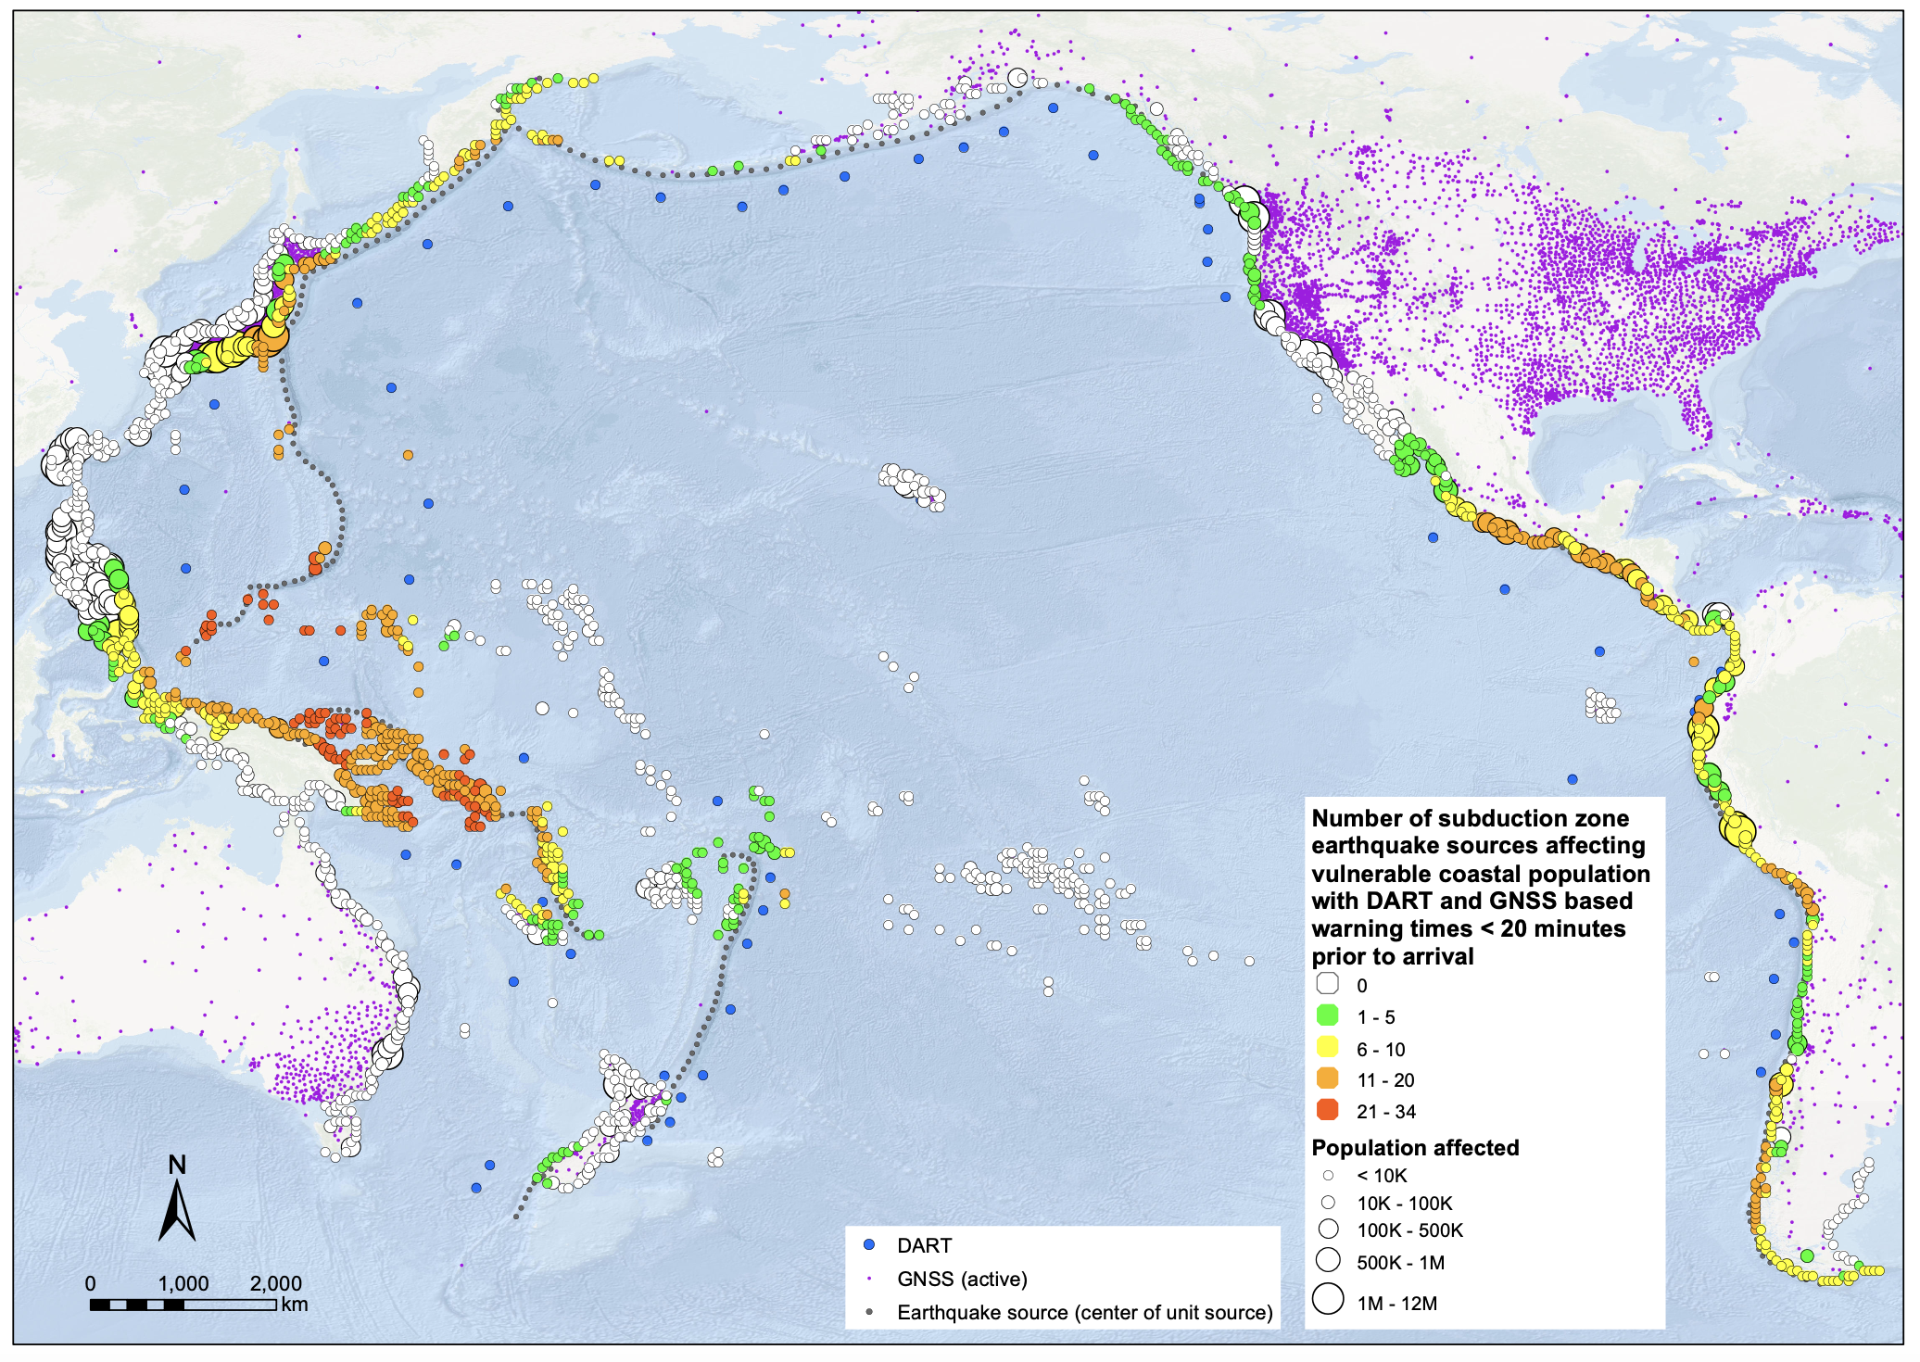
GNSS TEC potential for gains in forecasting
If we can use 1 DART or SMART for absolute amplitude calibration augmented by 2 GNSS (with 1000km radial TEC sensitivity) for spatial distribution of initial tsunami forecasting, then we can calculate the number of sources (earthquake) for which warning won’t be possible at least 20 minutes prior to wave impact – shown right

Slide 27
WG2 Task Team Forecasting from Ocean Observations (FOO)
WG2 TT Network
13 Sept, 2023
Nuku’alofa, Tonga
Co-Chairs:
Bill Fry
Vasily Titov

Slide 28
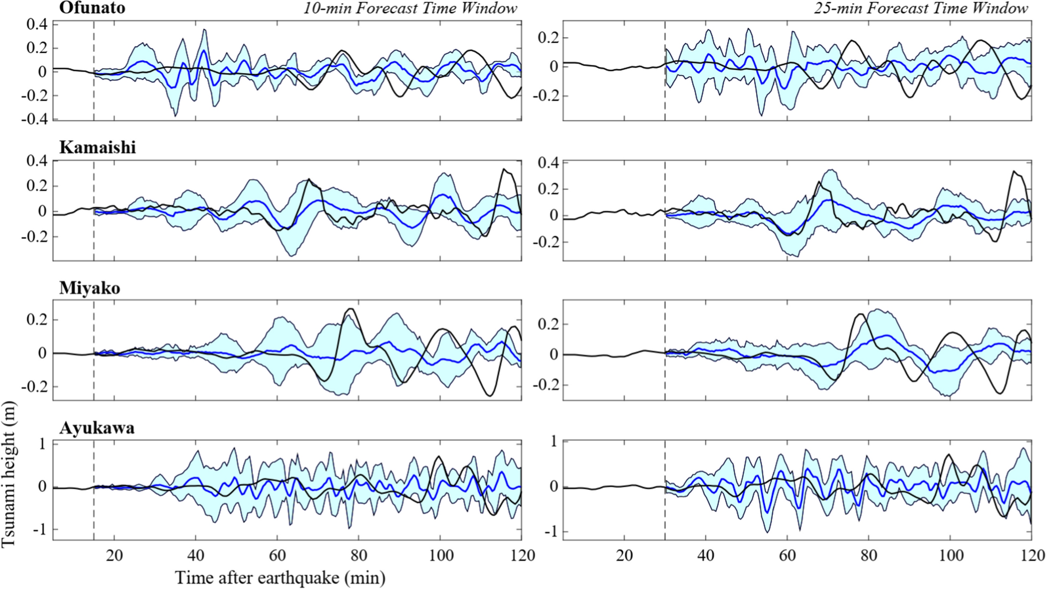
Big data approaches to forecasting
tFISH (Tsushima et al., 2009) – inversion for initial condition for forecast model (coastal amplitudes)
Assimilation (progressive forecast updates) – e.g. Maeda et al., 2015, Gusman et al., 2016
Neural networks / ML for coastal amplitude – e.g. Mulia et al. 2020, Liu et al., 2021
ML for inundation – Mulia et al., 2022
Wang et al., 2023

Slide 29
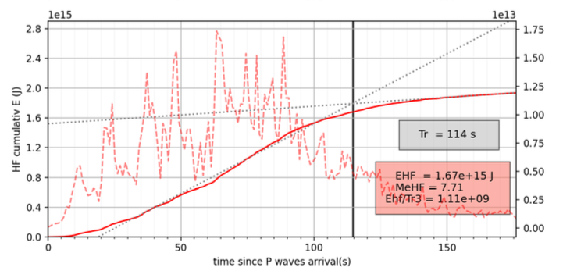
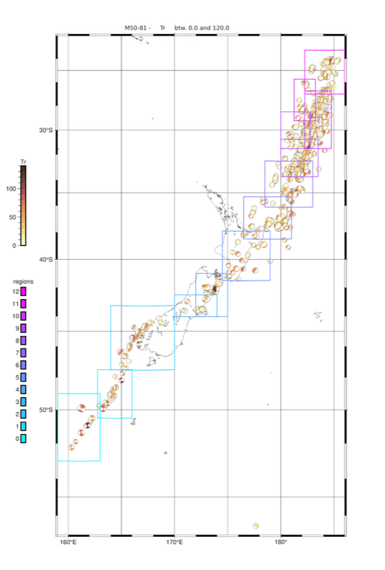
EQ source characterization advances
Regional wphase automation
  Pushing toward 15 or 10 minute solutions with regional Green’s Functions
Rupture duration, M_e and energy partitioning for slow tsunami earthquakes, SC module
Early-Est Td-T50 (INGV)
Chanony et al., in prep

Slide 30
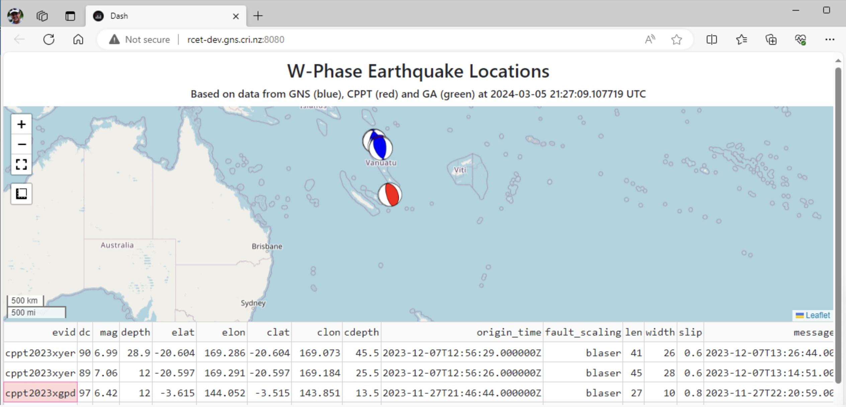
KAFKA clearing house prototype
GA/GNS/NEIC/CPPT collaboration
Metadata server

Slide 31
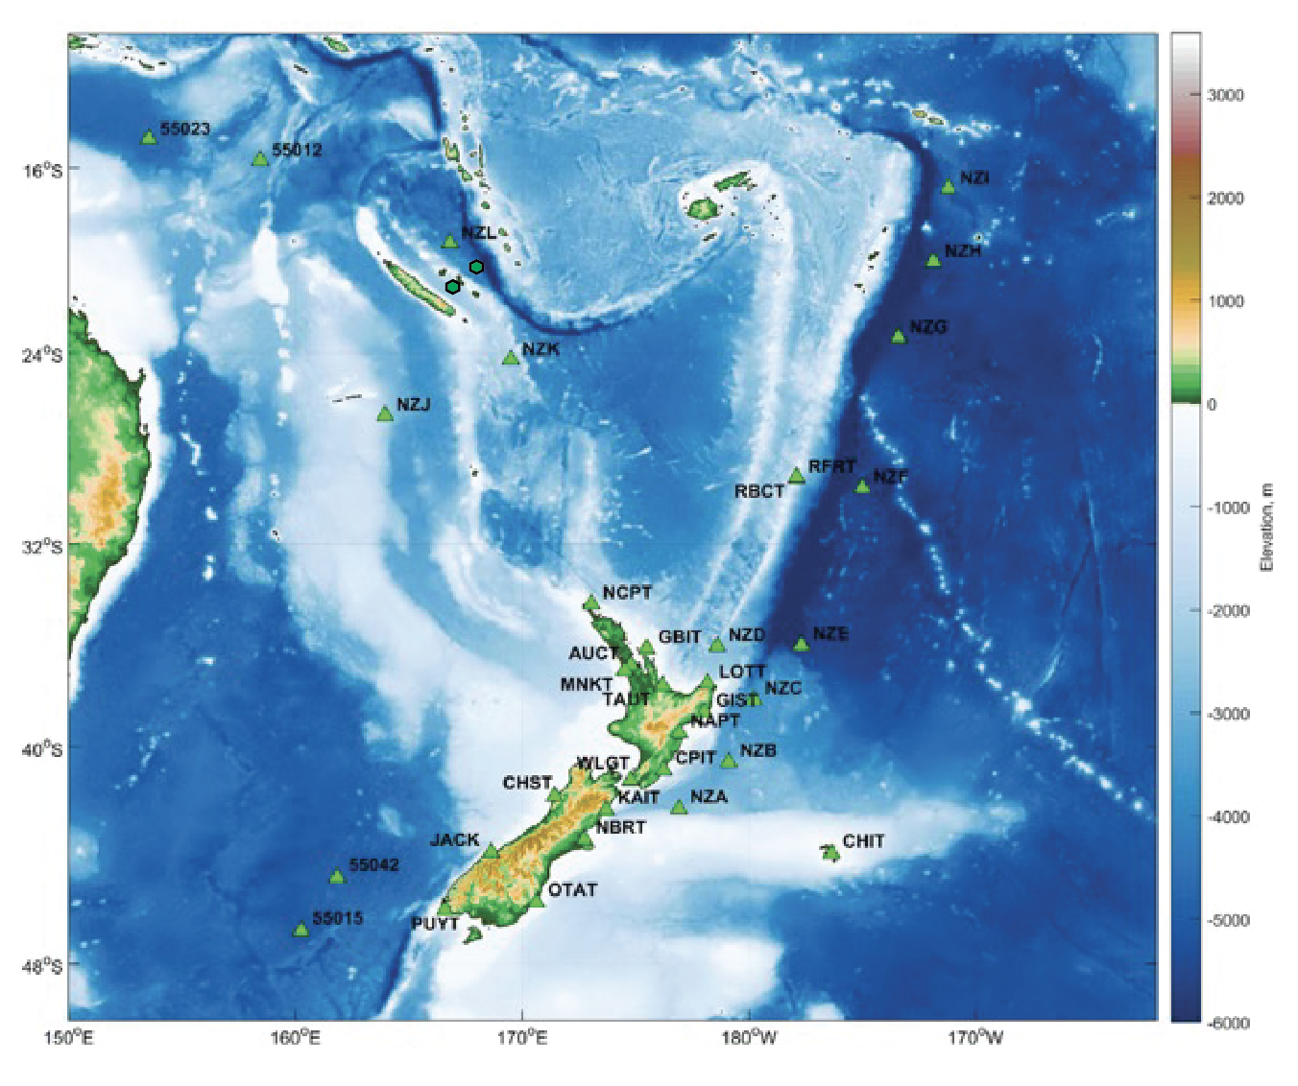
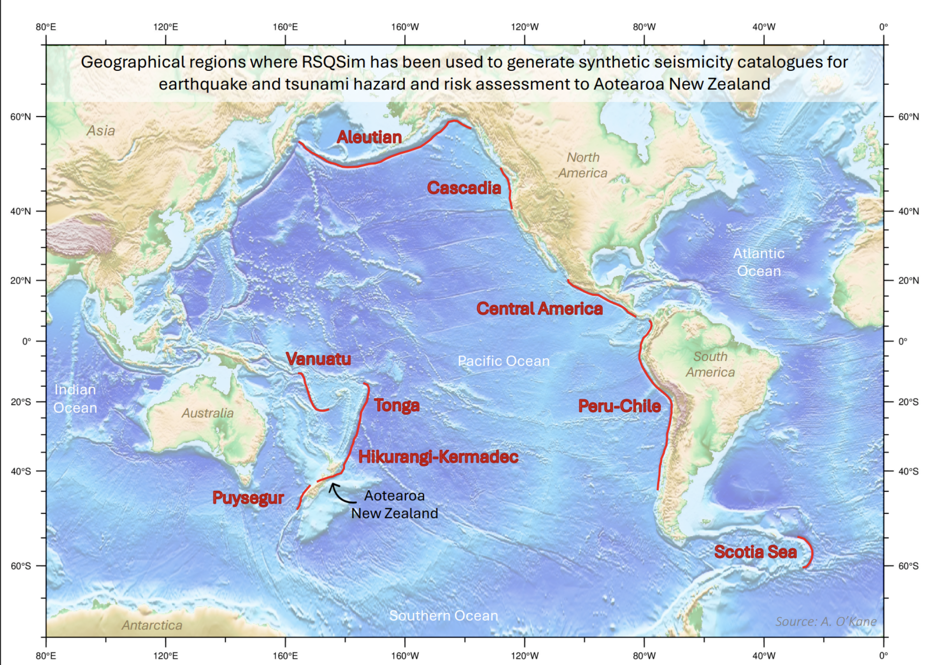
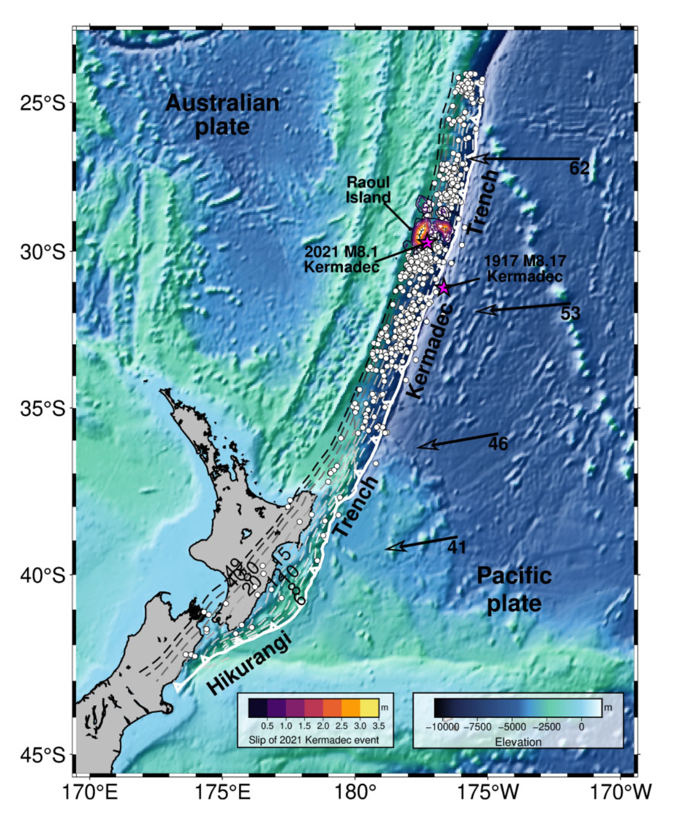
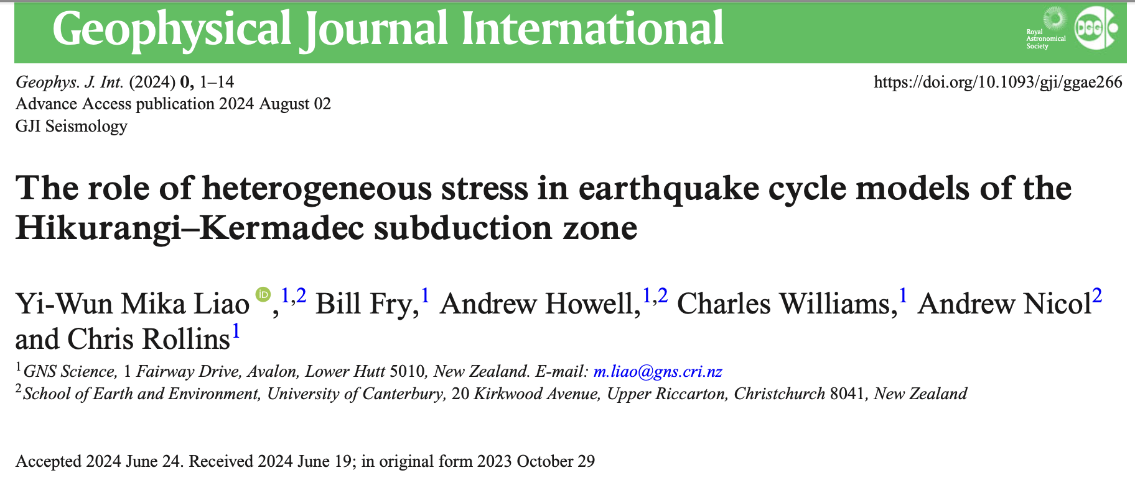
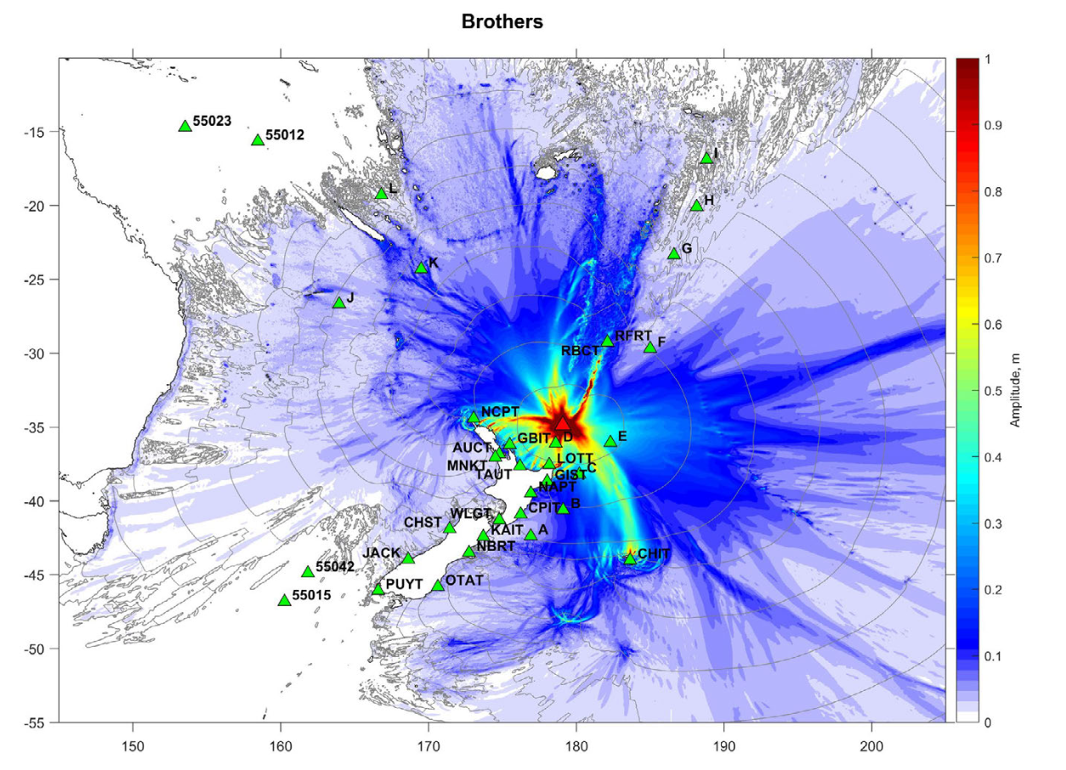
Candidate AI framework
Liao et al. 2024
Pilot based on earthquake cycle simulators and MCE from volcanoes
Calculating seismic (wm), GNSS (static) and tsunami (SMART+DART)
Scoping TEC and CI with partners (Sapienza, NASA JPL and NPL)
Gusman and Wang
U.K. funded pilot on Southern Cross

Slide 32
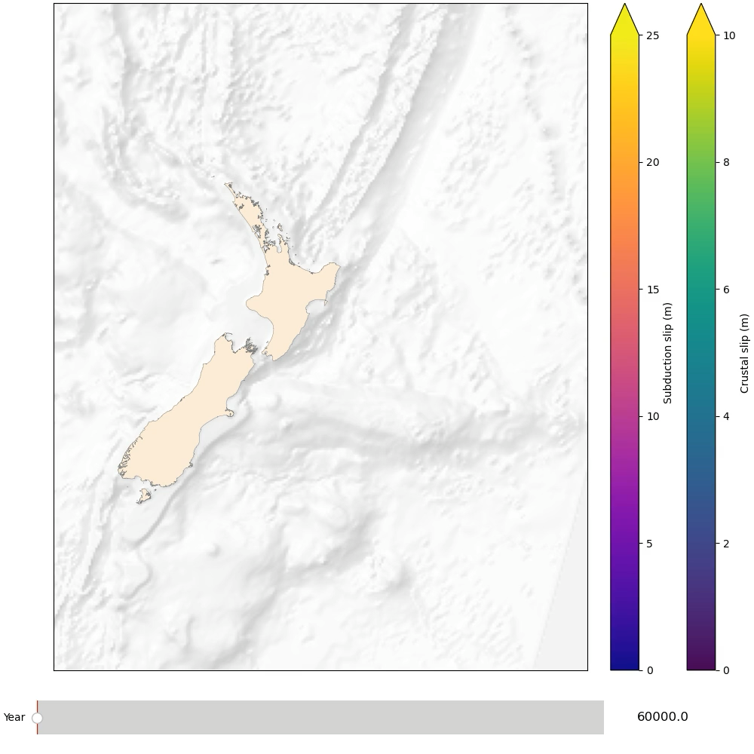
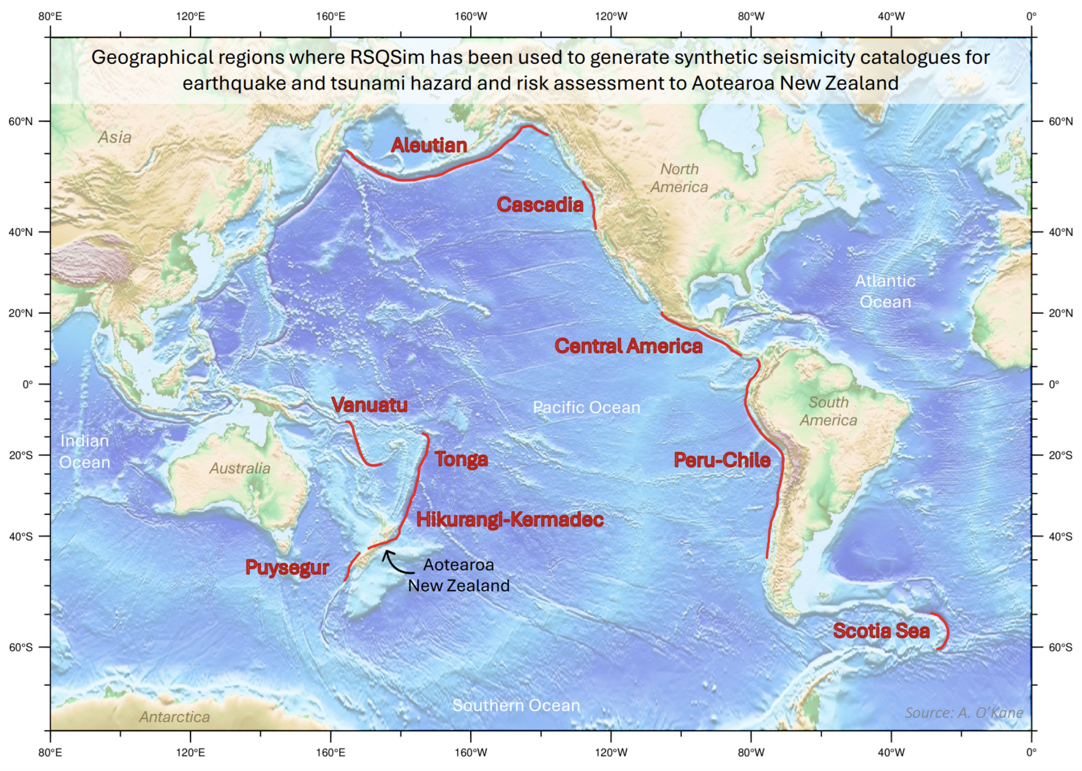
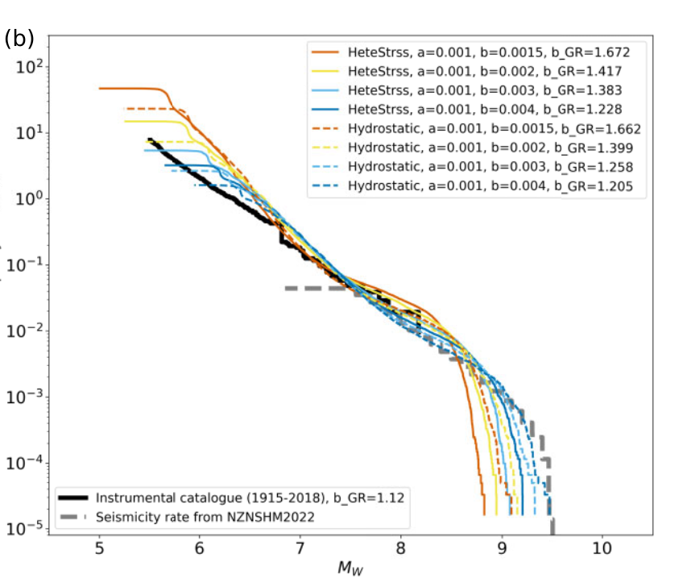
Dense Array inversion strategy (one possibility)
Synthetic observations and precalculated forecasts
Based on earthquake cycle simulations – millions of synthetic earthquakes
Liao, Howell, O’Kane, NZ group

Slide 33
FOO
Terms Of Reference
Compare and document existing strategies for source-independent tsunami early warning and quantify and document their operational usefulness. Efforts will include consideration of both existing and emerging ocean observations technologies and techniques.
Connect with appropriate entities in the WMO and IOC Oceanographic communities to allow best-practice direct observation driven forecasting techniques to be assessed for their usefulness in TEW.
Align efforts with the TT Integrated PTWS Sensor Networks to ensure that existing and likely future monitoring systems support TT recommendations.

Slide 34
Thank you very much for your kind attention.

