Slide 1
IODE (agenda item 3)
IOC GOOS & IODE WS, 2024-09-30—10-02

Slide 2
1. Purpose
https://www.iode.org
Established in 1961
Formally the IODE started out as a Working Group on Oceanographic Data Exchange which was created by the First IOC Assembly (19-27 October 1961). The Working Group became a Working Committee in 1973 through Resolution VIII-31, adopted by the 8th Session of the IOC Assembly (5-17 November 1973). It is a Primary Subsidiary Body of the IOC
“to enhance marine research, exploitation and development, by facilitating the exchange of oceanographic data and information between participating Member States, and by meeting the needs of users for data and information products”
It’s all about data sharing
IOC focus audience: ocean science community

Slide 3
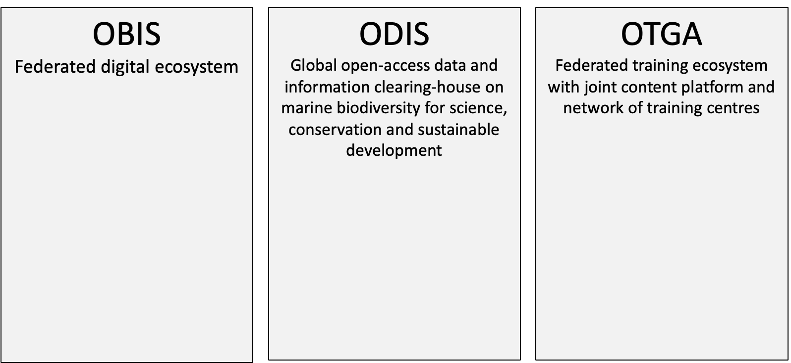
1a. IODE operational structure 2023
28 partners
World Ocean Database
GODAR
GTSPP
GOSUD
IQuOD
AquaDocs
OceanExpert
ICAN
OBPS (jointly with GOOS)
QMF
33 OBIS nodes
PacMAN
eDNA Expeditions
MARCO-BOLO
DTO-BioFlow
MPA Europe
eDNAquaPlan
BioEcoOcean
GOOS BioEco Portal
HAB portal
17 regional and specialized training centres
Close cooperation with IOC Capacity development Unit

Slide 4
2. Outcomes/outputs/products or services of the programme activity
OBIS considered as the ocean biodiversity “authority” within the UN;
ODIS recognized as a global digital ecosystem for ocean data and promoting IOC’s important role as global network of ocean data centres, hosted by IOC Member States which is essential for these Member States to comply with their obligations in international frameworks (e.g. SDG, BBNJ).
OTGA recognized as the training system of choice through its global network of regional and specialized training centres, hosted by IOC Member States, that promote south-south cooperation in ocean related learning

Slide 5
3. Current and potential users of the outputs, products or services: how do they assist research, ocean policy and management, industry, multilateral processes (e.g. SDG, BBNJ, …)
IODE data centres (NODCs) have been established by Member States mainly in ocean science government institutions. As such the main users of NODC data (and IODE programme activities) are ocean scientists;
ADUs are composed of OBIS nodes as well as national, regional, international and commercial entities. Main users are ocean scientists
See topic 4 for future opportunities

Slide 6
4. How does the programme activity contribute to the IOC value chain?
What is currently missing in IOC is a unit/section that deals with decision support. This results in a lack of users of data beyond the science community
We see the same problem at the national level (see topic 3)
IOC programmes are insufficiently visible/appreciated in the Ocean Decade
Data
Data and information products
Decision support, advice to regulatory frameworks
Observations
science
Offer
Demand
This is missing!!

Slide 7
5. Strategic planning for the next 5 years: priorities
Further develop the IOC Ocean Data and Information System (ODIS) into a global ocean data and information ecosystem making available data and information sources of all member states and to all member states
Further develop the Ocean Biodiversity Information System (OBIS) into a globally interconnected community of practice, facilitating seamless and near-real-time data flows, from biological observations to practical applications.
Ensure that all IOC Member States have the necessary capacity to manage ocean data and information (as part of the IOC value chain) and to develop products, services and policy advice for sustainable ocean planning and management
Align IODE with the Ocean Decade objectives/implementation plan as well as SOPM
Focus on building a (wider) user audience among ocean policy and management, industry, multilateral processes

Slide 8
6. Goals for an Integrated IODE-GOOS FAIR data landscape
Meet user requirements both on a National and Global level
A global digital representations of the marine ecosystem
An implemented Ocean Decade Data Strategy

