Slide 1
ICG / NEAMTWS
Chair Report
(Feb—Nov- 2024)
Alessandro Amato
ICG/NEAMTWS
XIX Session, Paris
27-29 November 2024

Slide 2

The ICG/NEAMTWS Chair activities Feb. - Nov. 2024
Official meetings and workshops to present NEAMTWS activities, goals, priorities (referring to NEAM Strategy 2030)
Several inter-sessional activities have been organized by Chair, Co-Chairs and the Secretariat, including SC meetings, discussions on ongoing and future projets (CW2), Tsunami Ready activities, etc.
Meetings of TSPs, TTs on Operations and Documentation
Unfortunately, during my first months as ICG Chair, I could not attend most of the TRRP ceremonies (only the last one in Italy in October 2024)

Slide 3
The ICG/NEAMTWS presentations Feb - Nov. 2024
TOWS WG XVII in Sendai, Japan (Feb. 2024)
PCTWIN project (UK-India funded by UKRI and the Indian Ministry of Earth Sciences) (remote) (May 2024)
ICG/Caribe remote (May 2024)
IOC 57th Exec. Council Paris, France (June 2024)
Presentation to Indonesia delegation (BMKG) at INGV, Italy (July 2024)
Presentation to China delegation (NMEFC) at INGV, Italy (July 2024)
Stromboli Workshop, Italy (Oct. 2024)
Global Symposium Banda Aceh, Indonesia (Nov. 2024)
IOTWS Assembly (remote) (Nov. 2024)
(+ other presentations in Italy in Universities and other Institutions)

Slide 4
The ICG/NEAMTWS activities/advancements 2023-2024
Key messages:
Recalling the NEAMTWS Strategic plan and goals
Continued operations (monitoring, warning, meetings, etc.) by 5 TSPs
6 recognized Tsunami Ready communities (and others coming soon)
Improved response in the NEAMWave23 (+ local exercises)
Closing of CoastWave project (2022-2024), Phase-2 started July 2024 (DG-ECHO)
Other projects on tsunami science and hazard - risk mitigation (+ EPOS, GTM, etc.)
New Task Team on Non-seismic tsunami sources (Stromboli test case, etc.)
New developments and technologies:
  New tide gauges in several MS coastal areas (20 in Marmara Sea, Türkiye)
  First cabled deep-ocean sensors connected to TSPs
  Two DART-like buoys coming in the Ionian sea (2025) + 1 near Stromboli
  Probabilistic Tsunami Forecasting - PTF implementation

Slide 5
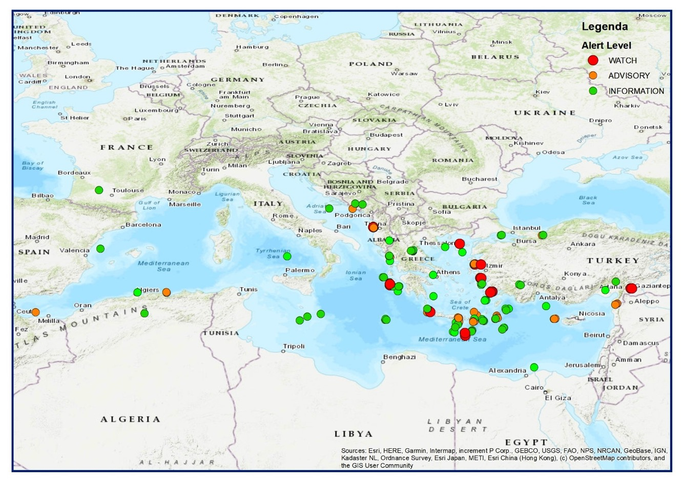
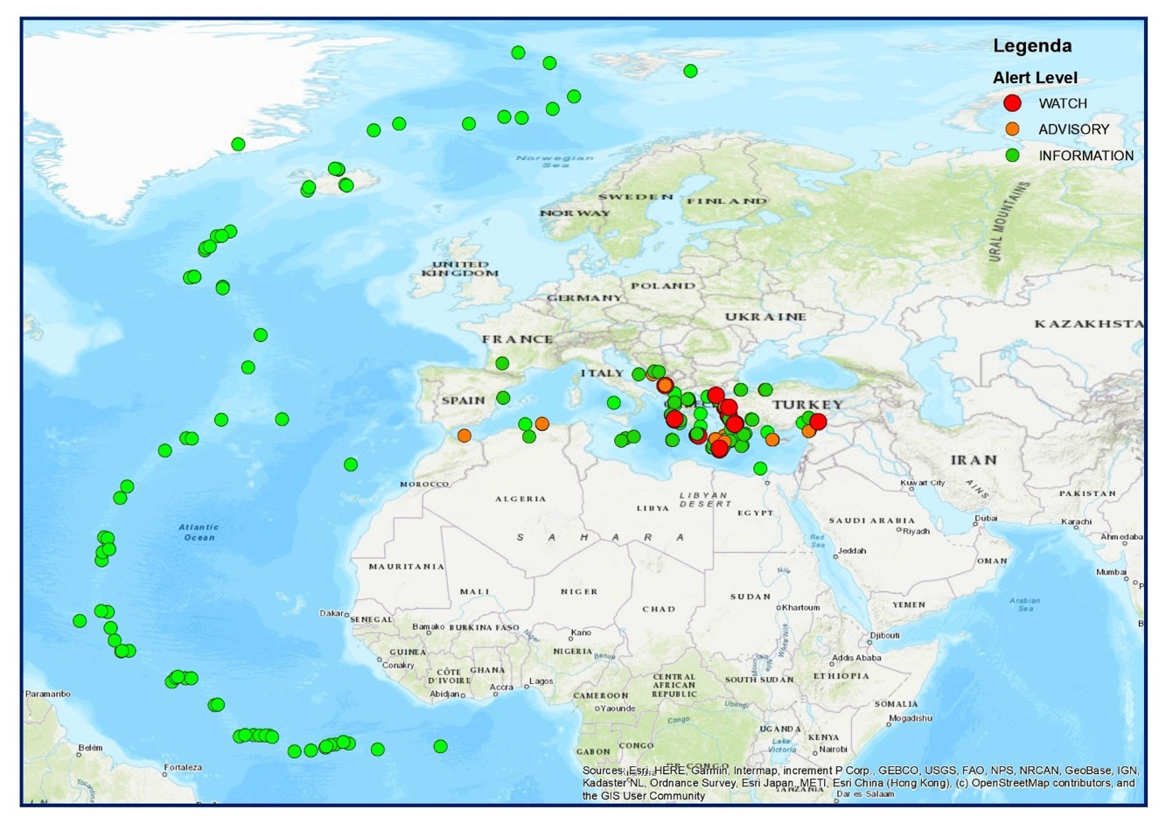
Events in the NEAM region in 2017-2024
5 TSPs (France, Greece, Italy, Portugal, Turkey)
210 Events (activations)
Mag 5.5 to 7.8 (5’-10’)
Mostly Information level
About 20 local WATCH* and ADVISORY (some of which confirmed)
1 basin-wide WATCH* event (Mediterranean) in 2023 (February 6)
2023-2024:
11 events M 5.5 to 7.9
  4 NE Atlantic
  7 Mediterranean
Mostly information level
  Feb. 6 – M 7.9 - Watch
  Feb 20 - M 6.3 - Advisory

Slide 6

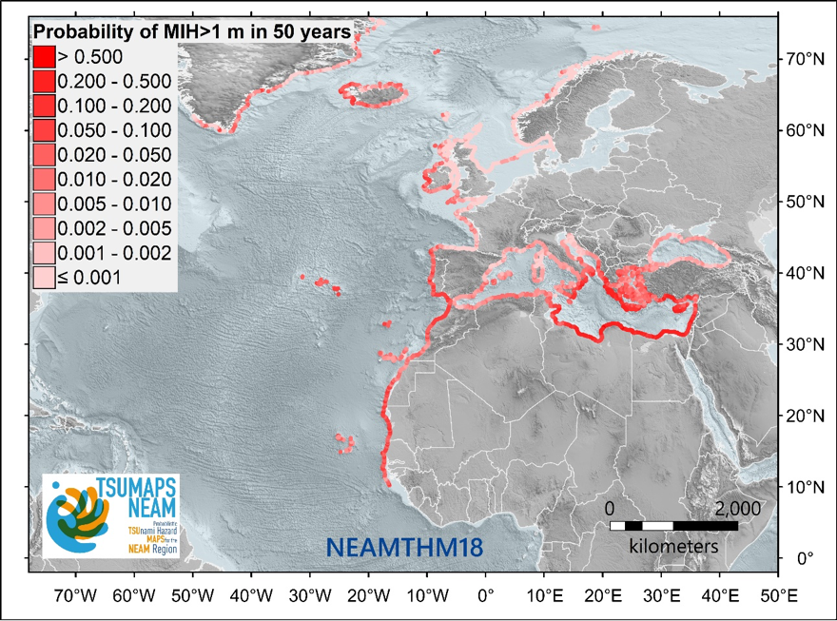
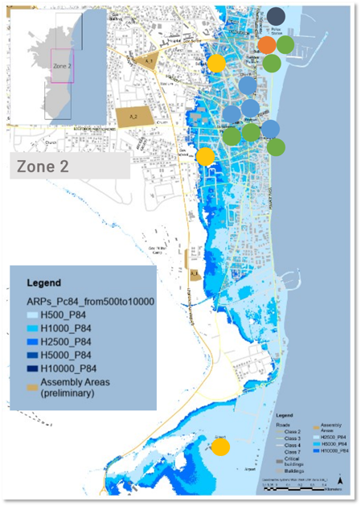
S-PTHA assessment at various scales (global to local)
In some countries (e.g. Italy) the TSUMAPS-NEAM S-PTHA were used to define the inundation zones.
Other approaches at regional / local scale are being adopted (e.g. France, Larnaca/Cyprus)

Slide 7
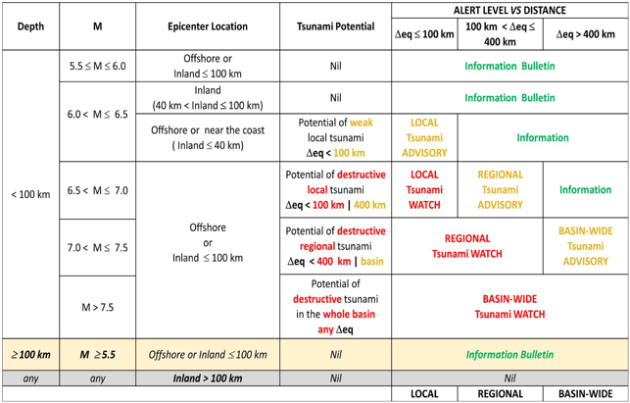
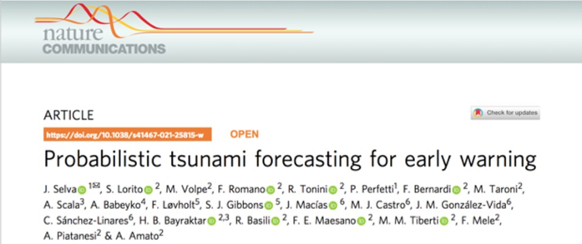
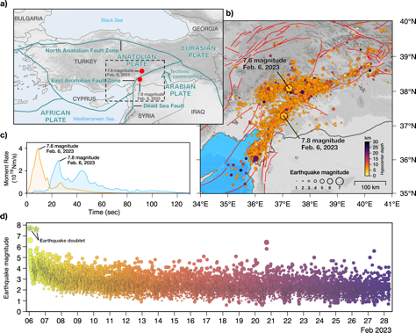
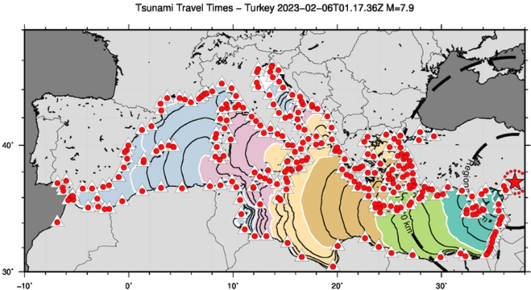
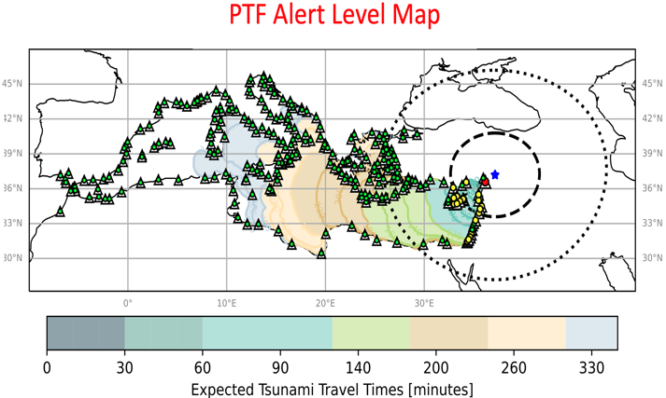
A BIG CHALLENGE: PROBABILISTIC TSUNAMI FORECAST
The 2023 February 6 Mw 7.8 earthquake was the first event to have triggered a basin-wide watch level (max) for the Mediterranean Sea.
Decision Matrix
In response to the tsunami warning, trains were stopped in different locations in Southern Italy for several hours, and evacuation of some coastal areas was enforced.
However, only a relatively small tsunami was recorded by Turkish close-by tide-gauges in the Eastern Mediterranean, with a maximum recorded amplitude of less than 50 cm.

Slide 8
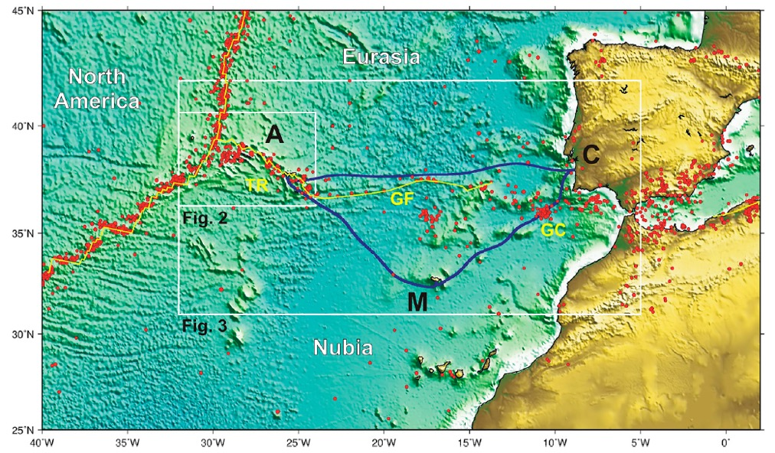
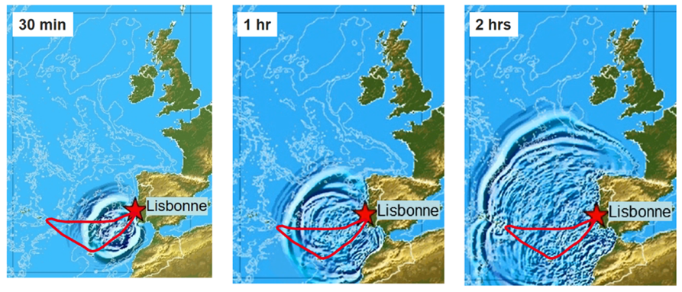
ONGOING ACTIVITIES: SMART CABLES IN THE ATLANTIC
New Submarine Cable Ring connecting Portugal Mainland-Azores-Madeira
Opportunity for a SMART system (SMART CAM) supported by Portugal
Operational in 2025-2026
Timeline of 1755-like tsunami propagation in NE Atlantic
(courtesy of IPMA, Portugal)

Slide 9
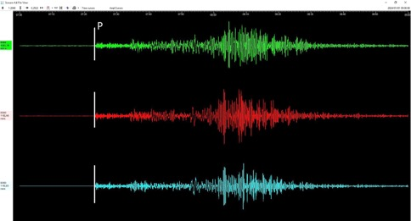
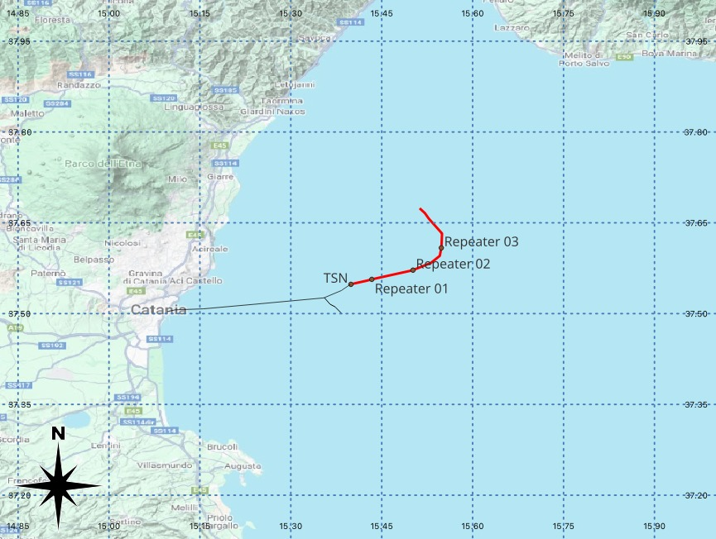
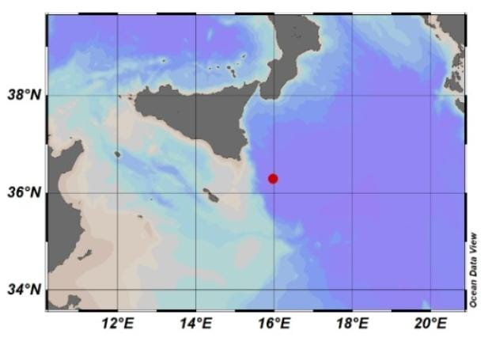
WESTERN IONIAN SEA INFRASTRUCTURE
Deployed December 2023
WEST COAST, EASTERN HONSHU, JAPAN
01/01/2024 07:10 M_{wpd} 7.4
Sicily
Calabria
Mt. Etna
INFN Km3NeT Observatory @ 3,500 m depth
Trillium 120s + hydrophone + P-T sensor (RBR)
Cabled with fiber optic to land (100km)
Courtesy of G. Marinaro (INGV)

Slide 10
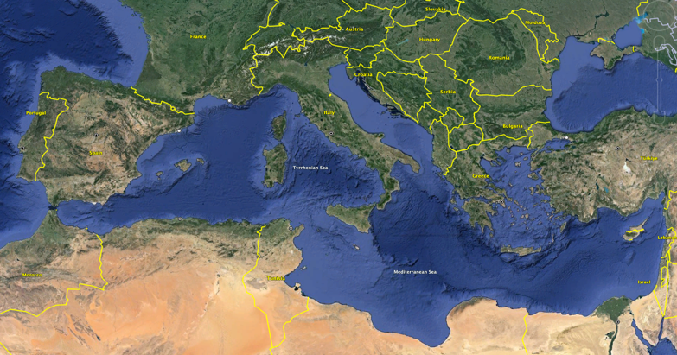
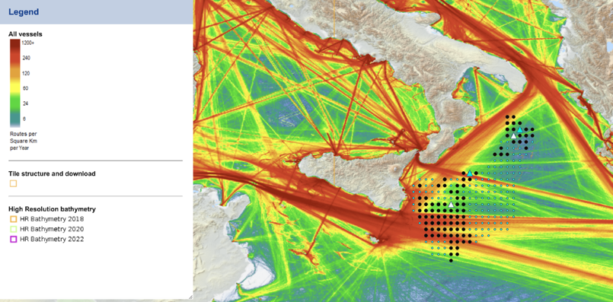
ONGOING ACTIVITIES: TSUNAMI BUOYS
2 tsunami buoys will be installed in the Ionian sea in Summer 2025
Location and technical requirements decided based on possible tsunami sources and ship traffic
Funding (~2.8 M€) by the Italian Ministery of Research through the European contribution Next Generation EU - NRRP (National Recovery and Resilience Plan) “MEET”, coord. by INGV

Slide 11
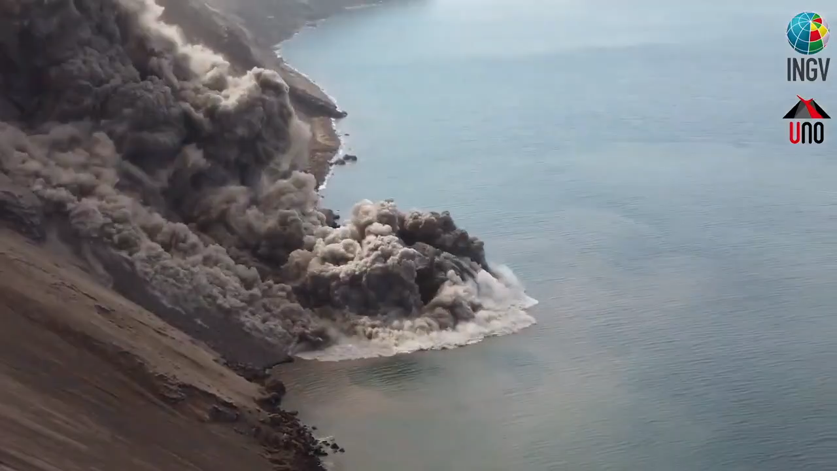
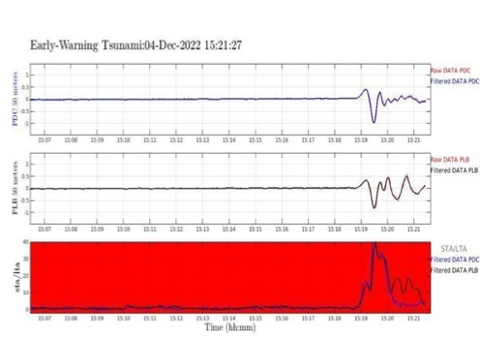
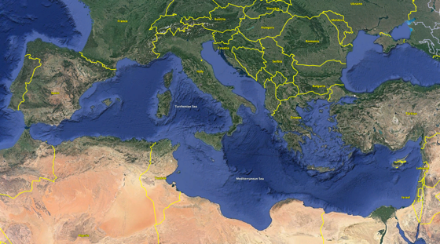
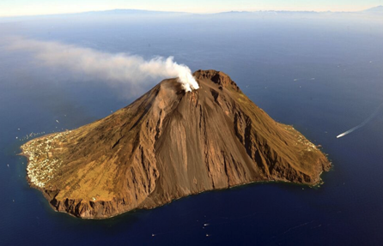
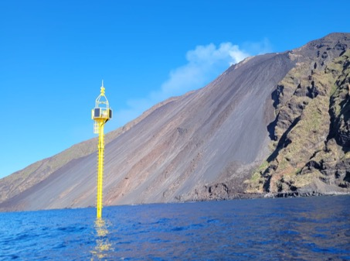
ONGOING ACTIVITIES: NON-SEISMIC TSUNAMI SOURCES
The ICG/NEAMTWS at the February 2024 session DECIDED to establish a new
Task Team on Non-Seismic Tsunami
Among other issues, this TT will be important to foster the integration of TWS specifically conceived for non-seismic tsunami with those already operating for seismic tsunami
TEWS for Stromboli volcano, Italy
1.5m tsunami of Dec. 4, 2022

Slide 12
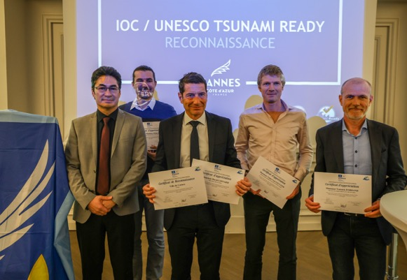
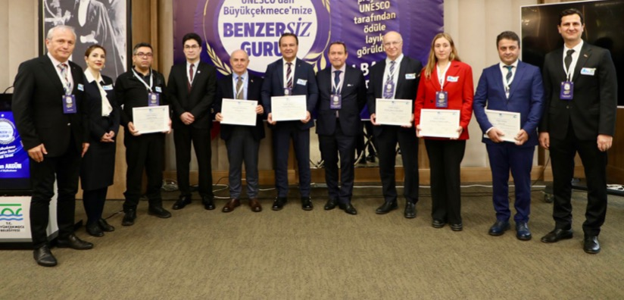
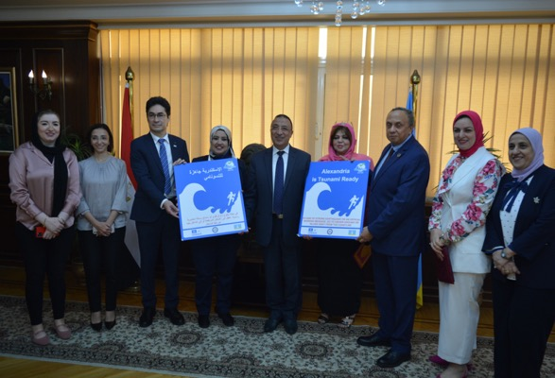
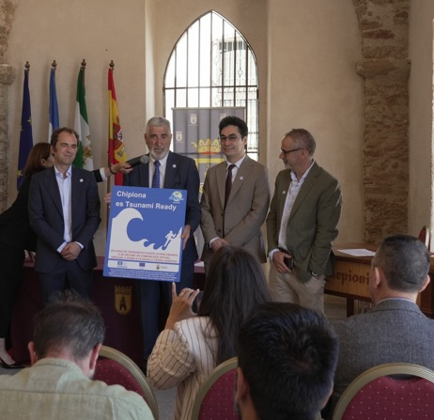
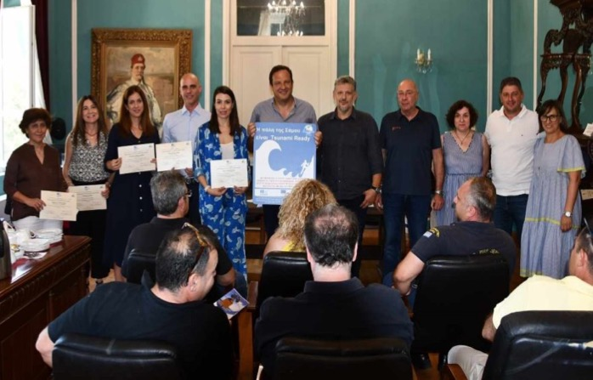
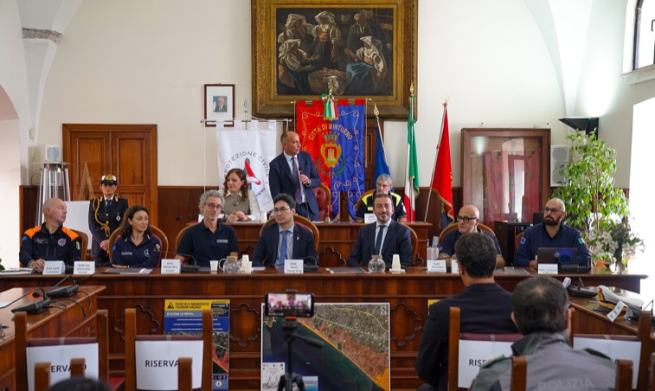
Tsunami Ready in NEAM region: first 6 communities in 2024
Cannes, France
Büyükçekmece, Itanbul, Turkeye
Alexandria, Egypt
Chipiona, Spain
Samos, Greece
Minturno, Italy

Slide 13

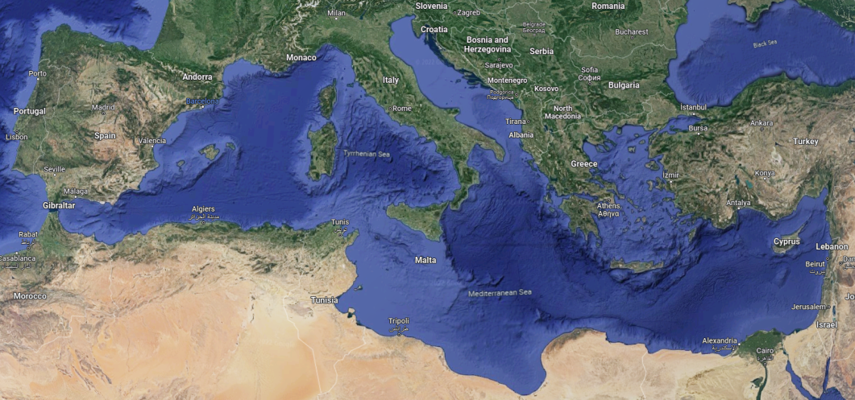
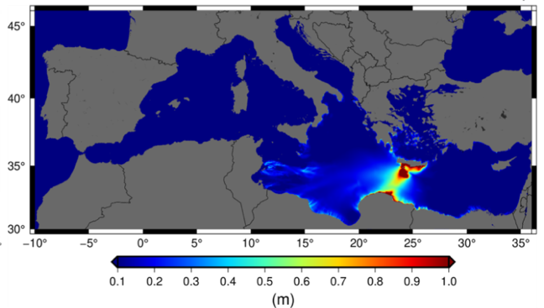
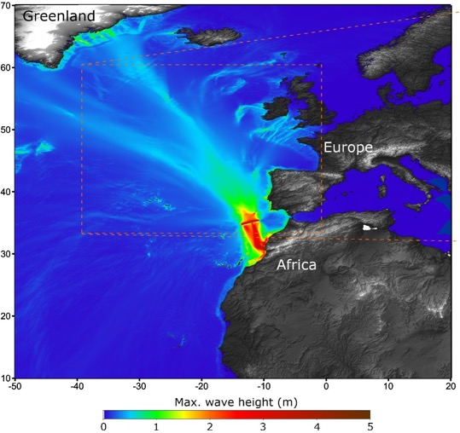
NEAMWave23 scenarios, Nov. 6-7, 2023
North Eastern Atlantic
Joint scenario (Mw=8.5) by IPMA & CENALT
NEAMWave25 (not close to WTAD)
Eastern Mediterranean
Joint Scenario (Mw=8.1) by INGV, NOA & KOERI

Slide 14
Current and future projects in NEAM ICG
DG-ECHO ‘CoastWAVE’ project in Cyprus, Egypt, Greece, Malta Morocco, Spain, and Türkiye on “Strengthening the Resilience of Coastal Communities in NEAM region…” (Phase 1) ended in 2024;
CoastWAVE Phase 2 approved and starting in July 2024 ”Scaling up….”;
New phase of COST Action AGITHAR - (Accelerating Global Science in Tsunami Hazard and Risk Analysis) to establish the Global Tsunami Model (GTM) organization;
Formal recognition of the TSUNAMI Thematic Core Service (TCS) within EPOS The European Plate Observing System (EPOS General Assembly in Dec. 2023);
Some other projects funded by EU contributing to the advancement of Tsunami science, including both R&D (DT-GEO) and warning-oriented (EPOS, GeoInquire)
DG-ECHO project NEAM-COMMITMENT (coord. NOA, Greece) with other MS and relevant stakeholders (2025-2027)

Slide 15
Main areas of interest were:
New offshore instruments
Stromboli local TWS vs. Regional NEAM TWS
Probabilistic Tsunami Forecast
PTHA at national and local levels
Tsunami Ready progress

Slide 16
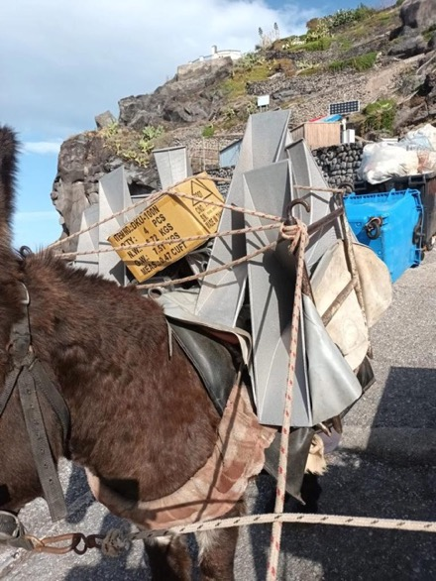
THANK YOU
The Stromboli MULE carrying new warning sirens around the volcano (Dec. 2023)

