Slide 1
Task Team on Non-Seismic Tsunami Sources (TT-NSTS)
Co-chairs: F. Romano (INGV) R. Omira (IPMA)
XIX ICG/NEAMTWS – Paris 26-29 November 2024

Slide 2
Terms of References of TT-NSTS
As reported during the XVIII ICG/NEAMTWS
The Task Team on Non-Seismic Tsunamis Sources will:
Explore potential approaches to assess hazard, monitor, and warn for non-seismic tsunamis (e.g., volcanoes, landslides including earthquake-induced landslides, meteotsunamis).
Identify critical areas in the NEAM region which may serve as test cases to guide future risk management strategies for non-seismic tsunamis.
The Task Team will be composed of:
All TSP Representatives;
NTWC Representatives;
Co-Chairpersons of existing NEAMTWS Task Teams and Working Groups.
Co-chairs to be elected by the ICG.

Slide 3
2024 Plan of Activity of TT-NSTS
Strategic Area | Activity | Time Frame | Responsible Per/ Inst | Status
Task Team on Non-Seismic Tsunami Sources | To gather information about potential approaches to assess hazard, monitor, and warn for tsunamis induced by volcanic activity and meteotsunamis | April-November 2024 | TT-NSTS co-chairs | In progress
 | To select a critical area in the NEAM region serving for exploring warning procedures related with non-seismic tsunami sources | by September 2024 | TT-NSTS co-chairs, TSPs | In progress
 | To contribute to organizing a workshop on volcanic tsunami sources | by November 2024 | TT-NSTS co-chairs, TSPs | Done
Meetings:
SC of 13/05/2024: presentation of the ToR
2nd Global Tsunami Symposium (Banda Aceh, 11-14November 2024): presentation of the Stromboli framework

Slide 4
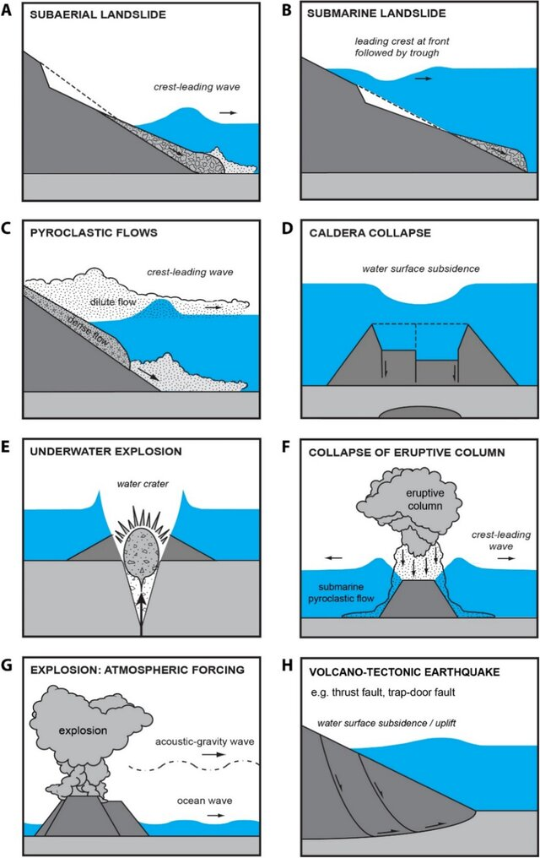
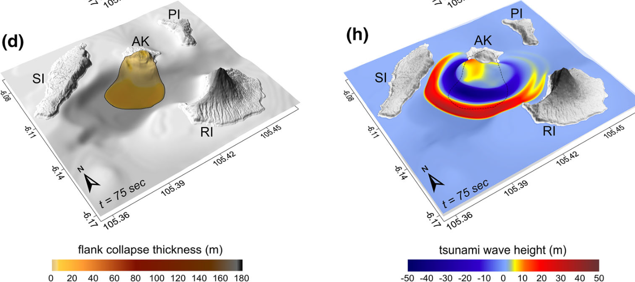
2024 Plan of Activity of TT-NSTS
Activity 1: To gather information about potential approaches to assess hazard, monitor, and warn for tsunamis induced by volcanic activity and meteotsunamis
Volcanic Tsunamis:
Hazard posed by volcanic tsunamis
Physical processes of generation:
1. Gravitational processes: Ritter Island 1888; Montserrat 1997 and 2003; Anak Krakatau 2018; Stromboli 2019
2. Explosive processes: Krakatau 1883; Myojin-sho 1952; Karymskoye Lake 1996; Hunga Tonga-Hunga Ha’apai 2022
3. Volcano-tectonic processes: Kilauea volcano 1975
Volcanic tsunami deposits:
as indicator of hazard
Numerical models of generation and propagation:
1. Volcanic Tsunami Generation: Static models (instantaneous transfer of the source energy to the water body) Dynamic models (progressive tsunami formation through source-water coupled dynamics)
2. Volcanic Tsunami Propagation: Depth-averaged nonlinear shallow water models ; dispersive Boussinesq-type models; Full Navier Stokes models
Monitoring and forecasting volcanic tsunamis:
1. Stromboli Tsunami Early Warning System
2. Anak Krakatau Tsunami Early Warning System
3. Japan volcanic Tsunami Forecasting
Schindele et al. 2024
Omira & Ramalho 2020

Slide 5
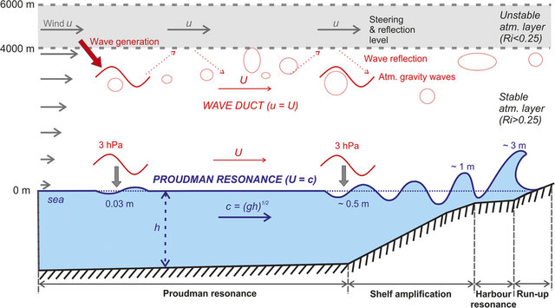
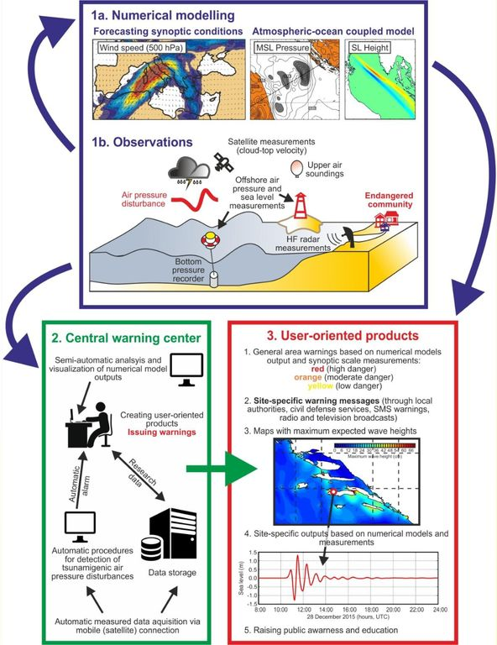
2024 Plan of Activity of TT-NSTS
Activity 1: To gather information about potential approaches to assess hazard, monitor, and warn for tsunamis induced by volcanic activity and meteotsunamis
Meteotsunamis:
Meteotsunami Hazard posed by volcanic tsunamis
Physical process of generation:
Atmospheric conditions leading to meteotsunami formation:
Atmospheric disturbances associated with hurricanes, frontal passages, squall lines, internal atmospheric waves, jumps in air-pressure.
Amplification of meteotsunami:
Proudman resonance; Greenspan Resonance; Harbour Resonance
Modeling of meteotsunami:
State-of-the-art coupled atmosphere-ocean modelling
Šepić et al. 2015
Monitoring and forecasting meteotsunamis:
Adriatic Sea Meteotsunami Early Warning System
1. Forecasting favourable synoptic conditions for meteotsunami formation;
2. Running coupled atmosphere-ocean numerical models to forecast
Meteotsunami amplification and heights;
3. Observation and measurement of tsunamigenic air-pressure disturbances;
4. User-oriented Meteotsunami threat levels:
Red (high danger), Orange (moderate danger) and Yellow (low danger).
Vilibic et al. 2015

Slide 6
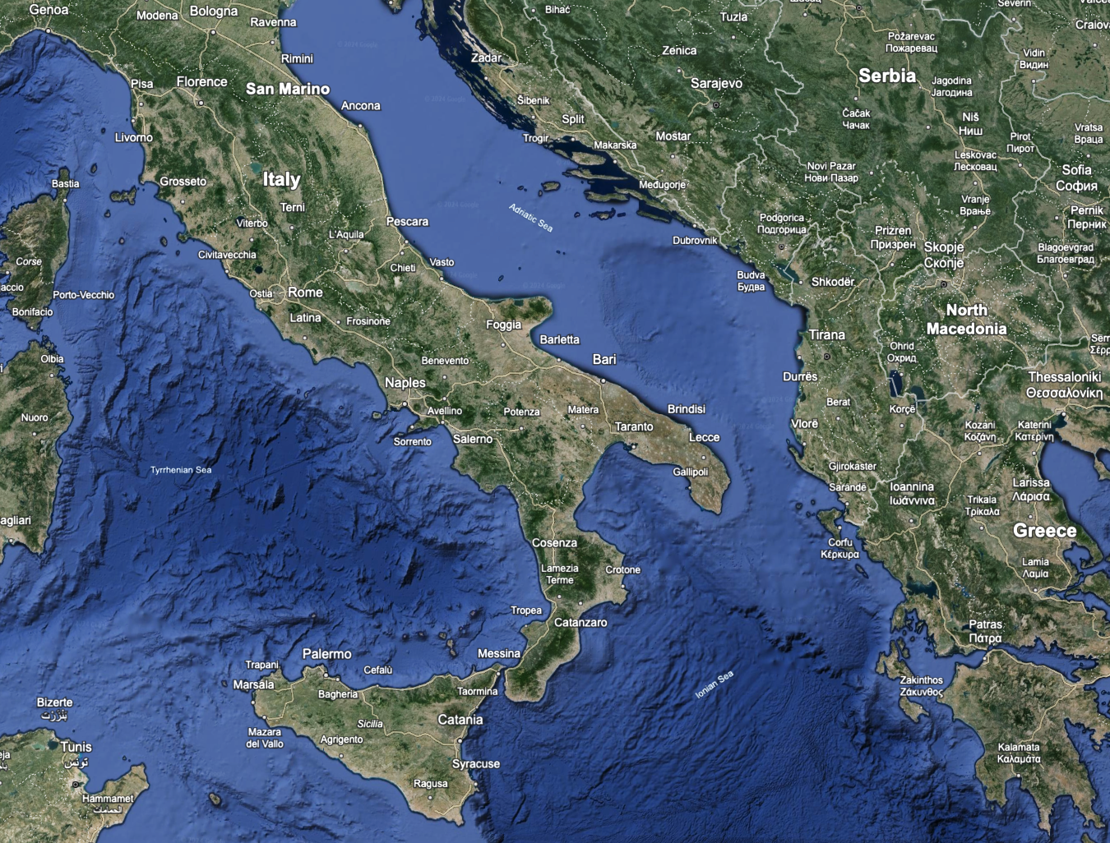
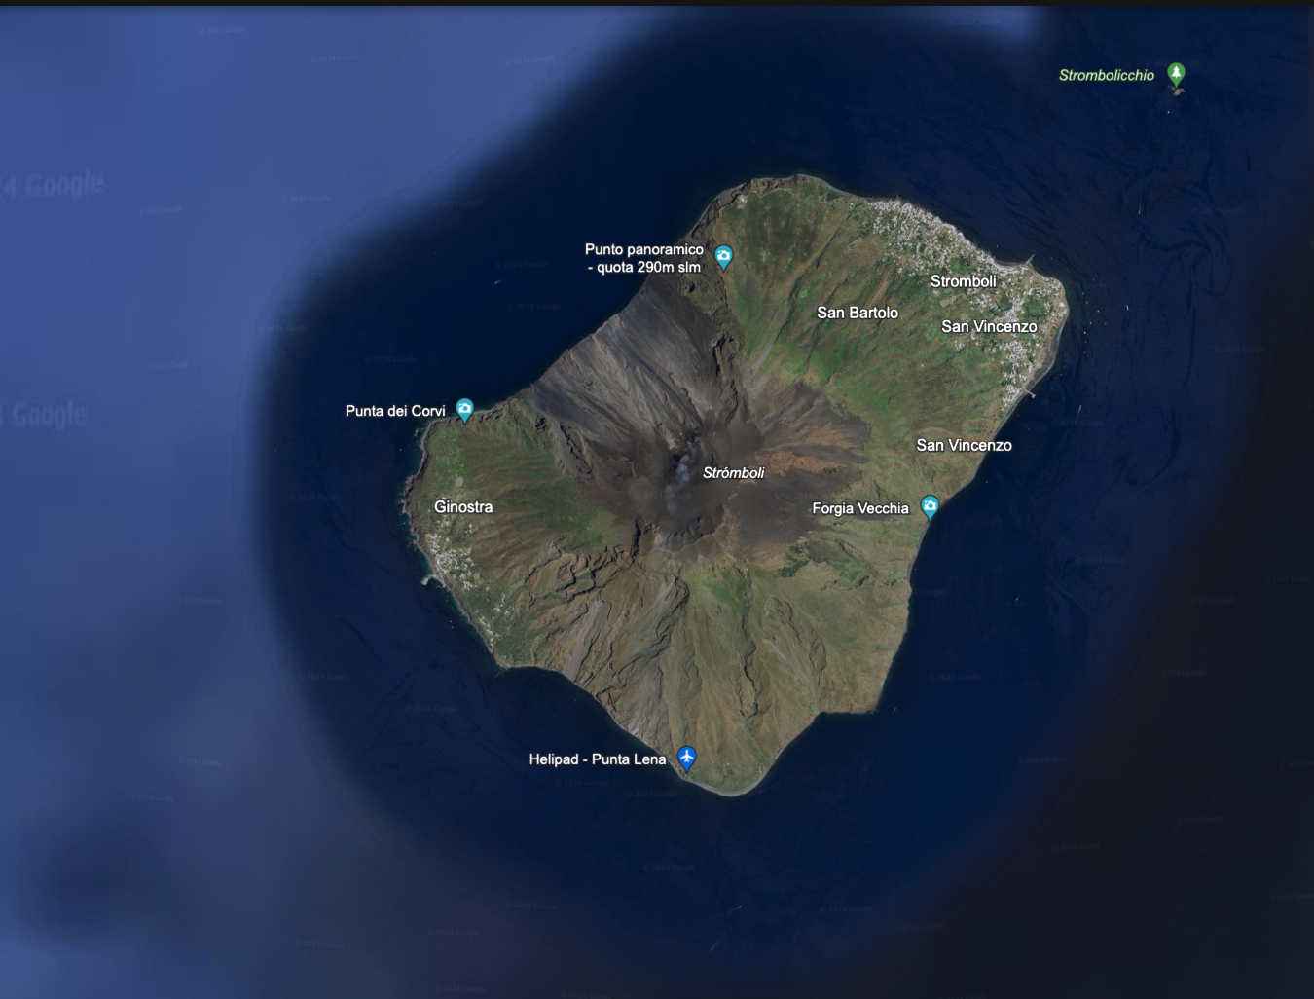
2024 Plan of Activity of TT-NSTS
Activity 2: Select a critical area in the NEAM region serving for exploring warning procedures related with non-seismic tsunami sources
Adriatic Sea (tsunami from meteotsunami events)
Stromboli (tsunami from volcanic events)
Non-seismic tsunamis are a new challenge for TEWS after some recent events (e.g. Anak Krakatau 2018, Hunga Tonga 2022)
Stromboli (volcanic activity)
&
Adriatic Sea (meteotsunami)
Are potential candidates for the NEAM region to explore warning procedures of non-seismic tsunamis

Slide 7
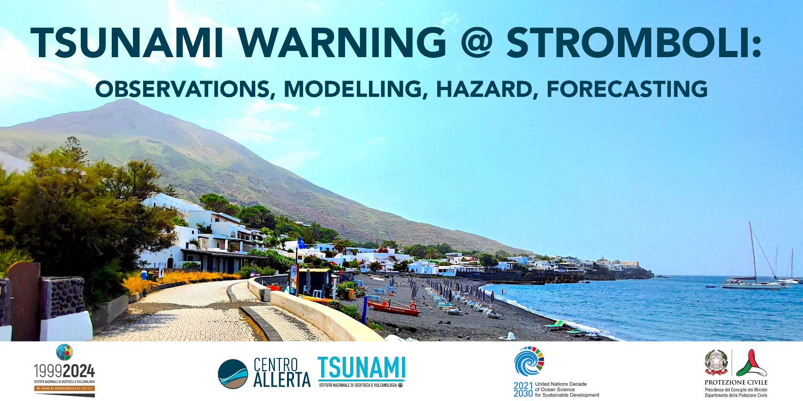
2024 Plan of Activity of TT-NSTS
Activity 3: To contribute to organizing a workshop on volcanic tsunami sources
Stromboli, 5-7 October 2024

Slide 8
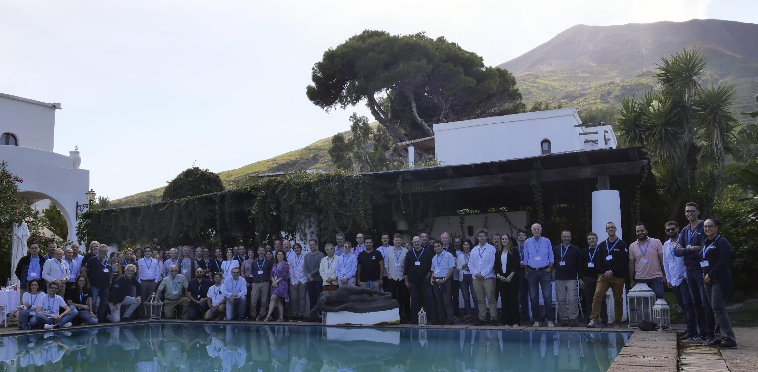
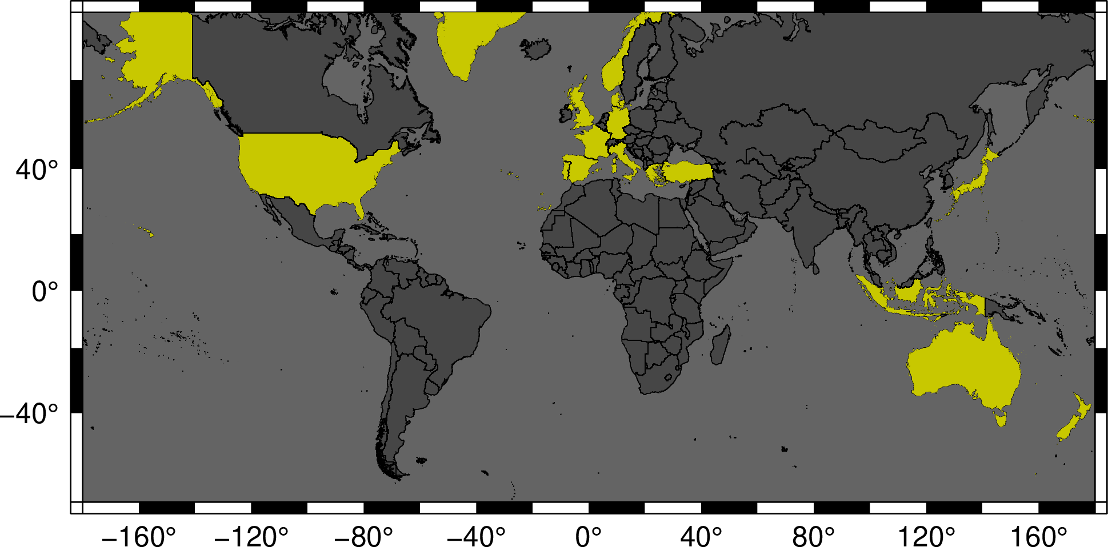
The reasons behind this workshop
Non-seismic tsunamis are a new challenge for TEWS after some recent events (e.g. Anak Krakatau, Hunga Tonga)
In Italy there are two TEWS, one for seismically induced tsunamis (CAT-INGV) and one for tsunami generated by the Stromboli’s volcanic activity that operate independently
moving towards a more comprehensive and unified approach to tsunami monitoring and tsunami risk management is necessary
Italian project promoted by Italian Civil Protection
A multi-hazard TEWS represents a challenge because it is necessary to address:
o Different types of observations with which the volcano and associated tsunami can be monitored
o Different types of numerical modelling of the generation and propagation phase of tsunamis generated by non-seismic sources
o Hazard analysis for volcanic tsunamis
o Alerting and tsunami forecasting procedures for this type of events (including the integration in the national and regional TEWS)
In this framework INGV organised an international workshop
Endorsed by the TT on Non Seismic Tsunami sources for the ICG/NEAMTWS
Endorsed by the UN Decade of Ocean Science for Sustainable Development
The workshop aimed at inviting worldwide geophysical experts to:
Review the state of the art about Observations, Modeling, Hazard, and Forecasting for tsunami generated by volcanic events
Review what Italy has in place for the Stromboli TEWS
Present their ideas for improvements based in the current knowldege
Suggest new direction research

Slide 9

The goals of the workshop
80 Experts of Universities and Research Institutes from 16 Countries
Endorsed by the TT on Non Seismic Tsunami sources for the ICG/NEAMTWS
Endorsed by the UN Decade of Ocean Science for Sustainable Development
The workshop aimed at inviting worldwide geophysical experts to:
Review the state of the art about Observations, Modeling, Hazard, and Forecasting for tsunami generated by volcanic events
Review what Italy has in place for the Stromboli TEWS
Present their ideas for improvements based on the current knowledge
Suggest new direction research

Slide 10
Some take-home messages from the Workshop
•The lead time for evacuation is small à precursory signals allow to save time but…
••…Paroxysms have a heterogenous character and in Stromboli are not always followed by tsunami as well as tsunami in Stromboli are not always preceded by paroxysms → we need to evaluate and balance the number of possible false/missed pre-alarms (that also affect the trust of population)
•The current tsunami warning in Stromboli is ALERT/NO ALERT → we need a gradation of the alert, at least for the locations in the mid- far-field
•Integration of different kinds of instrumental networks is crucial → warning based on multi-data approaches, data inversion and ML
•Continuous monitoring of topography and bathymetry is crucial → monitoring the volcano instability
•It is crucial to have standard tsunami alert bulletins for this kind of events and Standard Operation Procedures to integrate the local TEWS in Stromboli and the NEAMTWS TSP
The first step towards the creation of a research/knowledge network about Non-Seismic Tsunami Sources

Slide 11
TT-NSTS Membership
The Task Team will be composed of:
All TSP Representatives;
NTWC Representatives;
Co-Chairpersons of existing NEAMTWS Task Teams and Working Groups.
Is there a formal procedure to do that?
Some people from other Task Teams (e.g. TT on volcanic tsunamis for the PTWS) manifested an interest to be involved

Slide 12
TT-NSTS Provisional Plan of Actvity for 2025
The Task Team:
will continue to collect information about hazard and warning systems approaches/methodology
Will finalise the membership procedure
Will create a repo for collected data/information
Will organise a meeting with the TT members to discuss the collected information and decide on the selection of the potential areas in the NEAM region to explore warning procedures of non-seismic tsunamis
….

