Slide 1
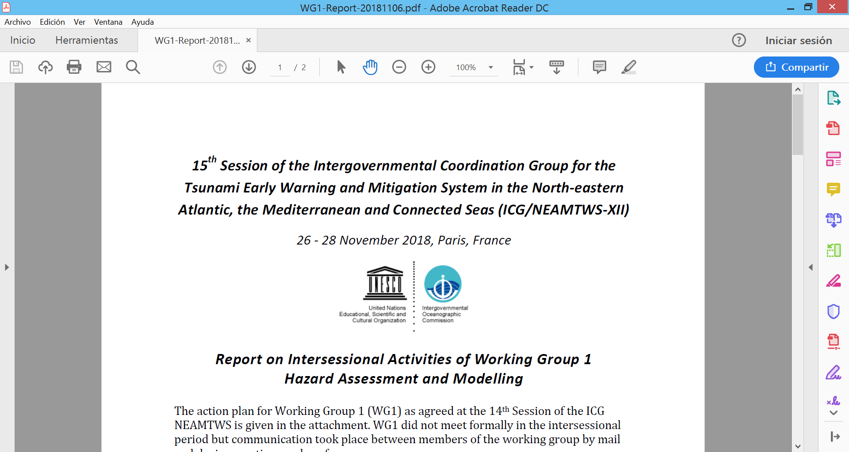
19th Session of the Intergouvenmantal Coordination Group for the Tsunami Early Warning and Mitigation System in the North-eastern Atalntic, the Medietrranean and Connected Seas (ICG/NEAMTWS-XVIII)
Paris, France 27-29 november 2024
Working Group 1 – Hazard assessment and modelling
Jorge Macías – Universidad de Málaga, Spain
Audrey Gailler – CEA, France
2024 Actions
WG1 members did not meet formally during the intersessional period but communication took place between members of the WG1 and other groups during meeting and conferences (need of an update list of members and a mailing list).
Some meetings (since previous ICG/NEAMTWS, 6-8 Feb 2024):
EPOS TCS Tsunamis – 1st Consortium Board Meeting – Potsdam (15-16 Feb)
ChEESE Review – Luxemburg (23 Feb)
CIG AGITHAR – Lisbon (18-19 March)
EGU 2024 – Viena (15-19 April)
KoM PCTWIN – Hyderabad, India (28-30 May)
Particiation in EPOS National Tsunami TCS
ChEESE General Assembly – Iceland (16-18 Sept)
ICG AGITHAR Final Meeting – Rome (27-27 Sept)
Workshop Stromboli (INGV) – Stromboli (4-8 Oct)
EPOS-EU TCS Tsunamis Ex Board and Consortium B.M. – Potsdam (6-8 Nov)
Geo-INQUIRE Annual Meeting – Warsaw (13-15 Nov)

Slide 2
(ICG/NEAMTWS-XVIV) – 27-29 November 2024 - WG1
Report on the Intersessional Activites of Working Group 1
Hazard Assessment and Modelling
2024 Actions
Items discussed during different project meetings (OUG drafting, CostWave II, conferences and other meetings):
OUG update (2/2):
Meeting in June (Athens and on-line) and October (Rome)
Take part in writing the “tsunami forecasting” chapter
NEAM basins, notion of competence zones and presentation of NEAM competence zones, Focal Points
ETA forecasting (TTT ETA forecasting, modeling-based ETA forecasting)
Tsunami height forecasting (Decision Matrices, Simulation-based forecasting, Uncertainty propagation and probabilistic forecasting)
Alert Levels determination (DM Reprise, From Probability to Alert levels)
Sharing of the draft report on basins definition (wrote within WG1 by IH-Cantabria in 2018) with TT-OP & TT-DOC co-chairs

Slide 3
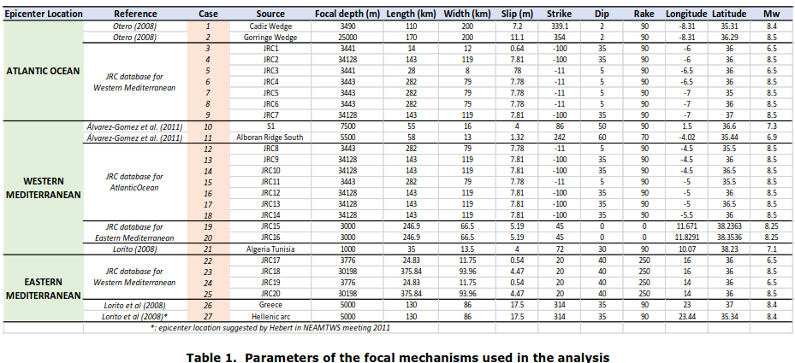
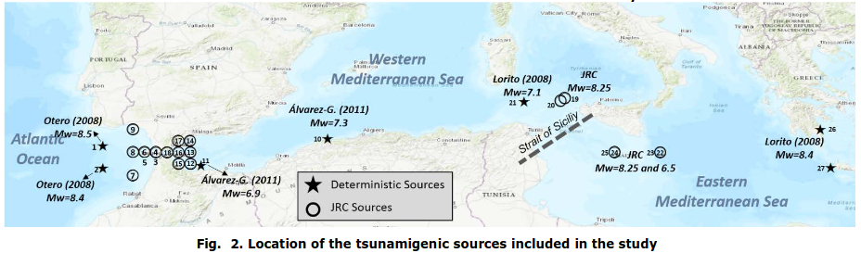
(ICG/NEAMTWS-XVIV) – 27-29 November 2024 - WG1
Report on the Intersessional Activites of Working Group 1
Hazard Assessment and Modelling

Slide 4
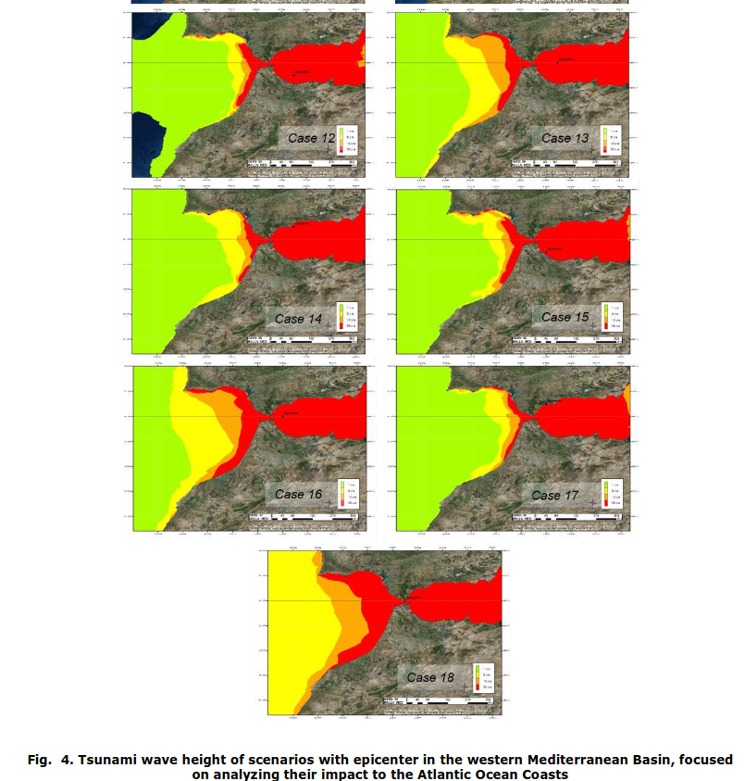
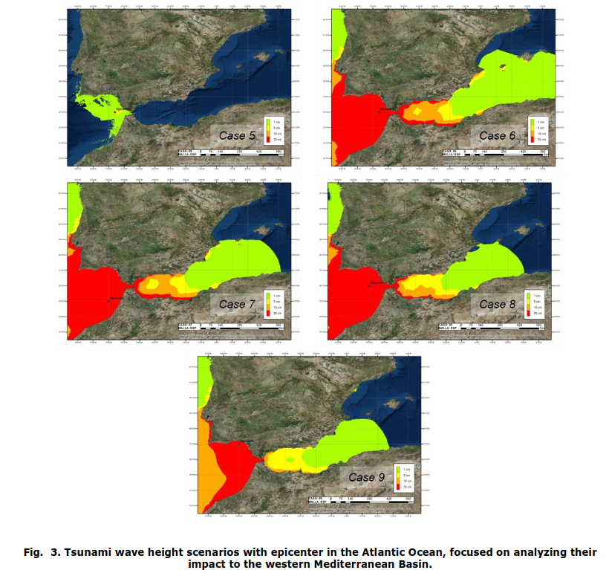
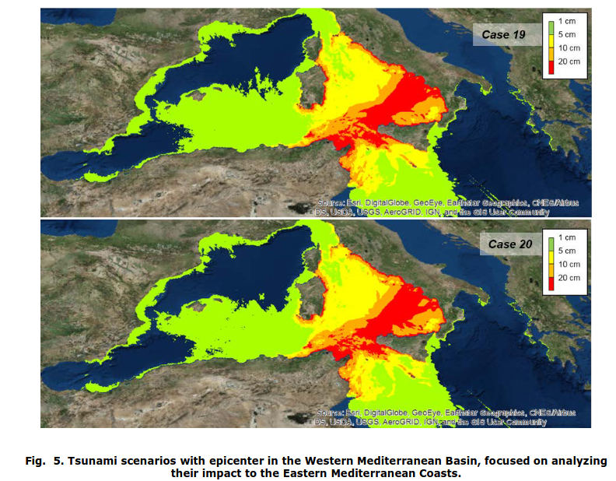
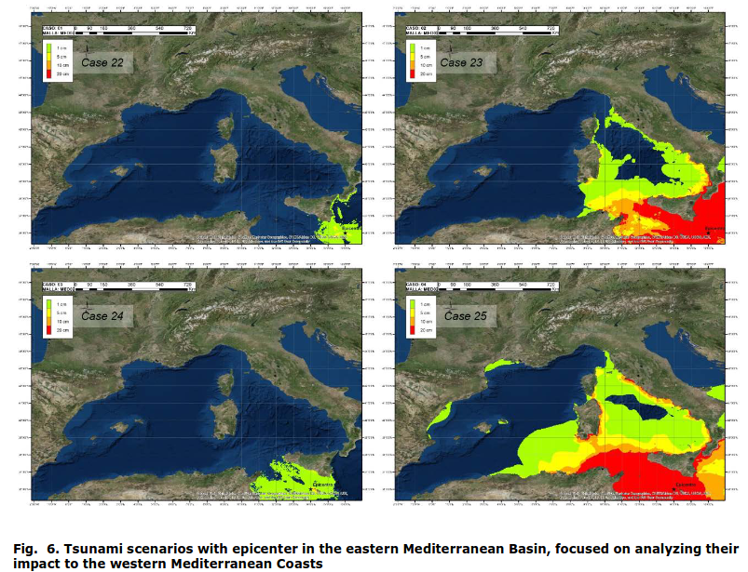
(ICG/NEAMTWS-XVIV) – 27-29 November 2024 - WG1

Slide 5
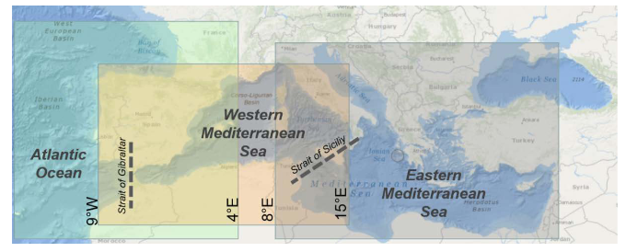
(ICG/NEAMTWS-XVIV) – 27-29 November 2024 - WG1
Items discussed during different project meetings (OUG drafting, CoastWave II, conferences and other meetings):
OUG update (2/2):
DM harmonization
DMs from all TSPs sent to WG1
On-line meeting with IPMA on 21/11/2024 regarding Atlantic DM haromization
CENALT DM too simple => needs to add the local level (<= 100km from the source), to be consistent with Portugal TSP, especially regarding Mw <= 7.0
IPMA is thinking of adding a DM accounting for Alboran Sea
Should DMs rely on TTT than distance from the epicenter to be more “accurate”?
Take part in the PSC of Coastwave II project
Risk indicators/maps could be derived from modeling and given map standards but societal components cannot be covered by WG1 (deterministic vs probabilistic)
Include risk in general way, need to start from application guidelines from PTHA maps

Slide 6
(ICG/NEAMTWS-XVIII) – 27-29 November 2024
Report on the Intersessional Activites of Working Group 1
Hazard Assessment and Modelling
WG1 Interaction with ongoing projects
DT-GEO - Improved hydrodynamics integration into PTF workflow
Geo-INQUIRE - VA SDL (Simulation Data Lake)
- VA Ch-HySEA (and others BingClaw/AmpFact/Gauss/Slip)
- TA Ch-HySEA / TA Ch-PTHA
ChEESE-2P
- Code improvements (dispersion) / New codes (Meteo-HySEA)
- Global Tsunami Hazard Map
- Complex multi-source tsunami modeling
PCTWIN (UK-India)
New projects
GANANA (EU-India) – TEWS / PTHA / European flagship codes
NEAM-COMMITMENT (UCPM-2024-KAPP - Knowledge for Action in Prevention and Preparedness)
COST Action THREAT (Tsunami Hazard and Risk Education through Accessible Training)

Slide 7
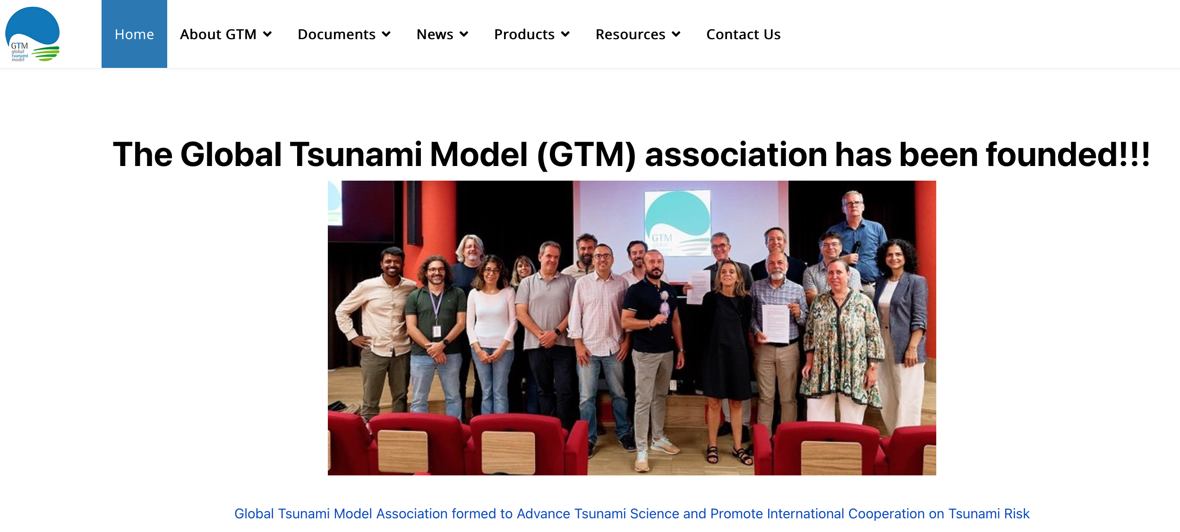
(ICG/NEAMTWS-XVIII) – 27-29 November 2024
Report on the Intersessional Activites of Working Group 1
Hazard Assessment and Modelling
GTM webpage and activities
Rome, Italy. September 26, 2024.

Slide 8
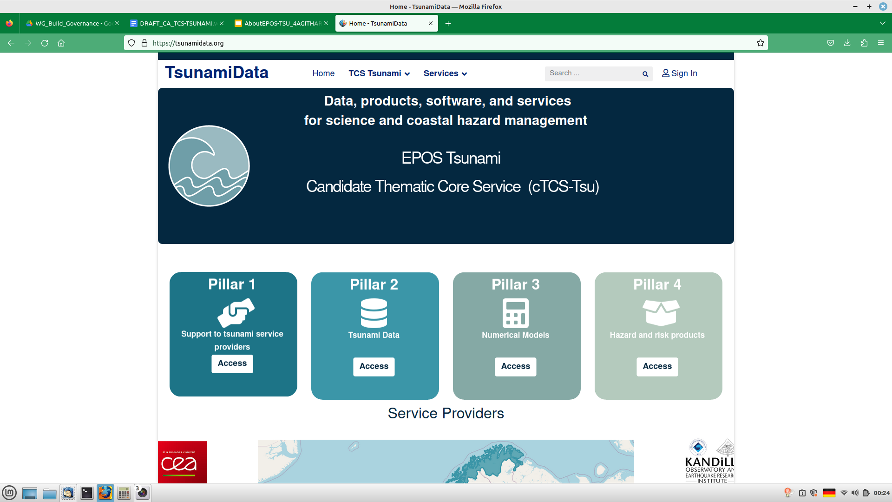
Community website https://tsunamidata.org
User_5 : docosane$reinculcate

Slide 9
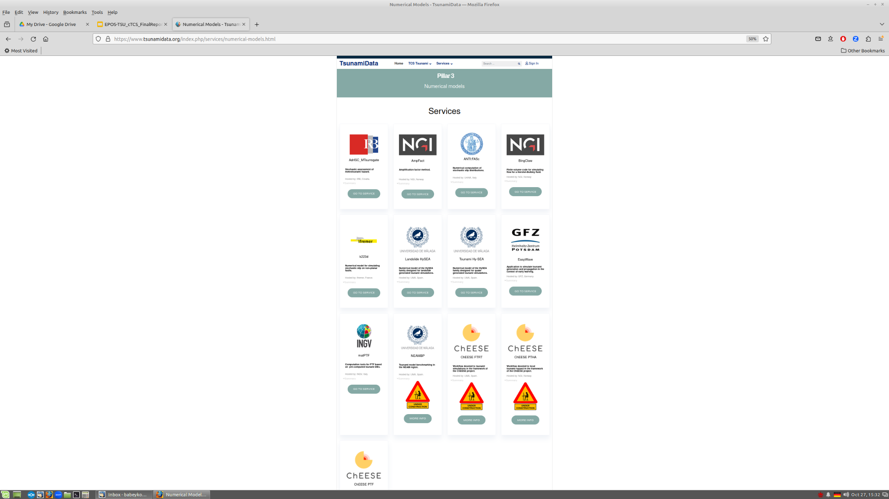
Community website: Pillar 3 Numerical Models
https://tsunamidata.org

Slide 10
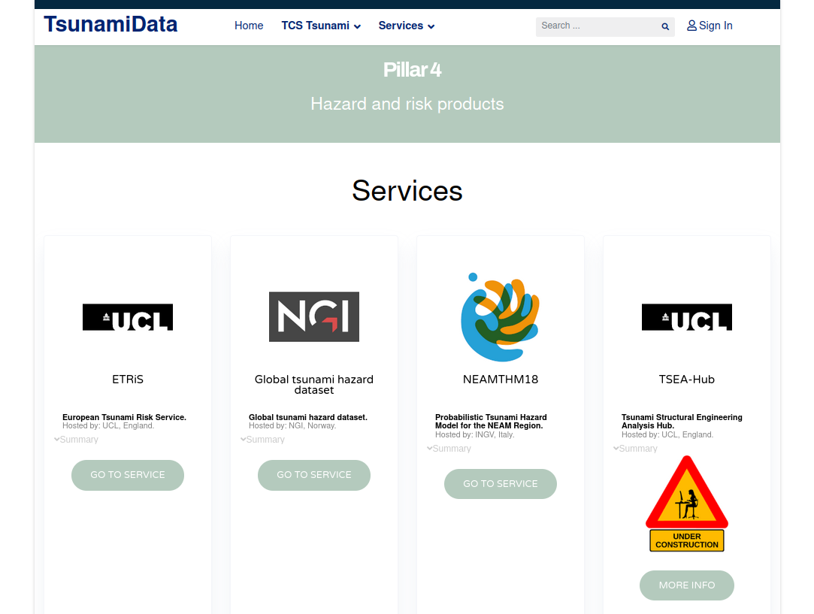
Community website: Pillar 4 Hazard and Risk products
https://tsunamidata.org

Slide 11
Plan of Actions (PoA WG1) 2025
1. Participate in OUG update
2. Elaborate a draft ToR of WG1, including Risk assessment.
3. Discuss methodologies and procedures for hazard assessment (deterministic vs probabilistic) for different applications: preparation, mitigation, evacuation (Tsunami Ready).
4. Contact WG4 to collaborate on a guideline on risk application (preparation, mitigation, evacuation) to be decided---
5. Collect more benchmark data for NEAMTWS. Spain, France, Italy, Greece, Portugal, Turkey, …

Slide 12
Plan of actions (WG1) 2025
Contribution in guidelines or standards for Tsunami Ready maps (hazard and evacuation) interaction with TT TR, WG4, and CoastWave II Project in regards with:
input required data
numerical tools
map approximation (deterministic, probabilistic)
standards for map construction (colors, minimal information to be included in maps,…etc)
discussion to initiate first with WG4; then internally in WG1
CoastWave II EU Project interaction: guidelines evacuation maps for Tsunami Ready (probabilistic and deterministic approximation)
Participation in COST Action AGITHAR CIG meetings and tasks
Having meetings (e.g. EGU, EPOS,…)
Nomination of a new co-chair for WG1

Slide 13
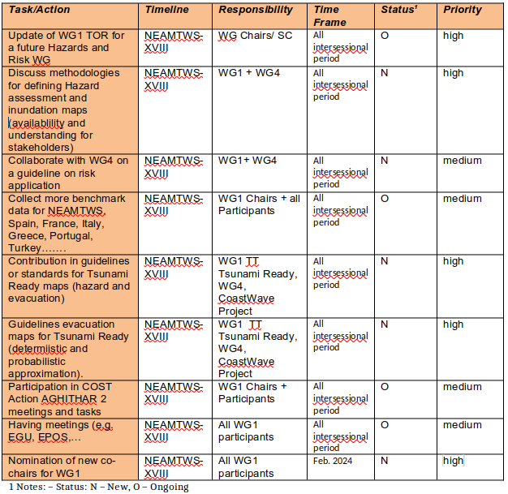
Plan of Action WG1 (agreed at ICG/NEAMTWS-XVIII)
Fev. 2024- Dec. 2024

