Slide 1
UNESCO-IOC ICG/NEAMTWS Working Group 2&3: Seismic, Geophysical and Sea Level measurements Co-chairs Anna von Gyldenfeldt (BSH) Musavver Didem Cambaz (KOERI) ICG/NEAMTWS XIII Session 27-29 February 2024 Paris, France

Slide 2
WORKING GROUP II/III : Seismic, Geophysical & Sea Level Measurements:
PLAN OF ACTION for 2024
CO-CHAIRS :
Anna von Gyldenfeldt (Federal Maritime and Hydrographic Agency / Germany),
Musavver Didem Cambaz (Kandilli Observatory and Earthquake Research Institute / Türkiye)
Strategic Area | Activity | Target / Result Indicators | Time Frame | Responsible Per/ Inst
Working Group 2+3: Seismic, Geophysical and Sea Level Measurements Anna von Gyldenfeldt (BSH, Germany) & Musavver Didem Cambaz (KOERI, Türkiye) | Transition from WG2/3 to Pillar 2of the Strategy Document Detection Warning and Dissemination | Decisions and recommendations | 2024 | WG2+3 / IOC Secretariat / Ta4sk Team on Operations / WG1
 | b) Identify reference contacts for Seismic, Geophysical & Sea Level networks, to be included in the sensor data-bases, in order to facilitate bilateral agreements. | IOC Circular Letter | 2024 | WG2+3 / IOC Secretariat
 | c) To compile an information catalogue about the contacts for sea level and seismic data, their availability and restrictions. | Decisions and recommendations | 2024 | WG2+3 / IOC Secretariat
 | d) Promotion of possible cooperation(s) with EuroGOOS Task Teams, like the one on HF radars for possible tsunami detection. | Report to ICG | ongoing | WG2+3 / EuroGOOS
 | e) Monitor the installation of SMART cable, ocean bottom instruments and other systems in the NEAM region. | Report to ICG | ongoing | WG2+3
 | f) Provide information on the (Tsunami Community) initiatives and projects regarding instrumentation and data availability. | Report to ICG | ongoing | WG2+3
 | g) Participation of WG2+3 co-chairs in meetings and the Steering Committee to report progress to the ICG/NEAMTWS. | 1 Co-Chairs meetings 2. Participation in SC 2024 3. Progress report to ICG/NEAMTWS | 2024 | WG2+3
 | h) Organize regular bimonthly virtual meetings with members relevant to Pillar 2 of the Strategy document. | Report to ICG | 2024 | WG2+3
WG2&WG3 – Seismic, Geophysical & Sea Level Measurements IOC-UNESCO ICG/NEAMTWS, 27-29 November 2024, Paris, France

Slide 3
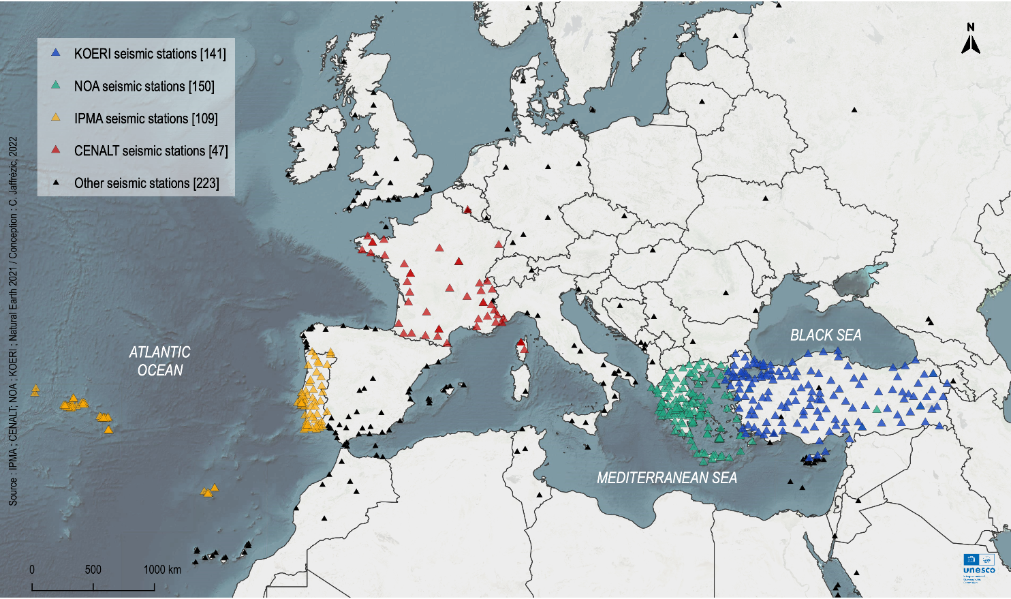
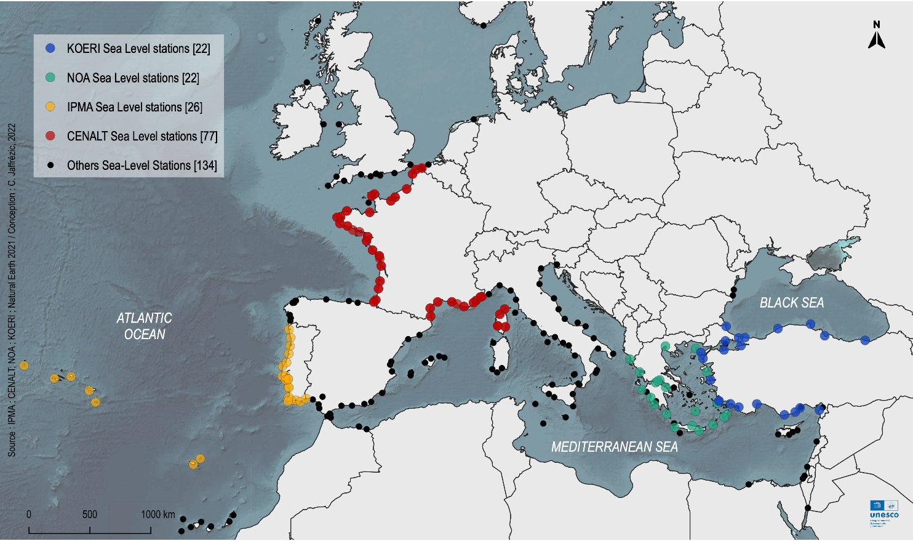
Seismic and Sea Level Data Base in NEAM REGION (2022)
Seismic Stations
Sea-Level Stations
by Claire Jaffrézic (UNESC0-IOC), March 2023
WG2&WG3 – Seismic, Geophysical & Sea Level Measurements IOC-UNESCO ICG/NEAMTWS, 27-29 November 2024, Paris, France

Slide 4
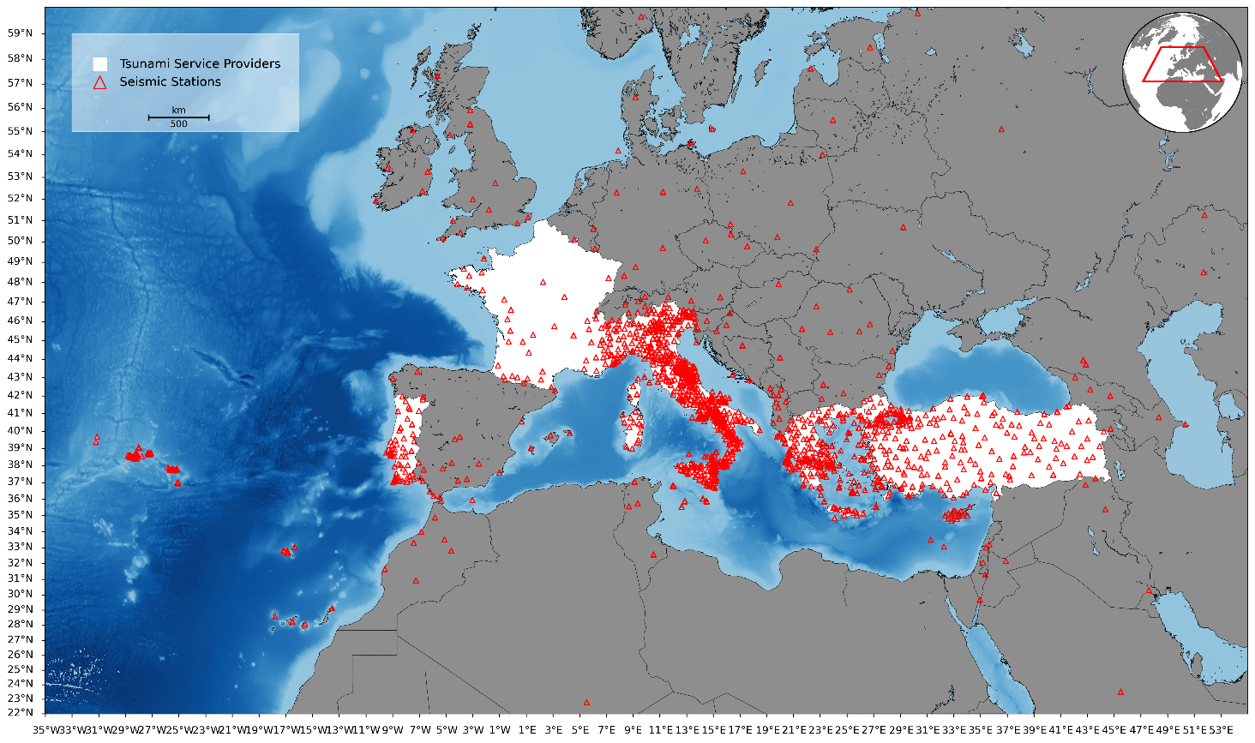
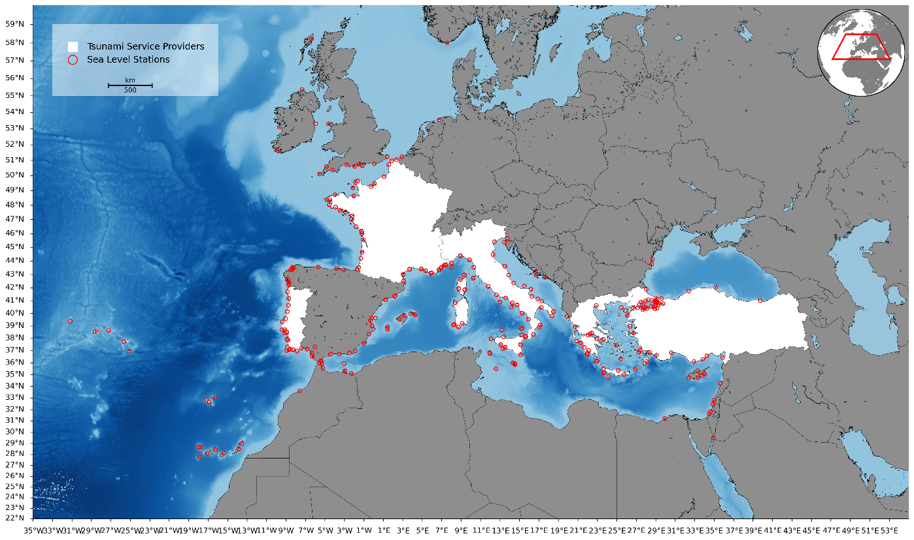
Seismic and Sea Level Data Base in NEAM REGION (2024)
Seismic Stations Monitored by TSP
Sea-Level Stations Monitored by TSP
WG2&WG3 – Seismic, Geophysical & Sea Level Measurements IOC-UNESCO ICG/NEAMTWS, 27-29 November 2024, Paris, France

Slide 5
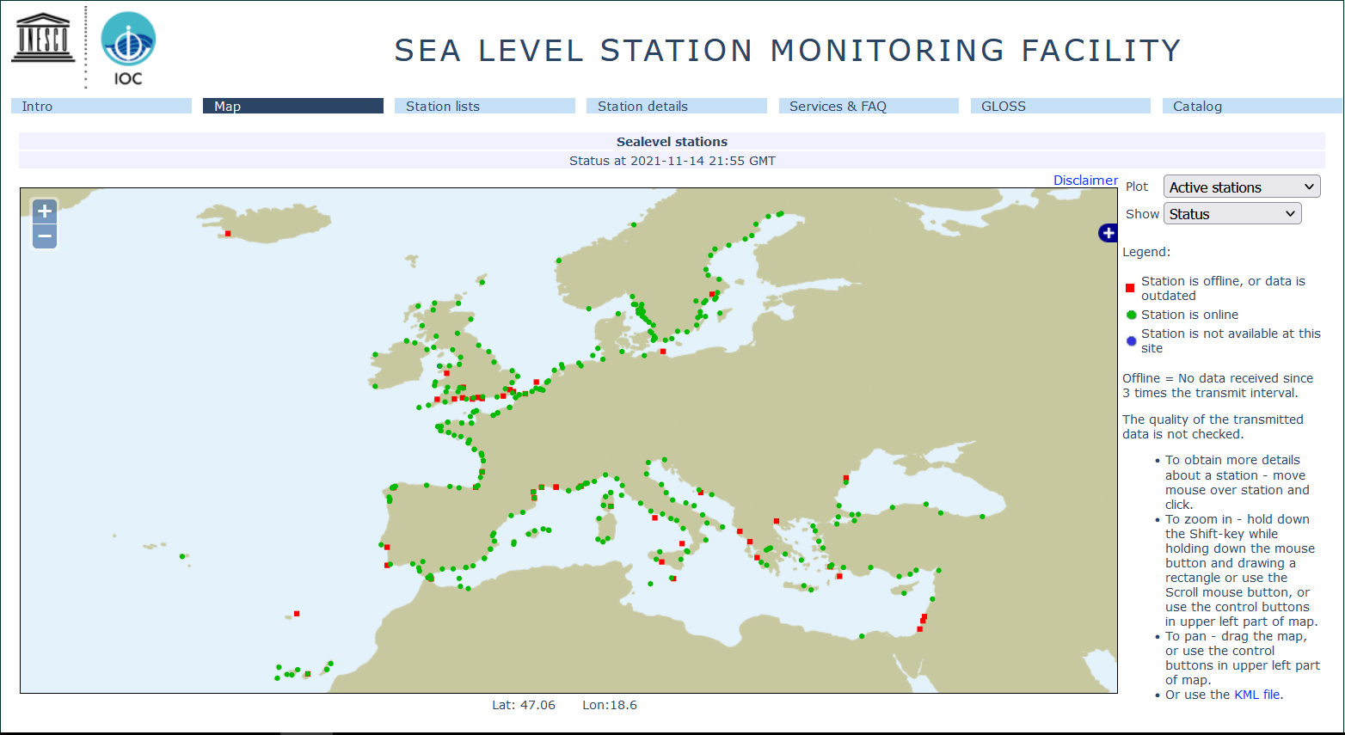
2024
2021
WG2&WG3 – Seismic, Geophysical & Sea Level Measurements IOC-UNESCO ICG/NEAMTWS, 27-29 November 2024, Paris, France

Slide 6
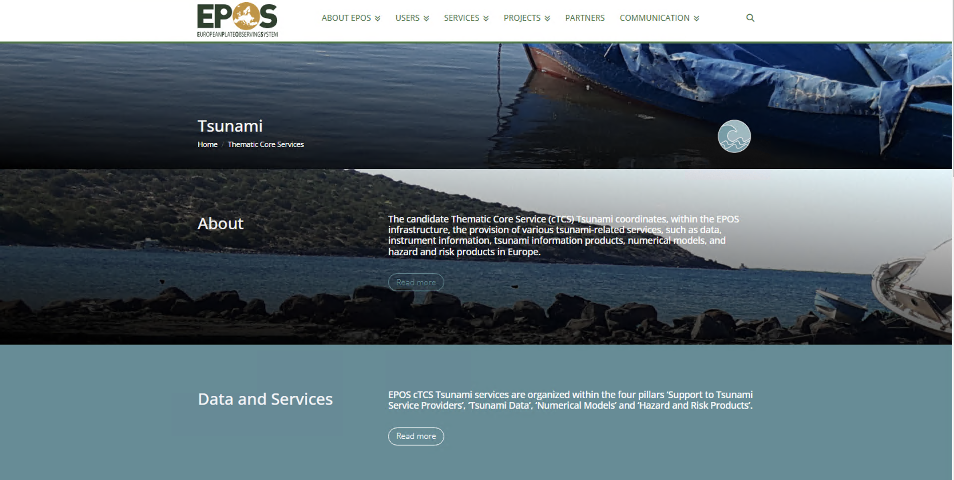
Publicly Accessible Tsunami Data Portal
https://www.epos-eu.org/tcs/tsunami
WG2&WG3 – Seismic, Geophysical & Sea Level Measurements IOC-UNESCO ICG/NEAMTWS, 27-29 November 2024, Paris, France

Slide 7
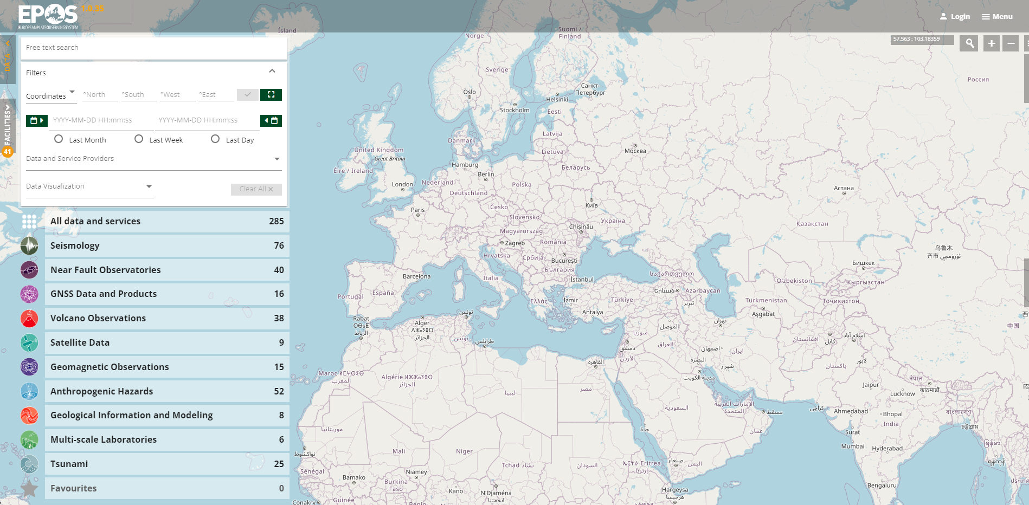
Publicly Accessible Tsunami Data Portal
25 Products of TSUNAMI;
Tsunami Effects,
History,
Observation Points,
Emprical Tsunami Risk Products,
Submarine Landslide Database,
…
https://www.ics-c.epos-eu.org/
WG2&WG3 – Seismic, Geophysical & Sea Level Measurements IOC-UNESCO ICG/NEAMTWS, 27-29 November 2024, Paris, France

Slide 8
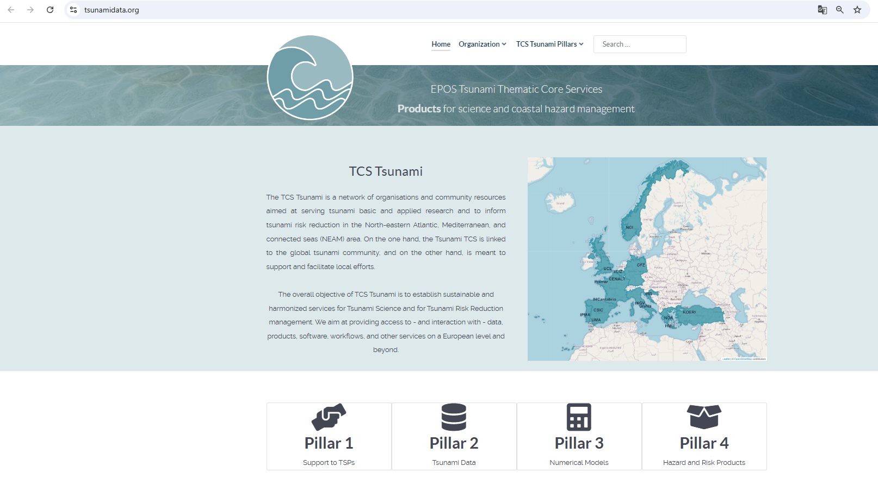
https://tsunami-data.org
WG2&WG3 – Seismic, Geophysical & Sea Level Measurements IOC-UNESCO ICG/NEAMTWS, 27-29 November 2024, Paris, France

Slide 9
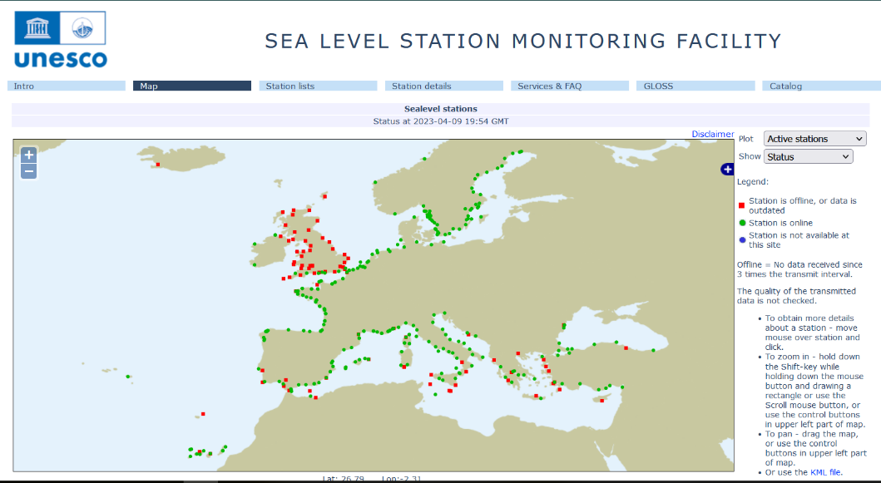
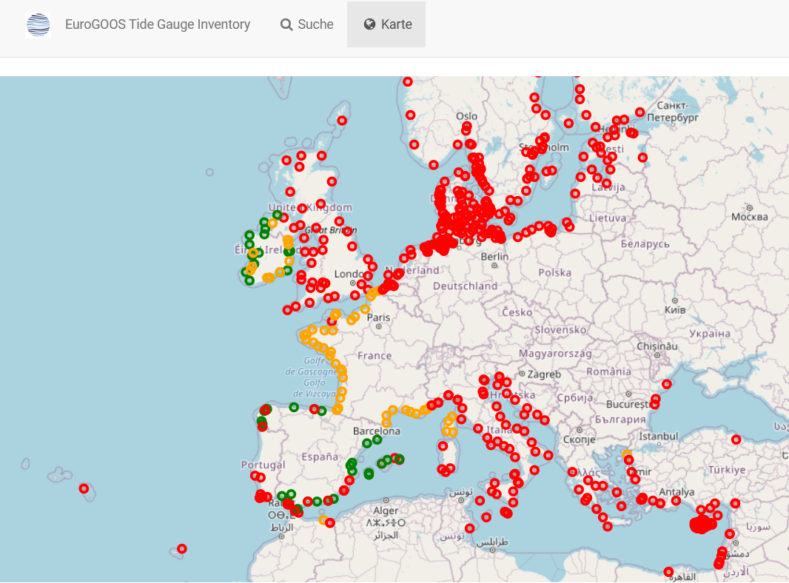
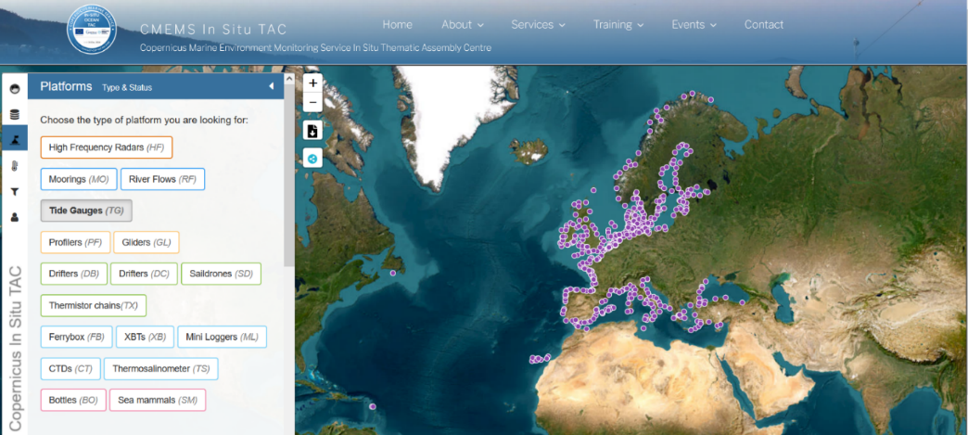
Publicly Accessible Sea Level Stations
EuroGOOS Tide Gauge Inventory
Metadata catalogue of all permanent, managed tide level monitoring stations across Europe and adjacent coastlines, including North Africa
IOC SLSMF
CMEMC In Situ TAC
Copernicus Marine Environment Monitoring Service In Situ Thematic Assembly Centre
WG2&WG3 – Seismic, Geophysical & Sea Level Measurements IOC-UNESCO ICG/NEAMTWS, 27-29 November 2024, Paris, France

Slide 10
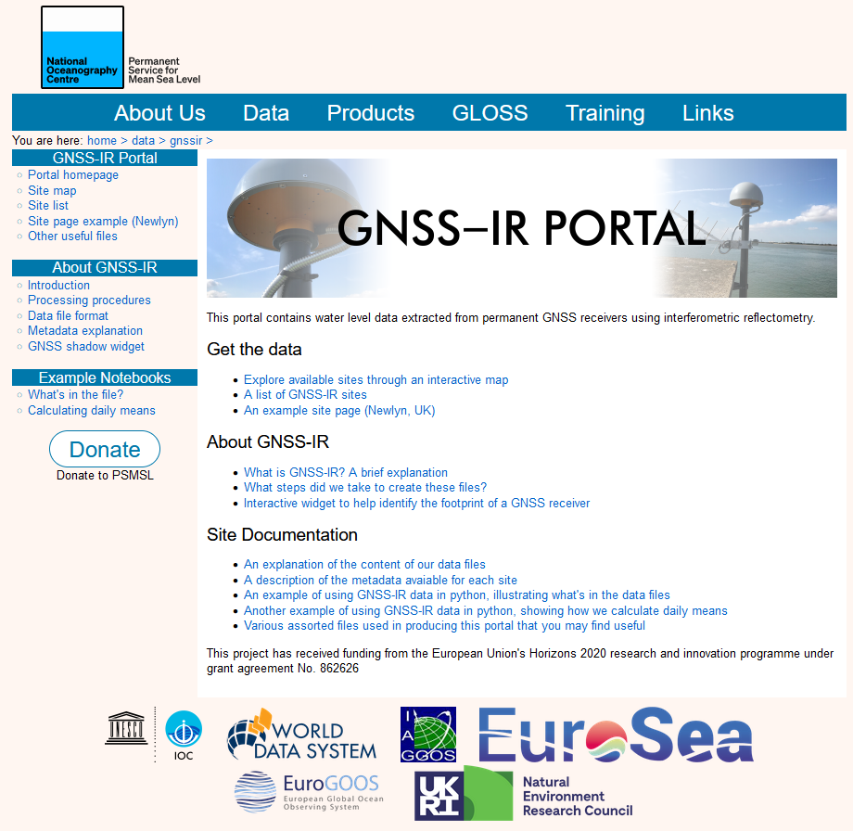
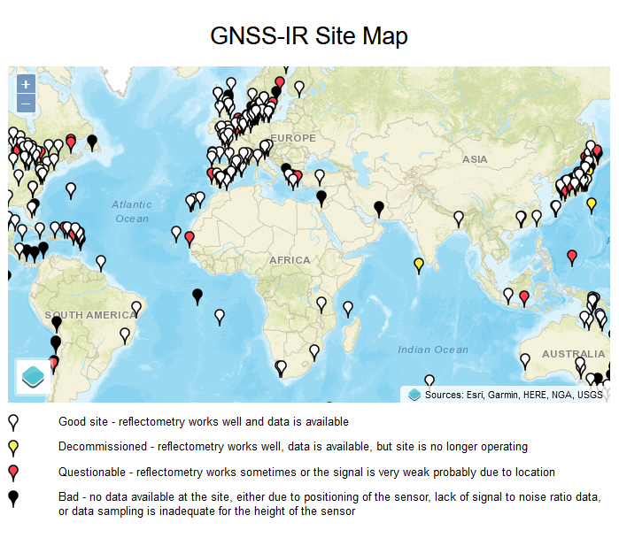
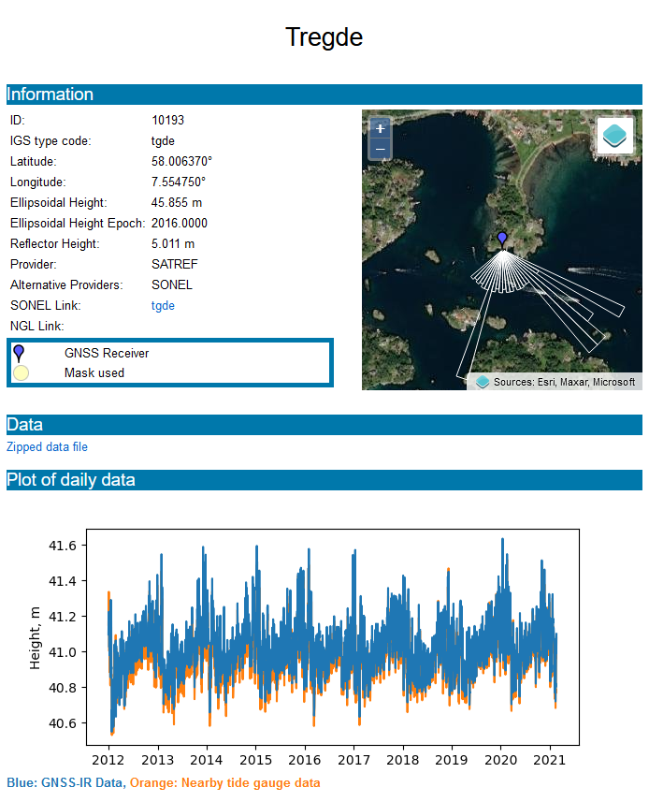
https://psmsl.org/data/gnssir/index.php
WG2&WG3 – Seismic, Geophysical & Sea Level Measurements IOC-UNESCO ICG/NEAMTWS, 27-29 November 2024, Paris, France

Slide 11
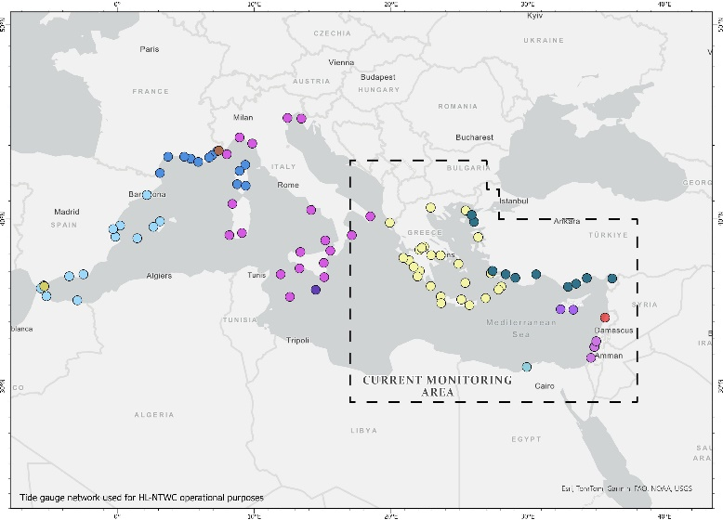
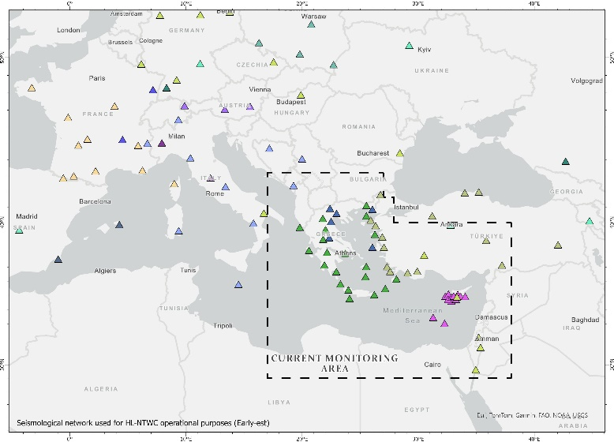
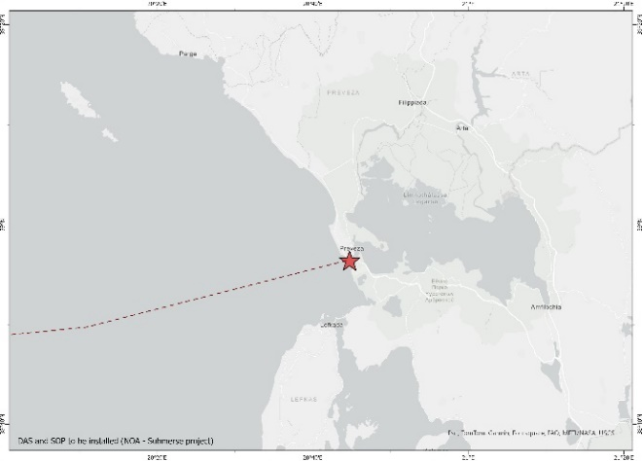
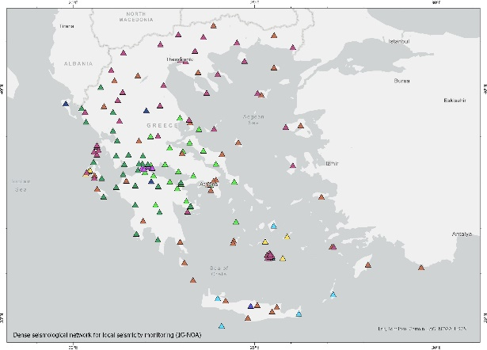
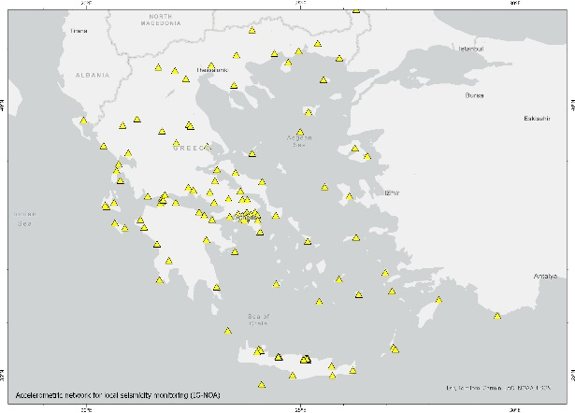
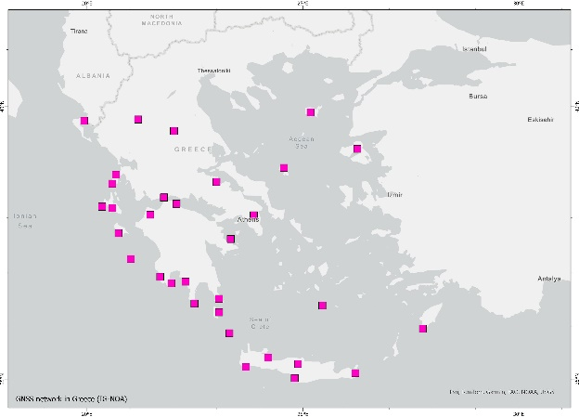
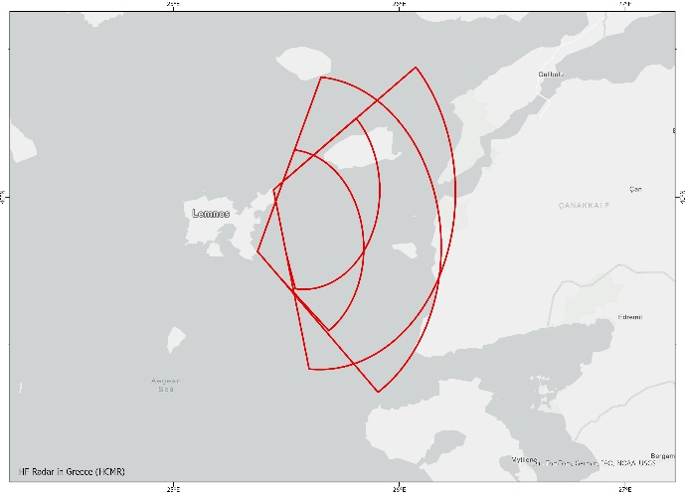
UPDATES FROM MEMBER STATES
GREECE
DAS NOA - SUBMERSE
HF RADAR GREECE
WG2&WG3 – Seismic, Geophysical & Sea Level Measurements IOC-UNESCO ICG/NEAMTWS, 27-29 November 2024, Paris, France

Slide 12
UPDATES FROM MEMBER STATES
ITALIA
Regarding the activity of ISPRA, In the course of 2024,
the installation of the Santa Maria di Leuca (SML) station was finalized.
So, currently, the sea level monitoring along the coasts of Italy is ensured by:
36 traditional stations of the National Tide Gauge Network
7 new generation stations specifically designed for tsunami detection and measurement (SiAM Network).
In the framework of the SiAM (Italian tsunami early warning system), ISPRA planned to install three new sea level stations to implement the sea level monitoring for tsunamis.
These additional stations will increase the SiAM Network up to 10 stations.
The locations of the new stations will be:
Lipari-Porticello (LP - Aeolian Islands - Sicily);
Scilla-Calabria (SC - Southern Italy, Tyrrhenian coast)
Corigliano Calabro ( CC - Southern Italy, facing the Ionian Sea).
WG2&WG3 – Seismic, Geophysical & Sea Level Measurements IOC-UNESCO ICG/NEAMTWS, 27-29 November 2024, Paris, France

Slide 13
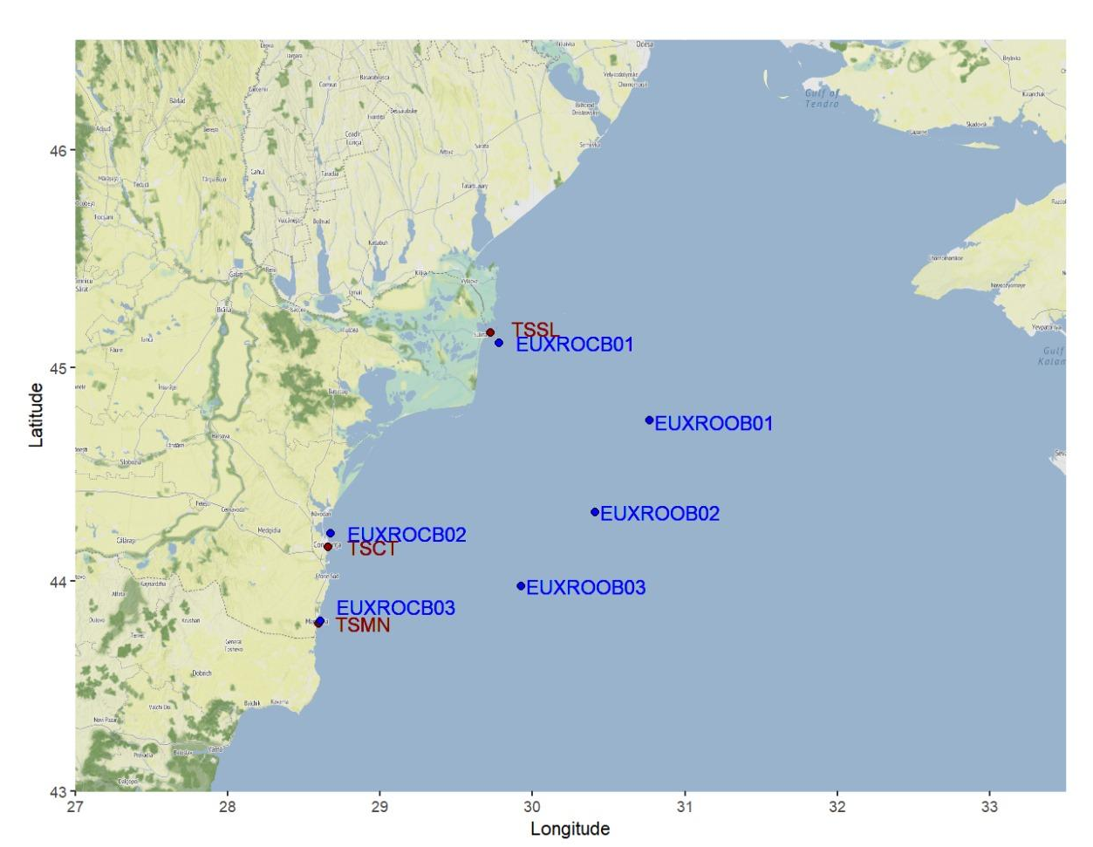
UPDATES FROM MEMBER STATES
ROMANIA
3 sea level gauges and 6 buoys
(belonging to GEOECOMAR)
WG2&WG3 – Seismic, Geophysical & Sea Level Measurements IOC-UNESCO ICG/NEAMTWS, 27-29 November 2024, Paris, France

Slide 14
UPDATES FROM MEMBER STATES
PORTUGAL
The contract for the supply of the ATLANTIC SMART CAM, between the Portuguese State and Alcatel Submarine Networks (ASN),
was signed in March 2024.
The project is under the responsibility of IP TELECOM, a public company.
Atlantic SMART CAM will consist of a ring of submarine cables, connecting Portugal mainland, Azores and Madeira islands, representing around
3500km of cable that will be equipped with sensors, accomplishing a double purpose of telecommunications and sensing.
- IPMA is providing support to IP TELECOM on the observer component of the system.
- The infrastructure should be fully implemented by the end of 2026.
- There will be 20 nodes equipped with ground motion sensors, absolute pressure and temperature sensors.
- The ground motion sensors will be accelerometer or broadband seismometer, to be decided node by node during the next months.
According to a press release from ASN, the ground motion sensors will be manufactured by Nanometrics
and the pressure and temperature ones by RBR.
The exact location of the sensors is not yet decided, but the geographic configuration will attend different
requirements, to be able to serve geophysical and environmental purposes.
- IPMA will receive the raw data in real-time and will be responsible to manage it, including its dissemination.
WG2&WG3 – Seismic, Geophysical & Sea Level Measurements IOC-UNESCO ICG/NEAMTWS, 27-29 November 2024, Paris, France

Slide 15
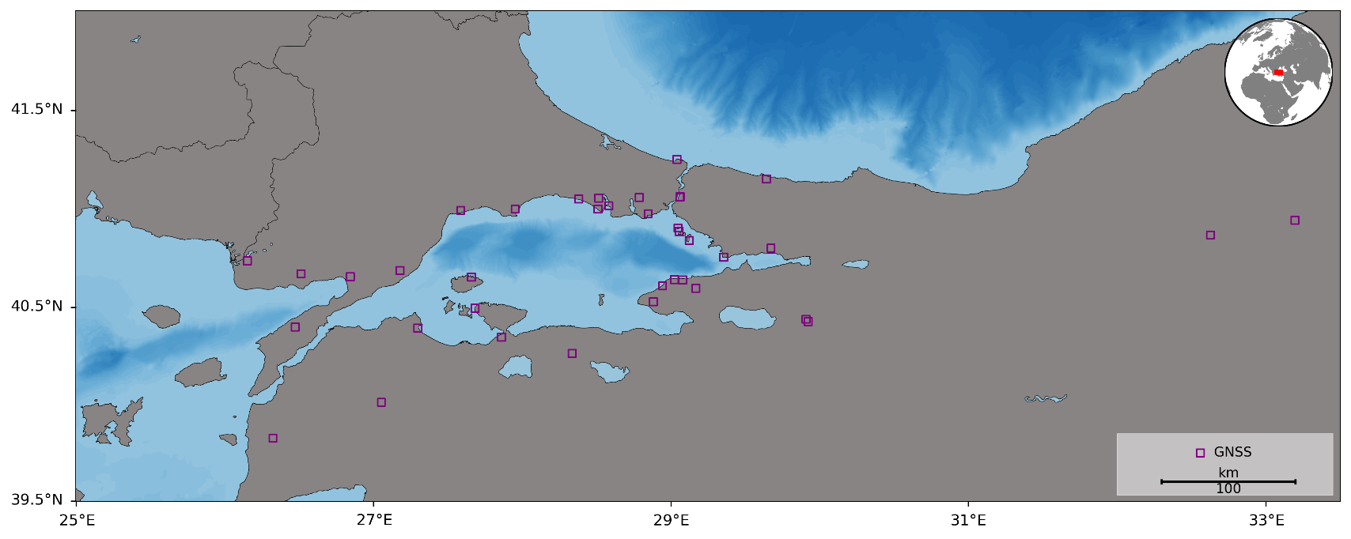
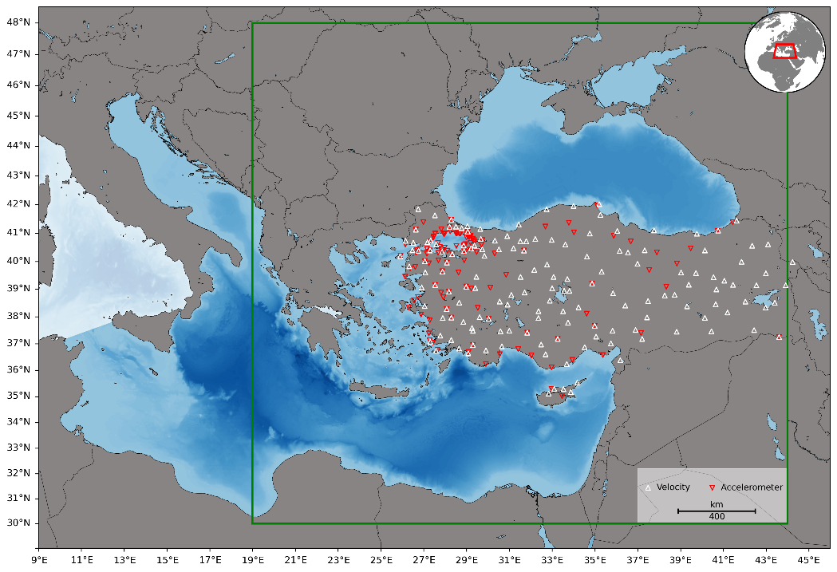
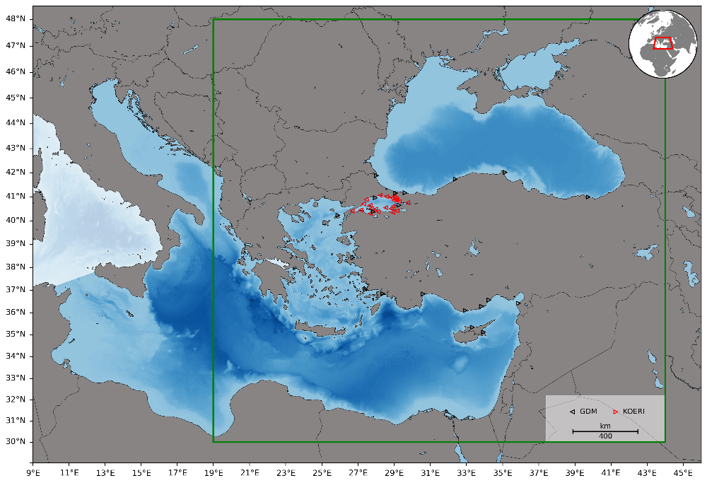
UPDATES FROM MEMBER STATES
TÜRKİYE
WG2&WG3 – Seismic, Geophysical & Sea Level Measurements IOC-UNESCO ICG/NEAMTWS, 27-29 November 2024, Paris, France

