Slide 1



The national System for Tsunami Warning (SiAM)
XIX ICG-NEAMTWS, Paris, UNESCO HQ, November 27-29, 2024

Slide 2
Presentation Plan
Hazard and inundation mapping
Warning (current monitoring, new methods /PTF, and new instruments)
Stromboli TWS
Awareness and Response

Slide 3
Hazard (and inundation maps for planning)

Slide 4
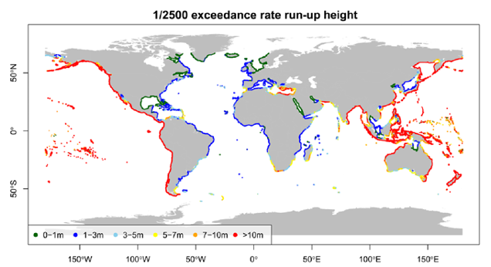
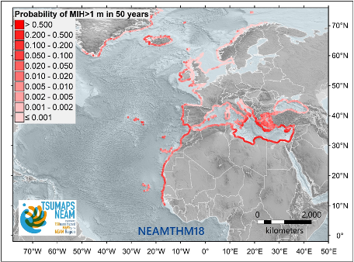
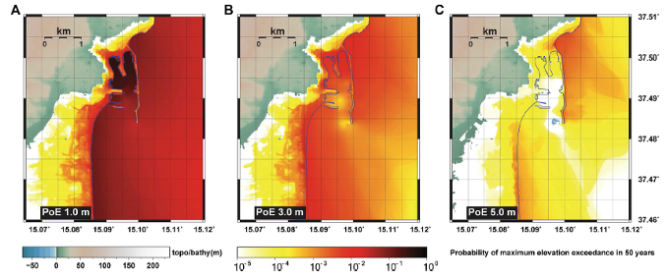

Hazard and inundation mapping in support of Tsunami Ready
PTHA across scales
PTHA-based nation-wide planning
New national S-PTHA (MPTS24) → updating of the inundation zones to be planned
Support to Spain, Greece, and Cyprus for nation-wide planning based on NEAMTHM18 PTHA in DG-ECHO NEAM-COMMITTMENT project
Regional and Local planning
Pilot action with Regione Calabria in preparation for updating of the inundation planning and emergency planning based on MPTS24 (both region-wide and pilot high-resolution sites)
High-resolution S-PTHA-based planning in Marzamemi in CoastWave2 (similar to Larnaca in CW1)
Support to High-resolution S-PTHA-based planning in Greece with consideration of building resistance for vertical evacuation planning and potential damage/collapses affecting evacuation routes (w/ NOA, GEM, IHC, UMA, etc.)
Stromboli V-PTHA in progress; multi-hazard planning envisaged in DG-ECHO NEAM-COMMITTMENT project (w/ NOA, UHA, UMA, etc.)
Contribution to other ICGs via GTM
Makran PTHA in UNESCAP project (IOTWMS)
India S-PTHA with consideration of landslides in PCTWIN UKRI project
Global
Davies et al., 2017
Basili et al., 2021
Local
Gibbons et al., 2020

Slide 5
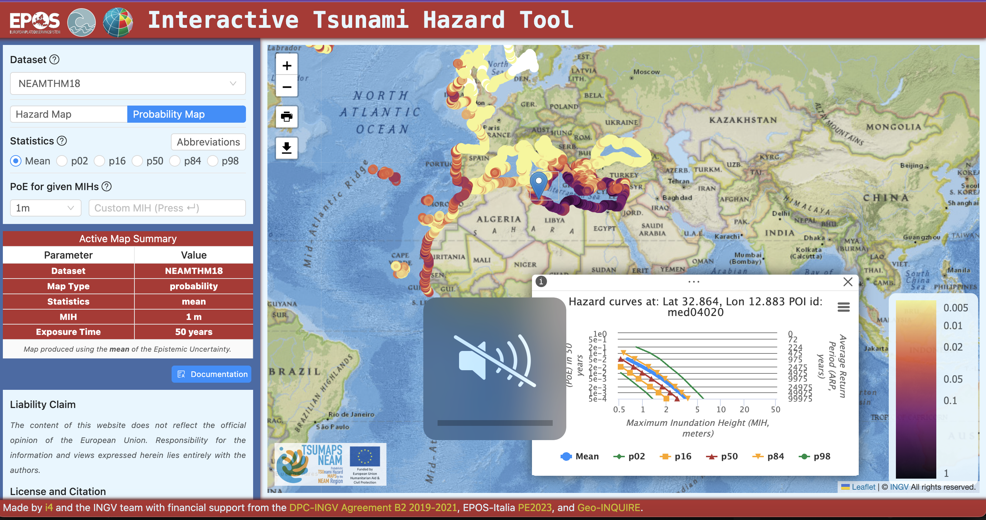
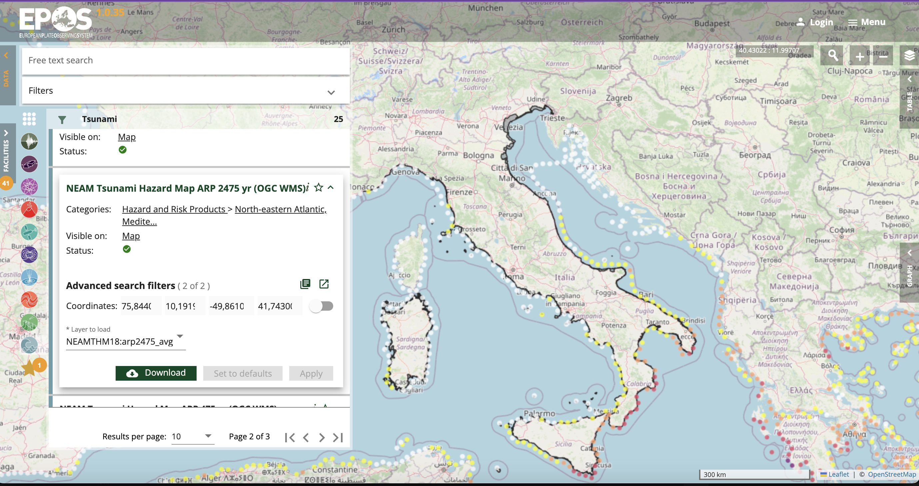

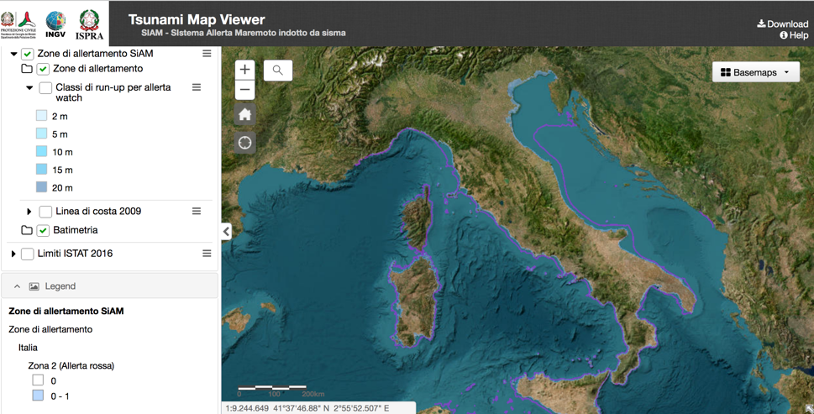


Hazard and inundation mapping in support of Tsunami Ready
Publication of hazard and inundation maps in national portals and via TCS Tsunami in EPOS
https://hazard.tsunamidata.org/?dataset=NEAMTHM18
https://www.ics-c.epos-eu.org/
TCS Tsunami
https://sgi2.isprambiente.it/tsunamimap/

Slide 6
Warning: recent events in the Mediterranean Sea

Slide 7
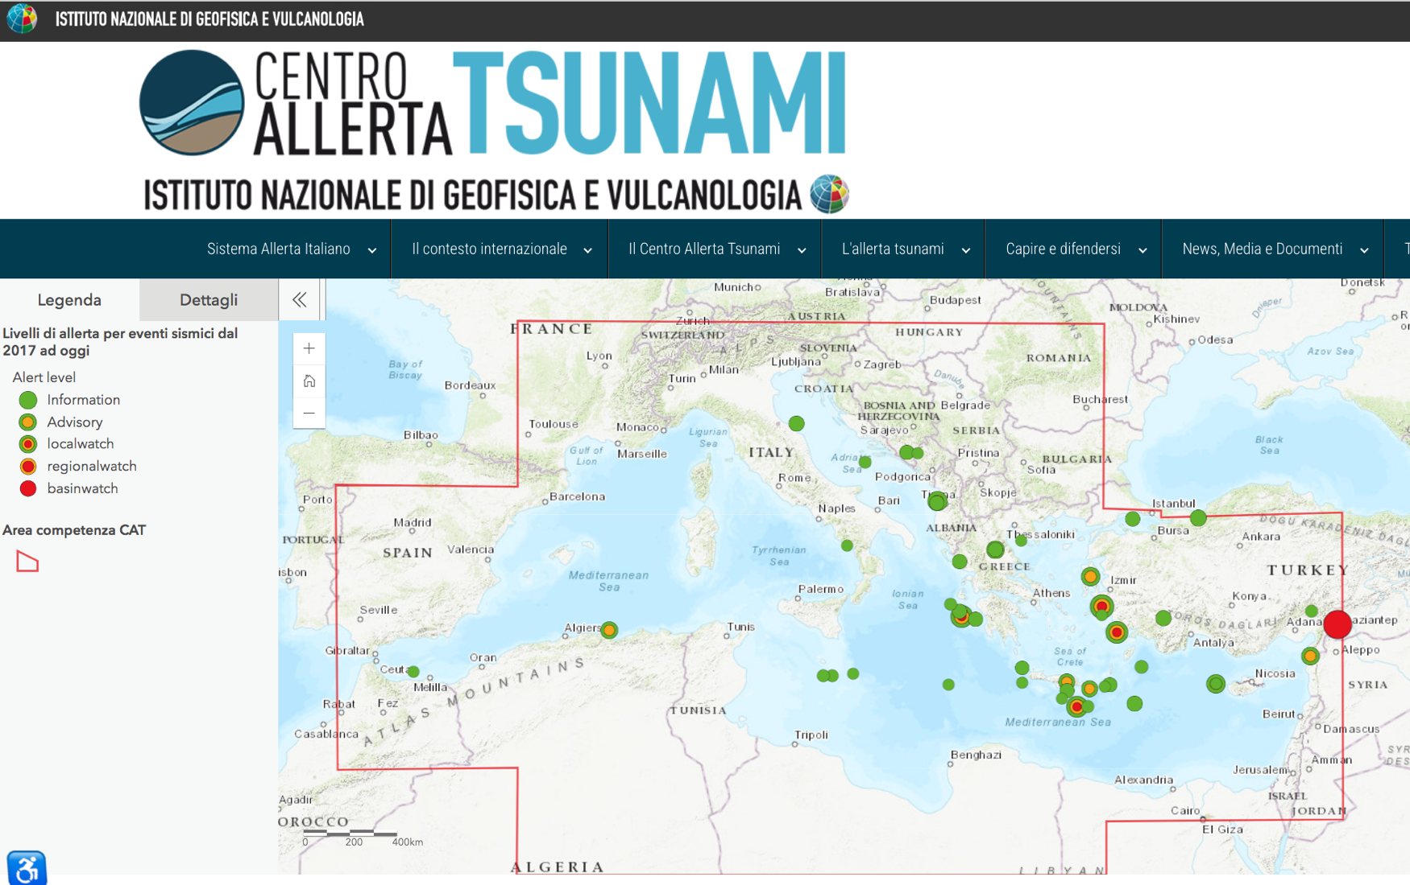
3 events in 2024 (at Nov. 25), all INFORMATION
3/11/2024
Information, Mwp=5,5
8 minutes
29/3/2024
Information
Mwp=5.8
5 minutes!!!
21/7/2024
Information
Mwp=5.5
9 minutes

Slide 8
Warning: Probabilistic Tsunami Forecasting (PTF)

Slide 9
CAT-INGV Administrative (but also substantial) steps
Evaluation of the method by INGV Scientific Council (S.C), appointed by the Board of Directors (Consiglio di Amministrazione) in 2022
Scientific Council - - - > Panel of international experts (5)
Meetings with CAT members – 1° report
New meeting with new S.C. Sept. 2024 – 2° report
Final (positive) opinion by the S.C. and Seismology Director in November 2024!!!
Final decision by the Board of Administration expected on November 29, 2024

Slide 10
PTF at the ICG and TOWS
Decision ICG/NEAMTWS-XVIII.1
.... Supports the investigation and possibility to adopt tsunami forecasting methods by TSPs which represent an improvement over the Decision Matrices presently in use with a view to reducing uncertainty and false alarms, particularly the forecasting methods which consider tsunami numerical modeling and uncertainty quantification (e.g., the Probabilistic Tsunami Forecasting PTF, pre-calculated scenario databases, etc.);
Also supports CAT-INGV (Centro Allerta Tsunami - Istituto Nazionale di Geofisica e Vulcanologia, Italy) TSP ongoing transition towards implementing a PTF based Decision Matrix, and requires that the methodology implemented is documented in the updated NEAMTWS Operational User Guide and that TSP subscribers are informed accordingly;

Slide 11
PTF at the ICG and TOWS
TOWS meeting, Sendai, February 2024
The Group noted: ... (xxvii) the need for more accurate and precise tsunami forecasts, especially in the complex tectonic context; (xxviii) the ICG/NEAMTWS investigation and possible adoption of the tsunami probabilistic forecasting method by TSPs in NEAMTWS, which may represent an improvement over the method in use with the goal of reducing uncertainty and false alarms, particularly the forecasting methods that consider tsunami numerical modelling and uncertainty quantification
Task Team on ‘Watch Operations’ is asked to evaluate the method and make suggestions for its implementation:
... (x) TT-TWO evaluate tsunami probabilistic forecasting methods and provide advice to TSPs and NTWCs in all ICGs;

Slide 12
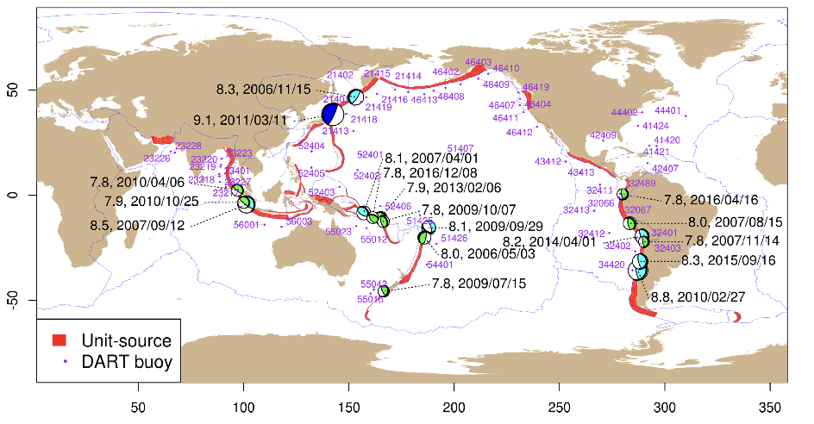
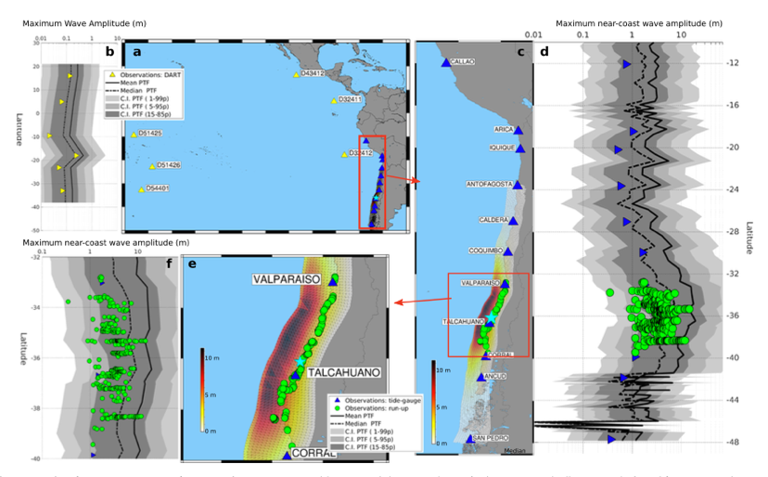
PTF calibration
2024: The PTF is being presently calibrated with tsunami observations and massive ensembles of synthetic tsunamis and it is expected to become operational at the CAT-INGV NEAMTWS Tsunami Service Provider in 2025.
Davies et al., 2019

Slide 13

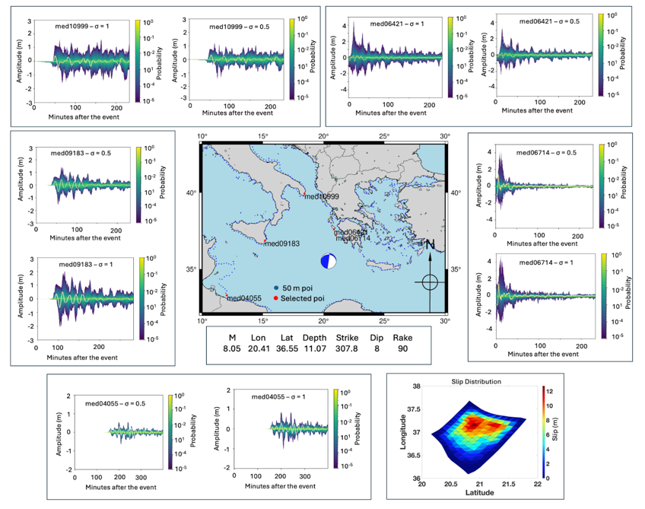
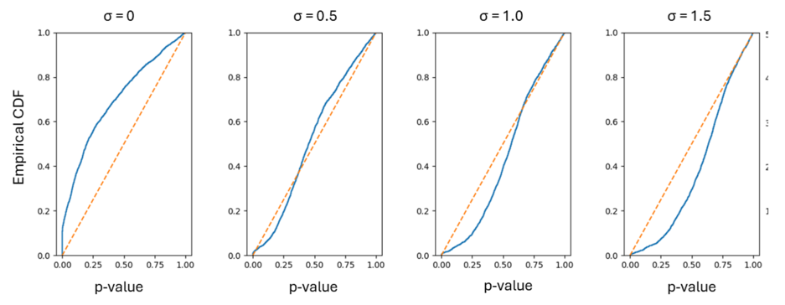
PTF calibration
2024: The PTF is being presently calibrated with tsunami observations and massive ensembles of synthetic tsunamis and it is expected to become operational at the CAT-INGV NEAMTWS Tsunami Service Provider in 2025.
200 kyr synthetic catalogue

Slide 14
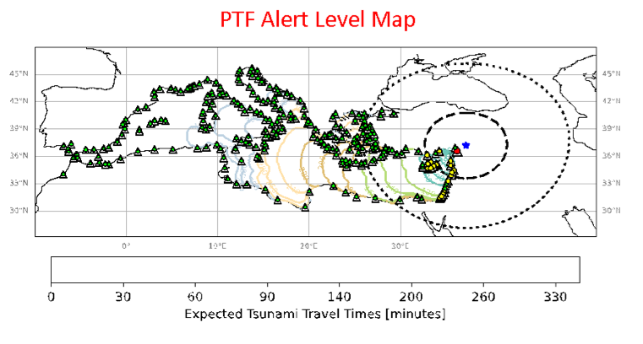
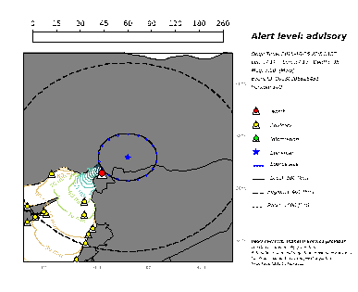
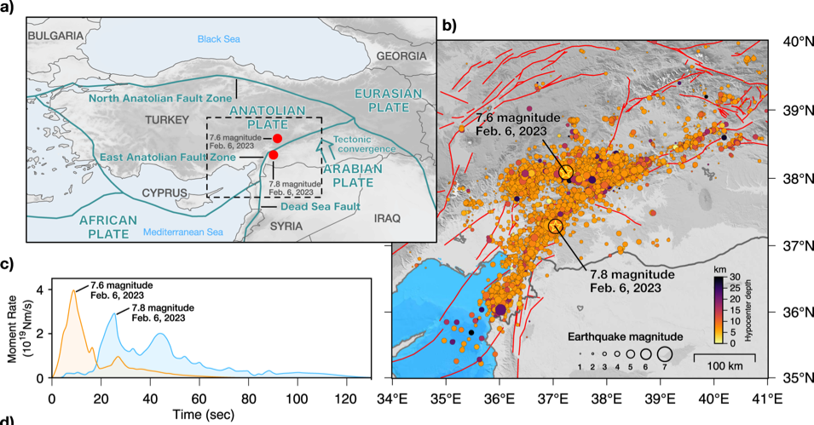
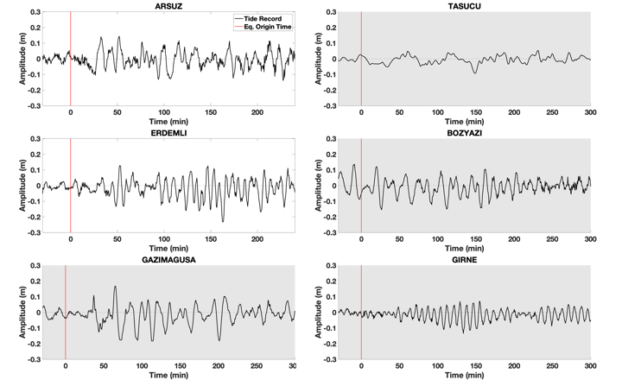
How PTF can be used: GNSS, Seismic, Tsunami data assimilation
The PTF can provide alerts in the near-field. If time allows, and if further data are available, such as the moment tensor and tsunami data, they can be assimilated in the PTF to refine the estimate.
Dal Zilio & Ampuero, 2023

Slide 15
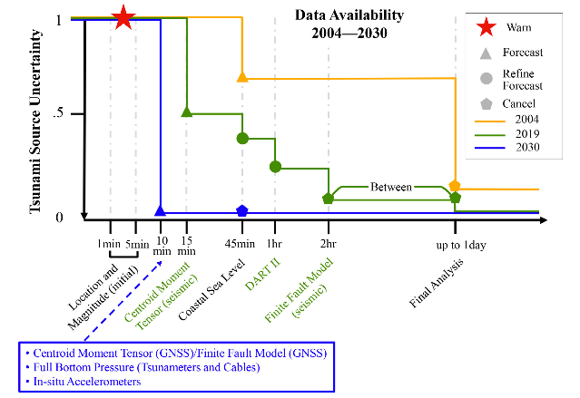
Conclusions. PTF is aligned with UN Decade Goals!
Uncertainty Quantification/Reduction for tsunami forecasting
Provide the decision-makers with actionable information
Account for tsunami propagation complexity (not only distance)
Avoid hard-thresholds → jumps of the alert levels
Angove et al., 2019
Notes:
goal 1 accuracy and timeliness

Slide 16
Warning: Improving the sea level observations with new land and offshore instruments

Slide 17
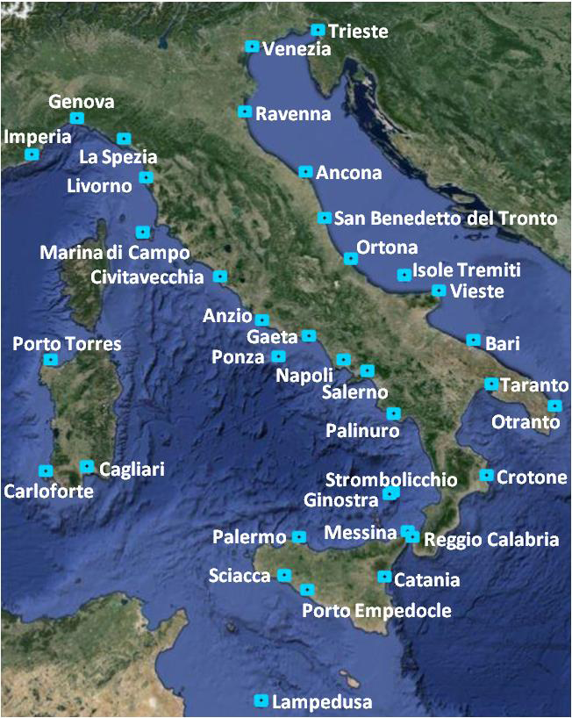
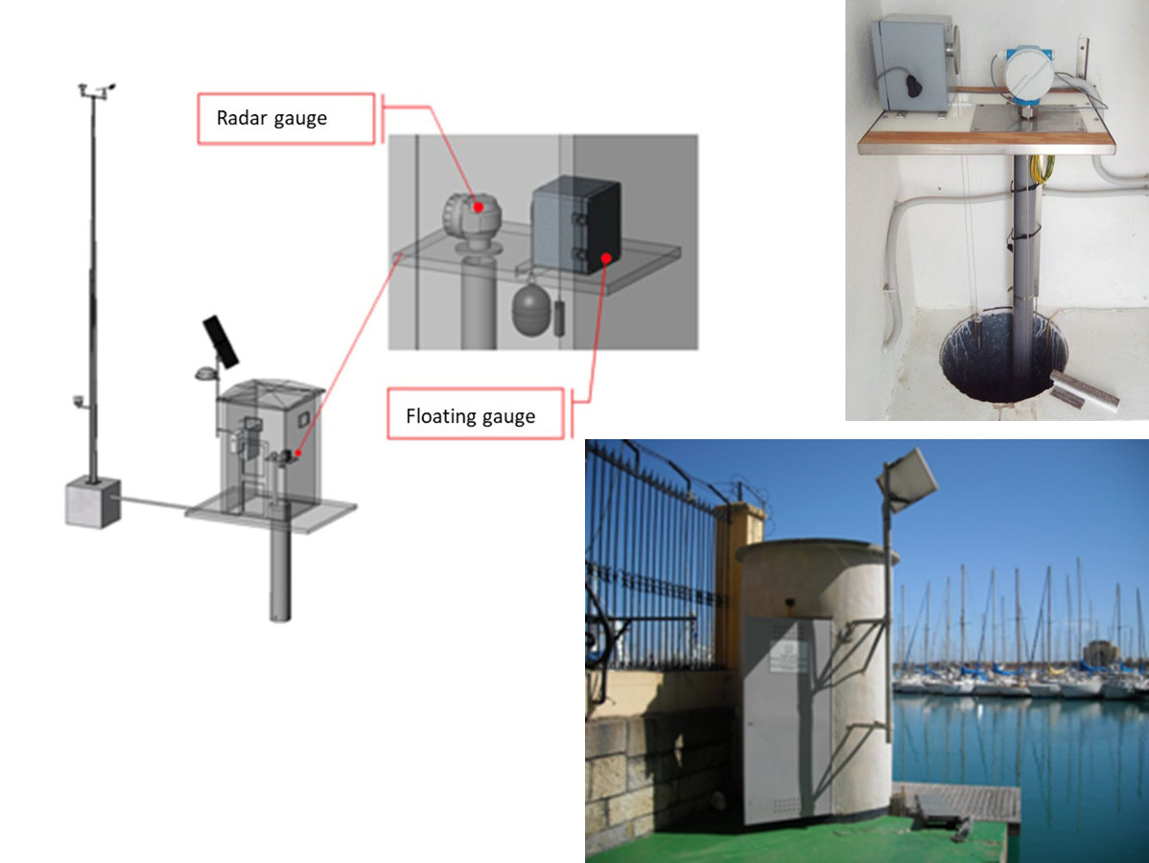
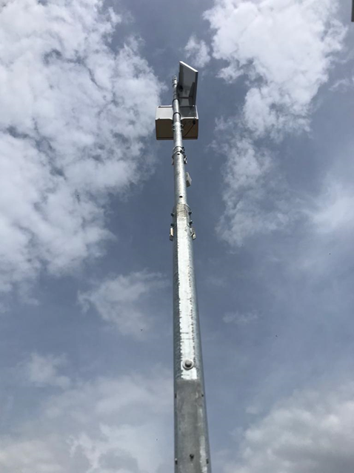
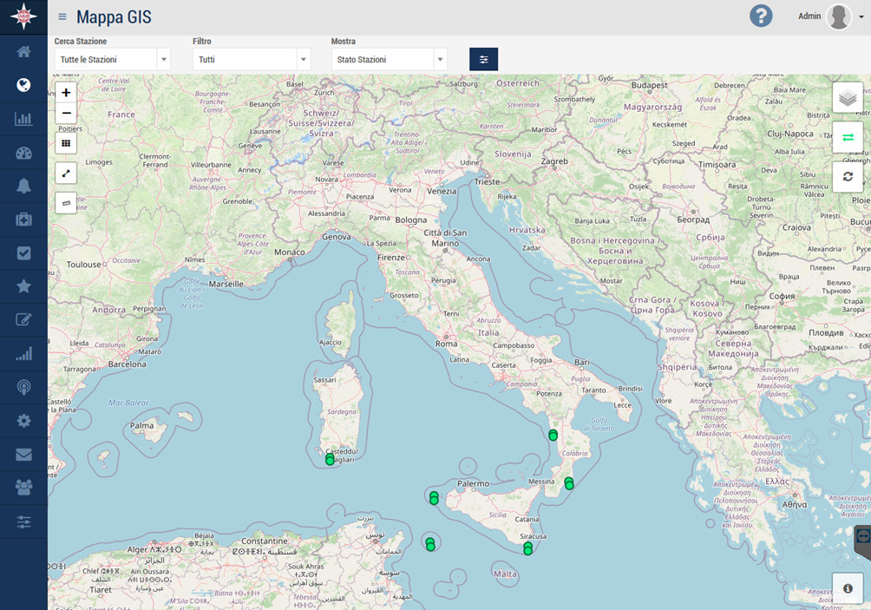
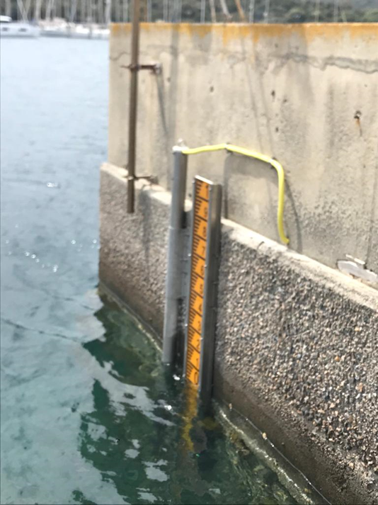
EVOLUTION OF THE ITALIAN TSUNAMI MONITORING SYSTEM
From 2017 to 2021, tsunami detection was performed by the national tide gauges network (RMN) located in the main Italian ports
RMN is an important sea level measurement network in the Mediterranean that measures sea level to determine tides and includes the meteomarine network of the Italian coasts
Its measured parameters, common for all stations, are:
microwave level sensor,
shaft-encoder level sensor (float), barometric sensor, temperature/humidity sensor,
water temperature sensor, wind speed sensor, wind direction sensor (metereology sensors)
Since May 2021, a new generation network,
designed exclusively for the identification and
timely characterization of tsunamis, is operational
Notes:
Simple structure not designed to withstand extreme events and sea level is recorded with a sensor, microwave or floating sensor, with full scale 2 meters

Slide 18

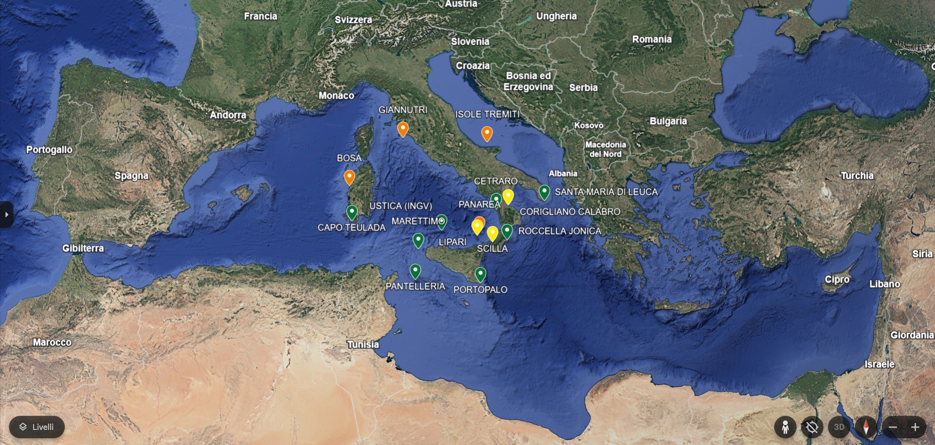
SiAM NETWORK GREEN = OPERATIONAL YELLOW = IN PROGRESS RED = PLANNED 2025

Slide 19
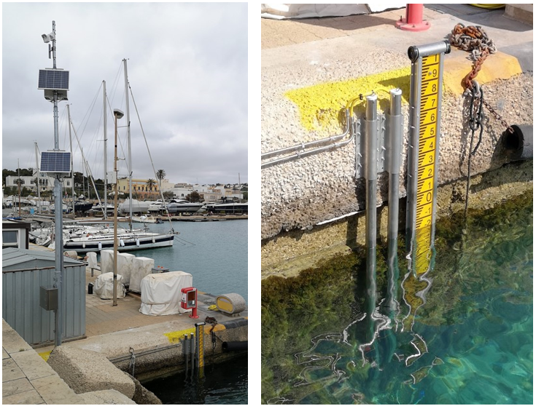
SiAM NETWORK UPGRADE
ISPRA’s new stations - plus series - in Santa Maria di Leuca - 2024
3rd piezometric sensor (greater data redundancy) in a 2nd stilling tube
Backup Datalogger (electronic redundancy)
Independent power supply of the secondary system (backup)
in addition to the technical features common to the other ISPRA’s new stations in the SiAM network installed since 2021
Primary system with independent power supply, on-board camera,
Datalogger, control unit - transmits in real time the sea level (m) - sampling rate 15 sec. (FAST transmission) – 2 high precision piezometric sensors (integrated water thermistor ) with full scale of 10 and 20 meters
Data transmission system (transmission redundancy)
UMTS 4 or 5G channel - 2 SIMs on board with different providers
IRIDIUM satellite module - starts in case of absence of UMTS signal
Data storage and transmission system are protected in sealed and IP68 waterproof boxes, on a pole about 10 m high - all metal components in AISI 316 steel (resistance to severe operating conditions)
Objectives: Reduction of interruptions due to faults, increased stability of the data collection system and transmission service (operational continuity)
The plus series configuration increases the sea level survey points from 2 to 3 and the independent measuring stations from 1 to 2
G. Giorgi – G. Arena - A. Barbano – C. Gera
(ISPRA-CN-COS- Technical-operational Section supporting the Italian National Tsunami Early Warning System (SiAM)
tsunami.isprambiente.it

Slide 20
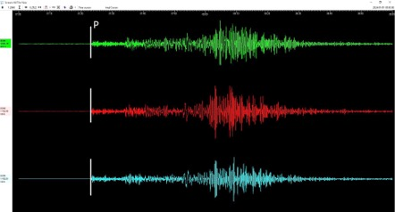
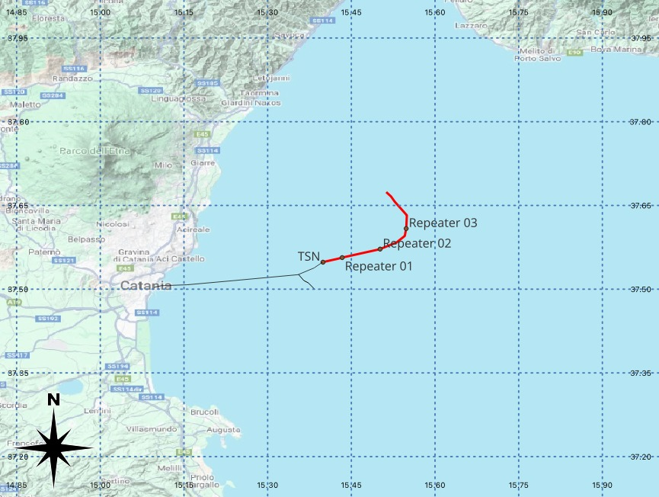
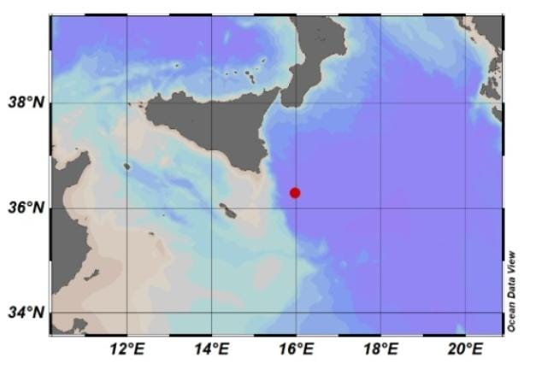
Offshore instruments
WESTERN IONIAN SEA INFRASTRUCTURE
Deployed December 2023
WEST COAST, EASTERN HONSHU, JAPAN
01/01/2024 07:10 M_{wpd} 7.4
Sicily
Calabria
Mt. Etna
INFN Km3NeT Observatory @ 3,500 m depth
Trillium 120s + hydrophone + P-T sensor (RBR)
Cabled with fiber optic to land (100km)
Courtesy of G. Marinaro (INGV)

Slide 21





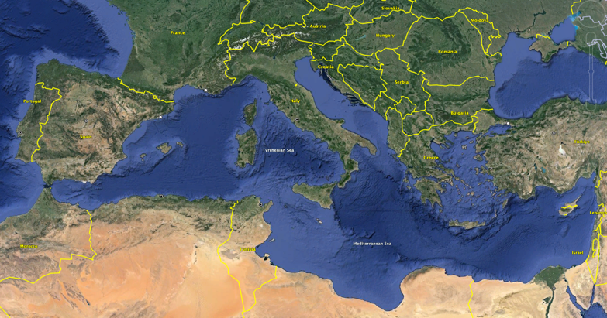
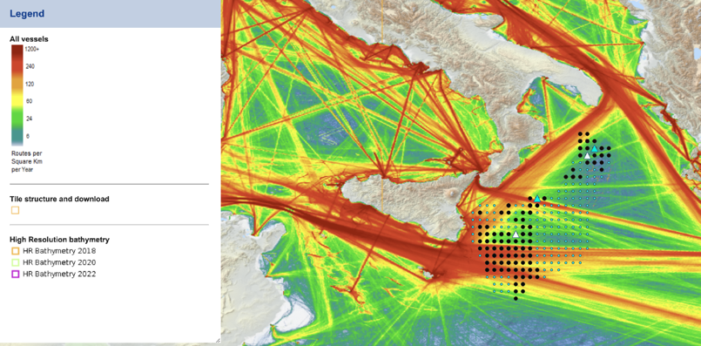

DART-LIKE TSUNAMI BUOYS
2 tsunami buoys will be installed in the Ionian sea by Summer 2025 by MSM (Mediterráneo Senales Marítimas) that was awarded contract
Location and technical requirements decided based on possible tsunami sources and ship traffic (in Italian exclusive economic zone)
Funding (~2.8 M€) by the Italian Ministery of Research through the European contribution Next Generation EU - NRRP (National Recovery and Resilience Plan) “MEET”, coord. by INGV
Missione 4 • Istruzione e Ricerca

Slide 22
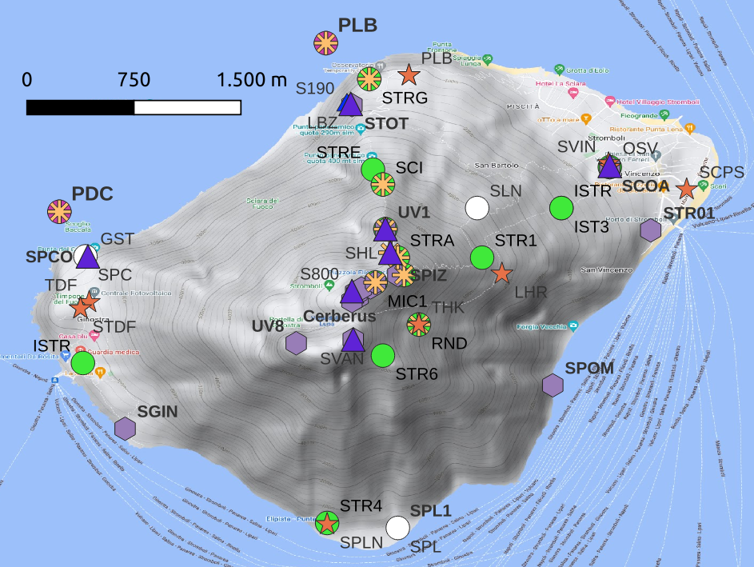
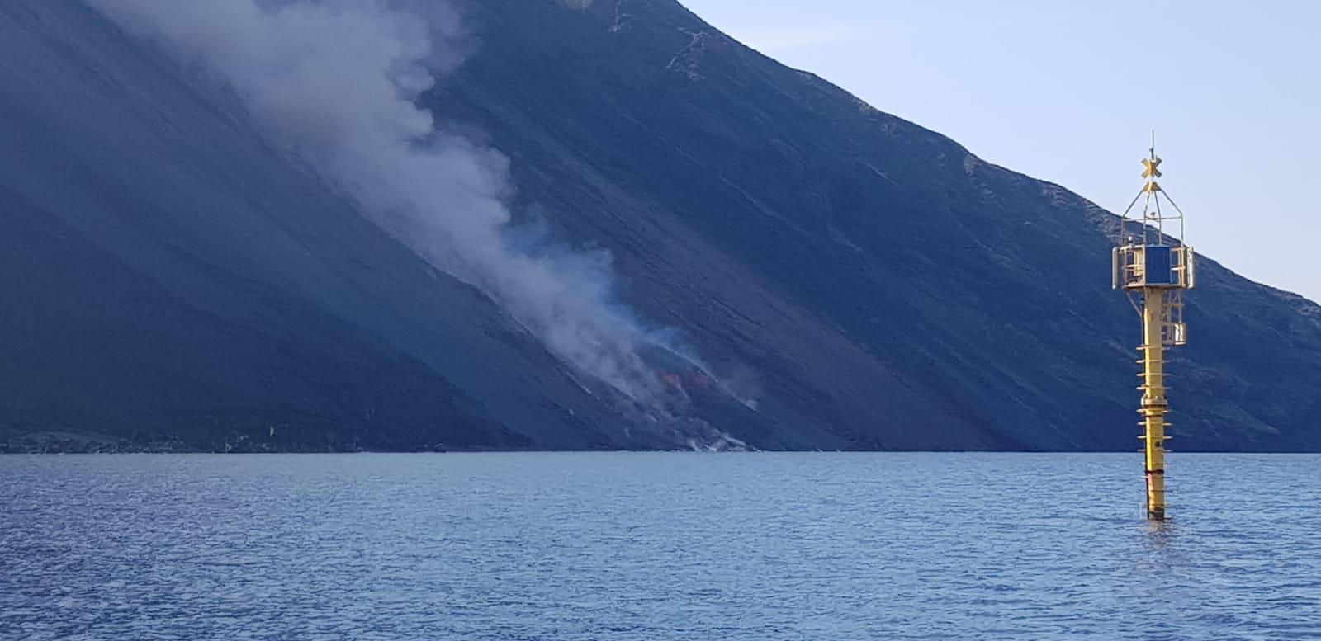
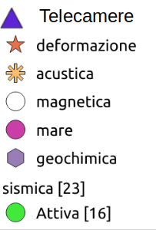
Stromboli Monitoring
Total: 63 stations
LGS: 23 stations
INGV-OE: 19 stations
INGV-OV: 12 stations
UniPA: 4 stations
INGV-PA: 4 stations
CPC-UNIFI: 1 stations
Instruments and stations currently in service
Seismic: n. 14 stations (Velocimeters and accelerometers)
Cameras: n.8 (Infrared + Visible)
Deformation: n.10 stations (GNSS, Tilt, Strain)
Infrasonic: n.12 stations (+2 on the sea network)
Sea: n. 2 stations (tide gauges)
Fluid geochemistry: n. 12 stations
(C/S, SO₂, CO₂ soil flux)
Courtesy of M. Orazi (INGV)
Ripepe & Lacanna 2024
Significant efforts to ‘instrument’ and monitor the volcano and the tsunamis

Slide 23
Seismic and Volcanic tsunamis – unifying the two TEWS
A synergistic Italian project started in August 2022 with the following goals:
Development of a single system for geophysical/geochemical monitoring of volcanic activity and sharing of related databases; Development of the experimental tsunami detection system
Probabilistic hazard estimation from tsunamis generated by slope collapses and pyroclastic avalanches and definition of flood maps and tsunami modelling
Development of the unique system for the rapid detection of paroxysms based on geophysical signals (ground deformation, seismicity, rate and eruption style variations); development of warning systems with longer precursor time (e.g. 60-80 min) based on the analysis and modelling of longer-term precursor signals
Survey on risk perception related to paroxysmal explosive events and tsunamis, for the definition of a communication strategy and the production of information materials (Moreschini et al., 2024)
Feasibility of integrating the Stromboli tsunami detection system with the CAT within SiAM and NEAMTWS

Slide 24
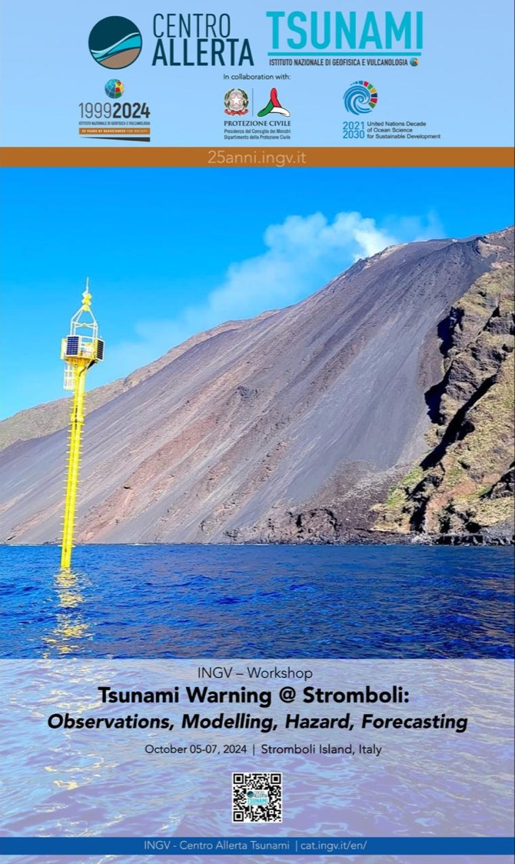
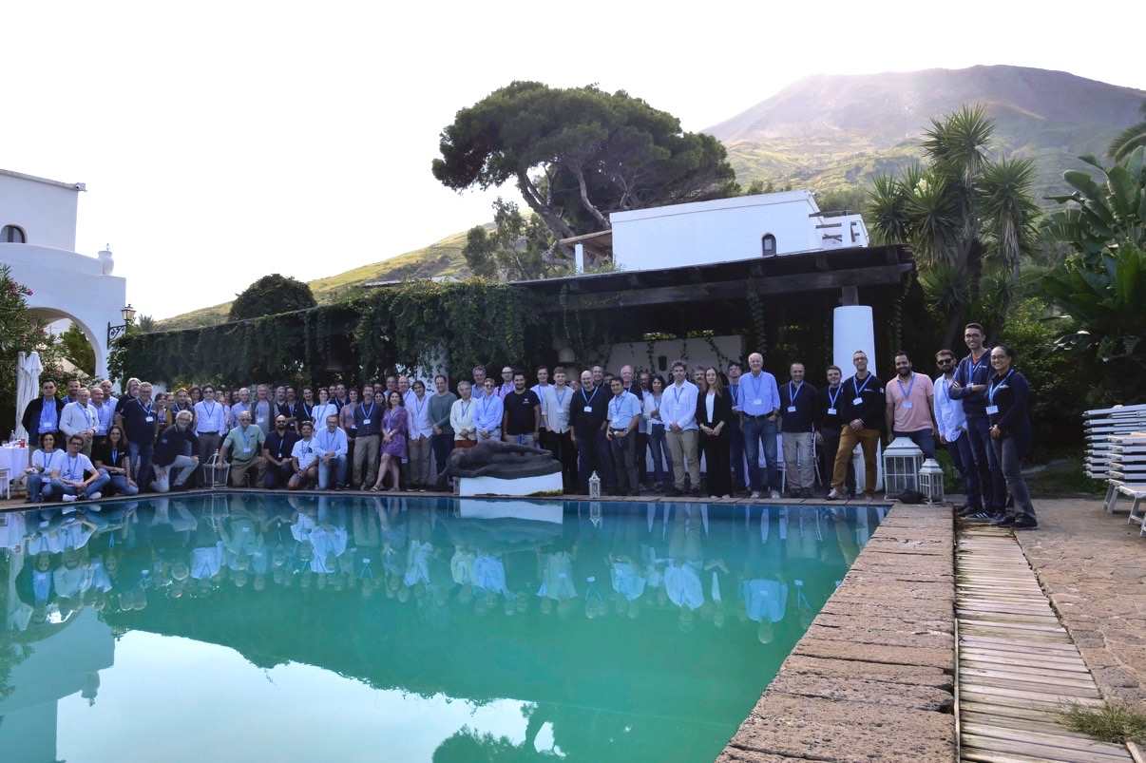
Stromboli tsunami workshop, Oct. 2024
See TT on non-seismic tsunamis

Slide 25
Awareness and Response: recent activities

Slide 26
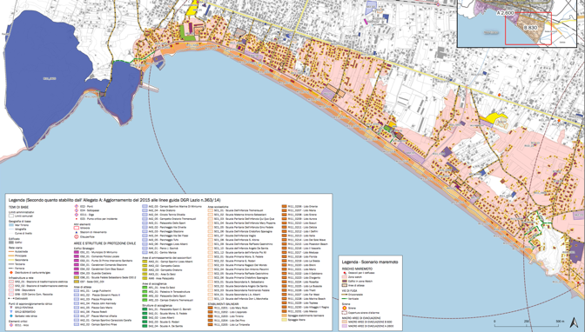
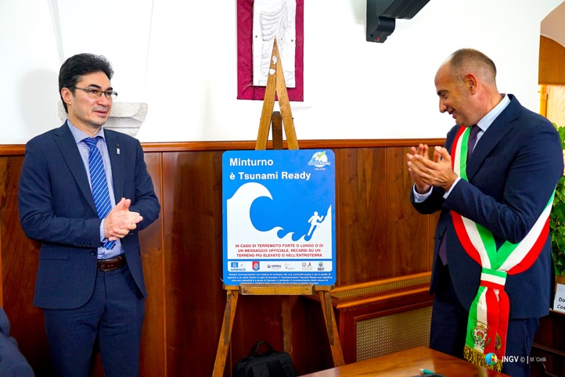
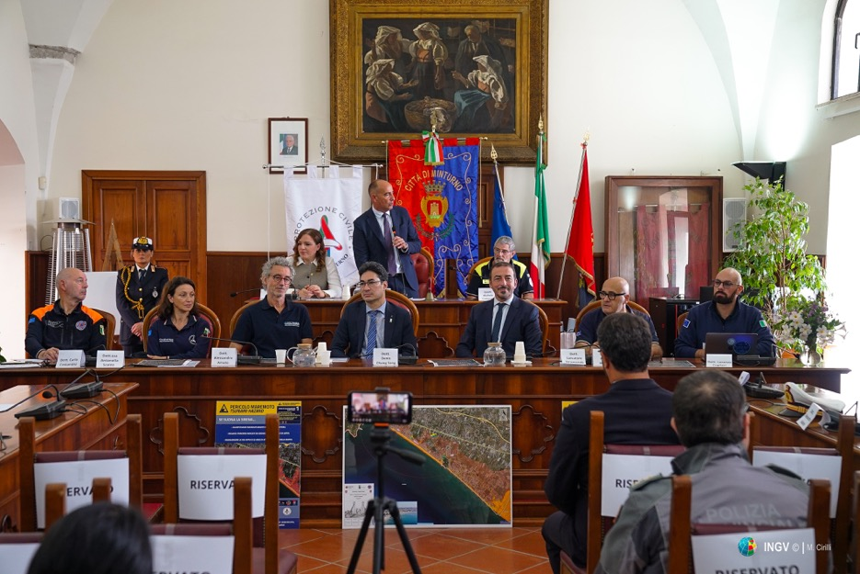
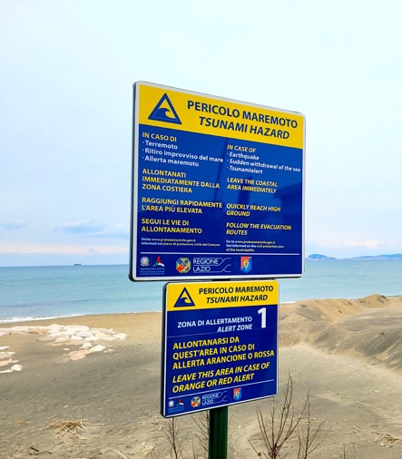
Minturno Tsunami Ready July 2024
TR recognition ceremony
October 2024
Notes:
Educational Video directed by Italian Civil Protection: “Io non rischio - Maremoto” in Italian and subtitled in English. To increase tsunami risk awareness in Italy. Published on YouTube and other official social platform
At the Genoa Science Festival (21 October to 3 November), a tsunami corner was set up with a didactic/interactive path for students and visitors. A tsunami video modelling in which the public could modify the physical parameters of using a leap-motion sensor was implemented. In this way, the visitors could change the height, length and consequent impact of the tsunami on the shore. (VIDEO PUBBLICO E VASCA)

Slide 27
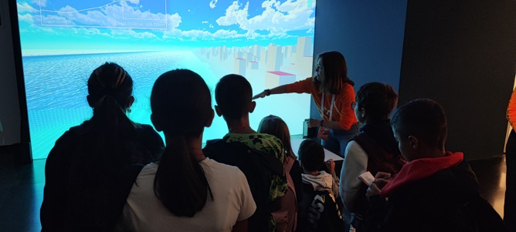
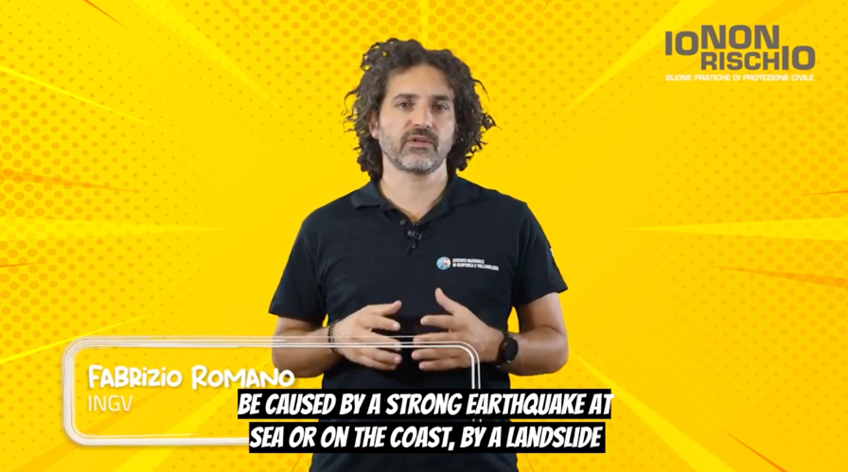
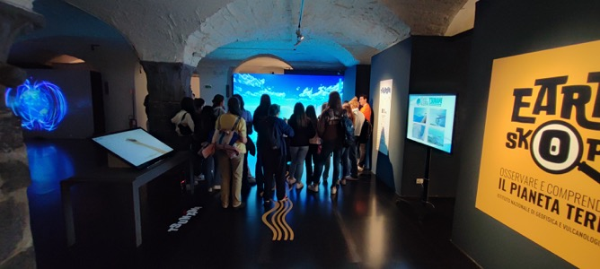
Education
Educational Video
directed by Italian Civil Protection:
“Io non rischio - Maremoto” in Italian and subtitled in English.
Genoa Science Festival (21 October to 3 November),
a tsunami corner was set up with a didactic/interactive
path for students and visitors.
Notes:
Educational Video directed by Italian Civil Protection: “Io non rischio - Maremoto” in Italian and subtitled in English. To increase tsunami risk awareness in Italy. Published on YouTube and other official social platform
At the Genoa Science Festival (21 October to 3 November), a tsunami corner was set up with a didactic/interactive path for students and visitors. A tsunami video modelling in which the public could modify the physical parameters of using a leap-motion sensor was implemented. In this way, the visitors could change the height, length and consequent impact of the tsunami on the shore. (VIDEO PUBBLICO E VASCA)

Slide 28
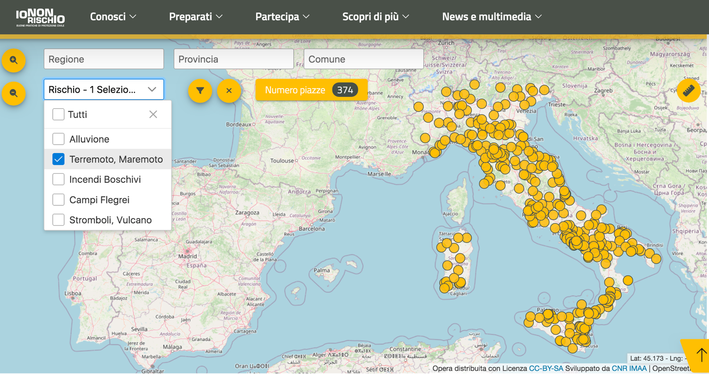
Education
‘Io Non Rischio - Maremoto’
National information campaign for tsunami risk mitigation in the squares of coastal municipalities.
Map shows coverage for the year 2024: 374 sqares out of 425 with tsunami risk
Notes:
With regard to the national Civil Protection campaign Io non rischio maremoto for tsunami risk mitigation, 374 squares were covered in 2024, as shown in the map.

Slide 29
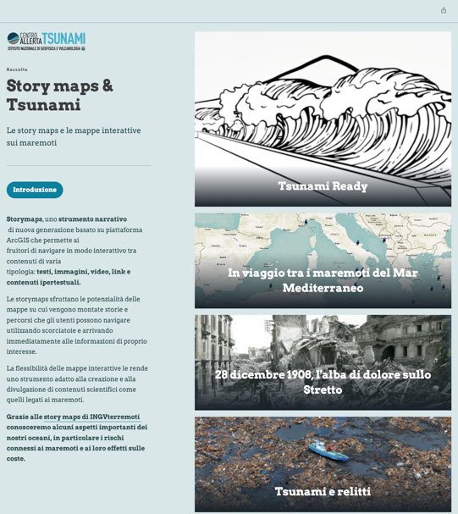
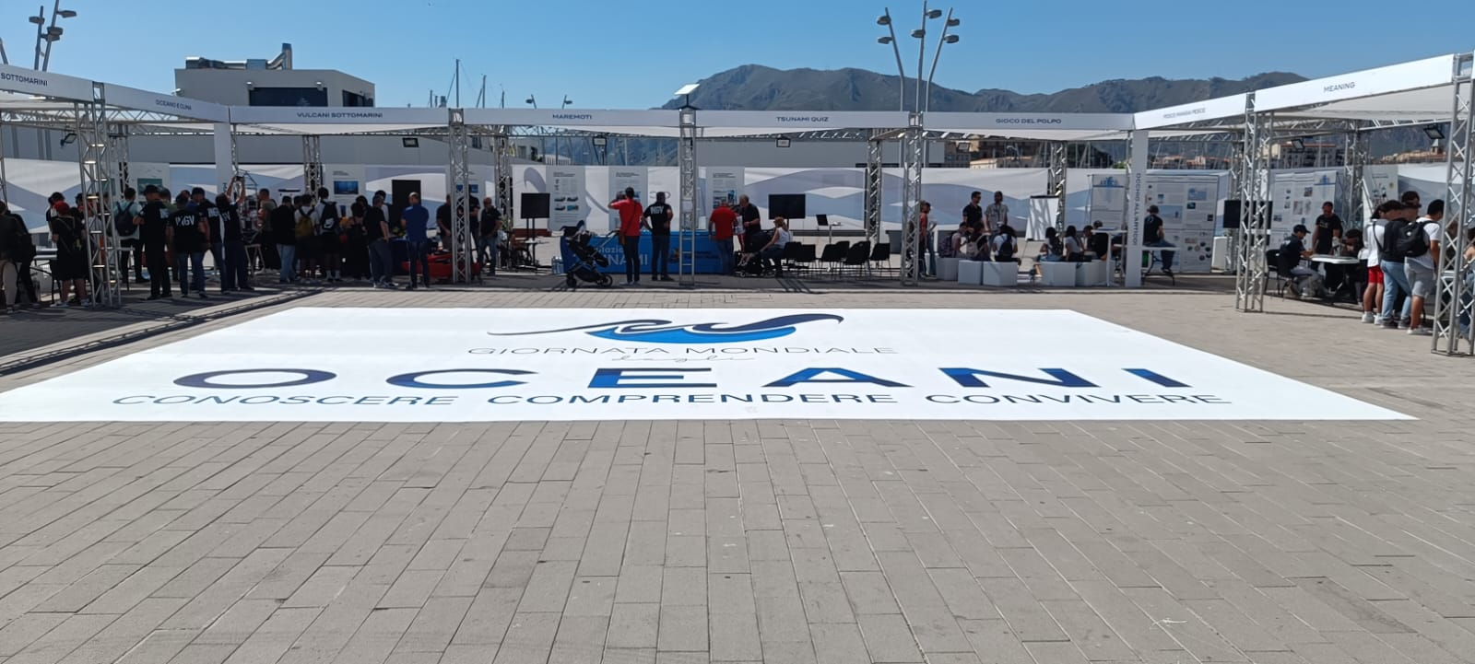
Education
Story Maps about:
Indian Ocean tsunami 2004;
Messina-Reggio 1908;
Wrecks of 2011 tsunami in the Pacific Ocean;
Tsunami Ready in Italy;
The 2004 Indian Ocean tsunami.
World Ocean Day (8 June)
public events were held at major INGV centres, also to raise tsunami risk knowledge and awareness.
Notes:
On the occasion of the World Ocean Day (8 June) public events were held at major INGV centres, also to raise tsunami risk knowledge and awareness. The largest events were held in Palermo, Sicily, and Rome, with the active involvement of the population. In Palermo, the tsunami tank and tsunami Quiz game were used. In Rome the Tsunami Quiz and tsunami storymaps were illustrated by researchers. The activities carried out during the day focused on the oceans and the risks connected to them at 360°.
Story Maps: Indian Ocean 2004; Messina-Reggio 1908; Relics of 2011 tsunami in the Pacific Ocean; Tsunami Ready in Italy; the 2004 Indian Ocean tsunami.

Slide 30
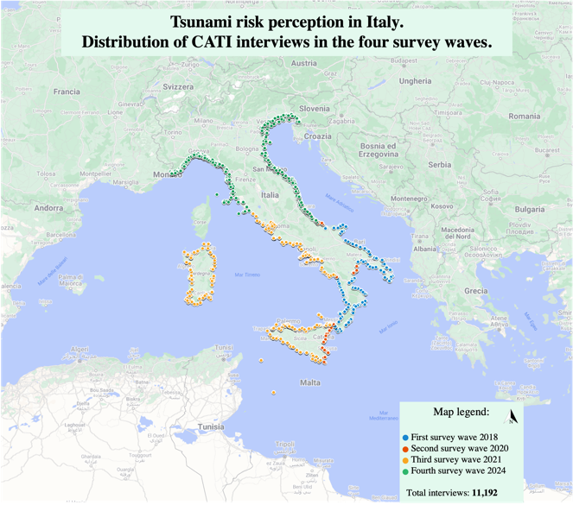
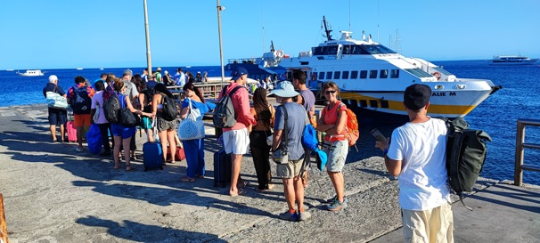
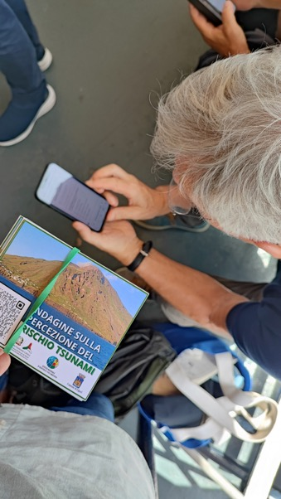
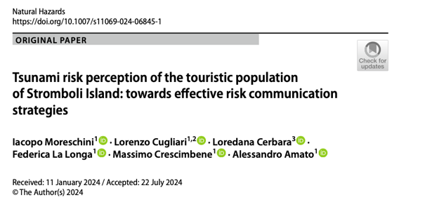
Risk Perception Assessment at national and local level
National Tsunami Risk Perception survey:
in 2024 we complete the survey by administering the tsunami risk perception questionnaire to the whole Italian population residing in coastal municipalities.
11.192 Questionnaire obtained
699 interviews on tsunami risk perception among tourists in Stromboli (Moreschini et al., 2024)
15 in-depth interviews to local residents
Notes:
Italian risk perception survey: in 2024 we complete the survey by administering the tsunami risk perception questionnaire to the whole Italian population residing in coastal municipalities. Finally we have an amount of 11.192 telephone interviews (CATI). Furthermore, in 2021 and 2024, tsunami risk perception was surveyed on two panels representing the entire Italian population, including inhabitants living in non-coastal municipalities. These additional surveys add 3000 cases to the sample and can be used as benchmarks for comparisons of tsunami risk perception (e.g. tourists/residents, those living on the coast, those living inland).
Between 2023 and 2024, 699 tourists visiting Stromboli Island were interviewed to assess their tsunami risk perception and knowledge of the warning systems on the island. The results were published in the paper by Moreschini et al., 2024. In addition, 15 in-depth interviews were conducted in June 2024 to survey tsunami risk perception and obtain more accurate information from Island residents. The texts of the interviews have yet to be analysed.

Slide 31
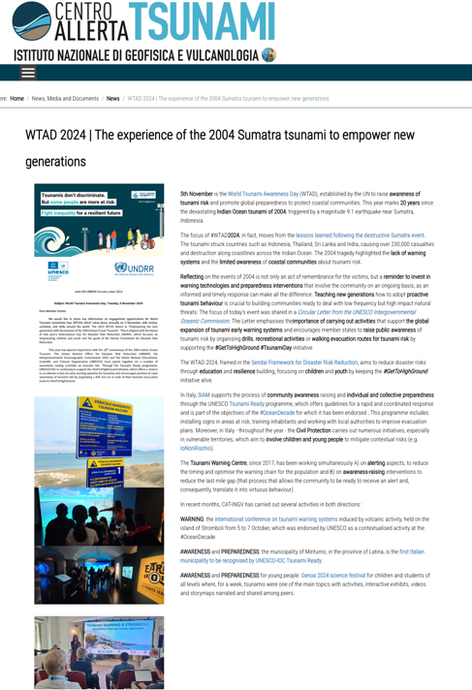
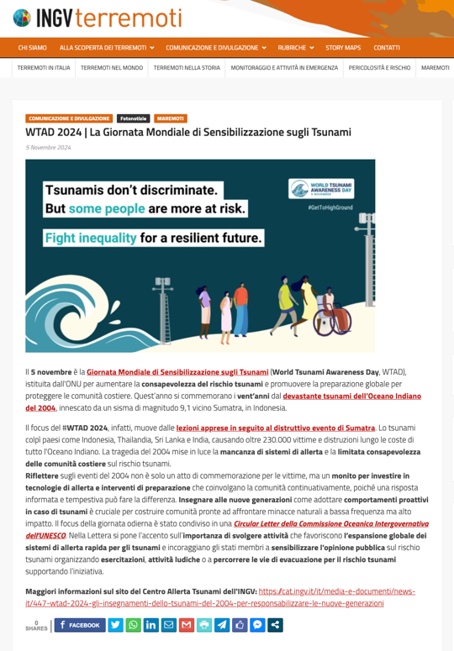
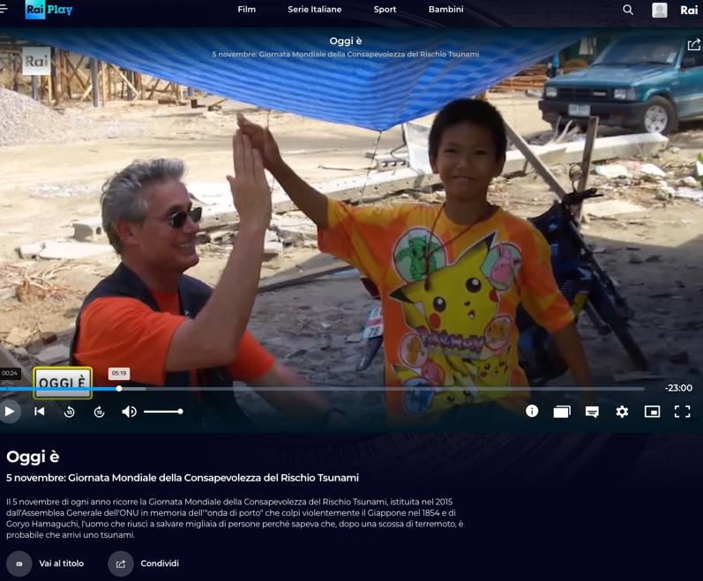
World Tsunami Awareness Day 2024
RAI Scuola documentary on the 2004 Indian Ocean tsunami
Notes:
WTAD 2024: Educational Video on tsunami for students and youth edited by RAI Public italian TV published on Nov. 5. Here are some activities that we have done to celebrate the WTAD: A news on Tsunami Alert Centre website in Italian and English also spread on social media A news on INGV Terremoti Blog shared on INGV platform On the national TV channel (RAI SCUOLA / RAI SCHOOL) a new episode of a television program was broadcast to celebrate WTAD and the 2004 tsunami 20th anniversary. The episode was recorded at INGV in October and tells about the Indian Ocean tsunami and how the warning system works today in our region. It was released on Nov. 5 at 6 pm, and is periodically transmitted on the channel. It is also freely available on demand

Slide 32
Papers 2024
Abbate, A., González Vida, J. M., Castro Díaz, M. J., Romano, F., Bayraktar, H. B., Babeyko, A., and Lorito, S.: Modelling tsunami initial conditions due to rapid coseismic seafloor displacement: efficient numerical integration and a tool to build unit source databases, Nat. Hazards Earth Syst. Sci., 24, 2773–2791, https://doi.org/10.5194/nhess-24-2773-2024, 2024.
Amato, A., Cugliari, L., Samperi, V., Funiciello, F. and De Filippis, L. (2024), 67(2), p. TP211. doi: 10.4401/ag-9063. https://doi.org/10.4401/ag-9063
Bahrouni, N., Meghraoui, M., Bayraktar, H.B. et al. Tsunami deposits in Tunisia contemporaneous of the large 365 CE Crete earthquake and Mediterranean Sea catastrophic event. Sci Rep 14, 4537 (2024). https://doi.org/10.1038/s41598-024-53225-7
Lay T., Romano F., Lorito S. (2024), Use of tsunami observations for resolving coseismic slip of recent and historic large submarine earthquakes, Annals of Geophysics, 67, 4, S427, https://doi.org/10.4401/ag-9142
Moreschini, I., Cugliari, L., Cerbara, L. et al. Tsunami risk perception of the touristic population of Stromboli Island: towards effective risk communication strategies. Nat Hazards (2024). https://doi.org/10.1007/s11069-024-06845-1

Slide 33
Papers 2024
Scala, A., Lorito, S., Escalante Sánchez, C., Romano, F., Festa, G., Abbate, A., et al. (2024). Assessing the optimal tsunami inundation modeling strategy for large earthquakes in subduction zones. Journal of Geophysical Research: Oceans, 129, e2024JC020941. https://doi.org/10.1029/
Selva et al. (2024). A novel multiple-expert protocol to manage uncertainty and subjective choices in probabilistic single and multi-hazard risk analyses, International Journal of Disaster Risk Reduction. https://doi.org/10.1016/j.ijdrr.2024.104641
Storrøsten, E.B., Ramalingam, N.R., Lorito, S., Volpe, M., Sánchez-Linares, C., Finn Løvholt, Steven J Gibbons, Machine learning emulation of high resolution inundation maps, Geophysical Journal International, Volume 238, Issue 1, July 2024, Pages 382–399, https://doi.org/10.1093/gji/ggae151
Grezio, A., Anzidei, M., Baglione, E. et al. Including sea-level rise and vertical land movements in probabilistic tsunami hazard assessment for the Mediterranean Sea. Sci Rep 14, 28873 (2024). https://doi.org/10.1038/s41598-024-79770-9
Wirp, S. A., Gabriel, A.-A., Ulrich, T., & Lorito, S. (2024). Dynamic rupture modeling of large earthquake scenarios at the Hellenic Arc toward physics-based seismic and tsunami hazard assessment. Journal of Geophysical Research: Solid Earth, 129, e2024JB029320. https://doi.org/10.1029/2024JB029320

Slide 34
Participation in international projects
CoastWAVE Phase 2 (July 2024) ”Scaling up and strengthening the resilience of coastal communities….”;
New phase - CIG - of COST Action AGITHAR - (Accelerating Global Science in Tsunami Hazard and Risk Analysis) which established the Global Tsunami Model (GTM) association;
TSUNAMI Thematic Core Service (TCS) within EPOS The European Plate Observing System (EPOS General Assembly in Dec. 2023) ERIC;
Other projects funded by EC and EuroHPC, contributing to the advancement of Tsunami science, development of tools and service provision (ChEESE-2P, DT-GEO, EPOS-ON, Geo-INQUIRE, SENSEI, …)
DG-ECHO project NEAM-COMMITMENT (coord. NOA, Greece) with other MS and relevant stakeholders (2025-2027)
Notes:
Let me conclude mentioning some of the most important projects and initiatives that are going on in our region. Besides the already mentioned CoastWAVE project there are other initiatives funded by the European Community, like the Agithar Cost Action working for the Global Tsunami Model, the EPOS Thematic Core Service recently approved, and other projects.

